Slide 1

Osha

Slide 2

The OSHA Alliance Program as of March 31, 2018

Slide 3
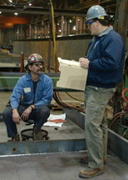
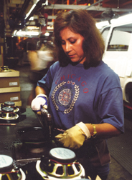

OSHA’s Mission
Assure so far as possible every working man and woman in the nation safe and healthful working conditions.
Notes:
Employers are responsible for providing a safe and healthful workplace for their workers. OSHA’s role is to assure the safety and health of America’s workers by setting and enforcing standards; providing training, outreach, and education; and encouraging continual improvement in workplace safety and health.

Slide 4
Role of Compliance Assistance and Cooperative PrograMS
Role of Compliance Assistance and Cooperative Programs
Supporting Agency Initiatives
Supporting Enforcement
Supporting Standard Setting
Notes:
OSHA’s comprehensive approach to workplace safety and health includes enforcement, standard setting, and compliance assistance and cooperative programs. OSHA’s compliance assistance and cooperative program activities help support the Agency’s enforcement, standard setting, and other priorities.
Supporting Agency Initiatives
OSHA’s compliance assistance and cooperative program activities support agency initiative, such as the Safe + Sound Campaign and Fall Prevention Campaign.
Enforcement
OSHA is the primary federal agency responsible for ensuring the safety and health of America's working men and women. The workplaces we oversee are diverse — more than 7 million offices, factories, shipyards, hotels, hospitals, concert halls, and construction sites.
Employers who comply with OSHA standards will experience a much safer and healthful workplace. OSHA vigorously enforces these standards – OSHA inspectors (called Compliance Safety and Health Officers) inspect workplaces and issue citations and penalties. In the most serious cases of workplace fatalities, the federal Department of Justice may criminally prosecute businesses that violate the law. Enforcement plays an important part in OSHA's efforts to reduce workplace injuries, illnesses, and fatalities. Through our Severe Violator Enforcement Program and other enforcement emphasis programs, we send a clear message that OSHA takes its mission seriously. When we find employers who fail to uphold their employee safety and health responsibilities, we deal with them strongly.
Standard Setting
OSHA is authorized by the Occupational Safety and Health Act to issue new standards and revise its existing standards. Standard setting is an important part of OSHA’s mission to protect the safety and health of America’s workforce.

Slide 5





OSHA’s Cooperative Programs
Alliance Program
OSHA Strategic Partnership Program
Voluntary Protection
Programs (VPP)
OSHA Challenge
On-site Consultation Program & Safety and Health Recognition Program (SHARP)
Notes:
OSHA offers cooperative programs under which businesses, labor groups, and other organizations can work cooperatively with the Agency to help prevent fatalities, injuries, and illnesses in the workplace.
Alliance Program. Through the Alliance Program, OSHA works with groups committed to worker safety and health to prevent workplace fatalities, injuries, and illnesses. These groups include unions, consulates, trade or professional organizations, businesses, faith- and community-based organizations, and educational institutions. OSHA and the groups work together to develop compliance assistance tools and resources, share information with workers and employers, and educate workers and employers about their rights and responsibilities. Alliance Program participants do not receive exemptions from OSHA inspections or any other enforcement benefits.
OSHA Strategic Partnership Program (OSPP). The OSPP provides the opportunity for OSHA to partner with employers, workers, professional or trade associations, labor organizations, and/or other interested stakeholders. OSHA Strategic Partnerships (OSP) are formalized through unique agreements designed to encourage, assist, and recognize partner efforts to eliminate serious hazards and achieve model workplace safety and health practices. Each OSHA Strategic Partnership establishes specific goals, strategies, and performance measures to improve worker safety and health. OSP models include those focused on improving safety and health in major corporations/government agencies, at large construction projects, and for entire industries. The OSPP is available to private sector industries and government agencies in locales where OSHA has jurisdiction.
Voluntary Protection Programs (VPP). The VPP recognize employers and workers in the private industry and federal agencies who have implemented effective safety and health management systems and maintain injury and illness rates below national Bureau of Labor Statistics averages for their respective industries. In VPP, management, labor, and OSHA work cooperatively and proactively to prevent fatalities, injuries, and illnesses through a system focused on: hazard prevention and control; worksite analysis; training; and management commitment and worker involvement. To participate, employers must submit an application to OSHA and undergo a rigorous onsite evaluation by a team of safety and health professionals. Union support is required for applicants represented by a bargaining unit. VPP participants are re-evaluated every three to five years to remain in the programs. VPP participants are exempt from OSHA programmed inspections while they maintain their VPP status.
OSHA Challenge. Launched in 2004 as a pilot program, OSHA Challenge provides interested employers and workers the opportunity to gain assistance in improving their safety and health management systems. Challenge Administrators experienced in safety and health guide Challenge Participants through a three-stage process to implement an effective system to prevent fatalities, injuries, and illnesses. An on-line tool is provided which breaks down the actions, documentation, and results desired. Graduates of OSHA Challenge receive recognition from OSHA as they incrementally improve their safety and health management systems. OSHA Challenge is available to general industry and construction employers in the private and public sectors under OSHA’s federal jurisdiction.
On-site Consultation Program. OSHA’s On-site Consultation Program offers free and confidential advice to small and medium-sized businesses in all states across the country, with priority given to high-hazard worksites. On-site Consultation services are separate from enforcement and do not result in penalties or citations. Consultants from state agencies or universities work with employers to identify workplace hazards, provide advice on compliance with OSHA standards, and assist in establishing safety and health management systems.
Safety and Health Achievement Recognition Program (SHARP). Employers that have a full On-site Consultation visit and meet other requirements may be recognized under SHARP for their exemplary safety and health management systems. Worksites that receive SHARP recognition are exempt from programmed inspections during the period that the SHARP certification is valid.

Slide 6
The Alliance Program
OSHA’s Alliances:
Established by OSHA’s National, Regional, Area Offices
Formed with a variety or organizations, including associations, unions, consulates, community and faith-based groups, and government agencies
Support OSHA’s key initiatives
Develop and disseminate compliance assistance information
Educate workers and employers about their rights and responsibilities
Do not exempt participants from OSHA inspections
Notes:
The Alliance Program was launched in 2002 to reach workers and employers that were not being reached by OSHA’s other cooperative programs.
OSHA has issued a directive, most recently updated in 2015, that lays out the parameters of the program. See Alliance Program Directive, CSP 04-01-002, (July 29, 2015).
Through the Alliance Program, OSHA works with groups committed to worker safety and health to prevent workplace fatalities, injuries, and illnesses. OSHA and the groups work together to share information with workers and employers, educate workers and employers about their rights and responsibilities, and develop compliance assistance tools and resources.
Alliance agreements do not include an enforcement component, such as exemption from general scheduled inspections or monitoring visits. Alliance agreements are not worksite-based – they generally focus on entire industries or hazards within the industries.

Slide 7
Alliance Program Agreements
Agreements follow a standard template
Initial agreements are for two years
Renewals can be up to five years
Notes:
The latest templates for Alliance agreements are available on the Alliance Program Web page at www.osha.gov/alliances.

Slide 8
Other Requirements
Participants must develop a work plan
Annual reports are required and posted on the Alliance Web page
Some form of worker involvement is generally required
Notes:
Templates for work plans and annual reports are available on the Alliance Program Web page at www.osha.gov/alliances.

Slide 9
Worker Involvement
Worker involvement requirement can be met in several ways:
Union, labor, worker advocacy group signatory
Worker involvement in implementation team
Contact OSHA’s Office of Outreach Services and Alliances for other ways

Slide 10
Alliance Program Goals
Raising awareness: outreach and communication
Training and education
Evaluate effectiveness
Notes:
The Alliance Program focuses on the following goals:
Raising awareness: outreach and communication, such as creating and sharing compliance assistance materials in English, Spanish, and other languages for workers and/or employers, conducting best practice seminars in support of OSHA’s enforcement initiatives, and speaking or exhibiting at conferences and meetings.
Training and education, such as developing training and education programs and seminars aimed at reducing workplace hazards, arranging for the delivery of training, and providing feedback on OSHA training curricula.
In addition, Alliance participants and OSHA work together to explore ways to evaluate the effectiveness of the Alliance.

Slide 11
Alliances by Fiscal Year
Notes:
This chart shows the number of active Alliances since the program’s inception in 2002.

Slide 12
Who’s Entering Alliances?
Types of Participants
Associations
Professional Societies
Labor Unions
Consulates
Community Organizations
Other Non-Traditional Non-Profits
Educational Institutions
Individual Companies
Government Agencies (only if joined with non-governmental organizations)
Industries Covered
Construction
Health Care
Manufacturing
Maritime
Landscaping
Oil and Gas
Window Washing
Temporary Workers
Many others
Notes:
OSHA enters into Alliances with a variety of organizations, including industry associations, professional societies, labor unions, consulates, community and faith-based groups, and other non-traditional non-profit groups.
The Alliances cover a variety of industries, including construction, health care, manufacturing, maritime, landscaping, oil and gas, and temporary workers.

Slide 13
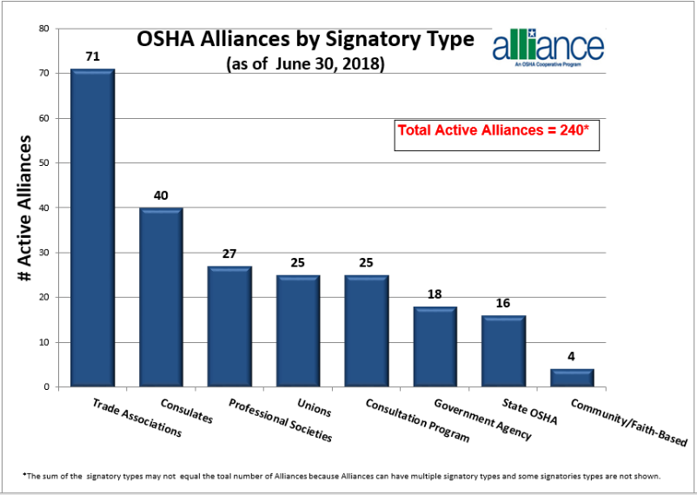
Alliances by Signatory Type
Notes:
This chart shows the number of active Alliances by various signatory types.

Slide 14
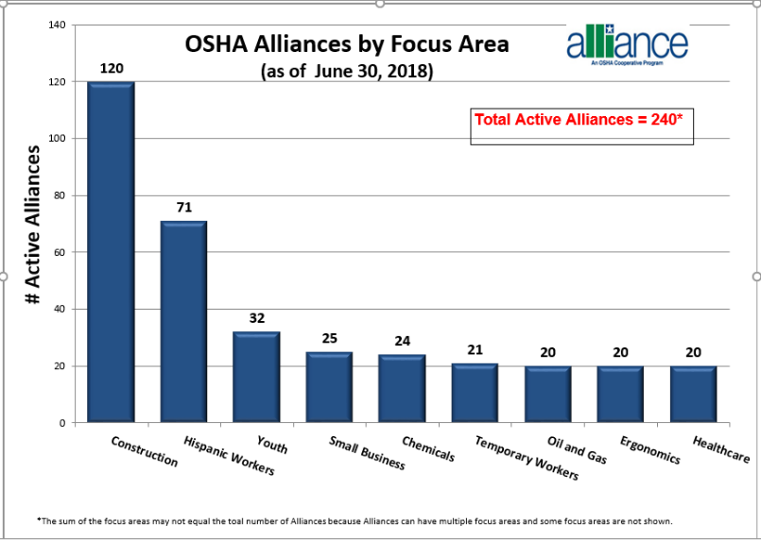
Alliances by focus area
Notes:
This slide shows the number of Alliances by OSHA’s focus areas.

Slide 15
Alliance Program Results
Outreach/dissemination to workers and employers
Support for OSHA’s key initiatives
Development and dissemination of products and resources
Training OSHA staff and others
Notes:
The Alliance Program produces concrete results in the form of outreach to workers and employers, support for OSHA’s key initiatives, compliance assistance tools,
Outreach/dissemination: OSHA conducts outreach to workers and employers through the Alliance Program. For example, OSHA may do presentations and exhibit at conferences sponsored by Alliance Program participants. The participants also work together to disseminate safety and health information on the affected industry and/or hazards. This allows OSHA to reach audiences, including small businesses and vulnerable workers, that it would not otherwise be able to reach.
Products and Resources: Through the Alliance Program, National Alliance Program participants develop products to provide information to workers and employers on specific industries or hazards covered by the Alliances. While these products are reviewed by OSHA subject matter experts, the products are for informational purposes only and do not necessarily reflect the official views of OSHA or the U.S. Department of Labor. Products include fact sheets, toolbox talks, safety manuals, videos, and Web pages. These products are posted on the Alliance participants’ Web sites and linked to on OSHA’s Web site. For a complete listing, see the Alliance Program Participants Developed Products page on the Alliance Program Web page. This Web page also includes a collection of Spanish-language products developed by Alliance Program participants.
Training: Alliance participants have developed and delivered training on various workplace safety and health topics. This training may be for OSHA staff (sharing of industry expertise with OSHA, State Plan, Consultation staff), or it may be provided to the public.

Slide 16
Alliance Program Results:
Outreach and Dissemination
Reaching New Audiences
OSHA presentations and exhibit booths
Dissemination of safety and health information to Alliance stakeholders, including small businesses and vulnerable workers
Notes:
Outreach/dissemination: OSHA conducts outreach to workers and employers through the Alliance Program. For example, OSHA may do presentations and exhibit at conferences sponsored by Alliance Program participants. The participants also work together to disseminate safety and health information on the affected industry and/or hazards. This allows OSHA to reach audiences, including small businesses and vulnerable workers, that it would not otherwise be able to reach.
Alliances may request speakers or exhibit booths to:
Share subject matter expertise
Share OSHA perspective
Share accomplishments of the Alliance
Share information on other OSHA cooperative programs
Share information on OSHA compliance assistance resources

Slide 17

Alliance Program Results:
Support for Key OSHA Initiatives
Safe + Sound Campaign
Falls in Construction Campaign
Temporary Worker Initiative
Heat Initiative
Oil and Gas Extraction
Notes:
Through the OSHA Alliance Program, Alliance Program participants support a number of OSHA outreach initiatives. For example:
Safe + Sound Campaign. Alliance participants have been critical in supporting this campaign.
Falls in Construction Campaign. Alliance Program participants support OSHA’s campaign to prevent falls in construction by, for example, holding their own safety stand-downs, disseminating OSHA’s publications, posting links to OSHA’s resources on their Web pages, and running stories in newsletters and magazines.
Temporary Worker Initiative. OSHA has a national Alliance with the American Staffing Association to improve safety and health for temporary workers. OSHA also has several Regional Alliances with staffing agencies.
Heat Initriative. Alliance Program participants support OSHA Campaign to Prevent Heat Illness in Outdoor Workers. For example, Alliance participants disseminate information to their stakeholders through various channels. OSHA also works with Lamar Outdoor Advertising on posting heat-related messages on billboards in states with the highest number of heat-related fatalities.
Oil and Gas Extraction. OSHA has a national Alliance and several Regional Alliances that focus on protecting workers in this industry.

Slide 18
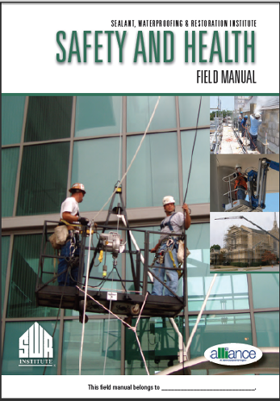
Alliance Program Results
Alliance Program Results:
Products and Resources
Screen captures of field manual developed through the OSHA and Sealant, Waterproofing & Restoration Institute Alliance
Notes:
Through the Alliance Program, Alliance Program participants develop products to provide information to employers and workers on specific industries or hazards covered by the Alliances. These products are for informational purposes only and do not necessarily reflect the official views of OSHA or the U.S. Department of Labor. The Alliance participants post the products on their Web sites and OSHA links to the products.
This slide shows the following product developed through the OSHA and Sealant, Waterproofing and Restoration Institute (SWR Institute) Alliance:
“Safety and Health Field Manual.” Contractors and workers can use the Field Manual to quickly identify the key hazards and OSHA requirements in this industry. This product is available in English and Spanish.

Slide 19
Alliance Program Results: Training and Educatiopn
Alliance Program Results:
Training and Education
  Develop Safety and Health Training for Industry Use
  Deliver Training Sessions to Workers
  Webinars
Notes:
Through Alliances, Alliance Program participants can create training modules on specific hazards or issues within their industry.
Through National Alliances, the development of training modules can help an industry establish consistent use of good practices
Through local Alliances, the development of training modules can be specific to the needs of the local constituency
Delivering training to workers is a common goal of local Alliance agreements. Training can either be modules developed through the Alliance or other safety and health training pertinent to the industry (e.g. OSHA 10-Hour Outreach Training Program).
Through the Alliance Program, Alliance participants have sponsored webinars on various workplace safety and health topics and made them available for free. For example, through the OSHA and Society for Chemical Hazard Communication (SCHC) Alliance, SCHC has sponsored a series of webinars on OSHA’s revised Hazard Communication Standard.

Slide 20
Alliance Program Results: Training and Education
Best Practices Seminars for OSHA Staff
Mobile Cranes
Digger Derricks
Mast Climbing Work Platforms
Industrial Trucks
Notes:
Training: Alliance Program participants have developed and delivered best practice seminars to OSHA’s Compliance Safety and Health Officers (CSHOs) and other National, Regional, Area Office, State Plan State, and On-site Consultation program staff around the country.
Examples of this training include:
Altec, Incorporated: Mobile Cranes; Digger Derricks; Insulated Aerial Devices; Wood Chippers
Scaffold & Access Industry Association: Mast Climbing Work Platforms
Industrial Truck Association: Industrial Trucks: Man, Machine and Environment

Slide 21
Alliance Program Roundtables
Comprised of organizations with a common interest in topics and issues
Provide participants with the opportunity to:
  Share specific topic-related information about Alliance-related activities and successes
  Network with others in the Program
  Develop compliance assistance tools and resources
Roundtable topics have included:
  Construction
  Hazard Communication/GHS
  Small Business
Notes:
Since the inception of the Alliance Program, OSHA has hosted meetings to bring together Alliance Program participants to network, identify opportunities for collaboration to develop programs and materials, and showcase their products and activities. OSHA recognized that the Alliance Program participants were interested in a number of the same topics and issues and their expertise could be leveraged by bringing them together to discuss these topics and develop related compliance assistance tools and resources. As a result, OSHA began scheduling and holding Alliance Program Roundtable meetings.
Construction Roundtable
OSHA formed the OSHA Alliance Program Construction Roundtable in 2004 to provide participants with the opportunity to share construction-related information about Alliance-related activities and successes, develop products, and network with others in the Program.
Hazard Communication/GHS Roundtable
Representatives from 17 Alliances met on July 18, 2012, to discuss the development of hazard communication compliance assistance resources. The group identified specific hazard communication issues to discuss the 2012 Hazard Communication Standard, and changes that industry can expect in training, labeling, and Safety Data Sheets (formally Material Safety Data Sheets).
Small Business Roundtable
Through the Alliance Program, a number of the Program's participants came together to participate in a Small Business Roundtable. During the Roundtable meetings, OSHA provided the Alliance Program participants an opportunity to work with the Agency to address safety, health and compliance assistance resources for the small business community. In addition, the Roundtable participants reviewed and provided OSHA with feedback on compliance assistance resources and OSHA's On-site Consultation programs. Roundtable meetings were held on September 8, 2005 and February 1, 2007.

Slide 22
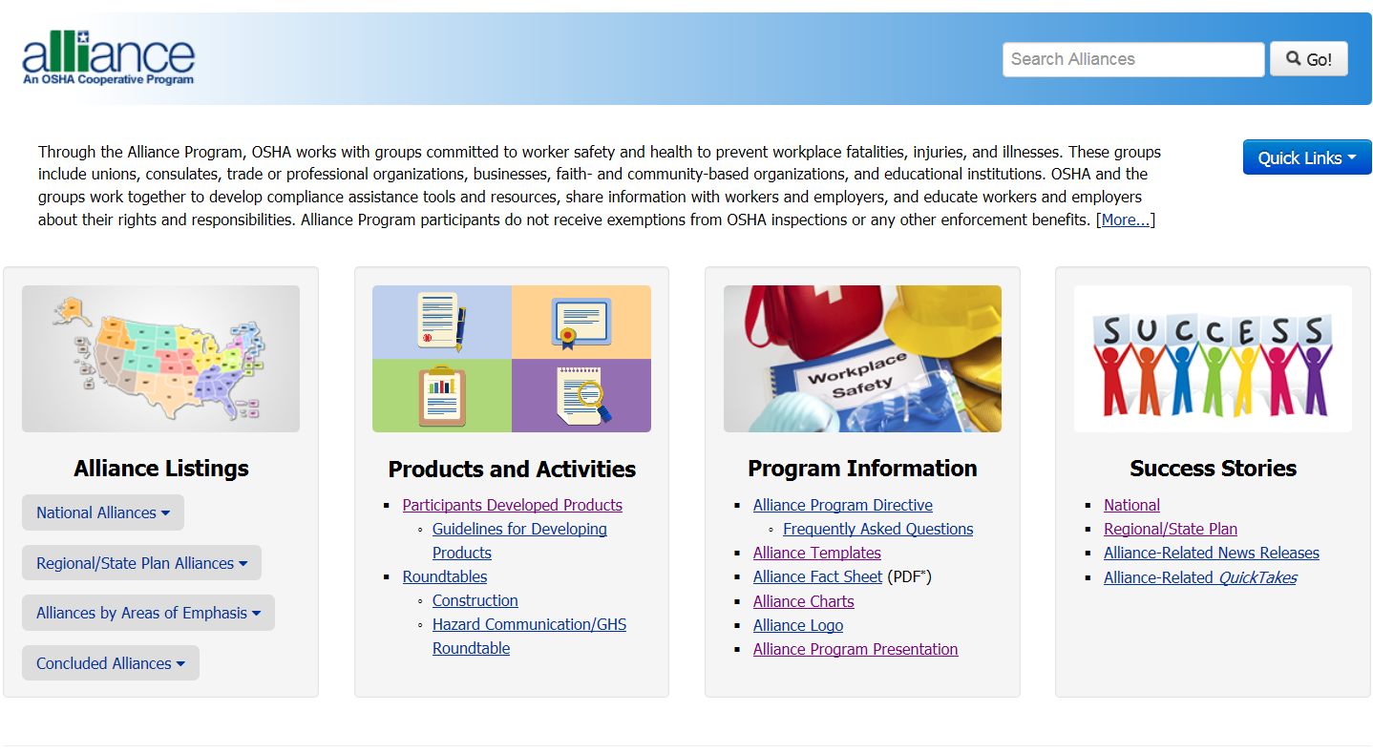
Alliance Program Web Page
Screen Capture of OSHA’s Alliance Program Web Page
Notes:
This slide is a screen capture of the OSHA Alliance Program Web page. OSHA’s Alliance Program Web page provides comprehensive information on the Alliance Program, including Alliance agreement templates, program participation criteria, information and guidance on the use of the Alliance Program logo, and a listing of products developed by program participants.
The Alliance Program Web page includes detailed information on each national Alliance, including the Alliance agreements, information about Alliance-related activities and events, milestones and successes, and products and resources developed through the Alliance. The Web page also includes information on OSHA’s Regional and Area Office Alliances, including the Alliance agreements and success stories.

Slide 23

OSHA www.osha.gov

