Slide 1
General Workplace Hazards
Developed by Western Iowa Tech Community College
This material was produced under a grant (SH-16634-07-60-F-19) from the Occupational Safety and Health Administration, U.S. Department of Labor. It does not necessarily reflect the views or policies of the U.S. Department of Labor, nor does the mention or trade names, commercial products, or organization imply endorsement by the U.S. government.
Notes:
Title page and credits for OSHA and WITCC.
Each section should include a more detailed, independent learning module of possible hazards within those situations.

Slide 2
The Objectives are to know the Safety of following
Falls
Electrical hazards
Caught-ins
Struck-bys
Motorized equipment tip-overs
Notes:
Examples of place and situations that hazards are present and need to be addressed.

Slide 3
Falls
Falls are the leading cause of fatalities
An average of 362 fatal falls occurred each year from 1995 to 1999, with the trend on the increase.
Notes:
Talk to the employees about the increase of falls that happen up to date. Explain on how these number have gone up and what OSHA is doing to decrease this.

Slide 4
The use of PFAS
After 6’ or 4’ (6’ Construction, 4’ General Industry)
The use of a body harness with a lanyard.
A guardrail system to protect you from falls from wall openings.
Notes:
Explain what the difference is between why 4’ and 6’ also talk about what the height is on scaffolds. Scaffolding is 10 feet fall standard. Body belts are no longer usably for fall protection during construction work.

Slide 5
Prevention
Select fall protection systems appropriate for given situations.
Use proper construction and installation of safety systems.
Supervise employees properly.
Use safe work procedures.
Train workers in the proper selection, use, and maintenance of fall protection systems.
Notes:
Talk about each of the bullets and explain what the necessary procedures to help reduce a fall.

Slide 6
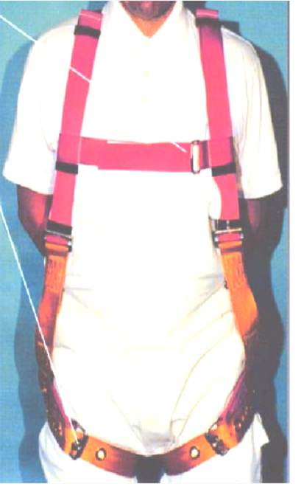
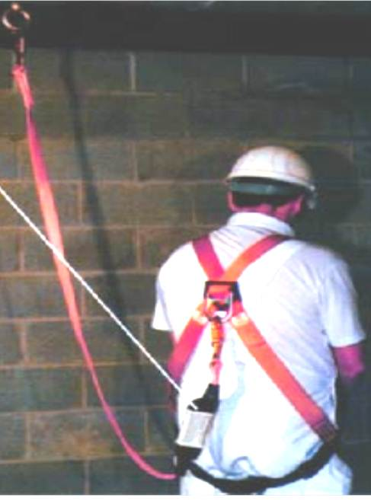
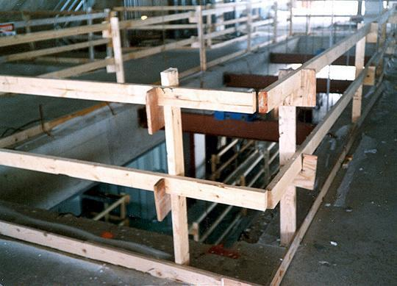
PFAS
The use of a body harness Lanyard Guardrail system
Notes:
Visual examples of PFAS equipment.

Slide 7
Electrical Hazards
An average of one worker is electrocuted on the job every day
There are four main types of electrical injuries:
  Electrocution (death due to electrical shock)
  Electrical shock
  Burns
  Falls
Notes:
Explain the dangers of electrical hazards.

Slide 8
Electrical Terminology
Current – the movement of electrical charge
Resistance – opposition to current flow
Voltage – a measure of electrical force
Conductors – substances, such as metals, that have little resistance to electricity
Insulators – substances, such as wood, rubber, glass, and bakelite, that have high resistance to electricity
Grounding – a conductive connection to the earth which acts as a protective measure
Notes:
Operating an electric switch is like turning on a water faucet. Behind the faucet or switch there must be a source of water or electricity with something to transport it, and with a force to make it flow. In the case of water, the source is a reservoir or pumping station; the transportation is through pipes; and the force to make it flow is provided by a pump. For electricity, the source is the power generating station; current travels through electric conductors (wires); and the force to make it flow - voltage, measured in volts, is provided by a generator.
Resistance
- Dry skin has a fairly high resistance, but when moist, resistance drops radically, making it a ready conductor.
- Measured in ohms.
Use extra caution when working with electricity when water is present in the environment or on the skin. Pure water is a poor conductor, but small amounts of impurities, such as salt and acid (both are contained in perspiration), make it a ready conductor.

Slide 9
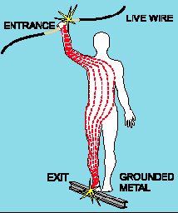
Electrical Shock
Received when current passes through the body
Severity of the shock depends on:
  Path of current through the body
  Amount of current flowing through the body
  Length of time the body is in the circuit
LOW VOLTAGE DOES NOT MEAN LOW HAZARD
Notes:
A small current that passes through the trunk of the body (heart and lungs) is capable of causing severe injury or electrocution.
Low voltages can be extremely dangerous because, all other factors being equal, the degree of injury increases the longer the body is in contact with the circuit.

Slide 10
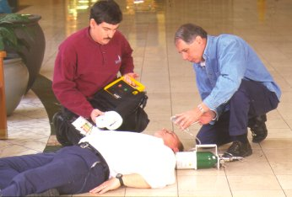
Dangers of Electrical Shock
Currents greater than 75 mA* can cause ventricular fibrillation (rapid, ineffective heartbeat)
Will cause death in a few minutes unless a defibrillator is used
75 mA is not much current – a small power drill uses 30 times as much
* mA = milliampere = 1/1,000 of an ampere
Defibrillator in use
Notes:
Discuss current through the heart versus current through the rest of the body. Emphasize the small level of current needed for injury versus the currents found in tools and process equipment.

Slide 11
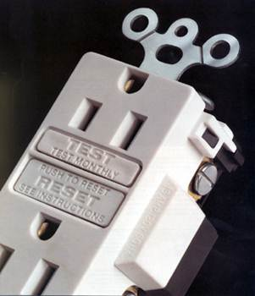
Ground-Fault Circuit Interrupter
This device protects you from dangerous shock
The GFCI detects a difference in current between the black and white circuit wires
(This could happen when electrical equipment is not working correctly, causing current “leakage” – known as a ground fault.)
If a ground fault is detected, the GFCI can shut off electricity flow in as little as 1/40 of a second, protecting you from a dangerous shock
Notes:
The GFCI continually matches the amount of current going to an electrical device against the amount of current returning from the device along the electrical path.
Whenever the amount of current going differs from the amount returning by approximately 5 milliamperes, the GFCI interrupts the electric power within as little as 1/40 of a second, protecting you from a dangerous shock.
GFCI’s are able to detect the loss of current resulting from leakage through a person who is beginning to be shocked. If this situation occurs, the GFCI switches off the current in the circuit.
GFCI’s are different from circuit breakers and fuses because they detect leakage currents rather than overloads.

Slide 12
Caught-ins
Caught-ins are anything that you can get your self caught-in creating a hazard such as.
Excavations
Machines
Conveyor belts
Anything you can get your-self caught-in
Notes:
Caught-in is any time you get caught-in where you cant move and someone has to help you get out of the danger.
Excavation Caught-in: Soil caving in.
Machines: Not using lock-out tag-out causing you to get caught between a machine.
Conveyor belts: Clothing getting stuck or sometime a part of your body.

Slide 13
Stuck-bys
Struck-by objects is another leading cause of construction-related deaths. Approximately 75% of struck-by fatalities involve heavy equipment such as trucks or cranes.
Safety and health programs must take into account the many ways struck-by accidents can occur. The following related hazards cause the most struck-by injuries.
Notes:
Discuss struck-bys statistics and causes.

Slide 14
Vehicles
Do not drive a vehicle in reverse gear with an obstructed rear view, unless it has an audible reverse alarm, or another worker signals that it is safe.
Drive vehicles or equipment only on roadways or grades that are safely constructed and maintained.
Do not exceed a vehicle's rated load or lift capacity.
Use traffic signs, barricades or flaggers when construction takes place near public roadways.
Notes:
Rules for proper vehicle use.

Slide 15
Falling/Flying Objects
Wear hardhats.
Stack materials to prevent sliding, falling, or collapse.
Use protective measures such as toeboards and debris nets.
Use safety glasses, goggles, face shields, etc., where machines or tools may cause flying particles.
Inspect tools, such as saws and lathes, to insure that protective guards are in good condition.
Make sure you are trained in the proper operation of powder actuated tools.
Notes:
Precautions and hazards associated with flying and falling objects.

Slide 16
Motorized Equipment tip-overs
Operator Training
Training must be done by a qualified person experienced with the particular lift model
Training must include:
  Nature of electrical, fall, and other hazards involved in operating
  lift
  Precautions for dealing with hazards
  Rated load capacity for the lift (including workers, tools,
  materials, bucket liner, etc.)
  Manufacturer requirements, as outlined in operator manual
  Demonstration of skill and knowledge in actual operation of the
  aerial lift
Notes:
Appropriate training and usage of motorized equipment. Discuss specific equipment found in that plant or industry setting.

Slide 17
Motorized Equipment tip-overs
Do not modify aerial lift without written permission
Check safety devices, operating controls before each use
Check area in which aerial lift will be used for:
  Level surface (Do not exceed manufacturer slope recommendations)
  Holes, drop-offs, bumps, debris, etc.
  Overhead obstructions and overhead power lines
  Stable surface
  Other hazards
Set outriggers, brakes, wheel chocks
Notes:
Discuss the proper safety and communication measures when using motorized equipment.

Slide 18
Preventing Tip-Overs
Do not exceed manufacturer rated load capacity limits
Do not travel to job location with lift in elevated position.
Set up proper work zone protection when working near traffic
Positioning of lifts
  Do not drive near drop-offs or holes.
  Do not raise platform on uneven or soft surfaces.
  Do not drive onto uneven or soft surfaces when elevated.
  Do not raise platform on slope or drive onto slope when elevated.
  Do not raise platform in windy or gusty conditions.
Avoid excessive horizontal forces when working on elevated scissor lifts
Notes:
Talk about the importance of following the lifts or any other motorized equipment safety manual for the rules and capacities.

Slide 19
Questions???
Notes:
Questions or comments concerning general workplace hazards.

