Slide 1
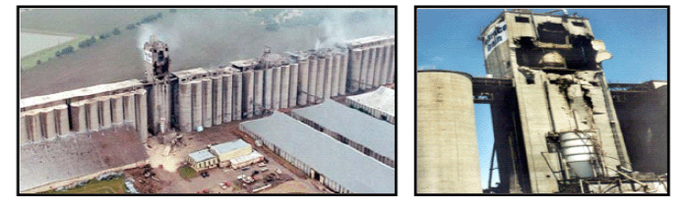
Combustible Dust
Preventing and Mitigating the Effects of Fire and Explosions
Developed by Western Iowa Tech Community College
This material was produced under a grant (SH-16634-07-60-F-19) from the Occupational Safety and Health Administration, U.S. Department of Labor. It does not necessarily reflect the views or policies of the U.S. Department of Labor, nor does the mention or trade names, commercial products, or organization imply endorsement by the U.S. government.

Slide 2

Training Outline
History of combustible dust incidents
  Related experience in grain handling
Elements of a dust explosion
Dust hazard assessment
  Components
  Combustibility
  Electrical
  Other hazards
Dust control
Ignition control
Damage control
Training
Notes:
Outline

Slide 3
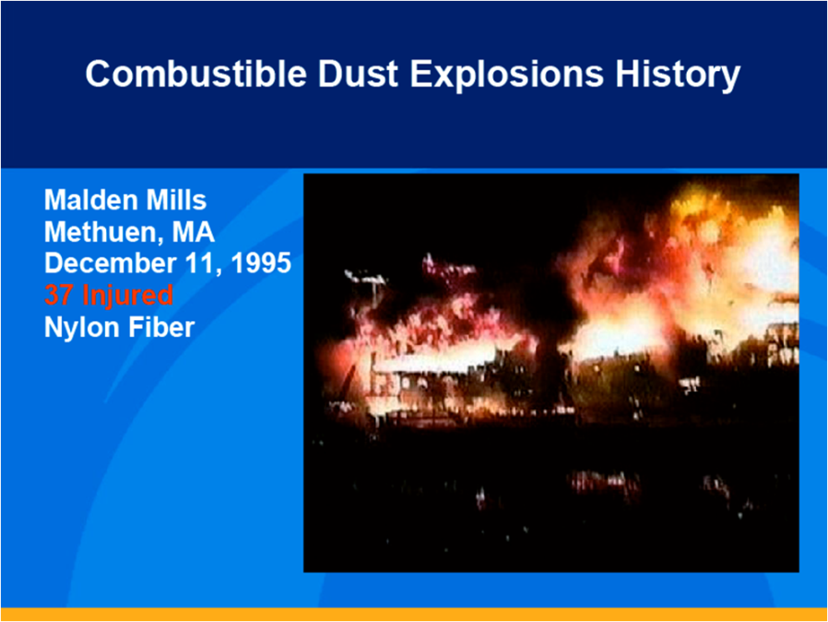
Notes:
On December 11, 1995, an explosion and fire virtually destroyed the Malden Mills facility in Methuen, Massachusetts, injuring 37. The Malden Mills facility produced Polartec fleece fabrics. According to reports by OSHA, the U.S. Fire Administration (USFA), and the Massachusetts State Fire Marshal’s Office, the originating event was likely a dust explosion involving nylon flock fibers. While reports of previous events at the same facility indicated that nylon fibers were ignited by static electricity, managers and employees did not generally understand that the fibers were an explosion hazard before the Malden Mills explosion.

Slide 4
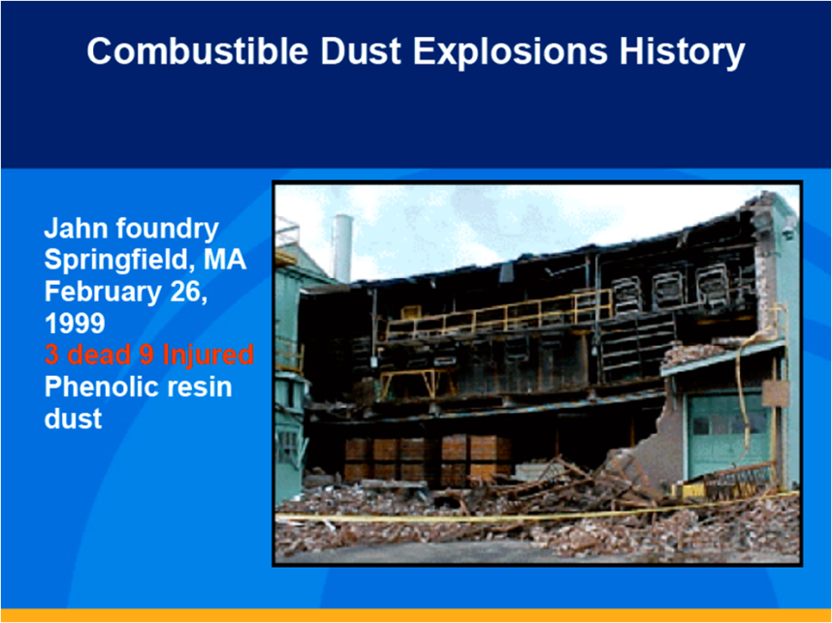
Notes:
A dust explosion in the Springfield, Massachusetts, casting facility for Jahn Foundry Corporation claimed the lives of three and injured nine on February 25, 1999; several foundry buildings were severely damaged.
Jahn Foundry produced iron castings from molten metal poured into shell molds. The molds were made onsite from sand and phenolic resin, and then cured in gas-fired ovens. A joint investigation team representing OSHA, the Massachusetts State Fire Marshal’s Office, and the Springfield Arson and Bomb Squad, concluded that, due to heavy resin deposits found inside exhaust ducting and on building surfaces, the incident involved a resin dust explosion in the shell mold area. The dust likely ignited, spreading a flame front through the building, which disturbed settled dust, causing a catastrophic secondary explosion.

Slide 5
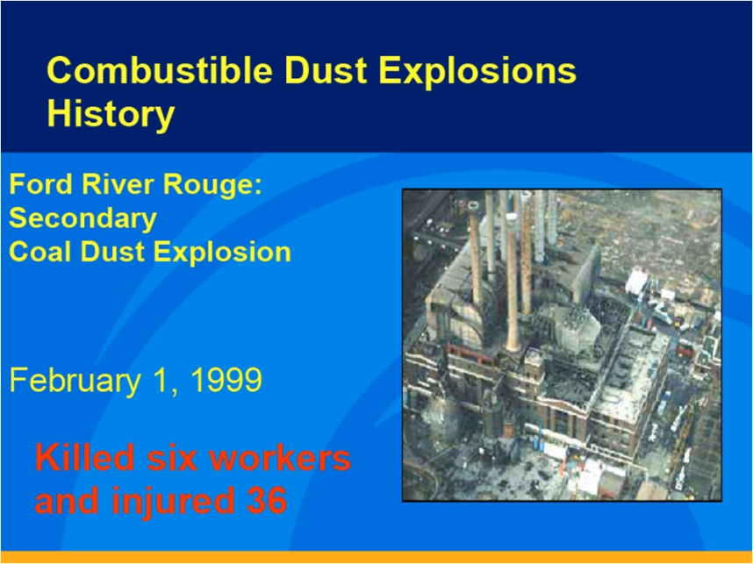
Notes:
One of the seven boilers that supplied power to the Ford Motor Company’s River Rouge manufacturing plant (near Dearborn, Michigan) exploded on February 1, 1999, killing six workers and injuring 36. Although the initial event was a natural gas explosion, witness accounts of dust accumulations before the explosion provided strong evidence of a secondary coal dust explosion. Coal dust accumulated on horizontal surfaces in the powerhouse was lofted and ignited by the initial explosion. One major finding of the Michigan Occupational Safety and Health Administration (MIOSHA) investigation of the explosion was that housekeeping to minimize coal dust accumulations was inadequate.

Slide 6
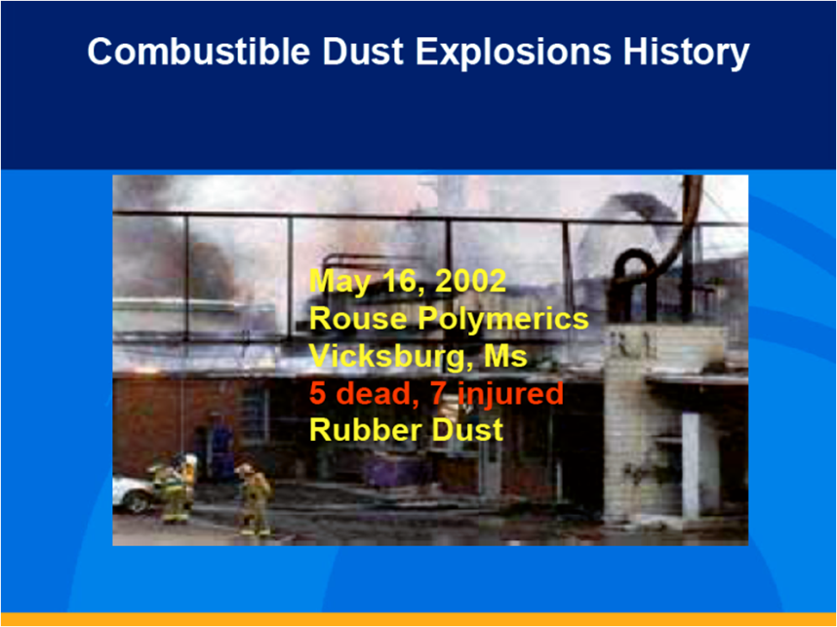
Notes:
On May 16, 2002, a rubber dust explosion at the Rouse Polymerics rubber recycling plant in Vicksburg, Mississippi, resulted in the deaths of five workers and injuries to seven others. The rubber recycling process included a wet slurry operation, followed by gas-fired drying of fine rubber paste. OSHA concluded that hot rubber entrained in the exhaust from product dryers fell onto the building roof, igniting a fire that was pulled into a product bagging bin. Evidence indicates that a primary fire occurred inside the bagging bin, which was not equipped with explosion venting, and spread to a screw conveyer. Dust layers that had accumulated on surfaces were lofted and ignited in a secondary explosion. The OSHA investigation report indicated that design and procedures for operating the gas-fired dryers and dust collector were inadequate, as was housekeeping, and that plant personnel lacked awareness of the hazards of accumulated layers of combustible rubber dust. Investigators also linked ineffective management of change to the incident.

Slide 7
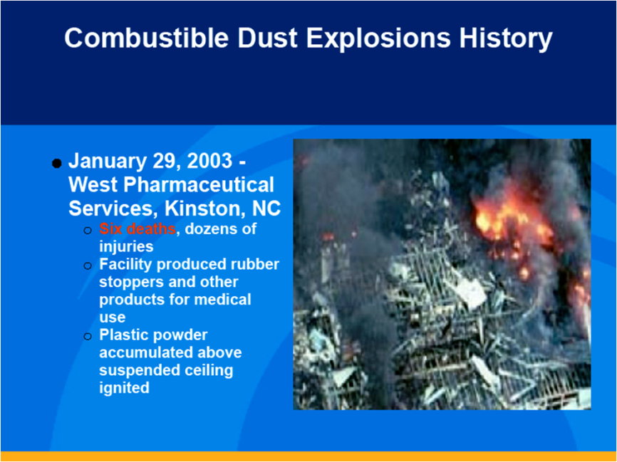
Notes:
On January 29, 2003, a massive dust explosion at the West Pharmaceutical Services facility in Kinston, North Carolina, killed six workers and destroyed the facility. The explosion involved a part of the building used to compound rubber.
West produced rubber syringe plungers and other pharmaceutical devices at the facility. In the rubber compounding process, freshly milled rubber strips were dipped into a slurry of polyethylene, water, and surfactant to cool the rubber and provide an anti-tack coating. As the rubber dried, fine polyethylene powder drifted on air currents to the space above a suspended ceiling.
Polyethylene powder accumulated on surfaces above the suspended ceiling, providing fuel for a devastating secondary explosion. While the visible production areas were kept extremely clean, few employees were aware of the dust accumulation hidden above the suspended ceiling, and the MSDS for the polyethylene slurry included no dust explosion warning. Even those employees who were aware of the dust accumulation had not been trained about the hazards of combustible dust. West did use a safety review process when the compounding system was designed and modified, but the dust explosion hazard was not addressed during the reviews. OSHA, the local fire department, an insurance underwriter, and an industrial hygienist had inspected the facility, but none had identified the potential for a dust explosion. In addition, the electrical equipment above the suspended ceiling in the rubber compounding section was not rated for use around combustible dust, as the National Electric Code (NEC) requires (for areas where combustible dust can accumulate). The CSB determined that if West had adhered to NFPA standards for combustible dust, the explosion could have been prevented or minimized.

Slide 8
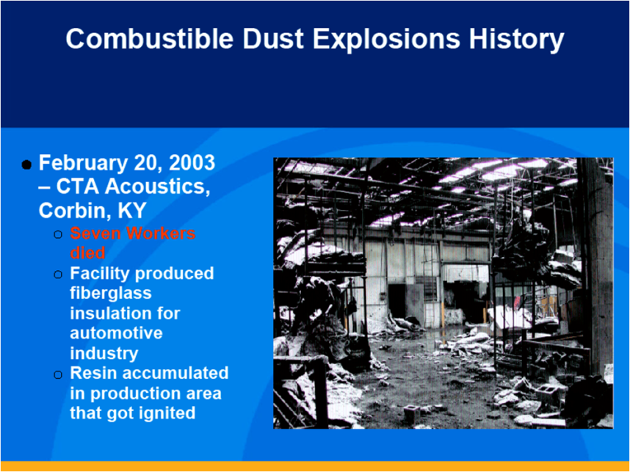
Notes:
On February 20, 2003, a series of dust explosions at the CTA Acoustics (CTA) facility in Corbin, Kentucky, claimed the lives of seven workers, injured 37, and destroyed the manufacturing facility.This facility primarily made acoustic insulation for automobiles.
The manufacturing process began by impregnating a fiberglass mat with phenolic resin, and then used air to draw the resin into the fiberglass webs. On the day of the explosion, a curing oven that had been left open because of a temperature control problem likely ignited the combustible resin dust stirred up by workers cleaning the area near the oven.
The CSB also found that plant design, work practices, and housekeeping problems contributed to causing the explosions. The CTA building was not designed to prevent or minimize secondary dust explosions (minimizing flat surfaces where dust can accumulate and using fire walls to separate production lines). Although management was aware of dust explosion hazards associated with the materials being used, dust had accumulated in dangerous amounts throughout the production areas, in vent ducting, and in dust collector housings, due to inadequate housekeeping and maintenance. In addition, employees routinely used compressed air and brooms to clean production lines, creating clouds of resin dust.
The MSDS for the resin used at CTA did not adequately communicate that the material posed a dust explosion hazard. In addition, the resin supplier, Borden Chemical (Borden), had not communicated to CTA the safety lessons from the 1999 Jahn Foundry resin dust explosion, even though documents obtained by the CSB indicated that Borden was aware of the explosion, which involved a resin similar to the one used at CTA.
The Kentucky Office of Occupational Safety and Health (KYOSHA) had inspected the facility, but had not issued citations regarding combustible dust hazards. In addition, the CTA facility had never been inspected by the Kentucky State Fire Marshal’s Office, and frequent inspections by CTA’s insurer had failed to identify phenolic resin as an explosion hazard. The CSB determined that if CTA had adhered to NFPA16 standards for housekeeping and fire/explosion barriers, the explosions could have been prevented or minimized.

Slide 9
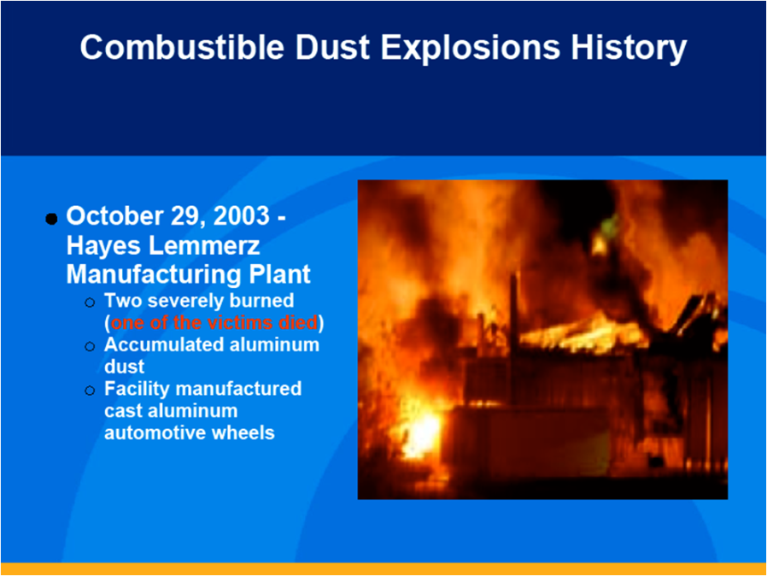
Notes:
On October 29, 2003, aluminum dust exploded at the Hayes Lemmerz International facility in Huntington, Indiana, killed one worker and injured several others. This explosion, which involved equipment used to remelt scrap aluminum, occurred in a part of the building where Hayes made cast aluminum and aluminum alloy automobile wheels. Scrap aluminum from the wheel manufacturing lines was chopped into small chips, pneumatically conveyed to the scrap processing area, dried, and fed into a melt furnace. Transporting and drying the aluminum chips generated explosive aluminum dust, which was then pulled into a dust collector.
The CSB determined that the explosion likely originated in the dust collector, which had not been adequately vented or cleaned, and was located too close to the aluminum scrap processing area. The initial explosion spread through ducting, causing a large fireball to emerge from the furnace. The dust collector system was not designed or maintained to prevent dust explosions, or to prevent a dust collector explosion from spreading through ducting. When the scrap and dust collector systems were added to the facility, Hayes did not follow management of change procedures that might have identified the dust explosion hazard. Hayes had also not cleaned dust from overhead beams and other structures. Some of this accumulated dust exploded (a secondary explosion), damaging the building roof. Previous dust fires at the facility were not investigated, facility employees had not been trained on the explosive nature of aluminum dust, and the Indiana Occupational Safety and Health Administration (IOSHA) had not identified dust explosion hazards during previous facility inspections. The CSB, in its report, determined that if Hayes Lemmerz had adhered to the NFPA standard17 for combustible metals, the explosion could have been prevented or minimized. The CSB report also included a recommendation for additional research to develop improved explosion protection for dust collectors in aluminum service.

Slide 10
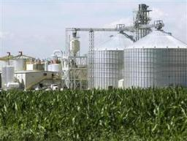
Related Experience in Grain Handling
In the late 1970’s a series of grain dust explosions in grain elevators left 59 people dead and 49 people injured.
In response to these events OSHA issued a safety and health information bulletin “Combustible Dust in Industry: Preventing and Mitigating the Effects of Fire and Explosions” (SHIB 07-31-2005) to provide employers and employees and other officials with information on the safety and health hazards associated with the storage and distribution of grain and includes all types of fibers and dust.
Notes:
In 1987, OSHA promulgated the Grain Handling Facilities standard (29 CFR 1910.272), which remains in effect. This standard, other OSHA standards such as Emergency Action Plans (29 CFR 1910.38), and updated industry consensus standards all played an important role in reducing the occurrence of explosions in this industry, as well as mitigating their effects. The lessons learned in the grain industry can be applied to other industries producing, generating, or using combustible dust.

Slide 11
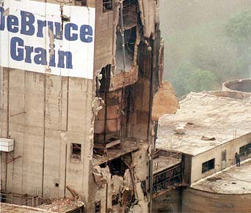
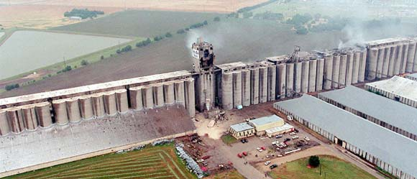
Explosion of
DeBruce
Grain
Elevator
Wichita, Kansas
8 June 1998
Notes:
Fatalities -- A total of seven men were fatally injured in the explosion. They were employees of either DeBruce Grain or Labor Source Incorporated (LSI).
The initial DeBruce Grain elevator explosion -- which set off a series of additional explosions of increasing severity -- occurred when grain dust was ignited in the east tunnel of the south array of silos. The most probable ignition source was created when a concentrator roller bearing, which had seized due to no lubrication, caused the roller to lock into a static position as the conveyor belt continued to roll over it. This "razor strop" effect on the roller raised its temperature to 260°C, well beyond the 220°C required to ignite layered grain dust which was plentiful inside the roller.
Because the belt was running in that tunnel at the moment of explosion it was creating a convective airflow. Witnesses reported that during elevator operation that the cloud of suspended grain dust was often so thick that during these times one could not see their hand in front of their face. The dispersion of the smoldering dust contained within the conveyer roller and its impact upon the floor dust layer, which would raise additional dust to also be dispersed by the convective flow would produce an ample fuel oxidizer mixture to be ignited by the glowing embers.
But it would be an error to focus on the details of likely ignition as the reason the elevator was destroyed. Of far greater consequence in causing the explosion -- and the key to preventing a similar one in the future (which should be the primary purpose for investigating any accident) -- are the deliberate DeBruce corporate decisions to (a) allow massive amounts of fuel to continually be created and distributed throughout the elevator -- awaiting any one of many possible sources of ignition, (b) forego repair and restoration of long-failed grain dust control systems, and (c) abandon preventive maintenance of elevator equipment -- particularly the grain conveyor and grain dust control systems. These three factors -- voluntarily exercised by DeBruce in opposition to widely-known and recognized methodology for explosion prevention -- caused the catastrophe. All three, which were well within DeBruce cognizance and control, made the disaster an inevitability

Slide 12
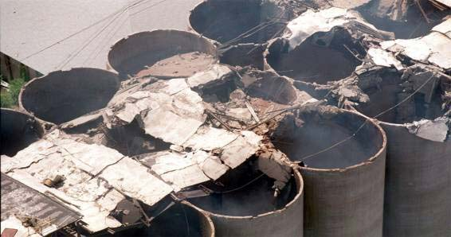
Aerial View of North Gallery, DeBruce Grain Elevator
Notes:
Most of the silo sheet-metal discharge spouts -- known as blast gates -- that release grain onto tunnel belts were either blown away or disabled so that all four tunnels were nearly choked with spilled grain. The force of successive explosions was sufficient to pulverize much of the structural concrete rather than simply break it into large chunks as usually occurs in grain elevator explosions of lesser severity. This effect was greatest at the north end of the elevator because of the large L / D (gun barrel) effect.

Slide 13
Elements of a Dust Explosion
Elements needed for a fire
  Combustible dust (fuel)
  Ignition source (heat)
  Oxygen in air (oxidizer)
Additional elements needed for a Combustible Dust Explosion
  Dispersion of dust particles in sufficient quantity and concentration
  Confinement of the dust cloud
Notes:
The 5 elements needed for a dust explosion.

Slide 14
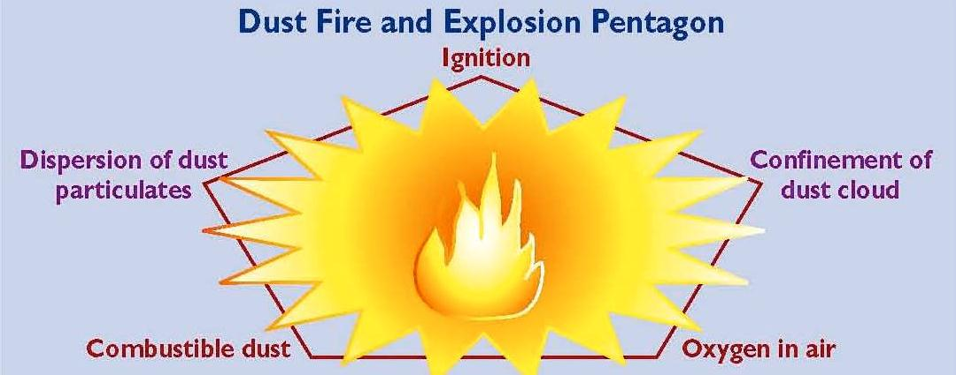
Notes:
The addition of the latter two elements to the fire triangle creates what is known as the "explosion pentagon“. If a dust cloud (diffused fuel) is ignited within a confined or semi-confined vessel, area, or building, it burns very rapidly and may explode. The safety of employees is threatened by the ensuing fires, additional explosions, flying debris, and collapsing building components.
An initial (primary) explosion in processing equipment or in an area were fugitive dust has accumulated may shake loose more accumulated dust, or damage a containment system (such as a duct, vessel, or collector). As a result, if ignited, the additional dust dispersed into the air may cause one or more secondary explosions. These can be far more destructive than a primary explosion due to the increased quantity and concentration of dispersed combustible dust.

Slide 15
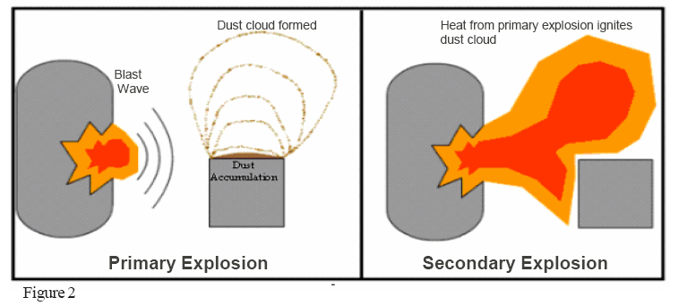
Notes:
An initial (primary) explosion in processing equipment or in an area where fugitive dust has accumulated may shake loose more accumulated dust, or damage a containment system (such as a duct, vessel, or collector). As a result, if ignited, the additional dust dispersed into the air may cause one or more secondary explosions. These can be far more destructive than a primary explosion due to the increased quantity and concentration of dispersed combustible dust.
If one of the elements of the explosion pentagon is missing, a catastrophic explosion can not occur. Two of the elements in the explosion pentagon are difficult to eliminate: oxygen (within air), and confinement of the dust cloud (within processes or buildings). However, the other three elements of the pentagon can be controlled to a significant extent, and will be discussed further in this document.

Slide 16
Facility Analysis Components
  Materials that can be combustible when finely divided;
  Dust Combustibility
  Processes which use, consume, or produce combustible dusts;
  Open areas where combustible dusts may build up;
  Hidden areas where combustible dusts may accumulate;
  Means by which dust may be dispersed in the air; and
  Potential ignition sources
Notes:
What do you need to identify when you do your analysis?
Is the dust combustible?
Any "material that will burn in air" in a solid form can be explosive when in a finely divided form.
Combustible dust is defined by NFPA 654 as: "Any finely divided solid material that is 420 microns or smaller in diameter (material passing a U.S. No. 40 Standard Sieve) and presents a fire or explosion hazard when dispersed and ignited in air."
Different dusts of the same chemical material will have different ignitability and explosibility characteristics, depending upon many variables such as particle size, shape, and moisture content. Additionally, these variables can change while the material is passing through process equipment. For this reason, published tables of dust explosibility data may be of limited practical value. In some cases, dusts will be combustible even if the particle size is larger than that specified in the NFPA definition, especially if the material is fibrous.⁷
Industrial settings may contain high-energy ignition sources such as welding torches. In these situations, test methods for dust ignition and explosion characteristics from ASTM International (originally the American Society for Testing and Materials) would be of value. and the relevant OSHA and other standards are listed in the "Sources of Additional Information" section of this document.

Slide 17
Facility Analysis Components
Electrical Classification
The facility analysis must identify areas requiring special electrical equipment classification due to the presence (or potential presence) of combustible dust
Notes:
The OSHA Electrical standard (29 CFR Part 1910
Subpart S) contains general requirements for electrical installations in hazardous areas. Detailed requirements for equipment and wiring methods are in NFPA 70, the National Electrical Code®. However, NFPA 70 does not define combustible dusts.
Further guidance on area classification is contained in NFPA 499, Recommended Practice for the Classification of Combustible Dusts and of Hazardous (classified) Locations for Electrical Installations in Chemical Process Areas. This document uses the same definition of combustible dust as NFPA 484 and NFPA 654. The overall dust hazard designation for electrical requirements is Class II. This is further broken down into Divisions which represent the probability of dust being present at any given time. Additionally, each dust is assigned a group (E, F, or G), representing the dust types (metal, carbonaceous, and other, respectively) with different properties. For instance, group E dusts are electrically conductive and electric current can pass through a layer of such dust under favorable circumstances, causing short circuits or arcs.

Slide 18
Facility Analysis Components
Other Hazard Analysis Considerations
The amount of dust accumulation necessary to cause an explosive concentration can vary greatly. This is because there are so many variables
  The particle size of the dust
  The particle size of the dust
  Ventilation system modes
  Ventilation system modes
  Physical barriers
  The volume of the area in which the dust cloud exists or may exist
Notes:
Many locations need to be considered in an assessment. One obvious place for a dust explosion to initiate is where dust is concentrated. In equipment such as dust collectors, a combustible mixture could be present whenever the equipment is operating. Other locations to consider are those where dust can settle, both in occupied areas and in hidden concealed spaces. A thorough analysis will consider all possible scenarios in which dust can be disbursed, both in the normal process and potential failure modes.
After hazards have been assessed and hazardous locations are identified, one or more of the following prevention, protection and/or mitigation methods may be applied. The references and information sources at the end of this document will assist in the decision process for the methods suitable to specific work sites. Additional guidance and requirements may be available from local or state fire and building code officials as well as OSHA Area or Regional Offices.

Slide 19
Dust Control
What can be done for dust control?
Notes:
Minimize the escape of dust from process equipment or ventilation systems;
Use dust collection systems and filters;
Utilize surfaces that minimize dust accumulation and facilitate cleaning;
Provide access to all hidden areas to permit inspection;
Inspect for dust residues in open and hidden areas, at regular intervals;
Clean dust residues at regular intervals;
Use cleaning methods that do not generate dust clouds, if ignition sources are present;
Only use vacuum cleaners approved for dust collection;
Locate relief valves away from dust hazard areas; and
Develop and implement a hazardous dust inspection, testing, housekeeping, and control program (preferably in writing with established frequency and methods).

Slide 20
Ignition Control
What can be done to control ignition sources?
Notes:
Use appropriate electrical equipment and wiring methods;
Control static electricity, including bonding of equipment to ground;
Control smoking, open flames, and sparks;
Control mechanical sparks and friction;
Use separator devices to remove foreign materials capable of igniting combustibles from process materials;
Separate heated surfaces from dusts;
Separate heating systems from dusts;
Proper use and type of industrial trucks;
Proper use of cartridge/powder activated tools; and
Adequately maintain all the above equipment.

Slide 21
Damage Control
What can be done for damage control?
Notes:
Separation of the hazard (isolate with distance);
Segregation of the hazard (isolate with a barrier);
Deflagration venting of a building, room, or area;
Pressure relief venting for equipment;
Provision of spark/ember detection and extinguishing systems;
Explosion protection systems (also refer to NFPA 69, Standard on Explosion Prevention Systems);
Sprinkler systems; and
The use of other specialized suppression systems.

Slide 22
Training
Workers are the first line of defense in preventing and mitigating fires and explosions. If the people closest to the source of the hazard are trained to recognize and prevent hazards associated with combustible dust in the plant, they can be instrumental in recognizing unsafe conditions, taking preventative action, and/or alerting management.
Notes:
While OSHA standards require training for certain employees, all employees should be trained in safe work practices applicable to their job tasks, as well as on the overall plant programs for dust control and ignition source control. They should be trained before they start work, periodically to refresh their knowledge, when reassigned, and when hazards or processes change.
Employers with hazardous chemicals (including combustible dusts) in their workplaces are required to comply with 29 CFR 1910.1200, the Hazard Communication standard. This includes having labels on containers of hazardous chemicals, using material safety data sheets, and providing employee training

Slide 23
Management
What is managements duty?
Notes:
A qualified team of managers should be responsible for conducting a facility analysis (or for having one done by qualified outside persons) prior to the introduction of a hazard and for developing a prevention and protection scheme tailored to their operation. Supervisors and managers should be aware of and support the plant dust and ignition control programs. Their training should include identifying how they can encourage the reporting of unsafe practices and facilitate abatement actions.

