Slide 1

Western Iowa Tech Community College
Used with permission from Penn State Ag & Engineering
This material was produced under a grant (SH-16634-07-60-F-19) from the Occupational Safety and Health Administration, U.S. Department of Labor. It does not necessarily reflect the views or policies of the U.S. Department of Labor, nor does the mention or trade names, commercial products, or organization imply endorsement by the U.S. government.

Slide 2
In this discussion we will cover the following:
How quickly entrapment in flowing grain can occur,
How difficult it is to get someone out when they are buried in grain,
The three most typical ways people become caught in or under grain,
How you should go about helping someone that is trapped inside.
Notes:
Introduction

Slide 3
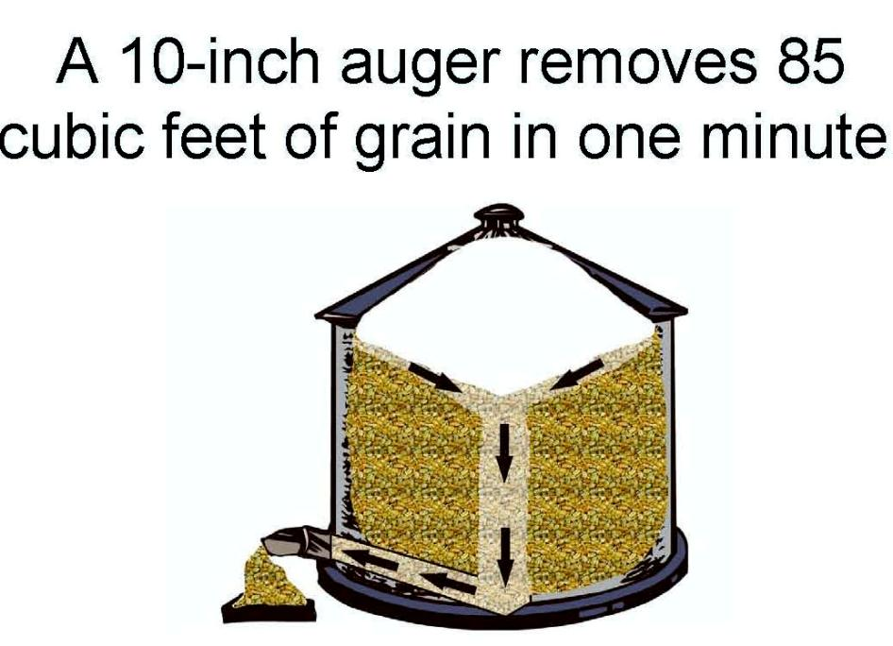
Notice the flow of the grain, from the top down the center
85 cubic feet of grain converts to about 65 bushels
Notes:
Notice the flow of the grain, from the top down the center
85 cubic feet of grain converts to about 65 bushels

Slide 4
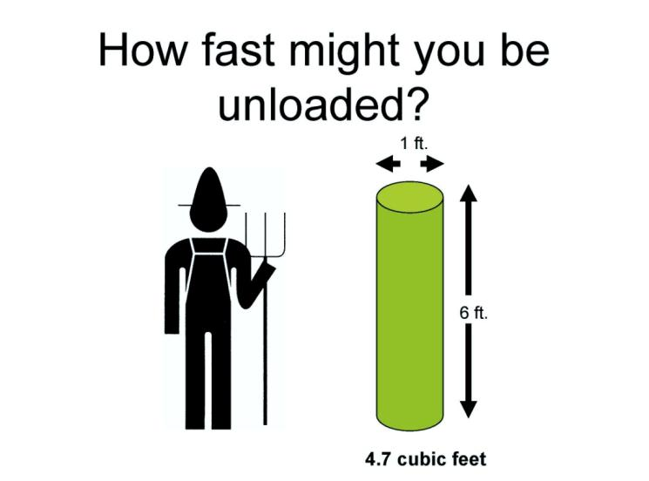
A 6 foot tall person weighting 180 pounds will average 12 inches around.
This results in that person having a volume of 4.7 cubic feet.
That person could be unloaded in 3.3 seconds!
Notes:
A 6 foot tall person weighting 180 pounds will average 12 inches around.
This results in that person having a volume of 4.7 cubic feet.
That person could be unloaded in 3.3 seconds! Relates to the speed that grain can be unloaded by the example auger in the pervious slide.

Slide 5
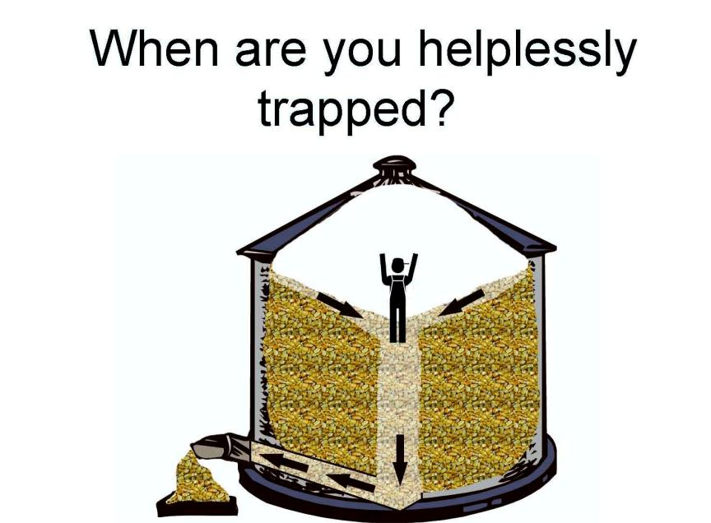
Do you have to be completely covered?
Up to your shoulders?
Up to your waist?
Once your knees are covered you will probably need some sort of assistance to free yourself.
Notes:
Do you have to be completely covered?
Up to your shoulders?
Up to your waist?
Once your knees are covered you will probably need some sort of assistance to free yourself.

Slide 6

When was the last time that you actually stood on grain?
The point is that no one stands on grain, we stand in grain.
Normally a person is going to sink 6-10 inches into the grain, depending on their size, weight, and the condition of the grain.
Notes:
When was the last time that you actually stood on grain?
The point is that no one stands on grain, we stand in grain.
Normally a person is going to sink 6-10 inches into the grain, depending on their size, weight, and the condition of the grain.

Slide 7
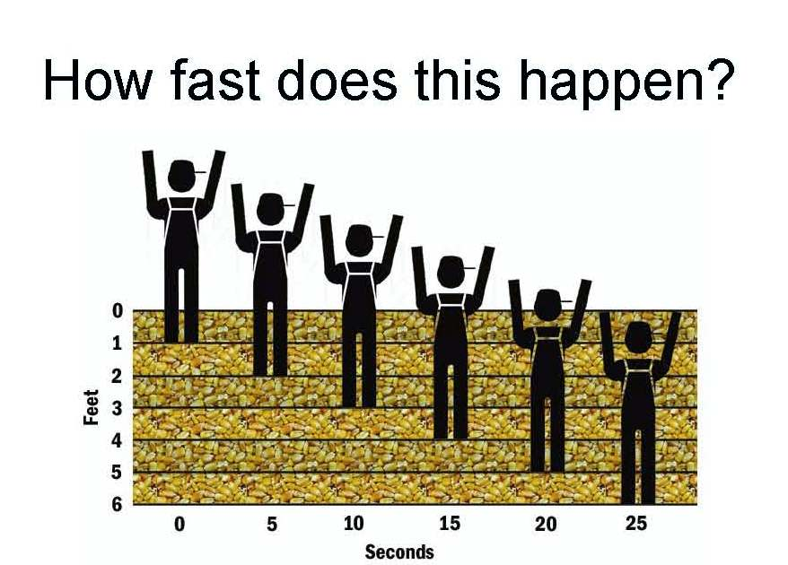
With all the previous information we begin to get the idea of just how fast a person can become trapped or completely buried by flowing grain.
Because we stand in grain, not on grain we start 6-10 inches below the surface,
If the grain is over your knees and still flowing under your feet you can become trapped in as few as 5 seconds,
In 25 seconds a 6 foot person can be buried above his head.
Notes:
With all the previous information we begin to get the idea of just how fast a person can become trapped or completely buried by flowing grain.
Because we stand in grain, not on grain we start 6-10 inches below the surface,
If the grain is over your knees and still flowing under your feet you can become trapped in as few as 5 seconds,
In 25 seconds a 6 foot person can be buried above his head

Slide 8
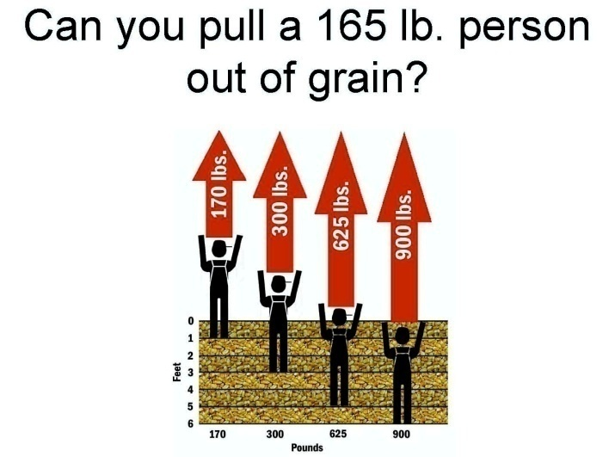
Notice that even 1 foot below the surface you add an extra 5 pounds of friction to the weight.
Keep in mind that you will never have ideal pulling conditions
  Most cases you will be outside the bin pulling through an access hole or on top of the bin pulling through the fill hole.
  Both cases will greatly reduce your pulling ability.
Think of the force you will be putting on the victim, unless the person has a full body harness you could unnecessarily injure the person.
The general rule is, if the person is up to their waist, don’t even attempt a lift.
Leave it to the rescuers
Notes:
Make it very clear that rescue should only be attempted by trained personal that have had very intensive training in rescue topics. This overview does not qualify as rescue training.
Keep in mind that you will never have ideal pulling conditions
Most cases you will be outside the bin pulling through an access hole or on top of the bin pulling through the fill hole.
Both cases will greatly reduce your pulling ability.
Think of the force you will be putting on the victim, unless the person has a full body harness you could unnecessarily injure the person.
The general rule is, if the person is up to their waist, don’t even attempt a lift.
Leave it to the rescuers

Slide 9
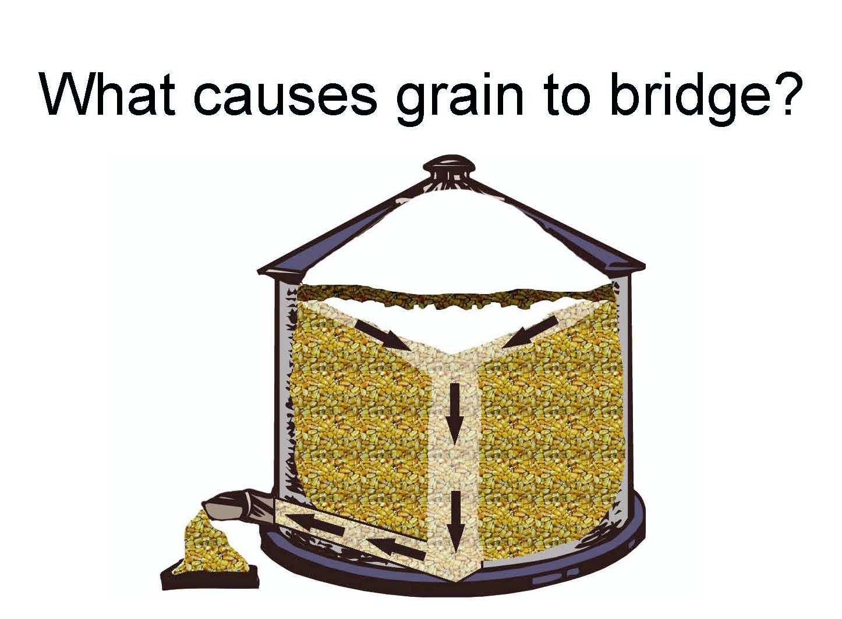
Grain that becomes wet and moldy can stick together in large masses or chunks
If this happens on the top surface, the running of the auger may create a cavity below the surface
This is normally referred as a bridge
Notes:
Grain that becomes wet and moldy can stick together in large masses or chunks
If this happens on the top surface, the running of the auger may create a cavity below the surface
This is normally referred as a bridge

Slide 10
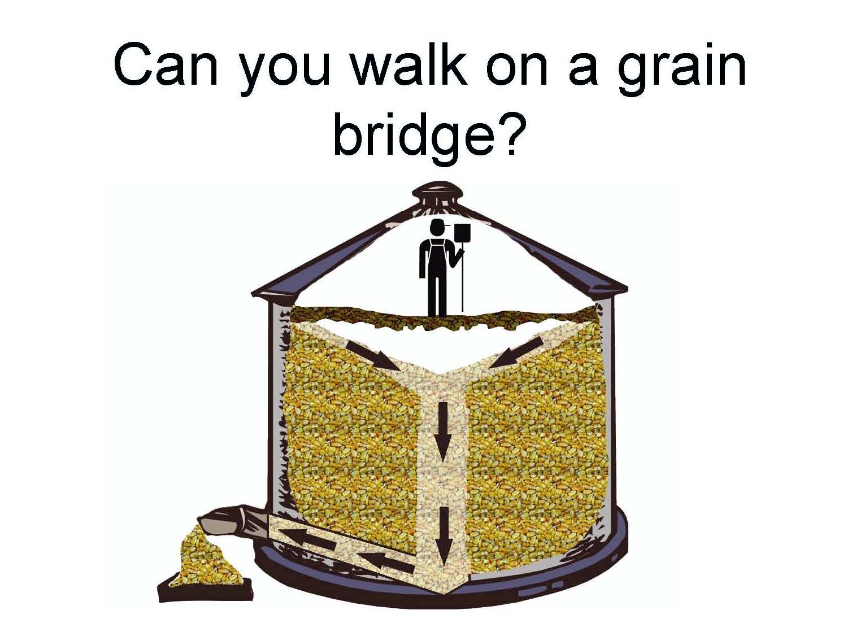
How do I break up the bridge?
Is it safe to walk on the bridge?
Unfortunately this is the choice that too many people make.
They go inside with a shovel or a pole and try to break it up.
And in some cases they leave the auger running!

Slide 11
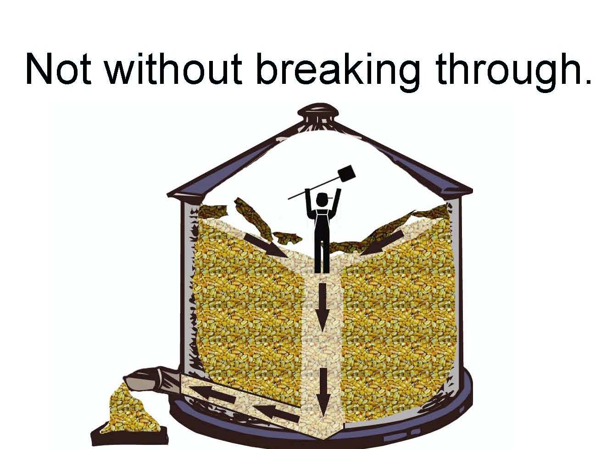
In any case the person will fall into the cavity and be covered with grain
If the auger was left running it would only be a matter of seconds before they would be at the bottom of the bin.
In most cases if you are completely covered with grain you will die of suffocating.
Notes:
In any case the person will fall into the cavity and be covered with grain
If the auger was left running it would only be a matter of seconds before they would be at the bottom of the bin.
In most cases if you are completely covered with grain you will die of suffocating.

Slide 12
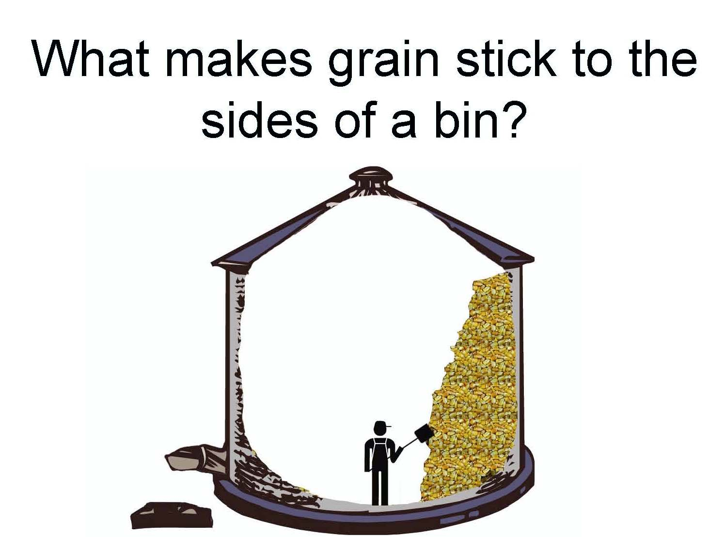
Grain sticks to the side of the bin for the same reasons as it bridges
It draws moisture and molds causing large masses
If the wall of grain is taller than you it can cover you when it breaks up
Notes:
Grain sticks to the side of the bin for the same reasons as it bridges
It draws moisture and molds causing large masses
If the wall of grain is taller than you it can cover you when it breaks up

Slide 13
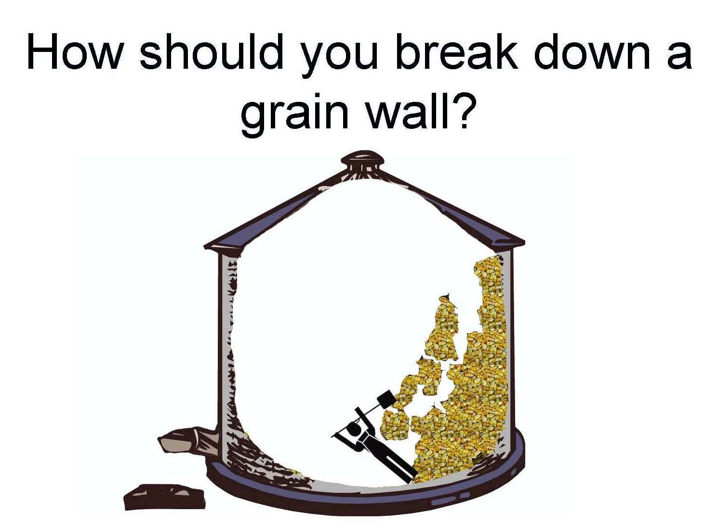
The tendency is to stand on the floor and break it up with a shovel or a pole
If the whole mass breaks loose it can quickly cover you
Notes:
The tendency is to stand on the floor and break it up with a shovel or a pole
If the whole mass breaks loose it can quickly cover you

Slide 14
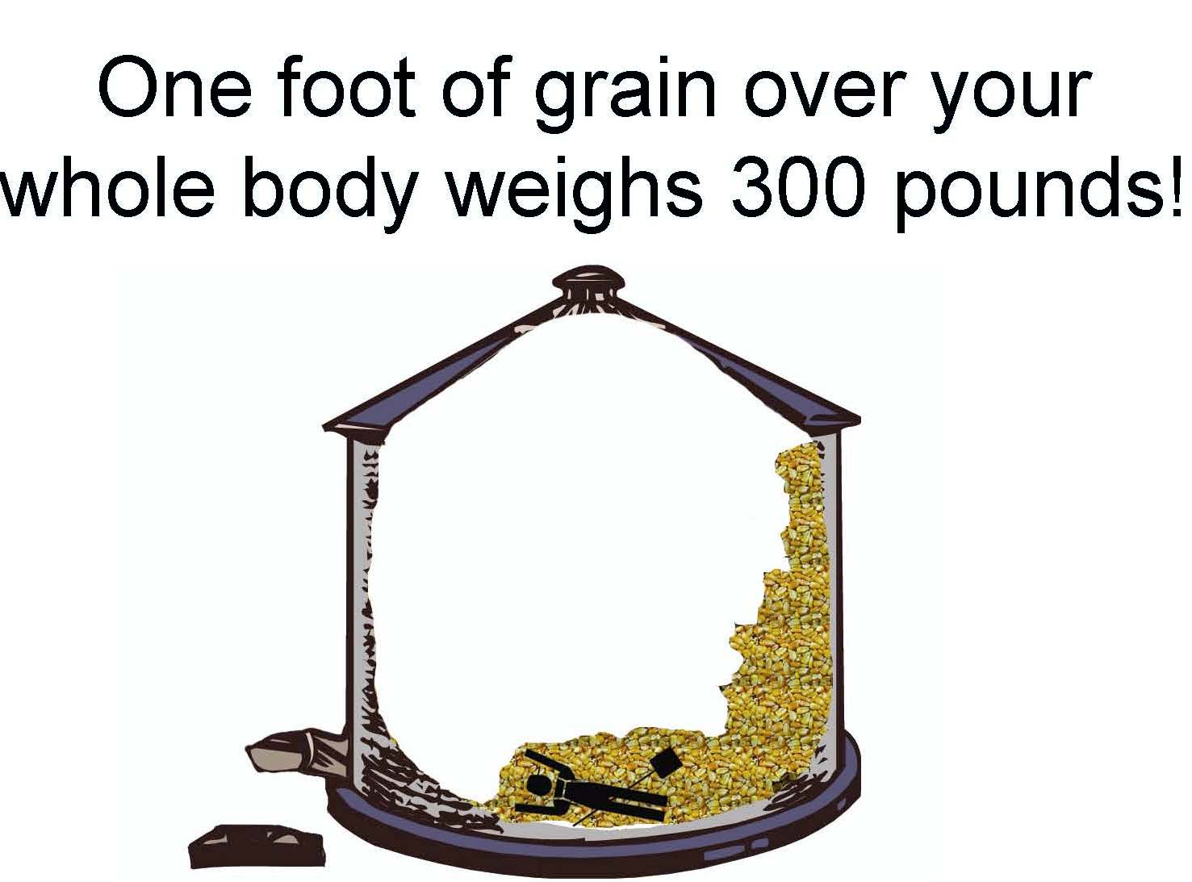
What surprises most people is that if you are laid out on the floor with 12 inches of grain such as shell corn covering you it is possible to have up 300 pounds of weight on your body!
Notes:
What surprises most people is that if you are laid out on the floor with 12 inches of grain such as shell corn covering you it is possible to have up 300 pounds of weight on your body!

Slide 15
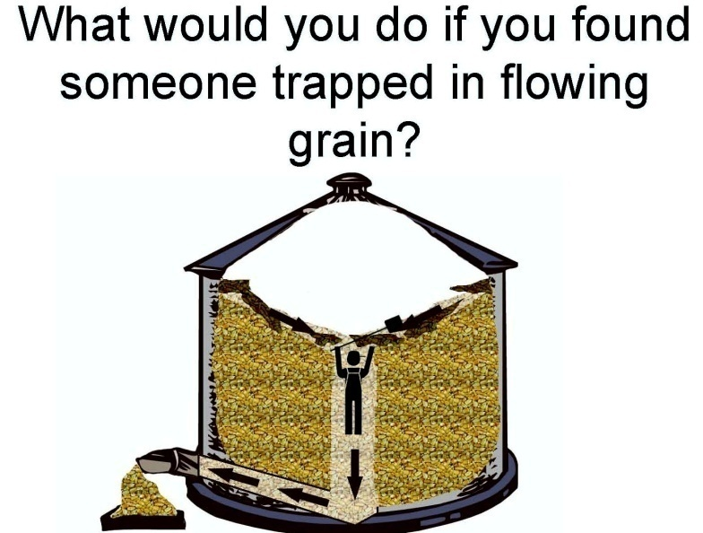
The 3 things you want to do are:
Make sure that the flow of grain is stopped
  Disable the power
    Cut the cord
    Remove the fuse
  Prevent anyone else from turning on the auger
Turn the ventilation fans on to supply the victim with fresh air
Call 911
Notes:
The 3 things you want to do are:
Make sure that the flow of grain is stopped
Disable the power
Cut the cord
Remove the fuse
Prevent anyone else from turning on the auger
Turn the ventilation fans on to supply the victim with fresh air
Call 911

Slide 16
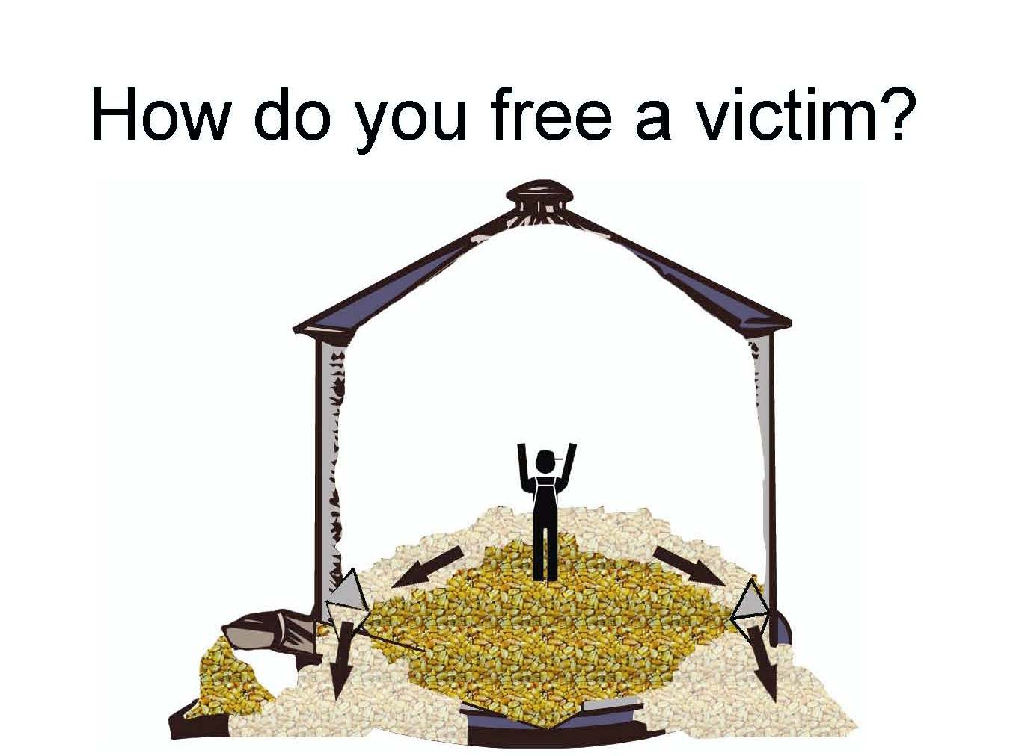
It is important to understand that we don’t remove the victim from the grain: we remove the grain from the victim
The rescuers will cut holes on both sides of the bin below the victim
  The holes are cut on both sides to keep the bin from toppling
Notes:
It is important to understand that we don’t remove the victim from the grain: we remove the grain from the victim
The rescuers will cut holes on both sides of the bin below the victim
The holes are cut on both sides to keep the bin from toppling

Slide 17
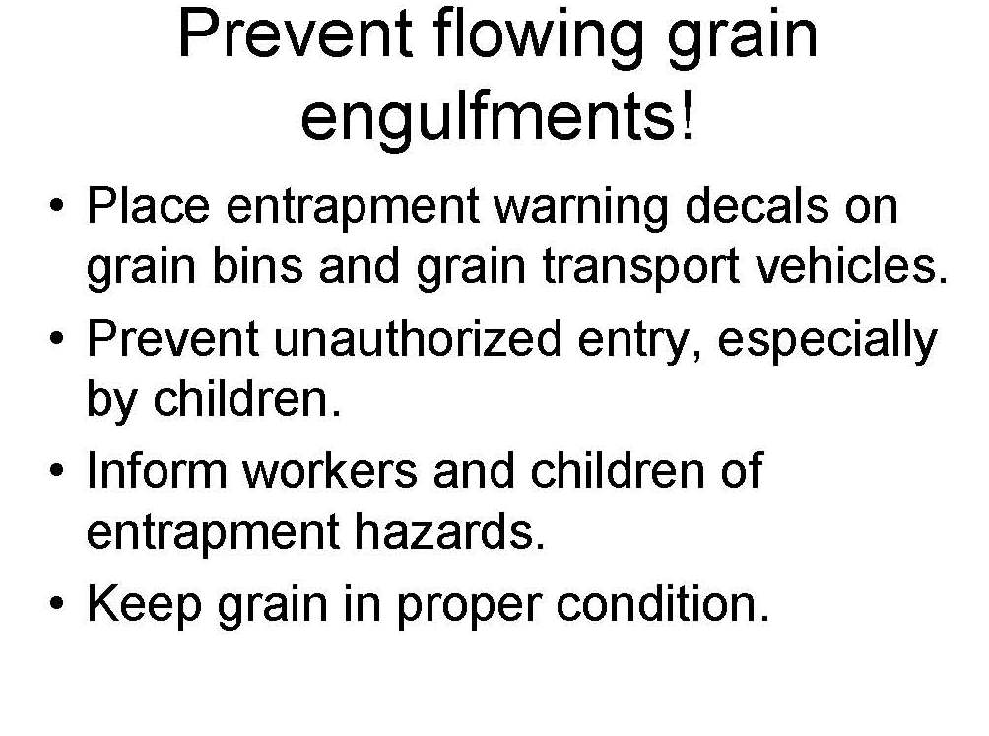
Notes:
Place warning decals on exterior bin
Do not permit children to enter
Inform workers of hazards
Keep grain in proper condition

Slide 18
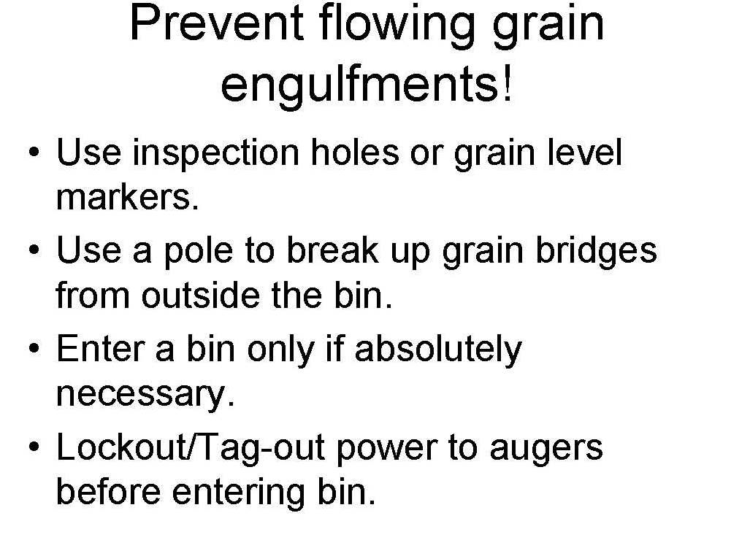
Notes:
Use inspection holes or grain level markers
Use a pole to break up bridges from the out side of the bin
Enter only if necessary
LOTO augers

Slide 19
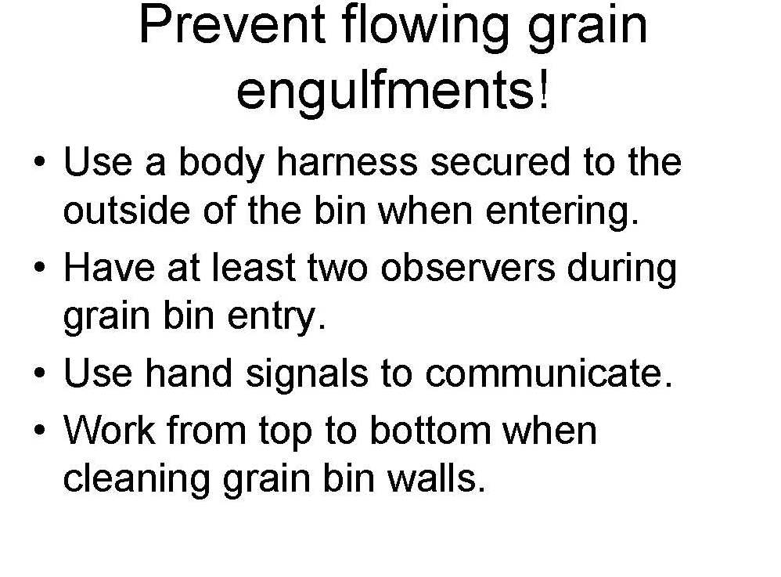
Notes:
Use a body harness secured to the outside of the bin when you enter
Have two observers during entry
Use hand signals to communicate
Work from top to bottom when cleaning

Slide 20


