Slide 1
Boiler Safety
Developed by Western Iowa Tech Community College
This material was produced under a grant (SH-16634-07-60-F-19) from the Occupational Safety and Health Administration, U.S. Department of Labor. It does not necessarily reflect the views or policies of the U.S. Department of Labor, nor does the mention or trade names, commercial products, or organization imply endorsement by the U.S. government.
Notes:
Introduction and overview.

Slide 2
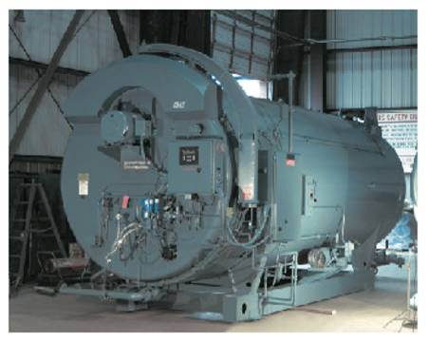
Boiler Room Hazards
A Risk Of Explosion Exists
High Pressure steam
Combustion Gases
Chemicals
Moving Machinery
Hot Surfaces
Notes:
There are four major categories of catastrophic failure which exists in the boiler itself.
1. Melt down. This is a result of the heating surface metal reaching its melting point. It is a result of the boiler operating on very low water conditions. This by itself will not cause an explosion but will do major damage to the boiler and create a dangerous situation which could lead to an explosion.
2. Thermal Shock This is a condition where low water causes the heating surfaces to become overheated and then cooler water is added. The water then flashes to steam which expands 1600 times its volume as water and causes the explosion because there is not enough room for the steam to expand.
3.Combustion explosions These can be a result of gases which build up and an ignition source ignites the gases. This can happen inside the boiler or outside. There are safety devices in place to avoid these situation and we will discuss these in the following slides.
4. Steam Pressure Excessive steam build up which exceeds the design pressures of the vessel. There are also safety device to prevent this.

Slide 3
Communication is Critical
Boiler operation information is communicated to the boiler operator starting the shift to specify any special procedures required.
Notes:
Communicate any special conditions, which safety checks were completed and what needs to be done, the boiler operator should have a duty checklist listing routine duties. A duty checklist helps to ensure quality and consistency in performing various tasks. The duty checklist is developed in conjunction with the boiler room log to ensure that critical duties such as safety valve testing are performed. When taking over a shift, any extraordinary concerns are communicated to the boiler operator starting the shift. This alerts the boiler operator of special procedures that may be required during the shift. Procedures commonly completed during a shift include water column and gauge glass blowdown, bottom blowdown, low water fuel cutoff testing, and flame scanner testing.

Slide 4
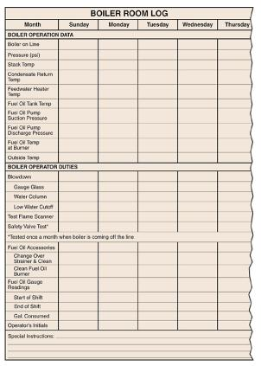
Boiler Log
The boiler room log lists boiler operation data that can be used to increase boiler safety and efficiency as well as identifying a potential malfunction.
Notes:
A boiler room log is used to record information regarding operation of the boiler during a given period of time. The number and frequency of the checks to be performed depend on the plant. Some plants maintain a log for every 8-hour period. Other plants maintain a log for a 24-hour period. Maintaining a boiler room log allows the operator to evaluate the past performance of the boiler. In addition, boiler room log information can be useful in determining the cause of a malfunction and/or predicting a possible problem.

Slide 5
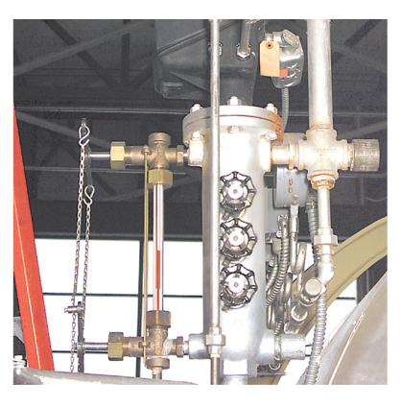
Water Level
The Normal Operating Water Level (NOWL) should be approximately in the middle of the gauge glass.
Notes:
Ensuring proper water level may be the most important duty of an operator. The gauge glass is the primary devise used in determining water level and must be maintained in proper condition. It is connected to the water column which levels out the turbulent water in the boiler so it can be accurately read.

Slide 6
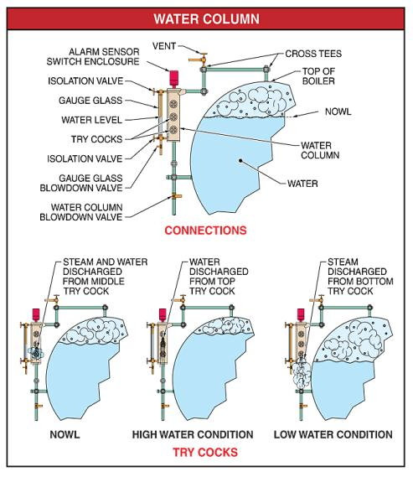
Try Cocks Try Cocks
Try cocks are used to determine the boiler water level if the gauge glass is not functional.
Notes:
All steam boilers must have two methods of determining the water level in the boiler. The gauge glass is the first and easiest method for determining boiler water level. A second method for determining boiler water level is try cocks. Try cocks are valves located on the water column used to determine the boiler water level if the gauge glass is not functional.

Slide 7
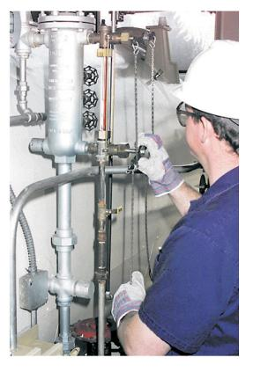
Water Column And Gauge Glass Blowdown
The water column is blown down first and then the gauge glass to remove any sediment. Water should enter the gauge glass quickly when the gauge glass blowdown valve is closed.
Notes:
When blowing down the water column and gauge glass, the operator should carefully monitor the action of the water in the gauge glass. Water should enter the gauge glass quickly when the gauge glass blowdown valve is closed, indicating that the lines are free of sludge, sediment, or scale buildup. If the water returns sluggishly to its normal level, there may be an obstruction partially blocking the flow of water. If the apparent obstruction cannot be removed by blowing down, then the boiler should be shut down and allowed to cool. If the gauge glass is integrated with the low water fuel cutoff, the float (or probe) chamber should be opened and inspected. Mud, scale, or sediment deposits should be removed completely. Linkage should also be examined to ensure proper working order. All connecting piping should be inspected for any obstructions.

Slide 8
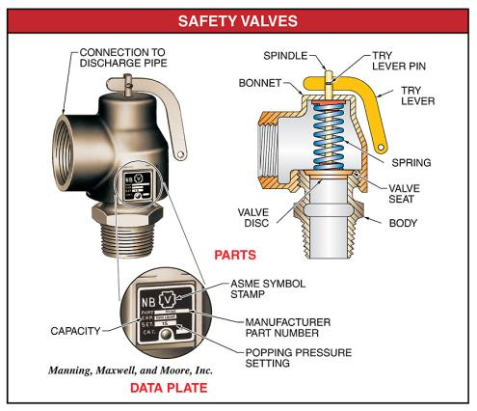
Safety Valve
The spring-loaded pop-off safety valve pops open when steam pressure exceeds the MAWP.
Notes:
The safety valve spring applies pressure to close the valve disc against the valve seat. (MAWP Maximum allowable working pressure.)The spindle aligns the valve disc with the valve seat. The try lever is connected to the spindle with the try lever pin. When the try lever is lifted during testing, the try lever contacts the bonnet, providing the leverage required to raise the spindle and valve disc. Safety valve capacity is the amount of steam, in pounds per hour (lb/hr), that the safety valve is capable of venting at the rated pressure of the safety valve. The safety valve capacity is listed on the data plate attached to the safety valve. For example, if the safety valve capacity is listed as 6900 lb on the data plate, the safety valve can discharge steam at 6900 lb/hr. The safety valve capacity must equal or exceed the boiler pounds per hour rating.

Slide 9
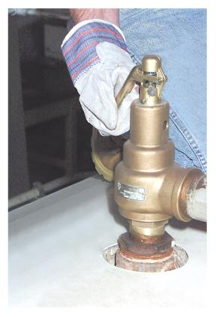
Safety Valve Test
Safety valves are routinely tested to ensure proper operation and must be serviced by an authorized manufacturer representative.
Notes:
There is no routine maintenance on a safety valve. However, safety valves are routinely tested to ensure proper operation. Safety valves are commonly tested by lifting the safety valve try lever.. With the boiler pressure at a minimum of 75% of the safety valve set pressure, the safety valve try lever is lifted to wide open position. Steam is discharged for 5 sec to 10 sec. The try lever is released, and the disk should snap to the closed position against the valve seat. Malfunctioning safety valves must be replaced as soon as possible. Replacement safety valves must comply with the ASME Boiler and Pressure Vessel Code and all design specifications of the boiler. Any adjustments or repairs to a safety valve must be performed by the manufacturer or an authorized manufacturer representative. An evaporation test can also be used it is more accurate because it replicates a more realistic situation The feedwater is secured and water is allowed to evaporate. This is not necessary if a proper type cutoff is used. PPE used for this testing would general require insulation gloves. Refer to your company safety plan for instructions.

Slide 10
Burner Control System
The safety devices are all wired through a burner controller. This will shutdown the fuel supply to the burner.
Notes:
All modern boilers have a flame safeguard system which monitors the burner for proper operation and will shut off the fuel supply if a flame is not detected in the boiler. There are different types and these shall be tested periodically.

Slide 11
Flame Scanner Test
When testing the flame scanner, the flame scanner sensor is covered to simulate a flame failure.
Notes:
The flame scanner is tested with the burner firing to simulate a flame failure. A flame failure can result in a furnace explosion from the ignition of accumulated fuel in the burner. The flame scanner is removed and the scanner sensor is covered. The main fuel valve should close and the flame failure alarm sounds. The flame scanner is cleaned as required and replaced. The programmer is reset by pressing the reset button and the burner is monitored through a complete firing cycle.

Slide 12
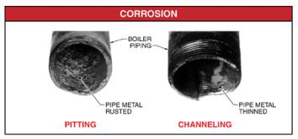
Water Treatment
Water must be treated for safety. Minerals can cause a build up of deposits and cause overheating of boiler parts.
Notes:
Corrosion is the rusting or pitting of boiler metal. Corrosion weakens boiler metal by the thinning (removal) of the metal. Corrosion causes pitting and channeling of the metal, which results in the thinning of tubes, piping, and other boiler components. Corrosion is primarily caused by oxygen in the boiler water. Feedwater is treated to remove oxygen by heating and/or chemical treatment. Heating the feedwater removes oxygen and carbon dioxide. Chemical treatment requires the addition of oxygen scavenger chemicals. An oxygen scavenger chemical is a chemical that combines with oxygen to form harmless compounds for removal from the boiler. Sodium sulfite is an oxygen scavenger that is commonly used to treat boiler water. Sodium sulfite combines with oxygen to form sodium sulfate, which accumulates at the bottom of the boiler. The sodium sulfate is then discharged from the boiler through the bottom blowdown valve.

Slide 13
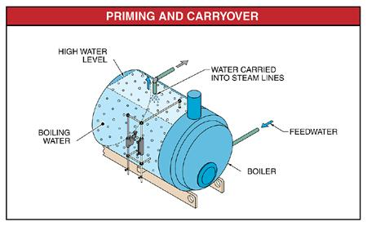
Carryover &
Carryover occurs when a high boiler water level causes water particles to be carried into steam lines.
Notes:
Priming is a condition that occurs when large slugs of boiler water are carried into the steam lines. Carryover is a condition that occurs when small particles of boiler water are carried into the steam lines. Both of these conditions can be caused by a high water level in the boiler. Priming and carryover can also be caused by a high concentration of chemicals in the boiler water, impurities in the boiler water that cause a high surface tension (such as oil), and/or opening a main steam stop valve too quickly.

Slide 14
Bottom Blowdown
During a bottom blowdown, the boiler should be under light load and the water level should be at the NOWL.
Notes:
The quick-opening valve is opened first when a quick-opening and slow-opening valve are used. The slow-opening valve is opened slowly to the full open position. The slow-opening valve takes the wear and tear of blowdown. Talk about water hammer caused by not following this process.

Slide 15
Steam Valves
Steam valves are opened slowly and gloves are worn to prevent burns.
Notes:
Steam valves are opened slowly to equalize pressure and warm the equipment downstream. This also allows steam traps to drain condensate so dangerous water hammer can be avoided.

Slide 16
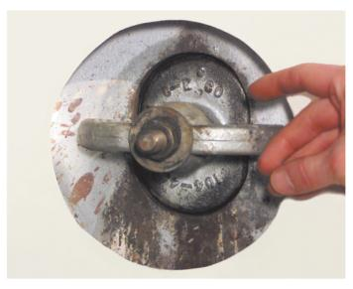
Handhole Covers
Manhole and handhole covers are removed to provide access to boiler parts during a boiler inspection.
Notes:
Before removing any covers, make sure all the proper permits and lockout tagout procedures have been followed. Make sure the boiler is not in a vacuum by opening the boiler vent valve. As soon as the boiler has been dumped, open the handholes, remove the manhole cover, and thoroughly flush and wash out the water side. Do not dump a boiler unless it can be flushed immediately. If a boiler is dumped and not flushed right away, the sludge and sediment air-dry on the heating surfaces, making it extremely difficult to clean. Compound gauge used for to determine if boiler is in a vacuum.

Slide 17
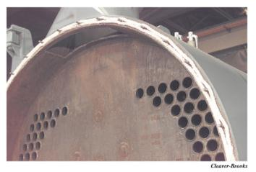
Boiler Inspection
All internal surfaces are exposed and cleaned prior to the boiler inspection.
Notes:
Frequently, the boiler inspector requires all of the plugs removed at the water column and the low water fuel cutoff controls opened so the inside float chamber can be inspected. Fusible plugs must be replaced. After both the fire side and water side of the boiler have been cleaned, notify the inspector that the boiler is ready for inspection.

Slide 18
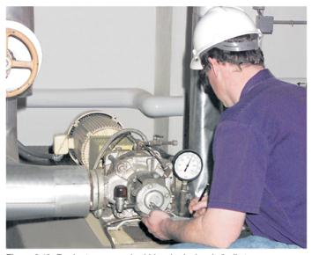
Pumps and Other Equipment
Pumps should be checked periodically to ensure proper bearing temperatures and checked for any unusual vibration. Do not wear loose clothing around moving parts.
Notes:
Pumps require little maintenance during normal operation. Periodic checks should be made to ensure proper bearing temperatures and check for any unusual vibration. Lubrication should follow manufacturer recommendations. Pump service should coincide with other scheduled maintenance to minimize effects on plant operations. During service, the bearings should be checked for wear and lubricant replaced or added. Flexible couplings should be opened and checked for wear and alignment. The coupling should be washed thoroughly and reassembled with new lubricant. The pump seals should also be inspected and, if necessary, replaced. If boiler room log entries indicate feedwater pump performance has significantly decreased, an overhaul of the pump may be required according to manufacturer specifications.

Slide 19
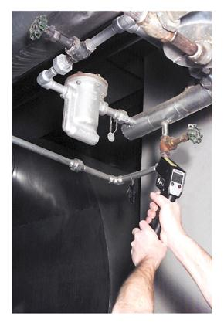
Steam Traps
Steam traps are checked for proper operation when determining the cause of a steambound feedwater pump.
Notes:
A steambound feedwater pump is a condition resulting from water pumped that becomes too hot and turns to steam. The feedwater pump is designed to pump liquids, but does not work with air or steam. To correct a steambound feedwater pump, water fed to the feedwater pump must be cooled. Water that is drawn from a condensate return tank may be cooled by adding water from the makeup system. Cool water can be carefully poured directly on the feedwater pump without spilling water on the motor if the problem persists. Steam traps on the condensate return line should also be tested for proper operation. In this example the steam trap is checked for operation with a hand held thermal temperature device.

Slide 20
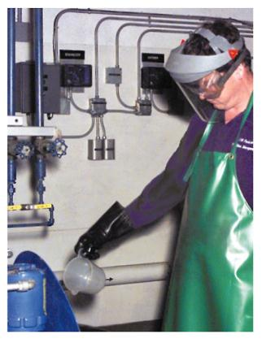
Protective Clothing
A face shield along with safety glasses provides eye protection when working with feedwater chemicals.
Notes:
OSHA requires eye protection when there is a reasonable probability of preventing injury to the eyes or face from flying particles, molten metal, liquid chemicals, chemical gases, radiant energy, or a combination of these. Eye protection is worn when replacing a gauge glass. Side protectors must be provided on all eye protection. Eye protection must be suitable for the work performed. The eye protection required varies with the task performed. For example, when inspecting a fire, the required lens is worn. Face shields are worn when working with feedwater chemicals. Eye protection must comply with OSHA 29 CFR 1910.133 – Eye and Face Protection. Standards for eye protection are specified in ANSI Z87.1-1989, Practice for Occupational and Educational Eye and Face Protection. Talk about eye wash stations and other PPE gloves, apron.

Slide 21
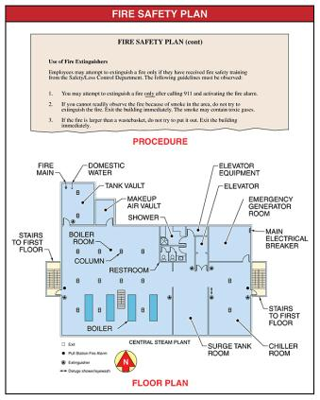
Fire Safety Plan
A fire safety plan includes the locations of fire alarms, fire extinguishers, the main electrical breaker, fire main, and exits for each area of the facility.
Notes:
In the event of a fire, the boiler operator must act quickly to minimize injury and damage. All facilities must have a fire safety plan. A fire safety plan establishes procedures that must be followed if a fire occurs. See Locations of fire alarms, fire extinguishers, the main electrical breaker, the fire main, and exits are listed for each area of the facility. Employee shall have annual fire extinguisher training. Discussion about electrical training for any that would have duty related to the electrical breaker.

Slide 22
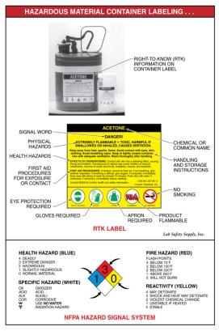
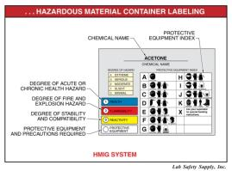
Chemical Safety
Containers that contain hazardous materials must be labeled, tagged, or marked.
Notes:
Containers that contain hazardous materials must be labeled, tagged, or marked with the identity of the hazardous material and appropriate hazard warnings per OSHA 29 CFR 1910.1200(f) – Labels and Other Forms of Warning. Container labeling differs from manufacturer to manufacturer. However, all container labels must include basic right-to-know (RTK) information to convey hazards of the chemical according to federal and state standards. The NFPA Hazard Signal System may be used to provide information at a glance. The NFPA Hazard Signal System uses a four-color diamond-shaped sign to display basic information about hazardous materials. Colors and numbers identify potential health (blue), flammability (red), reactivity (yellow), and special hazards (no special color). Degree of severity, by number, ranges from four (4), indicating severe hazard, to zero (0), indicating no hazard. Talk training for anyone using this label system to understand all symbol's and there meaning.

Slide 23
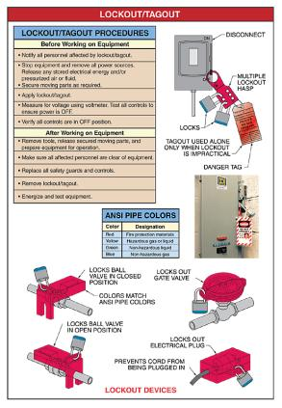
Lockout/Tagout
Lockouts and tagouts are applied to equipment to prevent injury from energized circuits and equipment operation during maintenance and repair.
Notes:
Lockouts and tagouts are applied to equipment to prevent equipment operation during maintenance and repair. Lockout is the use of locks, chains, or other physical restraints to positively prevent the operation of specific equipment. Tagout is the process of attaching a danger tag to the source of power to indicate that the equipment may not be operated until the tag is removed. Space on the danger tag may be used to specify lockout information. A tagout does not prevent the startup of equipment, but serves as a warning to operating and service personnel.. Written lockout/tagout procedures must be established for operating and maintenance procedures for each piece of equipment in the facility. Lockouts and tagouts are removed only by authorized personnel. A multiple lockout requires installation and removal of more than one lock on a multiple lockout hasp. OSHA would require the use of locks in most cases.

Slide 24
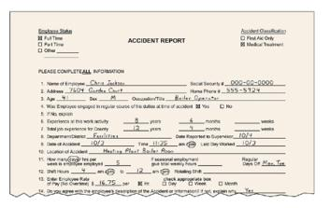
Accident Reports
An accident report details facts about an accident in the facility and is required for insurance claims.
Notes:
Boiler room accidents can occur at any time. Even though safety precautions are followed, the possibility of an accident still exists. Injuries resulting from accidents must be handled quickly and intelligently. After an accident, an accident report is filed. An accident report is a document that details facts about an accident in the facility. Accidents that occur must be reported regardless of their nature. Accident reports commonly include the name of the injured person, the date, time, and place of the accident, the name of the immediate supervisor, and the circumstances surrounding the accident. Accident report forms are required for insurance claims and become a permanent part of plant operation records.

