Slide 1
Course Material
Overview of Process Safety
Compliance with Standards
Process Hazard Analysis
Standard Operating Procedures
Safe Work Procedures
Mechanical Integrity
Management of Change
Auditing Process Safety Systems
Emergency Response Procedures
Notes:
This training on process safety was developed by the Center for Chemical Process Safety (CCPS), which is a Technology Alliance of the American Institute of Chemical Engineers. It was developed under an OSHA “Susan Harwood Grant”. We have just completed Module 7 on “Management of Change.” This is module 8 of 9 and is entitled “Auditing Process Safety Systems”. PSM audits evaluate management systems to ensure that they are in place and functioning in a manner that protects employees, customers, communities, the environment, and physical assets against process safety incidents.

Slide 2
8. Auditing Process Safety Management Systems
Process Safety Management for Biofuels
29 CFR 1910.119 (o)
Notes:
For hazardous processes, Process Safety Audits are required by OSHA’s Process Safety regulations, which are referenced on this screen.
The regulations state in the compliance audits topic that “employers shall certify that they have evaluated compliance with the provisions of this section at least every three years to verify that the procedures and practices developed under the standard are adequate and are being followed.”
This module will discuss
1) The implementation of an effective PSM auditing system, and
2) Using a PSM auditing system for continuous improvement in process safety.

Slide 3

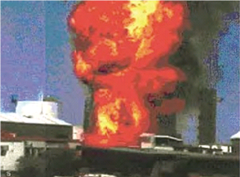
Explosion at Esso Longford Plant
September 25, 1998
Notes:
We will first start with a tragic failure of a process safety auditing system.
On September 25, 1998, the Esso Longford gas plant in Victoria, Australia suffered an explosion. Two employees were killed and eight others injured. Gas supplies to the State of Victoria were reduced by 95% as a result of the explosion.

Slide 4
Longford, Australia Explosion
Cost of Industry Disruptions
A$ 1,300,000,000
Ref.: (Royal Commission 1999, International Petroleum Encyclopedia 1999)
Notes:
With the Longford facility supplying 98 per cent of the state’s gas needs, most Victorian gas consumers were left without gas for 19 days. It is estimated that 1.4 million households and 89,000 businesses were affected.
In addition to directly affecting the daily lives of some 4 million Victorians for almost three weeks, the estimated cost of the accident to the Victorian economy was put at $1.3 billion Australian dollars, about $1 Billion US dollars.

Slide 5

Longford, Australia Explosion
Corporate PSM Audit
Notes:
An audit conducted by a corporate team six months prior to the explosion had incorrectly stated that the gas plant was successfully implementing its process safety management system.

Slide 6
Longford, Australia Explosion
PSM Deficiencies
Risk identification
Training
Operating Procedures
PSM documentation
Communications
Notes:
An Australian Royal Commission investigation of the explosion found long-standing deficiencies in the PSM areas listed on this screen.
Risk identification
Training
Operating Procedures
PSM documentation
Communications
A faulty PSM audit had cost the businesses in the state of Victoria 1 billion dollars. An effective PSM audit would have identified the PSM deficiencies and given management an opportunity to implement improvements.

Slide 7
Definition
PSM Systems Audit
PSM Process Audit
Reference: Guidelines for Risk Based Process Safety , 2007, CCPS/AIChE, p.600
Notes:
An audit is a systematic, independent review to verify conformance with prescribed standards of care. It employs a well defined review process to ensure consistency and to allow the auditor to reach defensible conclusions. A comprehensive PSM audit will require a team effort.
A PSM audit can be broken down into two components: a PSM systems audit, and a PSM process audit.
The systems component checks to see that procedures are in place to manage process safety. The process component checks to make sure that the PSM activities are properly following the system procedures.

Slide 8
Audit Benefits
Verify procedures
Determine improvements
Measure effectiveness
Enhance safety awareness
Reference: Guidelines for Process Safety Documentation, 1995, CCPS/AIChE, p.245
Notes:
A PSM systems audit will check to see that the PSM procedures are timely, complete, up-to-date, and in compliance with company policies, with applicable government regulations, and with accepted good process safety practices. By doing a field check on the system components with engineering and operations, the PSM audit is also an opportunity to gain feedback for corrective actions and improvements from those that are actually responsible for the day-to-day operation of the PSM program. This will serve not only to measure the effectiveness of the individual elements of the PSM program but also to enhance process safety awareness and boost confidence in the PSM program in the plant.

Slide 9
1. Assemble an audit team
Familiar with the process to be audited
Experienced in PSM
Notes:
The first step in performing a PSM audit at a facility is to designate an audit team. The audit team should be assembled from individuals that are somewhat familiar with the facility to be audited and familiar with process safety management. Experience in audit techniques is an added benefit.
An audit team not only reduces the time required to be on site but it also provides more than one perspective, which is invaluable in conducting an effective PSM audit.

Slide 10
Audit team composition
Team leader – Independent
Subject matter experts (SMEs)
Notes:
The audit team leader needs to be an experienced PSM auditor and needs to be independent from the facility being audited. In situations where multiple similar facilities exist, some companies have adopted the practice of interchanging some employees during a PSM audit. Trading employees temporarily for audits helps foster the sharing of knowledge between facilities.
Subject matter experts (SMEs) may be needed on an ad hoc basis for covering such topics as chemistry, process engineering, maintenance, operations, and safety critical systems.

Slide 11
Audit team composition
Area supervisor of the area being audited
Lead operator of the area being audited
Reference: Plant Guidelines for Technical Management of Chemical Process Safety, Revised Edition, 1992, CCPS/AIChE
Notes:
The audit team should include someone that is familiar with the details of the hour-to-hour, day-to-day operation of the facility being audited. He should be knowledgeable of what things are done, how they are done, and why they are done the way they are. An area supervisor or lead operator would be a good choice to fill this role.

Slide 12
2. Determine the audit timing and scope
Employee Participation
Process Safety Information
Process Hazard Analyses
Operating Procedures
Training
Contractors
Safe work procedures
Notes:
The next step in a PSM audit is for the audit team leader and the facility that is to be audited to agree on the timing of the audit and scope of the audit. The timing of the audit has to fit within the activities planned at the plant, such as turnarounds and startups. Some flexibility in scheduling will be needed in order to meet resource conflicts.
The audited facility needs to agree with the scope in order to prepare for the audit and in order to suggest areas that may need to be audited.
The audit scope should be based around the 14 elements of OSHA’s Process Safety Management regulations listed on this screen and the next.
The first seven elements of OSHA’s PSM system are:
Employee Participation
Process Safety Information
Process Hazard Analyses
Operating Procedures
Training
Contractors
Safe work procedures

Slide 13
OSHA PSM Elements
8. Mechanical Integrity
9. Hot work permit
10. Management of Change
11. Incident Investigation
12. Emergency Response
13. Compliance auditing
14. Trade Secrets
Notes:
The remaining seven OSHA PSM elements are listed on this screen:
Mechanical Integrity
Hot work permit
Management of Change
Incident Investigation
Emergency Response
Compliance auditing
Trade Secrets
This biofuels training program will discuss all fourteen of these elements during the course of the entre training. The next slide will reference the actual OSHA regulation.

Slide 14
OSHA PSM Website
29CFR1910.119
Part Number: 1910
Part Title: Occupational Safety and Health Standards
Subpart: H
Subpart Title: Hazardous Materials
Standard Number: 1910.119
Title: Process safety management of highly hazardous chemicals
Appendix: A, B, C, D
Notes:
The OSHA Website for process safety management of highly hazardous chemicals can be found at the link on this slide. Please click the phrase “Process safety management” to go to the OSHA website.

Slide 15
PSM Audit Guidance
Appendix C to §1910.119 -- Compliance Guidelines and Recommendations for Process Safety Management (Nonmandatory)
Notes:
Appendix C of OSHA 1910.119, “Compliance Guidelines and Recommendations for Process Safety Management (Nonmandatory)”, lists all fourteen elements of OSHA’s Process Safety Management program and can be used as a reference for preparing PSM audits.
Please click the text “Appendix C to 1910.119” to view the OSHA guidance document.

Slide 16
3. Written Audit Protocol
Audit Protocol
Audit Checklist
Notes:
Once the audit team has decided on the scope and the timing, a detailed audit protocol should be written. The audit protocol is a document that asks questions to determine whether or not a robust PSM system is in place and that the facility PSM process is effective in meeting the written requirements of the system. We will consider examples of some protocol questions as we progress through this training module.
A PSM audit checklist can be viewed by clicking on the words “Audit Checklist” in the slide above.
The audit team leader and the facility to be audited should agree on the written audit protocol.

Slide 17
Prepare for the audit
Audit team
Scope
Timing
Audit protocol
Notes:
Pre-audit tasks include forming the PSM audit team, scoping the audit, scheduling when the audit will occur, and writing an audit protocol. Once this is done, the site to be audited should gather the process safety information that will be required for the audit. The next slide gives some detail on the type of information that the host site should gather before the audit.

Slide 18
4. Pre-audit information required
1. Description of processes (PFDs)
2. Process Controls (P&IDs)
3. Organizational structure
4. PSM program description
Notes:
Information that should be gathered by the host site before the audit team arrives includes the following items:
Description of the processes to be audited. This should include a Process Flow Diagram (PFD), a list of chemicals used in the process, process chemistry, a tank farm layout showing storage locations and maximum quantities, process equipment layout, and a list of critical equipment from a PSM perspective. The last Process Hazard Analysis should also be available.
A description of process controls including Piping & Instrument Diagrams, Safety Instrumented Systems, and a written explanation of critical control functions.
Organizational structure of the unit to be audited, including line managers and their reporting structure. The structure should also show the interface of safety, health, environmental, process safety, and maintenance with the operating unit. Also note the senior executive to which the unit reports, since he should be copied on the list of audit recommendations.
The PSM program structure and the timing of the various PSM functions listed in the PSM Elements. Items such as documented PSM information, training records, procedures, management of change records and incident investigations should be readily available.

Slide 19
4. Pre-audit information required
5. Past audit reports & resolution of recommendations
6. Summary of local regulations
Notes:
In formation that should be gather by the host site before the audit team arrives also includes the following items:
The past two PSM audits, the recommendations (action items) from the audits, and the resolution of all action items.
A summary of local regulations that may impact the Process Safety program at the site. This should also include emergency response drills and requirements.

Slide 20

5. Plan onsite activities
Notes:
The audit team leader, with input from the team members and from the site being audited, should establish a detailed agenda for the onsite portion of the audit. This agenda should identify by name and function the various site personnel whom the audit team will want to interview. This will allow the site being audited to schedule their personnel to meet both their production requirements and the audit team’s needs.
Responsibility for auditing the fourteen elements of process safety covered in the audit protocol should be assigned to individual team members based on their expertise, past auditing experience, and interest in particular elements.

Slide 21

6. Kick-off Meeting
Closeout Meeting
Notes:
Once the time for the audit arrives and the audit team travels to the host site, the audit team should conduct a kick-off meeting prior to the start of the audit. This meeting should include facility management and facility staff responsible for process safety.
This meeting should be used to confirm the overall site schedule, discuss the mechanics of the audit, and answer any questions that the facility staff may have about the audit. It is an opportunity for the host site to temper any anxiety they make have about the audit by voicing their concerns.

Slide 22
6. Conducting the Audit
Record reviews
Direct observations
Interviews
Notes:
During the auditing process, the team should utilize the three audit techniques listed on this slide in order to collect data from the audited site.
All PSM records should be reviewed to make sure they are accurate and complete. The design of the PSM system should be analyzed – both the system and the procedures.
Hourly workers should be observed performing tasks that are covered by the PSM program.
Workers that are impacted by the PSM program, hourly workers and engineering, should be interviewed to ascertain their understanding of the PSM program and its activities.

Slide 23
6. Conducting the audit
Record reviews
1. Employee participation
2. Process Safety Info
3. PHAs
Notes:
With the pre-audit preparation mentioned earlier in this presentation (slides 18-19), the audit team should be able to conduct the review of records in a timely manner. Check records to make sure that hourly employees and contractors are being involved in process safety activities as dictated by the “Employee Participation” element of process safety. Check to make sure that the plant’s Process Safety Information is current. Check also that Process Hazard Analyses and PHA revalidations are current. PHA revalidations are required a minimum of once every five years.

Slide 24
6. Conducting the audit
4. Operating Procedures
5. Training
Mechanical Integrity
13. Compliance auditing
Record reviews
Notes:
Check the accuracy of operating and maintenance procedures; check training records, and Mechanical Integrity inspection records.
Sometimes, an outside observer can find schedule deficiencies that site personnel may overlook due to the pressure of day-to-day activities. A PSM corporate auditor for a specialty chemical manufacturer once discovered an overdue vessel inspection for a critical reaction vessel by reviewing the mechanical integrity equipment inspection schedule against conducted inspections.
Check the latest compliance audit against the OSHA Process Safety Management regulations.

Slide 25

13. Compliance Auditing Requirements
Every 3 years
Keep past 2 audits
Informal audits
Notes:
A compliance audit is required a minimum of once every three years. The past two compliance audits must be kept on file. It is good practice to conduct informal internal audits of 1/3 of the elements every year in order to maintain the system updated.

Slide 26
6. Conducting the audit
Direct Observations
6. Contractors
7. Safe work procedures
9. Hot work permit
Notes:
The audit team should walk about the facility observing whether safe work procedures and hot work permits are being properly followed, not only by company employees but particularly by contract employees.

Slide 27
6. Conducting the audit
10. Management of Change
11. Incident investigations
12. Emergency response plan
Interviews
Notes:
The audit team should also interview employees to determine if the PSM program is being followed.
Check Management of Change Records to make sure changes to all equipment involved in PSM covered processes were approved before the change was implemented Check also that training and a pre-startup safety review were conducted on the equipment before the equipment was placed into service. Ask the employees if they participate in such PSM activities.
Check to see that all process safety incidents are being properly recorded and that the incidents are being discussed during safety meetings. Are lessons learned from public incident investigations, such as those published by the Chemical Safety Board, being reviewed? Are incidents from other facilities being reviewed? Is the facility learning from near misses?
Ask employees how often the facility practices its Emergency Response Plan. Do employees know where to find a copy of the emergency response plan for their review?

Slide 28
Element 12 - Emergency Response Plan
Notes:
An emergency response plan is built around credible written scenarios. The scenarios are used to develop action plans and emergency procedures, to ascertain and mark egress routes, and to create simulations. It is extremely important that these scenarios and subsequent documents and training be updated and reviewed on a regular basis to ensure that the emergency response plan stays current with the process and equipment changes introduced in the plant.

Slide 29
Element 14
Trade Secrets
14. Trade secrets
Process Safety Information
Process Hazard Analysis
Operating Procedures
Incident Investigations
Emergency Response
Compliance Audits
Notes:
The OSHA regulations clearly state that “employers shall make all information necessary to comply with the section available to those persons responsible for compiling the process safety information, those assisting in the development of the process hazard analysis, those responsible for developing the operating procedures, and those involved in incident investigations, emergency planning and response, and compliance audits without regard to possible trade secret status of such information.”
Information necessary for the above PSM activities cannot be withheld on the basis of it being a “trade secret”.

Slide 30
6. Conducting the audit
Immediately inform facility management of imminent hazards
Notes:
The audit team should immediately notify facility management of any condition that presents an imminent hazard. Interrupt the audit activities to report the condition.

Slide 31

6. Conducting the audit
Daily share preliminary findings and observations
Notes:
The audit team should conduct daily progress review meetings with facility management and the facility PSM department to share audit observations and findings. The daily meeting should also give an update on the audit progress. There should be no surprises at the end of the audit.

Slide 32
6. Conducting the Audit
Focus on the written protocol
Audit Protocol
Notes:
The facility PSM audit should focus on the agreed upon audit protocol. Do not use the PSM audit as a “fishing expedition” to try to embarrass a sister facility.

Slide 33

Close-out Meeting
Closeout Meeting
Notes:
After completion of field activities (record reviews, observations, and interviews), the audit team should conduct a close-out meeting where all findings and observations are discussed. A draft audit report, even if only verbal, should be given to the facility during the close-out meeting.

Slide 34
7. Document the audit
Draft report
Feedback
Final report
Notes:
The first item of business for the audit team leader after the site visit should be the issuing of a written draft PSM audit report to the host facility. The draft report should list all findings and observations of the team.
The host facility should be allowed to respond to the draft report to correct any factual errors and to mention improvements that were implemented during the audit.
A final report should then be issued detailing the most recent status of the facility’s PSM program. The purpose of a PSM audit is not to assign blame, but to measure the effectiveness of and improve an existing Process Safety Management system. The final audit report should be an agreed upon list of recommendations for improving the facility’s PSM program.
Organizations conduct audits to determine the status of existing systems, to identify what needs improvement, and to avoid potential incidents.
Copies of the final audit should also be sent to upper management at the audited facility.

Slide 35
8. Address audit findings and recommendations
Notes:
A time frame for implementing the agreed upon recommendations should be the final outcome of the audit findings. The audited facility needs to assign a person and a due date to each recommendation.

Slide 36
9. Monitor completion of audit recommendations
Final Audit Report
Notes:
The completion of the recommendations need to be tracked jointly by the audited facility and the audit team leader. Regular reports need to be issued until all action items have been completed. The audit is not complete until ALL action items have been closed. A final report stating that all action items have been completed should be the last activity for the audit team leader.

Slide 37
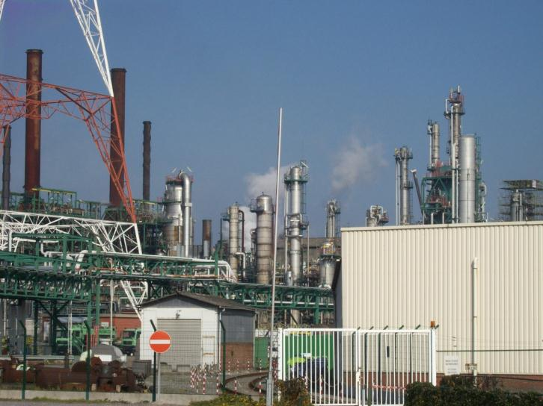
Monitor PSM maturation over time for each facility
Notes:
One advantage of retaining the past two audit documents is that improvements from one audit cycle to the next can be compared. The PSM system should be improving and becoming more robust with each audit.

Slide 38
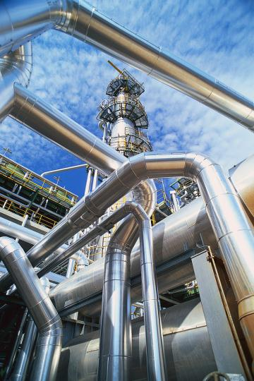
Share best practices
Notes:
Sharing of best practices among all facilities should be another outcome of the PSM audit cycle. Good practices from one location should be implemented at other locations.

Slide 39
Remaining Course Material
Overview of Process Safety
Compliance with standards
Process Hazard Analysis
Standard Operating Procedures
Safe Work Procedures
Mechanical Integrity
Management of Change
Auditing Process Safety systems
Emergency response procedures
Notes:
We have just completed Module 8 on “Auditing Process Safety Systems”.
This training module was the eighth of nine modules contained in this course. The screen shows all nine modules. Our next module will discuss “Emergency Response Procedures”

