Slide 1
ANSI Z10 Session 2 Introduction to the Standard
Notes:
The objective of this session is to introduce you to the ANSI Z10 Standard

Slide 2
Disclaimer
DISCLAIMER: This material was produced under grant number SH-19494-09-60-F-12 from the Occupational Safety and Health Administration, U.S. Department of Labor. It does not necessarily reflect the views or policies of the U.S. Department of Labor, nor does mention of trade names, commercial products, or organizations imply endorsement by the U.S. Government. The U.S. Government does not warrant or assume any legal liability or responsibility for the accuracy, completeness, or usefulness of any information, apparatus, product, or process disclosed.
To this end, permission is granted to use such copyrighted material solely for non-commercial, instructional, personal, or scholarly purposes. The material may be used and incorporated into other workplace safety and health programs on the condition that no fee may be charged for the subsequent use of the material. Use of the material for any other purpose, particularly commercial use, without the prior, express written permission of the copyright owner/s is prohibited. Furthermore, any modification to the material is prohibited without the prior, express written permission of the copyright owners.

Slide 3
Z10 Development Approach
In 1999, ANSI Accredited Standards Committee Z10 was approved
American Industrial Hygiene Association (AIHA) served as its Secretariat
Z10 Committee approach:
Broad makeup with input from US industry, labor, OSHA, etc.
Examined national/international standards, guidelines, practices from occupational, quality and environmental systems arenas
Adapted principles from ISO quality/environmental systems as well as International Labor Organization (ILO) guidelines and systems in use in the US (e.g., VPP, Responsible Care®)
Notes:
They put out a call for participants.
They announced the scope of the standard to be a standard of management principles and systems to allow and organization to design and implement approaches to continuously improvement their occupational health and safety performance

Slide 4
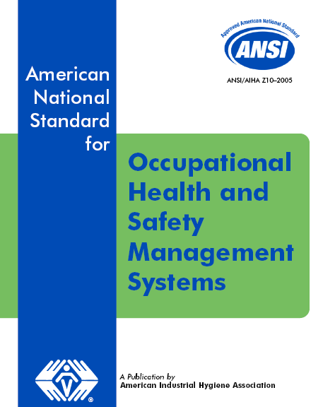
Z10 Purpose, Scope, Application
Scope:
Defines minimum requirements for OHSMS
Purpose:
Management tool to reduce risks of occupational injury, illnesses and fatalities
Application:
Organizations of all sizes and types
Includes Contractors
Notes:
Not meant to be a prescriptive standard—meant to be adapted to any organization
The standard defines what is to be accomplished—how it is accomplished is left up to the organization

Slide 5

Elimination of Root Causes
Organizational factors
Operational factors
Cultural factors
Notes:
One of the overall benefits to this standard is the elimination of root causes of accidents and incidents
Organizational factors—requires specific assignment of roles/responsibilities
Operational factors—requires things such as concise, auditable plans/procedures
Cultural factors—implementation of this should, over time, lead to a continuous improvement mind-set throughout the organization
You can hang a poster at the entrance to your plant that says something like, “Safety if Everybody’s Business” but this standard attempts to assure that this is the case

Slide 6

Z10 Elements
Scope, Purpose and Application
Definitions
Management Leadership and Employee Participation
Planning
Implementation and Operation
Evaluation and Corrective Action
Management Review
Appendices
Notes:
We’ll be taking about these elements in detail
The appendices provides valuable guidance information

Slide 7

Key Z10 Definitions
Employee | A person who is employed by the organization, or by a contractor to the organization when that person is under the day-to-day control of the organization
Ensure | To make every reasonable effort to fulfill the requirement
Organization | A public or private company, corporation, firm, enterprise, authority, or institution, or part or combination thereof, that has its own management functions
Hazard | A condition, set of circumstances, or inherent property that can cause injury, illness or death
Risk | An estimate of the combination of the likelihood of an occurrence of a hazardous event or exposure, and the severity of injury or illness that may be caused by the event or exposure
Notes:
Employee—includes contractors
Organization—can be broken out into units smaller than an entire company
You must understand the terms “hazard” and “risk” because of their frequency of use

Slide 8

Z10 OHSMS Cycle
CONTINUAL IMPROVEMENT
IMPROVE: employee H&S productivity satisfaction image
REDUCE: hazards risks incidents comp costs lost time
3.0 Policy Management Leadership & Employee Participation
7.0 Management Review
4.0 Planning
6.0 Checking and Corrective Action
5.0 Implementation and Operation
Notes:
Here is the ANSI Z10 version of the continuous improvement cycle
The good news is that most organizations have most of the elements in place…the trick is figuring out how to arrange them in the proper place in this system

Slide 9
Where are ISO 9001 and 14001 linkages with Z10 Elements?
Discussed in detail later in this course
In general, linkages should occur where the objectives of the various systems have common bonds:
Example: Industrial Company’s Environmental Objectives involves the elimination of certain toxic chemicals, which have also been identified as presenting a health and safety risk to employees (Safety Objective)
Notes:
The standard is meant to be compatible with ISO-based systems
In general, there might be some good linkages already in place

Slide 10
Z10 Framework Structure
1st Tier
Policy
2nd Tier
Procedures
3rd Tier
Job Instructions
4th Tier
Supporting Materials
Records, Forms, Tags, Logbooks, Etc.
Notes:
The overall framework is similar to ISO in terms of the document hierarchy

Slide 11
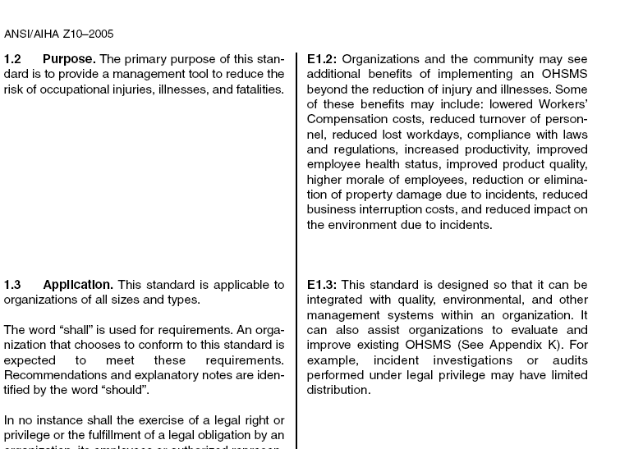
Z10 Format
Requirements in left column identified by the word “shall”
Recommended practices and explanations, use of “should”
Notes:
This is one of the major benefits of ANSI Z10 compared to 18001, the explanations

Slide 12
Z10 Disclaimer
In no instance shall the exercise of a legal right or privilege or the fulfillment of a legal obligation by an organization, its employees or authorized representative be considered a non-conformance with any requirement of this standard.
Those asserting those rights shall find alternative methods to conform to the standard consistent with the assertion of those rights.

