Slide 1
Health Hazards in Construction
Developed by:
Construction Safety Council
4100 Madison Street
Hillside, IL 60162
(800) 552-7744
www.buildsafe.org
Notes:
Prepare to Learn

Slide 2

Welcome to… Health Hazards in Construction
Construction workers are exposed to a variety of health hazards everyday. These men and women have the potential for becoming sick, ill and disabled for life.
Learn the health hazards on your job and know how to protect yourself…
Sadly, these health hazards (e.g., dangerous dust and other chemicals) can be unexpectedly brought home…
Notes:
Learn how to protect your family!

Slide 3
Course Contents
The purpose for the Occupational Safety and Health Administration (OSHA) and its enforcement duty under law.
Common health hazards found in construction.
An explanation Industrial Hygiene and toxicology.
Important terms and definitions used in health standards and toxicology.
Procedures for how to anticipate, recognize, evaluate and control health hazards in construction.
Hazard communication program for contractors & the Globally Harmonized System for Hazard Communication.
Respiratory protection program for contractors.
Hearing conservation program for contractors.
Notes:
This program is dedicated to all the workers who have sustained a life threatening or disabling illness as a result of an occupational exposure.

Slide 4
The Construction Safety Council will like to thank the following for their contributions and support:
The Occupational Safety and Health Administration (OSHA)
The National Institute for Occupational Safety and Health (NIOSH)
The United States Environmental Protection Agency (EPA)
Chicago Area Laborers – Employer Cooperation and Education Trust (LECET)
United Union of Roofers, Waterproofers and Allied Workers
elcoshimages.org
LeBlanc Building Co., Inc.
Milton R. Chicas
David Allie (4-Safety.com)
John Dimos, MS, CIH
Notes:
Thank you…

Slide 5
OSHA Disclaimer
This material was produced under grant number SH-19495-09-60-F-17 from the Occupational Safety and Health Administration, U.S. Department of Labor. It does not necessarily reflect the views or policies of the U.S. Department of Labor, nor does mention of trade names, commercial products, or organizations imply endorsement by the U.S. Government.
Notes:
General Disclaimer
This material is intended for training purposes only. Its purpose is to inform employers and employees of best practices in construction safety & health. This material is not a substitute for any provision of the Occupational Safety and Health Administration (OSHA) or any standards issued by OSHA. If at any time it is discovered that the materials presented vary from Federal or State OSHA regulations, American National Standards Institute (ANSI), EPA regulations, state laws or local ordinances, it is understood that those regulations, laws and ordinances will take precedence over the materials presented herein. In some cases, the information given may imply a higher level of protection then required in some Federal or State OSHA regulations. The mention of any products or materials by brand name in no way constitutes endorsement. Any products or materials not mentioned within this manual that may be considered acceptable as protective devices, equipment, or practices is not intentional and should not rule out their acceptability as employee or environmental protection.
OSHA Disclaimer
This material was produced under grant number SH-19495-09-60-F-17 from the Occupational Safety and Health Administration, U.S. Department of Labor. It does not necessarily reflect the views or policies of the U.S. Department of Labor, nor does mention of trade names, commercial products, or organizations imply endorsement by the U.S. Government.

Slide 6
Course Overview
Prepare an employer or its designated representative (job-site competent person) to understand and react to occupational health hazards in construction.
Learn how to anticipate, recognize, evaluate and control occupational health hazards
Learn how and when to make managerial decisions regarding health issues in construction.
Notes:
Employers have the responsibility to protect the safety and health of the worker. This course will help prepare an employer or its designated representative (job-site competent person) to understand and react to occupational health hazards in construction.
Course participants will learn how to anticipate, recognize, evaluate and control occupational health hazards; these hazards include, but are not limited to: chemical, physical, biological hazards. Special consideration will be given to occupational noise exposure in construction.
In addition, the participant will learn how and when to make managerial decisions, such as how to implement a job-site hazard communication program, how to select appropriate engineering & administrative controls and how to properly implement a personal protective equipment (PPE) program. Also, participants will gain insight as to when to consult the expertise of an Industrial Hygienist and/or other qualified person.
The goal of this course (Health Hazards in Construction) is to enhance communication of health hazards between employers & employees, to prepare an individual to make competent decisions on matters of occupational health exposures in construction, to equip this person with the knowledge and skills necessary to perform frequent and regular inspections of the job-site. At the conclusion, each course participant will posses the confidence to recognize and avoid unsafe conditions and will be able to identify regulations applicable to health hazards in construction.

Slide 7

Responsibility to Self & Family
Occupational health hazards can unexpectedly be brought home; wear personal protective equipment (PPE) on the job and do not bring home health hazards that can harm your family!
Notes:
A worker’s exposure to hazardous materials on the job can be unknowingly brought back to a person’s home; heavy metals such as lead dust, concrete crusted clothing and variety of oils, greases and solvents can all be unintentionally poisoning your family!
As a worker who might be exposed to these hazards, you have a responsibility to wear personal protective equipment (PPE), practice good hygiene and take advantage of training programs like this. Learn of the hazards associated with your job and protect your family.

Slide 8
Industrial Hygiene
Learning Goals…
Define industrial hygiene.
Recognize industrial hygiene’s relationship to OSHA.
Identify and define job hazard analysis
Be able to apply the classic industrial hygiene approach (anticipate, recognize, evaluate & control) to hazard abatement.
Notes:
Learning goals for this lesson.

Slide 9
Important Terms
Industrial Hygiene
Anticipate (hazards)
Recognize (hazards)
Evaluate (hazards)
Control (hazards)
Toxicology
Job Hazard Analysis
Hazard Abatement
Notes:
Important terms that will be discussed during this lesson.

Slide 10

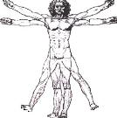

Chemical
Gases
Vapors
Fumes
Dusts
Fibers
Mists
Physical
Temperature
Noise
Repetitive Motion & Awkward Postures
Ionizing & Non-Ionizing Radiation
Biological
Fungi (Mold)
Bloodborne Pathogens
Bacteria
Poisonous Plants
Poisonous & Infectious Animals
Notes:
Health hazards in construction overview.
Question?
What are some other health hazards that course participants may have experienced?

Slide 11
Toxicology
Toxicology is the science that studies the poisonous or toxic properties of a substance.
Notes:
Toxicology is the science that studies the poisonous or toxic properties of a substance. The basic assumption of toxicology is that there is a relationship among the dose (amount), the concentration at the affected site, and the resulting effects. As part of your job as a construction worker, study and learn the hazardous effects of the substances that you work with; study the dangers associated with the above health hazards in construction.

Slide 12
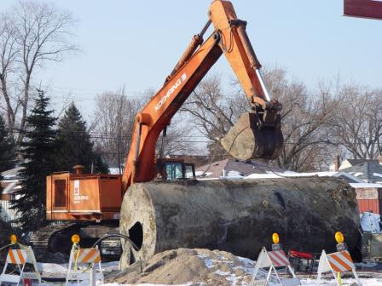
Anticipation of Health Hazards
knowing the history of the work involved.
Worker experience and education.
To anticipate hazards:
Survey job-site conditions
Be aware of the actions and behaviors of workers.
Notes:
Health hazards can be anticipated by knowing the history of the work involved as well as through worker experience and education; learn all the hazards associated with your job and be better prepared to make good decisions regarding your health and safety.
Generally, hazards associated with a particular job are either inherent (present before the worker shows up); or hazards can be created by the work (e.g., welding & cutting, use of fuel powered equipment, etc.).
To anticipate hazards:
Survey job-site conditions
Be aware of the actions and behaviors of workers.
What hazards can you anticipate in this picture?
Old fuel storage tank be excavated – site being prepared for rebuild (fueling station).

Slide 13
Hazardous Conditions
Confined or enclosed spaces (hazardous atmospheres).
Contaminated soil conditions (hazardous atmospheres).
Unsanitary conditions (poor housekeeping, poorly kept toilet facilities, etc.).
Presence of hazardous materials (dangerous coatings on structures & metal containing alloys, concrete & silica).
The use of hazardous chemicals (gases, solvents & glues).
The presence of residues left by degreasing agents, usually chlorinated hydrocarbons (chloroform and carbon tetrachloride).
Notes:
Hazardous conditions on construction job-sites, include, but are not limited to the follow…

Slide 14
Hazardous Conditions
Older buildings and structures; unoccupied dwellings (fungi/mold, asbestos & lead).
Extreme temperatures (hot & cold environments; working outside or in attics, boiler rooms, etc.).
Radiological exposures (nuclear power plants, antennas, hospitals, laboratories and the sun).
Loud noise (use of tools and equipment).
Hot work (welding and cutting).
The presence of plant and/or animal wildlife (poisonous venom, feces, rabies…).
Notes:
Hazardous conditions on construction job-sites, include, but are not limited to the follow…
Group Discussion… What health hazards can you anticipate on your job?

Slide 15
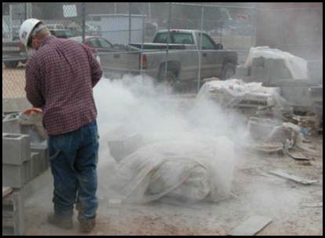
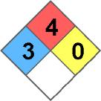

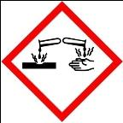

Recognition of Health Hazards
What do you see?
Visible material in the air
Settled dust
Warning signs, labels & decals
Notes:
Concrete cutting with saw creates obvious dust exposure.
Visible material in the air – If you see visible clouds of vapor or particles, there may be a serious exposure problem. Remember, however, that most gases and vapors are invisible, and that often the most dangerous particles are too small to see.
Settled dust – if there is chemical dust on the ground or other surfaces, it probably got there by settling out of the air. If disturbed, settled dust can become airborne again.
Warning signs, labels & decals – as required by OSHA’s Hazard Communication Standard (29 CFR 1910.1200) and other applicable standards.
Group Discussion…
What health hazards do you see on your job?

Slide 16

Recognition of Health Hazards
What do you smell or taste?
Odor
Odor threshold is the lowest level of a chemical that can be smelled by most people.
Olfactory fatigue - loss of sense of smell.
Taste
Notes:
Smell or taste could cause you to recognize a health hazard.
Odor – if you smell a chemical, you are inhaling it. However, some chemicals can be smelled at levels well below those that are harmful. The odor threshold is the lowest level of a chemical that can be smelled by most people. If a chemical’s odor threshold is lower than the amount that is hazardous, the chemical is said to have good warning properties. It is important to remember that for most chemicals, the odor thresholds vary widely from person to person. In addition, some chemicals, like hydrogen sulfide, cause you to rapidly lose your ability to smell them; this is called olfactory fatigue. With these cautions in mind, knowing a chemical’s odor threshold may serve as a rough guide to your exposure level.
Taste – Never taste something that might be a hazardous chemical. However, if you inhale a chemical or accidentally get some in your mouth, it may have a particular taste that warns you you’re being exposed (e.g., metal fumes)
Group Discussion…
What health hazards do you smell on your job?

Slide 17

Recognition of Health Hazards
Do you hear anything?
Sources of loud noise in construction:
Hand tools (e.g., metal hammers)
Power tools (e.g., jackhammers, grinders, saws, powder actuated tools)
Equipment (e.g., generators, excavators, cranes, trucks)
Blasting
Notes:
Loud noise can severely damage your hearing!
Sources of loud noise in construction:
Hand tools (e.g., metal hammers)
Power tools (e.g., jackhammers, grinders, saws, powder actuated tools)
Equipment (e.g., generators, excavators, cranes, trucks)
Blasting
Group Discussion…
What sources of loud noises are on your job?

Slide 18

Recognition of Health Hazards
Do you feel immediate symptoms?
Particles in you respiratory system.
Narcotic effect
Notes:
Feeling sick, dizzy or nauseous could mean you are being exposed to a health hazard.
Particles in you respiratory system – your nose and airways have mucous which traps particles and removes them when you cough or blow your nose.
Narcotic effect – When solvents are breathed in, they enter the blood stream and travel to other parts of the body, particularly the nervous system causing dizziness, headache, feelings of “drunkenness”, and tiredness. One result of these symptoms may be poor coordination which can contribute to falls and other accidents.
Group Discussion…
Have you ever felt sick or nauseous on the job (resulting from an on the job exposure)?

Slide 19
Recognition of Health Hazards
Not implementing engineering and/or administrative controls (e.g., wet methods, ventilation, and dust collection systems).
Not wearing appropriate Personal Protective Equipment (e.g., gloves, respirators, chemical suites, hearing protectors, etc.)
Not practicing good housekeeping.
Not following good hygiene practices.
Not performing a hazard analysis (e.g., air monitoring, dust sampling, noise metering, and biological monitoring & medical surveillance).
Notes:
Learn to recognize unsafe conditions and unsafe behaviors…
Not implementing engineering and/or administrative controls (e.g., wet methods, ventilation, and dust collection systems).
Not wearing appropriate Personal Protective Equipment (e.g., gloves, respirators, chemical suites, hearing protectors, etc.)
Not practicing good housekeeping.
Not following good hygiene practices.
Not performing a hazard analysis (e.g., air monitoring, dust sampling, noise metering, and biological monitoring & medical surveillance).

Slide 20
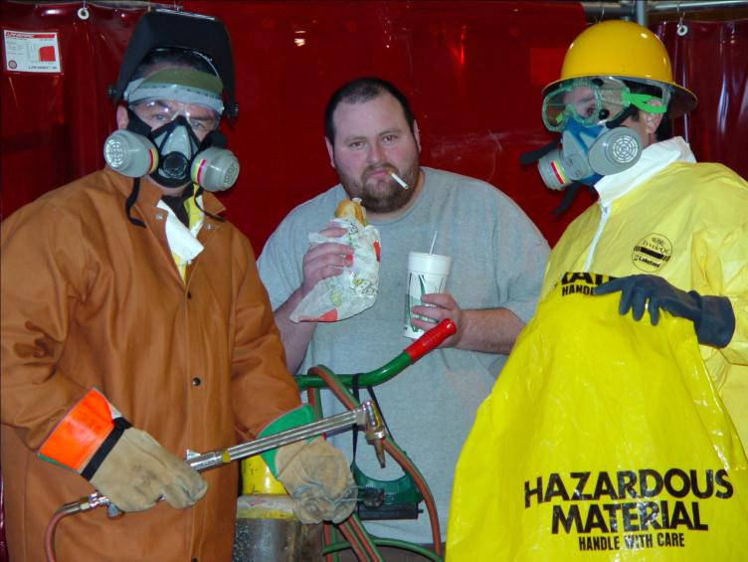
Know the safety procedures on your job and learn to recognize safety violations – report them and get them corrected!
Notes:
Never eat, drink, smoke or apply cosmetics in the areas where hazardous work is performed; employers must train their employees on how to recognize and avoid unsafe conditions and unsafe behaviors!

Slide 21
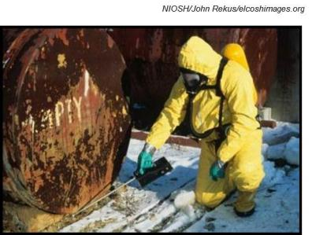
Evaluation of Health Hazards
Environmental & Personal Air Monitoring:
Does not measure you or what you are doing, but rather what you are exposed to on the job.
Must be done by a trained health professional (industrial hygienist or technician).
Area monitoring
Personal monitoring
Area Monitoring
Notes:
Trained health professional wearing personal protective equipment; evaluating job-site conditions.
Environmental and personal air monitoring is one way to determine exposure to most chemicals. There are instruments to measure contaminates in the air – chemical hazards, such as hazardous gases, vapors, fumes, dust/fibers & mists; also physical hazards, such as noise, heat stress and radiation.
Environmental & Personal Air Monitoring:
Air monitoring does not measure you or what you are doing, but rather what you are exposed to on the job.
Air monitoring must be done by a trained health professional (industrial hygienist or technician).
Monitoring can be done by measuring the air in a fixed location in the work area (area monitoring) or by placing the monitoring equipment on individual workers and measuring the amount they are exposed to (personal monitoring).

Slide 22
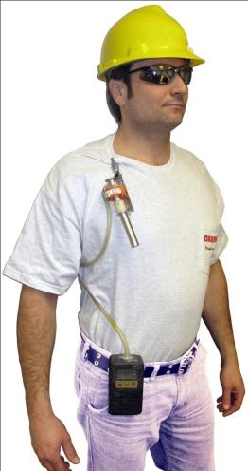
Personal Monitoring
Determines individual worker exposure.
Done during a specific time period…
8-hour (TWA)
15 minute (STEL)
Pump pulls air through a filter or tube, which traps the dust or toxin.
Notes:
Personal monitoring is done to determine individual worker exposure and area monitoring may be done to estimate possible exposure of a group of workers in a particular area. It is usually done during a specific time period, often as an 8-hour shift or 15 minute period to ensure compliance with OSHA standards.
Air monitoring may be done in a number of ways. Some toxins are measured by placing a small pump on your belt and a filter cassette or tube clipped on your collar with a flexible tube running between them. The filter or tube should be located as close as possible to your breathing zone (the air in front of your nose and mouth which you breathe).
The pump pulls air through the filter or tube, which traps the dust or toxin. After the sample has been taken, the filter or tube is sent to a laboratory. The laboratory uses scientific methods to measure the amount of contaminant on the filter or tube. It may take several days or longer before the results are ready from the laboratory.

Slide 23
Evaluation of Health Hazards
Biological Monitoring & Medical Surveillance
Medical surveillance records include:
Employee exposure records (results from personal air monitoring).
Employee medical records (results from biological monitoring).
Notes:
For chemicals that are absorbed by routes other than inhalation, such as through the skin and by ingestion, air monitoring may underestimate the amount of chemical absorbed into the body; to ensure accurate employee exposure, medical surveillance is sometimes necessary. The levels of the chemical (or its breakdown products) in the body can also be measured in the blood, urine, or exhaled air. Such testing is called biological monitoring. For several substances, biological monitoring is required by law when air monitoring results are above a certain level; employers must maintain the results of these tests as employee records.
Medical surveillance records include:
Employee exposure records (results from personal air monitoring).
Employee medical records (results from biological monitoring).

Slide 24

Employee Exposure & Medical Records
Retention of Medical Records…
Employee medical records – duration of the employee’s employment plus 30 years.
Employee exposure records for at least 30 years (personal air monitoring results).
Background data – 1 year
Notes:
Workers with possible exposure to or uses toxic substances or harmful physical agents on job-sites have rights to access exposure records. These rights and responsibilities can be found in OSHA’s standard 29 CFR 1926.33 (see 29 CFR 1910.1020 – Access to Employee Exposure and Medical Records).
Retention of Medical Records…
Employee medical records must be retained for at least the duration of the employee’s employment plus 30 years.
Employee exposure records for at least 30 years (personal air monitoring results).
Background data related to environmental, or workplace, monitoring or measuring—such as laboratory reports and worksheets—must only be retained for 1 year, so long as you preserve certain interpretive documents relevant to the interpretation of the data for 30 years.

Slide 25
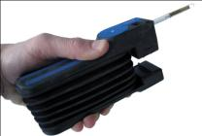
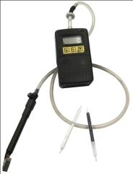
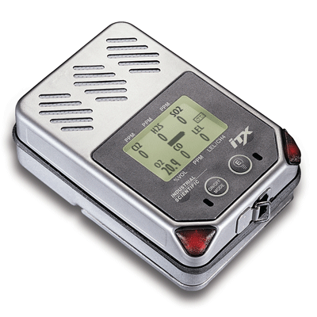

Air Monitoring Devices
Detector Tubes
Sampling Tubes
Multi or single gas/vapor detector
Passive badge gas/vapor sampler
Notes:
Detector Tubes
Detects different gases and vapors; often used as a survey tool to determine if a substance is present or not – does not determine exact quantity or employee exposure.
Easy to use and gives instant color change results; uses either a hand or a battery operated pump.
Often non-specific and has a high standard of error (± 25%).
Low cost.
Sampling Tubes
Easy to use and can sample for more than one chemical on a single tube.
Tubes must be specific for type of gas or vapor.
Not real time measurement – delay in results.
Highly accurate in determining exposure.
Low cost.
Multi or single gas/vapor detector
Real time measurement device that provides instant results; can be used as personal alarm monitors.
Detects a variety of toxic gases and explosive environments.
Easy to use, but requires calibration to be accurate; requires on-going maintenance.
Sensors wear out (need replacement).
Moderate to high cost.
Passive badge gas/vapor sampler
Device worn to passively measure exposure.
Simple to use; just put it on and go to work.
Accurate device, but limited to the number of chemicals measured.
Not real time measurement – delay in results.
Low cost.

Slide 26


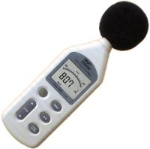
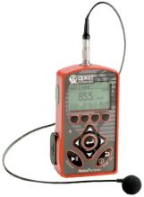
Air Monitoring Devices
Instant Swab Wipes
Filter Cassette
Sound Level Meter
Personal Dosimeter
Notes:
Instant Swab Wipes
Detects the presence of lead in paint or metals.
Does not give detail as to amount, only if substance is present.
May show false positive results; perform second wipe to confirm.
Low cost.
Filter Cassette
Used to determine an average exposure over a period of time (time weighted average).
Samples taken in the “breathing zone” of the employee.
Not real time measurement – delay in results.
Specific filters required for different substances.
Moderate cost.
Sound Level Meter
Measures ambient noise levels and is used as a surveying instrument; provides real time instant reading.
Easy to use.
Accurate device.
Calibration required.
Varies in cost.
Personal Dosimeter
Measures personal exposures to noise and determines exposure over a period of time (time weighted average).
Requires training to use.
Accurate device.
Calibration required.
High cost.

Slide 27
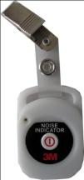

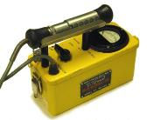

Air Monitoring Devices
Noise badge
Film Badge Dosimeters
Survey Instruments
Personal Alarm Monitors (RF)
Notes:
Noise badge
Indicates that user is being exposed to high levels of noise.
Simple to use.
No calibration required.
Real time instant reading; personal alarm.
Low cost.
Film Badge Dosimeters
Measures personal exposure to ionizing radiation.
Simple to use.
Passive reading.
Not real time measurement – delay in results.
Low cost.
Survey Instruments
Survey instrument to determine levels of ionizing radiation.
Easy to use.
Real time measurement.
High cost.
Personal Alarm Monitors (RF)
Measures personal exposures and provides instant results; used as a personal alarm.
Specific to type of radiation.
Easy to use.
Moderate to high cost.

Slide 28

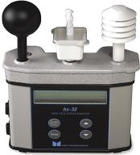
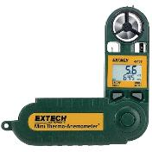
Air Monitoring Devices
Thermometer
Wet Bulb Globe Temperature (WBGT)
Thermo-Anemometer
Notes:
Thermometer
Measures air temperature.
Simple to use.
Accurate device.
Survey instrument.
Real time measurement.
Varies in cost.
Wet Bulb Globe Temperature (WBGT)
Estimates the effect of temperature, humidity, and solar radiation.
Requires training to use.
Accurate device.
Calibration required.
Measures personal exposures.
High cost.
Thermo-Anemometer
Measures wind speed and calculate wind chill temperature.
Simple to use.
No calibration required.
Real time instant reading.
Moderate to high cost.

Slide 29
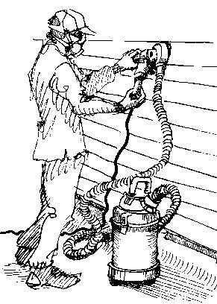
Control of Health Hazards
Hazard Abatement
To abate a hazard means to eliminate its affects.
Respirator – Personal Protective Equipment (PPE)
Local exhaust system (vacuum) – Engineering Control
Notes:
To abate a hazard means to eliminate its affects; this would cause a worker who might otherwise be exposed to a hazard not be exposed by means of one or more control strategy. These control strategies are chosen by preference according to the hierarchy of controls.
Implementing control strategies, such as engineering controls, safe work practices and wearing personal protective equipment will stop health hazards on your job!

Slide 30
Hierarchy of Controls
Elimination of hazard; Substitution with safe alternative.
Engineering; Ventilation & wet methods.
Administrative; Work practices, scheduling workers to minimize exposure, extended breaks, etc.
Personal Protective Equipment (PPE); Respiratory and hearing protection, protection of face, hand, feet, eyes & whole body.
Notes:
Controlling exposures to occupational hazards is the fundamental method of protecting workers. Traditionally, a hierarchy of controls has been used as a means of determining how to implement feasible and effective controls.
OSHA requires that employers use the hierarchy of controls in order of preference for protecting the worker.

Slide 31
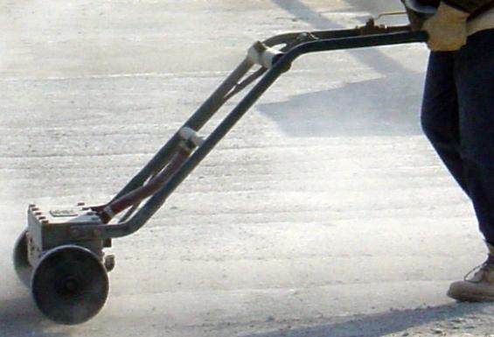
Job Hazard Analysis
What is it?
Materials & Equipment
Notes:
A job hazard analysis (JHA) is a technique that focuses on the relationship between the worker, the task, the tools, and the work environment; it’s an essential first step that helps an industrial hygienist determine the sources of potential problems.
During a job hazard analysis, a competent industrial hygienist will examine all materials & equipment being used; look at the process in which work is being performed and assess the people performing the work

Slide 32
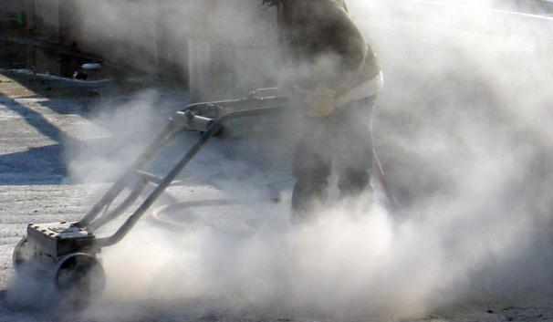
Job Hazard Analysis
How does it?
Process
Notes:
A job hazard analysis (JHA) is a technique that focuses on the relationship between the worker, the task, the tools, and the work environment; it’s an essential first step that helps an industrial hygienist determine the sources of potential problems.
During a job hazard analysis, a competent industrial hygienist will examine all materials & equipment being used; look at the process in which work is being performed and assess the people performing the work

Slide 33
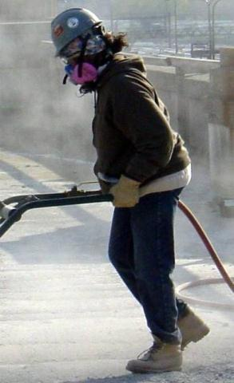
Job Hazard Analysis
Who are exposed?
People
Notes:
A job hazard analysis (JHA) is a technique that focuses on the relationship between the worker, the task, the tools, and the work environment; it’s an essential first step that helps an industrial hygienist determine the sources of potential problems.
During a job hazard analysis, a competent industrial hygienist will examine all materials & equipment being used; look at the process in which work is being performed and assess the people performing the work

Slide 34
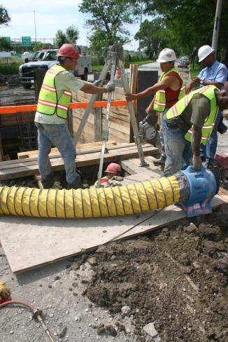
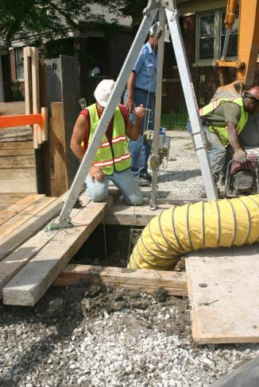
Job Hazard Analysis Example
Notes:
Look at the pictures and complete the analysis…
Job/Task:
What are the hazards?
How & who are exposed?
What controls are being implemented?
What (if any) further controls need to be implemented?
The Value of a Job Hazard Analysis
Supervisors can use the findings of a job hazard analysis to eliminate and prevent hazards in their workplaces. This is likely to result in fewer worker injuries and illnesses; safer, more effective work methods; reduced workers’ compensation costs; and increased worker productivity.
The analysis also can be a valuable tool for training new employees in the steps required to perform their jobs safely.
Determining whether a health hazard exists at your worksite is based on a combination of factors including observation, interviews, and measurements of the level of air contaminants arising from the work processes as well as an evaluation of the effectiveness of control measures in the workplace. These environmental measurements are then compared to exposure standards such as OSHA standards or other guidelines.

Slide 35


Use of Professionals & Consultants
The work involves many different or complex processes.
All employees must remain involved in the process of identifying and correcting hazards.
Occupational Health Teams
You
Notes:
If the work involves many different or complex processes, a professional may be needed to help conduct job-site evaluation and personal exposure monitoring. Sources of help include insurance companies, contractor associations, trade unions, and private consultants with safety and health expertise.
OSHA offers assistance through its regional and area offices and consultation services. Contact your local OSHA office for more information.
Even when outside help is received, it is important that all employees remain involved in the process of identifying and correcting hazards because job-site conditions change every day. New circumstances and a recombination of existing circumstances may cause old hazards to reappear and new hazards to appear. In addition, employees must be ready and able to implement whatever hazard elimination or control measures a professional consultant recommends.
Occupational Health Teams
The goal of a multidisciplinary occupational health and safety team is to design, implement, and evaluate a comprehensive health and safety program that will maintain and enhance health, improve safety, and increase productivity. Such programs often provide similar results for the families of workers, with resultant financial and other benefits for the corporation. Occupational health and safety professionals include occupational and environmental health nurses, occupational medicine physicians, industrial hygienists, safety professionals, and occupational health psychologists. Other related members of the multidisciplinary team are ergonomists, toxicologists, epidemiologists, human resource specialists, and industrial/organizational psychologists.
The most important member of the health team is you!

Slide 36
Occupational Safety & Health Administration (OSHA)
Learning Goals:
Identify the Occupational Safety and Health Administration (OSHA) as being the authority for protecting worker’s health and safety on the job.
Recognize both employer and employee rights and responsibilities under OSHA law.
Notes:
Learning goals for this lesson.

Slide 37
Important Terms
OSHA
OSHA’s General Duty Clause
Worker rights under OSHA Law
Notes:
Important terms that will be discussed during this lesson.

Slide 38
You Have A Right!
Occupational Safety & Health Act of 1970
To assure safe and healthful working conditions for working men and women;
By authorizing enforcement of the standards developed under the OSHAct;
By assisting and encouraging the States in their efforts to assure safe and healthful working conditions; and
By providing research, information, education, and conducting training in the field of occupational safety and health.
Notes:
The Occupational Safety and Health Act of 1970 (OSHAct) was passed by the United States Congress to prevent workers from being killed or seriously harmed at work. The law requires that employers provide their employees with working conditions that are free of known dangers. The Act created the Occupational Safety and Health Administration (OSHA), which sets and enforces protective workplace safety and health standards.
OSHA Duties…
To assure safe and healthful working conditions for working men and women; by authorizing enforcement of the standards developed under the OSHAct; by assisting and encouraging the States in their efforts to assure safe and healthful working conditions; and by providing research, information, education, and conducting training in the field of occupational safety and health.

Slide 39
General Duty Clause
5. Duties
Each employer
Shall furnish to each of his employees employment and a place of employment which are free from recognized hazards that are causing or are likely to cause death or serious physical harm to his employee;
Shall comply with occupational safety and health standards promulgated under this Act.
Each employee shall comply with occupational safety and health standards and all rules, regulations, and orders issued pursuant to this Act which are applicable to his own actions and conduct.
Notes:
What is OSHA’s General Duty Clause?
Section 5(a)(1) of the Occupational Safety and Health Act of 1970 has become known as the “General Duty Clause”. It is a catch all for citations if OSHA identifies unsafe conditions to which a regulation does not exist.

Slide 40
General Duty Clause Citation
An employer failed to keep the workplace free of a hazard to which employees of that employer were exposed.
The hazard was recognized. (Examples might include: through job-site safety personnel, employees, trade unions and other associations/organizations.)
The hazard was causing or was likely to cause death or serious physical harm.
There was a feasible and useful method to correct the hazard.
Notes:
OSHA believes there is always a feasible and useful method to correct any and all health hazards!

Slide 41

Health Hazards are Recognized by OSHA
See OSHA Enforcement Policy
Stop health hazards before they stop you!
Lung Disease
Skin Irritation & Rashes
Hearing Loss
Cumulative Trauma Disorders
Cancer
Death!
Notes:
A number of health related hazards in construction have been well documented over the years. We all heard of asbestos and the deadly lung disease asbestosis; because of the risks associated with working with and around asbestos, an OSHA standard was established.
Other health hazards are regulated as well, e.g., lead fumes and dusts, noise and standards relating to specific chemicals have been put into effect to protect the worker. It is not possible to address all potential health related issues in regulations; however, OSHA does have policies on how to hold employers accountable to exposing their employees to harmful substances that are not otherwise addressed in its standards to protect health (see OSHA Enforcement Policy).
With a general understanding of how to anticipate, recognize and control exposures to occupational health hazards, and by knowing where to obtain information about a particular substance (chemical); a contractor will be better prepared to make good decisions that will have a positive affect on their workers’ health.
To learn more about OSHA standards and the health hazards associated with your job, go to www.osha.gov
Learn all there is to know about the health hazards on your job!
Stop health hazards before they stop you!

Slide 42

Notes:
Employer are required to post this notice in all places of employment.
This free poster available from OSHA - the Best Resource for Safety and Health
Free assistance in identifying and correcting hazards or complying with standards is available to employers, without citation or penalty, through OSHA-supported consultation programs in each state. 1-800-321-OSHA www.osha.gov OSHA 3165-12-06R

Slide 43
Refusing to Work because Conditions are Dangerous
Refusing work is protected if…
You have asked the employer to eliminate the danger, and the employer failed to do so.
You refused to work in “good faith”.
A reasonable person would agree that there is a real danger of death or serious injury (illness).
There isn’t enough time, due to the urgency of the hazard, to get it corrected through regular enforcement channels, such as requesting an OSHA inspection.
Notes:
Workers have the right to refuse to do a job if they believe in good faith that they are exposed to an imminent danger. “Good faith” means that even if an imminent danger is not found to exist, the worker had reasonable grounds to believe that it did exist.
Your right to refuse to do a task is protected if all of the above following conditions are met.

Slide 44
Refusing to Work because Conditions are Dangerous
When all of these conditions are met, you take the following steps:
Ask your employer to correct the hazard;
Ask your employer for other work;
Tell your employer that you won’t perform the work unless and until the hazard is corrected; and
Remain at the worksite until ordered to leave by your employer.
Notes:
IF…
You believe working conditions are unsafe or unhealthful.
Your employer does not correct the hazard or disagrees with you about the extent of the hazard.
Your employer discriminates against you for refusing to perform the dangerous work.
THEN…
Call your employer’s attention to the problem.
File a complaint with OSHA.
Contact OSHA immediately. (800) 321-OSHA

Slide 45
Health Standards in Construction
Learning Goals:
Overview OSHA’s health standards in construction.
Be introduced to the American Conference of Governmental Industrial Hygienists (ACGIH)®
Be introduced to the National Institute for Occupational Safety and Health (NIOSH)
Become familiar with the terms and definitions used to describe occupational limits relating to health hazards.
Indentify OSHA’s special emphasis programs and compliance directives for enforcing health standards in construction.
Notes:
Learning goals for this lesson.

Slide 46
Important Terms
Hierarchy of Controls
Permissible Exposure Limit (PEL)
Action Level (AL)
Ceiling (C)
American Conference of Governmental Industrial Hygienists (ACGIH)
Threshold Limit Value (TLV)®
Notes:
Important terms that will be discussed during this lesson.

Slide 47
Important Terms
National Institute for Occupational Safety & Health (NIOSH)
Recommended Exposure Limit (REL)
Short Term Exposure Limit (STEL)
OSHA Special Emphasis Programs for Health
Notes:
Important terms that will be discussed during this lesson.

Slide 48
Health Standards in Construction Overview
Availability of medical services and first aid
Sanitation of the job-site (toilet facilities)
Availability of water (potable and non-potable)
Eating and drinking areas
Vermin control
Notes:
OSHA’s health standards in construction addresses issues such as; the availability of medical services and first aid, sanitation of the job-site (toilet facilities), the availability of water (potable and non-potable), eating and drinking areas and vermin control.

Slide 49
Health Standards in Construction Overview
Chemicals
Gases
Vapors
Fumes
Dusts & Fibers
Mists
Physical Health Hazards
Noise
Radiation
OSHA currently regulates exposure to approximately 400 substances!
Notes:
Health standards also cover exposures to air contaminants and other materials that can lead to illness and disability. These standards regulate chemicals in the forms of gases, vapors, fumes, dusts, fibers and mists; noise and radiation.
OSHA currently regulates exposure to approximately 400 substances!

Slide 50
Medical Services & First Aid
Make available medical personnel for advice and consultation on matters of occupational health.
Provisions for prompt medical attention in case of serious injury.
In the absence of an infirmary, clinic, hospital, or physician… a person who has a valid certificate in first-aid training must be available at the worksite to render first aid.
First aid supplies must be easily accessible when required.
Notes:
Medical Services & First Aid (29 CFR 1926.50)
The employer must insure the availability of medical personnel for advice and consultation on matters of occupational health.
Provisions must be made prior to commencement of the project for prompt medical attention in case of serious injury.
In the absence of an infirmary, clinic, hospital, or physician, that is reasonably accessible in terms of time and distance to the worksite, which is available for the treatment of injured employees, a person who has a valid certificate in first-aid training must be available at the worksite to render first aid.
First aid supplies must be easily accessible when required.
The contents of the first aid kit must be placed in a weatherproof container with individual sealed packages for each type of item, and shall be checked by the employer before being sent out on each job and at least weekly on each job to ensure that the expended items are replaced.
Proper equipment for prompt transportation of the injured person to a physician or hospital, or a communication system for contacting necessary ambulance service, must be provided.
In areas where 911 is not available, the telephone numbers of the physicians, hospitals, or ambulances must be conspicuously posted.
Where the eyes or body of any person may be exposed to injurious corrosive materials, suitable facilities for quick drenching or flushing of the eyes and body must be provided within the work area for immediate emergency use.

Slide 51
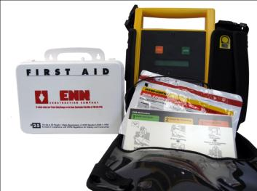
First Aid Kits
Available on all job-sites where a hospital, clinic or physician is not available in terms of time and distance.
Persons must be trained to use these supplies and be willing to give care.
An automated electronic defibrillator (AED) is highly recommended.
Notes:
First Aid Kits…
First aid kits must be available on all job-sites where a hospital, clinic or physician is not available in terms of time and distance.
Persons must be trained to use these supplies and be willing to give care.
An automated electronic defibrillator (AED) is highly recommended.
See…
Minimal contents of a generic first aid kit as described in American National Standard (ANSI) Z308.1 "Minimum Requirements for Industrial Unit-Type First-aid Kits".

Slide 52
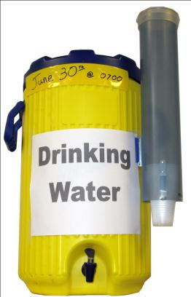
Sanitation of Job-Sites
Potable water (drinking water) must be provided.
Capable of being tightly closed, and equipped with a tap. Water must not be dipped from containers.
Clearly marked as to the nature of its contents and not used for any other purpose.
The common drinking cup is prohibited.
Notes:
Potable water (drinking water) must be made available on all job-sites.
An adequate supply of potable water (drinking water) must be provided in all places of employment.
Portable containers used to dispense drinking water must be capable of being tightly closed, and equipped with a tap. Water must not be dipped from containers.
Any container used to distribute drinking water must be clearly marked as to the nature of its contents and not used for any other purpose.
The common drinking cup is prohibited.
To ensure freshness, seal the container with tape – record date and time.
Sanitation of Job-Sites (29 CFR 1926.51)

Slide 53
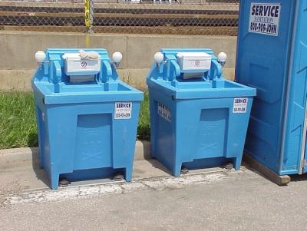
Washing Facilities
Provide adequate washing facilities for employees.
Facilities must be in near proximity to the worksite.
Maintained in a sanitary condition.
Good health starts with good hygiene!
Notes:
Washing Facilities [29 CFR 1926.51(f)]
Good health starts with good hygiene!
Portable washing facilities on construction job-sites will help to ensure proper hygiene and worker health.
The employer must provide adequate washing facilities for employees engaged in the application of paints, coating, herbicides, or insecticides, or in other operations where contaminants may be harmful to the employees. Such facilities must be in near proximity to the worksite and must be so equipped as to enable employees to remove such substances.
Washing facilities must be maintained in a sanitary condition.

Slide 54
Eating and Drinking Areas
No employee shall be allowed to consume food or beverages neither in a toilet room nor in any area exposed to a toxic material.
Notes:
Eating and Drinking Areas [29 CFR 1926.51(g)]
No employee shall be allowed to consume food or beverages neither in a toilet room nor in any area exposed to a toxic material.

Slide 55
Vermin Control
Prevent the entrance or harborage of rodents, insects, and other vermin.
Notes:
Vermin Control [29 CFR 1926.51(h)]
Every enclosed workplace must be so constructed, equipped, and maintained, so far as reasonably practicable, as to prevent the entrance or harborage of rodents, insects, and other vermin. A continuing and effective extermination program must be instituted where their presence is detected.

Slide 56
Permissible Exposure Limit (PEL)
Standards that limit the amount or concentration of a material.
Enforceable by OSHA.
Notes:
What is a Permissible Exposure Limit?
Health standards relating to exposure to gases, vapors, fumes, dusts, fibers and mists; noise and radiation, require some extra explanation. These standards limit the amount or concentration of a material (chemical, noise or radiation) that can be present in the workplace. To describe the limits, or amounts of these exposures, the term Permissible Exposure Limit (PEL) is used.
Permissible Exposure Limit (PEL); A legal standard set by OSHA for the maximum concentration of a chemical or substance in the air.
IMPORTANT! To comply with OSHA’s health standards related to environmental exposures to harmful gases, vapors, fumes, dust (fibers) & mists; noise and radiation, employers must first attempt to eliminate or reduce exposure through administrative or engineering controls.

Slide 57
Complying with OSHA Health Standards
Administrative or engineering controls must first be implemented whenever feasible.
Protective equipment or other protective measures must be used to keep the exposure of employees to air contaminants within the limits prescribed.
Competent industrial hygienist or other technically qualified person.
Follow OSHA’s respiratory protection standard.
Notes:
To achieve compliance with OSHA’s health standards:
Administrative or engineering controls must first be implemented whenever feasible.
When administrative or engineering controls are not feasible to achieve full compliance, protective equipment or other protective measures must be used to keep the exposure of employees to air contaminants within the limits prescribed.
Any equipment and technical measures used for this purpose must first be approved for each particular use by a competent industrial hygienist or other technically qualified person.
Whenever respirators are used, their use must comply with OSHA’s respiratory protection standard.

Slide 58
ACGIH–Threshold Limit Value (TLV) ®
American Conference of Governmental Industrial Hygienists
29 CFR 1926.55 Appendix A (1970 TLVs)
Exposure of employees to inhalation, ingestion, skin absorption, or contact with any material or substance at a concentration above those specified shall be avoided!
Current TLVs are not enforceable.
Notes:
The American Conference of Governmental Industrial Hygienists (ACGIH)
Since the early 1900’s, the ACGIH has been investigating, recommending, and annually reviewing exposure limits for chemical substances. The best known efforts by the ACGIH is the creation of the Threshold Limit Values of Airborne Contaminants; this publication contains a list of contaminants and their respected Threshold Limit Values (TLV’s)®. Today's list of TLV’s® includes 642 chemical substances and physical agents, as well as 47 Biological Exposure Indices (BEI’s)® for selected chemicals.
For more information on the ACGIH, visit their website at www.acgih.org

Slide 59
NIOSH – Recommended Exposure Limit (REL)
National Institute for Occupational Safety & Health
Levels that NIOSH believes would be protective of worker safety and health.
Highly protective.
Not enforceable by OSHA.
Notes:
A Recommended Exposure Limit (REL) is an occupational exposure limit that has been recommended by NIOSH to the Occupational Safety and Health Administration (OSHA).
Recommended Exposure Limit (REL); Levels that NIOSH believes would be protective of worker safety and health over a working lifetime if used in combination with engineering and work practice controls, worker training and personal protective equipment.

Slide 60

NIOSH Pocket Guide to Chemical Hazards
For more information on NIOSH and to access the Pocket Guide to Chemical Hazards, go to www.cdc.gov/niosh
Notes:
The NIOSH Pocket Guide to Chemical Hazards is a publication of NIOSH and is intended as a source of general industrial hygiene information on several hundred chemicals/classes for workers, employers, and occupational health professionals. The information found in the NIOSH Pocket Guide should help users recognize and control occupational chemical hazards.
For more information on NIOSH and to access the Pocket Guide to Chemical Hazards, go to www.cdc.gov/niosh

Slide 61
Additional Exposure Limits
Time Weighted Average (TWA)
The average employee exposure over an 8-hour period.
Action Level (AL)
Exposure level at which some OSHA regulations set to protect employees takes effect.
Ceiling Limit (C)
The maximum allowable level.
Short Term Exposure Limit (STEL)
Level that must not be exceeded when averaged over a specified short period of time (usually 15 minutes).
Notes:
The 8-Hour Time Weighted Average (TWA) is the average employee exposure over an 8-hour period, based on chemical measurements close to the worker. The measured level may sometimes go above the TWA value, as long as the 8-hour average stays below it. Most chemicals with PELs have a TWA value. Some chemicals have Ceiling or Short Term Exposure Limits in addition to – or instead of – TWA values.
The exposure level (concentration in air) at which some OSHA regulations set to protect employees takes effect; for example, workplace air analysis, employee training, medical monitoring, and recordkeeping. Exposure at or above action level is termed occupational exposure. Exposure below this level can also be harmful. This Action Level (AL) is generally half the PEL.
The Ceiling Limit (C) is the maximum allowable level. It must never be exceeded, even for an instant.
The Short Term Exposure Limit (STEL) is a level that must not be exceeded when averaged over a specified short period of time (usually 15 minutes). When there is an STEL for a substance, exposure still must never exceed the Ceiling Limit, and the 8-hour average still must remain at or below the TWA.

Slide 62
Exposure Limit Comparison Chart
STEL
C – (Ceiling)
Concentration
PEL
TLV
REL
Time
Notes:
C – (Ceiling) Never to be exceeded.
PEL – Enforceable by OSHA
TLV – Not enforceable by OSHA
REL – Not enforceable by OSHA

Slide 63
Hierarchy of Controls
Hierarchy of controls in order of preference:
Elimination of hazard; Substitution with safe alternative.
Engineering; Ventilation & wet methods.
Administrative; Work practices, scheduling workers to minimize exposure, extended breaks, etc.
Personal Protective Equipment (PPE); Respiratory and hearing protection, protection of face, hand, feet, eyes & whole body.
Notes:
Controlling exposures to occupational hazards is the fundamental method of protecting workers. Traditionally, a hierarchy of controls has been used as a means of determining how to implement feasible and effective controls.
OSHA requires that employers use the hierarchy of controls in order of preference for protecting the worker.
The idea behind this hierarchy is that the control methods at the top of the list are potentially more effective and protective than those at the bottom. Following the hierarchy normally leads to the implementation of inherently safer job-sites, ones where the risk of illness or injury has been substantially reduced.

Slide 64
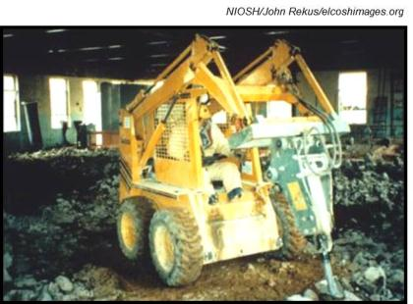
Elimination & Substitution
Automate the process; remove or isolate the worker.
Select and use a less toxic chemical.
Sub-contract out jobs to more qualified people.
Elimination & Substitution Example…
Skid steer loader with pneumatic hammer.
Notes:
Elimination and substitution, while most effective at reducing hazards, also tend to be the most difficult to implement in an existing process or job-site. If the project is still at the design or development stage, elimination and substitution of hazards may be inexpensive and simple to implement. For an existing process, major changes in equipment and procedures may be required to eliminate or substitute for a hazard.

Slide 65
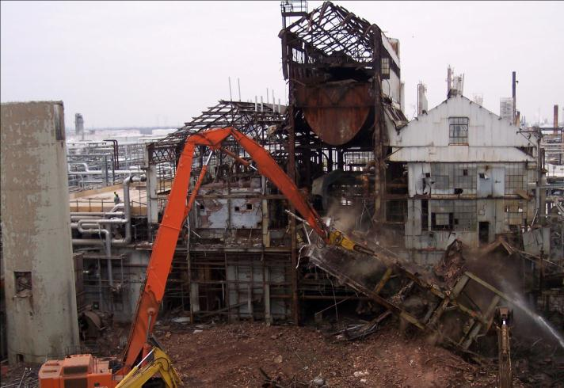
Elimination & Substitution
Notes:
Elimination & Substitution Example…
Demolition of structure using mechanical sheers; combined with the safe work practice of spraying water will significantly reduce worker exposure to harmful dust.

Slide 66
Engineering Controls
Using dust suppression (wet methods) and/or dust collection systems.
Installing and using mechanical ventilation;
General (dilution)
Local (exhaust) ventilation systems
Notes:
Engineering controls are used to remove a hazard or place a barrier between the worker and the hazard. This barrier can be placed at the source of the hazard, between the source and the worker, or at the worker. Well-designed engineering controls can be highly effective in protecting workers and will typically be independent of worker interactions to provide this high level of protection. The initial cost of engineering controls can be higher than the cost of administrative controls or personal protective equipment, but over the longer term, operating costs are frequently lower, and in some instances, can provide a cost savings in other areas of the process. Examples of engineering controls include, wet methods, ventilation and dust collection systems.

Slide 67
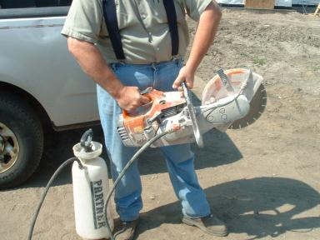
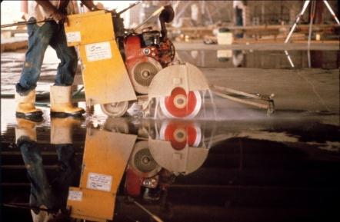
Wet Methods
NIOSH/John Rekus/elcoshimages.org
Engineering Control Example…
Water suppression system on concrete saw.
Notes:
Engineering Control Example…

Slide 68
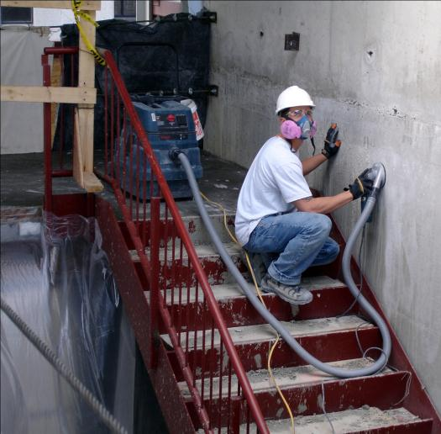
Dust Collection Systems
Notes:
Some studies have shown that wet cutting methods can reduce average respirable dust levels by up to 94 percent. However, if an employer determines that the use of a wet saw in a particular circumstance is not feasible, and the brick, concrete block or masonry must be cut dry, then the employer would be required to explore other engineering control options. Dust collection systems can be used, but they are typically not sufficient to reduce exposures below permissible limits and employees will usually need to be protected with appropriate respirators as well; monitoring the air will confirm exposure.
Engineering Control Example…
Dust collection system in use while worker is wearing respirator.

Slide 69
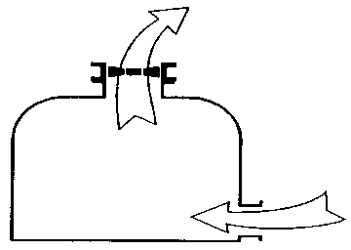
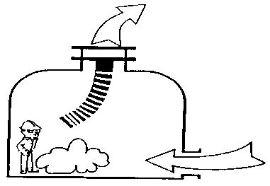
Mechanical Ventilation
General (Dilution) Ventilation…
Forces fresh air into an area and dilutes contaminants.
Local (Exhaust) Ventilation…
Removes contaminated air at its source.
Notes:
Mechanical ventilation consists of either general (dilution) ventilation systems or local (exhaust) systems.
General (Dilution) Ventilation…
Forces fresh air into an area and dilutes contaminants; this allows air to move through a space which ensures a fresh continual supply.
WARNING! Pure oxygen must not be used for ventilation purposes.
Local (Exhaust) Ventilation…
Removes contaminated air at its source; this prevents harmful dust, fumes & mists from contaminating the breathing air of the worker.
WARNING! Contaminated air exhausted from a working space must be discharged into the open air or otherwise clear of the source of intake air.

Slide 70
General (Dilution) Ventilation
General (dilution) ventilation works best when:
Air contaminants are widely disbursed throughout the area.
Toxicity levels and concentrations are low.
Notes:
General (dilution) ventilation must be of sufficient capacity and so arranged as to produce the number of air changes necessary to maintain breathing air to safe limits, as defined by OSHA permissible exposure limits (PELs).
General (dilution) ventilation works best when:
Air contaminants are widely disbursed throughout the area.
Toxicity levels and concentrations are low.

Slide 71
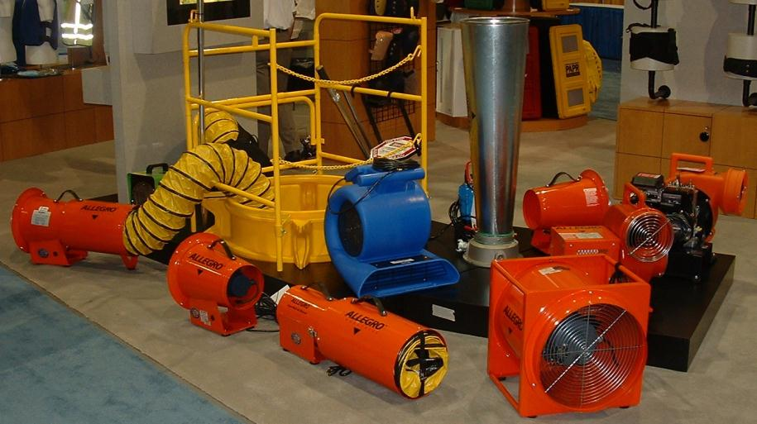
Ventilation Systems Examples…
Air moving equipment can be set up to either blow (dilute) or suck (exhaust).
Notes:
Ventilation Systems Examples…
Air moving equipment can be set up to either blow (dilute) or suck (exhaust).

Slide 72
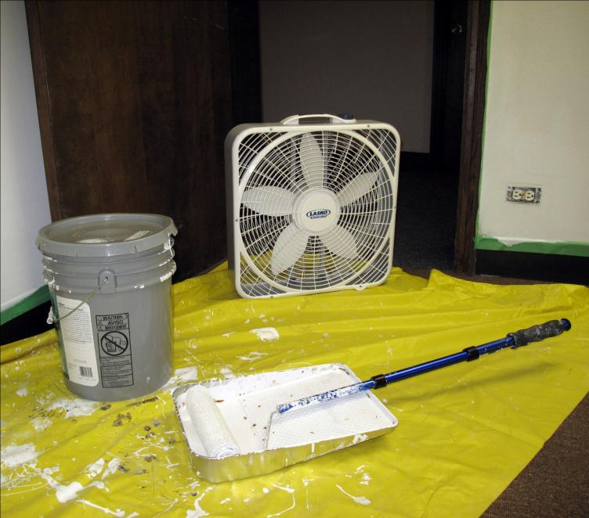
Notes:
General (dilution) ventilation can be applied to most jobs by simply opening a window or door and blowing fresh air into a space using a fan. Turn the fan around to blow air out and it becomes an exhaust ventilation system.

Slide 73
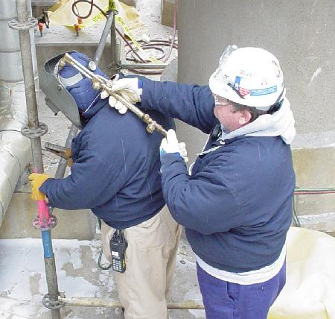
Never Ventilate with Pure Oxygen!
Notes:
Unsafe work practice…
Never use pure oxygen to blow or as ventilation. This could create an oxygen enriched environment causing an increased flammable or explosive condition.

Slide 74
Local (Exhaust) Ventilation
Local (exhaust) ventilation works best when:
Air contaminants are generated at a single source.
There’s a need to remove high levels and concentrations of a toxic material.
Notes:
Local (exhaust) ventilation consists of freely movable hoods intended to be placed by the welder or burner as close as practicable to the work. This system must be of sufficient capacity and so arranged as to remove fumes and smoke at the source and keep the concentration of them in the breathing zone within safe limits as defined by OSHA permissible exposure limits (PELs).
Local (exhaust) ventilation works best when:
Air contaminants are generated at a single source.
There’s a need to remove high levels and concentrations of a toxic material.

Slide 75
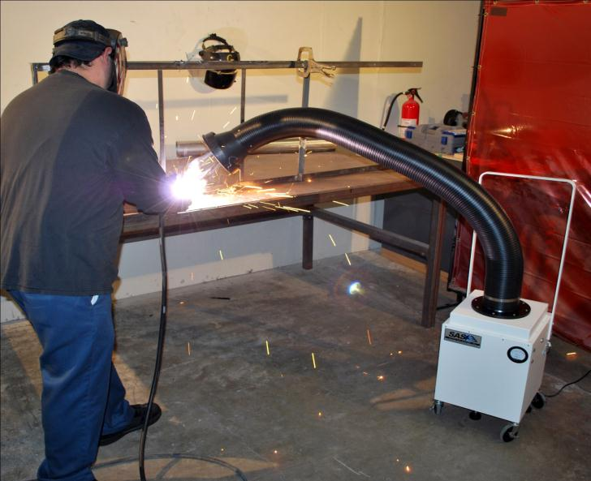
Courtesy of Sentry Air Systems, Inc. Houston, TX USA
Model 300 Welding Fume Extractor
www.sentryair.com
Notes:
Local Exhaust System Example…

Slide 76
Administrative Controls
Gathering all specialty equipment, including, ventilators, warning signs, personal protective equipment, etc. before starting work.
Performing operations that involve toxic substances at times when other workers are not present.
Isolate the work to a few employees.
Rotating workers through various job assignments.
Notes:
Administrative controls are changes in work procedures such as written safety policies, rules, supervision, schedules, and training with the goal of reducing the duration, frequency, and severity of exposure to hazardous chemicals or situations.

Slide 77
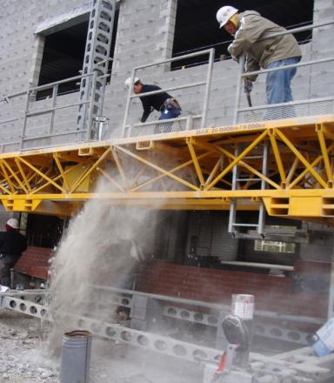
Dust Control
Use a sweeping compound to reduce airborne dust.
Wear personal protective equipment (respirator).
Schedule clean-up operations appropriately.
Warn others and clear the area of those who are affected by the dust and are not protected.
Sweeping hazard!
Notes:
Sweeping hazard!
Sweeping and the blowing of dust creates an inhalation hazard; consider the use of a vacuum to clean up job-sites.
Take precautions while sweeping!
Safe work practices while sweeping:
Use a sweeping compound to reduce airborne dust.
Wear personal protective equipment (respirator).
Schedule clean-up operations appropriately.
Warn others and clear the area of those who are affected by the dust and are not protected.

Slide 78
Personal Protective Equipment (PPE)
Consideration and use of PPE is only allowed when:
Engineering controls and/or work practices are not feasible.
Engineering controls or work practices are being implemented.
Engineering controls or work practices do not effectively reduce exposure to acceptable limits.
In cases of emergency.
Notes:
Controlling a hazard at its source is the best way to protect workers. However, when engineering, work practices and administrative controls are not feasible or do not provide sufficient protection, employers must provide personal protective equipment (PPE) to the employee and ensure its proper use.
Personal protective equipment (PPE) can only be used as a last resort!

Slide 79
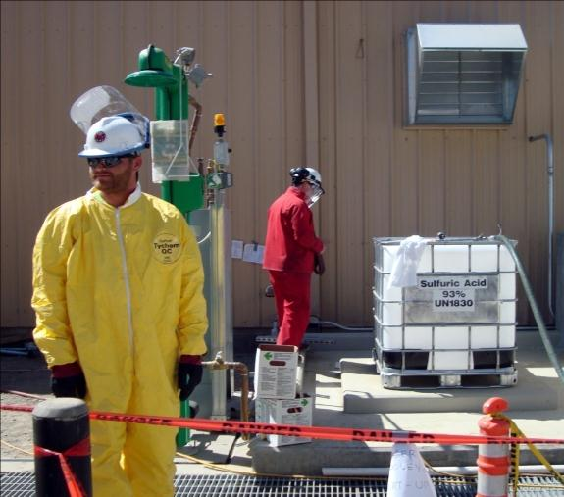
Personal Protective Equipment Example…
Chemical resistant suit, gloves, safety glasses and face shield.
Notes:
Personal Protective Equipment Example…
Chemical resistant suit, gloves, safety glasses and face shield

Slide 80
Feasible (Definition)
Technologically feasible
Engineering and administrative controls are being implemented and yet levels still remain above permissible exposure limits (PELs)
Economically feasible
Cost will not threaten the employer’s ability to remain in business.
Notes:
Feasible (Definition)
There are two key factors that would determine whether a control is feasible or not: technological feasibility and economical feasibility.
Technologically feasible; this is fairly straight forward, as long as all engineering and administrative controls are being implemented and yet levels still remain above permissible exposure limits (PELs), then in respect to the work being done; it is technologically not feasible to reduce exposures any lower. PPE may be worn in addition to engineering controls and administrative controls.
Economically feasible; OSHA would consider administrative or engineering controls economically feasible when the cost of implementing such controls will not threaten the employer’s ability to remain in business, or if such a threat to viability results from the employer’s failure to meet industry safety and health standards.
OSHA interprets the term “feasible” to conform to its ordinary meaning… “capable of being done”; if a recognized and accepted engineering or administrative control exists, it must be implemented before allowing the use of personal protective equipment, such as respirators and hearing protectors.

Slide 81
Personal Protective Equipment (PPE)
Is the device approved?
Is the device appropriate?
Is the worker properly trained?
Does the material have sufficient strength?
Will the material withstand repeated use?
Is the material flexible or pliable enough?
Will the material maintain its protective integrity?
Notes:
Questions regarding personal protective equipment (PPE):
Is the device approved?
Is the device appropriate for the type of hazard?
Is the worker wearing the device properly trained to understand the use, limitations and care instructions of the device?
Does the material have sufficient strength to withstand the physical stress of the tasks at hand?
Will the material withstand repeated use after contamination and decontamination?
Is the material flexible or pliable enough to allow end users to perform needed tasks?
Will the material maintain its protective integrity and flexibility under hot and cold extremes?

Slide 82
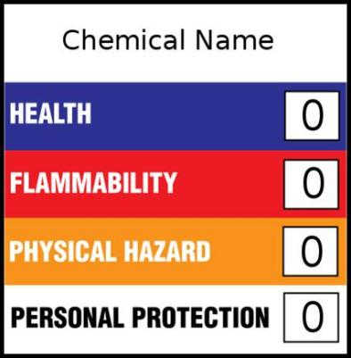
Hazardous Materials Identification System
Developed by the National Paint and Coatings Association (NPCA).
A numerical hazard rating that incorporates the use of labels with color-coded bars.
A special code identifying appropriate personal protective equipment (PPE) is also listed.
Notes:
HMIS (Hazardous Materials Identification System), developed by the National Paint and Coatings Association (NPCA), is a numerical hazard rating that incorporates the use of labels with color-coded bars. A special code identifying appropriate personal protective equipment (PPE) is also listed.
NOTE: Safety glasses must conform to the American National Standards Institute (ANSI Z 87.1 – Practice for Occupational & Educational Eye and Face Protection.

Slide 83
Personal Protective Equipment (PPE)
Employer Obligations:
Perform a “hazard assessment” of the workplace.
Identify and provide appropriate PPE.
Train employees in the use and care of the PPE.
Maintain PPE, including replacing worn or damaged PPE.
Periodically review, update and evaluate the effectiveness of the PPE program.
Notes:
PPE is equipment worn to minimize exposure to a variety of hazards. Examples include items such as gloves, foot and eye protection, hearing protection, hard hats and respirators.
Employer Obligations:
Perform a “hazard assessment” of the workplace to identify and control physical and health hazards.
Identify and provide appropriate PPE for employees.
Train employees in the use and care of the PPE.
Maintain PPE, including replacing worn or damaged PPE.
Periodically review, update and evaluate the effectiveness of the PPE program.
Employers Must Pay for Personal Protective Equipment (PPE)
With few exceptions, OSHA requires employers to pay for personal protective equipment used to comply with OSHA standards; employers cannot require workers to provide their own PPE. Even when a worker provides his or her own PPE, the employer must ensure that the equipment is adequate to protect the worker from hazards at the workplace.
Employers are not required to pay for:
Everyday clothing; such as long-sleeve shirts, long pants and normal work boots (including protective toe).
Ordinary clothing; such as winter coats, jackets and gloves.

Slide 84
Personal Protective Equipment (PPE)
Worker Responsibility:
Properly wear PPE.
Attend training sessions on PPE.
Care for, clean and maintain PPE.
Inform a supervisor of the need to repair or replace PPE.
Notes:
Worker Responsibility:
Properly wear PPE.
Attend training sessions on PPE.
Care for, clean and maintain PPE.
Inform a supervisor of the need to repair or replace PPE.
* The employer must pay for replacement PPE, except when the employee has lost or intentionally damaged the PPE.

Slide 85
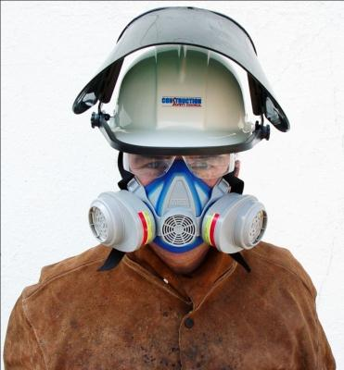
Limitations & Use of Respirators
All respirators leak!
Must be properly fitted and worn.
Respirators protect only the employees who are wearing them.
Respirators are uncomfortable to wear.
Use Only NIOSH Approved Respirators!
Notes:
Engineering and work practice controls are generally regarded as the most effective methods to control exposures to airborne hazardous substances. OSHA considers the use of respirators to be the least satisfactory approach to exposure control because…
All respirators leak!
Respirators provide adequate protection only if employers ensure, on a constant basis, that they are properly fitted and worn.
Respirators protect only the employees who are wearing them from a hazard, rather than reducing or eliminating the hazard from the workplace as a whole (which is what engineering and work practice controls do).
Respirators are uncomfortable to wear, cumbersome to use, and interfere with communication in the workplace, which can often be critical to maintaining safety and health.
The costs of operating a functional respiratory protection program are substantial — including regular medical examinations, fit testing, training, and the purchasing and maintenance of equipment.
Use Only NIOSH Approved Respirators!

Slide 86
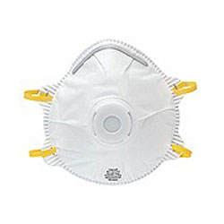
Approved Filtering Facepieces (Disposable)
Used for dust, mists, welding fumes, mold, etc.
Does not provide protection from gases or vapors.
Disposable & easy to breathe through.
Least protection (rated the same as elastomeric half-face).
Not allowed for use in atmospheres with less than 19.5% oxygen.
DO NOT USE FOR ASBESTOS.
Notes:
The appropriate respirator will depend on the contaminant(s) to which you are exposed and the protection factor (PF) required. Required respirators must be NIOSH-approved and medical evaluation, fit testing and training must be provided before use.

Slide 87
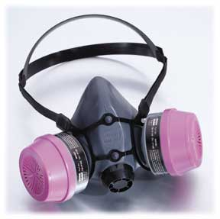
Half-Face Respirators (Elastomeric)
Used for protection against most vapors, acid gases, dust or welding fumes, mold.
Can be used with a variety of cartridges/filters.
Requires regular cleaning & maintenance.
Not allowed for use in atmospheres with less than 19.5% oxygen.
Notes:
The appropriate respirator will depend on the contaminant(s) to which you are exposed and the protection factor (PF) required. Required respirators must be NIOSH-approved and medical evaluation, fit testing and training must be provided before use.

Slide 88
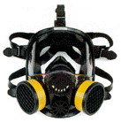
Full-Face Respirators (Elastomeric)
Used for protection against most vapors, acid gases, dust or welding fumes, mold.
Can be used with a variety of cartridges/filters.
Requires regular cleaning & maintenance.
Built in safety eye protection (ANSI Z87).
Not allowed for use in atmospheres with less than 19.5% oxygen.
Notes:
The appropriate respirator will depend on the contaminant(s) to which you are exposed and the protection factor (PF) required. Required respirators must be NIOSH-approved and medical evaluation, fit testing and training must be provided before use.

Slide 89
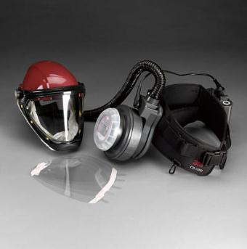
Powered-Air-Purifying Respirators (PAPR)
Battery powered fan pulls air through filters and blows air into the facepiece or hood.
Can be used with a variety of cartridges/filters.
Requires regular cleaning & maintenance.
Built in safety eye protection (ANSI Z87).
Easier to fit, easier on heart and lungs.
Not allowed for use in atmospheres with less than 19.5% oxygen.
Notes:
The appropriate respirator will depend on the contaminant(s) to which you are exposed and the protection factor (PF) required. Required respirators must be NIOSH-approved and medical evaluation, fit testing and training must be provided before use.

Slide 90
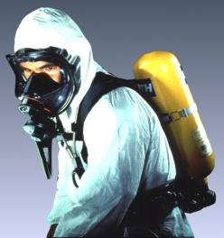
Self-Contained Breathing Apparatus (SCBA)
Used in immediately dangerous to life and health (IDLH) environments.
Requires regular cleaning & maintenance.
Built in safety eye protection (ANSI Z87).
Easier to fit.
Requires Compressed Gas Association (CGA) Grade D breathing air.
Can be used in Oxygen deficient atmospheres (less than 19.5% oxygen).
Notes:
The appropriate respirator will depend on the contaminant(s) to which you are exposed and the protection factor (PF) required. Required respirators must be NIOSH-approved and medical evaluation, fit testing and training must be provided before use.

Slide 91
Assigned Protection Factors
Type of respirator¹, ² | Quarter mask | Half mask | Full facepiece | Helmet hood | Loose Fitting facepiece
Air-Purifying Respirator | 5 | ³10 | 50 | .............. | ..............
Powered Air-Purifying Respirator (PAPR) | .............. | 50 | 1,000 | ⁴25/1,000 | 25
Supplied-Air Respirator (SAR) or Airline Respirator Demand mode Continuous flow mode Pressure-demand or other positive-pressure mode | .................. .................. .................. | 10 50 50 | 50 1,000 1,000 | .................. ⁴25/1,000 .................. | ................. 25 .................
Self-Contained Breathing Apparatus (SCBA) Demand mode Pressure-demand or other positive-pressure mode (e.g., open/closed circuit) | .................. .................. | 10 .................. | 50 10,000 | 50 10,000 | ................. .................
Notes:
Notes:
1 Employers may select respirators assigned for use in higher workplace concentrations of a hazardous substance for use at lower concentrations of that substance, or when required respirator use is independent of concentration.
2 The assigned protection factors in Table 1 are only effective when the employer implements a continuing, effective respirator program as required by this section (29 CFR 1910.134), including training, fit testing, maintenance, and use requirements.
3 This APF category includes filtering facepieces, and half masks with elastomeric facepieces.
4 The employer must have evidence provided by the respirator manufacturer that testing of these respirators demonstrates performance at a level of protection of 1,000 or greater to receive an APF of 1,000. This level of performance can best be demonstrated by performing a WPF or SWPF study or equivalent testing. Absent such testing, all other PAPRs and SARs with helmets/hoods are to be treated as loose-fitting facepiece respirators, and receive an APF of 25.
5 These APFs do not apply to respirators used solely for escape. For escape respirators used in association with specific substances covered by 29 CFR 1910 subpart Z, employers must refer to the appropriate substance-specific standards in that subpart. Escape respirators for other IDLH atmospheres are specified by 29 CFR 1910.134 (d)(2)(ii).

Slide 92
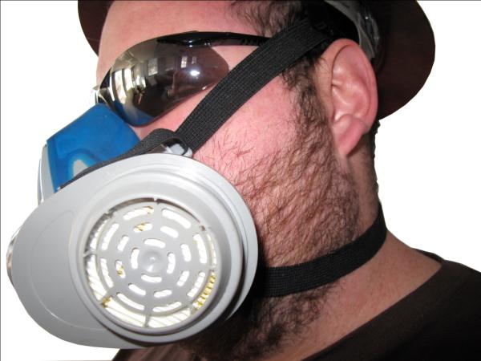
Facial Hair
Facial hair is not allowed while wearing a tight fitting facepiece respirator!
Notes:
Facial hair is not allowed while wearing a tight fitting facepiece respirator; it interferes with the fit and will allow more hazardous substances to leak into the facepiece. However, some mustaches, sideburns, and small goatees that are trimmed so that no hair underlies the seal of the respirator present no hazard and may be worn – only a properly performed fit test will ensure this.

Slide 93
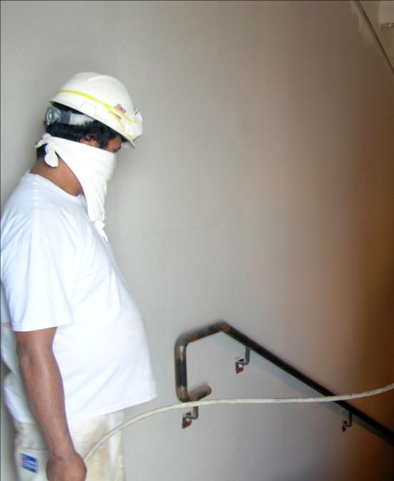
NOT
NIOSH
Approved!
Notes:
This worker is not wearing a NIOSH approved respirator.

Slide 94
Respirator Use
Employee must wear a respirator due to job-site conditions.
Voluntary use by employee.
Notes:
The allowable use of a respirator depends on certain circumstances; two scenarios in which an employee may wear a respirator are:
Employee must wear a respirator due to job-site conditions; if concentrations of airborne contaminants can not be effectively minimized to below permissible exposure limits through engineering or administrative controls then respiratory protection must be worn.
Voluntary use by employee; an employee may choose to wear a respirator under voluntary conditions when concentrations of airborne contaminants are below legal permissible exposure limits.

Slide 95
OSHA’s Special Emphasis Programs
National Emphasis Program – Crystalline Silica (CPL 03-00-007)
National Emphasis Program on Lead (CPL 03-00-009)
National Emphasis Program – Hexavalent Chromium (CPL 02-02-076)
Inspection Procedures for the Hazard Communication Standard – OSHA Instruction CPL 02-02-038.
Inspection Procedures for the Respiratory Protection Standard – OSHA Instruction CPL 02-00-120.
Inspection Procedures for Hexavalent Chromium Standard – OSHA Instruction CPL 02-02-074
Inspection Procedures for Occupational Exposure to Asbestos – OSHA Instruction CPL 02-02-063.
Notes:
OSHA considers health hazards to be a priority; a team of health experts (industrial hygienists) conduct workplace inspections focusing on health related issues. Health standards and Special Emphasis Programs are written to protect the worker and to give OSHA the authority to stop unsafe work.
For a complete listing of health standards and OSHA Special Emphasis Programs, go to www.osha.gov

Slide 96
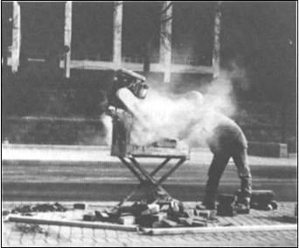
Notes:
WARNING! A cloud of dust surrounding a worker’s face is a serious health hazard. This condition will not go unnoticed and is considered to be immediately dangerous to life and health!

Slide 97
Competent Person
Learning Goals:
Be able to identify the definition of competent person and know how to apply its meaning to construction job-sites.
Identify the specific competent person requirements in OSHA’s health standards.
Learn an employer’s responsibilities towards injury and illness prevention and be able to explain OSHA’s employee training requirements.
Notes:
Learning goals for this lesson.

Slide 98
Important Terms
Competent person
Qualified person
Industrial Hygienist
Program administrator
Notes:
Important terms that will be discussed during this lesson.

Slide 99

Competent Person
Capable of identifying existing and predictable hazards.
Has authorization to take prompt corrective measures to eliminate them.
Notes:
To ensure a safe and healthful workplace, employers must designate a competent person to each job-site. This person has the responsibility to conduct frequent and regular inspections of the job-site, materials and equipment; this includes health related exposures. In addition to the inspection duties, a competent person will also perform regular and on-going safety training; this includes new hire worker orientation.
Competent Person means one who is capable of identifying existing and predictable hazards in the surroundings, or working conditions which are unsanitary, hazardous, or dangerous to employees, and who has authorization to take prompt corrective measures to eliminate them.
Health hazard communication is an important part of a competent person’s job!
To instructor – Identify in the OSHA standards where the term “competent person” appears (see Health Hazards in Construction Workbook).

Slide 100

Qualified Person
Possesses a recognized degree, certificate, or professional standing.
Extensive knowledge, training, and experience.
Successfully demonstrates ability to solve or resolve problems.
Notes:
To achieve compliance with [OSHA health standards] administrative or engineering controls must first be implemented whenever feasible. When such controls are not feasible to achieve full compliance, protective equipment or other protective measures must be used to keep the exposure of employees to air contaminants within the limits prescribed [by OSHA]. Any equipment and technical measures used for this purpose must first be approved for each particular use by a competent industrial hygienist or other technically qualified person.
Qualified Person means one who, by possession of a recognized degree, certificate, or professional standing, or who by extensive knowledge, training, and experience, has successfully demonstrated his ability to solve or resolve problems relating to the subject matter, the work, or the project.

Slide 101

Industrial Hygienist
A professional devoted to the anticipation, recognition, evaluation, prevention, and control of health hazards.
Notes:
To achieve compliance with [OSHA health standards] administrative or engineering controls must first be implemented whenever feasible. When such controls are not feasible to achieve full compliance, protective equipment or other protective measures must be used to keep the exposure of employees to air contaminants within the limits prescribed [by OSHA]. Any equipment and technical measures used for this purpose must first be approved for each particular use by a competent industrial hygienist or other technically qualified person.
Industrial Hygienist - A professional devoted to the anticipation, recognition, evaluation, prevention, and control of those environmental factors or stresses arising in or from the workplace which may cause sickness, impaired health and well being, or significant discomfort among workers.

Slide 102
Program Administrator
A respiratory protection program, when used, must be administered by a suitably trained program administrator.
Notes:
A respiratory protection program, when used, must be administered by a suitably trained program administrator (competent person).
NOTE: In OSHA’s Respiratory Protection Standard, the term “Program Administrator” is used to describe the person who has authority for ensuring compliance with the rule and administering the program.

Slide 103
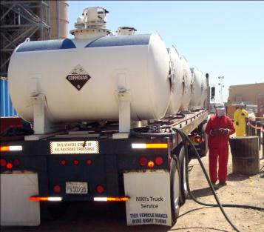
Accident Prevention Responsibilities
Employer must have a safety & health program that provides for:
Frequent and regular inspections of the job sites, materials, and equipment to be made by competent persons.
Notes:
Safety & Health Programs
[Safety & Health] programs must provide for frequent and regular inspections of the job sites, materials, and equipment to be made by competent persons designated by the employers.
Elements of an Effective Safety & Health Program…
Management Commitment and Employee Involvement – Establish clear policies for safe work and assign competent persons to the job-site to ensure that these safe work policies are being implemented and enforced. Communicate safety goals and provide visible top management commitment to show that the company is serious about safety.
Worksite Analysis – Conduct comprehensive baseline worksite surveys for safety and health hazards, perform regular inspections of the job-site and complete routine job hazard analyses.
Hazard Prevention and Control – Implement effective engineering, work practice (administrative) controls and provide personal protective equipment.
Medical Management – Ensure the availability of medical personnel for advice and consultation on matters of occupational health.
Safety and Health Training – Ensure that all employees understand the hazards to which they may be exposed and how to prevent harm to themselves and others from exposure to these hazards.
Program Evaluation – Review program to ensure that the existing policies, procedures and hazard prevention & control strategies are working and affective.

Slide 104

Employee Training Requirements
Recognition and avoidance of unsafe conditions.
Regulations applicable to work.
Safe handling and use of hazardous substances.
Personal hygiene.
Confined & enclosed spaces.
Notes:
The employer should avail himself of the safety and health training programs the Secretary (OSHA) provides.
The employer must instruct each employee in the recognition and avoidance of unsafe conditions and the regulations applicable to his work environment to control or eliminate any hazards or other exposure to illness or injury.
Employees required to handle or use poisons, caustics, and other harmful substances must be instructed regarding the safe handling and use, and be made aware of the potential hazards, personal hygiene, and personal protective measures required.
In job site areas where harmful plants or animals are present, employees who may be exposed must be instructed regarding the potential hazards, and how to avoid injury, and the first aid procedures to be used in the event of injury.
Employees required to handle or use flammable liquids, gases, or toxic materials must be instructed in the safe handling and use of these materials and made aware of the specific requirements contained in OSHA’s 29 CFR 1926 Subparts D, F, and other applicable subparts.
All employees required to enter into confined or enclosed spaces must be instructed as to the nature of the hazards involved, the necessary precautions to be taken, and in the use of protective and emergency equipment required. The employer must comply with any specific regulations that apply to work in dangerous or potentially dangerous areas.

Slide 105

Notes:
Worker in confined space wearing full-facepiece (elastomeric) – air purifying respirator.

Slide 106
Health Hazards in Construction
Learning Goals:
Be able to explain what a hazard is and how workers might be exposed to occupational health hazards in construction.
List the three categories of health hazards found in construction.
Overview the health effects of these hazards on the human body.
Define important terms used to describe dangerous & hazardous environments.
Notes:
Learning goals for this lesson.

Slide 107
Important Terms
Health Hazard
Acute Effects
Chronic Effects
Local Effects
Systemic Effects
Immediately Dangerous to Life & Health (IDLH)
Hazardous Atmosphere
Flammable & Explosive Environments
Oxygen Deficiency Hazard
Notes:
Important terms that will be discussed during this lesson.

Slide 108

What is a Health Hazard?
Chemical Hazards; such as gases, vapors, fumes, dusts/fibers, mists and substances found in OSHA PELs, NIOSH RELs, and ACGIH TLVs®
Physical Hazards; such as temperature, noise, repetitive motion & awkward postures, ionizing and non-ionizing radiation.
Biological Hazards; such as mold, bloodborne pathogens, bacteria, poisonous plants and animals, animal, bird and rodent feces.
Notes:
There are many definitions of health, but simply stated…
Health is the general condition of a person in all aspects, including, but not limited to: physical, mental and social well-being and not merely the absence of disease or infirmity.
A health hazard is any condition or activity that threatens a person’s well-being.
Learn all the health hazards on your job…
Anticipate, Recognize, Evaluate and Control these hazards.

Slide 109


Some health hazards are obvious, like working with chemicals…
Some health hazards are not so obvious, like awkward postures and noise exposure…
Notes:
Some health hazards are obvious, like working with chemicals…
Some health hazards are not so obvious, like awkward postures and noise exposure…

Slide 110

Acute Health Effects
Irritation; rashes & dry skin
Dermatitis (acute)
Corrosivity; burns or dissolves skin tissue
Sensitization; allergic reactions (anaphylactic shock)
Metal fume fever
Lethal Concentration (LC)
Skull & cross-bone symbol is used to warn of an acute toxicity hazard.
Notes:
Acute health effects are quickly seen, usually after exposures to fairly high levels or concentrations of hazardous substances. For example, fiberglass can immediately cause itchiness and skin irritation; an extremely loud noise can result in temporary or even permanent hearing loss.
A lethal concentration of carbon monoxide, CO (1200 ppm) is considered to be Immediately Dangerous to Life and Health (IDLH); a worker exposed to this acute amount of CO can lose consciousness and die.
Lethal Concentration (LC) - An indication of the lethality of a given substance or type of radiation.
LC50 - Is the concentration of a material, which causes the death of 50% (one half) of a group of test animals. The LC50 is one way to measure the short-term poisoning potential (acute toxicity) of a material.
Skull & cross-bone symbol is used to warn of an acute toxicity hazard; Globally Harmonized System.

Slide 111

Chronic Health Effects
Cancer
Asbestosis
Mesothelioma
Silicosis
Occupational Hearing Loss
Cumulative Trauma Disorder
Chronic health hazard symbol
Notes:
Chronic effects usually develop slowly. For example, if you breathe small amounts of asbestos fibers, you won’t even notice them. There are no acute effects. But if you inhale asbestos month after month, year after year, you greatly increase your chances of getting asbestos disease, such as lung cancer. This is a chronic effect.
Other examples of chronic health effects include hearing loss and cumulative trauma disorders; these are examples of physical health hazards.
Chronic health hazard symbol; Globally Harmonized System.

Slide 112

Worker with chronic health problems; he needs oxygen.
Notes:
Most health effects experienced in construction are typically chronic; this makes it difficult to associate where the exposure occurred. For example, a worker in their later years presents with a chronic health effect. The exposures that may have caused the damage could have occurred very early in his working life.

Slide 113


Local Health Effects
Concrete burns
Skin & eye irritation
Dermatitis
Poison Ivy
Tissue damage
Acid burn
Sunburn
Pictogram for Irritant & Sensitizer
Pictogram for Corrosive
Notes:
A local health effect refers to an adverse health effect that takes place at the point or area of contact. The site may be skin, mucous membranes, the respiratory tract, gastrointestinal system, eyes, etc. Absorption does not necessarily occur.
An example of a local health effect is an exposure to strong acids or alkalis resulting in skin damage.

Slide 114


Local Health Effects
Eye Irritation
Irritation to the
Throat, Nose, Mouth & Lungs
Substance makes contact with body…
Damage to body occurs at point of contact.
Skin irritation & Tissue Damage
Notes:
Local Health Effect

Slide 115



Systemic Health Effects
Asbestosis & Mesothelioma
Silicosis
Metal fume fever
Kidney damage
Allergic reactions
Infections
Radiation sickness
Nervous system failure
Reproductive system damage
Notes:
A systemic health effect refers to an adverse health effect that takes place at a location distant from the body's initial point of contact, for example, a chemical is inhaled into the lungs or absorbed through the skin, yet it affects the person’s kidney, liver or other part of the body.
Substances with systemic effects often have "Target Organs" in which they accumulate and exert their toxic effect. Often these effects are not seen until a critical body burden is reached.

Slide 116


Systemic Health Effects
Substance enters the body and is deposited throughout the system.
Damage to body occurs at locations remote from initial point of contact.
Nervous System Damage
Lung Cancer
&
Kidney Failure
Reproductive System Damage
Notes:
Substance enters the body (see Routes of Entry) and is deposited throughout the system.
Damage to body occurs at locations remote from initial point of contact.

Slide 117
Immediately Dangerous to Life & Health (IDLH)
Poses an immediate or delayed threat to life.
Would cause irreversible adverse health effects.
Would interfere with an individual's ability to escape unaided from a space.
Storage Tanks
Process Vessels
Bins
Boilers
Ventilation or Exhaust Ducts
Sewers & Manholes
Underground Utility Vaults
Tunnels
Pipelines
Open top spaces more than 4 feet in depth
Temporary Enclosures (heating enclosures for break)
Dumpsters
Stair-wells
Elevator Shafts
Basements
Attics
Trenches & Excavations
Notes:
An IDLH condition is one that poses an immediate or delayed threat to life or that would cause irreversible adverse health effects or that would interfere with an individual's ability to escape unaided from a space.
NOTE: Some materials may produce immediate transient effects that, even if severe, may pass without medical attention, but are followed by sudden, possibly fatal collapse 12-72 hours after exposure. The victim "feels normal" from recovery from transient effects until collapse. Such materials in hazardous quantities are considered to be "immediately" dangerous to life or health.

Slide 118

Hazardous atmospheres may exist in trenches.
Notes:
Hazardous atmospheres may exist in trenches. When a trench reaches a depth of 4 feet, they must be evaluated for IDLH conditions by a competent person.

Slide 119
Confined & Enclosed Spaces
Any space having a limited means of egress.
Subject to the accumulation of toxic or flammable contaminants.
Potential oxygen deficient atmosphere.
Notes:
"Confined or enclosed space" means any space having a limited means of egress, which is subject to the accumulation of toxic or flammable contaminants or has an oxygen deficient atmosphere. Confined or enclosed spaces include, but are not limited to, storage tanks, process vessels, bins, boilers, ventilation or exhaust ducts, sewers, underground utility vaults, tunnels, pipelines, and open top spaces more than 4 feet in depth such as pits, tubs, vaults, and vessels.
All confined or enclosed spaces must be evaluated for IDLH conditions!

Slide 120
Confined & Enclosed Spaces
Identify the hazards; oxygen deficiency, flammable and/or toxic.
Classify the space; enclosed space, confined space (hazards isolated), or permit required confined space.
Eliminate and/or control the hazards; engineering controls (ventilation) and/or personal protective equipment (PPE).
Coordinate entry operations; entrant & attendant responsibilities, ensure proper communication.
Ensure prompt rescue; team readily available, properly equipped & trained!
Notes:
Contractors must coordinate work in confined or enclosed spaces…
Identify the hazards; oxygen deficiency, flammable and/or toxic.
Classify the space; enclosed space, confined space (hazards isolated), or permit required confined space.
Eliminate and/or control the hazards; engineering controls (ventilation) and/or personal protective equipment (PPE).
Coordinate entry operations; entrant & attendant responsibilities, ensure proper communication.
Ensure prompt rescue; team readily available, properly equipped & trained!

Slide 121

Confined & Enclosed Spaces
Working in elevated lifts (locations) could cause you to be exposed to unexpected hazardous atmospheres.
Notes:
Enclosed space example…
Confined and enclosed spaces can exist where you least expect them; always survey the job-site for potential hazardous atmospheres.

Slide 122

Confined & Enclosed Spaces
Notes:
Entry into a confined space; means the action by which a person passes through an opening into a space and is considered to have occurred as soon as any part of the body breaks the plane of the space.
Confined space entry is serious and dangerous work; always follow approved confined space entry procedures!
This is not an approved entry…

Slide 123
Confined Space Entry Procedures
Understand the procedures for confined space entry.
Know the hazards of the specific space.
Review the specific procedures for each entry.
Understand how to use entry and rescue equipment.
Highly trained and skilled workers!
Notes:
Each employee who enters or is involved in the entry must:
Understand the procedures for confined space entry;
Know the hazards of the specific space;
Review the specific procedures for each entry, and;
Confined Space Training Facility (Construction Safety Council)
Understand how to use entry and rescue equipment.
Be highly trained and skilled.

Slide 124

Notes:
Confined Space Training Facility (Construction Safety Council)
Confined space rescue retrieval system.

Slide 125

Confined Space Entry Procedures
Test all confined spaces before you enter!
Oxygen Content
Flammable Environments
Toxic Substances
Notes:
Test all confined spaces before you enter!
Oxygen Content
Flammable Environments
Toxic Substances

Slide 126
Hazardous Atmospheres
Oxygen concentration below 19.5% or above 23.5%
Flammable gas, vapor, mist in excess of 10% of its lower flammable limit (LFL).
Airborne combustible dust at high concentrations.
Exposure to any substance above OSHA’s Permissible Exposure Limit (PEL).

Slide 127

What do you think?
Notes:
What do you think?
What are some of the health hazards in this picture?

Slide 128


Flammable & Explosive Hazards
LEAN
TOO MUCH AIR
RICH
TOO LITTLE AIR
EXPLOSIVE
TOO
LITTLE GAS
FLAMMABLE
MIXTURE
TOO
MUCH GAS
Pictogram for Flammable
Globally Harmonized System
Notes:
Flammable limits are defined as the concentration range in which a flammable substance can produce a fire or explosion when an ignition source (such as a spark or open flame) is present. The concentration is generally expressed as percent fuel by volume.
For example, Methane (CH4) has a Lower Flammable Limit (LFL) = 5.3%, and an Upper Flammable Limit (UFL) = 15.0%; if the air contains between 5.3% and 15% volume of air of methane, then a flammable environment exists.

Slide 129
Flammable & Explosive Hazards
HEAT
OXYGEN
FUEL
CHAIN
REATION
Keep fuel, heat & oxygen separated!
Notes:
Fire Tetrahedron
For a fire or explosion to occur, fuel, heat, oxygen, and a chemical chain reaction must be present. Removal of any one of these essential elements will result in the fire being extinguished or have never started.
Keep fuel, heat & oxygen separated!

Slide 130



Slide 131
Flammable Materials (Storage & Use)
No more than 25 gallons of flammable or combustible liquids may be stored in a room outside of an approved storage cabinet.
Not more than 60 gallons of flammable or 120 gallons of combustible liquids may be stored in any one storage cabinet. Not more than three such cabinets may be located in a single storage area.
Storage of liquid petroleum gas (LPG) within buildings is prohibited.
Only approved containers and portable tanks shall be used for storage and handling of flammable and combustible liquids.
Notes:
Flammable Liquid (Storage & Use):
No more than 25 gallons of flammable or combustible liquids may be stored in a room outside of an approved storage cabinet.
Not more than 60 gallons of flammable or 120 gallons of combustible liquids may be stored in any one storage cabinet. Not more than three such cabinets may be located in a single storage area.
Storage of liquid petroleum gas (LPG) within buildings is prohibited.
Only approved containers and portable tanks shall be used for storage and handling of flammable and combustible liquids.

Slide 132

Hazard Recognition
Improper storage of flammable & combustible liquids and gases; creates a potential fire hazard as well as a toxic atmosphere.
Notice the enclosed space hazard.
Notes:
Hazard Recognition
Improper storage of flammable & combustible liquids and gases; creates a potential fire hazard as well as a toxic atmosphere. Notice the enclosed space hazard.
No more than 25 gallons of a flammable or combustible liquid may be stored in a room outside of an approved storage cabinet.
Violation →

Slide 133

Flammable & Combustible Storage Cabinet
Photo courtesy of Justrite Mfg. Co.
Notes:
Picture shows more than 25 gallons of a flammable and combustible liquid stored in a room outside of an approved storage cabinet.

Slide 134

Hazard Control
An approved “Safety Can”…
A closed container of not more than 5 gallons capacity.
Has a flash-arresting screen.
Spring-closing lid and spout cover.
“Safety Can”
Photo courtesy of Justrite Mfg. Co.
Notes:
An approved “Safety Can” for storage and handling of flammable or combustible liquids:
A closed container of not more than 5 gallons capacity.
Has a flash-arresting screen.
Spring-closing lid and spout cover.
Safety cans are designed so that when subjected to heat, it will safely relieve internal pressure.

Slide 135

National Fire Protection Association (NFPA 704)
Blue
Red
4
1
0
White
Yellow
Notes:
National Fire Protection Association (NFPA 704)
The NFPA 704 Diamond is a means of disseminating hazard information for a material. The diamond is divided into four sections. Each of the first three colored sections (blue, red & yellow) has a number in it associated with a particular hazard. The higher the number is, the more hazardous a material is for that characteristic. The fourth section (white) includes special hazard information.
The NFPA 704 standard provides a readily recognized, easily understood system for identifying specific hazards. It addresses the health, flammability, instability, and related hazards that may be presented as short-term, acute exposures that are most likely to occur as a result of fire, spill, or similar emergency.
The objectives of NFPA 704 are:
To provide an appropriate signal or alert for the protection of both public and private emergency response personnel.
To assist in planning for effective fire and emergency control operations, including clean-up.
To assist all designated personnel, engineers, job-site, and safety personnel in evaluating hazards.

Slide 136









The Globally Harmonized System of Classification & Labeling of Chemicals
Gas
Aquatic Hazard
Explosive
Flammable
Corrosive
Oxidizer
Irritant & Sensitizer
Acute Toxicity
Chronic Health Hazard
Notes:
GasThis is the symbol that will appear on chemicals that are; gases under pressure, compressed gases, liquefied gases, refrigerated liquefied gases, dissolved gases.
Aquatic HazardThis is the symbol that will appear on chemicals which are acutely hazardous to fish, crustacea, or aquatic plants.
ExplosiveThis is the symbol that will appear on chemicals which are; unstable explosives, self reactive substances and mixtures, and organic peroxides.
FlammableThis is the symbol that will appear on chemicals that are flammable. Depending on the properties of the chemical(s); flammable gas, flammable aerosol, flammable liquid and vapor, flammable solid.
CorrosiveThis is the symbol that will appear on chemicals that have corrosive properties. Depending on the properties of the chemical(s); may be corrosive to metal, causes severe skin burns and eye damage, will cause serious eye damage.
OxidizerThis is the symbol that will appear on chemical that will release oxygen or behave like oxygen in a chemical reaction; causing a greater fire and explosion.
Irritant & SensitizerThis is the symbol that will appear on chemicals with less severe toxicity; harmful if swallowed, harmful in contact with skin, harmful if inhaled, causes skin and eye irritation, may cause allergic skin reaction.
Acute ToxicityThis is the symbol that will appear on the most severely toxic chemicals. Depending on the toxicity of the chemical, the skull and crossbones indicate that the chemical may be toxic or fatal; inhaled, swallowed, and/or contact with skin.
Chronic Health HazardThis is the symbol that will appear on chemicals that poses chronic health hazards; respiratory sensitization, germ cell mutagenicity, carcinogenicity, reproductive toxicity, specific target organ toxicity, and/or aspiration hazard.

Slide 137


Slide 138


Slide 139

Compressed Gas Cylinders
Well Ventilated
Fuel Gas
Oxygen
Well Protected
(Caps On & Secured)
20 Feet
Notes:
Compressed Gas Cylinders – “In Storage”
Oxygen cylinders in storage must be separated from fuel-gas cylinders or combustible materials (especially oil or grease), a minimum distance of 20 feet or by a noncombustible barrier at least 5 feet high having a fire-resistance rating of at least one-half hour.

Slide 140

Compressed Gas Cylinders & Confined Spaces
Use with caution around confined and enclosed spaces.
Never bring a compressed gas cylinder into a confined or enclosed space – including trenches.
Remove all hoses and leads from confined space when not in use.
Notes:
Compressed gas cylinders must be used with caution around confined and enclosed spaces!
Compressed gas cylinders must never be brought into confined spaces, this includes trenches.
Remove all hoses and leads from the enclosed/confined space when unoccupied and perform atmospheric testing to ensure air quality before returning to work.

Slide 141
Toxic vs. Flammable Environments
ZERO
“0”
TLV® & REL
PEL
IDLH
LFL
Increasing Concentrations
Notes:
Concentrations of flammable substances that may ignite or explode are substantially greater than concentrations harmful to health, or toxic. Meaning, if an exposure to a substance that is both toxic and flammable is present, death may happen due to its toxicity before an explosion may occur.

Slide 142
Oxygen Deficiency Hazards
Normal breathing air contains around 20.9% oxygen…
Oxygen deficient atmosphere – below 19.5%
Displacement
Consumption
Notes:
Normal breathing air contains around 20.9% oxygen…
Oxygen deficient atmosphere is when the percent of oxygen in air drops below 19.5%
Oxygen Deficiency Hazards are caused by:
Displacement – The presence of any gas, such as carbon dioxide, nitrogen and/or argon gas; these gases are common industrial gases used to purposely remove (displace) oxygen.
Consumption – The biological or chemical use of oxygen available in the environment. For example, workers consumption of oxygen through breathing, hot-work consuming oxygen around open flame and through oxidation of metal surfaces (e.g., iron oxide or rust).

Slide 143
Oxygen Deficiency Hazards
O2 Content | Effects and Symptoms
15 – 19% | Decreased ability to work strenuously. May impair coordination and induce early symptoms in persons with coronary, pulmonary, or circulatory problems.
12 – 14% | Respiration increases in exertion, pulse up, impaired coordination, perception, and judgment.
10 – 12% | Respiration further increases in rate and depth, poor judgment, lips blue.
8 – 10% | Mental failure, fainting, unconsciousness, ashen face, blueness of lips, nausea, and vomiting.
6 – 8% | 8 min., 100% fatal; 6 min., 50% fatal; 4-5 min., recovery with treatment.
4 – 6% | Coma in 40 sec., convulsions, respiration ceases, death.
Notes:
NOTE: Exposure to atmospheres containing 12% or less oxygen will bring about unconsciousness without warning. Unconsciousness can occur so quickly that individuals cannot help or protect themselves.

Slide 144
Chemical Health Hazards
Learning Goals:
Be able to explain what a chemical health hazard is and how construction workers might be exposed to these hazards.
Define important terms used to describe chemical hazards in the workplace.
Overview the health effects of these hazards on the human body.
Notes:
Learning goals for this lesson.

Slide 145
Important Terms
Gases, vapors, fumes, dusts/fibers & mists
Routes of entry
Units of concentration
Respirable
Breathable Air
Simple asphyxiant
Chemical asphyxiant
Gas & vapor density
Carcinogens
Toxic & highly toxic
Notes:
Important terms that will be discussed during this lesson.

Slide 146
Important Terms
Reproductive toxins
Irritants
Corrosives
Sensitizers
Hepatotoxins (liver toxins)
Nephrotoxins (kidney toxins)
Neurotoxins (nerve toxins)
Hematopoietic system (blood forming system)
Synergistic Effect
Your Right to Know
Material Safety Data Sheet (MSDS)
Notes:
Important terms that will be discussed during this lesson.

Slide 147
Chemical Health Hazards
Gas
Vapor
Fume
Dust/Fiber
Mist
Notes:
Chemical Health Hazard
A chemical health hazard means a chemical for which there is statistically significant evidence based on at least one study conducted in accordance with established scientific principles that acute or chronic health effects may occur in exposed employees. Chemical hazards may take the form of a gas, vapor, fume, dust/fiber and/or mist.
Chemical hazards can damage the lungs, skin, eyes, mucous membranes, and target specific organs in the body!

Slide 148


Routes of Entry
Inhalation
Ingestion
Absorption
Alveoli
Injection
Notes:
Inhalation is the primary route of entry for hazardous chemicals in the work environment. Nearly all materials that are airborne can be inhaled.
Absorption through the skin is another route of entry. The skin is the largest organ of your body and a common exposure site for liquid and airborne chemicals. Absorption through the skin can occur quite rapidly if the skin is cut or abraded. Intact skin is an effective barrier to many hazardous materials.
Ingestion - toxic materials can be swallowed and enter the body through the gastrointestinal tract. In the workplace, people can unknowingly ingest harmful chemicals when you eat, drink, or smoke in a contaminated work areas.
Injection occurs when a sharp object punctures the skin, allowing a chemical or infectious agent to enter your body. For example, injection can occur when a contaminated object such as a rusty nail punctures the skin.
Respiratory System (Inhalation)
The respiratory system is the major route of exposure for airborne chemicals. Once air contaminants are inhaled into your respiratory system, they may harm the tissues of the respiratory tract or lungs; cause serious scarring (local effect); and/or be dissolved in the blood and transported throughout the body (systemic effect).
The most serious damage is caused by contaminants that penetrate deep into the lower regions of the lung (alveoli).

Slide 149
Units of Concentration
(ppm) Parts per Million
(mg/m³) Milligrams per Cubic Meter of Air
(µg/m³) Micrograms per Cubic Meter of Air
(f/cc) Fibers per Cubic Centimeter of Air
Notes:
(ppm) Parts per Million
Used to express the amount of a gas or vapor; one part of a gas or vapor per million parts of air.
(mg/m³) Milligrams per Cubic Meter of Air
Used to express the amount of a toxic fume or dust; the amount of a substance (mg) in a given amount of space (m³).
(µg/m³) Micrograms per Cubic Meter of Air
Used to express the amount of a highly toxic fume or dust; the amount of a substance (µg) in a given amount of space (m³).
(f/cc) Fibers per Cubic Centimeter of Air
Fibers are any particle longer than 5 microns (µm), one millionth of a meter, and have an aspect ratio (length : width) greater than 3:1

Slide 150


Part Per Million (ppm)
Four (4) eye drops in a 55 gallon drum is equivalent to 1 part per million (1 ppm).
55 gallons
Notes:
(Ratio: 1/1,000,000)
One part per million is equivalent to four (4) eye drops of liquid in a 55 gallon barrel.

Slide 151


Milligrams per Cubic Meter of Air (mg/m³)
Empire State Building
X 1000 = 1 mg/m³
Approximate Volume = 1,000,000 m³
Notes:
Milligrams per Cubic Meter of Air (mg/m³)
One thousand (1,000) packets of artificial sweeter in the volume of the Empire State Building is equivalent to 1 milligram per cubic meter of air (1 mg/m³).

Slide 152
Micrograms per Cubic Meter of Air (µg/m³)
Empire State Building
X 1 = (1 µg/m³)
X 50 (artificial sweetener packets)
= 50 µg/m³
(OSHA PEL for Lead).
Approximate Volume = 1,000,000 m³
Notes:
Micrograms per Cubic Meter of Air (µg/m³)
One (1) packet of artificial sweeter in the volume of the Empire State Building is equivalent to 1 microgram per cubic meter of air (1 µg/m³).
50 artificial sweetener packets in the volume of the Empire State Building is equivalent to 50 µg/m³ (OSHA PEL for Lead).

Slide 153

Fibers per Cubic Centimeter (f/cc)
Fiber – Means a particulate form of asbestos, 5 micrometer (µm) or longer, with a length-to-width ratio of at least 3 to 1.
Notes:
Fiber – Means a particulate form of asbestos, 5 micrometer (µm) or longer, with a length-to-width ratio of at least 3 to 1.
Why f/cc for Asbestos?
The unit f/cc (Fibers per Cubic Centimeter) is used to describe limits for asbestos because it’s the number of fibers, not the overall weight of the material that is of concern. Asbestos fibers that are in size and shape (5µm long and length to width ratio of 3:1) are needle sharp particles that damage the inner portions of the lungs. In contrast, asbestos fiber that is shorter or of a length-to-width ratio less than 3:1 does not cause significant damage.

Slide 154




OSHA PEL for Asbestos
0.1 f/cc is equivalent to the number of fibers on the tip of a pencil mixed in with the volume of ten refrigerators.
Average amount of air a worker breathes during an 8-hour shift (ten refrigerators)
Notes:
The Occupational Safety & Health Administration (OSHA) has established a Permissible Exposure Limit (PEL) for asbestos; 0.1 f/cc over a time weighted average (TWA) of 8 hours.
Average amount of air a worker breathes during an 8-hour shift (ten refrigerators)
0.1 f/cc is equivalent to the number of fibers on the tip of a pencil mixed in with the volume of ten refrigerators.
On average, a worker will breathe 10,000,000 cubic centimeters (cc) of air in a typical work shift (8 hours); this is about the volume of 10 refrigerators. The number of asbestos fibers allowed by OSHA during this time period (0.1) can fit onto the tip of a pencil (about 1 million fibers).

Slide 155

Respirable Particles
Respirable dust is less than 10 microns (µm) in diameter!
Human hair is between 80 – 120 microns (µm) in diameter.
Notes:
Dust, fibers, fumes and other particles that can go past the nose and mouth and enter deep into the respiratory system are considered to be respirable; these particles are less than 10 microns (µm) in diameter.
A micron is 1 millionth of a meter (1/96,000 of an inch).
Human hair is between 80 – 120 microns (µm) in diameter.
Some exposures in construction, such as toxic fumes, dusts and mists occur from particles that are less than 10 microns (µm) in diameter; these exposures are invisible.
Examples of respirable (invisible) fume or dust:
Silica
Lead
Asbestos
Hexavalent Chromium

Slide 156

Respirable Particles
Respirable Dust, e.g., Lead, Silica & Asbestos (<10 µm)
A lower case 'o' when printed in Times New Roman size 10 (1mm).
Large Dog
Human Hair (80 – 120 µm)
1 m
1 cm
o
.000001
.001
0.01
0
1
Micron (µm)
Millimeter (mm)
Centimeter (cm)
Meter (m)
Notes:
Respirable particles comparison line.

Slide 157


Slide 158

Notes:
Fumes, dusts and some mist particles are so small that they are invisible; these particles can enter deep into the lungs and cause serious health effects.

Slide 159

High Efficiency Particulate Air (HEPA)
100
Capable of filtering 0.3 micrometer particles with 99.97% efficiency.
Notes:
High-efficiency particulate air filtration, or HEPA, is capable of filtering 0.3 micrometer particles with 99.97% efficiency, for use in contaminated environments.
Where airborne particles are less than 10 microns (µm) in diameter, a HEPA (100) rated respirator is highly recommended.
(See Respiratory Protection Program, page 201)
Examples of respirators with high-efficiency particulate air (HEPA) filtration; these are recommended to be used where airborne particles are less than 10 µm in diameter.
Respirators designated as HEPA will rated with a 100 efficiency.

Slide 160
Gases
Examples of gases found in construction:
Oxygen – used for welding and cutting.
Acetylene – used for welding and cutting.
Propane – used for heating & fuel.
Carbon Dioxide – used as an inert gas and can be found naturally in sewers.
Methane – the principle component of natural gas and found in earth deposits.
Notes:
Gases are materials that exist as individual molecules in the air at room temperature; gases are measured as a percent volume of air, or parts per million (ppm).

Slide 161

Gases
Examples of gases found in construction:
Hydrogen Sulfide –break down of organic matter and can be found naturally in sewers.
Carbon Monoxide – highly toxic and produced by the incomplete combustion of fuels.
Welding Gases – The welding arc can produce ozone, phosgene and carbon monoxide gases.
Diesel Exhaust – Nitrogen Dioxide.
Notes:
Gases are materials that exist as individual molecules in the air at room temperature; gases are measured as a percent volume of air, or parts per million (ppm).

Slide 162
Group Discussion…
How do Gases Affect the Body?
Who’s at Risk?
What hazardous gases are present on your job?
Notes:
Toxic gases can directly irritate the skin, throat, eyes or lungs (local health effect); or they may pass from the lungs into the blood stream to damage other parts of the body (systemic health effect). Some gases such as carbon dioxide can cause you to suffocate by displacing oxygen in the air.
Heavy equipment operators, welders and persons who enter into confined or enclosed spaces (plumbers & pipefitters, electricians and heating & air-conditioning workers) are the most at risk from chemicals in a gas form; laborers who enter into trenches are also at risk.
Group Discussion…
What hazardous gases are present on your job?

Slide 163
Gases
Important questions concerning gases:
What is the gas density?
What is the flammable range (LFL) of the gas?
How toxic is the gas (PEL, TLV, REL & IDLH)?
Is the gas a simple asphyxiant or a chemical asphyxiant?
Notes:
Gases used in construction are usually kept in compressed gas cylinders. The most common are oxygen and acetylene; these gases are used for hot work (e.g., cutting & welding of metals). However, some hazardous gases are found naturally in the earth and/or can be generated in sewer systems (e.g., carbon dioxide, methane & hydrogen sulfide).
Knowing the gas density, the flammable range and toxicity of the gas will help in understanding the hazards associated with the gas. Gases can also be classified as being either a simple asphyxiant or a chemical asphyxiant.

Slide 164



Gas Density
Helium .062
Gas Density
(Air = 1)
Propane 1.55
Carbon Dioxide 1.53
Notes:
Gas density is defined as the relative weight of a gas compared to air, which has an arbitrary value of one (1). If a gas density is less than one it will generally raise in air. If the gas density is greater than one it will generally sink in air.
WARNING! Gases with densities greater than one (1) will sink in air and displace oxygen within confined or enclosed spaces.

Slide 165

Breathable Air
Composition of Air
Substance (Gas) | % by Volume (ppm)
Nitrogen | 78% (780,000)
Oxygen | 20.9% (209,000)
Argon | 0.9% (9,000)
Carbon Dioxide | 0.1% (1,000)
Notes:
The air around us is a mixture of gases, mainly nitrogen and oxygen. But air also contains a small amount of water vapor, argon, and carbon dioxide. Understanding the air we breathe will better prepare us to recognize potential hazardous atmospheres.
Remember…
Oxygen Deficiency Hazard is when air contains less than 19.5% oxygen by volume.

Slide 166

Never use pure oxygen for ventilation, cooling or cleaning!

Slide 167


Simple Asphyxiants
Asphyxiant (Gas) | Gas Density | LFL | PEL | IDLH | NFPA 704M
Carbon Dioxide | 1.53 | NA | 5000 | 40,000 | Fire: 0 Health: 0 Reactivity: 0 Specific Hz: NA
Nitrogen | .97 | NA | E³ | NA | Fire: 0 Health: 0 Reactivity: 0 Specific Hz: NA
Argon | 1.38 | NA | E³ | NA | Fire: 0 Health: 0 Reactivity: 0 Specific Hz: NA
Methane | .55 | 5.3% | E³ | 5300 | Fire: 4 Health: 1 Reactivity: 0 Specific Hz: NA
Notes:
Gases can displace oxygen; these gases are called…
Simple Asphyxiants.
A simple asphyxiant is a gas that displaces oxygen, thus lowers the overall amount of oxygen in the air. A simple asphyxiant by itself is not toxic but can be hazardous because of the oxygen deficient atmosphere that it may create. Simple asphyxiants are especially dangerous in confined and enclosed spaces because the gas gets trapped and has no where to go.

Slide 168

Sewer Entry
Engulfment
Toxic gases
Explosive -Flammable gases
Oxygen Deficiency

Slide 169

Confined Space Hazards
Confined Space Hazards…
Always check for hazardous atmospheres!
Notes:
Before Entry into Confined Spaces:
Instruct employees to recognize and avoid unsafe conditions associated with their work environment.
Instruction employees on hazards involved in entering confined or enclosed spaces.
Evaluate the space for hazards and eliminate or protect against these hazards before entry.

Slide 170


Slide 171

Exposure to simple asphyxiants is like suffocating in a plastic bag.
Notes:
Lessons Learned – Simple Asphyxiants
Air is a mixture of different gases; oxygen is the most important element needed for human life. Because gases have different densities (air = 1), oxygen can be displaced. When this happens, oxygen levels drop and workers can become asphyxiated; oxygen deficiency is less than 19.5% by volume of air.

Slide 172

Temporary Heating Devices & Asphyxiation
Fresh air must be supplied in sufficient quantities.
OTI Southwest Education/elcoshimages.org
Notes:
To avoid asphyxiation while using temporary heating devices, follow these OSHA rules:
Fresh air must be supplied in sufficient quantities to maintain the health and safety of workers. Where natural means of fresh air supply is inadequate, mechanical ventilation must be provided.
When heaters are used in confined spaces, special care must be tanked to provide sufficient ventilation in order to ensure proper combustion, maintain the health and safety of workers and limit temperature rise in the area.

Slide 173

When using portable heaters, special care must be taken to provide sufficient ventilation in order to ensure a safe and healthful environment.
Notes:
When using portable heaters, special care must be taken to provide sufficient ventilation in order to ensure a safe and healthful environment.

Slide 174


Chemical Asphyxiant
Carbon Monoxide – “The Silent Killer”
Hydrogen Sulfide – Rotten Eggs
Notes:
Gases, if inhaled, can be toxic; these are called…
Chemical Asphyxiants.
Chemical asphyxiants reduce the body’s ability to absorb, transport, or utilize inhaled oxygen. They are often toxic at very low concentrations (a few ppm).
Carbon monoxide prevents oxygen transport by combining with hemoglobin
Hydrogen sulfide will cause a swelling of the air passage causing suffocation.

Slide 175

Carbon Monoxide (CO)
Odorless, colorless and toxic gas.
Found in combustion exhaust.
Notes:
Carbon monoxide is an odorless, colorless and toxic gas. Because it is impossible to see, taste or smell the toxic fumes, CO can kill you before you are aware of your exposure. At lower levels of exposure, CO causes mild effects that are often mistaken for the flu. These symptoms include headaches, dizziness, disorientation, nausea and fatigue. The effects of CO exposure can vary greatly from person to person depending on age, overall health and the concentration and length of exposure.
CO is found in combustion exhaust, such as those produced by cars, trucks and small gasoline engines (generators).
Gasoline engine (water pump) being operated inside a trench box (enclosed space); this is a potential hazardous exposure to carbon monoxide!

Slide 176

Good example of generator exhausts being vented to the outside.
Notes:
Good example of generator exhausts being vented to the outside.

Slide 177
Concentration of Carbon Monoxide (CO) & Health Effects
% Volume of Air | ppm | Health Effects
.02 | 200 | Possibly headache, mild frontal in 2-3 hrs.
.04 | 400 | Headache, frontal, and nausea after 1-2 hrs.
.08 | 800 | Headache, dizziness and nausea in 3/4 hour, collapse and possible unconsciousness in 2 hrs.
.12 | 1200 | Headache, dizziness and nausea in 20 min.; collapse, unconsciousness, possibly death in 2 hr.
Notes:
Concentration of Carbon Monoxide (CO) & Health Effects

Slide 178
Hydrogen Sulfide
Colorless, very poisonous, flammable gas.
Characteristic foul odor of rotten eggs.
Bacterial breakdown of organic matter in the absence of oxygen.
Found in swamps and sewers (manholes).
Notes:
Hydrogen sulfide is a colorless, very poisonous, flammable gas with the characteristic foul odor of rotten eggs. It often results from the bacterial breakdown of organic matter in the absence of oxygen, such as in swamps and sewers (manholes).
Just a few breaths of air containing high levels of hydrogen sulfide gas can cause death. Lower, longer-term exposure can cause eye irritation, headache, and fatigue.

Slide 179
Concentration of Hydrogen Sulfide & Health Effects
% Volume of Air | ppm | Health Effects
.0002 | .02 | Odor detected by human nose.
.001 | 10 | Irritation of the eyes, nose and throat.
.005 | 50 | Headache, dizziness and nausea; coughing and breathing difficulty.
.01 | 100 | Severe respiratory tract irritation, eye irritation, convulsions, coma & death in severe cases.
Notes:
Concentration of Hydrogen Sulfide & Health Effects
WARNING: when hydrogen sulfide is breathed in, it reacts with the moisture in the airways and forms an acid. This is highly irritating to skin tissue resulting in acute irritant health effects.

Slide 180

Welding, Cutting & Brazing Gases
Carbon Dioxide
Carbon Monoxide
Nitrogen Dioxide
Nitric Oxide
Hydrogen Fluoride
Ozone
Phosgene
Notes:
Decomposition, or break down of materials during welding, cutting and brazing could result in an exposure to hazardous gas.
A number of gases are produced as a normal part of the welding process. These gases may come from the welding arc (ozone & nitrogen oxides), or the burning process (carbon dioxide, carbon monoxide, hydrogen fluoride and phosgene).
Gases generated during welding, cutting and brazing; these may be produced by the welding operation:
Carbon Dioxide
Carbon Monoxide
Nitrogen Dioxide
Nitric Oxide
Hydrogen Fluoride
Ozone
Phosgene
Welders have potential exposure to hazardous gas.

Slide 181

Diesel Exhaust
Ensure proper ventilation.
Do not idle engines excessively.
See manufacturers MSDS.
Notes:
Diesel exhaust is a pervasive airborne contaminant in workplaces where diesel-powered equipment is used. Due to expanding use of diesel equipment, more and more workers are exposed to diesel exhaust. More than one million workers are exposed to diesel exhaust and face the risk of adverse health effects, ranging from headaches and nausea to cancer and respiratory disease.
Manufacturers and importers of diesel fuel are responsible for performing a hazard determination and transmitting the hazard information of diesel fuel to their downstream customers through Material Safety Data Sheets (MSDSs). As part of the evaluation, the manufacturer must anticipate the intended uses of the product, and consider the potential physical and health hazards to which employees may be exposed as a result of those uses. Any health or physical hazards associated with the exhaust must therefore be included on the MSDS.

Slide 182

Respiratory Protection for Exposure to Gases
Acid gas cartridges [White]
Organic vapor (OV) acid gas cartridges [Yellow]
Multi vapor gas cartridges [Olive Green]
3M™ Organic Vapor/Acid Gas Respirators 5000 Series
Notes:
NOTE: Before using any respirator and filter combination, always check with the manufacturer to ensure that it is approved and appropriate for the hazard.
Respiratory protection used to protect against gases include:
Acid gas cartridges [White]
Organic vapor (OV) acid gas cartridges [Yellow]
Multi vapor gas cartridges [Olive Green]

Slide 183


End of Service Life Indicator (ESLI)
The indicator completely changes color when the service life of the cartridge is expired.
The indicator background changes to a different color as the service life shortens.
Notes:
ESLI’s help to eliminate the guesswork in determining when a respirator’s cartridges should be replaced. ESLI’s are indicators on the side of each filter cartridge that change color as the charcoal or other absorbent inside absorbs the chemicals. The color change progresses from one end of the indicator window to the other. The service life of the filter is expired when the indication color fills the indicator window.
Many gas cartridges require an end of service life indicator (ESLI) due to their poor warning properties (e.g., hydrogen sulfide). If the cartridge does not have an ESLI, then a regular respirator cartridge change out schedule must be instituted by the employer.

Slide 184

Vapors
Examples of vapors found in construction:
Gasoline – used for fuel.
Organic Solvents – used as paint thinners (toluene & turpentine) & glue solvents (acetone & methyl ethyl ketone)
Nail polish remover, an organic solvent (usually acetone) has a distinctive vapor odor.
Notes:
Vapors are gaseous form of substances that are normally in a liquid state at room temperature and pressure. They are formed by evaporation; vapors are measured as a percent volume of air, or parts per million (ppm).
Nail polish remover, an organic solvent (usually acetone) has a distinctive vapor odor.

Slide 185


How are Vapors Formed?
Liquid reaches a certain temperature – Flash Point.
At Flash Point – vapor is released into the air.
The amount of vapor is dependent on the Vapor Pressure.
Water needs to be heated (212ºF) for vapors to be formed.
Some solvents give off vapor at or below room temperature (72ºF).
Notes:
Some solvents give off vapor at or below room temperature (72ºF).
Water needs to be heated (212ºF) for vapors to be formed.
Vapors may be formed when liquids are heated, for example, boiling water creates steam (a form of vapor); some solvents form vapors without being heated (these vapors are formed at or below room temperature). The temperature at which a liquid gives off vapor is called flash point. How much vapor is released into the air and how quickly the vapor will fill a space is based on a liquids vapor pressure.

Slide 186
Vapors
What is the vapor density?
What is the flash point of the liquid to which vapor is produced?
What is the vapor pressure?
What is the flammable range (LFL) of the vapor?
How toxic is the vapor (PEL, TLV, REL & IDLH)?

Slide 187


Vapor Density
Vapor Density
(Air = 1)
Gasoline 3 – 4
Turpentine 4.69
Notes:
Vapor density is defined as the relative weight of a vapor compared to air, which has an arbitrary value of one (1). If a vapor density is less than one it will generally raise in air. If the vapor density is greater than one it will generally sink in air. All vapor produced by solvents have densities greater than 1.

Slide 188

Flash Point
Flash Point is the minimum temperature at which a liquid gives off a vapor in sufficient concentration to ignite.
Notes:
The NFPA 704M Diamond uses a chemical’s flash point to rate its flammability.

Slide 189



How do Solvents Affect the Body?
Dissolve skin fats and oils.
Skin dryness, cracking, redness, and blisters
Local health effect
Vapors can be inhaled.
Central nervous system damage.
Systemic health effect
Notes:
Solvents are valuable because they can dissolve other substances. But they can also dissolve skin fats and oils. Most of the solvents used in construction cause some form of dermatitis – skin dryness, cracking, redness, and blisters (local health effect).
Some solvents have high vapor pressure, meaning that the solvent evaporates at low temperatures and very quickly; this will result in more vapor being produced causing more of a hazard (more vapor being inhaled).
When breathed in, solvent vapors can enter the blood stream and travel to other parts of the body, particularly the nervous system, resulting in a toxic exposure (systemic health effect).

Slide 190




Vapor Pressure
More Vapors
(More Hazardous)
Fewer Vapors
(Less Hazardous)
Toxic solvent with a relative low vapor pressure
Toxic solvent with a relative high vapor pressure
Notes:
Vapor pressure is the likelihood that a liquid will evaporate at room temperature. Chemicals with a high vapor pressure will evaporate more than chemicals with a low vapor pressure. If two chemicals are equally toxic to the body, the one with the higher vapor pressure is more hazardous because more of it will evaporate and be in the air to be inhaled.
One unit of measurement to describe a substances relative vapor pressure is “mmHg” (millimeter of mercury); the unit of pressure equal to the pressure exerted by liquid mercury one-millimeter-high column at a standard temperature.

Slide 191
Hazardous (Dangerous) Vapor Pressure
Vapor pressure is less than 1mmHg; it is not likely to evaporate (not an inhalation hazard).
Vapor pressure greater than 50 mmHg; it is likely to evaporate (is an inhalation hazard).
Notes:
Toxic substances become more hazardous when a greater potential for entry into the body exists, inhalation is the greatest potential for chemicals to enter the body; more airborne vapor, more hazardous the situation.

Slide 192
Group Discussion…
What hazardous vapors are present on your job?
Notes:
Group Discussion…
What hazardous vapors are present on your job?

Slide 193

Respiratory Protection for Exposure to Vapors
Organic vapor (OV) cartridge [Black]
Organic vapor (OV) acid gas cartridges [Yellow]
Multi vapor gas cartridges [Olive Green]
North 7700 Series Half-Face Respirator equipped with organic vapor acid gas cartridge (yellow)
Notes:
NOTE: Before using any respirator and filter combination, always check with the manufacturer to ensure that it is approved and appropriate for the hazard.

Slide 194
Fumes
Examples of fumes found in construction:
Welding Fumes
Asphalt
Naphtha – “Coal Tar” a brown or black thick liquid that comes from coal; it’s a skin irritant known to cause cancer.
Lead Fumes
Hexavalent Chromium (CrVI)
Notes:
Fumes are solid particles that are formed when a metal or other solid vaporizes and the molecules condense (or solidify) in cool air. This usually occurs during welding/cutting of metals, e.g., welding fumes. Fumes are also produced by hot asphalt during hot tar roofing and paving. Coal tar (naphtha) and plastics also produces fumes when heated.
Fumes are measured as a concentration of airborne particles in a given space (weight/volume); and are measured in either milligrams or micrograms per cubic meter of air (mg/m³) or (µg/m³).

Slide 195

Group Discussion…
Welding fumes are some of the most hazardous exposures a construction worker may experience.
Notes:
Group Discussion…
What hazardous fumes are present on your job?

Slide 196


How do fumes affect the body?
Irritate the skin, eyes and nose; causing an immediate (acute) health effect.
Fumes can easily pass from the lungs into the blood stream; resulting in a systemic health effect.
Fumes are respirable size particles that are inhaled and can enter the blood stream.
Notes:
Fumes are generated by heat; either by burning, welding, cutting and heating. At a certain temperature, a solid is vaporized – then as it cools, it forms a small particle; these particles are respirable.
Fumes can irritate the skin, eyes and nose; causing an immediate (acute) health effect. These affects are local to the point of contact, such as mucous membranes, eyes and lungs.
For example, cadmium (welding fume), can cause the lungs to fill with fluid, causing pulmonary edema (fluid in the lungs).
Fumes are respirable in size [less than 10 microns (µm)] and primarily affect the body when they are breathed in. Because of their small size, fumes can easily pass from the lungs into the blood stream; resulting in a systemic health effect.
Fumes are respirable size particles that are inhaled and can enter the blood stream.

Slide 197

Welding Fumes
Metal Fume Fever [Zinc (Galvanized Metal)]
Siderosis [Iron, Iron Oxide (Rust)]
Manganism (Manganese)
Notes:
Diseases that are caused by welding fumes.

Slide 198

Remember… Using proper engineering controls will help prevent diseases associated with welding and cutting, always use them!
Courtesy of Sentry Air Systems, Inc. Houston, TX USA
Model 300 Welding Fume Extractor
www.sentryair.com
Notes:
Remember… Using proper engineering controls will help prevent diseases associated with welding and cutting, always use them!

Slide 199

Asphalt Fumes
Made from petroleum.
Headache
Skin rash
Sensitization
Throat and eye irritation
Cough
Suspect carcinogen
No specific OSHA standards.
Must wear appropriate PPE.
Notes:
Workers who are exposed to fumes from asphalt, a petroleum product used extensively in road paving, can experience health effects such as headache, skin rash, sensitization, fatigue, reduced appetite, throat and eye irritation, cough, and skin cancer.
There are currently no specific OSHA standards for asphalt fumes. However, exposures to various chemical components of asphalt fumes are addressed in specific standards for the general and construction industries, such as personal protective equipment (PPE).
If asphalt contacts the skin, workers should immediately wash the affected areas with large amounts of soap and water, seek medical attention if acute skin irritation occurs.

Slide 200

Naphtha (Coal Tar)
By-product of coal.
Acne
Allergic skin reactions
Know to cause cancer
Photosensitivity – A condition in which a person becomes more sensitive to light.
Notes:
Coal tar is a brown or black liquid of high viscosity, which smells of naphthalene and aromatic hydrocarbons. Coal tar is among the by-products when coal is carbonized to make coke or gasified to make coal gas. Coal tars are complex and variable mixtures of phenols, polycyclic aromatic hydrocarbons (PAHs), and heterocyclic compounds, about 200 substances in all.
Coal tar pitch is a skin irritant which can cause acne and allergic skin reactions in exposed workers; it is know to cause skin cancer.
Exposure to the sun when working around coal tar pitch emissions (for long periods of time) could result in a photosensitivity reaction in some sensitized workers.
If coal tar naphtha contacts the skin, workers should immediately wash the affected areas with large amounts of soap and water, seek medical attention if acute skin irritation occurs.

Slide 201

Lead Fumes
Lead poisoning
Loss of appetite
Nausea &vomiting
Stomach cramps & constipation
Fatigue
Joint or muscle aches, anemia
Decreased sexual drive.
Notes:
Lead adversely affects numerous body systems and causes forms of health impairment and disease that arise after periods of exposure as short as days (acute exposure) or as long as several years (chronic exposure). The frequency and severity of medical symptoms increases with the concentration of lead in the blood. Common symptoms of acute lead poisoning are loss of appetite, nausea, vomiting, stomach cramps, constipation, difficulty in sleeping, fatigue, moodiness, headache, joint or muscle aches, anemia, and decreased sexual drive. Acute health poisoning from uncontrolled occupational exposures has resulted in fatalities. Long term (chronic) overexposure to lead may result in severe damage to the central nervous system and reproductive systems.

Slide 202


Plumbers Melting Pot (Lead)
Plumbers melt lead in special melting pots.
Cast iron joints and fittings.
Temperature must never exceeds 900°F.
Use electric pot with temperature gage.
Electric Melting Pot
Fuel (propane)
Melting Pot
Notes:
Plumbers sometimes will melt lead in special melting pots to make cast iron joints and fittings. This type of furnace may consist of a fire pot and valve assembly that mounts directly on a portable propane gas tank.
When melting lead, made sure the temperature never exceeds 900°F; heating lead above this temperature could cause the release of hazardous fumes. To ensure that the melted lead does not release hazardous fumes, use an electric melting pot with a temperature gage.

Slide 203

Hexavalent Chromium
(CrVI) compounds
Dyes, paints, inks, and plastics.
Stainless steel & chromium metal.
Health effects:
Lung cancer
Irritation or damage to the nose, throat, and lungs.
Irritation or damage to the eyes and skin.
Notes:
Chromium hexavalent (CrVI) compounds, often called hexavalent chromium, exist in several forms. Industrial uses of hexavalent chromium compounds include chromate pigments in dyes, paints, inks, and plastics; chromates added as anticorrosive agents to paints, primers, and other surface coatings; and chromic acid electroplated onto metal parts to provide a decorative or protective coating. Hexavalent chromium can also be formed when performing "hot work" such as welding on stainless steel or melting chromium metal. In these situations the chromium is not originally hexavalent, but the high temperatures involved in the process result in oxidation that converts the chromium to a hexavalent state.
Exposures to hexavalent chromium [Cr(VI)] are addressed in specific standards for the construction industry.

Slide 204
Respiratory Protection for Exposure to Fumes
Particulate Air Filter Use Description
Oil Designation | P | R | N
Efficiency
95 | Oil Proof Low Efficiency | Oil resistant Low Efficiency | Not Oil Proof Low Efficiency
99 | Oil Proof Medium Efficiency | Oil resistant Medium Efficiency | Not Oil Proof Medium Efficiency
100 | Oil Proof High Efficiency | Oil resistant High Efficiency | Not Oil Proof High Efficiency
Notes:
Fumes are generated by the vaporization of melted substances, which condense into solids. Therefore, most applications where fumes are present require respiratory protection that deals with particulate hazards. Particulate respirators fall into three filter designations -- N, R, and P, each with three levels of filter efficiency: 95%, 99%, and 100 (99.97%) – HEPA, resulting in a matrix of nine different filter classifications.
The selection of N, R, and P series filters depends on the presence or absence of oil particulates. If no oil particles are present in the work environment, use a filter of any series -- N, R, or P. If oil particles are present, use an R or P series filter (R series use is limited to eight hours of continuous or intermittent use). If oil particles are present, and a filter will be used for more than one work shift, use only a P series filter. Check for additional time restrictions required by the manufacturer.
A fume is not a gas. A fume is a small particle that is formed when metal is heated and volatizes in air as metal oxide. For example, molten lead gives off toxic lead oxides, while torched galvanized steel produces iron and zinc oxide which can produce welding fume fever.
Since most welding applications deal with fumes (very small respirable particles) – 100 (HEPA) rated filters are preferred.
If oil is present in the air, then an “R” or a “P” rated filter must be used.

Slide 205

Dusts & Fibers
Examples of Dusts & Fibers found in construction:
Crystalline Silica
Asbestos
Metal Dusts
Lead-Based Paint
Fiberglass
Notes:
Dusts are solid particles that are formed by handling, crushing, grinding, drilling, or blasting of materials. Fibers are solid particles whose length is at least 3 times greater than its width – hazardous asbestos is an example of a fiber.
Dusts are measured as a concentration of airborne particles in a given space (weight/volume); and are measured in either milligrams or micrograms per cubic meter of air (mg/m³) or (µg/m³).
Fibers are measured in f/cc (fibers per cubic centimeter).
Stone cutting by cut-off saw with diamond wheel; example of potential exposure to crystalline silica.

Slide 206
Dusts & Fibers
Important questions concerning dusts & fibers:
What is the particle size of the dust and/or fiber?
How toxic is the dust and/or fiber (PEL, TLV, REL & IDLH)?
How does the dust or fiber affect the body?
Is the dust or fiber regulated by OSHA?
Notes:
Important questions concerning dusts & fibers:
What is the particle size of the dust and/or fiber?
How toxic is the dust and/or fiber (PEL, TLV, REL & IDLH)?
How does the dust or fiber affect the body?
Is the dust or fiber regulated by OSHA?

Slide 207

How do dust & fibers affect the body?
Dusts
&
Fibers
Respirable dust
Notes:
Dust & fibers can irritate the eyes and nose; causing an immediate (acute) health effect. These affects are local to the point of contact, such as mucous membranes, eyes and lungs (e.g., shortness of breath, coughing and wheezing). Prolonged exposure to toxic dust can result in chronic health effects.
Remember…
Respirable dust, particles that are less than 10 microns (µm) in diameter, can enter deep into the lungs where damage can occur.

Slide 208

Body’s Defense against Dust
Cilia
Mucous
Notes:
The body’s defenses against large-sized dusts (mucous, the hair-like cells called cilia and special “dust-eating” white blood cells) can break down dust particles. However, these particles can dry out the mucous. Cigarette smoke paralyzes the cilia; this enables more dust particles to reach the lungs (see Synergistic Effect, page 140).

Slide 209

Notes:
Dusts are solid particles suspended in air. They may be produced by crushing, grinding, sanding, sawing or the impact of materials against each other; anyone performing these tasks is at risk.

Slide 210

Crystalline Silica
Quartz
Sand
Gravel
Clay
Granite
Other forms of rock
Smaller particles can be inhaled deep into the lungs - cause damage.
Notes:
Quartz is the second most abundant mineral in the Earth’s crust. It’s made up of silicone and oxygen.
Silica is one of the most common minerals in the earth’s crust. The most common form of crystalline silica is quartz, which is found in sand, gravel, clay, granite, and many other forms of rock.
Construction workers could be exposed to silica when cutting, grinding, drilling, sanding, mixing, or demolishing materials containing silica.
The size of the airborne silica particles determines the amount of risk. Smaller particles can be inhaled deep into the lungs where they can cause damage. Larger particles, such as beach sand, are not as great a concern because they are too large to inhale.

Slide 211

Silicosis
Disease of the lungs due to the breathing of dust containing crystalline silica particles.
NO cure!
Notes:
Silicosis is a disease of the lungs due to the breathing of dust containing crystalline silica particles. This dust can cause fibrosis or scar tissue formations in the lungs that reduce the lung's ability to work to extract oxygen from the air. There is no cure for this disease, thus, prevention is the only answer.
Chronic silicosis, the most common form of the disease, may go undetected for years in the early stages; in fact, a chest X-ray may not reveal an abnormality until after 15 or 20 years of exposure. The body's ability to fight infections may be overwhelmed by silica dust in the lungs, making workers more susceptible to certain illnesses, such as tuberculosis. As a result, workers may exhibit one or more of the following symptoms:
Shortness of breath following physical exertion
Severe cough
Fatigue
Loss of appetite
Chest pains
Fever

Slide 212

Concrete cutting with no engineering control or PPE!
Notes:
There are three types of silicosis, depending upon the airborne concentration of crystalline silica to which a worker has been exposed:
Chronic silicosis usually occurs after 10 or more years of overexposure.
Accelerated silicosis results from higher exposures and develops over 5-10 years.
Acute silicosis occurs where exposures are the highest and can cause symptoms to develop within a few weeks or up to 5 years.

Slide 213


Silicosis
Silicotic Lungs
Normal Healthy Lungs
Notes:
Silicosis is a type of fibrotic lung disease that develops when silica dust particles become trapped in the lungs and form scar tissue.
This can be seen in x-rays by the light areas on the lungs.
Special doctors referred to as “B” Readers are trained to identify diseases of the lungs caused by dust exposure.

Slide 214
Crystalline Silica
Exposures to crystalline silica dust include:
Concrete cutting.
Sandblasting for surface preparation.
Crushing and drilling rock and concrete.
Masonry and concrete work (e.g., building and road construction and repair).
Mining & tunneling.
Cement worker wearing a full-face piece negative pressure air purifying respirator.
Demolition work.
Cement and asphalt pavement manufacturing.

Slide 215

Notes:
Road work (street cutting): worker wearing respirator to protect against potential silica exposure.
NOTE: Respiratory protection must be used in conjunction with engineering controls and other safe work practices (e.g., wetting the work to minimize airborne dust).

Slide 216

Asbestos
Exposure during demolition or remodeling jobs.
Found in some taping compounds, asbestos cement, pipes and floor tiles.
Measured in fibers per cubic centimeter (ff/cc).
29 CFR 1926.1101 Asbestos
Notes:
Asbestos is well recognized as a health hazard and is highly regulated. And although asbestos is no longer used as an insulation material; building trades workers may still be exposed to asbestos during demolition or remodeling jobs. Asbestos may also still be found in some taping compounds, asbestos cement, pipes and floor tiles. Vinyl asbestos floor tiles may be as much as 15% to 20% asbestos, which is released when old flooring is removed.

Slide 217

Asbestosis
Asbestosis and mesothelioma
Rare form of cancer that develops from the protective lining that covers many of the body's internal organs.
Worker with chronic health problems; he needs oxygen.
Notes:
The inhalation of asbestos fibers by workers can cause serious diseases of the lungs and other organs that may not appear until years after the exposure has occurred. For instance, asbestosis can cause a buildup of scar-like tissue in the lungs and result in loss of lung function that often progresses to disability and death.
There is no cure for asbestosis; a doctor can only help you manage your symptoms.

Slide 218

Lead-Based Paint Dust
“White Lead" (a lead carbonate)
“Red Lead" (a lead oxide)
Notes:
Lead has been used since ancient times as a paint pigment. Two major chemical forms of lead are used as colors -- they are called "white lead" (a lead carbonate) and "red lead" (a lead oxide). Both types of lead provide a thick, heavy, tough coating; one that does not crack through wear or temperature variations because it can expand and contract in unison with the base metal to which it is attached. In addition, the chemical nature of lead causes it to provide corrosion resistance as well. For many years, lead paint has been used on bridges, water tanks, ships and other steel and iron structures.
“Lead-based paint” is defined in the Residential Lead-Based Paint Hazard Reduction Act (also known as Title X) as “paint, varnish, shellac, or other coating on surfaces that contain 1.0 mg/cm² or more of lead or 0.5 percent or more lead by weight.”

Slide 219

EPA Certified Lead Renovator
All work performed under the supervision of certified lead renovators.
Post signs and warn occupants of buildings.
Barricade off work area and contain lead dust.
Clean all objects and surfaces.
Notes:
The Environmental Protection Agency (EPA) has established training requirements for anyone who disturbs lead-based paint.
Contractor requirements under EPA lead renovation laws:
All work must be performed under the supervision of certified lead renovators.
Post signs clearly defining the work area and warn occupants of buildings to remain outside of the work area.
Barricade off work area and contain lead dust that is created during work.
Clean all objects and surfaces in and around the work area.

Slide 220

Fiberglass Insulation
Provide general or local exhaust ventilation systems.
Wear PPE.
Maintain PEL for nuisance dusts (15 mg/m³).
Notes:
Everyone has heard about the association between lung cancer and asbestos. Since some forms of asbestos are similar in appearance to fiberglass fibers, many people wonder if handling fiber-glass could also result in the development of cancer or other serious health hazards. Scientists have made over 400 studies of fiberglass in an attempt to answer this question. The conclusion is that it will not, because its properties are very different from asbestos. OSHA confirmed these findings in 1991 when it decided to regulate fiberglass as a nuisance dust, and not as a cancer causing agent. Still, precautions should still be taken while working with fiberglass.
Fiberglass insulation worker – personal protective equipment includes: hart hat, safety goggles, filtering facepiece (respirator), disposable suit & gloves.

Slide 221
Dust & Fiber Respirator Selection Guide
Hazard | Efficiency | Comments
Silica | 100 (HEPA) | Atmosphere supplying respirators may be required.
Asbestos | 100 (HEPA) | Requires specific respirators to be used based on task and exposure level. No disposable filtering facepieces allowed! Atmosphere supplying respirators may be required.
Lead | 100 (HEPA) | Requires specific respirators to be used based on task and exposure level. Atmosphere supplying respirators may be required.
Fiberglass Insulation | 95, 99 or 100 (HEPA) | No specific respirator required. Select approved respirator bases on exposure level, use and comfort.
Nuisance Dust | 95, 99 or 100 (HEPA) | No specific respirator required. Select approved respirator bases on exposure level, use and comfort.
Notes:
Respiratory protection for exposure to dusts & fibers will depend on the size of the particle and its level of toxicity. OSHA requires that specific respirators are used while working with the regulated substances asbestos and lead.
Remember…
To achieve compliance with OSHA Permissible Exposure Limits (PELs), administrative or engineering controls must first be implemented whenever feasible.

Slide 222

Mists
Examples of mists found in construction:
Oil mist
Paint mist
Pesticides
Aerosols
Notes:
Examples of mists found in construction:
Oil mist produced from lubricants used in metal cutting operations.
Paint mist from spraying operations.
Pesticides sprayed to control or eliminate foliage.
Aerosols from cans and bottles.
Mists are tiny droplets of liquid suspended in the air.
Mists are measured as a concentration of airborne particles in a given space (weight/volume); and are measured in either milligrams or micrograms per cubic meter of air (mg/m³) or (µg/m³).
Mists are generated on construction job-sites by spraying liquids, such as, paints/coatings, form oil, pesticides, etc…
Where employees are engaged in the application of paints, coatings, herbicides, or insecticides or in other operations where contaminants may be harmful to the employees; washing facilities must be in near proximity to the worksite and must be equipped as to enable employee to remove such substances.

Slide 223


How do mists affect the body?
Skin Desig-
nation
X
Mists
Notes:
Mists affect the body by being inhaled and absorbed through the lungs. Exposed skin can also absorb any mist causing a adverse health effect – this is health effect is labeled as a skin designation.
Mists can be…
Inhaled (through the lungs)
Ingested (by direct or indirect contact with the lips and mouth)
Absorbed (through exposed skin)
Injected (through high pressure & aerosol cans)
A "skin" designation serves as a warning that dermal absorption is a possible route of entry for a particular substance; this warning appears with some of the chemical hazards which are found in OSHA Standard, 29 CFR 1926.55 – Appendix A. The use of skin designation does not indicate that the substance may irritate the skin. Similarly, lack of a skin designation does not mean that the substance will not irritate or burn the skin. If a skin designation exists for a substance, be sure to wear chemical resistant clothing and gloves.

Slide 224

Respiratory Protection for Exposures to Mists
AOSafety 95110 Paint Spray Respirator
Filters designated as a “P” or “R” if the mist contains oil.
Organic Vapors
Paints
Lacquers
Enamels
Detachable Prefilter
Notes:
When exposed to mists, employees must wear a respirator that has filters designated as a “P” or “R” if the mist contains oil, if no oil is present then a “N” designated respirator filter is acceptable. These filters have efficiencies of 95, 99 or 100 (HEPA).
AOSafety 95110 Paint Spray Respirator
Protects against organic vapors and sprays of paints, lacquers, and enamels. Also provides protection against dusts and mists. Prefilter is detachable for easy replacement when it becomes clogged with paint sprays.

Slide 225








Chemical Health Hazard Categories
Carcinogen
Corrosive
Toxic & Highly Toxic
Irritant
Sensitizer
Affects a Target Organ
Notes:
Hazardous chemicals are classified as being a carcinogen, corrosive, toxic, irritant, sensitizer, or any chemical that affects a target organ (e.g., liver, kidney, nervous system, blood, lung, reproductive organs, skin & eyes).

Slide 226
Reproductive Toxins
Mutation
Permanent change of the genetic material in a cell.
Teratogen
Malformations of an embryo or fetus.
Benzene (mutagen)
Cadmium and compounds (fertility & teratogen)
Chloroform (mutagen)
Lead and compounds (fertility, teratogen & mutagen)
Mercury and compounds (fertility & teratogen)
Notes:
Reproductive toxins are chemicals that can damage the reproductive systems of both men and women. Exposure to these agents before conception can produce a wide range of adverse effects including reduced fertility, an abnormal fetus, reduced libido, or menstrual dysfunction. Maternal exposure after conception may cause prenatal death, low birth weight, birth defects, developmental and/or behavioral disabilities, and cancer.
A mutation is defined as a permanent change in the amount or structure of the genetic material in a cell. The terms mutagenic or mutagen are used to refer to those chemicals that cause an increased occurrence of mutations in populations of cells and/or organisms.
A teratogen is an agent that can cause malformations of an embryo or fetus. This can be a chemical substance, a virus or ionizing radiation.

Slide 227

Synergistic Effect
Two or more hazardous materials are present at the same time.
Smoking paralyses the body’s natural defense – cilia.
Notes:
Smoking increases the chances of illness if you work around hazardous substances.
When two or more hazardous materials are present at the same time, the resulting effect can be greater than the effect anticipated based on the cumulative effect of the individual substances.
An example of synergism is the increased risk of developing lung cancer caused by exposures to both cigarette smoking and asbestos. By either smoking one pack of cigarettes per day or being heavily exposed to asbestos, you may increase your risk of lung cancer to five to ten times higher than someone who does neither. But if you smoke a pack a day and are heavily exposed to asbestos, your risk may be 50 times higher than someone who does neither.
Smoking paralyses the body’s natural defense, specifically the cilia; smoking causes the cilia to relax and not perform its function as a dust capturing mechanism. This means that more dust and/or fiber can get inhaled into the lungs where damage can occur.

Slide 228

Your Right to Know!
OSHA – Hazard Communication Standard (HCS)
Chemical manufacturer responsibilities
Labels
MSDS
Notes:
In the early 80's, OSHA enacting the Hazard Communication Standard (HCS). A fundamental premise of the HCS is that employees who may be exposed to hazardous chemicals in the workplace have a right to know about the hazards and how to protect themselves. The HCS is therefore sometimes referred to as the "Worker Right-to-Know Legislation", or more often just as the "Right-to-Know" law.
OSHA's Hazard Communication Standard (HCS) requires the Chemical manufacturers and importers to evaluate the hazards of the chemicals they produce; also required are warning labels and material safety data sheets (MSDSs) to convey the hazard information to the users of the chemicals. Employers must ensure that all chemicals are properly labeled and that MSDSs are available on the job-site; training on how to take full advantage of this “Right-to-Know” must be conducted.

Slide 229
Contractors Guide to HCS Compliance
Become familiar with the OSHA’s Hazard Communication Standard (29 CFR 1910.1200)
Prepare and implement a Hazard Communication Program.
Assign a competent person to implement all aspects of the Program.
Identify all hazardous chemicals in the workplace.
Labels and other forms of warning must be in place.
Safety Data Sheets (SDSs) available.
Employee information and training conducted.
Notes:
Remember…
The best protection is prevention. With hazardous materials, the only way to prevent harm is to know all the hazards and precautions associated; take full advantage of your Right-to-Know!

Slide 230
Safety Data Sheet (SDS)
Identification
Hazard(s) Identification
Composition/Information on Ingredients
First-aid Measures
Fire-fighting Measures
Accidental Release Measures
Handling and Storage
Exposure Controls/Personal Protection
Physical & Chemical Properties
Stability & Reactivity
Toxicological Information
Ecological Information
Disposal Considerations
Transport Information
Regulatory Information
Other Information
Notes:
SDS Example – Group Discussion

Slide 231
Physical Health Hazards
Learning Goals:
Be able to explain what a physical health hazard is and how construction workers might be exposed to these hazards.
Define important terms used to describe physical hazards in the workplace.
Overview the health effects of these hazards on the human body.
Notes:
Learning goals for this lesson.

Slide 232
Important Terms
Heat Cramps, Heat Exhaustion & Heat Stroke
Frost Bite & Hypothermia
Noise Induced Hearing Loss
Cumulative Trauma Disorder
Ergonomics
Ionizing Radiation
Non-Ionizing Radiation
Melanoma
Notes:
Important terms that will be discussed during this lesson.

Slide 233
Physical Health Hazards
Temperature Extremes
Too hot or too cold.
Noise
Irreversible hearing loss.
Repetitive Motion
Cumulative Trauma Disorder
Radiation
Discomfort and eye damage (non-ionizing)
Cancer (ionizing),
Notes:
Temperature Extremes; such as environments that are too hot or too cold.
Noise; loud noise can damage your ear and cause irreversible hearing loss.
Repetitive Motion, Awkward Postures & Vibration; can cause carpal tunnel syndrome, tendonitis, back pain & muscle soreness and nerve damage.
Ionizing & Non-Ionizing Radiation; causes increased risk of cancer (ionizing), tissue heating, discomfort and eye damage (non-ionizing).

Slide 234

Heat
Heat Cramps
Electrolyte imbalance caused by sweating.
Too much and too little salt.
Do not rely on thirst to replenish fluids.
Heat Exhaustion
Headache
Nausea
Fainting
Heat Stroke
Hot, dry skin
High temperature
Notes:
Construction workers generally work outside and are exposed to heat, cold and the sun. Too much heat or cold, especially if combined with high humidity or high winds, can harm your health and interfere with work. Hot, humid conditions can cause heat exhaustion, cramps, and even fainting, while working in very cold conditions can result in chapped skin, frost-bite and hypothermia; cold temperatures can also increase the effects of vibration.
At times, workers may be required to work in hot environments for long periods. When the human body’s unable to maintain a normal temperature, heat-related illnesses can occur and may result in death.

Slide 235

Notes:
OSHA does not have a specific regulation regarding heat stress. However, feasible and acceptable methods can be used to reduce heat stress hazards in workplaces. These include, but are not limited to:
Monitor weather conditions (NOAA’s Heat Index) and adhere to precautions and warnings.
Permitting workers to drink water at liberty.
Establishing provisions for a work/rest regimen so that exposure time to high temperatures and/or the work rate is decreased.
Developing a program that provides for training on the effects of heat stress, and how to recognize heat-related illness symptoms and prevent heat-induced illnesses.

Slide 236

Sun
Cover up
Use sunscreen with a sun protection factor (SPF) of at least 30.
Wear a wide brim hard hat.
Wear UV-absorbent sunglasses (eye protection).
Limit exposure

Slide 237

Safe Work Practices (Heat)
Drink water frequently.
Wear light-colored, loose-fitting, breathable clothing.
Take frequent short breaks in cool shade.
Eat smaller meals before work activity.
Avoid caffeine and alcohol or large amounts of sugar.
Work in the shade.
Consult doctor regard medications.
Know limitations of PPE.
Notes:
The combination of heat and humidity can be a serious health threat during the summer months. If you work outside you may be at increased risk for heat related illness. So, take precautions. Here’s how:
Drink small amounts of water frequently.
Wear light-colored, loose-fitting, breathable clothing—cotton is good.
Take frequent short breaks in cool shade.
Eat smaller meals before work activity.
Avoid caffeine and alcohol or large amounts of sugar.
Work in the shade.
Find out from your health care provider if your medications and heat don’t mix.
Know that equipment such as respirators or work suits can increase heat stress.

Slide 238

Cold
Frostbite
Hypothermia
Wear several layers of clothing.
Wear gloves and a helmet liner.
Wear warm footwear with one or two pairs of warm socks.
Wear a scarf or face mask.
Take frequent short breaks in a warm shelter.
Drink warm, sweet beverages.
Eat warm, high calorie food such as pasta dishes.
Notes:
Prolonged exposure to cold, wet and windy conditions, even when the temperatures are above freezing, can be dangerous. Extreme cold conditions exist when the equivalent (wind) chill temperature is at or below -25° F (-32 °C). Wind chill temperature is a function of the actual temperature and the estimated wind speed. Under windless conditions, air provides an invisible blanket around the skin. As wind speed increases, this layer of heated air is carried away from the body at an accelerated rate resulting in apparent temperatures well below the air temperature.

Slide 239

Workers exposed to cold must dress appropriately for the weather.
Notes:
Workers who take certain medications, are in poor physical condition or suffer from illnesses such as diabetes, high blood pressure, or cardiovascular disease are at increased risk and should therefore check with a doctor for additional advice.

Slide 240

THE COLD STRESS EQUATION
LOW TEMPERATURE + WIND SPEED + WETNESS = INJURIES & ILLNESS
When the body is unable to warm itself, serious cold-related illnesses and injuries may occur, and permanent tissue damage and death may result.
Hypothermia can occur when land temperatures are above freezing or water temperatures are below 98.6°F/37°C. Cold-related illnesses can slowly overcome a person who has been chilled by low temperatures, brisk winds, or wet clothing.
Wind Speed (MPH)
0 10 20 30 40
30°F / -1.1°C –
20°F / -6.7°C –
10°F / -12.2°C –
0°F / -17.8°C –
-10°F / -23.3°C –
-20°F / -28.9°C –
-30°F / -34.4°C –
-40°F / -40°C –
-50°F / -45.6°C –
Little Danger
(Caution)
Freezing to Exposed Flesh within 1 Hour
Danger
Freezing to Exposed Flesh within 1 Minute
U.S. Department of Labor
Occupational Safety and Health Administration
OSHA 3156
1998
Extreme Danger
Freezing to Exposed Flesh within 30 Seconds
Adapted from: ACGIH® Threshold Limit Values, and Physical Agents Biohazard Indices, 1998 – 1999.

Slide 241

Occupational Noise
Noise is measured using sound level meters
Decibel (abbreviated dB) unit used to measure the intensity of a sound.
Standard Sound Level Meter
Quest Technologies
Notes:
Every year, approximately 30 million workers are exposed to hazardous noise that is often ignored because the harmful effects of overexposure are typically not visible and develop over an extended period of time (chronic health hazard). Damage to the ear could also occur from a single impact noise (explosion), this is an example of an acute hearing loss. Workers exposed to high noise levels can develop elevated blood pressure, ringing in the ears (tinnitus), and temporary and/or permanent hearing loss.

Slide 242


Normal Conversation
60 – 65 dB
Yelling
80 – 85 dB
Notes:
Hearing loss is often a chronic, long-term health effect that is caused by prolonged exposure to loud noise.

Slide 243

What is A–Weighted?
A-weighted response most resembles the sensitivity of the human ear.
Notes:
The sensitivity of the human ear to sound depends on the frequency or pitch of the sound. People hear some frequencies better than others; high frequency noise is much better heard than low frequency noise. Noise measurement readings can be adjusted to correspond to this fact; putting more emphasis, or weight, onto the frequencies that people can hear. An A-weighting filter which is built into the instrument de-emphasizes low frequencies or pitches.
Because the A-weighted response most resembles the sensitivity of the human ear, OSHA’s permissible exposure limit (PEL) for noise is determined using this scale.

Slide 244

Tinnitus
“Ringing in the ears”
Damage to tiny sensory hair cells in the inner ear.
Notes:
The National Institute of Health describes tinnitus as a “ringing in the ears”. Although not technically a disease, tinnitus is a symptom of something wrong.
People who work in noisy environments—such as construction workers and road crews, can develop tinnitus over time when ongoing exposure to noise damages tiny sensory hair cells in the inner ear that help transmit sound to the brain.
Anything you can do to limit your exposure to loud noise—by moving away from the sound or wearing earplugs or earmuffs—will help prevent tinnitus and/or hearing loss.

Slide 245

The Inner Ear
Cochlea
Ear Drum
Notes:
The inner ear is a complex system of bones, muscles and nerves. Inside the cochlea (part of the inner ear) are tiny hair-like structures that vibrate nerves which the brain interprets as sound. Loud noises can temporarily paralysis these hairs causing temporary hearing loss; prolonged exposure to loud noise can permanently destroy them!

Slide 246

Cochlea
Notes:
Micro photo of the spiral curve of the human cochlea revealing a total loss of the outer hair cells and their accompanying nerve fibers following occupational noise exposure; this is what could happen to people who expose themselves to prolonged levels of loud noise.

Slide 247

How Noise Damages the Ear
Like walking on grass.
Notes:
Every time you are exposed to loud noise, you damage the hair-like structures in the ear – much like walking on grass. Overtime a path is worn, and like the blades of grass, the tiny hair-like structures in the ear (cochlea) are permanently destroyed!
Think of the hair-like structures in the ear (cochlea) as grass; as grass is walked on, it gets smashed down and flattens, but over time the blades of grass spring back up – this is like temporary hearing loss. But, if the grass gets walked on repeatedly, over a long period of time, a path gets worn into the grass and the blades of grass get destroyed, never to come back – this is permanent hearing loss.

Slide 248

Notes:
The National Institute for Occupational Safety & Health (NIOSH) has conducted studies that show that people in the construction industry are at a higher risk of some kind of hearing loss due to their occupation; one such study was performed on carpenters. For more information on NIOSH and its studies on noise induced hearing loss, visit their website at www.cdc.gov/niosh

Slide 249
Occupational Noise Exposures (29 CFR 1926.52)
Duration per day, hours | Sound level dBA slow response
8 | 90
6 | 92
4 | 95
3 | 97
2 | 100
1 ½ | 102
1 | 105
½ | 110
¼ or less | 115
OSHA Requirement…
When employees are subjected to sound levels exceeding those listed in Table D-2, feasible* administrative or engineering controls must first be utilized. If such controls fail to reduce sound levels within the levels of the table (D-2), ear protective devices must be provided and used.

Slide 250
Engineering & Administrative Controls for Noise
Enclosures (operator cabs)
Routine maintenance on tools and equipment.
Lubrication to reduce friction.
Acoustical enclosures & sound absorbing materials.
Use rubber mallets to erect and dismantle scaffolding and formwork.
Rotate workers
Post warning signs.
Train all employees on how to properly wear hearing protective devices.
Notes:
Contractors can analysis jobs, tasks and equipment; once loud operations are identified, employers can then seek out alternative tools and equipment that are less noisy (eliminate the hazard).
Enclose equipment operators inside cabs.
Routine maintenance on tools and equipment can help to reduce sound; replace worn, loose, or unbalanced machine parts that cause vibration.
Keep machine parts well lubricated to reduce friction.
Place acoustical enclosures and barriers around generators.
Use sound absorbing material and vibration isolation systems on hand tools.
Use rubber mallets to erect and dismantle scaffolding and formwork.
Rotate workers performing loud tasks, and post signs warning of areas where hearing protection is required.
Train all employees on how to properly wear hearing protective devices.

Slide 251

Notes:
Equipment Operator Cab Enclosure

Slide 252

Notes:
Important administrative controls such as posting warning signs and the proper training of employees must be conducted along with the wearing of hearing protection.

Slide 253

Notes:
Plain cotton is not an acceptable protective device against noise.

Slide 254
Hearing Conservation Program
Monitoring of employee noise exposures.
Engineering, work practice, and administrative controls.
Signs and barriers to warn workers of high noise levels).
Individually fitted hearing protector.
Employee training and education.
Baseline and annual audiometry.
Procedures for preventing further occupational hearing loss.
Recording Keeping
Notes:
The Occupational Safety and Health Administration (OSHA) has determined that an effective hearing conservation program consists of the following elements:
Monitoring of employee noise exposures; (e.g., frequent and regular inspecton of the job-site is required by competent person).
The institution of engineering, work practice, and administrative controls for excessive noise; (e.g., maintain equipment to run smooth and quiet, rotate workers, put up signs and barriers to warn workers of high noise levels).
The provision of each overexposed employee with an individually fitted hearing protector with an adequate noise reduction rating; [e.g., attenuation to below 85 decibels (dBA)].
Employee training and education regarding noise hazards and protection measures; (e.g., inform workers of the hazards of noise and when and where to wear hearing protectors).
Baseline and annual audiometry; before beginning work, have an audiometry test conducted to establish pre-work conditions and periodically re-test to determine any hearing loss.
Procedures for preventing further occupational hearing loss by an employee whenever such an event has been identified (e.g., requiring employee use of hearing protective device at 85 decibels (dbA), and;
Recording Keeping (e.g., audiometry tests, inspection logs & noise monitoring data).
Every construction industry employer's hearing conservation program must incorporate as many of the above elements as are feasible*.
* Feasible means – capable of being done.

Slide 255

Notes:
Baseline and annual audiometry; before beginning work, have an audiometry test conducted to establish pre-work conditions and periodically re-test to determine any hearing loss.

Slide 256
Recommendations for Protecting Hearing…
Know your hazard.
Trust the annual audiogram.
Select hearing protection that is right for you.
Wear your hearing protection right.
To test the fit, cup your hands over your ears, then release.
Notes:
Know your hazard. Whenever possible, measure the noise levels in your environment on a frequent basis to determine exactly what the hazards are. Determine, if any, off-the-job exposures to noise.
Trust the annual audiogram. Rely on this information to gauge any hearing loss from year to year.
Select hearing protection that is right for you, that is comfortable for you, and that you will wear.
Wear your hearing protection right. Each type of hearing protector is slightly different. The important thing to remember is that you need to insert ear plugs correctly, or ear muffs completely over the ears. Then, you must always test the fit.
To test the fit, cup your hands over your ears, then release. If you can hear a difference, you may not be wearing your hearing protector correctly. Remove, and then fit again.

Slide 257

Noise Reduction Rating (NRR)
A hearing protector's ability to reduce noise.
The greater the NRR, the better the noise reduction.
Listed on the hearing protector box.
Noise
Reduction
Rating
29
DECIBELS
(When used as directed)
THE RANGE OF NOISE REDUCTION RATINGS FOR EXISTING HEARING PROTECTORS IS APPROXIMATELY 0 TO 30
(HIGHER NUMBERS DENOTE GREATER EFFECTIVENESS)
NMC Company Model Earplug
Notes:
The noise reduction rating (NRR) is the measurement, in decibels (dB), of how well a hearing protector reduces noise. The higher the NRR number the greater the noise reduction. This noise reduction rating is based on the C-weighted sound level scale. Because noise exposures are measured on the A-weighted sound level scale, an adjustment must be made to determine the actual noise reduction (see NRR Adjustment Calculation).

Slide 258
Proposed Noise Reduction Rating (NRR)
Minimally trained users (the lower number) vs. Highly motivated, trained users (the higher number).
Reflects A-weighted attenuation – no adjustment necessary.
NRR
21
Possible for most
individually trained users
to achieve or exceed
34
Possible for a few motivated
proficient users to achieve or
exceed
Noise
Reduction
Rating
0
10
20
30
40
50
Noise Reduction (dB) When Worn As Directed
Notes:
Under a new proposed regulation, a new rating system will be used. While it will be known as the NRR, it will now represent a range of expected protection, as opposed to a single-number estimate. While the proposed method still uses ANSI-standard lab testing to generate the attenuation ratings, the new range noise reduction rating (NRR) will provide an indication of how much attenuation minimally trained users (the lower number) versus highly motivated, trained users (the higher number) can be expected to achieve. For some hearing protectors, the spread of this range may be quite significant. Also, to more accurately depict attenuation of sound to the human ear, range noise reduction ratings are based on the A-weighted sound level scale (no adjustment calculation required).

Slide 259

OSHA NRR Adjustment Calculation
Noise
Reduction
Rating
29
NRR – 7
DECIBELS
(When used as directed)
THE RANGE OF NOISE REDUCTION RATINGS FOR EXISTING HEARING PROTECTORS IS APPROXIMATELY 0 TO 30
(HIGHER NUMBERS DENOTE GREATER EFFECTIVENESS)
For example…
Ear plugs with a listed NRR of 29…
29 – 7 = 22
NMC Company Model Earplug
Notes:
To adjust for inconsistencies in the human ear canal and the fact that manufacturers do not use the A-weighted sound level scale to determine noise reduction ratings, OSHA requires that the users of hearing protectors reduce downward the manufacturers’ noise reduction rating (NRR); this is done by subtracting seven (7) from the listed NRR.

Slide 260



NIOSH NRR Adjustment Calculation
Earmuffs | Subtract 25% from the manufacturer’s adjusted NRR
Formable Ear Plugs | Subtract 50% from the manufacturer’s adjusted NRR
All Other Ear Plugs (Canal Caps) | Subtract 70% from the manufacturer’s adjusted NRR
Notes:
NIOSH has established these percentages to reduce an adjusted noise reduction rating (NRR – 7, then reduce to percentages shown).
This additional reduction takes into consideration of inconsistency of use.

Slide 261




Dual Hearing Protection
22
(Adjusted NRR)
+ 5 = 27
(Dual Protection NRR)
Formable Ear Plugs
Listed NRR = 29
Adjusted NRR (29 – 7) = 22
Earmuffs
Listed NRR = 16
Adjusted NRR for Dual Protection = 5
Notes:
Workers whose 8-hour time weighted average exposures exceed 100 decibels should wear double hearing protection (wearing earplugs and earmuffs simultaneously).
NOTE: The term "double hearing protection" is misleading. The attenuation provided from any combination earplug and earmuff is not equal to the sum of their individual attenuation values.
To calculate the dual hearing protection using the noise reduction rating, take the higher NRR and add five (5) to the field adjusted NRR (listed NRR – 7 + 5); the extra five (5) is all that is added for the second device.

Slide 262

Dual Hearing Protection
WARNING!
Make sure that any plugs used with double protection do not have a cord; it will interfere with the fit of the earmuffs and not provide added protection.
Notes:
WARNING! Make sure that any plugs used with double protection do not have a cord; it will interfere with the fit of the earmuffs and not provide added protection.

Slide 263

Cumulative Trauma Disorders (CTDs)
Repetitive motions
Forceful exertions
Awkward postures
Static postures
Mechanical compression of soft tissues
Fast movement
Vibration
Lack of sufficient recovery
Notes:
Cumulative trauma disorders (CTDs) also known as repetitive strain injuries, repetitive motion disorders, overuse syndrome, and work-related musculoskeletal disorders are the largest cause of occupational disease in the United States and the most frequently reported type of occupational disease in Connecticut. CTDs are injuries of the musculoskeletal system (joints, muscles, tendons, ligaments, nerves, and blood vessels) which are caused by over use as a result of stressful work over a period of time.

Slide 264

Cumulative Trauma Disorders (CTDs)
NIOSH/Steve Clark/elcoshimages.org
Notes:
Concrete finishers using hand trowels can be very stressful on the back, hands and arms. If physically able to do so, stretching before work and taking mini breaks (a few seconds) can help relieve stress and fatigue. Try not to over reach, as this can be place additional stress on your back and wrists. Try to maintain a comfortable position while working.

Slide 265

Cumulative Trauma Disorders (CTDs)
Notes:
Construction work frequently demands performing tasks above the head and the use of vibrating hand and power tools, which are often poorly designed and uncomfortable. There are many different types of CTDs. The most well known CTDs related to construction work are tendonitis, carpal tunnel syndrome (CTS), rotator cuff tendonitis, tennis elbow, golfer’s elbow, thoracic outlet syndrome, Raynaud’s syndrome, and trigger finger.

Slide 266

Cumulative Trauma Disorders (CTDs)
Notes:
Construction work frequently demands performing tasks above the head and the use of vibrating hand and power tools, which are often poorly designed and uncomfortable. There are many different types of CTDs. The most well known CTDs related to construction work are tendonitis, carpal tunnel syndrome (CTS), rotator cuff tendonitis, tennis elbow, golfer’s elbow, thoracic outlet syndrome, Raynaud’s syndrome, and trigger finger.

Slide 267

Cumulative Trauma Disorders (CTDs)
Notes:
Construction work frequently demands performing tasks above the head and the use of vibrating hand and power tools, which are often poorly designed and uncomfortable. There are many different types of CTDs. The most well known CTDs related to construction work are tendonitis, carpal tunnel syndrome (CTS), rotator cuff tendonitis, tennis elbow, golfer’s elbow, thoracic outlet syndrome, Raynaud’s syndrome, and trigger finger.

Slide 268
Cumulative Trauma Disorders (CTDs)
Tendonitis
Carpal tunnel syndrome (CTS)
Rotator cuff tendonitis
Tennis elbow
Golfer’s elbow
Thoracic outlet syndrome
Raynaud’s syndrome
Trigger finger
Notes:
Construction work frequently demands performing tasks above the head and the use of vibrating hand and power tools, which are often poorly designed and uncomfortable. There are many different types of CTDs. The most well known CTDs related to construction work are tendonitis, carpal tunnel syndrome (CTS), rotator cuff tendonitis, tennis elbow, golfer’s elbow, thoracic outlet syndrome, Raynaud’s syndrome, and trigger finger.

Slide 269
Preventing CTDs
Hand tools with smooth, rounded edges and long handles.
Job layout - Tools, parts, and equipment should be easy to reach.
Job rotation or reassignment.
Regular breaks
Adjusting physical factors in the work environment.
The ability to stretch and move around.
Notes:
Hand tools with smooth, rounded edges and long handles are better than tools with hard edges and short handles.
Work area layout is very important. Your tools, parts, and equipment should be easy to reach without excessive stretching or bending.
Job rotation or reassignment as well as and having a variety of job duties is helpful in preventing CTDs from occurring. Using different muscles and body parts helps to prevent CTDs caused by repetition, force, and awkward posture.
Regular breaks give your muscles and tendons time to heal naturally from repetitive motions and force.
Adjusting physical factors in the work environment such as temperature, lighting, and humidity can also help prevent CTDs.
The ability to stretch and move around whenever you feel any pain or tingling in your neck, shoulders, arms, or hands is essential to the prevention of CTDs.

Slide 270

Ergonomics
Study of fitting the job to the person…
Fits your hand.
Allows a good grip.
Takes less effort.
Does not require you to work in an awkward position.
Does not dig into your fingers or hand.
Comfortable and effective.
Paladin Tools 1300 Series
Ergonomically-designed handles for effortless operation.
Notes:
Ergonomics is the study of fitting the job to the person rather than forcing the person to fit the job. An ergonomist is a trained professional who is qualified to evaluate and make recommendations regarding work areas, work organizations, work practices, tools, and equipment. Once a CTD has developed, however, early diagnosis and treatment are very important in order to prevent further or permanent damage.
Tool Tip
A tool can be considered “ergonomic” when it fits the task you do, fits your hand, allows a good grip, takes less effort, does not require you to work in an awkward position, does not dig into your fingers or hand, and is comfortable and effective. Remember that a tool designed for one task may put more stress on the hand or wrist when used for a different task.

Slide 271




Pre-Work Stretch & Flex Trunk & Low Back
Notes:
Side Bend
Feet shoulder width apart, arms at side.
With one hand, reach up overhead and slowly lean towards opposite side. Keep both feet flat on ground.
Hold for 3 – 5 seconds.
Return to starting position and repeat as desired.
Back Bend
Feet shoulder width apart, hands on hips.
Looking straight ahead slowly and gently bend backwards.
Caution – you should feel tension, not pain in the low back.
Hold for 3 – 5 seconds (do not hold your breath).
Return to starting position and repeat as desired.

Slide 272



Pre-Work Stretch & Flex Legs
Notes:
Hamstring Stretch
Raise your foot on an elevated surface, at least 10” to 12” high (a truck’s running board or overturned bucket).
Looking forward, slowly bend at the hip keeping raised leg straight.
Stop when you feel tension and hold 3 – 5 seconds.
To increase tension, pull toes towards body.
Switch legs and repeat stretch.
Quadriceps Stretch
Holding on for balance with your left hand, grab your right foot or ankle with your right hand.
Hold for 3 – 5 seconds and feel the pull in the front of your thigh.
Repeat on opposite side.

Slide 273


Pre-Work Stretch & Flex Upper Body
Notes:
Chest & Shoulder Stretch
Standing up straight, raise your arms with your elbows bent so that your upper arms are parallel to the floor, fingers pointing up.
Slowly squeeze your shoulder blades together and hold for 3 – 5 seconds.
Return to the starting position and repeat.

Slide 274




Pre-Work Stretch & Flex Forearm Stretch
Notes:
Forearm Stretch
Hold your arms out straight in front of you with your palms facing down.
Make a loose fist with your hands.
Slowly and gently bend your fists down towards the floor. Your knuckles should be pointing towards the floor.
Now, slowly and gently rotate your fists.
Hold for 3 – 5 seconds. You should feel a stretch from the topside of the wrists out to the elbow.
Relax and shale out your hands and arms.
Repeat as desired.

Slide 275


Pre-Work Stretch & Flex Open Hand Stretch
Notes:
Open Hand Stretch
Start with your hands in a loose fist position.
Slowly open your hands and extend your fingers.
Return to a loose fist position and repeat as desired.

Slide 276

Ionizing Radiation
Alpha particles
Beta particles
Gamma rays
X-Rays
Symbol for
Radiation
Notes:
Symbol for Radiation
Ionizing radiation is energy in the form of waves or particles that has enough force to remove electrons from atoms. One source of radiation is the nuclei of unstable atoms. As these radioactive atoms seek to become more stable, their nuclei eject or emit particles and high-energy waves. This process is known as radioactive decay. Some radioactive materials, such as radium, uranium, and thorium, have existed since the formation of the earth. The radioactive gas radon is one type of radioactive material produced as these naturally-occurring radioisotopes decay. Human activities, such as the splitting of atoms in a nuclear reactor, can also create radioactive materials.
The major types of radiation emitted during radioactive decay are alpha particles, beta particles, and gamma rays.

Slide 277

Stopped by a sheet of paper
Stopped by a layer of clothing or by a few millimeters of a substance such as aluminum
Stopped by several feet of concrete or a few inches of lead
Notes:
Alpha Particles
Alpha particles are energetic, positively charge particles consisting of two protons and two neutrons. Alpha particles are commonly emitted in the radioactive decay of the heaviest radioactive elements. Even though they are highly energetic, the high mass of alpha particles means they move slowly through the air.
Beta Particles
Beta particles are fast moving electrons emitted from the nucleus during radioactive decay. Humans are exposed to beta particles from man-made and natural radiation sources.
Gamma Rays
Like visible light and x-rays, gamma rays are weightless packets of energy called photons. Gamma rays often accompany the emission of alpha or beta particles from a nucleus. They have neither a charge nor a mass and are very penetrating. Several feet of concrete or a few inches of lead may be required to stop gamma rays.
X-Rays
X-rays are high-energy photons produced by the interaction of charged particles with matter. X-rays and gamma rays have essentially the same properties but differ in origin. X-rays are either produced from a change in the electron structure of the atom or are machine produced. They are emitted from processes outside the nucleus, while gamma rays originate inside the nucleus. They also are generally lower in energy and therefore less penetrating than gamma rays. A few millimeters of lead can stop x-rays.

Slide 278



Non-Ionizing Radiation
Infrared Radiation (IR)
Microwave (MW) & Radiofrequency (RF)
Extremely Low Frequency (ELF)
Symbol for
Infrared Radiation (IR)
Symbol for
Microwave (MW) & Radio (RF)
Symbol for
Magnetic Field
Notes:
Non-ionizing radiation refers to any type of electromagnetic radiation that does not carry enough energy to ionize atoms or molecules – that is, to completely remove an electron from an atom or molecule.
Non-ionizing radiation includes the spectrum of infrared (IR), microwave (MW), radio frequency (RF), and extremely low frequency (ELF) and ultraviolet (UV). Lasers commonly operate in the UV, visible, and IR frequencies. Non-ionizing radiation is found in a wide range of occupational settings and can pose a considerable health risk to potentially exposed workers if not properly controlled.

Slide 279

Ultraviolet Radiation (UV)
Welding & cutting creates radiant energy that must be protected against (see requirements for filter lens shade number).
Notes:
Ultraviolet radiation (UV) has a high photon energy range and is particularly hazardous because there are usually no immediate symptoms of excessive exposure. Sources of UV radiation include the sun, black lights, welding arcs, and UV lasers.

Slide 280

Ultraviolet Radiation (UV)
Notes:
Hazard Control Example…
Worker wearing sun protection for back of neck.

Slide 281


Ultraviolet Radiation (UV)
NIOSH/John Rekus/elcoshimages.org
Bad Work Practice – not wearing a shirt will result in sunburn and skin damage.
Bad Work Practice – welder unprotected from ultraviolet radiation.
Notes:
Bad Work Practice – not wearing a shirt will result in sunburn and skin damage.
Bad Work Practice – welder unprotected from ultraviolet radiation.

Slide 282

Melanoma
Type of skin cancer.
Leading cause of death from skin disease.
Excessive exposure to sun light.
Notes:
Melanoma is the most dangerous type of skin cancer and is the leading cause of death from skin disease. The single most contributing factor that causes melanoma is excessive exposure to sun light. Complications of melanoma include damage to internal organs and damage to deep tissue. Side effects of treatment include nausea, hair loss, fatigue and pain.

Slide 283
Protect Against UV Radiation
Avoiding working in the sun.
Wear protective clothing and (hats).
Apply sunscreens
Notes:
Avoiding working in the sun, wear protective clothing (hats) and apply sunscreens.
Protective clothing can include long pants, hats, and long-sleeved shirts. Sun-resistant fabrics are more efficient in blocking UV radiation.
Physical sunscreens (e.g., zinc oxide) are opaque (and often greasy) products that reflect or block both UVA and UVB. Chemical sunscreens are non-opaque (i.e., you can see through them on your skin). They absorb UVA, UVB, or both. Wide spectrum sunscreens are intended to block both types of UV radiation.
Sunscreens are rated according to Sun Protection Factor (SPF), an index of protection against skin erythema (reddening of the skin). SPF ranges from 1-50 or more. The higher the SPF is, the more protection it offers from UVB radiation.
* SPF 15 sunscreen may absorb more than 92 percent of UVB radiation.
* SPF 30 sunscreen may absorb 96.7 percent.
* SPF 40 sunscreen may absorb 97.5 percent of UVB radiation.

Slide 284
Biological Health Hazards
Learning Goals:
Be able to explain what a biological health hazard is and how construction workers might be exposed to these hazards.
Define important terms used to describe biological hazards in the workplace.
Overview the health effects of these hazards on the human body.
Notes:
Learning goals for this lesson.

Slide 285
Important Terms
Fungi (mold)
Histoplasmosis
Hantavirus
Blood Borne Pathogens
Universal Precautions
HIV
Hepatitis – HBV & HCV
Rabies
Notes:
Important terms that will be discussed during this lesson.

Slide 286
Biological Health Hazards
When working in health care facilities.
Accumulation of animal waste and the presence of rodents, insects and birds.
During demolition and remolding of old structures.
During clearing operations and the removal of plants, trees and other foliage.
Landscaping
Notes:
Biological agents include bacteria, viruses, fungi (mold), other microorganisms and their associated toxins. They have the ability to adversely affect human health in a variety of ways, ranging from relatively mild, allergic reactions to serious medical conditions, even death. These organisms are widespread in the natural environment; they are found in air, water, soil, plants, and animals. Because many microbes reproduce rapidly and require minimal resources for survival, they are a potential danger in a wide variety of occupational settings.

Slide 287

Fungi (Mold)
Molds are organized into three groups:
Allergenic
Pathogenic
Toxigenic
Notes:
Biological Hazards Example…
Flood damaged structure – preparing for demolition; mold invested building and potential harborage of rodents, insects and other vermin.
Fungi (mold) are found everywhere – both indoors and outdoors all year round. The terms fungi and mold are often used interchangeably, but mold is actually a type of fungi. There are many thousands of species of mold and most if not all of the mold found indoors comes from outdoor sources. Mold seems likely to grow and become a problem only when there is water damage, high humidity, or dampness.
Molds are organized into three groups according to human responses: Allergenic, Pathogenic and Toxigenic.

Slide 288


How do Molds Affect the Body?
Spores small enough to be airborne.
Considered respirable.
Produce toxic agents known as mycotoxins.
Mold
Notes:
Molds produce and release millions of spores small enough to be airborne. They can also produce toxic agents known as mycotoxins. Spores and mycotoxins can have negative effects on human health.
The most common route of entry into the body is through inhalation; mold has a characteristic smell – if you smell mold, you could be inhaling mold.
Mold is generally visible; however, some of the most toxic mold spores are small enough to be considered respirable [less than 10 micrometers (10 µm) in diameter].

Slide 289

Notes:
Remember… molds can be found almost anywhere; they can grow on virtually any substance, providing moisture is present.
Basic Mold Cleanup
Make sure the working area is well ventilated.
Place mold damaged materials in a plastic bag and discard.
Clean mold off hard surfaces and other nonporous materials with detergent and water, and dry completely.
Disinfect these cleaned surfaces with one of the following household bleach solutions: 1/4 cup household bleach per 1 gallon of clean water for light contamination. 1 ½ cups household bleach per 1 gallon of clean water for heavy contamination.

Slide 290

Histoplasmosis
Disease caused by inhaling the spores of a fungus called Histoplasma capsulatum (H. capsulatum).
Fungus seems to grow best in soils having high nitrogen content, especially those enriched with bird manure or bat droppings.
My droppings can
make you sick!
Notes:
Histoplasmosis is an infectious disease caused by inhaling the spores of a fungus called Histoplasma capsulatum (H. capsulatum). Histoplasmosis is not contagious; it cannot be transmitted from an infected person or animal to someone else.
H. capsulatum is a dimorphic fungus, which means it has two forms. It is a mold in soil at ambient temperatures, and after being inhaled by humans or animals, it produces a yeast phase when spores undergo genetic, biochemical, and physical alterations. Spores of H. capsulatum are oval and have two sizes. Macroconidia (large spores) have diameters ranging from 8 to 15 micrometers (μm), and microconidia (small spores) range from 2 to 5 μm in diameter. Yeast cells of H. capsulatum have oval to round shapes and diameters ranging from 1 to 5 μm.
Histoplasmosis primarily affects a person’s lungs, and its symptoms vary greatly. The vast majority of infected people are asymptomatic (have no apparent ill effects), or they experience symptoms so mild they do not seek medical attention and may not even realize that their illness was Histoplasmosis. If symptoms do occur, they will usually start within 3 to 17 days after exposure, with an average of 10 days. Histoplasmosis can appear as a mild, flu-like respiratory illness and has a combination of symptoms, including malaise (a general ill feeling), fever, chest pain, dry or nonproductive cough, headache, loss of appetite, shortness of breath, joint and muscle pains, chills, and hoarseness.
H. capsulatum grows in soils throughout the world. In the United States, the fungus is endemic and the proportion of people infected by H. capsulatum is higher in central and eastern states, especially along the Ohio and Mississippi River valleys. The fungus seems to grow best in soils having high nitrogen content, especially those enriched with bird manure or bat droppings.
Construction workers who work in areas where there is the accumulation of bird and/or bat droppings must be protected against the harmful effects of H. capsulatum.

Slide 291

Hantavirus Pulmonary Syndrome
Disease spread by rodents that is similar to the flu.
Virus is in urine and feces.
Notes:
Hantavirus is a disease spread by rodents that is similar to the flu. The virus is in their urine and feces, but it does not make the carrier animal sick. Humans are thought to become infected when they are exposed to contaminated dust from mice nests or droppings.
The disease is not passed between humans. People may encounter contaminated dust when cleaning long-empty homes, sheds, or other enclosed areas.

Slide 292


Respiratory Protection for Exposures to Fungi (Mold)
Avoid breathing in mold or mold spores!
Approved Filtering Facepiece Respirator (Disposable) – any combination of N, R & P with efficiency 95, 99 or 100.
Half Mask, Elastomeric, Air Purifying Respirator – any combination of N, R & P with efficiency 95, 99 or 100.
Notes:
Respiratory protection for exposure to fungi (mold) will depend on the size of the particle and its level of toxicity. When ever you smell or see the presence of mold, it is important to take precautions to LIMIT YOUR EXPOSURE to mold and mold spores.
Avoid breathing in mold or mold spores!
In order to limit your exposure to airborne mold, wear at a minimum an N-95 respirator; for higher level of protection use a 99 or 100 (HEPA) rated filter. If oil is present in the air then make sure to use either an R or a P designated filter.

Slide 293

Bloodborne Pathogens
Hepatitis B Virus (HBV)
Hepatitis C Virus (HCV)
Human Immunodeficiency Virus (HIV)
Symbol for
Bloodborne Pathogen
Notes:
Bloodborne pathogens means pathogenic microorganisms that are present in human blood and can cause disease in humans. These pathogens include, but are not limited to, hepatitis B virus (HBV), hepatitis C virus (HCV) and human immunodeficiency virus (HIV).
Bloodborne pathogens include:
Hepatitis B Virus (HBV)
Hepatitis C Virus (HCV)
Human Immunodeficiency Virus (HIV)

Slide 294

How Bloodborne Pathogens are Spread
Present
Route of Entry
Quantity
Susceptible
For an infection to occur, all four conditions must be present.
Notes:
For any disease to be spread, including bloodborne diseases, all four of the following conditions must be met:
A pathogen must be present;
There has to be enough of the pathogen to cause disease;
The pathogen enters the body through a route of entry; and
The person is susceptible to the pathogen.

Slide 295

Universal Precautions
Concept of bloodborne disease control which requires that all human blood and fluids be treated as if known to be infectious.
Protect yourself against bloodborne pathogens – always wear gloves.
Notes:
Universal precautions are OSHA's required methods of control to protect employees from exposure to all human blood and other bodily fluids. The term "universal precautions" refers to a concept of bloodborne disease control which requires that all human blood and fluids be treated as if known to be infectious for HIV, HBV, HCV or other bloodborne pathogens.

Slide 296

Preventing Disease
Frequent hand washing will help to prevent sickness and disease.
Notes:
Get vaccinated for hepatitis B and follow the universal precautions towards bloodborne pathogens. Also, practice good hygiene; hands must be washed after using toilet facilities and before preparing food.
NOTE: The viruses that cause hepatitis can live outside the body and be infectious for certain periods of time. A good rule of thumb is that wet material is infectious and dried material is much less infectious.

Slide 297



Poisonous Plants
Poison Ivy
Poison Oak
Poison Sumac
Others?
Notes:
The old saying "Leaves of three, Let it be!" is a helpful reminder for identifying poison ivy and oak, but not poison sumac which usually has clusters of 7-13 leaves. Even poison ivy and poison oak may have more than three leaves and their form may vary greatly depending upon the exact species encountered, the local environment, and the season. Being able to identify local varieties of these poisonous plants throughout the seasons and differentiating them from common nonpoisonous look-a-likes are the major keys to avoiding exposure.

Slide 298
Poisonous & Infectious Animals
Rabies
What are, if any, the poisonous & infectious animals on your job-site?
Notes:
A number of different poisonous & infectious animals are found throughout the United States; workers should be made aware of these health hazards before starting work in a specific location.
Group Discussion…
What are, if any, the poisonous & infectious animals on your job-site?

Slide 299
Special Considerations for Construction
Host Employer
Controlling Contractor
Sub-Contractors
Remember… Cheap is good, until someone gets hurt!
Notes:
To help protect the health of a construction worker, it is important to understand how construction work operates and that special situations need to be considered. These special considerations can make protecting a construction worker’s health a challenge…
Construction sites are temporary and change constantly as the work moves ahead.
New trades arrive on the site constantly; this creates problems for enforcing protective regulations.
Multi-employer work sites; several trades may share the same work area, exposing each other to unsuspected hazards.
Construction workers change employers often and will work for a number of different contractors during the course of their career; making it difficult to track and monitor an individual’s exposure.
Small and specialty trade contractors do not often have the resources or expertise to effectively anticipate, identify and control occupational health hazards.

Slide 300
Questions?
Notes:
Ask the class if anyone has questions – Thank you.

