Slide 1
Moving large, heavy loads is crucial to today's manufacturing and construction industries.
Much technology has been developed for these operations, including careful training and extensive workplace precautions.
There are significant safety issues to be considered, both for the operators of the diverse "lifting" devices, and for workers in proximity to them.

Slide 2

RIGGING fundamentals
Presented By: HENNEPIN TECHNICAL College in partnership with Federal OSHA Susan Harwood Grant
This material was produced under Grant # SH-19496-09-60-F-27 from the OSHA, U.S. Dept of Labor. It does not necessarily reflect the views or policies of the U.S. Dept of Labor, nor does mentioning of trade names, commercial products, or organizations imply endorsement by the U.S. Government.

Slide 3
Course Introduction
Instructor(s)
Classroom
Restrooms
Emergency Exits
Breaks
Introduction to TurningPoint

Slide 4

TurningPoint

Slide 5
R _ G _ I _ G
N I G
E J W
I B B
C E X

Slide 6

Rigging Fundamentals

Slide 7
Why are we here?
Rigging Fundamentals

Slide 8
Why Are We Here?
Crane and Rigging Accidents
An annual average of 22 construction workers were killed in crane-related incidents from 1992 to 2006, according to The Center for Construction Research and Training.
OSHA regulations and standards
Because we care about you, your co-workers, and your families.
Everyone is entitled to go home from work, EVERY DAY!

Slide 9
Occupational Safety and Health Administration (OSHA)
Code of Federal Regulations (29 CFR):
General Duty Clause:
(a) Each employer
(1) shall furnish to each of his employees employment and a place of employment which are free from recognized hazards that are causing or are likely to cause death or serious physical harm to his employees;
(2) shall comply with occupational safety and health standards promulgated under this Act.

Slide 10
Occupational Safety and Health Administration (OSHA)
Code of Federal Regulations (29 CFR):
General Duty Clause:
(b) Each employee shall comply with occupational safety and health standards and all rules, regulations, and orders issued pursuant to this Act which are applicable to his own actions and conduct.

Slide 11
29 CFR Occupational Safety and Health Regulations (OSHA Standards)
1910; Occupational Safety and Health Standards
1926; Safety and Health Regulations for Construction
Subpart N: Materials Handling and Storage
1910.179 - Overhead and gantry cranes.
1910.180 - Crawler locomotive and truck cranes.
1910.184 - Slings.
Subpart N: Cranes, Derricks, Hoists, Elevators, and Conveyors
1926.251 - Rigging equipment for material handling.
1926.550 - Cranes and derricks.

Slide 12
American Society of Mechanical Engineers (ASME)
Standards
B30.9: Slings
B30.10: Hooks
B30.16: Overhead Hoist Underhung
B30.20: Below the Hook Lifters
B30.21: Lever Hoist
B30.26: Rigging Hardware

Slide 13
Definition of Terms
Rigging Fundamentals

Slide 14
Overhead lifting refers to an object raised more than six feet above the ground.
True
False

Slide 15
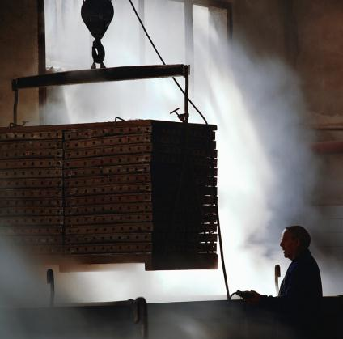
Overhead Lifting
“Process of lifting that would elevate a freely suspended load to such a position that dropping a load would present a possibility of bodily injury or property damage.”

Slide 16
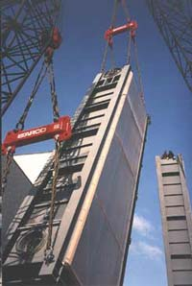
Working Load Limit (W.L.L.)
The MAXIMUM load that shall be applied in direct tension to undamaged straight length of a sling or hoisting equipment

Slide 17
The Working Load Limit [WLL] is ____ of the rigging equipment.
Less than the breaking strength
Equal to the breaking strength
Greater than the breaking strength

Slide 18
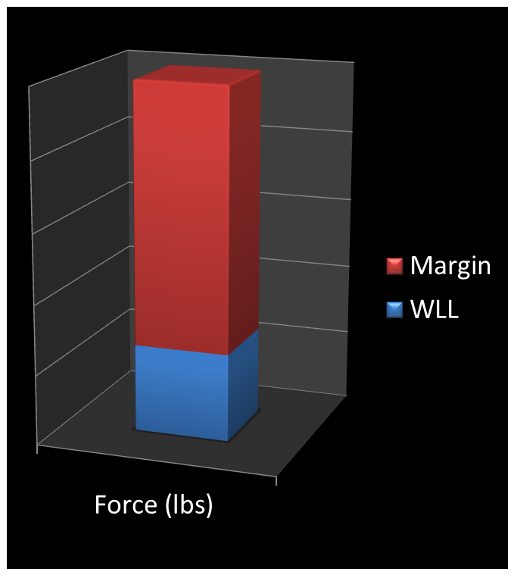
Design Factor
A ratio of the breaking strength to the working load limit
Example: If a chain sling has a breaking strength of 28,400# and a W.L.L. of 7,100#; it would have a design factor of 4:1

Slide 19
Design Factor
Component | Minimum Design Factor
Nylon rope sling | 5:1
Polyester rope sling | 5:1
Polypropylene rope sling | 5:1
Alloy steel chain sling | 4:1
Wire rope sling | 5:1
Metal mesh sling | 5:1
Synthetic web sling | 5:1
Synthetic round sling | 5:1

Slide 20

Elongation
The ability of a piece of load bearing material to permanently increase in length before it fails or breaks
Expressed as a percentage of increase over its original length

Slide 21
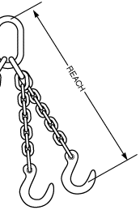
Reach
The distance measured from the top of the master link to the bowl of the load hook.

Slide 22

Sling Hitches
Vertical

Slide 23

Sling Hitches
Vertical
Choker

Slide 24
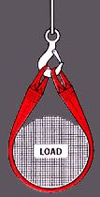
Sling Hitches
Vertical
Choker
Basket

Slide 25

Who Are These People?
Designated person
Competent person
Qualified person

Slide 26
OSHA Says…
The term "designated" personnel means selected or assigned by the employer or the employer's representative as being qualified to perform specific duties.

Slide 27
OSHA Says…
Competent Person
Qualified Person
29 CFR 1926.32(f) states: "Competent person" means one who is capable of identifying existing and predictable hazards in the surroundings or working conditions, which are unsanitary, hazardous, or dangerous to employees, and who has authorization to take prompt corrective measures to eliminate them.
29 CFR 1926.32(l) states: "Qualified" means one who, by possession of a recognized degree, certificate, or professional standing, or who by extensive knowledge, training and experience, has successfully demonstrated his ability to solve or resolve problems relating to the subject matter, the work, or the project.

Slide 28
Unattended
A condition in which the operator of a hoist is NOT at, or within 26 feet of, the operating control devices.
OSHA 1910.179(n)(3)(x).

Slide 29
“HOIST”
hoist (hoist) v. hoist·ed, hoist·ing, hoists
1. To raise or haul up with or as if with the help of a mechanical apparatus.
2. To raise to one's mouth in order to drink: hoist a few beers.

Slide 30
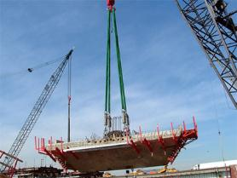
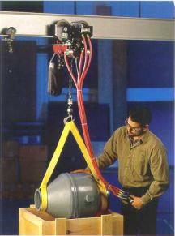
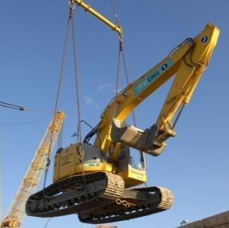
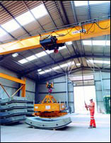
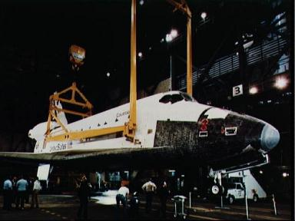
Regardless of The Load You Hoist…

Slide 31
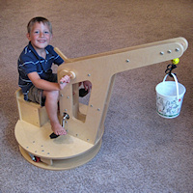
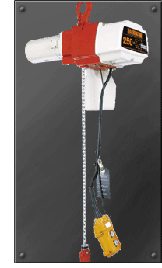
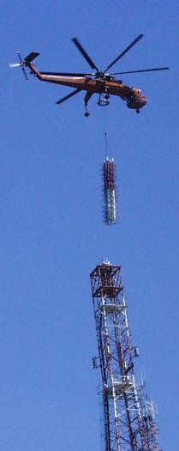
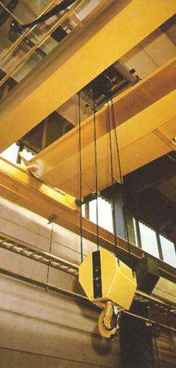
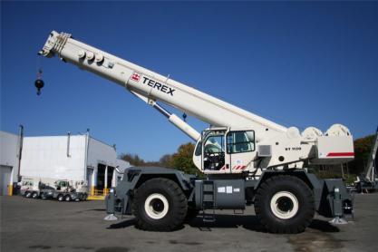
…Or What You Hoist It With…

Slide 32
…The Objective is to Hoist It Safely.
HOISTSAFE

Slide 33
HOISTSAFE
 | H
 | O
 | I
 | S
 | T
 | S
 | A
 | F
 | E

Slide 34
HOISTSAFE
How | H | heavy is the load?
 | O
 | I
 | S
 | T
 | S
 | A
 | F
 | E

Slide 35
Determining Load Weight
Actual or calculated weight of object or materials being lifted
Include weight of rigging equipment and hardware
How HEAVY is the load?

Slide 36
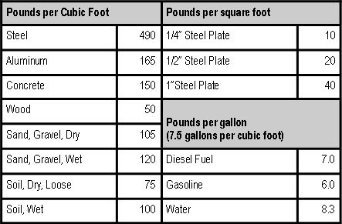
Determining Load Weight
Actual weight obtained from engineering data, shipping papers, catalogs.
Calculated weight based on common materials.
Volume of object
Weight of material
Reduced for air (voids)
How HEAVY is the load?

Slide 37
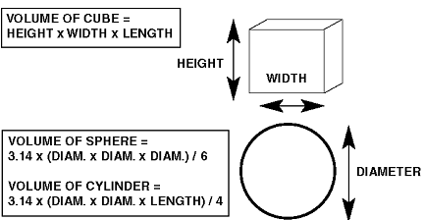
Determining Load Weight

Slide 38
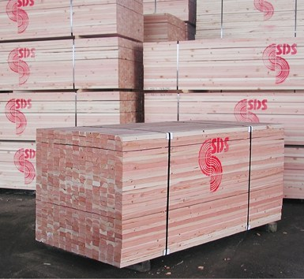
Worksheet Problem #1
800#
2,400#
4,800#
12,800#

Slide 39
Worksheet Problem #1
4’ x 4’ x 16’ = 256 cubic feet
Wood weighs 50 pounds per cubic foot
256 c.f. x 50#/c.f. = 12,800#

Slide 40
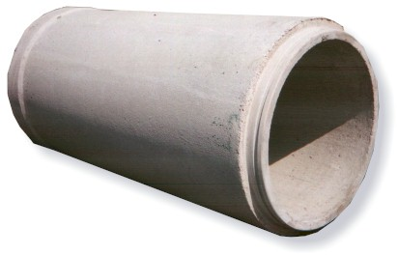
Worksheet Problem #2
1,415#
3,150#
9,900#
39,565#

Slide 41
Worksheet Problem #2
Outside Diameter
3.14 x (4 x 4 x 12) / 4
150.72 Cu. Ft.
Inside Diameter
3.14 x (3 x 3 x 12) / 4
84.78 Cu. Ft.
Total Volume
65.94 Cu. Ft.
66 cubic feet of concrete
150 pounds per cubic foot
66 x 150
TOTAL WEIGHT
9,900 pounds

Slide 42
Worksheet Problem #3
120#
140#
240#
480#

Slide 43
Worksheet Problem #3
4’ x 3’ = 12 square feet
½” steel plate = 20 lbs/sq. ft.
12 s.f. x 20 lbs/sq. ft. = 240#

Slide 44
Determining Load Weight
Known
Data plate
Engineering specifications
Shipping papers
“Tribal Knowledge”
Estimated
Volume of object
Density of materials
Adjusted for voids (air)
How HEAVY is the load?

Slide 45
HOISTSAFE
How | H | heavy is the load?
What are the | O | operating limitations of the crane and rigging?
 | I
 | S
 | T
 | S
 | A
 | F
 | E

Slide 46
CRANE OPERATING CAPACITY
HOISTSAFE
What are the OPERATING LIMITATIONS of the crane and rigging?

Slide 47
Crane Operating Capacity
Manufacturer's operating notes supplied with the machine contain important information concerning load handling capacities of cranes.
Mistakes in calculating capacity can cause accidents.
Several factors to be considered when calculating a cranes load capacity, including the following:
What are the OPERATING LIMITATIONS of the crane and rigging?

Slide 48
Crane Operating Capacity
Load Radius: the horizontal distance between the center of the crane rotation to center of the load.
Boom length: including the jib, swing away extension or any other attachments that may increase length of the boom.
Quadrant of operation: the area of operation that the lift is being made in; note different quadrants usually have lower lifting capacities.
What are the OPERATING LIMITATIONS of the crane and rigging?

Slide 49
Crane Operating Capacity
Boom angle: the angle formed between the horizontal plane of rotation and center line of the boom.
Weight of any attachments: jib, lattice extension or auxiliary boom point.
Weight of handling devices: ball, block, and/or any necessary rigging.
What are the OPERATING LIMITATIONS of the crane and rigging?

Slide 50
LOAD RADIUS (FT) | BOOM LENGTH 35’ |  |  | BOOM LENGTH 50’ |  |  | BOOM LENGTH 65’ |  |  | LOAD RADIUS (FT)
 | BOOM ANGLE | OVER FRONT (LBS) | 360° (LBS) | BOOM ANGLE | OVER FRONT (LBS) | 360° (LBS) | BOOM ANGLE | OVER FRONT (LBS) | 360° (LBS)
10 | 66.7 | 110,000 | 110,000 | 73.9 | 60,100 | 60,100 |  |  |  | 10
12 | 63.1 | 96,700 | 93,700 | 71.5 | 60,100 | 60,100 |  |  |  | 12
15 | 57.5 | 75,200 | 73,100 | 69.7 | 60,100 | 60,100 | 73.2 | 58,800 | 58,800 | 15
20 | 47.1 | 53,600 | 52,300 | 61.5 | 54,900 | 53,600 | 68.5 | 52,200 | 52,200 | 20
25 | 34.5 | 40,700 | 39,700 | 54.8 | 42,000 | 41,100 | 63.7 | 42,700 | 41,700 | 25
30 | 14.8 | 31,900 | 31,200 | 47.4 | 33,400 | 32,700 | 58.6 | 34,100 | 33,400 | 30
35 |  |  |  | 39.0 | 27,300 | 26,700 | 53.3 | 28,000 | 27,400 | 35
40 |  |  |  | 28.8 | 22,000 | 21,000 | 47.6 | 22,700 | 21,700 | 40
45 |  |  |  | 12.4 | 17,400 | 16,500 | 41.3 | 18,300 | 17,400 | 45
50 |  |  |  |  |  |  | 34.1 | 14,900 | 14,200 | 50
55 |  |  |  |  |  |  | 25.2 | 12,300 | 11,700 | 55
60 |  |  |  |  |  |  | 10.9 | 10,100 | 9,600 | 60

Slide 51
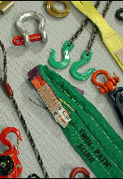
Sling Capacity
HOISTSAFE
What are the OPERATING LIMITATIONS of the crane and rigging?

Slide 52
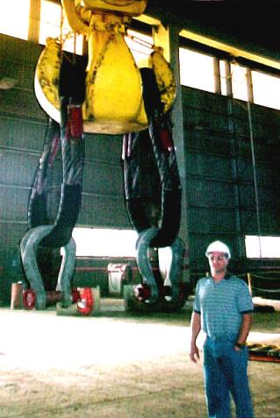
Sling Capacity
Load bearing material
Alloy chain
Wire rope
Synthetic
Metal mesh
Upper and Lower End Attachments
What are the OPERATING LIMITATIONS of the crane and rigging?

Slide 53
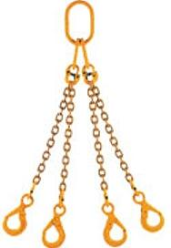
Alloy Chain slings
HOISTSAFE
What are the OPERATING LIMITATIONS of the crane and rigging?

Slide 54
Alloy Chain Slings
Advantages
Disadvantages
Flexible
Impact resistant
Easy to inspect
Can be used at relatively high temperatures
Completely repairable
Minimum elongation
Corrosion resistant
Durable
Heavy
Moderate initial cost
What are the OPERATING LIMITATIONS of the crane and rigging?

Slide 55
NACM WELDED STEEL CHAIN SPECIFICATIONS
Grade 30 Proof Coil Chain
General purpose, carbon steel chain. Used in a wide range of applications.
Not to be used in overhead lifting.
What are the OPERATING LIMITATIONS of the crane and rigging?

Slide 56
NACM WELDED STEEL CHAIN SPECIFICATIONS
Grade 43 High Test Chain
A carbon steel chain widely used in industry, construction, agricultural and lumbering operations.
Not to be used in overhead lifting.
What are the OPERATING LIMITATIONS of the crane and rigging?

Slide 57
NACM WELDED STEEL CHAIN SPECIFICATIONS
Grade 70 Transport Chain
A high quality, high strength carbon steel chain used for load securing.
Not to be used in overhead lifting.
What are the OPERATING LIMITATIONS of the crane and rigging?

Slide 58
NACM WELDED STEEL CHAIN SPECIFICATIONS
Grade 80 Alloy Chain
Premium quality, high strength alloy chain, heat treated, used in a variety of sling and tie down applications.
For overhead lifting applications, only Alloy Chain should be used.
What are the OPERATING LIMITATIONS of the crane and rigging?

Slide 59
NACM WELDED STEEL CHAIN SPECIFICATIONS
Grade 100 Alloy Chain
Premium quality, highest strength alloy chain, heat treated, used in a variety of sling and tie down applications.
For overhead lifting applications, only Alloy Chain should be used.
What are the OPERATING LIMITATIONS of the crane and rigging?

Slide 60
Elongation
Elongation shall not be less than:
20% for Grades 80 and 100;
15% for Grades 30, 43, 70, and Stainless;
10% for Machine, Coil, and Passing Link chain.
What are the OPERATING LIMITATIONS of the crane and rigging?

Slide 61
Working Load Limit
 | Working Load Limit (lbs)
Size | Proof Coil Grade 30 | High Test Grade 43 | Transport Grade 70 | Alloy Grade 80 | Alloy Grade 100 | Alloy Grade 120
1/4 | 1,300 | 2,600 | 3,150
9/32 |  |  |  | 3,500 | 4,300 | 5,200
5/16 | 1,900 | 3,900 | 4,700 | 4,500 | 5,700
3/8 | 2,650 | 5,400 | 6,600 | 7,100 | 8,800 | 10,600
1/2 | 4,500 | 9,200 | 11,300 | 12,000 | 15,000 | 17,900
5/8 | 6,900 | 13,000 | 15,800 | 18,100 | 22,600
3/4 |  |  |  | 28,300
7/8 |  |  |  | 34,200
1 |  |  |  | 47,700
1-1/4 |  |  |  | 72,300

Slide 62

Ambient Conditions
High temperatures can significantly reduce the W.L.L. of slings.
Extreme temperatures can cause permanent damage.
Foundries
Arc welding
What are the OPERATING LIMITATIONS of the crane and rigging?

Slide 63
Reduction of Working Load Limit
Chains should not be used outside of the -40°F to 400°F (-40 °C to 204 °C) temperature range without consulting the chain manufacturer.
The specific working load limit reductions for Grade 80 and Grade 100 chains used at and after exposure to elevated temperatures have been established and are shown in Table XII.
What are the OPERATING LIMITATIONS of the crane and rigging?

Slide 64
Reduction Of Working Load Limit
Temperature |  | Grade Of Chain
°F | °C | Grade 80 |  | Grade 100
 |  | While At Temperature | After Exposure | While At Temperature | After Exposure
<400 | <204 | None | None | None | None
400 | 204 | 10% | None | 15% | None
500 | 260 | 15% | None | 25% | 5%
600 | 316 | 20% | 5% | 30% | 15%
700 | 371 | 30% | 10% | 40% | 20%
800 | 427 | 40% | 15% | 50% | 25%
900 | 482 | 50% | 20% | 60% | 30%
1,000 | 538 | 60% | 25% | 70% | 35%
>1,000 | >538 | OSHA 1910.184 requires all slings exposed to temperatures over 1000° F to be removed from service

Slide 65
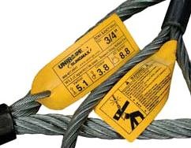
Wire Rope SLINGS
HOISTSAFE
What are the OPERATING LIMITATIONS of the crane and rigging?

Slide 66
Wire Rope Slings
Advantages
Disadvantages
Low initial cost
Lighter weight than alloy chain
Low strength to weight ratio
Difficult to inspect
Easily kinked
Internal corrosion
Not repairable
What are the OPERATING LIMITATIONS of the crane and rigging?

Slide 67
Wire Rope Slings
Mechanical Splice Slings – Single Part Body – IPS – 6 x 19 IWRC RATED CAPACITY (lbs.)
 |  |  | Basket Hitch – Sling Angle
Size (in.) | Vertical | Choker | 90° | 60° | 45°
1 / 4 | 1,120 | 820 | 2,200 | 1,940 | 1,580
3 / 8 | 2,400 | 1,840 | 4,800 | 4,200 | 3,400
1 / 2 | 4,400 | 3,200 | 8,800 | 7,600 | 6,200
5 / 8 | 6,800 | 5,000 | 13,600 | 11,800 | 9,600
3 / 4 | 9,800 | 7,200 | 19,600 | 17,000 | 13,800
7 / 8 | 13,200 | 9,600 | 26,000 | 22,000 | 18,600
1 | 17,000 | 12,600 | 34,000 | 30,000 | 24,000
1 – 1 / 8 | 20,000 | 15,800 | 40,000 | 34,000 | 28,000
 |  |  | D/d ratio is 20 or greater

Slide 68
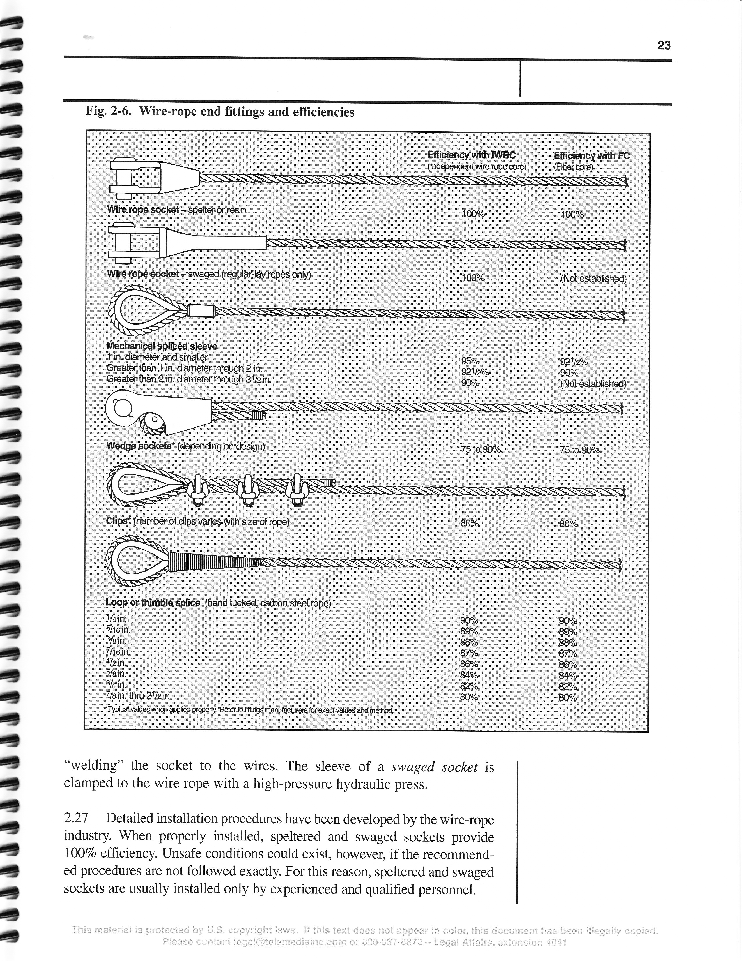
Wire Rope Slings
What are the OPERATING LIMITATIONS of the crane and rigging?

Slide 69
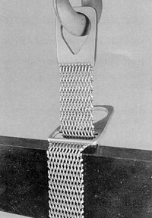
Metal Mesh SLINGS
HOISTSAFE
What are the OPERATING LIMITATIONS of the crane and rigging?

Slide 70
Metal Mesh Slings
Advantages
Disadvantages
Flexibility
Wide bearing surface
Resists abrasion and cutting
Resists corrosion
Subject to crushing
Any broken wire is cause for removal from service
What are the OPERATING LIMITATIONS of the crane and rigging?

Slide 71

Synthetic SLINGS
HOISTSAFE
What are the OPERATING LIMITATIONS of the crane and rigging?

Slide 72
Synthetic Slings
Advantages
Disadvantages
Light weight
Easy to rig
Low initial cost
Reduced load damage
Low heat resistance
194° F.
Subject to cuts and abrasion
Subject to chemicals and UV
Cannot be repaired
What are the OPERATING LIMITATIONS of the crane and rigging?

Slide 73
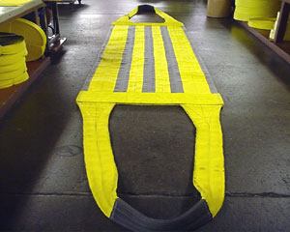
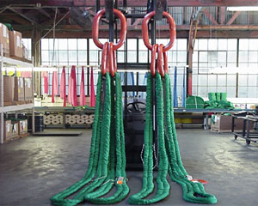
Synthetic Clings
Flat / Tubular Slings
Round Slings
What are the OPERATING LIMITATIONS of the crane and rigging?

Slide 74
Polyester Round Slings
Width (In.) | Color | Rated Capacity (Lbs.)
 |  | Vertical | Choker | Basket
2 | Purple | 3,000 | 2,400 | 6,000
 | Black | 4,500 | 3,600 | 9,000
 | Green | 6,000 | 4,800 | 12,000
 | Yellow | 9,000 | 7,200 | 18,000
3 | Gray | 12,000 | 9,600 | 24,000
 | Red | 14,000 | 11,200 | 28,000
 | Brown | 17,000 | 13,600 | 34,000
 | Blue | 22,000 | 17,600 | 44,000
4 | Orange | 26,000 | 20,800 | 52,000
 |  | 32,000 | 25,600 | 64,000
5 |  | 50,000 | 40,000 | 100,000
 |  | 60,000 | 48,000 | 120,000

Slide 75


Number of Attachment Points
Double leg slings share the load equally*
Triple leg slings have 50% more capacity than double leg slings.
Quad leg slings rely on the fourth leg for stability only, not additional lift capacity.
What are the OPERATING LIMITATIONS of the crane and rigging?

Slide 76
Operating Limitations
Crane Capacity Charts
Mobile Crane
Boom angle
Boom extension
Overhead Crane
Static versus Dynamic loads
Slings and Hardware
Vertical capacity
Basket capacity
Choker capacity
Bridle capacity
What are the OPERATING LIMITATIONS of the crane and rigging?

Slide 77
HOISTSAFE
How | H | heavy is the load?
What are the | O | operating limitations of the crane and rigging?
When was the last | I | inspection performed?
 | S
 | T
 | S
 | A
 | F
 | E

Slide 78

Sling Inspection
HOISTSAFE
When was the last INSPECTION performed?

Slide 79
Every sling inspection must be documented.
True
False

Slide 80
OSHA 1910.184 ASME B30.9
Reasons
Ensure safe equipment
Gain knowledge and experience:
Nature of lifts being made
Sling usage
Operator competence
Inspections
Daily / Periodic before use (NO records)
Minimum annual with records
Frequently, as warranted
Record Keeping
Most recent report
Test certificates
When was the last INSPECTION performed?

Slide 81
Periodic inspection of slings should be performed by a competent person.
True
False

Slide 82
Daily / Period Inspection
A thorough periodic inspection of slings shall be performed by a competent person designated by the employer and shall include a thorough inspection for:
Wear
Deformation
Elongation
Sharp traverse nicks and gouges in chain
Cuts
Corrosion
Heat damage
Hardware
Latches for proper seating, operation and distortion
Hooks for wear and distortion
When was the last INSPECTION performed?

Slide 83
HOISTSAFE
How | H | heavy is the load?
What are the | O | operating limitations of the crane and rigging?
When was the last | I | inspection performed?
How will | S | sling angles affect lifting capacity?
 | T
 | S
 | A
 | F
 | E

Slide 84
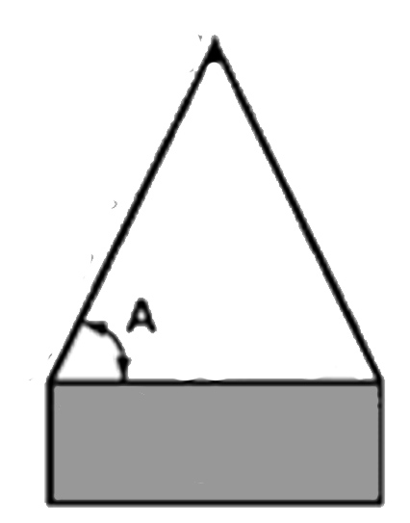
Sling Angle

Slide 85

A 24-can case of beer weighs…
10 pounds
15 pounds
20 pounds
25 pounds

Slide 86

Beer Facts
One can of beer weighs 13.1 ounces
13.1 oz. x 24 cans = 314.4 oz.
The cardboard box weighs 7 ounces
314.4 + 7 = 321.4 oz.
321.4 oz. ÷ 16 oz. per pound
20 pounds

Slide 87
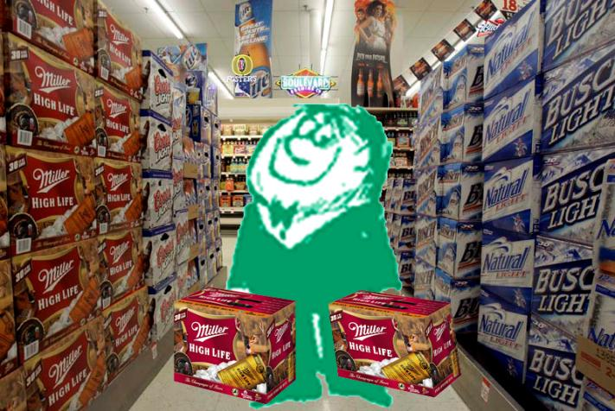
How much does it weigh?
How will SLING ANGLES affect lifting capacity?

Slide 88
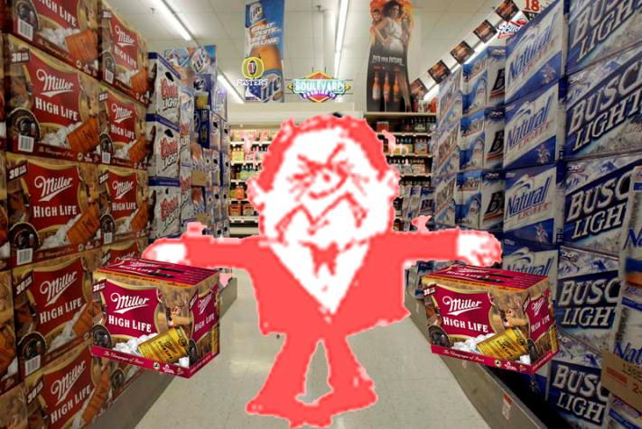
How heavy does it feel?
How will SLING ANGLES affect lifting capacity?

Slide 89
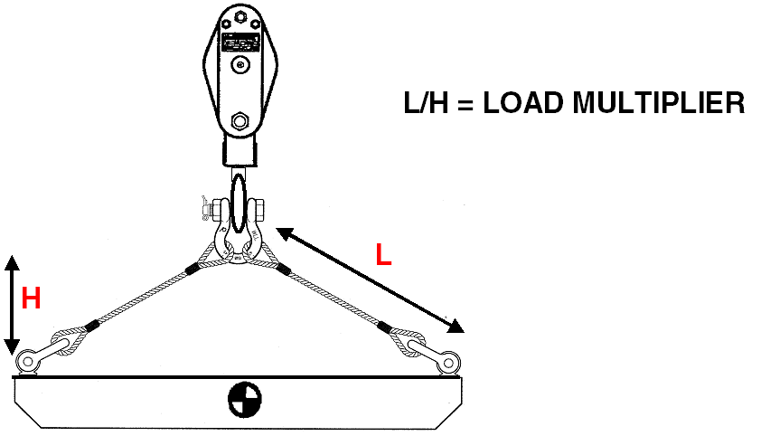
Sling Angle Factor
SLING ANGLE CHART
Angle from Horizontal [A] | S.A.F. [L ÷ H]
90° | 1.000
60° | 1.155
45° | 1.415
30° | 2.000
A

Slide 90
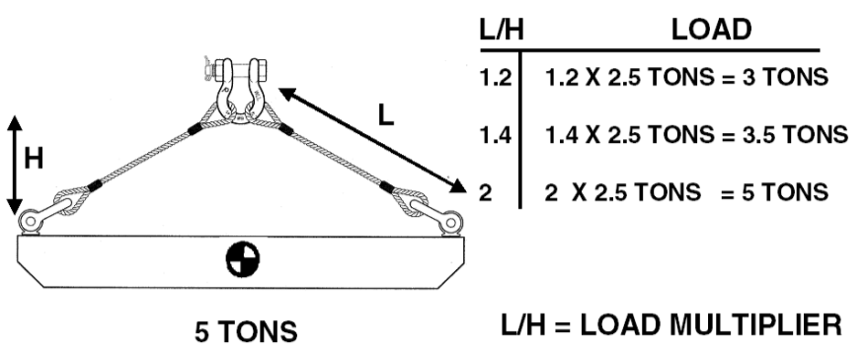
Sling Angle Factor

Slide 91
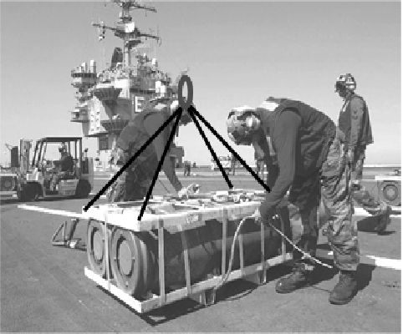
Worksheet Problem #4
1,700#
2,268#
2,266#
567#

Slide 92

Worksheet Problem #4
How many legs will actually carry the load?
Three

Slide 93
Worksheet Problem #4
What is the share of the load?
1,133.3333333333#

Slide 94
Worksheet Problem #4
What is the load factor?
3’ ÷ 1.5’ = 2.0

Slide 95
Worksheet Problem #4
What is the tension in each sling leg?
2.0 x 1,133# = 2,266#
2.0 x 1,134# = 2,268#

Slide 96
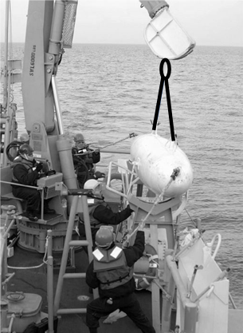
Worksheet Problem #5
1,746#
5,856#
5,888#
6,400#

Slide 97
Worksheet Problem #5
What is the share of the load?
6,400# ÷ 2 = 3,200#

Slide 98

Worksheet Problem #5
What is the load factor?
5.5 ÷ 3 = 1.83333333333333
1.83
1.84
2.00

Slide 99
Worksheet Problem #5
What is the tension in each sling leg?
3,200# x 1.833333333 = 5,866.6666666667#
5,856#
5,888#
6,400#

Slide 100
Worksheet Problem #5
What other factors might affect sling capacity?
Wet environment for synthetic slings
Dynamic loading as object enters and leaves water

Slide 101
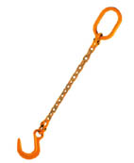
Grade 80 Alloy Chain Slings
Single
Chain Trade Size | Chain Size | Working Load Limit (lbs)
9/32” | .279 | 3,500
3/8” | .404 | 7,100
½” | .529 | 12,000
5/8” | .625 | 18,100
¾” | .801 | 28,300
7/8” | .881 | 34,200
1” | 1.000 | 47,700
1-1/4” | 1.250 | 72,300
How will SLING ANGLES affect lifting capacity?

Slide 102
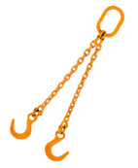
Grade 80 Alloy Chain Slings
Double |  | 90° | 60° | 45° | 30°
Chain Trade Size | Chain Size | Working Load Limit (lbs)
9/32” | .279 | 7,000 | 6,100 | 4,900 | 3,500
3/8” | .404 | 14,200 | 12,300 | 10,000 | 7,100
½” | .529 | 24,000 | 20,800 | 17,000 | 12,000
5/8” | .625 | 36,200 | 31,300 | 25,600 | 18,100
¾” | .801 | 56,600 | 49,000 | 40,000 | 28,300
7/8” | .881 | 68,400 | 59,200 | 48,400 | 34,200
1” | 1.000 | 95,400 | 82,600 | 67,400 | 47,700
1-1/4” | 1.250 | 144,600 | 125,200 | 102,200 | 72,300
How will SLING ANGLES affect lifting capacity?

Slide 103
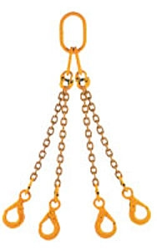
Grade 80 Alloy Chain Slings
T & Q |  | 90° | 60° | 45° | 30°
Chain Trade Size | Chain Size | Working Load Limit (lbs)
9/32” | .279 | 10,500 | 9,100 | 7,400 | 5,200
3/8” | .404 | 21,300 | 18,400 | 15,100 | 10,600
½” | .529 | 36,000 | 31,200 | 25,500 | 18,000
5/8” | .625 | 54,300 | 47,000 | 38,400 | 27,100
¾” | .801 | 84,900 | 73,500 | 60,000 | 42,200
7/8” | .881 | 102,600 | 88,900 | 72,500 | 51,300
1” | 1.000 | 143,100 | 123,900 | 101,200 | 71,500
1-1/4” | 1.250 | 216,900 | 187,800 | 153,400 | 108,400
How will SLING ANGLES affect lifting capacity?

Slide 104
Wire Rope Slings
Mechanical Splice Slings – Single Part Body – IPS – 6 x 19 IWRC RATED CAPACITY (lbs.)
 |  |  | Basket Hitch – Sling Angle
Size (in.) | Vertical | Choker | 90° | 60° | 45°
1 / 4 | 1,120 | 820 | 2,200 | 1,940 | 1,580
3 / 8 | 2,400 | 1,840 | 4,800 | 4,200 | 3,400
1 / 2 | 4,400 | 3,200 | 8,800 | 7,600 | 6,200
5 / 8 | 6,800 | 5,000 | 13,600 | 11,800 | 9,600
3 / 4 | 9,800 | 7,200 | 19,600 | 17,000 | 13,800
7 / 8 | 13,200 | 9,600 | 26,000 | 22,000 | 18,600
1 | 17,000 | 12,600 | 34,000 | 30,000 | 24,000
1 – 1 / 8 | 20,000 | 15,800 | 40,000 | 34,000 | 28,000
 |  |  | D/d ratio is 20 or greater
How will SLING ANGLES affect lifting capacity?

Slide 105
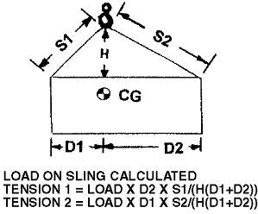
Sling Angle – Unequal Legs

Slide 106
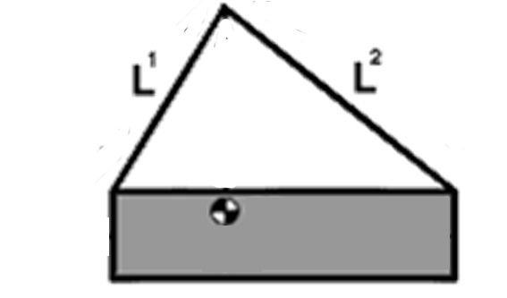
Sling Angle – Unequal Legs
S1 = 5’
S2 = 8’
H = 4’
D1 = 3’ D2 = 7’
L = 1,000#
How will SLING ANGLES affect lifting capacity?

Slide 107
Sling 1
Tension = Load x D2 x S1/(H(D1 + D2))
Tension = 1,000 x 7 x 5/(4(3+7))
Tension = 1,000 x 7 x 5/40
Tension = 1,000 x 7 x 0.125
Tension = 875#

Slide 108
Sling 2
Tension = Load x D1 x S2/(H(D1 + D2))
Tension = 1,000 x 3 x 8/(4(3+7))
Tension = 1,000 x 3 x 8/40
Tension = 1,000 x 3 x 0.2
Tension = 600#

Slide 109
Sling Angle – Unequal Legs
S1 = 875#
S2 = 600#
L = 1,000#
How will SLING ANGLES affect lifting capacity?

Slide 110
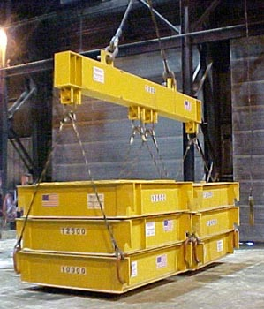
Sling Angle – Spreader Beam
Distributes load evenly without excessive sling angles
Requires greater headroom clearance
How will SLING ANGLES affect lifting capacity?

Slide 111
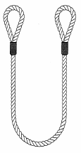
Vertical Basket Hitch
Two times the single leg capacity
Legs must be vertical to within 5 degrees
D/d must be greater than 20/1
d
D
How will SLING ANGLES affect lifting capacity?

Slide 112

Double Wrap Basket Hitch
Excellent load control for loose materials and good grip on smooth surfaces.
Twice the single leg capacity.
Sling wrap must be lay side by side
Do not overlap at bottom of load
Adjust sling as slack is taken up
How will SLING ANGLES affect lifting capacity?

Slide 113

Choker Hitch
75-80% OF SINGLE LEG CAPACITY
ANGLE OF CHOKE MUST BE GREATER THAN 120 DEGREES
How will SLING ANGLES affect lifting capacity?

Slide 114

Double Wrap Choker Hitches
EXCELLENT LOAD CONTROL FOR LOOSE MATERIALS AND GRIP ON SMOOTH SURFACES
75-80% OF SINGLE LEG CAPACITY
ANGLE OF CHOKE MUST BE GREATER THAN 120 DEGREES
SLING WRAP MUST LAY SIDE BY SIDE
DO NOT OVERLAP AT BOTTOM OF LOAD
How will SLING ANGLES affect lifting capacity?

Slide 115
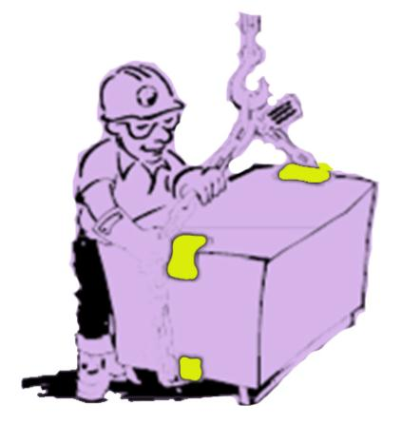
Sling Angles – Edge Protection
When edges are sharp or abrasive
Sling damage may occur
When sling angle become shallow.
Lateral loading may crush object being lifted.
How will SLING ANGLES affect lifting capacity?

Slide 116
Sling Angles
Sling tension
Loads tend to hang vertically
Forcing load points away from vertical requires force
Reaction to the force increases sling tension
Crush Force
The result of forcing load points away from vertical
Cribbing
Protects the sling from being damaged
Protects the load from being crushed
How will SLING ANGLES affect lifting capacity?

Slide 117
HOISTSAFE
How | H | heavy is the load?
What are the | O | operating limitations of the crane and rigging?
When was the last | I | inspection performed?
How will | S | sling angles affect lifting capacity?
Have you performed a | T | test lift to check stability?
 | S
 | A
 | F
 | E

Slide 118

Load Stability
HOISTSAFE
Have you performed a TEST LIFT to verify stability?

Slide 119
Load Stability
Capture the Center-of-Gravity
When suspended an object will always center itself under the lift point
Center the lift above the center of gravity, not the physical center of the object
Calculating the C.G.
Have you performed a TEST LIFT to verify stability?

Slide 120
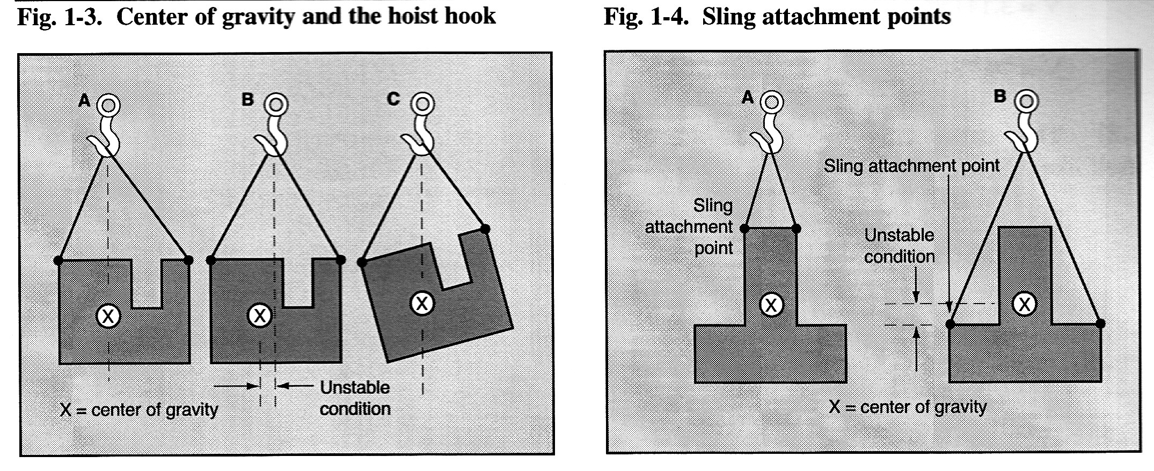
Center of Gravity
Have you performed a TEST LIFT to verify stability?

Slide 121
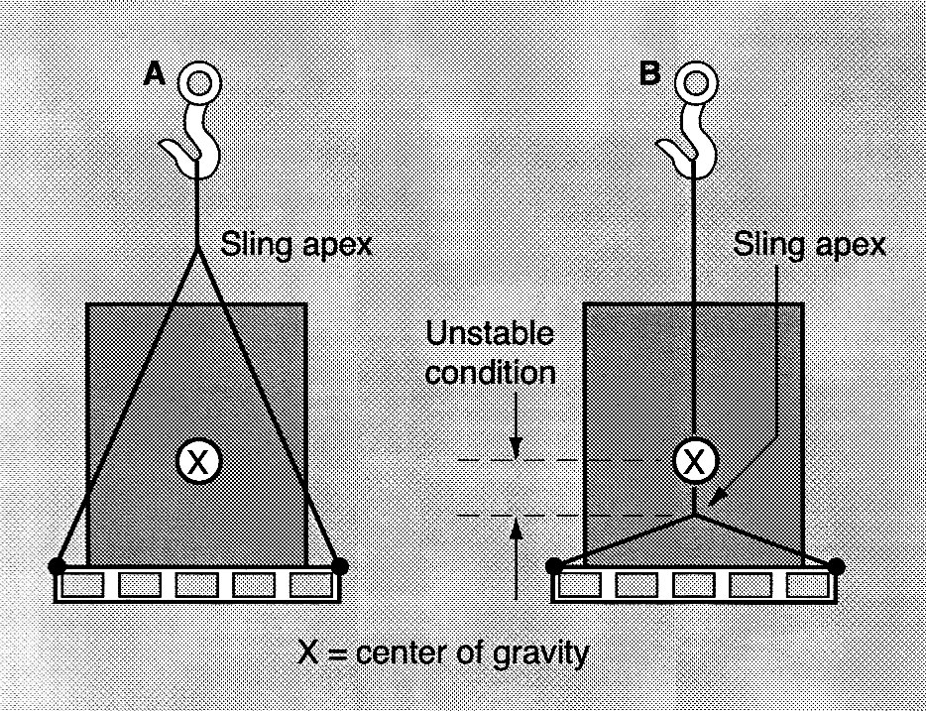
Center of Gravity
Have you performed a TEST LIFT to verify stability?

Slide 122
HOISTSAFE
How | H | heavy is the load?
What are the | O | operating limitations of the crane and rigging?
When was the last | I | inspection performed?
How will | S | sling angles affect lifting capacity?
Have you performed a | T | test lift to check stability?
Move the load with | S | smooth and steady actions
 | A
 | F
 | E

Slide 123

Safe Hoist and crane Operations
HOISTSAFE
Move the load with SMOOTH AND STEADY actions.

Slide 124
Safe Hoist and Crane Operations
General
Make certain that multiple-part lines are not twisted around each other.
Be sure that hoist rope or chain is properly seated in sheaves or pocketwheels.
Make certain that the load will not contact any obstructions.
Avoid swinging the load or load hook while traveling.
Avoid sudden acceleration and deceleration of the load.
Move the load with SMOOTH AND STEADY actions.

Slide 125
Safe Hoist and Crane Operations
General
Avoid severe contact between the trolley and trolley stops on the tracks, and between a crane and crane stops on railways.
When winds become dangerous high during an outdoor job, discontinue use of the equipment and anchor it as recommended.
Move the load with SMOOTH AND STEADY actions.

Slide 126
Safe Hoist and Crane Operations
General
If power is interrupted during operation of a crane or hoist, place all controls in the “OFF” position.
If more than one hoist or crane must be used to lift or move a load, ONE person should be assigned responsibility for the operation.
Move the load with SMOOTH AND STEADY actions.

Slide 127
Safe Hoist and Crane Operations
Special Heavy Lifts
Lifts in excess of the rated capacity
Each heavy lift must be analyzed and authorized by a qualified person
ONLY applies to the specific lift
Does NOT authorize any heavy lifts in everyday operations
Move the load with SMOOTH AND STEADY actions.

Slide 128
Safe Hoist and Crane Operations
Pulling a Load
Use of hoists and cranes for pulling a load is NOT recommended.
If necessary use a pulley (snatch) block to re-direct force to the load.
Avoid ‘side pull’ on the hoist.
Use second hoist anchored to a structural member to achieve load pulls
Consult supervisor before any load pulling operations
Move the load with SMOOTH AND STEADY actions.

Slide 129
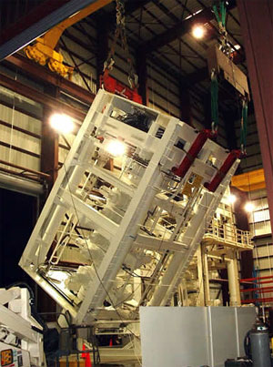
Safe Hoist and Crane Operations
Turning a Load
Visualize the load and its center of gravity
Visualize sling positions while turning
Determine if blocks or supports will be required
Determine how load will be controlled
Tagline
Two-hook turn
Move the load with SMOOTH AND STEADY actions.

Slide 130
Safe Hoist and Crane Operations
Smooth, steady application of lifting force
Allows hoist and rigging to adjust to change
Minimizes spin
Reduces wear on wire and synthetic rope
NO shock loading
Especially with wire rope slings
Move the load with SMOOTH AND STEADY actions.

Slide 131

Standard hand signals
HOISTSAFE
Move the load with SMOOTH AND STEADY actions.

Slide 132
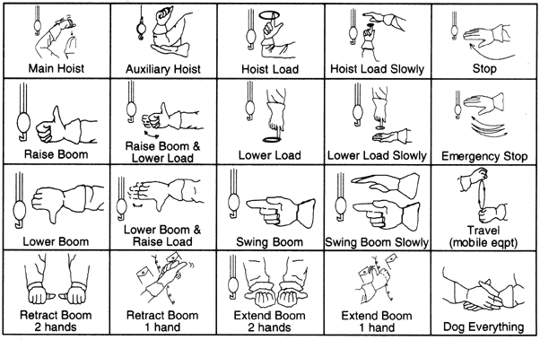
Standard Hand Signals
Move the load with SMOOTH AND STEADY actions.

Slide 133
HOISTSAFE
How | H | heavy is the load?
What are the | O | operating limitations of the crane and rigging?
When was the last | I | inspection performed?
How will | S | sling angles affect lifting capacity?
Have you performed a | T | test lift to check stability?
Move the load with | S | smooth and steady actions
Is the | A | area clear of personnel and obstructions?
 | F
 | E

Slide 134
Area Clear
Personnel
Barriers and warning signs
May distract crane operator
Security personnel
Vehicles and equipment
Block visibility
Is the AREA CLEAR of personnel and obstructions?

Slide 135
HOISTSAFE
How | H | heavy is the load?
What are the | O | operating limitations of the crane and rigging?
When was the last | I | inspection performed?
How will | S | sling angles affect lifting capacity?
Have you performed a | T | test lift to check stability?
Move the load with | S | smooth and steady actions
Is the | A | area clear of personnel and obstructions?
Can the load be | F | Flown and landed safely?
 | E

Slide 136

Flying the Load
Is there a clear, unobstructed path from lift point to landing?
Do NOT fly the load over people.
Maintain clearance from objects such as buildings, vehicles and utilities.
Can the load be FLOWN AND LANDED safely?

Slide 137
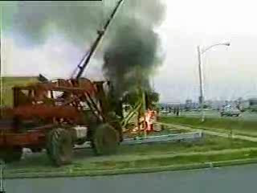
Flying the Load
Can the load be FLOWN AND LANDED safely?

Slide 138
Flying the Load
Utility lines
Clearly identified
Shielding
Maintain minimum clearances
Voltage | Distance from Power Lines
≤ 50kV | 10 feet
200 kV | 15 feet
350 kV | 20 feet
500 kV | 25 feet
650 kV | 30 feet
800 kV | 35 feet
Construction Safety Council
Can the load be FLOWN AND LANDED safely?

Slide 139
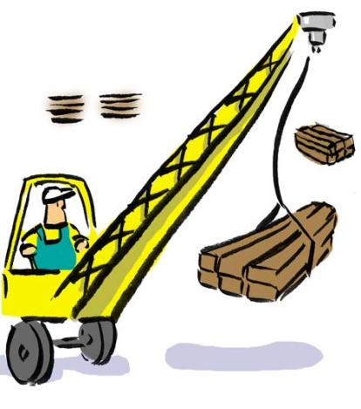
Flying the Load
Swing and Travel
Use smooth, steady motions to fly the load.
Keep the load under control.
Avoid dynamic loading or load shifting.
Can the load be FLOWN AND LANDED safely?

Slide 140
Landing the Load
Plan where the load will be landed before lifting.
Consider the weight, type, and shape of load.
Land the load on a firm, flat surface.
Can the load be FLOWN AND LANDED safely?

Slide 141
Landing the Load
Land load on blocks / cribbing to allow removal of slings.
NEVER land a load directly on the slings.
Chock cylindrical loads to prevent rolling.
Slowly relieve tension on hoist and rigging.
Can the load be FLOWN AND LANDED safely?

Slide 142
HOISTSAFE
How | H | heavy is the load?
What are the | O | operating limitations of the crane and rigging?
When was the last | I | inspection performed?
How will | S | sling angles affect lifting capacity?
Have you performed a | T | test lift to check stability?
Move the load with | S | smooth and steady actions
Is the | A | area clear of personnel and obstructions?
Can the load be | F | flown and landed safely?
How will the | E | environment affect the safety of the lift?

Slide 143
Environmental Considerations
Weather
Terrain
Chemical Conditions and Exposure
How will the ENVIRONMENT affect the safety of the lift?

Slide 144
Tag lines are only required when winds exceed 20 mph
True
False

Slide 145
Weather
Wind
Tag lines shall be used unless their use creates an unsafe condition [OSHA 1926.550(g)(6)(iii)]
How will the ENVIRONMENT affect the safety of the lift?

Slide 146
Rigging is affected at temperatures…
Below -40° F
Below 32° F
Above 190° F
Above 400° F

Slide 147
Weather
Wind
Temperature
Chain and wire rope affected below -40° F
Synthetic affected above 190° F
Wire rope affected above 300° F
Chain affected above 400° F
How will the ENVIRONMENT affect the safety of the lift?

Slide 148
Weather
Wind
Temperature
Precipitation
How will the ENVIRONMENT affect the safety of the lift?

Slide 149
Weather
Wind
Temperature
Precipitation
Visibility
How will the ENVIRONMENT affect the safety of the lift?

Slide 150

Terrain
Level
Dry
Stable
Wet / Mud
Frozen
How will the ENVIRONMENT affect the safety of the lift?

Slide 151

Chemical Conditions and Exposure
Corrosives
Attack all metal components
Attack certain types of synthetic components
How will the ENVIRONMENT affect the safety of the lift?

Slide 152
Corrosives
NYLON
POLYESTER
Nylon has excellent resistance to most substances.
Nylon has excellent resistance to hydrocarbons (such as gasoline, kerosene and diesel fuel), oils, cleaning solutions and alkalis.
It is however attacked by oxidizing agents, organic acids, mineral acids and aromatic alcohols.
Polyester has excellent resistance to most substances.
It is resistant to acids, oxidizers such as hydrogen peroxide and most solvents.
Polyester has excellent resistance to hydrocarbon fuels, oils and lubricants.
It is however attacked by strong alkalis
How will the ENVIRONMENT affect the safety of the lift?

Slide 153
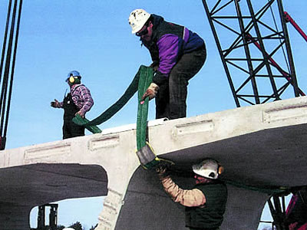
Safe Rigging Practices
Rigging Fundamentals

Slide 154
The Thought Process of Rigging
What is to be done with the load?
What tools are needed to perform the assigned task?
Is the capacity of the tools adequate to handle the loads and forces involved in lifting and moving?
How can the hookup be made?
What will happen when the load is lifted?

Slide 155
Safe Rigging Practices
Whenever possible, avoid sharp, inefficient sling angles by using longer slings or a spreader beam.
Do not pull slings from under a load when the load is resting on the sling.
Do not drag slings over sharp objects or abrasive surfaces.
Do not leave slings lying where heavy loads may be set down on top of them, or where vehicles may drive over them.

Slide 156
Safe Rigging Practices
Slings should be stored in an assigned area.
The storage should be such that the slings will not be subject to kinking or other mechanical damage, corrosive atmosphere, or excessive temperature.
Damaged slings should always be repaired before they are placed in the assigned storage area.
Do NOT make temporary repairs of slings with miscellaneous or makeshift parts.
Fiber-rope slings should not be made from ropes less than ½ inch in diameter.

Slide 157
Safe Rigging Practices
Do not use metal-mesh slings in which the spirals are locked or do not move freely.
Do NOT hammer a metal-mesh sling to straighten a spiral or cross rod, or to force a spiral into position.
If metal-mesh slings are used in pairs, they should be attached to a spreader beam.

Slide 158
Who is responsible for safe rigging?
OSHA
ANSI
Competent person
Everyone associated with the movement of the load

Slide 159
Make Every Day a Safe Workday!

