Slide 1
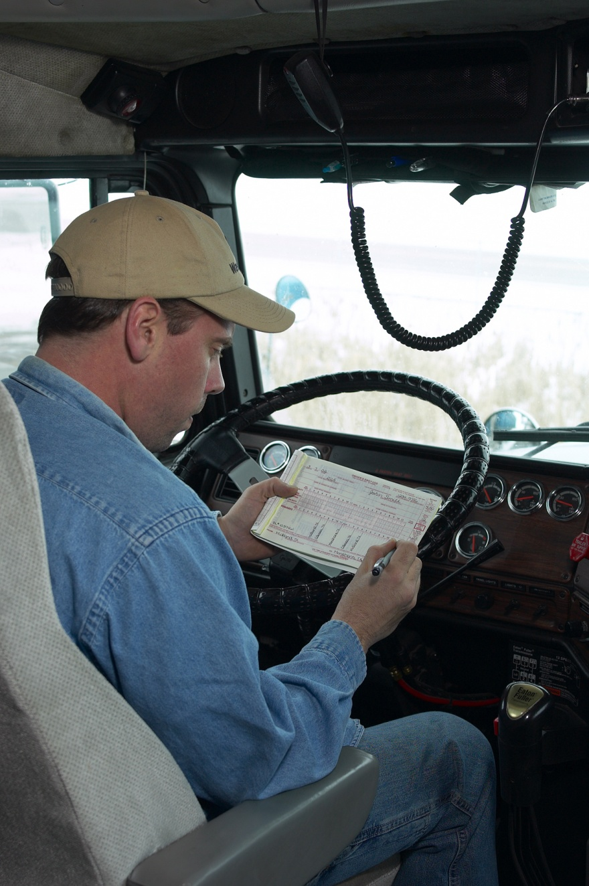

NEW
HOURS-OF-SERVICE
REGULATIONS
Effective October 1, 2005

Slide 2
IMPACT ON INDUSTRY
This regulation –
Provides an increased opportunity for drivers to obtain necessary rest and restorative sleep.
Provides flexibility to move products while operating safely.
Notes:
We are aware that our regulations have a major impact on the national economy through industry operations.
We developed this rule to enhance safety, but we try to never lose sight of the operational realities of our complex national transportation system.
This hours-of-service rule provides an increased opportunity for drivers to obtain necessary rest and restorative sleep, while also recognizing life’s realities by providing the flexibility to move products while operating safely.
We know that these rules are important not only to the "trucking industry," but to all industries that use trucks as critical components of their business operations, as well as the general public.

Slide 3
HOURS-OF-SERVICE RULES
2003 Rule Property Carrying CMV Drivers Compliance Through 09/3005 | 2005 Rule Property Carrying CMV Drivers Compliance On & After 10/01/05
May drive a maximum of 11 hours after 10 consecutive hours off duty. | No Change
May not drive beyond the 14th hour after coming off duty, following 10 consecutive hours of duty. | No Change
May not drive after 60/70 hours of duty in 7/8 consecutive days. A driver may restart a 7/8 consecutive day period after taking 34 or more consecutive hours off duty. | No Change
Commercial motor vehicle (CMV) drivers using a sleeper berth must take 10 hours off duty, but may split sleeper berth time into two periods provided neither is less than 2 hours. | CMV drivers using the sleeper berth provision must take at least 8 consecutive hours in the sleeper berth, plus 2 consecutive hours either in the sleeper berth, off duty, or any combination of the two.
Passenger-carrying carrier/drivers are not subject to the above rules. These operations must comply with the hours-of-service limitations in 49 CFR 395.5.
Notes:
Rule at a Glance –
This rule includes requirements for drive time behind the wheel, on-duty time, off-duty time, a fatigue recovery period, and sleeper-berth use.
It also includes new provisions for short-haul drivers. These provisions are discussed later in this presentation.

Slide 4
2005 HOS RULE
Rule Requires 10 Consecutive Hours of Off-Duty Time.
Rule increases potential for quality sleep.
Data shows that drivers are getting over 1 hour more sleep than under the pre-2003 rule.
Notes:
In the 2003 rule, the agency expanded required off-duty time to 10 consecutive hours, thereby increasing the opportunity for drivers to sleep an additional two hours per day. This new rule also requires the 10 consecutive hours off-duty.
The longer off-duty time allows drivers opportunities for regular schedules and increases the potential for quality sleep. The studies on fatigue indicate that the amount and quality of sleep a person receives has a strong influence on alertness.
Our research shows that drivers are now sleeping over 1 hour more than under the pre-2003 rule, enabling them to maintain a healthy lifestyle. This is a significant improvement over previous sleep findings.

Slide 5
2005 HOS RULE
Adopts drive-time limit of 11 hours.
Prohibits drivers (with some exceptions) from driving beyond the 14th hour after coming on duty following 10 consecutive hours off duty.
Adopts a 34-hour recovery provision.
Adopts 60/70 hour weekly maximum
on-duty times after which a driver may not operate a commercial motor vehicle.
Notes:
A drive-time limit of 11 hours reconciles the interests of safety and operational flexibility. The new rule, just as the 2003 rule, prohibits drivers (with some exceptions) from driving beyond the 14th hour after coming on duty following 10 consecutive hours off duty.
We are also re-adopting the 34-hour recovery provision that was in the 2003 HOS rule. The research on CMV drivers supports the conclusion that a period of 34 hours is sufficient for recovery from cumulative fatigue. We believe it will provide drivers the opportunity for two periods of sleep.
We also decided to re-adopt the traditional limits on maximum weekly on-duty time after which a driver may not operate a commercial motor vehicle.
Drivers may not drive after reaching a maximum of 60 hours of on-duty time in any consecutive 7-day period, or 70 hours in any consecutive 8-day period. But drivers may restart that maximum on-duty period of 60- or 70-hours by taking 34 consecutive hours off-duty.

Slide 6
Current record-keeping rules remain the same. Current records of duty status (logbooks) and supporting documents remain the same. 100 air-mile radius CMV drivers may continue to use a timecard or timesheet as their record of duty status. New requirements apply to “short-haul” property-carrying drivers.
RECORD-KEEPING REQUIREMENTS

Slide 7
A Word About Short-Haul Drivers
Short-haul drivers typically perform a variety of non-driving tasks during the day, including:
Loading and unloading,
Making deliveries,
Entering and exiting the vehicle many times,
Lifting and carrying packages, and
Dealing with customers.
Notes:
These short-haul drivers typically perform a variety of non-driving tasks during the day, including loading and unloading, making deliveries, entering and exiting the vehicle many times, lifting and carrying packages, and dealing with customers.

Slide 8
Short-Haul Provision Supported By Research
Short-Haul Drivers-
Represent about half of the registered truck fleet; but are involved in less than 10% of
fatal truck crashes.
Those Covered by the New Short-Haul Provision-
Have less than 7% of all fatigue-related fatal truck crashes.
Are involved in fewer crashes than other types of drivers.
Notes:
This short-haul provision is supported by research indicating that these drivers are involved in fewer crashes than drivers of other vehicle types, and will be able to remain alert and vigilant for an additional two hours, two days a week.
In fact, this segment of drivers are involved in only 7% of fatigue-related fatal truck crashes.
They also return home each evening where restorative sleep is more consistently available.

Slide 9
SLEEPER-BERTH PROVISION
CMV drivers using the sleeper-berth provision must take at least 8 consecutive hours in the sleeper berth, plus a separate period of at least 2 consecutive hours off duty, any part of which may be in the sleeper berth.
Notes:
Another key change in the new rule requires drivers who use sleeper berths to take 8 consecutive hours in the sleeper berth, plus a separate period of at least two consecutive hours off-duty. The additional two or more hours may be taken in or out of the sleeper berth.
This rule addresses the concerns about driver fatigue resulting from sleep fragmentation by requiring a consecutive 8-hour sleeper-berth period.
This allows drivers to obtain one primary period of sleep and have a second 2 or more hours off-duty or sleeper berth period, or a combination of both, to use at their discretion for breaks, naps, meals, and other personal matters.

Slide 10
EXCEPTIONS AND EXEMPTIONS
Construction Materials and Equipment
No change in 24-hour restart
For a driver of a CMV that is used primarily in the transportation of construction materials and equipment, any period of 7 or 8 consecutive days may end with the beginning of any off-duty period of 24 or more successive hours.

Slide 11
49 CFR § 395.1(e)(1) 100 Air-Mile Radius Driver
Impact on Other FMCSRs
10 consecutive hours off-duty.
Limited to 11 hours driving.
May continue to use a timecard or timesheet
instead of the record of duty status.
The driver returns to work reporting location and is released from work within 12 consecutive hours if using the 100 air-mile logbook exemption provision.
Notes:
This remains distinct from the new short-haul for provision drivers of non-CDL vehicles in 49 CFR §395.1(e)(2).

