Slide 1
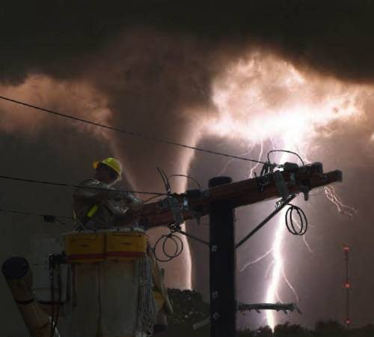
Electrical Safety
Unsafe condition
Notes:
1926 Subpart K ‑ Electrical
This presentation is designed to assist trainers conducting OSHA 10-hour Construction Industry outreach training for workers. Since workers are the target audience, this presentation emphasizes hazard identification, avoidance, and control – not standards. No attempt has been made to treat the topic exhaustively. It is essential that trainers tailor their presentations to the needs and understanding of their audience.
This presentation is not a substitute for any of the provisions of the Occupational Safety and Health Act of 1970 or for any standards issued by the U.S. Department of Labor. Mention of trade names, commercial products, or organizations does not imply endorsement by the U.S. Department of Labor.
This presentation addresses electrical safety requirements that are necessary for the safety of construction employees and is divided into major divisions as follows:
Overview. Includes why electricity is dangerous and how it works.
Hazard / Controls. Covers the main hazards and explains the best ways to prevent these hazards from occurring.
General Planning and Controls.

Slide 2
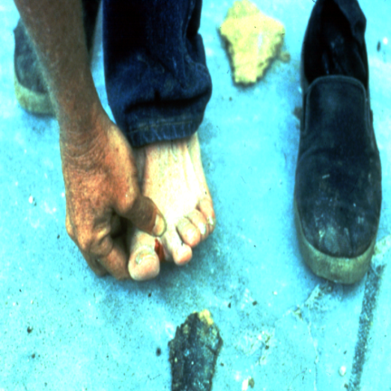
Electricity - The Dangers
About 5 workers are electrocuted every week
Causes 12% of young worker workplace deaths
Takes very little electricity to cause harm
Significant risk of causing fires
Notes:
Whenever you work with power tools or electrical circuits there is a risk of electrical hazards, especially electrical shock. Risks are increased at construction sites because many jobs involve electric power tools.
Electrical trades workers must pay special attention to electrical hazards because they work on electrical circuits. Coming in contact with an electrical voltage can cause current to flow through the body, resulting in electrical shock and burns. Serious injury or even death may occur.
Electricity has long been recognized as a serious workplace hazard, exposing employees to electric shock, electrocution, burns, fires, and explosions. In 1999, for example, 278 workers died from electrocutions at work, accounting for almost 5 percent of all on-the-job fatalities that year, according to the Bureau of Labor Statistics. What makes these statistics more tragic is that most of these fatalities could have been easily avoided.

Slide 3
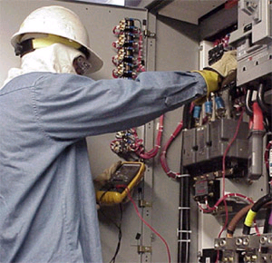
What primarily causes electrocution?
Contact with overhead power lines
Contact with live circuits in panels
Poorly maintained cords and tools
Lightning strikes
Trained electrician servicing an electrical panel.
Notes:
Trainer Notes:
Be sure to review all of items and point out that many operating engineers have been killed by contact with live overhead lines. This picture depicts a trained electrician with proper electrical PPE servicing an electrical panel. Stress with the class how only a trained electrician can work in a live electrical panel. They should always attempt to get the circuits shut down and locked out.

Slide 4
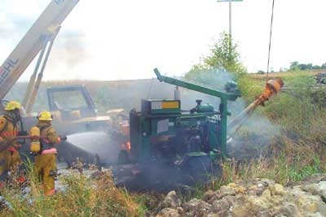
Four Main Types of Electrical Injuries
Shock
Burns
Falls due to contact with electricity
Electrocution (death)
Aftermath from contact with power lines
Notes:
Trainer Notes:
The following text describes the fatality pictured in this slide:
In 2003, a 53-year-old construction worker was electrocuted and died when the forklift he was guiding hit an overhead powerline and became energized. The victim was connected to the forklift by a cable he was holding. The system arced to the grass and caught the grass on fire. The operator initially stayed in the cab until the fire spread to the forklift then jumped clear as instructed in prior training.

Slide 5
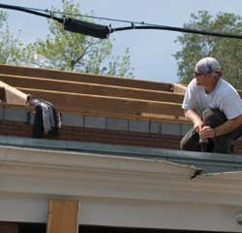
Working With Electricity At Heights
Many falls are caused by accidental contact with electricity
Be aware! Maintain safe working distances
Unsafe condition
Notes:
Trainer Notes:
Workers need to be cautioned that the risks of electricity are greater while working at elevations because any contact with electricity, no matter how mild, can cause a physical reaction that can result in a fall. The situation is made more difficult because it may not be possible to shut off the electricity and it may be high voltage.
This would be a good opportunity to discuss the hierarchy of controls. Ask the class what controls they can think of and what level of the hierarchy they represent. Here are some possible answers:
Have the electricity shut down = Engineering control
Maintain a safe working distance = Administrative control
Wear personal fall arrest system = Personal protective equipment

Slide 6
Electrical Shock
An electrical shock is received when electrical
current passes through the body.
You will get an electrical shock if a part of your
body completes an electrical circuit by…
Touching a live wire and an electrical ground, or
Touching a live wire and another wire at a different voltage.
Notes:
Electricity travels in closed circuits, and its normal route is through a conductor. Electric shock occurs when the body becomes a part of the circuit.
Grounding is a physical connection to the earth, which is at zero volts.
The metal parts of electric tools and machines may become energized if there is a break in the insulation of the tool or machine wiring. A worker using these tools and machines is made less vulnerable to electric shock when there is a low-resistance path from the metallic case of the tool or machine to the ground. This is done through the use of an equipment grounding conductor—a low-resistance wire that causes the unwanted current to pass directly to the ground, thereby greatly reducing the amount of current passing through the body of the person in contact with the tool or machine.

Slide 7
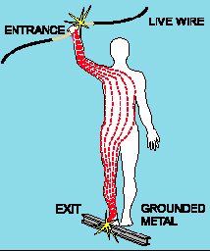
Shock Severity
Severity of the shock depends on:
  Path of current through the body
  Amount of current flowing through the body (amps)
  Duration of the shocking current through the body,
LOW VOLTAGE DOES NOT MEAN LOW HAZARD
Notes:
Other factors that may affect the severity of the shock are:
- The voltage of the current.
- The presence of moisture
- The general health of the person prior to the shock.
Low voltages can be extremely dangerous because, all other factors being equal, the degree of injury increases the longer the body is in contact with the circuit.
The resistance of the body varies based on:
The amount of moisture on the skin (less moisture = more resistance)
The size of the area of contact (smaller area = more resistance)
The pressure applied to the contact point (less pressure = more resistance)
Muscular structure (less muscle = less resistance)

Slide 8
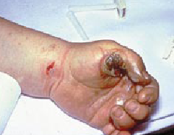
Burns
Most common shock-related injury
Occurs when you touch electrical wiring or equipment that is improperly used or maintained
Typically occurs on hands
Very serious injury that needs immediate attention
Notes:
Shock-related injuries include burns, internal injuries, and injuries due to
involuntary muscle contractions.
The most common shock-related injury is a burn. Burns suffered in electrical incidents may be one or more of the following three types.
Electrical burns cause tissue damage, and are the result of heat generated by the flow of electrical current through the body. These are one of the most serious injuries you can receive and require immediate attention.
Arc or Flash burns are caused by high temperatures near the body produced by an electrical arc or explosion. Attend to them immediately.
Thermal contact burns occur when skin comes in contact with overheated electric equipment, or when clothing is ignited by an electrical incident.

Slide 9
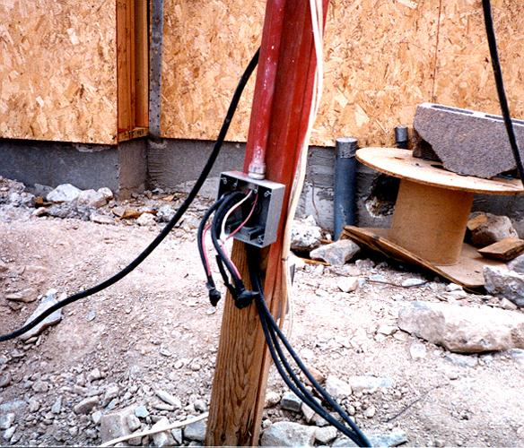
Hazard – Exposed Electrical Parts
Cover removed from wiring or breaker box

Slide 10
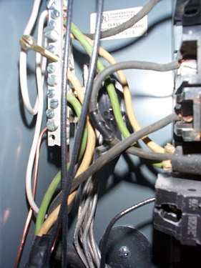
Control – Isolate Electrical Parts
Use guards or barriers
Replace covers
Guard live parts of electric equipment operating at 50 volts or more against accidental contact
Notes:
Reference 1926.403(i)(2)
Except as required or permitted elsewhere in the subpart, live parts of electric equipment operating at 50 volts or more shall be guarded against accidental contact by cabinets or other forms of enclosures, or by any of the following means:
* By location in a room, vault, or similar enclosure that is accessible only to qualified persons.
* By partitions or screens so arranged that only qualified persons will have access to the space within reach of the live parts. Any openings in such partitions or screens shall be so sized and located that persons are not likely to come into accidental contact with the live parts or to bring conducting objects into contact with them.
* By location on a balcony, gallery, or platform so elevated and arranged as to exclude unqualified persons.
* By elevation of 8 feet or more above the floor or other working surface and so installed as to exclude unqualified persons.

Slide 11
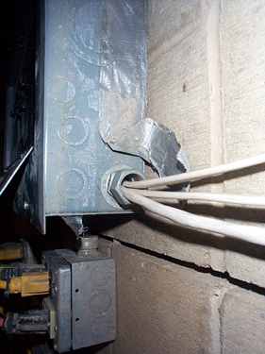
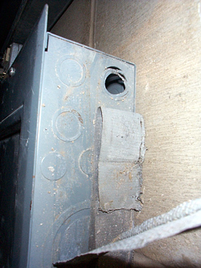
Control – Isolate Electrical Parts - Cabinets, Boxes & Fittings
Conductors going into them must be protected, and unused openings must be closed
Notes:
Reference 1926.405(b)(1)
Conductors entering boxes, cabinets, or fittings. Conductors entering boxes, cabinets, or fittings shall be protected from abrasion, and openings through which conductors enter shall be effectively closed. Unused openings in cabinets, boxes, and fittings shall also be effectively closed.
Covers and canopies. All pull boxes, junction boxes, and fittings shall be provided with covers. If metal covers are used, they shall be grounded. In energized installations each outlet box shall have a cover, faceplate, or fixture canopy. Covers of outlet boxes having holes through which flexible cord pendants pass shall be provided with bushings designed for the purpose or shall have smooth, well‑rounded surfaces on which the cords may bear.

Slide 12
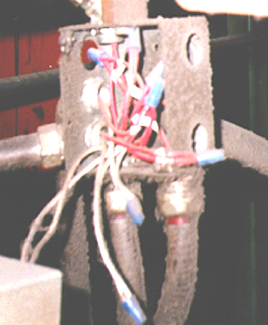
Control – Close Openings
Junction boxes, pull boxes and fittings must have approved covers
Unused openings in cabinets, boxes and fittings must be closed (no missing knockouts)
Photo shows violations
of these two requirements

Slide 13
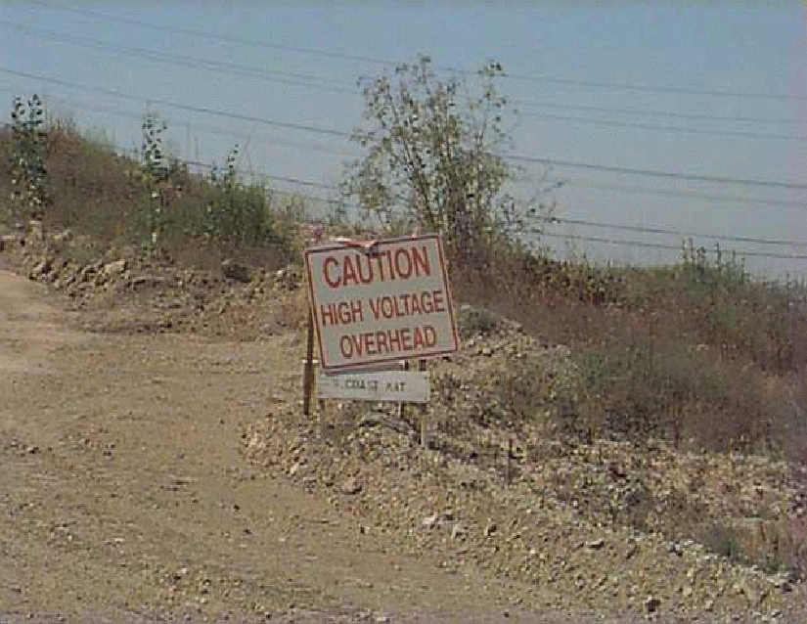
Notes:
This one cautions against high voltage overhead. You don’t want to be raising the truck bed. It’s a temporary sign, but it is adequate and acceptable.

Slide 14

Overhead Power Lines
The #1 Killer
Notes:
Trainer Notes:
Power lines are the number one killer of operating engineers when electricity is involved.

Slide 15
Why do overhead power lines pose a major problem?
Overhead lines are typically not insulated. Any covering is generally a weather protection, not insulation.
Over 90 percent of the contacts occur on overhead distribution lines
Operators are normally safe if they stay on the equipment
Ground personnel are over 8 times more likely to be killed
Notes:
Trainer Notes:
Ask this question and then work through each bullet item, emphasizing key points:
Overhead lines are typically not insulated. The covering that a worker sees is generally to protect the line from weather, not to protect a worker from electrocution;
Over 90 percent of the contacts occur on overhead distribution lines, which is a real concern to crane operators;
Operators are normally safe if they stay on the equipment; and
Ground personnel are over 8 times more likely to be killed because contact with overhead lines on equipment usually provides a path to ground that can avoid the operator, but workers around the equipment are grounded and the current will flow through them.
Other points you can raise:
If you touch a power line, electricity will attempt to travel through your body.
When electricity travels through the body, it heats up and burns body tissue internally.
Electricity leaves the body violently, causing burns or even blowing an exit hole.

Slide 16
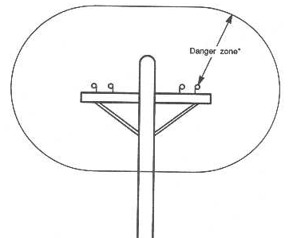
How do I protect myself from overhead power lines?
All equipment – ladders, scaffolds, cranes, trucks, forklifts, etc. – MUST maintain a minimum 10 foot clearance from 50 kV or less, including service entrance cable (unless insulated)
Add 4 inches for every kV over 50 kV
Notes:
Trainer Notes:
OSHA’s standard requires that all equipment – ladders, scaffolds, cranes, trucks, forklifts, etc. – MUST maintain a minimum 10 foot clearance from 50 kV or less, including service entrance cable (unless insulated). As the voltage (and therefore the danger) increases, the distance must be increased by adding .4 inches for every kV over 50 kV. This awkward number came about because the original standard was in the metric system and 1 centimeter equals 0.4 inches. It is easier to understand the more protective guidelines from the American National Standards Institute (ANSI):
100 kV - 15 feet
350 kV - 20 feet
500 kV - 25 feet

Slide 17
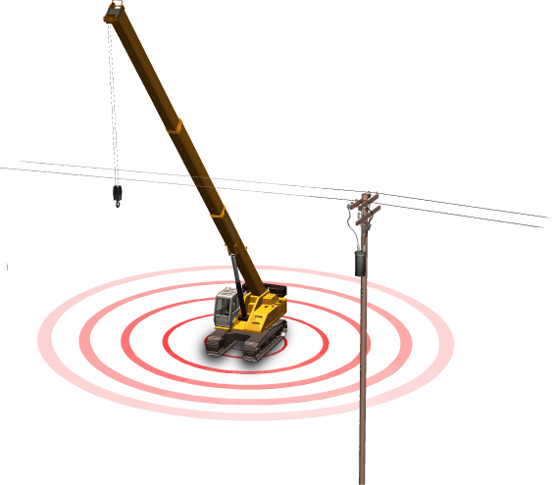
The Ground May Be Energized!
Electricity decreases with the resistance of the ground
As potential drops, fields develop around the electrified machine
If you step across a line of unequal potential, you could be electrocuted
Notes:
Trainer Notes:
Discuss the process of voltage decreasing by the resistance of the ground. Energy fields can be set up around the grounded object. If a person steps across two different levels of voltage or touches an object at a different level, electricity may pass through the body.

Slide 18
What do you do if contact with lines occurs?
Stay on the machine if possible
Warn all others to stay away
Notify power company immediately
Attempt to move away but assure line is not “connected”
Notes:
Trainer Notes:
Emphasize that it is difficult for an operator not to panic when the boom contacts an overhead line, but these recommendations should be followed:
Stay on the machine if possible;
Warn all others to stay away;
Notify power company immediately; and
Attempt to move the equipment away but assure line is not “connected.”

Slide 19
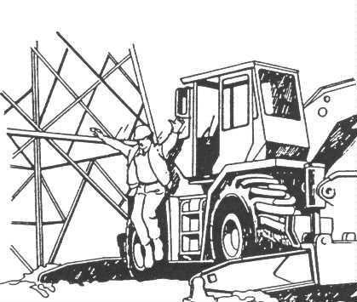
Get away safely!
If you must get out, jump with your feet together
Do not touch the machine or outriggers
Hop or shuffle out of the area
Notes:
Trainer Notes:
Point out the red circle and indicate that operators have saved their lives by following the guidance of jumping with their feet together. Emphasize that they need to land with their feet together and hop away. They need to avoid touching the equipment and particularly the outriggers at all costs – the results are almost always deadly!

Slide 20
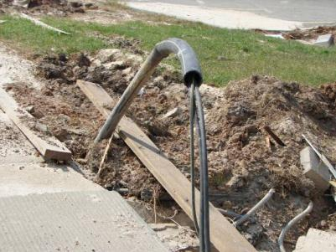
Underground power lines present constant danger
Look for evidence of underground utilities
Call Dig-Safe, the utility company, or equivalent
If contact occurs, follow same procedures as for overhead lines
Exposed power lines
Notes:
Trainer Notes:
This picture is an example of damaged and exposed power lines and cables.
Point out that contractors must:
Look for evidence of underground utilities;
Call Dig-Safe, the utility company, or equivalent; and
If contact occurs, follow same procedures as for overhead lines.
As an instructor, you may want to refresh yourself on the OSHA standard:
1926.651(b)(1) The estimated location of utility installations, such as sewer, telephone, fuel, electric, water lines, or any other underground installations that reasonably may be expected to be encountered during excavation work, shall be determined prior to opening an excavation.
1926.651(b)(2) Utility companies or owners shall be contacted within established or customary local response times, advised of the proposed work, and asked to establish the location of the utility underground installations prior to the start of actual excavation. When utility companies or owners cannot respond to a request to locate underground utility installations within 24 hours (unless a longer period is required by state or local law), or cannot establish the exact location of these installations, the employer may proceed, provided the employer does so with caution, and provided detection equipment or other acceptable means to locate utility installations are used.

Slide 21
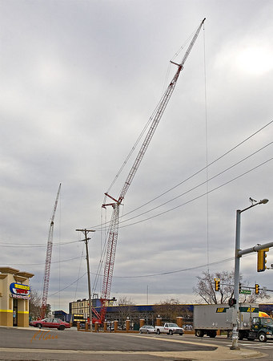
Overhead power lines
Photo courtesy of Robert Carr
Notes:
Trainer Notes:
The potential hazard again is the risk of the cranes contacting power lines.
As background information, the photographer, Robert Carr, described this scene as:
“Two Manitowoc track-mounted lattice boom cranes with luffing booms supporting luffing jibs supporting fixed jibs on top. Cranes are servicing reconstruction of seating in stadium, from position outside and above stadium perimeter. Taken at The Big House, University of Michigan Stadium, Ann Arbor, Michigan, 2006.”

Slide 22
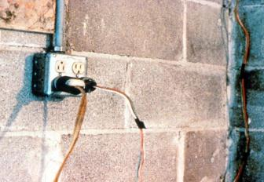
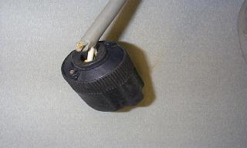
Hazard – Defective Cords & Wires
Plastic or rubber covering is missing
Damaged extension cords & tools
Notes:
Extension cords may have damaged insulation. Sometimes the insulation inside an electrical tool or appliance is damaged. When insulation is damaged, exposed metal parts may become energized if a live wire inside touches them. Electric hand tools that are old, damaged, or misused may have damaged insulation inside. If you touch damaged power tools or other equipment, you will receive a shock. You are more likely to receive a shock if the tool is not grounded or double-insulated.

Slide 23
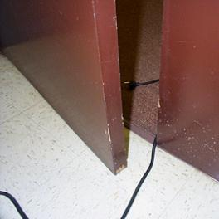
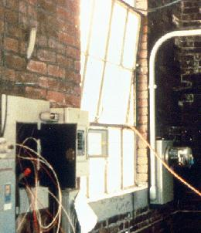
Hazard – Damaged Cords
Cords can be damaged by:
  Aging
  Door or window edges
  Staples or fastenings
  Abrasion from adjacent materials
  Activity in the area
Improper use can cause shocks, burns or fire
Unsafe condition
Notes:
Reference 1926.405(a)(2)(ii)(I)
The normal wear and tear on extension and flexible cords at your site can loosen or expose wires, creating hazardous conditions. Cords that are not 3-wire type, not designed for hard-usage, or that have been modified, increase your risk of contacting electrical current.

Slide 24
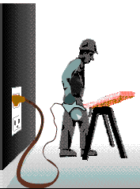
Grounding
Grounding creates a low-resistance path from a tool to the earth to disperse unwanted current.
When a short or lightning occurs, energy flows to the ground, protecting you from electrical shock, injury and death.
Notes:
Grounding is a secondary method of preventing electrical shock.
Grounded electrical systems are usually connected to a grounding rod that is placed 6-8 feet deep into the earth.
Grounded - connected to earth or to some conducting body that serves in place of the earth.
Grounded, effectively (Over 600 volts, nominal.) Permanently connected to earth through a ground connection of sufficiently low impedance and having sufficient ampacity that ground fault current which may occur cannot build up to voltages dangerous to personnel.
Grounded conductor. A system or circuit conductor that is intentionally grounded.
Grounding conductor. A conductor used to connect equipment or the grounded circuit of a wiring system to a grounding electrode or electrodes.

Slide 25
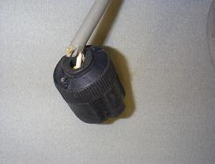
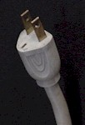
Hazard – Improper Grounding
Tools plugged into improperly grounded circuits may become energized
Broken wire or plug on extension cord
Some of the most frequently violated OSHA standards
Unsafe condition
Notes:
The most frequently violated OSHA electrical regulation is improper grounding of equipment and circuitry. The metal parts of an electrical wiring system that we touch (switch plates, ceiling light fixtures, conduit, etc.) should be grounded and at 0 volts. If the system is not grounded properly, these parts may become energized. Metal parts of motors, appliances, or electronics that are plugged into improperly grounded circuits may be energized. When a circuit is not grounded properly, a hazard exists because unwanted voltage cannot be safely eliminated. If there is no safe path to ground for fault currents, exposed metal parts in damaged appliances can become energized.
Extension cords may not provide a continuous path to ground because of a broken ground wire or plug.
Electrical systems are often grounded to metal water pipes that serve as a continuous path to ground. If plumbing is used as a path to ground for fault current, all pipes must be made of conductive material (a type of metal). Many electrocutions and fires occur because (during renovation or repair) parts of metal plumbing are replaced with plastic pipe, which does not conduct electricity.

Slide 26
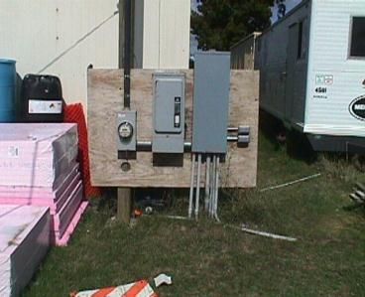
Control - Electrical Protective Devices
Automatically opens circuit if excess current from overload or ground-fault is detected – shutting off electricity
Includes GFCI’s, fuses, and circuit breakers
Fuses and circuit breakers are overcurrent devices. When too much current:
    Fuses melt
    Circuit breakers trip open
Notes:
To prevent too much current in a circuit, a circuit breaker or fuse is placed in the circuit. If there is too much current in the circuit, the breaker “trips” and opens like a switch. If an overloaded circuit is equipped with a fuse, an internal part of the fuse melts, opening the circuit. Both breakers and fuses do the same thing: open the circuit to shut off the electrical current
The basic idea of an overcurrent device is to make a weak link in the circuit. In the case of a fuse, the fuse is destroyed before another part of the system is destroyed. In the case of a circuit breaker, a set of contacts opens the circuit. Unlike a fuse, a circuit breaker can be re-used by re-closing the contacts. Fuses and circuit breakers are designed to protect equipment and facilities, and in so doing, they also provide considerable protection against shock in most situations. However, the only electrical protective device whose sole purpose is to protect people is the ground-fault circuit-interrupter.

Slide 27
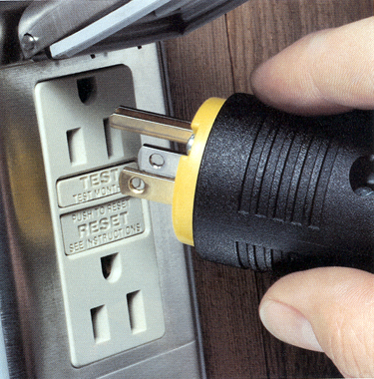
Power Tool Requirements
  Have a three-wire cord with ground plugged into a grounded receptacle, or
  Be double insulated, or
  Be powered by a low-voltage isolation transformer
Notes:
Common Examples of Misused Equipment = OSHA Violations
* Using multi-receptacle boxes designed to be mounted by fitting them with a power cord and placing them on the floor.
* Fabricating extension cords with ROMEX® wire.
* Using equipment outdoors that is labeled for use only in dry, indoor locations.
* Attaching ungrounded, two-prong adapter plugs to three-prong cords and tools.
* Using circuit breakers or fuses with the wrong rating for over-current protection, e.g. using a 30-amp breaker in a system with 15- or 20-amp receptacles. Protection is lost because it will not trip when the system's load has been exceeded.
* Using modified cords or tools, e.g., removing ground prongs, face plates, insulation, etc.
* Using cords or tools with worn insulation or exposed wires.

Slide 28
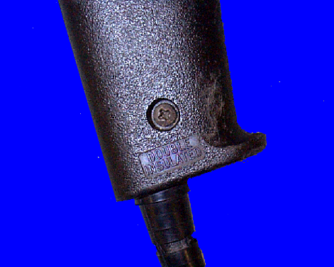
Preventing Electrical Hazards - Tools
Inspect tools before use
Use the right tool correctly
Protect your tools
Use double insulated tools
  Double Insulated marking
Notes:
* Use tools and equipment according to the instructions included in their listing, labeling or certification.
* Visually inspect all electrical equipment before use. Remove from service any equipment with frayed cords, missing ground prongs, cracked tool casings, etc. Apply a warning tag to any defective tool and do not use it until the problem has been corrected.

Slide 29
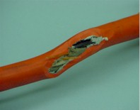
Clues that Electrical Hazards Exist
Tripped circuit breakers or blown fuses
Warm tools, wires, cords, connections, or junction boxes
GFCI that shuts off a circuit
Worn or frayed insulation around wire or connection
Unsafe condition
Notes:
There are “clues” that electrical hazards exist. For example, if a GFCI keeps tripping while you are using a power tool, there is a problem. Don’t keep resetting the GFCI and continue to work. You must evaluate the “clue” and decide what action should be taken to control the hazard.
There are a number of other conditions that indicate a hazard.
Tripped circuit breakers and blown fuses show that too much current is flowing in a circuit. This could be due to several factors, such as malfunctioning equipment or a short between conductors. You need to determine the cause in order to control the hazard.
An electrical tool, appliance, wire, or connection that feels warm may indicate too much current in the circuit or equipment. You need to evaluate the situation and determine your risk.
An extension cord that feels warm may indicate too much current for the wire size of the cord. You must decide when action needs to be taken.
A cable, fuse box, or junction box that feels warm may indicate too much current in the circuits.
A burning odor may indicate overheated insulation.
Worn, frayed, or damaged insulation around any wire or other conductor is an electrical hazard because the conductors could be exposed. Contact with an exposed wire could cause a shock. Damaged insulation could cause a short, leading to arcing or a fire. Inspect all insulation for scrapes and breaks. You need to evaluate the seriousness of any damage you find and decide how to deal with the hazard.
A GFCI that trips indicates there is current leakage from the circuit First, you must decide the probable cause of the leakage by recognizing any contributing hazards. Then, you must decide what action needs to be taken.

Slide 30
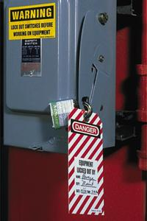
Lockout and Tagging of Circuits
Apply locks to power source after de-energizing
Tag deactivated controls
Tag de-energized equipment and circuits at all points where they can be energized
Tags must identify equipment or circuits being worked on
Notes:
Reference 1926.417:
(a) Controls. Controls that are to be deactivated during the course of work on energized or de-energized equipment or circuits shall be tagged.
(b) Equipment and circuits. Equipment or circuits that are deenergized shall be rendered inoperative and shall have tags attached at all points where such equipment or circuits can be energized.
(c) Tags. Tags shall be placed to identify plainly the equipment or circuits being worked on.
(d) Lockout and tagging. While any employee is exposed to contact with parts of fixed electric equipment or circuits which have been de-energized, the circuits energizing the parts shall be locked out or tagged or both.
Case study
An electrician was removing a metal fish tape from a hole at the base of a metal light pole.
(A fish tape is used to pull wire through a conduit run.) The fish tape became energized, electrocuting him. As a result of its inspection, OSHA issued a citation for three serious violations of the agency’s construction standards.
If the following OSHA requirements had been followed, this death could have been prevented.
• De-energize all circuits before beginning work.
• Always lock out and tag out de-energized equipment.
• Companies must train workers to recognize and avoid unsafe conditions

Slide 31
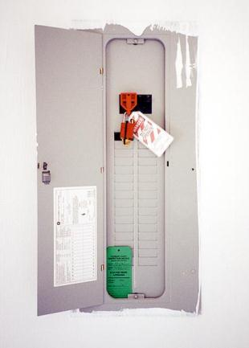
Preventing Electrical Hazards - Planning
Plan your work with others
Plan to avoid falls
Plan to lock-out and tag-out equipment
Remove jewelry
Avoid wet conditions and overhead power lines
Notes:
Make your environment safer by doing the following:
Lock and tag out circuits and machines.
Prevent overloaded wiring by using the right size and type of wire.
Prevent exposure to live electrical parts by isolating them.
Prevent exposure to live wires and parts by using insulation.
Prevent shocking currents from electrical systems and tools by grounding them.
Prevent shocking currents by using GFCI’s.
Prevent too much current in circuits by using overcurrent protection devices.

Slide 32
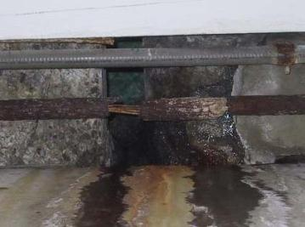
Avoid Wet Conditions
If you touch a live wire or other electrical component while standing in even a small puddle of water you’ll get a shock.
Damaged insulation, equipment, or tools can expose you to live electrical parts.
Unsafe condition
Notes:
A damaged tool may not be grounded properly, so the housing of the tool may be energized, causing you to receive a shock.
Improperly grounded metal switch plates and ceiling lights are especially hazardous in wet conditions. If you touch a live electrical component with an uninsulated hand tool, you are more likely to receive a shock when standing in water. But remember: you don’t have to be standing in water to be electrocuted. Wet clothing, high humidity, and perspiration also increase your chances of being electrocuted.
Use extra caution when working with electricity when water is present in the environment or on the skin. Pure water is a poor conductor, but small amounts of impurities, like salt and acid (both are in perspiration), make it a ready conductor.

Slide 33
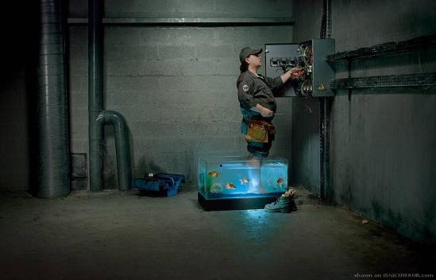
Avoid Wet Conditions
Improperly grounded metal switch plates & ceiling lights are especially hazardous in wet conditions.
Wet clothing, high humidity, and perspiration increase your chances of being electrocuted.
Unsafe condition

Slide 34
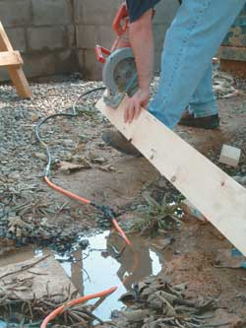
What if I work in wet conditions with electricity?
Avoid working in wet conditions, whenever possible
Use approved electrical equipment for wet conditions
Do not stand in wet areas and operate electrical equipment
How many unsafe acts can you identify?
Notes:
Trainers Notes:
Remind the class that, based on Ohms Law, working in wet conditions greatly reduces the resistance and puts workers at increased risk of electrocution. Using the hierarchy of controls, the highest level of protection comes from eliminating the hazard: avoid working in wet conditions, whenever possible. If that can’t be done, using approved electrical equipment can help.
Ask the class how many things they can see that are wrong in this picture. Make sure they note the patched cord running through the puddle.

Slide 35
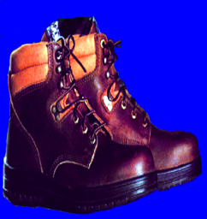
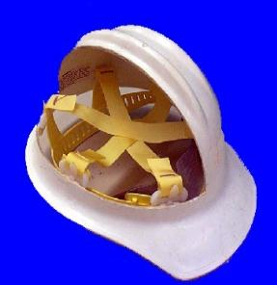
Preventing Electrical Hazards - PPE
    Proper foot protection (not tennis shoes)
    Rubber insulating gloves, hoods, sleeves, matting, and blankets
    Hard hat (insulated - nonconductive)
Notes:
Personal protective equipment (PPE) should always be the last line of defense against a hazard. If the hazard is unavoidable, and cannot be addressed in any other safe manner, then employees must be fitted with proper PPE.
Safety shoes should be nonconductive and protect your feet from completing an electrical circuit to ground. They can also protect against open circuits of up to 600 volts in dry conditions. These shoes should be used with other insulating equipment and in connection with active precautions to reduce or eliminate the potential for providing a path for hazardous electrical energy.
When it is necessary to handle or come close to wires with a potential live electrical charge, it is essential to use proper insulating PPE to protect employees from contact with the hazardous electrical energy.
Specific types of hard hats are needed when performing electrical work.
A “Class B” Electrical/Utility type hard hat protects against falling objects and high-voltage shock and burns.

Slide 36
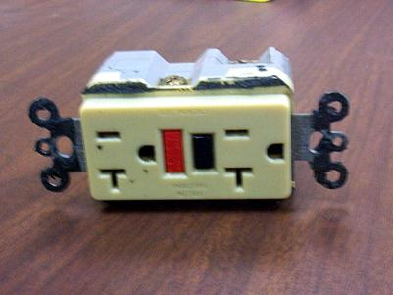
Preventing Electrical Hazards – Proper Wiring and Connectors
    Use and test GFCI’s
    Check switches and insulation
    Use three prong plugs
    Use extension cords only when necessary & assure in proper condition and right type for job
    Use correct connectors
Notes:
If the polarity is reversed on a GFCI, the lights will test good, but the press to test button will not trip the circuit.

Slide 37
Training
Train employees working with electric equipment in safe work practices,
Deenergize electric equipment before inspecting or repairing
Using cords, cables, and electric tools that are in good repair
Lockout / Tagout recognition and procedures
Use appropriate protective equipment
Notes:
1926.21(b)(2)
De-energizing Electrical Equipment.
Accidental or unexpected starting of electrical equipment can cause injury or death. Before ANY inspections or repairs are made, the current must be turned off at the switch box and the switch padlocked in the OFF position. At the same time, the switch or controls of the machine or other equipment being locked out of service must be securely tagged to show which equipment or circuits are being worked on.
Employees shall be trained in and familiar with the safety-related work practices that pertain to their respective job assignments.

Slide 38
What if someone gets electrocuted?
Look first, but don't touch
Turn off the source of electricity if possible. If not, move the source away from you and the affected person using a non-conducting object
Get Emergency Medical Services there
Try not to touch burns
If qualified, start basic first aid and CPR as necessary until EMS arrives
Notes:
Trainer Notes:
Ask the class if anyone has been on a job where someone got a serious shock. Stress that quick and appropriate action is needed to save the victim AND to be sure you aren’t also a victim. These common sense recommendations should be reviewed because during an emergency it is easy to do the wrong thing.
Look first. Don't touch the victim because current can still be flowing through his or her body.
Turn off the source of electricity if possible. If not, move the source away from you and the affected person using a non-conducting object.
Get EMS there.
Try not to touch burns.
If you are qualified, start basic first aid and CPR as necessary until EMS arrives.

