Slide 1
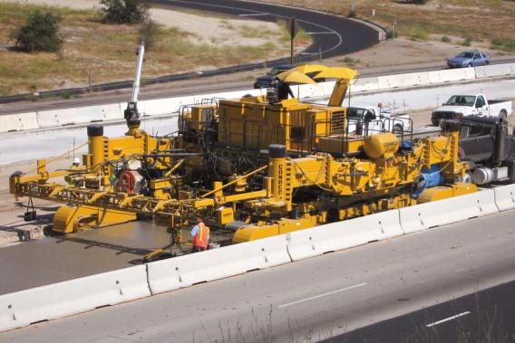

WORK ZONE
Safety Training
This material was produced under grant SH-19504-SH9 from the Occupational Safety and Health Administration, U.S. Department of Labor. It does not necessarily reflect the views or policies of the U.S. Department of Labor, nor does mention of trade names, commercial products, or organizations imply endorsement by the U.S. Government. This free training was made possible through a Susan Harwood Grant from the US Department of Labor’s Occupational Safety & Health Administration and the support of the Associated General Contractors of ND.

Slide 2
Emergency Preparedness in Remote Work Zones

Slide 3
National Safety Council Mission
The mission of the National Safety Council is to educate and influence people to prevent accidental injury and death.

Slide 4
Construction Workers
Work in the middle of a work zone and will be most affected when emergencies occur
Notes:
This is the story of Ed who works for the CCC Company in the middle of the state. The Construction company owner has asked a newbie to get started on a new training program for the company. The newbie is Ed who has just started working in highway construction following graduation.
The boss asked Ed to develop a plan to help his buddies in case there is a problem on the highway in a work zone.
Ed was mystified by the project but was willing to help his co workers & friends.
Work in the middle of a work zone and will be most affected when emergencies occur

Slide 5
You are Important!
As construction workers you are going to be facing the reality of the situation soon
Notes:
Ed didn’t know what to do but he did know that his work was important to the CCC company. Ed decides he needs to find out more before he can do any planning. Ed knows that his coworkers are important and he would want them to help if something happened.
As construction workers you are going to be facing the reality of the situation soon

Slide 6
Now What?
Do you know the things to do or have the skills to face the situation?
There are conflicting ideas about emergencies and do they leave you uncertain about the next steps?
Notes:
Ed just started with the company and he had some knowledge from watching TV about disasters plus he had volunteered in a disaster serving food. But that was just during a hail storm, what would happen if it was on the highway? Plus there were other people there directing to help. So many things to think about!
Ed started asking questions and did some research and he knew in the end he wanted to make sure he kept his job, kept his friends safe, and most important he wanted to make sure he kept his family safe.
Do you know the things to do or have the skills to face the situation?
There are conflicting Ideas about emergencies and do they leave you uncertain about the next steps?

Slide 7
Family, Friends, a Great Job
Seeing the BIG picture will help you decide “What to Do” “When to Do It” and “How to Do it” so you will be able to return home safely after a work zone emergency
Notes:
There are many different aspects or ideas about emergencies and Ed had no clue what to do. Ed knew there had to be steps to help but what were they and could he put something together that his boss at CCC company would appreciate.
Ed further evaluated the pictures he had in his mind and had this Seeing the BIG picture will help you decide “What to Do” “When to Do It” and “How to Do it” so you will be able to return home safely after a work zone emergency

Slide 8
The Big Picture is a Puzzle
Three key pieces to the puzzle will help us see the picture.
Why should I help?
What will I need if I have to help?
Will there be any planning?
Notes:
Ed asked some of buddies what they thought about being prepared in the work zone. Some said they would help right away, some said no way buddy I am going to help myself, others asked “Why Should I help?”
Ed further explored the possibilities of an emergency and decided if you guys help me in an emergency then what? One person suggested calling for help and leaving another said to just leave and someone asked “what will I need if I have to help?”
Ed’s boss asked if he knew what to do or if he had everything he needed? Ed asked around and his foreman mentioned something about maybe planning? Ed compiled his thoughts and came up with the Big Picture. The key to the puzzle was answering these three questions
Three key pieces to the puzzle will help us see the picture.
Why should I help?
What will I need if I have to help?
Will there be any planning?
Ed focused on answering the first question. “Why should I help?”

Slide 9
Why should I help?
Lets find out by solving the puzzle?
Notes:
Lets find out by solving the puzzle?
Ed asked his boss about the work zone he was going to be working in and his boss said “you better prepared to handle them all” “GREAT” said Ed and he started looking at the highway construction site just up the road form the office since it was so close to the his home. The boss said to make sure no rock was not turned over in his findings.
Well Ed started thinking about the work zone and it seemed pretty simple but figured there had to be reasons why he should help
The first thing that came to mind was;
1 What is a work zone other than where I show up to?
2 What is it that I need to worry about?
3 Do I need to practice before I do anything?

Slide 10
Three reasons
First, We need to identify what is a work zone?
Second, we need to recognize what are the hazards in a work zone?
Third , what training do I need to help?
Notes:
First, We need to identify what is a work zone?
Second, we need to recognize what are the hazards in a work zone?
Third , what training do I need to help?
Having figured out some reasons to help in a work zone Ed went about researching the three main reasons the first was what is a work zone. Ed Googled Work Zone and found the following definition.

Slide 11
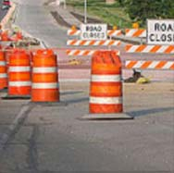
Definition of a Work Zone
What do you think of when we say work zone?
A work zone is an area of a traffic way where construction, maintenance, or utility work activities are identified by warning signs, including those on transport devices that mark the beginning and end of a construction, maintenance or utility work activity.
e.g., signs, flashing lights, channelizing devices, barriers, pavement markings, flagmen, warning signs and arrow boards mounted on the vehicles in a mobile maintenance activity)
Notes:
What do you think of when we say work zone? Ed found this definition to help but had other thoughts as well
Is it office area? We work there
Is it at home in the garage? We work there
Most of you have a good idea of what we are thinking about and this is the definition I found from researching the topic
Work Zone - A work zone is an area of a traffic way where construction, maintenance, or utility work activities are identified by warning signs, including those on transport devices that mark the beginning and end of a construction, maintenance or utility work activity.
(e.g., signs, flashing lights, channelizing devices, barriers, pavement markings, flagmen, warning signs and arrow boards mounted on the vehicles in a mobile maintenance activity)

Slide 12
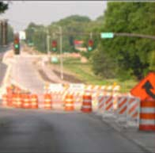
What Warning Signs are there?
It extends from the first warning sign, signal or flashing lights to the END ROAD WORK sign or the last traffic control device pertinent for that work activity.
Notes:
Ed asked himself what warning signs they meant?
Work zones also include roadway sections where there is ongoing, moving (mobile) work activity such as lane line painting or roadside mowing only if the beginning of the ongoing, moving (mobile) work activity is designated by warning signs or signals.
Ed’s boss asked him if he knew how long he would be working in the work zone and if he knew the differences in length of the work. He thought he just showed up! But Ed found out there are three different types of time.

Slide 13
Additional pieces to the puzzle encompass length of time
Long Term
Intermediate-Term Stationary
Short Term Stationary
Mobile
Notes:
Ed checked out a book he found at the CCC company road shack called MUTCD?
The Manual on Uniform Traffic Control Devices (MUTCD) provides some general guidelines for utility work zones. However, significant flexibility exists in these guidelines that is often interpreted in many different ways by utility companies/contractors/road agencies that create non-uniformity, which results in heightened risks for both motorists and workers.
What he found was a definition for

Slide 14
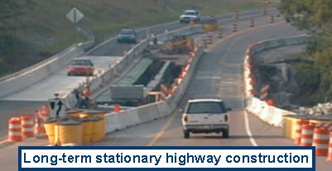
Long Term
“Long-term stationary is work that occupies a location more than 3 days
Notes:
“Long-term stationary is work that occupies a location more than 3 days

Slide 15
Intermediate-Term Stationary
work that occupies a location more than one daylight period up to 3 days, or nighttime work lasting more than 1 hour
Notes:
work that occupies a location more than one daylight period up to 3 days, or nighttime work lasting more than 1 hour

Slide 16
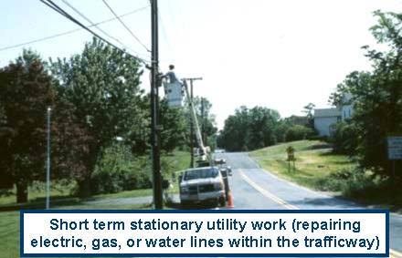
Short Term
is daytime work that occupies a location for more than 1 hour within a single daylight period
Notes:
is daytime work that occupies a location for more than 1 hour within a single daylight period

Slide 17
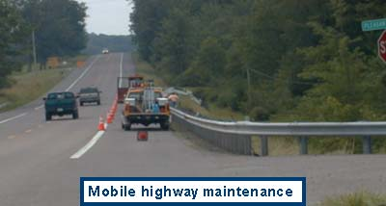
Mobile
work that moves intermittently or continuously
Notes:
Work that moves intermittently or continuously
Ed asked his boss if there were situations in which they was work but excluded them? His boss said there were but didn’t know advised Ed to check in the book at the shack and found this is the case in theses situations.

Slide 18
Work Zone – Exclusions
Can you tell me if there are any Exclusions?
Excludes - Private construction, maintenance or utility work outside the traffic way. For example, a building being constructed or the lines being painted for a business' parking lot stalls.
Notes:
Can you tell me if there are any Exclusions?
Excludes - Private construction, maintenance or utility work outside the traffic way. For example, a building being constructed or the lines being painted for a business' parking lot stalls.
Ed knows there are four types of Work Zone but what is a work zone identified by? He asked one of his coworkers who does a lot of the signs and said ‘Ed they are identified by using markers in zones- you should know that.

Slide 19
A work zone is identified by four zones
Can anyone tell me what they are and their definition?
Advance Warning
Transition
Activity
Termination
Termination Area - traffic resumes normal path
Activity Area - where work takes place
Work Space - space for workers, equipment, and material storage
Buffer Space - provides protection for traffic and workers
Transition Area - moves traffic from normal path
Advance Warning Area ? notifies traffic of what to expect ahead
Notes:
READ 1st Can anyone tell me what they are and their definition?
Advance Warning
Transition
Activity
Termination
Termination Area - traffic resumes normal path
Activity Area - where work takes place
Work Space - space for workers, equipment, and material storage
Buffer Space - provides protection for traffic and workers
Transition Area - moves traffic from normal path
Advance Warning Area ? notifies traffic of what to expect ahead

Slide 20
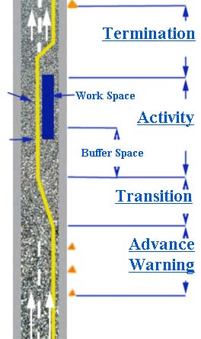
Diagram of a Work Zone Area Location of Crash -

Slide 21
Definition: Work Zone Crash
A traffic crash in which the first harmful event occurs within the boundaries of a work zone or on an approach to or exit from a work zone resulting from an activity, behavior or control related to the movement of the traffic units through the work zone.
Notes:
Work Zone Crash - a traffic crash in which the first harmful event occurs within the boundaries of a work zone or on an approach to or exit from a work zone, resulting from an activity, behavior or control related to the movement of the traffic units through the work zone.
Includes collision and non-collision crashes occurring within the signs or markings indicating a work zone or occurring on approach to, exiting from or adjacent to work zones that are related to the work zone

Slide 22
Work Zone Related?
Was the accident in or near a construction, maintenance or utility work zone?
Notes:
Was the Accident in or near a construction, maintenance or utility work zone?
If the answer to one of the 2 statements next then is yes, then it is we will have a couple of examples to see if we can identify them from the drawings.
Did the first harmful event occur within the boundaries of a work zone?
2. Did the first harmful event occur on an approach to or exit from a work zone, resulting from an activity, behavior, or control related to the movement of the traffic units through the work zone?

Slide 23
Work Zone Related?
An accident that occurs in or related to a construction, maintenance, or utility work zone, whether or not workers were actually present at the time of the accident. ‘
Work zone related’ accidents may also include those involving motor vehicles slowed or stopped because of the work zone, even if the first harmful event occurred before the first warning sign.
Notes:
An accident that occurs in or related to a construction, maintenance, or utility work zone, whether or not workers were actually present at the time of the accident. ‘
Work zone related’ accidents may also include those involving motor
vehicles slowed or stopped because of the work zone, even if the first harmful event occurred before the first warning sign.

Slide 24
Work Zone Crash Example
An automobile on the roadway loses control within a work zone due to a shift or reduction in the travel lanes and crashes into another vehicle in the work zone.
Notes:
For example:
An automobile on the roadway loses control within a work zone due to a shift or reduction in the travel lanes and crashes into another vehicle in the work zone.

Slide 25
Work Zone Crash 2nd Example
A van in an open travel lane strikes a highway worker in the work zone.
Notes:
A van in an open travel lane strikes a highway worker in the work zone.

Slide 26
Work Zone Crash 3rd Example
A highway construction vehicle working on the edge of the roadway is struck by a motor vehicle in transport in a construction zone.

Slide 27
Work Zone Crash Example Exclusions
Excludes single-vehicle crashes involving working vehicles not located in traffic way.
Notes:
Excludes single-vehicle crashes involving working vehicles not located in traffic way.

Slide 28
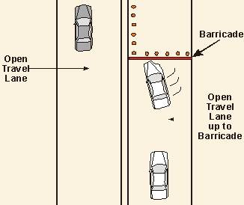
Examples #1
The un stabilized situation begins on a portion of the traffic way open to the public and the first harmful event occurs in construction area closed by barricades or cones.
Motor Vehicle Accident?
YES
Work Zone Accident?
YES
Notes:
The un stabilized situation begins on a portion of the traffic way open to the public and the first harmful event occurs in construction area closed by barricades or cones.
Motor Vehicle Accident? YES Work Zone Accident? YES

Slide 29
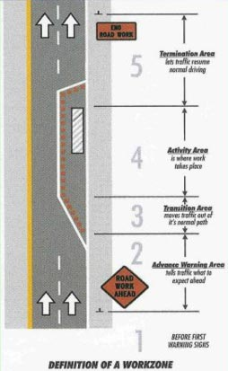
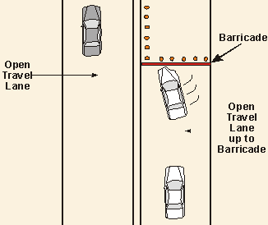
Example #1 b
Notes:
This slide shows where in the work zone the crash occurred

Slide 30
Fatalities in Motor Vehicle Traffic Crashes by State and Construction/Maintenance Zone (2008)
State
Not in Construction/Maintenance Zone 36, 541
In Construction/Maintenance Zone 720
Total Number 37,261
Notes:
See handout
Fatalities in Motor Vehicle Traffic Crashes by State and Construction/Maintenance Zone (2008)
State Not in Construction/Maintenance Zone In Construction/Maintenance Zone Total Number Number Number Alabama 954 12 966 Alaska 60 2 62 Arizona 920 17 937 Arkansas 581 19 600 California 3,364 70 3,434 Colorado 537 11 548 Connecticut 260 4 264 Delaware 118 3 121 District of Columbia 34 0 34 Florida 2,897 81 2,978 Georgia 1,457 36 1,493 Hawaii 106 1 107 Idaho 224 8 232 Illinois 1,012 31 1,043 Indiana 798 16 814 Iowa 402 10 412 Kansas 378 7 385 Kentucky 821 5 826 Louisiana 890 22 912 Maine 150 5 155 Maryland 580 11 591 Massachusetts 356 7 363 Michigan 969 11 980 Minnesota 447 9 456 Mississippi 782 1 783 Missouri 942 18 960 Montana 225 4 229 Nebraska 202 6 208 Nevada 318 6 324 New Hampshire 137 2 139 New Jersey 583 7 590 New Mexico 360 6 366 New York 1,225 6 1,231 North Carolina 1,412 21 1,433 North Dakota 103 1 104 Ohio 1,177 13 1,190 Oklahoma 732 17 749 Oregon 410 6 416 Pennsylvania 1,445 23 1,468 Rhode Island 65 0 65 South Carolina 916 4 920 South Dakota 116 3 119 Tennessee 1,024 11 1,035 Texas 3,248 134 3,382 Utah 274 1 275 Vermont 73 0 73 Virginia 808 16 824 Washington 518 3 521 West Virginia 376 4 380 Wisconsin 597 8 605 Wyoming 158 1 159 Total 36,541 720 37,261 Puerto Rico 399 0 399 Note: 'In Construction/Maintenance Zone' includes Construction, Maintenance, Utility, and Work Zone, Type Unknown
Source: 2008 Fatality Analysis Reporting System (FARS) - ARF, NHTSA

Slide 31
Summary of a Rural Work Zone
A work zone is an area of a traffic way where construction, maintenance, or utility work activities are identified by warning signs/signals/indicators.
Notes:
A work zone is an area of a traffic way where construction, maintenance, or utility work activities are identified by warning signs/signals/indicators.
Ed told his boss he understands the work zone and how it is identified but his coworkers are still wondering again why should we help in a work zone. Ed wanted to know more about the hazards he might find in the work zone

Slide 32
Three reasons why we should help a person in a work zone
First, we need to identify what is a work zone?
Second, we need to recognize what are the hazards in a work zone?
Third , what training do I need to help?
Notes:
First, We need to identify what is a work zone? I think we have accomplished what is a work zone and what its size is and what can occur
Second, we need to recognize what are the hazards in a work zone?
Third , what training do I need to help?

Slide 33
Work Zone Hazards are ?
Kinds of Emergencies
Natural and manmade
Three of the most common?
Notes:
Work Zone Hazards are identified by how we recognize them;
(Introduce the Guest Speaker from the National Weather Service “Warning Meteorologist” either before the next topic or after review of the hazards. If no “warning meteorologist is available in your location then be prepared to discuss the NOAA radio and warnings provided by the weather service after conclusion of this topic.
Kinds of Emergencies
Natural and manmade – three of the most common
Emergency Drill Brainstorming

Slide 34
Overview
Biological threats
Blackouts
Chemical threats
Earthquakes
Explosions
Extreme Heat
Fires
Floods
Hurricanes
Influenza Pandemic
Landslide and debris flow
Motor Vehicle
Nuclear Threat
Radiation Threat
Thunderstorms
Tornadoes
Wildfires
Winter Storms and Extreme Cold
Notes:
Biological threats
Blackouts
Chemical threats
Earthquakes
Explosions
Extreme Heat
Fires
Floods
Hurricanes
Influenza Pandemic
Landslide and debris flow
Motor Vehicle
Nuclear Threat
Radiation Threat
Thunderstorms
Tornadoes
Wildfires
Winter Storms and Extreme Cold
Work Zone Hazards that will impact how you deal with them in a work zone is being able to understand the hazard and being prepared.
Knowing what to do during an emergency is an important part of being prepared and may make all the difference when seconds count.

Slide 35
Biological Threat
A biological attack is the deliberate release of germs or other biological substances that can make you sick.
Notes:
Many agents must be inhaled, enter through a cut in the skin or be eaten to make you sick. Some biological agents, such as anthrax, do not cause contagious diseases. Others, like the smallpox virus, can result in diseases you can catch from other people.
If There is a Biological Threat
Unlike an explosion, a biological attack may or may not be immediately obvious. While it is possible that you will see signs of a biological attack, as was sometimes the case with the anthrax mailings, it is perhaps more likely that local health care workers will report a pattern of unusual illness or there will be a wave of sick people seeking emergency medical attention. You will probably learn of the danger through an emergency radio or TV broadcast, or some other signal used in your community. You might get a telephone call or emergency response workers may come to your door.
If you become aware of a substance get away quickly and follow the emergency planning we will discuss laterIf you become aware of an unusual and suspicious substance nearby:
Quickly get away.
Protect yourself. Cover your mouth and nose with layers of fabric that can filter the air but still allow breathing. Examples include two to three layers of cotton such as a t-shirt, handkerchief or towel. Otherwise, several layers of tissue or paper towels may help.
Wash with soap and water.
Contact authorities.
Watch TV, listen to the radio, or check the Internet for official news and information including what the signs and symptoms of the disease are, if medications or vaccinations are being distributed and where you should seek medical attention if you become sick.
If you become sick seek emergency medical attention.

Slide 36
Blackouts
The biggest Blackout in U.S. history occurred on August 14, 2003, leaving roughly 50 million people without power. Blackouts can happen anywhere, and to anyone, so being prepared is important.
Notes:
The biggest Blackout in U.S. history occurred on August 14, 2003, leaving roughly 50 million people without power. Blackouts can happen anywhere, and to anyone, so being prepared is important.

Slide 37
Blackouts
The last big blackout in the United States took place almost exactly thirteen years ago, August 11, 1996, when some 4 million customers in nine Western states and parts of Mexico lost power for as long as 10 hours.
Notes:
The last big blackout in the United States took place almost exactly thirteen years ago, August 11, 1996, when some 4 million customers in nine Western states and parts of Mexico lost power for as long as 10 hours.

Slide 38
Blackouts
In 1977, a blackout left some 9 million people in New York City without power for up to 25 hours starting on July 13.
In the Great Northeast Blackout of 1965, the largest in U.S. history, at least 25 million people in New York, New England and portions of Pennsylvania and New Jersey lost electricity for a day starting late in the afternoon of November 9.
Notes:
In 1977, a blackout left some 9 million people in New York City without power for up to 25 hours starting on July 13.
In the Great Northeast Blackout of 1965, the largest in U.S. history, at least 25 million people in New York, New England and portions of Pennsylvania and New Jersey lost electricity for a day starting late in the afternoon of November 9.
The outage occurred quickly and rippled across a large area. Cities affected included New York, Cleveland, Ohio, Detroit, Michigan, and Toronto and Ottawa, Canada.
In just three minutes, starting at 4:10 p.m., 21 power plants shut down, according to Genscape, a company that monitors the output of power plants.
It was unclear what caused the outage, although state and federal officials agreed that it was not terrorism.
One possibility was a lightning strike in the Niagara region on the U.S. side of the border, according to the Canadian Department of National Defense. A spokeswoman for the Niagara-Mohawk power grid said the cause was still unknown, but that it was not a lightning strike.
A spokesman for the Canadian prime minister's office said the cause was a fire at a Con Edison power plant in New York.
Canadian Defense Minister John McCallum blamed an outage at a nuclear power plant in Pennsylvania, but the state's Emergency Management Agency said there had been no problems at any of the state's five nuclear plants and that all were operating normally.

Slide 39
Chemical Threat
A chemical attack is the deliberate release of a toxic gas, liquid or solid that can poison people and the environment.
Notes:
Possible Signs of Chemical Threat
Many people suffering from watery eyes, twitching, choking, having trouble breathing or losing coordination.
Many sick or dead birds, fish or small animals are also cause for suspicion
Note difference with Biological

Slide 40
Earthquakes
An earthquake is the sudden, rapid shaking of the earth, caused by the breaking and shifting of subterranean rock.
Notes:
An earthquake is the sudden, rapid shaking of the earth, caused by the breaking and shifting of subterranean rock. While earthquakes are sometimes believed to be a West Coast phenomenon, there are actually 45 states and territories throughout the United States that are at moderate to high risk for earthquakes including the New Madrid fault line in Central U.S. Since it is impossible to predict when an earthquake will occur, it is important that you and your family are prepared ahead of time.

Slide 41
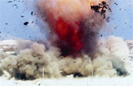
Explosions
Dynamite is one example of a chemical explosive. An explosive is anything that, once ignited, burns extremely rapidly and produces a large amount of hot
gas in the process.
Notes:
"What is dynamite and how does it work?."
Dynamite is one example of a chemical explosive. An explosive is anything that, once ignited, burns extremely rapidly and produces a large amount of hot gas in the process. The hot gas expands very rapidly and applies pressure. Other explosives that you commonly hear about are nitroglycerin and TNT, but anything from gasoline to ammonium nitrate fertilizer to special plastic explosives are in the same class. Dynamite is an absorbent material soaked in nitroglycerin.
Gasoline is what we are probably most familiar with, so let's start with it. Gasoline is made up of hydrogen and carbon atoms in chains. If you ignite a quantity of gasoline, it burns extremely rapidly -- oxygen in the air combines with the hydrogen and carbon atoms to create CO2 gas and H20 vapor (along with a lot of heat) in large quantities. The hot, expanding gas creates an expanding pressure wave that can blow things apart (or, in an engine, provide useful work).
Most true explosives contain the oxygen they need for burning in the chemical. This allows burning to occur much more quickly. Nitroglycerin, for example, has the chemical formula C3H5(ONO2)3. The carbon and hydrogen combine with oxygen, and the nitrogen is liberated.
Dynamite is simply some sort of absorbent material (like sawdust) soaked in nitroglycerin. The absorbent material makes the nitroglycerin much more stable. You normally use a blasting cap to detonate dynamite -- a blasting cap creates a small explosion that triggers the larger explosion in the dynamite itself.

Slide 42
Extreme Heat
A heat wave is an extended period of extreme heat, and is often accompanied by high humidity.
Notes:
A heat wave is an extended period of extreme heat, and is often accompanied by high humidity.
These conditions can be dangerous and even life-threatening for humans who don't take the proper precautions.
Talk about the number of deaths and how they add up to more than the total from other disasters.
See next slide

Slide 43
Extreme Heat Statistics
8,015 people have died from excessive heat in the U.S. between 1979 and 1999
More than the number people who have died from hurricanes, lightning, tornadoes, floods, and earthquakes combined
Most of these deaths have occurred during the summer months
Notes:
8,015 people have died from excessive heat in the U.S. between 1979 and 1999
More than the number people who have died from hurricanes, lightning, tornadoes, floods, and earthquakes combined
Most of these deaths have occurred during the summer months

Slide 44
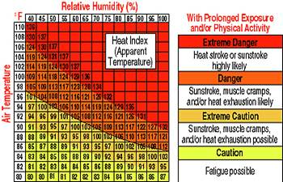

Slide 45
Fires
While flames are dangerous, heat and smoke can be more dangerous and can sear your lungs.
Notes:
While flames are dangerous, heat and smoke can be more dangerous and can sear your lungs.
As the fire burns, poisonous gases are emitted that can cause you to become disoriented or drowsy, which could put you into a heavy sleep. The leading cause of fire-related deaths is asphyxiation, outnumbering burns by a three-to-one ratio

Slide 46
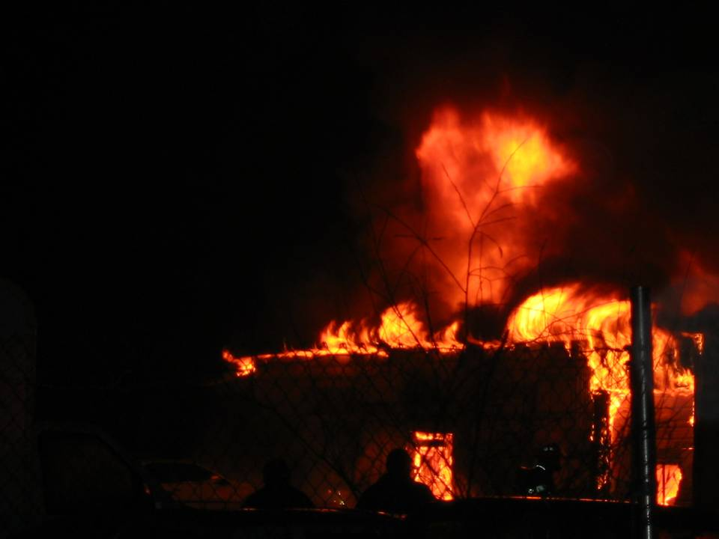
Signs of Fire
Flames or smoke
A fire alarm sounding

Slide 47
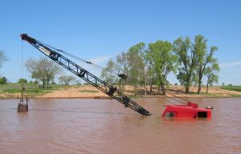
Floods
Flooding is the nation's most common natural disaster.
Flooding can happen in every U.S. state and territory.
Notes:
Flooding is the nation's most common natural disaster. Flooding can happen in every U.S. state and territory.
However, all floods are not alike. Some can develop slowly during an extended period of rain, or in a warming trend following a heavy snow. Others, such as flash floods, can occur quickly, even without any visible signs of rain. It’s important to be prepared for flooding no matter where you work, but particularly if you are in a low-lying area, near water or downstream from a dam. Even a very small stream or dry creek bed can overflow and create flooding.

Slide 48
Hurricanes
Hurricanes are severe tropical storms that form in the southern Atlantic Ocean, Caribbean Sea, Gulf of Mexico and in the eastern Pacific Ocean.
Notes:
Hurricanes are severe tropical storms that form in the southern Atlantic Ocean, Caribbean Sea, Gulf of Mexico and in the eastern Pacific Ocean. Scientists can now predict hurricanes, but people who live in coastal communities should plan what they will do if they are told to evacuate. Probably not a big work zone hazard.

Slide 49
Influenza Pandemic
You can prepare for an influenza pandemic now.
You should know both the magnitude of what can happen during a pandemic outbreak and what actions you can take to help lessen the impact of an influenza pandemic on you and your family.
Notes:
You can prepare for an influenza pandemic now.
You should know both the magnitude of what can happen during a pandemic outbreak and what actions you can take to help lessen the impact of an influenza pandemic on you and your family.

Slide 50
Pandemics are Dangerous
Influenza Pandemic | Date | U.S. Deaths | Worldwide Deaths
Spanish Flu | 1918-19 | 675,000 | 50 million
Asian Flu | 1957-58 | 70,000 | 1-2 million
Hong Kong Flu | 1968-69 | 34,000 | 700,000

Slide 51
Landslides and Debris Flow
Landslides, also known as mudslides or debris flow, occur in all U.S. states and territories, and can be caused by a variety of factors including earthquakes, storms and fires.
Notes:
Landslides, also known as mudslides or debris flow, occur in all U.S. states and territories, and can be caused by a variety of factors including earthquakes, storms and fires.
Landslides can occur quickly, often with little notice, and the best way to prepare is to stay informed about changes in and around your home that could signal that a landslide is likely to occur.

Slide 52
Motor Vehicle
Non-collision
Overturn/rollover
Fire/explosion
Immersion
Jackknife
Cargo/equipment loss or shift
Fell/Jumped from motor vehicle
Other non-collision
Notes:
Non-collision
07 Overturn/rollover
08 Fire/explosion
09 Immersion
10 Jackknife
11 Cargo/equipment loss or shift
12 Fell/Jumped from motor vehicle
13 Other non-collision

Slide 53
Motor Vehicle
Collision with person, vehicle, or object not fixed:
Pedestrian
Pedal cycle
Railway vehicle
Animal – wild
Animal – domestic
Motor vehicle in transport
Parked motor vehicle
Motor vehicle used as equipment (snowplow plowing)
Work zone/maintenance equipment
Barricade
Notes:
Collision with person, vehicle, or object not fixed
20 Pedestrian
21 Pedal cycle
22 Railway vehicle
23 Animal - wild
24 Animal - domestic
25 Motor vehicle in transport
26 Parked motor vehicle
27 Motor vehicle used as equipment (snowplow plowing)
28 Work zone/maintenance equipment
29 Barricade

Slide 54
Motor Vehicle
Collision with fixed object:
Bridge overhead structure
Bridge pier or support
Guardrail
Concrete traffic barrier
Other traffic barrier
Highway traffic sign post/sign
Traffic signal support/signal
Overhead sign support/sign
Light/luminaire support
Utility pole
Other post, pole, or support
Culvert
Curb
Ditch
Embankment
Approach
Construction – pavement cutout/road materials
Fence
Mailbox
Tree/Shrubbery
Rock
Snow bank
Other fixed object (wall, building, tunnel, etc.)
Notes:
Collision with fixed object
40 Impact attenuator/crash cushion
41 Bridge overhead structure
42 Bridge pier or support
43 Bridge rail
44 Guardrail face
45 Guardrail end
46 Concrete traffic barrier
47 Other traffic barrier
48 Highway traffic sign post/sign
49 Traffic signal support/signal
50 Overhead sign support/sign
51 Light/luminaire support
52 Utility pole
53 Other post, pole, or support
54 Culvert
55 Curb
56 Ditch
57 Embankment
58 Approach
59 Construction – pavement cutout/road materials
60 Fence
61 Mailbox
62 Tree/Shrubbery 63 Delineator post
64 Rock
65 Snow bank
66 Other fixed object (wall, building, tunnel, etc.)

Slide 55
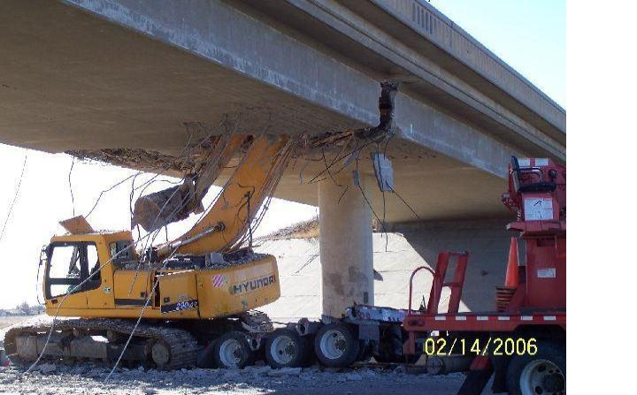
Unsafe condition

Slide 56

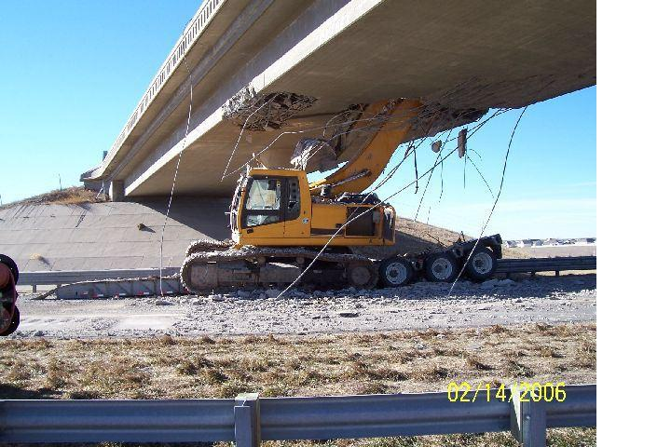
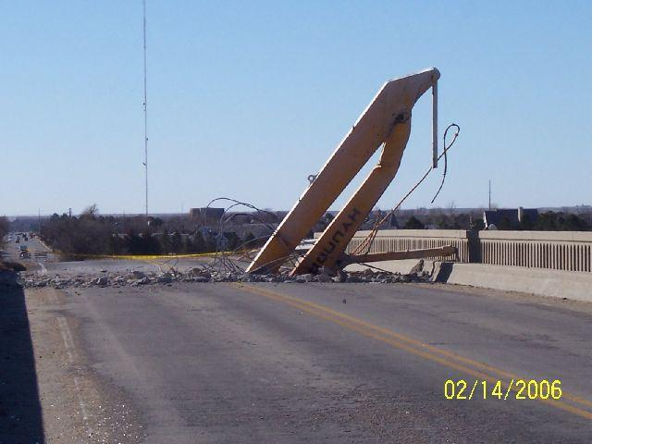
Unsafe Condition

Slide 57
Unsafe Condition

Slide 58
Nuclear Threat
A nuclear blast is an explosion with intense light and heat, a damaging pressure wave and widespread radioactive material that can contaminate the air, water and ground surfaces for miles around.
Notes:
A nuclear blast is an explosion with intense light and heat, a damaging pressure wave and widespread radioactive material that can contaminate the air, water and ground surfaces for miles around
While experts may predict at this time that a nuclear attack is less likely than other types, terrorism by its nature is unpredictable.

Slide 59
Radiation Threat
A radiation threat, commonly referred to as a "dirty bomb" or "radiological dispersion device (RDD)", is the use of common explosives to spread radioactive materials over a targeted area.
It is not a nuclear blast.
Notes:
A radiation threat, commonly referred to as a "dirty bomb" or "radiological dispersion device (RDD)", is the use of common explosives to spread radioactive materials over a targeted area.
It is not a nuclear blast.
The force of the explosion and radioactive contamination will be more localized.
While the blast will be immediately obvious, the presence of radiation will not be clearly defined until trained personnel with specialized equipment are on the scene.
As with any radiation, you want to try to limit exposure. It is important to avoid breathing radiological dust that may be released in the air.

Slide 60
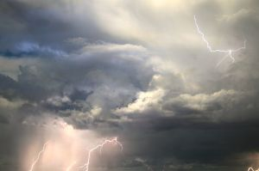
Thunderstorms and Lightning
In the United States, lightning kills 300 people and injures 80 on average, each year.
Notes:
All thunderstorms produce lightning and all have the potential for danger.
Those dangers can include tornadoes, strong winds, hail, wildfires and flash flooding, which is responsible for more fatalities than any other thunderstorm-related hazard.
Lightning's risk to individuals and property is increased because of its unpredictability, which emphasizes the importance of preparedness.
It often strikes outside of heavy rain and may occur as far as 10 miles away from any rainfall. Most lightning deaths and injuries occur when people are caught outdoors in the summer months during the afternoon and evening.

Slide 61

Tornadoes
Tornadoes are nature's most violent storms
Notes:
Tornadoes are nature's most violent storms
They can appear suddenly without warning and can be invisible until dust and debris are picked up or a funnel cloud appears. Planning and practicing specifically how and where you take shelter is a matter of survival.
Be prepared to act quickly. Keep in mind that while tornadoes are more common in the Midwest, Southeast and Southwest, they can occur in any state and at any time of the year, making advance preparation vitally important.

Slide 62
Wildfires
According to Weather.com, an average of 1.2 million acres of U.S. woodland burn every year and more than four out of every five wildfires are caused by people.
Notes:
According to Weather.com, an average of 1.2 million acres of U.S. woodland burn every year and more than four out of every five wildfires are caused by people.
The U.S. Fire Administration reported that in 2005 alone, 66,552 wildfires took place and 8,686,753 acres were burned. If you live where there is an abundance of plants and other vegetation that can easily catch fire, you may be vulnerable to wildfires and you should take the following three simple steps to prepare.

Slide 63

Winter Storms and Extreme Cold
While the danger from winter weather varies across the country, nearly all Americans, regardless of where they live, are likely to face some type of severe winter weather at some point in their lives.
Notes:
While the danger from winter weather varies across the country, nearly all Americans, regardless of where they live, are likely to face some type of severe winter weather at some point in their lives.
That could mean snow or subfreezing temperatures, as well as strong winds or even ice or heavy rain storms. One of the primary concerns is the winter weather's ability to knock out heat, power and communications services to your home or office, sometimes for days at a time. The National Weather Service refers to winter storms as the “Deceptive Killers” because most deaths are indirectly related to the storm. Instead, people die in traffic accidents on icy roads and of hypothermia from prolonged exposure to cold. It is important to be prepared for winter weather before it strikes.
NEXT WE WILL LOOK AT PLANNING and DRILLS

Slide 64
Emergency Drill Brainstorming
What is the Worst Case Scenario at your work zone?
What is the second most common possibility?
Who is responsible?
Review
Notes:
What is the Worst Case Scenario at your work zone? Write on news print responses and determine which one to work on with the group
What is the second most common possibility?
Who is responsible? Make up a person if no one suggests a position
Review
Conducting an Emergency Response Drill To start planning, ask yourself, "What is our worst-case scenario

Slide 65
Understanding what its about that will help my co worker in a work zone?
A valuable tool to use in deciding how these will affect your area is to identify their probability of occurring in your work zone.
We can use this table to identify probability so
Type of Emergency
Probability
Human Impact
Property Impact
Business Impact
Internal Resources
External Resources
Notes:
A valuable tool to use in deciding how these will affect your area is to identify their probability of occurring in your work zone. After figuring out the probability you will need to find out or determine what you can do to alleviate any problems that may occur in a work zone. Why is it a problem?
We can use this table to identify probability so you can handle the situation.
Type of Emergency
Probability
Human Impact-did we lose workers
Property Impact-what equipment is still working
Business Impact-can you still work
Internal Resources-who to call
External Resources-who will help
Total
High Low
5 1
High Impact
5
1 Low Impact
Weak 5 Resources
1 strong Resources

Slide 66
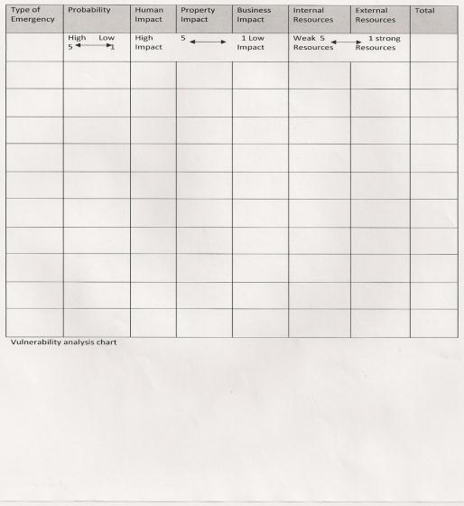
Notes:
Ed and the guys at CCC company have figured out the probability of a hazard happening in the work Zone and understand that they need more than just the knowledge of what a work zone is and the hazards they will need training
Please note this Is a handout and will appear differently

Slide 67
Hazard Activity
Biological threats
Blackouts
Chemical threats
Earthquakes
Explosions
Extreme Heat
Fires
Floods
Hurricanes
Influenza Pandemic
Landslide and debris flow
Motor Vehicle
Nuclear Threat
Radiation Threat
Thunderstorms
Tornadoes
Wildfires
Winter Storms and Extreme Cold
Notes:
hand out Vulnerability analysis graph in determining what the class thinks is the worst thing that can happen based on the groups of 5 per group of four provided there are 20 in the class; adjust as necessary
The information in this exercise should take about 45 minutes. Discern the emergency and work through the what ifs. Groups of 4-5 each group will take
15 minutes set up
15 planning
15 discussion of results

Slide 68
Three reasons why we should help a person in a work zone
First, We need to identify what is a work zone?
Second, we need to recognize what are the hazards in a work zone?
Third , what training do I need to help?
Notes:
First, We need to identify what is a work zone? I think we have accomplished what is a work zone and what its size is and what can occur
Second, we need to recognize what are the hazards in a work zone?
Third , what training do I need to help?
So we are guessing the worst case scenario may be something with a fire or an accident or a tornado if the group decides something else we will have to evaluate the finding differently for each of the next scenarios for training

Slide 69
Based on the brainstorming example lets figure out the training puzzle probability
Medical?
Emergency preparedness?
Resources?
Notes:
Medical?
Emergency preparedness?
Human Resources?

Slide 70
Typical emergencies in a work zone 16,090 cases
Over exertion back strain or strains
Fractures broken bones
Cuts lacerations
Bruises & contusions
Burns
Amputations
Heart attack
Bites & stings
Noise
Notes:
According to numbers issued by Bureau of Labor Statistics for heavy construction in 2009 there were 16,090 cases: 5580 were sprains, strains, and tears- 2,180 fractures- 1440 cuts, lacerations and punctures- 1260 bruises & contusions, 290 burns- 110 chemical burns, 130 amputations.
Injury and Illness: 5830 contacts with objects(struck by object, struck against, caught in)- 2970 falls including to a lower level or same level, 490 slips or trips- 2090 overexertion
Over exertion back strain or strains
Fractures broken bones
Cuts lacerations
Bruises & contusions
Burns
Amputations
Heart attack
Bites & stings
Burns-chemical & Electrical
Noise

Slide 71
Typical emergencies in a work Zone 16,090 cases
Injury and Illness
Contacts with Objects
Falls
Slips & Trips
Overexertion
Notes:
According to numbers issued by Bureau of Labor Statistics for heavy construction in 2009 there were 16,090 cases: 5580 were sprains, strains, and tears- 2,180 fractures- 1440 cuts, lacerations and punctures- 1260 bruises & contusions, 290 burns- 110 chemical burns, 130 amputations.
Injury and Illness: 5830 contacts with objects(struck by object, struck against, caught in)- 2970 falls including to a lower level or same level, 490 slips or trips- 2090 overexertion
Over exertion back strain or strains
Fractures broken bones
Cuts lacerations
Bruises & contusions
Burns
Amputations
Heart attack
Bites & stings
Burns-chemical & Electrical
Noise
Injury and Illness
1.Contacts with Objects
2.Falls
3.Slips & Trips
4.Overexertion

Slide 72
Medical Emergencies
Notes:
Take steps to give you the upper hand in responding to emergencies

Slide 73
Regulations (Standards - 29 CFR) Medical services and first aid. - 1910.151
1910.151(a)
The employer shall ensure the ready availability of medical personnel for advice and consultation on matters of plant health.
1910.151(b)
In the absence of an infirmary, clinic, or hospital in near proximity to the workplace which is used for the treatment of all injured employees, a person or persons shall be adequately trained to render first aid. Adequate first aid supplies shall be readily available.
1910.151(c)
Where the eyes or body of any person may be exposed to injurious corrosive materials, suitable facilities for quick drenching or flushing of the eyes and body shall be provided within the work area for immediate emergency use.
Notes:
1910.151(a)
The employer shall ensure the ready availability of medical personnel for advice and consultation on matters of plant health.
1910.151(b)
In the absence of an infirmary, clinic, or hospital in near proximity to the workplace which is used for the treatment of all injured employees, a person or persons shall be adequately trained to render first aid. Adequate first aid supplies shall be readily available.
1910.151(c)
Where the eyes or body of any person may be exposed to injurious corrosive materials, suitable facilities for quick drenching or flushing of the eyes and body shall be provided within the work area for immediate emergency use.

Slide 74
Regulations (Standards - 29 CFR) Medical services and first aid. - 1926.50 App A
First aid Kits (Non-Mandatory)
Minimum Requirements for Industrial Unit-Type First-aid Kits". The contents of the kit listed in the ANSI standard should be adequate for small work sites
Notes:
First aid supplies are required to be easily accessible under paragraph Sec. 1926.50(d)(1). An example of the minimal contents of a generic first aid kit is described in American National Standard (ANSI) Z308.1-1978
"Minimum Requirements for Industrial Unit-Type First-aid Kits". The contents of the kit listed in the ANSI standard should be adequate for small work sites.
When larger operations or multiple operations are being conducted at the same location, employers should determine the need for additional first aid kits at the worksite, additional types of first aid equipment and supplies and additional quantities and types of supplies and equipment in the first aid kits.
In a similar fashion, employers who have unique or changing first-aid needs in their workplace, may need to enhance their first-aid kits. The employer can use the OSHA 200 log, OSHA 101's or other reports to identify these unique problems. Consultation from the local Fire/Rescue Department, appropriate medical professional, or local emergency room may be helpful to employers in these circumstances. By assessing the specific needs of their workplace, employers can ensure that reasonably anticipated supplies are available.
Employers should assess the specific needs of their worksite periodically and augment the first aid kit appropriately.
If it is reasonably anticipated employees will be exposed to blood or other potentially infectious materials while using first-aid supplies, employers should provide personal protective equipment (PPE). Appropriate PPE includes gloves, gowns, face shields, masks and eye protection (see "Occupational Exposure to Blood borne Pathogens", 29 CFR 1910.1030(d)(3)) (56 FR 64175

Slide 75
What is First Aid ?
First aid refers to medical attention that is usually administered immediately after the injury occurs and at the location where it occurred.
Notes:
First aid can include cleaning minor cuts, scrapes, or scratches; treating a minor burn; applying bandages and dressings; the use of non-prescription medicine; draining blisters; removing debris from the eyes; massage; and drinking fluids to relieve heat stress. OSHA's revised recordkeeping rule, which went into effect January 1, 2002, does not require first aid cases to be documented.
For example: A worker goes to the first-aid room and has a dressing applied to a minor cut by a registered nurse. Although the registered nurse is a health care professional, the employer does not have to report the accident because the worker simply received first aid. The selected references below provide more information on first aid.

Slide 76
Medical and First Aid OSHA Standards
Section 5(a)(1) of the OSHA Act, often referred to as the General Duty Clause, requires employers to "furnish to each of his employees employment and a place of employment which are free from recognized hazards that are causing or are likely to cause death or serious physical harm to his employees".
Notes:
Section 5(a)(1) of the OSHA Act, often referred to as the General Duty Clause, requires employers to "furnish to each of his employees employment and a place of employment which are free from recognized hazards that are causing or are likely to cause death or serious physical harm to his employees".
Section 5(a)(2) requires employers to "comply with occupational safety and health standards promulgated under this Act".

Slide 77
Medical Training
CPR
First Aid
Blood borne pathogens
Notes:
CPR Why would this help beyond the basic?
First Aid Specifically maybe burns, head injuries, medical emergencies?
Blood borne pathogens are we worried?

Slide 78
Five Reasons to get CPR Training
1. By the time someone needs CPR they are dead.
2. Being helpless in a crisis situation is a horrible feeling. When the victim is a friend or coworker you will want to know how you can help.
3. CPR training teaches you how to handle a situation where you need to take control and give commands.
Notes:
1. By the time someone needs CPR they are dead. Their heart has stopped and they are no longer breathing. CPR at this point can only help a person until professionals arrive at the scene.
2. Being helpless in a crisis situation is a horrible feeling. When the victim is a friend or family member you will want to know how you can help. CPR is a life saving skill that can be crucial in a life or death situation. CPR training will also teach you what not to do in an emotional situation. For example, sometimes it's best not to move an injured person. If you are a parent your first instinct might be to pick up your child. This might not be the right thing to do and with proper training, you will learn what is helpful and what is potentially harmful.
3. CPR training teaches you how to handle a situation where you need to take control and give commands. "Hey you, in the yellow shirt call 911." "Hey you, with the glasses, wait over there to flag down the ambulance."

Slide 79
Five Reasons to get CPR training
4. CPR training teaches you how to use a defibrillator.
5. CPR training will teach you how to keep yourself safe in an emergency situation.
Notes:
4. CPR training teaches you how to use a defibrillator. Defibrillators are located in many public spaces such as community centres, swimming pools and senior centres. They are good to have in public spaces but they are even better, if there are people around who are trained to use them.
5. CPR training will teach you how to keep yourself safe in an emergency situation. If something horrible has happened you need to know how to quickly analyze the scene for your own safety. Broken glass, possible explosions and bodily fluids are things you might not think about if you are running toward someone to help them out.

Slide 80
Five Reasons to get CPR training
Being trained in CPR is crucial for anyone. More trained citizens means a safer and faster acting community.
Many organizations offer CPR training. National Safety Council and the Red cross are a couple of examples.
Get Trained!
Notes:
Being trained in CPR is crucial for anyone. More trained citizens means a safer and faster acting community.
Many organizations offer CPR training. Red Cross are a couple of examples. The courses are not very long or expensive. It's definitely worth it!
Get Trained!

Slide 81
First Aid Training Will Help Me? How?
The key aims of first aid can be summarized in three key points:
Preserve life
Prevent further harm
Promote recovery
First aid training also involves the prevention of initial injury and responder safety, and the treatment phases.
Notes:
The key aims of first aid can be summarized in three key points:
Preserve life - the overriding aim of all medical care, including first aid, is to save lives
Prevent further harm - also sometimes called prevent the condition from worsening, this covers both external factors, such as moving a patient away from any cause of harm, and applying first aid techniques to prevent worsening of the condition, such as applying pressure to stop a bleed becoming dangerous.
Promote recovery - first aid also involves trying to start the recovery process from the illness or injury, and in some cases might involve completing a treatment, such as in the case of applying a plaster to a small wound.
First aid training also involves the prevention of initial injury and responder safety, and the treatment phases.
The first few minutes after an injury or medical emergency are the most crucial to determine the rate and duration of recovery. Knowing what to do in the event of an injury or emergency will help you stay calm and take the proper actions and precautions to help the victim have the best chances of a full recovery.
If you work with other people, have children or spend time participating in sports or other hobbies that could result in injuries, you should know first aid. You never know when someone might get injured and knowing what to do to at least help them feel comfortable until professional help arrives will be so beneficial to the patient. Of course, you often cannot do it alone. It’s important to have supplies on hand just in case of an emergency (and a box of adhesive bandages doesn’t count as a first aid kit!) Having a well stocked first aid kit in your home and vehicle and a smaller kit in your purse or briefcase will ensure that you’re prepared where ever you are.
Taking a course on first aid and CPR can help you help the people you encounter on a daily basis. Furthermore, knowing these skills will help you remain calm in the event of an emergency because you’ll know exactly what you need to do

Slide 82
Bloodborne Pathogens
This section applies to all occupational exposure to blood or other potentially infectious materials.
Notes:
This section applies to all occupational exposure to blood or other potentially infectious materials.
If your job responsibilities involve occupational exposure to bloodborne pathogens you will need additional training that is specific to your work environment and work practices. You will also need to be given the opportunity to ask questions of the person conducting the training session.
In an emergency situation involving blood or potentially infectious materials, you should always use Universal Precautions and try to minimize your exposure by wearing gloves, splash goggles, pocket mouth-to-mouth resuscitation masks, and other barrier devices.
If you are exposed, however, you should:
Wash the exposed area thoroughly with soap and running water. Use non-abrasive, antibacterial soap if possible.
If blood is splashed in the eye or mucous membrane, flush the affected area with running water for at least 15 minutes.
Report the exposure to your supervisor as soon as possible.
Fill out an exposure report form, if you desire. This form will be kept in your personnel file for 40 years so that you can document workplace exposure to hazardous substances

Slide 83

OSHA
Bloodborne Pathogen Standard
Designed to eliminate or minimize employees’ exposure to human blood and other potentially infectious materials (OPIM) in the workplace
Went into effect in 1992
1-83

Slide 84
Quiz Time

Slide 85
The employer shall ensure the ready availability of medical personnel for advice and consultation on matters of plant health. Relates to what standard?
Regulations (Standards - 29 CFR) Medical services and first aid. - 1910.151
Notes:
The employer shall ensure the ready availability of medical personnel for advice and consultation on matters of plant health. Relates to what standard?
Regulations (Standards - 29 CFR) Medical services and first aid. - 1910.151

Slide 86
Typical emergencies in a work zone 16,090 cases What was the number 1?
Overexertion
Notes:
Overexertion

Slide 87
"Minimum Requirements for Industrial Unit-Type First-aid Kits“ How are the minimum contents determined?
The contents of the kit listed in the ANSI standard should be adequate for small work sites.
Notes:
The contents of the kit listed in the ANSI standard should be adequate for small work sites.

Slide 88
CPR training will teach you?
How to help before its too late How to use an AED How to be safe How to manage emergencies

Slide 89
What was designed to eliminate or minimize employees’ exposure to human blood and other potentially infectious materials (OPIM) in the workplace?
Bloodborne Pathogens Standard
Notes:
Bloodborne Pathogens Standard

Slide 90
Emergency Preparedness
Notes:
Ed and the guys are now thinking they have some basic medical training needs and ideas and the importance of having it when there is an emergency due to one of the hazards in a work zone. But the boss at CCC company wants them to have preparedness training.
The next question is what is Emergency Preparedness Training?

Slide 91
Work Zone Emergency Preparedness Training
Remote work zone emergency preparedness must account for all hazards.
Both man made and natural disasters.
Notes:
Ed needs to know what is emergency preparedness and how do you determine the steps? Ed knows we need to know all about the hazards which we looked at earlier
Remote work zone emergency preparedness training must account for all hazards.
Both man made and natural disasters.
You should plan in advance to manage any emergency situation.
Assess the situation Most importantly …….. Use common sense and available resources to take care of yourself, your coworkers, and your business ‘s recovery.

Slide 92
Work Zone Emergency Preparedness Training
Use common sense and available resources to take care of yourself, your coworkers, and your business ‘s recovery.
Risk Assessment area of expertise that can range from self-assessment to an extensive engineering study
Notes:
Use common sense and available resources to take care of yourself, your coworkers, and your business ‘s recovery.
Risk assessment is a sophisticated area of expertise that can range from self-assessment to an extensive engineering study. The specific industry, size and scope of your individual company will determine your organization's risk assessment needs.
Know what kinds of emergencies might affect your company both internally and externally.
Find out which natural disasters are most common in the areas where you operate. You may be aware of some of your community's risks; others may surprise you.
Ed and his buddies already determined its going be_______________________ from the exercise we did earlier

Slide 93
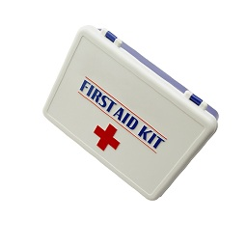
Preparations for Emergencies
KNOW:
What to do
Where first aid and emergency kits are kept
Emergency phone numbers
Do you use 911 or a different emergency telephone number?
Notes:
What to do
Where first aid kits are kept
Emergency phone numbers
Do you use 911 or a different emergency telephone number?

Slide 94
Preparing for Emergencies
Most injuries can be prevented
Take steps!
Always follow safety procedures required by OSHA
Notes:
Most injuries can be prevented
Take steps!
Always follow safety procedures required by OSHA

Slide 95
Best Practices for Response & Recovery Training
Worksite Evaluation
Exposure Monitoring
Hazard Control
Work Practices
Personal Protective Equipment (PPE)
Training
Notes:
The CCC company has experienced disasters before and did learn from them that are certiain aspect to returning back to work help: these are some of the basics that need to be involved in training and learning what to do in a work zone
Worksite Evaluation
Exposure Monitoring
Hazard Control
Work Practices
Personal Protective Equipment
Training Component

Slide 96
Best Practices for Response & Recovery
Worksite Evaluation
Evaluate the work site to identify if safety or health hazards such as the following are present
Exposure Monitoring
As appropriate, conduct task-specific exposure monitoring during response and recovery activities
Notes:
Worksite Evaluation Evaluate the work site to identify if safety or health hazards such as the following are present: fall, electrocution, noise, cut/laceration hazards; high ambient temperatures; hazardous substances; or infectious materials
Exposure Monitoring As appropriate, conduct task-specific exposure monitoring during response and recovery activities as follows: When required by a specific standard (e.g., as specified in OSHA standards for lead, asbestos, benzene, and noise).
When exposure is reasonably anticipated to be greater than the "action level," as required by an individual OSHA substance-specific standard. This is recommended for assessing exposure to other chemicals that response and recovery workers may be exposed to. Screening data, previous sampling results, and anecdotal information may be evaluated to assess an employee's anticipated exposure.

Slide 97
Best Practices for Response & Recovery
Hazard Control
Mitigate hazards according to the hierarchy of controls listed
Work Practices
work practices provide for basic safety, sanitation, and good housekeeping
Notes:
Hazard Control Mitigate hazards according to the hierarchy of controls listed below: Elimination or substitution: Whenever possible, eliminate the hazard from the work area (e.g., repair or remove fallen electrical power lines before allowing other work to proceed in the area). Although desirable, elimination and substitution may not be options for most airborne/chemical hazards created by a natural disaster.
Engineering controls: Take steps to reduce or eliminate exposure to a hazard, such as by guarding the pinch points associated with a machine's moving parts, providing ventilation to a permit-required confined space, using heavy equipment with temperature-controlled cabs, and placing barriers around the swing radius of rotating heavy equipment.
Work practice or administrative controls: Implement work procedures that reduce the probability of exposure. For example, use well-rested crews and daylight hours to perform higher hazard or unfamiliar tasks, take frequent breaks during hot weather, remove non-essential personnel from the area during certain task/operations, and decontaminate equipment and personnel after contact with contaminated floodwater or chemicals. When possible, use water to suppress dust and work up-wind in dusty conditions. Where extensive hot work is performed in the form of cutting and burning, use extended length torch handles to increase the distance from the individual's breathing zone to the generation of toxic fumes.
Performing specific Job Hazard Analyses (JHAs) often will identify important work practice controls. OSHA provides additional assistance on developing JHAs. See Job Hazards Analysis (OSHA Publication 3071, 2002). Personal protective equipment (PPE): If other controls are not available, infeasible, or do not provide sufficient protection, select and use PPE appropriate for the hazard and level of exposure. OSHA provides additional assistance on selecting and using PPE.
Work Practices The following work practices provide for basic safety, sanitation, and good housekeeping. These practices minimize exposure to health hazards and contaminants during most activities. Establish and maintain evacuation routes and an alerting system to notify individuals in case an evacuation becomes necessary.
Provide, maintain, and inspect fire protection and suppression equipment for the fire hazards in the work area.
Ensure that first aid supplies and services, and medical care are readily available.
Drink water from sources proven to be safe for drinking.
Do not consume food or beverages that were exposed to floodwaters or perishables that may have spoiled. Additionally, do not eat, drink, or smoke in areas containing debris, floodwaters, or sludge.
Wash hands before eating, drinking, smoking, or using the restroom. If potable water is not available, use hand sanitizer or commercial sanitizing wipes.
Minimize accumulation of trash and keep garbage in closed containers.
Use insect repellent containing DEET or Picaridin to prevent insect bites.
Minimize the creation or disturbance of dust and work upwind of dusty activities when possible.
Provide prompt first aid for cuts and scrapes. Antibiotic resistant bacteria can result in severe injury and illness. Wash and sanitize cuts and scrapes without delay and report the injury to your supervisor. Bandage/cover cuts and scrapes and keep them from coming in contact with polluted or contaminated floodwater. Seek medical help at the first sign of infection.

Slide 98
Best Practices for Response & Recovery
Personal Protective Equipment (PPE)
select PPE that will protect employees from these hazards, and ensure that employees use the PPE selected
Training
Train employees engaged in response and recovery operations to recognize and avoid the hazards to which they may be exposed while performing their jobs
Notes:
Personal Protective Equipment (PPE)
Assess the workplace hazards, select PPE that will protect employees from these hazards, and ensure that employees use the PPE selected. Equipment must be properly fitted to the employee. Train employees in the use, operation, and limitations of equipment, as well as how to put on and remove the equipment properly (i.e., donning and doffing techniques). Inspect equipment before each use and repair or replace as needed (e.g., when ripped, torn). Maintain and store PPE in a clean and sanitary manner. Maintain adequate supplies for timely replacement of lost, worn, or broken PPE.
Training Train employees engaged in response and recovery operations to recognize and avoid the hazards to which they may be exposed while performing their jobs. This training may be composed of the following elements: Job-specific training necessary for employees to develop the skills needed to perform their assigned task/operation.
Task- or operation-specific training on how to perform the job safely, including any training mandated by specific standards. This may include training/information related to hazard communication, hazardous waste cleanup and emergency response, selection and use of PPE, work with lead and asbestos, use of tools, and working safely at elevations.
Training about the general hazards, conditions, and work expected to be performed. Training should be conducted before employees are deployed. Discuss common stressors for response and recovery workers, such as extended work shifts, acclimatization issues, less than ideal sleeping and eating conditions, and critical incident stress concerns.
Site-specific training that covers the hazardous conditions and exposures that employees may encounter at a particular location. Identify specific controls such as specialized equipment, work practices, and additional PPE necessary for the particular job site. These controls may be identified in a Job Hazard Analysis (JHA) developed for the task or operation.
Daily job briefings covering the day's work plan, anticipated hazards, and required exposure controls.
Maintain records of employee training and make these available for inspection by agencies having jurisdiction. Training records include training certificates, attendance rosters, and course curricula. NOTE: Contracts with private employers to assist in the response and recovery should specify the particular safety and health training for which the contractor is responsible.

Slide 99
Table Top Exercises
Objectives
Enhance understanding of current Emergency Preparedness/Business Continuity plans
Identify gaps in Preparedness and Response plans
Foster collaboration and coordination opportunities among internal departments and outside agencies
Clarify roles and responsibilities supervisors, staff, and the public in a large scale work zone emergency
Notes:
Ed and the company have established best practices from past experiences now they need to more about the planning portion
Tabletop Exercise utilizing the need for training. What do we plan for using training During a tabletop exercise, crisis team members respond to incoming information about a hypothetical crisis as if it were real. A moderator and role players feed crisis team members details as the scenario unfolds. For example, a scripted role player calls the program office, "This is a drill. This is Sgt. Friday, reporting a camp van rollover A graphic element in an application or on a Web page that changes its color or shape when the pointer is moved (rolled) over it. See JavaScript rollover. See also n-key rollover. on highway 15 with multiple injuries." During the drill, the crisis team leader assigns tasks and facilitates resolution of the crisis.

Slide 100
Emergency Planning
Through our planning we are a trained team that is an extension of the company because;
1.We know the steps for readiness
2.We have the supplies
3.We know what to do when it happens
Notes:
Through our planning we are a trained team that is an extension of the company because;
1.We know the steps for readiness
2.We have the supplies
3.We know what to do when it happens

Slide 101
7 Steps to Readiness
Identify & detail critical functions
Identify Vulnerabilities & Challenges
Classify employees
Create a communication protocol
Cross-train employees
Implement workplace policies
Educate your employees
Notes:
Identify & detail critical functions
Identify Vulnerabilities & Challenges
Classify employees
Create a communication protocol
Cross-train employees
Implement workplace policies
Educate your employees
Business continuity is the process by which your business can plan ahead to reduce interruptions and increase the ability to resume operations in the event of an interruption.
It is not the intent of this course to tell your company what planning efforts it needs to do, but it is important in the development of the work zone planning piece to understand where it fits in the bigger picture.
Business continuity planning (BCP) typically follows these general planning steps:
Create a Work Zone continuity team
The team should be comprised of those members of the work zone whose expertise is necessary to plan comprehensively. Typically this means including people from different areas in your business that are key to maintaining operations in the work zone. Your team may include representatives from human resources, maintenance, administration, operations, IT, safety and security.
Scope & assumptions
Prior to beginning the planning effort the scope and assumptions must be determined. The scope addresses the extent of the planning (e.g., will all sites be included, will all operational levels be included, will all-hazards be included, etc.) and the assumptions address the premises the plan will be built upon (e.g., electricity will be available, communications available, employees will be able to work, etc.).
Assess current plans, policies & protocols
Most businesses have some basic plans, policies and protocols in place to deal with work zone emergencies or events that may occur and disrupt work. Additionally, businesses also have a series of government safety standards that may also apply to their operations. These items need to be reviewed and evaluated by the planning team to determine the extent to which they are congruent (or conversely incongruent) with the other items under review; outdated; and, useful to the current planning effort.
Some of the items businesses may include in this review include: employee training manuals; OSHA or other health/safety standards that your business must comply with; employment handbooks; policies relating to computer use and security; data backup procedures; evacuation procedures (e.g., written procedures and marking of evacuation routes); basic safety documents; specialized training materials and procedural instructions for large or dangerous equipment; and, local, state and federal ordinances pertinent to day-to-day operations and risk management planning items.
Review insurance
Existing insurance polices should be reviewed to ensure that current coverage is adequate and not duplicative. Insurance companies should also be contacted to ascertain whether discounts are available for those businesses with continuity of operations plans. All insurance policy information (e.g., policy limits, renewal dates, and agent contact name and number) should be compiled and included in the plan and in an easily accessible off-site location.
Collect basic information on employees, customers, creditors and vendors
Basic information on employees, customers, creditors and vendors must be gathered and centrally located in the planning document and at an easily accessible off-site location. The type of information collected about employees should contain at the least basic contact information (in-office and at home telephone and email) and an emergency contact person (with a telephone number and the relationship to the employee indicated).
Customer, creditor and vendor information may be sensitive and closely-held information within your business and should be collected and handled with that in mind. In compiling this information relevant account numbers, sales representatives, and any other specific information that would be necessary to have during an event should be listed. In addition, alternate vendors should also be listed on the vendor list in the event that the primary vendor is unable to meet the business’s needs during an event.
Identify and detail critical functions (resources, equipment)
Critical functions are identified and detailed to allow the work zone to better prepare for an interruption of work in the zone. Chronicling the detailed steps involved in performing each function as well as the resources and equipment necessary to the function’s performance, the work zone can take necessary steps to protect the zone, invest in training for additional personnel to perform the work, and make the necessary preparations to perform some of the work off-site if necessary. An information collection sheet for critical functions is will be reviewed later
Risk assessment
The goal of a risk assessment is to better understand the risks that face the work zone. Risks are assessed based on probability, frequency, general impact (physical, financial, emotional, operational, etc.) and ability to recover. Risk assessment tools can vary from work zone to work zone based on the nature of the work or services provided. The risk assessment lays the base to later decisions regarding resource allocation, training and exercising. A poorly done risk assessment leads to a poorly prepared work zones. All potential hazards/events should be assessed. A sample risk assessment tool is included.
Function recovery strategy & timeline
Upon completion of the analysis the business or work zone management is able to discuss strategies and the timelines involved in getting back up. This may involve other sites, backup personnel, alternate approaches to a work zone, etc. Once the strategy is designed the necessary support for the recovery strategies can be put into place. This may include activities such as creating memorandums of understanding with backup sites, cross-training of employees, identification of alternate vendors, and the creation of policies and procedures.
Assess, prioritize & implement
In the process of discovering critical work zone functions’ vulnerabilities, there is an opportunity to identify possible activities that will either reduce the hazard or event impact or completely remove people, property and the work zones overall well-being from harm’s way. Potential activities should be assessed, prioritized and implemented. Many can be completed at no cost or at a relatively low cost. Examples of no cost and low cost activities include: moving equipment to higher ground; securing heavy objects; cross-training employees; elevating inventory; changing vendors or locating backup vendors.
The ability to remove the potential for a negative outcome is a powerful proactive step; however, these type of expenditures can be difficult to support in a “what if” framework. This is where a strong risk assessment can be illustrative and supportive of the need. It is also helpful to remember that by reviewing these steps are very effective in reducing the work zones or businesses' potential liability in an event.
Plan compilation
All the documents, lists and other items can now be compiled into “the plan”. The plan should be stored in both a hard copy and electronic format, should be available both on and off-site, should be easily accessible and user friendly. It will be frequently modified (particularly over the first few years) and updated and as such should not be viewed as “completed”. Ideally, planning is a process that is never “completed”; it is just more finely tuned as it progresses.
Training & exercise schedule
After the work zone plan is compiled, a training and exercise schedule should be developed to map out the training necessary to implement the plan and the exercises required to test the effectiveness of the plan. Training and exercises should also include evaluative measures to ensure that they accomplish the goal they set out to and if not, to allow for changes in future trainings and exercises. Also, after action reports should be completed as a part of each exercise and any errors or omissions in the plan or training needs that become apparent during the exercise should be noted as requiring further attention.
Communicate, train and exercise the plan
A plan that is effective in implementation is a plan that has been thoroughly communicated, trained and exercised. The best plans only start on paper with a goal of integrating the actions and expectations into the business’s knowledge base and culture. In a work zone emergency, employees will first revert to their training and existing knowledge base. For this reason businesses that prepare employees find that their employees are less panicked, more assured, and more capable in a crisis.
Plan maintenance/updating
Plans must be maintained and regularly updated. Planning is a process that continues to evolve and as such so must “the plan”. A systematic review of the plan should occur every one or two years and updating (as it relates to changes in personnel, suppliers, etc.) should be ongoing (at least quarterly). All plan documents should have an update date in the footer and each update should be inserted into every existing copy of the plan. When multiple hard copies are circulated this updating may be more difficult. A schedule and procedure for maintenance and updates should be established upon the first compilation of the plan to ensure that the plan will remain viable and useful.

Slide 102
Identify & detail critical work zone functions
This entails the following process:
identify the function
detail what is involved in the function (i.e., step-by-step if possible so that the function can be duplicated by someone who does not do it everyday - it is helpful to think the way one would when training a new trainee)
identify the resources necessary to perform that function (e.g., hardware, supplies, personnel, physical space, etc.)
list all the personnel presently trained to perform the function.
Notes:
Not all the work or functions within a work zone are critical to its day-to-day operations. Prior to beginning any planning efforts, businesses must identify the critical functions that are necessary to continue work during an emergency event.
This entails the following process: 1) identify the function; 2) detail what is involved in the function (i.e., step-by-step if possible so that the function can be duplicated by someone who does not do it everyday - it is helpful to think the way one would when training a new trainee); 3) identify the resources necessary to perform that function (e.g. supplies, personnel, physical space, etc.); and 4) list all the personnel presently trained to perform the work.
In identifying and detailing critical work functions businesses are typically shocked to learn how contained the knowledge base can be for any given function. Typically upon examining the depth of a critical function it is learned that only two or three individuals in the operation are versed in performing the function. If the function has been detailed at least someone else can step into the role and work through the steps. If in addition to the detailing another employee (or two) is trained on how to perform the function, the business now has dramatically decreased its odds of losing the function based on absenteeism.
Once the functions have been identified and detailed, each lead man can list the functions from most to least important and identify those functions that need greater employee depth. At this time functions can also be reviewed and grouped based on whether their performance is workplace specific or can be performed off-site. This grouping will be valuable in shaping solutions and preparing for events that interrupt critical functions and threaten the work zones continued operations.

Slide 103
Identify Vulnerabilities & Challenges
After the critical work zone functions have been identified and detailed, the business can identify its vulnerabilities based on the hazards it faces.
Notes:
After the critical work zone functions have been identified and detailed, the business can identify its vulnerabilities based on the hazards it faces.
Leads to the next point on causalities

Slide 104
Identify Vulnerabilities & Challenges
In work zones nationwide:
In 2007, there were 835 work zone fatalities.
In 2006, there were 1,010 work zone fatalities.
In 2005, there were 1,074 work zone fatalities.
Nationally, on average, three work zone fatalities occur every day or about one every eight hours.
In addition, an average of 160 work zone injuries occur every day or about one every nine minutes.
Notes:
In work zones nationwide:
In 2005, there were 1,074.
In 2006, there were 1,010.
In 2007, there were 835 work zone fatalities.
Nationally, on average, three work zone fatalities occur every day or about one every eight hours. In addition, an average of 160 work zone injuries occur every day or about one every nine minutes.
The situation is serious for both drivers and workers.
Highway construction is one of the most dangerous occupations in the United States. The risk of death is seven times higher for highway workers than for an average worker.
Work zone crashes tend to be more severe than other types of crashes.
After the critical functions have been identified and detailed, the business can identify its vulnerabilities based on the hazards it faces. In this class the focus is on an extreme event, but the same method used in reviewing vulnerabilities in this type of event can be used for other hazard events as well. For the purpose of bringing businesses up to speed quickly, this step addresses underlying assumptions that apply to a work zone event and the vulnerabilities and challenges that may emerge

Slide 105
Identify Vulnerabilities & Challenges
Highway construction is one of the most dangerous occupations in the United States.
The risk of death is seven times higher for highway workers than for an average worker.
Notes:
Highway construction is one of the most dangerous occupations in the United States.
The risk of death is seven times higher for highway workers than for an average worker.
Work zone crashes tend to be more severe than other types of crashes.
After the critical functions have been identified and detailed, the business can identify its vulnerabilities based on the hazards it faces.
In this class the focus is on an extreme event, but the same method used in reviewing vulnerabilities in this type of event can be used for other hazard events as well. For the purpose of bringing businesses up to speed quickly, this step addresses underlying assumptions that apply to a work zone event and the vulnerabilities and challenges that may emerge

Slide 106
Brainstorm ideas
Vulnerabilities
Challenges
Exposure to vehicles
Weather
Traffic stopping backed up
Emergency vehicles not arriving
Getting help arriving
Workers having communication issues
Notes:
Don’t expose the list, have students come up with the ideas then add them if they don’t. Be sure to have these in place before the training.
Vulnerabilities
Exposure to vehicles
Weather
Traffic stopping backed up
Emergency vehicles not arriving
Challenges
Getting help arriving
Workers having communication issues

Slide 107
Classify employees and others
Emergency planning efforts for all employees and other personnel should be designated as belonging in one of two classifications based on the nature of their work with the business – from essential to non-essential.
Notes:
To shortcut the time and energy involved in work zone emergency planning efforts for all employees and other personnel should be designated as belonging in one of two classifications based on the nature of their work with the business – from essential to non-essential.
These classifications allow your work zone to better plan for the potential on and off-site challenges.
Employee classification also helps identify those employees that are good choices for cross-training.

Slide 108
Employee Classification Chart
Classification 1 Essential to operations & must work
Classification 2 Not essential to operations, not necessary for them to work and must leave
Brainstorm: Who are these people?
Vendors
Public
Land owners?
Notes:
Make reference to OSHA reporting and the need for critical employees to be on site for first aid

Slide 109
Name the different ways you communicate at work during an Emergency
Notes:
. The first part involves you having people list all the ways they will be able to communicate when working in a remote work zone. This will show all the various ways that people utilize to communicate in the field. This could also show the difference in thinking, in terms of alternative communication, from construction workers as opposed to a company executive.
For the second part, you would have a random slide in another section that pops up and says an emergency has struck and your power has gone out. You would then see if the crews can use the communication methods that were previously mentioned. You might also have them try to come up with additional alternate ways they can communicate now that they know their power is out. This could show how reliant people are on technology, and maybe stress the importance of finding alternate ways to communicate.

Slide 110
Create communication protocol
Two-way communication is central before, during and after a work zone emergency.’
Consider setting up a telephone calling tree, an email or text alert or a call-in voice recording to communicate with employees in an emergency.
Notes:
Two-way communication is central before, during and after a work zone emergency.’
Communication with employees, customers and vendors is an important part of maintaining work zone operations.
Include emergency preparedness information in.
Consider setting up a telephone calling tree, an email or text alert or a call-in voice recording to communicate with employees in an emergency.

Slide 111
Create communication protocol
Designate a phone number where employees can leave an "I'm Okay" message in a catastrophic disaster.
Provide all co-workers with wallet cards detailing instructions on how to get company information in an emergency situation. Include telephone numbers or Internet passwords for easy reference.
Notes:
Designate a phone number where employees can leave an "I'm Okay" message in a catastrophic disaster.
Provide all co-workers with wallet cards detailing instructions on how to get company information in an emergency situation. Include telephone numbers or Internet passwords for easy reference.
Ensure you have established staff members who are responsible for communicating regularly to employees.
Identify co-workers in your organization with special needs.
Engage people with disabilities in emergency planning.
Ask about communications difficulties, physical limitations, equipment instructions and medication procedures.
Identify people willing to help co-workers with disabilities and be sure they are able to handle the job. This is particularly important if someone needs to be lifted or carried.
Plan how you will alert people who cannot hear an alarm or instructions.

Slide 112
Cross-train employees
Train to double or triple depth is tied to the number of employees, their classification, the resources of the business available, and the technical expertise required
Notes:
Train to double or triple depth is tied to the number of employees, their classification, the resources of the business available, and the technical expertise required
The ability to double or triple depth is tied to the number of employees, their classifications, the resources the business has available, and the technical or educational expertise required for the function. Not all functions can be easily cross-trained (e.g., electrical lineman).
When cross-training within work zone jobs there are typically obvious areas where cross-training can be easily accomplished. Cross-training that is contained within a specific activity or location is less time and cost-intensive. Employees that work together in the same work zone on a day-to-day basis are more likely to understand how the function fits into their overall operations, are easier to put in place for once a month on-the-job refresher training, and are more likely to retain the training.
In cross-training on this level it is important to note a couple of issues. First, employees that work closely together in one work zone or location may be absent at the same time at a higher rate than across the remainder of the business. Cross-training within the work zone is good, but this proviso underscores the rationale for cross-training outside the location.
Second, while swap training is a good approach (Bob trains for Bill’s job and vice versa), it is problematic if the function consumes an employee full-time and if both employees in the swap perform critical functions. In swap training, try and pair employees that do not perform a critical function with those that do. Also, be cognizant of creating swap training scenarios wherein the function only accounts for a percentage of the employee’s overall job description. If the swap training pairs employees who each spend 50% of their time doing different critical functions the ability to perform two critical functions can now be built into one employee.
Cross-trained employees must regularly practice their cross-trained skill to retain it. It is recommended that employees perform in their cross-trained capacity at least once a month. It is important that not all cross-trained employees have their skills reinforced at the same time. Cross-trained employees should have an opportunity to work with the primary employees and other cross-trained employees on these performance days. The greater the exposure cross-trained employees have to the breadth of employees they may be working with in their cross-trained capacity, the better.
While cross-training can seem complex given the discussion above, in practice it is the only way to guarantee that your business is able to maintain the employee depth that may be necessary. Spending time on the dialogue on the front-end can alleviate many of the challenges in effectively using cross-trained employees.

Slide 113
Implement Workplace policies
If its not in writing its not going to be followed
Notes:
Employees should be informed that a disregard for these policies is a disregard for the business’s continued operation.
While most employees care enough about themselves, fellow workers and the business’s viability to comply absent the threat of discipline, there seems to always be at least one employee who ignores the rules.
Employees that are found to be non-compliant should be written up and the focus of the discipline should be insubordination with existing policy. The acknowledgment that the employee signed (see step 7 in this guide) will come in handy in supporting the insubordination disciplinary action should there ever be any question regarding the fairness or validity of the action. Should the business create policy and not enforce it, the business is left open to litigation from employees who relied on the reasonable enforcement of the policies to help keep them safe and became ill because the policies were not reasonably enforced.

Slide 114
Educate your employees
The final step in preparing for an emergency in a work zone is educating employees about the business’s plan, policies, procedures and expectations.
Notes:
The final step in preparing for an emergency in a work zone is educating employees about the business’s plan, policies, procedures and expectations.
Every employee should be mandated to attend an informational meeting that explains how the business will address key issues in a pandemic event. As a part of this informational meeting employees should be given a folder that includes pertinent information on policies and procedures related to operational, human resource and healthy workplace initiatives.
Additionally, information on individual preparedness should be included. The information in the folder should be briefly reviewed in the meeting. Employees should be verbally informed at the meeting that any violation of the policies and procedures set forth in the folder will result in disciplinary action, up to and including, termination.
Employees should be asked to more deeply review the information in the folder at home and to sign an acknowledgement that indicates that they have reviewed and understood the material (individual items in the folder should be listed with check boxes so that the employee has to actually check off each item) and that they are aware that violation of the polices and procedures in relation to such an event will result in disciplinary action, up to and including, termination. The form should provide a space for the employee to print and sign their name and it should also be dated. The return of the form must be required of all employees and it should be returned within a week of the informational meeting. The business should indicate to employees at the time the folder is distributed where employees should direct any questions they may have regarding the information provided. Signed acknowledgements should be placed in employees’ files.
The folder should be retained at the employees’ home and should contain at a minimum: the communication protocol for employees; healthy workplace policy and procedure information; a Frequently Asked Questions sheet on absence, health care and insurance, and compensation issues; and, a pamphlet on individual preparedness.
This informational meeting is an opportunity for the business to assure employees that steps are being taken to protect them and their jobs. If possible, the top executives of the business should at least make a brief statement at the meeting to emphasize the importance of the message and the level of value placed on informing employees of the business’s preparedness actions. Informed employees are more likely to act rationally and stick with the business in a pandemic event.

Slide 115
Emergency Supplies

Slide 116
Where should you begin?
Brainstorming Activity:
Notes:
Before you show the slide that has a list of emergency supplies, you could have the participants list all the supplies that they think could be useful to have in an emergency supply kit. Basically, they would be creating their own supply list that would be applicable to themselves. After they have created their own list, you could show them your list of all the supplies. This could show them not only the basic supplies essential to survival but also additional materials that could help them in various situations.
Where should you begin? If you're just getting started in assembling your supplies, start by putting together a 72 hour kit. If you are trying to prepare for a specific type of emergency, be sure to see our emergency prepreparedness plans.
72 hour kits
MREs (Meals Ready to Eat), backpacking foods, and emergency rations
Emergency heating
Cooking supplies
Emergency lighting
First aid kits
Water storage
Home wall safes
Protection from the elements

Slide 117
Where should you begin?
The internet is full of emergency preparedness kit supplies
If you're just getting started in assembling your supplies, start by putting together a 72 hour kit.
Notes:
Where should you begin? If you're just getting started in assembling your supplies, start by putting together a 72 hour kit. If you are trying to prepare for a specific type of emergency, be sure to see our emergency prepreparedness plans.
72 hour kits
MREs (Meals Ready to Eat), backpacking foods, and emergency rations
Emergency heating
Cooking supplies
Emergency lighting
First aid kits
Water storage
Home wall safes
Protection from the elements

Slide 118
Where should you begin?
72 hour kits
MREs (Meals Ready to Eat), backpacking foods, and emergency rations
Emergency heating
Cooking supplies
Emergency lighting
First aid kits
Water storage
Protection from the elements
Notes:
72 hour kits
MREs (Meals Ready to Eat), backpacking foods, and emergency rations (show example)
Emergency heating (show Example)
Cooking supplies
Emergency lighting
First aid kits
Water storage
Protection from the elements

Slide 119
Suggested minimum needs: 2 hours
Water
1 Gallon (8 lbs.) per person for 3 days (8 drops chlorine bleach per gallon)
Food
Minimal of Noncook, Lightweight, Palatable, Can Opener, Cooking and Eating Utensils
Clothing
1 Change, Extra Shoes, Raingear, Adequate Winter Wear
Bedding
Blankets
Sanitation
Airtight Bucket or Porta Pottie, Toilet Paper, News Paper, Soap, Towel, Disinfectant, Trash Bags, Bleach
First Aid Kit
Personal Medications
Shelter
Tent or Tarp, Rope 1/4" x 36'
Tools
Pocket Knife, Small Tools, Axe, Pointed Shovel
Light
Flashlight, Batteries, Candles, Matches
Communication
Radio, Batteries, 1 Whistle Per Person
Fuel
For Cooking, Light, Heat
Money
Cash and Change
Notes:
Water
1 Gallon (8 lbs.) per person for 3 days (8 drops chlorine bleach per gallon)
Food
Minimal of Noncook, Lightweight, Palatable, Can Opener, Cooking and Eating Utensils
Clothing
1 Change, Extra Shoes, Raingear, Adequate Winter Wear
Bedding
Blankets
Sanitation
Airtight Bucket or Porta Pottie, Toilet Paper, News Paper, Soap, Towel, Disinfectant, Trash Bags, Bleach
First Aid Kit
Personal Medications
Shelter
Tent or Tarp, Rope 1/4" x 36'
Tools
Pocket Knife, Small Tools, Axe, Pointed Shovel
Light
Flashlight, Batteries, Candles, Matches
Communication
Radio, Batteries, 1 Whistle Per Person
Fuel
For Cooking, Light, Heat
Money
Cash and Change

Slide 120
Water Storage and Purification
Storing water
Finding or obtaining water
Purifying water
Notes:
water is probably the most necessary element for human life, with the exception of oxygen.
When planning your water resources for survival you need to deal with three areas:
Storing water
Finding or obtaining water
Purifying water

Slide 121
Storing Water
You should count on two to three gallons of water per-person per-day.
Notes:
You should count on two to three gallons of water per-person per-day.
While this is more water than necessary to survive (except in hot climates or after strenuous exertion) it ensures water is available. (Double check on giveaways to students?)
Commercial gallon bottles of filtered/purified spring water often carry expiration dates two years after the bottling date. A good rotation program is necessary to ensure your supply of water remains fresh and drinkable.
Purchase cases of six one-gallon jugs, which frequently go on sale for just under 50 cents per gallon. The heavy-duty cardboard boxes stack easily and protect the jugs from rupturing.

Slide 122
Storing Large amounts of Water
For self-storage of large amounts of water, you're probably better off with containers of at least 5 gallons.
Notes:
Food-grade plastic storage containers are available commercially in sizes from five gallons to 250 or more.
Containers with handles and spouts are usually five to seven gallons, which will weigh between 40 and 56 pounds. Get too far beyond that and you'll have great difficulty moving a full tank.
55 gallon drums and larger tanks are also useful for long-term storage. But make sure you have a good pump on hand!
Solutions designed to be added to water to prepare it for long-term storage are commercially available. Bleach can also be used to treat tap water from municipal sources. Added at a rate of about 1 teaspoon per 10 gallons, bleach can ensure the water will remain drinkable.
Recommended rotating the water in storage tanks every year.

Slide 123
Food Storage Guidelines
Do we need extra food in a work zone?
Hopefully, you will have plenty food when there is an emergency.
Here are five steps to planning for a work zone emergency
Notes:
Do we need extra food in a work zone?
Hopefully, you will have plenty food when there is an emergency, but just in case its an extended emergency here are a few ideas to provide the extra push to get you moving forward on building your food storage inventory. Even its just extra food bars.
Here are five steps to planning for a work zone emergency

Slide 124

Step One Determine how far out you want your food storage to last
Notes:
You want to plan out as far as possible. Just be prepared to incorporate the food in your emergency inventory into your normal daily use and replenish it.
Usually you plan for 16 to 24 hours individually. Have something extra in case the worker doesn’t have more to bring.

Slide 125
Step Two Determine what you want in your inventory
Keep in mind that the following are simply guidelines, not hard and fast rules written in stone.
Every person has different tastes and needs, so be sure to adjust slightly to your own preferences.
Notes:
These food storage tips will hopefully assist you in developing a food storage inventory plan that is realistic and useful. Be sure to consult our food storage guidelines as you begin implementing your strategy.
Keep in mind that the following are simply guidelines, not hard and fast rules written in stone. Every person has different tastes and needs, so be sure to adjust slightly to your own preferences.

Slide 126
ONE YEAR FOOD STORAGE FAMILY OF FOUR (4)
ITEM POUNDS Wheat 650 Enriched White Flour 60 Corn Meal 145 Rolled Oats 145 White Enriched Rice 290 Pearled Barley 15 Spaghetti & Macaroni
Notes:
Not needed for a work zone but here is an example of what a family needs for storage to give you an idea
What do you think? Where’s the beer☺

Slide 127
ONE YEAR FOOD STORAGE FAMILY OF FOUR (4)
TOTAL GRAINS 1450 Beans (dry) 100 Beans, Lima (dry) 5 Beans, Soy (dry) 5 Peas, split (dry) 5 Lentils (dry) 5 Dry Soup Mix 20
TOTAL LEGUMES 140 Vegetable Oil 8 gal Shortening 16 Mayonnaise 8 qts Salad Dressing 4 qts Peanut Butter 16
Notes:
Not needed for a work zone but here is an example of what a family needs for storage to give you an idea
What do you think? Where’s the beer☺

Slide 128
ONE YEAR FOOD STORAGE FAMILY OF FOUR (4)
TOTAL FATS/OILS 104 Milk, Nonfat Dry 60 Milk, Evaporated (12oz) 48 cans
TOTAL MILK 64 Sugar, Granulated 160 Sugar, Brown 12 Molasses 4 Honey 12 Corn Syrup 12 Jams and Preserves 12 Fruit Drink, Powdered 24 Flavored Gelatin 4
TOTAL SUGARS 240 Dry Yeast 2 Soda 4 Baking Powder 4 Vinegar 2 gal Chlorine Bleach 1 gal Salt 32 Water 56 gal (2 wks)
Notes:
Not needed for a work zone but here is an example of what a family needs for storage to give you an idea
What do you think? Where’s the beer☺

Slide 129
ONE YEAR FOOD STORAGE FAMILY OF FOUR (4)
ITEM POUNDS Wheat 650 Enriched White Flour 60 Corn Meal 145 Rolled Oats 145 White Enriched Rice 290 Pearled Barley 15 Spaghetti & Macaroni
TOTAL FATS/OILS 104 Milk, Nonfat Dry 60 Milk, Evaporated (12oz) 48 cans
TOTAL GRAINS 1450 Beans (dry) 100 Beans, Lima (dry) 5 Beans, Soy (dry) 5 Peas, split (dry) 5 Lentils (dry) 5 Dry Soup Mix 20
TOTAL LEGUMES 140 Vegetable Oil 8 gal Shortening 16 Mayonnaise 8 qts Salad Dressing 4 qts Peanut Butter 16
TOTAL MILK 64 Sugar, Granulated 160 Sugar, Brown 12 Molasses 4 Honey 12 Corn Syrup 12 Jams and Preserves 12 Fruit Drink, Powdered 24 Flavored Gelatin 4
TOTAL SUGARS 240 Dry Yeast 2 Soda 4 Baking Powder 4 Vinegar 2 gal Chlorine Bleach 1 gal Salt 32 Water 56 gal (2 wks)
Notes:
Not needed for a work zone but here is an example of what a family needs for storage to give you an idea
What do you think? Where’s the beer☺

Slide 130
Step Three Consider where you are going to store your food
Select a cool, dry area of your work zone like a storage shed?
Notes:
Your food storage safety must be considered whenever you are assembling your long-term food supply.
Store your food in a cool, dry place away from a lot of sunlight.
Store your food in airtight containers where possible.
Avoid placing your food storage containers directly on the floor.
10# tin cans are commonly used for food storage. With the proper lid, they keep products fresh, dry and they do not change the taste of the food like other containers will.
A neat trick in storing products in air tight food storage containers is to drop a small piece of dry ice into the container prior to filling it up. Set the lid on top of the container, but don't seal it. Let the dry ice expand into a gas for about 30 minutes, then seal the lid on. This effectively removes the air from the container prior to you sealing it up because the C02 is heavier than air and will stay in the container.

Slide 131
Step Four An easy way to start out is to assemble a 72 hour kit.
Ideal for keeping on hand in the event of emergencies, power failures, hurricanes, floods, and other unexpected events, this 72-hour Emergency Meal Kit provides hearty meals that are easy to prepare under challenging circumstances.
Notes:
Ideal for keeping on hand in the event of emergencies, power failures, hurricanes, floods, and other unexpected events, this 72-hour Emergency Meal Kit provides hearty meals that are easy to prepare under challenging circumstances. (Show an Example)
The kit includes three breakfasts, three side vegetables, and six 10-ounce packets of lunch or dinner entrees.
Featuring a seven-year shelf life, all of the meals can be easily prepared by adding water. Kit Contents:
* Granola with blueberries and milk * Scrambled eggs with Bacon * Scrambled eggs with ham and peppers * Garden green peas * Whole kernel corn * Cut green beans * Beef stroganoff * Chicken teriyaki * Chili mac with beef * Rice and chicken * Pasta primavera * Sweet and sour pork with rice
Once you have that assembled, begin working towards your goal. A natural step up from 72 hours is two weeks. Then attempt one month and then on to a 3 month food supply. Simply purchase a little bit each visit to the grocery store and before you know it, you'll have built up an excellent emergency supply.

Slide 132
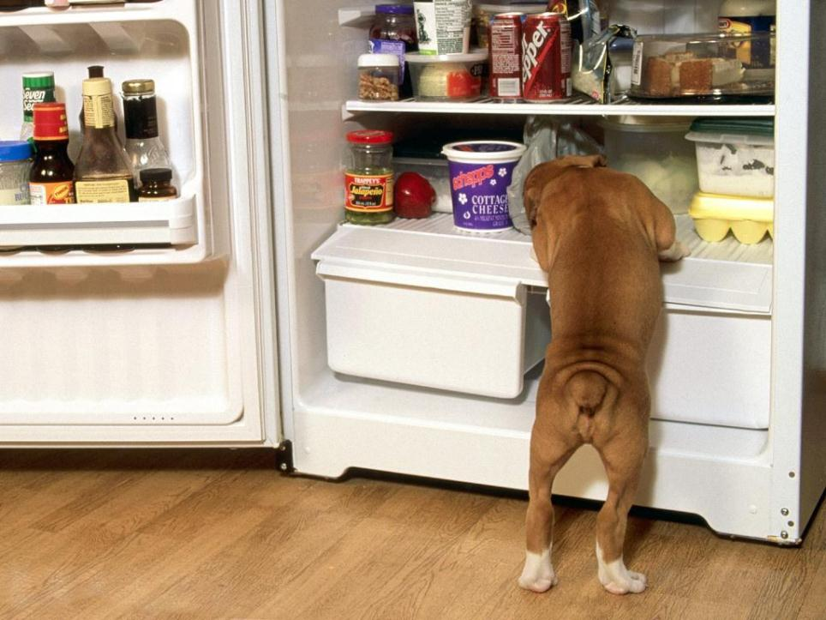
Ever consider what our dogs must think of us? I mean, here we come back from a grocery store with the most amazing haul -- chicken, pork, half a cow. They must think we're the greatest hunters on earth! - Anne Tyler

Slide 133
Step Five Be prepared to rotate through your food storage on a regular basis
Pay close attention to the code dates and store your food in a manner that promotes food storage safety.
Notes:
As mentioned early in these food storage guidelines, be prepared to rotate through your food storage on a regular basis so that you don't waste the food by letting it go bad.
Pay close attention to the code dates and store your food in a manner that promotes food storage safety.

Slide 134
Emergency Planning
Through our planning we are a trained team that is an extension of the company because;
1.We know the steps for readiness
2.We have the supplies
3.We know what to do when it happens
Notes:
Through our planning we are a trained team that is an extension of the company because;
1.We know the steps for readiness
2.We have the supplies
3.We know what to do when it happens

Slide 135
Deciding to Stay or Go
Notes:
An activity that could be useful for this topic is to develop a questionnaire that asks people if they should stay or go. These situations can either be handed out on paper or simply presented as a slide in your presentation. If there are individuals who are working out in rural work zones, it might be important for them to know when exactly they should stay or go. This activity will help guide their decision in that process.

Slide 136
Crisis Management and Humans
Early Crisis situations were either caused by people or by natural disasters within the surrounding environment.
People fought other people or ran away and either fought wild animals or ran away.
These responses are called the flight or fight response.
Notes:
Early Crisis situations were either caused by people or by natural disasters within the surrounding environment.
Solutions to these crises were very simple until the last two centuries. People fought other people or ran away and either fought wild animals or ran away. Natural hazards such as quicksand and falling rock were avoided.
Fighting or fleeing were two basic human responses to sudden events that we still display. These responses to sudden events that we still display. These responses are called the flight or fight response. These responses can reduce the effectiveness of crisis management and business continuity management activities, and may incapacitate victims, bystanders and respondents within a crisis situation should such actions lead to inappropriate behaviors.
Natural weather and geological disruptions (volcanic eruptions and earthquakes) were seen as beyond human control and understanding, and thus were caused by some ‘godlike’ beings. Such activity were seen as caused by some specific god who became displeased with humans in her or his domain. Crisis management actions were thus quite simple- PLACATE THE specificate god with some form of ritual offering( worship, gift giving, and sacrifice of living animals or humans)
Many of still react superstitiously to crisis situations. We feel guilty at having survived or express beliefs about our sins catching up with us because of some negative impact. Most crisis situations feel threatening, and often leave us feeling powerless. The feelings of pwerless can often lead us to try to identify guilty people so that we can blame them for exposing us to feelings of threat, guilt, and being endangered.
People are core to crisis management and business recovery. Without people (and their valued resources) there would be no crisis situations. With out STAFF, SUPPLIERS< and CUSTOMERS there would be no exchange of labor and resources that generate business and wealth for organization. We need to LOOK after people who are in our organizations- These people are the Stakeholders as they each have a ‘STAKE’ in the organization- includes customers. Suppliers, product users, owners government and regulatory agencies. Each of these groupings needs careful management during response and recovery periods if we want a positive outcome.

Slide 137
We are staying and need to control Traffic Through Traffic Incident Management Areas
US Department of Transportation-Federal Highway Administration

Slide 138
The Standard:
The needs and control of all road users through a work zone shall be an essential part of highway construction, utility work, maintenance operations, and the management of traffic incidents
Notes:
The needs and control of all road users (motorists, bicyclists, and pedestrians within the highway, including persons with disabilities in accordance with the Americans with Disabilities Act of 1990 (ADA), Title II, Paragraph 35.130) through a TTC zone shall be an essential part of highway construction, utility work, maintenance operations, and the management of traffic incidents
Support: A traffic incident is an emergency road user occurrence, a natural disaster, or other unplanned event that affects or impedes the normal flow of traffic.
A traffic incident management area is an area of a highway where temporary traffic controls are imposed by authorized officials in response to a road user incident, natural disaster, hazardous material spill, or other unplanned incident. It is a type of TTC zone and extends from the first warning device (such as a sign, light, or cone) to the last TTC device or to a point where vehicles return to the original lane alignment and are clear of the incident.

Slide 139
The Guidance
In order to reduce response time for traffic incidents, highway agencies, appropriate public safety agencies should mutually plan for occurrences of traffic incidents along the major and heavily traveled highway and street system.
Notes:
In order to reduce response time for traffic incidents, highway agencies, appropriate public safety agencies (law enforcement, fire and rescue, emergency communications, emergency medical, and other emergency management), and private sector responders (towing and recovery and hazardous materials contractors) should mutually plan for occurrences of traffic incidents along the major and heavily traveled highway and street system.
Responders arriving at a traffic incident should, within 15 minutes of arrival on-scene, estimate the magnitude of the traffic incident, the expected time duration of the traffic incident, and the expected vehicle queue length, and then should set up the appropriate temporary traffic controls for these estimates.
http://www.workzonesafety.org/video
Cutting the time that highways are shut down can save millions in lost time and productivity for motorists stuck in long backups. According to transportation officials, the value of the saving ranges from $15 an hour for the average commuter to $70 an hour for commercial vehicles.

Slide 140
Sections 6I.01. 6I.02, 6I.03 Training of On-Scene Responders
Guidance:
Responders:
Trained in safe practices
Aware of their visibility (or lack thereof) to oncoming traffic
Move incident away from traveled roadway or provide warning
Notes:
The first paragraph of the GUIDANCE statement in Section 6I.04 as proposed in the NPA has been removed and that paragraph has been added to Sections 6I.01, 6I.02, and 6I.03, as this recommendation for training of on-scene responders is generally applicable to all types of traffic incidents but especially major and intermediate ones. That statement reads:
Guidance
On-scene responders should be trained in safe practices for accomplishing their tasks in and near traffic. Responders should always be aware of their visibility to oncoming traffic and take measures to move the traffic incident as far off the traveled roadway as possible or to provide for appropriate warning.

Slide 141
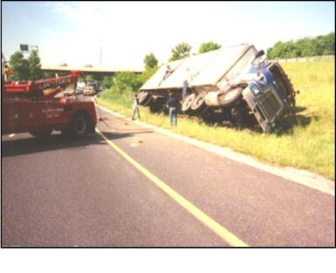
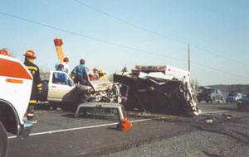
Control of Traffic Through Traffic Incident Management Areas
:
Major > 2 hour
Intermediate 30 min to 2 hours
Minor < 30 min
Unsafe Condition
Unsafe Condition
Notes:
A new chapter, numbered and titled “Chapter 6I Control of Traffic Through Traffic Incident Management Areas.” has been added
This new chapter contains text from Section 6G.19 Control of Traffic Through Incident Areas (as numbered in the 2000 MUTCD) in its entirety with several modifications and additional information on the use of temporary traffic control devices for traffic incident management zones.
The new chapter contains a general section as well as sections on major, intermediate, and minor traffic incidents, and on use of emergency-vehicle lighting (flashing or rotating beacons or strobes). This Chapter is included to recognize the importance of safely and efficiently controlling traffic through traffic incident areas and the unique characteristics of incidents and the traffic controls that should be used.
each of which has unique traffic control characteristics and needs. These classes are:
Major—expected duration of more than 2 hours;
Intermediate—expected duration of 30 minutes to 2 hours; and
Minor—expected duration under 30 minutes.
The primary functions of TTC at a traffic incident management area are to move road users reasonably safely and expeditiously past or around the traffic incident, to reduce the likelihood of secondary traffic crashes, and to preclude unnecessary use of the surrounding local road system.
Examples include a stalled vehicle blocking a lane, a traffic crash blocking the traveled way, a hazardous material spill along a highway, and natural disasters such as floods and severe storm damage.

Slide 142
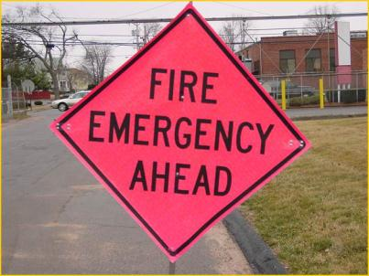
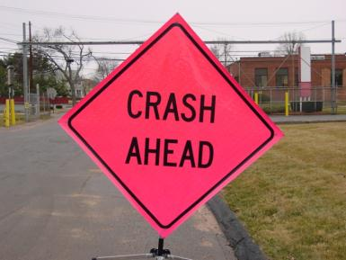
Control of Traffic Through Traffic Incident Management Areas
Fluorescent Pink color for warning and guide signs used for incident management

Slide 143
Major Traffic Incidents
Major traffic incidents are typically traffic incidents involving hazardous materials, fatal traffic crashes involving numerous vehicles, and other natural or man-made disasters.
These traffic incidents typically involve closing all or part of a roadway facility for a period exceeding 2 hours.
Notes:
Support: Major traffic incidents are typically traffic incidents involving hazardous materials, fatal traffic crashes involving numerous vehicles, and other natural or man-made disasters. These traffic incidents typically involve closing all or part of a roadway facility for a period exceeding 2 hours.
Guidance: If the traffic incident is anticipated to last more than 24 hours, applicable procedures and devices set forth in other Chapters of Part 6 should be used\
PART 6 TABLE OF CONTENTS CHAPTER 6A. GENERAL Section 6A.01 General CHAPTER 6B. FUNDAMENTAL PRINCIPLES Section 6B.01 Fundamental Principles of Temporary Traffic Control CHAPTER 6C. TEMPORARY TRAFFIC CONTROL ELEMENTS Section 6C.01 Temporary Traffic Control Plans Section 6C.02 Temporary Traffic Control Zones Section 6C.03 Components of Temporary Traffic Control Zones Section 6C.04 Advance Warning Area Section 6C.05 Transition Area Section 6C.06 Activity Area Section 6C.07 Termination Area Section 6C.08 Tapers Section 6C.09 Detours and Diversions Section 6C.10 One-Lane, Two-Way Traffic Control Section 6C.11 Flagger Method of One-Lane, Two-Way Traffic Control Section 6C.12 Flag Transfer Method of One-Lane, Two-Way Traffic Control Section 6C.13 Pilot Car Method of One-Lane, Two-Way Traffic Control Section 6C.14 Temporary Traffic Control Signal Method of One-Lane, Two-Way Traffic Control Section 6C.15 Stop or Yield Control Method of One-Lane, Two-Way Traffic Control CHAPTER 6D. PEDESTRIAN AND WORKER SAFETY Section 6D.01 Pedestrian Considerations Section 6D.02 Accessibility Considerations Section 6D.03 Worker Safety Considerations CHAPTER 6E. FLAGGER CONTROL Section 6E.01 Qualifications for Flaggers Section 6E.02 High-Visibility Safety Apparel Section 6E.03 Hand-Signaling Devices Section 6E.04 Flagger Procedures Section 6E.05 Flagger Stations

Slide 144
Major Traffic Incidents- Support
Support: A road closure can be caused by a traffic incident such as a road user crash that blocks the traveled way. Road users are usually diverted through lane shifts or detoured around the traffic incident and back to the original roadway.
Guidance: On-scene responders should be trained in safe practices for accomplishing their tasks in and near traffic. Responders should always be aware of their visibility to oncoming traffic and take measures to move the traffic incident as far off the traveled roadway as possible or to provide for appropriate warning.
Notes:
Support:
A road closure can be caused by a traffic incident such as a road user crash that blocks the traveled way. Road users are usually diverted through lane shifts or detoured around the traffic incident and back to the original roadway.
Guidance: On-scene responders should be trained in safe practices for accomplishing their tasks in and near traffic. Responders should always be aware of their visibility to oncoming traffic and take measures to move the traffic incident as far off the traveled roadway as possible or to provide for appropriate warning.
A combination of traffic engineering and enforcement preparations is needed to determine the detour route, and to install, maintain or operate, and then to remove the necessary traffic control devices when the detour is terminated. Large trucks are a significant concern in such a detour, especially when detouring them from a controlled-access roadway onto local or arterial streets.
During traffic incidents, large trucks might need to follow a route separate from that of automobiles because of bridge, weight, clearance, or geometric restrictions. Also, vehicles carrying hazardous material might need to follow a different route from other vehicles.
Some traffic incidents such as hazardous material spills might require closure of an entire highway. Through road users must have adequate guidance around the traffic incident. Maintaining good public relations is desirable. The cooperation of the news media in publicizing the existence of, and reasons for, traffic incident management areas and their TTC can be of great assistance in keeping road users and the general public well informed.
The establishment, maintenance, and prompt removal of lane diversions can be effectively managed by inter-agency planning that includes representatives of highway and public safety agencies.

Slide 145
Intermediate Traffic Incidents
Intermediate traffic incidents typically affect travel lanes for a time period of 30 minutes to 2 hours, and usually require traffic control on the scene to divert road users past the blockage.
Responders should always be aware of their visibility to oncoming traffic and take measures to move the traffic incident as far off the traveled roadway as possible or to provide for appropriate warning.
Notes:
Support: Intermediate traffic incidents typically affect travel lanes for a time period of 30 minutes to 2 hours, and usually require traffic control on the scene to divert road users past the blockage. Full roadway closures might be needed for short periods during traffic incident clearance to allow traffic incident responders to accomplish their tasks.
Responders should always be aware of their visibility to oncoming traffic and take measures to move the traffic incident as far off the traveled roadway as possible or to provide for appropriate warning
Guidance: All traffic control devices needed to set up the TTC at a traffic incident should be available so that they can be readily deployed for intermediate traffic incidents. The TTC should include the proper traffic diversions, tapered lane closures, and upstream warning devices to alert approaching traffic of the end of a queue.
Attention should be paid to the end of the traffic queue such that warning is given to road users approaching the end of the queue.
If manual traffic control is needed, it should be provided by qualified flaggers or uniformed law enforcement officers.
Option: If flaggers are used to provide traffic control for an incident management situation, the flaggers may use appropriate traffic control devices that are readily available or that can be brought to the traffic incident scene on short notice.
Guidance: When flares are used to initiate TTC at traffic incidents, more permanent traffic devices should replace them as soon as practical. Both the flare and its supporting device should then be removed from the roadway.

Slide 146
Tabletop exercises
Master List of Exercise Objectives
1. ALERT NOTIFICATION
2. COMMUNICATIONS
3. COORDINATION & CONTROL
4. EMERGENCY PUBLIC INFORMATION
5. DAMAGE ASSESSMENT
6. HEALTH & MEDICAL
7. INDIVIDUAL/FAMILY ASSISTANCE
8. PUBLIC SAFETY
9. PUBLIC WORKS
10. RESOURCE MANAGEMENT
11. WARNING
12. EFFECTIVENESS OF WARNING
13. OTHER NON-EMERS OBJECTIVES
NOTE: It is recommended that no more that 6 – 8 or so objectives are chosen for any one
Notes:
The presented scenarios are intended to be frameworks or a source of ideas which can be shaped, expanded or altered to meet the specific risk management needs of the exercise planner. Scenarios differ in format, completeness, scope and message style depending upon available information.
Master List of Exercise Objectives
This list serves as a range of possible exercise objectives and should not be interpreted as
meaning that every listed objective must be included in every exercise. You should select
only those objectives that are related to the scope of your specific scenario.
1. ALERT NOTIFICATION
· To demonstrate the ability to alert, mobilize, and activate the personnel, facilities,
and systems required for emergence response, and provide for subsequent shift
change staffing to maintain 24-hour operations.
2. COMMUNICATIONS
· To determine the ability to establish and maintain communications essential to
support response to an incident/accident.
· To demonstrate the ability to establish, use, maintain, and manage
communications essential to support emergency or disaster response and
recovery.
3. COORDINATION & CONTROL
· To determine the effectiveness of mutual aid plans and the coordination among
jurisdictions or organizations if responding to a major emergency.
· To determine the effectiveness of procedures for requesting resources from a
higher level of government.
· To determine the level of cooperation and coordination between agencies,
departments, and organizations of the jurisdiction in responding to problems
associated with a major emergency or disaster.
· To determine the ability of EOC personnel to assess events, make decisio ns on
corrective action measures, and direct field personnel on procedures to remedy
problems.
· To determine the level of knowledge that EOC personnel possess regarding plan
familiarity, emergency operations, and decision-making.
· To determine the capabilities of the jurisdiction to effectively utilize support
agencies when local forces are fully committed or incapable of providing a
needed service.
· To determine the adequacy of facilities, equipment, displays, and other materials
to support emergency operations.
· To determine the ability to direct, coordinate, and control emergency response
activities through operations of an Incident Command System (ICS).
· To demonstrate the capability to direct, coordinate, and control emergency
response and recovery operations.
· To demonstrate the adequacy of facilities, equipment, displays, and associated
materials to support direction and control of emergency operations.
5
Master List of Objectives (continued)
4. EMERGENCY PUBLIC INFORMATION
· To determine the capability of the emergency public information system to
provide official information and instruction to diverse populations in order to
facilitate timely and appropriate public response during a major emergency or
disaster.
· To demonstrate the capability to coordinate the formulation and dissemination of
clear, accurate, and consistent information to the public and news media, and to
control the spread of rumors that could impact on the public safety.
5. DAMAGE ASSESSMENT
· To demonstrate the ability to organize and conduct damage assessment after a
major emergency or disaster, and implement follow- up procedures to facilitate
response and recovery.
6. HEALTH & MEDICAL
· To determine the ability to protect emergency responder health and safety.
· To determine the ability to imple ment appropriate measures for containment,
recovery, and clean up of a release of a hazardous material.
· To determine the adequacy of personnel, procedures, equipment, and vehicles for
transporting injured individuals, and the adequacy of medical personnel and
facilities to support the operation.
· To demonstrate the capability to mobilize and employ health and medical
resources and mitigate public health problems during a major emergency or mass
disaster situation.
· To demonstrate the capability to take actions required for initial assessment and
response to an identified radiological emergency.
· To demonstrate the capability to identify and mobilize resources and organize the
delivery of crisis assistance and other human services in response to a major
emergency or disaster.
7. INDIVIDUAL/FAMILY ASSISTANCE
· To determine the adequacy of the evacuation plan for the jurisdiction and the
ability of officials to effectively coordinate an evacuation.
· To determine the adequacy of procedures for establishing and operation
emergency shelters for evacuees.
· To determine the adequacy of procedures for ensuring the safety and health of
persons at emergency shelters.
· To demonstrate the capability to make decisions for population protection and the
adequacy of procedures and capabilities to implement those decisions under
emergency or disaster conditions.
· To demonstrate the capability and procedures to provide facilities and operating
resources for the reception, registration, and congregate care of persons displaced
from their homes or lodgings by an emergency or disaster.
6
Master List of Objectives (continued)
8. PUBLIC SAFETY
· To determine the effectiveness of search and rescue procedures during a major
emergency or disaster.
· To determine the capabilities of the fire/rescue department to effectively perform
fire fighting, rescue, hazardous materials containment, and similar hazard
abatement duties during a major emergency or disaster.
· To determine the adequacy of procedures for limiting access to
hazardous/evacuated areas and key governmental facilities and to provide security
for the same.
· To determine the adequacy of the re-entry decision process following an
evacuation.
· To determine the organizational ability and resources necessary to implement site
security and to control traffic flow.
· To determine the ability to identify the hazardous material(s) involved in an
incident/accident and to access the hazards associated with the material involved
during both the emergency and post-emergency phases.
· To demonstrate the capabilities of fire/rescue agencies to effectively respond to
firefighting, rescue, and hazardous materials threats which occur during a major
emergency or disaster.
· To demonstrate the capability to organize and direct urban search and rescue
activities, develop priorities for urban search and rescue support, and manage the
mission assignment of Federal urban search and rescue forces in response to a
catastrophic disaster.
· To demonstrate the capability to maintain law and order, provide evacuation
traffic direction and flow control, and provide security and access control at
shelters, vital facilities, and evacuated areas.
9. PUBLIC WORKS
· To determine the adequacy of procedures for providing to field forces such
support services as food and refreshments, apparatus and equipment maintenance,
sanitary facilities, and medical care.
· To determine the adequacy of procedures for restoring and repairing essential
services and vital facilities during a major emergency or disaster.
· To demonstrate the capability to organize and provide emergency repair and
restoration of public works, public utilities, and other critical facilities; debris
clearance; and other emergency protective measures in response to a major
emergency or disaster.
7
Master List of Objectives (continued)
10. RESOURCE MANAGEMENT
· To determine the thoroughness, usefulness, understandability, and accuracy of the
emergency operations plan and other key references.
· To determine the effectiveness of procedures for deployment of emergency
personnel and equipment during a major emergency or disaster.
· To determine adequacy of procedures for replacement of fatigued personnel
during an emergency or disaster.
· To determine if a system has been developed for recruiting, training, and using
volunteers during a major emergency or disaster.
· To determine the capabilities of agencies, departments, and organizations of the
jurisdiction to effectively handle emergencies involving any natural,
technological, or man-made hazard.
· To determine the ability of public officials to conduct their duties in accordance
with standard operating procedures (SOP’s), the emergency operations plan
(EOP), and state statutes.
· To demonstrate the ability to locate, mobilize, and manage (including allocation
and prioritization) personnel, equipment, supplies, facilities, and services under
emergency or disaster conditions.
11. WARNING
· To demonstrate the capability to promptly alert and notify the public of imminent
disaster or hazardous conditions and to disseminate instructional messages to the
public on the basis of authority from, or decisions by, appropriate State and local
officials.
12. EFFECTIVENESS OF WARNING
· To determine the adequacy of equipment and procedures for alerting and warning
the population in the event of a major emergency or disaster.
13. OTHER NON-EMERS OBJECTIVES
· To determine if officials have coordinated utility disaster plans with the local
emergency operations plan.
· To determine the capabilities of the jurisdiction to handle routine/normal incidents
in addition to responding to events associated with a major emergency or disaster.
· To determine the ability to document response to an incident/accident.
NOTE: It is recommended that no more that 6 – 8 or so objectives are chosen for any one
exercise.
Hazardous Material Accident-Ammonia Leak from Fixed Facility
Wednesday, October 20-7:00 a.m.
A pleasant morning in ______ County. The temperature is in the mid forties under partly
cloudy skies; with a steady wind from the northeast at 15 mph. On County Trunk Road
___, a teacher is driving east to _____ High School when she suddenly swerves the car to
avoid hitting a dog. The car leaves the roadway and ruptures a filler pipe on an anhydrous
ammonia storage tank at the _____ Co-op. The car also knocks down a telephone pole,
causing a live wire to “dance” around the teacher’s disabled car.
Phase 1
The accident is witnessed by two people: the driver of a car following approximately 500
feet back and a Co-op employee in the office 150 feet north of the impact. Within
minutes the roadway is covered with a thick cloud causing a backup of traffic and a
minor collision involving a van and school bus with 25 children on board.
The driver of the car remains unconscious and is upwind and out of immediate danger.
Three co-op workers run towards the car to assist the driver, but panic when they see the
live wire and leave the scene to report the accident to 911.
Phase 2
A dispatched sheriff’s department patrol car approaches the scene from the north and
notes a strong smell of ammonia. A visual assessment of the scene reveals an
unconscious adult in a car near the coop; an unconscious adult in a van on the highway
and a disabled school bus loaded with young children.
Two individuals who have left their car to help the school bus are overcome by ammonia
fumes and are lying on the ground. The school bus driver has noticed a “cloud” heading
towards the bus and begins to panic, which in turn has caused the children to panic and
start to leave the bus by the exit door.

Slide 147
Wildfire-Rural
Following a ten-week period of drought, vegetation throughout _________ County is
extremely dry. At 8:30 a.m. on this hot, sunny day, a power line snaps due to strong
winds and falls to the ground, touching off a brush fire near County Highway ________.
The fire, pushed by 30 mph winds, spreads rapidly through the dry grass, brush, and
trees. By 10:00 a.m., acres are burning and local firefighting resources from the Towns of
______ and ______ are fully committed. The fire has now jumped County Highway
_____ and is within a mile of a new work zone and a new housing development outside of the Town of _______. It appears likely that firefighters will not be able to stop the flames from
reaching the work zone and the homes.
The weather forecast for the remainder of the days calls for hot, sunny
conditions with winds of 25-35 mph.
Questions
1. Should an evacuation be ordered?
2. If so, how will the order be disseminated and carried out?
3. Where will evacuees be sent?
4. How will the public be notified of the shelter locations?
5. What firefighting forces and other resources can be called upon to assist local
firefighters?
6 What agreements been worked out with nearby jurisdictions and the state for
additional firefighting resources?
7. Should the construction company and homeowners be advised to hose down their roofs and combustibles in their yards prior to evacuation?
8. What steps can be taken to prevent citizens from entering the fire area?
9. Should the services of the construction company be recruited for constructing fire breaks?
Notes:
Following a ten-week period of drought, vegetation throughout _________ County is
extremely dry. At 8:30 a.m. on this hot, sunny day, a power line snaps due to strong
winds and falls to the ground, touching off a brush fire near County Highway ________.
The fire, pushed by 30 mph winds, spreads rapidly through the dry grass, brush, and
trees. By 10:00 a.m., acres are burning and local firefighting resources from the Towns of
______ and ______ are fully committed. The fire has now jumped County Highway
_____ and is within a mile of a new work zone and a new housing development outside of the Town of _______. It appears likely that firefighters will not be able to stop the flames from
reaching the work zone and the homes.
The weather forecast for the remainder of the days calls for hot, sunny
conditions with winds of 25-35 mph.
Questions
1. Should an evacuation be ordered?
2. If so, how will the order be disseminated and carried out?
3. Where will evacuees be sent?
4. How will the public be notified of the shelter locations?
5. What firefighting forces and other resources can be called upon to assist local
firefighters?
6 What agreements been worked out with nearby jurisdictions and the state for
additional firefighting resources?
7. Should the construction company and homeowners be advised to hose down their roofs and combustibles in their yards prior to evacuation?
8. What steps can be taken to prevent citizens from entering the fire area?
9. Should the services of the construction comapny be recruited for constructing fire breaks?

Slide 148
Blizzard
Blizzard Emergency
It is the morning of October 26, a cloudy day with a temperature reading of 28 degrees
Fahrenheit. By 6 am, snow begins to fall and winds begin to increase. By 10:00 am., five
inches of snow have fallen and forecasters are calling for snow to continue throughout the
afternoon and evening.
As offices close down early, traffic jams form throughout the city. By 1:00 p.m., snowfall
has reached 12 inches and many vehicles are getting stuck in drifting snow.
By 2:00 p.m., accumulations have reached 14 inches and temperatures have fallen to 21
degrees Fahrenheit. Hundreds of vehicles are abandoned next to the highway where the ______construction company is rushing to finish their fall work.
The interstate highway that runs through town is also full of stranded motorists who are
unfamiliar with the area. People who leave their vehicles run the risk of becoming
disoriented and lost in the work zone, while those who remain in their vehicles run the risk of freezing or being poisoned by carbon monoxide from their vehicles’ exhausts.
The forecast calls for temperatures to dip into the teens with continued blowing
snow.
Questions
1. What actions should the city have taken early in the afternoon in order to reduce
the number of motorists becoming stuck?
2. What actions can be taken by the construction company to rescue stranded motorists?
3. What arrangements can be made to provide shelter for motorists who have
abandoned their vehicles?
4. How will emergency information concerning the storm and survival techniques be
disseminated?
5. What procedures will be implemented to facilitate the delivery of emergency
services such as medical treatment, firefighting, and law enforcement?
Notes:
Blizzard Emergency
It is the morning of October 26, a cloudy day with a temperature reading of 28 degrees
Fahrenheit. By 6 am, snow begins to fall and winds begin to increase. By 10:00 am., five
inches of snow have fallen and forecasters are calling for snow to continue throughout the
afternoon and evening.
As offices close down early, traffic jams form throughout the city. By 1:00 p.m., snowfall
has reached 12 inches and many vehicles are getting stuck in drifting snow.
By 2:00 p.m., accumulations have reached 14 inches and temperatures have fallen to 21
degrees Fahrenheit. Hundreds of vehicles are abandoned next to the highway where the ______construction company is rushing to finish their fall work.
The interstate highway that runs through town is also full of stranded motorists who are
unfamiliar with the area. People who leave their vehicles run the risk of becoming
disoriented and lost in the work zone, while those who remain in their vehicles run the risk of freezing or being poisoned by carbon monoxide from their vehicles’ exhausts.
The forecast calls for temperatures to dip into the teens with continued blowing
snow.
Questions
1. What actions should the city have taken early in the afternoon in order to reduce
the number of motorists becoming stuck?
2. What actions can be taken by the construction company to rescue stranded motorists?
3. What arrangements can be made to provide shelter for motorists who have
abandoned their vehicles?
4. How will emergency information concerning the storm and survival techniques be
disseminated?
5. What procedures will be implemented to facilitate the delivery of emergency
services such as medical treatment, firefighting, and law enforcement?

Slide 149
Airplane Crash
Airplane Crash
A 707 aircraft takes off from ______Airport during a thunderstorm. As it is climbing, it
encounters a wind shear condition at an altitude of 250 feet.
Within seconds, the plane slams into a work zone area three quarters of a
mile south of the airport in a commercial/residential area. Upon impact, the plane is torn apart and leaking jet fuel ignites.
Dozens of stores, warehouses, and single-family homes are destroyed over a three-block
area. There are numerous injuries and fatalities among passengers and people on the
ground.
Fire/rescue units from the city and _____ Airport respond to the scene. They encounter a
situation that will require their full resources and capabilities. Additional fire/rescue and
police units are requested, as well as the fire mobile command post. Construction workers, On- lookers and media personnel have arrived and are standing too close to the hazardous area as well as
interfering with incident response operations.
Questions
1. Where are additional response resources available?
2. How will you coordinate the services of many agencies and jurisdictions that will
Respond in the work zone?
3. How will you deal with the crowds and the media?
4. How will you warn the public to stay away from the crash site?
5. Will you obtain the heavy equipment to assist with the clearing of roadway
debris and rescue operations?
6. How will the victims be treated and transported to hospitals?
7. Where will the deceased be taken?
8. Who and what agencies will disseminate official information to the public?
9. What arrangements and agencies will be involved for dealing with relatives of the
victims?
Notes:
Airplane Crash
A 707 aircraft takes off from ______Airport during a thunderstorm. As it is climbing, it
encounters a wind shear condition at an altitude of 250 feet.
Within seconds, the plane slams into a work zone area three quarters of a
mile south of the airport in a commercial/residential area. Upon impact, the plane is torn apart and leaking jet fuel ignites.
Dozens of stores, warehouses, and single-family homes are destroyed over a three-block
area. There are numerous injuries and fatalities among passengers and people on the
ground.
Fire/rescue units from the city and _____ Airport respond to the scene. They encounter a
situation that will require their full resources and capabilities. Additional fire/rescue and
police units are requested, as well as the fire mobile command post. Construction workers, On- lookers and media personnel have arrived and are standing too close to the hazardous area as well as
interfering with incident response operations.
Questions
1. Where are additional response resources available?
2. How will you coordinate the services of many agencies and jurisdictions that will
Respond in the work zone?
3. How will you deal with the crowds and the media?
4. How will you warn the public to stay away from the crash site?
5. Will you obtain the heavy equipment to assist with the clearing of roadway
debris and rescue operations?
6. How will the victims be treated and transported to hospitals?
7. Where will the deceased be taken?
8. Who and what agencies will disseminate official information to the public?
9. What arrangements and agencies will be involved for dealing with relatives of the
victims?

Slide 150
Construction Headquarters
Heavy rains are falling as a fast moving thunderstorm system pushes through ______
County. A Tornado Watch is in effect for a five county region. At 2:15 p.m. a tornado
touches down at the Hamilton Grove Construction Park, destroying between 3 to 5 construction building housing workers assembling concrete road barriers and damaging many others. There are numerous fatalities and injuries, and many victims are trapped.
In addition, fires have broken out in a few locations, cars have been overturned, power
and telephone lines are down, lines connecting buildings to propane tanks have been
broken, and debris are scattered throughout the area. Many of the “walking wounded” are
milling around the construction area, lost and confused. Heavy rain continues to fall and
additional thunderstorms are expected throughout the afternoon and evening.
Questions
1. How will you go about rescuing a significant number of people scatted throughout
the park?
2. How will you go about treating a large number of injured persons simultaneously?
3. What will you do about the hazards created by the leaking propane cylinders and
downed power lines?
4. What will be done to facilitate the movement of emergency vehicles through
debris-clogged streets?
5. Who will coordinate the services of volunteers?
6. Where will emergency shelters be established?
7. Where will emergency personnel and volunteers take cover if another tornado
should hit the same area?
Notes:
Heavy rains are falling as a fast moving thunderstorm system pushes through ______
County. A Tornado Watch is in effect for a five county region. At 2:15 p.m. a tornado
touches down at the Hamilton Grove Construction Park, destroying between 3 to 5 construction building housing workers assembling concrete road barriers and damaging many others. There are numerous fatalities and injuries, and many victims are trapped.
In addition, fires have broken out in a few locations, cars have been overturned, power
and telephone lines are down, lines connecting buildings to propane tanks have been
broken, and debris are scattered throughout the area. Many of the “walking wounded” are
milling around the construction area, lost and confused. Heavy rain continues to fall and
additional thunderstorms are expected throughout the afternoon and evening.
Questions
1. How will you go about rescuing a significant number of people scatted throughout
the park?
2. How will you go about treating a large number of injured persons simultaneously?
3. What will you do about the hazards created by the leaking propane cylinders and
downed power lines?
4. What will be done to facilitate the movement of emergency vehicles through
debris-clogged streets?
5. Who will coordinate the services of volunteers?
6. Where will emergency shelters be established?
7. Where will emergency personnel and volunteers take cover if another tornado
should hit the same area?

Slide 151
Hazardous Material Accident-Ammonia Leak from Fixed Facility
Wednesday, October 20-7:00 a.m.
A pleasant morning in ______ County. The temperature is in the mid forties under partly
cloudy skies; with a steady wind from the northeast at 15 mph. On County Trunk Road
___, a teacher is driving east to _____ High School when she suddenly swerves the car to
avoid hitting a dog. The car leaves the roadway and ruptures a filler pipe on an anhydrous
ammonia storage tank at the _____ Work Zone. The car also knocks down a telephone pole,
causing a live wire to “dance” around the teacher’s disabled car.
Phase 1
The accident is witnessed by two construction workers: the driver of a car following approximately 500 feet back and a construction employee in the office 150 feet north of the impact. Within
minutes the roadway is covered with a thick cloud causing a backup of traffic and a
minor collision involving a van and school bus with 25 children on board.
The driver of the car remains unconscious and is upwind and out of immediate danger.
Three workers run towards the car to assist the driver, but panic when they see the
live wire and leave the scene to report the accident to 911.
Phase 2
A dispatched sheriff’s department patrol car approaches the scene from the north and
notes a strong smell of ammonia. A visual assessment of the scene reveals an
unconscious adult in a car near the coop; an unconscious adult in a van on the highway
and a disabled school bus loaded with young children.
Two individuals who have left their car to help the school bus are overcome by ammonia
fumes and are lying on the ground. The school bus driver has noticed a “cloud” heading
towards the bus and begins to panic, which in turn has caused the children to panic and
start to leave the bus by the exit door.
What do the construction people need to do right away?
What can be done to protect the work zone or anything?
What should the workers use to help in this situation?
Communications should begin with?
What further planning would help in this situation
Notes:
Wednesday, October 20-7:00 a.m.
A pleasant morning in ______ County. The temperature is in the mid forties under partly
cloudy skies; with a steady wind from the northeast at 15 mph. On County Trunk Road
___, a teacher is driving east to _____ High School when she suddenly swerves the car to
avoid hitting a dog. The car leaves the roadway and ruptures a filler pipe on an anhydrous
ammonia storage tank at the _____ Work Zone. The car also knocks down a telephone pole,
causing a live wire to “dance” around the teacher’s disabled car.
Phase 1
The accident is witnessed by two construction workers: the driver of a car following approximately 500 feet back and a construction employee in the office 150 feet north of the impact. Within
minutes the roadway is covered with a thick cloud causing a backup of traffic and a
minor collision involving a van and school bus with 25 children on board.
The driver of the car remains unconscious and is upwind and out of immediate danger.
Three workers run towards the car to assist the driver, but panic when they see the
live wire and leave the scene to report the accident to 911.
Phase 2
A dispatched sheriff’s department patrol car approaches the scene from the north and
notes a strong smell of ammonia. A visual assessment of the scene reveals an
unconscious adult in a car near the coop; an unconscious adult in a van on the highway
and a disabled school bus loaded with young children.
Two individuals who have left their car to help the school bus are overcome by ammonia
fumes and are lying on the ground. The school bus driver has noticed a “cloud” heading
towards the bus and begins to panic, which in turn has caused the children to panic and
start to leave the bus by the exit door.
What do the construction people need to do right away?
What can be done to protect the work zone or anything?
What should the workers use to help in this situation?
Communications should begin with?
What further planning would help in this situation

Slide 152
Hazardous Material Accident-Ammonia Leak from Train Car
Monday, June 1-4:00 p.m.
The Soo Line/Canadian Pacific Railway is crossing _____ Street in downtown ________.
The freight training is traveling in a southwest direction and is slowing its rate of speed as
it nears the rail switch near the downtown area where ___________ company is working to fix the shoulder of the roadway.
This city has a large usage of rail traffic with both freight and passenger trains entering the city daily.
The weather is beautiful today; temperatures are near 58 degrees with light winds (5mph)
from of the west. The train engineer had a warning displayed on the engine control panel
that the train has lost an air supply; this causes the train to proceed to an emergency stop.
The conductor retrieves the compressed load bill and proceeds to investigate the problem.
Phase 1
The conductor exits the train. He quickly identifies a derailment of numerous cars. He
identifies a strong odor that resembles ammonia. Without delay, he notifies the engineer
of a four-car derailment with hazardous chemical release and activates the railroad
emergency response plan. The engineer notifies the chief railroad dispatcher and the local
emergency response teams are notified.
Phase 2
The first responding unit reports a large white cloud over the area. The tank car releasing
the chemical has been identified as placard #1005. This car is near the work zone and the railroad depot. Another one of the derailed boxcars contained a load of sand, which has spilled across the
roadway at ______ and _____ blocking access to the area.
Phase 3
Many additional resources are required to handle a situation of this magnitude. The
daycare center on Superior Street has called the police department inquiring about the
emergency. They are reporting a strong odor at their location. Many of the children are
coughing and have complaints of eye irritation. Road blockage from the sand spill is
causing a large backup of traffic off state Hwy ________.
1. Who is in charge of the incident at this point?
2. What are response priorities?
3. Are response resources adequate? If not, where will additional resources be
obtained?
4. What and who should be involved in the ICS?
5. What role will public information play in the response?
Notes:
Monday, June 1-4:00 p.m.
The Soo Line/Canadian Pacific Railway is crossing _____ Street in downtown ________.
The freight training is traveling in a southwest direction and is slowing its rate of speed as
it nears the rail switch near the downtown area where ___________ company is working to fix the shoulder of the roadway.
This city has a large usage of rail traffic with both freight and passenger trains entering the city daily.
The weather is beautiful today; temperatures are near 58 degrees with light winds (5mph)
from of the west. The train engineer had a warning displayed on the engine control panel
that the train has lost an air supply; this causes the train to proceed to an emergency stop.
The conductor retrieves the compressed load bill and proceeds to investigate the problem.
Phase 1
The conductor exits the train. He quickly identifies a derailment of numerous cars. He
identifies a strong odor that resembles ammonia. Without delay, he notifies the engineer
of a four-car derailment with hazardous chemical release and activates the railroad
emergency response plan. The engineer notifies the chief railroad dispatcher and the local
emergency response teams are notified.
Phase 2
The first responding unit reports a large white cloud over the area. The tank car releasing
the chemical has been identified as placard #1005. This car is near the work zone and the railroad depot. Another one of the derailed boxcars contained a load of sand, which has spilled across the
roadway at ______ and _____ blocking access to the area.
Phase 3
Many additional resources are required to handle a situation of this magnitude. The
daycare center on Superior Street has called the police department inquiring about the
emergency. They are reporting a strong odor at their location. Many of the children are
coughing and have complaints of eye irritation. Road blockage from the sand spill is
causing a large backup of traffic off state Hwy ________.
1. Who is in charge of the incident at this point?
2. What are response priorities?
3. Are response resources adequate? If not, where will additional resources be
obtained?
4. What and who should be involved in the ICS?
5. What role will public information play in the response?

Slide 153
Review
We identified:
What is a work zone, the hazards, and what is a work zone crash
We identified the hazards in a work zone,
What training we need
We identified the 7 steps to readiness
We saw the supplies needed
We practiced the planning

