Slide 1
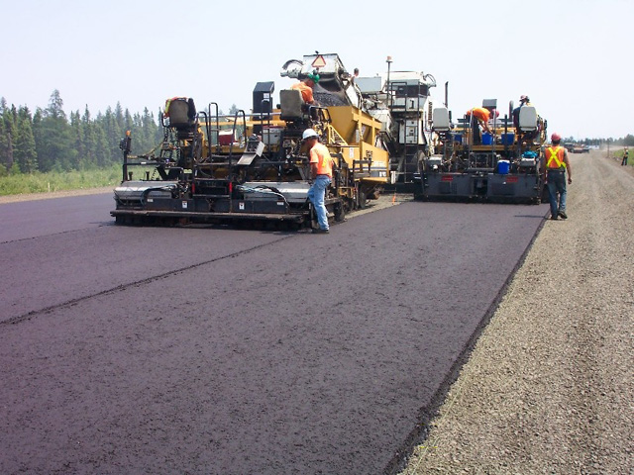
Hazardous Materials

Slide 2
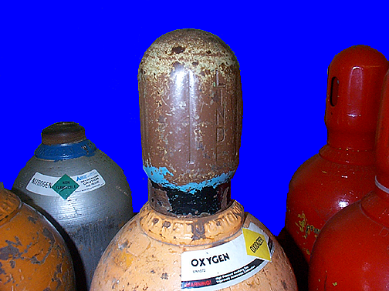
Compressed gases
Caps and plugs in place
Visually inspect gas cylinders to make sure they are in safe condition
Damage
labels

Slide 3
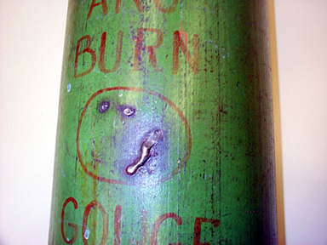
BURN
GOUGE

Slide 4
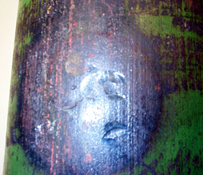
GOUGE

Slide 5

CUT

Slide 6
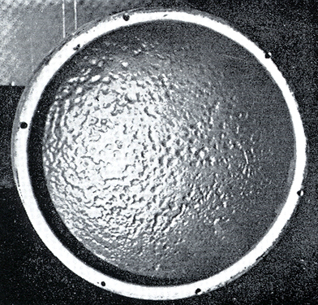
Pitting due to corrosion

Slide 7
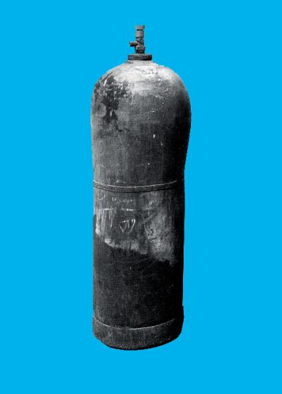
Cylinders are manufactured with reasonably symmetrical
shape. Cylinder which have definite bulges shall be removed from service
Bulge

Slide 8
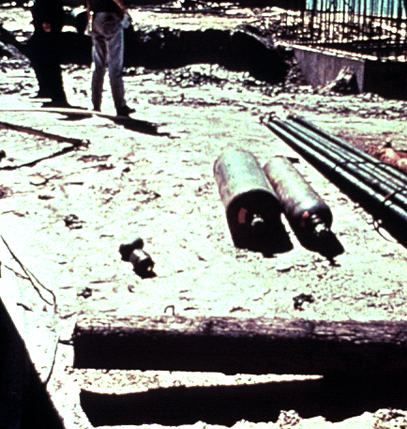
101(b) "Compressed gases."
The in-plant handling, storage, and utilization of all compressed gases in cylinders, portable tanks, rail tankcars, or motor vehicle cargo tanks shall be in accordance with Compressed Gas Association Pamphlet P-1-1965, which is incorporated by reference as specified in Sec. 1910.6
Unsafe condition

Slide 9
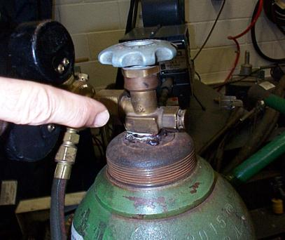
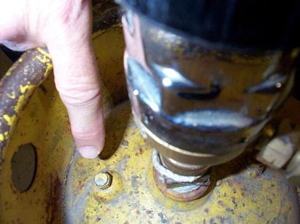
01(c) "Safety relief devices for compressed gas
Compressed gas cylinders, portable tanks, and cargo tanks shall have pressure relief devices installed and maintained in accordance with Compressed Gas Association Pamphlets S-1.1-1963 and 1965 addenda and S-1.2-1963, which is incorporated by reference as specified in Sec. 1910.6.

Slide 10
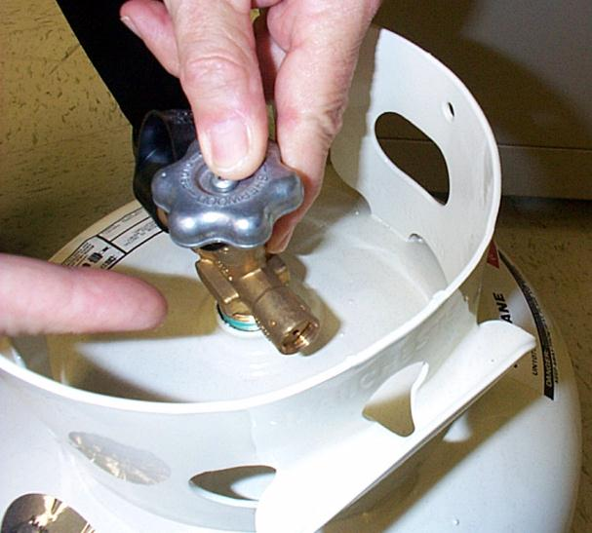
Propane Tank - Relief Valve

Slide 11
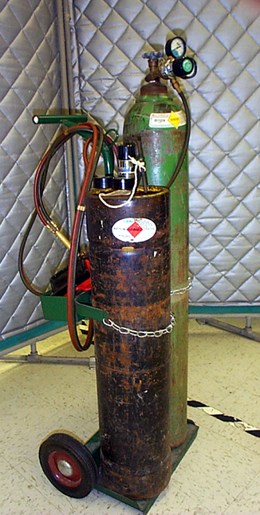
Suitable hand truck

Slide 12
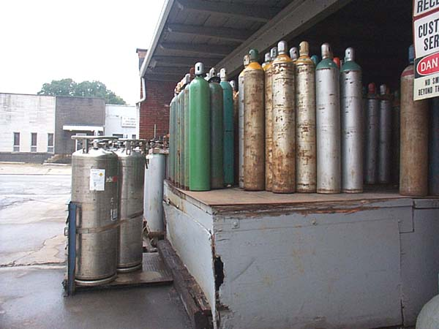
Storing Cylinders
Local Regs
Posting
Separation (different types)
Separation (charged & empty)
Storage rooms
Highly flammable substances
Avoid dampness
Protection of cylinders
Care of cylinders
Unsafe condition

Slide 13
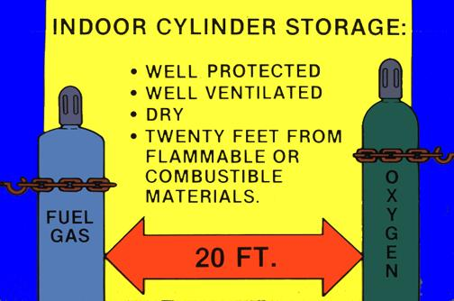
Separation of Flammable Gases

Slide 14
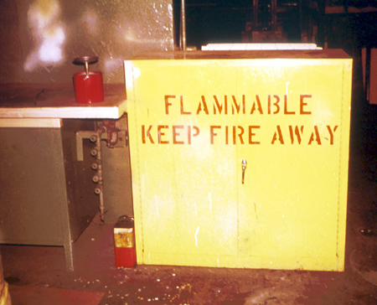
Flammable storage
cabinet
Unsafe condition

Slide 15
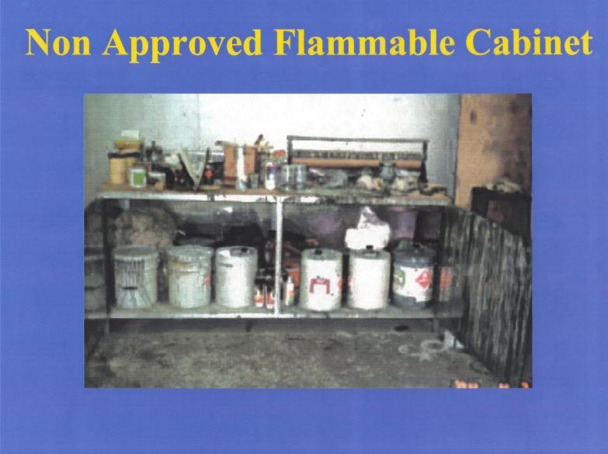
Storage cabinet

Slide 16
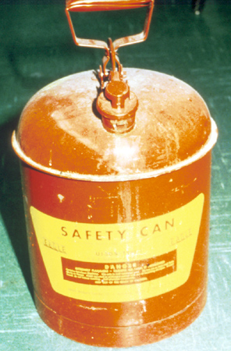
Spring operated
gasoline can

Slide 17
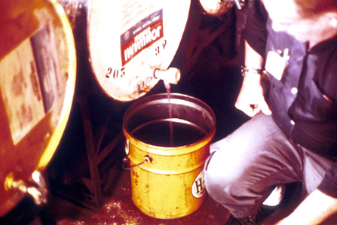
Not an approved valve

Slide 18
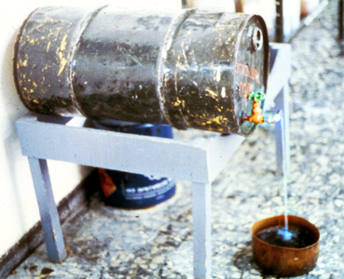
Not approved butterfly
valve

Slide 19
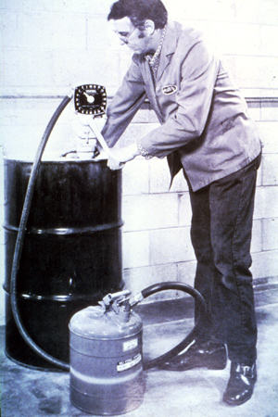
Filling container from the top

Slide 20
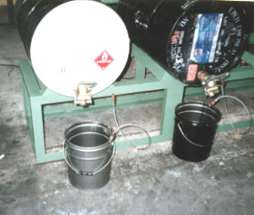
Bonding

Slide 21
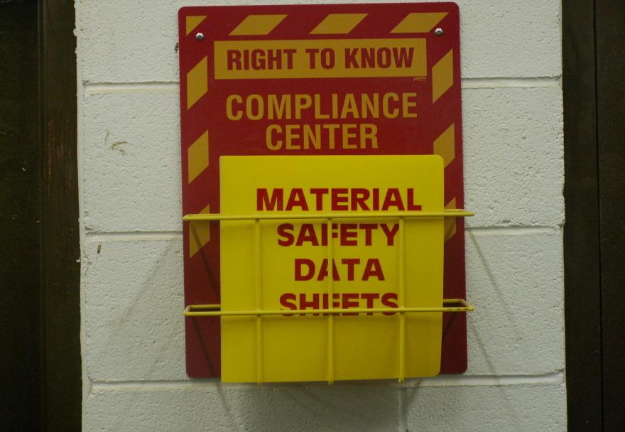
MSDS Notebook
Notes:
Discuss MSDS. Its purpose and sections of MSDS

Slide 22
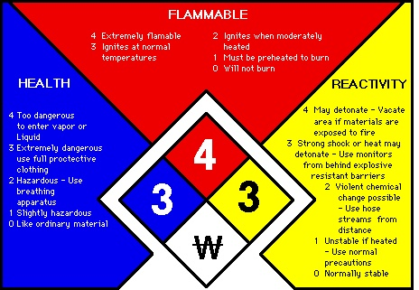
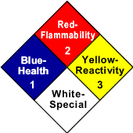
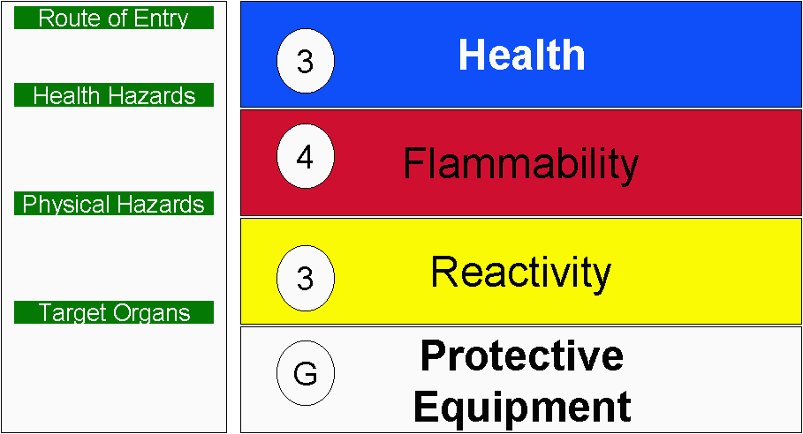
Notes:
Expand on proper labeling of containers

