Slide 1
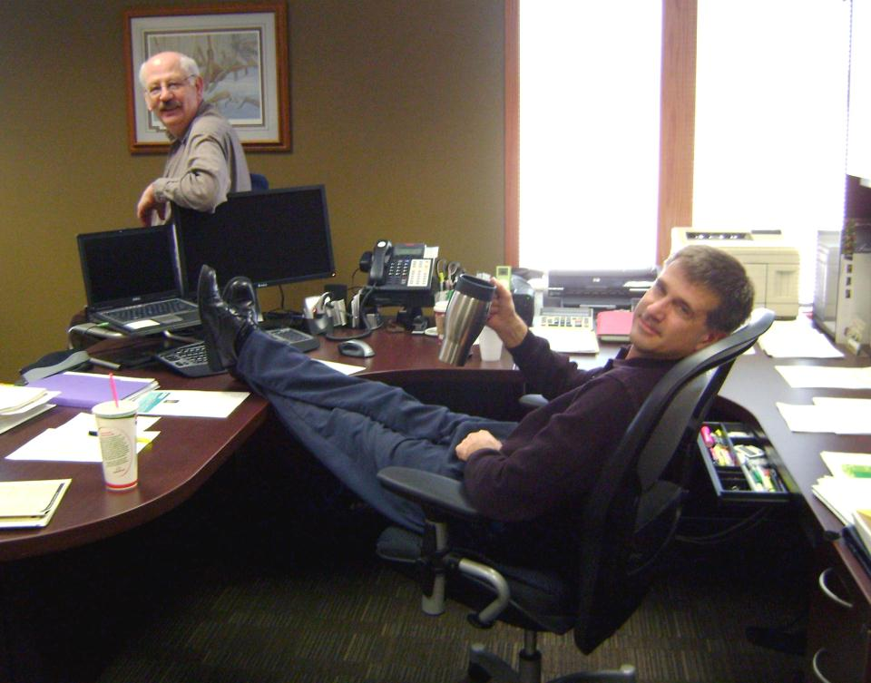
How would you like it if people drove their cars thru your office?

Slide 2
Work Zone Safety
More than 40,000 people are injured each year as a result of motor vehicle crashes in work zones

Slide 3
How serious is the WZ Problem?
835 fatalities
$4.4 billion Annual Cost
75 workers killed by vehicles/equipment
2007 Statistics

Slide 4
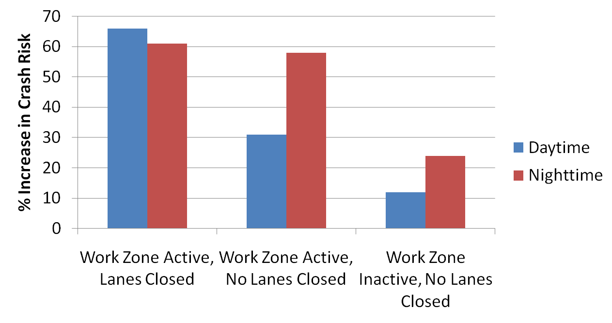
How is Motorist Crash Risk Affected?

Slide 5
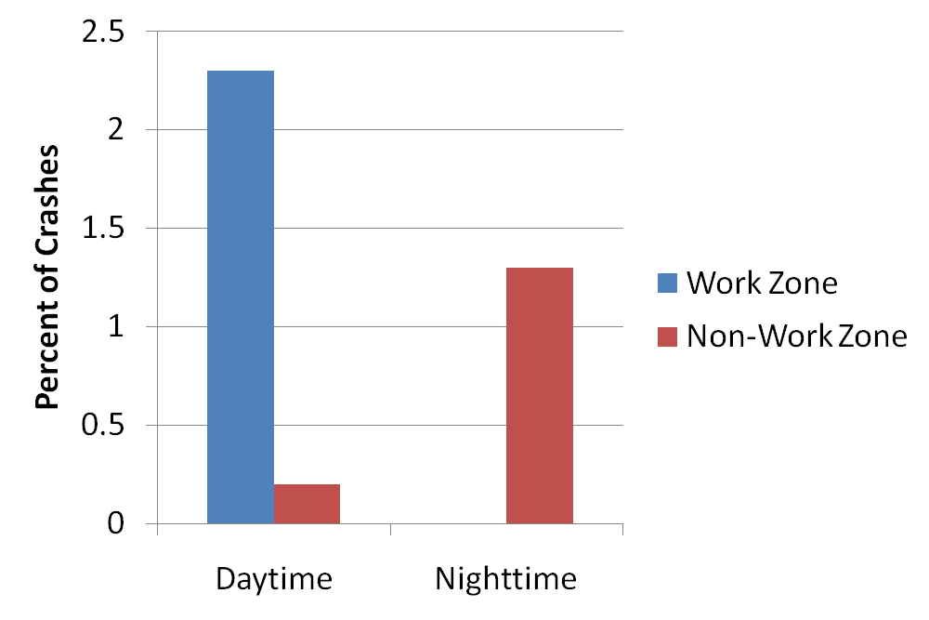
Drowsy Driving in Work Zones

Slide 6
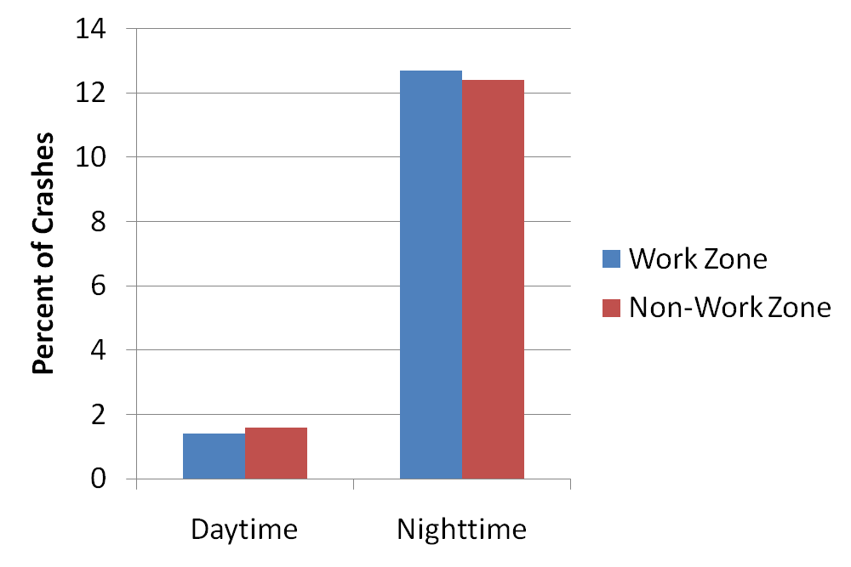
Drunk Driving in Work Zones

Slide 7
Highway Equipment Related Fatalities
Passengers
8%
Workers on Foot
57%
Operators
35%
Source: Bureau of Labor Statistics
Notes:
Trainers Notes:
Most of the workers on foot are killed by being run-over by equipment, especially backing equipment. Some are killed by equipment tip-over or failure.
The most common cause of operator fatality is equipment roll-over. Many passengers are killed because they were not in a proper seat and were riding on steps, fenders, tailgates, buckets, etc., and fell off.

Slide 8
Highway Worker Fatalities
Construction Equipment
41%
Other
18%
Vehicle Entering
Work Area
22%
Traffic Crash
19%
Source: Bureau of Labor Statistics
Notes:
Trainers Notes:
Reinforce that the number one cause of highway worker fatalities is being killed by construction equipment.
Deaths from vehicles entering work areas are usually the result of driver error or improperly erected work zones.

Slide 9
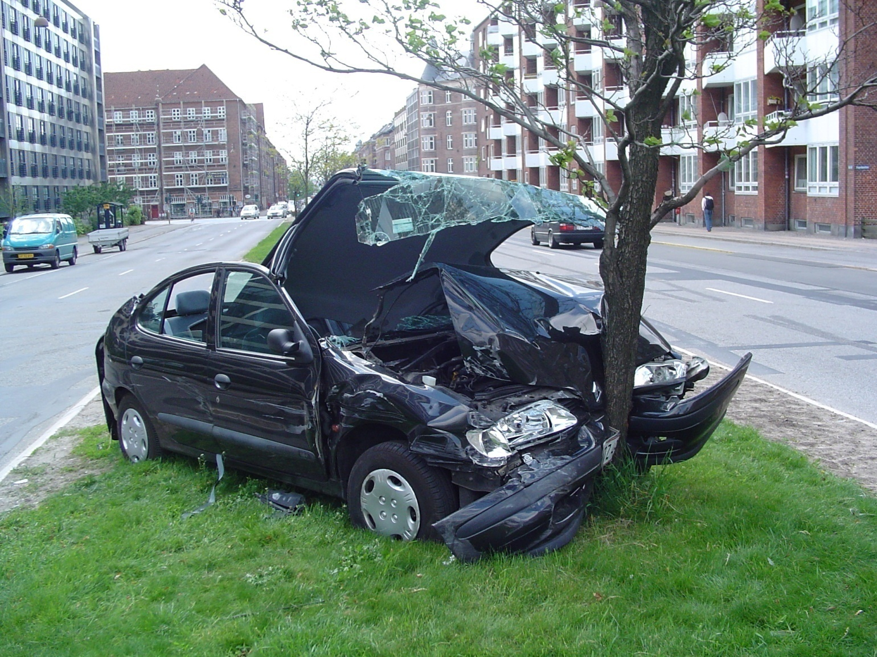
Work Zone Safety
Speed: the number one concern in work zone safety

Slide 10

Work Zone Safety
Distracted Driving:
Reaching/looking for items in the car
Things, events outside of the car/rubbernecking
Cell phones
Adjusting the radio
Eating
Grooming
Children and pets
Unsafe Condition

Slide 11
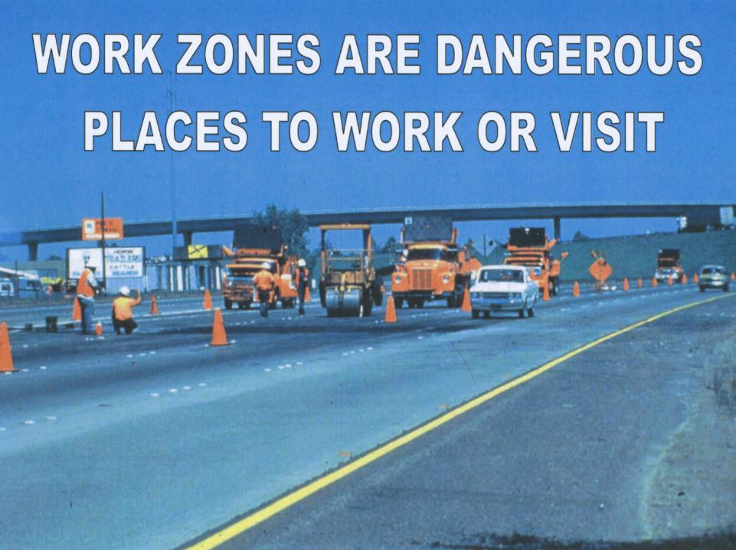

Slide 12
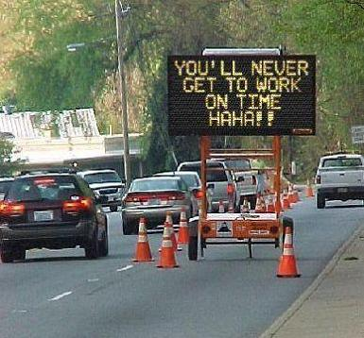
What does WZ Safety mean to the public?

Slide 13
Work Zone Safety
As a result of the Public’s Perception…
…the desired effect of our traffic control sometimes gets compromised.

Slide 14
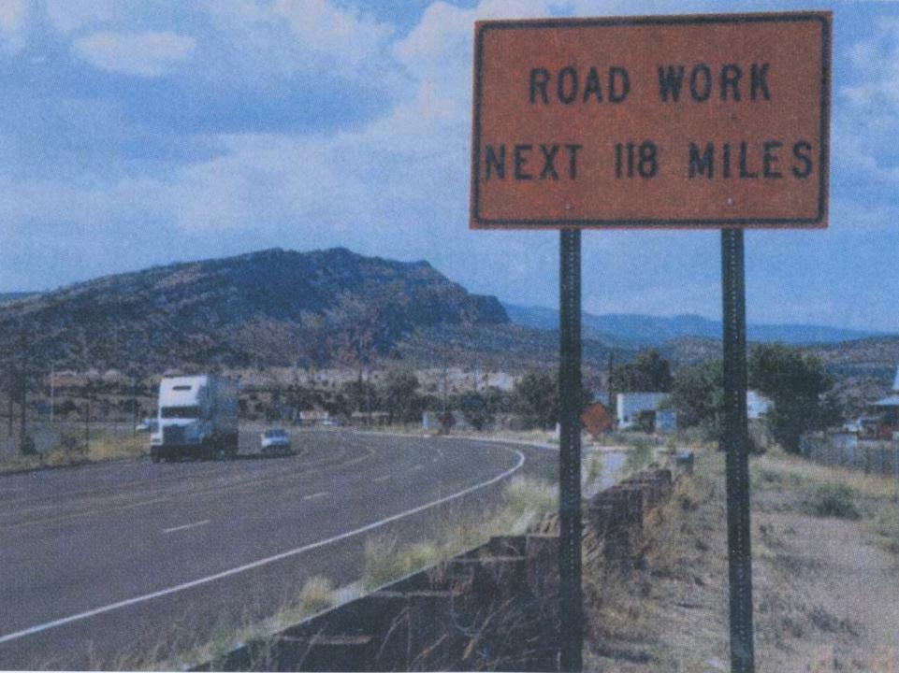

Slide 15
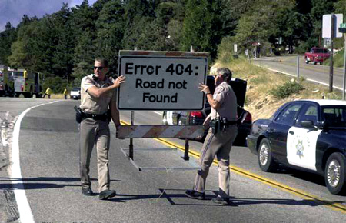

Slide 16
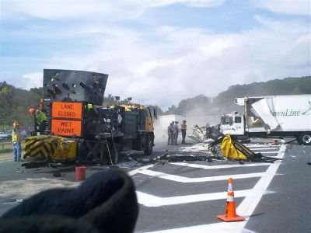
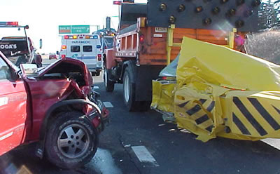
What does WZ safety mean to the contractor?

Slide 17
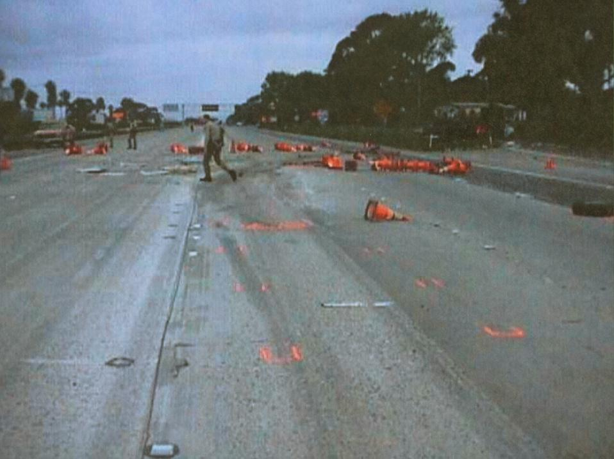

Slide 18
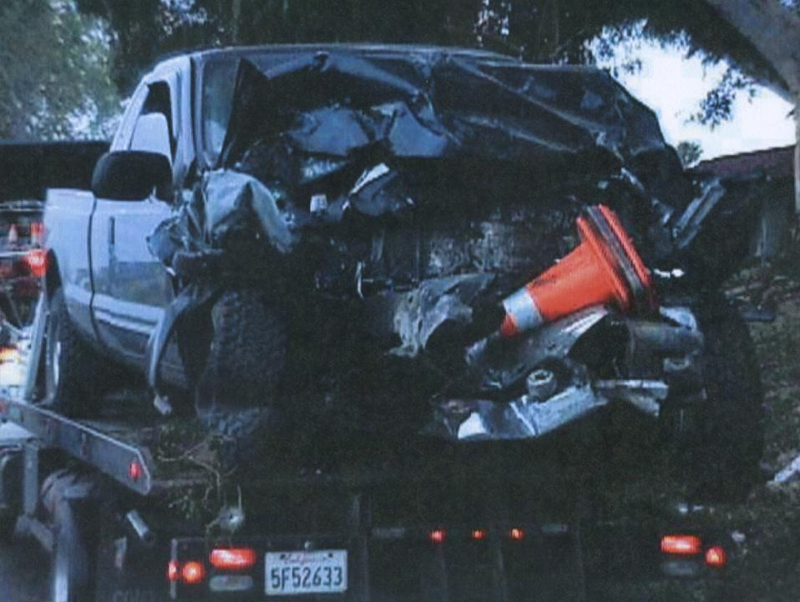

Slide 19
Safety
Remember, there is only 1 goal
You, the motorist, bicyclist and the pedestrian must go home at the end of each work day.
There are no other acceptable alternatives.

Slide 20
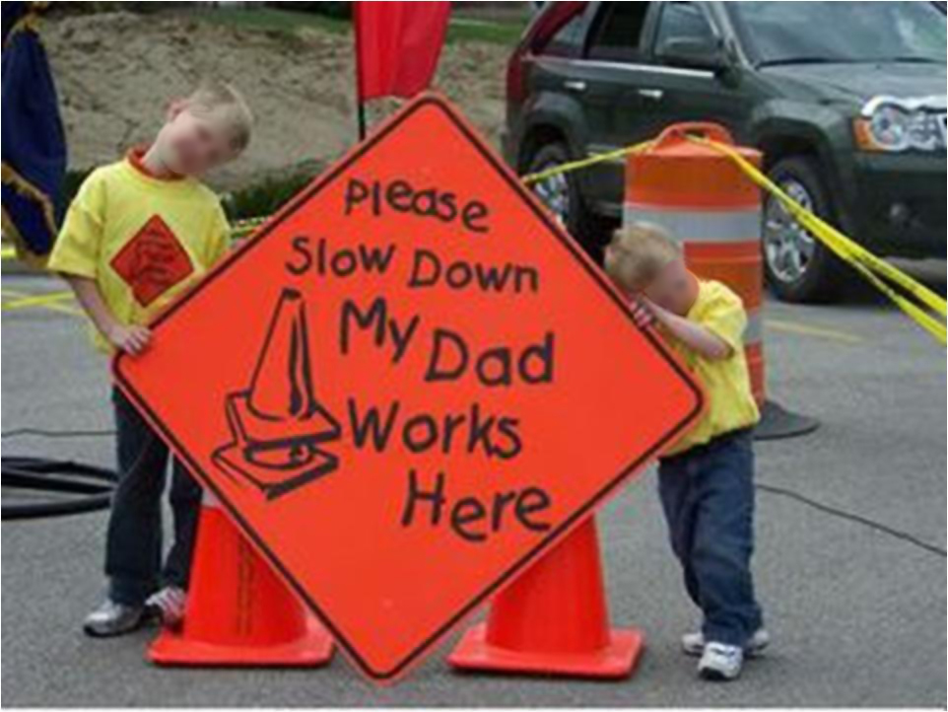

Slide 21
Traffic Issues
Sight Distance – Blind Curves
Need extra signage
High Speed – High Traffic Volume
No gaps for merging vehicles
Stopping traffic is impractical and unsafe
Tailgating
Motorists following trucks into work space
Panic stops
The motorist NEEDS MORE information

Slide 22
Work Zone Issues
Acceleration/Deceleration lanes
Short or non-existent
Signage indicating merge/exit points
Signs give vague information
Messages left up 24/7
Flagging operations
Works best with low traffic and moderate construction trucks
Low construction truck traffic means intermittent flagging
Proper rules are forgotten
Information must be accurate and REAL TIME!

Slide 23
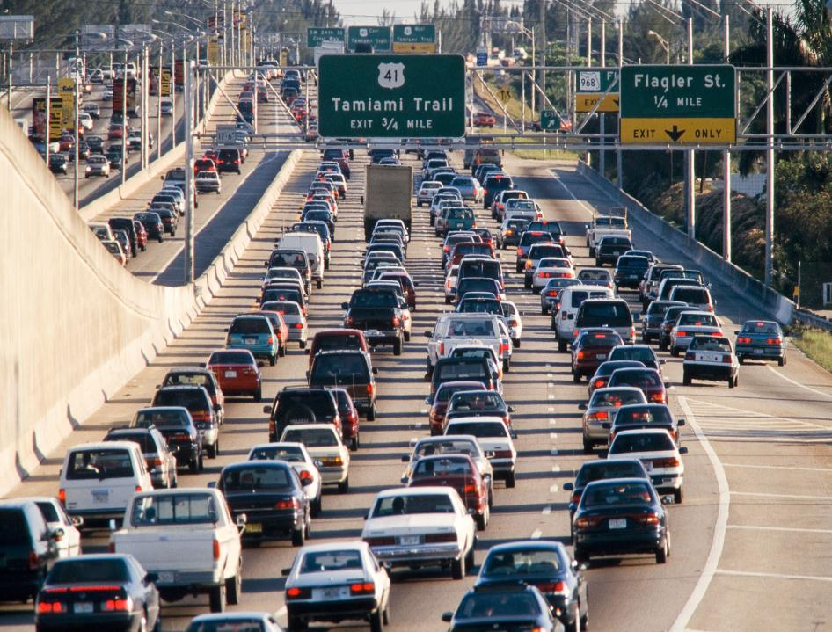

Slide 24
Work Zone Safety
Congestion on our roads is growing. Vehicle miles of travel are growing at a rate greater than mile of roadway:
Between 1982 and 2002, vehicle miles traveled increased by 79 percent, while highway lane miles only increased 3 percent during the same period.
(U.S. Department of transportation, Federal Highway Administration, Highway Statistics 2001, Publication No. FHWA-PL-02-020 Washington, DC , 2001.)

Slide 25
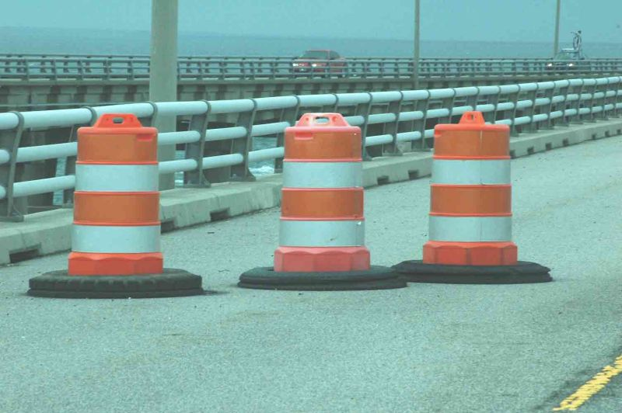
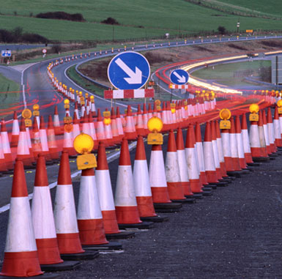
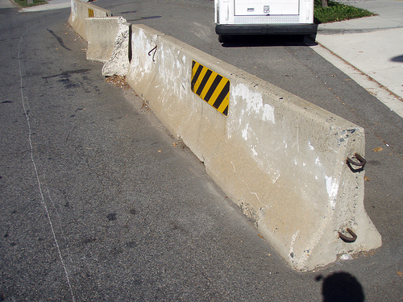
Internal Work Zone Traffic Control for worker protection
Traffic cones from Europe
Not proper use of Jersey Barrier

Slide 26
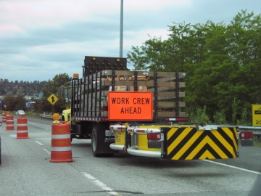
Additional Truck Mounted Attenuators (as needed for project)

Slide 27
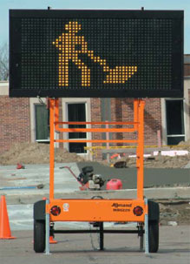
Additional Message Boards

Slide 28
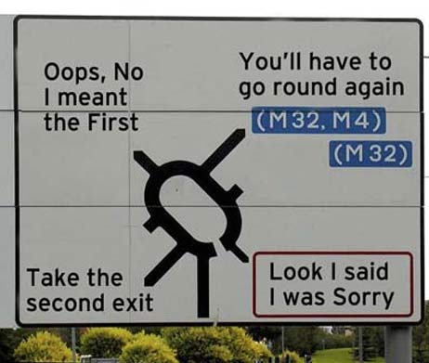

Slide 29
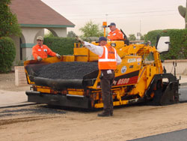
Backer Spotter

Slide 30
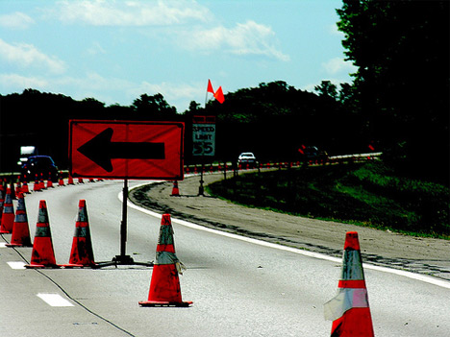
Trucks – access and egress

Slide 31
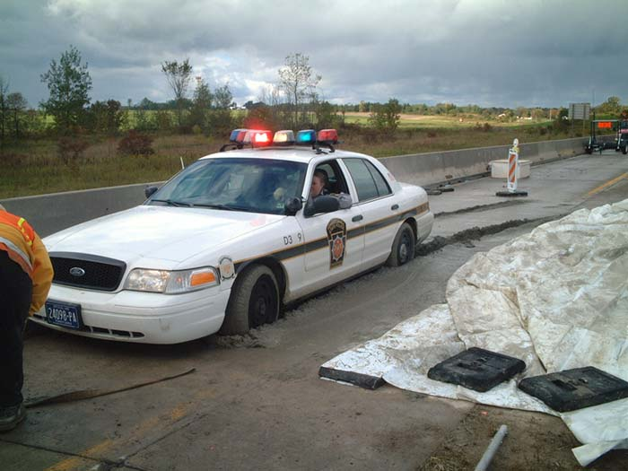
Additional Law Enforcement

Slide 32
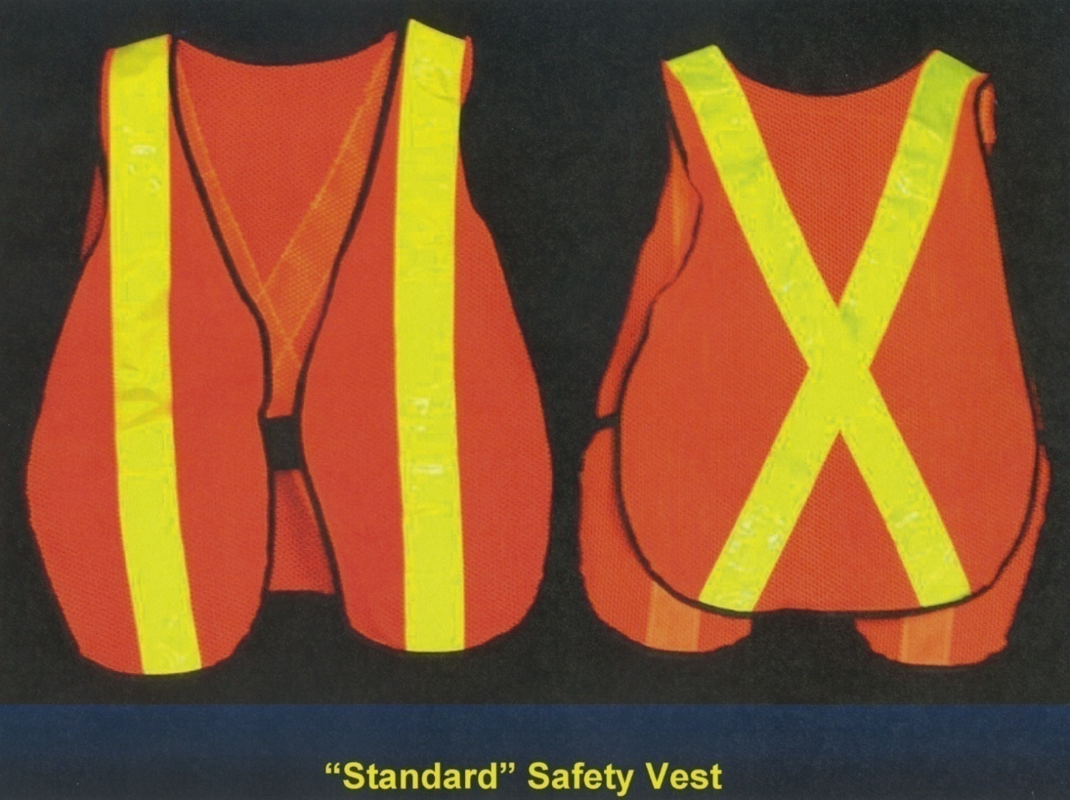
Making Worker more Visible

Slide 33

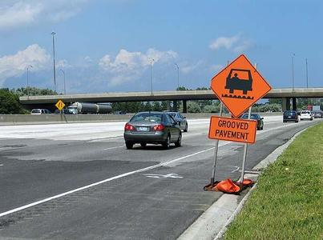
Additional Warnings

Slide 34
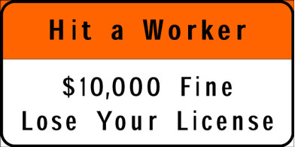
Additional Warnings

Slide 35
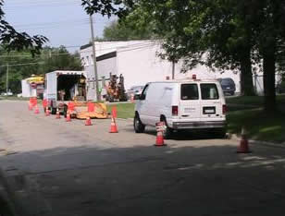
CONES ARE ONLY APPROPRIATE AT SHORT TERM SITES

Slide 36
Traffic Control Devices
Effective
Changeable message signs
Arrow panels
Warning flags and lights on signs
Effective buffer space
Trained flaggers and spotters

Slide 37
Other TCDs & Safety Devices
Enhanced flagger setups
Intrusion alarms
Rumble strips
Pace or pilot vehicle
High quality work zone pavement markings and removal of misleading markings
Reduced channelizing device spacing

Slide 38
Good TTC Achieves Multiple Goals
Movement of vehicles, bicycles, pedestrians
Accommodates transit operations
Provides access to property and utilities
Protects workers and work operations
Allows efficient completion of the work
Bottom line = reasonably safe & efficient movement of road users while protecting workers & completing work efficiently

Slide 39
What is an Internal Traffic Control Plan?
Developed by the contractor
Coordinates vehicle and equipment movement inside the work zone
Limits exposure of workers on foot to construction traffic
Reduce hazards for equipment operators

Slide 40
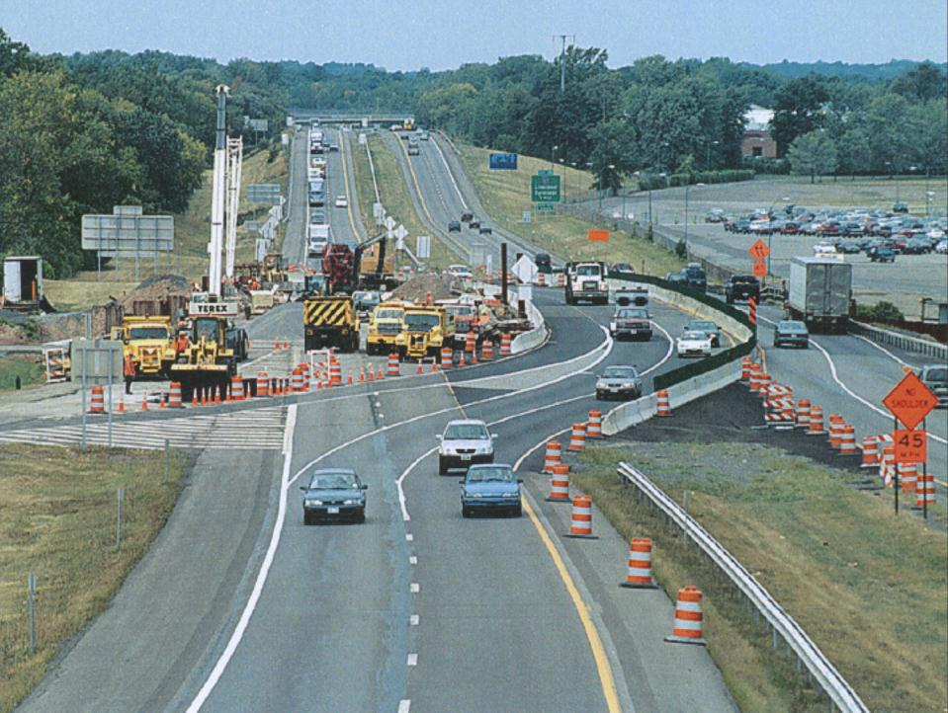

Slide 41
“Stage” the Roadway Work Zone
Advance Warning
Transition
Activity – Work space, Buffer space, Traffic space
Termination

Slide 42
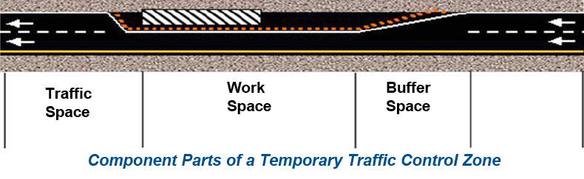
Work Zone Safety
Traffic control plan is needed
Traffic control devices must be used inside the work zone
First warning should be 4-8 times (in feet) the speed limit (in mph)
Flaggers and others need high visibility, reflective clothing and training
Notes:
Trainers Notes:
OSHA makes the following recommendations:
Give motorists plenty of warning of upcoming work zones; place the first warning signs at a distance calculated as 4 to 8 times (in feet) the speed limit (in mph)-use a higher multiplier for higher speed areas (e.g., a 15 mph road should have its first warning sign at least 60 feet from the work zone, while a work zone needed in a 65 MPH zone should have its first sign approximately 520 feet away).
Work zone safety requires:
Traffic control plan is needed
Traffic control devices must be used inside the work zone
First warning should be 4-8 times (in feet) the speed limit (in mph)
Flaggers and others need high visibility, reflective clothing and training

Slide 43
Principles of Safe Traffic Control
Plan for Safety
Keep if Moving
Communicate
Monitor
Plan for the Worst
Train

Slide 44
The Future of Work Zones
It is possible to reduce work zone accidents
Goals:
Indentify and create best practices
Implement Internal Traffic Control strategies for improved motorist information on destination and delay

Slide 45
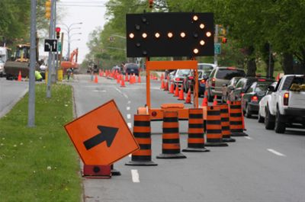
Considerations
Pre-shift meeting with all involved
Everyone must know what is happening for the day.

Slide 46
Work Zone Safety
However…
“The owner would not always allow us to place additional safety devices on the job!”
“We did not get paid for a lot of those extra safety devices!”

