Slide 1
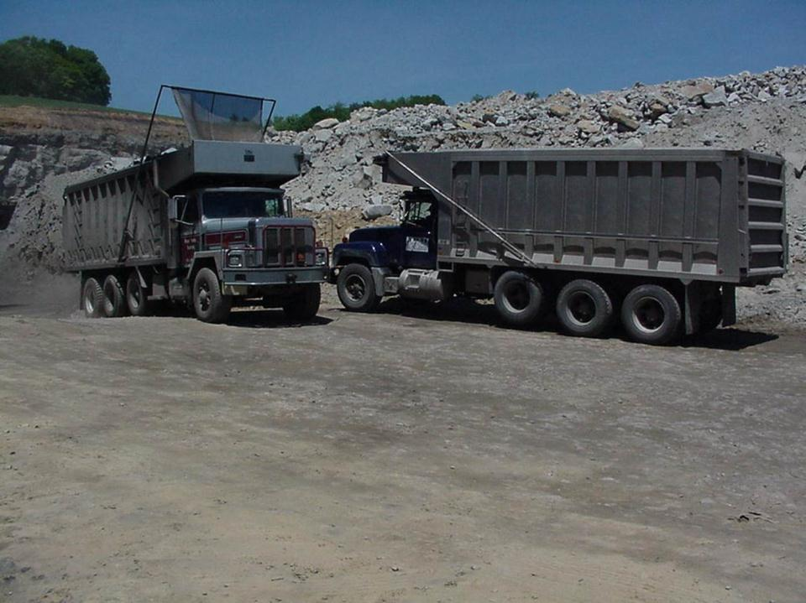
Mobile Equipment
Pre/Post Operational Examination
Training

Slide 2
Perform safety checks of heavy equipment before start of each shift. (Suggestions from Wayne State U.)
Walk fully around equipment and look for hazards
Inside cab remove trash, clean dirty windows, adjust mirrors, check fire extinguisher, turn on all exterior lights, make sure seatbelt is ready to use
Outside, check lights, tires, suspension, steering, fluid levels, exterior hoses and filters. Look for unguarded moving parts or other unsafe conditions
After starting engine, check gauges, warning lights and engine sounds
Before moving, warn people in the area, test equipment’s movements and make sure back up alarms can be heard
Notes:
Trainers Notes:
This information is going to be common knowledge to operating engineers, but other trades may not know it and operators may become complacent in performing some of these checks. Wayne State University developed this checklist with funding from OSHA and should be mentioned as the source.
Operators should follow the procedures below before the start of each shift (a check list is recommended):
Approach equipment, walk fully around it and look for hazards on or near equipment.
Inside the cab, remove trash, make sure cab windows are clean, adjust mirrors, check fire extinguisher, turn on all exterior lights, make sure seatbelt is ready to use.
Outside, check lights, tires, suspension and steering system, exterior hoses and filters. Look for cracks in metal structure, unguarded moving parts or other unsafe conditions, and check engine compartment and belts. Make sure fluid levels are correct.
Inside again, check all gauges and warning lights before starting. Make sure parking brake is set and other manufacturer’s engine start-up guidelines are followed. Start engine; check gauges & warning lights again. Check engine sounds.
Before moving, warn people in area, test your equipment’s movements and make sure the backup alarms can be heard.

Slide 3
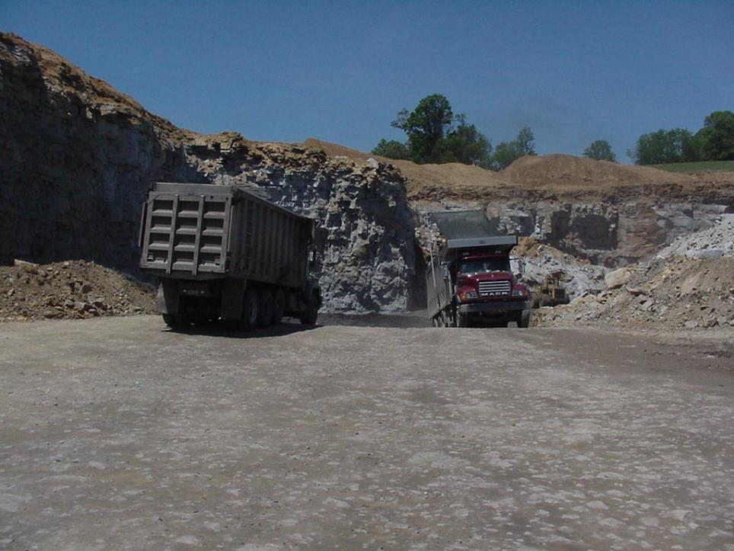
Pre Operational Examination
Equipment operators should develop a “Zero Compromise” safety attitude. This means that they will not operate equipment that is not properly maintained.
An operator’s knowledge of the machine and the functions is directly proportional to his/her ability to safely operate the machine and to control it in an emergency.

Slide 4
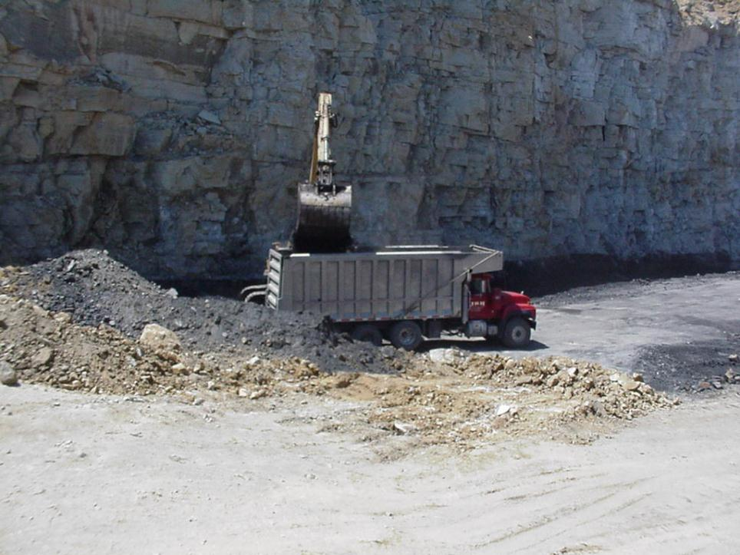
Inspecting the workplace for potentially hazardous conditions is an important part of every equipment operator’s job.
This includes performing pre/post shift examination of their machine.

Slide 5
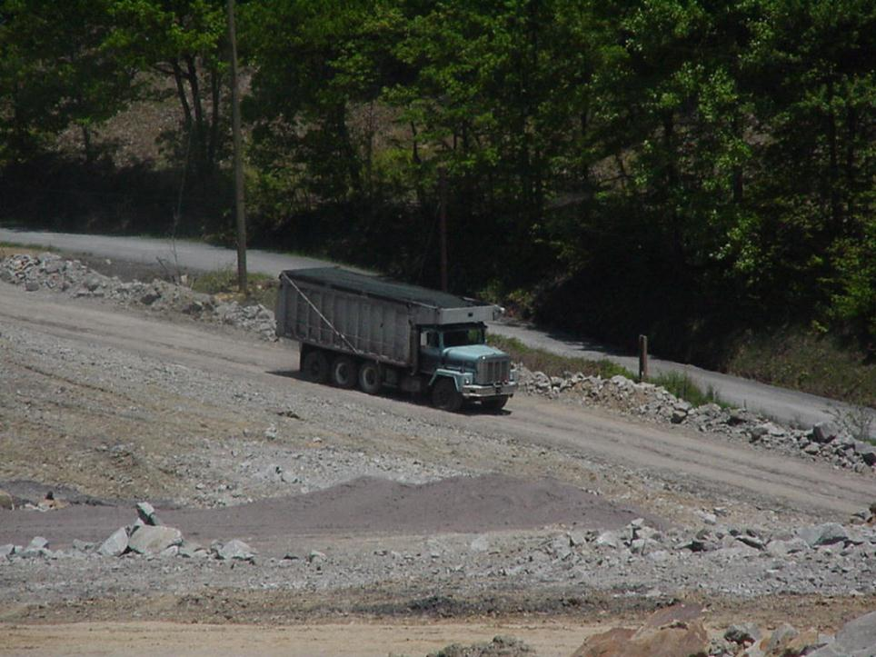
Using an equipment inspection system, will help the operator to make sure that the machine is mechanically sound and in safe operating conditions.

Slide 6
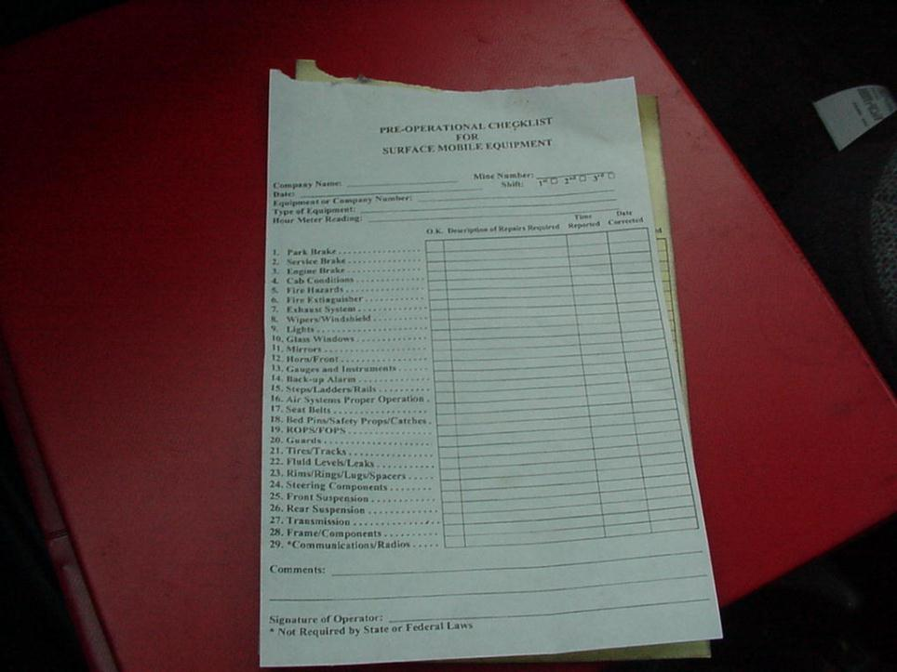
You Should…
Perform a systematic pre-operational examination of the machine using a designated examination report form to record findings and comments.

Slide 7
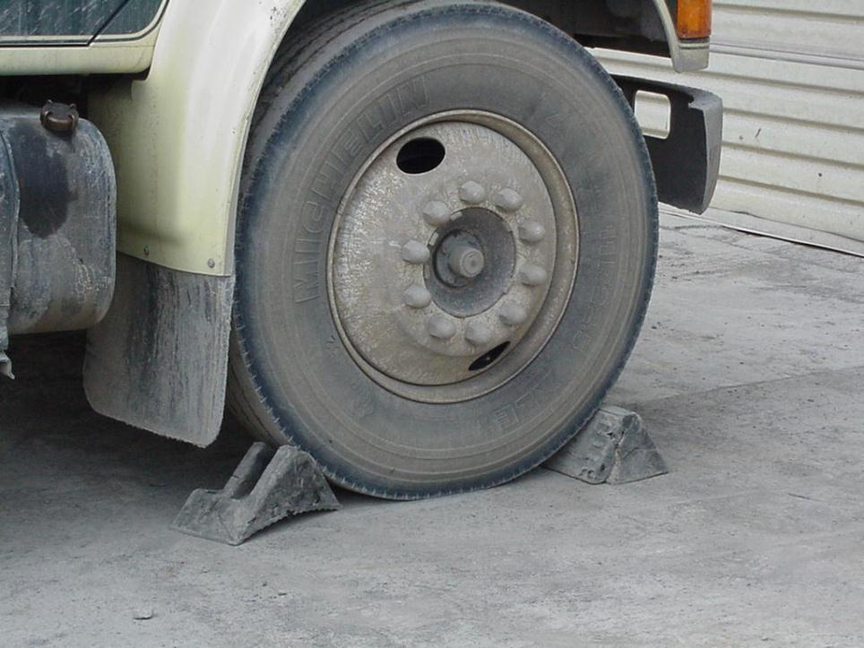
Prepare the Machine
Notes:
Park the machine on level ground, out of the traffic pattern and note its general condition.
Chock the machine against movement.
Review the last machine examination report. Note any defects reported by the previous operator. Confirm that repairs were made.

Slide 8
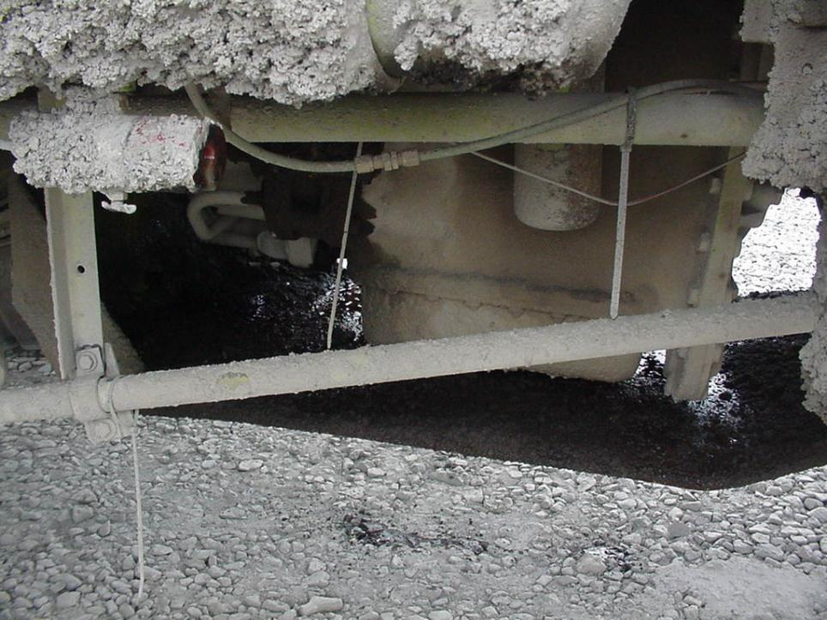
Accumulations of combustible materials
Unsafe condition
Notes:
Flammable liquids shall not be allowed to accumulate where they can create a fire hazard.
Look below for signs of leakage
Check all hoses
Check for oil accumulations on engine

Slide 9
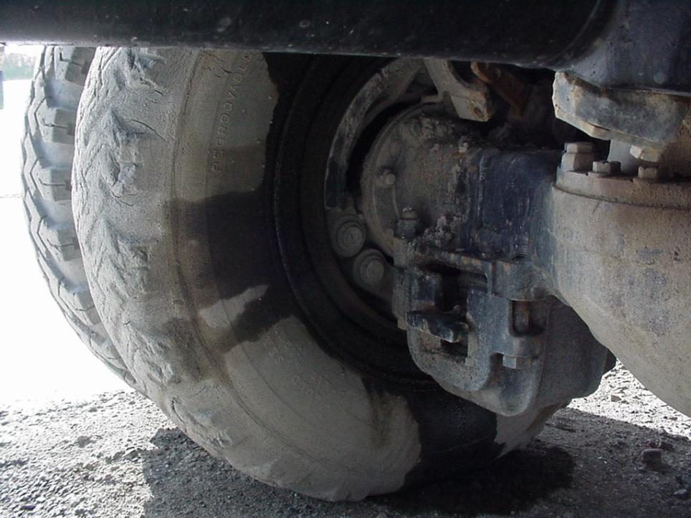
Front and Rear Brakes
Unsafe condition
Notes:
Check brake lines for damage and insecure mounting. Check brake linings, if visible, for large cracks, and missing pieces, and verify that there is no oil or grease on linings, drums, or discs. Listen for air leaks and with the aid of a coworker who can apply/release the brakes, check for excessive slack adjuster travel.

Slide 10
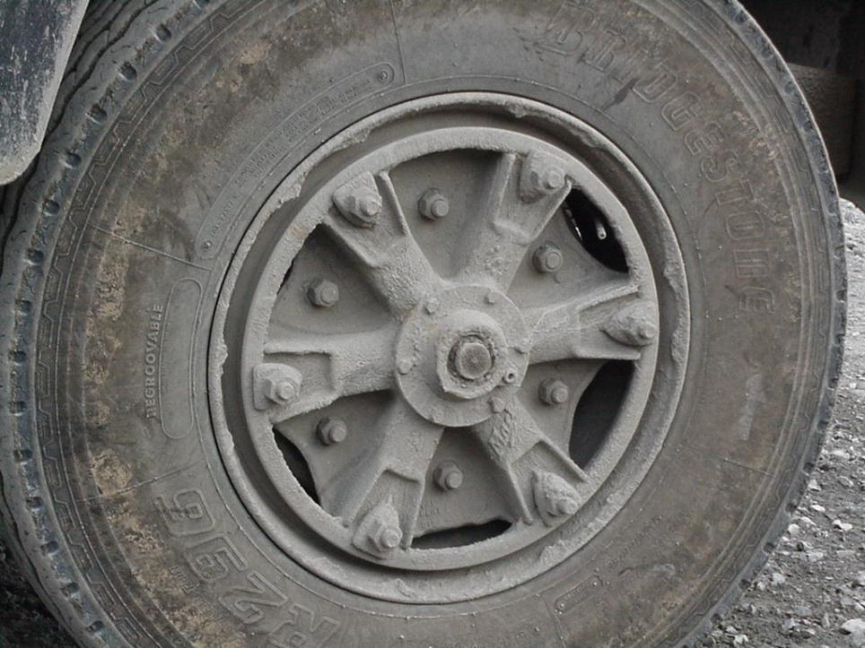
Tires-Wheels Front and Rear
Notes:
Check tires for bulges, leaks, side wall separation, cuts, exposed fabric, worn spots, and evidence of misalignment.
See that tires are properly inflated and do not contact any part of the machine.

Slide 11
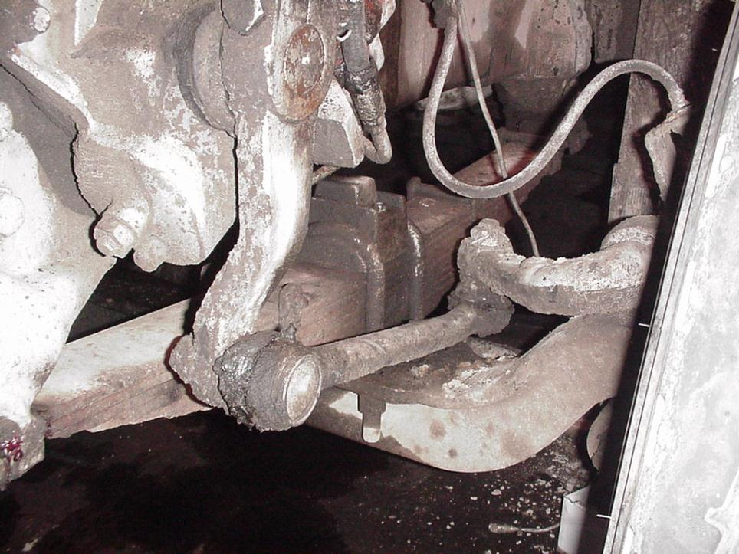
Steering System
Notes:
Check steering wheel sector linkage, fluid levels, hoses, drag links, pitman linkage, tie rod linkage, spindle linkage, sector gear mounts, keeper pins and steering connections.

Slide 12
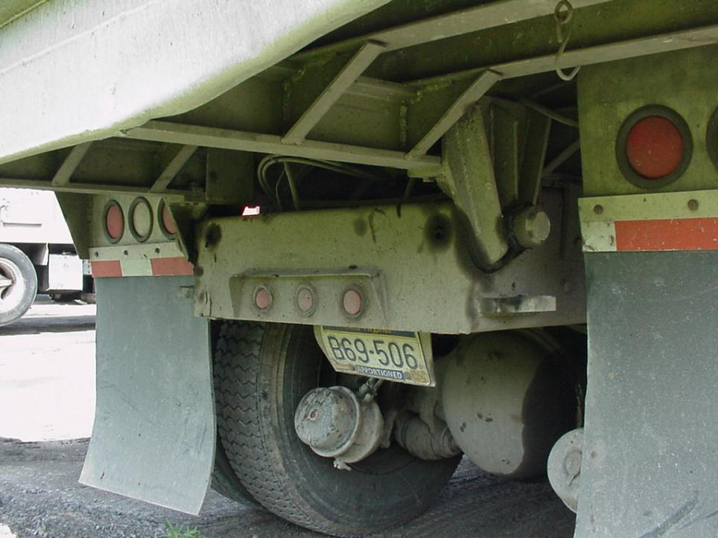
Bed Pins

Slide 13
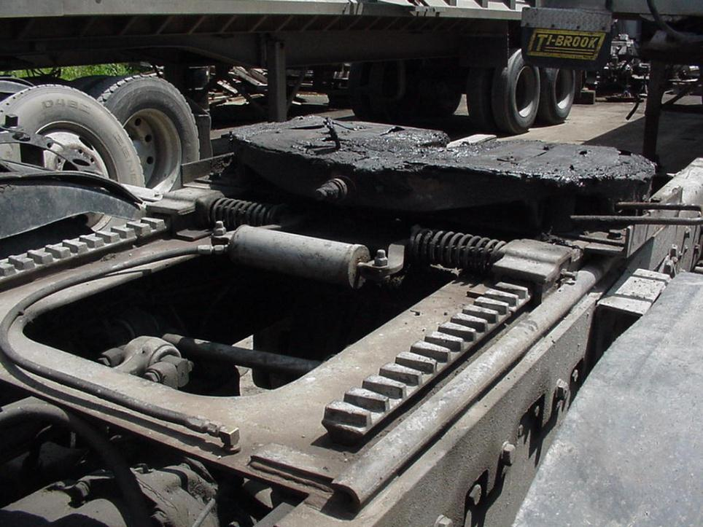
Fifth Wheel
Notes:
Check frame attachment and all related components, such as cross members, welds, bolts, release handle and locking device.

Slide 14
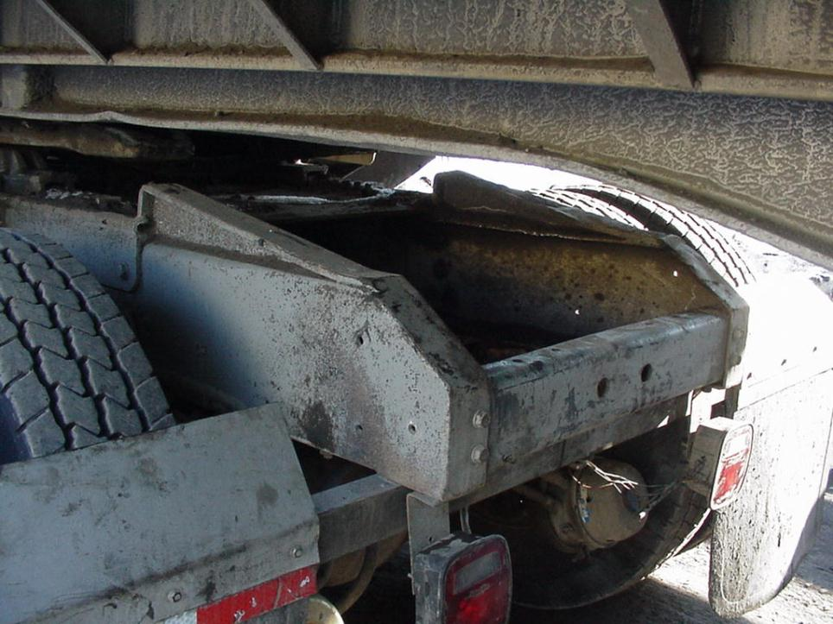
Frame/Cross Members
Notes:
Examine main frame and cross members for cracks and worn or defective components.

Slide 15
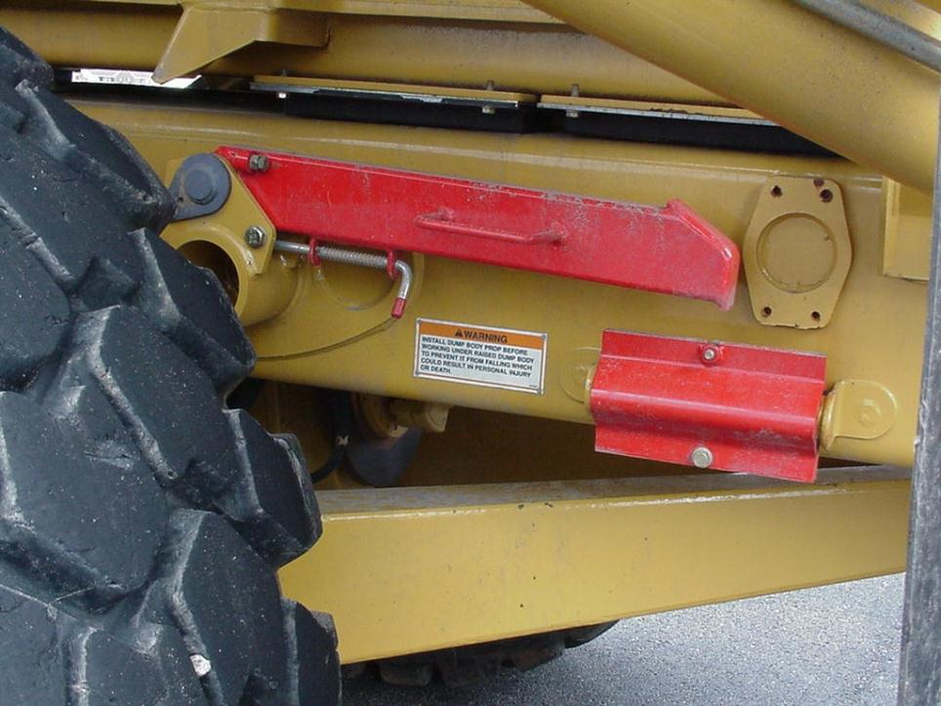
Safety Props/Catches
Notes:
Check for availability and substantial bracket installation.

Slide 16
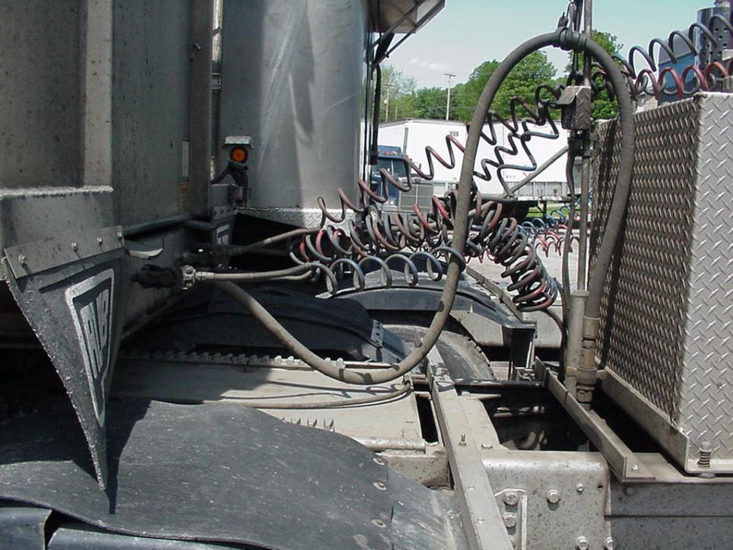
Air Supply Lines
Notes:
Check for air leaks, damaged hoses and connections. Insure that hoses are properly suspended. Air line connections should be labeled.

Slide 17
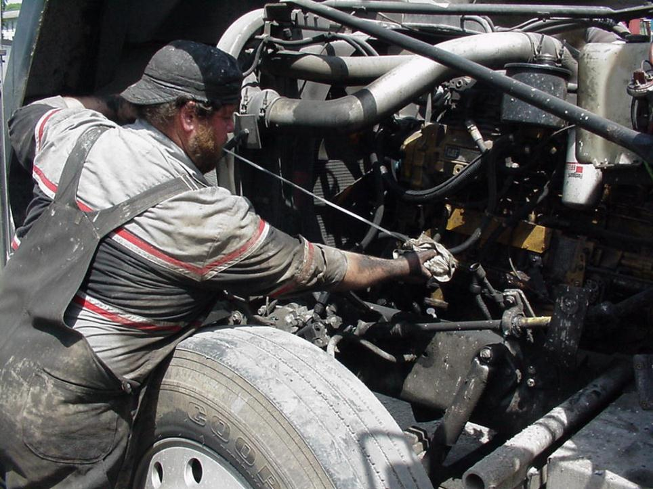
Engine Compartment
Notes:
Check engine oil, coolant, power steering and transmission fluid levels.

Slide 18
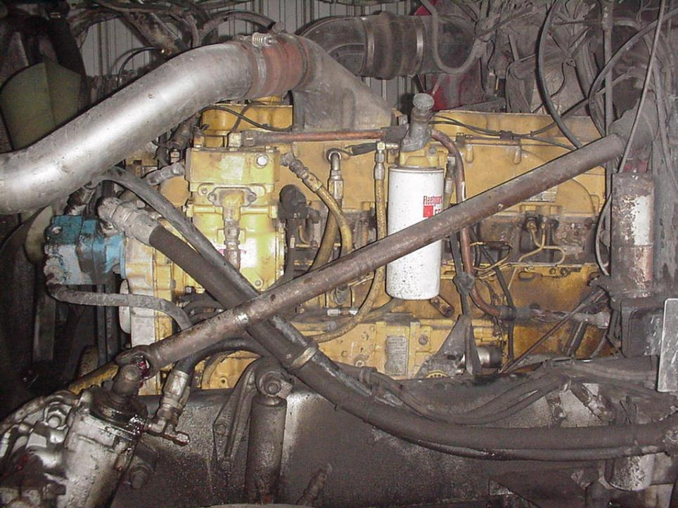
Engine Compartment
Notes:
Check all hoses for signs of leakage or seeping.

Slide 19
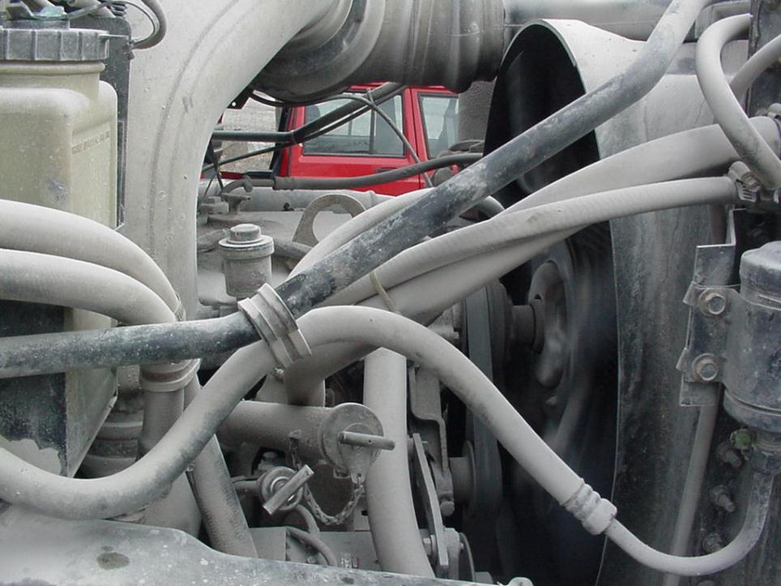
Guards
Notes:
Moving parts should be guarded to protect persons from flywheels, couplings, shafts, fan blades, and similar moving parts that can cause injury.
Check for proper installation, construction and design as required by the manufacture.

Slide 20
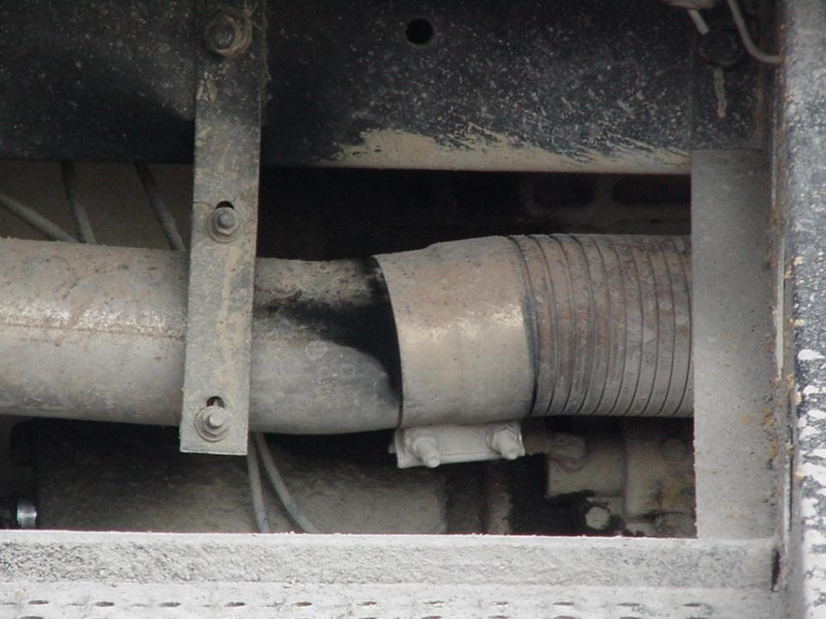
Exhaust
Unsafe condition
Notes:
Observe exhaust system for leaks (especially under the operator’s compartment)

Slide 21
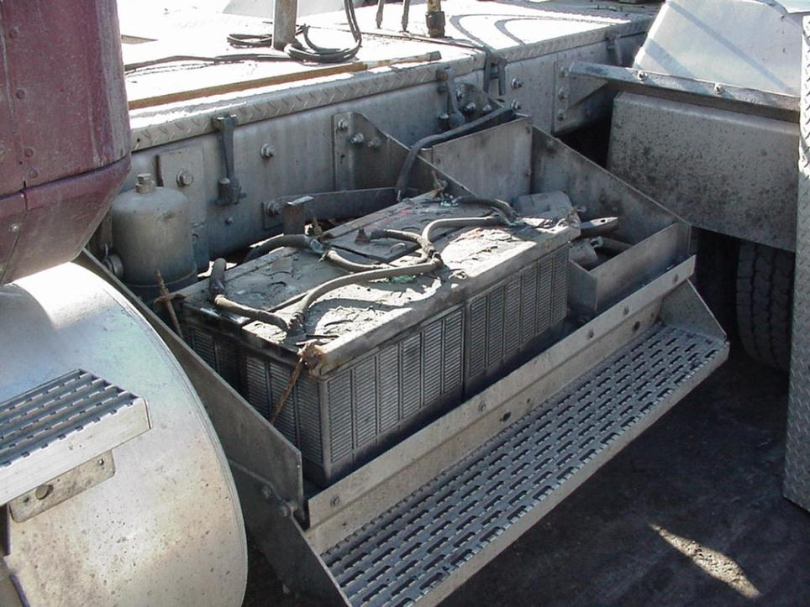
Battery
Notes:
Insure that batteries are secured and in their proper location.
If you do not have the proper personal protective equipment do not attempt to perform battery maintenance. Battery maintenance should be performed by experienced maintenance personnel.

Slide 22
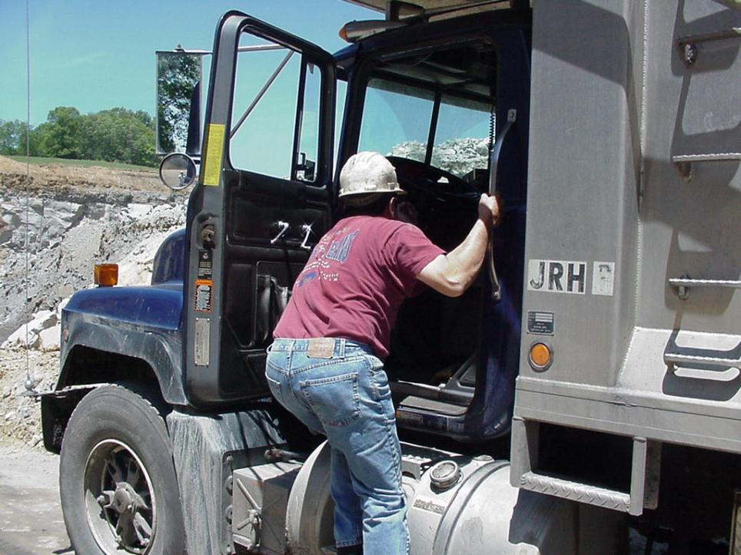
Steps/Grab Rails
Notes:
Insure grab irons, hand holds, steps, ladders, service platforms, etc., are free and clear of mud, ice, snow, securely fastened and in general good condition.

Slide 23
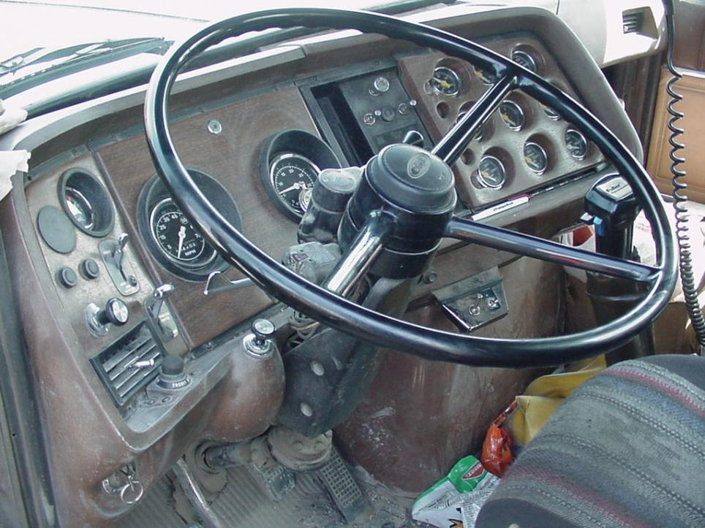
Operators Cab
Poor Housekeeping
Notes:
Check gauges and warning lights before starting the engine and after the engine is running for proper warning and operating ranges.

Slide 24
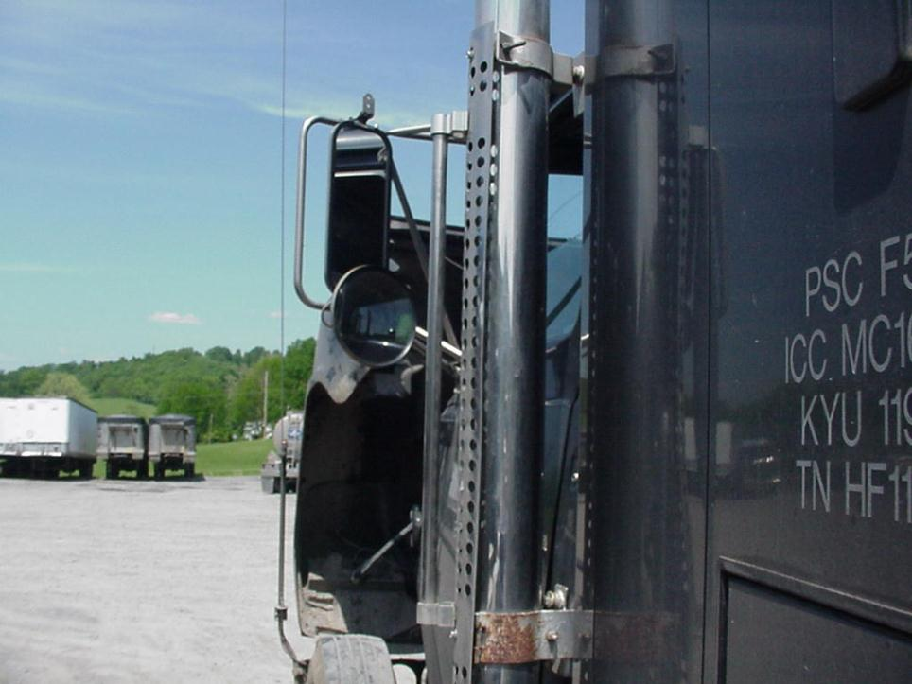
Mirrors
Notes:
Mirrors on machines are installed to help the operator be sure persons and equipment are clear of the machine being operated.
Adjust mirrors to provide the desired visibility especially to the rear area of the machine
Check for broke or missing glass.

Slide 25
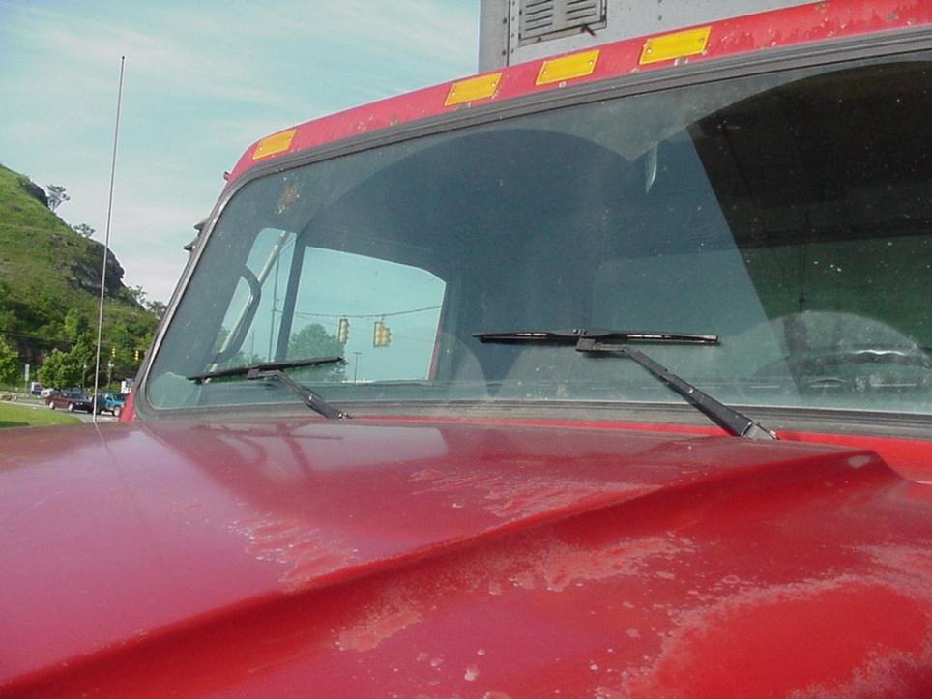
Windshield Wipers & Glass
Notes:
Conduct a visual examination of the wiper arms, blades and observe proper operation.
Check all mechanical components for deterioration of rubber and plastic parts.
If equipped check windshield washer for proper operation

Slide 26
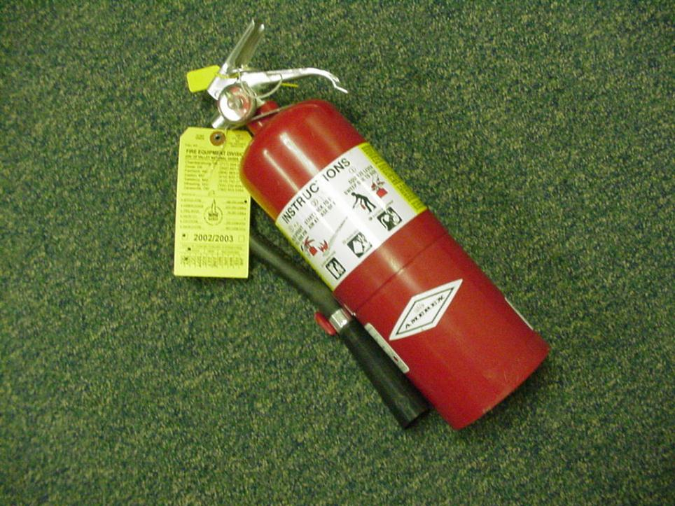
Examination of fire fighting equipment.
Notes:
Fire extinguishers shall be examined and examination shall be recorded on a permanent tag attached to the extinguisher.

Slide 27
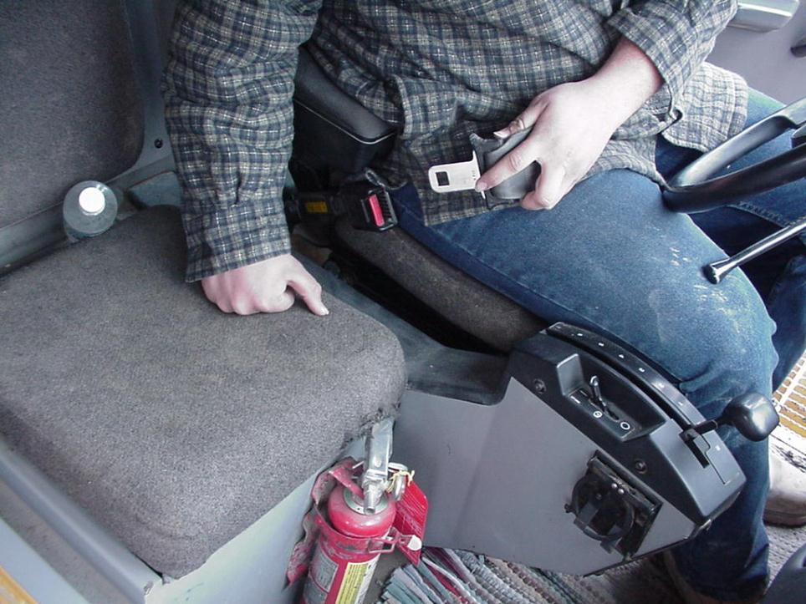
Seat belts
Notes:
Seat belts should be provided and worn in haulage trucks.
Seat Belts should be maintained in functional condition, and replaced when necessary to assure proper performance.

Slide 28
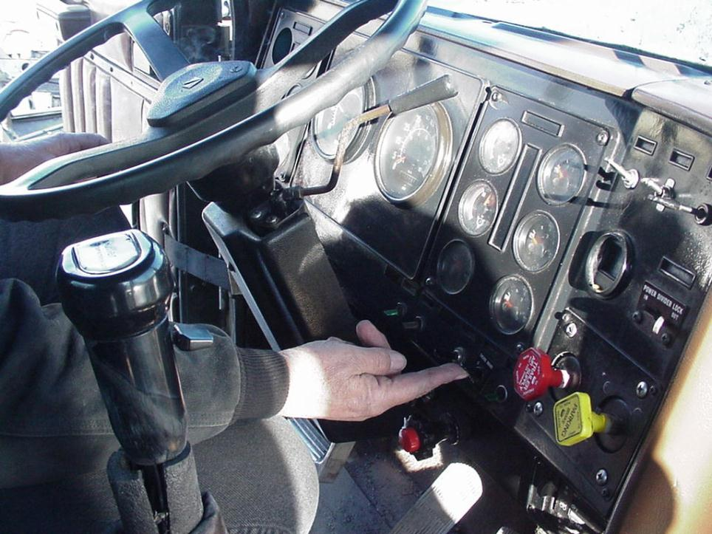
Electrical-Mechanical Retarder System
Notes:
At a slightly accelerated speed, test the electrical/mechanical retarder system.

Slide 29
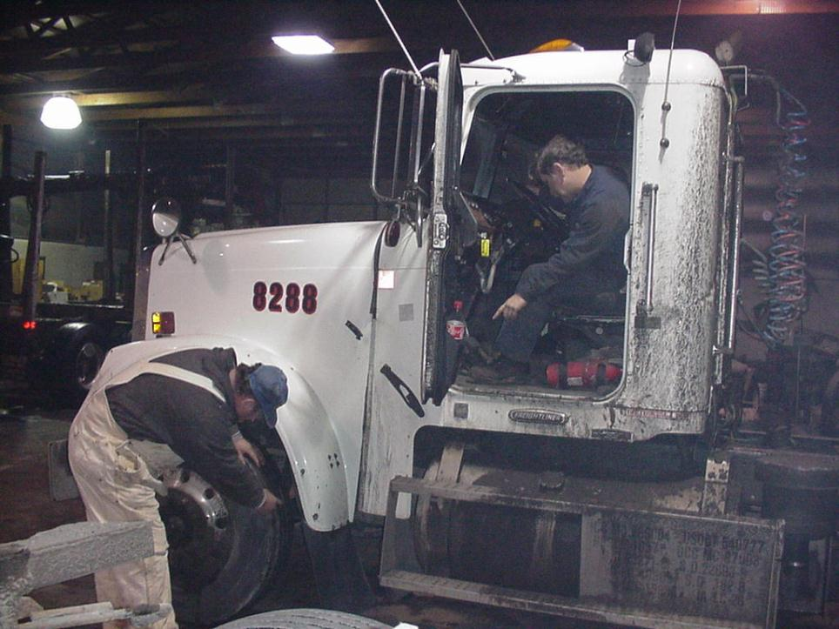
Service Brake
Notes:
Depress service brake pedal and keep depressed while observing air gauge for excessive loss of air pressure.
Walk around the vehicle while looking and listening for air leaks in hoses, valves and all air connections. When possible use the buddy system.

Slide 30
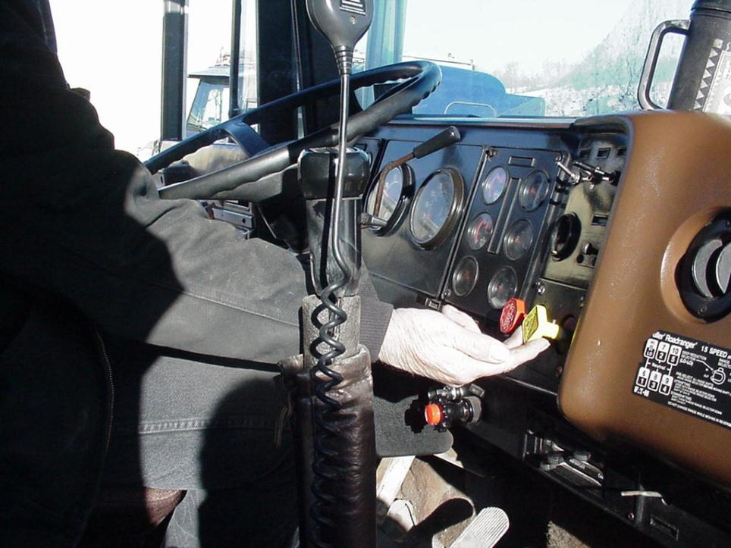
Park Brake
Notes:
Insure that park brake will hold the vehicle on the maximum grade the vehicle will be traveling.
Manufacturer recommendations should always be followed.

Slide 31

Air Systems-Proper Operation
Notes:
Start vehicle and allow air pressure to build to proper operating range.
Check air gauges for proper operating range to insure the air system is charged properly and that the air compressor and governor are operating properly.
Check all master control valves and all other air control valves for leaks and proper position.

Slide 32
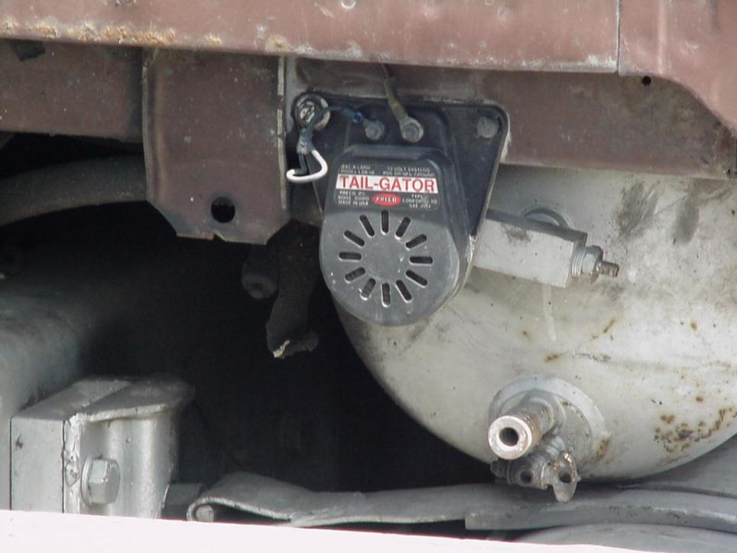
Horns and Backup Alarms
Notes:
External alarms, such as backup alarms and horns are provided to attract attention to the machine. The machine must not be operated until they are functional.

Slide 33
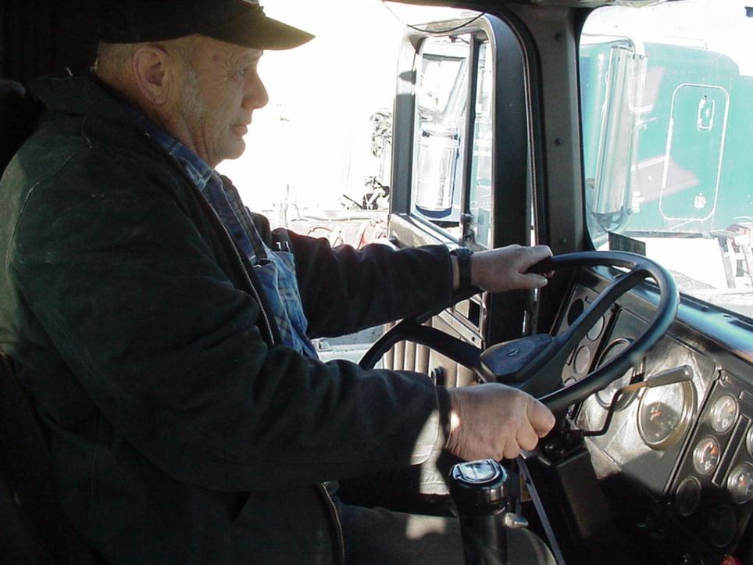
Steering
Notes:
Test the steering system for response, when you can safely maneuver the machine.

Slide 34
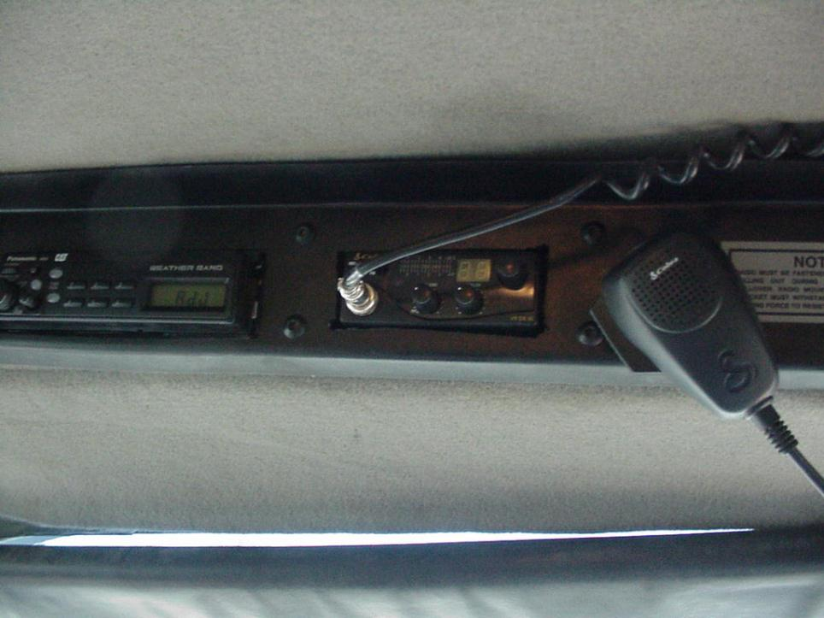
Communications
Notes:
Check communications system to insure proper operation.

Slide 35
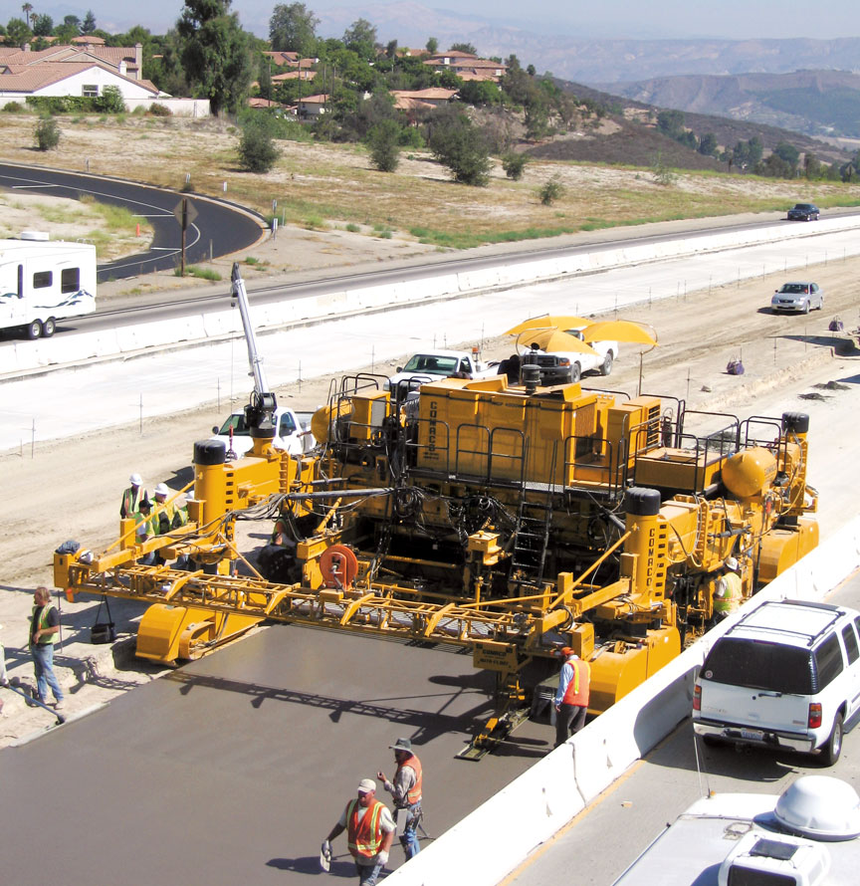
Blind Areas Around Construction Equipment

Slide 36
Definition of Blind Area
A blind area is the area around a vehicle or piece of construction equipment that is not visable to the operators, either by direct line-of-sight or indirectly by use of internal and external mirrors.

Slide 37
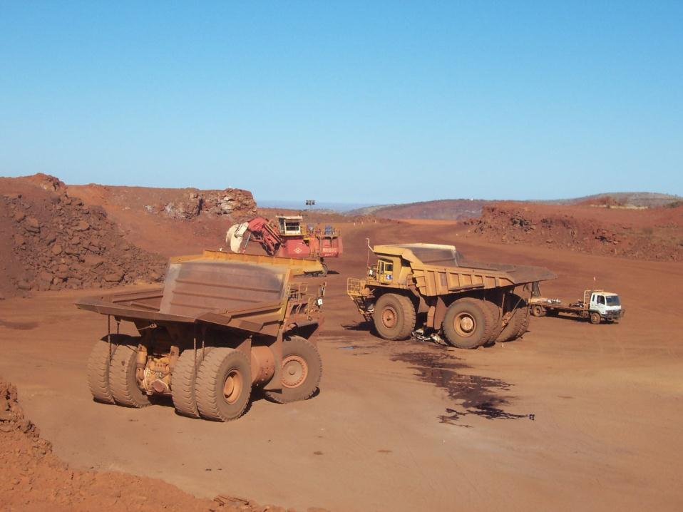

Slide 38
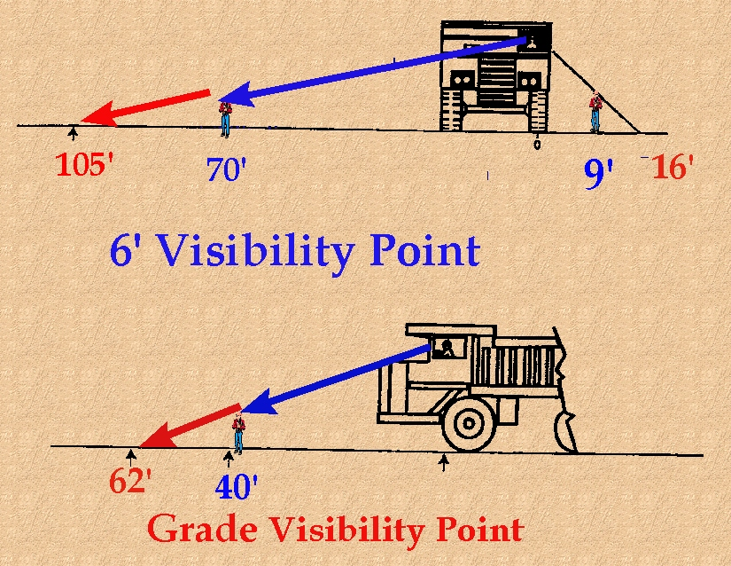
Notes:
This truck driver cannot see the ground closer than 105 feet out the right side, 16 feet out the left side, and 62 feet out the front. Truck drivers are always operating “in the blind.” They see only what is far ahead and continue on, hoping the condition will be the same when they get there. You can imagine the blind areas around some even larger trucks that are 320 or 340 ton capacity. It's over 200 feet away before the driver can see the ground.

Slide 39
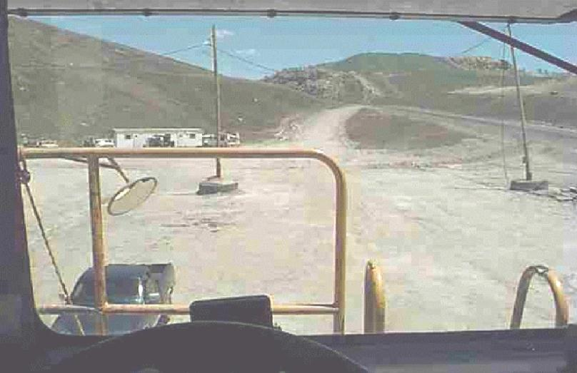
Notes:
Here is a view from the driver’s seat of a 240-ton haul truck. The black pickup truck is parked about 68 feet away. If it was approximately 6 feet closer, the driver probably would not see it.

Slide 40
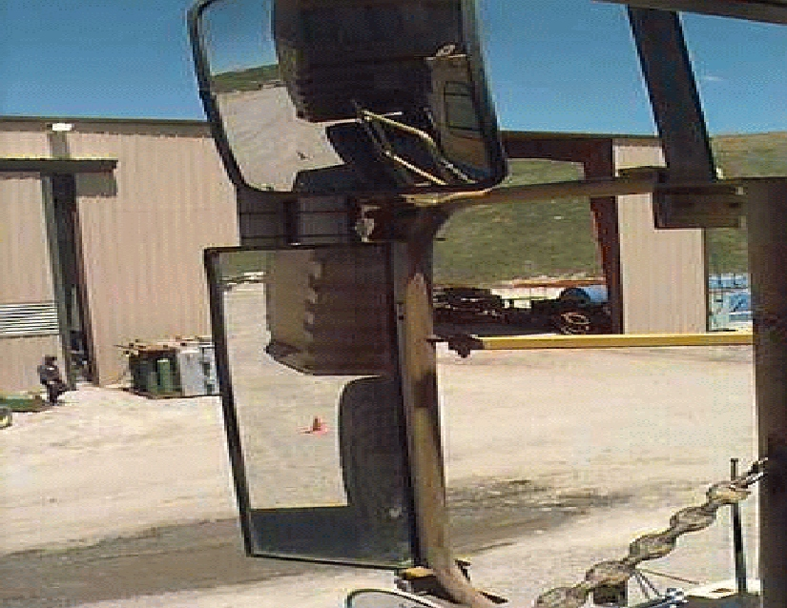
Notes:
Here are the mirrors that the truck drivers use on the left side of the truck. The rectangular, long, flat mirror is the one that most truck drivers use most of the time. The mirror above it is convex. It helps by enlarging the viewing area. But this view is distorted and not as clear as the flat mirror. When drivers are backing up they’re mainly watching what the rectangular mirror shows from the bottom of the left rear tire all the way to the top of the truck bed.

Slide 41
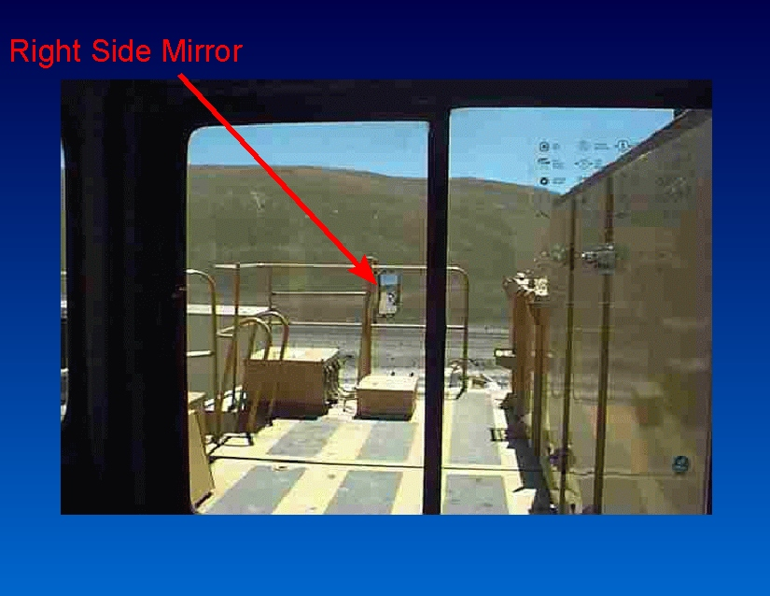
Notes:
In this view from the driver’s seat you can see the convex mirror on the right side. This mirror can be as much as 20 to 25 feet away from the driver on larger trucks. You can see that the image is not very big, and it’s often blurred. Sometimes the mirror is reflecting the same shade of color as the background view. It’s very hard for the driver to see that far away. Painting a bright colored border around that mirror could help the driver pick it out quicker.
Some companies add things to this walkway, such as fire extinguishers on the handrails. These things reduce visibility. Anything that blocks visibility increases the danger around these trucks.

Slide 42
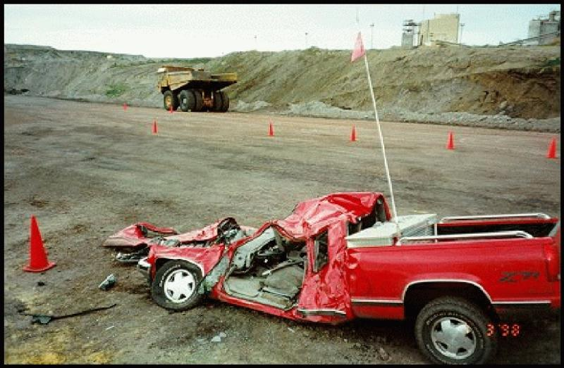
Notes:
In this fatal mine accident scene you’re looking at the foreman’s red pickup truck. The large truck in the background was the truck that ran over the pickup. The sequence of events began with the foreman driving the pickup truck. He called the haul truck driver and said that he was going to relieve him. The foreman was going to drive the large truck for a while. He pulled up to the large truck, parked at its right front corner, walked around the large truck, and entered the driver's compartment. The regular truck driver went down and had just gotten into the pickup truck when the foreman took off and ran over the pickup that he had just parked. Because he couldn’t see the pickup, he forgot about it. Even the flag on the pickup’s "buggy whip" did not alert the foreman.

Slide 43
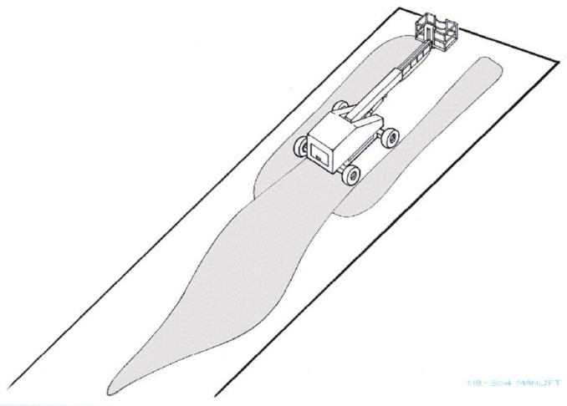
Eye level 10 feet - 0 in above
ground level
34’ 0”
36’ 4”
Manlift
68’ 0”
95’ 0”

Slide 44
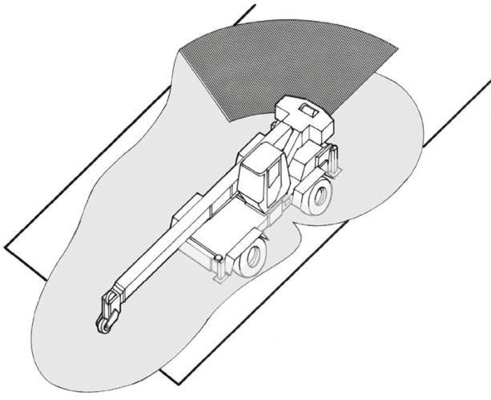
Area of fully
obstructed view
Eye level 7 feet - 0 in above
ground level
25’ 5”
17’ 8”
15’ 9”
10’ 0”
3’ 0”
16’ 4”
Hydraulic Crane
27’ 2”

Slide 45
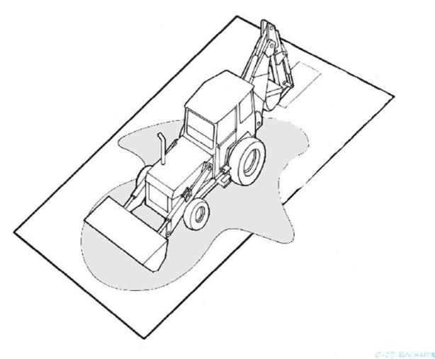
Eye level 7 feet - 7 in above
ground level
8’ 4”
29’ 1”
9’ 1”
7’ 7”
18’ 5”
Tractor Backhoe

Slide 46
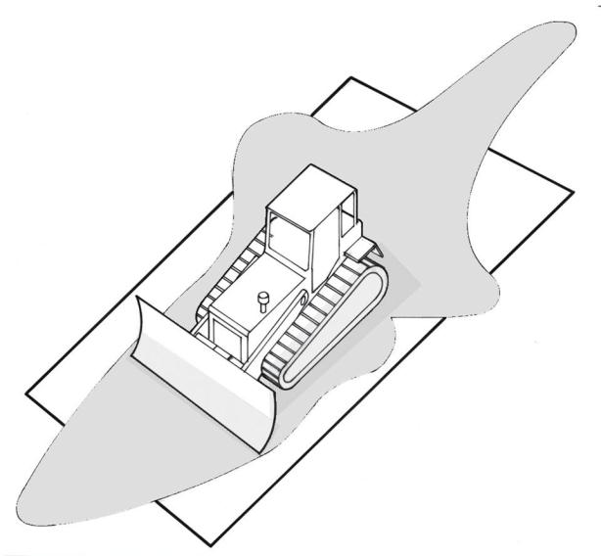
Eye level 6 feet - 3 in above
ground level
16’ 0”
8’ 2”
8’ 2”
3’ 10”
12’ 5”
12’ 1”
Bulldozer
18’ 7”

Slide 47
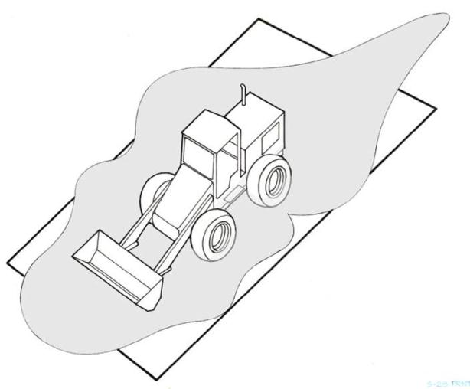
Eye level 10 feet - 0 in above
ground level
28’11”
14’ 8”
16’ 2”
14’ 3”
21’ 11”
14’ 10”
Front End Loader

Slide 48
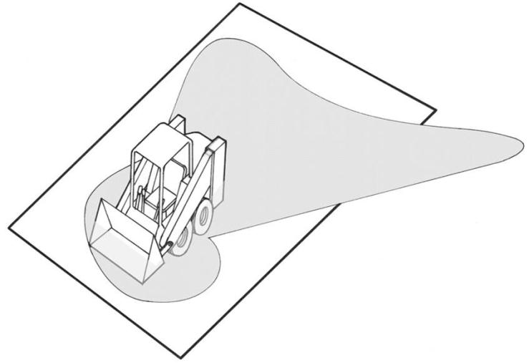
Eye level 5 feet - 5 in above
ground level
11’ 7”
11’ 5”
21’ 8”
4’ 10”
6’ 1”
3’ 1”
Bobcat/Skid Steer
6’ 3”

Slide 49
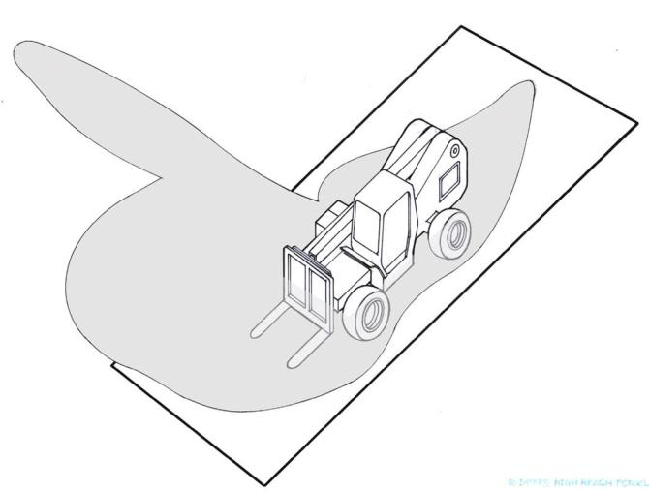
Eye level 7 feet - 3 in above
ground level
85’ 0”
18’ 2”
7’ 9”
10’ 9”
3’ 0”
39’ 0”
Terex
Telehandlers
21’ 2”
14’ 10”

Slide 50
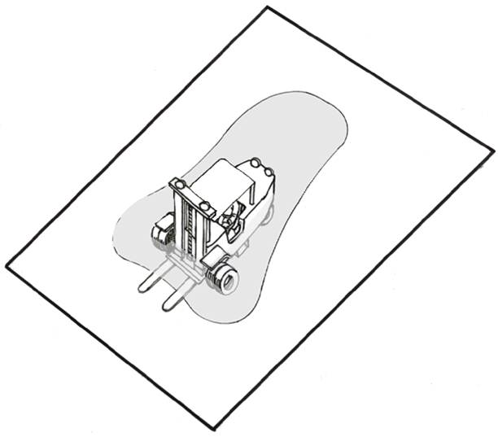
Eye level 6 feet above
ground level
8’ 6”
3’ 1”
3’ 8”
5’ 7”
3 Ton Forklift

Slide 51
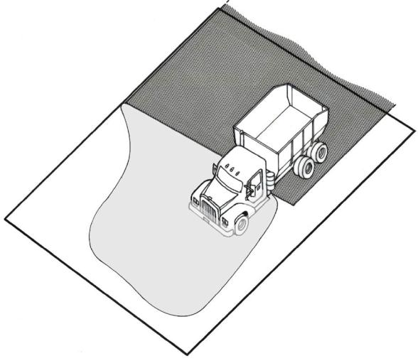
Eye level 7 feet - 1 in above
ground level
Area of fully
obstructed view
25’ 0”
22’ 0”
6’ 0”
24’ 2”
5 Ton Dump Truck
22’ 2”

Slide 52
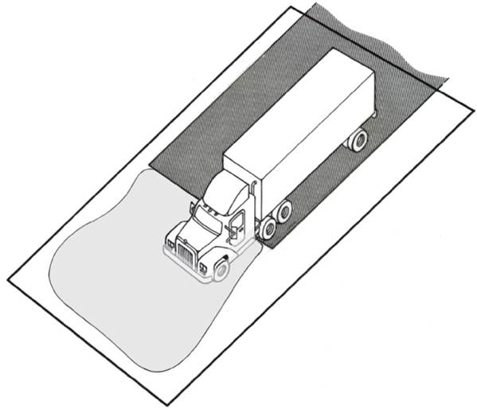
Eye level 6 feet - 10 in above
ground level
Area of fully
obstructed view
27’ 1”
6’ 5”
42’ 8”
40’ 6”
Tractor Trailer
36’ 8”

Slide 53
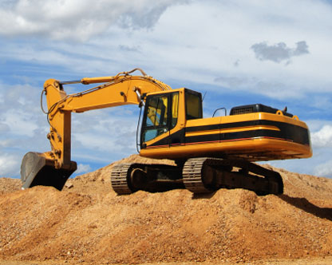
Struck By

Slide 54
How do these injuries and fatalities occur among vehicle operators? (McCann, J. Safety Research, 2006)
63% involved operators falling or jumping from their vehicle and then being run over by it
Don’t jump, ride it out wearing your seat belt
Operators on foot who were struck by vehicles were run over by their own vehicle, mostly due to it being left in gear or failure to set brakes
Notes:
Trainers Notes:
Ask the following question and review each bullet.
How do these injuries and fatalities occur among vehicle operators?
63% involved operators falling or jumping from their vehicle and then being run over by it
The author strongly recommended that operators not jump, but ride it out while wearing the seat belt.
All 9 operators on foot who were struck by vehicles were run over by their own vehicle, mostly due to it being left in gear or failure to set brakes

Slide 55


Rollovers caused nearly one-fourth of vehicle-related deaths!
Bulldozers and loaders caused nearly half of rollover deaths
Photo courtesy Robert Carr
Notes:
Trainers Notes:
Point out the statistics in this slide, but consider reviewing the case below (or one from your experience). This case is number 97KY032 in the NIOSH fatality database called FACE. It is available at: http://www.cdc.gov/niosh/face/stateface/ky/97ky032.html
In 1997 in Kentucky, a 56-year-old bulldozer operator was killed while clearing land on a steep hillside. He was self-employed and used the John Deere 450C bulldozer that he owned for logging on his own property, as well as doing work for others when needed. He owned mountain property near his home and he used the bulldozer to clear a series of paths in the hills for logging. At approximately 8 pm on the day of the incident, he was using the bulldozer to clear a path leading downhill where he planned to put a sawmill. As he was grading, he backed the bulldozer to the edge of the path and the soft dirt gave way causing the dozer to overturn and roll several times down the hillside. The bulldozer was equipped with a Rollover Protective Structure (ROPS), but the victim was not wearing a seatbelt. He was thrown out as it rolled and the vehicle came to rest on top of him at the bottom of the hill. A neighbor witnessed the incident and called 911 for assistance. Rescue personnel were dispatched at 8:24 pm and arrived at the scene at 8:48 pm. The county coroner was summoned and pronounced the victim dead at the scene. In order to prevent similar incidents from occurring, FACE investigators recommend that:
Operators of heavy equipment should wear a seatbelt when using vehicles equipped with a ROPS
Operators should use extra caution when using heavy equipment on steep terrain

Slide 56


How do rollovers occur? (McCann, J. Safety Research, 2006)
37% of rollovers involving operators occurred when a vehicle went over an embankment or slope.
Off-highway truck involved in fatality, courtesy of NIOSH
Notes:
Trainers Notes:
It is important to impress upon the class that embankments or slopes were involved when nearly half of the rollovers occurred that killed workers. Extra care is needed on slopes. Consider reviewing the following case study from NIOSH (FACE 2000-05, available at: http://www.cdc.gov/niosh/face/In-house/full200005.html). The image is the lower picture.
A 48-year-old male truck driver (the victim) died after the off-highway truck he was operating rolled 49 feet over an embankment and came to rest on its top in 4 feet of water. The victim was hauling dirt that was being cut from a bank to clear ground for a 3-mile stretch of a new freeway project. As the victim was traveling up a haulage road, a road grader that was scraping mud from the road was traveling toward him from the opposite direction. The victim steered the truck to the right to allow the grader to pass. As he did, a portion of the built-up haulage road gave way under the truck's right-side tires, causing the truck to overturn. The truck rolled over twice while traveling 49 feet down the embankment, and came to rest on its top in 4 feet of water. The grader operator immediately ran to the truck and pulled the victim clear. With the help of two flaggers, they placed the victim on the bottom of the truck cab. The two flaggers initiated cardiopulmonary resuscitation (CPR) on the victim while the emergency medical service (EMS) was called from a company truck. The EMS arrived at the scene within 8 minutes and summoned the county coroner, who pronounced the victim dead at the scene.
NIOSH investigators concluded that, to prevent similar incidents, employers should:
ensure that employees adhere to established standard operating procedures
ensure that heavy-equipment operators are properly trained and proficient in the operation of the equipment they are assigned to operate
Additionally, employers and manufacturers should:
evaluate the possibility of installing video equipment in the cabs of heavy equipment or installing hood-mounted mirrors that would allow operators to clearly see how close their equipment is to road edges.

Slide 57

How do rollovers occur? (McCann, J. Safety Research, 2006)
28% occurred while loading or unloading heavy equipment off trailer trucks
Photo courtesy Robert Carr
Notes:
Trainers Notes:
The McCann study found that 28% of rollovers occurred while loading or unloading heavy equipment off trailer trucks. Ask the class what can be done to prevent these or review the following fatality case study from California (FACE Investigation 97CA011). The file can be found at: http://www.cdc.gov/niosh/face/stateface/ca/97ca011.html
A 65-year old heavy equipment operator died when multiple parts of his body were crushed between the side of a track-driven front-end loader and a concrete curb. The decedent was backing the front-end loader off a low-bed trailer in anticipation of using it to level a pad for a new home. While backing it off, the front-end loader went off the right side of the trailer. The decedent attempted to jump free, but was pinned underneath the machine. The front-end loader had a rollover protective structure (ROPS) and a seat belt which the decedent did not use. The decedent, an owner-operator of a bulldozer, had borrowed this piece of equipment and had limited experience in its operation. No written documentation of a safety program, instructions for off-loading the equipment, or training were available. The CA/FACE investigator recommends that, in order to prevent future occurrences, employers should:
ensure that ROPS equipped-front-end loader operators stay in their machines with their seatbelts fastened when operating the machine, even if it is in danger of rolling over.
require operators to demonstrate operating proficiency before they use a particular type of machine.
develop and use as a training tool, a written procedure for off-loading equipment from trailers.

Slide 58
How can we prevent rollovers while loading and unloading equipment?
Make sure the trailer is secure and on a level surface
Inspect the deck for debris, blocking or chains
Have a spotter help properly align the equipment up the ramps
Be sure equipment is properly secured
Notes:
Trainers Notes:
Many tip-over accidents occur during the loading or unloading of equipment.
Equipment can also slide off trailers or loading ramps.
How can we prevent rollovers while loading equipment?
Make sure the trailer is secure and on a level surface
Inspect the deck for debris, blocking or chains
Have a spotter help properly align the equipment up the ramps
Be sure equipment is properly secured

Slide 59

If a rollover occurs, what greatly improves your chances of surviving?
Wearing a seat belt! 23% of the fatalities weren’t wearing their seat belt
What level of the hierarchy of controls is this?
A buckled seat belt keeps the operator
within the zone of protection of the Rollover
Protective Structure (ROPS). Courtesy CDC.
Notes:
Trainers Notes:
This information is still from the McCann research. He found wearing a seat belt greatly improves the chances of surviving a rollover! 23% of the fatalities weren’t wearing their seat belt. Ask what level of the hierarchy of controls this is and then ask them to defend their answer. (The seat belt is the bottom of the hierarchy, PPE; but ROPS are a passive engineering control).
Case study:
The CDC reports an incident that occurred at the end of a shift for a truck driver with 10 years of experience who started to dump his last load on the waste pile. As he backed up, he hit the berm at an angle, causing the left rear wheels to break through the berm. The truck slid then rolled several times on its way down the 60-foot bank, finally landing upright. The driver unbuckled his seat belt, crawled out of the damaged cab and walked away.

Slide 60

What are the struck-by hazards of dumping trucks?
Trucks can become unstable with the boxes raised
If an end gate chain breaks, you could be covered in material (asphalt is 400° )
Beds must be lowered for maintenance or properly blocked
Truck that released two tons of hot asphalt on a driver inspecting the brakes.
Courtesy Kentucky FACE reports
Notes:
Trainers Notes:
Ask the main question, review the following examples and see if the class can think of others.
Trucks can become unstable with the boxes raised
If an end gate chain breaks, you could be covered in material, like asphalt at 400 degrees
Trucks should never be worked on with the beds elevated. OSHA has a Safety and Health Information Bulletin (SHIB 09-18-2006) on this.
SHIB 09-18-2006 indicates that 29 CFR 1926.600(a)(3)(i) requires that dump bodies shall be fully lowered or blocked when being repaired or when not in use; 29 CFR 1926.601(b)(10) also requires that in construction settings, trucks with dump bodies shall be equipped with positive means of support, permanently attached, and capable of being locked in position to prevent accidental lowering of the body while maintenance or inspection work is being done.
Consider using the following FACE case, Kentucky Case Report: 05KY036. It is available on the web in great detail with good photos at: http://www.cdc.gov/niosh/face/stateface/ky/05KY036.html
On June 6, 2005 a 55-year-old male dump truck driver (Driver 1) died when he was buried waist deep in 400-degree Fahrenheit asphalt. Driver 1 stopped along the highway to help another dump truck driver (Driver 2), (both were independent truck drivers), who had experienced brake problems. As the two men were examining the pneumatic brake system at the rear of the disabled dump truck, the tailgate opened unexpectedly, spilling hot asphalt onto Driver 1 who was under the rear of the truck. According to an emergency report, approximately two tons of asphalt fell out from the tailgate, burying Driver 1 up to his waist in the hot asphalt. Driver 2 crawled out from under the truck and with his bare hands, tried to remove Driver 1 from the asphalt. Realizing rescuers needed more space and to try and stop more asphalt from falling on his friend, with both arms and hands severely burned, Driver 2 got back into the cab of the truck and moved it forward a few feet. By this time, Driver 3 had stopped and helped extract Driver 1 from the asphalt by using a shovel. Emergency rescuers used shovels to remove Driver 1 from the asphalt and performed CPR and took vital signs for about 20 minutes. The emergency report states Driver 1 was awake but confused and talking to his rescuers for 5 – 10 minutes before passing out. As emergency personnel were trying to save him, Driver 1 died at the scene.
The following recommendation was made: Tailgate chains should always be secured to the dump truck.
According to several dump truck drivers, chains on tailgates of dump trucks can be used to regulate the volume of rock when it is unloaded. The driver can choose to not hook the chains and dump the full load into one big pile, or hook the chains and spread the rock slowly in a line. When asphalt is unloaded, chains are not usually used. The tailgate is released, and the bed raised in increments to allow the asphalt to slide out of the truck bed. As a backup safety mechanism when hauling asphalt or any other material including rock, the chains should be secured tightly to the side of the truck. Chains should be secured before the bed is loaded with material and unsecured when the truck reaches its destination and is preparing to dump its load. Securing the chains would provide the driver a backup safety feature if the tailgate trip handle failed.

Slide 61

Notes:
These illustrations show good practice.
You should always be on level ground. This keeps the center of gravity over the rear wheels, and any stuck material in the bed will usually slide out. It’s even better if you’re uphill two or three degrees. The center of gravity moves forward, but it affects the angle for material sliding out of the bed very slightly. You never want to dump a load when going downhill, because that moves the center of gravity back. If you have any stuck or frozen material in the top of this bed, it will just flip the truck backwards. Also, if dumping downhill, you may have water buildup in front of the berm which will affect the stability of the ground.
Looking from the front, it should always be level. You never want to dump on a sidehill or slope. You also have to watch out for soft ground, where one side may sink in.

Slide 62
Lessons learned from fatalities for workers on foot
McCann
Journal of Safety Research
2006
Notes:
Trainers Notes:
Make the point that operating engineers who were killed while working outside their equipment provide other Lessons about struck-by hazards. This information is also from Michael McCann’s article in the Journal of Safety Research, 2006.

Slide 63

Vehicles backing up caused 43% of struck-by vehicle deaths (McCann, J. Safety Research, 2006)
Notes:
Trainers Notes:
Be sure to click on the image. It is a videoclip shot by the IUOE Local 825 in New Jersey. Vehicles backing up caused 43% of struck-by vehicle deaths (McCann, 2006).
You can also use the following case study from NIOSH, FACE report 2006-03, which is available at: http://www.cdc.gov/niosh/face/In-house/full200603.html
On July 18, 2006, a 21-year-old male road construction worker (the victim) was fatally injured when a dump truck partially loaded with asphalt backed over him. The victim was a member of a road construction crew working at night on a state highway paving project. The dump truck driver was backing through the work zone, with the truck's back up alarm sounding, toward the next section of roadway to be paved when the truck struck the victim. The paver and paving crew had already re-positioned to the next section of roadway to be paved. The dump truck driver was watching the driver's side mirror as he was backing to align the truck with the re-positioned paver. As he was backing he did not see anyone behind the truck. He then saw something appear out from under the front of the truck, at which time he stopped the truck. Evidence suggests the victim had his back to the dump truck. The victim had not been assigned tasks within the workzone, but may have been shoveling spilled asphalt. Emergency medical services (EMS) personnel were called and arrived on the scene to find the victim deceased.
NIOSH investigators concluded that, to help prevent similar occurrences, employers should:
ensure that backing procedures are in place for the use of mobile construction vehicles, and use spotters for assistance when backing trucks and equipment in the work zone.
ensure that all workers, including sub-contractors, receive work zone safety training and are familiar with standard operating procedures before beginning work or being allowed entry into the work zone.
ensure that during planning phases of roadway construction, procedures are developed which minimize backing distances of vehicles and equipment through the work zone.
ensure that the work zone is properly illuminated.
consider installing after-market electronic signaling devices or sensors on construction vehicles to help monitor the presence of workers on foot within blind areas.
implement a "buddy system" for employees working around construction equipment
consider having paving machine(s) and crew(s) remain in a safe area at the paving location until clean up work is complete and all workers are in the clear and accounted for

Slide 64

How should we safely back up equipment?
Have audible back-up alarms
Have a spotter to direct the operator if visibility is restricted
Keep adequate clearance behind the vehicle
Always pay attention to backing equipment
Consider electronic signaling devices or sensors on vehicles to monitor workers
Notes:
Trainers Notes:
Ask the main question and as you review the items below, allow class members to provide their experiences.
Have audible back-up alarms, but be aware that workers get used to the sound and have routinely been run over by equipment with working alarms.
Have a spotter to direct the operator if visibility is restricted
Keep adequate clearance behind the vehicle
Always pay attention to backing equipment
Consider electronic signaling devices or sensors on vehicles to help monitor workers. These can be purchased after-market.

Slide 65

For workers who were struck by objects…
41% from vehicle parts like backhoe buckets
38% from falling vehicle loads
18% from vehicles falling onto workers in trenches
Notes:
Trainers Notes:
This is a continuance of the McCann data, but you should point out that 41% of those workers struck by objects were killed from vehicle parts.
The following NIOSH FACE report (2004-07) is available in much more detail at: http://www.cdc.gov/niosh/face/In-house/full200407.html
On July 27, 2004, a 46-year-old chain saw operator (victim) was cutting root balls from trees pushed over during site clearing, when he sustained fatal crushing injuries after being struck by the bucket of a track-mounted hydraulic excavator. The excavator operator was using the bucket on the excavator to push over trees, straighten downed trees for stumping, and move damaged trees to a large burn pile. When he realized he had not seen the victim for approximately 15 minutes, he moved the excavator to get a better view of the area and saw the victim on the ground. He jumped out of the excavator and ran to the victim. Unable to get a response when he called to the victim, he ran to his employer who called 911 on his cell phone. The employer drove to the main road to help emergency medical service personnel (EMS) locate the incident site. Police officers responded within minutes and the excavator operator accompanied them to the incident site. The victim was pronounced dead at the scene at 10:30 a.m. by EMS personnel.
NIOSH investigators concluded that, to help prevent similar occurrences, employers should
ensure that the phases of work are planned and executed to minimize the exposure of workers on foot to moving equipment.
ensure that excavator operators and workers on foot maintain visual or audible contact at all times.
develop, implement, and enforce a comprehensive written safety program for all workers which includes training in hazard recognition and the avoidance of unsafe conditions. A written training plan should require training for all excavator operators that includes the equipment manufacturers’ recommendations for safe equipment operation, and should require appropriate training for workers engaged in site clearing and logging operations.
provide workers with appropriate personal protective equipment (PPE) and ensure its use.
Additionally,
general contractors should ensure through contract language that all subcontractors have appropriate safety programs and training specific to the work to be performed.

Slide 66

Workers on foot
20% of fatalities involved crane loads or crane booms
Notes:
Trainers Notes:
Point out that 20% of struck-by fatalities involved crane loads or crane booms. Move to the case study that is featured in the next slide.

Slide 67

Everyone must stay out from under all loads!
Notes:
Trainers Notes:
This is common knowledge, but workers are still killed by being struck by loads. This shot is from the cleanup at Ground Zero. There were approximately 40 near misses at the site. One of those incidents involved several firefighters in a large pit looking for human remains when a large I-beam was going to be moved overhead. A safety person made them evacuate the area until after the pick, much to their dismay. While the beam was going directly over the pit, the I-beam failed from the heat and stress of the building collapse and fell right into the spot where the firefighters had been working. It surely would have killed one or all of them.

Slide 68

What causes crane rollovers?
Soft ground
Inadequate outrigger support
Overload
Crane out of level
Booming out while swinging a load
Fatality caused by crane tip-over at library expansion project. (Photo courtesy of NIOSH and The Blade/Toledo Ohio)
Notes:
Trainers Notes:
This is a good case study you can review. The photo is from the actual fatality investigation in Ohio in 1999.
On October 13, 1999, a 50-year-old male carpenter at a municipal construction site died after he was struck by a loaded concrete bucket during a crane tip-over. The victim was removing forms from a newly constructed concrete wall while a concrete finishing crew was filling empty forms approximately 20 feet away. Concrete was being hoisted from street level with a crawler-mounted mobile crane and landed under the direction of a roof-top spotter. The victim’s employer had contracted with a crane rental company to supply the crane and a certified crane operator with 26 years of experience.
As the crane operator hoisted a 1-cubic-yard bucket load of concrete, swung it over the roof, and boomed out toward the empty forms, the crane lost stability, tipping toward the victim. When the crane operator realized the crane was tipping, he radioed a warning to the spotter who yelled out a warning to the roof-top workers. The victim had just started to react when the uncontrolled concrete bucket swung toward him, striking his head and shoulder. The victim was pronounced dead at the scene from blunt force head and chest injuries.
Evaluation of the crane configuration, the distance of the intended landing site from the crane’s center pin, and the manufacturer’s load chart indicated that the crane’s recommended capacity had been exceeded. In addition, investigators found that the crane’s Load Moment Indicator (LMI) had been known to indicate false readings in the past and had not been repaired/recalibrated. This malfunctioning LMI may have contributed to the incident by providing the operator with false information [NIOSH 2000].

Slide 69

The swing radius on a crane should be marked
Notes:
Trainers Notes:
This is another video, which you can activate by clicking inside the image.

Slide 70

Why is the worker on foot at risk of being struck by the equipment?
What is the right way to approach this loader?
Notes:
Trainers Notes:
This is a video. After running the video, ask the class how the worker on foot should have approached the loader. Note that standing anywhere but directly at the ladder puts the worker at risk of being caught by a wheel if the vehicle moves accidentally. After you get the right answer go on to the next slide, which is another video showing the right way to do it.

Slide 71

Why is a worker on foot at risk?
What is the right way to approach this backhoe?
Notes:
Trainers Notes:
This video is an identical sequence, but with a crane rather than a loader. Run the video before asking the questions and then go to the next slide.

Slide 72

Conditions that contributed to the deaths of workers maintaining equipment? (McCann, J. Safety Research 2006)
81% - the brakes were not set or the parts they were working on were not locked out
19% - the vehicle was moved while being worked on
Unsafe condition
Notes:
Trainers Notes:
The following information is taken directly from Michael McCann’s research:
“A contributing cause in 21 of the 26 deaths (81%) of maintenance workers due to being struck by vehicles/objects or caught in/between was a failure to set brakes or otherwise lock out the vehicle or vehicle parts while working on it. In five of these deaths, a driver or other person moved the vehicle while it was being worked on. Five of the eight other causes of death of these workers involved repairing vehicle tires, which exploded, and they were struck by the tire rim.” Vol 37, p. 514.
The following NIOSH FACE case study (2002-08) covers the most common maintenance operation: Lubrication of equipment. The full story, with images, is available at: http://www.cdc.gov/niosh/face/In-house/full200208.html. An image of the dump body lock is on the next slide.
On June 24, 2002, a 21-year-old Hispanic dump-truck driver (the victim) died after being caught between the frame and dump body of an off-road dump truck while performing routine lubrication. The victim was working for an excavation contractor at a landfill expansion site on the day of the incident. The victim's foreman drove by the area where the company service truck was set up and stopped to investigate when he heard the air compressor running but not the usual clicking sounds made when workers are greasing their trucks. He found the victim caught between the frame and dump body of the truck. The foreman called out for help and then called 911 from his cell phone. An excavator operator working nearby responded to the foreman's call for help and climbed into the cab of the truck and raised the bed. Emergency medical services (EMS) and law enforcement personnel responded within 10 minutes. EMS personnel transported the victim by ambulance to a local hospital where he was pronounced dead.
NIOSH investigators concluded that, to help prevent similar occurrences, employers should:
ensure that raised dump bodies are blocked against inadvertent lowering before employees work under them
develop, implement, and enforce a comprehensive written safety program for all workers which includes training in the recognition and avoidance of unsafe conditions and in required safe work practices that apply to their work environments
ensure that workers who are part of a multilingual workforce comprehend instructions in safe work procedures for the tasks to which they are assigned

Slide 73


How can we reduce risks during maintenance work?
What’s wrong with this?
Photo courtesy Laborers-AGC
Lockout/ tag-out before doing work
Set parking brake
Chock wheels
If engine must be on, work with 2 people
Block dump truck bed, following manufacturer’s recommendations
Dump body lock
from fatality case
Unsafe conditions
Notes:
Trainers Notes:
NEVER work under equipment supported only by jacks or their own hydraulics.
All equipment must be properly shut down, parking brakes set and be adequately blocked before maintenance workers can work around or under equipment.
Lock-out, tag-out before doing work
Set parking brake
Chock wheels
Block dump truck bed
If engine must be on, work with 2 people

Slide 74

Dismantling equipment can be deadly
Actual photo of boom collapse during crane disassembly that killed master mechanic (courtesy NIOSH)
Notes:
Trainers Notes:
Work through this case study. It is the only one in this module about crane disassembly:
On March 17, 1997, a 42-year-old master mechanic was fatally injured while dismantling a crane boom. The victim and two coworkers were dismantling the crawler-mounted lattice boom crane in preparation for transport. The crane boom had been lowered to 8½ feet off the ground and was supported by the boom pendants. The victim positioned himself under the pinned connections between the inner (heel or base) section and the center section of the boom. The victim removed the pins from the bottom connections. When the victim removed the last of the two pins, the boom sections fell, striking and pinning the victim underneath [NIOSH 1997].

Slide 75

Unsafe condition
Photo courtesy the Laborers-AGC Training Fund
Notes:
Trainers Notes:
Hazard: being struck-by the equipment.
Controls:
Try to do the work without having to raise the bed. (elimination)
If it is necessary to raise the bed, make sure the truck is not running, the brake is locked, and the controls are in correct position. (engineering control)
Make sure the bed is blocked and if there is a dump body lock, it is engaged. (engineering control)

Slide 76

On Thursday, April 21, 2005, a 22 year old contractor was fatally injured while repairing a Caterpillar 980 G front-end loader. The victim was working in the articulation area of the front-end loader when it unexpectedly pivoted, crushing the victim within the pinch point.

Slide 77

On May 27, 2004, a 37 year old truck driver with four years mining experience was fatally injured at a sand and gravel operation. The victim and two co-workers were dismantling a crusher for shipment to another mine site. A front-end loader, with a jib boom attachment, was being used to slightly lift the crusher discharge conveyor. During this operation, the conveyor support arm broke away from the fixed fastening base allowing the conveyor to suddenly swing upward. The victim, who was attempting to remove the pin from a support arm, was struck by a portion of the conveyor.

Slide 78

Unsafe Condition
Notes:
Here's a similar situation, but the person is lower and further back in the bucket. But it's still hazardous to be riding in a bucket like this. As the loader builds up speed, it begins to lope and the bucket begins to move up and down. If the driver needed to stop suddenly, there would be nothing for the person in the bucket to hold onto. The person would go flying out, and the loader would probably run over him/her. Also, the operator cannot see anyone down in the bucket like that. The operator has no way of knowing if someone is in there or not.

Slide 79

Unsafe condition
Notes:
A person is being transported illegally here. Traveling in a bucket of a front-end loader is very unsafe.

Slide 80

Notes:
Berms are the subject of frequent problems at mines. Berms must be maintained on the outside edge of all haul roads where there’s a danger of overturning.

Slide 81

Notes:
Here’s an illustration that shows what happens when a tire hits the berm. Most berms in the nation’s mines are constructed of a soft material. The first thing a tire does when it goes into this earth berm is to sink in.
MSHA policy states that berms be at least mid-axle height to the largest equipment that uses that road. For example, if the mid-axle height of our largest piece of equipment, or half way up the wheel, is three feet, we would have to have a berm that is at least three feet high. This berm is, by no means, meant to stop a runaway vehicle. It is only there to be used like a curb on a city street. It’s just to let you know when you’re at the edge of the road, not to prevent you from going over the edge.

Slide 82

Unsafe condition
Notes:
This shows a berm where a truck went through it. You can tell that the tires cut right through the berm. The berm did not prevent the vehicle from going over. It did not even slow it down. It was only there for the purpose of warning the driver.

Slide 83

Notes:
A berm did stop this 18-wheeler, over-the-road type truck. The berm was higher than the mid-axle height. The contact angle was such that the truck went along the berm instead of directly through it, and it did bring the truck to a stop.

Slide 84

Unsafe condition
Notes:
The berm shown here looks very good, but is actually worthless. Remember that when the tire hits this soft material it penetrates. Then the tire starts compacting the material until it can hold the weight that it’s being subjected to. When the material holds the weight, the tire starts climbing. This berm is built of soft material. The material was "downsloped" (pushed off the edge of the road). It is not resting on a solid base.

