Slide 1
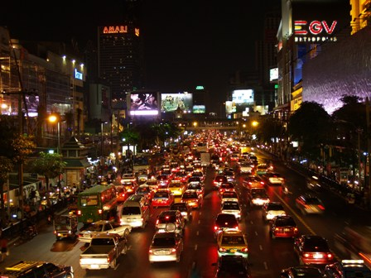
Night Operations

Slide 2
Early Morning Accidents
The incident at Three Mile Island nuclear plant occurred at 4am
The Chernobyl nuclear disaster happened in the early morning hours
The Union Carbide chemical accident in Bhopal happened in the pre-dawn hours
This is a time of great vulnerability for truck drivers, railroads, miners, postal workers, …even surgeons and nurses.

Slide 3
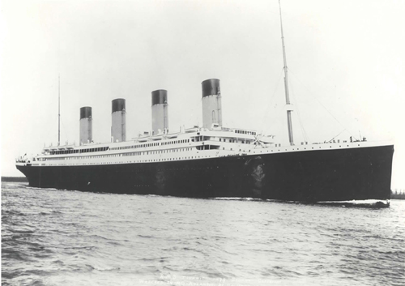
Early Morning Accidents
The Titanic…

Slide 4
Night Work Advantages
Reduced traffic volume
Better access to work site
Longer work shifts – maybe
Cooler temperatures
Reduced business impact

Slide 5
Night Work Concerns
Visibility
Noise & glare
Work quality
Staffing issues
Cost – labor, materials, traffic control
Logistics, supervision
Worker & driver alertness
Impaired drivers
Higher speeds
SAFETY

Slide 6
Night Safety Concerns
Irresponsible driver behavior
High speed
Driver confusion
Work space intrusions
Poor visibility
Irresponsible worker behavior

Slide 7
Overview of Night work Concerns
Night work entails additional risks
Night work can be safe for workers and travelers
Enhanced traffic controls reduce risks
Planning is critical for safe, efficient operations

Slide 8
Why is Safety a Concern at Night?
Reduced visibility
Drunk/drugged drivers
Drowsy drivers
Higher operating speeds past the work area
Implies that crash risks, and maybe crash severity, is higher when working at night.

Slide 9
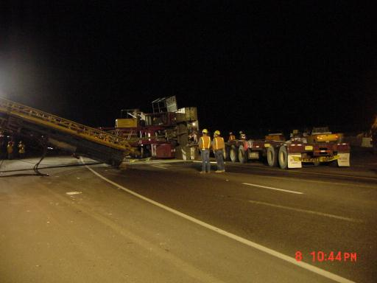
Dangers of Shift Work
According to Occupational Hazards Magazine:
  Work related injuries increase 15.2% for swing shift
  Work related injuries increase 27.9% for night shift
  Injury numbers are compared to day- shift operations
  Employees are 36% more likely to be injured on their fourth consecutive night shift.
Notes:
Picture is of a 222 crane that tipped over in Albuquerque in 2002. Loaded onto a trailer with 180’ of boom, with leads and pile hammer attached. Truck driver adjusted the load and the whole thing went over. Accident happened at 11:30 p.m. and the free way had to be open by 5 a.m.
Review statistics.

Slide 10
Circadian Rhythms
Humans are biologically day – oriented as a species
  Functions best during the daylight hours
  Sleep best at night

Slide 11
Biological Hazards
Chronic sleep problems affect 60-80% of all shift workers
Stomach disorders are 4-5 times more likely
Chronic fatigue impacts 80% of shift workers

Slide 12
Nutrition
Start the day with high protein and shift to carbohydrates as bedtime approaches
Try to eat one meal with the family daily
Establish a meal schedule (normal for you) whatever hours you work
Eat at least 3 meals spaced at consistent intervals to fuel your body

Slide 13
Nutrition
Shift workers are more susceptible to digestive problems due to irregular eating habits.
Working at night means that you eat at night when the stomach and digestive system are typically at rest

Slide 14
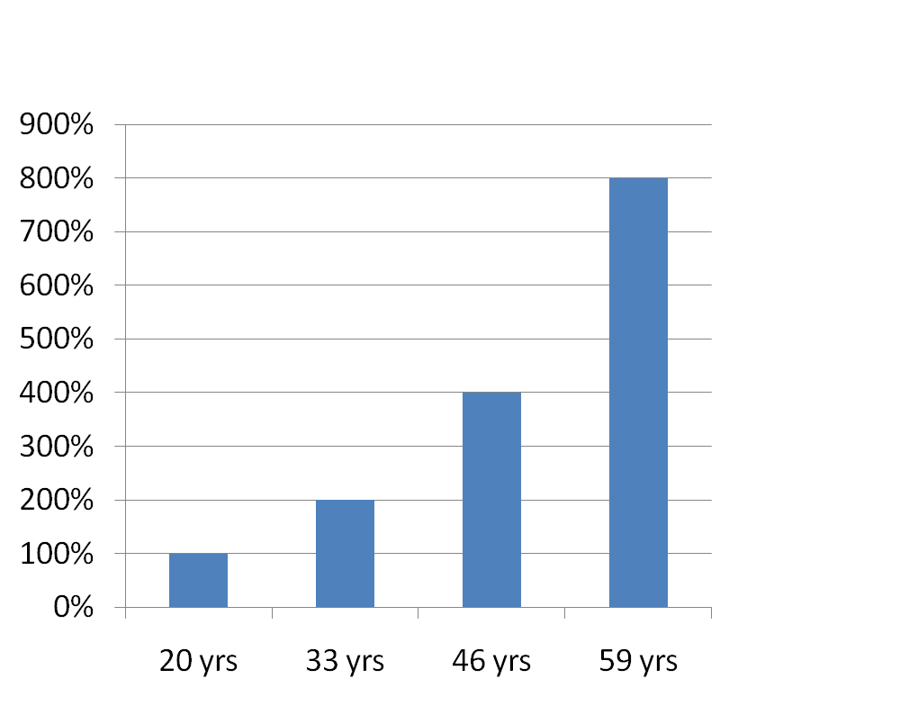
The amount of light a motorist requires to see during nighttime doubles every 13 years

Slide 15
5 Practical Solutions
Effective signs
Enhanced channelization
Visible workers
Visible work vehicles/equipment
Effective temporary lighting

Slide 16
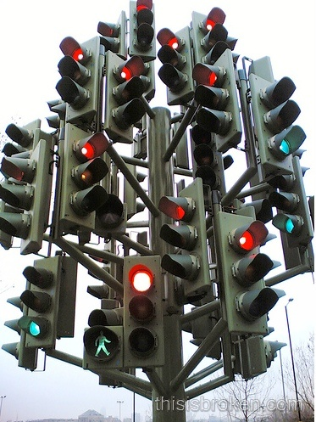

Slide 17
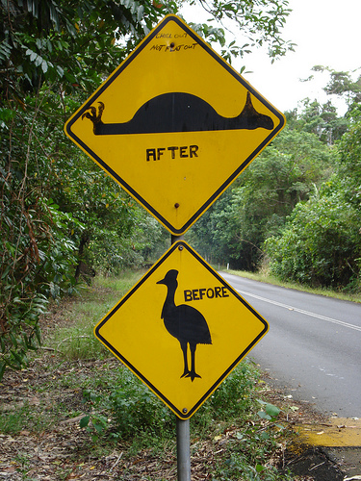

Slide 18


Slide 19
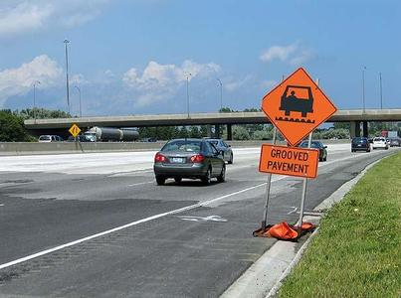

Slide 20


Slide 21
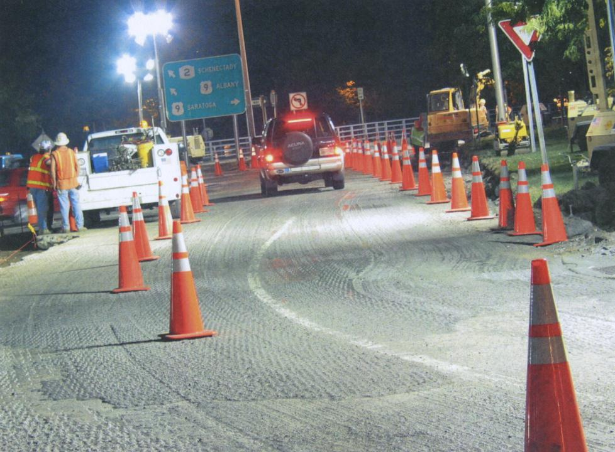

Slide 22
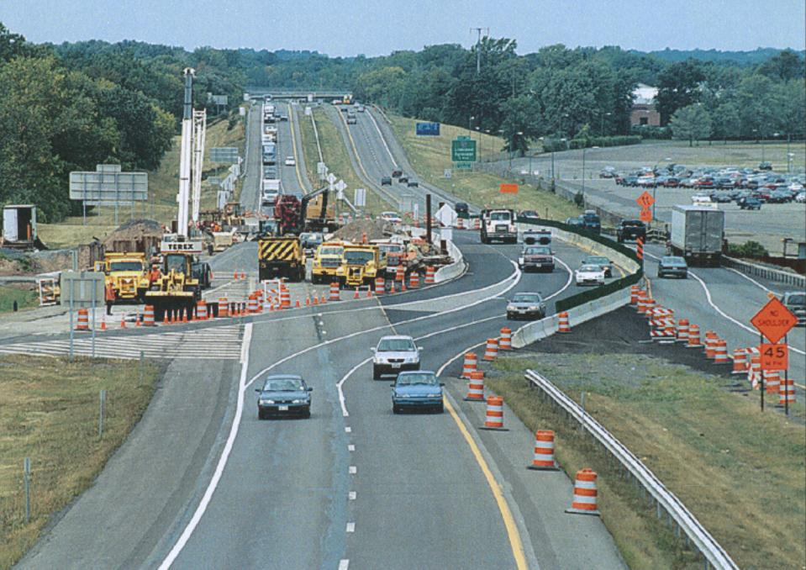

Slide 23
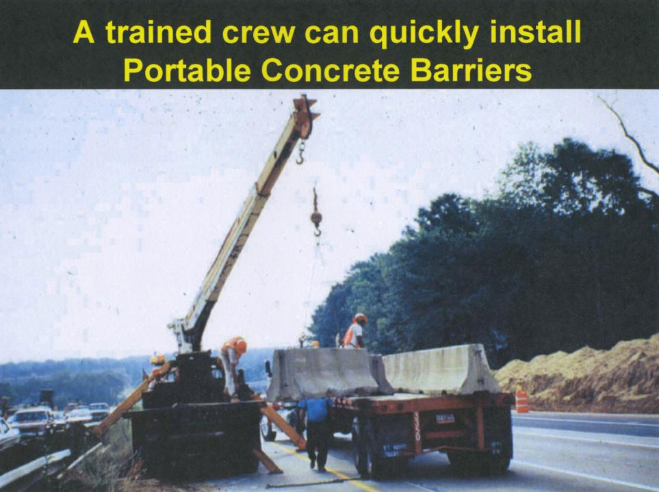

Slide 24
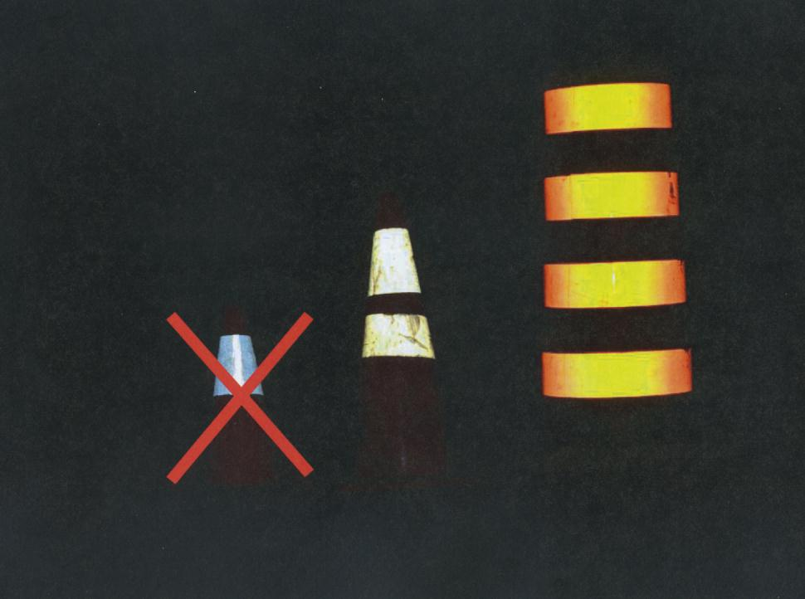

Slide 25
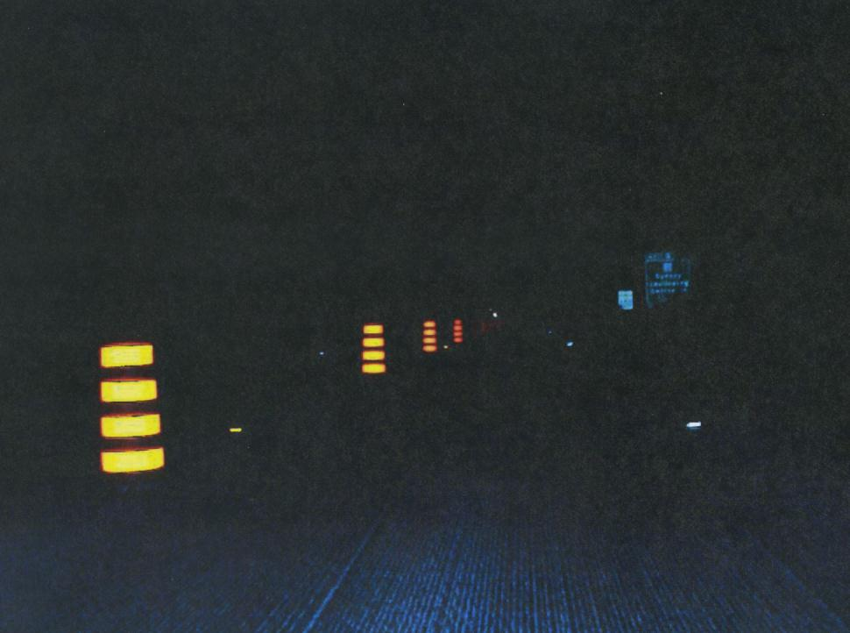

Slide 26
Worker Visibility
High visibility apparel essential
Addressed in MUTCD Part 6
ANSI/ISEA 107-2004
Class 3 for night work
Illumination plus hi-vis apparel

Slide 27
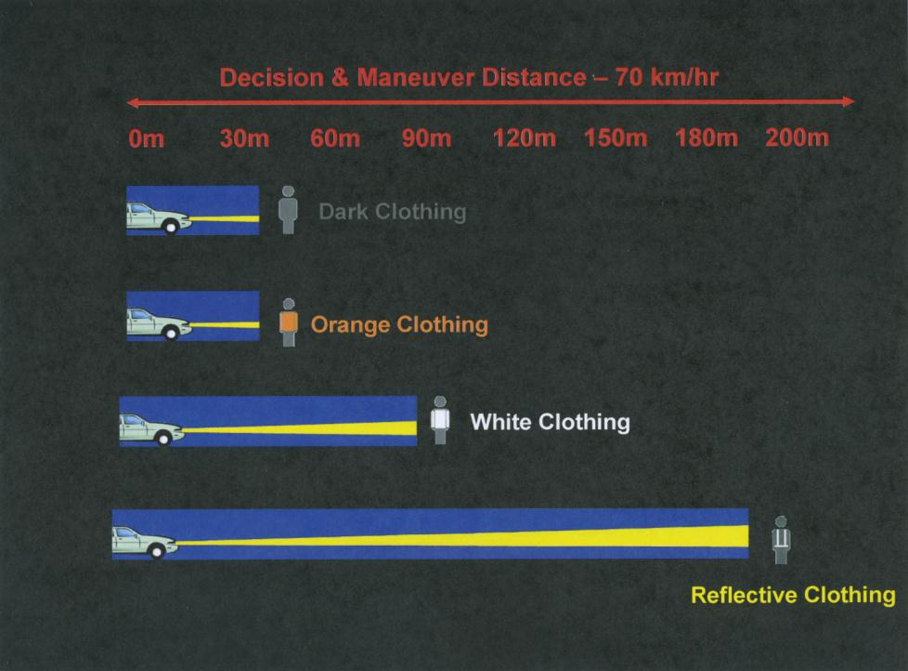

Slide 28
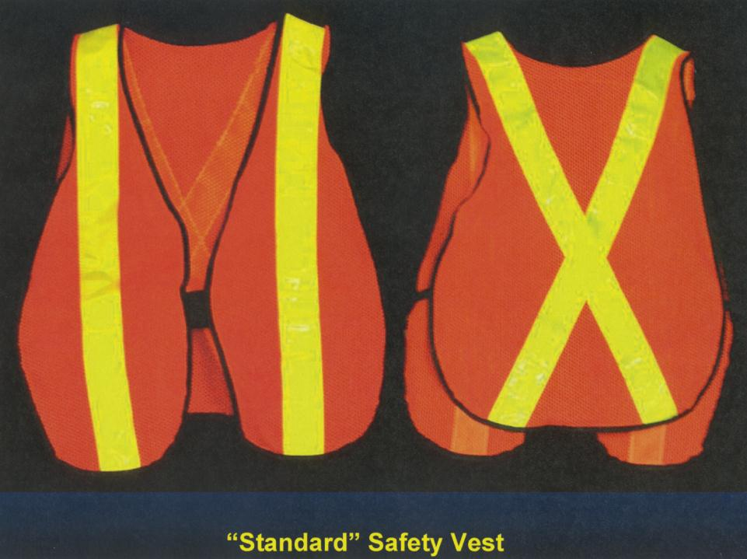

Slide 29
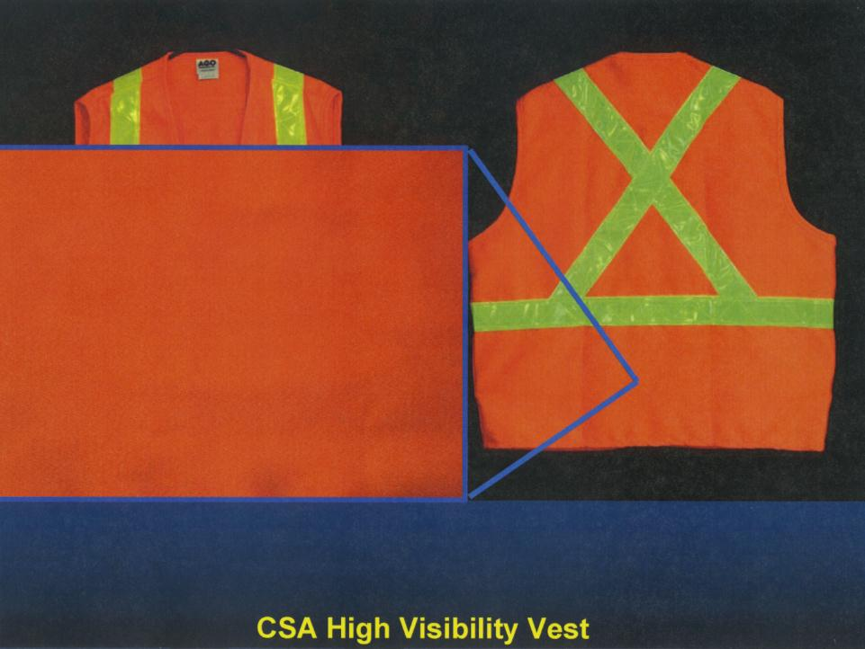

Slide 30
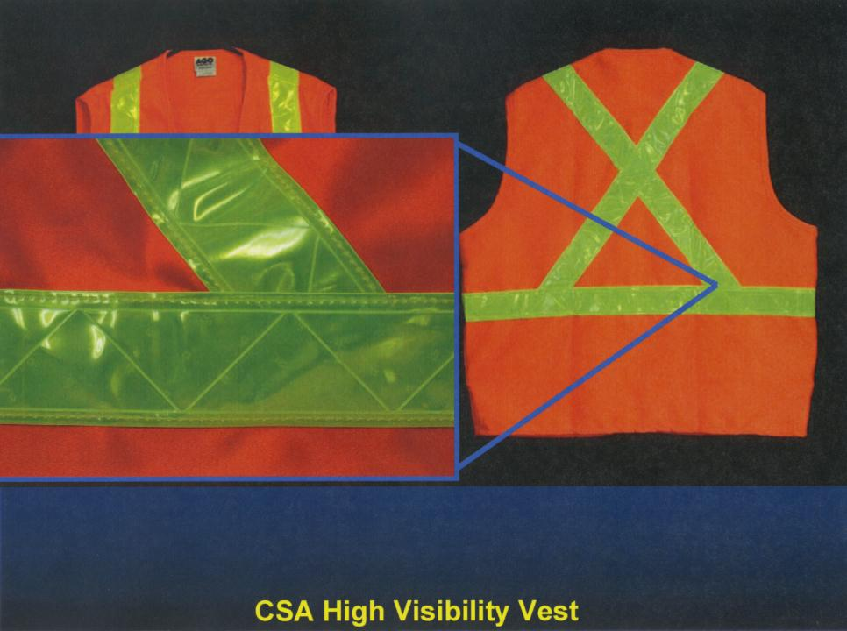

Slide 31
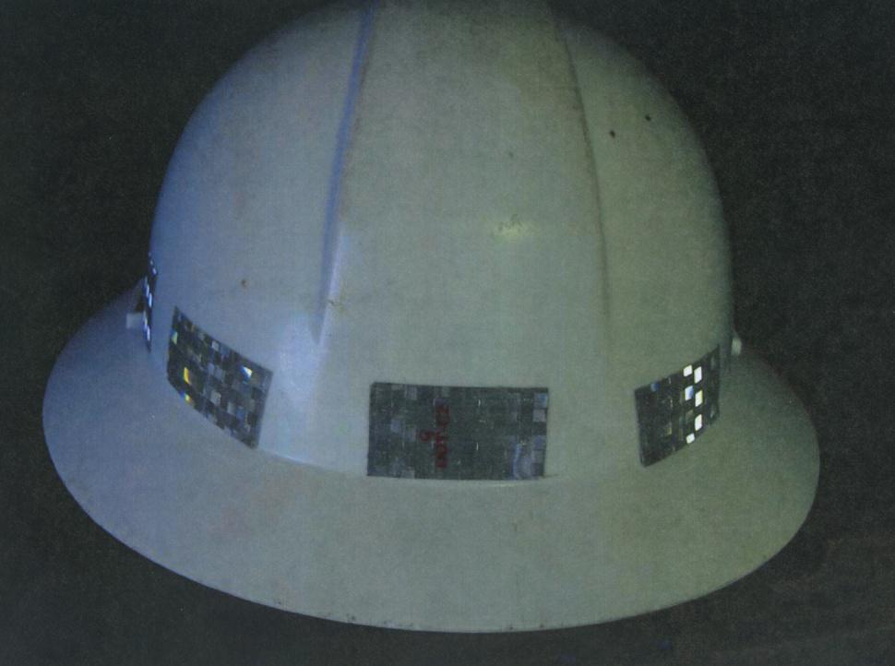

Slide 32
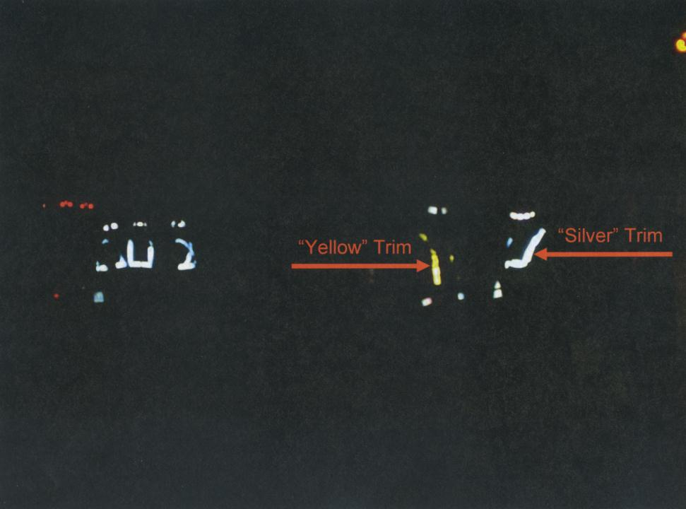

Slide 33
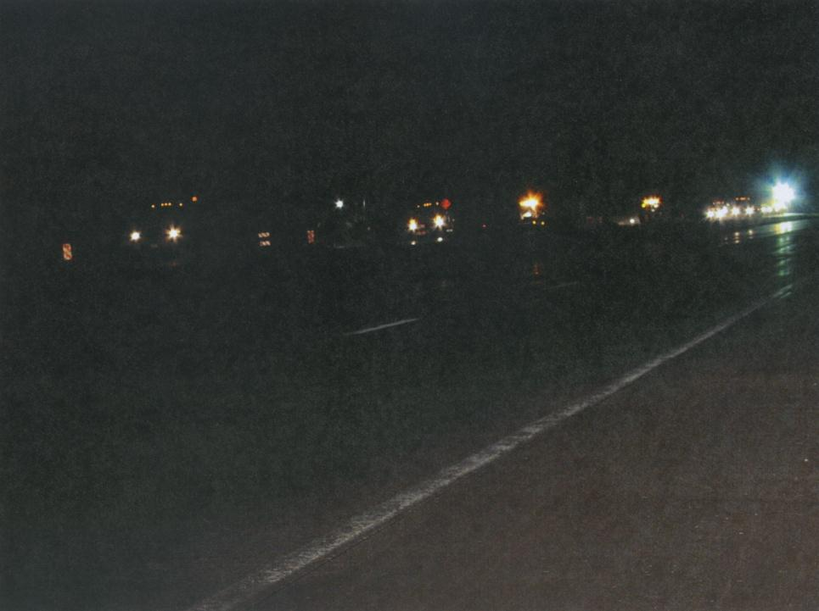

Slide 34
Temporary Lighting for Night Work
Good lighting essential for night work (Safety, quality, productivity, moral)
Adequate illumination, glare control
Lighting plan recommended

Slide 35
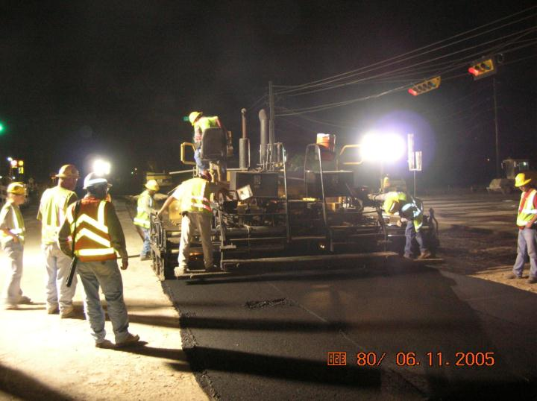
Work area and equipment should be well lit
Notes:
Well lit work areas increase employee and equipment visibility. More light in the work area on night shifts increases employee alertness and normalizes biological functions.

Slide 36
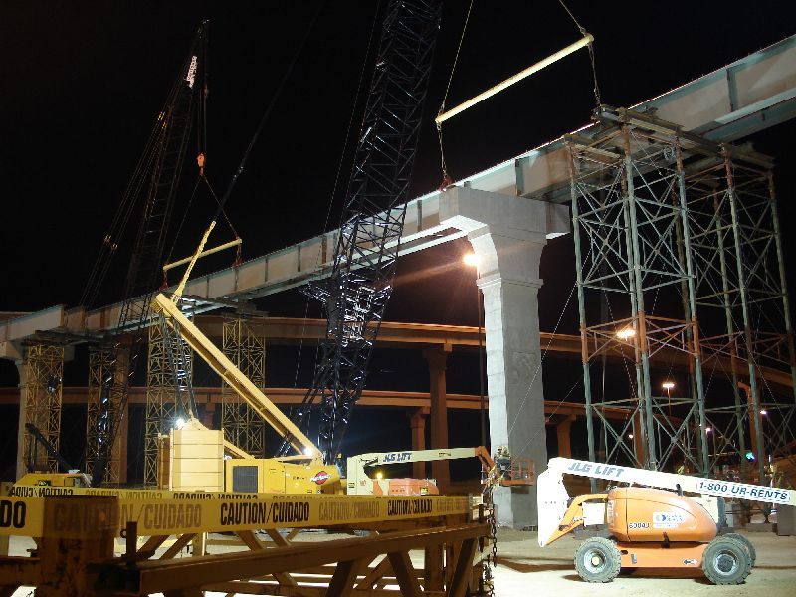

Slide 37
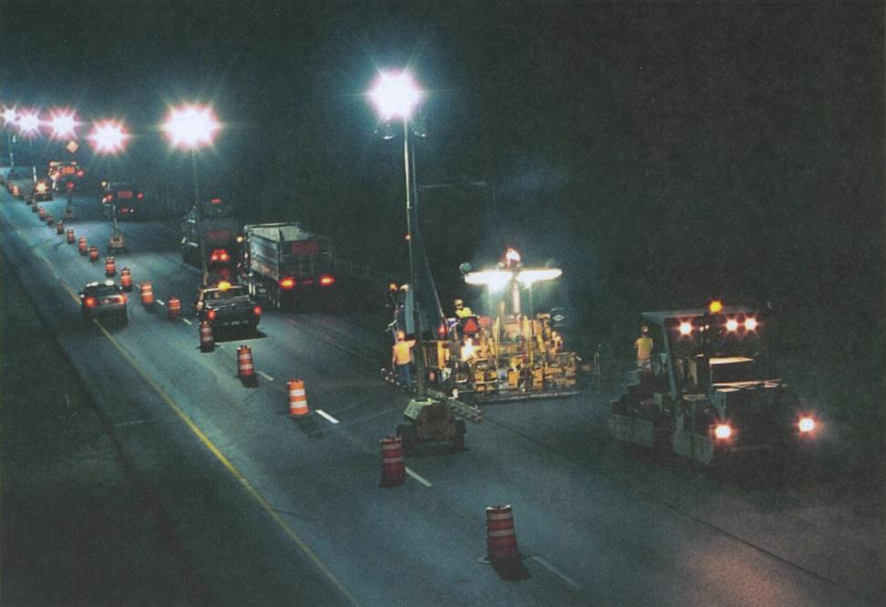

Slide 38
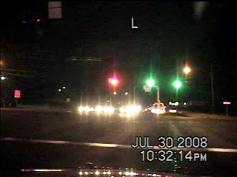

Slide 39
Illumination for Flagging
Provide temporary illumination for flagging stations
Supplement permanent roadway lighting
Avoid glare, shadows, backlighting
Use floodlight towers or other overhead luminaries

Slide 40
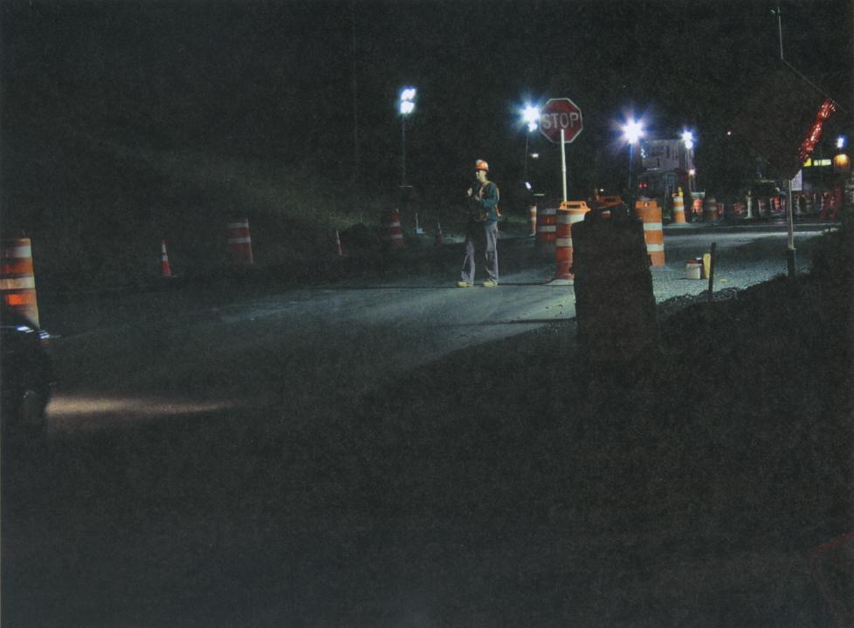
Unsafe condition

Slide 41
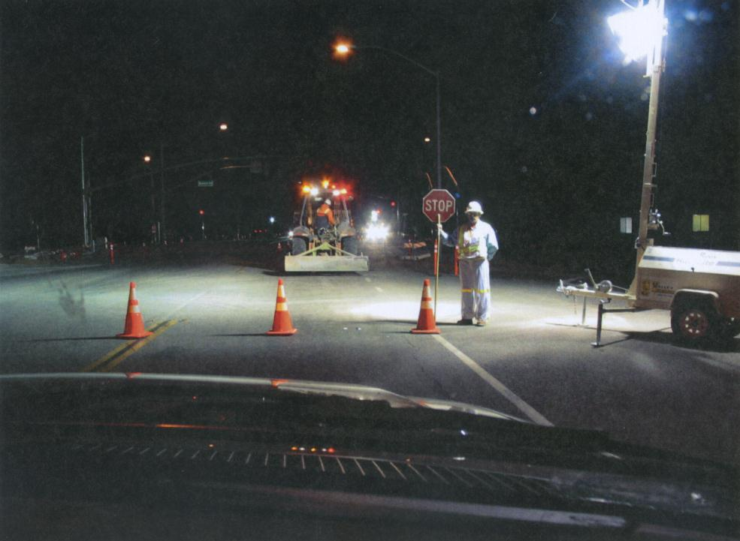

Slide 42
