Slide 1
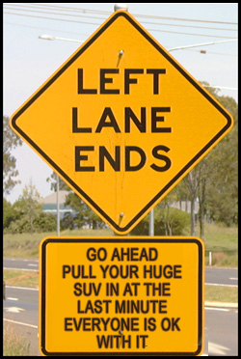
Road
Rage

Slide 2
What is it?
Road rage is almost always a progression
Usually not a single incident
Starts with relatively small things
Person responds
Other person responds in turn
We can end up in a bad place

Slide 3
HOW IT STARTS
Often starts with aggressive driving behaviors
  Improper stops
  Failure to yield
  Inconsistent speed
  Changing lanes too frequently
  Speeding
  Not following traffic signals
  Improper passing
  Loud music
  Failure to use turn signals

Slide 4
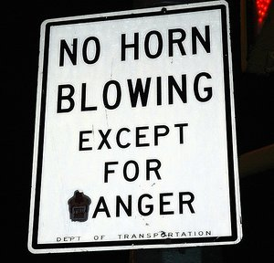

Slide 5
WHAT COMES NEXT?
Power struggle
  Using horns
  Using braking to retaliate
  Flashing lights
  Cutting people off
  Not moving out of passing lane
  Tailgating
  Yelling, gesturing, honking

Slide 6
FINALLY – WE ARE THERE
Road rage
  Firearms
  Assault with car, fists, or other weapons
  Chasing other vehicles
  Drunk driving
  Excessively high speed

Slide 7
Control
You cannot control how another driver behaves
You can control how you respond to behavior
Choose not to participate – no escalation

Slide 8
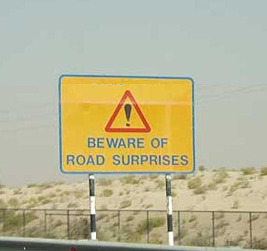

Slide 9
Work Zone Triggers
We are interfering with peoples travel
They may be stressed before they get to us
What could be the driver’s response?

Slide 10
Heading off trouble
Good driver information
Proper set up to keep traffic flowing
Adequate distances
Courteous, controlled interaction

Slide 11
