Slide 1
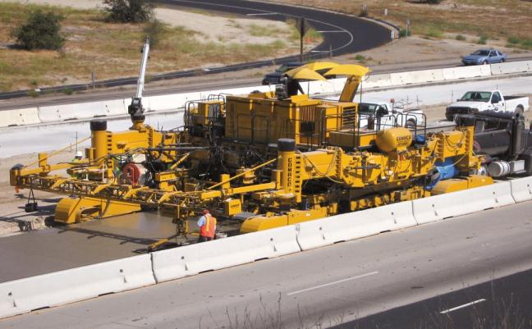

WORK ZONE
Safety Training
This material was produced under grant SH-19504-SH9 from the Occupational Safety and Health Administration, U.S. Department of Labor. It does not necessarily reflect the views or policies of the U.S. Department of Labor, nor does mention of trade names, commercial products, or organizations imply endorsement by the U.S. Government. This free training was made possible through a Susan Harwood Grant from the US Department of Labor’s Occupational Safety & Health Administration and the support of the Associated General Contractors of ND.

Slide 2
Traffic Control For Construction workers
Presented by the
North Dakota Safety Council
Notes:
Welcome all attendees to the Traffic Control Supervisor’s class. Introduce yourself and give a brief background of self.

Slide 3
Disclaimer
This material was produced under grant SH-19504-SH9 from the Occupational Safety and Health Administration, U.S. Department of Labor. It does not necessarily reflect the views or policies of the U.S. Department of Labor, nor does it mention of trade names, commercial products, or organizations imply endorsement by the U.S. Government.

Slide 4
Introductions
Name
Employer
Job Responsibilities
Years of Experience

Slide 5
Housekeeping
No Smoking
Cell phones and pagers – OFF or Vibrate
Location of –
Restrooms
Emergency Exits
5-10 minute breaks about every hour or two
Lunch on your own – 1 hour
Refreshments

Slide 6
Take Notes
Notes help you grasp information faster
Notes may be used on the final test along with your MUTCD

Slide 7
Why Notes?
Over the next 48 hours
You retain only 10% of what you hear
You retain only 30% of what you hear and see.
You retain 70% of what you hear, see and take notes on.

Slide 8
Section: 1
Course Introduction

Slide 9
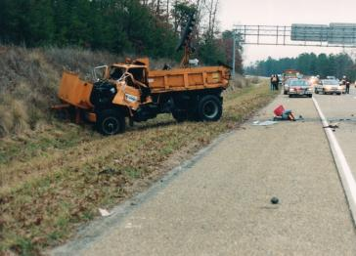
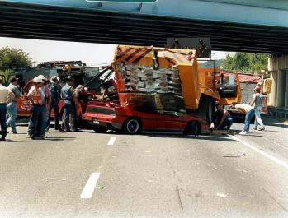
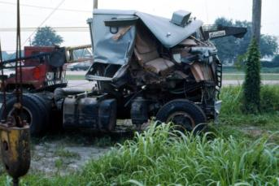
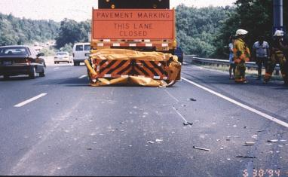
Why is Traffic Control Important?
Notes:
MUTCD – DESIGNED FOR DAYTIME OPERATIONS ONLY
10 part document – We will discuss parts 1, 5, & 6
8500 Fatalities in WZ since 2001 (8200 World Trade Center, Pentagon and the War on Terror)
Every 13 hours someone is killed in a WZ – 80% are motorist
Traffic Control should have a minimal impact on traffic. This will allow for smooth flow and safer work zone.
“Moth Effect” – people (drunk) have a tendency to drive towards the light.
Crash trucks have saved many lives.

Slide 10
Why are we Training on Traffic Control?
Save Lives – yours and others
Traffic Control Plans
Reduces Liability
Cities
Counties
Contractors
Project Owners
It’s the LAW in many States and OSHA requires training for all construction workers 1926.21(b)(2)
Notes:
Traffic control plans need to be prepared by certified personnel.
OSHA Handout

Slide 11
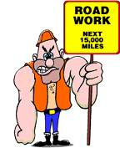

Slide 12
Work Zone Accidents
2-3% of all reported accidents occur in or around work zones
Driver Inattention and excessive speeds leading cause
More victims were automobile drivers and passengers than workers
Higher percentage of side swipe and rear end accidents
Over 40% of accidents occur in transition area
~ 1000 FATALITIES annually; 20% workers
Notes:
Drivers will indicate to an officer they were driving the speed limit
Transition Area – MUTCD 6C-3
Also discuss how the MUTCD is organized: 6 = Part, C = Chapter, 3 = Page. A . (dot) = Section

Slide 13
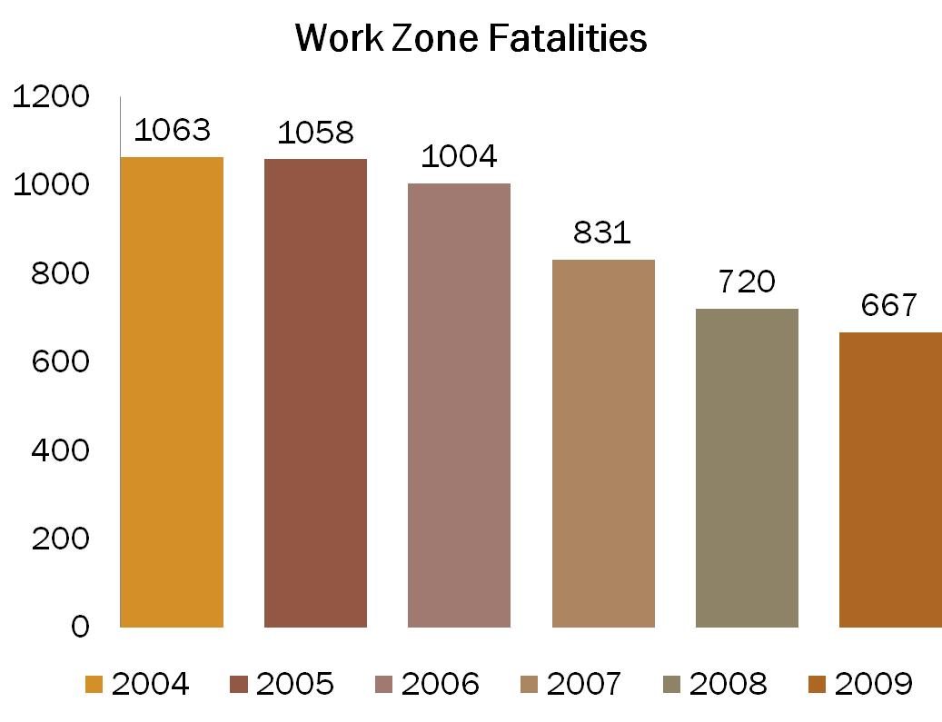
National Statistics
Source: Fatality Analysis Reporting System (FARS) 2009 ARF, NHTSA

Slide 14
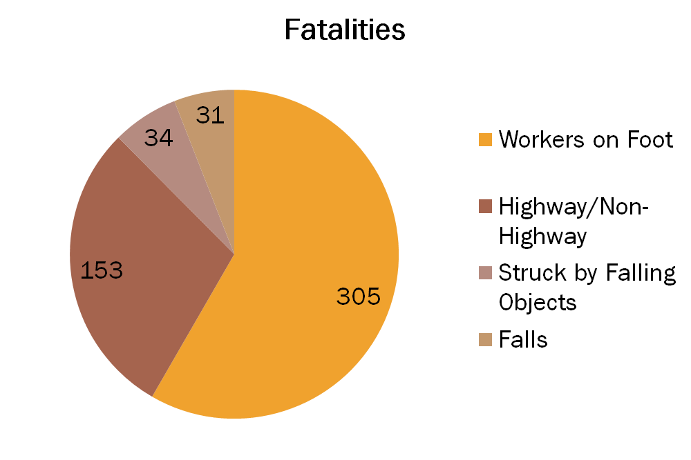
Highway Worker Fatalities
Source: Bureau of Labor Statistics
Notes:
14
Reinforce that the number one cause of a highway worker fatality is being killed by construction equipment.
Internal Control Plans
Where you Park
Haul Roads
No Zones of Equipment
Vehicles entering work areas are usually the result of driver error or improperly erected work zones.
Highway/Non-Highway originated with the worker operating the vehicle, mobile equipment, prior to the incident.

Slide 15
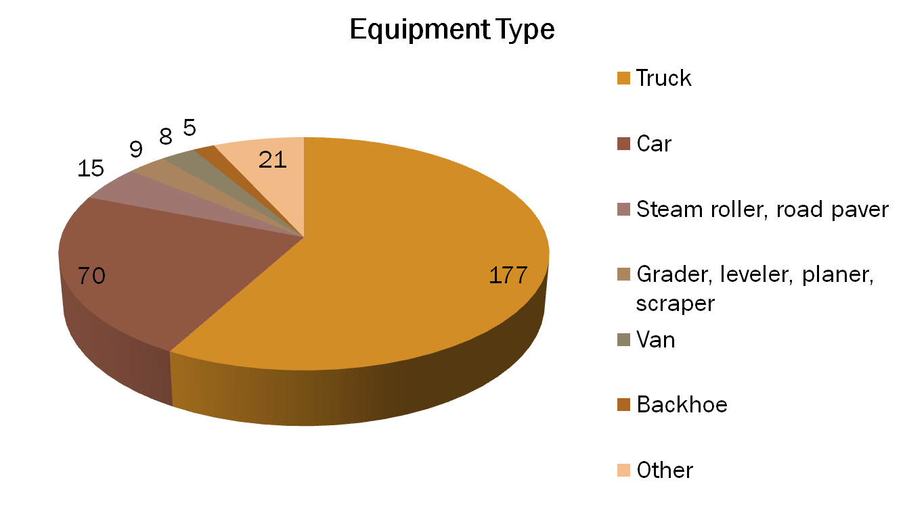
Highway Equipment Related Fatalities
Source: Bureau of Labor Statistics
Notes:
15
Most of the workers on foot are either killed by being run-over by equipment, especially backing equipment.
Some are killed by equipment tip-over or failure.
The most common cause of operator fatality is equipment roll-over.
Many passengers are killed because they were not in a proper seat and were riding on steps, fenders, tailgates, buckets, etc., and fell off.
Truck includes Dump, Pickup, Semi
21 other

Slide 16
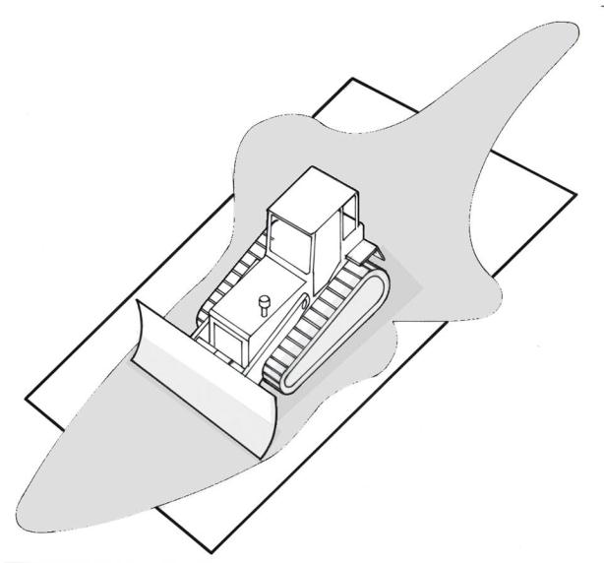
Eye level 6 ft - 3 in above
ground level
16’ 0”
8’ 2”
8’ 2”
12’ 5”
3’ 10”
12’ 1”
18’ 7”
Bulldozer
Notes:
Internal Control Plan

Slide 17
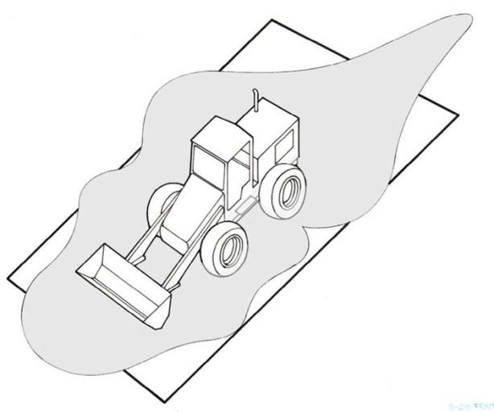
Eye level 10 ft - 0 in above
ground level
28’11”
14’ 8”
16’ 2”
14’ 3”
14’ 10”
21’ 11”
Front End Loader
Notes:
Internal Control Plan

Slide 18
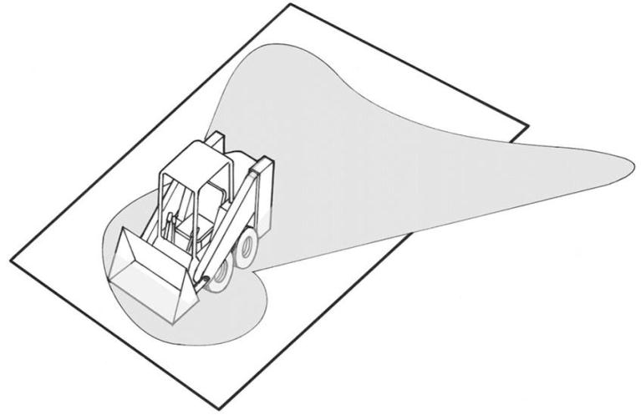
Eye level 5 ft - 5 in above
ground level
11’ 7”
11’ 5”
21’ 8”
4’ 10”
6’ 1”
3’ 1”
6’ 3”
Bobcat/Skid Steer
Notes:
Internal Control Plan

Slide 19
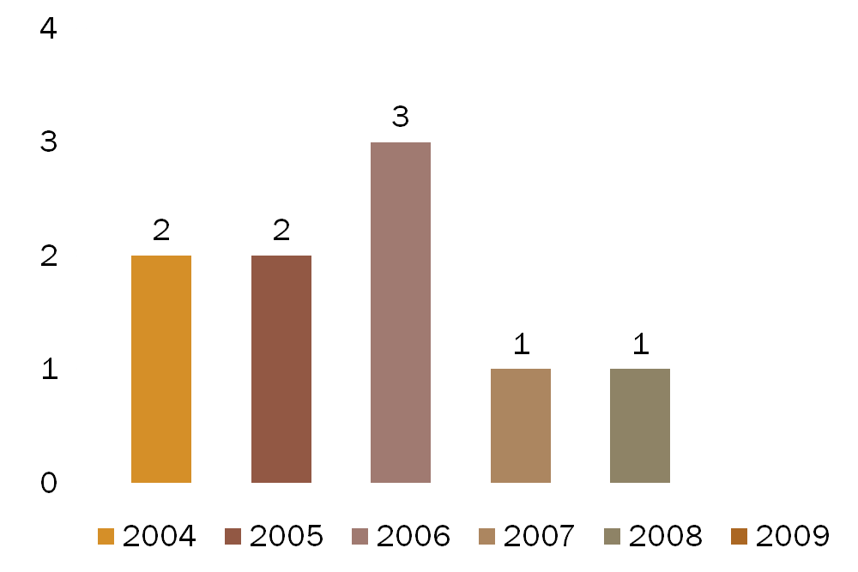
ND Work Zone Fatalities
Zero Fatalities in 2009
Source: NDDOT
Notes:
140 motor vehicle crashes….zero in a work zone!

Slide 20
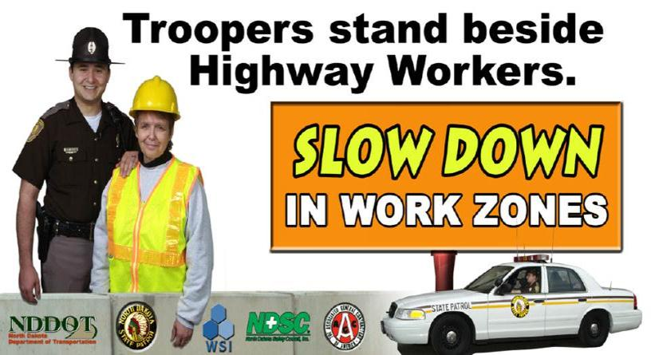
Work Zone Safety Campaign

Slide 21
Work Zone Fines
Took affect in August of 2003
$80 – Active Work Zone
1,300 tickets issued
Speeding
Following to closely
Passing in no-passing zones
Notes:
Fines Doubled from $40 - $80

Slide 22
How do we make work zones safer?
Good Communication! (i.e. advance warning, safe path of travel)
Traffic Control Serves to provide Motorist, Pedestrian and worker safety by clearly:
Warning
Guiding
Separating
Notes:
Most reports/ Legal Claims deal with the Advanced Warning.

Slide 23
Section 2
Traffic Control Standards

Slide 24
Course Objective
Introduce the Basic Elements of Work Zone Traffic Control
Develop a working knowledge of Part 6 of the MUTCD
Develop Traffic Control Supervisor skills including:
Planning
Installing
Monitoring
Modifying and Removing
Notes:
Set the tone of your presentation by clearly defining the course objectives.
Tell your audience what the course includes and how you plan to approach
each phase of Work Zone Traffic Control.
MUTCD – Minimum is in Bold Print
1A – 10 – Definitions
6D.03 – Worker Safety

Slide 25
Basic Concept of Standard Work Zone Traffic Control
Consistent
Efficient – Minimize impact of Traffic
SAFE
We accomplish this through:
Prior Planning & Designing
Proper Installation
Daily Monitoring
Notes:
Introduce the concepts of safety and efficiency and their relationship
to traffic control.
There are no traffic control activities that can be knowingly put in place unsafely.
Stimulus Funds – ARRA (American Recovery and Reinvestment Act ) – Projects will trigger OSHA – Worker Safety

Slide 26
Watch Person
Shall be provided to patrol the project to assure that the traffic control devices are properly placed in accordance with the traffic control plans and standards
Project shall be patrolled at least twice daily
On weekends and days when no work is in progress, once each morning and once each evening
Provide documentation to the Engineer of the watchperson’s hours and activities

Slide 27
Information on Standards
Federal – MUTCD, contains the Minimum standards applicable to All streets and highways
State/Local – go beyond Minimum. All states are required to have a manual which conforms with the MUTCD
OSHA – has adopted the MUTCD by reference
December 11, 2002 – Final Rule
Regional Emphasis Program REP - Region 8 – Traffic Controls
ARRA funded Projects - Target Inspections
Notes:
Standards, guidelines, regulations, and specifications can also be found in: 1910.6
States Standards Specification
Special Provisions
Contract documents
Traffic Control Plans (TCP)
City “Barricade Manuals”
Utility Guides
State/Local traffic laws and ordinances
1926.201 Flagger - Handout

Slide 28
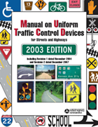
What is the MUTCD?
The Manual on Uniform Traffic Control Devices (MUTCD) was developed to create standardized control during roadway construction, maintenance, and utility (work zone) operations.

Slide 29
MUTCD
Changes as technology and society changes
Developed by the Federal Highway Administration (FHWA)
Affects all streets and highways that are open to public travel
Applies to “Everyone” working on those streets or highways
Notes:
Societal Change – impaired drivers, different drivers – less tolerance

Slide 30
OSHA Requirements
Can enforce worker safety requirements in the MUTCD
OSHA’s jurisdiction:
Worker safety
High-visibility clothing
Hardhats
Safety shoes
Currently reviewing traffic control as a “known hazard”
State Plan States and Federal Jurisdiction States
Notes:
Know Hazard, Recognized by OSHA – General Duty Clause
Possible requirements
Highly visible clothes, hardhats, and safety shoes
PPE information

Slide 31
Abbreviations
MUTCD Manual on Uniform Traffic Control Devices
DOT Department of Transportation
TCP Traffic Control Plan
TTCZ Temporary Traffic Control Zone
(Work Zone)
Notes:
A brief introduction to the acronyms used in Traffic Control
Some other abbreviations might talk about:
TCS – Traffic Control Supervisor
TA – Typical Application Diagrams – 6H-7
TCD – Traffic Control Device
TCT – Traffic Control Technician

Slide 32
Definitions Page 1A-10 MUTCD
Upstream Traffic
Traffic coming at the work zone
Downstream Traffic
Traffic leaving the work zone
Shall…..a mandatory condition
No allowance for deviation –Minimum requirement
Should….an advisory condition – “Best Practice”
recommended
May……a permissive condition
Optional & Allowed
Notes:
I-1 – Standards are in Bold
Stress the importance of defining traffic as either upstream or downstream.
Plant the seed that all traffic will be defined this way through out the class.
Introduce the north arrow as method of clarifying direction.

Slide 33
“Shall” Language in Standards
“Traffic control devices or their supports shall not bear any advertising message or any other message that is not related to traffic control.”
Standard identified in the MUTCD as minimum!
BOLD FONT
Are cited directly by OSHA
Notes:
1A-1

Slide 34
“Should” Language for Guidance statements
“Additional traffic control devices and criteria contained in other Parts of the Manual should be considered for use on low volume roads.”
OSHA and some attorneys use should language as a basis for citations (General Duty see 6D.03[F.]) or questioning of program strength if recommendations –SHOULD – are not followed consistently

Slide 35
“May” Language for Option Statements
“Temporary traffic barriers, including shifting portable or moveable barrier installations to accommodate varying directional motor vehicle traffic demands, may be used to separate two way motor vehicle traffic.”

Slide 36
Support Statements in MUTCD
Periodically throughout the MUTCD support statements appear for background information and to provide a basis of understanding of that section.

Slide 37
Fundamental Principles of Traffic Control
SECTION 3

Slide 38
Fundamental Principles
Two Standards
“Control of the road users through a temporary traffic control zone shall be an essential part of highway construction, utility work, maintenance operations and incident management”
“All temporary traffic control devices shall be removed as soon as practical when they are no longer needed.” “When work is suspended for short periods of time, temporary traffic control devices that are no longer appropriate shall be removed or covered.”
Notes:
When planning for temporary traffic control in these work zones,
it can be assumed that it is appropriate for road users to use extra caution.
6B-1
6B-2

Slide 39
Fundamental Principle
Motorist, Pedestrian and Worker safety in temporary traffic control zones should be an integral and high priority element of every project, from planning to construction phases.
Road user movements should be inhibited as little as practical,
Drivers will only adjust their speed if they clearly perceive a need to do so.
Notes:
6B-1
Parts 1 & 6
Speed Reduction – Drop 10 – No Questions
Drop 20 – better be a good reason

Slide 40
Fundamental Principle
Drivers, Pedestrians should be guided in a clear and positive manner
Provide a roadside recovery area or clear zones
Store work equipment, workers’ private vehicles, materials and debris away form roadway to minimize getting hit. (6B.01)
Notes:
Clear Zone – 30ft off the shoulder – What is your clear zone for the project?
6B-2 – Middle of the page
“crash worthy” = 350 compliant

Slide 41
Fundamental Principle
“Each person whose actions affect TTC zone safety should receive training appropriate to level of decisions they have to make.”
OSHA 1926.21(b)(2) training required for all construction workers

Slide 42
Fundamental Principle and Traffic Control Management Plans (TCMP)
Depending on scope of the project each State DOT complies with requires relating to projects by having established programs relating to:
Public Relations and clean communications
Audit of work zones (internal and external)
Traffic control plans review process
Systemic approach to traffic control including ability to manage impacts to the entire system (ITS = 1 solution)

Slide 43
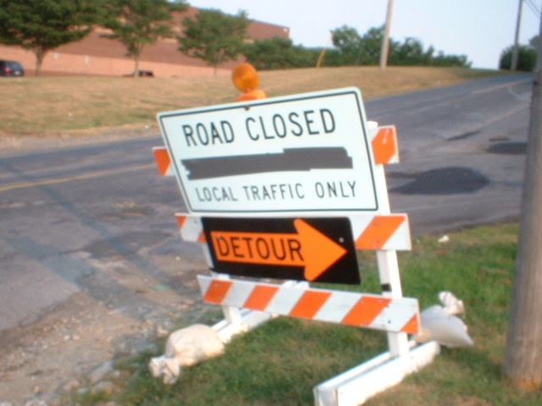
Good Public Relations?

Slide 44
Section 4
Human Factors -
Understanding Your Customer
Notes:
Use this chapter as an opening to put your audience at ease and the foundation
for your presentation.

Slide 45
Human barriers lead to At-Risk Behavior
Misleading practice of relying on common sense.
Safety is a continuous battle with human nature.
The power of peer pressure.
The power of authority.
False Perception of Risk.
Familiarity breeds complacency.

Slide 46
What are the Human Barriers?
1. Misleading practice of relying on common sense.
Individual intuition is acquired by personal experience and education.
The record demonstrates “common sense” isn’t all that common.

Slide 47
What are the Human Barriers?
2. Safety is a continuous battle with human nature.
Most people, young and old, do not think they will experience an accident. Why?
Fortunately, it’s rare that an injury accident follows unsafe behavior.
“It can’t happen to me.”

Slide 48
What are the Human Barriers?
3. The power of peer pressure.
People will often deny reality and their own judgment in order to conform to a larger group.
The bigger the group, the stronger the influence.
Just one dissenter can often prevent another from succumbing to potentially dangerous conformity at work.
“That’s the way everyone else always does it.”

Slide 49
What are the Human Barriers?
4. The power of authority.
People, especially the young, will blindly follow the instruction of an authority figure even when the result can be surely harmful. - Obedience study, Prof. Stanley Milgram, Yale University.
“I was just following orders.”

Slide 50
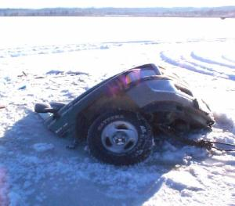
What are the Human Barriers?
5. False Perception of Risk.
Workers have to rely on their 5 basic senses to influence their thinking about identifying and responding to a potential risk.
These everyday sensations are dramatically affected by many personal factors that influence our perception of a risk.
The perception of risk is usually much lower than actual risk.

Slide 51
What are the Human Barriers?
“We’ve been doing it this way for 25 years and no one’s been hurt yet.”
6. Familiarity breeds complacency.
The more we know about a risk, the less it threatens us.
Safety staff will bombard us with training, memos, signs, slogans, and verbal warnings but it’s still hard to compete with a complacency-induced familiarity caused by working close to a hazard for a long time without incidence.

Slide 52
Causes of Incidents
Driver performance
Environmental conditions
Weather
Lighting
Road surface

Slide 53
Causes of Fatalities & Injuries
Vehicle intrusions into work space
Workers entering the traffic path
Inadequate traffic control plan (TCP)
Ineffective or improper use of traffic control devices and methods
Use of improper clothing
Visibility
Retroreflectibility
Notes:
Vehicle Intrusion – Downstream Taper is most common
TCP – Great on paper but not in the field

Slide 54
Driver Performance
A drivers performance will be impacted by:
Expectancy – is the work zone a surprise? Is it set up as the driver would expect?
Perception time – the time between a driver seeing a situation and realizing that a hazard exists
Reaction time – the time between a driver’s realization of a hazard and taking action to avoid it.
Ability – physical ability of the driver to react appropriately
Vision – how well a driver sees under varying circumstances?
Notes:
Expectancy = Similarities, what to expect, consistency
Reaction Time = (milliseconds) ¾ to 5/8 of a second. At night = 2 ½ seconds
That is why our path provides a safe path of travel

Slide 55
Elements of the Transportation System
Roadway
designed
constructed and maintained
Vehicle
designed
manufactured
Driver
What you see is what you get
Notes:
Roadway = consistent
Vehicle = consistent
Driver = you get what you get – Learn on the job!
This slide establishes the concept that only the motorist can be guided.
The driver is the customer. Traffic Control systems must be designed to
accommodate this client.

Slide 56
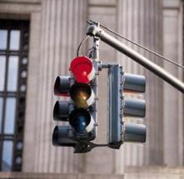
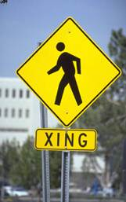

Additional Elements
Traffic Signals
Traffic (Pedestrians)
Environment
Notes:
These are additional system components which the driver must contend with. They impact our work
6D-1 Pedestrian Safety
ADA = American w/ Disabilities Act

Slide 57
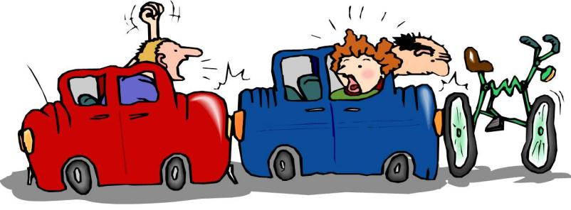
Driving Tasks
Tasks consist of:
Observation and monitoring road way events
Making decisions and taking specific actions
Notes:
Drivers are constantly collecting information, processing data, making decisions and taking actions.

Slide 58
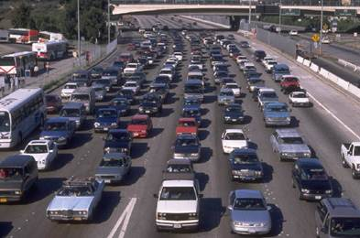
Driver Characteristics
Drivers over rate their ability
Drivers attitudes vary
Notes:
9 out of 10 drivers consider themselves above average drivers!

Slide 59
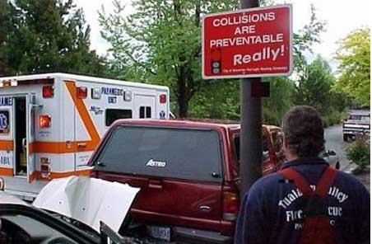

Slide 60
Pedestrians
Thinking about something else, not focusing on the task of walking
Unaware of their local environment
Willing to take chances
Very “shortest path” oriented
Notes:
6D-1

Slide 61
Environmental Conditions
Environmental conditions include the condition of the road, lighting, and weather
Work Zone operations can negatively impact road conditions, creating hazards

Slide 62
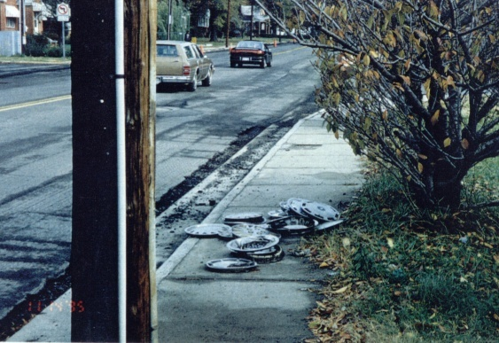
Note the uneven edge of the road
How many people lost hubcaps?

Slide 63
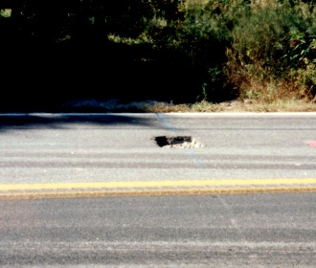
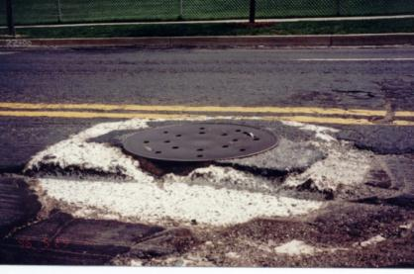
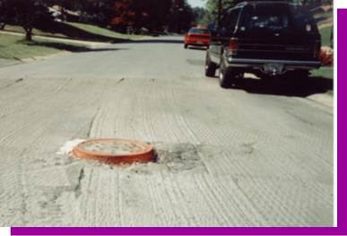
Holes and Raised Utilities

Slide 64
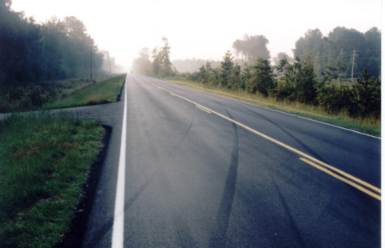
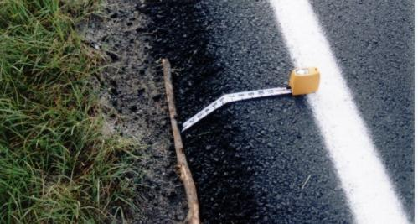
Steep Drop-Offs
Notes:
Vertical Drop – 1 ¾ inch drop is declared a hazard.

Slide 65
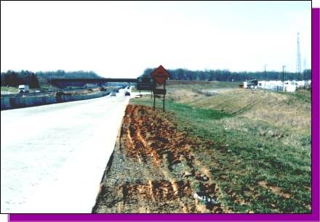
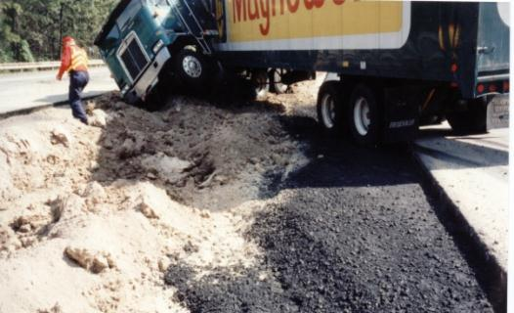
Soft and Low Shoulders

Slide 66
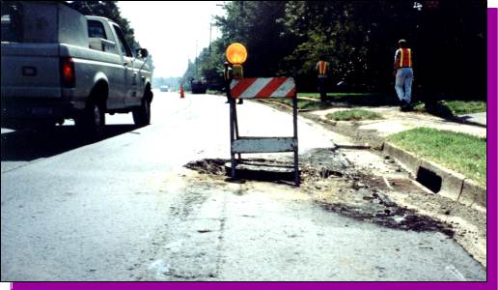
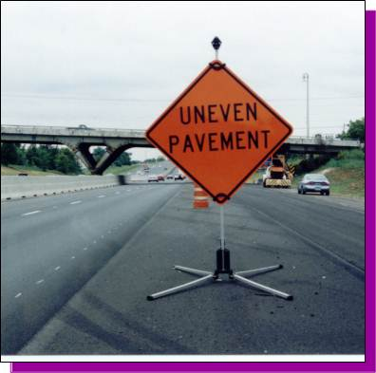
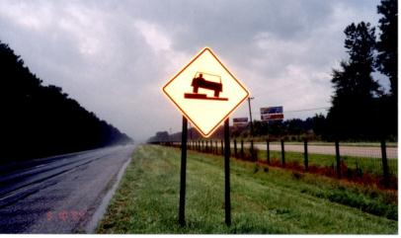
Properly Mark Surface Hazards
Notes:
Uneven Payment – Acceptable
Sign – obsolete
Chevrons in the right direction!

Slide 67
Driver Variability
Skill Levels
All over the board
Attitudes
Road Rage
Physical Ability
Alcohol\Drug use
Tourists
Most of the time, Drivers Perform at a level below their capability
Notes:
Large Part is impairment
Driving is a complex task: Driving experience builds a store of knowledge which drivers can draw on. Experience increases the “odds” for a positive reaction to conditions and events.
Characteristics of each individual driver vary widely on different time scales.
- Minutes, Hours/day, and Years
There is no “design driver” which can be used as a representative of the driving population.
Some states don’t even make drivers education for teenagers mandatory. North Dakota still makes it new drivers take the drivers education.
Most of the time drivers perform at levels below their capability. Must design the traffic control for the driver who is tired, ill, or otherwise impaired.
Great slide to encourage group participation. Everyone has a story about
their customer.
Introduce the concept of liability. The customer is always correct, even
if impaired. Traffic control systems must be correct at all times.

Slide 68
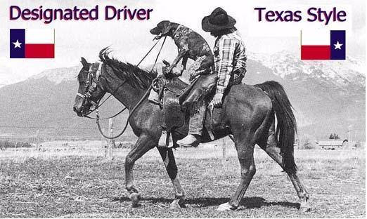
Alcohol Usage

Slide 69
Variation in Ability
AGE
Near Schools
Elderly
EXPERIENCE
Ability levels vary
PHYSICAL STATE
Eyesight
Reaction time
MENTAL STATE
Notes:
Ford Motor Company conducted a survey on how people ranked
themselves as drivers and came up with a remarkable
statistics “Nine out of ten drivers are better than average”.

Slide 70
Driver Age and Experience
Older drivers have poorer vision and reduced reaction time.
In most cases, nighttime vision decreases with age
Problems increase when signs are not well maintained, Channelizing devices are not properly placed, and there are abrupt changes in the levels of lighting
Vision problems increase in poor weather conditions
Population is growing older

Slide 71
Driver Age and Experience
New drivers lack experience
Little experience recognizing work zone warnings
May become nervous when operating their vehicle in narrower lanes or adjacent to concrete barriers, barrels or cones
May over correct or react in an unpredictable way
May be unappreciative of the dangers found in work zones, and fail to reduce speeds or avoid distractions

Slide 72
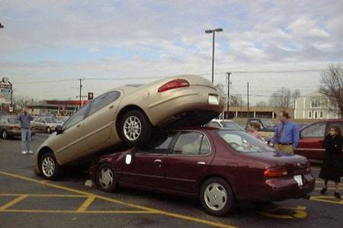
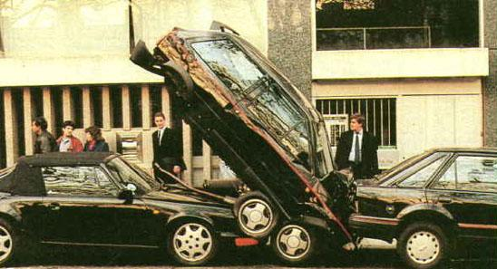
Variation in Abilities

Slide 73
Perceptual Ability
Drivers acquire most info by sight
“Cone of Satisfactory Vision”
“Cone of Clear Vision”
Placement of traffic control devices as close to the drivers line of vision
TCD need to be kept far enough away so that they do not become hazards to themselves.
Notes:
Cone of Satisfactory Vision (Animals – peripheral Vision) – only 20 degrees wide, to see objects
outside this cone of satisfactory vision generally will
require head and/or eye movement.
Cone of Clear Vision (Tailgating) – which objects are in focus and can be readily interpreted.
This is the one which traffic signals and signs should be placed.
Pedestrians must be considered a component of traffic flow.
Getting messages across to the pedestrian is much more difficult.
They are less concerned with the task of walking than the driving public is with driving.

Slide 74
Vision
Cone of satisfactory vision — 20 degrees; see objects without moving head
Cone of best vision — 3 degrees; a person fixes or focuses on an object
Peripheral vision — 120-160 degrees; see movement only
Cone of clear vision — 10 degrees x 6 degrees; objects in focus and interpreted

Slide 75
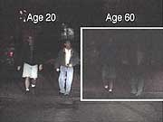
Eyesight and Age
Notes:
A U of MI study states each 13 years after the age of 20 the average person requires 2X
the amount of light to see the same thing a 20 year old sees. 33 2X, 46 4X, 59 8X.

Slide 76
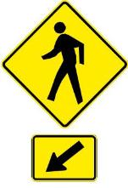
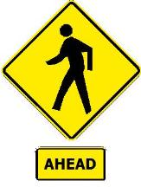
Perceptual Ability
Pedestrians
Considered a component of traffic flow
Urban areas
Usually far less concerned with their walking task
Notes:
Runners & Bicyclists must follow the rules
A new application for advance crossing and crossing signs is added.
The 2 new signs are identical in design.
In the past, the Crossing Signs were distinguished from Advance Crossing Signs
by the use of crosswalk lines on the sign. However, people rarely noticed the difference.
The FHWA has deleted the crosswalk lines and the same sign is used for
both the advance and the crossing location.
The crossing sign, when used to provide ADVANCE
notice to road users, is supplemented with the legend “AHEAD”
or with an appropriate distance plaque. When used at the crossing
location, the crossing sign must be supplemented with a diagonal
downward pointing arrow unless the crosswalk has pavement markings.
If the crossing location does have crosswalk pavement markings,
the diagonal downward pointing arrow plaque is not required.

Slide 77
Acquiring Information
People read from:
Left to right
Top to bottom
Only a few words can be read from a moving vehicle.
Symbols or a simple messages work well
Three words are a desirable maximum
Notes:
These principles are taken into account in the design and locations of standard signs
contained in the MUTCD.
Stress the need for clear concise wording.
The fewer words on a sign the better the message.
2 phases only – 6F-.55
1A – 15-17
Example STOP one word but very effective at getting the point across.

Slide 78
Memory
Message needs to be close to action
Message to complex, could be forgotten
Incorrect or misleading in the past, driver will disregard the info the next time
Standard devices, located consistent and in proper order reinforces driver’s memory for future reference
Notes:
If the message is too far from the point of action, it may be forgotten by the driver.
Attention – this must be considered when designing and laying out traffic Control Zones.
It can range from 10 minutes to 30 seconds.

Slide 79
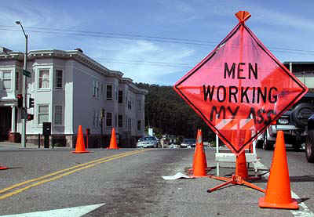

Slide 80
Reaction Time
Once info is received, process available data and take appropriate action
Four Steps
Perception – receiving
Intellectual – processing
Decision – deciding
Reaction - reacting

Slide 81
Reaction Time
More time is required when:
The situation is unfamiliar
There are several choices
The problem posed is complex
Not at his/her best, physically or mentally
The motorist is distracted from the driving task
fatigue
cellular phone
reading the paper
Notes:
Motorists need to receive information, process the info, make a decision and then they
must react to the new surroundings/situation.
Motorists require time to understand the message and then react to it.
Introduce the correlation of speed and distance. The faster the traffic
flow the greater the distance required for advance warning.

Slide 82
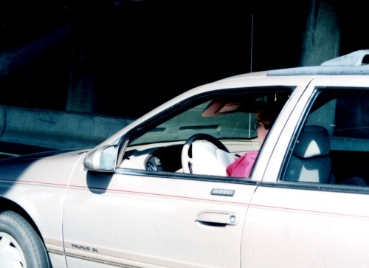
Reaction Time
Worker Safety Is Impacted by Motorist Behavior
Reading a Book on the Interstate
Unsafe Condition

Slide 83
Conditioned Response
Habits are developed by drivers
Normal Driving Habits include:
Maintaining uniform speed for a given situation
Traveling in a given lane
Assume the right-of-way unless otherwise instructed
Notes:
Pavlov’s dog – present a stimulus – we will repeat those successes
People develop conditioned responses that will dictate on how they behave in a given situation.
Extra effort is required in those situations (WZTC) where drivers must change there
normal habits.

Slide 84
Expectancy
People are creatures of Habit
Decisions are made based on past experiences
Motorists expect things to work a certain way
Everyone stops
When everyone operates in the same manner it’s efficient and safe
Notes:
Motorists expect things to happen in certain way. Their actions reflect
these expectations.
Example: Flagger Ahead but no flag person. This sets up others for failure.
Don’t lie to your customer.

Slide 85
Drivers Priorities
Basic driving tasks
Control
Guidance
Use appropriate devices
Restore existing devices after project
Flaggers used when only absolutely necessary
Navigation
Roadway – first place guidance info is received
Traffic Control Devices – are the second sources of information
Notes:
The drivers primary concern is to maintain the control of his/her vehicle.
When the instructions obtained from the signs are seen to be in conflict
with what the roadway indicates, the motorist is more likely to believe the ROAD!
When not worried about guidance and control driver will focus on navigation.

Slide 86
Recognizing Choices
Three Part Process
1. Identify alternative course of action
2. Evaluate the probability of success for each
of the alternatives
3. Select from among the alternatives
Notes:
This creates the reaction time

Slide 87
Recognizing Choices
Multiple options may confuse the motorist
Choices require time to evaluate
Some motorists can’t decide on anything
Efficient\Safe Traffic Control Minimizes Options.
Keep it Simple & Straightforward – KISS
One clear choice
Notes:
Recognizing and selecting choices:
Identify alternative courses of action.
Evaluate the possibility of success for each alternative.
Select which alternative the driver is going to use.
Keep the system simple; try not to introduce options which may confuse.
- No abrupt changes
- No unauthorized speed changes
- Provide designated areas for work vehicles
- Get work done as quickly as possible
- Accommodate pedestrians
Reduce the number of choices!

Slide 88
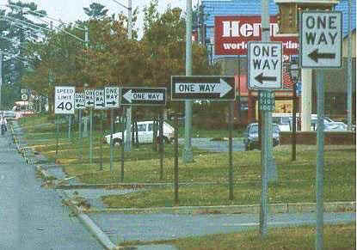
Choices?

Slide 89
Accommodating the Driver
Recognize that drivers make their own decisions based upon information that is available to them and their past successful experiences
Can not be controlled
Traffic control needs to work with the drivers and natural tendencies

Slide 90
Things to Remember in Design of TTCZ
Provide clear Advance Warning
Allow adequate time for driver decision and response
Clearly indicate the desired path, don’t just block the lane
Keep congestion to a minimum
Notes:
Advanced Warning – bases for many lawsuits
Allow adequate time – C, B, A distances

Slide 91
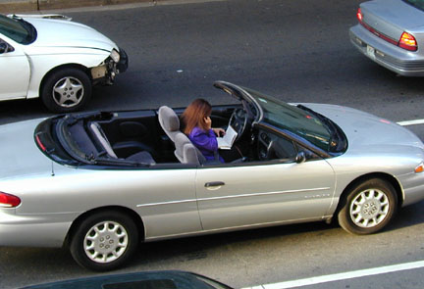
All Too Typical
Unsafe Condition
Notes:
1

Slide 92
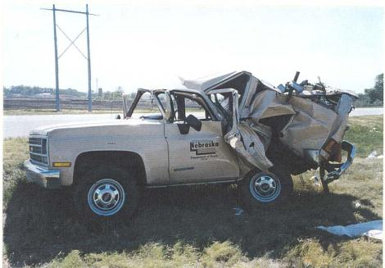
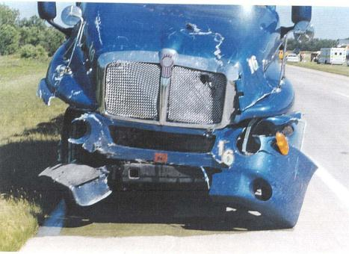
Suburban after impact
Tractor-trailer following incident

Slide 93
Section 5
Work Zone Traffic Control Objectives
Notes:
Begin to get more specific during this session. Lead your audience into
chapter three. This is the last chance to get everyone prepared for your
message.

Slide 94
Purpose of TTCZ
Is to Protect:
Motorists
Bicyclists
Pedestrians
Workers
Notes:
Why do we set Traffic Control Systems?
The forgotten customer Pedestrians and Handicapped persons.

Slide 95
Conflicts to overcome in Work Zones
Surprise
Changes and unusual travel patterns
Conflicting information and confusion
Distractions
Temporary devices
Additional hazards created by the work
Workers material and equipment in the traveled way
Dirt and debris
Capacity restrictions and congestion changes
Notes:
Based on the Risk – Protection has to fit the hazard

Slide 96
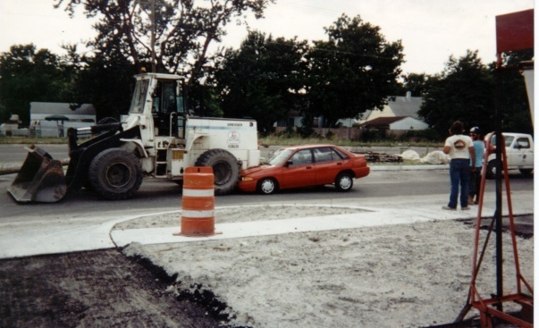
Equipment and the Public
Don’t Mix

Slide 97
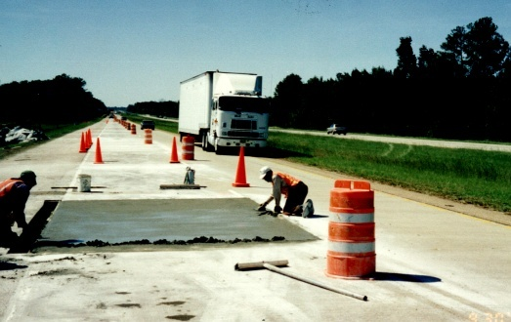
Work Zones Are Different
Truck traveling at 70 mph (Unsafe Condition)
Location of Work Is Extremely Dangerous

Slide 98
Work Zones Control Systems
Warn the Road User of hazards
Through effective selection and placement of devices.
Guide motorists and pedestrians through the WZ
In a clear and positive manner (mutcd)
Separate motorists, pedestrians, and workers
Notes:
Establish the requirement for adequate advance warning.
Clear, concise warning and guidance is mandatory for a successful
Traffic Control System.

Slide 99
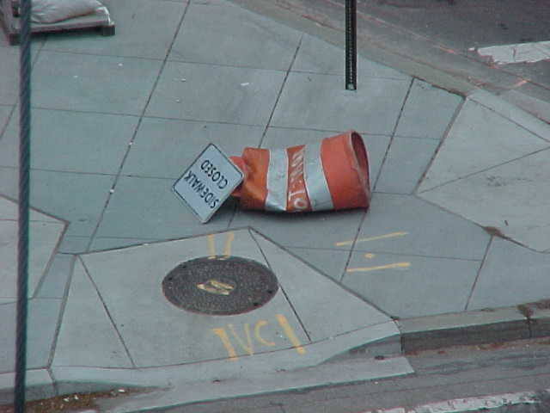
Guide Pedestrians/Bicyclists
Notes:
Not only does the MUTCD concern itself with traffic safety for motorists,
but for bicyclists and pedestrians, too. Here is a drum with a sign that was
used to tell pedestrians that the sidewalk was closed due to work that was
going on. Part of compliance with the MUTCD and to make conditions safe
for motorists, bicyclists, and pedestrians is to maintain your traffic control
devices. If they break or get damaged and are no good, replace or fix them.
I guess the herd of buffalo that ran down the street didn't notice the sign
(can you blame them, buffalo can't read), and nobody replaced the drum
and sign.

Slide 100
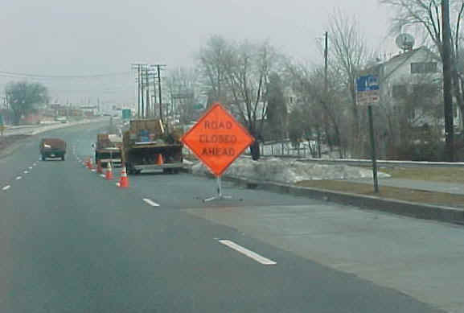
Unsafe Condition
Notes:
Is this road really closed or is the lane closed to traffic?
Appropriate signage is a step toward Covering Your organization’s Assets!

Slide 101
Basic Principles
Use familiar devices
Prepare concise, simple TCP’s
Minimize the disruption to traffic
Provide adequate devices to provide positive guidance in all weather conditions
Monitor the integrity of the system with a pro-active inspection program.
Notes:
Introduce the class to the basics. This is your goal to get everyone to buy
off on these principles.
Stress the importance of a pro-active inspection program.
Provide safe and expeditious movement of traffic, while the work activity
is completed as rapidly, safely, and efficiently as possible.
Need to make SAFETY an integral high priority on every project that you
are a part of. Use traffic control devices that the traveling public is familiar
with. TCP that can be easily implemented.
Inspection – Watchperson Report – minimum

Slide 102


Uniformity
Notes:
In today's era of driver distraction and the controversy over cell phone usage in the car,
the MUTCD gives us sameness and uniformity so drivers know what to expect.
That helps us communicate more effectively. Uniformity of size, color, and shape
also provides a consistent message to road users so that they can expect to see
the same traffic control application no matter where they travel. Additionally,
uniformity provides manufacturers of traffic control devices with consistent design standards.

Slide 103
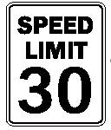

Basic Principles
Avoid Inhibiting Traffic:
Minimize speed reduction
Avoid frequent and abrupt changes in traffic lanes
Minimize the duration of work activities
If possible work during off peak hours of the day
Notes:
Minimize speed – theme throughout the MUTCD, every project will be different
Can’t reduce more than 10mph increments
Keep traffic disruptions to a minimum if at all possible.
Picture – No Hardhats, part of uniform, there is the “potential”

Slide 104
Basic Principles
Guide
In a clear and positive way
Use adequate warning, delineation, and channelization for all weather events and visibility concerns
Completely remove inappropriate pavement markings and mask signs
Notes:
Need to insert a picture of inappropriate markings that should have been removed.

Slide 105
Basic Principles
Routine inspections
Assign people trained responsibility for routine inspections
Change traffic control when necessary
Check job sites under all conditions
If devices are no longer need remove immediately
Notes:
Need to make sure that you Document these inspections!!
Individuals need to be trained in safe traffic control to perform effective traffic control.
Check work sites under all types of traffic volumes, day and night, and under all
weather conditions.
Removing of an advanced warning for flaggers ahead. Not to give miss representing
information to the traveling public.

Slide 106
Basic Design Considerations
Where is the work to occur:
Outside the shoulder
On the shoulder
In the traveled way
What type of roadway:
Rural Roads
Urban streets
Major arterial and freeways
Notes:
Traffic control is a common sense business. The TCS needs to understand
that all Traffic Control Plans are a function of location.
Example: Closing one lane of a road with five vehicle movements a day
is less challenging than closing one lane of street with 5,000 movements
per day.

Slide 107
Typical Project Traffic Control
Planning
Design
Pre-construction activities
Installation
Activities during construction
Removal
Evaluation

Slide 108
Planning
Gather all available data
Assess roadway characteristics
Traffic volumes/conditions
Involve those that are affected
Identify all agencies that may have jurisdiction

Slide 109
Design
Select the best traffic control alternative
Based on
Safety
Cost
Efficiency
How construction is to be accomplished
Site issues, Phases
Notes:
May have to adjust the TTCD

Slide 110
Design “Selecting How Best to Control Traffic”
Based upon:
Traffic factors
Duration of work
Location of work
Type of work
Weather
Roadway characteristics

Slide 111
Design “Traffic Factors”
Traffic Volumes
Average daily – Flow/Volume
Peak hour
Seasonal
Holiday
Special events - Concerts
Traffic Speeds (posted, measured)

Slide 112
Design “Duration of Work”
Long term stationary
Intermediate term stationary
Short term stationary
Short duration
Mobile
Notes:
6G-1
Bold = minimums

Slide 113
Location of Work
Outside the Shoulder Edge
Devices may not be needed if work is confined to an area 15 ft or more from the edge of shoulder
Road Machinery Ahead – if equipment occasionally comes closer to the road way
Notes:
Advanced Warning Area

Slide 114
Location of Work
On or Near Shoulder Edge
Signed as if work is on the road itself, part of the drivers “recovery area”
Advance warning signs are required
Shoulder closure taper required on an 8+ foot paved shoulder
Notes:
We have to let them know we are taking the shoulder
Channelizing devices are used to:
- Close the shoulder
- Direct traffic
- Keep the work space visible to the motorist
- Portable barriers may be needed to prevent encroachment of errant vehicles into the work space

Slide 115
Location of Work
On Median of Divided Highway
Requires traffic control for both directions of traffic
Advance warning signs
Channelization devices

Slide 116
Location of Work
Traveled Way
Advanced warning
General message that work is taking place
Information about specific hazards
Actions the driver must take to drive through the temporary traffic control zone
Notes:
“Road Work Ahead”
“Right Lane Closed”
Advise, Warn, Instruct

Slide 117
Roadway Type
Urban Arterial roads
Urban Multi-lane Divided and Undivided Highways
Rural two lane roads and other highways
Freeways and Expressways

Slide 118
Pre Construction Activities
Notify those affected
Pre-construction meeting
Public works department
Utilities
Water and sewer
Phone
Cable
Inspection of devices before delivery to the site
Identify the clear zone for all phases and configurations of the project through completion

Slide 119
Work Zone Incidents
Root Cause(s) – Conditions, Hazards, TCP Implementation, Training, Execution of Training, Driver Impaired
TCS, project engineer and superintendent need to evaluate all incidents to prevent recurrence
Public’s attitude is effected by the way highway contractors perform work
Notes:
Conflict arises when the motoring public and work crews are in a space that is normal
used by the public. The need is there to constantly monitor the incidents occurring
within the project limits, and work with the agency’s traffic engineering staff to take
actions necessary to eliminate or minimize the accident problems. In urban areas,
this often means working on streets and highways that are severely congested
before any work begins. In rural areas, highways often must be rebuilt and there
is usually no alternative route available to detour the traffic around it.
Work Zones present the most direct contact that people have with highway contractors,
state, local highway agencies. The way work is conducted on streets and highways
has a big effect on the public’s attitude.

Slide 120

Work Zone Incidents
Liability Issues
On-Site Reviews by the FHWA
High points
Marked improvement
Specialized equipment
training
Deficiencies
Insufficient detail to traffic control plans
Poor maintenance of TC devices
Minimal contractor management of safety at worksites
Flagger performance
Notes:
The average citizen is more very likely to use court actions if they feel that they have
been injured due to the fault of someone else. “Possible give examples of recent cases”
FHWA has become more involved because of the rising trend in work zone accidents.
They are conducting on site reviews of the work zones.
High Points:
Marked improvement in traffic control maintenance and utility work zones
over previous reviews. Use of arrow boards, variable message signs, raised
pavement markers, temporary barriers
Training was adequate for persons responsible for traffic control,
except for flaggers.
Deficiencies:
No guidance in temporary striping and removal of striping.
Inadequate clearance or protection from fixed objects ,
false work, piers, deep pavement drop offs, etc.
There was a difficulty to get corrective actions accomplished
quickly, no person on the work force can be used as a contact with the
responsibility for solutions.

Slide 121

Work Zone Incidents
Unsafe Condition
Notes:
The Paddle is inside the hazard
No tapper area

Slide 122
Section 6
Traffic Control Plans
Notes:
This session can be confusing. There is a lot of information to be
presented. There is some math which trouble those with minimal
math skills.
This can be a very satisfying session for the instructor because you begin
to see the learning start.
The individual participants will be responsible for completing their own plans.
Try to use examples that pertain to things your audience does in real life.
Example: Landscaping maintenance on islands in the street.

Slide 123
What is a Traffic Control Plan
A drawing of the control zone
Description and list of devices to be used
Special personnel requirements
Schedule of when activities will be conducted
Phone numbers of people to contact in case of an emergency
Notes:
What is a Traffic Control Plan? Detail all the information required. – Typically not to scale
Schedules for times during the day, week, or year when work is not permitted or when
lanes are to remain open.
Traffic Control Plans are a method of communication between the TCS
and the project management.
Design of the TCP considers all factors for developing the best system to guide traffic
through the work zone.
Construction Activities should be accounted for in preparation of the TCP: these items
need to be kept in mind to promote a better traffic control plans.
determine the complexity of each activity
Identify overlapping activities
Address work activities that may have been overlooked
Anticipate special problems that might come up as the job progresses

Slide 124
Factors to consider
Location of the work (off shoulder)
Speed and number of vehicles
Length of the work area (duration)
Hazards created by the work (repairing)
Duration of the project (How long – 6G-1)
Expected delays to the motorist (Public Relations)
Work method and sequence (phases)
Notes:
The TCS needs to know certain things prior to developing the Plan.
Want to keep the work zone length to an minimum. The longer the work zone with
no work taken place the more likely the motorists are going to speed up and disobey signs.
Work delays are a very important thing to know so that the motorists can possible
chose an alternate route of traffic, thus eliminating the traffic delays.
Example: Its good to know where the contractor will begin work activities.
Work Zone Traffic Control Plans are in part Common Sense and Good Judgment.

Slide 125
Traffic Control Plan (TCP)
Hours of work in compliance with special provisions
Placement of signs and barricades
Use of devices such as:
Cones
Barrier type VII
Stationing of Flaggers
Access control
Length of lane closure
Notes:
Barrier type vii = major change from millennium edition – new design
Stationing of Flaggers – Job Aid Handout (6E-1)
Access control – emergency vehicles – don’t have right to override workers
Explain the requirements of the governing agency for developing the
Method of Handling Traffic.
DOT may require a plan for the contractor for all projects before work starts.
This plan details how the contractor will handle the traffic for the scheduled construction work.
What information in pertinent for the Method of Handling Traffic?

Slide 126
Use of Typical Plans
2003 MUTCD has 46 typical plans TA’s
TA’s are the minimum requirements, more than one may be used to satisfy your project needs
TA’s can be upgraded
Additional devices
Flashing arrow panels
Additional signs
Higher grade sheeting on signs
Notes:
Most TCS candidates do not realize that Part VI of the Manual contains
Typical Applications which may be used to simplify their planning.
TA’s found in the MUTCD Part VI are minimum requirements:
additional devices may be used to supplement the layout
Sign spacing may be increased
Taper lengths may be increased
Difficult or hazardous conditions require a higher-type treatment than typical.
The standards issued by your local jurisdiction must be met first.
Stress using typical applications and refer your plan to specific TA.
This ties the plan to the manual which strengthens the plan.
TA’s minimize the opportunity to forget things. Remember TA’s are the
minimum requirement. You can add more do not do less.

Slide 127
Upgrading Devices
Larger signs – 48”
Improved pavement markings
Barrier instead of Channelizing devices
Variable message signs
Longer advance warning areas
Longer tapers
Lighting
Notes:
Barrier instead of channelizing device – in line of
Longer advance warning areas – line of sight issues
Lighting – glare for drivers, hard shadows – OSHA = ft Candles
A proactive plan tries to anticipate site conditions. Why problems can be
expected their impact may be minimized by using more devices, larger
devices, arrow panels, etc..
Lighting you could use steady burn lights for delineation, flashing lights for isolated
hazards, illuminated signs, floodlights.

Slide 128
Desirable Modifications
Additional devices
Flashing arrow panels
More channelizing devices
High intensity sheeting for warning signs
Additional signs – BUT take care not to “Over Sign”

Slide 129
Considerations for Specific Conditions
Additional devices may be required
Level of protection should fit the hazard
Devices should be considered as a system
Provide a buffer space where possible
What if - the motorist fails to get the message; how are you going to design a system of protection for workers and pedestrians?
Notes:
Point out that the hazard dictates the level of protection. The greater the
hazard the more Stuff that is required.
Good Judgment and Proper training is required when modifying the typical applications to suit
a particular work site. Modifications must always comply with the principles set forth in the
MUTCD Parts 1, 5, 6.
Buffer space explain and stress its importance.
Devices are elements of the total Work Zone System.

Slide 130
Principles for Pedestrians
Pedestrians and vehicles should be separated
Walkways should be a minimum of 4’ wide
Walkways should be kept clear of obstructions & appropriate slope to grade
Lights may be required to delineate the path
Delineate all hazards occurring near the walkway
Notes:
6D-1
Normal situations that normally warrant walkways: sidewalks cross work zone, school
route crosses the work zone, significant pedestrian exists, and existing property
generates pedestrian activity.
Pedestrians are the forgotten element of traffic control. All Work Zone
Traffic control plans should provide adequate provisions to ensure
unimpeded pedestrian traffic.
Provisions for ADA are important to the planning process.

Slide 131
Work Zone Activity
Work on the Right of Way
Work activities off the roadway and shoulders
Minimal hazards
Shoulder Work
Motorists must be advised
Single warnings sign “Shoulder Work” = minimum
Channelizing devices to close off the work space

Slide 132
Work Zone Activity
Haul Road Crossing
Advance warning
Flagging or traffic signals
When closed barricade haul road
Clean the pavement
Remove signs
Notes:
Barricade haul road – so public don’t drive on haul road
Clean pavement – EPA – storm water, cleaning equipment

Slide 133
Work Zone Activity
Two-Lane Highway
Short two way traffic taper (100ft)
Used to slow approaching traffic
MUTCD TA 7-17
Flaggers should be stationed at each end of the work zone
Notes:
Look at TA 7-17

Slide 134
Work Zone Activity
Four-Lane, Two Way Roadway – undivided
Two lanes closed
Divert traffic into opposing roadway
TA 33
Move Traffic One lane at a time
Two tapers separated by 1/2L
Notes:
Look at TA - 33

Slide 135
Intersections
Cross Streets require:
Advance warning signs
Traffic devices
Appropriate Markings
Should consider the effects on the traffic signals
Notes:
Look at TA - 26

Slide 136
Detours
Direct traffic onto another roadway
Installed periodically to assure driver is on the correct route
Should warn of the closure in advance
Should guide traffic back to the original roadway

Slide 137
Principles for Pedestrians
Should be directed across the street if a safe passage cannot be provide
Signs located near sidewalk should have a 7 foot clearance
Use warning lights to delineate a path for pedestrians
Stage work so that both sidewalks aren’t closed at one time.
Notes:
If you have bicycles you should provide an alternate travel route for them through the work area.
The path however, should not be the same that is used for the pedestrian traffic.

Slide 138
Bicycles
Provide alternative routes through the work zone
Should not be directed onto the same path as pedestrians

Slide 139
Traffic Control Zone
Advance Warning Area
Transition Area
Activity Area
Work Area
Buffer Space
Termination Area
Notes:
Take your time and explain the elements of the Work Zone.
Make sure everyone understands what occurs in each area of the Zone.
The work zone extends from the first warning sign in advance of a work zone to the point beyond the are were traffic is no longer affected.

Slide 140

Notes:
6C-3

Slide 141
Advanced Warning Area

Slide 142

Advance Warning Area
All Temporary Traffic Control have an advance warning area
Usually diamond shape signs
Can be series of signs
Can be a single sign
Dependent on roadway type
and roadway speed
Notes:
Can be a single sign – only on low volume, low speed rads

Slide 143



Advance Warning Area
Drivers are informed of the Work Zone
Information is offered by a series of signs
The First: Attention
The Second: Detailed Information
The Third: Specific Information
More signs may be used if the situation warrants.
Notes:
Explain what occurs in the Advance Warning Zone>
You get the motorists attention. Let them know something is about to occur.
Start with general information get more specific as you move downstream.
Drivers need enough time to alter driving patterns. The information on the signs indicate what actions need to be taken by the motorist.
The driver is given more information if the actual distance is shown on the sign,
as is often done on long term projects. THIS IS BECOMING A LIABILITY ISSUE,
IF THE DISTANCES ARE WRONG.

Slide 144
Special Considerations for Advanced Warning Area
Urban areas
Intersections
Alleys
Shopping centers
Side streets
Rural highways
Greater warning distance
Divided roadways
Signing on both sides of the roadway
Parked vehicles
Higher signs
Driveways
Should not block view of entering vehicles
Existing Signs
Not applicable should be covered or removed

Slide 145

A
B
C
Notes:
TA - 10

Slide 146

Inadequate Signing

Slide 147
Transition Area

Slide 148
Transition Area
Required for lane closures
Traffic is moved from the normal travel lanes
May contain various types of tapers to close lanes or move traffic
40% of work zone accidents
Notes:
6C-8 1 Skip = 40’ 2 Skip = 80’
High Speed > = 45 mph
L = Length of Taper
W = Width (lane width 11’ to 12’ – no less than 10’)
S = Speed
L = W x S
Low Speed < = 40 mph
L = W x S x S / 60

Slide 149
Tapers
Beginning of tapers should not be hidden behind curves
Should begin well in advance of the view obstruction
Tapers should be lengthened, not shortened
Increases effectiveness
Look for skid marks
Sign that advanced warning is insufficient

Slide 150
Merging Taper
Typically used to close one lane of a multilane roadway and cause traffic from that lane to merge into an adjacent
Should be long enough to enable merging drivers to have adequate warning and sufficient length to adjust their speeds
Requires the longest distance

Slide 151
Shoulder Taper
Beneficial on a high speed roadway where shoulders are part of the activity area
At least 1/3 L
If used as a travel lane, need to use a normal merging or shifting taper

Slide 152
Shifting Taper
Used to move traffic into a different travel path
If more space is available, a longer minimum taper is beneficial
Where minimum taper unable to be met:
Supplement the channelizing devices with other devices - arrow panel
Control traffic manually in the merging area

Slide 153
Tapers
Merging Tapers = L
Shoulder Tapers = 1/3 L
Shifting Taper = 1/2 L
One-Lane, Two-way = Max 100 feet
Termination Taper = Min 100’
Notes:
Formulas for determining the length of a merging taper L
Practice your examples in advance so you can do them I your head.
L=lane width x speed
L=12 FT X 60 MPH
l=720 FT.
Do the math on a board. Write every step down. Encourage the TCS candidates
to do the same. If a math error occurs at least it may be spotted if the steps
are written down.

Slide 154
Taper Length
Taper length is calculated by formulas based on: Vehicle speed S & Lane width W
>45mph L=Speed X Width (L=S*W)
<40mph L=Speed Squared X Width divided by 60 (L=(S*S)W÷60)
Notes:
People have problems with the formula for low speed road ways. The
difficulty comes the squaring function. Be patient and explain how to
square a number until everyone understands how to do it.
A number squared is not times 2.

Slide 155
Device Spacing
Merging Taper Spacing = Speed Limit
55 mph = 55 feet spacing (L/S)+1
Termination Taper Spacing
20 feet apart
One-Lane, Two-Way Taper
10ft to 20ft Maximum
Tangent Device Spacing
Twice the speed limit (60mph = 120 feet)
Notes:
Explain device spacing:
Page 61 of the Manual gives the definition for device spacing in tapers
and tangent channelization .
Remember the concept of speed and distance. The greater the speed the
greater the length of the Work Zone.

Slide 156
Double Lane Closure Taper
Close two adjacent lanes
Taper should be separated to avoid conflicts
Separation length is twice the taper length (2L) = length between tapers
Device Spacing
Same as for channelizing tapers except an extra device is added only to the first taper

Slide 157

Merging Taper followed by a Merging Taper
Separated by a
minimum of 2L,
where L is the length of the merging taper

Slide 158

Example
W = 12 foot
S = 55 mph
L = ?
660 foot minimum
2L = ?
1320 foot minimum

Slide 159
Activity Area

Slide 160
Activity Area
Two Components:
Actual space used for work
Buffer zone
Table 6C-2; p 6C-7 MUTCD suggested length
Longitudinal - Upstream or downstream of the work
Lateral - Parallel to work area
Notes:
The Activity Area is composed of two zones.
Buffer Zone - no work or equipment
Work zone - Actual work area.
Page 22 of the Manual for suggested buffer spacing.
Work area is set aside for exclusive use by workers, equipment, and construction materials. Usually delineated by channeling devices or shielded by barriers to exclude traffic and pedestrians.

Slide 161
Buffer Space
Open/unoccupied between the transition and work areas
Provides a margin of safety for both traffic and workers
Provides room to stop before the work area
Channeling devices along the edge
Notes:
When using a moving operation, the buffer space is the space between the shadow vehicle,
and the work vehicle.
It’s important that the area be free of equipment, workers, materials, and parked vehicles.

Slide 162
Longitudinal Buffer Space
Recovery area for out of control vehicles
Protects workers
No work Allowed/Always Empty
No vehicles, equipment or materials allowed
Optional, but is highly recommended
Based on stopping distances

Slide 163
Lateral Buffer Space
No set distance or table
Case by case
Engineering judgment
Lateral Buffer
Notes:
ND Street/Highway – must maintain 10ft minimum

Slide 164
Work Area
Work activity takes place
Exclusive use by workers, equipment, and construction materials
May be fixed or moving location
Delineated by channelizing devices or shielded by barriers to exclude traffic

Slide 165
Minimizing the Conflicts
Using familiar traffic control devices properly
Safe entrance and exit for work vehicles
Adequate advance warning
Truck mounted attenuators for worker protection
Flashing lights on work vehicles that are exposed to traffic
Provide a safe parking area for workers private vehicles (Internal Traffic Control Plan)

Slide 166
Termination Area
Downstream of the work area
Typically short
Used to allow traffic to clear the work area and return to normal traffic lanes.
End Road Work (optional)
Downstream Taper
Min. 100 ft. (per lane closed)
Notes:
The last segment of the Work Zone Traffic Control Zone. This is where
you move the motorist back into the lanes of traffic prior to the WZTC.
Tell the customer the Road Work is completed and they are past the hazards
of this WZ.

Slide 167

Scenario #1
Slide 2-167
Notes:
TA = 39
Shifting Taper ½ L
Flat ½ L
6H-2&3
167

Slide 168

Answer - Scenario #1
Notes:
168

Slide 169

Scenario #2
Notes:
169

Slide 170

Answer - Scenario #2 (better)
Notes:
TA = 37
170

Slide 171

Answer - Scenario #2 (acceptable)
Notes:
TA = 38
171

Slide 172

Scenario #3
Notes:
172

Slide 173

Answer - Scenario #3
Notes:
TA = 10 also 11 and 12
1 lane 2 way traffic
Taper Max 100’ on Both Sides
173

Slide 174
Section 7
Traffic Control Devices
Notes:
174
Traffic Control devices are those things that are approved by the MUTCD that are used to implement a traffic control plan in the field. They are the objects that the motorist sees and responds to in driving through the traffic control system.
Introduce the class to all the devices available to them. Explain where
the Manual describes each device.

Slide 175
Guidance Basic Requirements
Fulfill a need
Command attention
Convey a clear, simple meaning
Command the respect of the motorist
Give adequate time for proper response
Notes:
175
If a device is not required do not use it.
Attention getting devices aid the motoring public. Flags, larger than standard
size are acceptable options.
KISS Keep it simple straightforward
Devices in good repair and clean get more attention than sub standard devices.
The greater the speed the greater the distance required to make the system
efficient and safe.

Slide 176

Fulfill A Need
Notes:
176

Slide 177
Command Attention
Notes:
177

Slide 178

Sign Placement
Signs must be placed where they can be seen!!!
Photo: Mike Barton
Notes:
178

Slide 179

Command Attention
Notes:
179

Slide 180
Convey a Clear, Simple Meaning
Notes:
180

Slide 181

Clear Simple Meaning
Message is wordy
A simpler message would suffice; “STOP” or “RR Crossing”
Photo: Mike Barton
Notes:
181

Slide 182

How fast would you like to drive?
Notes:
182

Slide 183

Clear, Positive Guidance
Notes:
183

Slide 184
Command Respect
Notes:
184

Slide 185

Unsafe Condition
Notes:
Sign Hidden
185

Slide 186
Adequate Time for Proper Response
Notes:
186

Slide 187

Advance Warning (Montgomery County, MD)
There must always be adequate advanced warning for any road work.
Amount depends on road speed, lane width, and other road conditions
Notes:
187

Slide 188

Advanced Warning
Notes:
188

Slide 189
Standards of Uniformity
MUTCD Part 6
Applies to all roads open to the public
States may adapt the manual or develop their own with the manual as a guide.
States may supplement the manual to reflect the laws of the state.
Requirements in the manual are the effective minimums.
Notes:
189
Introduce the class to Part VI of the MUTCD. Explain how to find information.
Tell the class what information is available in the manual.
Ask them to sign their manuals. This imparts the importance of this tool.
Instill the concept that the manual provides only the minimum requirements.
Its OK to do more but never acceptable to do less.

Slide 190
Standards of Uniformity
Size/Shape
Colors
Retroreflectorization
Messages
Placement
Operation
Maintenance
Notes:
190

Slide 191
R1-1
W8-1
G20-1
Exit Sign
Notes:
191

Slide 192

It Finally Happened!
Provided by Kevin R
Notes:
192

Slide 193
Placement
Placed to command attention by the driving public
Be positioned within the specified distance of the point, object, or situation that applies
Location, along with legibility, will provide traveling public at normal speed adequate time to make the proper decision
Notes:
Due not create a hazard themselves
193

Slide 194

Unsafe Condition
Notes:
194

Slide 195

Visibility
Vehicles must not be parked in front of traffic control devices
Part of maintenance involves making sure devices are visible
Notes:
Arrow Board
195

Slide 196

Operations and Maintenance
Devices must be used in a uniform and consistent manner so driver will respond correctly to the device
Maintenance
Legibility is retained
Device is visible
Device is clean
Device is in good working order
Notes:
196
There is two types of maintenance functional and physical maintenance.
Functional maintenance of TC devices should be provided to determine if the device
meets the current traffic operational needs or they need to be changed. Physical
maintenance of traffic control devices should be performed to ensure that legibility and
visibility of the devices is maintained for example (cutting down vegetation and
shrubbery that obstructs the view)
The devices need to function properly to other traffic controls devices in the vicinity
during both day and night conditions.

Slide 197

Poor Maintenance “Duct Tape”
Notes:
197

Slide 198


Condition of Drums
Notes:
198

Slide 199

Cleanliness (Las Vegas)
Notes:
199

Slide 200

Proper Cleaning
Notes:
Hazcomm
200

Slide 201
Uniformity
Enhances recognition and understanding
Promotes consistent interpretation
Reduces costs by minimizing device inventory
Gains respect of motorists and reinforces expectancies
Notes:
201
Uniformity is the basic concept of the MUTCD. The manual establishes uniformity in
the design and application of devices by specifying characteristics and procedures in
the following areas: Design, Application, Location
The MUTCD contains 10 sections, we are most concerned with parts 1, 5, and 6.
Part 1 describes general provisions, Part 5 deals with low volume Rural Roads, and
Part 6 has to do with Work Zones.

Slide 202
MUTCD
Establishes uniformity in design and application by specifying:
Design
Application
Location
Notes:
202

Slide 203
Signs for Communication
Remember Signs:
Advise – “regulatory signs”
Warn – “warning signs”
Instruction – “guide signs”
For the Road and Sidewalk user
Notes:
203
The Traffic Control Supervisor cannot talk with each motorist so devices
become the method of mass communication relating to the Work Zone. The common
form of communication are signs or channelizing devices. Roadway construction needs
to have maximum communication because of the unexpected hazards in or adjacent
to the roadway that the motorist are exposed to.

Slide 204
Channelizing Devices
Guide the motorist
Indicate hazardous areas
Exclude traffic from the actual work space
Must be preceded by WARNING Signs
Notes:
Provide a safe Path of Travel
204

Slide 205
Sign Selection
Is the sign appropriate?
Does it specify a required action?
Is the driver alerted to a hazard?
Notes:
205

Slide 206

Sign Lettering & visibility
- Proper sign letter color and letter size is crucial
Cannot be read at a distance
Not retro- reflective
Notes:
206

Slide 207

Unsafe Condition
Notes:
207

Slide 208
Warning Signs
Work zone warning signs have black legend with orange background
Target Value - Ability to seen (shrubs, rocks)
Priority Value - Take precedent over existing signs (Mask)
Legibility – adequate cleaning and maintenance
Retroflectivity
Notes:
208
Special construction and maintenance signs follow the basic standards for all highway
signs as to shape.
Everyone is familiar with Work zone warning signs, but where does Part VI
of the Manual describe each sign in depth. You enhance the priority of a value
when it is placed first by avoiding unnecessary signs, placing them in an uncongested
area, removing or covering signs that are not applicable or by using flashing lights or flags.
Why do target and priority values become an issue?
Retroflective material sends energy back to the source.

Slide 209

Notes:
Old style tubes
209

Slide 210

Notes:
210

Slide 211

Adequate Enforcement
Notes:
Lights should avoid glare
211

Slide 212

Clear Driver Guidance
Notes:
212

Slide 213
Effective Channelization
Notes:
213

Slide 214

Effective Lighting
Notes:
214

Slide 215
Check Signs
Drive through at night using low beams to check retro-reflectivity
Compare a piece of new material with in place signs
Notes:
215

Slide 216

Covering Signs
When work is completed or not going on, signs must be covered, turned away from traffic, or removed from the road side.
Notes:
Conflicting signs must be masked – plastic covers
216

Slide 217

Covering Signs
Retro reflective signs can reflect right through burlap
(also, this is what orange flags are for; not for flagging!)
Notes:
217

Slide 218
Sign Positioning
Located to be easily seen
Drivers need time to respond
General rule – keep on the right hand of roadway
Construction and maintenance
On shoulder
Within roadway
On barricades
Notes:
218
On roadways with two or more lanes in one direction, place additional signs on the left hand side.

Slide 219
Factors Affecting Stopping Distance
Traffic Speeds
Vehicles Weight
Type of Road
Road and Weather Conditions
Visibility
Notes:
Reaction time
219

Slide 220

Regulatory Signs
Typically Rectangular in shape
Black legend on White background
Approval is required prior to modifying!
Notes:
220
Railroad signs are round and may never be taken down unless their
replacement is in place.
Only authorized personnel shall remove or replace regulatory signs.
Approval before modifying includes the reduction of speed in a construction zone.
Placement of regulatory signs should be placed at a point where the regulation of
law becomes effective.
For example: ROAD CLOSED should be placed where no traffic is permitted
beyond that point
ROAD CLOSED TO THRU TRAFFIC should be placed at the point where through
traffic must detour, but local traffic is allowed to continue.

Slide 221
Design Standards
Regulatory Signs
Rectangular in Shape
Exceptions
Stop
Yield
Do Not Enter
Wrong Way
Road Closure Signs
Long Dimension is horizontal
Road Closed
Road Closed to Through Traffic
Road Closed X Miles Ahead
Notes:
221

Slide 222
Placement
Place at point where regulation of law becomes effective
Road Closed
Placed where no traffic is permitted beyond that point
Road Closed to Thru Traffic
Through traffic must detour. . . Local traffic allowed to continue
Notes:
222

Slide 223

Warning Signs
Give notice of:
Potential hazards
Unusual or unexpected conditions
Typically diamond shaped
Permanent warning signs have a black legend with yellow background
Work zone warning signs use black legends with orange background
Notes:
223
These signs will lose their attention getting value if they are overused. Signs which are very restrictive of the driving public usually loose the respect of the motorists.
Work zone warning signs with the orange background, the orange is used to draw attention to the temporary nature and to the hazards that are approaching.
Chevron signs are used at curves they help in delineation of horizontal road alignment. Chevrons are especially effective at night.
Have to see 2 signs the entire time moving around a curve

Slide 224
Exceptions
Railroad Crossing . . . Round with yellow background
No Passing Zone: Pennant Shape
2 - Way Radio and Cellular phone warning – orange and rectangular
Large Arrow: Rectangular
Chevron: Used on Curves
Very effective at night
Notes:
Chevrons – at least 3, which 2 you must see at all times
224

Slide 225
Supplemental Warning Plates
Added to warning signs
Immediately below the diamond sign
Are not to be used by themselves
Color scheme should be the same as the one they supplement
Care needs to be taken when using speed plates along with turn signs
Notes:
225
They add information to warning signs. Appropriate distance message may be
displayed n a supplemental plate below warning signs such as advanced flagger.
Advisory speed plates are square in shape. They are used to advise drivers of
recommended maximum safe speeds.

Slide 226
Guide Sign Examples
Detour
Detour w/arrow
Road Work Next X Miles
End Road Work
Pilot Car Information
Notes:
226

Slide 227
Channelizing Devices
Cones
Tubular markers
Vertical panels
Drums
Barricades
Barriers
Notes:
227
The function of channeling devices are to warn road users of conditions created by work
activities in or near the roadway and to guide road users. Provide a smooth and gradual
motor vehicle traffic flow from one lane to another.
Stress the difference between Barricades and Barrier.
Barrier is a physical barrier. “Jersey Barrier, Temporary Traffic Control Barriers”, Concrete Type 4.

Slide 228
Basics of Channelization
Channelizing Devices
Move traffic
Delineate a safe passageway
Guide the driver in a Positive manner
Channelizing devices are Elements of the total TTCZ system.
Notes:
228
What is the purpose of channelizing traffic?
Provides positive guidance for the motorist.
Should be constructed and ballasted to perform in a predictable manner when
inadvertently struck by a vehicle. Channel devices should be crashworthy.
Fragments or other debris from the device or the ballast should not pose a hazard
to road users or workers in the immediate area.

Slide 229


Tubular Markers
Day and Low Speed Roadways
Minimum height 18”
One 3” band of Reflectorization
Fastened to the pavement or weighted bases
Night and/or Freeway High Speed Roadway
Minimum height 28”
Two 3” bands of Reflectorization
Fastened to the pavement or weighted bases
Notes:
229
Positive feature is they use little space. Good for zones with
limited space.
Tubes are a high maintenance device.
Minimal respect from motorists.
Cones and tubes should be reflectorized or equipped with lighting devices for maximum visibility.
The material should look the same during both day and night operations.
Advantages of Cones and Tubes:
Are minor impedances to traffic flow, will not damage a vehicle when hit, are well
recognized and understood, also are very easy to store and transport.
Tubes can also be made self restoring if they are hit by a motorist.

Slide 230

Notes:
230

Slide 231


Cones
Day and Low Speed Roadways
Standard height 18”
Orange Color
Night and/or Freeway High
Speed Roadway
Standard height 28”
Orange Color
Permissible to add a flag
Notes:
231
Stress the state minimum requirements for height. States may have a
more stringent spec than the Manual.
Example: Colorado requires 36” minimum on freeways and for night
time operations. (Generally high speed is above 40 mph)
Cones shall be a minimum of 28 inches in height when they are used on freeways and other
high speeds highways, on all highways during nighttime or whenever more conspicuous
guidance is needed.
Cones are easy to install. Motorists respect the size.
They are easily displaced.
It is possible to double cone. Use a marginal cone on the bottom with an
acceptable one on top. This minimizes wind displacement. Ballast should be kept to the
minimum amount needed. Ballast, however, should not present a hazard if the cones are
inadvertently struck.
Traffic cones may be used to channel road users, divide opposing motor vehicle traffic lanes,
divide lanes when two or more lanes are kept open in the same direction, and delineate
short duration maintenance and utility work.

Slide 232

Vertical Panels
8 to 12 inches wide
Minimum height 24”
Stripe is 6 inches
Stripe slashing shall indicate the desired traffic lane.
Notes:
232
Vertical panels are a very positive device which is respected by the motorist.
Panels are substantial which minimizes displacement also motorist try to
avoid contact with them.
are effective where available lateral spacing is limited, useful as a traffic separators
and for shoulder channelization on narrow shoulders, can be used to supplement drums.
Remember “Crash worthy”
Some will accept lights

Slide 233


Drums
Highly visible
Appear to be Formidable
Command Respect of drivers
No Steel or Open tops
Accept lights
Notes:
233
Drums are very effective devices. They do require space may not be
good for sites with limited area.
Ballast may be a problem if it is place on top of the drum.
Ballast LOW
Drums should not be weighted with sand, water, or any other material to an extent that
would make them hazardous to motorists, pedestrians, or workers. When they are used
for regions susceptible to freezing, they should have drainage holes in the bottom so water
will not accumulate and freeze causing a hazard if struck by a motorist.
Can be used as either a channelizing or warning device.
- they are highly visible
- appear to be formidable objects
- command the respect of drivers
Lights may be added.

Slide 234
Barricades
Three types
Type I
Type II
Type III
8 to 12 inch width of rails
Orange and white stripes at 45 degree angle
6 inch wide stripes
Lights may be used “increasing visibility”
Diagonal stripes point at the drivers lane
Notes:
234
Type I or Type II barricades are intended for situations where traffic is maintained through
the work area. To mark a specific hazard and to channelize traffic.
Type II are to be used on high speed roadways, expressways, and freeways.
Type III used to physically close a road way at the point of closure.
The barricades command drivers respect and they get that. As well as they are highly visible
with the large reflectorized area, effective means to support signs, good for pedestrian control,
provide a good support for barricade lights.
Ballast should be placed on the lowered parts of the frame. Never place ballast on the top of
any striped rail. Solid objects such as blocks should not be used. Ballast placed to high can
become a safety concern as the objects become a projectile, which could injury the traveling
public or workers in work zones.

Slide 235

Barricades
Notes:
235
Type I, Type II, Direction Indicator, Type III, and Vertical Panel barricades are available
in several different designs, constructed of various materials (plastic, wood, metal). Lights may
be optional in certain states.

Slide 236
Type I and II
Mark a Hazard
Channelize Traffic
Type II: More Reflective area intended for expressway work
Notes:
236

Slide 237

Type I
This barricade is directing traffic into the pipes
Notes:
237

Slide 238

Type III
Used to Physically close a roadway
Notes:
238

Slide 239

Traffic Control Devices
Changeable Message Boards
Concrete Barriers
Note Wrong Direction of Chevrons
Notes:
Portable Message Signs
239

Slide 240
Four Primary Functions of a TTB
To keep vehicular traffic form entering work areas, such as excavations or material storage sites;
Positive protection for workers, bicyclists, and pedestrians from motor vehicle traffic;
Separate opposing direction of vehicular traffic;
Separate vehicular traffic, bicyclists, and pedestrians from the work area such as false work for bridges and other exposed objects.
Notes:
Temporary Traffic Barriers
240

Slide 241

Type VII Temporary Traffic Barriers
May be used in tapers only in low speed urban applications
Constructed with:
Concrete
Plastic water filled
Notes:
241
Not allowed to use the tongue and groove system of concrete barricades. These barricade
system’s don’t meet the crash test requirements, as they fail to transfer tension and momentum.

Slide 242

Temporary Traffic Control Barriers
6F.65 TTB’s shall be supplemented with delineation for improved day and night visibility when used to channelize traffic
6F.81 end treatments Flared/Attenuation
Notes:
242

Slide 243

What’s Wrong
Notes:
243

Slide 244
Requirements for Crash Cushions
Shall be crashworthy
Shall be designed for application under prescribed conditions
Shall be inspected periodically
If damaged, shall be promptly repaired or replaced
Notes:
244

Slide 245



Traffic Control Devices Crash Cushions
Notes:
Based on speeds
245

Slide 246


Traffic Control Devices
Truck Mounted Attenuators
Notes:
Rated for type of road/speed
Gross Vehicle Weight
246

Slide 247
Truck – Mounted Attenuators
Located upstream of the work area
Shall be designed for the specific application intended
Work as a system
Vehicle is part of that system
Arrow Panels
Rotating/strobe lights
Changeable message signs
Used For
Shadow vehicles
Barrier vehicles
Advance warning trucks
Notes:
247

Slide 248

Before Crash
Notes:
248

Slide 249

After Crash
Notes:
249

Slide 250
Other Devices
High-Level Warning Devices
Pavement Markings
Delineators
Arrow displays
Message panels
Speed displays
Notes:
250

Slide 251
Pavement Markings
Paint with bead retroreflectorization
Raised reflectorized markers
Preformed adhesive backed retro – reflective tape
Cold preformed reflective plastics
Hot reflectorized plastics, epoxies, other materials
Removal of Painted Markings
Notes:
251
Removal of painting markings:
Grinding, burning, chemical treatment, sandblasting, high pressure water jetting.
Treatment should have a minimum effect on the roadway surface, to not material
damage the pavement surface or texture.
Night inspection should be done to make sure that the marks have been removed
effectiveness.
Over – painting appropriate markings with black paint and bituminous solutions is
disallowed by the MUTCD parts 1, 5,6.
If new replacement markings provide good visibility, slight scars generally will not
be mistaken for pavement markings.
Other hazards – Silica from sandblasting

Slide 252
Removal of Markings
May require a combination of methods
Abrasive
Solvents
Peel up
Burning
Water Jets
Notes:
252

Slide 253
Verify Removal
Night Inspection
Flashlight Inspection
Black paint will not accomplish objective “Not allowed by the MUTCD”
Notes:
Seinfeld Episode
253

Slide 254


Traffic Control Devices
Pavement Markings
Notes:
254

Slide 255


Pavement Markings
Make Certain Pavement Markings Are Clearly Visible
Completely Remove Old Marking Materials
Notes:
255

Slide 256
Warning Lights
Type A Flashing low-intensity
Type B Flashing high-intensity
Type C Steady burn low-intensity
Advantages:
Panels covered in dust or snow
Visibility decreased due to rain, snow, fog
Barricades placed on curves, corners, driveways
Pedestrians and cyclists traveling without headlights will be warned
Notes:
256
Type B – both day & night 6F-40 .78
Explain the difference between the three types.
Give examples of where and when each type is used.
Warning lights used to indicate hazards, to show the safe way of travel through a work
zone at night.

Slide 257
Arrow Displays
Placement varies as needed to achieve the desired recognition distance
Can be adjusted near curves, ramps, median crossovers and side road intersections
On the shoulder near the start of the taper for stationary lane closures
Notes:
257

Slide 258


Arrow Panels
Notes:
258
Guidance on Arrow Panels has been added to the Millennium Edition of the MUTCD to
help maintain traffic flow efficiency and improve safety. An arrow panel is a sign with
a matrix of elements capable of either flashing or sequential displays. An arrow panel
is intended to provide additional warning and directional information to assist in merging
and controlling road users through or around a temporary traffic control zone.

Slide 259
Message Boards
May be used in stationary applications
May be used in mobile applications
Work Zone Travel Information
Motorists want to know what is happening
Informed motorists are less likely to become frustrated and drive aggressively
Gives control back to the driver to choose and alternate route
Relieves demand and congestion by encouraging selection of alternate routes or modified travel plans.
Two Phases only
Notes:
259

Slide 260
Message Boards (Requirements)
Automatically adjust brightness
Include display screen for pre-display
Include power source or battery for continuous operation when power failure
Be a minimum of 7’ above the ground
Not Scroll Text
See Pages 1A-15 through 1A-17
Notes:
260

Slide 261

Notes:
261

Slide 262
Other Devices
High-Level Warning Devices
Delineators
Speed Displays
Temporary Traffic Signals
Screens
Rumble Strips
Notes:
262
Explain how technology is expanding the range of tools available to the
TCS.
High Level Warning Devices – consist of a minimum of three flags, are used to supplement
other channeling devices. The flags must be 16 inches square or larger. Most often used
in high traffic areas where vehicles ahead might be blocking the view.
Delineators are reflectors that clearly reflecting light under normal atmospheric conditions
light up by a high beam of a passing vehicle. Should always be used in conjunction with
other devices, and should be the same color as the edge line that they identify.
Temporary Traffic Signals – used in place of flag person, haul roads, alternating traffic using
single lane traffic.
Screens – block drivers view of activities that can lead to the distraction from the driving duty.
Very useful at long term projects.
Rumble Strips – Alert motorists of upcoming hazards and are able to get the motorists attention.
Don’t be afraid to try new devices and concepts.
Speed Displays are very effective in controlling speed.
Motorists respond to digital displays.

Slide 263

Notes:
263

Slide 264


Slide 265

Temporary Traffic Control Signals
Used in place of flaggers
Bridge jobs
Automated or manually operated
Notes:
265

Slide 266

Glare Screens
Used to block drivers view of activities which may distract from his/her driving task
Reduces headlight glare from oncoming traffic
Useful on long term construction projects
Notes:
266

Slide 267

Proper Devices
Unsafe Condition
Notes:
Violation – Wet floor signs from inside the store
267

Slide 268
Section 8
System Installation and Removal
Notes:
The planning is complete now it is time implement the plan.
This the most dangerous time in the life of WZTC . This the time that persons
must come within close proximity to the motoring public.

Slide 269
Overview
Installation and removal of WZTC represents the most HAZARDOUS times in the life of the work zone!
Drivers do expect workers on the road way
Motorists may become confused
Initially everyone involved is unfamiliar with the site.
Notes:
Everyone is vulnerable at this time. The motorist is not
expecting any changes to the road way.
Workers may be unfamiliar with the site.

Slide 270
Coordination
Coordination with affected groups
Advance publicity
Selection of day and time for installation
Selection of work crew hours
Consideration of emergency requirements
Waterline breaks Gas Main Breaks
Power lines down Sewer Disruption
Pavement Blowup Miscellaneous

Slide 271
Risk Management
Be prepared:
Use only trained personnel
Have to proper devices on site with backups
Ensure all equipment is operating prior to installation.
Coordinate with all affected entities
Complicated systems may require a practice run.
Notes:
Positive things to do which will minimize exposure to the motoring public.
The limited availability of skilled workers necessitates training of site
personnel. To assume everyone knows how to set up a WZTC is a
formula for failure.
Only crew members trained for their tasks, with a great emphasis on safety.
Ensure that all people know their job duties prior to going into the field. Supervisor’s
need to review the process.

Slide 272
Murphy’s Law
The truck transporting devices will break down.
The most critical sign will be backed over by the TCS pickup.
No one notified DOT of the lane closure
The arrow panel won’t flash.
You’re on the wrong street.
Notes:
If it can’t or shouldn’t happen IT WILL AT THE MOST INOPPORTUNE TIME.
That’s when you are on the street at rush hour and the truck stops.

Slide 273
Inventory and Storage
Equipment for roadway sites must be in good condition to reduce:
Breakdowns
Delays
Increased site occupancy time
Notes:
1926.20b4
Manufacturers of equipment – owners manual
Troubleshooting section – make copies

Slide 274
Installation Procedure
Begin installation in the direction traffic moves. Upstream to Downstream
Advance Warning Area FIRST
Transition Area SECOND
Activity Area THIRD
Termination Area FOURTH
Notes:
When conditions permit begin installation at the up stream end and work
systematically downstream to the final device.

Slide 275

Installation of Traffic Control Devices
Notes:
Representative of driving – not to scale

Slide 276
Key Installation Issues
When one direction of traffic will be directed into opposing traffic lanes
Pavement marking for the opposing traffic should be placed first
When signs/devices are placed/removed and replaced:
Paint a spot to allow the process to repeat efficiently
DRIVERS DO NOT EXPECT WORKERS IN THE ROADWAY SETTING UP THE CONTROL ZONE
Notes:
Its essential to channelize opposing traffic out of its lane before moving oncoming
traffic into the lane.

Slide 277
Installation Continued
Remember to never direct traffic into opposing traffic. Set-up for opposing traffic first!!
Shadow vehicles provide additional worker protection.
Devices should be moved out with the worker facing oncoming traffic
Each device placed one foot further into the lane being closed
Walk the devices on from the shoulder.
Warn drivers of workers presence
Notes:
THE GOAL OF THE ENTIRE INSTALLATION PROCESS IS TO MAKE THE ENTIRE
OPERATION SAFE!!!
When devices are supposed to be set and removed a number of times spots should be painted
as to were each device should be placed. These devices should never be stored on the shoulder
of the roadway as they might be mistaken for a shoulder closing.
Taper set up
1. Set the devices on the edge of the road.
2. Space each device the proper distance(length) from one another.
3. Walk each device in placing each device one foot further onto the
roadway.

Slide 278

Notes:
Beacons

Slide 279
Cone Placement
Can be done on foot or from a truck
Truck should have a suitable worker platform… not sitting on a tailgate to avoid severed legs in an accident
Platform must provide fall prevention
On high speed roads, a shadow vehicle is indicated
Notes:
No standard from OSHA regarding these vehicles

Slide 280

Steps for Installing Lane Closures
Lay out the traffic control and mark locations
Locate and mark all utilities
Install first sign motorists will see

Slide 281
Removal
Appropriate signs are in place to protect crews
Work completed and area is clear
Appropriate pavement markings are restored
Approval obtained
Removal starts in reverse order of installation
Last In First Out (LIFO)
Determine the best method for each project

Slide 282
Ballast
Place ballast LOW
Protect ballast from water penetration
Train personnel the proper way to install ballast.
Notes:
Placing ballast low is integral to safety. Airborne ballast becomes a hazard.
Never place concrete as ballast. Becomes a very dangerous situation if hit by motorist.

Slide 283

Improper Ballasting of Devices

Slide 284

Improper Ballasting of Devices

Slide 285
Expressway Lane Closures
Exterior Lane Closures
Protection vehicle travels shoulder or exterior lane
Protection vehicle stops 100 feet upstream while first sign are placed . . . Repeat for both sides of the road way
Exterior Lanes
Where a shoulder is along one edge
Interior Lanes
Such as a center lane or lanes

Slide 286
Modification and Removal
Never leave the hazard unprotected!
May have to setup a modified system prior to removal of the existing.
Removal process should work the opposite of installation Downstream to Upstream
Areas lacking shoulder space require removal in a downstream direction.
Portable concrete barriers require special care and planning to place and remove
Notes:
If site conditions permit modification and removal of the system shall be
completed beginning at the downstream end working upstream.
This allows the remaining devices to provide some security for the worker.

Slide 287
Maintenance
TTCZ systems require upkeep
A function of the hazard involved
Ensure all devices are performing as intended
Clean to ensure visibility
Device displacement
Physical deterioration
Notes:
Devices require maintenance on a regular schedule. This includes
cleaning reflective surfaces after each weather occurrence.
Mechanical units shall be well maintained at all times.
Faded or damaged reflective material shall be removed and replaced.

Slide 288


Sign Maintenance
Inspect Regularly
Keep Clean, Replace as Needed
Check Lighting
Position Properly
Display When Applicable

Slide 289


Poor Traffic Control Device Maintenance
Cones Down
Chevrons in Wrong Direction

Slide 290
Damage from Construction
Weather
Malfunctions and burn outs
Spent fuels or batteries
Battery operated lights
Diesel or gasoline generator sets
Physical deterioration
Dust, Dirt, and Grime
Sign surface

Slide 291
Inspection Plan
Develop a formal plan
Define inspection procedures
Insure repairs are completed
Day and Night inspections are required
Formal documentation of all inspections, repairs, modifications and cleaning
Review all incidents
Notes:
Inspection of the WZTC is an on going operation both daytime and nighttime.
Every inspection shall be documented including date, time and actions
taken. Names of the persons completing the inspection are required.

Slide 292
Inspection Procedures
Responsibility
One person overall responsible for traffic control
Routine inspections by this person
Periodic inspections as a back up by senior contractor staff
Lines of communication open at all levels

Slide 293
Inspection Frequency
Determined by:
Project size & scope
Potential Risks and exposures
Severity of hazard
Frequency of damage incurred
Number of deficiencies observed
Traffic volume and speed
Notes:
2 inspections per day in ND – Morning & Evening

Slide 294

Road Closed (Las Vegas)
This was left after hours.
Notice the skid marks. It would be awful easy to drive into this!
Photo: Harry Ramsey
Notes:
Chevron wrong directions

Slide 295

Velcro is coming off, cars might end up in the wrong lanes
Notes:
Cloth face – velcro coming off

Slide 296
Documentation
Starting and ending time
Location of the work
Project name
Personnel involved
Equipment used
What was accomplished
Notes:
The job is not complete until the paper work is finished. If something bad
happens on WZTC there will never be enough documents. In the event
there is litigation every will wish the would have documented better.

Slide 297
Record Keeping
Starts in the shop/yard with inventory
Recording traffic controls
Photographs keyed to diary
Description of time/location/direction and photographers name
Videotape drive through of work zone
Special notes made on construction plans (on TCP if possible)
Diary entries
Installation/change/removal/inspection

Slide 298
Training
Clean reflectorized materials
Operate and maintain equipment
Install and ballast devices
Document and keep records
Use the MUTCD
Work Safe – Clear Expectations
Use personal protective equipment
Notes:
Never assume someone knows how to work safely. Train your crews how
to work safely. Teach them what you expect from them. Teach them how to
accomplish this goal in a safe, professional manner.
Skilled personnel are in short supply so train your own.

Slide 299

Section 9
Flagger Ahead
Notes:
There are several good movies relating to flagging operations. Since flagging
movies are produced by State DOT’s, try to get a movie appropriate to your
Local state.
Show the video from ATSSA on flagging and the video put out by United Highway Technologies.
Flaggers have a great deal of responsibility on the job. The safety of workers,
motorists, cyclists, and pedestrians depend on the directions they give.
Everyone relies on the flag person to give them proper directions through
the work zone and passing through them safely.

Slide 300
When to Use Flaggers
Stop traffic
Slow traffic passing through the work zone
Protect the workers
Clearly visible to approaching traffic to allow proper driver response
Notes:
Stress that devices rather than persons are the method of choice for most
situations. Flaggers should be considered only when a devices are not
effective.
Major problems with flagging operations:
Flag persons are vulnerable to traffic
Flagging is one of the most hazardous activities on the roadway
Usually flaggers are not trained properly
Flagging procedures are employed where safer methods of traffic could be used
Osha looks at flaggers as a safety monitor

Slide 301
Problems with Flagging
Flaggers are vulnerable to traffic
One of the most hazardous activities on the roadway
Often inadequately trained
At times employed where safer methods of traffic control could be used
Notes:
One of the challenges in working as Flag person is learning to work safely and
comfortably in different geographic locations, environmental conditions and at
various times of the day. Flaggers may be asked to work on all types of streets.
Road configurations also affect the way you control traffic in the work zone.
It is important that you learn about all the hazards that are related to these
locations and conditions so that you can make the appropriate precautions.

Slide 302



Flagger Hazards
Paddle Placed in Cone; Flagger in Shadow
Confusing Signal
Flagger Not Facing Oncoming Traffic

Slide 303
Flagging Situations
MUTCD Part 6, Chapter 6E
“Flagging should only be employed when required to control traffic or when all other methods of traffic control are inadequate to warn and direct drivers.”

Slide 304
Flagging Situations
One way alternately used for both directions of travel
Moving equipment across the roadway
Traffic speeds need to be reduced
“Personal touch” is needed to keep public apprised of the situation ahead
Installing and removing traffic control devices

Slide 305

Flagging Duties
Knowledge of traffic regulations
Understand flagging techniques
Dress for the job
Be familiar with the work site
Stay Alert
Notes:
Flagging being responsible for human safety and direct public contact requires, qualified
personnel be selected. A flaggers job should not be given to someone who is incompetent
to perform other work. The potential liability resulting form accidents in the work zone
dictate the FLAGGER be one of the more responsible workers.
Often flaggers wear garments which dominate their safety vests.
Example: Duck color overalls and faded safety vests.
Position: Insure the flagger is visible to the motorist. A flagger may
be absorbed by the surrounding environment.
Example: Autumn colors (leaves) may hide a flagger.

Slide 306
Qualifications (Minimum)
Sense of responsibility for the safety of the public and the workers
Adequate training in safe temporary traffic control practices
Average intelligence
Good physical condition, including sight, mobility, and hearing
Mental alertness and ability to react in an emergency
Courteous but firm
Neat Appearance

Slide 307
Flagging Equipment Attire
Vest, shirt, jacket – orange, yellow, green or fluorescent colors
Night time – retroreflective material Type 3
Hard hat
Neat appearance to command motorist respect
Air horn to warn workers of out of control vehicle
Notes:
In Minnesota it is required that flaggers wear type two vests, pants, and a hat all of this
material must be retro – reflective.
Should this be made mandatory in North Dakota?
I saw a contractor using it in North Dakota and it really made the individual stand out and
helped in identifying the flagger from the rest of the crew. I drove through the same
work site before they wore the full suit and it was hard to pick out the person.
You want to draw motorists attention to the flagger.

Slide 308

Flagger Attire
Notes:
Type 3 ensemble

Slide 309
Flagger Responsibilities
Protecting yourself and coworkers from traffic
Protecting traveling public form dangers of work zone
Guide traffic through the work site

Slide 310
How should you act on the job?
Inform drivers briefly
Stay visible
Don’t argue but be firm
Control and direct
Train for and Apply Good judgment
You are the face of the project to the traveling public
Notes:
Flaggers are not enforcers their mission is to guide and direct traffic.
Confrontations with motorists is not in their job description.
Your responsibilities as a flagger.
protecting yourself and co-workers that are passing through the work zone
Protecting the traveling public form construction dangers
Guiding traffic efficiently through a construction site

Slide 311
Flagging Equipment Stop/Slow Paddles
Stop/Slow paddle to be used (Red flags emergency use only) more positive guidance provided
Paddle at least 18 inches wide
Letters at least 6 inches high
One side red stop sign with white letters and border
Slow written in black on an orange background
Sign attached to a rigid pole 5-6 feet in length
Notes:
Night time flagging requires proper illumination of the flag station and equipment.
A well lighted flagging station and/or a reflectorized paddle sign plus a flash light,
lantern or other lighted signal that will display a red warning light shall be used.
Flags can also be used in emergencies or when a one flagger station is used.

Slide 312


Slide 313


“FLAGS” only for Emergencies
Notes:
Red Flags

Slide 314
Night Flagging Operations
Always have at least two escape routes
Flag station shall be illuminated at night
Wear hard hats and vest “retro reflective” Type 3
Do not leave station unless you are relieved by a trained, properly dressed flag person
Recommendations
Flashlights
Lighted wands
Lighted paddles
Signs

Slide 315

Notes:
Flagger station illuminated

Slide 316
Flagger Stations
ALWAYS clearly visible to approaching traffic
Positioned ahead of the work area to permit proper driver response
Distance determined by speed (see chart)
Advanced Flagger Sign
No less than 500 feet of the Flagger on a high speed highway
Whenever Flagger not present the sign should be removed, covered, face down

Slide 317
Positioning of Flagger
Stand on the shoulder
Move to the center line after first vehicle has been stopped so other approaching drivers can see you
Short construction and maintenance lane closures where adequate, one flagger may be sufficient to control traffic
Flagger may stand on the shoulder opposite the work area

Slide 318

Flagging Procedures
To STOP traffic
Face traffic
STOP paddle face toward traffic
Free arm extended with open hand above shoulder toward traffic

Slide 319

Flagging Procedures
Release Traffic
Slowly turn paddle and motion with free arm for vehicles to proceed
Never wave the sign
Return to your original position on the shoulder until next vehicle arrives

Slide 320

Flagging Procedures
Slow Traffic
Only the “Slow” side of the paddle shall be shown.
Motion with free hand for vehicles to proceed slowly by using an open palm toward traffic in an up an down pumping action

Slide 321
Flagger Control
Visual or Audible Communications
Helpful for flaggers to communicate
Supervisor can give updates to flaggers of hazards drivers will be faced with
Example: Temporary road closures
Violators
Warn other workers if out of control vehicle
Air horns

Slide 322
Flagger Control
Pilot Car
Used as a guide through the site
Provisions should be made to know the last vehicle in the group
Sign of car
“PILOT-CAR – FOLLOW ME”
Notes:
Controls Speed
Accordion Effect – trying to keep up

Slide 323
Flagging Operations
Proper advance warning
Flagger station visible to oncoming traffic
Flaggers use proper equipment
Flaggers dressed properly
Flagger sign removed when not needed
Notes:
Stress the importance of removing the flagger warning sign when
flagging operations have ceased.
Light the flagger station during night time operations.
Often flaggers are sent out with subpar equipment.
Junk equipment should be retired.

Slide 324
Supervisors Role
Success dependent upon proper supervision
Don’t assume employees will understand job duties without complete instructions
Inform Flaggers of their role and relationship to the entire project – critical role
Lasting impressions are made by the public by the brief contact that your people have with the public.

Slide 325

Unsafe Condition

Slide 326

Unsafe Condition

Slide 327

Unsafe Condition

Slide 328

Flagger Safety
Stand in the Proper Location
Remain Attentive
Always Face Traffic
Communicate Effectively
Clothing and Equipment Meet Standards
Proper Training

Slide 329
Section 10
Worker Safety
Notes:
329

Slide 330
Worker Safety
Retro reflective vests for low light/night work
Seen through a full range of body motions
Three vest classifications
Hard Hats (Recommended)
Safety Glasses
Notes:
330

Slide 331

Three Classes of Vest
Class 1
217” fluorescent background
155” of reflective material
Class 2
775” fluorescent background
201” of reflective material
Class 3
1240” fluorescent background
310” of reflective material
Notes:
ANSI = 6.1.6 Contiguous 360 Degree Visibility
Performance Class 1, 2 or 3 garments, such as vests, waistcoats, jackets, ponchos, coveralls,
And bib overalls, shall have contiguous areas of retro reflective or combine-performance
materials encircling the torso and placed in such a manner to provide 360 degree
visibility of the wearer.
PPE Hazard Assessment
331

Slide 332

Non-Retro Reflective Clothing
Notes:
332

Slide 333

Retro-Reflective Clothing
Notes:
333

Slide 334

Stay Within the Work Zone
Notes:
334

Slide 335

Improve Visibility of Equipment and Traffic Control Devices
Notes:
335

Slide 336

Setting
Unsafe Condition
Notes:
Paving Operation
Some reflectivity in some vests
Old style vests – non reflective
Crowded workplace
336

Slide 337

Drivers View
Fan
Bug Shield
Mirror
Air Cleaner and Door Post
Stickers
Note difficulty in seeing the head of a man of same height. A worker in a white hard hat would be “invisible.”
Notes:
337

Slide 338


It may be difficult for operators and passing motorists to see WOFs.
Notes:
Workers on Foot
338

Slide 339
Risk Management
Define traffic control responsibilities
Require TCP prior to start of construction
Hold preconstruction meetings
Comply with procedures set forth in the MUTCD
Inspect and maintain the integrity of the TCP
Photograph or otherwise document
Notes:
Common sense items which may minimize the potential of a court appearance.
Use this as a class review because your presentation should have stressed
these issues. This is another opportunity to say it again as a summary.

Slide 340
Risk Management
Provide properly functioning devices at all times.
Inspect at regular intervals day night
Record inspections
Document all actions relating to traffic control
Store materials a safe distance from the travel way

Slide 341
Risk Management Team
Legal
Consrtuction
Enforcement
Risk
Management
Team
Engineers
Education
Safety
Maintenance

Slide 342
The Best Defense is a Good Road
How to do it right?
Train employees
Anticipate Problems
Audit technical documents
Adequate interpretation of specifications
MUTCD
Construction Codes
Standard Drawings
AASHTO Roadside Design Guide
Road Safety Audit

Slide 343
Plan to provide safety for Motorists, Workers and Pedestrians
QUESTIONS
COMMENTS
SUGGESTIONS
Notes:
That is the goal!

