Slide 1
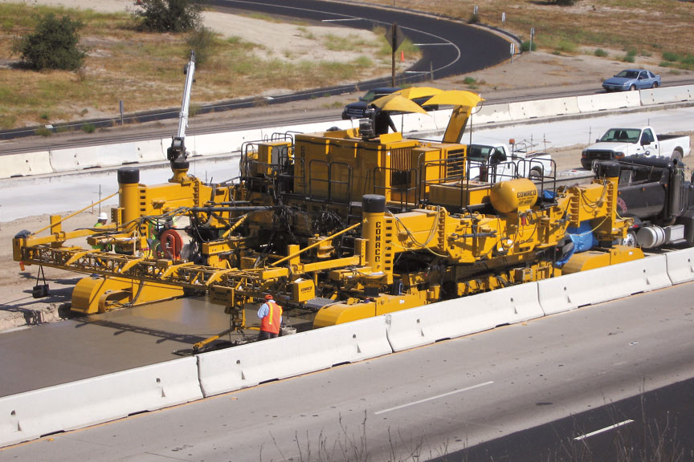

WORK ZONE
Safety Training
This material was produced under grant SH-19504-SH9 from the Occupational Safety and Health Administration, U.S. Department of Labor. It does not necessarily reflect the views or policies of the U.S. Department of Labor, nor does mention of trade names, commercial products, or organizations imply endorsement by the U.S. Government. This free training was made possible through a Susan Harwood Grant from the US Department of Labor’s Occupational Safety & Health Administration and the support of the Associated General Contractors of ND.

Slide 2
Syllabus
Introduction to WZ Safety
Mobile Equipment Safety
Falls
Electrical Safety
Hazardous Materials
Trenching and Excavation
Personal Protective Equipment
Night Operations and Temporary Traffic Controls
DOT Hours of Service
Wake Up and Get Some Sleep
Drug and Alcohol Awareness
Closing

