Slide 1
Eye Health & Safety
Offered by
Worker Justice Center of NY
Through
OSHA Susan Harwood Capacity Building Training Grant
This material was produced under grant #SH20827SH0 from the Occupational Safety and Health Administration, U.S. Department of Labor. It does not necessarily reflect the views or policies of the U.S. Department of Labor, nor does mention of trade names, commercial products, or organizations imply endorsement by the U.S. Government.

Slide 2
Pre-test
Notes:
OSHA requires us to do a test before and after the presentation.
I’m going to read the questions. You can write the responses for each one.

Slide 3
1
Can the sun’s rays affect the health of your eyes?

Slide 4
2
Does wearing a cap or hat help protect you from the effects of the sun’s rays?

Slide 5
3
Is it important to wear sunglasses or safety glasses while working?

Slide 6
4
Is it necessary to seek medical attention in case a chemical gets in your eyes?

Slide 7
Today’s topic:
Your eyes
Notes:
How to protect your eyes
The effects of the sun on your eyes
What can be done in case of an emergency for eye injuries and when you should seek medical attention
The importance of sunglasses/safety glasses

Slide 8
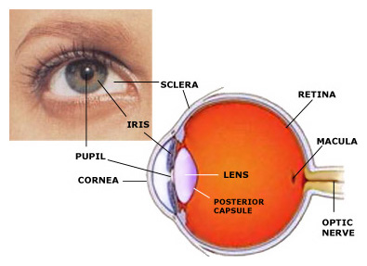
Parts of the eye
Notes:
We will be focusing on four parts:
Iris- Controls the light that enters the eye. It is the colored part of the eye around the pupil.
Pupil- The light enters the eye here. It is the hole in the iris.
Cornea and Lens- The cornea is a transparent bulge over the pupil. With these two parts working together, the light converges to create a sharp image.
Sclera – the white part of the eye

Slide 9
Causes of Eye Injuries
Dust or dirt
Foreign objects
Chemicals
Plant material
Sun
Wind
Notes:
The eyes are a very important part of the body. At work, your eyes are at risk because of these factors. We’re going to talk about some illnesses that result from these factors, and how to protect yourself.

Slide 10

Symptoms of Eye Injuries
Problems with vision
Eye pain
Change in color of the eye
Pupils are different sizes.
There is a growth in or near the eye that does not go away in 10 days.
Notes:
Change in eye color – if the white part of the eye turns red or pink.

Slide 11
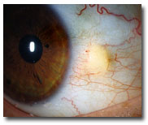
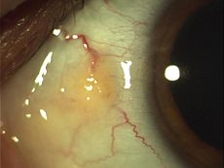
Eye Conditions: Pinguecula
These conditions are related to long exposure to UV rays and eye irritation from dry, dusty conditions.
Notes:
Pinguecula is a yellowish area on the white of the eye. Usually it is on the side closest to the nose. It is not a tumor. It is an alteration of normal tissue resulting in a deposit of protein and fat.

Slide 12
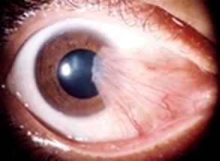
Pterygium
These conditions are related to long exposure to UV rays and eye irritation from dry, dusty conditions.
Notes:
Pterygium is fleshy tissue that grows over the corneas of the eye. It may be small, or grow large enough to cover the pupil and block vision. Pterygium most commonly occurs on the inner corner of the eye, but can appear on the outer corner as well.

Slide 13

The Sun’s Rays
Notes:
Ultraviolet rays: Radiation from the sun that is invisible. It can damage the eyes and skin.
UVA: goes deeper into the skin and eyes to cause damage
UVB: damages the outer layers of skin and eyes

Slide 14
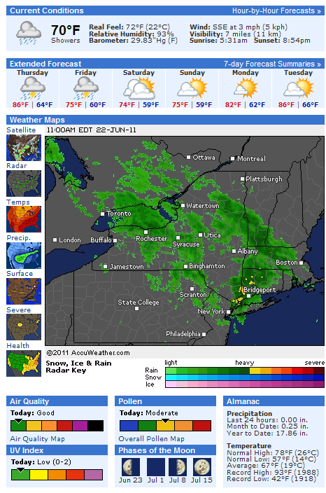

Calculating the Danger
UV Index
Notes:
The UV Index – indicates the strength of UV radiation from the sun from 1 (low) to 11+ (very high). You can use this index to know your risk and take precautions when you work in the sun.
0-2 Low, 3-5 Moderate, 6-7 High, 8-10 Very High, 10+ Extreme

Slide 15
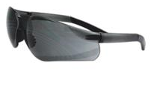
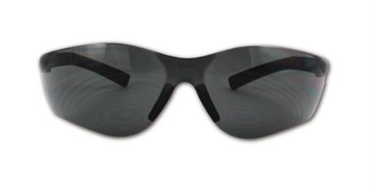
Protecting your eyes
Notes:
It is important to protect your eyes at work. It helps the health of your eyes in the long term. There are many ways that you can protect your eyes and keep them healthy.
Choose sunglasses that block 99-100% of UVA and UVB rays. Look for information on the label about protection from UV rays. Don’t use glasses that don’t offer information about this protection.
Wear safety glasses to prevent injuries with sharp objects, plants, stones, dust, pesticides and other chemicals. Safety glasses should have the imprint of Z87. This means that they are approved for protection in case of impact.

Slide 16
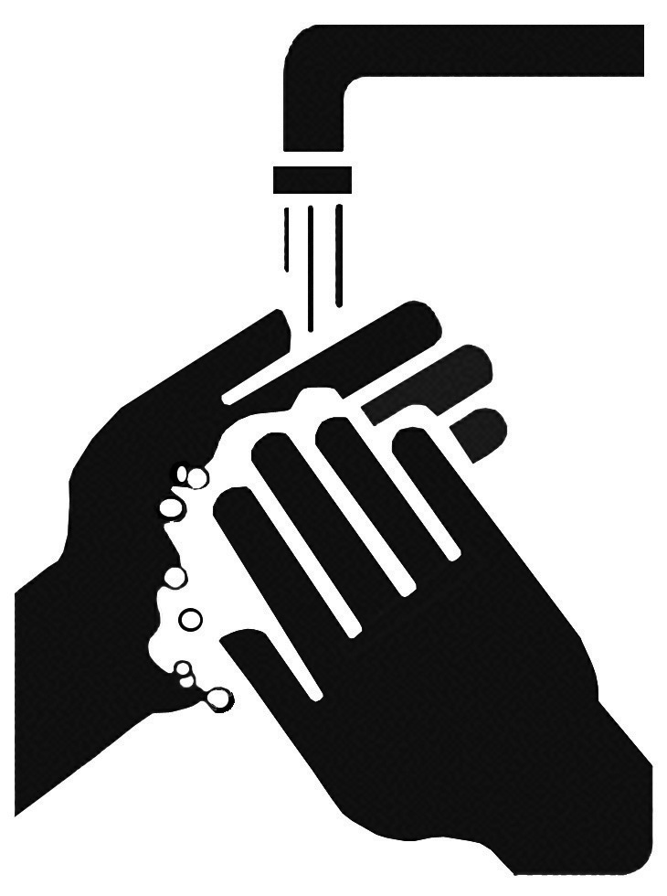
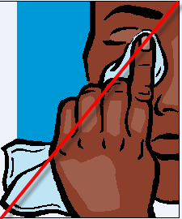
Protecting your eyes
Notes:
Wash hands to prevent getting chemicals, dirt and germs in the eye. Don’t touch your eyes when you are unable to wash your hands.

Slide 17
Protecting your eyes
Notes:
Use gloves to prevent getting chemicals, dirt and germs on the hands when hand washing is not possible.

Slide 18

Protecting your eyes
Notes:
Wear a wide-brimmed hat or a baseball cap to protect your eyes from the sun and from plants.
Use a cloth to keep sweat out of your eyes.
Use extra precaution during the hours of 10 to 2, when the sun’s rays are the strongest.

Slide 19
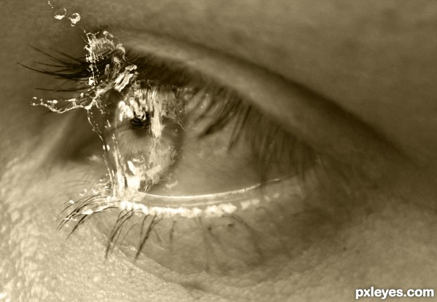
In case of emergency: Chemicals in the eye
Rinse the eye with clean water for 15 minutes. Get medical attention immediately.

Slide 20
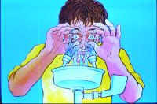
In case of emergency: Dust or dirt in the eye
Rinse the eye with clean water for 5 minutes. If it does not feel better, get medical attention immediately.

Slide 21
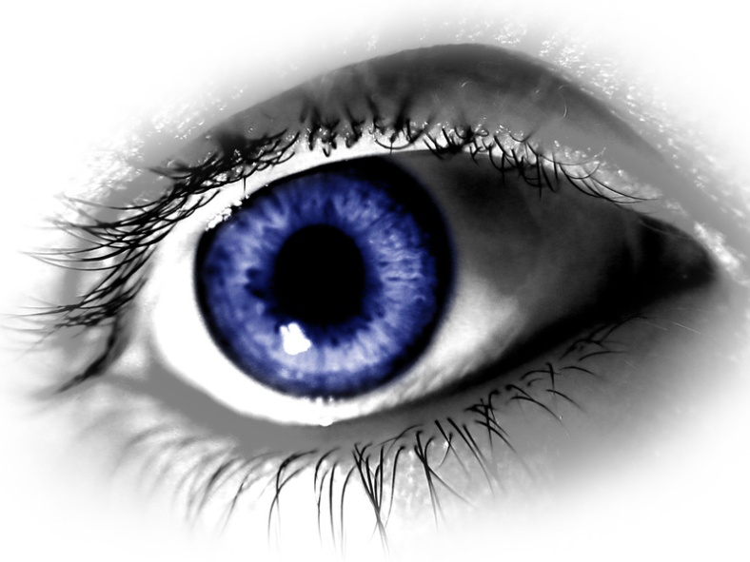
In case of emergency: Foreign body sensation in the eye
This may be due to a scratch on the cornea from dust or other small particles. Wash the eye thoroughly. If the sensation persists, seek medical attention.

Slide 22
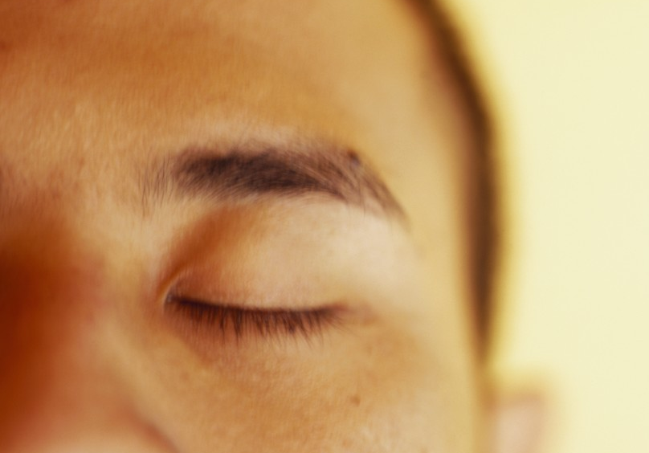
In case of emergency: Cut on the eyelid or eyeball
Close the eye and cover it with gauze or a clean cloth. Seek medical attention immediately if the cut is very deep or if it is on eyeball.

Slide 23
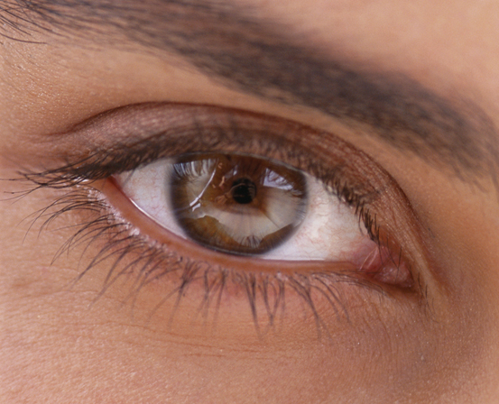
In case of emergency: Blood on the eyeball
This can have many causes. Seek medical attention immediately.

Slide 24
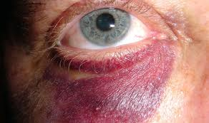
In case of emergency: Black eye
Wrap ice in a towel and place it on the eye for 15 minutes. Repeat this every 1-2 hours for 48 hours.

Slide 25
In case of emergency: Object impaled in the eye
Cover BOTH eyes with a bulky dressing. Do not put any pressure on either eye. Seek medical attention immediately.
Notes:
Your eyes always move together. Cover both eyes to minimize movement (which could cause more damage).

Slide 26
I don’t wear safety glasses because…
Notes:
What are the reasons why participants do not wear safety glasses currently?

Slide 27
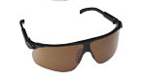
Why should you wear glasses with UV protection?
Notes:
Protect from the sun—direct light and reflected light.
Easier to see clearly in the bright sun.
Prevent dust, dirt and pollen from getting into the eye and irritating them.
Eyes are not red and painful at the end of the day.
Keep branches and leaves away from eyes.
Protect eyes from incidents with tools or machines.
Keep pesticides and chemicals from splashing in the eye.
Prevent eye illnesses like growths on eye.

Slide 28
Contact OSHA
Syracuse Office 3300 Vickery Road North Syracuse, New York 13212 (315) 451-0808
Buffalo Office 130 S. Elmwood Avenue, Suite 500 Buffalo, NY 14202-2465 (716) 551-3053
Notes:
If you work in Wayne or Ontario Counties, contact the Syracuse office.
If you work in Monroe County/western NY, contact the Buffalo office.

Slide 29
Questions?

Slide 30
1
Can the sun’s rays affect the health of your eyes?

Slide 31
2
Does wearing a cap or hat help protect you from the effects of the sun’s rays?

Slide 32
3
Is it important to wear sunglasses or safety glasses while working?

Slide 33
4
Is it necessary to seek medical attention in case a chemical gets in your eyes?

Slide 34
Thank you!
Post-test and Evaluations
Farmworker Legal Services of New York
1-800-724-7020

