Slide 1
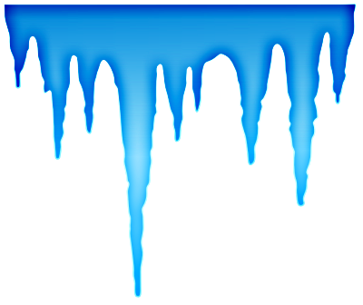
Working in the Cold
Offered By
Farmworker legal services of ny, inc
Through
Osha susan harwood capacity building training grant
This material was produced under grant #SH20827SH0 from the Occupational Safety and Health Administration, U.S. Department of Labor. It does not necessarily reflect the views or policies of the U.S. Department of Labor, nor does mention of trade names, commercial products, or organizations imply endorsement by the U.S. Government.

Slide 2
True or False?
Frostbite damages blood vessels.
True ___ False ___
You should rub frostbitten skin.
True ___ False ___
It is better to dress in layers than to wear one warm sweater.
True ___ False ___
If someone who has been shivering in the cold falls asleep, you should wake him/her.
True ___ False ___
If you experience cold risks in your job, you may be able to make a complaint to OSHA.
True ___ False ___

Slide 3
Today’s topic is C O L D
What are the dangers of working in cold weather?
What should you watch for?
What can happen if you don’t take precautions?
How can these conditions be treated?
What is the best prevention?
Notes:
Overview of this session

Slide 4
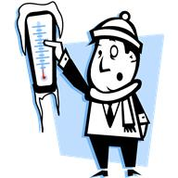
Working in the Cold
What is the body’s response to cold?
Notes:
Image from office.microsoft.com
Your body tries to keep itself at 37◦ C (98.6◦ F)
When the temperature drops, blood vessels constrict, decreasing flow to toes, fingers, feet, hands
This keeps your organs warmer, but can cause real problems for extremities

Slide 5
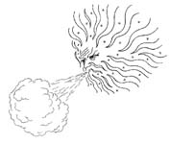
Working in the Cold
Wind Chill
When the temperature is low and the wind is blowing, you need greater protection for your skin and body because wind increases the risk that your flesh will freeze
Notes:
Image from free-clipart.net

Slide 6
Working in the Cold
Hypothermia
The body is unable to retain its core temperature
Frostbite
Skin tissue freezes, blood vessels are damaged
Notes:
Cold temperatures pose two major risks to your health

Slide 7
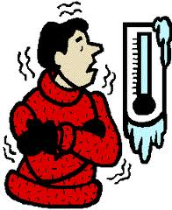
Hypothermia
When body temperature drops, the first symptoms are:
Shivering
Blue lips and fingers
Poor coordination
Notes:
Image from office.microsoft.com

Slide 8
Hypothermia
As body temperature continues to drop, symptoms worsen:
Confusion
Faulty thinking
Slower heartbeat
Shallow breathing
In the worst cases, hypothermia causes:
Unconsciousness
Heartbeat may not be heard
No shivering
No detectable breathing
Ultimately, death

Slide 9
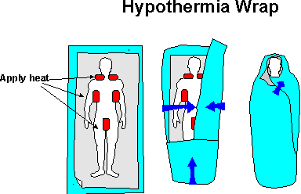
Hypothermia
Treatment
Gently take the person to shelter – sudden movements may disturb heart rhythm
Keep the person awake
Remove wet clothing; wrap in warm blankets
Gradually warm neck, underarms, groin (NOT extremities)
Notes:
Image from Rick Curtis, Outdoor Action Program http://www.princeton.edu/~oa/safety/hypocold.shtml
http://www.princeton.edu/~oa/safety/hypocold.shtml 1995 - 2010, all rights reserved, Rick Curtis, Outdoor Action Program, The Trustees of Princeton University. You may set up links to material found at the Outdoor Action Web Site. Printed versions of the material may be distributed for nonprofit educational use as long as no fees are charged for the material, attributions are made to the author, and no content changes are made. Commercial use of this material either in electronic or printed form is prohibited.

Slide 10
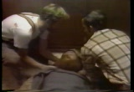
Hypothermia
Apply direct body heat
If person is conscious, give warm, sweet drinks
Monitor breathing; administer artificial respiration if necessary
Get medical help as soon as possible
Notes:
http://www.archive.org/about/terms.php

Slide 11
Hypothermia
Prevention
Understand the dangers
Take shivering people to shelter
Avoid cold exposure if you have heart ailment, lung disorder, diabetes
Eat high-calorie foods
Drink soups and warm, sweet beverages
Take regular breaks in a shelter
Remove damp or wet clothing immediately
Notes:
Understand how dangerous prolonged exposure to cold and wind-chill can be
Severe shivering is a sign of suffering
Certain health conditions = greater risk of negative effects (irregular heartbeat, asthma, diabetes)
These conditions make people more vulnerable to cold weather
High calorie foods release heat into blood stream
Avoid caffeine and alcohol as they increase heat loss or dehydration

Slide 12
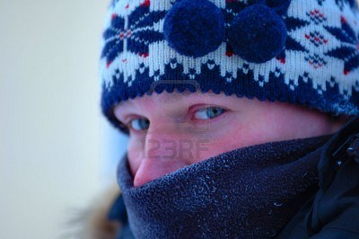
Prevention
Clothing
Notes:
http://www.123rf.com/photo_3095404_freezing-male-person.html
Royalty free stock photos
Wear several layers as air captured between layers acts as insulation
Synthetic fabrics that don’t absorb moisture (sweat) should be worn next to skin
Outer clothing should be water and wind resistant in wet and windy weather
If clothing gets wet, immediately change to dry clothes – especially at temperature below 2◦C (36◦F)
Wear hats or hoods to reduce heat loss & protect ears; face cover may be needed
Wear shoes with one thick or two thin pairs of socks
If you get hot, open jacket, don’t remove hats/gloves

Slide 13
Prevention
Workers showing any of these signs should immediately seek shelter:
Extreme shivering
Fatigue
Drowsiness
Irritability
Confusion
Others should monitor their symptoms and get medical help if worker’s condition worsens or fails to improve

Slide 14
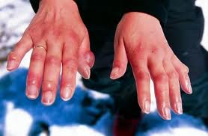
Frostbite
When skin is exposed to extreme cold, or is in contact with extremely cold items (especially metal), heat is lost or, in the latter case, transferred to the item
Early symptoms include a prickling sensation, numbness, waxy appearance – not always pain
Notes:
http://firstaid.about.com/od/heatcoldexposur1/ig/Frostbite-Pictures/

Slide 15
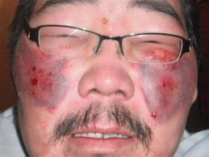
Frostbite
Frostbite is most likely to affect your face, ears, fingers, and toes
Left untreated, frostbite blackens and blisters the skin; may cause gangrene
Notes:
http://firstaid.about.com/od/heatcoldexposur1/ig/Frostbite-Pictures/

Slide 16
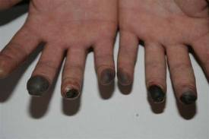
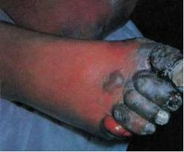
Frostbite
It’s not pretty!
You can lose your toes!
Notes:
http://firstaid.about.com/od/heatcoldexposur1/ig/Frostbite-Pictures/

Slide 17
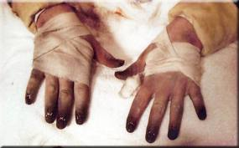
Frostbite
Treatment
Notes:
Rubbing affected tissue can permanently damage the skin.
http://firstaid.about.com/od/heatcoldexposur1/ig/Frostbite-Pictures/
Gradually warm affected areas with body heat or immersion in warm (not hot) water
DO NOT RUB affected areas
Do not walk on frostbitten feet
Apply sterile bandages to blisters to prevent them from breaking
Get medical attention as soon as possible

Slide 18
Frostbite
People at Added Risk
Those who have had frostbite previously
Those with heart ailments
Those with asthma, bronchitis, or diabetes
Those with vibration/white finger disease
Those on certain medications (check with a health care practitioner)

Slide 19
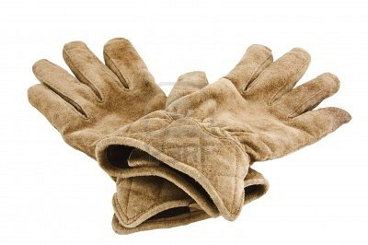
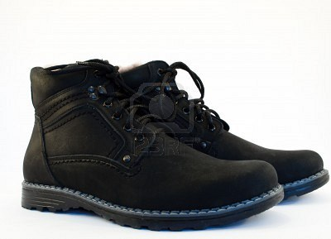
Prevention
Preventive Measures:
Do not leave skin exposed
Notes:
http://www.123rf.com/photo_6200901_winter-boots.html
Royalty free photos
Wear appropriate gloves, boots, face/head covering
Wear layers of loose clothing
Do not let your skin touch metal objects
Do not assume that the absence of pain means you’re not being harmed

Slide 20
Prevention
When possible:
Schedule outdoor work for warmer times of day
Reduce physical exertion in cold weather
Job-share to reduce length of time each worker is exposed
Have warm liquids available (not caffeine or alcohol)
Have a shelter nearby
Monitor co-workers’ appearance & behavior
Keep blankets, matches, rain gear, extra clothes and emergency food supplies nearby
Share information about effects of cold exposure with co-workers

Slide 21
True or False?
Frostbite damages blood vessels.
True ___ False ___
You should rub frostbitten skin.
True ___ False ___
It is better to dress in layers than to wear one warm sweater.
True ___ False ___
If someone who has been shivering in the cold falls asleep, you should wake him/her.
True ___ False ___
If you experience cold risks in your job, you may be able to make a complaint to OSHA.
True ___ False ___

