Slide 1


Kisa ou we?
Danje ki kapab asosye ak OSHA a
OSHA - Susan Harwood Training Grant

Slide 2

DISCLAIMER: This material was produced under grant number SH 208 32–SH–0 from the Occupational Safety and Health Administration, U.S. Department of Labor. It does not necessarily reflect the views or policies of the U. S. Department of Labor, nor does mention of trade names, commercial products, or organizations imply endorsement by the U. S. Government. The U.S. Government does not warrant or assume any legal liability or responsibility for the accuracy, completeness, or usefulness of any information, apparatus, product, or process disclosed.
COPYRIGHT INFORMATION: This material is the copyrighted property of Miami Dade College. By federal regulation, OSHA reserves a license to use and disseminate such material for the purpose of promoting safety and health in the workplace. Miami Dade College hereby authorizes employers and workplace safety and health professionals to use this material, distributed by or through OSHA, in their workplaces or practices in accordance with the guidance contained in the material.
To this end, permission is granted to use such copyrighted material solely for non-commercial, instructional, personal, or scholarly purposes. The material may be used and incorporated into other workplace safety and health programs on the condition that no fee may be charged for the subsequent use of the material. Use of the material for any other purpose, particularly commercial use, without the prior, express written permission of the copyright owner/s is prohibited. Furthermore, any modification to the material is prohibited without the prior, express written permission of the copyright owners.
OSHA - Susan Harwood Training Grant

Slide 3
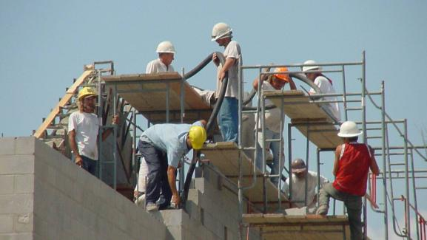
Ki prensis ke ou dwe aplike le ou jwen danje sa yo?
Men de twa konsey:
FP pati M – travaye yo sou mi an
FP pati L – travaye yo nan estanda
Akse – pati L, yo itilize yon echel Soupati X
Soupati E PPE
Soupati D santé/ pwoteksyon
OSHA - Susan Harwood Training Grant

Slide 4
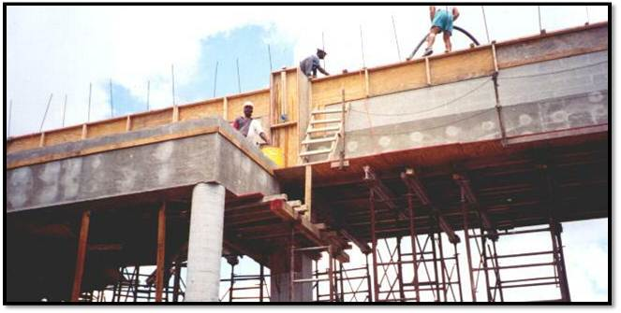
Ki prensis ke ou dwe aplike le ou jwen danje sa yo?
Men de twa konsey:
Sub M – Travay nan strikti
Sub L - ap travay sou X nan echafodaj Sub
konstriksyon nechèl ak enstalasyon Sub Q - danje impalement, ase fòs nan sistèm kofraj Sub E - PPE
OSHA - Susan Harwood Training Grant

Slide 5
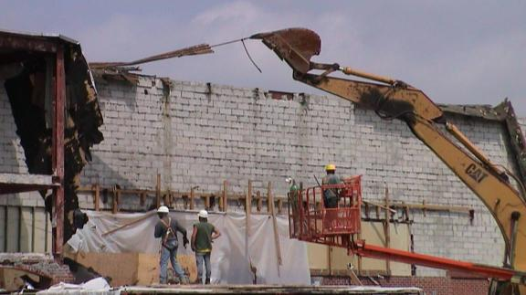
Ki prensis ke ou dwe aplike le ou jwen danje sa yo?
Kèk sijesyon: Sub M - pwoteksyon Otòn, itilize mobil
Sub L - balistrad echafodaj, sekirite boomlift
Sub T - operasyon demolisyon
Sub H Dokiman mwayen.
OSHA - Susan Harwood Training Grant

Slide 6
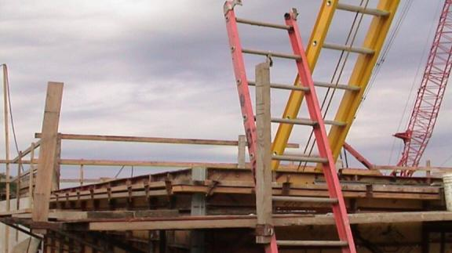
Ki prensis ke ou dwe aplike le ou jwen danje sa yo?
Kèk sijesyon: Sub L - echafodaj konstriksyon, balistrad
Sub X - enstalasyon epi sèvi ak nechèl
OSHA - Susan Harwood Training Grant

Slide 7
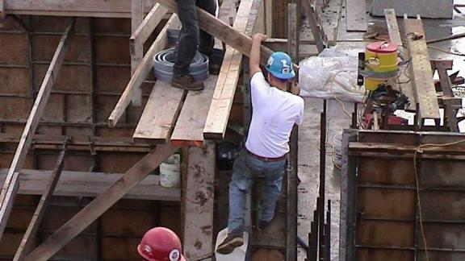
Ki prensis ke ou dwe aplike le ou jwen danje sa yo?
Kèk sijesyon:
Sub L - echafodaj konstriksyon platfòm, aksè, pwoteksyon pou pa tonbe
Sub E - PPE – chapo pou pwoteksyon, bak, manke linèt sekirite
Sub D - rezèv pou pote dlo
Sub M – glise epi tonbe na danje, antre nan two
Sub P - sekirite fouy, grenpe
OSHA - Susan Harwood Training Grant

Slide 8
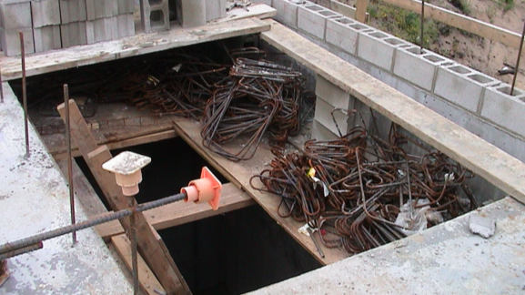
Ki prensis ke ou dwe aplike le ou jwen danje sa yo?
Kèk sijesyon:
Sub L - echafodaj konstriksyon platfòm, kapasite Sub X - konstriksyon nechèl ak enstalasyon
Sub Q - impalement danje Sub M - pwoteksyon pou soti tonbe nan planche, nan twou, oswa sou bò etaj
OSHA - Susan Harwood Training Grant

Slide 9
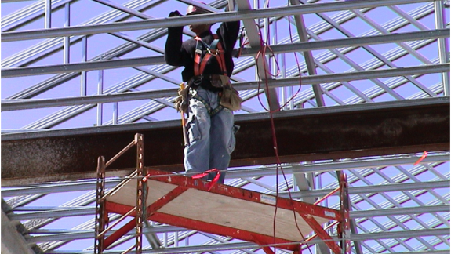
Ki prensis ke ou dwe aplike le ou jwen danje sa yo?
Sub L - mobil sèvi ak echafodaj
Sub M - pwoteksyon pou tonbe (sonje nan premye plan, li se 80’ nan tè a sou kab yo), pwen kapasite Anchorage Roule echafodaj mobil la ka esansyèlman danjere, epi gen kondisyon trè espesifik pou itilize san pa gen danje, sitou lè anplwaye yo rete sou echafodaj la. Asire w ke w konsilte kondisyon ki aplikab yo nan Soupati L la.
OSHA - Susan Harwood Training Grant

Slide 10
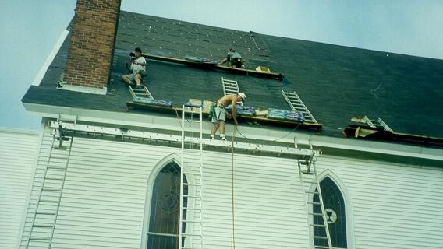
Ki prensis ke ou dwe aplike le ou jwen danje sa yo?
Kèk sijesyon: Sub L – Utilize nechèl Jack, pwoteksyon pou soti tonbe nan wotè maksimòm echafodaj jack nechèl la ki se 20’
Sub M - pwoteksyon pou soti tonbe nan anle twati kay ki apik
Sub E - PPE (oswa mank ladan l')
Sub X - Nechèl pou izaj enstalasyon.
OSHA - Susan Harwood Training Grant

Slide 11
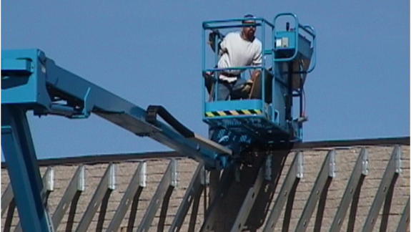
Ki prensis ke ou dwe aplike le ou jwen danje sa yo?
Kèk sijesyon: Sub L - Aryel izaj travay platfòm , pwoteksyon pou kondisyon tonbe
Sub M - pwoteksyon pou tonbe nan kwen twati
E Sub - PPE Sub C - Fòmasyon, kalifye, konpetans, efikas pwogram sekirite - sa a se kontremèt la sou chantye a, se pa dirijan se pa egzanp nan travay la ki nesesè
Ou dwe mare senti sekite tout tan lè w ap itilize leve boom
OSHA - Susan Harwood Training Grant

Slide 12
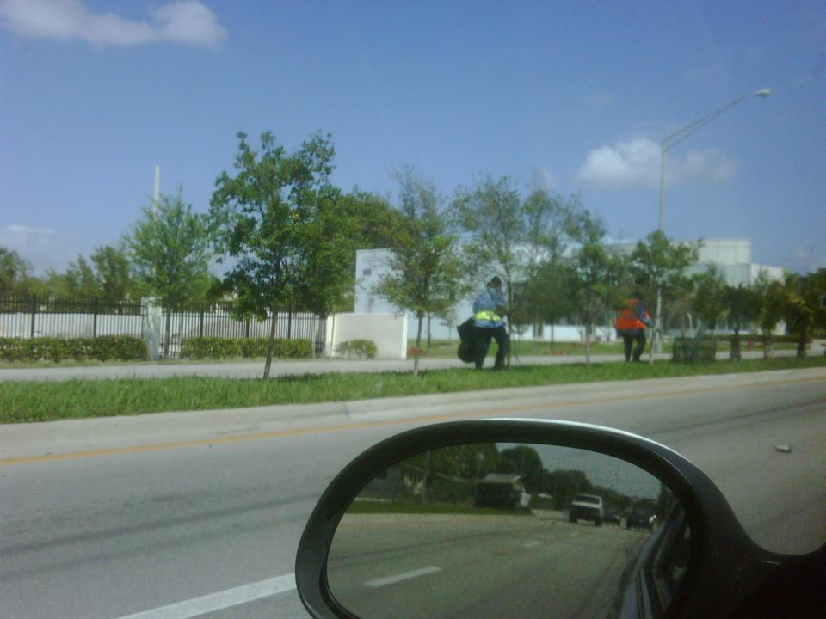

OSHA - Susan Harwood Training Grant

Slide 13
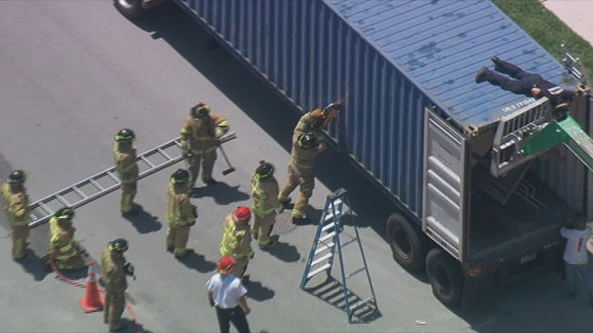
OSHA - Susan Harwood Training Grant

Slide 14
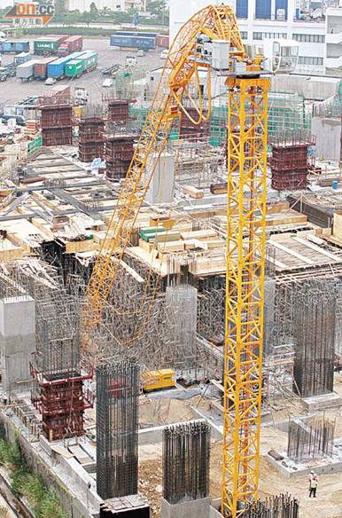
OSHA - Susan Harwood Training Grant

Slide 15
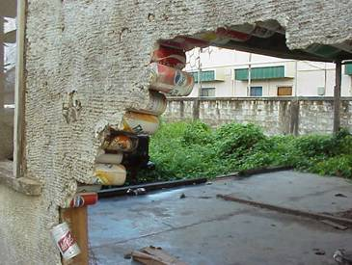
OSHA - Susan Harwood Training Grant

Slide 16
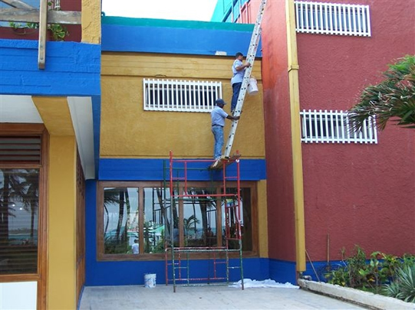
OSHA - Susan Harwood Training Grant

Slide 17
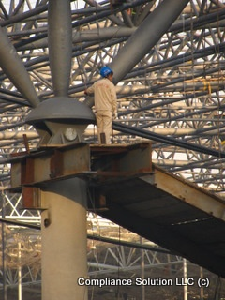
OSHA - Susan Harwood Training Grant

Slide 18
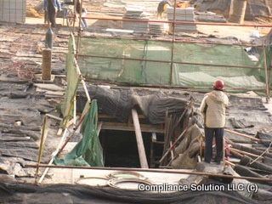
OSHA - Susan Harwood Training Grant

Slide 19
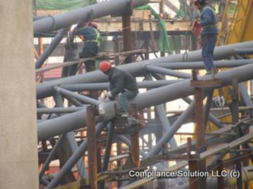
OSHA - Susan Harwood Training Grant

Slide 20
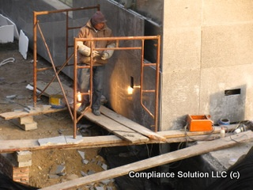
OSHA - Susan Harwood Training Grant

Slide 21
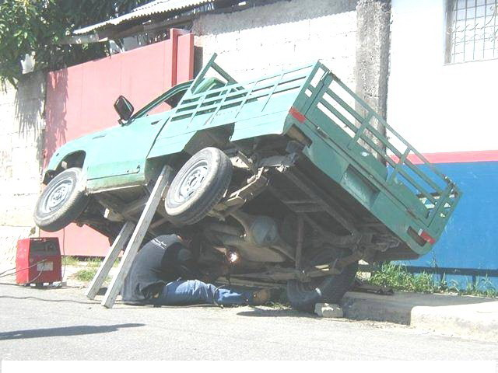
OSHA - Susan Harwood Training Grant

Slide 22
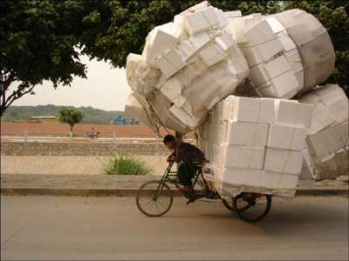
OSHA - Susan Harwood Training Grant

Slide 23
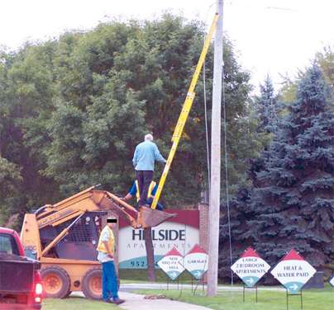
OSHA - Susan Harwood Training Grant

Slide 24
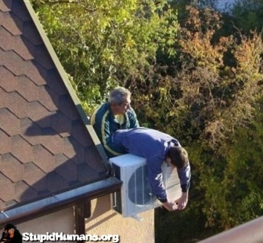
OSHA - Susan Harwood Training Grant

