Slide 1
identifying
JOB HAZARDS
Safe and Secure
Safety Training Series

Slide 2
This material was produced under grant number
SH-20835-10-60-F-37 from the Occupational Safety and Health Administration, U.S. Department of Labor.
It does not necessarily reflect the views or policies
of the U.S. Department of Labor, nor does mention
of trade names, commercial products, or organizations
imply endorsement by the U.S. Government.
Telamon Corporation is an equal opportunity provider and employer. Auxiliary aids and services are available upon request to individuals with disabilities.

Slide 3
HAZARDS –
WHAT ARE THEY AND HOW CAN I PREVENT THEM?

Slide 4
Module
Objectives
Employers and employees will learn to work together to help improve conditions in their workplace by:
  Identifying Job Hazards
  Reviewing Sources of Information on Hazards
  Understanding Hazard Control Methods

Slide 5
Hazards –
What are They?
Health and safety hazards in the workplace include those things that cause stress or poses potential risks to a worker’s physical, mental emotional well being.

Slide 6
Hazards –
What are They?
The goal of a company’s health and safety program is to create an injury-free workplace and the most effective way to do that is to eliminate or reduce the hazards that cause those injuries and illnesses.

Slide 7
Hazards –
What are They?
When looking for hazards in the workplace, the most common areas to check are:
  Equipment
  Environment,
  Materials,
  Facilities, and
  Processes

Slide 8
Hazards –
What are They?
In order to prevent injuries, it is important to use the systematic approach to hazard analysis:
      Identify
      Evaluate
      Control

Slide 9

Check for Understanding
Time for Group Activity!
10-15 MINUTES

Slide 10
Hazards –
What are They?
Staying informed increases your awareness and helps you to more readily identify hazards.

Slide 11
Hazards –
What are They?
To ensure that a worker stays informed they must first know where to go to find the information they need.

Slide 12
Hazards –
What are They?
Knowing what hazards are and where to learn more about them is really important.
But remember, Identifying and Evaluating are only part of the equation – now we must learn how to Control them.

Slide 13
Hazards –
How Do I Prevent Them?
The Hierarchy of Hazard Controls is a health and safety process model for ensuring workplace safety and helping you toward the goal of an injury-free workplace.
MOST
EFFECTIVE
LEAST
EFFECTIVE

Slide 14



Hazards –
How Do I Prevent Them?
MOST
EFFECTIVE
LEAST
EFFECTIVE

Slide 15
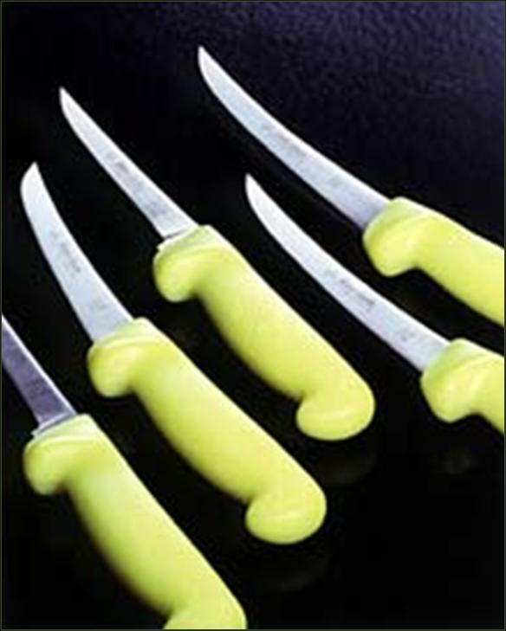
Hazards –
How Do I Prevent Them?
MOST
EFFECTIVE
Elimination
The best way to control a hazard is to eliminate it and remove the danger.
LEAST
EFFECTIVE

Slide 16
Hazards –
How Do I Prevent Them?
Substitution
The second most effective method is to substitute something else in its place that would be non-hazardous or less hazardous to workers.
MOST
EFFECTIVE
LEAST
EFFECTIVE

Slide 17
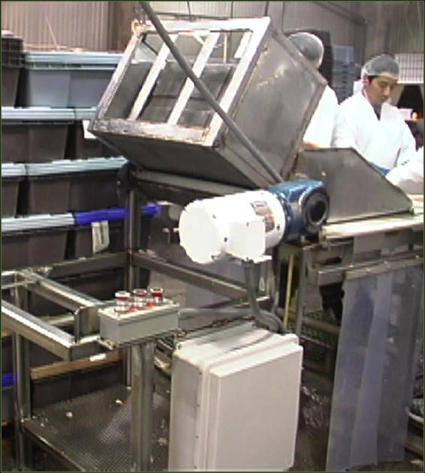
Hazards –
How Do I Prevent Them?
Engineering Controls
If a hazard cannot be eliminated or a safer substitute cannot be found, the next best approach is to use engineering controls to keep the hazard from reaching the worker.
MOST
EFFECTIVE
LEAST
EFFECTIVE

Slide 18
Hazards –
How Do I Prevent Them?
Administrative Controls (Training and Work Practices)
If engineering controls are not available, administrative controls should be the next consideration. Administrative controls involve changes in workplace policies and procedures.
MOST
EFFECTIVE
LEAST
EFFECTIVE

Slide 19
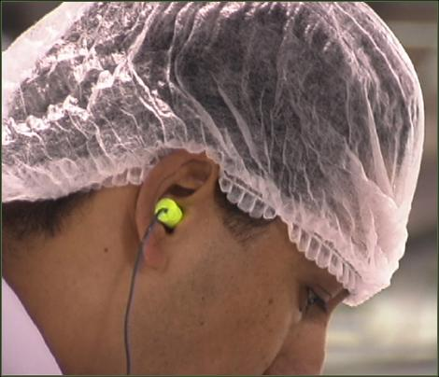
Hazards –
How Do I Prevent Them?
Personal Protective Equipment
The use of personal protective equipment (PPE) is a way of controlling hazards by placing protective equipment directly on workers' bodies.
MOST
EFFECTIVE
LEAST
EFFECTIVE

Slide 20
Hazards –
How Do I Prevent Them?
IDENTIFY, EVALUATE and CONTROL
In the following slides, read the work scenario, IDENTIFY the hazard, EVALUATE the importance of addressing the hazard and share what CONTROL method you would use to deal with it.

Slide 21
Hazards –
How Do I Prevent Them?
SCENARIO #1
A person takes an adjustable stand and stacks it on top of another adjustable stand to reach an area where they can’t reach, such as a drip pan or other overhead area.

Slide 22
Hazards –
How Do I Prevent Them?
SCENARIO #2
A worker uses a knife to repeatedly stab the meat (product) with the blade and drags it towards them or lifts it and brings it towards them to trim.

Slide 23
Hazards –
How Do I Prevent Them?
SCENARIO #3
The same worker refuses to take the time to stop and steel their knives resulting in a dull knife that requires more force and slowing down the line.

Slide 24
Check for Understanding
Time for Group Activity!
10-15 MINUTES

Slide 25
A job hazard is:
Any job that can cause extreme danger risks.
Something that can kill you.
Anything in the workplace that can cause stress of potential injury to a person’s physical, mental or emotional well-being.
All of the above.
None of the above.
Notes:
Participants could answer with a show of hands or if you have access to an audience response system you can use it.

Slide 26
What is an area that you would not commonly look for a job hazard?
Equipment
Environment
Materials
Facilities
Processes
None of the above
Notes:
Participants could answer with a show of hands or if you have access to an audience response system you can use it.

Slide 27
Check for Understanding
What are the three steps to conducting a hazard analysis?
1
2
3
Notes:
Who can remember the three steps to hazard analysis we just talked about? Identify, Evaluate and Control

Slide 28
Check for Understanding
FILL IN THE BLANK
If you are eliminating or reducing hazards, you are said to be _______________ hazards.
Notes:
controlling

Slide 29
Check for Understanding
SHORT ANSWER
What is the hierarchy of hazard control?
List in order of importance – most to least.
Notes:
Activity Options: Create a mnemonic or conduct a word scramble.
Elimination
Substitution
Engineering Controls
Administrative Controls
PPE

Slide 30
To Extend Your Learning, Check Out the Resources Below
Poultry Processing Industry eTool (http://www.osha.gov/SLTC/etools/poultry/)
North Carolina Department of Labor Occupational Safety and Health Division, A Guide to Safe Work Practices in the Poultry Processing Industry
http://www.oshainfo.gatech.edu/ergo-training/trainer.html

Slide 31
Susan Harwood Safety Training Grant Program Team
Ivy Bonk, Program Coordinator
Debra Stewart, Corporate Risk Mgmt. Specialist
Jennifer Shahan, State Director
Telamon Corporation
Elizabeth Eades-Guerrero,
Regional EHS Manager, Tyson Foods
Sam Fulginiti, Safety Manager
Amick Farms, Maryland
Stephen Ridgell, Program Specialist, MOSH

