Slide 1

Fall Recognition
Developed by Western Iowa Tech Community College
This material was produced under a grant (SH20836SHO) from the Occupational Safety and Health Administration, U.S. Department of Labor. It does not necessarily reflect the views or policies of the U.S. Department of Labor, nor does the mention of trade names, commercial products, or organization imply endorsement by the U.S. Government.
Notes:
Title page and credits for OSHA and WITCC. Western Iowa Tech Community College, 4647 Stone Avenue, P.O. Box 5199, Sioux City,
Iowa 51102-5199, a nonprofit organization, hereby authorizes the use of this picture in grant #SH20836SHO.

Slide 2
Here are some things we will discuss:
What makes falls happen?
Lack of training
Site specific hazards
Lack of a Competent Person if necessary
Lack of knowledge, skills, and abilities
Equipment failure
Notes:
Lack of training, site specific hazards, lack of a competent person if necessary, lack of KSA’s (knowledge, skills, abilities), and equipment failure are the majority of the causes of falls. Instructor will give an example of each but they will be talked about in depth later in the module.
Examples are as follows:
Scuba diving requires training. If a person was required to use scuba equipment and did not receive training, that piece of scuba equipment would become a hazard.
There will be specific hazards for communication towers located near large bodies of water which is rust. Towers located inland are susceptible to rust but not in the amount or concentration.
If a person had never experienced drivers education, that person would not have the have the knowledge, skills, or abilities needed to obtain a drivers license.
Every tool used in any industry has a designated purpose. Equipment fails when tools are used for purposes other than the intended use. For example, using a screwdriver as a chisel or using an adjustable wrench as a hammer.

Slide 3
Lack of Training
When workers are exposed to specific hazards such as falls, electrical, and so on, training/retraining must be completed prior to the exposure.
Training should cover (not limited to):
The nature of falls
Personal Protective Equipment (PPE)
Emergency procedures
Rights and responsibilities of both employee and employer
Notes:
Retraining requirements:
1926.503(c)
"Retraining." When the employer has reason to believe that any affected employee who has already been trained does not have the understanding and skill required by paragraph (a) of this section, the employer shall retrain each such employee. Circumstances where retraining is required include, but are not limited to, situations where:
1926.503(c)(1)
Changes in the workplace render previous training obsolete; or
1926.503(c)(2)
Changes in the types of fall protection systems or equipment to be used render previous training obsolete; or
1926.503(c)(3)
Inadequacies in an affected employee's knowledge or use of fall protection systems or equipment indicate that the employee has not retained the requisite understanding or skill.

Slide 4
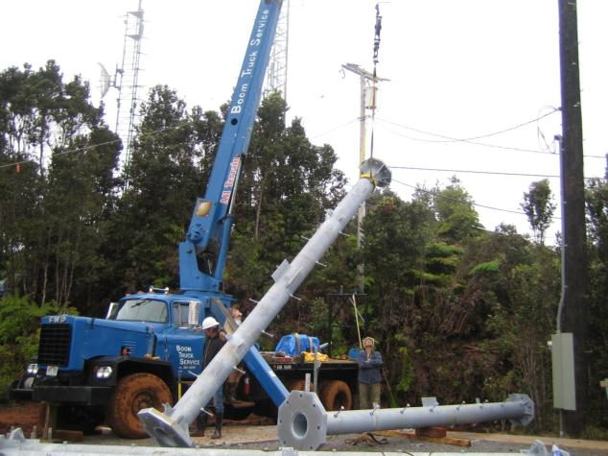
Lack of Training
Notes:
The picture is intended to get the participants to identify the hazards present. In this case, the employee appears to be standing under a suspended load. Western Iowa Tech Community College, 4647 Stone Avenue, P.O. Box 5199, Sioux City,
Iowa 51102-5199, a nonprofit organization, hereby authorizes the use of this picture in grant #SH20836SHO.

Slide 5
Lack of Training
Lack of training leads to situations where the consequences can be severe. Answer the following two questions and we will discuss as a group.
1. Is there a greater risk of an accident if employees have not received training to identify hazards?
2. If employers are responsible for providing a safe and healthful workplace, does lack of training make the workplace unsafe?
Notes:
Training on hazards that are present in the workplace is a necessity. By not training employees on site specific hazards, those employees have been faced with hazards they may not have been subjected to had the training occurred.

Slide 6
Could this have been avoided?
Read the summary portion of the handout.
On a piece of paper, list the hazards you find.
We will review as a group and discuss the hazards we find.
Notes:
Issue NIOSH In-house FACE Report 2000-07 to participants. This can be found at: http://www.cdc.gov/niosh/face/In-house/full200007.html.
The new OSHA directive CPL 02-01-036, which incorporates the old directive CPL 2-1.29, describes the policy in regards to employees riding the load line. The old directive said that employees were not to ride the line if the work being preformed was under 200 feet. The new directive allows employees to ride the line to any elevation as long as the all requirements outlined in CPL 02-01-036 are met.

Slide 7

Site Specific Hazards
It is very important to understand that with each new locations comes the potential for new hazards.
These hazards can come from any of the following (but not limited to):
Physical location
Changes in process
Different safety equipment
Notes:
Not one workplace is the same. By changing the physical location, process by which work is done, and using different safety equipment new hazards are created. Engineering and work practice controls will be discussed.

Slide 8
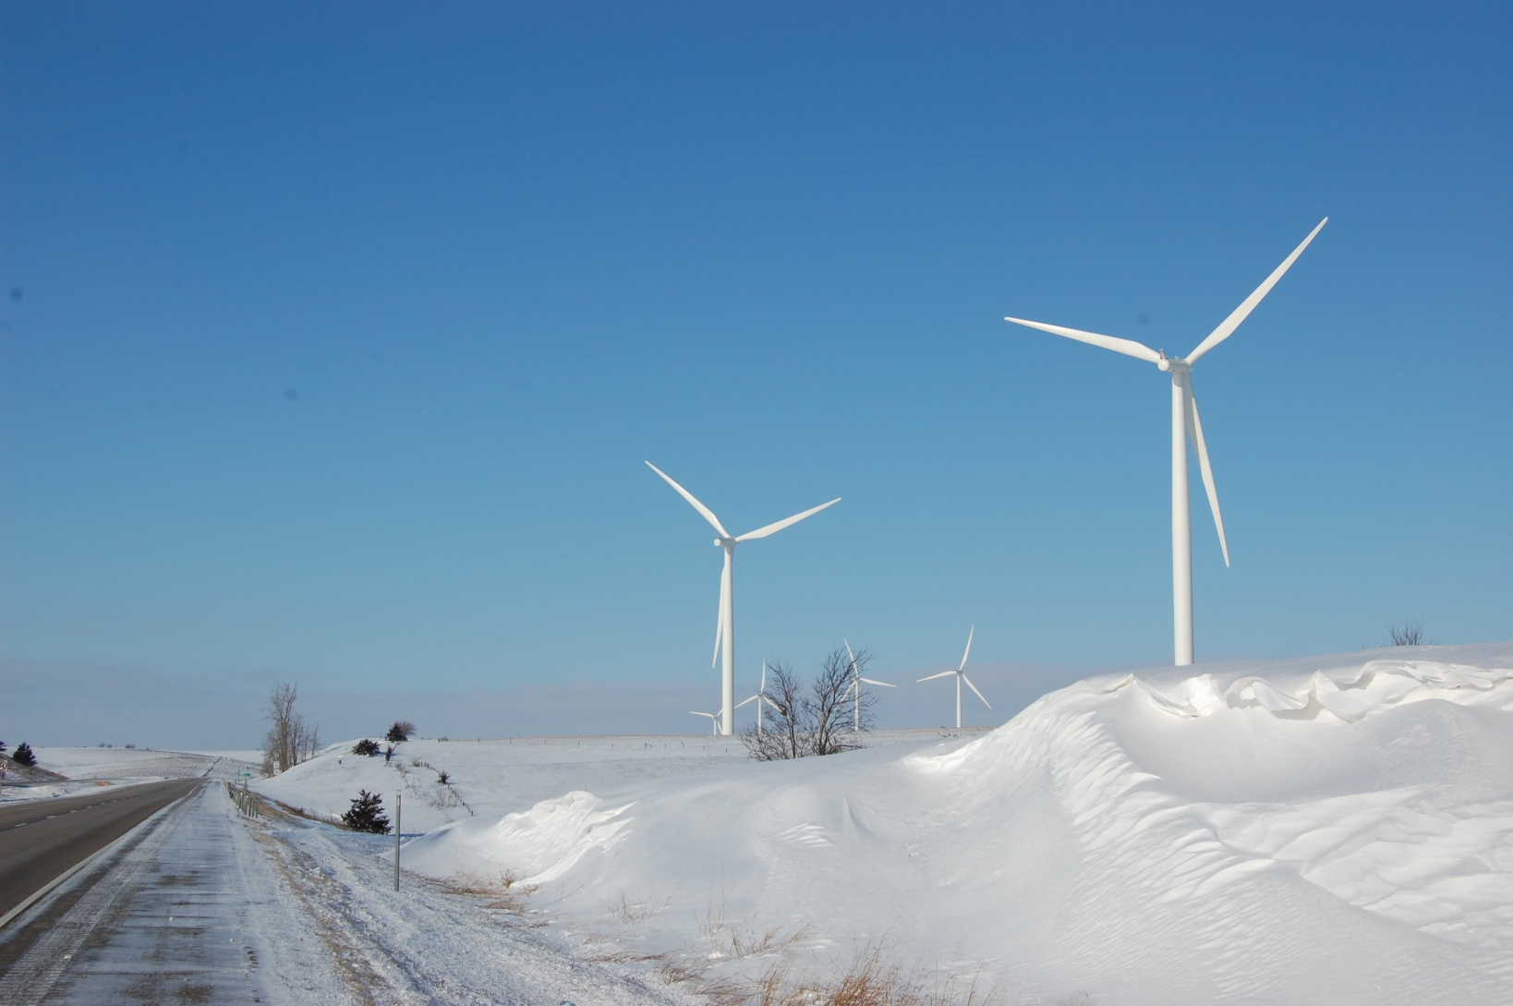
Site Specific Hazards
What hazards can you identify at this site?
Notes:
This picture is intended to get the participant to think about hazards on sites just by looking at it. Examples of hazards at this site include but are not limited to: ice, snow, wind, and road traffic. Western Iowa Tech Community College, 4647 Stone Avenue, P.O. Box 5199, Sioux City,
Iowa 51102-5199, a nonprofit organization, hereby authorizes the use of this picture in grant #SH20836SHO.

Slide 9
Competent Person
If a safety monitoring system is used, the employer must ensure that the safety monitor:
Is competent in the recognition of fall hazards
Is capable of warning workers of fall hazard dangers and in detecting unsafe work practices
Is operating on the same walking/working surfaces of the workers and can see them
Is close enough to work operations to communicate orally with workers and has no other duties to distract from the monitoring function
Notes:
When no other alternative fall protection has been implemented, the employer shall implement a safety monitoring system. Employers must appoint a competent person to monitor the safety of workers.

Slide 10
Lack of Knowledge, Skills, and/or Abilities
Knowledge – understanding gained from actual experiences
Example:
If you had never experienced a fall before, do you know what it feels like?
Notes:
Source – The Merriam-Webster Dictionary New Edition
This question or a similar question is used to relate the subject matter to the participant.

Slide 11
Lack of Knowledge, Skills, and/or Abilities
Skills – the ability to use one’s knowledge effectively in doing something
Example:
Would you know how to safely climb a structure without proper fall protection training?
Notes:
Source – The Merriam-Webster Dictionary New Edition
This question or a similar question is used to relate the subject matter to the participant.

Slide 12
Lack of Knowledge, Skills, and/or Abilities
Able (Abilities) – having sufficient power, skill, or resource to accomplish an objective
Example:
Would you be able to safely climb a structure with a personal fall arrest system if you were unable to use your arms and/or legs?
Notes:
Source – The Merriam-Webster Dictionary New Edition
This question or a similar question is used to relate the subject matter to the participant.

Slide 13
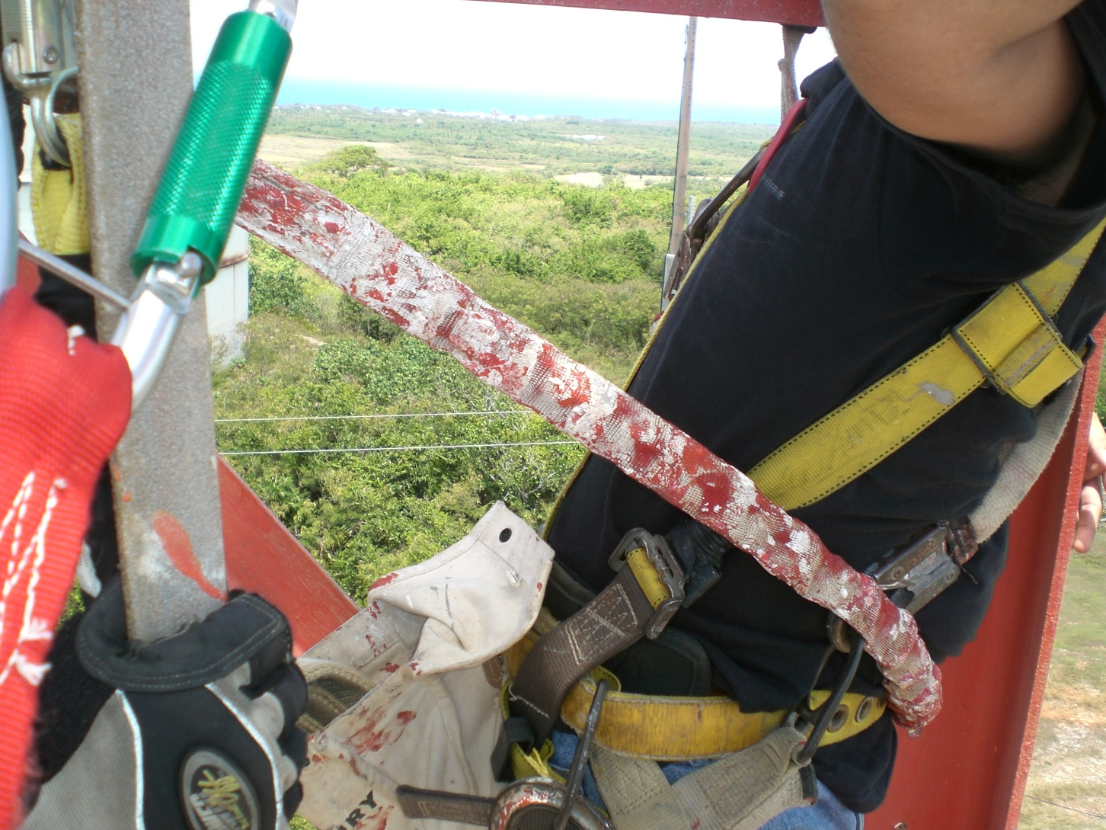
Equipment Failure
Notes:
The objective of this picture is for the participant to gauge whether the equipment will work to its ability if a fall occurs. In this case, the paint on the lanyard appears to be very thick and may impede the lanyard from working properly. Western Iowa Tech Community College, 4647 Stone Avenue, P.O. Box 5199, Sioux City, Iowa 51102-5199, a nonprofit organization, hereby authorizes the use of this picture in grant #SH20836SHO.

Slide 14
Equipment Failure
Overloaded equipment
Exceeding load ratings
Not accounting for environmental issues
Missing or unreadable load chart
Lack of experience/training
Notes:
It will be explained to the participants that the causes listed above are not the only causes of equipment failure. We will discuss other causes further.

Slide 15
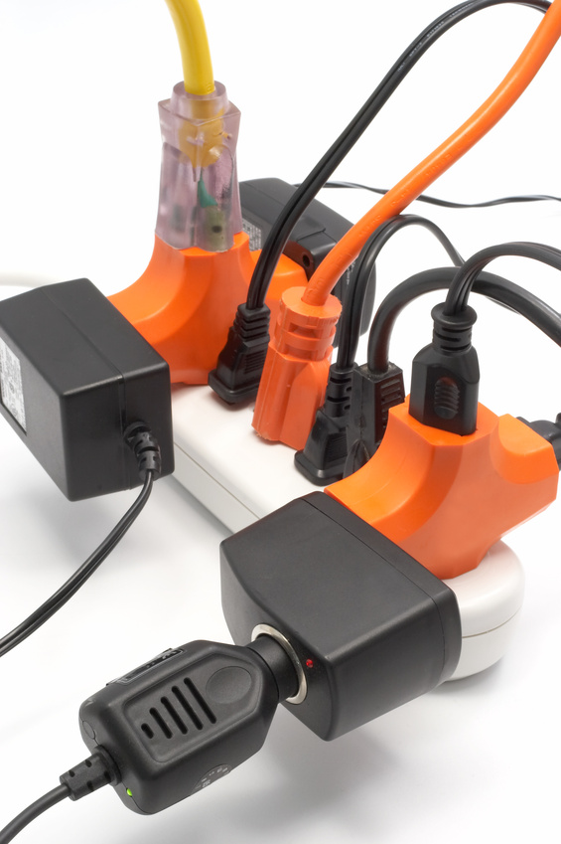
Equipment Failure
Equipment not properly used
Examples are as follows:
Using a crane in extremely high winds
Moving a scissor lift or aerial lift while fully extended
Notes:
Misuse and lack of training, which are similar but not the same, are areas in which require the main focus. By properly using equipment and keeping safety in the forefront of thought, we can significantly reduce the amount and severity of accidents in not only the construction industry but all industries.

Slide 16
Equipment Failure
Lack of inspections
Ask the following questions:
When should inspections be performed on the equipment?
Who should be conducting the inspections?
Does there need to be a record of these inspections?
Notes:
Inspections are done for several different reasons:
To inform the user of wear and possible damage.
To ensure the equipment is being properly used.
Recordkeeping purposes.
Verification that proper maintenance is being performed.
To keep all people that could be affected by its use, safe.

Slide 17
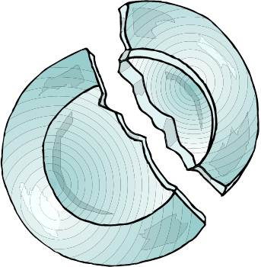
Equipment Failure
Reusing damaged equipment
Damaged equipment must be marked that it is damaged
This equipment shall be removed from service
Notes:
The instructor will show the class damaged equipment and have the participants explain where the equipment is damaged. The ability of the participants to identify damaged equipment is extremely important.

Slide 18
The Hazards of a Fall
We learned about how the following areas can impact the recognition of a hazard:
Lack of Training
Site Specific Hazards
Lack of Knowledge, Skills, & Abilities
Equipment Failure
Notes:
The participants will be asked to review and discuss questions in these four major areas.
Some of the review questions may include:
The hazards created from lack of training?
What site specific hazards have you encountered on a job site?

Slide 19
The Hazards of a Fall
With the information we have discussed, you should be able to:
Recognize common hazards
Identify areas in which hazards can be created
Prevent fall hazards from becoming a reality
Notes:
Summary page with closing statements and questions from participants.

Slide 20
Employee Rights and Responsibilities
You have the right to:
A safe and healthful workplace
Know about hazardous chemicals
Information about injuries and illnesses in your workplace
Complain or request hazard correction from employer
Notes:
The information above was taken from the new 2 hour Intro to OSHA PPT, slide #10.
The instructor will discuss employee rights and responsibilities with the participants.

Slide 21
Employee Rights and Responsibilities
You have the right to:
Training
Hazard exposure and medical records
File a complaint with OSHA
Participate in an OSHA inspection
Be free from retaliation for exercising safety and health rights
Notes:
The instructor will discuss employee rights and responsibilities with the participants.

Slide 22
Employee Rights and Responsibilities
OSHA website: http://www.osha.gov and OSHA offices: Call or Write (800-321-OSHA)
Compliance Assistance Specialists in the area offices
National Institute for Occupational Safety and Health (NIOSH) – OSHA’s sister agency
OSHA Training Institute Education Centers
Doctors, nurses, other health care providers
Public libraries
Other local, community-based resources
Notes:
The information above was taken from the new 2 hour Intro to OSHA PPT, slide #40.
The instructor will discuss employee rights and responsibilities with the participants.

Slide 23
…and stay safe!
Notes:
The final slide of the module.

