Slide 1
CEPA
A Health and Safety Training
For Construction Workers

Slide 2
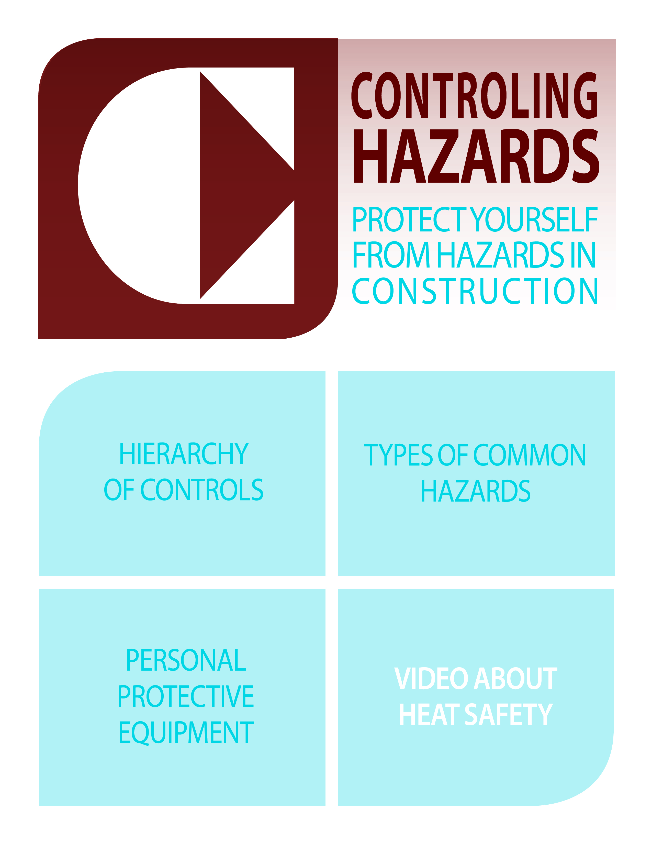

Slide 3
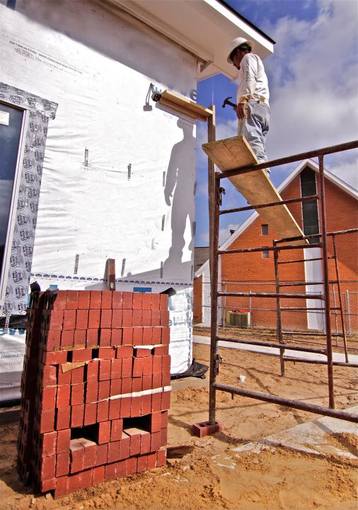

Slide 4
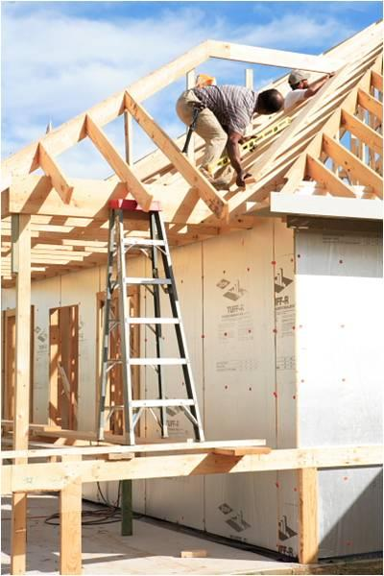

Slide 5
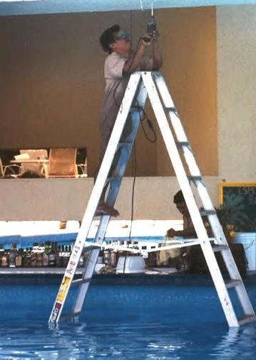

Slide 6
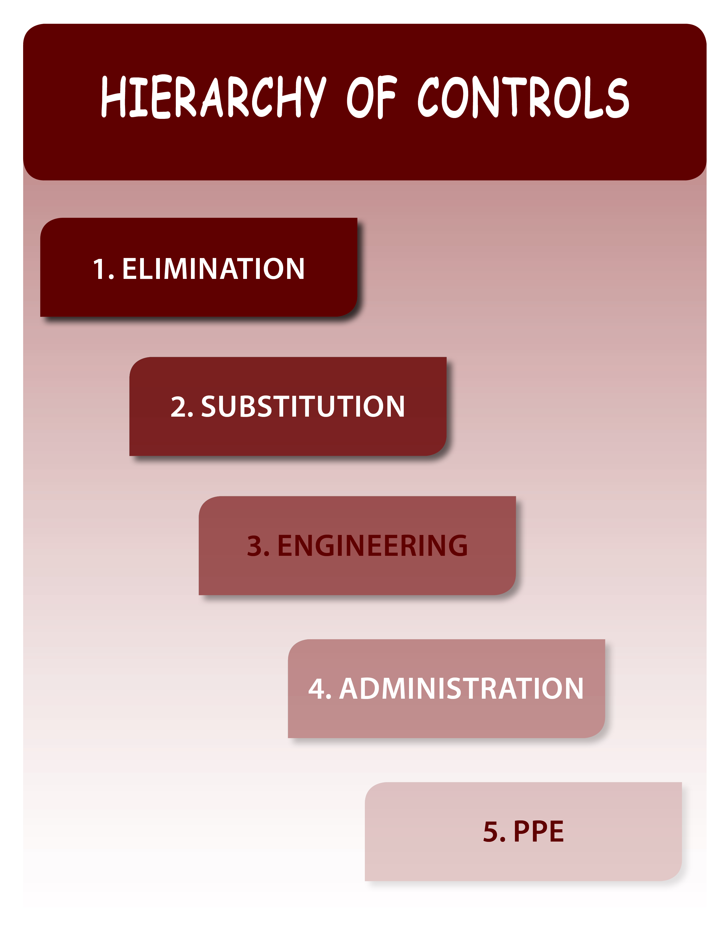

Slide 7
HEAT
Be safe when working in hot weather

Slide 8
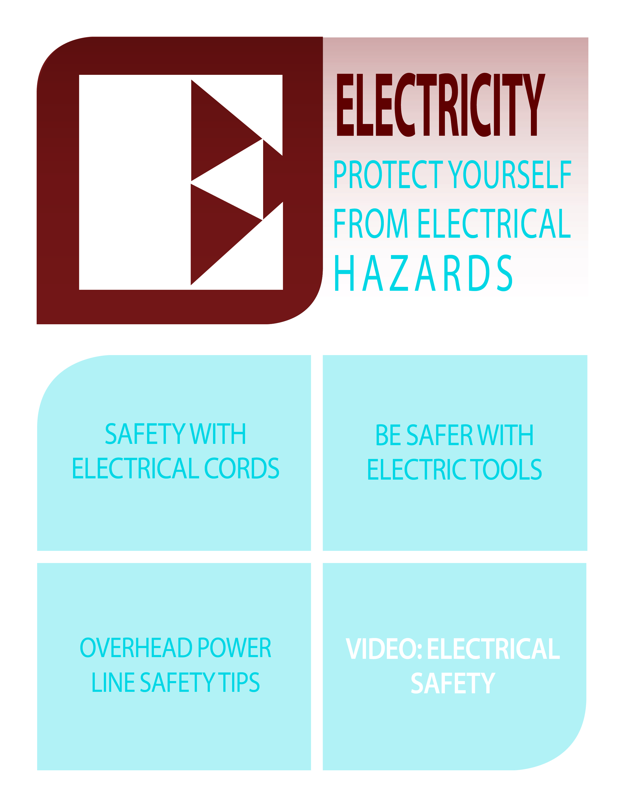

Slide 9
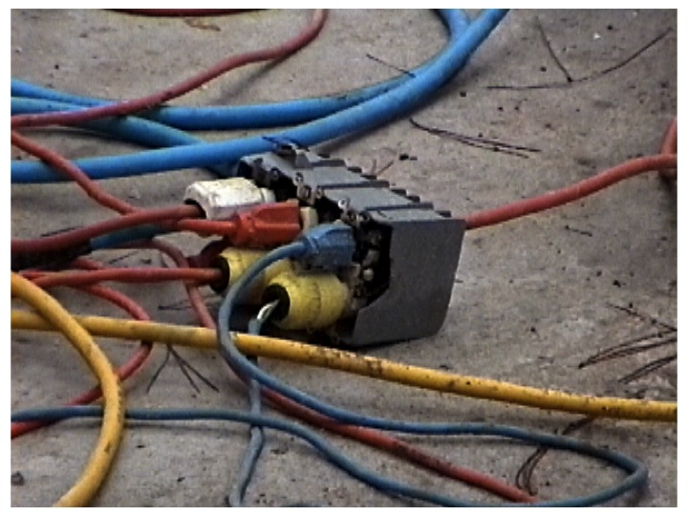

Slide 10
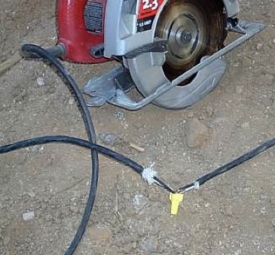

Slide 11
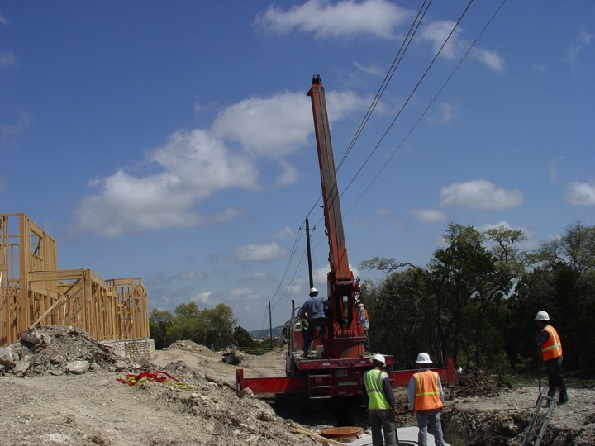

Slide 12
ELECTRICITY
Protect yourself from electrical dangers

Slide 13


Slide 14
ABOUT OSHA
Your rights & responsibilities under OSHA

Slide 15
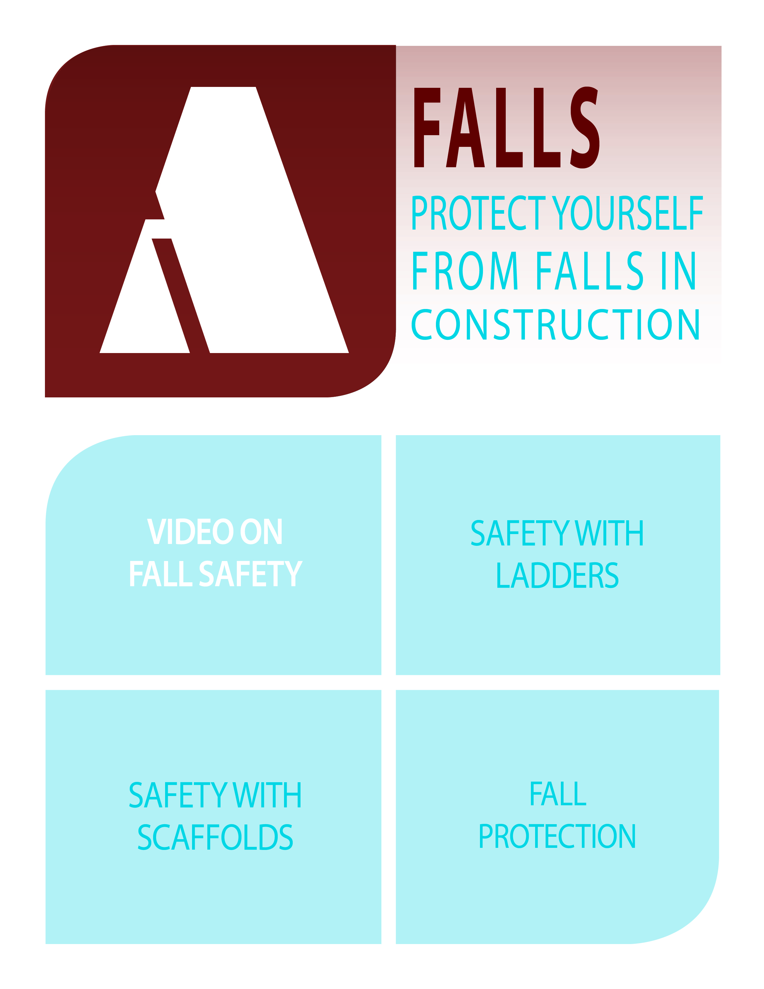

Slide 16
FALL HAZARDS
Protect yourself from fall dangers in construction

Slide 17
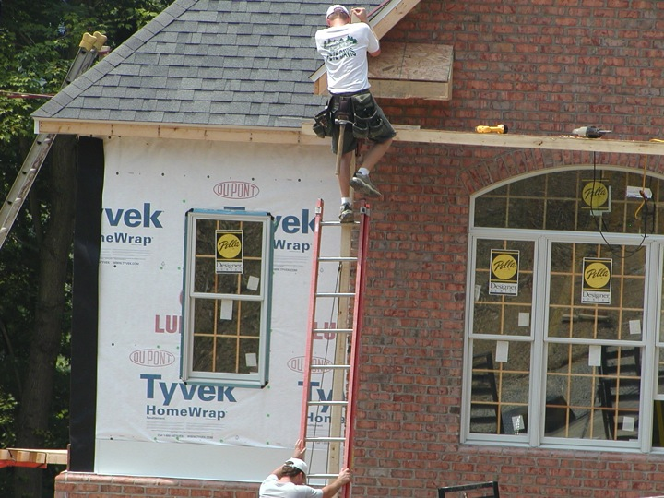

Slide 18
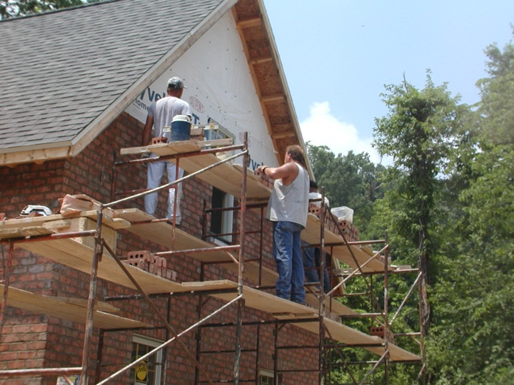

Slide 19
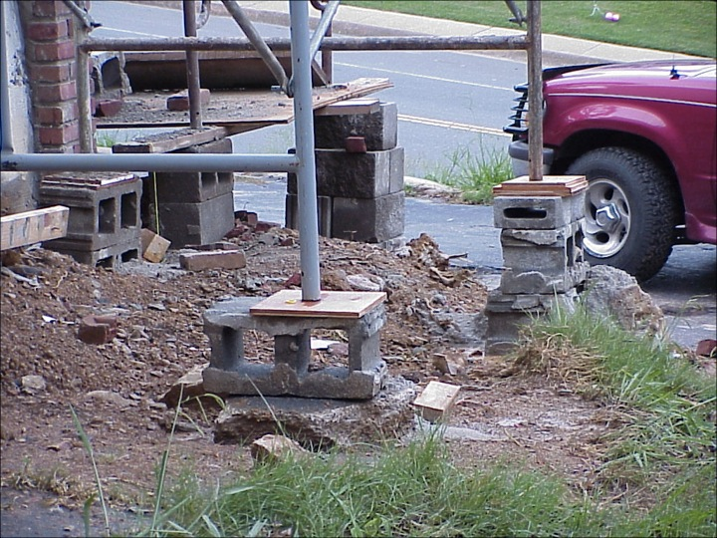

Slide 20
CEPA
A summary of common hazards and how to protect yourself and others

Slide 24


Slide 25
CEPA
A Health and Safety Training
For Construction Workers

Slide 26


