Slide 1
Basic Hazard Awareness
“This material was produced under the grant SH-20839-SHO from the Occupational Safety and Health Administration, U.S. Department of Labor. It does not necessarily reflect the views or policies of the U.S. Department of Labor, nor does mention of trade names, commercial products, or organizations imply endorsement by the U.S. Government.”

Slide 2
Objectives
By the end of this workshop, you will:
Identify how workplace injuries or illnesses can affect your everyday life.
Identify common symptoms, aches/pains, illnesses and injuries that are associated with your work.
Identify and recognize the exposures and hazards linked to work-related illnesses and injuries.
Develop solutions and strategies to address these identified hazards.

Slide 3
CHEMICAL & DUST HAZARDS
(cleaning products, pesticides, asbestos, etc.)
ERGONOMIC HAZARDS
(repetition, lifting, awkward postures, etc.)
BIOLOGICAL HAZARDS
(mold, insects/pests, communicable diseases, etc.)
WORK ORGANIZATION HAZARDS
Things that cause STRESS!
SAFETY HAZARDS
(slips, trips and falls, faulty equipment, etc.)
PHYSICAL HAZARDS
(noise, temperature extremes, radiation, etc.)

Slide 4
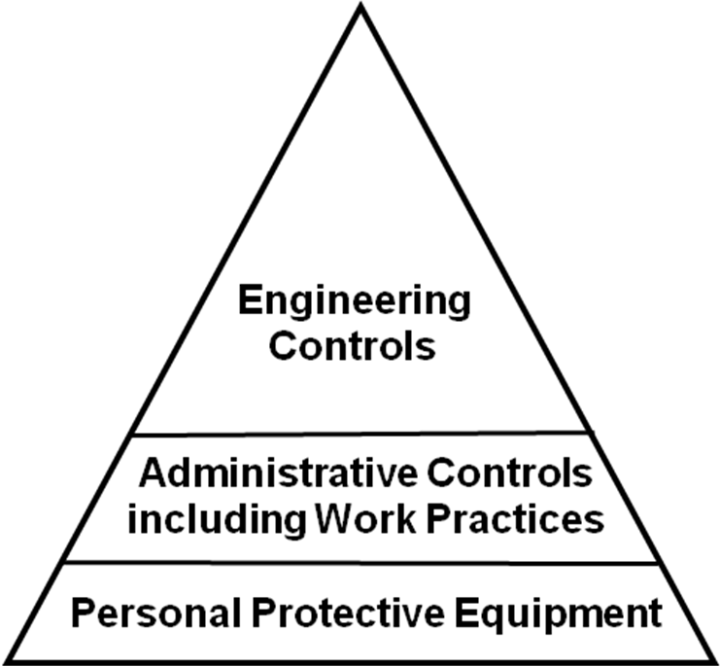
Hierarchy of Controls
Elimination/Substitution
Most Effective
Requires a physical change to the workplace
Requires worker or employer to do something
Requires worker to wear something
Least Effective
Notes:
These are referred to as the hierarchy of controls, how you prevent or control a hazard:
Elimination/Substitution: The main goal for any fix to a hazard or exposure is to eliminate it altogether or substitute a product or method of doing the work to a less hazardous alternative. (e.g. green cleaning products)

Slide 5


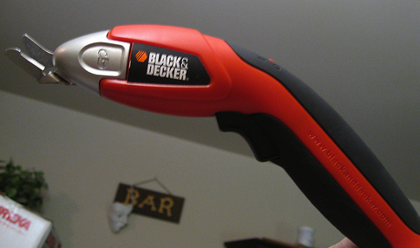
CONTROLS: Engineering
CONTROL AT THE SOURCE!
Limits the hazard but doesn’t entirely remove it.
Other Examples:
Mechanical Guards
Wet Methods for Dust
Enclosures/Isolation
Dilution Ventilation
Image: by JohnRH4's photostream
Image: by Kare_Products
Local Exhaust
Proper equipment
Image: by purpleslog’s photostream
Re-designed Tools
Notes:
The basic concept behind engineering controls is that, to the extent feasible, the work environment and the job itself should be designed to eliminate hazards or reduce exposure to hazards. While this approach is called engineering controls, it does not necessarily mean that an engineer is required to design the control. Engineering controls are the "first line of defense" against injury/illness, because they have the potential to completely eliminate a hazard, and do not rely on human behavior to be effective. For instance, rather than require employees to wear respiratory protection which must be monitored, inspected, trained, managed, it's much more effective to install a ventilation system that does not require any of those management activities or, better yet, find an alternative substitute that is less hazardous.
Images from: Creative Commons:
You are free:
to Share — to copy, distribute and transmit the work
to Remix — to adapt the work
Under the following conditions:
Attribution — You must attribute the work in the manner specified by the author or licensor (but not in any way that suggests that they endorse you or your use of the work).
Image: by Kare_Products
Image: by JohnRH4's photostream
Image: by purpleslog's photostream

Slide 6
CONTROLS: Administrative
Aimed at Reducing Employee Exposure to Hazards but Not Removing Them!
Changes in work procedures such as:
Written safety policies/rules
Schedule changes, such as:
Lengthened or Additional Rest Breaks
Job Rotation
Adjusting the Work Pace
Training with the goal of reducing the duration, frequency and severity of exposure to hazards
Notes:
Administrative controls (or work practice controls) are changes in work procedures such as written safety policies, rules, supervision, schedules, and training with the goal of reducing the duration, frequency, and severity of exposure to hazardous chemicals or situations.
As with work practice controls, administrative controls normally are used in conjunction with other controls that more directly prevent or control exposure to hazard.
Image: Powerpoint Clipart

Slide 7



CONTROLS: PPE Personal Protective Equipment
Control of LAST RESORT!
Special Clothing
Eye Protection
Hearing Protection
Respiratory Protection
CONTROL IS AT THE WORKER!
Notes:
Personal protective equipment (PPE): A method that prevents a worker from being exposed to the hazard by something the worker wears (e.g., gloves, hardhat, of safety glasses). PPE is considered the method of last resort because PPE does nothing to reduce or eliminate the hazard. If the PPE fails, immediate exposure is the result. Examples of PPE include:
a. Special clothing: like gloves, aprons, boots, coveralls, etc.
b. Eye protection: like safety glasses or face shields
c. Hearing protection
Respiratory protection: for emergency or short-term protection.
Images: all from OSHA website

Slide 8
Hierarchy of Controls
Elimination/Substitution
Most Effective
Requires a physical change to the workplace
Requires worker or employer to do something
Requires worker to wear something
Least Effective

Slide 9
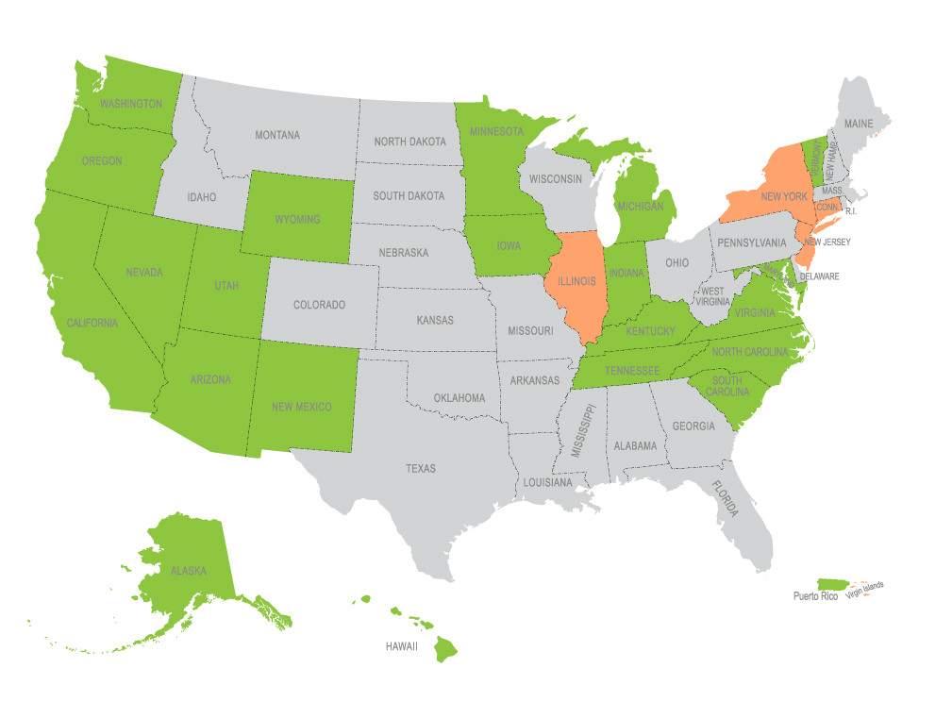
OSHA STATE PLAN STATES
Notes:
This map shows that our public employee members in 27 states enjoy the same OSHA rights as all workers in the private sector. They have a legal right to a safe and healthy workplace.
All public employers in the 27 OSHA states are required to follow OSHA standards. When they are not in compliance, workers and their unions have the right to file a complaint and receive an inspection if they feel that their working conditions are unsafe.
But, the map also shows that there are millions of public workers in the rest of the states that have no OSHA protection. Unfortunately, any type of protection for public employees in non-OSHA state plan states are spotty at best.
Even with OSHA coverage … many of the hazards we are exposed to everyday don’t have standards that address them.
Image: Pamela Wolfe, AFT

Slide 10
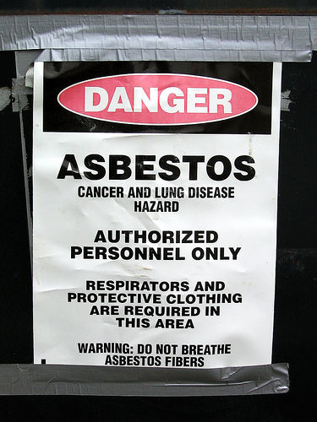
OSHA Asbestos Standard
Applies in all 50 states for school employees
Provides protection for custodians and maintenance workers who must remove or handle asbestos as part of their duties.
OSHA also protects any school employee in any state who is harassed or discriminated against for complaining about asbestos exposure.
Image: by Beige Alert's photostream
Notes:
Image: by Beige Alert's photostream

Slide 11

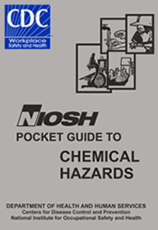
Valuable resource for information on all types of hazard exposures
Can conduct Health Hazard Evaluations (HHE) if requested by union or members
Notes:
The National Institute for Occupational Safety and Health (NIOSH), the research arm of OSHA is another valuable resource for information on hazard exposures. They can also come into workplaces and do Health Hazard Evaluation (HHE) if requested by the union or members in response to a hazard exposure.
Images: NIOSH

Slide 12
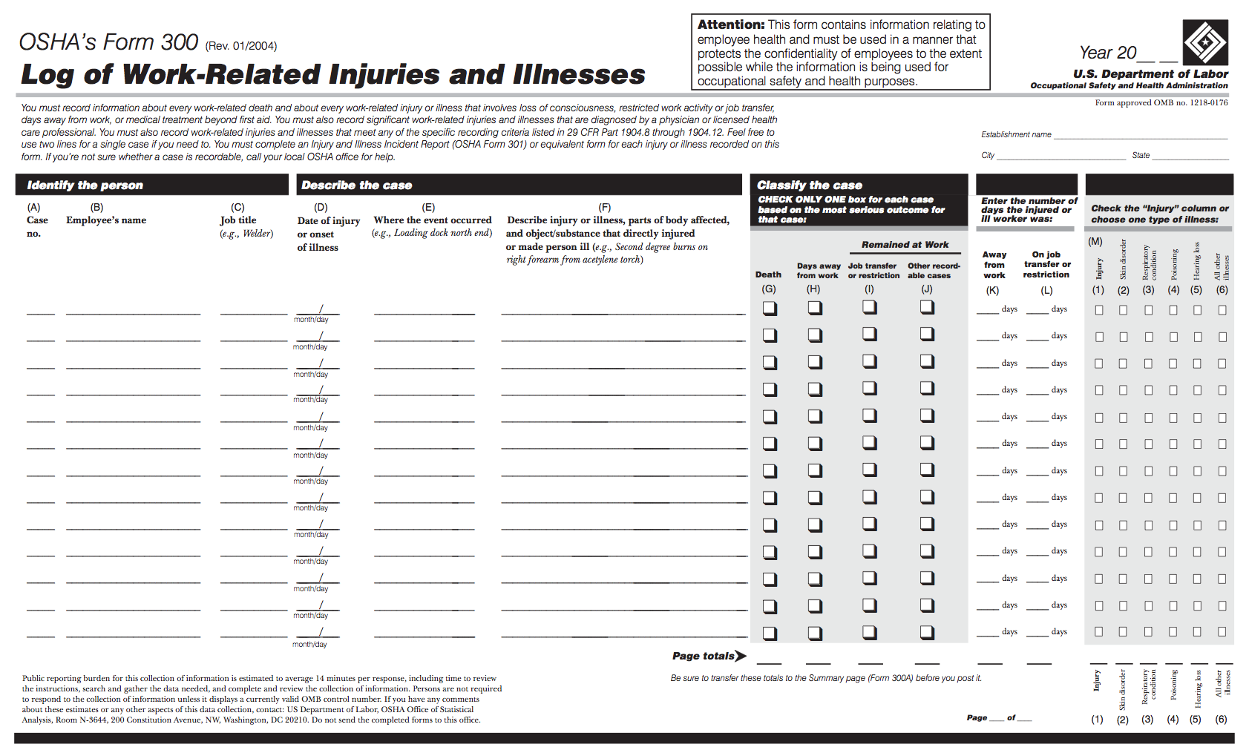
OSHA 300 Log of Injuries and Illnesses
Employer must post all work-related injuries and illnesses that result in a day or more away from work.
You have a right to request copies and/or see log.
Employer must post a summary of these logs each year from February 1 – April 30.
Notes:
Required in the 27 state plan states that cover public employees. This is a model for what should be required for all workplaces.
Image: OSHA PDF

