Slide 1
What’s Bugging You? Communicable Diseases
“This material was produced under the grant SH-20839-SHO from the Occupational Safety and Health Administration, U.S. Department of Labor. It does not necessarily reflect the views or policies of the U.S. Department of Labor, nor does mention of trade names, commercial products, or organizations imply endorsement by the U.S. Government.”

Slide 2
Objectives
After this workshop, you will be able to:
Identify health effects and agents for six common communicable disease exposures
Identify their routes of transmission
Identify the methods to prevent transmission
Strategize on the elements of an effective school or workplace policy to prevent or eliminate exposure

Slide 3
The “BUGS”!
Community-acquired methicillin-resistant staphylococcus (CA-MRSA)
Pertussis or whooping cough
Influenza or colds
Ringworm (tinea)
Fifth’s Disease
Tuberculosis

Slide 4
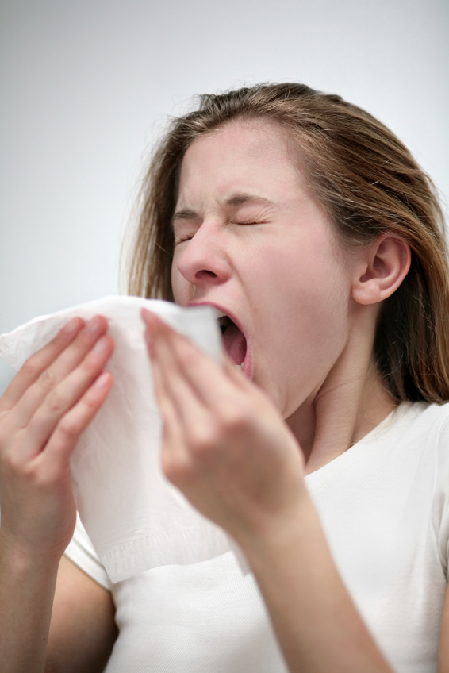
Exposure Through the Air
When someone who has an infection, sneezes or coughs, their microbes (germs) can travel through the air on tiny, nearly invisible droplets of saliva (spit) or mucous.
Another person can then breathe in those droplets or fine aerosols.
That person’s risk of becoming infected depends on how many droplets the person inhales and for how long.
Notes:
Some microbes can be transmitted through the air.
Each time you breathe you inhale and exhale billions of microbes that float in the air.
When you sneeze, microbes are expelled at about 100 mph, so it’s always a good idea to cover your mouth and to stay away from anyone who’s sneezing.
Poor school ventilation can also contribute to transmission of microbes through the air. We’ve known that since 1923 when the New York State Regents did a study of schools. In that study, schools that were well ventilated had far fewer student absences due to colds and respiratory infections than schools that had poor ventilation. The microbes can become more concentrated in poorly ventilated areas.
Image: Power point clipart

Slide 5
Exposure Through Skin & Object Contact
“Bugs” can sometimes spread through touching infectious materials or through contamination of personal items brought into the workplace.
Notes:
Some “bugs” can infect the skin. As you can see, MRSA for the most part is skin infection – transmission occurs when broken or abraded skin.
Common objects that can spread some “bugs” (not all) include: backpacks, contaminated combs, hat and other personal items - even teddy bears.
Image: Power point clipart

Slide 6
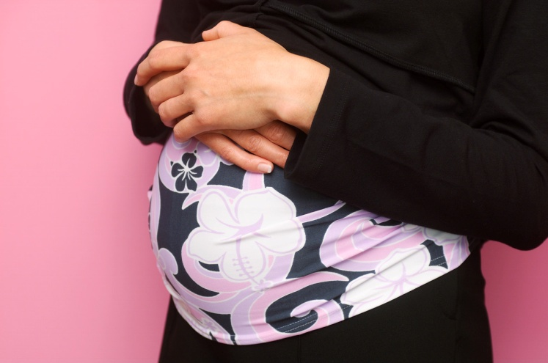
Susceptible Individuals
Those with chronic illnesses such as asthma, chronic lung disease and chronic heart disease
Cancer patients who are undergoing chemotherapy
Persons who have had an organ transplant and take drugs to suppress their immune systems
Diabetics
AND pregnant women (their fetuses or unborn children)
Notes:
Image: Power point clipart

Slide 7

Protections – For All of Us!
Vaccination
Universal Precautions
Hand-washing
Reassignment when there’s an outbreak
Notes:
Image: Power point clipart

Slide 8
Vaccinations
Most school staff need at a minimum:
A booster tetanus and diphtheria every 10 years
Chicken pox vaccination if you never had chickenpox or don’t know whether you had it or not (2 shots)
Hepatitis B vaccination (3 shots)
Influenza or flu vaccination every year – the flu virus mutates or changes constantly
Notes:
Everyone born after 1957 should consult their physicians to make sure that they had right the measles, mumps, rubella (MMR) immunization.
Folks with diabetes, cancer and other chronic conditions should also have the pneumonia vaccine as well.
Get your shots! Getting vaccinated against diseases could save your life.

Slide 9
Universal Precautions
Assume Everyone Is Infected
Use barriers between you and a person’s blood/body fluids
Wear gloves when coming into contact with blood/body fluids
Wash hands after removing gloves
When exposure can’t be prevented – wash all exposed skin
Use disinfectants to clean all spills
Place used sharps (needles/lancets) in a puncture proof container

Slide 10
Communicable Disease Policies
Training for staff
A reporting & communication system to report communicable diseases
Immunizations free of charge
Medical removal of a staff person who may be at risk
Special counseling to staff at special risk
Supplies of alcohol gel hand sanitizer & opportunities to wash hands
A written exposure control plan
Notes:
Image: Power point clipart

Slide 11
Blood-borne Pathogens Standard
Requires employers to maintain a written plan and to identify, in writing, tasks and procedures as well as job classifications where occupational exposure to blood occurs.
Plan must be accessible to employees and employers must review and update it at least annually.
Mandates universal precautions be practiced and employers must provide, at no cost, appropriate PPE such as gloves, gowns and masks.
Requires hepatitis B vaccine to be made available to all employees who have occupational exposure to blood within 10 working days of assignment, at no cost, at a reasonable time and place.
Mandates training initially upon assignment and annually.
Notes:
Among other things, the standard requires:
Requires employers to maintain a written plan and to identify, in writing, tasks and procedures as well as job classifications where occupational exposure to blood occurs.
The plan must be accessible to employees and employers must review and update it at least annually--more often if necessary to accommodate workplace changes.
Mandates universal precautions be practiced and employers must provide, at no cost, appropriate personal protective equipment such as gloves, gowns and masks.
Standard requires hepatitis B vaccine to be made available to all employees who have occupational exposure to blood within 10 working days of assignment, at no cost, at a reasonable time and place.
Mandates training initially upon assignment and annually.
This is a good model for other communicable disease exposures.

