Slide 1
Effective Health and Safety Committees – Part One
This material was produced under the grant SH-20839-SHO from the Occupational Safety and Health Administration, U.S. Department of Labor. It does not necessarily reflect the views or policies of the U.S. Department of Labor, nor does mention of trade names, commercial products, or organizations imply endorsement by the U.S. Government.

Slide 2
Objectives
By the end of this session, you will know the:
  Hazards associated with your workplace and best methods to control for them
  Key elements for well-functioning health and safety committees
  Basic legal requirements for health and safety in your workplace

Slide 3
Key Principles of Health and Safety
Employer is responsible for maintaining a safe and healthy workplace
Employees should be involved in developing policies and programs
There should be no sanctions for H&S related activities
Employer should implement best and most effective practices/policies to protect workers from hazards

Slide 4

Overview of Hazards
What’s going on in your workplace?
Images by: Diamond Rubber Products' photostream
Notes:
Activity: Have them work in groups to identify key hazards in the workplace – flipchart answers
Images - Creative Commons:
You are free:
to Share — to copy, distribute and transmit the work
to Remix — to adapt the work
Under the following conditions:
Attribution — You must attribute the work in the manner specified by the author or licensor (but not in any way that suggests that they endorse you or your use of the work).
Image by: Diamond Rubber Products' photostream

Slide 5
CHEMICAL & DUST HAZARDS
(cleaning products, pesticides, asbestos, etc.)
ERGONOMIC HAZARDS
(repetition, lifting, awkward postures, etc.)
BIOLOGICAL HAZARDS
(mold, insects/pests, communicable diseases, etc.)
WORK ORGANIZATION HAZARDS
Things that cause STRESS!
SAFETY HAZARDS
(slips, trips and falls, faulty equipment, etc.)
PHYSICAL HAZARDS
(noise, temperature extremes, radiation, etc.)
Notes:
“Work organization” is at the center of the chart and all the other hazard categories surround it. This is because for many workplace health and safety issues the way our jobs are designed can be a contributing factor to other hazards we might experience.
For example, a staff member may trip and fall in a hallway because they’re rushing to get back to their desk because of an important deadline they must meet. The slip and fall results in an injury but the job demand is the root of the problem. We have to keep asking WHY something happened until we find the true cause of the problem. In order to start thinking of solutions, we need to know ALL of the potential hazards.

Slide 6
Bureau of Labor Statistics Data, 2009
Injury and illness rate for public workers significantly higher than among private industry workers
  (5.8 vs. 3.6 cases per 100 workers)
Custodians fall into the top 5 in these categories:
  highest number of days away from work
  musculoskeletal injury incidents
Notes:
Discussion: Impact of identified hazards on health.
Nearly 863,000 injury and illness cases were reported among State and local government workers combined in 2009, resulting in a rate of 5.8 cases per 100 workers—significantly higher than the rate among private industry workers (3.6 cases per 100 workers).

Slide 7
Rank and File Survey Results
THIS PAGE WILL VARY FOR EACH LOCAL UNION
Notes:
Discussion – Reporting Problems: Have you heard from membership about these concerns? Reporting issues to union?

Slide 8
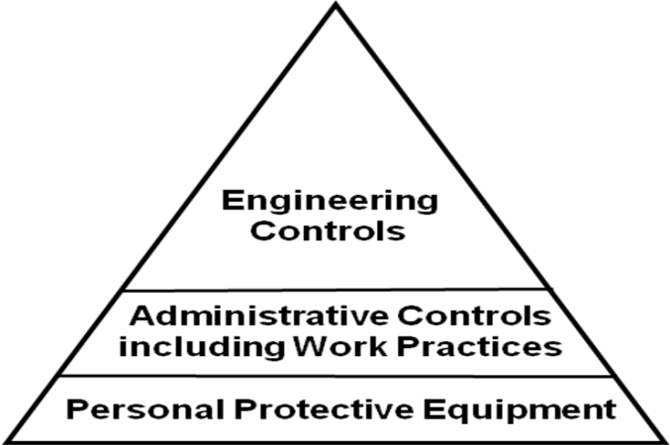
Hierarchy of Controls
Elimination/Substitution
Most Effective
Requires a physical change to the workplace
Requires worker or employer to do something
Requires worker to wear something
Least Effective
Notes:
The goal of any solution is to provide the maximum amount of protection by eliminating or minimizing the exposure or hazard.
These are referred to as the hierarchy of controls, how you prevent or control a hazard:
Elimination/Substitution: The main goal for any fix to a hazard or exposure is to eliminate it altogether or substitute a product or method of doing the work to a less hazardous alternative. (e.g. green cleaning products)

Slide 9

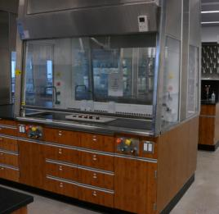

CONTROLS: Engineering
CONTROL AT THE SOURCE!
Limits the hazard but doesn’t entirely remove it.
Other Examples:
Mechanical Guards
Wet Methods for Dust
Enclosures/Isolation
Dilution Ventilation
Image: by JohnRH4's photostream
Image: by Kare_Products
Local Exhaust
Proper equipment
Image: by purpleslog’s photostream
Re-designed Tools
Notes:
The basic concept behind engineering controls is that, to the extent feasible, the work environment and the job itself should be designed to eliminate hazards or reduce exposure to hazards. While this approach is called engineering controls, it does not necessarily mean that an engineer is required to design the control.
Engineering controls are the "first line of defense" against injury/illness, because they have the potential to completely eliminate a hazard, and do not rely on human behavior to be effective. For instance, rather than require employees to wear respiratory protection which must be monitored, inspected, trained, managed, it's much more effective to install a ventilation system that does not require any of those management activities or, better yet, find an alternative substitute that is less hazardous.
Images from: Creative Commons:
You are free:
to Share — to copy, distribute and transmit the work
to Remix — to adapt the work
Under the following conditions:
Attribution — You must attribute the work in the manner specified by the author or licensor (but not in any way that suggests that they endorse you or your use of the work).
Image: by Kare_Products
Image: by JohnRH4's photostream
Image: by purpleslog's photostream

Slide 10
CONTROLS: Administrative
Aimed at Reducing Employee Exposure to Hazards but Not Removing Them!
Changes in work procedures such as:
  Written safety policies/rules
  Schedule changes, such as:
    Lengthened or Additional Rest Breaks
    Job Rotation
    Adjusting the Work Pace
Training with the goal of reducing the duration, frequency and severity of exposure to hazards
Notes:
Administrative controls (or work practice controls) are changes in work procedures such as written safety policies, rules, supervision, schedules, and training with the goal of reducing the duration, frequency, and severity of exposure to hazardous chemicals or situations.
As with work practice controls, administrative controls normally are used in conjunction with other controls that more directly prevent or control exposure to hazard.
Image: Powerpoint Clipart

Slide 11



CONTROLS: PPE
Personal Protective Equipment
Control of LAST RESORT!
Special Clothing
Eye Protection
Hearing Protection
Respiratory Protection
CONTROL IS AT THE WORKER!
Notes:
Personal protective equipment (PPE): A method that prevents a worker from being exposed to the hazard by something the worker wears (e.g., gloves, hardhat, of safety glasses). PPE is considered the method of last resort because PPE does nothing to reduce or eliminate the hazard. If the PPE fails, immediate exposure is the result. Examples of PPE include:
a. Special clothing: like gloves, aprons, boots, coveralls, etc.
b. Eye protection: like safety glasses or face shields
c. Hearing protection
Respiratory protection: for emergency or short-term protection.
Images: all from OSHA website

Slide 12
Hierarchy of Controls
Elimination/Substitution
Most Effective
Requires a physical change to the workplace
Requires worker or employer to do something
Requires worker to wear something
Least Effective
Notes:
Activity: Use as a review – have them come up with examples of controls for a hazard they identified earlier.

Slide 13
Major Elements of an Effective Safety and Health Program
Management Commitment and Employee Involvement
Worksite Analysis
Hazard Prevention and Control
Safety and Health Training
Notes:
These are what OSHA believes are key elements of effective H&S programs.
Guidelines call for systematic identification, evaluation, and prevention or control of general workplace hazards, specific job hazards, and potential hazards which may arise from foreseeable conditions.
The major elements of an effective safety and health program include:
Management Commitment and Employee Involvement
Worksite Analysis
Hazard Prevention and Control
Safety and Health Training

Slide 14

Management Commitment and Employee Involvement Go Together!
  Top management involvement should be visible and have authority and resources to implement program
  Employee involvement in the program and in decisions that affect their safety and health should be encouraged
Notes:
Top management involvement in implementing the program so that all employees understand that it is a serious commitment.
This commitment provides the motivating force and resources for organizing and controlling activities within an organization and ability to get things done.
Requires that responsible parties have the necessary authority and equipment, so that assigned responsibilities can be met.
Encourage employee involvement in the program and in decisions that affect their safety and health (e.g., inspection or hazard analysis teams; developing or revising safe work rules; training new hires or co-workers; assisting in accident investigations) .
Employee involvement provides the means through which workers develop and express their own commitment to safety and health protection. OWNERSHIP!
Make full use of everyone’s insight and energy.
Requires an atmosphere that employees feel encouraged to participate and report health and safety concerns.
Image: Microsoft clipart

Slide 15
Management Commitment & Employee Involvement
  A clearly stated worksite policy should be established and communicated with specific goals and objectives.
  All aspects of the program should have assigned responsibility and accountability.
  Program operations need to be reviewed at least annually, to evaluate and make revisions as needed.
Notes:
A clearly stated worksite policy on safe and healthful work and working conditions so that all personnel with responsibility at the site and personnel at other locations with responsibility for the site understand the priority of safety and health protection in relation to other organizational values.
A clear goal for the safety and health program and objectives for meeting that goal so that all members of the organization understand the results desired and the measures planned for achieving them.
Assignment of responsibilities for all aspects of the program, so that managers, supervisors, and employees in all parts of the organization know what performance is expected of them.
Holding managers, supervisors, and employees accountable for meeting their responsibilities, so that essential tasks will be performed.
Annual reviews of program operations to evaluate their success in meeting the goal and objectives, so that deficiencies can be identified and the program and/or the objectives can be revised when the goal and objectives are not met.

Slide 16
Worksite Analysis
Identify all existing hazards and conditions that might create new hazards
An efficient program includes actively analyzing the work and the worksite to anticipate and prevent harmful occurrences
Notes:
Part of an efficient program is to actively analyze the work and the worksite to anticipate and prevent harmful occurrences.
Identification of all hazards by conducting baseline worksite surveys for safety and health and periodic comprehensive update surveys.
Also included would be an analysis of planned and new facilities, processes, materials, and equipment; and another of routine job hazards.
Regular site safety and health inspections, so that new or previously missed hazards and failures in hazard controls are identified.

Slide 17
Hazard Prevention and Control
Triggered by a determination that a hazard or potential hazard exists.
  Where feasible, prevent hazards by effective design of job or job site.
  Where elimination is not feasible, control hazards to prevent unsafe and unhealthful exposure.
  Elimination or control must be accomplished in a timely manner.
Notes:
Once a hazard or potential hazard has been identified, the next step is to determine how to control or prevent that hazard.
Where feasible, prevent hazards by effective design of job or job site.
Where elimination is not feasible, control hazards to prevent unsafe and unhealthful exposure.
Elimination or control must be accomplished in a timely manner.

Slide 18
Safety and Health Training
Address the safety and health responsibilities of all personnel.
Ensure that all employees understand the hazards to which they may be exposed and how to prevent harm to themselves and others.
Ensure that managers understand their safety and health responsibilities.
Notes:
Training is a critical part of a health and safety program. It should
Ensure that all employees understand the hazards to which they may be exposed and how to prevent harm to themselves and others from exposure to these hazards
Ensure that managers understand their safety and health responsibilities
Addresses the safety and health responsibilities of all personnel.
Training is most effective when incorporated into other training
about performance requirements and job practices.
Complexity depends on size and complexity of worksite and nature
of hazards.

Slide 19

What standards or regulations exist for the hazards you identified?
Notes:
Activity: Review list of hazards they identified and ask whether or not a standard or regulation exists to address the hazard.
Image: OSHA!

Slide 20
Recordkeeping
Requires most employers with more than 10 workers to keep a log of injuries and illnesses.
Workers have the right to review the current log, as well as the logs stored for the past 5 years.
Workers also have the right to view the annually posted summary of the injuries and illnesses (OSHA 300A).
Notes:
OSHA has both standards and regulations. An example of an important regulation: Recordkeeping
A Reportable Injury – Requires More Than First Aid or Results in Lost Work Time, Restricted Duties or Job Transfer
Recordkeeping: Every employer covered by OSHA who has more than 10 employees, except for certain “low-hazard” industries such as education, retail, finance, insurance, real estate, and some service industries, must maintain OSHA-specified records of job-related injuries and illnesses.
The OSHA Form 300 is an injury/illness log, with a separate line entry for each recordable injury or illness (essentially those work-related deaths, injuries and illnesses other than minor injuries that require only first aid treatment and that do not involve medical treatment, loss of consciousness, restriction of work or motion, or transfer to another job).
A summary section of the OSHA Form 300, which includes the total of the previous year's injury and illness experience must be posted each year from February through April.
It’s a great tool to use if workers suspect a pattern of injury or illness when they are documenting their grievance or complaint.
Image: Microsoft clipart

Slide 21
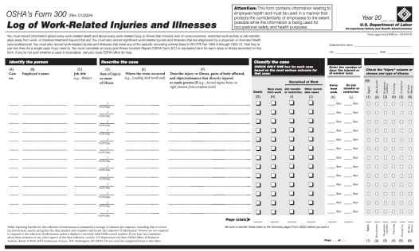
OSHA 300 Log
Used to document and classify work-related injuries and illnesses and severity of each case.
Annual summary shows totals of injuries and illnesses for the year in each category.
Summary must be posted in a visible location February 1 through April 30 each year.
Notes:
OSHA 300A Summary Log of Injuries and Illnesses. (Hand out sample logs and review).
The Log of Work-Related Injuries and Illnesses is used to classify work-related injuries and illnesses and to note the extent and severity of each case.
The summary shows the work-related injury and illness totals for the year in each category.
At the end of the year, the number of incidents are counted for each category and then these totals are transferred from the Log to the Summary.
The Summary must be posted in a visible location so employees are aware of injuries and illnesses occurring in their workplace.
The Summary must be provided to employees and their representatives when requested.
Summary page must be posted from February 1 to April 30 of the year following the year covered by the form.
Image: OSHA

Slide 22
Access to Exposure and Medical Records: 1910.1020
Exposure Records
  Environmental and biological monitoring
    Personal
    Workplace
  Material Safety Data Sheets
Medical Records
  Questionnaires
  Results of examinations
  Laboratory tests
  Medical opinions, diagnoses, etc.
  First aid records
  Description of treatments
Notes:
This is an important STANDARD (versus regulation!)

Slide 23
Hazard Communication Standard 1910.1200
To ensure that employers and employees know about work hazards and how to protect themselves so that the incidence of illnesses and injuries due to hazardous chemicals is reduced.
Hazard Communication
Program
Container
Labeling
Material Safety
Data Sheet
Program
MSDS
Label
Notes:
29 CFR 1910.1200: The Hazard Communication (HazCom) standard establishes uniform requirements to make sure that the hazards of all chemicals imported into, produced, or used in U.S. workplaces are evaluated, and that this hazard information is transmitted to affected employers and exposed employees.
Standard Covers Workers Who “May Be Exposed to Hazardous Chemicals Under Normal Working Conditions or Foreseeable Emergencies”
The Hazard Communication Standard is broken down into FIVE SECTIONS:
1. Hazard Determination - The HazCom standard is different from other OSHA health rules because it covers all hazardous chemicals. The rule also incorporates a “downstream flow of information,” which means that producers of chemicals have the primary responsibility for generating and disseminating information, whereas users of chemicals must obtain the information and transmit it to their employees.
2. Written Program - A written plan listing all chemicals present, the location of written materials for workers, and the name of a responsible person must be kept by the employer. Workers & their Union rep have a right to see a copy of this written program.
3. Employee Training - Annual and new hire training must be given on Material Safety Data Sheets, Labeling, Personal Protective Equipment, Health Hazards and Emergency Procedures.
4. Labeling for all chemicals
5. Material Safety Data Sheets for all chemicals

Slide 24
Occupational Exposure to Hazardous Chemicals in the Laboratory 1910.1450
Requires a Chemical Hygiene Plan
  Capable of protecting employees from health hazards associated with hazardous chemicals in that laboratory
  Capable of keeping exposures below the limits
Requires:
  Standard Operating Procedure
  Employee information and training
  Designation of Chemical Hygiene Officer
Plan shall be readily available to employees and employee representatives
Notes:
Requires a Standard operating procedures relevant to safety and health considerations to be followed when laboratory work involves the use of hazardous chemicals
Criteria that the employer will use to determine and implement control measures to reduce employee exposure to hazardous chemicals including engineering controls, the use of personal protective equipment and hygiene practices; particular attention shall be given to the selection of control measures for chemicals that are known to be extremely hazardous
Designation of personnel responsible for implementation of the Chemical Hygiene Plan including the assignment of a Chemical Hygiene Officer, and, if appropriate, establishment of a Chemical Hygiene Committee
The employer shall provide employees with information and training to ensure that they are apprised of the hazards of chemicals present in their work area. Such information shall be provided at the time of an employee's initial assignment to a work area where hazardous chemicals are present and prior to assignments involving new exposure situations. The frequency of refresher information and training shall be determined by the employer.

Slide 25
Blood-borne Pathogen Standard 1910.1030
Purpose: To Prevent Needle sticks and Other Exposures at Work to Blood and Body Fluids that Contain Blood
Employer Responsibilities:
  Identify Workers at Risk
  Provide Safe Needles
  Ensure Universal Precautions are Practiced
  Provide Personal Protective Equipment
  Provide Prompt Evaluation and Treatment
  Provide Hepatitis B Vaccinations
  Recordkeeping
  Train Workers Annually
Notes:
The employer must:
Identify worker exposures to blood or OPIM
Review all processes and procedures with exposure potential
Re-evaluate when new processes or procedures are used

Slide 26
Asbestos Hazard Emergency Response Act – AHERA
Applies to all schools!
Requires Employers to:
  Establish Asbestos Management Plan for every school site
  Conduct regular inspections and assess conditions of ACB
  Provide training for custodial/maintenance staff in general awareness and more extensive training for workers doing small jobs and/or emergency cleanups
  Covers state and local workers who perform asbestos work who aren’t covered by OSHA
Notes:
AHERA REQUIRES: Regular Inspection of school for ACBM, Assessment of Condition of ACBM, Sampling to confirm asbestos (bulk sampling), Written asbestos management plan at every school site (anyone can see it), Plans for re-inspections, Preventative Measures, Operations and Maintenance Plan (in the larger Asbestos Management Plan)
TSCA: - EPA's Worker Protection Rule (40 CFR Part 763, Subpart G) extends the OSHA standards to state and local employees who perform asbestos work and who are not covered by the OSHA Asbestos Standards, or by a state OSHA plan.
Custodial/Maintenance: A minimum of 2 hour awareness training
14 hour training for workers doing small jobs and emergency clean-ups:
skills in handling asbestos materials
proper respirator use and maintenance
hands-on training in the use of respirators, protective equipment and work practices
interpreting the management plan

Slide 27
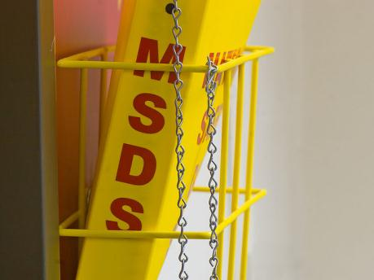
Finding Information
What reports, logs and documents should be collected and reviewed by the committee?
How often should they be reviewed?
Image: nebarnix's photostream
How do you think you should ask for these programs and records?
Notes:
Image: nebarnix's photostream

Slide 28
Committee Resources
What training do you feel you need to be a better committee member?
  Legal Assistance, contacts?
  Union resources?
  Other allies/expertise? Who?
  TIME, TIME, TIME……..
Notes:
Discussion: What resources can help us achieve our goals? People/organizations? Research?
Image: Microsoft clipart

Slide 29

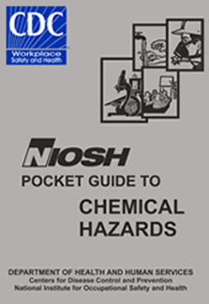
Valuable resource for information on all types of hazard exposures
Can conduct Health Hazard Evaluations (HHE) if requested by union or members
Notes:
The National Institute for Occupational Safety and Health (NIOSH), the research arm of OSHA is another valuable resource for information on hazard exposures. They can also come into workplaces and do Health Hazard Evaluation (HHE) if requested by the union or members in response to a hazard exposure.
Images: NIOSH

Slide 30
Next Steps: Your Homework Assignment!
Employer compliance!
  Using checklists to research what’s going on in the workplace.
    Hazard Communication
    Access to Medical and Exposure Records
    Bloodborne Pathogens
    Asbestos
    Occupational Exposure to Hazardous Chemicals in the Laboratory
Notes:
Handout the following checklists: Review checklists and assign committee members a checklist to research compliance at their workplace. This is their homework assignment.
Hazard Communication
Access to Medical and Exposure Records
Bloodborne Pathogens
Asbestos
Occupational Exposure to Hazardous Chemicals in the Laboratory

