Slide 1
Effective Health and Safety Committees – Part Three
This material was produced under the grant SH-20839-SHO from the Occupational Safety and Health Administration, U.S. Department of Labor. It does not necessarily reflect the views or policies of the U.S. Department of Labor, nor does mention of trade names, commercial products, or organizations imply endorsement by the U.S. Government.

Slide 2
Objectives
After this session, committee members will know:
  The basics of conducting a workplace inspection
  How to “map out” health and safety concerns
  Allies in this process
  Barriers that may come up and strategies on how to overcome them

Slide 3
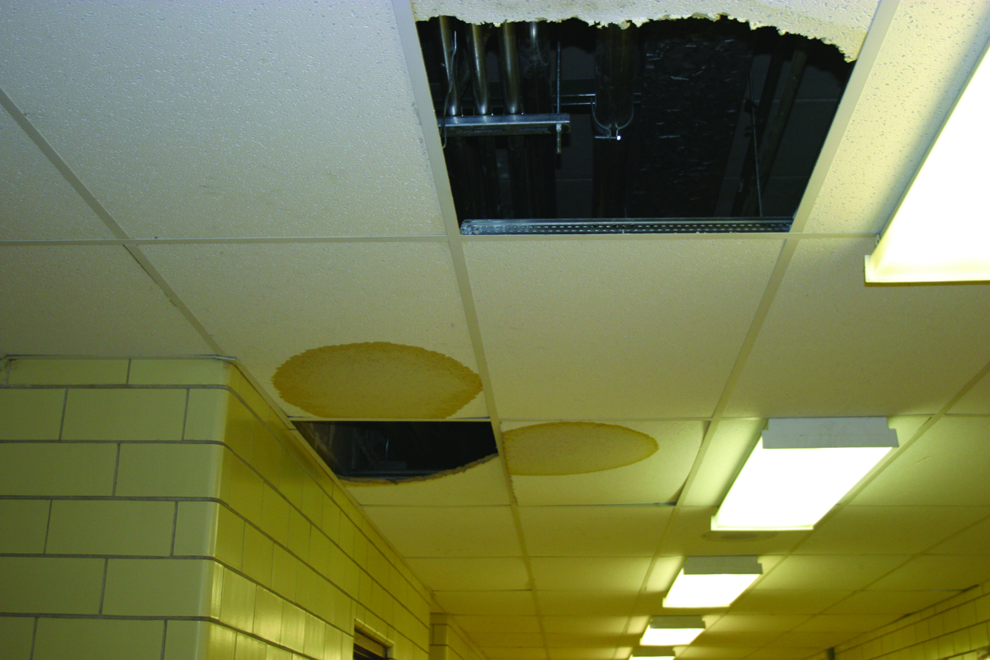
Action Plan: Inspections
When and how?
Notes:
Why are workplace inspections important?
Workplace inspections help prevent injuries and illnesses. Through critical examination of the workplace, inspections identify and record hazards for corrective action. Health and safety committees can help plan, conduct, report and monitor inspections. Regular workplace inspections are an important part of the overall occupational health and safety program.

Slide 4
Inspections are Important:
They allow you to:
  Listen to the concerns of workers
  Gain further understanding of jobs and tasks
  Identify existing and potential hazards
  Determine underlying causes of hazards
  Monitor hazard controls
  Recommend corrective action

Slide 5
How do I identify workplace hazards?
Conducting an Inspection
Becoming a Detective!
  Every inspection must examine who, what, where, when and how!
  Your goal is to discover the following:
    What can go wrong?
    What are the consequences?
    How could it arise?
    What are other contributing factors?
    How likely is it that the hazard will occur?

Slide 6
Where to Start!
Look at all workplace elements - the environment, the equipment and the process.
  The environment includes such hazards as noise, vibration, lighting, temperature, and ventilation.
  Equipment includes materials, tools and apparatus for producing a product or a service.
  The process involves how the worker interacts with the other elements in a series of tasks or operations.

Slide 7
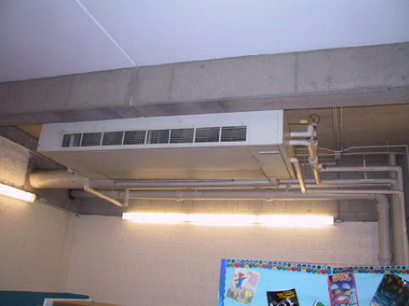
Walk-Around Inspection
Conduct a walk-around inside and outside the building to identify possible hazards
  Start with problem areas first, if there are any identified.
  Get help from co-workers

Slide 8
CHEMICAL & DUST HAZARDS
(cleaning products, pesticides, asbestos, etc.)
ERGONOMIC HAZARDS
(repetition, lifting, awkward postures, etc.)
BIOLOGICAL HAZARDS
(mold, insects/pests, communicable diseases, etc.)
WORK ORGANIZATION HAZARDS
Things that cause STRESS!
SAFETY HAZARDS
(slips, trips and falls, faulty equipment, etc.)
PHYSICAL HAZARDS
(noise, temperature extremes, radiation, etc.)
Notes:
Remember to think about all the hazard categories!

Slide 9
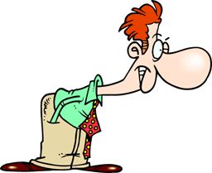
The Best Tools of the Trade
Being the eyes and nose of your workplace
Using your checklists!
Maintaining organized paperwork and documentation

Slide 10
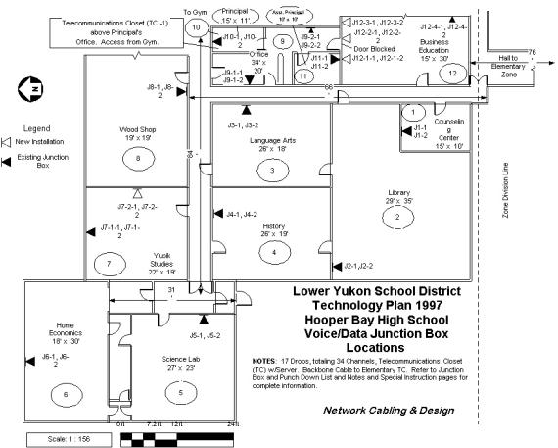
Mapping the Building
Picture of the workplace and its hazards based on staff experiences and knowledge
Tool to communicate to members and administration
Once “seen” the issues are more likely to be addressed and not swept under the rug.
Notes:
Talk about the benefits of mapping out the workplace.
Way to organize all the information you’ve gathered.
Becomes a visual representation of the data that makes the problem “pop”.
Multi-level mapping
survey results
pollutant sources
Can create own legend.
Might be able to identify patterns or particularly problematic areas visually.

Slide 11
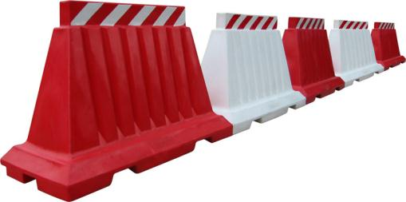
Allies and Barriers
A sobering and honest review
  Small barriers
  Large barriers
Steps to overcome those barriers
  Allies
  Research
  Organizations
Notes:
ACTIVITY:
Who are the power players at your workplace?
Who do you go to for solutions?
Who are your allies?
What are the greatest barriers to your health and safety committee being successful and how might these barriers be overcome?

Slide 12
Homework Review!
What is the most important health and safety issue within your facility that the committee should address first?
What do you think you need to be effective and how will you go about accomplishing that?
How does your solution benefit:
  The union?
  The employer?
  The community?
Notes:
Activity: Developing an action plan! What they hope to accomplish and how they’re going to do it!

