Slide 1
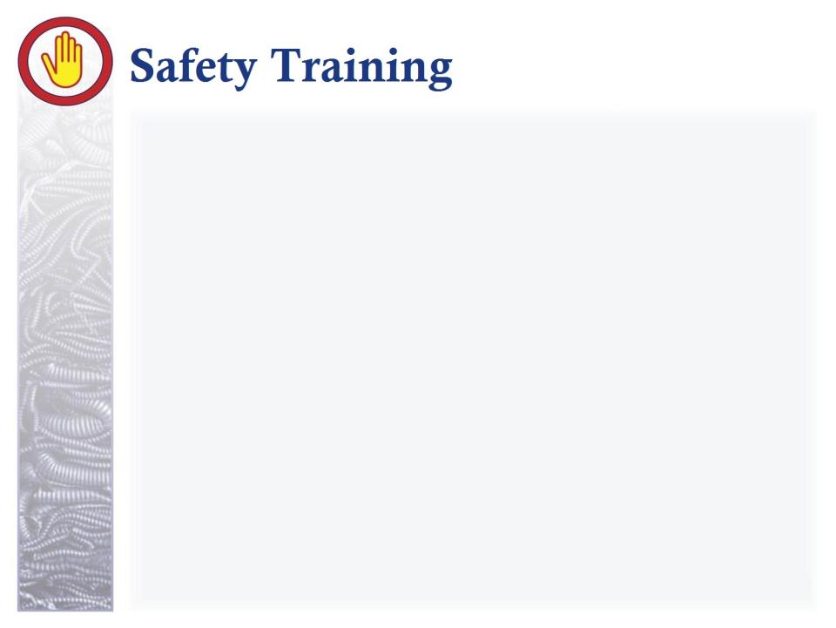
BLOODBORNE PATHOGENS “Statistics and Pathophysiology” Part 2 of 4 Standard 29 CFR 1910.1030
Produced by
Idaho State University
Office of Workforce Training
workforcetraining.isu.edu

Slide 2

“This material was produced under grant SH20849SHO from the Occupational Safety and Health Administration, U.S. Department of Labor. It does not necessarily reflect the views or policies of the U.S. Department of Labor, nor does mention of trade names, commercial products, or organizations imply endorsement by the U.S. Government.”

Slide 3
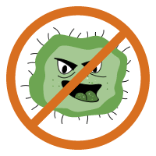
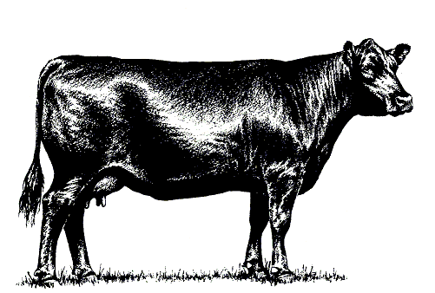
Bloodborne + Pathogen = Live/thrive in blood
Infectious Agent
Reservoir
Port of Exit
Means of Transmission
Port of Entry
Vulnerable Host
Notes:
Bloodborne refers to the second link of the chain of infection, the reservoir. Pathogen is defined as a disease or infection causing microbe. So, a bloodborne pathogen is an infection causing microbes that lives and thrives in blood.

Slide 4
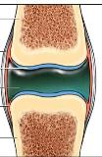

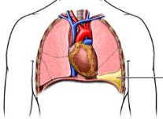
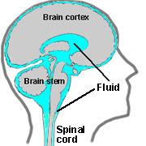
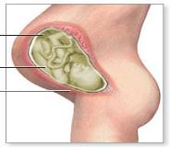
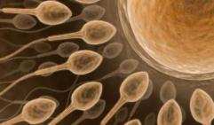
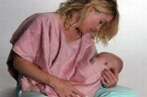
O.P.I.M
Notes:
In addition to blood, there are other body fluids that might contain microbes that can transmit and thrive in the blood stream. If these fluids in the host come in contact with the blood of another, the infection will pass on. These are referred to as OPIM or other potentially infectious materials. I want to spend a second or two on each, in hopes these will stick more than those fluids that are not a risk. We’ll look at those briefly in a minute.

Slide 5
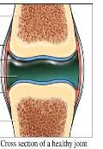
O.P.I.M
Notes:
There is cerebrospinal fluid, a clear fluid found in the area surrounding the brain and spinal cord. A traumatic injury to the brain might lead to exposure through a crushed skull or draining out the ears.

Slide 6
O.P.I.M
Notes:
Or synovial fluid. The fluid that surrounds the knee joint. A broken leg that breaks the skin might lead to exposure.

Slide 7
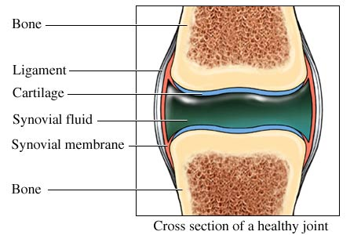
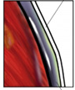
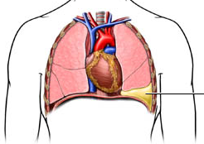
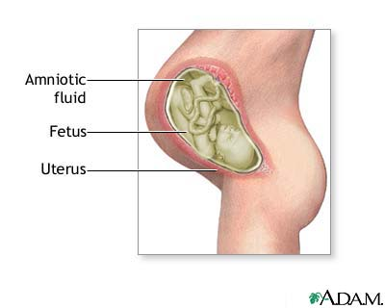


O.P.I.M
Notes:
Pericardial fluid, which is fluid surrounding the heart or pleural fluid, which is fluid surrounding the lungs. Not a huge risk out in the community, but a crushed chest might expose someone to these.

Slide 8
O.P.I.M
Notes:
Sperm or vaginal secretions is the source of many BBP infections. Obviously sex is the culprit here. And remember this does not just involve sexual intercourse. Oral sex or foreplay can lead to exposure. Healthcare workers might be exposed through cleaning these areas.

Slide 9
O.P.I.M
Notes:
Breast milk is another. A lot of people are surprised at this one. That baby can get an infection from it’s mother simply by breastfeeding.

Slide 10
O.P.I.M
Notes:
And, finally, amniotic fluid – that fluid that surrounds the fetus in the womb. Now, there is a barrier that prevents a lot of things from going into the amniotic sac, but some microbes are able to get through. For example, meningitis is usually an airborne pathogen. A person coughs, another inhales and it’s passed along. However, once the mother is infected, she can pass it to her fetus through her blood stream. Now, there is some controversy on whether HIV can pass through to the amniotic fluid of an infected mother or if it’s passed on through blood exposure during delivery.

Slide 11
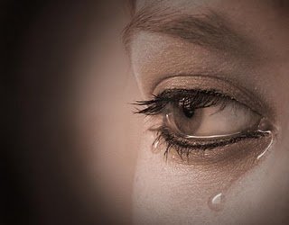
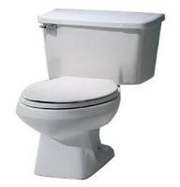
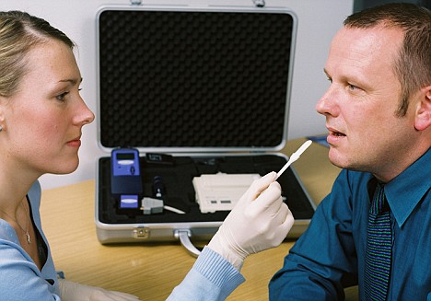

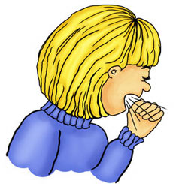
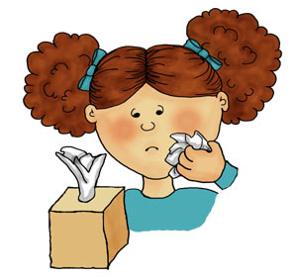

1
2
3
4
NOT O.P.I.M
5
6
7
Notes:
A few minutes ago I mentioned there are body fluids that are not considered other potentially infectious materials, unless visibly contaminated with blood. These include tears, feces or urine, saliva, nasal secretions, sputum, sweat and, finally, vomit. Now, when I was researching the most current information on HIV, I saw a case where an HIV infected person chewed food, then gave it to an infant. The infant contracted the HIV. But it’s likely that both the infected person and the infant had open access to the blood stream within the mouth or throat…like bleeding gums or a canker sore. It is extremely rare that both would have access to the blood stream at the same time, but there is a risk. So remember, even these are a risk if they contain blood.

Slide 12
Quiz Time!
Which would put you at GREATEST risk of contracting a bloodborne pathogen in the work setting?
Will had a little too much to drink last night and vomits on the break room table right in front of you
Rebecca forgets to cover her cough…and you’re standing across from her
John has a heart attack and requires mouth to mouth resuscitation until the ambulance arrives
Sally’s water broke and you are assigned to stay with her until the ambulance arrives
You are holding something in place for Mike when your arm comes in contact with his forehead, which is covered in sweat
Notes:
Let’s say you are at work and one of the following situations occurred. Which would put you at GREATEST risk of contracting a bloodborne pathogen? Will had a little too much to drink last night and vomits on the break room table right in front of you. Rebecca forgets to cover her cough…and you’re standing across from her. John has a heart attack and requires mouth to mouth resuscitation until the ambulance arrives. Sally’s water broke and you are assigned to stay with her until the ambulance arrives. You are holding something in place for Mike when your arm comes in contact with Mike’s forehead, covered in sweat. Let’s see if your right.

Slide 13
Quiz Time!
Which would put you at GREATEST risk of contracting a bloodborne pathogen in the work setting?
Will had a little too much to drink last night and vomits on the break room table right in front of you
Rebecca forgets to cover her cough…and you’re across from her
John has a heart attack and requires mouth to mouth resuscitation until the ambulance arrives
Sally’s water broke and you are assigned to stay with her until the ambulance arrives
You are holding something in place for Mike when your arm comes in contact with his forehead, which is covered in sweat
Notes:
While Will might annoy everyone, especially housekeeping, he is not a great risk unless he is an alcoholic and the vomit is tarry in character. That would indicate a bleeding ulcer, so there would then be risk. Rebecca is equally annoying and you are at risk of contracting infections other than a bloodborne one – especially because you are being exposed to both saliva and sputum, but the risk of a bloodborne infection is minimal. John would only be a risk if…say he had his wisdom teeth extracted and you had gum disease. Sweat is no risk, so Mike is safe, although a bit gross. So only Sally puts you at great risk. Learning these body fluids can be a matter of life and death for you, so look back a couple times to make the information stick.

Slide 14

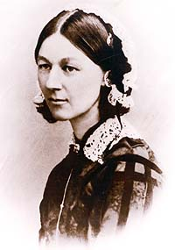
Don’t always need a live host…
Notes:
Now is a good time to make a clarification. For some reason, people think that when a person dies, any microbes in their body fluids die too. That is simply not true. A person’s blood is still infectious after death and that can be a significant time. I read a story once about the infection epidemics of the 17 and 1800s. Black plague, anthrax, tuberculosis and the like. People who dies of anthrax were buried in this spot. Decades later, a crop was planted on the same spot and people contracted anthrax from it. At the time the crops were planted we had pretty much erradicated anthrax in the US. So the investigators had a very hard time figuring out the source. Remember many microbes can survive outside a living host; waiting for the opportunity to enter a living host. Embalming and caskets for burial have reduced this type of thing.

Slide 15

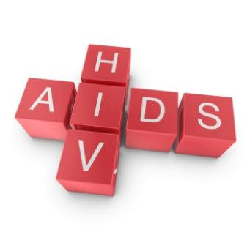

Notes:
So you’re aware, bloodborne pathogens include many microbes. There is the microbe that cause Syphilis – a sexually transmitted disease. Epstein-Barr syndrome is a virus that attacks the nervous system, paralyzing the person either temporarily or permanently. Rabies – a virus passed on from the saliva of a rabid animal that leads to psychosis and extreme muscle contractions that never stop. There are many others besides these, but because we don’t have an unlimited amount of time, for our purposes we will discuss only two more common and devastating BBPs, HIV and Hepatitis. We’ll cover information about those microbes we won’t cover for those on the slide, but the strategies used to prevent HIV and hepatitis infections apply to any bloodborne pathogen.

Slide 16

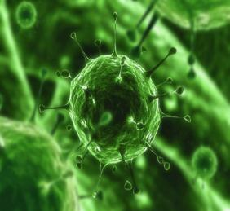
Pathophysiology
Notes:
In this section of the presentation, we will move into pathophysiology and statistics surrounding the two bloodborne pathogens. The goal is for you to understand why we need to be on our toes and do all we can to prevent spread of these microbes, so listen closely.

Slide 17
What the heck is ‘pathophysiology’?
General information
Causes and risk factors
Normal structure
Normal function
Disease effects on normal structure/function
Signs/symptoms
Diagnosis & treatment
Notes:
So, what does pathophysiology mean? Pathophysiology includes 7 categories of information about the disease. By learning these categories of information, we understand a lot more about the risk to us and those around us.

Slide 18
What the heck is ‘pathophysiology’?
General information
Causes and risk factors
Normal structure
Normal function
Disease effects on normal structure/function
Signs/symptoms
Diagnosis & treatment
Notes:
First is important general information about the disease that does not fit into one of the other categories.

Slide 19
What the heck is ‘pathophysiology’?
General information
Causes and risk factors
Normal structure
Normal function
Disease effects on normal structure/function
Signs/symptoms
Diagnosis & treatment
Notes:
Risk factor and/or causes of the disease

Slide 20
What the heck is ‘pathophysiology’?
General information
Causes and risk factors
Normal structure
Normal function
Disease effects on normal structure/function
Signs/symptoms
Diagnosis & treatment
Notes:
The normal structure of the diseased organ or body system.

Slide 21
What the heck is ‘pathophysiology’?
General information
Causes and risk factors
Normal structure
Normal function
Disease effects on normal structure/function
Signs/symptoms
Diagnosis & treatment
Notes:
The normal function of the diseased organ or body system.

Slide 22
What the heck is ‘pathophysiology’?
General information
Causes and risk factors
Normal structure
Normal function
Disease effects on normal structure/function
Signs/symptoms
Diagnosis & treatment
Notes:
How the disease affects the normal structure and function of the organ or body system

Slide 23
What the heck is ‘pathophysiology’?
General information
Causes and risk factors
Normal structure
Normal function
Disease effects on normal structure/function
Signs/symptoms
Diagnosis & treatment
Notes:
Signs and symptoms of the disease

Slide 24
What the heck is ‘pathophysiology’?
General information
Causes and risk factors
Normal structure
Normal function
Disease effects on normal structure/function
Signs/symptoms
Diagnosis & treatment
Notes:
And finally, diagnosis & treatment of the disease.

Slide 25
What the heck is ‘pathophysiology’?
General information
Causes and risk factors
Normal structure
Normal function
Disease effects on normal structure/function
Signs/symptoms
Diagnosis & treatment
Notes:
Now, normal function, how the disease effects normal function and the signs and symptoms are closely related. I will present those three together.

Slide 26
Pathophysiology of hepatitis
Notes:
First, hepatitis. Again, remember that I am trying to give you motivation to really focus when we are talking about prevention and the OSHA bloodborne pathogen standard. Science can be complex, but if you start out small and build on that knowledge, it’s not so difficult. So, let’s get started with general information on hepatitis.

Slide 27
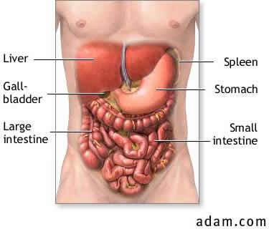
Inflammation
Liver
Hepatitis
General Information
Notes:
Hepatitis is defined as inflammation of the liver. While it can be caused by other things, like extreme alcoholism, the hepatitis viruses are the main sources. Notice I said viruses, not virus.

Slide 28
5 TYPES
A
B
C
D
E
General Information
Notes:
That’s because there are 5 different types of hepatitis virus. Many are aware of hepatitis A, B and C, but are surprised to hear there are also hepatitis D and E

Slide 29
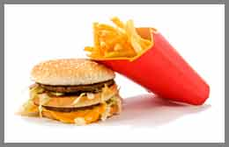
5 TYPES
A
B
C
D
E
General Information
Notes:
Hepatitis A & E are passed by the fecal-oral route rather than body fluid to body fluid. Say, a person working at your local restaurant or school lunch room. They cook a meal, but forget to wash their hands after toileting. The hepatitis A virus is passed from the contaminated hand to the food. When the customer eats the food, the virus enters the new host…sound familiar? E-coli is passed the same way. Hepatitis E is rare in the US.

Slide 30
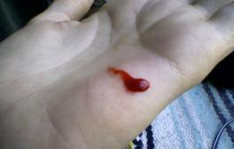
5 TYPES
A
B
C
D
E
General Information
Notes:
On the other hand, hepatitis B, C and D are passed by blood and body fluids.

Slide 31
5 TYPES
A
B
C
D
E
General Information
Notes:
Hepatitis D needs the presence of hepatitis B to cause disease and is also rare in the US.

Slide 32
5 TYPES
A
B
C
D
E
General Information
Notes:
Therefore, our focus will be on the types of hepatitis that are passed via blood or body fluids AND common in the US: Hepatitis B and C.
While not true with all forms of hepatitis, hepatitis B and C have a lot in common. First we’ll look at similarities; then differences of these types of hepatitis.

Slide 33
Hep B
Hep C
Same: Exposure to blood and body fluids – needle stick, cut, sexual contact, PERINATAL
Differences:
Incubation 6-24 wks
Multiple sex partners/ MSM
Infectious longer than other types
Same: Exposure to blood and body fluids – needle stick, cut, sexual contact, PERINATAL
Differences:
Incubation 5-12 wks
IV drug use
Up to 85% getchronic hepatitis
Notes:
Hepatitis B and C are the same in the ways one can be exposed – blood and body fluids, such as a needle stick, a cut, sexual contact or exposure during birth – which is called perinatal.

Slide 34

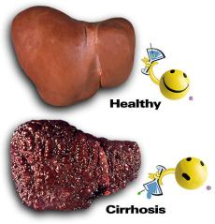
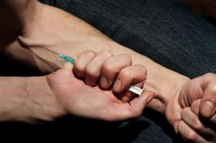
Hep B
Hep C
Same: Exposure to blood and body fluids – needle stick, cut, sexual contact, PERINATAL
Differences:
Incubation 6-24 wks
Multiple sex partners/ MSM
Infectious longer than other types
Same: Exposure to blood and body fluids – needle stick, cut, sexual contact, PERINATAL
Differences:
Incubation 5-12 wks
IV drug use
Up to 85% get chronic hepatitis
Notes:
Now differences. First, incubations period. The time from exposure to first symptoms...when most seek healthcare. Hepatitis B has an incubation period of 6 to 24 weeks, where hepatitis C has an incubation period of 5-12 weeks. Remember, the person is infectious in the incubation period, but showing no signs or symptoms. Hepatitis B is more likely to involve men who have sex with men or high risk sexual behavior such as multiple sex partners, where hepatitis C is more commonly associated with the high risk behavior of IV drug use. I did find some data on the Centers for Disease Control website saying there is no higher incidence of hepatitis among people in a monogamous homosexual relationship than those in a monogomous heterosexual relationship. I was glad to see this. It contradicts the bigotted belief that AIDS is Gods way of getting rid of people who are homosexual. More likely it is lack of protection amongst this population at a time the disease was not understood that has led to more people who are homosexual contracting the disease. Now, hepatitis B is infectious longer than other types of hepatitis. I think it’s due to that incubation period being twice as long as with hepatitis C. This is bad, but with hepatitis C, the person is almost guaranteed to develop chronic hepatitis. There is an 85% chance, which can lead to cirrhosis. Cirrhosis is not curable. The person will eventually progress to full liver failure. The only cure for liver failure is a liver transplant and the IV drugs that likely caused the disease takes them off the organ donation list until clean for a year. As you can see from this, hepatitis is NOT something you want to get. If you are one of those who refuses immunizations, you might want to change your mind for this one. The risks are just too great if you get it, especially if you work in an area where blood exposure is more than a slight risk, increasing the chances of contracting the infection. I am not talking about healthcare settings, but any work setting with sharp or heavy instruments or equipment.

Slide 35
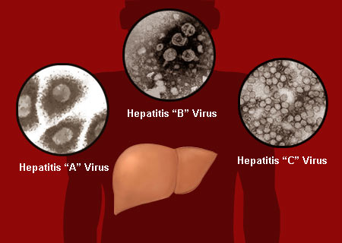
Hep stats!
100:1 (hep/HIV)
National
New cases 2007
Hep B – 43,000
Hep C – 17,000
Chronic hepatitis 2007
Hep B – 1.2 million
Hep C – 3.2 million
Ages 25-44
Men > women
Americans of African descent or Asian descent (reducing)
Idaho follows the national trend
Notes:
I want to go over a few state and national statistics for hepatitis. Statistics will be a few years back due to delay caused by collecting and analyzing data. These CDC statistics were in one report dated July 2010. At least for now, it is standard to recollect data every five to ten years, like census. So, according to the CDC national data, one hundred times more people die each year from hepatitis than die from AIDS. In 2007 there were 43,000 new cases and 1.2 million chronic cases of hep B and 17,000 new cases and 3.2 million chronic cases of hep C. The age with the highest risk is 25-44 years of age. Men contract it more than women and Americans of African or Asian descent have traditionally had the highest incidence. Americans of Asian descent are reducing over time. This is because it is recognized and teaching amongst those populations have reduced risk factors. Now, per the Idaho Department of Health and Welfare, Idaho follows the national trends.

Slide 36
Occupational Hepatitis B Exposure
Needle sticks – 30% rate of infection if exposed to blood infected with a bloodborne pathogen
Greater risk of infection than other bloodborne pathogens
NOTE:
SURFACE CONTACT, even if dry
Lives over a week in dry state!!
Notes:
This would be the natural time to look at occupational or job related hepatitis B exposure. There is a high rate of infection with needle stick injuries. 30% of people exposed this way become infected. That means the virus is very potent. In fact, hepatitis B has a higher rate of infection by any exposure than the other BBPs. I put a note there...the virus needs a host cell to survive, but blood is a type of host cell and even dry can keep the virus alive for over a week! Do not assume that dry blood holds no risk. All of these things are likely the reason the hepatitis B vaccine and another common hepatitis, hepatitis A, are now routine childhood immunizations.

Slide 37
Occupational Hepatitis C Exposure
Needle sticks – 2% rate of infection if exposed to blood infected with a bloodborne pathogen
Lives on surfaces?
Do you:
Eat nutritiously?
Get adequate sleep?
Suffer too much stress?
Have a disease that impairs your immune system?
Take medications that impair your immune system?
Notes:
If the worker gets stuck with a needle and the person at the receiving end of the needle has hepatitis C, the person only has a 2 percent chance of becoming infected. And there is less confidence that hepatitis C can live on a surface outside a live host. However, both this slide and the last give us an opportunity to look at two concepts. First, you can see that some viruses are more quote/unquote ‘virulent’ than others..that is more capable of causing infection. Second...why doesn’t EVERYONE exposed become infected? Going back to that chain of infection...the vulnerable host. People with strong immune systems will be able to fight the infection. They may be a carrier and not get the disease or they may resist it all together. Remember the immune system can be affected by a multitude of things...nutrition, sleep, stress, age, or diseases or treatments that affect the immune system. I made a list of things to ask yourself about your immune system. Are you eating nutritiously or are you eating a donut with coffee every day for breakfast? Are you getting at least 7 hours of sleep a night or are you an insomniac failing to seek treatment? These first two, particularly, can create a feeling of being run down or fatigued. These alone are some of the greatest risks to a lower immune system. Are you allowing life stressors to greatly affect you? Bills, children rebelling, job stressors and other life events have an effect. The greater the number of stressors or stressors of greater significance like divorce or death, the more the immune system is affected. The body needs to combat the effects of stress, so does a poorer job of maintaining immunity. Do you have a disease or take medications that lower your immune system? Cancer treatments, leukemia and a number of other conditions increase your risk. Medications can also lower the immune system. Breathing treatments or oral medication that contain corticosteroids or steroids themselves will lower the immune system, increasing the risk the person would become infected. Now, there’s not too much one can do about these last two or another risk factor – age under two or over sixty – except to realize that you are at higher risk so need to take better care to avoid exposure. If you answered no to the first two bullets there and yes to the third, seeking treatment is recommended.

Slide 38
Normal liver structure & function
Notes:
To understand hepatitis’ effects on the body, we need to talk about the normal structure and function of the organ infected...the liver. Remember these are steps two and three of pathophysiology.

Slide 39
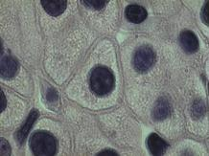
Normal Structure
Notes:
In an adult, the liver is a 3 lb triangular organ about the size of a football. It’s located in the upper right abdomen, taking up most of that portion of the abdomen. The tip extends into the upper left abdomen. There are 2 major lobes, made up of over 100,000 cells. You can see the two lobes in the bottom left image there and the microscopic cells in the top right.

Slide 40
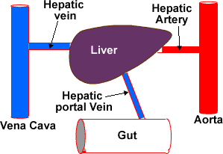
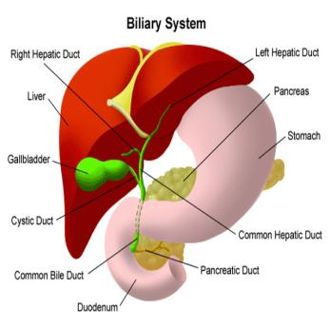
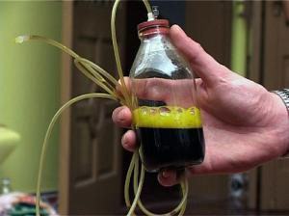
Normal Structure
Notes:
There are two veins, rather than the one most organs have. You can see that in the top image. We’ll talk about why that is significant in a minute. The liver is connected to the gall bladder. You can see this circled in the bottom image. It’s a hollow organ that stores bile produced by the liver. Bile is a substance about the consistency of maple syrup and is fluorescent green. You can see it there in the bottom right image. The gallbladder is in turn connected to the small bowel – called the duodenum in the image. The duodenum is where the fat and bile meet up.

Slide 41
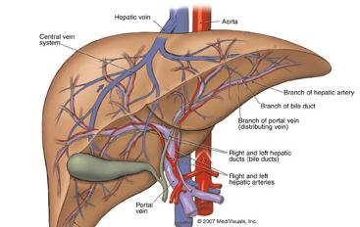
Normal Function
Notes:
Now let’s move into normal function. Considered a gland, the liver is one of the body’s most complex organs. It’s also highly vascular because all blood is filtered through the liver. The equivalent of 4 cans of pop flowing through the organ per minute – a liter and a half every minute!

Slide 42

Metabolism of toxins, drugs and alcohol
Fluid balance
Conversion of reproductive hormones to usable form
Metabolism of nutrients
Normal Function
Notes:
There are OVER 500 functions of the liver!! They can be grouped into four broader functions. Metabolism of toxins, drugs and alcohol. Fluid
balance. Conversion of reproductive hormones to usable form and Metabolism of nutrients. If your like me, a list like this makes the mind wander
without clarification, so let’s look at each of these for a minute. But let’s also add in disease effects and symptoms you’ll see in the person so it
makes more sense.

Slide 43

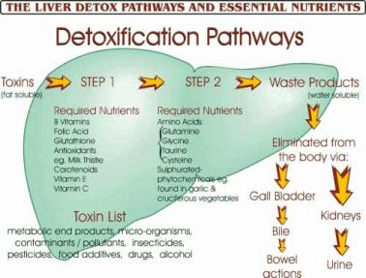

Metabolism of toxins, drugs and alcohol
Fluid balance
Conversion of reproductive hormones to usable form
Metabolism of nutrients
Normal Function/Disease Effect/Signs & Symptoms
Notes:
First...toxins, drugs and alcohol. With a malfunctioning liver, the person would be overdosed if given or taking normal amounts of medications, drugs or alcohol. That’s because the liver cannot do it’s role of detoxifying the blood. The liver contains specialized cells just for the function of converting a toxin to a less toxic substance. Detoxifying means it takes the chemical that enters and alters it so it is harmless to the body. When toxins, drugs or alcohol are not converted, the person has a magnified effect from these chemicals or they could even die from overdose with an amount that would not kill a person with a normal liver.

Slide 44

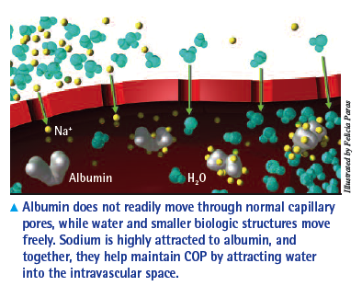
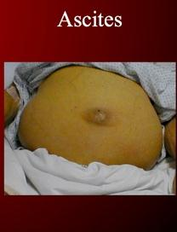
Metabolism of toxins, drugs and alcohol
Fluid balance
Conversion of reproductive hormones to usable form
Metabolism of nutrients
Normal Function/Disease Effect/Signs & Symptoms
Notes:
Next, fluid balance. Fluid balance means we are neither dehydrated nor do we have too much fluid on board. There are a lot of things going on, but basically our bodies break down protein we eat, like meat, into a substance called albumin. It’s so big it can’t leave the blood vessels and go into tissues of our body like other substances in our body can. Water is attracted to this protein, so stays with the protein rather than leave the blood vessel. If too much fluid leaves the blood vessel, the person would have too much fluid in the tissues. In a person with impaired liver function, the protein is not broken down into albumin by the liver, thus the blood has no or little protein. Fluid leaks out into the tissues. Swelling can be significant, especially in areas with little bone and stretchy tissue, like the abdomen you see in the bottom right image there. That’s called ascites. None of what you see there is fat and believe it or not, the abdomen can get so swollen, it hangs nearly to the floor. That’s rare, but gives you an idea of how bad it can get...

Slide 45
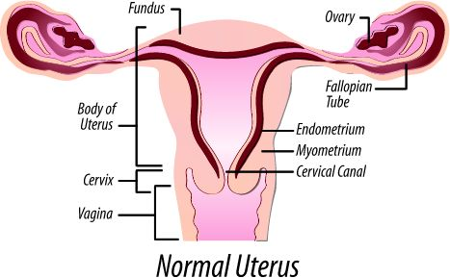
Metabolism of toxins, drugs and alcohol
Fluid balance
Conversion of reproductive hormones to usable form
Metabolism of nutrients
Normal Function/Disease Effect/Signs & Symptoms
Notes:
Converts reproductive hormones, such as estrogen and testosterone, to a usable form. The person will have problems with fertility, may take on characteristics of the other sex and likely won’t be interested in sexual intercourse.

Slide 46
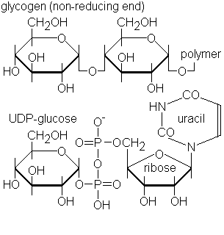
Metabolism of toxins, drugs and alcohol
Fluid balance
Conversion of reproductive hormones to usable form
Metabolism of nutrients
Normal Function/Disease Effect/Signs & Symptoms
Notes:
And finally metabolism of nutrients. I saved this for last, because it’s related to more functions than the other categories. That’s carbohydrate metabolism there in the image. I’m not going to go into complex chemical reactions like shown, but I do want to expand a bit on nutrient metabolism.

Slide 47

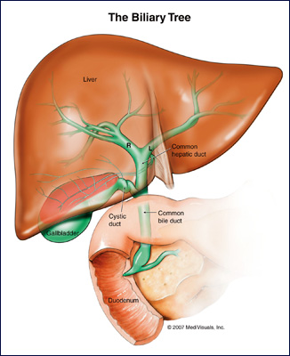
Metabolism of nutrients
Fat digestion/absorption
Notes:
First, it makes the bile we need to break down fat for use. A few slides back I clarified the liver makes bile. Bile breaks down fat in the small bowel to a usable form. A diseased liver makes less bile, so fat breakdown is impaired. Between this and the problem breaking down protein, the person will lose weight. The swelling from too much fluid might mask it though.

Slide 48
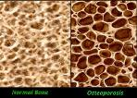
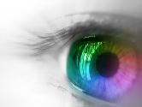
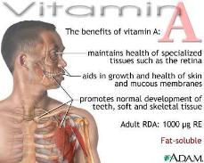
Vitamins A – D – E - K
Metabolism of nutrients
A – Bone, reproduction, vision
D – Bone, teeth
Calcium – bones, muscle contraction
Phosphorus – bones
E – Reproduction, muscle, anti-
oxidant
K – Blood clotting
Notes:
It also stores vitamins A,D,E, and K and some minerals like iron, calcium, phosphorus and iodine. A diseased liver will be unable to store the vitamins, so the person will show signs of not having enough. Let’s look at each of the four vitamins first. Vitamin A is associated with things like building bone, reproduction and vision, so the person would have issues with brittle bones, added infertility problems and may show vision problems.

Slide 49
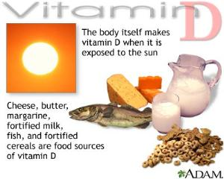
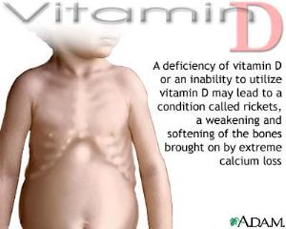
Vitamins A – D – E - K
Metabolism of nutrients
A – Bone, reproduction, vision
D – Bone, teeth
Calcium – bones, muscle contraction
Phosphorus – bones
E – Reproduction, muscle, anti-oxidant
K – Blood clotting
Notes:
Vitamin D is associated with bone and teeth formation. Also Calcium and phosphorus cannot be absorbed without it. So the person will show signs of deficiency of vitamin D, calcium and phosphorus. The body can’t maintain bone and teeth strength; muscle weakness can also occur.

Slide 50
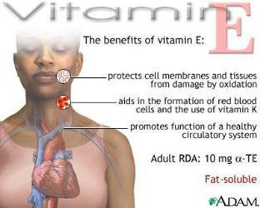

Vitamins A – D – E - K
Metabolism of nutrients
A – Bone, reproduction, vision
D – Bone, teeth
Calcium – bones, muscle contraction
Phosphorus – bones
E – Reproduction, muscle, antioxidant
K – Blood clotting
Notes:
Vitamin E is associated with reproduction, muscle formation and is an antioxident. Anti-oxidants reduce damage to cells. A diseased liver would again affect fertility, muscle weakness is even worse and cells are damaged throughout the body due to the lack of antioxidants.

Slide 51

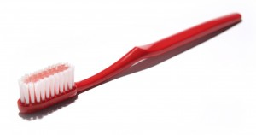
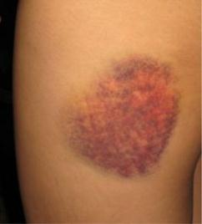

Vitamins A – D – E - K
Metabolism of nutrients
A – Bone, reproduction, vision
D – Bone, teeth
Calcium – bones, muscle contraction
Phosphorus – bones
E – Reproduction, muscle, anti-oxidant
K – Blood clotting
Notes:
Vitamin K is associated with blood clotting. The person with a diseased liver will have problems with excess bleeding with the smallest bumps or every day things like brushing teeth or shaving. Now, we’re not talking about a little tiny bleed here. There is a real risk of bleeding to death from what most of us consider minor nicks.

Slide 52
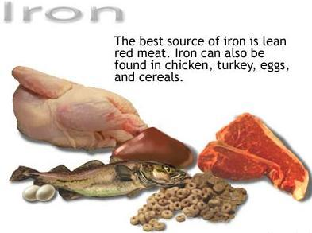
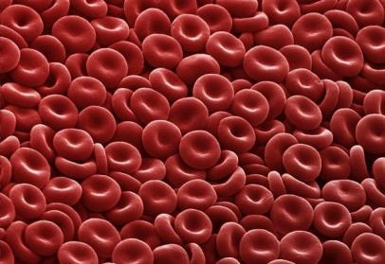
Metabolism of nutrients
Iron storage
Notes:
The liver also stores iron – A nutrient vital for production of blood cells. Blood cells take oxygen to cells. With a diseased liver, the person will be anemic, so weak and short of breath.

Slide 53
Metabolism of nutrients
Receives & breaks down carbs
Key Nutrients
Carbs
(breakdown)
Proteins
(breakdown)
Fats
(Excess carbs/protein)
Notes:
It also receives the three key nutrients absorbed through the small intestine and metabolizes them to a usable form or stores them as fat. This means carbohydrates and protein are broken down for energy. And any excess is stored as fat.

Slide 54
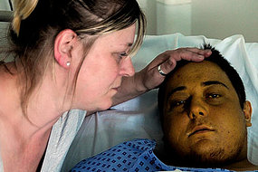


Bile blockage = Jaundice
Metabolism of nutrients
Notes:
Finally, when the organ is so diseased it swells, it prevents the bile that is produced from entering the gallbladder. The bile is redirected to the blood stream. Anywhere blood flows is tinted yellow. That called jaundice and is often one of the first signs of hepatitis. The skin and eyes will be most obvious, but the bile will darken the urine – another sign. Now, because it can’t get to the bowel, the person’s stool will NOT be tinted by the bile. It’s the main source of color, so the stool might resemble clay rather than the normal brown or green.

Slide 55




Diagnosis:
Blood test
Physical exam
Diagnosis & Treatment
Notes:
Ok, that final category for pathophysiology is diagnosis & treatment of the disease. A physical exam will show an enlarged liver. The person will likely complain of pain in the right upper abdomen because the enlarged liver will be pressing on nerves in the area. Any of the signs and symptoms we discussed a few minutes ago might be present as well. All are clues. Ultimately, the person diagnosing will support complaints and physical exam will a blood test that detect the presence of the virus and a liver biopsy may be performed to show the effects on the liver.

Slide 56
Treatment:
Long duration
Medication
Rest
Good nutrition
Adequate fluids
Frequent doctor visits for monitoring progress
Hospitalized?
Substance abuse treatment if appropriate
Evaluate for chronic hepatitis & complications
Treat chronic hepatitis & complications
Diagnosis & Treatment
Notes:
Treatment can be intensive and weeks in duration. This being a virus, they would not be given an antibiotic, but would instead give medications to stimulate the immune system and those that support the other signs. In addition, it is important that the person do all they can to support healing, like get adequate rest, good nutrition & adequate fluids.

Slide 57
Treatment:
Long duration
Medication
Rest
Good nutrition
Adequate fluids
Frequent doctor visits for monitoring progress
Hospitalized?
Substance abuse treatment if appropriate
Evaluate for chronic hepatitis & complications
Treat chronic hepatitis & complications
Diagnosis & Treatment
Notes:
When diagnosed, the person may be hospitalized or may simply be seen more frequently for monitoring. Obviously, the worse the symptoms, the more likely hospitalization will be required. The person’s hope of cure and not contracting chronic hepatitis is hampered by substance abuse. If they continue to use, cure will be delayed and there is a much higher risk of contracting chronic hepatitis. This is one of the reasons hepatitis C is more likely chronic, because those that contract it are more likely IV drug users than other categories. The person will be monitored for contracting the chronic form of the disease and treated it they get it.

Slide 58
Quiz Time!
5 TYPES
A
B
C
D
E
Which?
Bloodborne
Common in the U.S.
Most at risk population: MSM
Infectious longer
Less likely to become chronic
Notes:
Ok, quiz time again. Which types of hepatitis is bloodborne and common in the U.S.? The at risk population are men who have sex with men, they are infectious longer, but less likely to develop chronic hepatitis.

Slide 59
Quiz Time!
5 TYPES
A
B
C
D
E
Which?
Bloodborne
Common in the U.S.
Most at risk population: MSM
Infectious longer
Less likely to become chronic
Notes:
Hopefully you selected hepatitis B.

Slide 60
Quiz Time!
Which of the following is NOT associated with hepatitis effects on the liver?
Dehydration
Bleeding
Jaundice
Overdose on normal amounts of medication
Notes:
Next, which of the following is NOT associated with hepatitis effects on the liver? SAY SLOWLY CHERYL: Dehydration, bleeding, jaundice, and overdose on normal amounts of medication.

Slide 61
Quiz Time!
Which of the following is NOT associated with hepatitis effects on the liver?
Dehydration
Bleeding
Jaundice
Overdose on normal amounts of medication
Notes:
Hopefully you selected dehydration. The person is the opposite of dehydrated, accumulating a lot of fluid in the tissues due to the lack of protein in the blood stream. Bleeding and bruising CAN occur from not storing vitamin K in the liver. Jaundice IS a side effect of the swollen and inflammed liver. The bile can’t get through to the gall bladder, so all tissues are tinted fluorescent yellow. The sluggish liver can’t detoxify the blood, so medications can cause a magnified response. The person is at high risk of overdose.

Slide 62
For your continued learning…
One in twenty URL:
http://www.hepb.org/about/1in20/index.htm
Samuel So, MD, FACS: "How Serious is Hepatitis B?"
http://www.hepb.org/expforum/speaker.aspx?speakerID=drSo_07&language=English
Hillel Tobias, MD, FACS: "What is the impact of hepatitis B in the US?"
http://www.hepb.org/expforum/speaker.aspx?speakerID=drTobias&language=English
Notes:
So that’s hepatitis pathophysiology. I’ve placed three URL from the hepatitis B foundation: The first is a video called One in Twenty. It causes the statistics to sink in a bit. I’ve also included two podcasts by physician’s on how serious hepatitis B is and the impact in the US. These are for those curious to learn more. Remember that URL can change – almost daily it seems – and are at high risk of being typed in wrong. Today's search engines are advanced enough that typing in the title may be more effective.

Slide 63
Pathophysiology of HIV/AIDS
Notes:
Ok, so we’ve covered hepatitis. Let’s move into the pathophysiology of HIV and AIDS.

Slide 64

Human Immunodeficiency Virus (HIV)
Microbe isolated (discovered) - 1984
1984 - 2011 – epidemic
<2009 – No entry into US if HIV positive
General Information
Notes:
In 1984 the human immunodeficiency virus was isolated. In a little over 25 years it has gone from a few isolated cases to a world-wide epidemic. Here’s an interesting bit of trivia: Prior to December 2009, there was a ban on people entering the country who were known to have HIV. Due to concepts that will be clear later, a person can have the disease for years and not know it. The ban was ineffective, so was removed.

Slide 65


HIV/AIDS stats!
General Information
Notes:
So, what are risk factors to HIV infection? Statistics help clarify this, but basically all of the body fluids I talked about before that are bloodborne or other potentially infectious materials are a risk. The highest risk are two of those listed there on the slide - still men who have sex with men – non monogamous - and IV drug users. The heterosexual category includes those who have had multiple sex partners, exposure during birth or breast feeding and those past menopause who think they’re safe to have unprotected sex. When looking at race, for some reason, African Americans have a higher incidence… Now, I’m not talking about Africa – where AIDS is an extreme epidemic – but American citizens. I’ve heard some discussion of more unprotected sex amongst this population. Latinos are the next highest category at 17%. All other races are encompassed in the 38% there. I did find some data stating that all are at higher risk if they are exposed and also have another STD, trauma to the genitalia like with rape or are on their menstrual period.

Slide 66
More HIV/AIDS stats!
National:
1 million HIV cases in the US (1/5 unaware)
Approximately 56,000 new HIV cases in the US each year
Approximately 18,000 people in the US die from AIDS each year
Nearly 600,000 people have died since onset in the US
75% of new HIV cases are men
Link:
Interactive U.S. map
http://www.pbs.org/wgbh/pages/frontline/aids/atlas/us.html
Living with HIV
New diagnoses of HIV
Death from AIDS
General Information
Notes:
Looking at some more statistics: National data shows we have one million cases of HIV in the US. Most scary is that one out of five don’t know they are infected. There are approximately 56,000 new HIV cases in the US each year – think about that - that’s an average of 1000 people per state. Approximately 18,000 people in the US die from AIDS each year, over half a million have died since onset in the US. 75% of new HIV cases are men. I’ve included a link to a very interesting PBS website. It shows you the most recent data on those living with HIV, new diagnoses of HIV and death from AIDS.

Slide 67
More HIV/AIDS stats!
Idaho
Does NOT follow national trends
less cultural/sexual diversity
More conservative populations
4% of national HIV cases
About 1000 people HIV positive
79% male
79% Caucasian
40% 20-29 years of age
MSM most common (<50%) – also IDU and multiple sex partners
5 pediatric HIV cases between 1984-2007
AIDS – Same except age – older
Pocatello DHW has HIV clinic
General Information
Notes:
While Idaho followed national trends for hepatitis, it does not do the same for HIV and AIDS. This is likely due less racial and sexual diversity and a more conservative population than states with big cities, so less likely to exercise risky behaviors. Also, states that have a lot of international travel to and from have a higher incidence than anywhere in the nation – especially those closest to Asia and Africa. At last count, we make up about 4% of national HIV cases – around 1000 people are HIV positive in the state at any given time. Of those, 79% are male and 79% are Caucasian. Almost half or 40% are in the 20-29 year age group. Unprotected and multiple partner sex is a likely cause. This population is also still young enough to be in a bit of denial about one’s own mortality. Men who have sex with men ARE still the most common population, although they are less than 50%. National MSM were over 50% of cases. IV drug use and multiple sex partners are the predominant remaining cases. I was glad to see there have only been five pediatric cases in Idaho since the discovery of the disease. AIDS follows the same pattern except age of onset, which is later. While we have less incidence in Idaho, we can’t get comfortable. The world is getting more and more mobile and denial is still rampant. Pocatello health department has an HIV clinic for a reason. Most cases are in Pocatello, Idaho Falls and Boise. Now, remember this data is a few years back. Each year the incidence of crystal meth use rises in rural areas. People who use crystal meth use the same poor judgment as those using IV drugs, so are more likely to exercise high risk behaviors.

Slide 68
More HIV/AIDS stats!
International:
Africa/Asia – 80% of people infected with HIV
U.S. one of top six nations for HIV infections
~25 million in the world have died from AIDS
~33 million in the world are HIV positive
December 1st is World AIDS Day
Link:
Interactive WORLD map
http://www.pbs.org/wgbh/pages/frontline/aids/atlas/world.html
Living with HIV
Receiving drugs
Death from AIDS
General Information
Notes:
Finally, let’s look at the international data, which is the most shocking: Over 80% of people infected with HIV live in parts of Africa or Asia, although the US is considered one of top six nations for HIV infection. 25 million people in the world have died from AIDS, 33 million are HIV positive…remember not all are tested. This only includes those who were tested. I put a note there that December 1st is World AIDS Day. I do want to go into why the stats are so high in Africa and Asia. These continents have many third world countries who do not have the luxury of planned parenthood and all that it entails. Education, testing and protection are key to stopping this disease and only in recent years have the rest of us realized the impact of that many world citizens having the infection. Things are slowly improving, but belief systems are a problem. If we do not believe that lifestyle is a risk, we don’t use the tools available to protect us. Many don’t trust the agenda of outsiders, so don’t believe our teaching about HIV causes. The URL there will take you to an interactive world map, showing those living with HIV, those receiving drugs and death from AIDS. The nice thing about both this map and the US map is you can continue to check the site for changes over time.

Slide 69
Occupational HIV infections
Only 57 documented (140 possible) occupational infections in US 1981-2006:
48 puncture or cut injuries
5 mucous membrane or broken skin exposure
2 a combination of the above
2 unknown
Notes:
These general statistics are informative, but what are the workers risks of contracting the disease? I am finding discrepancies on the Center for Disease control website about the age of these statistics...but it appears in all the history of HIV and AIDS between 1981, when first isolated, and 2006 there are only 57 documented occupational infections in the US. Another 140 cannot be confirmed, but are suspected to be related to occupational exposure. Not terribly high...unless you’re the one exposed. Of the 57 confirmed, 48 occurred from skin puncture or cut, like a needle stick or getting cut with a scalpel. Five were caused by exposure of mucous membranes or broken skin, such as with a splashing or touching blood or OPIM with the worker having an open wound like a hangnail; 2 are a combination of puncture/cut injuries and mucous membrane or broken skin exposure and two are from unknown sources...although I don’t know how they are confirmed occupational exposures when the source is unknown...From review of the article I pulled this data from, I suspect it is not the exposure in question, but the type of fluid in question.

Slide 70
Occupational HIV infections
Occupation | Confirmed occupational transmission | Possible occupational transmission
Nurse | 24 | 35
Laboratory worker, clinical | 16 | 17
Physician, nonsurgical | 6 | 12
Laboratory technician, nonclinical | 3
Housekeeper/maintenance worker | 2 | 13
Technician, surgical | 2 | 2
Embalmer/morgue technician | 1 | 2
Health aide/attendant | 1 | 15
Respiratory therapist | 1 | 2
Technician, dialysis | 1 | 3
Dental worker including dentist |  | 6
Emergency medical technician/paramedic |  | 12
Physician, surgical |  | 6
Other technician/therapist |  | 9
Other health care occupation |  | 6
Total | 57 | 140
Notes:
This slide shows a breakdown of confirmed cases and possible cases based on occupation. Those working with blood and body fluids more regularly, like nurses or laboratory personnel are of course the highest, but there are twelve suspected cases among emergency medical personnel. Low down on this list...until you consider that these listed are only 15 occupations out of over 100 healthcare fields.

Slide 71
Occupational HIV infections
No new confirmed HIV sero-conversion between 2000-2006 from occupational exposure
Many possible exposures under investigation
Virus does not survive on surfaces outside the body.
Not transmitted by surface contact with dried blood.
Notes:
Now, between 2000 and 2006, there were no new confirmed conversions from HIV negative to hiv positive from occupational exposure, although many cases are under investigation. I did put a note that HIV does not appear able to live in blood outside the host, so dried blood is not suspected to be a risk for HIV infection.

Slide 72
Why worry with such low risk?
No vaccine!
No cure!
End result – DEATH!
Costly therapy with bad side effects if exposed
More than one antiretroviral drug given
Some strains resist antiviral therapy
Notes:
So...why worry with such a low risk? Well, unlike hepatitis B, there is no vaccine and no cure. Death is a likely result. If you are exposed, the treatment is expensive, has bad side effects...and some strains of the virus are resistant to therapy. We don’t want this!

Slide 73
Disease ≠ microbe
Disease = immune system response to microbe
General Information
Notes:
The thing that makes HIV tricky is what it does to the body. It does not directly cause illness, like hepatitis. Instead, it attacks the immune system. People with AIDS die from infections or other illness caused by an inadequate immune system (such as when certain types of cancer develop). So…let’s talk about what our immune system does for us so we understand what the disease affects.

Slide 74



Normal Structure & Function
MACROPHAGE
Notes:
The immune system can be VERY complex as you can see from the images here – many body organs are involved and lots of processes occur. We don’t have weeks to study this, so I will only go so far as to aid understanding. The immune system prevents or responds to local or body-wide infections. When a pathogen enters our body, there is a body-wide response. A fever develops which causes a lot of things like weakness, loss of appetite and/or generally not feeling well. White blood cell production also increases. Different types have different functions. One type, called a T-cell as shown in the left image there, stimulates the immune response. Another type, a macrophage, seen in the bottom image, acts like pac man, enveloping the pathogen and keeping it inside until it can take it out of the body. Yet another type learns the make up of the pathogen, then stimulates the creation of a thing called an antibody. The next time the person is exposed to the pathogen, these antibodies attach to the pathogens at the area it would have attached to the body, disabling it. Another type can enter cells – not all can – and secretes a substance that kills the pathogen. Fluid shifts from the entire body to the area of infection. This moves immune system stuff, like white blood cells to the wound. Dependent on the area the pathogen is in, we may have any number of responses.

Slide 75
Any area: Pain & Swelling
Skin wound: Red/warm/pus
Lungs: Sputum production increases
Stomach/Bowel: Vomiting & diarrhea
Kidneys/Bladder: Increased urine production
Normal Structure & Function
Notes:
In any area pain is a common sign. Its caused by irritation and swelling. Swelling – due to fluid shift we’ll talk about in a minute.

Slide 76
Any area: Pain & Swelling
Skin wound: Red/warm/pus
Lungs: Sputum production increases
Stomach/Bowel: Vomiting & diarrhea
Kidneys/Bladder: Increased urine production
Normal Structure & Function
Notes:
The skin will become red near the infected site and may be hot to touch. Pus may also come out of the wound. This is from the immune system attempting to isolate the pathogen so it can’t infect the entire body. It may be a mild, pimple-like sac all the way to huge abscess or boil. If you like gross stuff, go check out popping a MRSA boil into YouTube. Some pretty gross stuff there – or as I say, some pretty cool stuff there. Many healthcare workers are odd that way.

Slide 77
Any area: Pain & Swelling
Skin wound: Red/warm/pus
Lungs: Sputum production increases
Stomach/Bowel: Vomiting & diarrhea
Kidneys/Bladder: Increased urine production
Normal Structure & Function
Notes:
The lungs will show an increased production of sputum which envelops the pathogen, so it can be coughed out. Cough medicine is often not recommended unless the person is becoming sicker from the cough – like not sleeping – because cough medicine prevents the immune system from doing it’s job. The same with fever reducers with a fever less than 102 degrees.

Slide 78
Any area: Pain & Swelling
Skin wound: Red/warm/pus
Lungs: Sputum production increases
Stomach/Bowel: Vomiting & diarrhea
Kidneys/Bladder: Increased urine production
Normal Structure & Function
Notes:
Infection of the stomach and/or bowel results in vomiting and diarrhea. Again, medications to override these immune functions can worsen the infection...

Slide 79
Any area: Pain & Swelling
Skin wound: Red/warm/pus
Lungs: Sputum production increases
Stomach/Bowel: Vomiting & diarrhea
Kidneys/Bladder: Increased urine production
Normal Structure & Function
Notes:
Next, the kidneys and bladder – The immune system increases the production of urine to wash the microbe out when urinating. This is why someone who has a urinary tract infection feels the urge to urinate. To get the infected urine out before it can worsen the infection. Again, these are not symptoms of disease, but symptoms of immune response to the disease. When the immune system doesn’t function, these do not occur. Thus the infection worsens and worsens.

Slide 80
2nd and later exposure
Normal immune system:
First exposure
Disease Effects
HIV:
First exposure
No response
Notes:
I could go on and on through every body system. The point is that there are thousands of body responses intended to keep pathogens out or kill them once they enter. The first time we’re exposed, the immune response may be mild. But due to immune system ‘memory’ exposures after the first will have a much stronger immune response. This is the understanding behind immunizations. Even dead particles cause an immune response, so the next time we have a stronger response. We don’t want our first exposure to, say, measles mumps or rubella to be weak, so we expose the body via the MMR. But remember, our immune system is not able to do it’s job with HIV infection. We do not get the immune response because it has deactivated our immune system. This allows microbes to take over infecting multiple body systems.

Slide 81
How does HIV/AIDS affect the body?
It doesn’t…at first
Carrier – HIV negative up to six months…a few longer (contagious all this time)
HIV positive – can be years before AIDS (no signs or symptoms, contagious)
Full blown AIDS
80’s – 13 month death sentence
Now – 20 years or longer if:
Treatment available
Treatment complied with (expensive!!)
Prevention in infants born to HIV infected mothers?
Notes:
So, how do HIV and AIDS affects the body? At first, not at all. A person can be a carrier, but show up HIV negative. It can be years before they convert or they might never convert. The average is six months or less. That’s why exposure requires testing at time of exposure and six months later. Remember a carrier can pass on the disease. We are studying people who have been exposed – sometimes multiple times, who never contract HIV. Many researchers think the cure to AIDS is in studying their blood…So, once HIV positive, can be years before AIDS develops. Modern medications have increased this time to an average of 8-10 years. The person is asymptomatic, so without testing may be passing the disease. Now, the picture of full blown AIDS has gotten much better! In the 80’s, if a person was diagnosed with AIDS, they rarely lived over a year after diagnosis. Today, we are seeing people who have lived with the disease since its onset – 20 or more years. Treatment is a big determinant – it has to be available and followed – this is hard because AZT, the primary treatment is very expensive! They can even prevent contraction of HIV if treatment is started before it can infect. A lot of babies born to mothers with AIDS have not contracted the disease.

Slide 82

How does HIV/AIDS affect the body?
Disease Effects
Notes:
Once HIV gets to a certain number they attack T-cells. A reminder those T-cells stimulate the immune system. Without adequate number, there will be little or no immune response. Doctors, PA’s and nurse practitioners are monitoring movement from HIV positive to full blown AIDS by the number of T-cells. The fewer there are, the closer to AIDS, the closer to a severe infection.

Slide 83

Signs & Symptoms
No exact time HIV becomes AIDS
Virus count
T cell count
Late HIV: | Early AIDS | Late AIDS
Multiple opportunistic infections Pneumonia Yeast infection Herpes simplex/zoster | Meds to slow virus no longer effective Virus count climbs T cells drop | Serious infections occur Cancer occurs – Kaposi’s sarcoma, non-Hodgkin’s lymphoma Virus begins to affect body, not just immune system Nervous: Dementia, meningitis, reduced movement progressing to paralysis Lungs: Pneumonia, TB GI: Nausea, vomiting and diarrhea; extreme weight loss Urinary: Kidney failure
Notes:
So, what signs and symptoms occur? First, it’s important to clarify that there is no exact moment when a person converts from late HIV to early AIDS. They will gradually move from no symptoms with early HIV to multiple opportunistic infections – remember these normal flora are just waiting for that opportunity to move from helpful to harmful. Pneumonia, yeast infection, herpes, skin infections and the like. As they move into AIDS, the medications are no longer slowing the growth, so the virus count climbs and the T cells drop. In late AIDS, serious infection occur cancers associated with the immune system can occur – like Kaposi’s sarcoma or non-hodgkin’s lymphoma. The virus NOW begins affecting the body. I give a few body systems there for example.For the nervous system we’ll see Dementia, meningitis, reduced movement progressing to paralysis. Lungs: Pneumonia, TB. GI: N/V/D, extreme weight loss. Urinary: Kidney failure.

Slide 84

Why so hard to cure (or vaccinate)?
Host cell is home
Kill it, kill host cells
Notes:
So why has this one stumped so many researchers? HIV uses our own cells to reproduce, so is very hard to kill. If we kill it, we kill the cells it resides in. That’s why a cure or vaccine has been slow coming. HIV is also adaptive to it’s environment. It can change it’s structure. In laboratories, vaccines have worked for a short period, then the virus changes itself and the vaccine no longer works.

Slide 85


Treatment
Treatment:
HAART – anti viral therapy
Medications to ease symptoms
VERY EXPENSIVE & harsh on the body
Notes:
Treatment for HIV is to both reduce the viral growth and treat symptoms and is extremely expensive. Until recently, insurance companies could deny coverage.

Slide 86


Social stigmatism
High risk behavior leading to HIV/AIDS can make family turn from person
Loss of social support, expense, and not feeling well can result in severe depression
Oprah
Notes:
In addition, the high risk behavior leading to HIV and AIDS and the likelihood of death can make family and friends turn from the person. The loss of this support, the expense of the treatment and not feeling well can lead to severe depression. However, I was watching Oprah once where she discussed a show from back in the 80s. There was a gentleman from down south who was HIV positive and gay, everyone in town knew he was. He had recently moved back to town from the big city to have family support. When he entered the city pool, everyone got out and the Mayor declared the pool toxic, needing drained and cleaned. After a lot of press, they had a town hall meeting on the Oprah show. These folks worsened things even more by telling him he was essentially the spawn of Satan, didn’t deserve to live, and had no right to be in their town. He needed to go back to people of his kind. The whole town ganged up on him, with only his family supporting him. Now, in there defense, at that time even those in healthcare, who were suppose to understand certain things about the disease, were wanting to wear radiation gear to care for those who were HIV positive with AIDS. Up to that point, infections didn’t kill people. The show concluded by bringing the worse offenders back to see if they still felt the same way. Many did, but many educated themselves on both homosexuality and AIDS, saw there was little if any risk swimming in the pool with him if it was adequately clorinated and apologized profusely to his family. We are no where near where we need to be with social stigmatism, but we’re making progress. Please treat people with HIV and AIDS like you do everyone else. You may be the only one doing so.

Slide 87
For your continued learning…
When HIV Becomes AIDS
http://www.youtube.com/watch?v=68I7JlVhuhY
HIV Vaccine: One Step Closer
http://www.youtube.com/watch?v=dwHIw8QGUnY&feature=fvw
HIV Scare Hits High School
http://www.youtube.com/watch?v=N80A6rqfVHM&feature=channel
Notes:
I’ve included some URLs to some youtube short films here for your continued learning. The first does a nice job of showing AIDS signs and symptoms. The second is preliminary success at developing a vaccine. The third shows how close to home this disease can be – an HIV scare in a high school. Again, let your curiosity drive you.

Slide 88
References
LeMone, P., Burke, K. & Bauldoff, G. (2011). Medical-Surgical Nursing: Critical Thinking in Patient Care. Pearson Education, Inc.
Mosby’s Dictionary of Medicine, Nursing and Health Professions. (2010). Mosby-Elsevier.
Retrieved 1/10/11:
http://www.cdc.gov/hepatitis
http://www.cdc.gov/hiv
http://www.healthandwelfare.idaho.gov
http://www.cdc.gov/HAI/organisms/hiv/Surveillance-Occupationally-Acquired-HIV-AIDS
Notes:
I’m hopeful you’ve learned a lot about hepatitis B and HIV, the two primary bloodborne pathogens. Obviously not something you want to contract. Prevention of the disease is preferred over treatment after contracting the disease. That’s what the final two presentations are about. Ways to keep yourself and others safe from these bloodborne pathogens.

