Slide 1
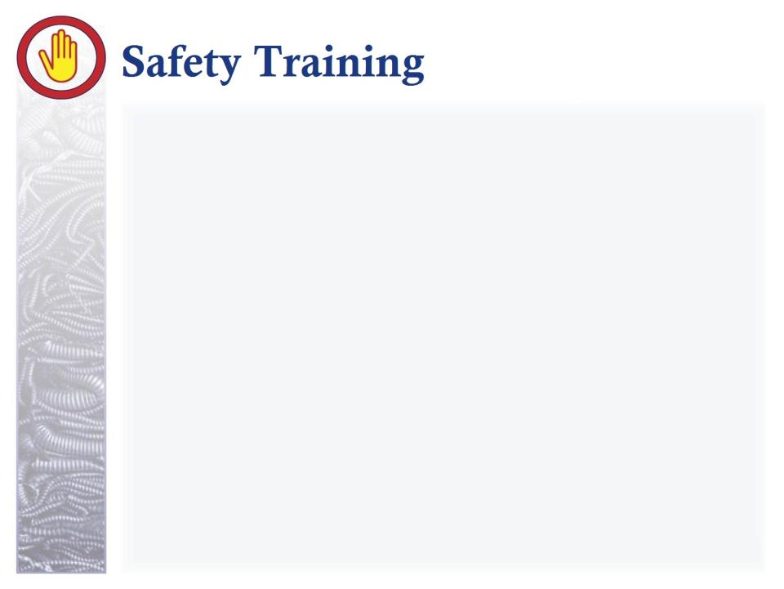
BLOODBORNE PATHOGENS
“Prevention”
Part 3 of 4
Standard 29 CFR 1910.1030
Produced by
Idaho State University
Office of Workforce Training
workforcetraining.isu.edu
Notes:
Welcome back. In part one of this presentations we covered microbes and the chain of infection. In part two we defined bloodborne and other potentially infectious material before reviewing the pathophysiology and statistics surrounding the three most common bloodborne pathogens. Today we move into strategies intended to prevent the spread of bloodborne pathogens from host to host. Let’s get started.

Slide 2
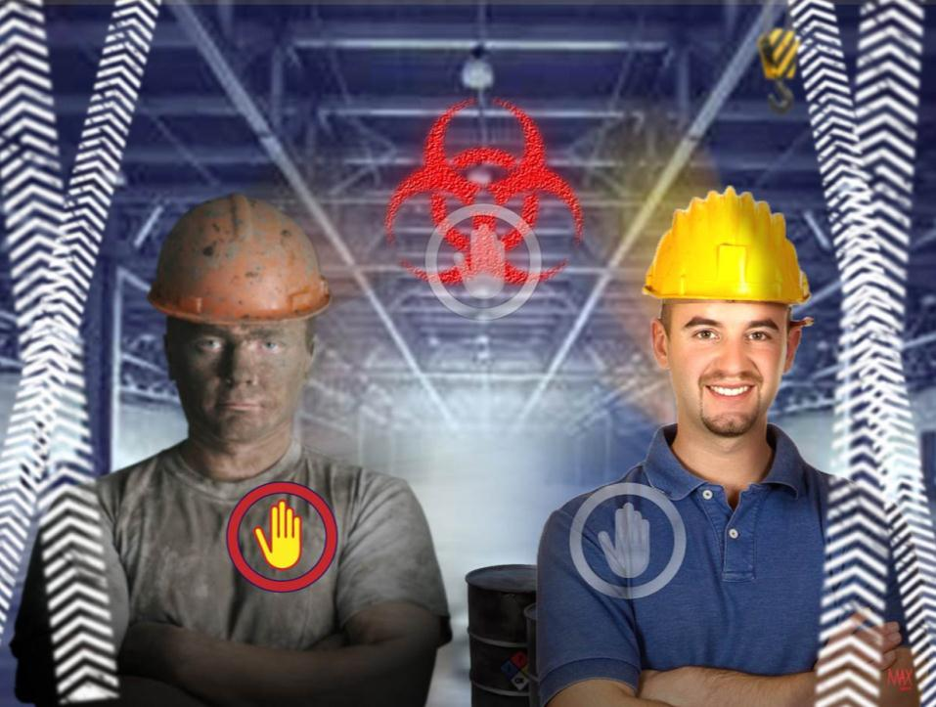
“This material was produced under grant SH20849SHO from the Occupational Safety and Health Administration, U.S. Department of Labor. It does not necessarily reflect the views or policies of the U.S. Department of Labor, nor does mention of trade names, commercial products, or organizations imply endorsement by the U.S. Government.”

Slide 3
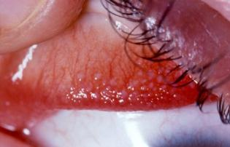

Work associated risks
Work associated risks
  Splash mucous membranes (eyes, nose, mouth)
      Permeable membrane – microbes can move through
  Contaminated sharp objects
  Exposure of non-intact skin (wounds, rashes)
Notes:
Before we can look at preventing their spread, we need to look at work associated risks. Prevention strategies will be directed toward preventing these three things. First is splashing of mucous membranes with blood or OPIM. Our mucous membranes are what is called permeable. This means microbes can move through them into the blood stream. These membranes are located in our eyes, our nose and our mouth. If you pull your lower eyelid down you’ll see the membrane.

Slide 4
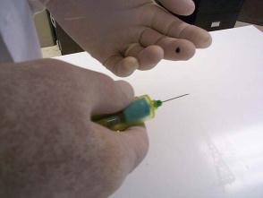
Work associated risks
Work associated risks
  Splash mucous membranes (eyes, nose, mouth)
      Permeable membrane – microbes can move through
  Contaminated sharp objects
  Exposure of non-intact skin (wounds, rashes)
Notes:
Next, contamination with sharp objects. Of course this includes medical devices such as needles and scalpels, but also includes non-medical sharps, such as broken glass or sharp industrial tools.

Slide 5
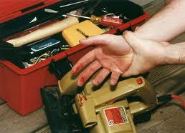
Work associated risks
Work associated risks
  Splash mucous membranes (eyes, nose, mouth)
      Permeable membrane – microbes can move through
  Contaminated sharp objects
  Exposure of non-intact skin (wounds, rashes)
Notes:
And, last but not least, exposure of non-intact skin, such as wounds and rashes. There are a multitude of possibilities on this one...wounds can be apparent, such as shown in the image there, or may be inside a mouth, leaking from the brain or spine, and so on. Always be alert to potential sources of exposure, keeping both blood and OPIM in mind.

Slide 6
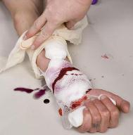
Contamination Sources
Direct handling or contact with Human blood or OPIM
Equipment, supplies or tools contaminated with blood or OPIM
Removed tissues or organ contaminated with blood or OPIM
Cultures containing bloodborne pathogens
Work associated risks
Notes:
We also need to look at this from the angle of contamination sources. The most obvious is direct handling or contact with human blood or OPIM. Say you work at an industrial plan that uses sharp tools or materials. A peer gets cut with a saw and is obviously hemorrhaging. Instinct is to stop the flow of blood immediately. That’s why it’s so important to know the location of protective equipment BEFORE an accident happens. If you just have to go get it, your more likely to use it than if you first have to locate it before you go get it. If you can’t get to gloves or the like, at least use a barrier that is moisture proof or too thick for the blood to leak through rather than touch the wound directly. You may have a hangnail or small laceration allowing microbes to enter.

Slide 7
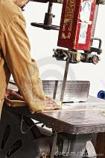

Contamination Sources
Direct handling or contact with Human blood or OPIM
Equipment, supplies or tools contaminated with blood or OPIM
Removed tissues or organ contaminated with blood or OPIM
Cultures containing bloodborne pathogens
Work associated risks
Notes:
We also need to consider equipment, supplies or tools contaminated with blood or OPIM. From table surfaces to gauze pads to scissors to bedding. Anything could be contaminated, so always be looking for obvious contamination, but remember other potentially infectious material will be less obvious than blood.

Slide 8
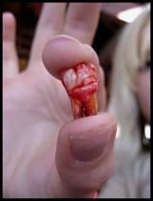
Contamination Sources
Direct handling or contact with Human blood or OPIM
Equipment, supplies or tools contaminated with blood or OPIM
Removed tissues or organ contaminated with blood or OPIM
Cultures containing bloodborne pathogens
Work associated risks
Notes:
Our third contamination source might be removed tissues or organs contaminated with blood or OPIM. I included an extracted tooth for the sake of good taste, but the sky is the limit on tissues or organs when it comes to medical or industrial settings. One might be exposed to any organ or tissue. Remember the host does not need to be alive. Examples of tissue include medical AND TRAUMATIC amputations or tissue removed during a biopsy or surgery. Say the man a couple slides back from the industrial accident has cut of his finger. You would wear gloves if necessary to handle the finger.

Slide 9
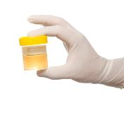
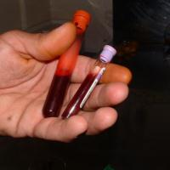
Contamination Sources
Direct handling or contact with Human blood or OPIM
Equipment, supplies or tools contaminated with blood or OPIM
Removed tissues or organ contaminated with blood or OPIM
Cultures containing bloodborne pathogens
Work associated risks
Notes:
And, a source more specific to laboratories, but a risk outside this setting so included: Cultures containing bloodborne pathogens. Laboratory specific risks might include petri dish or test tube cultures. An example of a non laboratory risk would be any setting where blood samples were taken or where sample containing blood or OPIM were collected...such as sputum, urine or stool. The word culture can be perceived loosely...say you are an EMT. You respond to a call at your local bar. A drunken gentleman has taken a fall. When you arrive, the man is hostile. He shows his hostility by spitting in your face. He might have injured the inside of his mouth. There may be blood in the spit. The spit gets in your eyes where those mucous membranes are...I think you get the point.

Slide 10

How do YOU prevent exposure?
Work associated risks
STANDARD PRECAUTIONS!
AKA universal precautions
Assumption:
ALL blood or OPIM is infectious!!
Notes:
So, how do YOU prevent exposure? Well, the center for disease control and prevention created two types of precautions: Standard precautions and transmission-based precautions. With standard precautions – previously known as universal precautions – we assume all blood or OPIM is infectious. We’ll look at the other category – the transmission based precautions – later in the presentation, but standard precautions alone are highly effective against spreading infection.

Slide 11
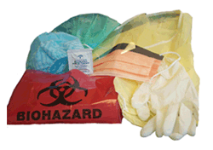
All intended to keep you and those around you safe!
Basis of Standard Precautions:
Work associated risks
Engineering controls
Safe work practices
Personal protective equipment
Notes:
So, what is meant by Standard Precautions? Well, by three adaptations to the work environment, we can reduce or prevent the spread of bloodborne pathogens. Most of the rest of this presentation will be covering these three broad categories. But first, I want to briefly review the categories.

Slide 12
All intended to keep you and those around you safe!
Basis of Standard Precautions:
Work associated risks
Engineering controls
Safe work practices
Personal protective equipment
Notes:
First, is adapted engineering controls. Equipment, instruments and devices have been invented with the sole purpose of preventing exposure to bloodborne pathogens.

Slide 13
All intended to keep you and those around you safe!
Basis of Standard Precautions:
Work associated risks
Engineering controls
Safe work practices
Personal protective equipment
Notes:
We’ve also begun to realize certain practices increase the risk of exposure...and certain practices decrease the risk of exposure. Examples of adapted practice include washing your hands – called hand hygiene in the medical world – cough etiquette, caring for and cleaning the environment around us, and vaccinating against the most lethal and common pathogen we can be exposed to: hepatitis B. I’ll discuss many others, but this gives you an idea of what is meant by safe work practices.

Slide 14
All intended to keep you and those around you safe!
Basis of Standard Precautions:
Work associated risks
Engineering controls
Safe work practices
Personal protective equipment
Notes:
Remember...All three categories are intended to keep you and those around you safe. In fact, standard precautions are the only way of preventing HIV exposure and because there is no vaccine or hepatitis C, the same applies to it. Only standard precautions will prevent it’s spread. So let’s look at each of these more closely...starting with engineering controls.

Slide 15
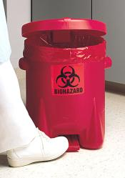
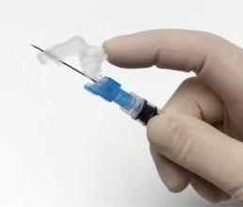
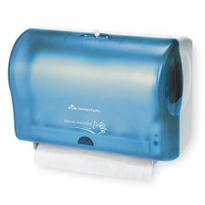
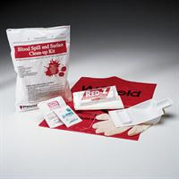
Engineering Controls
Work associated risks
Examples:
Safety needles/syringes
Sharps container
Cleanable work surfaces
Leak-proof containers
‘Hands off’ lids and hand hygiene tools
Blood spill kits
Adapted equipment, instruments, devices
Notes:
The devices you see in the images there are all intended to prevent exposure to BBPs. Some are healthcare specific like safety needles. Others have had such an impact we are seeing them in our daily lives, like the paper towel dispenser. One of the big moves, as you can see in two of the images, is toward hands free tools and equipment – that is, you don’t have to touch a surface that is normally highly contaminated to open or dispense something from the device. I give other examples to the left there. From the exposure incident information from part II, we know the safety needles are one of the most important deviced to keep healthcare workers safe. I teach the skill of giving an injection, but we use oranges to learn the skill so there is no risk of exposure. Being financially aware, I try to order lower cost items and needles without a safety device are lower cost. I had a heck of a time finding non safety style needles for the class...and, honestly, I’m kind of glad! Other examples of engineering controls I’ve listed there are the sharps containers, cleanable work surface – so less carpet or cloth covered furniture - leak proof containers, those hands off lids and hand hygiene tools I mentioned a few minutes ago, and, as you can see in the bottom left image there, a blood spill kit that contains gloves, an absorbent towel, a biohazard bag and various disinfectants. These are a great thing to put with the first aid kit outside of medical settings.

Slide 16
Safe Work Practices
Work associated risks
Examples:
No eating, drinking, applying makeup or smoking in areas where blood or OPIM are a risk
Correct personal and hand hygiene
Cough etiquette
Plan before doing
Care of environment
Hepatitis B vaccination
Proper handling of biological waste (including spills/disposal of biological waste)
Strategies to prevent exposure to BBP
Notes:
Now for safe work practices. This one is a big one and I want to go over each of the examples listed here, so you get a better idea of standard safe work practices to avoid exposure.

Slide 17
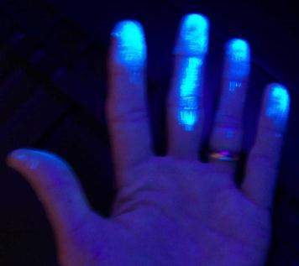

Work associated risks
No eating, drinking, applying makeup or smoking in areas where blood or OPIM are a risk
Safe Work Practices
Strategies to prevent exposure to BBP
Notes:
First No eating, drinking, applying makeup or smoking in areas where blood or OPIM are a risk. There are even signs to this effect. The reason is that we touch out faces numerous times with each of these activities and often do so subconsciously. Prior to teaching nurses how to properly wash their hands I do this activity called glo germ. The idea is that we apply a substance that shows up under black light to all parts of the hands; then ask the person to go wash their hands. Any glowing areas are those that were missed in the handwashing and are suppose to represent microbes that were not removed.

Slide 18
Work associated risks
No eating, drinking, applying makeup or smoking in areas where blood or OPIM are a risk
Safe Work Practices
Strategies to prevent exposure to BBP
Notes:
Well a few years back I adapted this activity to prove a point. Instead of telling them it was to teach handwashing, I crossed my fingers and told them I was testing them for a latex allergy. I applied the substance to their hands and then continued to lecture for another 20 minutes before releasing them to wash their hands. Of course we had the usual problems with hand hygiene. We’ll go over those in a few minutes. But the funny part was where else we found the glow substance. From a full handprint on the side of the face, to marks on both sides of the mouth, to obvious picking of the nose, to smudges near the nose and on glasses from pushing glasses up and yes, some on the eyelashes near the mucous membranes. The point hit home strongly…although they were a bit upset for being tricked. I now just tell the story because I need students to trust me to believe what I teach them.

Slide 19
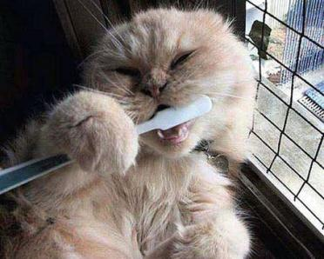
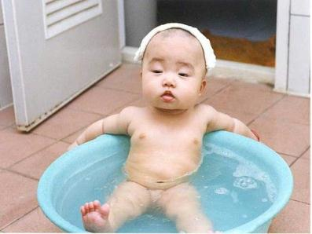
Work associated risks
Personal and hand hygiene
Safe Work Practices
Strategies to prevent exposure to BBP
Notes:
Next hygiene. This is talking about two separate topics here. First, your general personal hygiene and then hand hygiene. A lot of people don’t realize THEY are the problem, not the setting. This applies to both hygiene situations. Let’s expand.

Slide 20
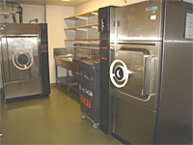
Highly contaminated (100,000 microbes per inch)
Toilet seats
Contaminated
(10,000 microbes per inch)
Surfaces that have not been cleaned within 24 hours
Clean/ Disinfected
(100 microbes per inch)
Chemical disinfectants
Sterile
(microbe free)
Autoclave
Genitalia
Ground
Bottom of shoes
Any surface coming in contact with highly contaminated items
Hands after washing
Medical gloves
Chemical sterilization
Freshly laundered linen
Work associated risks
Notes:
I’ll draw your attention to the slide. Starting in the upper left and moving clockwise, I’ve divided the circle into highly contaminated, contaminated, clean and sterile to show you the various levels of dirty and clean. The upper left quarter of the image represents highly contaminated areas. I give examples of toilet seats, genitalia, the ground and the bottom of shoes. There are not many more dirty surfaces than these. If someone were to take a swab of one inch of the highly contaminated surface, rub it on a microscope slide and then check it out under a microscope, they might expect to count around 100,000 microbes. Remember their really tiny. A contaminated surface, on the other hand, is one that has not been washed in over 24 hours or one that has come in some contact with a highly contaminated surface, but only a small part. Microbes can migrate across or fall off surfaces, so the longer it’s been since cleaning, the more contaminated the surface, so this can vary a bit.

Slide 21
Highly contaminated (100,000 microbes per inch)
Toilet seats
Contaminated
(10,000 microbes per inch)
Surfaces that have not been cleaned within 24 hours
Clean/ Disinfected
(100 microbes per inch)
Chemical disinfectants
Sterile
(microbe free)
Autoclave
Genitalia
Ground
Bottom of shoes
Any surface coming in contact with highly contaminated items
Hands after washing
Medical gloves
Chemical sterilization
Freshly laundered linen
Work associated risks
Notes:
The next category is the one that surprises people. If, say, we take a standard disinfectant solution from our grocery store and spray it on the surface you would NOT remove all microbes. There would still be about 100 microbes plus spores, which are the eggs of the microbes, in that area…100 that could cause an infection. Other clean items include freshly laundered items, hands after washing and medical gloves. The final category is sterile. There are only two things that sterilize a contaminated item. Extreme heat, such as the medical autoclave shown in the image there, or chemicals that are known to kill all microbes called chemical sterilizers. That autoclave will take an item to 250 degrees fahrenheit for fifteen minutes. The chemical bath is about the same. Both of these are reserved for medical settings. So, what’s my point? Can you guess?

Slide 22


Personal Hygiene
Work associated risks
Poor personal hygiene significantly increases the number of microbes in the surrounding area...
Microbes that can cause infection!
Notes:
It means that poor personal hygiene significantly increases the number of microbes in the surrounding area...Microbes that can cause an infection! This applies to a large number of circumstances from wearing the same clothing every day to failing to bathe daily to wearing old shoes that are never washed to failing to brush teeth once or twice a day to never cleaning under the finger nails. Also, the longer between washing the higher the chance one of the really nasty microbes is residing on you! In general, the genitalia, teeth and face should be washed at least daily and the rest of the body at least every other day to prevent microbes overgrowing.

Slide 23
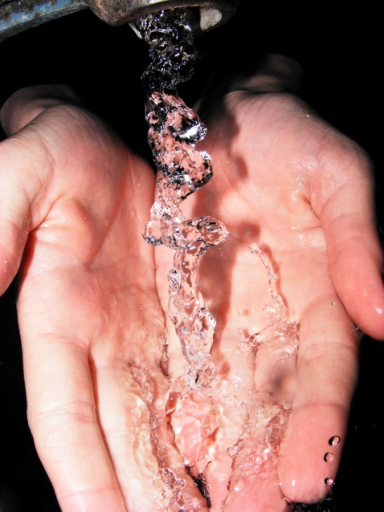
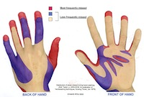
Hand Hygiene
Work associated risks
Visibly dirty/contaminated:
  Soap and water!
  At least 15 seconds of rubbing all hand surfaces
  Frequently missed:
    Under/around nails
    In creases of knuckles
    Wrist
    Creases in palms of hands
    Under rings/watch
Notes:
Besides the feet and genitalia, the hands are probably the dirtiest part of the body. That’s because we do so much with them. What you see on the slide are general guidelines...If the hands are visibly dirty or contaminated, you want to use soap and water. A standard is at least fifteen seconds of rubbing all hand surfaces and that does not include time to wet or rinse hands. Just the washing should last fifteen seconds. Singing the alphabet or Jingle Bells or Twinkle Twinkle Little Star is about 15 seconds, but if you’re not into childish tunes, you can adapt a song you like to the process. Please do note that there are areas frequently missed. This is demonstrated with every group of students I’ve worked with in the glo germ activity and include under the nails, around the nail, in the creases of knuckles, up the wrists, in the creases of the palms of the hands or under rings or watches. I recommend purposely focusing on these areas and you don’t have to worry about the fifteen seconds passing. Cleaning out from under the fingernails is recommended in really clean settings, like patient care settings.

Slide 24
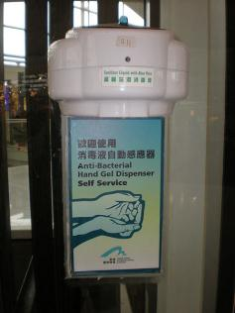
Work associated risks
NOT visibly dirty/contaminated
Hand gel x 3 applications
  Rub on all hand surfaces until dry
  At least 60% alcohol
  Remember ‘anti-bacterial’
  NOT anti-viral... Anti-fungal... or anti-protozoan...
  Soap and water after three applications
Notes:
I once read a study about hundreds of doctors and nurses in a hospital and the regularity of handwashing. They found that nurses only washed their hands when they should about 60% of the time and doctors were even worse...less than 50%! In the same study they determined causes to be inconvenient sink locations, unwillingness to take the time for a full handwashing due to a heavy workload and things like that. Thus the introduction of antimicrobial hand gel. Now, I am one of their biggest supporters because infection rates in hospitals has dropped since their introduction. It’s a convenient and easy way to clean the hands. You do need to rub it on all hand surfaces, but can do that walking to your next job function...you don’t have to stay at a sink. However, enough can’t be said about the error in using this as the only form of hand hygiene...First, it must be at least 60% alcohol to be effective. And, not surprisingly, they are finding it does not kill all microbes...I say not suprisingly because sometimes it’s called antimicrobial...and sometimes it’s called antibacterial...implying it kills bacteria...not the other three categories of microbes. The reality is it does kill many of the others, just not all. If hand gel is made available to you please use it, but remember to wash with soap and water after three applications.

Slide 25
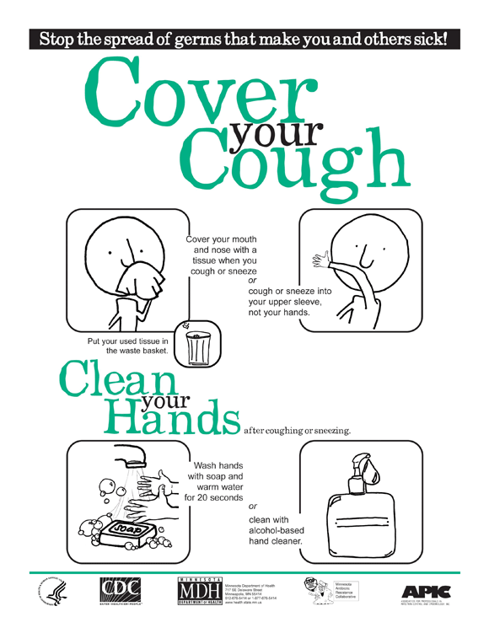
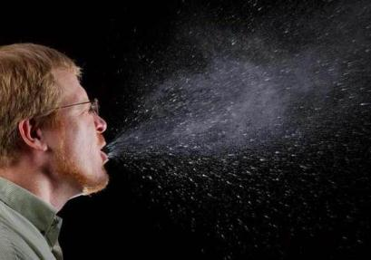
.
Cough
Etiquette
Work associated risks
Safe Work Practices
Strategies to prevent exposure to BBP
Notes:
Continuing with our list of examples, our next safe work practice is cough etiquette. We’ve all been taught this since childhood. This poster is an example of reminders being placed in public and work areas. Many microbes, including MRSA are found in the airways and a cough or sneeze force air out at a rate between 40 and 100 miles per hour. You can see that in the right image there. The area where microbes can land is pretty big. They’ve traditionally said three feet is the standard, but I question this. Mucus leaving your nose and mouth at 100 miles an hour is going to go further than spray leaving at 40... If you can’t get a tissue, at least cough or sneeze into your shoulder. And remember, it’s not just your nose to cover in a sneeze or your mouth to cover in a cough. Cover both the nose and the mouth when coughing or sneezing. If you cough or sneeze into your hands wash well and wash at once!

Slide 26
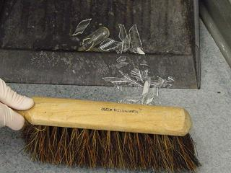
Plan before doing...
Safe Work Practices
Strategies to prevent exposure to BBP
Notes:
The next safe work practice is to plan before doing. This is a general safety step in all settings. Acting on autopilot in the work setting is the cause of numerous accidents. Rushing is never a good idea either. For example, say a co-worker cuts himself with broken glass. Many see the blood and panic...got to get it stopped. Instead, we need to pause for a second and NOT act on instinct. That person would have to be losing an enormous amount of blood to be at risk of death before I could put a pair of gloves on. I would really hesitate before touching another’s blood without gloves on. It’s also a good idea to plan the cleanup to prevent exposure. Say the cause of the co-worker’s injury was from broken glass. If you jump in without reading that you should sweep up glass rather than pick it up, you increase your risks of cut yourself with the same contaminated glass...and increase your risks of contracting one of those deadly bloodborne pathogens we’ve talked about.

Slide 27

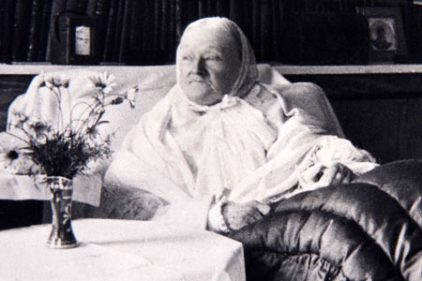
Work associated risks
Care of the environment
Safe Work Practices
Strategies to prevent exposure to BBP
Notes:
Now we move into care of the work environment. Florence Nightingale, who is shown in the image there, is considered the founder of the field of nursing. Most of us have heard of her, but don’t know much beyond that. She was a lady who was born to a wealthy family around 1830. But, unlike most wealthy families, her father allowed her to go to school. Educated women challenged the status quo, so this was not popular at the time. Women of wealthy families could sometimes take classes related to the arts, but certainly not the science, math and philosophy classes Ms. Nightingale took. A highly religious woman, she felt a call to help humans at their most vulnerable. Through her father’s connections, she was able to defy another standard of the time by bringing a team of nurses she had trained to an army hospital during the Crimean War. Women were considered too fragile for the realities of war, so you can imagine the protest. Before she and the team came to the army hospital the infection rates were extremely high – estimated at about 90%. That is 9 out of 10 people entering the hospital without an infection and leaving with an infection if they didn’t die. An estimated 1 in 2 died from that infection. To give you an idea...linen was so dirty it was stiff, old blood and other body fluids were on the floor of the operating room, slop pots used to go to the bathroom and vomit were emptied and never cleaned and you couldn’t see through the windows...if the curtains were left open, which they weren’t. And this says nothing about hand hygiene, use of disinfectants or cleaning surgical tool...which were non existent.

Slide 28
Work associated risks
Care of the environment
Safe Work Practices
Strategies to prevent exposure to BBP
Notes:
One of Florence Nightingale’s biggest sacred cows was cleanliness – both of the environment and the person. She is one of the first to make the connection between a contaminated environment and infection rates. So, when she entered the army hospital, you can imagine her response. She and her team’s first project? Throwing open the curtains and scrubbing that place from floor to ceiling - attic to basement. Then teaching the army doctors and assistants about hand hygiene and disinfectants. As you can imagine, the infection rates and death rates plummeted to close to what we see today.

Slide 29
Work associated risks
Care of the environment
Safe Work Practices
Strategies to prevent exposure to BBP
Notes:
But even today, most people in society don’t fully understand infection control. For example, they don’t realize that microbes can travel. It’s a waste of time to keep most of room clean if you are leaving part of that room contaminated to highly contaminated. Microbes can move across a surface, can be blown onto a surface and can do what we call ‘aerosolize.’ Like an aerosol can. This means flushing the toilet results in a fine spray of mist contaminated with stool or urine particles and the microbes that are in them. Where those drops land, the microbes land.

Slide 30
Work associated risks
Care of the environment
Safe Work Practices
Strategies to prevent exposure to BBP
Notes:
Before we leave this slide, students are fascinated by another story of Florence Nightingale, so I’ll take a few minutes to tell it. Florence established a routine for working that included sending the nurses home at the end of the day, but staying there the whole night. This was significant because no one else stayed...not the doctors or their assistants. There was a mind set of “if they survive the night we’ll take care of them then.” So Florence took a rocking chair and placed it at the end of one of the halls and every couple of hours would walk the halls with her lamp illuminating the way. Many of the army soldiers journals mention how this impacted their stay – they now felt safe and cared for whenever they saw the glow of the lamp in the hall. A very self-sacrificing lady and worthy of her reputation.

Slide 31
Decontamination of equipment & surfaces
Work associated risks
Infection Control Today: Know your surface! (http://www.infectioncontrol.com )
Influenced by:
# of people
Amount of activity
Air circulation
Amount of moisture
Presence of materials that promote microbial growth
Orientation of surface (horizontal/vertical)
All work surfaces cleanable?
Microbes thrive:
Moist
Warm
Dark
Little air flow
Notes:
Now, there area rules out there for decontamination of equipment and surfaces, especially medical equipment and surfaces. In an article titled Know Your Surface, Infection Control Today identifies that not all surfaces are equally contaminated. They clarify the level of contamination is influenced by a number of factors...the number of people who visit the area – the more that do, the higher the contamination. The amount of activity - the more activity the more the chance of microbes leaving the host and landing on the surface...but on the other hand, microbes have a better chance of surviving in less mobile areas...more on that in a minute. Air circulation is a big one. As you can see from the Florence Nightingale story, we’ve known for some time that cleaning affected infection rates...this and hand hygiene have been around for a while. In addition, someone got the idea of quarantining people known to have bad infections. So, healthcare workers were a bit perplexed as to why infections were occurring when they practiced such meticulous infection control and isolated those with infections. Finally, someone made the connection that microbes were moving through the air vents of the hospital. Once they created a quarantine room where the air did not circulate to the rest of the hospital, but exchanged air with the outside instead, again, the problem disappeared.

Slide 32
Decontamination of equipment & surfaces
Work associated risks
Infection Control Today: Know your surface! (http://www.infectioncontrol.com )
Influenced by:
# of people
Amount of activity
Air circulation
Amount of moisture
Presence of materials that promote microbial growth
Orientation of surface (horizontal/vertical)
All work surfaces cleanable?
Microbes thrive:
Moist
Warm
Dark
Little air flow
Notes:
The amount of moisture is another big one. There is a saying that microbes thrive in moist, warm, dark environments with little air or water flow. However, a warm, dark environment with little air flow without the presence of moisture has minimal risk. That clarifies the impact of moisture. This is a good time to point out another infection control principal. Microbes can move through tightly woven wet surfaces, but can’t through tightly woven dry surfaces. For example...say you are washing your hands and use a paper towel to turn off the faucet...if you use a wet paper towel you might as well just grab the faucet, because the microbes on that faucet can move through the paper towel onto your hands. Microbes are naturally moist. If you use a dry paper towel they get stuck on the other side of the paper towel rather than move through. A good idea to use a paper towel, but make sure it’s dry. Surface contamination is also influenced by the presence of materials that promote microbial growth. Now, this is a big one...and the possibilities are endless when it comes to microbes. Microbes aren’t around to make our lives difficult. There is a process called the rotting cycle. They are suppose to cause rot because that causes decomposition and allows the cycle of growth and decomposition to be cyclic. However, any organic matter is prime food for microbes. It can include food itself or body substances. That microbe isn’t picky. For example, failing to clean up a food spill in the break room or failing to wash the toilet for a month. The microbe will thrive in both circumstances. Finally...orientation of surfaces will influence level of contamination. Gravity results in fewer microbes sticking to vertical surfaces... You see this when you dust a set of shelves. The dust (and therefore microbes) settles on the horizontal surfaces at a much higher rate than vertical surfaces. Obviously, the best situation is one where all work surfaces are cleanable and not all are. But do your best with what you have...be a force for change if you suspect high contamination of a non-cleanable work surface.

Slide 33
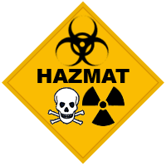

Disinfectants:
Many lists of disinfectants based on type of work environment.
Notes:
No matter where you work, we all have housekeeping responsibilities. We all also have responsibility to take the initiative if we see a contaminated surface needing attention. In a health setting, I may need to call a housekeeper or might be the one to clean the surface myself, but housekeepers should be the ones cleaning highly contaminated surfaces such as toilets. Otherwise we risk becoming highly contaminated ourselves... The housekeeper does not touch patients, so is the more appropriate personnel for the job. There are many lists of disinfectants to use based on your type of work environment. If you work in a healthcare setting, check out the CDC website on disinfectants and their use. If you work in an industrial or manufacturing setting, the EPA has their lists of disinfectants and their use. As you know, they each are considered hazardous materials, so have their own page in the hazardous materials manual – use, storage, cleaning up a spill...those kinds of things. As someone who nearly killed herself by failing to use gloves with a carpet cleaner...I am a big promoter of reading labels and hazmat manuals. But I digress...

Slide 34

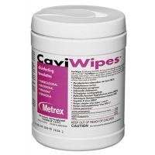
Disinfectants:
Many lists of disinfectants based on type of work environment.
Disinfectants are not equal!
Notes:
No matter the setting, remember that disinfectants are not equal and many have little impact on bloodborne pathogens.

Slide 35
Disinfectants:
Many lists of disinfectants based on type of work environment.
Disinfectants are not equal!
Type of solution to use for bloodborne pathogen contamination:
  Medical grade chemicals (Chlorhexidine; Cavicide)
  Fresh 10:1 water to bleach solution
  NOT alcohol – dries too fast
Notes:
There are medical grade disinfectants such as chlorhexidine or Cavicide – aka cavi wipes. Or, a less expensive but effective alternative, a fresh 10:1 water to bleach solution. Both concentration and freshness of the solution are important. Alcohol is great for cleansing the skin before an injection, but dries to quickly to be an effective disinfectant for surfaces, plus is highly flammable, so it is not used for that purpose.

Slide 36
Disinfectants:
Many lists of disinfectants based on type of work environment.
Disinfectants are not equal!
Type of solution to use for bloodborne pathogen contamination:
  Medical grade chemicals (Chlorhexidine; Cavicide)
  Fresh 10:1 water to bleach solution
  NOT alcohol – dries too fast
Employer should have list of areas to be cleaned, interval of cleaning and who is assigned to clean
Notes:
I’ve included some other general guidelines such as assuring your employer has a process for regularly cleaning the environment – all of the environment. This should include the areas to be cleaned, how often and who is assigned which jobs from cleaning out the fridge to cleaning the bathrooms. AND of course, someone watching to assure It’s being done at the times it’s assigned.

Slide 37
Disinfectants:
Many lists of disinfectants based on type of work environment.
Disinfectants are not equal!
Type of solution to use for bloodborne pathogen contamination:
  Medical grade chemicals (Chlorhexidine; Cavicide)
  Fresh 10:1 water to bleach solution
  NOT alcohol – dries too fast
Employer should have list of areas to be cleaned, interval of cleaning and who is assigned to clean
Follow manufacturer instructions for contact time!
Notes:
The last entry there refers to contact time...one of the reasons alcohol is ineffective. If I take a disinfectant, spray it onto a surface and wipe it right off microbes can survive. Some wait time is in order. Bleach solutions, for example, needs to stay in contact with the surface for at least two minutes to be effective. I’ll share a story to stress another point related to this. My husband was in a dirt bike accident and had some road rash. It’s standard to ask about the last tetanus shot with road rash and my husband was far enough out that he was due for a booster. The nurse came in with the shot and an alcohol swab. I noticed she failed to wash her hands, but assumed she had before preparing the shot. She also didn’t wear gloves. So, she cleanses my husband’s arm with the alcohol swab. Then let go of the arm, started pressing on the area she cleansed to find the correct location. I assumed she would clean the arm again, since she had touched the site after cleaning it...but before I could even get a word out...she injected the needle. I spoke up and asked her about it...I’m a nurse educator after all and feel obligated to speak up when I see an incorrect practice. She got a bit flustered and left the room. We went home. In the middle of the night my husband woke me up. His arm was twice it’s normal size and the worst area wasn’t the road rash...it was the spot where the nurse gave the injection. Healthcare has enough of heavy penalties for mistakes, so I didn’t sue, but did call and let them know of the outcome...which was met with defensiveness...sigh.

Slide 38

Work associated risks
Hepatitis B Vaccination
Occupational infection rates have dropped 95% since the vaccine became standard (1982)
Safe Work Practices
Strategies to prevent exposure to BBP
Notes:
Our next safe work practice is the hepatitis B vaccine. While there isn’t one for hepatitis C, there is for hepatitis B, because those who might be exposed to blood or OPIM are at great risk of contracting the disease than the general public. It’s not really a strategy to prevent exposure, but instead a strategy intended to react the second a person is exposed. Since it became standard, the occupational infection rates have dropped by 95%!

Slide 39
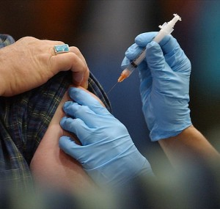
Hepatitis B Vaccination
Three dose series
  Initial dose – w/in 10 days of hire
  One month after initial dose
  Six months after initial dose
Work associated risks
Safe Work Practices
Strategies to prevent exposure to BBP
Notes:
The vaccine is a three dose series given over six months. First, the initial dose, followed a month later by the second and 5 months later by the third. This is a bit problematic in general society because people often forget to come back for that third dose. Your employer is required to track and assure the third dose, so the problem is less apparent in work settings.

Slide 40
Hepatitis B Vaccination
Three dose series
  Initial dose – w/in 10 days of hire
  One month after initial dose
  Six months after initial dose
Booster not required
  Check immunity if exposed (blood test)
  May give additional hep B vaccine or medication that stimulates immune system
Work associated risks
Safe Work Practices
Strategies to prevent exposure to BBP
Notes:
The vaccine is considered a life-long immunization, not requiring a booster. Instead, if you become exposed, they draw your blood to check the level of immunity. If you’re low, they then give a booster or give a medication, called immunoglobulin, that boosts your immune system.

Slide 41
Hepatitis B Vaccination
Three dose series
  Initial dose – w/in 10 days of hire
  One month after initial dose
  Six months after initial dose
Booster not required
  Check immunity if exposed (blood test)
  May give additional hep B vaccine or medication that stimulates immune system
Can decline (assume liability) – but can also change mind
Work associated risks
Safe Work Practices
Strategies to prevent exposure to BBP
Notes:
As with most immunizations, you can decline the vaccine – usually by signature – but whatever you sign will probably ask you to verify that you understand you will then assume all liability. This means workman’s comp won’t cover you if you get hepatitis B as part of your work and the employer has no obligation to do things like pay for your care or leave your position open while you recover...think long and hard before you decline it.

Slide 42
Hepatitis B Vaccination
Three dose series
  Initial dose – w/in 10 days of hire
  One month after initial dose
  Six months after initial dose
Booster not required
  Check immunity if exposed (blood test)
  May give additional hep B vaccine or medication that stimulates immune system
Can decline (assume liability) – but can also change mind
No cost to employee
Work associated risks
Safe Work Practices
Strategies to prevent exposure to BBP
Notes:
The last thing we’ll discuss related to the hepatitis B vaccine is that those working in settings where they are at risk of exposure to blood or OPIM cannot be charged for the vaccine.

Slide 43
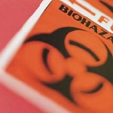
Handling, disposing of, labeling and transport of biohazard
Biohazard: A biological agent or condition that is a hazard to humans or the environment (Merriam-Webster online)
  Sources:
  Human (or animal) blood
  Human (or animal) OPIM
  Infected human waste
  Used sharps
  Laboratory/clinical waste contaminated with blood, tissues, cells or OPIM
Safe Work Practices
Notes:
Next it’s important to discuss handling, disposing of, labeling and transport of biohazard. A biohazard is defined by Merriam Webster online as A biological agent or condition that is a hazard to humans or the environment. Some expand this to include other animals...just realize if it has blood or OPIM it can infect. The sources shown there include human or animal blood or OPIM. Or infected human waste.

Slide 44

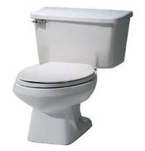
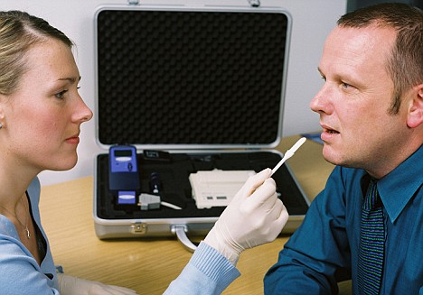
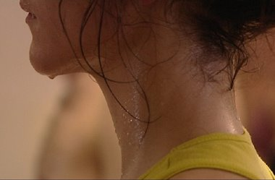
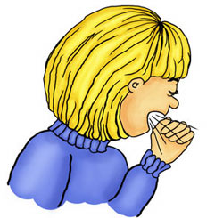
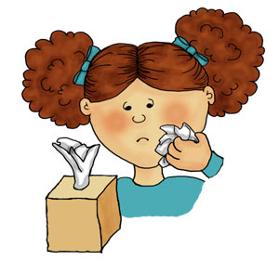

1
2
3
4
NOT O.P.I.M
5
6
7
Notes:
If you recall this slide from part II of this presentation, #2 there includes stool and urine and #7 is vomit. Unless contaminated with blood or OPIM, they are not infectious...this is supported by the CDC...but they can become contaminated with blood or OPIM. For example, the person who drinks heavily and is bleeding in the stomach or bowel. Their vomit or stool will contain blood, so is potentially infectious. Now, it might not appear as frank blood. Digest blood in vomit resembles wet coffee grounds and stool is black and tar like.

Slide 45
Handling, disposing of, labeling and transport of biohazard
Biohazard: A biological agent or condition that is a hazard to humans or the environment (Merriam-Webster online)
  Sources:
  Human (or animal) blood
  Human (or animal) OPIM
  Infected human waste
  Used sharps
  Laboratory/clinical waste contaminated with blood, tissues, cells or OPIM
Notes:
Obviously the last two sources here are big ones... used sharps and laboratory or clinical waste contaminated with blood, tissues, cells or OPIM. This presentation is for various populations, so I want to spend a few minutes on these two. Even if you are not a healthcare worker, please listen as I will include things for all settings in that discussion.

Slide 46
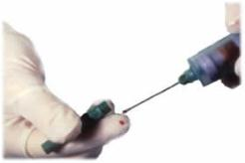
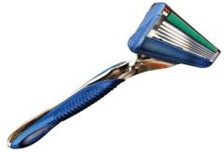

Sharp Safety
Sharp: Any instrument or device that can cut or puncture skin
  Medical: Needles, scalpals, etc.
  Non-medical: Glass, razors, metal, wires, etc.
Notes:
First, sharps...A sharp includes any instrument or device that can cut or puncture skin. The obvious medical devices include needles and scapels, but we also need to consider medical devices that can cut, but aren’t intended to – like a laboratory pipette or beaker – and non medical sources like broken glass like bottles, razors, metal, wires and the like. Some forget that a blunt impact can break something after it is put in the garbage. Too often we see housekeepers or custodians getting cut from glass that broke after it was added to the garbage. Remember that when placing glass into a trash receptacle.

Slide 47
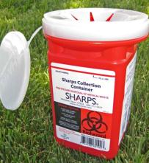
Sharp Safety
Sharp: Any instrument or device that can cut or puncture skin
  Medical: Needles, scalpals, lab pipette’s etc.
  Non-medical: Glass, razors, metal, wires, etc.
Place needles directly into a sharps container
Notes:
Now for ways to avoid getting stuck! There are distinct rules about sharp safety...and those who are in denial about their own mortality. Please don’t be one of those and work in healthcare or other areas of potential blood born pathogen exposure. The first rule stresses the importance of never leaving a sharp laying around. There is an old standard we see from time to time – a standard that preceded our understanding of infection control. That is, a healthcare worker giving an injection or starting an IV line poking the needle into a mattress to assure he or she doesn’t get stuck while finishing the procedure. Unfortunately too many have forgotten it was there, it gets caught in the linen when bedding is changed and we have a housekeeper getting stuck when laundering the linen. If you give injections as part of your job, know where your sharp is at all time and get into the habit of going directly to the sharps container after the injection...no exceptions...bringing one with you if necessary.

Slide 48
Sharp Safety
Sharp: Any instrument or device that can cut or puncture skin
  Medical: Needles, scalpals, etc.
  Non-medical: Glass, razors, metal, wires, etc.
Place needles directly into a sharps container
Place ANY sharp in a rigid, puncture proof container
Notes:
Next...No sharp should be placed in something that increases the risk of either breaking the item or cutting yourself when disposing of the item, like a garbage sack...even when not contaminated with biohazard...because someone can later step on or bang the bag against a surface, breaking the glass item. If not contaminated...a puncture proof container. If contaminated, a puncture proof container labeled as biohazard. You could even place the container inside a biohazard bag.

Slide 49
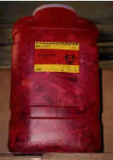
Sharp Safety
Sharp: Any instrument or device that can cut or puncture skin
  Medical: Needles, scalpals, etc.
  Non-medical: Glass, razors, metal, wires, etc.
Place needles directly into a sharps container
Place ANY sharp in a rigid, puncture proof container
Never allow hand to enter ‘dip’ opening
Replace sharps container when ¾ full
  DON’T overfill
  Never attempt to re-open a closed sharps container
Notes:
The next two are related to two practices that increase a person’s risk of a needle stick. The first is putting any part of your hand into the dip of a sharps container. The second is failing to empty a sharps container until it is bulging full. Sharps can be long...4 to 6 inches long. Say someone dropped the sharp in there and it is sitting with the needle up and in the opening. You put a sharp in the opening and get stuck. Obviously emptying the container when it is ¾ full will reduce this risk, but it’s also a good idea to drop the sharp from far just enough up that you hand or fingers never enter the opening. If you do see a needle sitting in the opening, be proactive and give the container a gentle shake so it will fall into the container. If that doesn’t fix the problem don’t try to move it with your hands. Some hemostats or tongs will work. Also stressed? When a container is full we can lock the lid closed. It’s important we never reopen a closed and sealed sharps container. The force to do so can cause contaminated sharps to fly in all directions.

Slide 50
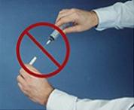
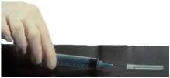
Sharp Safety
Sharp: Any instrument or device that can cut or puncture skin
  Medical: Needles, scalpals, etc.
  Non-medical: Glass, razors, metal, wires, etc.
Place needles directly into a sharps container
Place ANY sharp in a rigid, puncture proof container
Never allow hand to enter ‘dip’ opening
Replace sharps container when ¾ full
  DON’T overfill
  Never attempt to re-open a closed sharps container
Avoid recapping – if you must, use a cap holder or the scoop method and use one hand!
Notes:
Next...avoid recapping used needles. Now, there are slight risks with any needle stick, but the real risk of infection comes from the contaminated sharp. I am stunned at the number of times I still see people recapping used needles. I can only guess a type of denial is going on, but from that data on occupational hepatitis and HIV exposures...we know this is the number one way of exposure. Don’t be the one who has to learn every lesson the hard way. This is too hard of a lesson for anyone.

Slide 51
Handling, disposing of, labeling and transporting laboratory or clinical waste contaminated with blood, tissues, cells or OPIM
  Wear appropriate personal protective equipment when handling biological waste
Notes:
Our final topic of safe work practices is related to handling, disposing of, labeling and transporting clinical waste contaminated with blood, tissues, cells or OPIM. We have four concepts we’re talking about here. Handling, disposing, labeling and transporting. If not understood or done incorrectly the risks of exposure skyrocket. First is to wear appropriate personal protective equipment when handling biological waste. We’re going to move to protective equipment as our final topic of this presentation, but I wouldn’t want to exclude that here as its probably the most important step of all.

Slide 52
Handling, disposing of, labeling and transporting laboratory or clinical waste contaminated with blood, tissues, cells or OPIM
  Wear appropriate personal protective equipment when handling biological waste
  Infectious or pathogenic waste must be labeled and held in a closed/covered leak-proof container & may not be stored greater than 24 hrs before moving from clinical areas
Notes:
The next two we’ve already touched on a bit. First infectious or pathogenic waste must be labeled and held in a closed or covered leak-proof container in clinical areas. And those containers must be emptied at least every 24 hours. We’ve all seen those biohazard containers at our doctor’s offices. The OSHA rules apply to those. They must be emptied every 24 hours. Do you have any suspicions, based on what you know so far, about why that is? Well, the longer that biohazard stays, the more microbes can reproduce or travel.

Slide 53
Handling, disposing of, labeling and transporting laboratory or clinical waste contaminated with blood, tissues, cells or OPIM
  Wear appropriate personal protective equipment when handling biological waste
  Infectious or pathogenic waste must be labeled and held in a closed/covered leak-proof container & may not be stored > than 24 hrs before moving from public or clinical areas
  Double bag if outside of first bag is contaminated
Notes:
When removing the biohazard bag from the biohazard container, it the outside of the bag is contaminated it is appropriate to double bag the item.

Slide 54
Handling, disposing of, labeling and transporting laboratory or clinical waste contaminated with blood, tissues, cells or OPIM
  Wear appropriate personal protective equipment when handling biological waste
  Infectious or pathogenic waste must be labeled and held in a closed/covered leak-proof container & may not be stored > than 24 hrs before moving from public or clinical areas
  Double bag if outside of first bag is contaminated
  Medical sharps in labeled sharps container: Rigid, leakproof, closeable
Notes:
And, one we’ve seen before...Medical sharps are to be placed in a labeled sharps container. And the container needs to be rigid, leakproof and closeable.

Slide 55
Handling, disposing of, labeling and transporting laboratory or clinical waste contaminated with blood, tissues, cells or OPIM
  Wear appropriate personal protective equipment when handling biological waste
  Infectious or pathogenic waste must be labeled and held in a closed/covered leak-proof container & may not be stored > than 24 hrs before moving from public or clinical areas
  Double bag if outside of first bag is contaminated
  Medical sharps in labeled sharps container: Rigid, leakproof, closeable
  Do not put liquids into biohazard bags
Notes:
Next, we don’t put liquids into biohazard bags. This is talking about liquid only and more than say a teaspoon or two. So for example an IV bag that has not been emptied or a bag of blood that was opened, but never infused. Remember that the liquid may not be contaminated until it mixes with things in the bag. The bag may be punctured and that contaminated liquid can spill all over the surface it’s sitting on.

Slide 56
  Biohazard may be stored onsite for up to 30 days if the storage area is locked, kept tidy and labeled as a biohazard storage area
Notes:
Now, this next one may not apply to you. Biohazard may be stored onsite for up to 30 days if the storage area is locked, kept tidy and labeled as a biohazard storage area. Non-medical settings likely won’t have an onsite biohazard storage. This is usually a bulk storage area where multiple biohazard are stored until they can be transported from the facility. So that doctor’s office that must empty their mini biohazard containers every 24 hours can place those bags into this storage area until it is transported from the facility.

Slide 57
  Biohazard may be stored onsite for up to 30 days if the storage area is locked, kept tidy and labeled as a biohazard storage area
  Do not mix biohazard with other types of waste
    Radioactive
    Chemical
    Drugs
Notes:
Just like most hazardous materials, we don’t mix this one with others. That includes radioactive waste, chemical waste or drugs.

Slide 58
  Biohazard may be stored onsite for up to 30 days if the storage area is locked, kept tidy and labeled as a biohazard storage area
  Do not mix biohazard with other types of waste
    Radioactive
    Chemical
    Drugs
  Regular Trash?
    No red bags
    No sharps containers
    Nothing with a biohazard warning label
Notes:
Now, so we’re clear...we should never find materials contaminated with blood or OPIM in regular trash. No biohazard bags, no sharps containers...nothing with a biohazard warning label!

Slide 59
  Biohazard may be stored onsite for up to 30 days if the storage area is locked, kept tidy and labeled as a biohazard storage area
  Do not mix biohazard with other types of waste
    Radioactive
    Chemical
    Drugs
  Regular Trash?
    No red bags
    No sharps boxes
    Nothing with a biohazard warning label
  Laws about transport of biohazard – know them before transporting (Transportation Department)
Notes:
And last, but not least...transport of the biohazard from the place of employment to it’s permanent disposal area. This is often a burn facility that will destroy the waste...not a public garbage dump. There is almost never a time when a healthcare or industrial worker has to transport their own biohazard. Even at ISU we don’t transport biohazard, but instead call our biohazard department. If you are required to transport it, just like radioactive waste transport laws there are laws about transporting biohazard. The Idaho Transportation Department website has information on hazardous material transport, as all states do, but a call may be more helpful for this specific type of biohazard.

Slide 60
All intended to keep you and those around you safe!
Basis of Standard Precautions:
Work associated risks
Engineering controls
Safe work practices
Personal protective equipment
Notes:
Ok, so we’ve covered two of the Standard Precautions categories: engineering controls and safe work practices. Now let’s discuss our final category, protective equipment. As I already hinted...this is probably the most important part of the process.

Slide 61
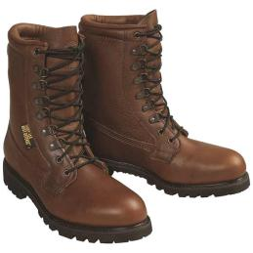
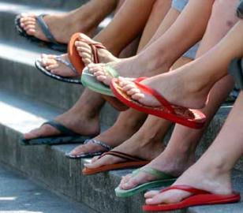
Personal protective equipment (PPE)
Work associated risks
Gloves
Body coverings
Mouth, nose, eye protection
Ventilation device (mouthpiece)
Footwear
Notes:
There are protective equipment all over the place...from the guard on the saw that protects us from the blade to the hard hat that protects our heads. Here we are talking more personal...Personal protective equipment. No matter the setting, personal protective equipment fall into four general categories. Gloves; something to protect the body; mouth/nose and/or eye protection; footwear and ventilation devices. The ventilation device is for those who perform CPR, so they don’t have to really be mouth to mouth with the victim. In the last entry I expand protective equipment to include footwear. To give you an example of what I’m talking about, in industrial settings where large or sharp equipment or supplies are used, steel toed boots are standard. This is to prevent your blood from spilling if something falls on your foot. That would expose another to your blood. In medical settings we don’t wear steel toed boots, but we do avoid open toed shoes. Imagine a used shot needle falling out of my hand and landing on my foot. Obviously there is little protection if we have nothing covering the foot, so that’s pretty standard across all health environments. Plus there is the risk of an open sore on the foot with a biohazard exposure. AND...That’s about all I’m going to say about footwear, but do want to spend a bit of time on the other three types of protective equipment.

Slide 62
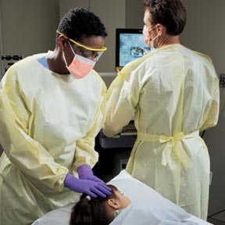
Employer responsibilities for PPE:
Work associated risks
ANY setting where there is a risk of exposure to blood or OPIM
Notes:
Your employer has obligations surrounding PPE in any setting where there is a risk of exposure to blood or OPIM.

Slide 63
Employer responsibilities for PPE:
Work associated risks
ANY setting where there is a risk of exposure to blood or OPIM
Supplied by employer – even individual needs
Notes:
First, your employer must purchase them...not you...even if needing special equipment like latex free gloves when the worker has a latex allergy.

Slide 64
Employer responsibilities for PPE:
Work associated risks
ANY setting where there is a risk of exposure to blood or OPIM
Supplied by employer – even individual needs
Must:
  Be stored in a clean, dry area
  Be available (informed employees)
  Fit
  Be appropriate for the task
  Cleaned or disposed of properly
Notes:
Then they must store them in a clean, dry area, make them available and inform employees of the location, assure they fit, are appropriate for the task and are cleaned or disposed of properly. I am going to come from a medical angle with this one because I want to stress that while things are definitely different from setting to setting, we respond to biohazard in similar ways. I’ll ask you to transfer the information to your setting, but will give examples.

Slide 65
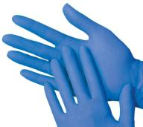
Gloves
Work associated risks
Know your size before needing
Notes:
First the rules about gloves. You don’t want to be scurrying to try on gloves or wear the wrong size in an emergency, so it’s a good idea to try a pair on before the emergency occurs.

Slide 66
Gloves
Work associated risks
Know your size before needing
Medical grade for biohazard (not utility)
Notes:
They should be medical grade gloves. Medical grade gloves are prepared in a cleaner fashion than utility gloves. Utility gloves are for handling chemicals.

Slide 67
Gloves
Work associated risks
Know your size before needing
Medical grade for biohazard (not utility)
Single use, disposable
Notes:
They are always single use and disposable. Don’t wash or reuse them.

Slide 68
Gloves
Work associated risks
Know your size before needing
Medical grade for biohazard (not utility)
Single use, disposable
Application easy – inspect for holes/damage
Notes:
To apply the gloves is easy, but you should inspect them for damage or holes before putting them on.

Slide 69
Gloves
Work associated risks
Know your size before needing
Medical grade for biohazard (not utility)
Single use, disposable
Application easy – inspect for holes/damage
Removal of contaminated gloves
Notes:
Removal has to be done in a certain way to avoid exposing you to the biohazard. Start by grabbing the OUTSIDE of the first glove at the wrist and pulling it off. Then place that glove in the palm of the still-gloved hand. The second glove is removed by placing the fingers INSIDE the cuff of the second glove and pull it off and over the other glove. So one glove is inside of the other. You then put them in a biohazard container and wash. We wash after glove removal because of the size of the pathogen. They are really tiny and there is a risk of a pin size hole in the glove that the microbe could move through. Obviously there are few incidents that would not require the use of gloves if blood or OPIM were present. They are in all blood spill kits, where the rest aren’t.

Slide 70
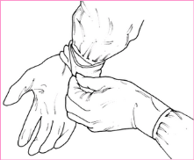
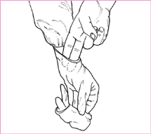
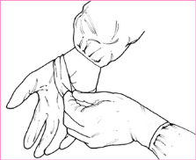
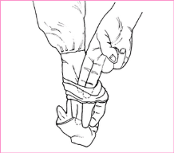
Gloves
Work associated risks
  Grab OUTSIDE of the first glove at wrist and pull off
  Place that glove in the palm of the gloved hand.
  Push fingers INSIDE cuff of second glove and pull off and over other glove
  Dispose in biohazard container
  Wash hands immediately
Notes:
Removal has to be done in a certain way to avoid exposing you to the biohazard. Start by grabbing the OUTSIDE of the first glove at the wrist and pulling it off. Then place that glove in the palm of the still-gloved hand. The second glove is removed by placing the fingers INSIDE the cuff of the second glove and pull it off and over the other glove. So one glove is inside of the other. You then put them in a biohazard container and wash. We wash after glove removal because of the size of the pathogen. They are really tiny and there is a risk of a pin size hole in the glove that the microbe could move through. Obviously there are few incidents that would not require the use of gloves if blood or OPIM were present. They are in all blood spill kits, where the rest aren’t.

Slide 71
Gloves
Work associated risks
Know your size before needing
Medical grade for biohazard (not utility)
Single use, disposable
Application easy – inspect for holes/damage
Removal of contaminated gloves:
  Grab OUTSIDE of the first glove at wrist and pull off
  Place that glove in the palm of the gloved hand.
  Push fingers INSIDE cuff of second glove and pull off and over other glove
  Dispose in biohazard container
  Wash hands immediately
Public perception: ALL gloves are contaminated
Notes:
If your job requires you to regularly wear gloves you should be aware that the public perceives ALL gloves to be contaminated.

Slide 72
OSHA:
Gloves. Gloves shall be worn when it can be reasonably anticipated that the employee may have hand contact with blood, other potentially infectious materials, mucous membranes, and non-intact skin; when performing vascular access procedures except as specified in paragraph (d)(3)(ix)(D); and when handling or touching contaminated items or surfaces.
Work associated risks
Notes:
So…what does OSHA say about gloves? Gloves shall be worn when it can be reasonably anticipated that the employee may have hand contact with blood, other potentially infectious materials, mucous membranes, and non-intact skin; when performing vascular access procedures except as specified in paragraph (d)(3)(ix)(D); and when handling or touching contaminated items or surfaces.

Slide 73
OSHA:
Gloves. Gloves shall be worn when it can be reasonably anticipated that the employee may have hand contact with blood, other potentially infectious materials, mucous membranes, and non-intact skin; when performing vascular access procedures except as specified in paragraph (d)(3)(ix)(D); and when handling or touching contaminated items or surfaces.
Disposable (single use) gloves such as surgical or examination gloves, shall be replaced as soon as practical when contaminated or as soon as feasible if they are torn, punctured, or when their ability to function as a barrier is compromised.
Work associated risks
Notes:
Disposable (single use) gloves such as surgical or examination gloves, shall be replaced as soon as practical when contaminated or as soon as feasible if they are torn, punctured, or when their ability to function as a barrier is compromised.

Slide 74
OSHA:
Gloves. Gloves shall be worn when it can be reasonably anticipated that the employee may have hand contact with blood, other potentially infectious materials, mucous membranes, and non-intact skin; when performing vascular access procedures except as specified in paragraph (d)(3)(ix)(D); and when handling or touching contaminated items or surfaces.
Disposable (single use) gloves such as surgical or examination gloves, shall be replaced as soon as practical when contaminated or as soon as feasible if they are torn, punctured, or when their ability to function as a barrier is compromised.
Disposable (single use) gloves shall not be washed or decontaminated for re-use.
Work associated risks
Notes:
Disposable (single use) gloves shall not be washed or decontaminated for re-use.

Slide 75
Latex Allergy
Becoming more common
Repeated exposure to latex
Symptoms start mild – skin irritation
Progress over time to mild allergy symptoms: Hives, runny nose, itchy eyes or nose, irritated throat
Anaphylactic shock possible
Options:
  To avoid development of an allergy, wear gloves only when needed
  Nitrile or vinyl gloves
Notes:
For those of you who might wear medical grade gloves, latex allergies are becoming more common and are caused by repeated exposure to latex proteins over time. Symptoms will start mild – generally irritated skin, but can progress to mild allergy symptoms like hives, runny nose, itchy eyes or nose and irritated throat or even to full blown anaphylactic shock. This is an emergency...the person’s tongue and airway will swell and the airway will eventually close off. I suffer a latex allergy – it’s one of the reasons I’m no longer at the bedside. EVERYTHING in healthcare is latex – blood pressure cuffs, IV tubing, cathers...not to mention the gloves. To avoid an allergy from developing, wear gloved only when needed. If you develop one, there are nitrile or vinyl gloves available. Those are nitrile in the image there. Again, your employer is obligated to purchase these for you if you have an allergy.

Slide 76
OSHA: The employer shall ensure that appropriate personal protective equipment in the appropriate sizes is readily accessible at the worksite or is issued to employees. Hypoallergenic gloves, glove liners, powderless gloves, or other similar alternatives shall be readily accessible to those employees who are allergic to the gloves normally provided.
Notes:
OSHA STATES: The employer shall ensure that appropriate personal protective equipment in the appropriate sizes is readily accessible at the worksite or is issued to employees. Hypoallergenic gloves, glove liners, powderless gloves, or other similar alternatives shall be readily accessible to those employees who are allergic to the gloves normally provided.

Slide 77
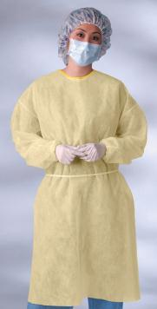

Body Coverings
Work associated risks
Gowns, aprons, hair covers, shoe covers, etc.
Disposable – single use
Moisture resistant – NOT proof
Notes:
Body coverings include gowns as seen in both images, aprons, hair covers as seen in the left image and shoe covers as seen in the right. Gowns and aprons protect us if we brush against a contaminated surface. Shoe and hair covers protect our hair and shoes. These are disposable, single use items and moisture resistant, but not moisture proof. I had a time when I was caring for a gentleman who was hemorrhaging out of his carotid artery. Every time his heart beat a spurt of blood would shoot across the room. I was changing gowns about every five minutes and thank goodness for the shoe and hair protectors. That’s probably the only time I wore the hair and shoe covers, but I see them all the time in the
operating room. These items are the least likely to be seen outside medical environments. When I say medical environments I include those where emergency medical personnel work. When these are applied, it’s important they be wrapped around the entire back before tying at the neck and waist.

Slide 78
OSHA:
Gowns, Aprons, and Other Protective Body Clothing. Appropriate protective clothing such as, but not limited to, gowns, aprons, lab coats, clinic jackets, or similar outer garments shall be worn in occupational exposure situations. The type and characteristics will depend upon the task and degree of exposure anticipated
Work associated risks
Notes:
OSHA:
Gowns, Aprons, and Other Protective Body Clothing. Appropriate protective clothing such as, but not limited to, gowns, aprons, lab coats, clinic jackets, or similar outer garments shall be worn in occupational exposure situations. The type and characteristics will depend upon the task and degree of exposure anticipated

Slide 79



Masks & Eyewear
Work associated risks
Protect eyes, nose, mouth
Masks:
  Various types of masks – standard, face shield type, type with very small pores (N-95 respirator)
  Tie masks or masks with loop around ears
  Contaminated when wet
Goggles are cleansed between use
Notes:
Face masks protect the eyes, nose and mouth – those mucous membranes that microbes can pass through. There are various types. A standard face mask is acceptable for most circumstances, but not all. Microbes are all tiny, but can vary in size. Some are so small they can fit through the pores of a standard face mask. For example, the microbe that causes tuberculosis. Then a special mask is used that must be fit to the user. Now, to draw your attention to a couple things. The lady on the left is wearing a mask that loops behind the ears. The man on the left is wearing the type that tie. Notice how he has the ties at the top of his head. That prevents the mask from squeezing out at the sides and allowing microbes in. The mask also has a wire at the top that allows you to fit it to the nose. That prevents splashing from the top and prevents moisture from breathing from fogging glasses. People often put masks on inside out. You know the inside because there is a sponge material at the top that collects moisture so your breathing doesn’t steam up your glasses. Like with the others, once it gets wet from breathing, it is contaminated. An industrial worker would more likely wear one of these than a gown, but only if the exposure risk is great involving splashing of body fluids. Goggle or glasses with top and side shields are not disposable, but are to be cleansed with a disinfectant between use.

Slide 80
OSHA:
Masks, Eye Protection, and Face Shields. Masks in combination with eye protection devices, such as goggles or glasses with solid side shields, or chin-length face shields, shall be worn whenever splashes, spray, spatter, or droplets of blood or other potentially infectious materials may be generated and eye, nose, or mouth contamination can be reasonably anticipated.
.
Work associated risks
Notes:
OSHA:
Masks, Eye Protection, and Face Shields. Masks in combination with eye protection devices, such as goggles or glasses with solid side shields, or chin-length face shields, shall be worn whenever splashes, spray, spatter, or droplets of blood or other potentially infectious materials may be generated and eye, nose, or mouth contamination can be reasonably anticipated.

Slide 81
ALL
Work associated risks
Outside contaminated
Inside not contaminated UNLESS wet
Notes:
Now, there are some general rules for all of them regarding contamination. Immediately after applied the outside is considered contaminated. The inside of any of the devices are only considered contaminated if they get wet. This goes back to microbes being able to move through a wet surface, but getting stuck on a dry surface. I want to discuss circumstances where a person would wear all of these items to demonstrate that we really need to be on our toes with use of this equipment.

Slide 82

Work associated risks
Isolation room/Isolation precautions
Notes:
A few minutes ago I discussed that airborne pathogens can pass from room to room within the air vents of hospitals or any health facility. In response to that, a room was engineered to directly exchange air with the outside environment rather between rooms. These are called isolation rooms. Not all rooms in a health facility are isolation rooms, but there are rules about working in isolation rooms to keep microbes isolated to that room. I’m going to share a story...not to diminish your image our local Emergency Medical Personnel, but to stress that the rules take some focus and transference to understand and implement. It also stresses that all of us need to spend more time understanding the rules of safety in our work settings.

Slide 83

Work associated risks
Notes:
I was working with a group of CNA students at one of our local nursing homes. We were using an empty room to practice bedmaking. We knew it was only temporarily empty. The resident assigned to the room had been transferred to the hospital a few days before because he had a MRSA infection in his lungs, but was expected back that day. If you remember from part I of this presentation, MRSA is that microbe that is resistant to antibiotics and there is too much of it at our area nursing homes. So we were just finishing up making the bed when we heard a commotion out in the hallway. I stepped out to see what was going on and saw the resident on a cart being pushed down the hallway. He was a very large man – like 500 pounds – so needed six EMS personnel for the transport. All six EMTs and or paramedics were wearing protective equipment...and the resident was wearing none. I’m the EMT course coordinator at ISU, so am familiar with infection control in ambulance transports. This definitely violated those rules and any rules surrounding protective equipment.

Slide 84
Work associated risks
OSHA RULE:
  PPE must not be worn in any common or public area
Notes:
You likely don’t know why this was problematic, so let’s review one OSHA rule and two healthcare rules: OSHA mandates that PPE is NOT worn in any common or public areas. Healthcare standards clarify that outside an isolation room, the person who is infectious wears the protective equipment and before the worker enters the room of that person, he or she must apply protective equipment.

Slide 85
Work associated risks
OSHA RULE:
  PPE must not be worn in any common or public area
HEALTHCARE RULES IF PERSON IS KNOWN TO HAVE A TRANSMISSION-BASED INFECTION:
  Outside a patient room the PERSON wears protective equipment
Notes:
You likely don’t know why this was problematic, so let’s review one OSHA rule and two healthcare rules: OSHA mandates that PPE is NOT worn in any common or public areas. Healthcare standards clarify that outside an isolation room, the person who is infectious wears the protective equipment and before the worker enters the room of that person, he or she must apply protective equipment.

Slide 86
Work associated risks
OSHA RULE:
  PPE must not be worn in any common or public area
HEALTHCARE RULES IF PERSON IS KNOWN TO HAVE A TRANSMISSION-BASED INFECTION:
  Outside a patient room the PERSON wears protective equipment
  To enter a patient room the WORKER wears protective equipment
Notes:
You likely don’t know why this was problematic, so let’s review one OSHA rule and two healthcare rules: OSHA mandates that PPE is NOT worn in any common or public areas. Healthcare standards clarify that outside an isolation room, the person who is infectious wears the protective equipment and before the worker enters the room of that person, he or she must apply protective equipment.

Slide 87
Correct rule application
Work associated risks
At hospital EMS personnel:
Apply gown/mask/gloves before entering patient room
Notes:
At the hospital, the EMS personnel were suppose to apply a gown, mask and gloves before entering the patient’s room. It is to be in that order...gown, mask, gloves over the edges of the gown cuff.

Slide 88
Correct rule application
Work associated risks
At hospital EMS personnel:
Apply gown/mask/gloves before entering patient room
Enter room and assist person to apply mask
Notes:
Once in there, they assist the person to apply a mask. We don’t want that person coughing on someone in a public setting and passing on the infection.

Slide 89
Correct rule application
Work associated risks
At hospital EMS personnel:
Apply gown/mask/gloves before entering patient room
Enter room and assist person to apply mask
At doorway remove protective equipment – gloves, gown, mask – and wash
Notes:
Then at the doorway they remove their gloves, then their gown and finally their mask, before washing. So, how does this transfer to what I SHOULD have seen at the nursing home? If you determined we should have see the resident wearing a mask and the EMS personnel with no protective equipment...except maybe gloves...you’re right! By doing the reverse an entire nursing home was exposed to respiratory MRSA.

Slide 90
Correct rule application
Work associated risks
At hospital EMS personnel:
Apply gown/mask/gloves before entering patient room
Enter room and assist person to apply mask
At doorway remove protective equipment – gloves, gown, mask – and wash
At nursing home EMS personnel:
Apply equipment before entering resident room
Enter room, assist person to remove mask
At doorway remove protective equipment (gloves, gown, mask) & wash
Notes:
Now, once they got to the nursing home they needed to again apply the equipment before entering the room. Then assist the person to bed and to remove their mask and again at the doorway remove the equipment and wash. This is a good time to discuss the order of removal. Because hands touch more than anything, they are usually the most contaminated, plus we need our hands to remove the rest and we don’t want to contaminate areas with our gloves when removing those. So they’re removed first. Then the gown is untied and removed touching only the inside with your ungloved hands as you remove it and roll it up for disposal. Finally, the mask is removed, holding only the ties before dropping it into the biohazard container. Had they worn goggles, they could be removed right before the mask.

Slide 91
DEFENSIVE – NOT!
Work associated risks
Six didn’t catch error?
Embarrassed, not defensive
Called fire captain
Presented at regional paramedic meeting
At first defensive...then grateful
Notes:
When I saw this I asked who was in charge and explained my position. They were a bit embarrassed, but were soon on their way. Being an educator and being coordinator of the EMT program...I couldn’t just let it slide that not one of the six caught the error. So, I called the city fire captain, but didn’t tell him the place or the date...my goal was not to get anyone in trouble. He was mortified – he knew exactly what they had done wrong as a paramedic himself – and was grateful to know of the incident. He asked me to present at a regional paramedic meeting. At first I was met with a bit of defensiveness and we spent a bit of time discussing application of the standards. By the end they too were grateful once it sunk in exactly what the breech of standards was.

Slide 92

Work associated risks
OSHA BBP STANDARD
Notes:
Well, we’ve covered prevention pretty thoroughly...that leaves only the standard itself to go over in part IV.

