Slide 1
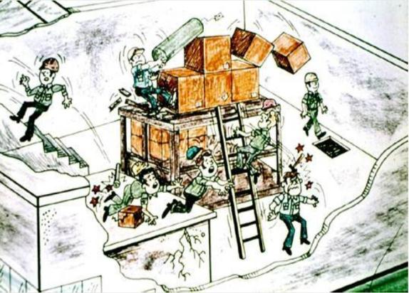
Walking-Working Surfaces
This material was produced under grant [SH20856SH0] from the Occupational Safety and Health Administration, U.S. Department of Labor. It does not necessarily reflect the views or policies of the U.S. Department of Labor, nor does mention of trade names, commercial products, or organizations imply endorsement by the U.S. Government

Slide 2
Introduction
Slips, trips and falls cause:
the majority of general industry accidents
15 percent of all accidental deaths
more fatalities than all other causes but motor vehicles
OSHA’s standards for walking and working surfaces apply to all permanent places of employment, except where only domestic, mining, or agricultural work is performed
Notes:
29 CFR Part 1910 Subpart D
Walking-Working Surfaces (§1910.21 to 1910.30)

Slide 3
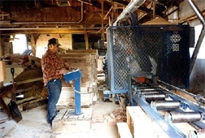
General Requirements Housekeeping
Workplaces must be kept clean, orderly, and sanitary
Workroom floors must be maintained as clean and dry as possible
Notes:
Some of the most frequently cited violations in Subpart D involve housekeeping [1910.22(a)].
Drainage must be maintained and gratings, mats or raised platforms must be provided where wet processes are used.
Every floor, working place and passageway must be kept free from protruding nails, splinters, holes, or loose boards to facilitate cleaning.

Slide 4
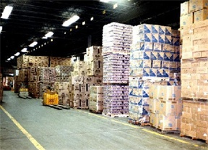
General Requirements Aisles and Passageways
Keep clear and move obstructions that could create a hazard
Mark permanent aisles and passageways
Aisles must be sufficiently wide where mechanical handling equipment is used
Notes:
1910.22(b)

Slide 5
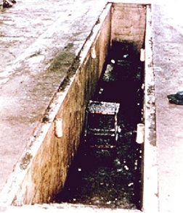
General Requirements Covers and Guardrails
Provide covers and/or guardrails to protect workers from the hazards of open pits, tanks, vats, ditches, and the like.
Notes:
1910.22(c)

Slide 6
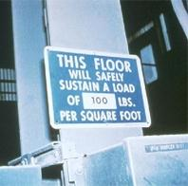
General Requirements Floor Loading Protection
Load ratings must be marked on plates and be conspicuously posted
Do not exceed the load rating limit
Notes:
1910.22(d)

Slide 7
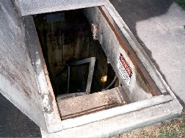
Floor Opening
An opening measuring 12 inches or more in its least dimension in a floor, platform, pavement, or yard, through which persons may fall.
Notes:
1910.21(a)(2)

Slide 8
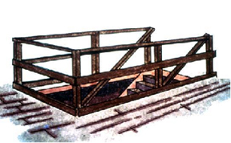
Guarding Floor Openings Definitions
Standard railing. Consists of top rail, mid rail, and posts. Height from the upper surface of top rail to floor level is 42 inches. Mid rail height is 21 inches.
Standard toeboard. 4 inches high, with not more than ¼-inch clearance above the floor.
Notes:
1910.23(e)(1) and (4)

Slide 9
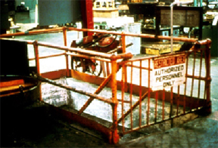
Stairway Floor Openings
Must be guarded by a standard railing on all exposed sides (except at entrance).
Notes:
1910.23(a)(1)

Slide 10
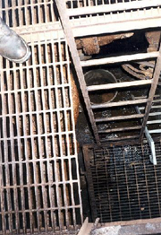
Ladderway Floor Openings
Guard with a standard railing with toeboard on all exposed sides (except entrance)
Guard the passage through the railing with a swinging gate or offset it to prevent someone from walking into the opening
Notes:
1910.23(a)(2)

Slide 11
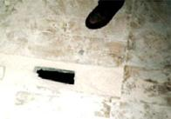
Floor Hole
An opening measuring less than 12 in. but more than 1 in. in its least dimension, in a floor, platform, pavement or yard, through which materials but not persons may fall
Every floor hole into which persons can accidentally walk must be guarded by either:
standard railing with toeboard
cover
Notes:
1910.21(a)(1)
1910.23(a)(8)
While the cover is not in place, the floor hole shall be constantly attended by someone or shall be protected by a standard railing with a standard toeboard.
Every floor hole into which persons cannot accidentally walk (because of fixed machinery, equipment, or walls) shall be protected by a cover that leaves no openings more than 1 inch wide. The cover shall be securely held in place to prevent tools or materials from falling through.

Slide 12
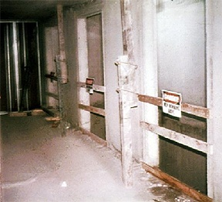
Wall Openings
Opening at least 30 in. high and 18 in. wide, in a wall or partition, through which persons may fall
Wall openings from which there is a drop of more than 4 feet must be guarded
Notes:
1910.23(b)(1)
Guard using one of the following: rail, roller, picket fence, half door, or equivalent barrier.
Where there is exposure below to falling materials, a removable toe board or the equivalent must also be provided.

Slide 13
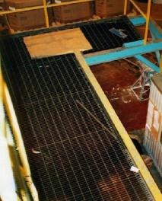
Open-Sided Floors and Platforms
Open-sided floors or platforms 4 feet or more above adjacent floor or ground level must be guarded by a standard railing (or equivalent) on all open sides, except where there is an entrance to a ramp, stairway, or fixed ladder
A toeboard is required when, beneath the open sides:
persons can pass,
there is moving machinery, or
there is equipment with which falling materials could create a hazard
Unguarded Platform
Notes:
1910.23(c)(1)

Slide 14
Open-Sided Floors, Walkways, Platforms, and Runways
Regardless of height, a standard railing and toeboard must be used to guard:
- open-sided floors
- walkways
- platforms, or
- runways
above or adjacent to dangerous equipment, pickling or galvanizing tanks, degreasing units, and similar hazards.
Notes:
1910.23(c)(3)

Slide 15
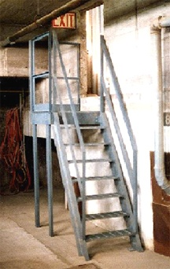
Stairways
Flights of stairs with four or more risers must have standard stair railings or handrails.
Notes:
1910.23(d)(1)
1910.23(e)(2)

Slide 16
Fixed Industrial Stairs
Treads must be slip resistant with uniform rise height and tread width
Must be able to carry 5 times expected load; minimum of 1000 pounds
Minimum width of 22 inches
Violation here – several steps bent and damaged
Notes:
1910.24
Applies to interior and exterior stairs around machinery, tanks and other equipment, and stairs leading to or from floors, platforms or pits.
Does not apply to stairs used for fire exit purposes, to construction operations, to private residences, or to articulated stairs, such as those on floating roof tanks.
Fixed industrial stairs are required for access to and from places of work where operations necessitate regular travel between levels.

Slide 17
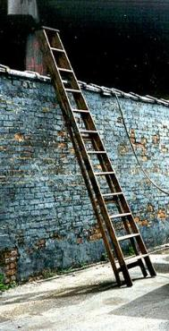
Portable Ladders
Ladders used to gain access to a roof or other area must extend at least 3 feet above the point of support
Withdraw defective ladders from service and tag or mark "Dangerous, Do Not Use“
Never use ladders in a horizontal position as scaffolds or work platforms
Never use metal ladders near electrical equipment
Notes:
1910.25
1910.26
Maximum length: Stepladders – 20 ft, single-rung ladders – 30 ft., two-section rung ladders – 60 ft.
Stepladders must be equipped with a metal spreader or locking device to securely hold the front and back sections in an open position.
All ladders must be inspected periodically, kept in good condition at all times, and must be free from sharp edges, splinters, oil grease, or other defects which would affect their use.
- Always place the ladder on secure footing and lock in place.
- Short ladders shall not be spliced together to make long ladders.
- The top of a regular stepladder shall not be used as a step.
- Always face the ladder when climbing or descending.

Slide 18
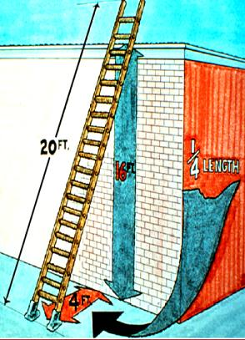
Ladder Angle Portable Rung and Cleat Ladders
Use at angle where the horizontal distance from the top support to the foot of the ladder is ¼ the working length of the ladder (length along ladder between the foot and top support).
Notes:
1910.25

Slide 19
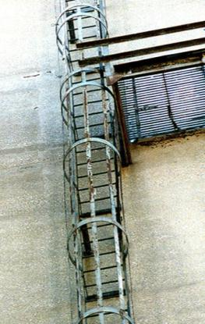
Fixed Ladders
Permanently attached to a structure, building or equipment
Cages or wells required if longer than 20 ft. to a maximum unbroken length of 30 ft.
Ladder safety devices may be used on tower, water tank and chimney ladders over 20 ft. in unbroken length instead of cage protection
Notes:
1910.27
All fixed ladders must be inspected regularly and be maintained in a safe condition.
Preferred pitch in range of 75 to 90 degrees with horizontal.

Slide 20
Scaffolding General Requirements
Must be capable of supporting four times the maximum intended load
Do not alter or move while in use
Protect workers on scaffolds from overhead hazards
If higher than 10 ft., use guardrails, midrails and toeboards
Use wire mesh between the toeboard and guardrail if people work or pass underneath
Must be equipped with access ladder or equivalent
Notes:
1910.28
Damaged or weakened scaffolds must not be used.
A safe means must be provided to gain access to the working platform level through use of a ladder, ramp, etc.
Never work on scaffolds during storms, high winds, ice, or snow.
Always be aware of the hazards of overhead power lines when working on scaffolds.

Slide 21
Summary
Slips, trips, and falls constitute the majority of general industry accidents
OSHA’s standards for walking and working surfaces include requirements for housekeeping, guarding floor and wall openings and holes, industrial stairs and ladders
Keeping working surfaces clean, dry, and uncluttered can prevent many workplace accidents

