Slide 1

Operative Plasterers’ and Cement Masons’ International Association (OPCMIA)
OSHA Employee Rights and Employer Responsibilities
Notes:
Introduce yourself and explain your OSHA experience, specifically as it relates to employer and employee rights under OSHA.
Review facility logistics: Emergency exits, restrooms, break rooms, smoking areas, etc.
Explain that this course is designed to introduce students to employer and employee rights as determined by OSHA regulations.
Ask the students if they have any questions before getting started.
Welcome to the OPCMIA OSHA Employee Rights and Employer Responsibilities training program.
Use this space for notes.

Slide 2
Program Introduction
Purpose:
Provide introductory information about OSHA
Topics:
Why is OSHA important to you?
What rights do employees have under OSHA?
What responsibilities does an employer have under OSHA?
What do the OSHA standards say?
How are OSHA inspections conducted?
Where can you go for help?
Notes:
2
Review the purpose of this training program and the topics that will be covered during this course.
Use this space for notes.

Slide 3
Why is OSHA important to you?
Notes:
3
Explain that this portion of the program will introduce the students to a brief history of OSHA and OSHA’s mission, explain how OSHA fits into the national strategy, explain the costs associated with injuries and illnesses, and will cover employer recordkeeping requirements under OSHA 29 CFR 1904 and the forms used for said recordkeeping.
Ask the student if they have any questions before proceeding.
Use this space for notes.

Slide 4

Why is OSHA important to you?
Objectives:
Explain history of OSHA
Identify OSHA’s mission
Explain how OSHA fits into the National strategy
Explain the costs associated with injuries and illness
Explain employer recordkeeping requirements under OSHA 29 CFR 1904
Explain when & how to use OSHA forms 300, 300A, & 301 in the recordkeeping process
Notes:
4
Review the objectives.
Use this space for notes.

Slide 5

Why is OSHA important to you?
History of OSHA:
Agency of the U.S. Department of Labor
Responsible for worker safety & health protection
December 29, 1970 - President Nixon signs OSH Act
Created OSHA agency on April 28, 1971
Notes:
5
Ask the students to tell you when during their work experiences did they first hear about OSHA.
Ask the students to tell you what they thought about OSHA at that time.
Ask students to tell you what they think OSHA’s job is.
Ask the class if anyone has seen the OSH Act. Tell them that they can find it on OSHA’s website.
OSHA stands for the Occupational Safety and Health Administration, an agency of the U.S. Department of Labor. OSHA’s responsibility is worker safety and health protection.
On December 29, 1970, President Nixon signed the Occupational Safety and Health Act of 1970 (OSH Act), which was created by the U.S. Congress. This Act created OSHA, the agency, which formally came into being on April 28, 1971. With the creation of OSHA, for the first time, all employers in the United States had the legal responsibility to provide a safe and healthful workplace for employees. And, there were now uniform regulations that applied to all workplaces.
OSHA began because until 1970, there were no national laws for safety and health hazards.
The OSH Act is also known as Public Law 91-596. It covers all private sector employers and their workers in the 50 states and all territories and jurisdictions under federal authority. Employers and workers in many fields, including but not limited to manufacturing, construction, longshoring, agriculture, law, medicine, charity and disaster relief are covered by OSHA.
The OSH Act covers Federal workers by conducting inspections in response to complaints, but OSHA cannot propose monetary fines against federal agencies.

Slide 6
Why is OSHA important to you?
OSHA’s Mission:
Save lives, prevent injuries, & protect the health of America’s workers
Is carried out by:
Developing job safety & health standards
Enforcing standards through worksite inspections
Maintaining a reporting & recordkeeping system
Track job-related injuries & illnesses
Providing training programs
Notes:
6
Explain that another one of OSHA’s responsibilities is to assist states in their health and safety efforts through the development of OSHA approved job safety and health programs operated specifically by those individual states requesting the assistance.
Remind the students that they can refer to the OSHA website for specific information on State Plans and a State Plan directory.
OSHA assists States in their efforts to assure safe and healthful working conditions, through OSHA approved job safety and health programs operated by individual states. State plans are OSHA-approved job safety and health programs operated by individual states instead of federal OSHA. States with approved plans cover most private sector employees as well as state and local government workers in the state. State plan programs respond to accidents and employee complaints and conduct unannounced inspections, just like federal OSHA. Some states have OSHA-approved plans that cover only state and local government workers.
For more information on State Plans and a State Plan directory refer to the OSHA website (www.osha.gov).
Use this space for notes.

Slide 7
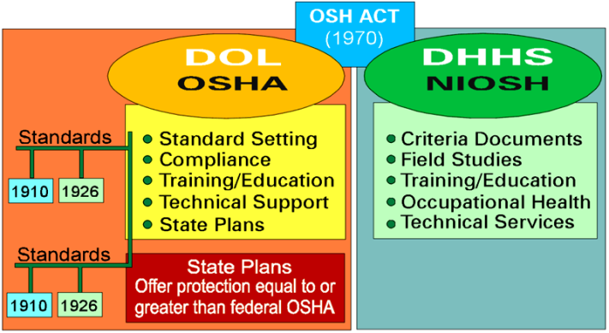
Why is OSHA important to you?
How Does OSHA Fit Into the National Strategy?
Notes:
7
Explain that the National Institute for Occupational Safety and health (NIOSH) is an agency in the Department of Health and Human Services that works closely with OSHA.
Ask the students to list the parties that provide input on safety standards. (Answers include: employers, employer associations, workers, unions, manufacturers, professional groups, government agencies, states, and advisory committees.)
Explain that OSHA also enforces 29 CFR 1928 (Agriculture), 1915 (Shipyard), 1917 (Marine Terminal) and 1918 (Longshoring).
OSHA has five main duties that affect employers and employees. These duties are listed on the screen. The first three duties are clear and require little explanation. Providing technical support refers to the process by which OSHA assists employers with selecting and using hazard abatement methods that comply with regulations. State plans were discussed on the previous page.
NIOSH is the National Institute for Occupational Safety and Health. Because this course focuses on OSHA regulations, very little time is spent on NIOSH. However, you should know that NIOSH provides many technical services that can help workers, especially with work-related health problems. Additionally, you should note that NIOSH does not have enforcement or compliance duties.
Criteria documents developed by NIOSH are technical or scientific materials used by OSHA in the standard setting process. NIOSH gathers information for criteria documents from field studies it conducts. One type of field study NIOSH conducts is the Health Hazard Evaluation (HHE). Workers or employers who believe they have a safety or health problem in their workplace can request NIOSH to conduct an HHE. NIOSH will evaluate the problem and, if reasonable to do so, will conduct a field study. During an HHE, NIOSH will identify any safety or health problems and inform parties about any violations of standards and make recommendations for correcting them to the employer. However, NIOSH will not issue any citations. Only OSHA can issue citations.

Slide 8
Why is OSHA important to you?
Statistics:
7 million workers in the construction trades in the U.S.
Construction trade accidents account for:
370,000 injuries per year (Avg. -1,000/day)
1,200 deaths per year (Avg. - 100/month)
Construction companies spend $170 billion/year on costs associated with injuries/illness
Workers who suffer a disabling injury can lose 40% of their income over a 5-year period
20% of workplace fatalities occur in the construction industry
Accident costs account for 6.5% of construction dollars spent
Notes:
8
Note: The first two bullets are according to the U.S. Bureau of Labor and Statistics (2008).
Note: Bullets three and four are according to OSHA (2008).
Note: The last two bullets are according to the Home Builders Institute’s Safety and Security (2008).
Explain that injuries/illness are a form of waste just like faulty products because they require money and resources to address.
Note: Costs associated with OSHA citations and fines will be discussed later in this program.
For a company, injuries and illness increase workers’ compensation and retraining costs, OSHA injury/illness rates, insurance premiums, absenteeism, and faulty products or work assignments.
Preventative measures, such as attending training, can help construction workers be safer in the workplace. Learning about jobsite hazards and proper safety practices empowers workers to make wiser choices, and ultimately reduce the number of injuries on the job.
Use this space for notes.

Slide 9
Why is OSHA important to you?
Occupations with High Fatal Injury Rates 2009 (According to DOL)
Fishing
200.0
56
Logging
61.8
34
Aircraft Pilots/Flight
Engineers
57.1
63
Farmers/Ranchers
38.5
293
Roofers
34.7
60
Structural Iron/Steel
Workers
30.3
18
Recyclable Materials
Collectors
25.2
19
Indust. Machinery Installation,
Repair, & Maintenance
18.5
81
Deliver/Sales & Truck Drivers
18.3
586
Construction
18.3
224
250
200
150
100
50
0
200
400
600
800
*Total Fatal Work Injuries = 4,340
*All Worker Fatal Injury Rate = 3.3
Fatal Work Injury Rate
Per 100,000 Full-time Equivalent Workers
Number of Fatal Work Injuries
Notes:
9
Review the Department of Labor (2009) fatal injury statistics for various occupations and compare the construction industry numbers with those of other trades.
Compare the number of fatal injuries in the construction industry in 2009 with the average over the ten year period from 1997 to 2007 (1,200 per year) as discussed on the previous screen.
Ask the students why they think the fatal injury rates in the construction injury in 2009 (224) was much lower than the typical average (1,200/year) that was discussed on the previous screen.
Use this space for notes.

Slide 10

Why is OSHA important to you?
Costs Associated with Injuries and Illness:
More Compensation Claims =
Higher EMRs =
Higher Insurance Rates
Time away by experienced workers
Training replacements
Retraining for injured workers
Light duty workloads for injured workers upon returning to work
Post-traumatic repercussions (e.g. workers who witness injuries/death)
Notes:
10
Review how the points listed on the screen apply to costs associated with injuries.
Ask the students if they know what Experience Modification Rates (EMR) for Workers’ Compensation Insurance are.
Explain that the EMR is used by the insurance industry to determine premiums for workers’ compensation insurance.
Explain that lower rates, meaning that fewer or less severe accidents had occurred than were expected, result in lower insurance costs. A contactor's EMR is adjusted annually by using the rate for the first three of the last four years.
Contractors should pay close attention to their Experience Modification Rates (EMR) for Workers' Compensation Insurance.
The Experience Modification Rate is a widely used indicator of a contractors past safety performance. The insurance industry has developed experience rating systems as an equitable means of determining premiums for workers' compensation insurance. These rating systems consider the average workers' compensation losses for a given firm's type of work and amount of payroll, and predict the dollar amount of expected losses to be paid by that employer in a designated rating period, usually three years. Rating is based on comparisons with other firms doing similar types of work, and the employer is rated against the average expected performance in each work classification. Losses incurred by the employer for the rating period are then compared to the expected losses to develop an experience rating.
Workers' compensation insurance premiums for a contractor are adjusted by this rate, which again is called the Experience Modification Rate (EMR). Lower rates, meaning that fewer or less severe accidents had occurred than were expected, result in lower insurance costs. A contactor's EMR is adjusted annually by using the rate for the first three of the last four years.

Slide 11
Why is OSHA important to you?
Employer Recordkeeping:
OSHA 29 CFR 1904:
Requires employees covered by OSHA & with 10+ employees to keep records of injuries & illnesses that result in:
Death
Days away from work
Restricted work or transfer to another job
Medical treatment beyond first aid
Loss of consciousness
Significant injury or illness diagnosed by health care professional (cancer, chronic irreversible disease, fractured or cracked bone, punctured eardrum)
Notes:
11
Ask the students to share with the class what they know about OSHA 29 CFR 1904, Employer Recordkeeping.
Ask the students to explain why it is so important for an employer to keep accurate injury and illness records.
Note: Employer recordkeeping forms and guidelines will be discussed on the remaining screens in this section of the training program.
Note: Specific employee rights regarding access to injury and illness records will be discussed later in this training program.
OSHA’s Recordkeeping Rule (OSHA 29 CFR 1904) requires most employers with more than 10 workers to keep a log of injuries and illnesses. The log, which is also called the OSHA 300, must contain all work-related injuries and illnesses resulting in lost workdays, restricted work or transfer to another job, as well as any incident requiring more than first aid treatment.
An employee records cases on the OSHA 300 Log of all employees on its payroll: hourly, salaried, executives, part-time, seasonal, and migrant workers. Additionally, they must record cares for employees not on payroll if the employer supervises workers on a day-to-day basis, for temporary help services, employee leasing services, personal supply services, and contractors.
Recordkeeping is an important part of an employer’s responsibilities. Keeping records allows OSHA to collect survey material, helps OSHA identify high-hazard industries, and informs you, the worker, about the injuries and illnesses in your workplace. Workplaces in low-hazard industries such as retail, service, finance, insurance, and real estate are exempt from recordkeeping requirements.
For specific information on exactly which cases must be recorded, you can go to Title 29 of the Code of Federal Regulations (CFR) Part 1904–“Recording and Reporting Occupational Injuries and Illnesses.”

Slide 12
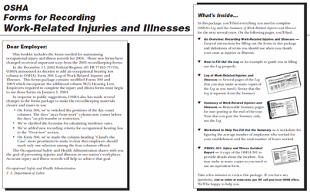
Why is OSHA important to you?
OSHA Recordkeeping Forms:
OSHA Form 300
Log of Work-Related Injuries & Illnesses
OSHA Form 301
Injuries & Illness Incident Report
OSHA Form 300A
Summary of Work Related Injuries & Illnesses
Notes:
12
Ask the students to share what they know about OSHA Forms 300, 301, and 300A.
Select the graphic to show a PDF which provides information and instructions on filing out the recordkeeping forms.
Explain to the students that this document as well as OSHA Forms 300, 301, and 300A are available on the OSHA website.
Note: This is the first of eleven PDF documents that will be accessed from within the presentation. It is advised that you close each PDF document after viewing it in order to prevent an excessive number of PDF windows to be open simultaneously. Use the PDF “zoom” tool to show the details of each document. The PDF documents in this program can also be found in Appendix A.
Recordkeeping forms that employers must keep are the OSHA Form 300, 301, and 301A. These recordkeeping forms and guidelines for filling them out are available on the OSHA website at www.osha.gov/recordkeeping/RKforms.html.
Note: The documents launched from within this presentation can be found in the appendix of this guide. You may want to refer to them during this training program.
Use this space for notes.

Slide 13
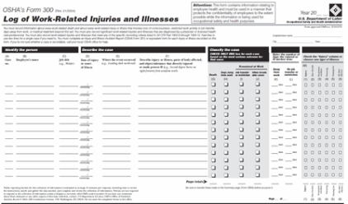
Why is OSHA important to you?
OSHA Form 300:
Log of Work-Related Injuries & Illnesses:
Record of all recordable work-related injuries & illnesses
Asks where event occurred (not department where worker is regularly employed)
Employer must provide workers & their union copy of 300 Log by end of next business day following request
Notes:
13
Select the graphic to show a PDF of OSHA Form 300.
Ask the students to share any experiences they may have had with OSHA Form 300.
Share any experiences you may have had with OSHA Form 300.
The Log of Work-Related Injuries and Illnesses (commonly called the OSHA 300 Log) is used to list injuries and illnesses and track days away from work, restricted, or transferred.
OSHA Logs can be used to evaluate types, frequency, and severity of injuries/illness, and can help identify nature and location of hazards needing elimination or control.
Use this space for notes.

Slide 14
Why is OSHA important to you?
OSHA Form 300 (cont.):
Issues of privacy & recordkeeping:
Employers CAN NOT put names on OSHA 300 Log in cases of:
Sexual assault
Mental illness
Hepatitis, HIV infection
Tuberculosis
Needle sticks/sharps injuries contaminated with blood
Injury/illness to intimate body part
Other illness if employee “independently & voluntarily” requests name not be recorded
Employer keeps confidential list of names
Notes:
14
Ask the students to explain why privacy in recordkeeping is important.
Ask the students to share any experiences they may have had with privacy concerns regarding employer recordkeeping procedures.
Remind the students that they can find more information on privacy and recordkeeping at OSHA 29 CFR 1904.29(b)(7) on the OSHA website.
“Privacy concern cases” are those involving an intimate body part, mental illness, HIV, etc. For more detail, see OSHA 29 CFR 1904.29(b)(7) on the OSHA website.
Use this space for notes.

Slide 15
Why is OSHA important to you?
OSHA Form 300 (cont.):
Limitations of OSHA Logs:
Injuries/illnesses which may not be recorded:
Assault on worker resulting only in first aid treatment
Early signs & symptoms of musculoskeletal disorders
Injuries/illnesses which employer does not believe are work-related
Work-related stress
Injuries which result in lost time only on the day of the incident
Cases in industries exempt from recordkeeping requirements
All other injuries/illnesses THAT ARE NOT REQUIRED to be recorded on the 300 Log (i.e. injuries that do not result in death, days away from work, transfer to another job, etc.)
Notes:
15
Review the limitations of the OSHA logs.
Ask the students to explain how these limitations could adversely effect an employer’s injury and illness records.
Ask the students to explain how these limitations could benefit an employer’s injury and illness records.
OSHA logs may provide an incomplete picture of injuries/illnesses in the workplace for several reasons.
First, some types of injuries/illness are not recorded (see list on screen).
Second, some safety incentive programs and injury discipline policies may discourage workers from reporting injuries.
Lastly, as stated earlier, workplaces in low-hazard industries such as retail, service, finance, insurance, and real estate are exempt from recordkeeping requirements. Other “low-hazard” industries include: bakeries, liquor stores, medical doctor offices and clinics, and motorcycle dealers.
Use this space for notes.

Slide 16
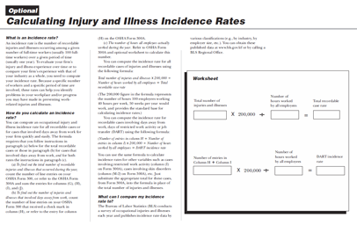
Why is OSHA important to you?
OSHA Incident Rates Form:
Optional form used to calculate injury and illness incident rates
# of fatalities
# of injuries/illness involving lost workdays
# of days away from work
# of days of restricted work
# of injuries/illness w/out lost workdays
Compute incident rates:
# of incidents x 200,000 hrs. ÷ # of hrs. worked = Incident Rate
Notes:
16
Select the graphic to show a PDF of the OSHA Incident Rates Form.
Explain that this form is optional and is not required by OSHA 29 CFR 1904.
Ask the students if they are familiar with OSHA Incident Rates.
Ask the students to share any experiences they may have had with the OSHA Incident Rates Form.
Share any experiences you may have had with the OSHA Incident Rates Form.
A contractor, having the number of hours the employees worked during the year can compute incident rates for any of the items listed on the screen using the formula:
Number of incidents x 200,000 hours ÷ Number of hours worked = Incident Rate
In calculating the OSHA recordable incident rate, the number of incidents in the formula is the total of the number of fatalities, injuries and illnesses involving lost and restricted workdays, and injuries and illness without lost workdays.
The 200,000 hours in the formula represents the equivalent of 100 employees working 40 hours per week, 50 weeks per year, and is the standard base for incident rates.
OSHA incident rates also show past safety performance. Since these are uniform national standards, employers can easily compare their rates with the rates in different parts of the country. Additionally, owners should request from contractors, OSHA incident rates for the three most recent years.
Use this space for notes.

Slide 17
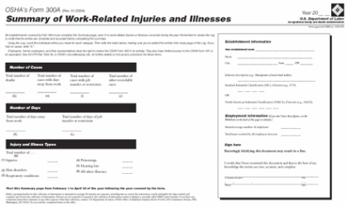
Why is OSHA important to you?
OSHA 300A Form:
Summary of Work-Related Injuries & Illness:
Yearly summary of injuries & illness
Posted annually for previous year (2/1 to 4/30)
Used for calculating incidence rates
Must be certified by company executive as correct & complete
Notes:
17
Select the graphic to show a PDF of the OSHA 300A Form.
Ask the students to share any experiences they may have had with the OSHA 300A Form.
Share any experiences you may have had with the OSHA 300A Form.
The Summary (OSHA Form 300A) shows the totals for the year in each category. A company executive must certify that he or she has examined the OSHA Log and believes that the annual summary is correct and complete. The summary must be posted from February 1 to April 30 of each year in a place where notices to workers are usually posted, such as an employee bulletin board.
Use this space for notes.

Slide 18
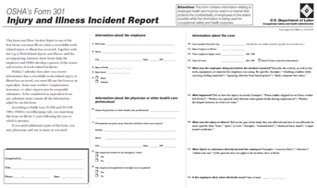
Why is OSHA important to you?
OSHA 301 Form:
Injury & Illness Incident Report:
Provides detailed information on how each case occurred
Must be completed for every incident recorded on 300 Log
Employees must be given copy by end of next business day following request
Useful for linking extended work hours with increased injury rates
Notes:
18
Select the graphic to show a PDF of the OSHA 301 Form.
Ask the students to share any experiences they may have had with the OSHA 301 Form.
Share any experiences you may have had with the OSHA 301 Form.
The Injury and Illness Report (Form 301) is used to record more information about each case. Employers can use a workers’ compensation or insurance form, if it contains the same information.
Use this space for notes.

Slide 19
Why is OSHA important to you?
OSHA 301 Form (cont.):
Injury & Illness Incident Report:
Employee representative is only entitled to receive part of form containing information about case with personal information about employee removed
Employee representative must be given copy of form within seven calendar days following request
Notes:
19
Ask the students to explain why they think employee representatives are only entitled to the part of the OSHA 301 Form that contains information about the case, and not to personal employee information.
Use this space for notes.

Slide 20
Why is OSHA important to you?
Discussion Questions
Why was OSHA necessary?
Which OSHA form is used by an employer to record injuries and illnesses?
Notes:
20
Use this space for notes.
Ask the students to answer the review questions on the screen.
Answer – Before 1970 there were no uniform or comprehensive laws to protect workers against workplace hazards.
Answer – OSHA 300 Form.
Note: Answers shown on the next screen.

Slide 21
Why is OSHA important to you?
Discussion Questions
Why was OSHA necessary? (Before 1970 there were no uniform or comprehensive laws to protect workers against workplace hazards.)
Which OSHA form is used by an employer to record injuries and illnesses? (OSHA 300 Form.)
Notes:
21
Use this space for notes.
Discuss the correct answers.

Slide 22

Why is OSHA important to you?
Summary:
History of OSHA
OSHA’s mission
OSHA’s place in the National strategy
Costs associated with injuries and illness
Employer recordkeeping requirements under OSHA 29 CFR 1904
OSHA forms 300, 300A, & 301
Any Questions?
Notes:
22
Review the topics covered in this section of the training.
Ask the students if they have any questions before proceeding.
Use this space for notes.

Slide 23
What rights do employees have under OSHA?
Notes:
23
Explain that this portion of the program will introduce the students to employee rights under OSHA regarding: hazardous chemicals at the workplace, access to information on injuries and illnesses, complaints or requesting corrections, training, access to exposure and medical records, filing complaints with OSHA, participation in OSHA inspections, freedom from retaliation, and employee responsibilities at the workplace.
Ask the student if they have any questions before proceeding.
Use this space for notes.

Slide 24

What rights do employees have under OSHA?
Objectives:
Explain employee rights regarding:
Hazardous chemicals at the workplace
Access to information on injuries & illnesses
Complaints or requesting corrections
Training
Access to exposure & medical records
Filing complaints with OSHA
Participation in OSHA inspections
Freedom from retaliation
Explain employee responsibilities at the workplace
Notes:
24
Review the objectives.
Use this space for notes.

Slide 25

What rights do employees have under OSHA?
General Employee Rights:
Be provided with a safe & healthful workplace
Request information on hazards & controls
Submit a written request to NIOSH for information or for a Health Hazard Evaluation (HHE)
Section 5(a)(1) of the OSH Act
“Each employer shall furnish to each of his employees employment and a place of employment which are free from recognized hazards that are causing or are likely to cause death or serious physical harm to his employees."
Notes:
25
Review the importance of Section 5(a)(1) of the OSH Act.
Ask the students to list employee rights under OSHA that they are familiar with.
Explain that these rights as well as other will be discussed in this section of the training program.
Ask the students to explain why employee rights are so important.
Ask the students to provide examples of how a safe and healthful workplace is provided [or should be provided] at their workplace or worksite.
The Occupational Safety and Health Act of 1970 gave workers many new rights related to safety and health. OSHA standards which have been issued since then, such as the Hazard Communication or “Right to Know” standard, provide additional rights.
Most importantly, the creation of OSHA provided workers the right to a safe and healthful workplace. Section 5(a)(1) of the OSH Act states: “Each employer shall furnish to each of his employees employment and a place of employment which are free from recognized hazards that are causing or are likely to cause death or serious physical harm to his employees." A safe and healthful workplace means that hazards are removed and workers are trained. If a hazard cannot be removed completely, protection (for example, respirators or earplugs) must be provided.
Some examples of a safe/healthful workplace include fall protection and training are provided and required when working at high levels on a construction site, and machines and equipment with rotating and moving parts are guarded.
Use this space for notes.

Slide 26

What rights do employees have under OSHA?
Activity: Legal Health & Safety Rights
Notes:
26
Complete the Legal Health and Safety Rights activity with the students.
Note: The instructions for this activity can be found in Appendix B at the end of this guide.
Use this space for notes.

Slide 27
What rights do employees have under OSHA?
Hazardous Chemicals:
Right to know about hazardous chemicals
Employers must have written HazCom programs:
Container labeling
Material Safety Data Sheets (MSDSs)
Worker training on physical & health hazards of chemicals:
Protective measures & PPE
Safe work practices
Emergency procedures
MSDS Sections:
Section I: Manufacturer’s name & contact information
Section II: Hazardous Ingredients
Section III: Physical/chemical properties
Section IV: Fire & explosion hazard data
Section V: Reactivity data
Section VI: Health hazard data
Section VII: Precautions for safe handling & use
Section VIII: Control measures
Notes:
27
Ask the students if they are aware that they have the right to know about hazardous chemicals at their workplace.
Ask the students to list the hazardous chemicals used at their workplace.
Ask the students to explain how they are made aware of said chemicals and the type of training that is provided.
Ask the students to share any experiences they may have had, or heard of, regarding hazardous chemicals, and how their right to know about said chemicals impacted the situation.
Share your experiences with employee rights to know about hazardous chemicals.
Another important right is the Right to Know about hazardous substances in your workplace. Employers must have a written, complete hazard communication program that includes information on: container labeling, Material Safety Data Sheets (MSDSs), and worker training. The training must include the physical and health hazards of the chemicals and how workers can protect themselves; including specific procedures the employer has implemented to protect workers, such as work practices, emergency procedures, and personal protective equipment.
The program must also include a list of the hazardous chemicals in each work area and the means the employer uses to inform workers of the hazards of non-routine tasks. In addition, the program must explain how the employer will inform other employers of hazards to which their workers may be exposed (for example, contract workers).
Use this space for notes.

Slide 28
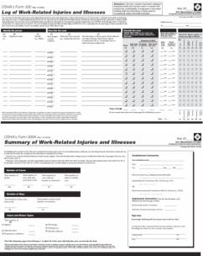

What rights do employees have under OSHA?
Information About Injuries/Illness:
OSHA’s Recordkeeping rule:
Most employers with more than 10 workers must keep injury & illness logs
Right to:
Review current logs & logs stored for past 5 years
View annually posted summary of injuries & illnesses (OSHA 300A)
Notes:
28
Ask the students if they are aware that they have the right to review injury and illness records.
Ask the students if their employer has set up a way for them to report injuries and illnesses, if so, what are the procedures?
Ask the students to share any experiences they may have had regarding their right to review information on injuries and illnesses.
Share any experiences you may have had with your right to review injury and illness records.
As discussed earlier in this program, OSHA’s Recordkeeping rule requires most employers with more than 10 workers to keep a log (OSHA 300 Form) of injuries and illnesses. As an employee you have the right to review the current log, as well as the logs stored for the past 5 years.
The employer must provide this log by the end of the next workday. The names and other information on the log may not be removed, unless the case is a “privacy concern case.”
You also have the right to view the annually posted summary of the injuries and illnesses (OSHA 300A).
The right to review the log includes former employees, their personal representatives, and authorized employee representatives.
Use this space for notes.

Slide 29
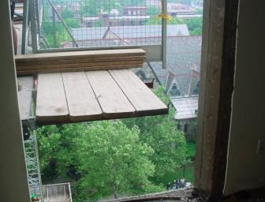
What rights do employees have under OSHA?
Complain or Request Corrections:
Right to bring up workplace safety & health concerns to employer:
Must be made in good faith
Will not be discharged or discriminated against
May refuse to do work if you feel you are being exposed to imminent danger
OSHA 29 CFR 1977.9(c):
Protects workers who complain to their employer
Notes:
29
Ask the students if they are aware that they have the right to complain or request corrections at their workplace.
Ask the students if they have ever reported a hazard to their employer, if so, what was the outcome?
Select the link on the screen to show a PDF that provides additional information on employee rights to refuse work because conditions are dangerous.
Share any experiences you may have with your right to complain or request corrections.
Explain that the photo shows examples of safety concerns that can be reported.
Workers may bring up safety and health concerns in the workplace to their employers without fear of discharge or discrimination, as long as the complaint is made in good faith. OSHA regulations [29 CFR 1977.9(c)] protect workers who complain to their employer about unsafe or unhealthful conditions in the workplace. You cannot be transferred, denied a raise, have your hours reduced, be fired, or punished in any other way because you have exercised any right afforded to you under the OSH Act.
1977.9(c) states: “the principles of the Act would be seriously undermined if employees were discouraged from lodging complaints about occupational safety and health matters with their employers. Such complaints to employers, if made in good faith, therefore would be related to the Act, and an employee would be protected against discharge or discrimination caused by a complaint to the employer.”
Since you are often closest to potential safety and health hazards, you have a vested interest in reporting problems so that the employer gets them fixed. If the hazard is not getting corrected, you should then contact OSHA.
Use this space for notes.

Slide 30

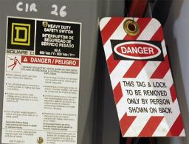
What rights do employees have under OSHA?
Training:
Right to receive training on health & safety hazards & standards that employers must follow
Required training:
Lockout / Tagout
Bloodborne pathogens
Noise
Confined spaces
Fall hazards
PPE
Various other areas
Notes:
30
Ask the students if they are aware that they have the right to receive training.
Ask the students if they felt that the training they received prepared them to safely complete work assignments. Why or why not?
Ask students to share any mishaps they may have had, or heard of, due to a lack of training.
Ash the students to share any experiences they may have had, or herd of, where proper training helped prevent a mishap.
Share any training experiences you may have had and how they effected your work.
You have a right to get training from your employer on a variety of health and safety hazards and standards that your employer must follow. We’re already discussed the training required under OSHA’s Hazard Communication (Right to Know) standard.
Other required training includes lockout-tagout, bloodborne pathogens, noise, confined spaces, fall hazards in construction, personal protective equipment, and a variety of other subjects.
Use this space for notes.

Slide 31

What rights do employees have under OSHA?
Examine Exposure & Medical Records:
OSHA 29 CFR 1910.1020:
Right to examine & copy records
Employee exposure to toxic substances & harmful physical agents:
Metals & dusts (lead, cadmium, silica)
Biological agents (bacteria, viruses, fungi)
Physical stress (noise, heat, cold, vibration, repetitive motion, & ionizing & non-ionizing radiation)
Notes:
31
Ask the students if they are aware that they have the right to examine exposure and medical records.
Explain that the right includes permission to duplicate and retain a copy of the records.
Ask the students to share any experiences they may have had, or heard of, where they were required to examine exposure and medical records.
Share any experiences you may have had with examining exposure and medical records.
Under OSHA’s standard 1910.1020, you have the right to examine and copy exposure and medical records, including records of workplace monitoring or measuring a toxic substance. This is important if you have been exposed to toxic substances or harmful physical agents in the workplace, as this regulation may help you detect, prevent, and treat occupational disease.
Examples of toxic substances and harmful physical agents are: metals and dusts, such as, lead, cadmium, and silica, biological agents, such as bacteria, viruses, and fungi, and physical stress, such as noise, heat, cold, vibration, repetitive motion, and ionizing and non-ionizing radiation.
OSHA standards require employers to measure exposure to harmful substances, and workers or their representatives have the right to observe the testing and examine the results. If the exposure levels are above the limit set by the standard, the employer must tell workers what will be done to reduce their exposure.
Use this space for notes.

Slide 32
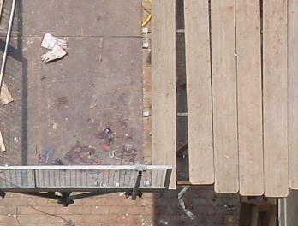
What rights do employees have under OSHA?
File a Complaint:
Right to file complaint with OSHA:
Violations of safety/health standards
Imminent danger situations
May have name withheld from employer
Right to find out OSHA’s action on complaint
Request review if inspection is not made
Notes:
32
Ask the students if they are aware that they have the right to file a complaint.
Ask the students to list some examples of imminent danger situations.
Ask the students to share any experiences they may have had, or heard of, with filing a complaint to OSHA.
Share any experiences you may have had with filing a complaint with OSHA.
Explain that the photo shows examples of safety violations that can be reported to OSHA if the employer fails to correct them.
Note: The process for filing a complaint will be discussed later in this program.
You may file a complaint with OSHA if you believe a violation of a safety or health standard, or an imminent danger situation, exists in your workplace. You may request that your name not be revealed to your employer. You can file a complaint on OSHA’s web site, in writing or by telephone to the nearest OSHA area office. You may also call the office and speak with an OSHA compliance officer about a hazard, violation, or the process for filing a complaint.
If you file a complaint, you have the right to find out OSHA’s action on the complaint and request a review if an inspection is not made.
Use this space for notes.

Slide 33
What rights do employees have under OSHA?
Participate in OSHA Inspections:
Right to:
Have employee representative accompany OSHA inspector
Respond to questions from inspector during inspection
Talk to inspector privately after inspection
Point out hazards & describe:
Injuries, illnesses, or near misses that resulted from those hazards
Any safety/health concerns
Note: The OSHA representative shall conduct a closing conference with the employer representative and employee representatives either jointly or separately, as circumstances dictate.
Notes:
33
Ask the students if they are aware that they have the right to accompany the OSHA inspector during the inspection, or to have a representative accompany the inspector.
Ask the students to share any experiences they may have had, or heard of, regarding the right to accompany an OSHA inspector during an inspection.
Share any experiences you may have had with OSHA inspections.
If an OSHA inspection is conducted in your workplace, you have the right to have your representative accompany the inspector on the inspection. You also have the right to talk to the inspector privately. You may point out hazards, describe injuries, illnesses or near misses that resulted from those hazards and describe any concern you have about a safety or health issue.
Note: The OSHA representative shall conduct a closing conference with the employer representative and employee representatives either jointly or separately, as circumstances dictate.
Use this space for notes.

Slide 34
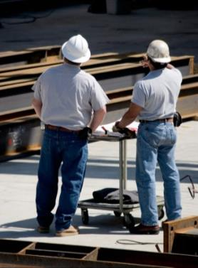
What rights do employees have under OSHA?
Participate in OSHA Inspections (cont.):
Right to:
Find out about inspection results & abatement measures
May object to dates set for violation to be corrected
Must be done in writing within 15 days
Request an informal conference
Be notified by OSHA if employer contests citation
May participate in hearing
Notes:
34
Remind the students how important it is that objections to dates set for violations to be corrected must be made in writing within 15 days.
You have the right to find out about inspection results and abatement measures, and get involved in any meetings or hearings related to the inspection. You may also object to the date set for the violation to be corrected and be notified if the employer files a contest.
CONTEST: If an employer disagrees with the results of the OSHA inspection, he or she may submit a written objection to OSHA, called a Notice of Contest.
Be aware that you request an Informal Conference within 15 working days from the time you received the OSHA Notice with the OSHA Area Director to discuss the violations and/or the abatement dates.
Use this space for notes.

Slide 35
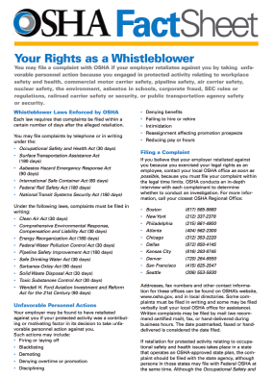
What rights do employees have under OSHA?
Freedom From Retaliation:
Right to:
Be free from retaliation for exercising safety & health rights
Seek safety & health on the job without fear of punishment (described in Section 11(c) of OSH Act)
Safety incentive & injury discipline programs may violate Section 11(c)
Contact OSHS within 30 days if punished for exercising safety & health rights
Notes:
35
Ask the students if they are aware that they have the right to be free from retaliation for seeking safety and health on the job.
Discuss how safety incentives and injury discipline programs may violate Section 11(c) of the OSH Act.
Select the graphic to show a PDF that provides OSHA information on your rights as a whistleblower.
Ask the students to share any experiences they may have had, or heard of, regarding retaliation for whistleblowing.
Share any experiences you may have had with retaliation for whistleblowing.
Workers have a right to seek safety and health on the job without fear of punishment. That right is spelled out in Section 11(c) of the OSH Act. The law says the employer shall not punish or discriminate against employees for exercising such rights as complaining to the employer, union, OSHA, or any other government agency about job safety and health hazards.
Workers are also protected for participation in OSHA inspections, conferences, hearings, and other OSHA-related activities. Workers also have the right to refuse to do a job if they believe in good faith that they are exposed to an imminent danger. "Good faith" means that even if an imminent danger is not discovered after a situation is investigated, the worker had reasonable grounds to refuse work because they honestly believed that a hazard did exist. Since the conditions necessary to justify a work refusal are very stringent, refusing work should be an action taken as a last resort. If time permits, the condition should be reported to OSHA or the appropriate government agency.
If you believe you have been punished for exercising your safety and health rights, you must contact OSHA within 30 days.
Use this space for notes.

Slide 36
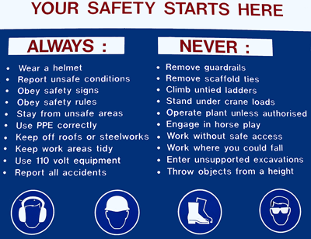
What rights do employees have under OSHA?
Employee Responsibilities:
Comply with all safety & health regulations & standards
Immediately report hazardous conditions to employer
Immediately notify co-workers of hazards
Report defective equipment, machines, or inadequate safeguards
Notes:
36
Remind the students that they are responsible for complying with all OSHA and workplace safety and health regulations.
Remind the students that even though OSHA will not cite workers for safety and health violations, it is important that they follow all safety and health regulations to keep themselves safe.
Ask the students to share any experiences they may have had, or heard of, where an employee exercised one of the responsibilities listed on the screen.
Share any experiences you may have had with the responsibilities listed on the screen.
OSHA holds employers responsible for the safety and health conditions in the workplace and does not cite workers for violations. However, Section 5(b) of the OSHA Act states that each employee shall comply with occupational safety and health standards and all applicable rules, regulations and orders.
Workers are encouraged to follow all appropriate safety and health rules, and wear protective equipment while working.
Use this space for notes.

Slide 37
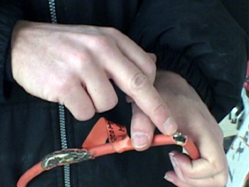
What rights do employees have under OSHA?
Employee Responsibilities (cont.):
Turn in defective tools & equipment
Follow all reasonable safety & health rules of employer
Report any work-related injuries or illness to employer
Ask supervisor/employer about work assignment concerns
Notes:
37
Ask the students to share any experiences they may have had, or heard of, where an employee exercised one of the responsibilities listed on the screen.
Share any experiences you may have had with the responsibilities listed on the screen.
Use this space for notes.

Slide 38
What rights do employees have under OSHA?
Discussion Questions
When may a worker refuse to do work?
Within how many days must an employee contact OSHA if they feel they were punished for exercising their rights to health and safety?
Notes:
38
Use this space for notes.
Ask the students to answer the review questions on the screen.
Answer – When they feel they are being exposed to imminent danger.
Answer – Within 30 days.
Note: Answers shown on the next screen.

Slide 39
What rights do employees have under OSHA?
Discussion Questions
When may a worker refuse to do work? (When they feel they are being exposed to imminent danger.)
Within how many days must an employee contact OSHA if they feel they were punished for exercising their rights to health and safety? (Within 30 days.)
Notes:
39
Use this space for notes.
Discuss the correct answers.

Slide 40
What rights do employees have under OSHA?
Summary:
Employee rights regarding:
Hazardous chemicals at the workplace
Access to information on injuries & illnesses
Complaints or requesting corrections
Training
Access to exposure & medical records
Filing complaints with OSHA
Participation in OSHA inspections
Freedom from retaliation
Employee responsibilities at the workplace
Any Questions?
Notes:
40
Review the topics covered in this section of the training.
Ask the students if they have any questions before proceeding.
Use this space for notes.

Slide 41
What responsibilities does an employer have under OSHA?
Notes:
41
Explain that this portion of the program will introduce the students to employer responsibilities under OSHA, including responsibilities regarding accident prevention programs, employee training, OSHA injury/illness recordkeeping, Discrimination against workers, first aid & medical care, safety at the workplace, job hazard analyses, and safety on multi-employer sites.
Ask the student if they have any questions before proceeding.
Use this space for notes.

Slide 42

What responsibilities does an employer have under OSHA?
Objectives:
Explain employer responsibilities regarding:
Accident prevention programs
Employee training
OSHA injury/illness recordkeeping
Discrimination against workers
First aid & medical care
Safety at the workplace
Job hazard analyses
Safety on multi-employer sites
Notes:
42
Review the objectives.
Use this space for notes.

Slide 43
What responsibilities does an employer have under OSHA?
Establish Safe Workplace:
OSHA 29 CFR 1926.20(a)(1)
Section 107 of the Act requires that it shall be a condition of each contract which is entered into under legislation subject to Reorganization Plan Number 14 of 1950 (64 Stat. 1267), as defined in 1926.12, and is for construction, alteration, and/or repair, including painting and decorating, that no contractor or subcontractor for any part of the contract work shall require any laborer or mechanic employed in the performance of the contract to work in surroundings or under working conditions which are unsanitary, hazardous, or dangerous to his health or safety.
Important examples of responsibilities:
OSHA 29 CFR 1926.20(b) Accident Prevention
OSHA 29 CFR 1926.21(b) Education & Training
Notes:
43
Review how OSHA 29 CFR 1926.20(a) regulates that employers must provide a safe workplace for its employees.
Ask the students to share any experiences they may have had, or heard of, where employees were required to work in unsafe work conditions.
Share any experiences you may have had were you were required to work in unsafe conditions.
Note: OSHA 29 CFR 1926.20(b) and 1926.21(b) will be discussed on the next two screens.
The OSH Act makes the employer responsible for providing a safe workplace. This responsibility described in OSHA 29 CFR 1926.20(a)(1). states: “Section 107 of the Act requires that it shall be a condition of each contract which is entered into under legislation subject to Reorganization Plan Number 14 of 1950 (64 Stat. 1267), as defined in 1926.12, and is for construction, alteration, and/or repair, including painting and decorating, that no contractor or subcontractor for any part of the contract work shall require any laborer or mechanic employed in the performance of the contract to work in surroundings or under working conditions which are unsanitary, hazardous, or dangerous to his health or safety.”
Two very important examples of these employer responsibilities are found in OSHA 29 CFR 1926.20(b) concerning accident prevention and in OSHA 29 CFR 1926.21(b) concerning safety training and education.
Use this space for notes.

Slide 44
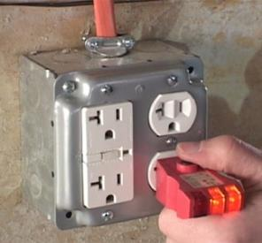
What responsibilities does an employer have under OSHA?
Establish Accident Prevention Programs:
Establish, update, & communicate safe operating procedures to employees
Employ competent persons to regularly inspect jobsites, materials, & equipment
Provide safe tools/equipment
Remove, tag, or render unusable those that are not
Permit only qualified workers to operate equipment or machinery
Provide & pay for PPE
Notes:
44
Explain to the students that OSHA 29 CFR 1926.20(b) provides regulations on employer responsibilities regarding accident prevention programs.
Ask the students if their employers regularly comply with the guidelines listed.
Ask the students to share any experiences they may have had, or heard of, regarding an employers failure to establish an accident prevention program.
Share any experiences you may have had with an employers failure to establish an accident prevention program.
Review the difference between a competent person and a qualified person.
OSHA 29 CFR 1926.20(b) makes the employer responsible for setting up a program to “provide for frequent and regular inspections of jobsites, materials, and equipment ... by competent persons designated by the employer.” The employer is also responsible for providing safe tools and equipment and for removing from work, tagging, or rendering unusable any equipment which isn’t.
The employer can allow only employees qualified by training or experience to operate equipment and machinery.
Many OSHA standards specifically require the employer to train workers in the safety and health aspects of their jobs. Other OSHA standards make it the employer’s responsibility to limit certain job assignments to those who are “certified,” “competent,” or “qualified”—meaning that they have had special previous training, in or out of the workplace.
Employers are required to determine if PPE should be used to protect their workers. OSHA also requires that employers pay for most required PPE, except for uniforms, items worn to keep clean, weather-related gear, logging boots, and non-specialty safety toe protective footwear (including steel-toe shoes or steel-toe boots) and non-specialty prescription safety eyewear, as long as the employer permits the items to be worn off the job-site.

Slide 45

What responsibilities does an employer have under OSHA?
Instruct Employees:
In hazard recognition/avoidance & applicable regulations
To handle or use:
Poisons, caustics, & other toxic/harmful substances
Flammable liquids & gases
That enter into confined spaces
Notes:
45
Explain to the students that OSHA 29 CFR 1926.21(b) provides regulations on employer responsibilities regarding employee training.
Ask the students to discuss whether or not they feel they have received sufficient enough training in hazard recognition and the other various topics listed.
Ask the students to share any experiences they may have had, or heard of, regarding an employers failure to properly train its employees.
Share any experiences you may have had with an employers failure to properly train its employees.
OSHA 29 CFR 1926.21(b) make an employer responsible for providing instruction “in the recognition and avoidance of unsafe conditions” and “the regulations applicable to [the] work environment to control or eliminate any hazards or other exposures to illness and injury.”
Some of the unsafe conditions specifically described in the standards are found in OSHA 29 CFR 1926.21(3) through (6)(i).
OSHA’s Hazard Communication standard applies to both General Industry and Construction workers and requires that employers provide workers with effective information and training on hazardous chemicals in their work area at the time of their initial assignment, and whenever a new physical or health hazard is introduced. In addition, as we discussed earlier, chemical-specific information must always be available through labels and material safety data sheets (MSDSs).
Use this space for notes.

Slide 46

What responsibilities does an employer have under OSHA?
Employee Training:
Provide employee training as required by OSHA standards
Keep records of training
Provide to OSHA on request
Makes copies of standards available to employees
Inform employees about OSHA
Notes:
46
Ask the students to give some examples of specific OSHA training they may have received through their employer.
Ask the students if and how their employers inform them about OSHA standards relating to their work assignments.
Ask the students if their employers make OSHA standards available to them.
Share any OSHA related training experiences you may have had.
In the construction standards there are more than 80 references to training that the employer is responsible for providing to workers exposed to potentially hazardous working conditions or substances.
In addition to accident prevention and training, the employer has many other general responsibilities which are described in the OSHA standards.
Use this space for notes.

Slide 47

What responsibilities does an employer have under OSHA?
OSHA Injury/Illness Records:
Keep OSHA-required injury/illness records
Post annual summaries each year
February through March
Allow OSHA access to records
Provide medical exams when required
Provide workers access to their exposure & medical records
Inform workers how to report an injury or illness
Report to OSHA within 8 hours a fatality or hospitalization of 3+ workers
Notes:
47
Ask the students if their employers post annual OSHA injury/illness records.
Ask the students to share any experiences they may have had, or heard of, where accessing an injury/illness record was required.
Ask the students to discuss the procedures they use to report injuries or illnesses to their employer.
Share any experiences you may have had with OSHA injury/illness records or injury/illness reporting procedures.
Employers must keep records of injuries and illnesses including: setting up a reporting system, upon request, providing copies of logs to both OSHA and employees alike, posting the annual summary, and reporting within 8 hours any accident resulting in a fatality or the hospitalization of 3 or more workers.
Recordkeeping is an important part of an employer’s responsibilities. Keeping records allows OSHA to collect survey material, helps OSHA identify high-hazard industries, and informs you, the worker, about the injuries and illnesses in your workplace.
As discussed earlier when covering worker rights, you have a right to access medical records. Additionally, when you are working with chemicals or other hazardous substances, your employer may be required to conduct monitoring or provide medical examinations that involve you. An example of this would be if you are working with lead, such as removing or stripping substantial quantities of lead-based paints on large bridges and other structures. Plumbers, welders, and painters are among those workers most exposed to lead. Your employer must give you copies of medical or exposure records involving you if you request them.
Use this space for notes.

Slide 48
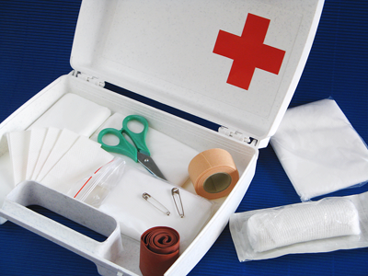
What responsibilities does an employer have under OSHA?
First Aid & Safety:
Provide first aid supplies & medical care
Develop/maintain a fire protection & suppression program
Develop an Emergency Action Plan:
Routes
Rescue and medical duties
Alarm systems
Evacuation plan
Training
Notes:
48
Ask the students to discuss first aid and medical care provided to them at work through their employers.
Ask the students if their employers have an Emergency Action Plan in place and if so, to describe its components.
Ask the students to share any experiences they may have had, or heard of, where an Emergency Action Plan, or lack of one influenced the outcome of an incident.
Share any experiences you may have had with an Emergency Action Plan.
It is important to remember that an Emergency Action Plan should be reviewed and updated periodically so that it is up-to-date, accurate, and so that it address the current working environment.
Use this space for notes.

Slide 49

What responsibilities does an employer have under OSHA?
Work Area Conditions:
Ensure illumination for all construction areas, aisles, stairs, ramps, runways, corridors, offices, shops, & storage areas
Keep scrap materials cleared from work areas, passageways, stairs, & buildings
Remove combustible debris:
Provide containers with covers for garbage, oily, flammable, or hazardous materials
Notes:
49
Ask students to share any experiences they may have had, or heard of, regarding unkempt work areas. What happened? What role did employer responsibilities regarding workplace conditions play? How could have it been prevented?
Share any experiences you may have had with employer responsibilities regarding workplace conditions.
Use this space for notes.

Slide 50
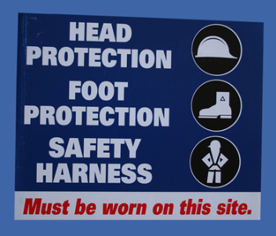
What responsibilities does an employer have under OSHA?
Work Area Conditions (cont.):
Provide drinking water, toilets, washing facilities, eating areas, & change rooms
Arrange & maintain exits to provide free & unobstructed egress from all parts of buildings & structures
Use color codes, posters, labels, or signs to warn employees of hazards
Notes:
50
Ask the students to share any experiences they may have had, or heard of, regarding the points listed. What role did employer responsibilities, or lack their of, play in the incident.
Share any experiences you may have had had with the points listed and discuss the role employer responsibilities played in the situation.
Use this space for notes.

Slide 51
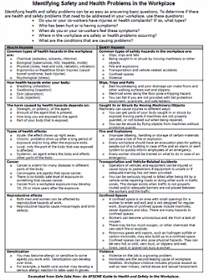
What responsibilities does an employer have under OSHA?
Ensuring a Safe Workplace:
Conducting a job hazard analysis:
Project hazard analysis
Done prior to project by contractor to identify project phases & hazards
Phase hazard analysis
Done prior to each project phase to analyze site conditions & work activities
Job safety analysis
Done prior to start of any task by supervisor or foreman (competent person)
Notes:
51
Ask the students to explain what a job hazard analysis is.
Ask the students if they have ever participated in any of the three parts of a job hazard analysis, and if so, to explain.
Describe different work environments and ask the students to identify potential hazards that might be found during each part of a job hazard analysis. Have them identify the possible mitigating measures.
Select the graphic to show a PDF that provides information on ways to identify potential safety and health problems at work.
Note: Explain that a job hazard analysis is not a standard, just a best safe work practice.
In order to keep workers safe an employer must conduct a job hazard analysis. The three parts of a job hazard analysis include the: project hazard analysis, phase hazard analysis, and job safety analysis.
The project hazard analysis is done by the project contractor prior to starting the job and seeks to identify project phases and hazards. It provides the basis for the site-specific safety plan and it is the responsibility of the project contractor to communicate the results to the subs.
The phase hazard analysis is done prior to each project phase to analyze site conditions and work activities. It is used to update the project hazard analysis and site safety plan. The contractor or sub doing the work is responsible for communicating results to other contractors, supervisors, and workers at the site.
The job safety analysis is done prior to the start of any task by a supervisor or foreman (competent person) and focuses on actual worksite conditions and procedures. The supervisor or foreman is responsible for communicating the results to the workers at the site.
Be aware that a job hazard analysis is not a standard, but it is a best safe work practice.

Slide 52

What responsibilities does an employer have under OSHA?
Comply with Other OSHA Standards:
Post OSHA poster or state equivalent prominently in the workplace
Cooperate with OSHA compliance officers
Furnish names of employee reps
Do not discriminate against workers who exercise rights under OSH Act Section 11(c)
Post OSHA citations & abatement verification notices next to site involved for at least 3 days
Notes:
52
Ask the students if they have ever been discriminated or retaliated against, or know another worker who was, for exercising their rights under OSHA in seeking a safe and healthful workplace.
Share any experiences you may have had with discrimination or retaliation for exercising your rights under OSHA in seeking a safe and healthful workplace.
Select the graphic to show a PDF of the OSHA Job Safety and Health poster. Review the employer and employee rights it identifies.
OSH Act Section 11(c) prohibits employers from discharging or in any manner retaliating against workers for exercising their rights under the Act.
Depending upon the circumstances of the case, "discrimination“ can include: firing or laying off; demoting; denying overtime or promotion; disciplining; reducing pay or hours, and other actions. If you believe your employer has discriminated against you because you exercised your safety and health rights, contact your local OSHA Office right away. The OSH Act gives you only 30 days to report discrimination.
An OSHA citation informs the employer and workers of the standards violated, the length of time set for correction, and proposed penalties resulting from an OSHA inspection. Your employer must post a copy of each citation at or near places where the violations occurred for 3 days, or until the violation is fixed (whichever is longer). Employers also have to inform workers of what they have done to fix the violation, allow workers to examine and copy abatement documents sent to OSHA, and tag cited movable equipment to warn workers of the hazard.
Use this space for notes.

Slide 53
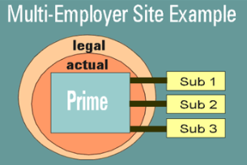
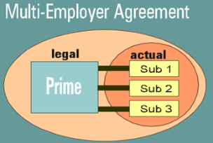
What responsibilities does an employer have under OSHA?
Safety on Multi-employer Sites:
Prime contractor:
Maintains safe & healthful conditions throughout worksite
Can enter into agreement with subs to have them provide services or fulfill specific obligations
Removes prime from actual, but not legal responsibility for compliance
Agreements can make both prime & subs responsible for compliance
Notes:
53
Ask the students to share any experiences they may have had regarding safety and health responsibilities on multi-employer sites.
Share any experiences you may have had regarding safety and health responsibilities on multi-employer sites.
On multi-employer sites, the general contractors, project managers, or other such entities (called ‘primes’) are responsible for the safety and health of their employees and for the maintenance of safe and healthful conditions throughout the site. This means that OSHA can legally cite the prime for standard violations by the subcontractors and can hold the primes actually responsible for correcting them. Even so, in some cases, the primes may enter into agreements with subcontractors to make them responsible for the actual workplace conditions under which they perform their work. When primes do this, they may pass on the actual responsibility for safe and healthful conditions to the subs. Even so, they may (it depends on a case by case basis), along with the subs, still be legally responsible for the conditions. Thus, both the prime and the sub are responsible for compliance and can receive OSHA citations for safety or health violations.
However, the advantage of this arrangement for the prime is evident. The subs are often in the best position to monitor and control their own hazards. But the arrangement also motivates the prime to make the sub provide the required safety and health conditions.
Use this space for notes.

Slide 54
What responsibilities does an employer have under OSHA?
Site Safety:
The following four categories of employer can be cited because of the same unsafe condition:
Creating Employer - actually created the hazard
Controlling Employer - has responsibility over the site and has authority to require correction of unsafe conditions for the entire site or the specific area of the site at which the OSHA inspector finds the hazard
Correcting Employer - responsible for the correction of any hazard
Exposing Employer - exposes its employees to a hazard whether created by it or not
Notes:
54
Review the four categories of employers and provide examples for each type of situation.
Use this space for notes.

Slide 55
What responsibilities does an employer have under OSHA?
Activity: Workers’ Rights Activity
Notes:
55
Complete the Workers’ Rights activity with the students.
Note: The instructions for this activity can be found in Appendix B at the end of this guide.
Tell the students that the “Twelve Statements” form, which is required for this activity, can be found in the appendix of their guide.
Note: The “Twelve Statements” form required for this activity can be found in the appendix of this guide. It is on the last page of the appendix.
Use this space for notes.

Slide 56
What responsibilities does an employer have under OSHA?
Discussion Questions
What types of accident must an employer report to OSHA within eight hours?
Who can be held responsible for health and safety on multi-employer sites?
Notes:
56
Use this space for notes.
Ask the students to answer the review questions on the screen.
Answer – Accidents resulting in a fatality or fatalities, or the hospitalization of three or more employees.
Answer – Prime and/or subcontractors depending on the situation.
Note: Answers shown on the next screen.

Slide 57
What responsibilities does an employer have under OSHA?
Discussion Questions
What types of accident must an employer report to OSHA within eight hours? (Accidents resulting in a fatality or fatalities, or the hospitalization of three or more employees.)
Who can be held responsible for health and safety on multi-employer sites? (Prime and/or subcontractors depending on the situation.)
Notes:
57
Use this space for notes.
Discuss the correct answers.

Slide 58
What responsibilities does an employer have under OSHA?
Summary:
Employer responsibilities regarding:
Accident prevention programs
Employee training
OSHA injury/illness recordkeeping
Discrimination against workers
First aid & medical care
Safety at the workplace
Job hazard analyses
Safety on multi-employer sites
Any Questions?
Notes:
58
Review the topics covered in this section of the training.
Ask the students if they have any questions before proceeding.
Use this space for notes.

Slide 59
What do the OSHA standards say?
Notes:
59
Explain that this portion of the program will identify OSHA standards that pertain to construction trades and other general industries, identify the ten most accessed OSHA standards in general industry, and explain how to access Most Frequently Cited (MFC) data on Department of Labor (DOL) website.
Ask the student if they have any questions before proceeding.
Use this space for notes.

Slide 60

What do the OSHA standards say?
Objectives:
Identify OSHA standards that pertain to construction trades & other general industries
Identify the ten most accessed OSHA standards in general industry
Explain how to access Most Frequently Cited (MFC) data on Department of Labor (DOL) website
Notes:
60
Review the objectives.
Use this space for notes.

Slide 61
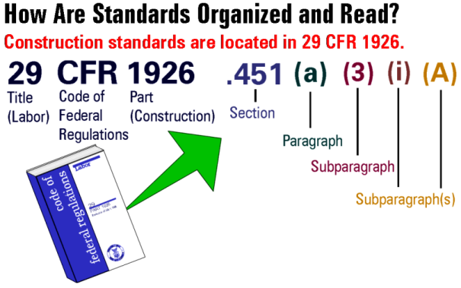
What do the OSHA standards say?
Reading OSHA Standards
Notes:
61
Ask the students to share what they know about the Code of Federal Regulations (CFR) 29, construction standards.
Ask the students if they know how to read OSHA standards.
Review how to read the parts (section, paragraph, etc.) of a standard.
OSHA standards are federal regulations, so they appear in the Code of Federal Regulations (CFR). The Code of Federal Regulations is divided into Titles based on departments or agencies. OSHA is in the Department of Labor. The Labor Title is 29. Next is the Part. The Part is a subdivision within an agency. For example, safety and health in general industry are in Part 1910. For safety and health in construction, the Part is 1926 and includes some parts of 1910.
Once you have the book in hand, here’s how the standards are read. First locate specific topics by looking in the index and then going to a section. For example, scaffolding is section .451. In each section, the topic begins with a small letter in parenthesis. For example, the topic (a) in section .451 is called “capacity.” Next is the requirement, a number in parenthesis. In this case .451(a)(6) requires scaffolds to be designed by a qualified person and constructed and loaded in accordance with that design. If the requirement is further subdivided, it will have a paragraph, given by a roman numeral in parenthesis: (i) for example. And sometimes a subparagraph which is given by upper case alpha, such as (A).
The construction and general industry standards, 1926 and 1910, are also divided into 26 alphabetical subparts. Each subpart corresponds with a different type of hazard. Consequently, when referring to the construction standard, some experts refer to “Subpart M” or “Subpart K.” These subpart references are used in addition to the numerical references.

Slide 62

What do the OSHA standards say?
OSHA Standards:
General Industry (1910)
Construction (1926)
Maritime (1915)
Agriculture (1928)
If no specific OSHA standards exist, comply with General Duty Clause 5(a)(1) of OSH Act of 1970
Notes:
62
Explain to the students where employer responsibilities are listed.
Select the first link on the screen to access OSHA Part 1910 General Industry.
Select the second link on the screen to access OSHA Part 1926 Construction.
Select the third link on the screen to access the General Duty Clause 5(a)(1).
Select the fourth link on the screen to access the OSH Act of 1970.
You can find most of the employer’s responsibilities in the OSHA standards in 1926 and 1910. Others are found in Parts 1903 and 1904. For some, you need to look at the OSH Act. These resources are supplemented with many other documents including OSHA Policy Directives and Instructions such as those found in OSHA’s Field Operations Manual (F.O.M.).
Your OSHA Area Office can also assist you with questions on employer and employee rights.
Remember, a key requirement in identifying the employer’s responsibilities under the OSH Act is found in Section 5(a)(1) of the Act. This section requires “each employer to furnish ... a place of employment free from hazards that are likely to cause death or serious physical harm to his/her employees.” Under this provision of the Act, OSHA can issue citations for any “recognized hazard” (e.g. ergonomics and air monitoring in confined spaces) even if not covered by a specific standard.
1910 - www.osha.gov/pls/oshaweb/owasrch.search_form?p_doc_type=STANDARDS&p_toc_level=1&p_keyvalue=1910
1926 - www.osha.gov/pls/oshaweb/owasrch.search_form?p_doc_type=STANDARDS&p_toc_level=1&p_keyvalue=1926
General Duty Clause 5(a)(1) - http://www.osha.gov/pls/oshaweb/owadisp.show_document?p_table=OSHACT&p_id=3359
OSH Act 1970 - www.osha.gov/pls/oshaweb/owasrch.search_form?p_doc_type=OSHACT&p_toc_level=0&p_keyvalue=&p_status=CURRENT

Slide 63
What do the OSHA standards say?
General Industry (10 Most Accessed Standards)
General Industry (1910)
Bloodborne Pathogens – 1910.1030
Hazard Communication – 1910.1200
Respiratory Protection – 1910.134
Occupational Noise Exposure – 1910.95
Powered Industrial Trucks – 1910.178
Permit-required Confined Spaces – 1910.146
Lockout/Tagout – 1910.147
Hazardous Waste Ops. & Emergency Response – 1910.120
Guarding Floor & Wall Openings and Holes – 1910.23
Personal Protective Equipment – 1910.132
Notes:
63
Review the 10 most assessed OSHA standards.
Ask the students to identify the standards they are familiar with or have received training on.
Ask the students to give examples of other standard topics they are familiar with.
Share other standards you feel are important to the construction trades.
Select the link on the screen to access OSHA Part 1910 General Industry.
Use this space for notes.

Slide 64
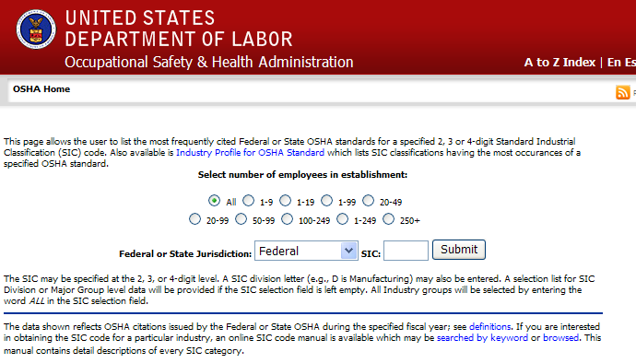
What do the OSHA standards say?
Most Frequently Cited (MFC) Data
Notes:
64
Ask the students to share any information they have about the Most Frequently Cited (MFC) Data.
Select the graphic to access the Department of Labor, Most Frequently Cited website.
Demonstrate for the students how to use the website to access data.
Most Frequently Cited (MFC) Data can be assessed from the Department of Labor website at http://www.osha.gov/pls/imis/citedstandard.html.
To search data on this webpage:
Select number of employees
Select Federal or specific state
SIC (select):
ALL for all industry groups
C for Construction
D for Manufacturing (General Industry)
373 & 449 for Maritime
Shown are search results for:
All sizes of establishments, in
Federal jurisdiction, with
Construction SIC codes.

Slide 65
What do the OSHA standards say?
Discussion Questions
What part of OSHA 29 CFR regulates General Industry?
What part of OSHA 29 CFR regulates the Construction Industry?
Notes:
65
Use this space for notes.
Ask the students to answer the review questions on the screen.
Answer – Part 1910.
Answer – Part 1926.
Note: Answers shown on the next screen.

Slide 66
What do the OSHA standards say?
Discussion Questions
What part of OSHA 29 CFR regulates General Industry? (Part 1910.)
What part of OSHA 29 CFR regulates the Construction Industry? (Part 1926.)
Notes:
66
Use this space for notes.
Discuss the correct answers.

Slide 67
What do the OSHA standards say?
Summary:
OSHA construction trades & general industry standards
Ten most accessed OSHA standards in general industry
Most Frequently Cited (MFC) data on (DOL) Department of Labor website
Any Questions?
Notes:
67
Review the topics covered in this section of the training.
Ask the students if they have any questions before proceeding.
Use this space for notes.

Slide 68
How are OSHA inspections conducted?
Notes:
68
Explain that this portion of the program will identify the procedures that are used to conduct OSHA inspections, identify the six OSHA inspection priority categories, explain the types of OSHA citations and subsequent penalties, explain the steps of an OSHA inspection, explain the process used by OSHA for issuing citations, identify employer & employee rights under OSHA after a citation is issued.
Ask the student if they have any questions before proceeding.
Use this space for notes.

Slide 69

How are OSHA inspections conducted?
Objectives:
Identify the procedures that are used to conduct OSHA inspections
Identify the six OSHA inspection priority categories
Explain the types of OSHA citations & subsequent penalties
Explain the steps of an OSHA inspection
Explain the process used by OSHA for issuing citations
Identify employer & employee rights under OSHA after a citation is issued
Notes:
69
Review the objectives.
Use this space for notes.

Slide 70

How are OSHA inspections conducted?
OSHA Inspections:
Workplace inspections:
Authorized by OSH Act
Completed by OSHA compliance safety & health officers (CSHOs)
Conducted at reasonable times
Occur without advanced notice except in rare circumstances (e.g. Imminent Danger)
Notifying an employer in advance of an inspection can result in fines & jail
Notes:
70
Ask the students to share any experiences they may have had, or heard of, regarding OSHA inspections.
Share any experiences you may have had with OSHA inspections.
The OSH Act authorizes OSHA compliance safety and health officers (CSHOs) to conduct workplace inspections at reasonable times. OSHA conducts inspections without advance notice, except in rare circumstances (for example, when there is a report of an Imminent Danger). In fact, anyone who tells an employer about an OSHA inspection in advance can receive fines and a jail term.
Use this space for notes.

Slide 71
How are OSHA inspections conducted?
OSHA Inspection Priority
1st
Imminent Danger
Hazard where death or serious injury is likely before the danger can be eliminated by normal enforcement procedures.
2nd
Catastrophe/Fatality
Death(s) or incident(s) resulting in inpatient hospitalization of three or more employees.
3rd
Complaint/Referral
Complaint by worker or worker representative of referral from a recognized professional.
4th
Programmed
Aimed at high-risk areas based on OSHA’s targeting and priority methods.
5th
Follow-up
Completed after citations to assure employer has corrected violations.
6th
Monitoring
Used for long-term abatement follow-up or to assure compliance with variances.
Notes:
71
Explain that OSHA conducts six types of inspections to determine if employers are in compliance with standards.
Review the six priority categories.
Ask the students to share any experiences they may have had, or heard of, regarding OSHA inspection priorities.
Share any experiences you may have had with OSHA inspection priorities.
1st Priority - Imminent Danger: This is a condition where there is reasonable certainty a danger exists that can cause death or serious physical harm. OSHA may contact the employer and try to have workers removed from danger. A CSHO then makes an inspection no later than one day after receiving the report.
2nd Priority - Fatalities and Catastrophes: OSHA starts these investigations as soon as possible after getting a report. CSHOs gather evidence to determine the causes of the event and if violations occurred.
3rd Priority - Complaints and Referrals: A worker or worker representative can file a complaint about a safety or health hazard in the workplace. Referrals usually are from a government agency, such as NIOSH or a local health department. They are handled the same way as complaints.
4th Priority - Programmed Inspections: These inspections cover industries and employers with high injury and illness rates, specific hazards, or other exposures. There may also be special emphasis programs in just one OSHA region or certain area offices, based on knowledge of local industry hazards.
OSHA also conducts Follow-up and Monitoring Inspections. These inspections are made as needed, and take priority over Programmed Inspections. A follow-up is made to see if violations cited on an earlier inspection were fixed. Monitoring inspections are made to make sure hazards are being corrected and workers are protected whenever a long period of time is needed for a hazard to be fixed.

Slide 72
How are OSHA inspections conducted?
Steps of an OSHA Inspection:
Present Credentials
Identifies self
Shows credentials to employer & employees representative
Explains scope/purpose of inspection
Conduct Opening Conference
Explains inspection process
Explains how penalties are determined
Explains employee rights
Conducts employee interviews
May conduct a review of records prior to walk-around
Walk-around Inspection
Walks around/observes conditions
Takes measurements, photos & video
Talks to workers (may be in private)
Inspects records
Examines postings
Points out hazards
Discusses abatement methods
Hold Closing Conference
Discuss findings, violations, & abatements
Conducts closing interviews with employer & employee representatives
Notes:
72
Review the four major steps of an OSHA inspection.
1. Presenting Credentials: When arriving at the workplace, the CSHO finds out who is in charge and presents his or her credentials. Employers can require OSHA to get a warrant prior to inspections.
2. Opening Conference: The CSHO finds out if workers are represented and, if so, makes sure that the worker representative participates in all phases of the inspection. If the employer or worker representative objects to a joint conference, separate conferences are held.
3. The Walkaround: The CSHO along with the employer and worker representatives inspect the work areas for potentially hazardous working conditions. Violations are pointed out and documented. The CSHO may also conduct interviews, take measurements, photographs and video, and monitor worker exposure to noise, air contaminants, etc. Worker interviews may be done in private and a union representative may be present.
4. Closing Conference: The CSHO holds a closing conference with the employer and the worker representatives, jointly or separately. When the employer does not want to have a joint conference, the CSHO will normally hold the conference with the worker representative first, so that worker input is received before employers are informed of proposed citations. Apparent violations and estimated times for correction are discussed. Employers are informed of their rights/responsibilities related to the inspection. Employer and worker representatives are told of their rights to take part in any future meetings and contest rights. No citations are given out at this time. Citations are mailed at a later date.

Slide 73
How are OSHA inspections conducted?
Issuing of Citations:
OSHA issues citations (within 6 months of inspection) when hazards exist
OSHA issues citations to employer by:
Certified mail
Hand delivery
Employers must post citations:
At or near where violation happened
For three days or until hazard is abated
Within 15 days of citations:
Employers & employees may have joint or separate informal conference(s)
Employers may ask for changes in the citation, penalty, or abatement dates
Employees may ask for changes in abatement dates
Notes:
73
Review the procedures for issuing of citations.
Ask the student to share any experiences they may have had, or heard of, regarding the issuing of OSHA citations.
Share any experiences you may have had with the issuing of OSHA citations.
The CSHO takes the findings back to the office and writes up a report. The Area Director reviews it and makes the final decision about the citations and penalties.
Citations inform the employer and workers of: regulations and standards the employer allegedly violated, any hazardous working conditions covered by the OSH Act’s General Duty Clause, the proposed length of time set for abatement of hazards, and any proposed penalties.
Citations are sent by certified mail to the facility. The employer must post a copy of each citation at or near the place the violation occurred for 3 days or until it is fixed. Employers must also inform workers and their representatives of the correction they make.
Use this space for notes.

Slide 74
How are OSHA inspections conducted?
Violations & Penalties
Other-than-Serious
$0 to $7,000
Serious
$1,500 to $7,000
Willful
$5,000 to $7,000 (no criminal willful disregard)
$250,000 to $500,000 / jail (death, criminal disregard)
Repeated
Up to $70,000
Failure to Abate
Up to $7,000 per day
Falsifying Information
$10,000, up to 6 months in jail
Violation of Posting/ Abatement Verification
$1,000, to $7,000
Notes:
74
Ask the students to give examples for the different types of violations. (e.g. Serious Violations: lack of guardrails on scaffolds over ten feet; Other-than-Serious violations: poor housekeeping.)
Ask the students to share any experiences they may have had, or heard of regarding OSHA citations and subsequent penalties.
Share any experiences you may have had with OSHA citations and subsequent penalties.
Explain that OSHA may adjust a penalty downward depending on the gravity of the violation, the employer's good faith (efforts to comply with the Act), history of previous violations, and size of business.
Other-than-Serious: A violation that has a direct relationship to safety and health, but probably would not cause death or serious physical harm.
Serious: A violation where there is substantial probability that death or serious physical harm could result and that the employer knew, or should have known, of the hazard.
Willful: A violation that the employer intentionally and knowingly commits or a violation that the employer commits with plain indifference to the law.
Repeated: A violation that is the same or similar to a previous violation.
Failure to Abate: OSHA may propose an additional penalty for each day an employer fails to correct a previously cited violation beyond the required date.
Falsifying Information: This occurs when an employer deliberately provides false information to OSHA.
Violation of Posting: The employer has to post citations and abatement verification for three days or until the hazard is corrected. The posting has to be near the violation or at a central location.

Slide 75
How are OSHA inspections conducted?
Employer Rights Under OSHA After Citations:
Employers may:
Request informal conference with OSHA to request changes to citations, penalties, & dates
Petition for Modification of Abatement (PMA)
Enter into an informal settlement agreement with OSHA
Contest citations, abatement period, or proposed penalty in writing within 15 days of issue
Notes:
75
Ask the students to share any experiences they may have had, or heard of, regarding an employer exercising their rights after receiving an OSHA citation.
Share any experiences you may have had regarding an employer exercising their rights after receiving an OSHA citation.
Regarding citations, employers may request an informal conference with OSHA to discuss the case. They can also reach a settlement agreement with OSHA that adjusts citations and penalties in order to avoid prolonged legal disputes. If an employer decides to contest the citation, the abatement date, and/or the proposed penalty, this must be done, in writing, within the 15-working day contest period. The area director forwards the notice of contest to the Occupational Safety and Health Review Commission (OSHRC). An administrative law judge decides the case. Employer have a right to participate in the hearing and request a further review of the judge's decision by the commission.
Note: Employers have the right to request an extension of time for an abatement date if they cannot meet the time stated on the citation for a cited item. This is called a petition for modification of abatement, or PMA. If a violation or abatement date is contested by the employer, the situation does not have to be fixed until there is a final legal order. If only the penalty is contested, the violation must be fixed by the date in the citation.
Use this space for notes.

Slide 76
How are OSHA inspections conducted?
Employee Rights Under OSHA After Citations:
Employees may:
Discuss with OSHA issues raised by inspection, citation, notice of penalties, employer’s notice of contest, abatement methods & dates
Appeal abatement time during informal conference
Not contest citations, amendments, deletions of citations, penalties, or lack of penalties
Notes:
76
Ask the students to share any experiences they may have had, or heard of, regarding an employee exercising their rights after their employer received an OSHA citation.
Share any experiences you may have had regarding an employee exercising their rights after their employer received an OSHA citation.
Like employers, workers also have the right to disagree with (or appeal) parts of an OSHA citation. Workers and their representatives may request an informal conference with OSHA to discuss the inspection, citations, penalties or a notice of contest (if filed by the employer). Workers may also contest the abatement time for any violation and an employer's petition for modification of abatement (PMA), but they cannot contest citations or penalties. If a worker plans to contest an abatement time, they should be prepared to provide information to support their position.
Workers also have the right to participate in the hearing and request a further review of the judge's decision by the commission.
Use this space for notes.

Slide 77
How are OSHA inspections conducted?
Discussion Questions
What are some of the reasons that would cause OSHA to conduct an inspection at your workplace?
What types of OSHA violations can result in a jail sentence?
Notes:
77
Use this space for notes.
Ask the students to answer the review questions on the screen.
Answer – If a worker files a complaint, if there is a fatality, or if there is an imminent danger situation.
Answer – Criminal willful violations and falsifying information.
Note: Answers shown on the next screen.

Slide 78
How are OSHA inspections conducted?
Discussion Questions
What are some of the reasons that would cause OSHA to conduct an inspection at your workplace? (If a worker files a complaint, if there is a fatality, or if there is an imminent danger situation.)
What types of OSHA violations can result in a jail sentence? (Criminal willful violations & falsifying information.)
Notes:
78
Use this space for notes.
Discuss the correct answers.
Note: Explain that criminal willful violations refer to willful violations combined with criminal investigations.

Slide 79
How are OSHA inspections conducted?
Summary:
Procedures used to conduct OSHA inspection
Six OSHA inspection priority categories
Types of OSHA citations & subsequent penalties
Steps of an OSHA inspection
Process used by OSHA when issuing citations
Employer & employee rights under OSHA after a citation is issued
Any Questions?
Notes:
79
Review the topics covered in this section of the training.
Ask the students if they have any questions before proceeding.
Use this space for notes.

Slide 80
Where can you go for help?
Notes:
80
Explain that this portion of the program will identify sources within the workplace and worksite for getting help and information, identify sources outside of the workplace and worksite for getting help and information, and explain the procedures for filing an OSHA complaint.
Ask the student if they have any questions before proceeding.
Use this space for notes.

Slide 81
Where can you go for help?
Objectives:
Identify sources within the workplace & worksite for getting help & information
Identify sources outside of the workplace & worksite for getting help & information
Explain the procedures for filing an OSHA complaint
Notes:
81
Review the objectives.
Use this space for notes.

Slide 82
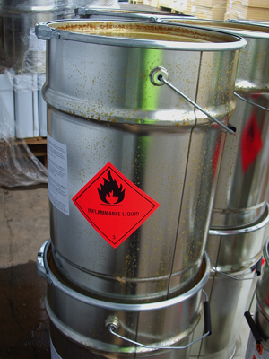
Where can you go for help?
Getting Help/Information
Sources within the workplace/worksite:
Employer or supervisor, co-workers & union representatives
Material Safety Data Sheet (MSDS)
Information on chemicals
Labels & warning signs
Employee orientation manuals or other training materials
Work tasks & procedures instruction
Notes:
82
Review the sources within the workplace/worksite where you can get safety and health help or information.
Ask the students to identify other safety and health information sources available within the workplace/worksite.
Ask the students to share any experiences they may have had, or heard or, where a safety and health source within the workplace/worksite helped prevent an incident.
Share any experiences you may have had where a safety and health source within the workplace/worksite helped prevent an incident.
Employer or supervisor, co-workers and union representatives - Discuss safety and health problems with your employer. You can also talk over your concerns with other workers or your union representatives.
Material Safety Data Sheet (MSDS) for information on chemicals - If working with chemicals, the MSDS can give you important information about its hazards, precautions and PPE requirements.
Labels and warning signs - Labels and signs can show hazard information and make you aware of a potential safety or health hazard. Signs are not intended to take the place of actual hazard corrections. Sign and labels must be understood by all workers, therefore signs must be bilingual when necessary.
Employee orientation manuals or other training materials - Orientation manuals and training materials about your job should include information about how to work safely. Employers are required to provide training and all manuals and training materials should be written clearly and spell out what you need to know about your job hazards. They can also serve as a resource if you have questions at a later time.
Work tasks and procedures instruction - Written job or task instructions can provide information about the proper and safe way to perform a job. OSHA considers some tasks very hazardous (e.g. locking out machinery), and requires employers to have written procedures. Ask for clarification if you are unsure.

Slide 83
Where can you go for help?
Getting Help/Information (cont.)
Sources outside the workplace/worksite:
OSHA website & OSHA offices
Compliance Assistance Specialists in area offices
National Institute for Occupational Safety & Health (NIOSH)
OSHA Training Institute Education Centers (OTIEC)
Doctors, nurses, & other health care providers
Public libraries
Other local, community-based resources
Other safety & health resources
Notes:
83
Select the first link on the screen to access the OSHA website and demonstrate how to use some of its features.
Select the second link on the screen to access the NIOSH website and demonstrate how to use some of its features.
Select the third link on the screen to access the OTIEC website and demonstrate how to use some of its features.
Select the fourth link on the screen to show a PDF which identifies various other safety and health resources.
The OSHA website (www.osha.gov) provides information in English and Spanish. Resources include Fact Sheets and QuickCards (see the Publications page). They provide easy-to-read, basic safety information.
You can contact OSHA by calling or visiting your local area or regional office. Compliance Assistance Specialists conduct many training sessions and have training materials and information that can be useful.
As discussed earlier, NIOSH (http://www.cdc.gov/niosh/) can conduct HHEs of workplaces in cases where workers are getting sick from an unknown cause or working in conditions not regulated by OSHA.
OTIEC (http://www.osha.gov/dte/edcenters/index.html) and other University occupational and environmental health programs offer OSHA courses and a variety of safety and health programs.
Doctors, nurses, and other health care providers can be a resource on the health effects of toxic substances, proper medical and first aid treatment, and other health-related issues.
Public libraries have books, journals and magazines on various safety and health topics, as well as internet.
Other local, community-based resources, such as the National Council for Occupational Safety and Health (COSH) (http://www.coshnetwork.org/) can also be a valuable resource.

Slide 84
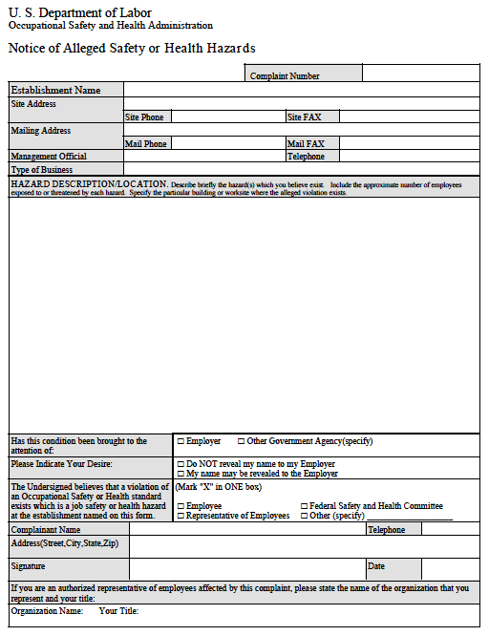
Where can you go for help?
Filing an OSHA Complaint:
Workers can file complaint
Worker representative can file complaint
File complaint:
By downloading OSHA-7 Form Online at OSHA website:
Using the online Complaint Form
By telephoning or visiting OSHA Regional or Area Offices
For emergency & life threatening situations call:
OSHA Regional or Area Offices
1-800-321-OSHA
Notes:
84
Select the first link on the screen to access the OSHA-7 Form on the OSHA website. (Note: Selecting the onscreen graphic will launch the same form as the link except it is in the PDF format and is housed on the CD itself.
Select the second link on the screen to access the OSHA online complaint form.
Select the third link on the screen to access the OSHA webpage that helps identify OSHA Regional and Area Offices.
If you, your co-workers and/or your union representative determine that an OSHA inspection is needed to get workplace hazards corrected, you have several options.
You can download the complaint form from OSHA’s website (http://www.osha.gov/oshforms/osha7.pdf), complete it and mail or fax it to OSHA. A written, signed complaint submitted to the OSHA area or State Plan office is most likely to result in an onsite inspection.
You can file a complaint online (http://www.osha.gov/pls/osha7/eComplaintForm.html). However, most online complaints are handled by OSHA’s phone/fax system, which means they are resolved informally over the phone.
You can telephone or visit your local regional or area office (http://www.osha.gov/html/RAmap.html) to discuss your concerns. After the discussion, OSHA staff can give or send you a complaint form if you wish to file.
Note that if a hazard is life-threatening, call the Regional or local office or 1-800-321-OSHA immediately.

Slide 85

Where can you go for help?
Filing an OSHA Complaint (cont.):
Be specific & include appropriate details
OSHA determines if inspection is necessary
Workers do not have to reveal their name
Notes:
85
Remind the students of the importance of filling out a complaint form as accurately and with as much detail as possible.
Ask the students to share any experiences they may have had, or heard of, regarding the filing of an OSHA complaint.
Share any experiences you may have had regarding the filing of an OSHA complaint.
Be specific and include appropriate details: The information may be the only description of the hazard that the inspector will see before the inspection. An inspector bases research and planning on this information.
Establishment Name, Address, & Type of Business: The inspector’s research on the company and the industry’s hazards will be based on this information.
Hazard Description/Location: The hazard description is the most important part of the form. Your answer should explain the hazards clearly. Identify the location so the inspector will know where to look.
You should indicate on the form if you have tried to get the employer to fix the hazard before filing the complaint. Also indicate if a local fire or building department has been notified of these hazards.
Do NOT reveal my name: OSHA will keep your name off the complaint, if you wish. Remember that discrimination for health and safety activity is illegal. If you are a union representative, you may wish to have your name on the complaint.
Signature and address: It is important to sign the complaint if you want OSHA to conduct an onsite inspection. Also, your address will allow OSHA to send copies of inspection related materials to you.

Slide 86
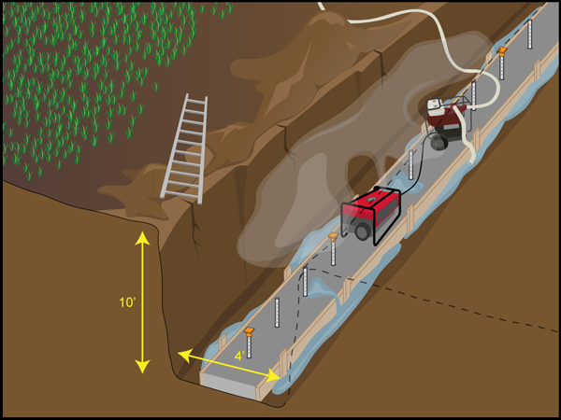
Where can you go for help?
Activity: OSHA Complaint Form
Notes:
86
Instructors: This is a very important class activity that should not be skipped. The goal is to have each student complete and OSHA complaint form.
Ask the students to identify the unsafe jobsite conditions from the graphic “Activity: OSHA complaint Form”.
Note: 1. Trench is neither benched nor shored (cracks and fishers in the soil). 2. Dirt amassed at the top of the trench. 3. No means for egress. 4. Water in the trench. 5. Carbon monoxide emits from gas powered generator from inside confined space (no proper ventilation). 6. Unguarded rebar in the footing.
Ask the students if the conditions should be reported.
Pass out: Blank OSHA complaint forms. Note: The OSHA complaint form can be found in the appendix of the participant guide and in appendix A of this guide.
Divide the students into groups and assign each group one of the six unsafe worksite conditions. Ask each student to fill out their OSHA complaint form based on their group’s unsafe condition. Call on students in each group and have them describe the type of information they included in their complaint form. Review the different sections of the form.
Activity: OSHA Complaint Form
Identify the unsafe jobsite conditions.
Should these conditions be reported?
Fill out the OSHA complaint form located in the appendix of this guide.
Discuss the type of information you included in your complaint form.
Remember, even though employees do have the right to file an OSHA complaint, it may be best to go through the chain-of-command when doing so.
Use this space for notes.

Slide 87
Where can you go for help?
Discussion Questions
Who is permitted to file an OSHA complaint?
Can a worker remain anonymous when filing an OSHA complaint?
Notes:
87
Use this space for notes.
Ask the students to answer the review questions on the screen.
Answer – Anyone can file a complaint.
Answer – Yes, workers are not required to reveal their names.
Note: Answers shown on the next screen.

Slide 88
Where can you go for help?
Discussion Questions
Who is permitted to file an OSHA complaint? (Anyone can file a complaint.)
Can a worker remain anonymous when filing an OSHA complaint? (Yes, workers are not required to reveal their name.)
Notes:
88
Use this space for notes.
Discuss the correct answers.

Slide 89
Where can you go for help?
Summary:
Sources within the workplace & worksite for getting help & information
Sources outside of the workplace & worksite for getting help & information
Procedures for filing an OSHA complaint
Any Questions?
Notes:
89
Review the topics covered in this section of the training.
Ask the students if they have any questions before proceeding.
Use this space for notes.

Slide 90
Program Review
Review:
The importance of OSHA, including the history of safety and health regulation leading to the creation of OSHA and OSHA’s mission
Worker rights under OSHA
Employer responsibilities
OSHA standards
OSHA inspections
Safety and health resources, including how to file a complaint
Notes:
90
Review the topics covered in this program.
Ask the students if they have any questions on any of the information covered in this training program.
Use this space for notes.

Slide 91
Program Complete
Notes:
91
Ask the students to fill out and return the course evaluation form found at the end of their guides. A copy of the form is also located at the end of this guide.
The program has been completed.
Please fill out the course evaluation form found at the end of this guide and return it to your instructor.
Use this space for notes.

