Slide 1
OSHA NOTICE & DISCLAIMER
“This material was produced under grant SH20866SH0 from the Occupational Safety and Health Administration, U.S. Department of Labor. It does not necessarily reflect the views or policies of the U.S. Department of Labor, nor does mention of trade names, commercial products, or organizations imply endorsement by the U.S. Government”

Slide 2
CHAINSAW SAFETY (Module #1)
CHAINSAWS Can be DANGEROUS!
The Professional logger KNOWS what to do.
Know what they know – and use SAFE OPERATING PROCEDURES
SAFETY DEVICES are required to be engineered into the chainsaw design by ANSI B175.1-1991(American National Standards Institute)..but…
NO SAFETY DEVICE is perfect – they help, but YOU are the best accident prevention method!

Slide 3
THE BASICS, & USE in the FOREST (Module #1)
FIRST, THE BASICS:
CHAINSAWS Can be DANGEROUS!
The Professional logger KNOWS what to do.
Know what they know – and use SAFE OPERATING PROCEDURES
SAFETY DEVICES are required to be engineered into the chainsaw design by ANSI B175.1-1991(American National Standards Institute)..but…
NO SAFETY DEVICE is perfect – they help, but YOU are the best accident prevention method!

Slide 4
CHAINSAWS – MAJOR SAFETY ITEMS
CHAINSAW PARTS
GRIP & PERSONAL PROTECTIVE EQUIPMENT
START-UP METHODS
SAFE OPERATION-Cut Speed & Areas
KICKBACK & SPRINGBACK Prevention
MAINTENANCE & FUELING

Slide 5
CHAINSAW PARTS – a typical saw
CHAINSAWS have similar parts.
There may be differences, but parts are typical.
Parts FAIL:
1) over time,
2) when maintenance and repairs aren’t done.

Slide 6
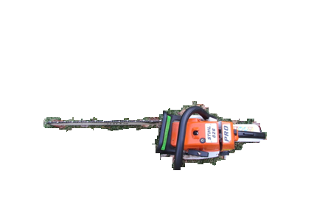
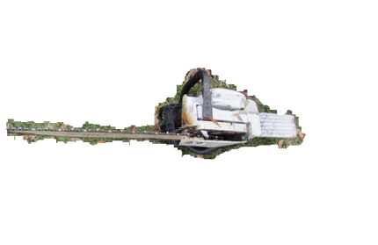
CHAINSAW PARTS – a typical saw
TOP VIEW
BOTTOM VIEW

Slide 7
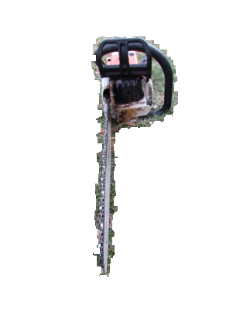
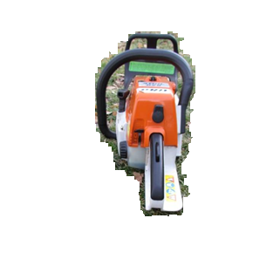
CHAINSAW PARTS – a typical saw
FRONT VIEW
BACK VIEW

Slide 8
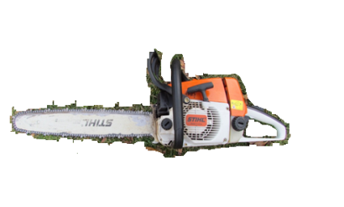
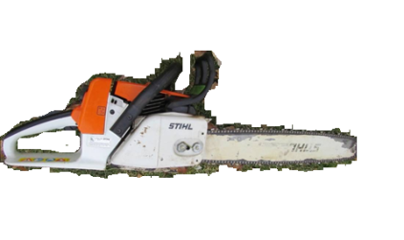
CHAINSAW PARTS – a typical saw
LEFT VIEW
RIGHT VIEW

Slide 9
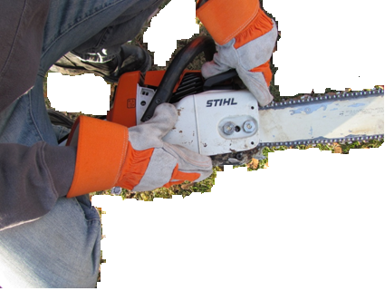
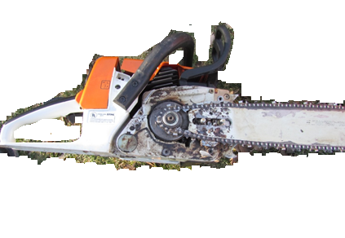
CHAINSAW PARTS – a typical saw
CHAIN & SPROCKET COVER
CHAIN & SPROCKET Properly seated

Slide 10
GRIPPING THE CHAINSAW
Two hand operation ALWAYS – chainsaws were designed to operate that way.
Don’t operate it when you’re tired – concentration and firm grip will be lost.

Slide 11
GRIPPING THE CHAINSAW
When the chainsaw is running…
Use firm TWO-HAND GRIP
Grip that’s too tight results in vibrational damage (numbness & burning sensation - white finger disease)
Right hand on Rear handle, Left hand on Front handle…
While sawing, keep a firm grip - don’t let go.

Slide 12
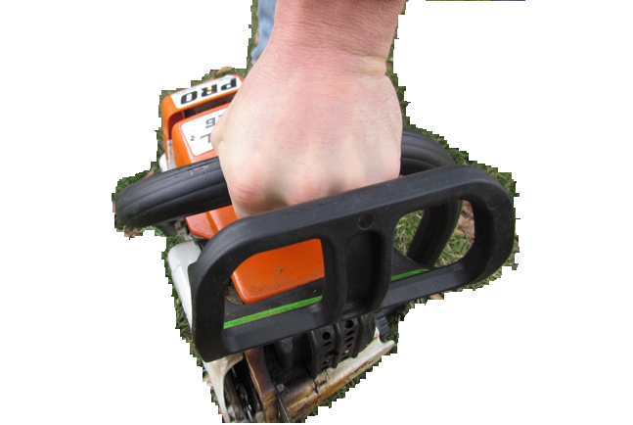
WHAT HAPPENS WHEN GRIP IS TOO TIGHT?
Your fingers and knuckles turn white. Vibration from the chainsaw over time can cause circulatory and nerve damage. This can be avoided by using a firm but not too tight grip. This image shows a “too tight” grip. →

Slide 13
YOU NEED PERSONAL PROTECTIVE EQUIPMENT
Protective gloves.
Head protection (hardhats).
Safety eyewear to prevent the impact of chips and bits.
Sturdy boots-Corkers, which contain spikes for grip in icy weather. These are advised year-round because of the possibility of walking on logs.
Hearing Protective Equipment (HPE) to protect hearing loss and wood and other material falling into your ears.
LEG CHAPS – To prevent a chainsaw from cutting your legs.

Slide 14

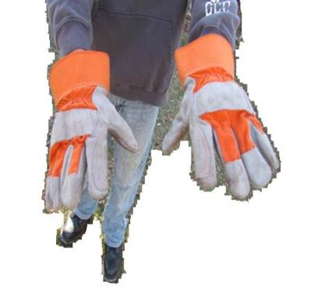
PERSONAL PROTECTIVE EQUIPMENT (PPE)
Head, Ear & Eye
Hand Protection

Slide 15
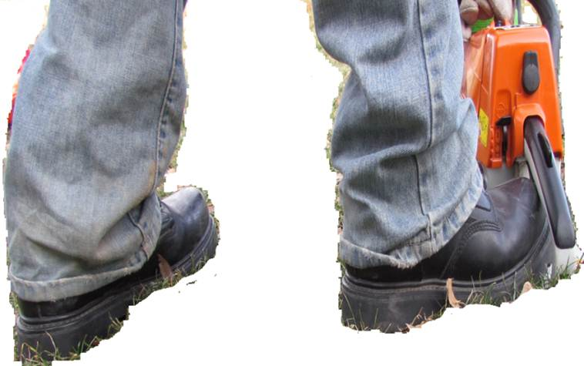
PPE-Footwear

Slide 16
PPE - FOOTWEAR WHAT YOU NEED TO KNOW 1- Your feet need to be protected by heavy boots 2- “CORKERS” have traction spikes for walking on ICY SURFACES, such as logs. 3-“CORKERS” are HIGHLY ADVISED in winter.

Slide 17
PUT ON YOUR CHAPS! WHAT YOU NEED TO KNOW 1- TWO KINDS – External & Internal 2- EXTERNAL is usually ORANGE, fits over pants 3-INTERNAL are usually GRAY, and worn underneath pants. 4-BOTH are made of KEVLAR fiber that resists cuts!

Slide 18
ABOUT INTERNAL CHAPS! WHAT YOU NEED TO KNOW 1- Some LOGGERS use internal CHAPS. 2-They can barely be seen. 3-INTERNAL CHAPS are usually GRAY, and worn underneath pants. 4-CHAPS are made of KEVLAR fiber that resists cuts!

Slide 19
QUICK TEST
Answer this question: What are some safe operating rules for working with chainsaws?
A – grip it right and not too tight. B – wear personal protective equipment.
C – all the above.

Slide 20
START-UP METHODS
START-UP METHOD #1 - On the GROUND:
STEP #1 - Engage the CHAIN BRAKE so chain can’t move.
STEP#2 - Solid surface, open area, secure footing and balance.
STEP #3 - LEFT HAND on handle bar, pressing down.
STEP#4 - RIGHT FOOT into back handle and press down.
STEP#5 - RIGHT HAND pull on starter grip until it starts.
Here’s what the steps look like…

Slide 21
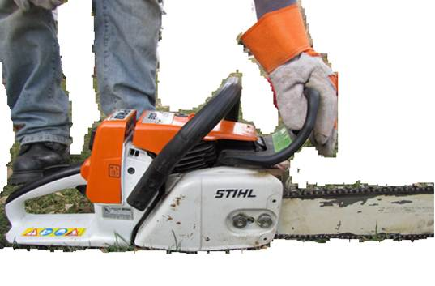
METHOD #1 – Start-Up On The Ground…
STEP #1-Engage the CHAIN BRAKE so chain can’t move (push it forward until it clicks)→

Slide 22
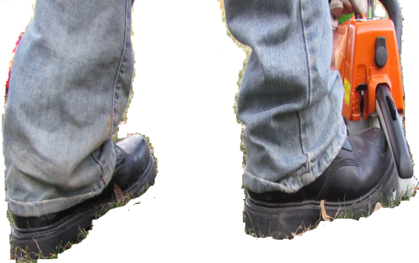
METHOD #1 – Start-Up On The Ground…
STEP#2-solid surface, open area, secure footing and balance →

Slide 23
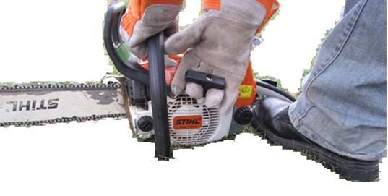
METHOD #1 – Start-Up On The Ground…
STEP #3-LEFT HAND on handle bar, pressing down →

Slide 24
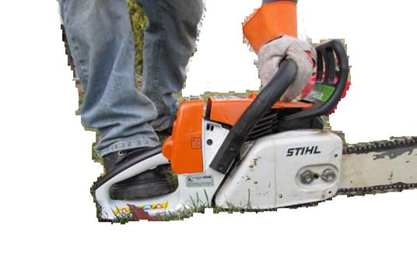
METHOD #1 – Start-Up On The Ground…
STEP#4-RIGHT FOOT into back handle and press down →

Slide 25
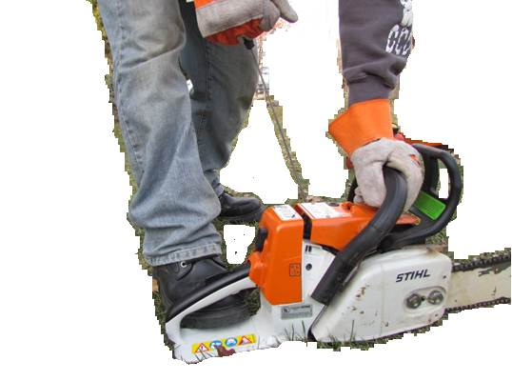
METHOD #1 – Start-Up On The Ground…
STEP#5-RIGHT HAND pull on starter grip until it starts →

Slide 26
START-UP METHODS
START-UP METHOD #2 – Between the Knees:
STEP #1 - Engage the CHAIN BRAKE so chain can’t move.
STEP#2 - LEFT HAND GRIP on front handle, arm straight.
STEP #3 - REAR HANDLE between legs just above knees.
STEP#4 - STAY on level ground with secure footing.
STEP#5 - RIGHT HAND pull on starter grip until it starts.
Here’s what the steps look like…

Slide 27

METHOD #2 – Between the Knees…
STEP #1-Engage the CHAIN BRAKE so chain can’t move (push it forward until it clicks)→

Slide 28
METHOD #2 – Between the Knees…
STEP#2-solid surface, open area, secure footing and balance →

Slide 29
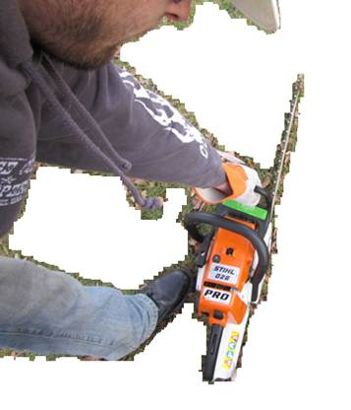
METHOD #2 – Between the Knees…
STEP#3-LEFT HAND GRIP on front handle, arm straight →

Slide 30
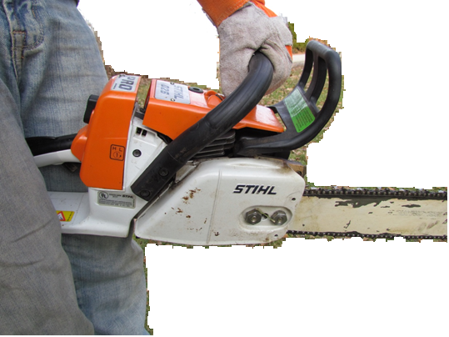
METHOD #2 – Between the Knees…
STEP #4-REAR HANDLE between legs just above knees →

Slide 31
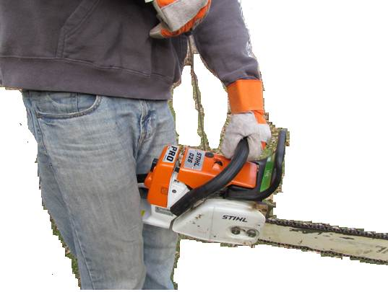
METHOD #2 – Between the Knees…
STEP#5-RIGHT HAND pull on starter grip until it starts
→

Slide 32
QUICK TEST
Answer this question: What are the only two ways of properly starting a chainsaw?
A – on the ground method. B – between the knees method.
C – drop starting method.
D – only A or B.

Slide 33
REVIEW OF SAFE STARTING OPERATIONS
CHAINSAW starting can be dangerous!
Drop starting is especially dangerous!
Two other starting methods will be explained.

Slide 34
DROP STARTING IS DANGEROUS – DON’T DO IT! WHAT YOU NEED TO KNOW 2- In a REAL SITUATION, ANYTHING can happen. 3-The chainsaw brake could fail, and the saw could cut ANY part of your body.

Slide 35
SAFE STARTING METHOD #1 - ON THE GROUND! WHAT YOU NEED TO KNOW 1- ENGAGE the chain brake. 2- BOOT through Handle, HAND on Grip. 3-PULL start ON GROUND.

Slide 36
SAFE STARTING METHOD #2 – BETWEEN THE KNEES! WHAT YOU NEED TO KNOW 1- ENGAGE the chain brake. 2- HANDLE between the knees. 3-PULL start.

Slide 37
CONTROLLING YOUR WORK ENVIRONMENT
CHECK YOUR SAW POSITION!
Keep the saw away from your body whenever the engine runs.
Don’t let anything contact the saw when it starts…
When stopped, cover the guide bar with a “scabbard” (or a case) and pointed “bar back”, with its hot muffler AWAY from you…
Shut the engine off before putting it down.

Slide 38
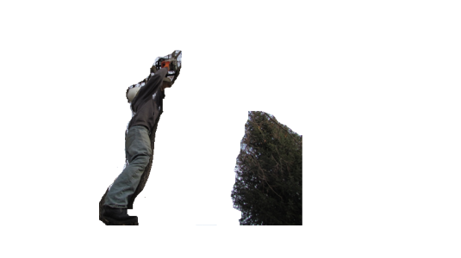
NEXT, PREPARE THE AREA!
Make your saw cut when you have:
Kept others AWAY from your work area…
A clear work area…
Secure footing… and
A retreat pathway AWAY from falling trees.

Slide 39
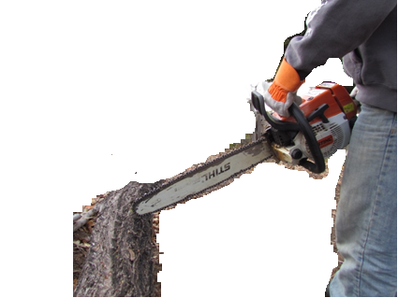
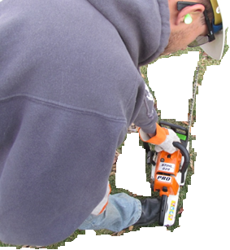
CHECK YOUR SAW POSITION!
Keep the saw away from your body whenever the engine runs
Don’t let anything contact the saw when it starts…

Slide 40
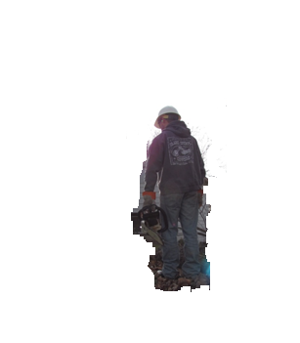
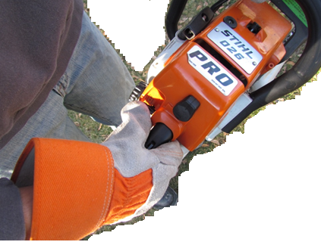
CHECK YOUR SAW POSITION!
When stopped, cover the guide bar with a “scabbard” (or a case) and pointed “bar back”, with its hot muffler AWAY from you…
Shut the engine off before putting it down.

Slide 41
SAFE & UNSAFE OPERATIONS
Small diameter branches and brush can grab the chain or pull you off balance.
Keep Oil and Fuels off the handles.
Don’t operate the saw in enclosed areas. If areas are poorly ventilated, TOXIC Carbon Monoxide will build up!
Operating a chainsaw while in a tree is very dangerous – get specialized training for this task.
Look at these examples of SAFE & UNSAFE Operations…

Slide 42
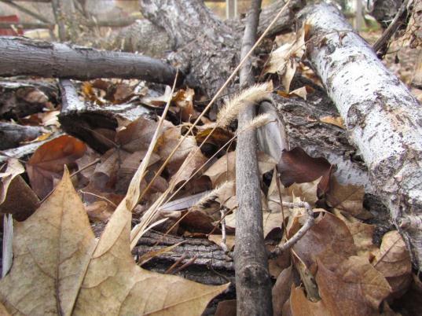
UNSAFE OPERATION
Small diameter branches and brush can grab the chain or pull you off balance →

Slide 43
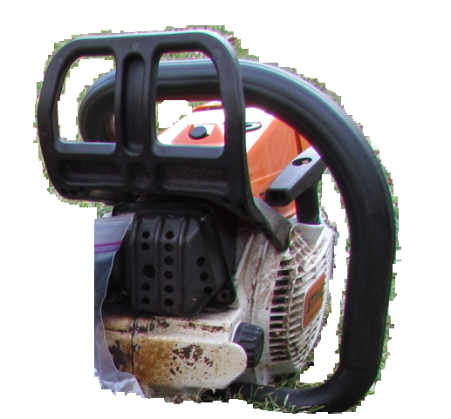
SAFE OPERATION
Keep Oil and Fuels off the handles →

Slide 44
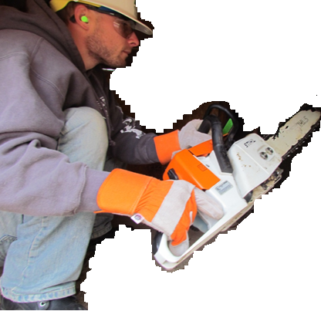
UNSAFE OPERATION
Don’t operate the saw in enclosed areas. If areas are poorly ventilated, TOXIC Carbon Monoxide (CO) will ←build up!

Slide 45
UNSAFE OPERATION
Operating a chainsaw while in a tree is very dangerous – get specialized training for this task. →

Slide 46
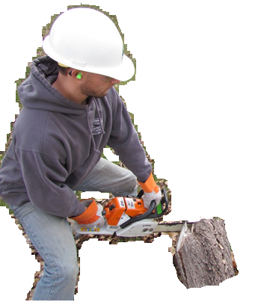
UNSAFE OPERATION
Operate or start chainsaw at least 10 feet away from fuels. →

Slide 47
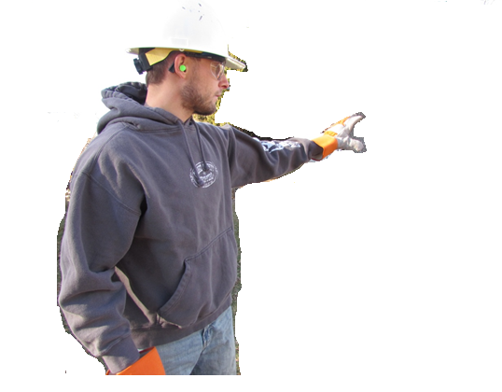
UNSAFE OPERATION
Keep others away when starting or operating ←chainsaws.

Slide 48
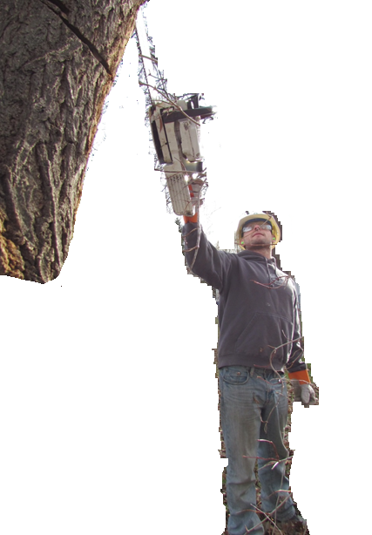
UNSAFE OPERATION
One hand operation is likely to get you injured or killed – AVOID IT. →

Slide 49
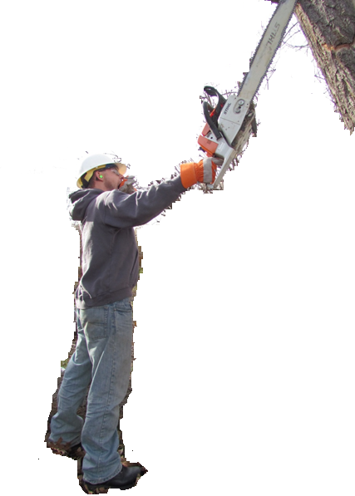
UNSAFE OPERATION
AVOID SAWING when you’re tired or not paying attention! →

Slide 50
QUICK TEST
Answer this question: What are some safe operating rules for working with chainsaws?
A – No “one hand” operation! B – Saw close to others
C – Make sure footing is secure
D – A & C only.

Slide 51
CHAINSAW OPERATION
SAFE OPERATION
MAINTENANCE & FUELING

Slide 52
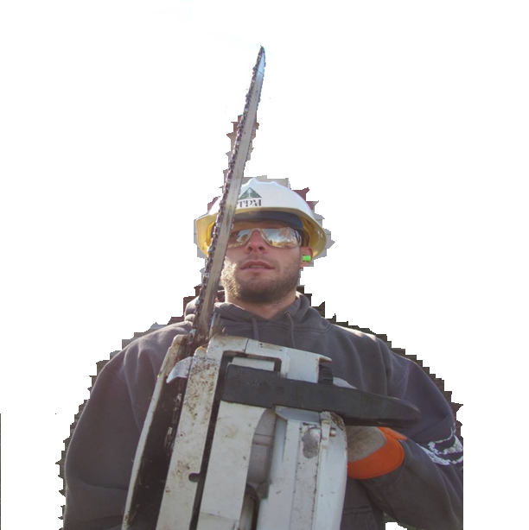
WHAT IS KICKBACK?
WHAT YOU NEED TO KNOW:
It happens when a saw gets caught& pinched in wood.
It happens when the saw bar tip contacts wood.
The guide bar is kicked up and BACK AT THE OPERATOR, very quickly!

Slide 53
AVOIDING KICKBACK
KICKBACK PREVENTION:
Do your chainsaw cuts at high engine speeds.
AVOID dangerous acts like overreaching and cutting above shoulder height.
Follow the chainsaw manufacturer’s instructions for these critical items:
Chain maintenance and sharpening.
Correct replacement of guide bars and chains.
Many manufacturers require reduced kickback bars and chains.

Slide 54
AVOIDING KICKBACK
Do your chainsaw cuts at high engine speeds! A typical
chain may operate
at or above
40 miles per
hour →
→ → →

Slide 55
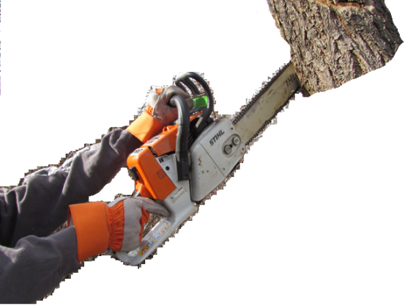
AVOIDING KICKBACK
AVOID
dangerous acts
like overreaching
and cutting
above
shoulder
height. →

Slide 56
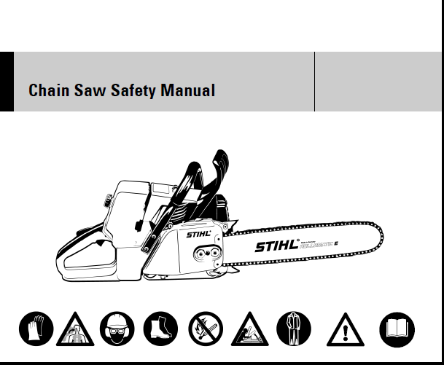
AVOIDING KICKBACK
Follow the chainsaw manufacturer’s instructions for these critical items:
Chain maintenance and sharpening.
Correct replacement of guide bars and chains.
Many manufacturers require reduced kickback bars and chains. →

Slide 57
WHAT IS SPRINGBACK?
SPRINGBACK happens when…
A limb or branch cut by a chainsaw is partially cut…and…
The wood fibers are under tension and about ready to snap…
When the wood is cut or the tension is too much, the limb or branch snaps and can move in your direction, with a lot of force!

Slide 58
WHAT IS BINDING?
BINDING happens when…
A log does not lay flat, and its fibers cause TENSION and COMPRESSION.
Wood fibers are under TENSION occur along the top. This is because every part of the log tries to be equal.
Wood fibers are under COMPRESSION occur along the bottom. This is because every part of the log tries to be equal.

Slide 59
GRAVITY FLEXES LOGS WHAT YOU NEED TO KNOW: 1- “Moving” wood fibers create STRESS in the wood. 2- STRESSES in the wood create TENSION along the top & COMPRESSION along the bottom. 3-KNOW where these are, and use the correct cutting technique. 4-AVOID explosive tension & compression release.

Slide 60
TENSION & COMPRESSION WHAT YOU NEED TO KNOW: 1- LOGS are not rigid – they’re stressed by gravity. 2- TENSION occurs along the top, because wood fibers are trying to PULL APART. 3-COMPRESSION occurs along the bottom, because wood fibers are trying to COME TOGETHER. 4-UNSAFE SAWING will release explosive tension & compression.

Slide 61
MORE ON SAFE CHAINSAW USE
SEE the “Limbing & Bucking” Log Safety Module!

Slide 62
SAFE OPERATION-Shut-Down
FINALLY, when you’re ready to shut-down,
Shut the engine off before putting it down.
When stopped, cover the guide bar with a “scabbard” and pointed “bar back”, with its hot muffler AWAY from you…
OR, put the saw in a carry case.

Slide 63
SAFE OPERATION – Shut Down …
Shut the engine off before putting it down. →

Slide 64
MAINTENANCE & FUELING
WHEN should you have your saw REPAIRED?
If you damage it…
Something critical doesn’t work – for example Your saw chain does not stop when the throttle trigger is released..
The saw chain becomes dulled…
The stop bar doesn’t work…
ANY other potentially hazardous condition develops!
Have it repaired BEFORE operating it.
It’s critical to have correct repairs done – or parts like flywheels can shatter.

Slide 65
TAKE CARE OF YOUR CHAINSAW
Check the following every time before you begin chainsaw operation:
ADD the correct fuel-oil mixture to the fuel tank…
FILL the bar oil tank…
CHECK that the chain is sharp and tensioned…
CHECK that the chain cover is tight…
REMOVE any debris from the chain bar…
CHECK saw is in good condition and has been recently serviced…

Slide 66
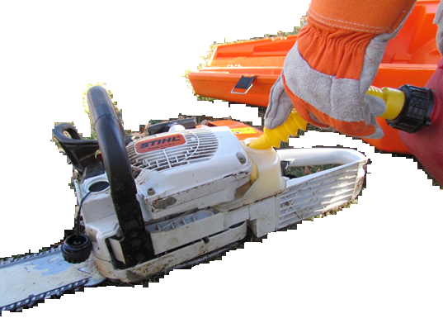
SAFE OPERATION – PREPARE YOUR SAW
ADD the correct fuel-oil mixture to the fuel tank…→

Slide 67
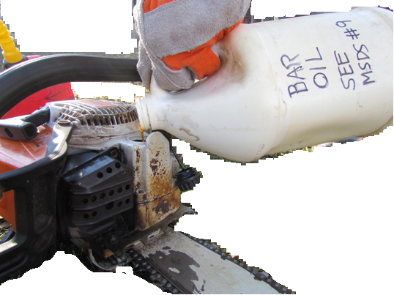
SAFE OPERATION – PREPARE YOUR SAW
FILL the bar oil tank…→

Slide 68
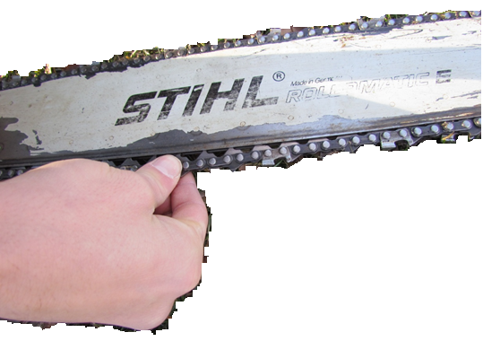
SAFE OPERATION – PREPARE YOUR SAW
CHECK that the chain is sharp and tensioned…→

Slide 69
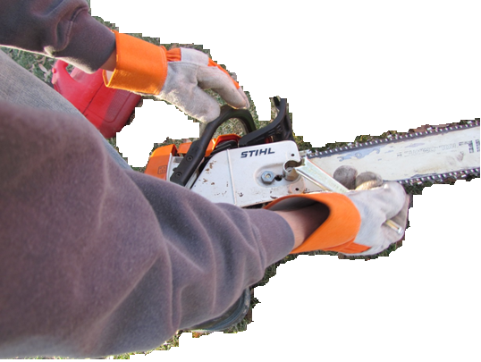
SAFE OPERATION – PREPARE YOUR SAW
CHECK that the chain cover is tight…→

Slide 70
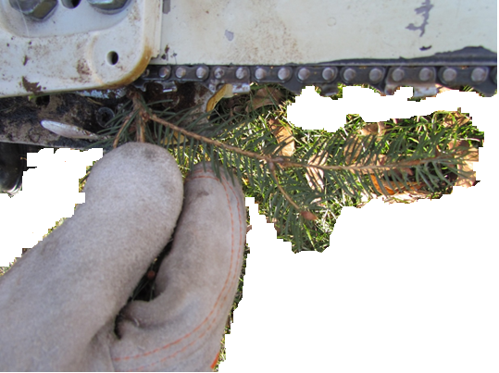
SAFE OPERATION – PREPARE YOUR SAW
REMOVE any debris from the chain bar…→

Slide 71
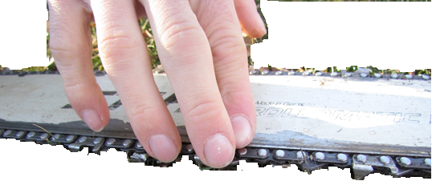
SAFE OPERATION – PREPARE YOUR SAW
CHECK saw is in good condition and has been recently serviced…→

Slide 72
SAFE FUELING WHAT YOU NEED TO KNOW 1-don’t fuel up on the ground. 2-use an approved fueling container. 3-fuel up away from sources of heat.

Slide 73
QUICK TEST
Answer this question: What are some safe operating rules for working with chainsaws?
A – check the chain. B – make sure it’s properly fueled and oiled.
C – all the above.

Slide 74
CHAINSAW WRAP-UP
Professional Loggers DON’T TAKE CHANCES!
FOLLOWING PROCEDURES means you come home safe…
You know the right way, and it’s UP TO YOU!

Slide 75
OSHA NOTICE & DISCLAIMER
“This material was produced under grant SH20866SH0 from the Occupational Safety and Health Administration, U.S. Department of Labor. It does not necessarily reflect the views or policies of the U.S. Department of Labor, nor does mention of trade names, commercial products, or organizations imply endorsement by the U.S. Government”

