Slide 1
Ergonomic Risk Factors
"This material was produced under the grant SH-20867-SH0 from the
Occupational Safety and Health Administration, U.S. Department of Labor.
It does not necessarily reflect the views or policies of the U.S.
Department of Labor, nor does mention of trade names, commercial
products, or organizations imply endorsement by the U.S. Government."
Notes:
Welcome.
Introductions.
I’d like to ask some questions to find out how you are affected by ergonomic issues in your workplaces, and what kind of background you have.

Slide 2
Does your job cause you pain?
Notes:
Please stand up if your job causes you pain.

Slide 3
Do you represent anyone who works in pain?
Notes:
Please stand up if you represent people who work in pain.

Slide 4
What does that pain mean?
You have to expect a few aches and pains as you get older…
Notes:
Should we accept that pain as a fact of life?

Slide 5
I think it’s my job that’s wearing me down…and it doesn’t have to be this way!

Slide 6
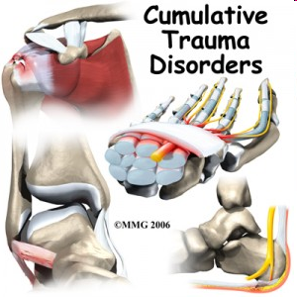
Notes:
Work-related musculoskeletal disorders, or WMSDs, are injuries that occur to the soft tissues of the body – the muscles, tendons (attach muscle to bone), ligaments (attach bone to bone), joints, blood vessels and nerves.
These injuries can include rotator cuff injuries and bursitis in the shoulder, epicondylitis (a form of tendinitis) in the elbow, carpal tunnel syndrome in the wrist, low back pain and bursitis of the knee.
WMSDs tend to occur gradually, accumulating from months or even years of work, as opposed to sudden injuries such as a broken bone due to a fall or a neck injury from a motor vehicle accident.
Work-related pain is an indication of conditions that could lead to – or have already resulted in work-related injury.
We take these injuries very seriously. They should never be accepted as part of the job.

Slide 7
Have you had ergonomics training ?
Notes:
In order to understand where we need to start for this session, I’d like to find out how many of you have had ergonomics training already?

Slide 8
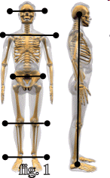
Stand in a Neutral Posture
Notes:
Let’s quickly review a few basic principles of ergonomics.
Everyone please stand in a neutral posture.
What would happen if I ask you to stand like that for the rest of the hour?
We know that we can avoid stressing our body by spending as much time as possible in a neutral posture.
Except for…?

Slide 9
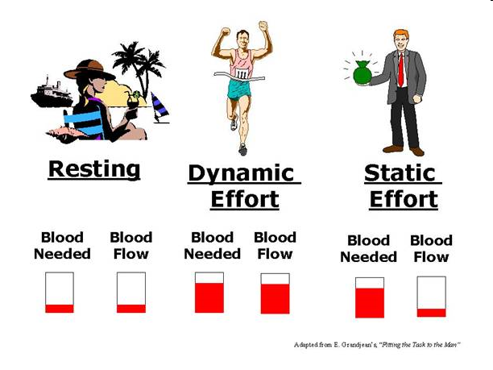
Notes:
Neutral is good – but static, meaning having to stay in the same position for a long time – is not good.
Another way to put this is – although moving too much can be fatiguing, not moving enough is also fatiguing!
Known Hazard
“Statically standing in one posture reduces the flow of nutrients to and the removal of wastes from the muscles, tendons, and
vertebra. This can lead to venous pooling of blood and an increase in pressure in the lower extremities. Additionally, it creates
a contact stress to the bottoms of the feet. Statically standing in one place for prolonged periods of time increase the risk of
development of MSDs of the legs and feet such as pain, fatigue, and varicose veins.”

Slide 10
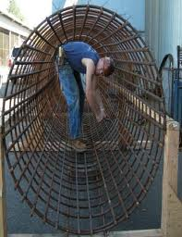
Stand in an Awkward Posture
Notes:
Our jobs are full of awkward postures that take us out of the safe neutral zone.
Posture is an important factor in preventing soft tissue injuries.
Let people sit down

Slide 11
What are other risk factors for musculo-skeletal injuries?
Notes:
Get suggestions for risk factors.
Write them on the flip chart.

Slide 12
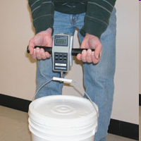
Force

Slide 13
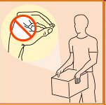
Grip
Notes:
Force is not just how we use large muscles to move heavy weights.
Grip is another form of force.
Canadian guidelines advise against using a pinch grip to support 2.2 pounds for more than 2 hours a day

Slide 14
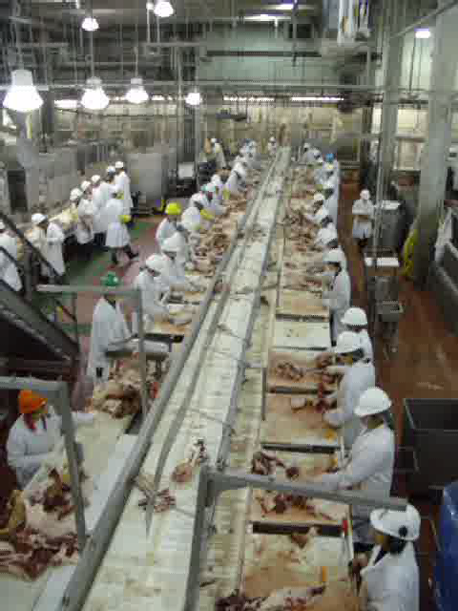
Repetition
Notes:
Does repetition have any relationship to chain speed, under-staffing or production pressures?
Are these issues regulated by OSHA?

Slide 15
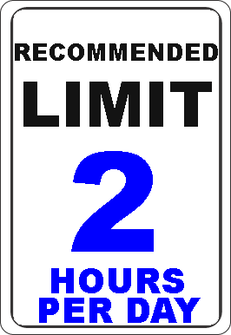
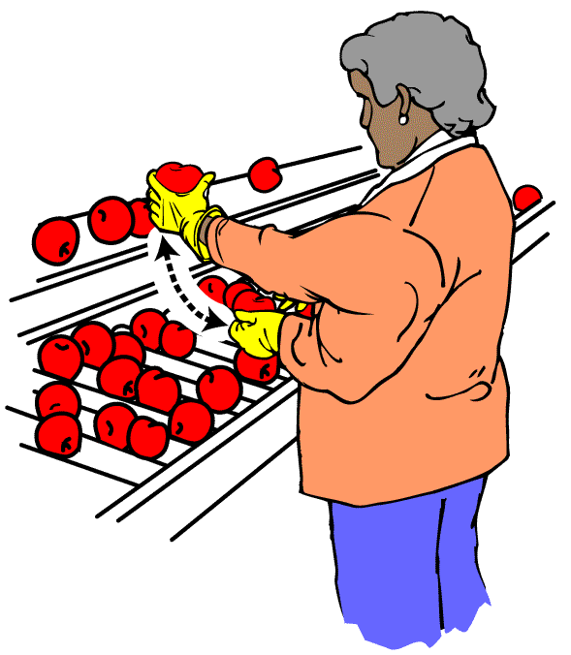
Repetitive motion
Repeating the same motion with the neck, shoulders, elbows, wrists or hands, every few seconds is repetitive motion
WA State Dept. of Labor and Industries
Notes:
All of these factors are influenced by duration. We need to know how often a movement is repeated AND for how long.

Slide 16
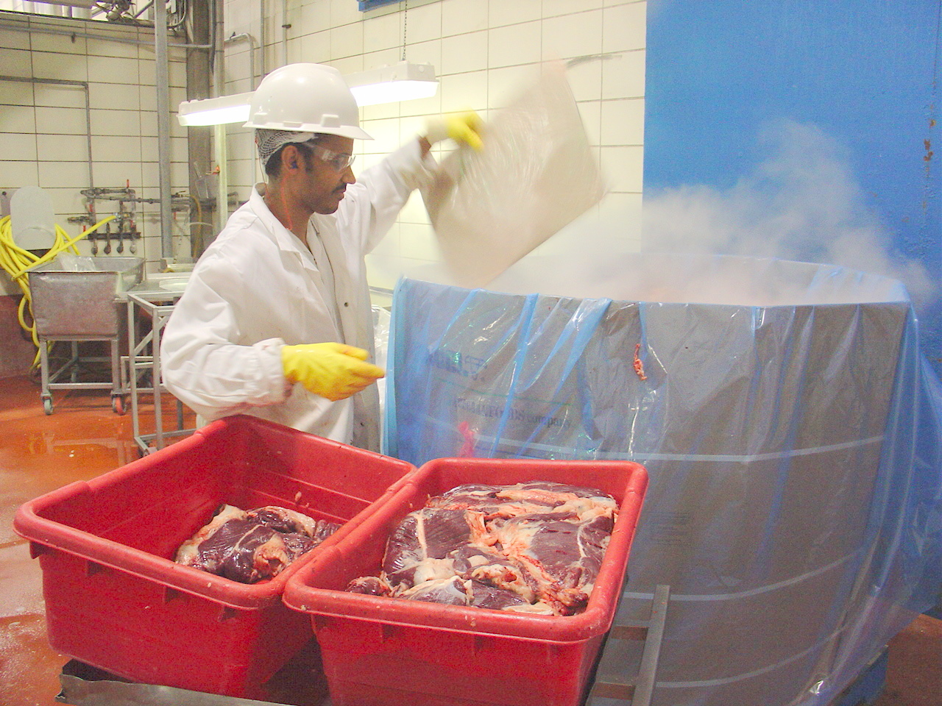
Cold
Notes:
Cold environments compromise muscle efficiency
Possible vascular and neurological damage
Workers with cold-desensitized fingers may exert more force than necessary exposing muscles, soft tissues, and joints to increased forces

Slide 17
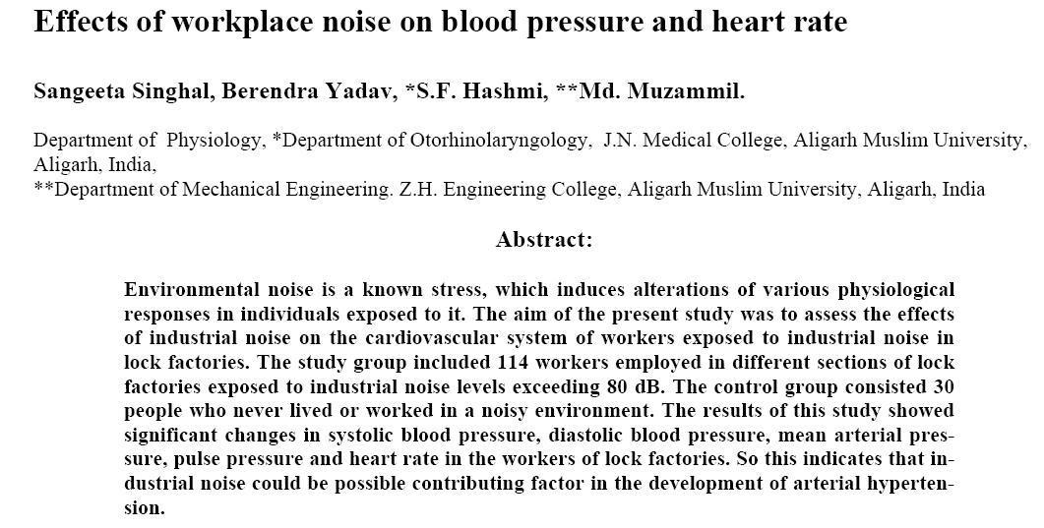
NOISE
Notes:
We mentioned that work-related musculoskeletal disorders affect not only the muscles, ligaments and tendons – but also the blood vessels and nerves.
Noise has an impact on the heart and blood vessels and can also be considered an ergonomic factor.
What does OSHA say about noise in the workplace. Is the employer required to do anything if noise levels are too high?
Many workers believe that the employer’s responsibility is to provide ear plugs or other hearing protection..
But the noise standard actually requires a far more important step before handing out earplugs.
The employer has to try to control the noise – quiet things down or isolate the source of noise from the worker.

Slide 18

OSHA's noise standards specify that feasible administrative or engineering controls must be used to reduce noise to acceptable levels and that personal protective equipment, such as ear plugs and ear muffs, must be used only as supplements when administrative or engineering controls are not completely effective.

Slide 19
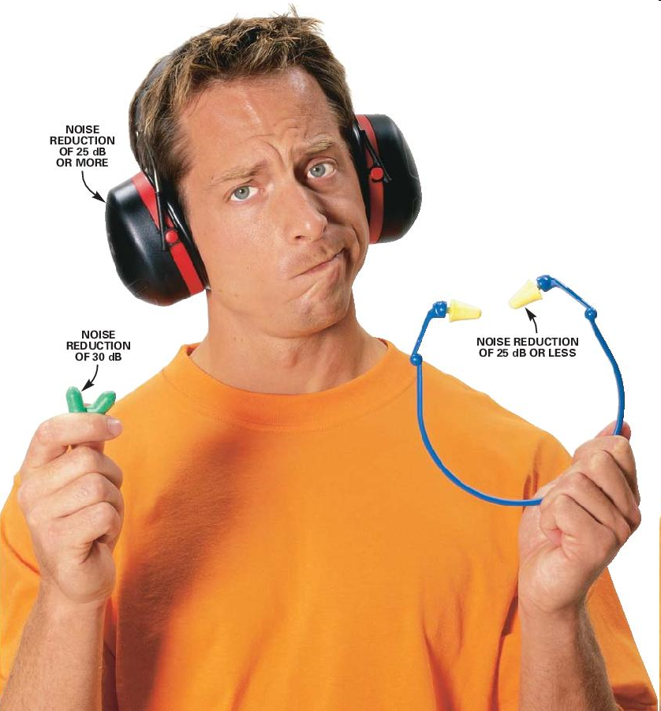
You mean they have to find ways to reduce the noise – not just hand out earplugs?????

Slide 20
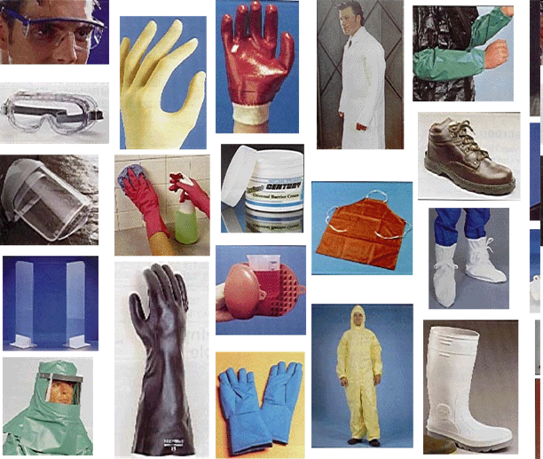
Notes:
While we’re on the subject – let’s mention the impact of PPE on ergonomics.
Is it easier to work with gloves or without them?
What about respirators?
When PPE interferes with people’s ability to work – what is the first thing you should investigate?

Slide 21
Change the workplace -
NOT the worker!
Notes:
Is there a way to eliminate the need for PPE?
Maybe a less toxic chemical can be used, maybe the noise can be abated or isolated, maybe what ever is keeping the floor wet can be redirected?

Slide 22
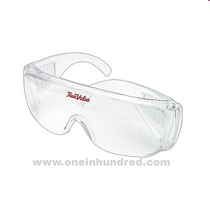
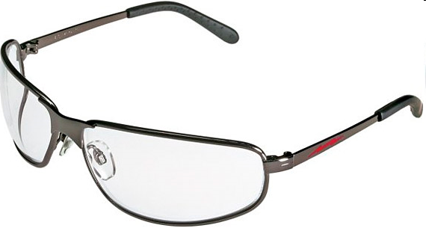
Notes:
If the job cannot be made safe without PPE – make sure the PPE fits and is comfortable.
Does anyone have a problem as a steward with employees who are being disciplined for failing to wear their PPE?
Is fit or comfort ever an issue in these situations?
One-size-fits-all visitor’s glasses are not appropriate for constant use.

Slide 23
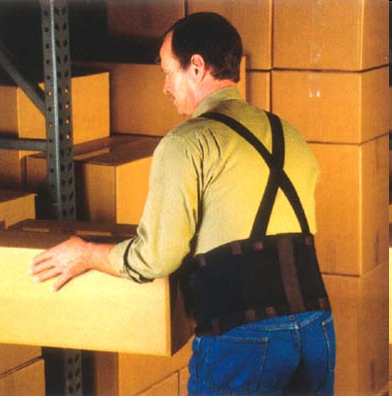
What about back belts?

Slide 24
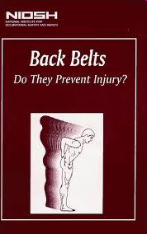
Back belts: The effectiveness of back belts in reducing the risk of back injury among heal workers remains unproven. If workers falsely believe they are protected when wearing belts, they may attempt to lift more than they would without a belt. This poses a risk of injury to the worker (See Back belts: Do They Prevent Injury? (DHHS) (NIOSH) Publication No. 94-127).

Slide 25
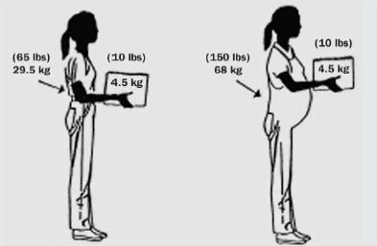
Interaction of Factors
This figure shows the amount of stress that occurs on the lower back increases when the object is lifted further away from the body
Notes:
Risk factors interact to create stresses on the body. It is a good idea to learn to think about these factors working together. Often when you reduce one, you increase another. This might create unintended consequences.

Slide 26
Why do we care about risk factors?
Why not just focus on solutions?

Slide 27
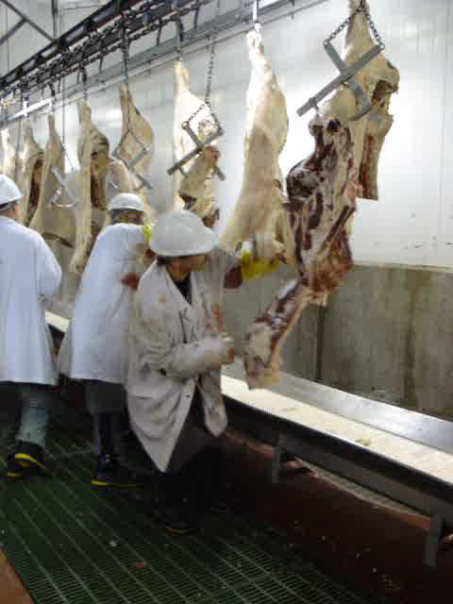
To identify the jobs that hurt people, so we know which jobs to look at
Notes:
Understanding risk factors helps us identify jobs that could hurt people

Slide 28
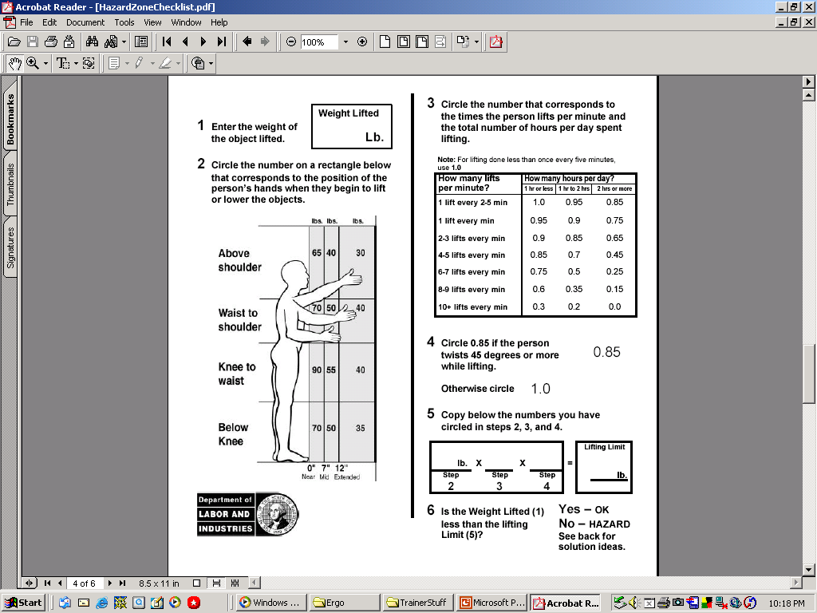
So our solutions can be effective
Notes:
We want to intervene where we can do the most good.
Analysis of risk factors helps us figure out what to change.
Sometimes changing one risk factor will have an unintended effect on another one.
Let’s practice with an example of a worker who faces a conveyor and who pulls a 50 pound container of stock from a shelf above shoulder height, about 12” away. This worker has to reach for new stock about once every 2 minutes all day long.
If you put these numbers into your work sheet you should get:
50
Circle 30
Circle 0.85 (once every 2 minutes all day long)
Circle 1.0 (not twisting)
30 x 0.85 x 1.0 = 25.5 pounds This is the safe weight that can be lifted in this job.
Compare your answer to the number you wrote in step 1
So, let’s reduce the weight to 25 pounds and fill in a new worksheet.
25
30
0.75 our repetitions have gone up
1.0
30 x 0.75 x 1 = 22.5
What happened? When the repetitions went up the amount of weight that could safely be moved went down.
You can experiment with this example by changing different things. The point is that just changing the weight, or just changing the reach does not necessarily solve the problem. The changes we made were improvements, but the risk of injury is still high.

Slide 29
What about “personal risk factors”?
Weight
Fitness
Age
Nutrition
Gender
Hobbies
Notes:
Has anyone been told that their carpal tunnel is probably due to their knitting hobby or bowling?
What is the problem with focusing on things we can’t control such as age or gender?

Slide 30
Small Group Assignment
Work as a group at your table
Each person should describe a job in their workplace that has many ergo risk factors – act out the motions involved in the job
Decide on the worst job at your table – based on the ergonomic risk factors. Make a list of the risk factors.
Remember we are looking for jobs that are most likely to cause injury – not the smelliest or grossest job.
Be prepared to present your table’s worst job to the rest of the group

Slide 31
Large Group Activity
Have each group act out and explain the worst job from their table.
Ask other participants name the risk factors – if possible, use the WA Dept of Labor & Industries calculator to evaluate the jobs
Decide on the worst job based on the Risk Factor Analysis

