Slide 1
Hazard Recognition
This material was produced under grant SH20867SHO from the Occupational Safety and Health Administration, U.S. Department of Labor. It does not necessarily reflect the
views or policies of the U.S. Department of Labor, nor does mention of trade names, commercial products, or organizations imply endorsement by the U.S. Government."
Notes:
Welcome
Intros
This workshop is a skill building workshop. The point of the exercises we’ll be doing is not to get all the right answers. The point is to develop your ability to ask more questions and to give you the confidence to keep asking those questions.

Slide 2
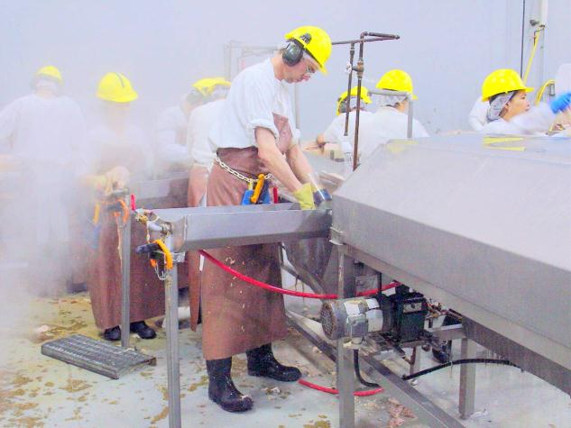
How would a safety detective look at this photo differently than a steward?
Notes:
Many of you are stewards and as stewards you are very tuned in to the workers you represent.

Slide 3
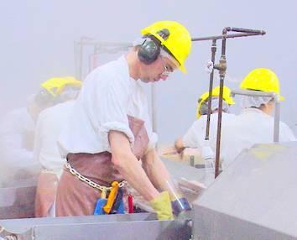
Steward’s Eye View
Notes:
A good steward is focused on the members.

Slide 4
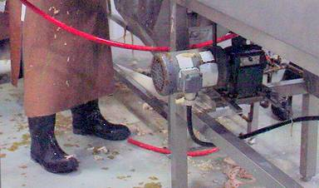
Safety Detective’s View
Notes:
A skillful safety detective looks at the environment where the union members work.
In this workshop we will practice the skill of looking with a safety detective’s perspective.
We will work on identifying the hazards in equipment, machines and systems.

Slide 5
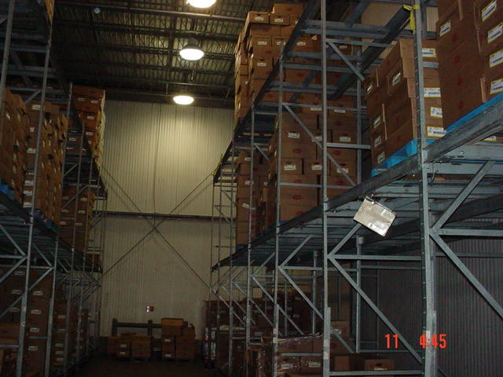
Notes:
Do you have any initial impressions of this warehouse?

Slide 6
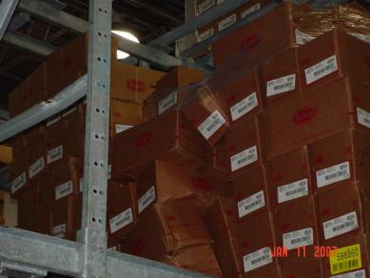
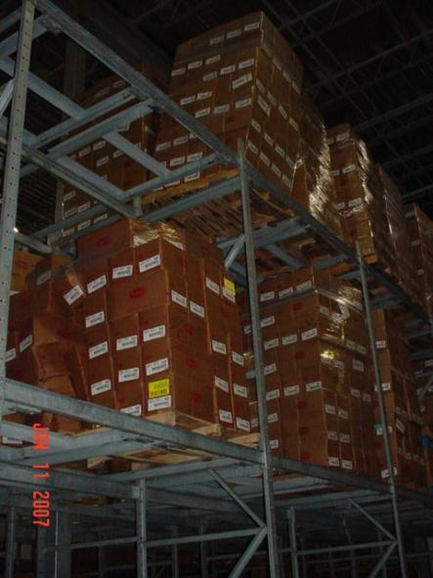
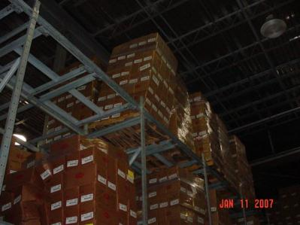
Notes:
The stacks look unstable.
Why are the stacks so unstable? – maybe the problem here is that the fork truck drivers are being careless?
Let’s look a little closer.

Slide 7
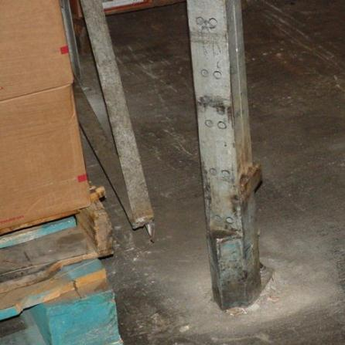
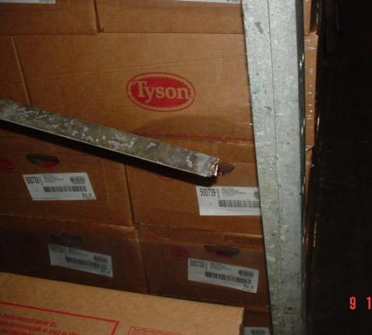
Notes:
It looks as though part of the problem could be that there are broken welds on the stacks.
But why?
Are the stacks coming apart because the welders did a poor job?
Are the stacks unstable because the fork truck drivers keep running into them?
Let’s look for more clues.

Slide 8
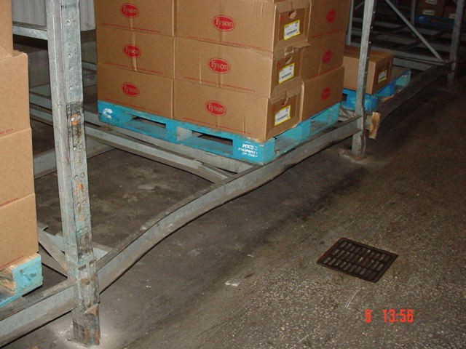
Notes:
Here’s another clue.
Fork trucks are obviously slamming into the stacks.
But why are the fork truck drivers slamming into the stacks?
Are they careless? Does the company need to discipline drivers who are running into the stacks?
Let’s look a little closer.

Slide 9
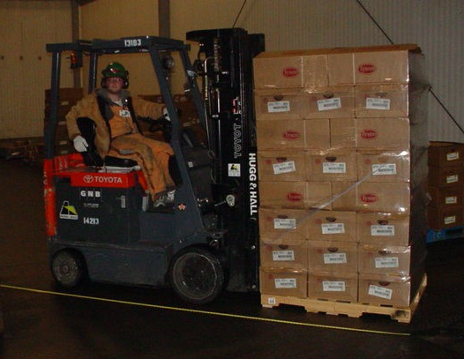
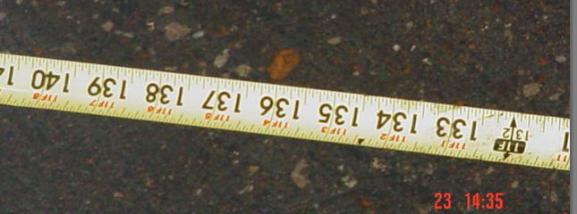
Notes:
The length of the truck with a pallet on its forks is around 132”

Slide 10
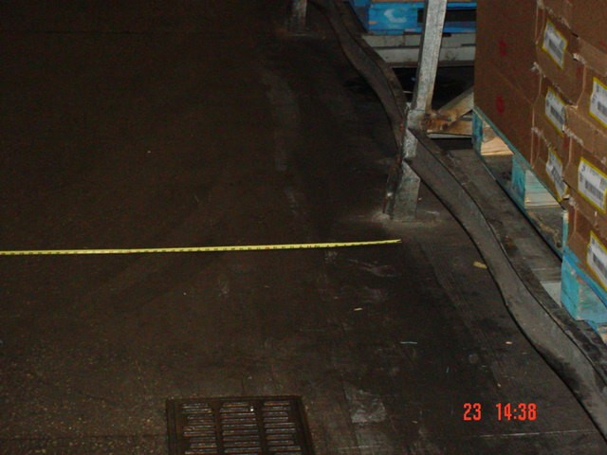
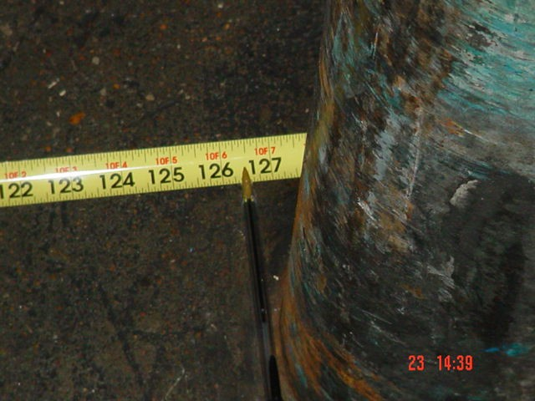
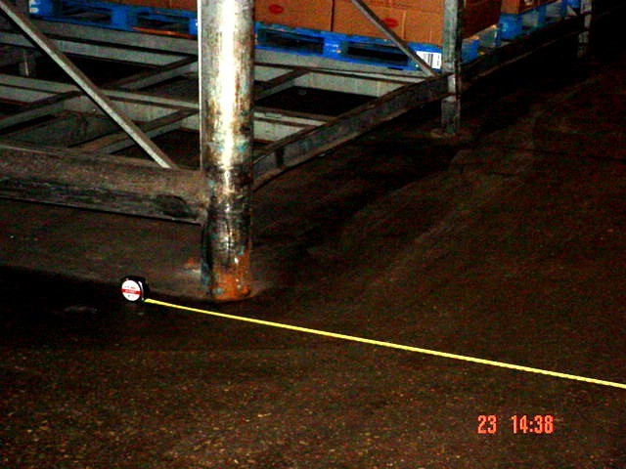
Notes:
The width of the aisle is about 127”
The extra 4” has to come from somewhere.
If the company had ordered the truck drivers to be more careful, would that have solved the problem?
If the welds on the stacks had been repaired, would that have solved the problem?
What if the company had disciplined drivers for careless driving?
The problem can only be fixed when the hazard is identified correctly.

Slide 11
“Everyone, and that includes you and me, is at some time careless, complacent, overconfident, and stubborn. At times each of us becomes distracted, inattentive, bored, and fatigued. We occasionally take chances, we misunderstand, we misinterpret, and we misread. These are completely human characteristics …
Because we are human and because all these traits are fundamental and built into each of us, the equipment, machines and systems that we construct for our use have to be made to accommodate us the way we are, and not vice versa.”
retired professor from the Engineering Department of Johns Hopkins University, Al Chapanis
Notes:
Can anyone explain what this means?
Who agrees with this statement?
Who disagrees?

Slide 12
What is a Hazard? A hazard is something that can cause harm.
Thing | Knife | Cut
Substance | Asbestos | Mesothelioma
Energy Source | Electricity | Shock, electrocution
Condition | Wet Floor | Slips, falls

Slide 13
Which of these things is a hazard?
A worker who is not wearing PPE
Silicosis
Rotating equipment
A missing guard
Notes:
This is a very difficult question.
Ask your self: If I am exposed to blank, could I be harmed?
If I am exposed to a worker who is not wearing PPE could I be harmed?
No. A worker who is not wearing PPE is not a hazard. PPE is a way of trying to control exposure to a hazard. If there is no hazard you don’t need PPE.
If I am exposed to silicosis could I be harmed?
No. Silicosis is a disease that results from exposure to a hazard. The hazard is exposure to silica.
If I am exposed to rotating equipment could I be harmed?
Yes. Rotating equipment is a hazard. We can control this hazard by guarding it. Guards prevent exposure to the hazard of rotating equipment.
If I am exposed to a missing guard could I be harmed?
No. A missing guard is only important if there is exposure to a hazard. A missing guard on a machine that is locked out or not functional is not a hazard.

Slide 14
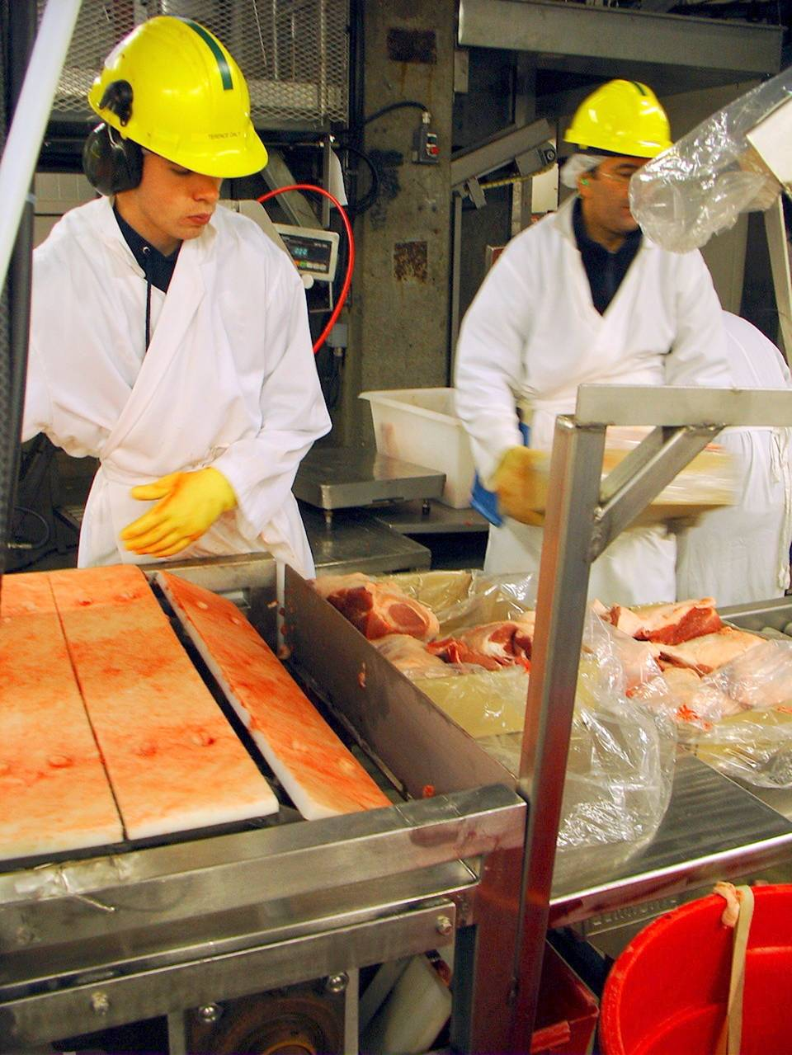
Notes:
We’ll be looking at a series of photographs, and we’ll be trying to focus on the work environment in these photos. We’re looking for possible hazards. Of course since these are just photos we won’t have all the information we need to determine whether or not a true hazard exists. Everything we identify as a possible hazard will require more investigation.

Slide 15
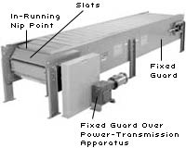
Slat Conveyor Pinch Point
Notes:
The slat conveyor presents a number of serious pinch points.
It’s possible that the guard was removed to make room for another work position.

Slide 16
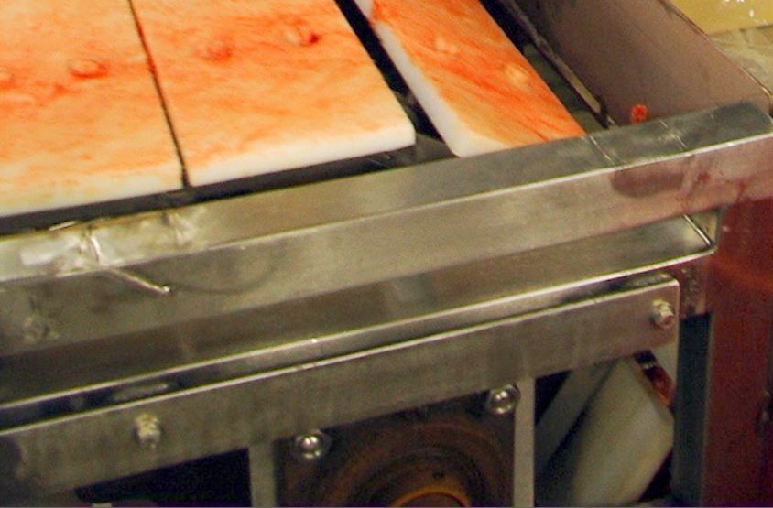
Notes:
The end of this conveyor shaft has a collar that is held in place with at least one set screw. This could snag a lock of hair or a piece of clothing and wind it up on the shaft.

Slide 17
Guard the ends of spinning shafts
OSHA standard, §1910.219(c)(2)(i) states, "All exposed parts of horizontal shafting seven (7) feet or less from floor or working platform, … shall be protected by a stationary casing enclosing shafting completely or by a trough enclosing sides and top or sides and bottom of shafting as location requires."

Slide 18
Guard the ends of spinning shafts
1910.219(c)(4)(i) Projecting shaft ends shall present a smooth edge and end and shall not project more than one-half the diameter of the shaft unless guarded by nonrotating caps or safety sleeves.

Slide 19
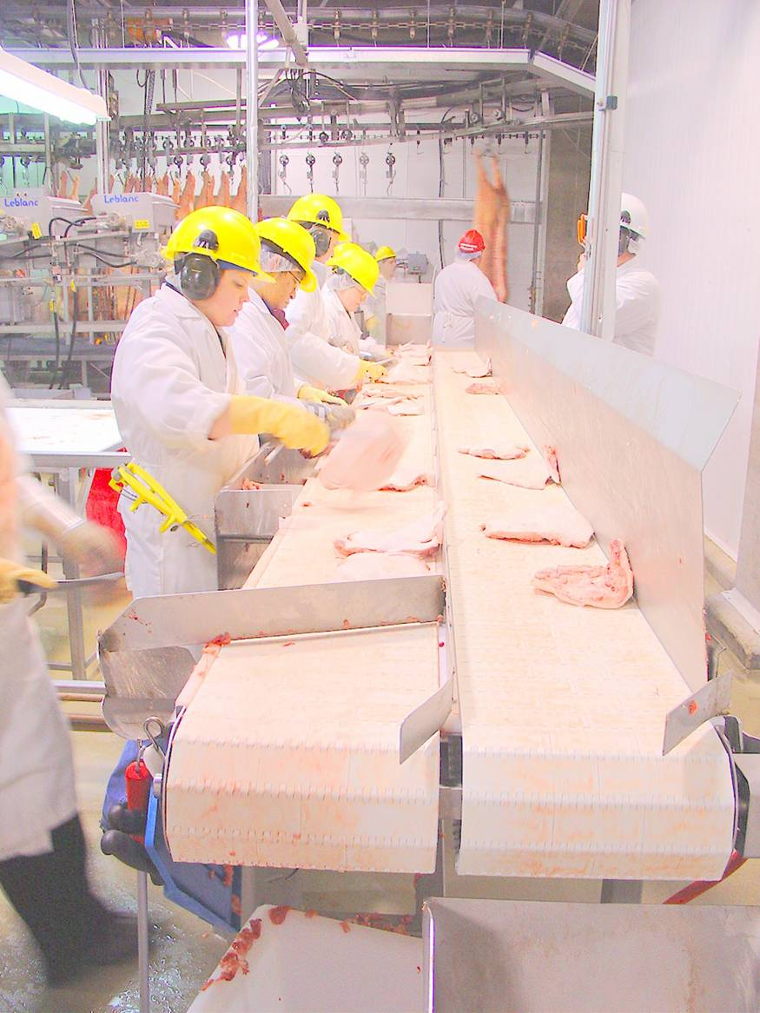
Shaft Ends Guarded on Both Sides

Slide 20
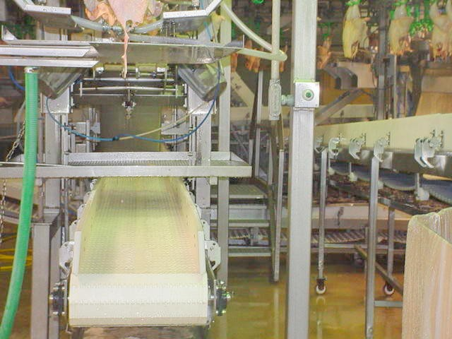

Slide 21
Notes:
Unguarded shaft ends

Slide 22
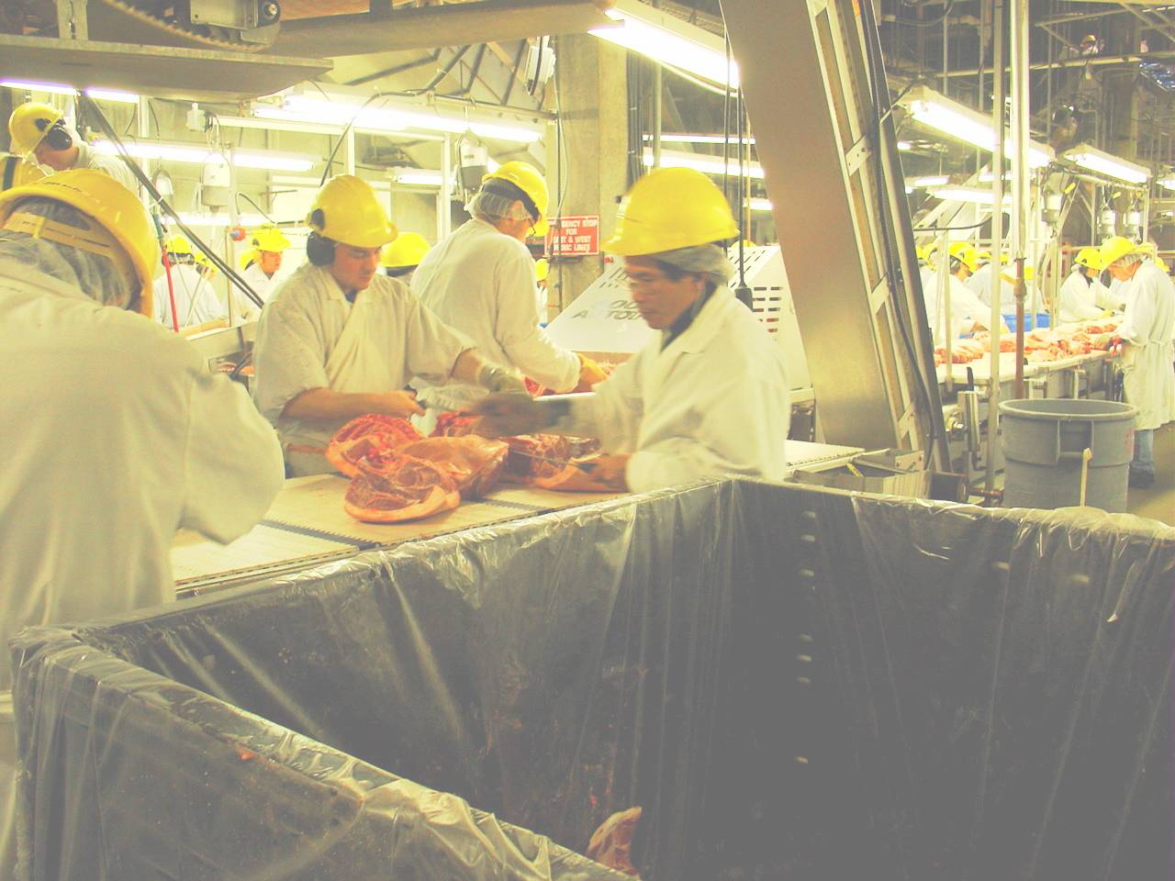

Slide 23
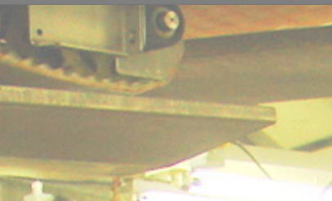
Over 7 feet?
Notes:
This exposed shaft might not need to be guarded. You would want to measure to be sure it is more than 7 feet above the work platform.
Would there be any reason to guard this shaft even if it is not required by OSHA to be guarded?

Slide 24
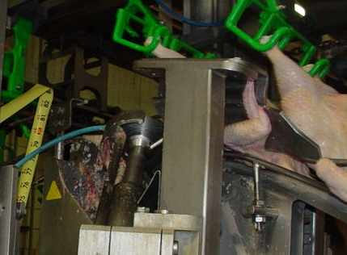
What is the Hazard?
Notes:
Is there a hazard here?

Slide 25
What is the Hazard?
People need to stay away from machinery?
There is no hazard because this is an automatic machine.
There should be a sign warning about the moving blade
There is a spinning blade
(choose one)
Notes:
The hazard is the spinning blade (D)
Statements A and C refer to possible ways to control the hazard.

Slide 26
Machines must be guarded
1910.212(a)(1)
Types of guarding. One or more methods of machine guarding shall be provided to protect the operator and other employees in the machine area from hazards such as those created by point of operation, ingoing nip points, rotating parts, flying chips and sparks.

Slide 27
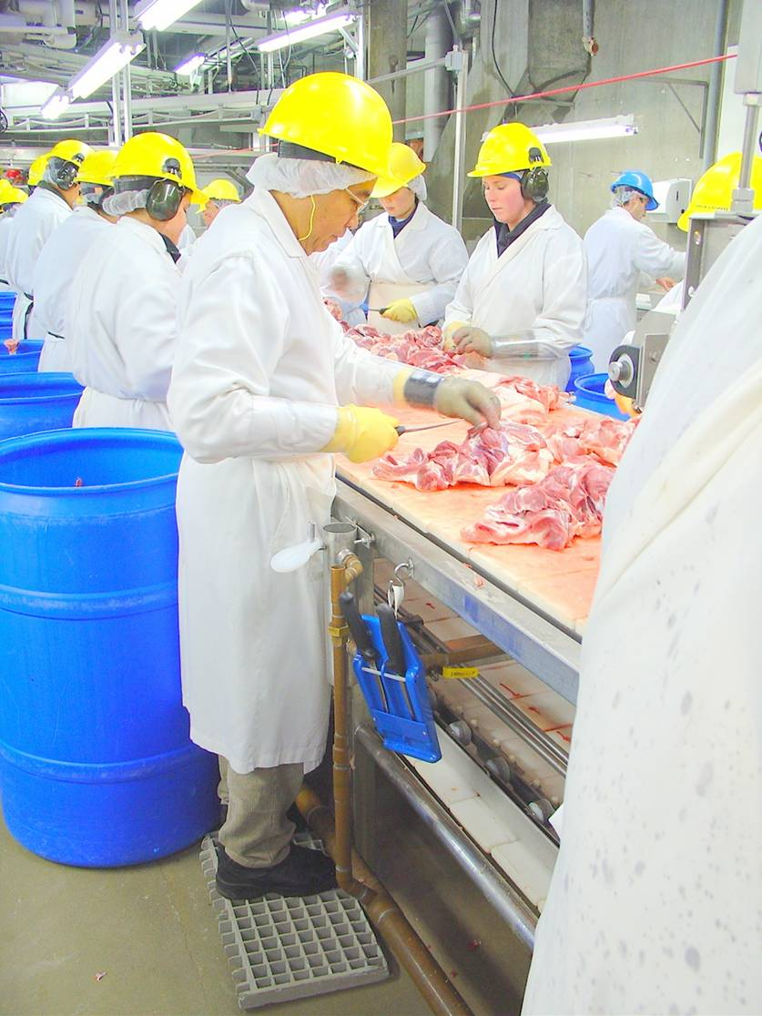
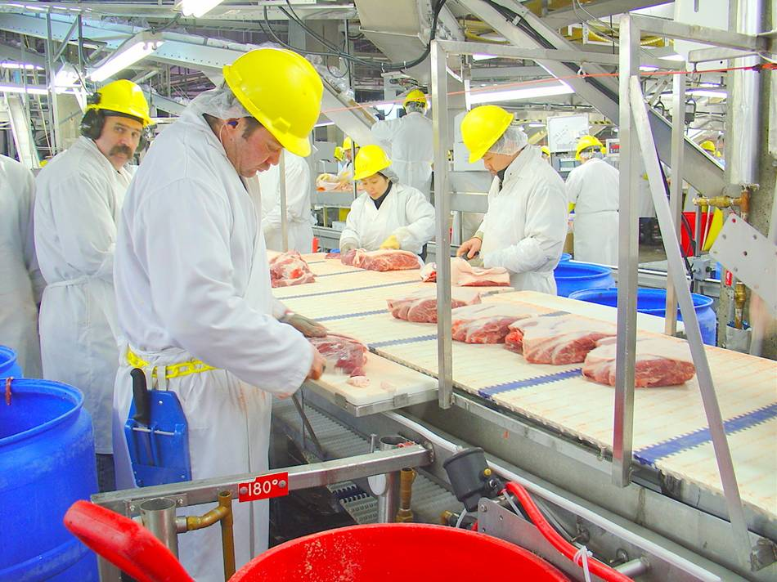
Notes:
Can you identify any hazards in these photos?

Slide 28
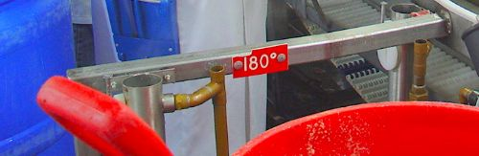
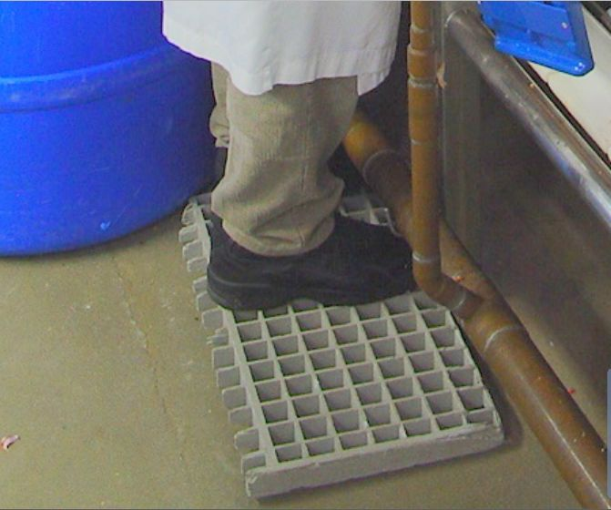
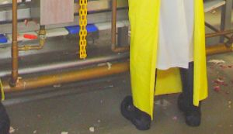
Notes:
Does 180 degrees present a hazard?
Skin burns at about 130 degrees.

Slide 29
What is the Hazard?
There should be something covering the workers’ skin OR
People should be careful around hot pipes OR
There are uninsulated pipes carrying 180 degree water in the work area (choose one)
Notes:
The hazard is the hot, uninsulated pipes (C).
Statements A and B refer to ways of controlling the hazard.

Slide 30
Insulate Hot Pipes
1910.261(k)(11): Steam and hot-water pipes. All exposed steam and hot-water pipes within 7 feet of the floor or working platform or within 15 inches measured horizontally from stairways, ramps, or fixed ladders shall be covered with an insulating material, or guarded in such manner as to prevent contact.

Slide 31
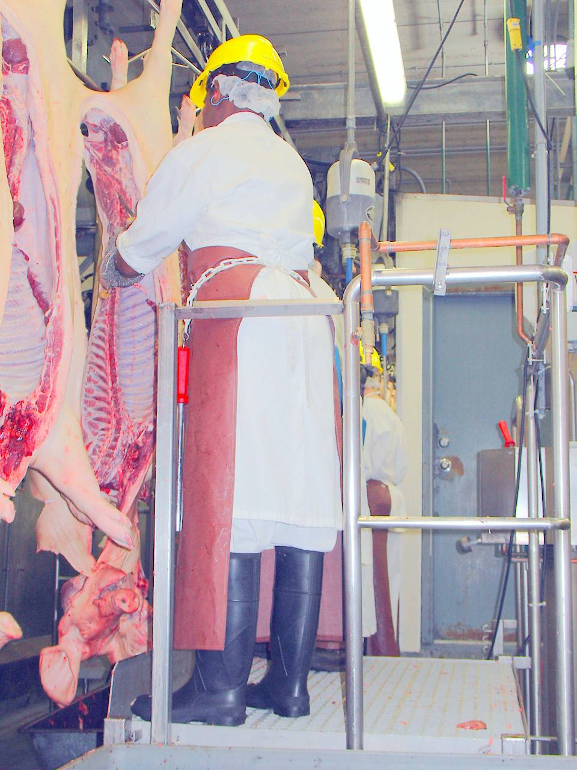

Slide 32
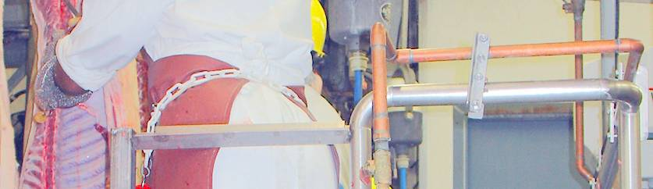
Exposed Hot Pipes
Notes:
What if the company decided to solve the problem by requiring more protective equipment rather than insulating the pipes?

Slide 33
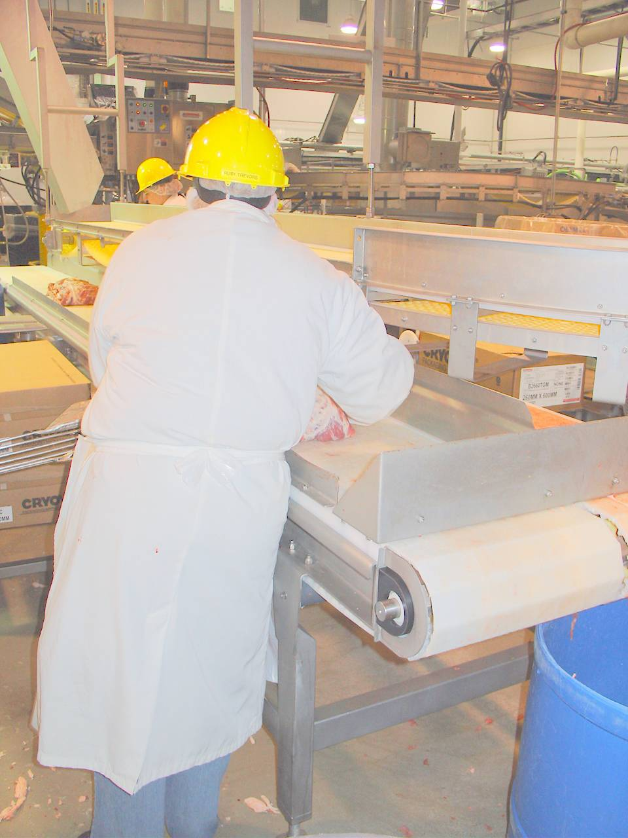
Notes:
What hazards can you identify in this photo?

Slide 34
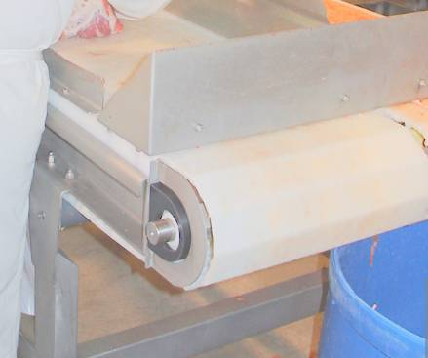
Exposed shaft, sharp edges
Notes:
Why would we care about sharp edges on sheet metal when we’re dealing with a shop full of really sharp knives?

Slide 35
A case-crossover study of occupational laceration injuries in pork processing: methods and preliminary findings. Lander, L. et al, March 21, 2008
“Sharp edges of doors and steel containers were an unexpected and preventable source of lacerations.”

Slide 36
What is the Hazard?
Workers are not being careful around sharp edges on doors and steel containers OR
Workers should wear their PPE at all times OR
There are sharp edges on doors and steel containers in the work area (choose one)
Notes:
The hazard is (C) – sharp edges.
A and B refer to ways of controlling the hazard.

Slide 37
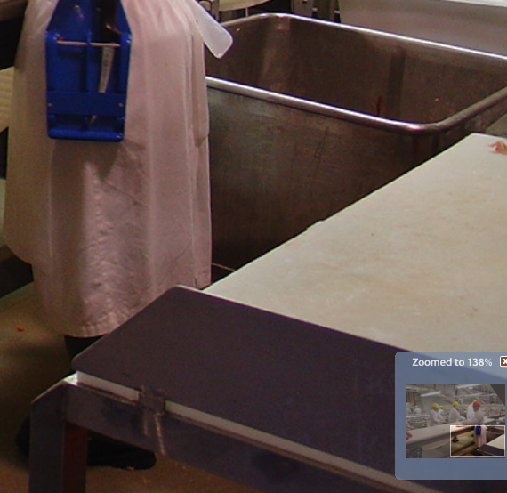
Examples of Rounded Edges
Notes:
Work stations and equipment can be designed to eliminate sharp edges.

Slide 38
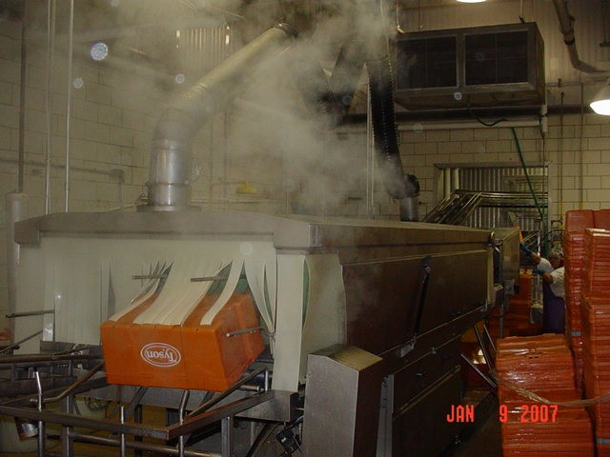

Slide 39
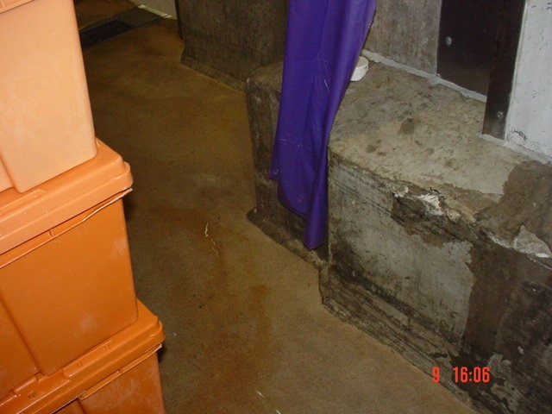
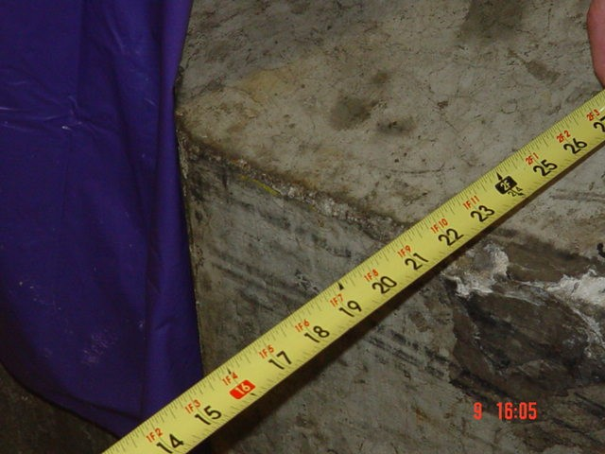

Slide 40
An exit access must be at least 28 inches (71.1 cm) wide at all points. Where there is only one exit access leading to an exit or exit discharge, the width of the exit and exit discharge must be at least equal to the width of the exit access.

Slide 41
1910.36(g)(4) Objects that project into the exit route must not reduce the width of the exit route to less than the minimum width requirements for exit routes.

Slide 42
Exit routes must be free and unobstructed. No materials or equipment may be placed, either permanently or temporarily, within the exit route.

Slide 43
What is the Hazard?
The path to the emergency exit was obstructed OR
The worker did not keep her area clean OR
The workers stored more boxes than they need in the area (choose one)
Notes:
The hazard is the obstructed path to the emergency exit.
Statements B and C might be true but they do not identify the hazard.

Slide 44
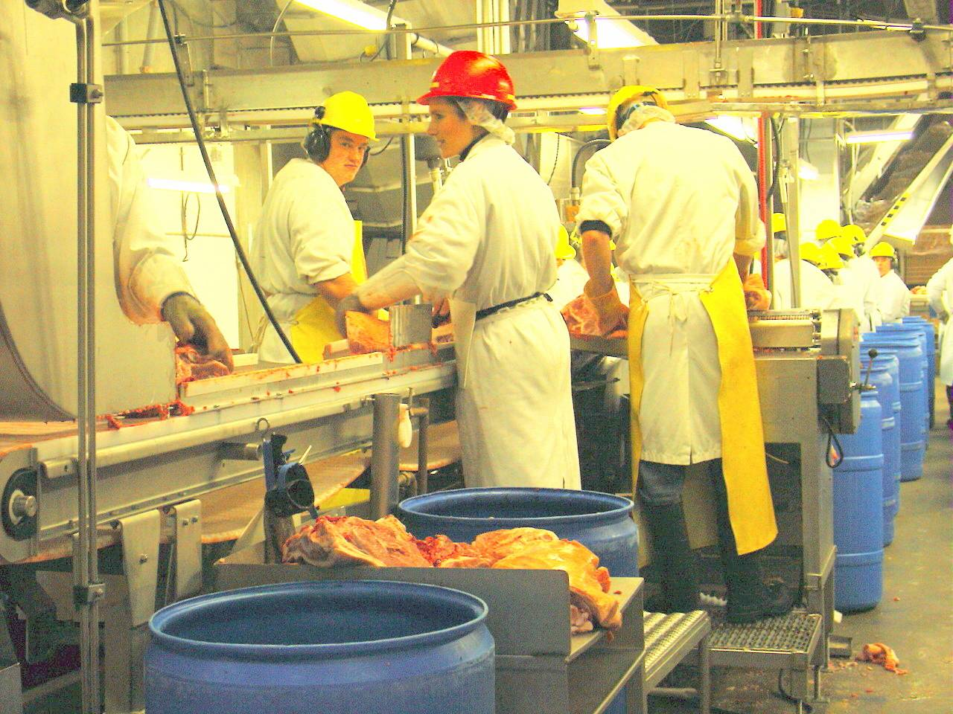

Slide 45
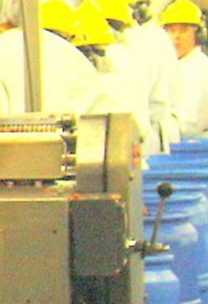
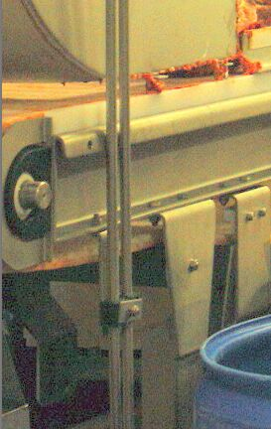

Slide 46
General Safety
Machine controls should be under the control of the operator – not hanging out in aisle-way

Slide 47
What is the Hazard?
The machine control is located where someone could accidentally hit it OR
The operator must pay close attention to his surroundings OR
People walking by should be careful not to hit the machine control (choose one)
Notes:
The hazard is the location of the machine control.
Statements B and C might be true, but they do not describe the hazard.

Slide 48
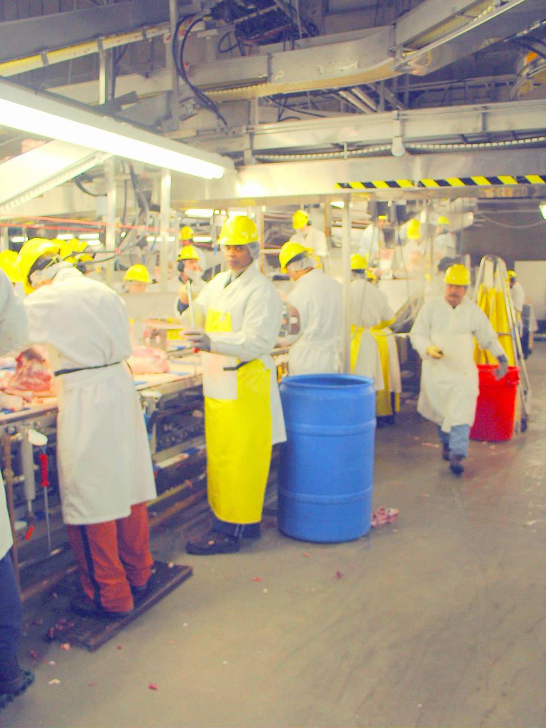

Slide 49
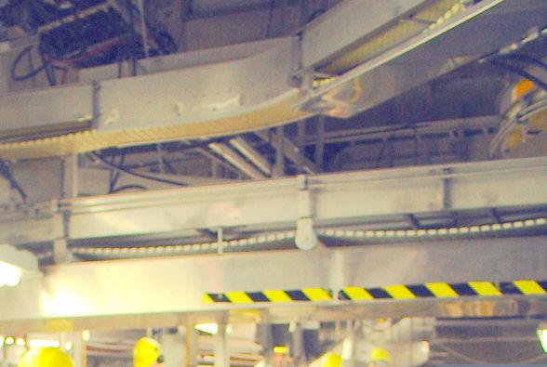
Notes:
Why is the underside of one section of the overhead conveyor guarded, and another section is not? Was the guarding removed and not replaced?
What ran into the ductwork?

Slide 50
What is the Hazard?
Fork truck drivers need to be more careful OR
They need to put a sign on the ductwork OR
The ductwork might be too low for the traffic in the area (choose one)
Notes:
The height of the ductwork relative to the traffic in the area is the hazard.
A and B might be helpful for controlling the hazard, but they do not describe the hazard.

Slide 51
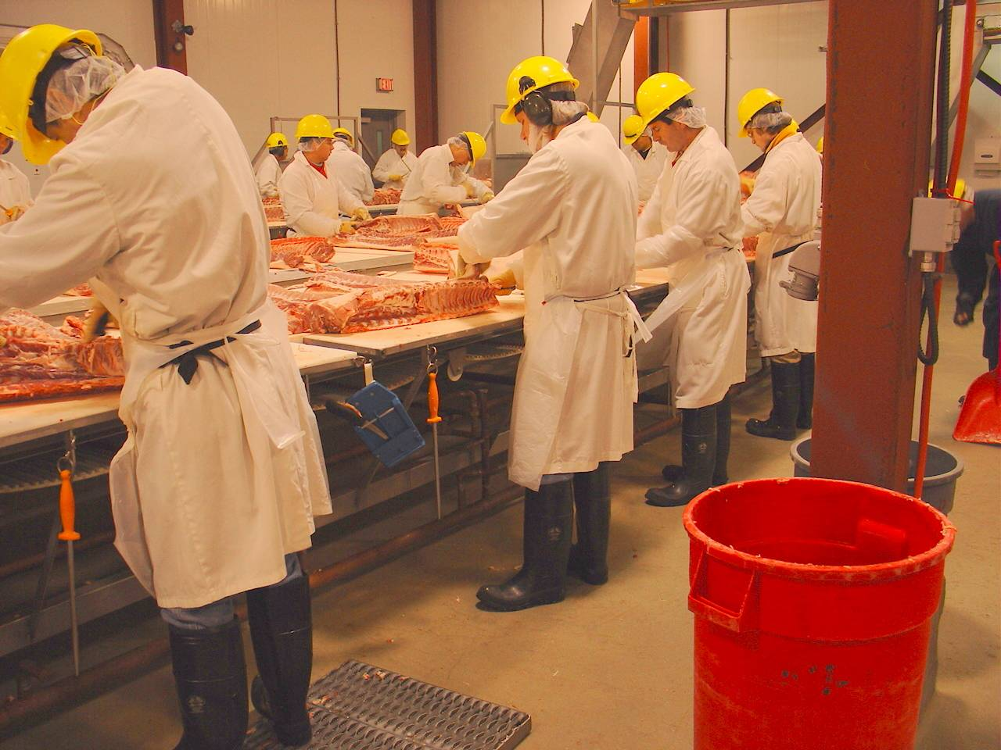
Notes:
Why is the tallest worker on this line the only one standing on a platform?

Slide 52
What is the Hazard?
People should pay attention to the ergonomics training OR
There are not enough platforms to go around OR
The height of the work surface is too low for this worker (choose one)
Notes:
The hazard is the mismatch between the height of the worker and the height of his work surface (C).

Slide 53
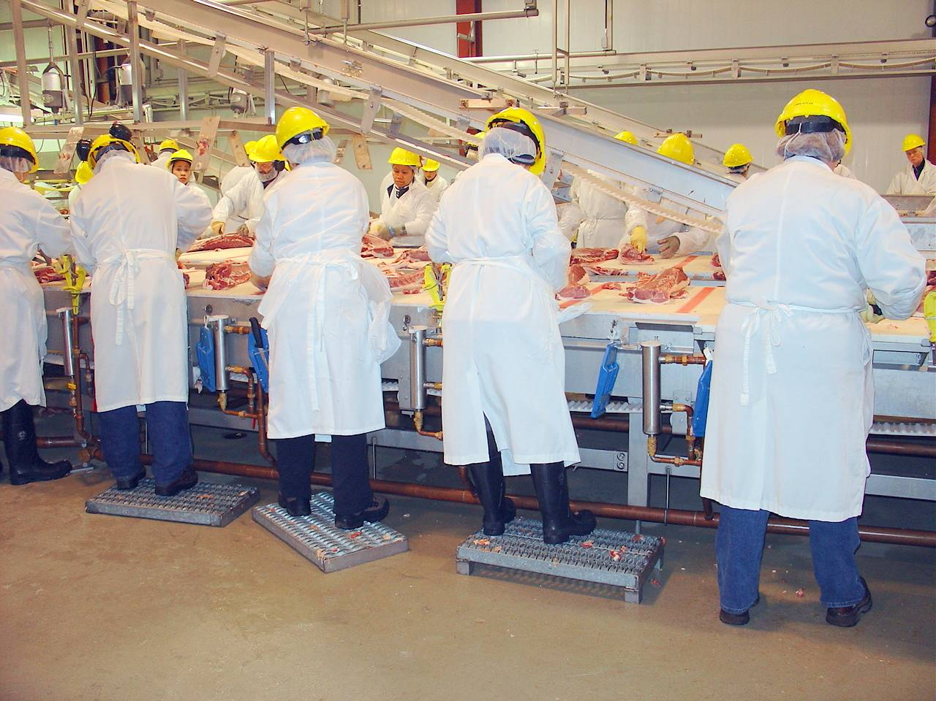

Slide 54
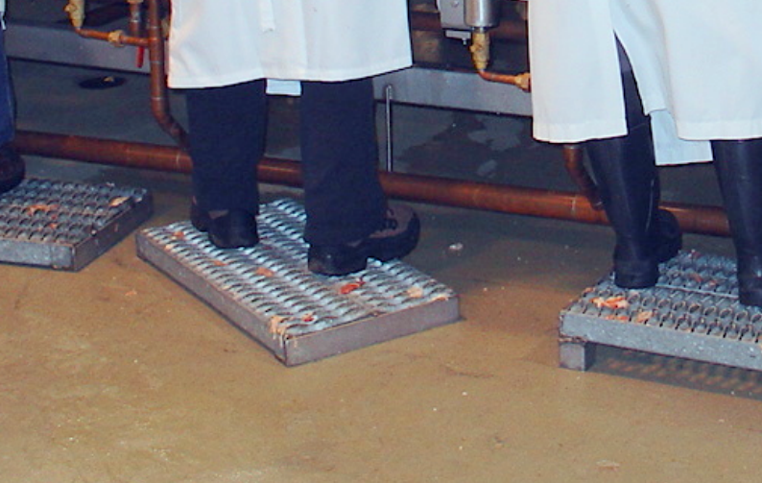
How stable is this platform?

Slide 55
What is the Hazard?
The work platforms slip on the floor OR
The worker did not straighten out his platform OR
There is no sign warning about slippery floors (choose one)
Notes:
The fact that the platforms slip on the floor is the hazard (A).

Slide 56
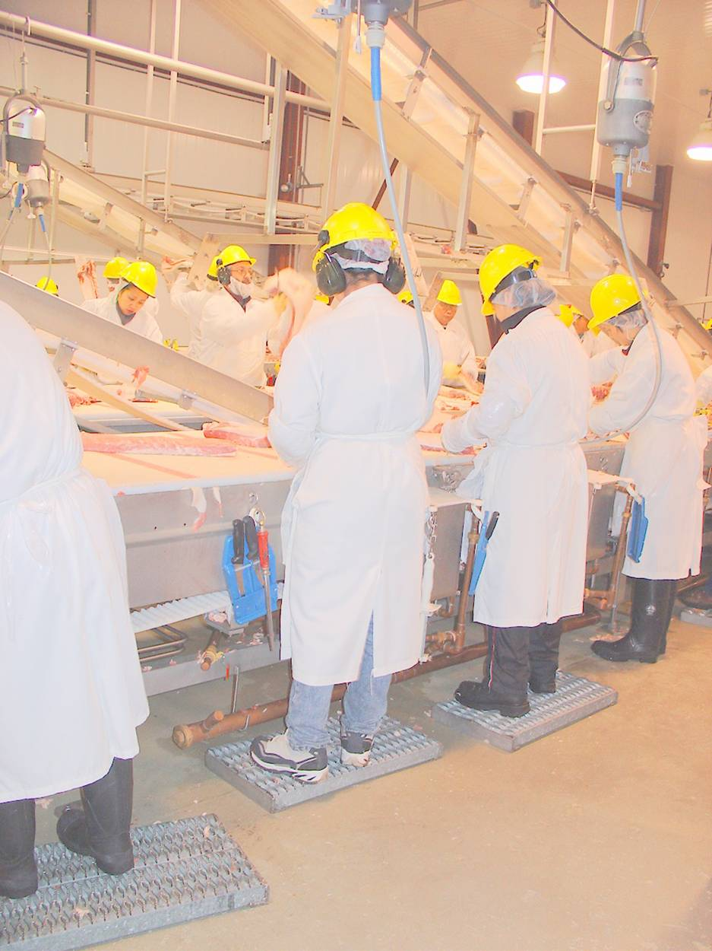

Slide 57
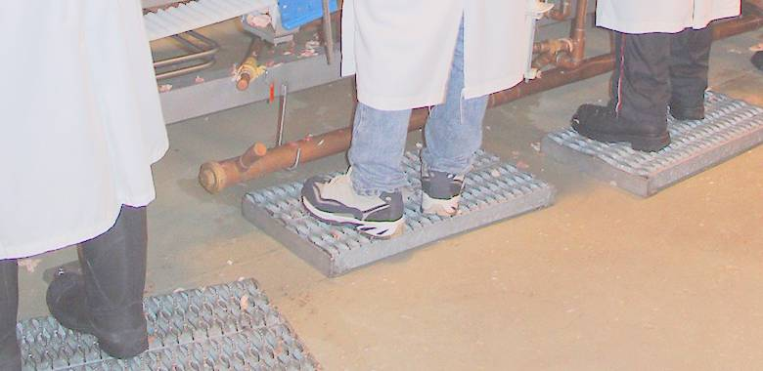
Protruding Pipe Segment

Slide 58
What is the Hazard?
The pipe is protruding into the work area OR
The workers are not aware of their surroundings OR
The company has not trained people to be aware of their surroundings (choose one)
Notes:
The protruding pipe is the hazard.

Slide 59
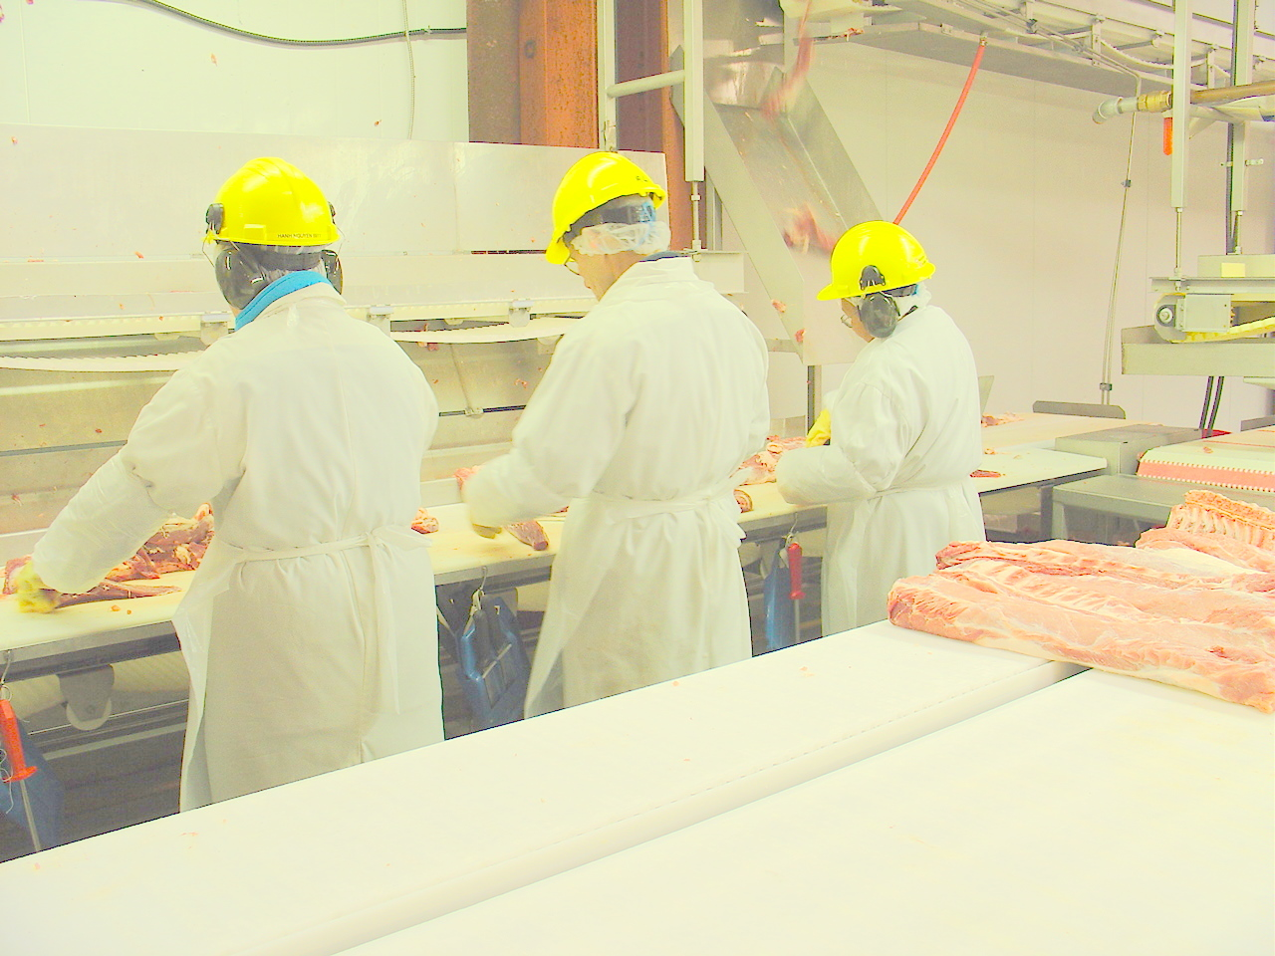

Slide 60
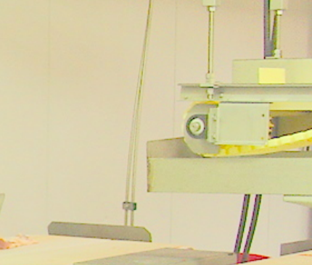
Exposed shaft

Slide 61
What is the Hazard?
There is no hazard because everyone is wearing hard hats OR
OSHA says you have to guard spinning shaft ends OR
There is an unguarded spinning shaft that could entangle loose clothing, hair or other objects (choose one)
Notes:
The hazard is the spinning shaft.

Slide 62
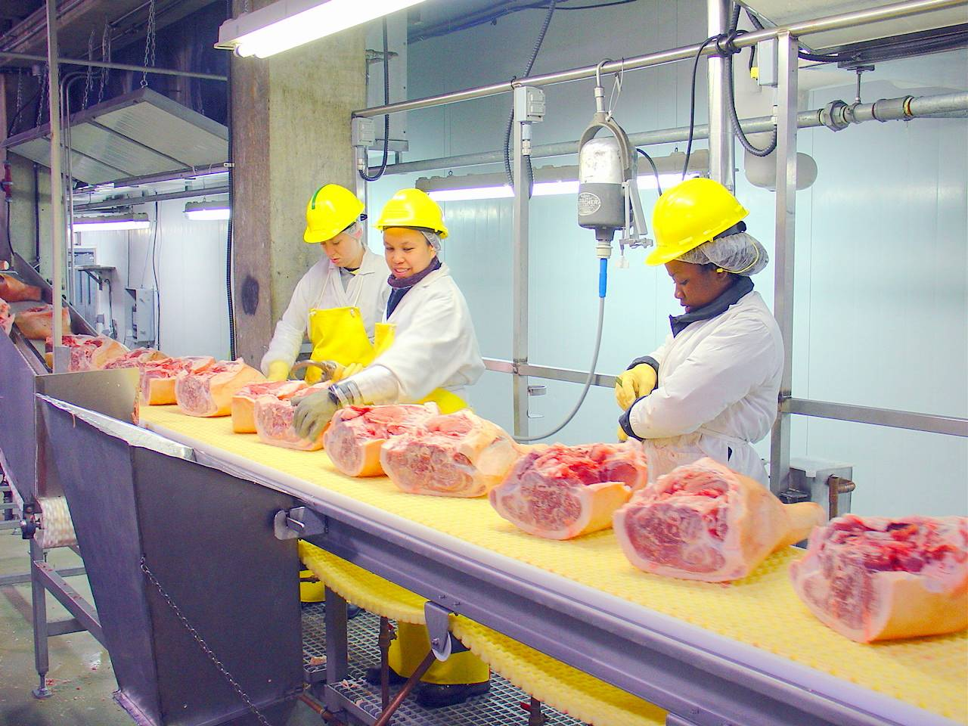

Slide 63
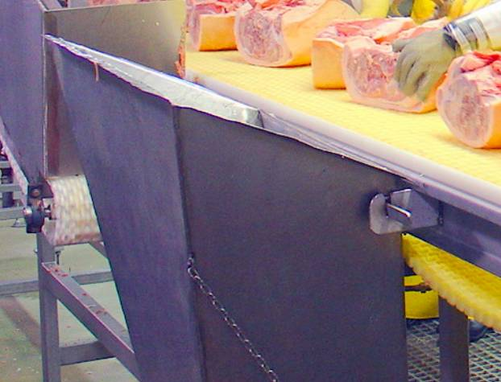
Sharp Edges on Bin

Slide 64


Slide 65

Blocked Emergency Exit

Slide 66
What is the Hazard?
The company should discipline people for blocking the exit OR
There is no hazard because it is easy to move empty boxes to get out the exit OR
The emergency exit is blocked
Notes:
The hazard is the blocked emergency exit.

Slide 67


Slide 68

Bad Intersection
Notes:
Watch for Falling Hogs!
This intersection combines a number of hazards:
Often the most dangerous locations on monorail systems is at corners or transitions – this corner has apparently been a problem in the past
In addition to falling hogs, the floor here slopes to the drain – so you have a slope and an especially slippery floor because of the concentration of blood, etc. going toward the drain.
In other words, you have an intersection where the floor is slippery and sloped, with a steady stream of hogs – some of which might fall as they turn the corner.
What could you do to make this intersection safer?

Slide 69
What is the Hazard?
People need to be careful and watch for falling hogs when they walk through this area OR
There is a pedestrian area with a number of dangerous conditions – the floor slopes to a drain, the floor is often slippery with blood, and hogs fall off the chain in this area. (choose one)
Notes:
Statement B describes the hazard.

Slide 70


Slide 71

Gap at Steps

Slide 72
Fixed Industrial Stairs
1910.24(f)
"Stair treads." …Rise height and tread width shall be uniform throughout any flight of stairs …

Slide 73
What is the Hazard?
Workers should be careful and watch their feet on this platform OR
There should be a sign warning of the gap at the steps OR
The step is not even with the work platform (choose one)
Notes:
Statement C describes the hazard.

Slide 74


Slide 75

Rated for Wet Environment? Missing Piece on Angle Drive?

Slide 76
What is the Hazard?
Maintenance did not install the right motor OR
If the motor is not rated for a wet environment water could come into contact with the electrical components of the motor and cause a short
Notes:
We do not know the rating for this motor, but we would want to investigate to see if it is rated for a wet environment (B).

Slide 77


Slide 78

Rated for Wet Environment?

Slide 79

Caulk on Motor?

Slide 80

Hose Segment on Floor?

Slide 81

How Stable is this Piping?

Slide 82

Stable?

Slide 83
What is the Hazard?
The unstable piping could break and spill hot water on the workers and electrical components OR
People need to be careful not to lean on the piping since there are no supports OR
There are not enough pipefitters in this plant (choose one)
Notes:
The unstable piping could create a hazard (A).

Slide 84


Slide 85

Makeshift Wiring?

Slide 86
Protection of Flexible Cords
1910.305(a)(2)(x) Flexible cords and cables shall be protected from accidental damage, as might be caused, for example, by sharp corners, projections, and doorways or other pinch points.1910.305(a)(2)(xi) Cable assemblies and flexible cords and cables shall be supported in place at intervals that ensure that they will be protected from physical damage. Support shall be in the form of staples, cables ties, straps, or similar type fittings installed so as not to cause damage.

Slide 87
What is the Hazard?
People should not use extension cords instead of permanent wiring OR
Extension cords can be damaged when tied in knots or wrapped around sharp corners. OR
OSHA prohibits wrapping extension cords around sharp corners (choose one)
Notes:
OSHA standards help us identify hazards, but the actual hazard is the potential damage that can result from misusing extension cords (B).

Slide 88

Pulley With Spokes

Slide 89
What is the Hazard?
There is no hazard – the machine came like that OR
People should keep their hands away from the spokes OR
Spokes create a pinch point where fingers can get caught (choose one)
Notes:
The pinch points created by the spokes are the hazard (C).

Slide 90


Slide 91

How high is this sprocket?

Slide 92
What is the Hazard?
The exposed chain and sprocket create a pinch point OR
There is no hazard – the sprocket is over 7 ft. off the floor OR
There is no hazard because the chain has always been like that (choose one)
Notes:
The pinch point created by the exposed chain and sprocket is the hazard (A).

Slide 93


Slide 94

Hoses on Floor

Slide 95
All places of employment, passageways, storerooms, and service rooms shall be kept clean and orderly and in a sanitary condition

Slide 96
What is the Hazard?
The worker did not pay attention to housekeeping OR
Workers in this area must pay attention to objects on the floor OR
The hose on the floor could trip someone (choose one).
Notes:
The trip hazard is the hazard (C).

Slide 97

Notes:
What is the red cord that you can see above these workers’ heads?

Slide 98
Emergency Stops
Equip conveyors with emergency stop controls that require manual resetting before resuming conveyor operation.
Install clearly marked, unobstructed emergency stop buttons or pull cords within easy reach of employees.
Provide continuously accessible conveyor belts with emergency stop cables that extend the entire length of the conveyor belt to allow access to the cable from any point along the belt.

Slide 99


Slide 100
What is the Hazard?
People must be aware of their surroundings at all times OR
Hard hats are necessary to avoid head injuries in this area OR
Pipes are protruding into the work area
(choose one)
Notes:
The protruding pipes are the hazard (C).

Slide 101
1910.36(g)(1)
The ceiling of an exit route must be at least seven feet six inches (2.3 m) high. Any projection from the ceiling must not reach a point less than six feet eight inches (2.0 m) from the floor.

Slide 102


Slide 103
Notes:
If the deadbolt was locked during a smoky fire when it was hard to see, do you think people could easily find the deadbolt on the top of the door?

Slide 104
What is the Hazard?
There is no hazard. The door is not locked. OR
People have to be careful to keep the door unlocked during working hours OR
The door could be locked during an emergency. Workers might not know where to unlock the door. (choose one)
Notes:
The possibility of the door being locked during an emergency is the hazard (C).

Slide 105
1910.36(d)(1)
An exit door must be unlocked. Employees must be able to open an exit route door from the inside at all times without keys, tools, or special knowledge. A device such as a panic bar that locks only from the outside is permitted on exit discharge doors

Slide 106


Slide 107
What is the Hazard?
There is an open pit, a hose, and debris where people walk OR
Workers should not allow chickens to fall on the floor OR
There should be a sign warning people about the open pit, the slippery floor and the hose.
Notes:
The combination of the open pit and debris on the floor create the hazard (A).

Slide 108
1910.22(c)
"Covers and guardrails." Covers and/or guardrails shall be provided to protect personnel from the hazards of open pits, tanks, vats, ditches, etc.

Slide 109
What Next?
Set Priorities
Frequency of exposure
How many people are exposed for how often?
Severity
How badly could someone be hurt?
What other factors would you want to consider?

Slide 110
Choosing Issues
Is there an obvious, achievable solution?
Be Careful!
If your proposed solution involves putting more protective equipment on people, be sure to think it through carefully.
Is there a way to eliminate the hazard?
Is there an engineering control that would change the workplace – not the worker?

Slide 111
Choosing Issues (continued)
Is there an obvious, achievable solution?
Be Careful!
If your proposed solution involves making new rules, be sure to think it through carefully.
What could be the unintended consequences of the union pushing for new safety rules?
Is there a way to change the workplace instead of changing the worker?

Slide 112
Choosing Issues (continued)
Is this an issue your co-workers care about?
Will co-workers get involved in pushing for change?
Is there general agreement about this issue across shifts and affected departments?

Slide 113
Summary & Evaluation
What important points did you learn or have reinforced today?
Will you do anything differently when you return to your plant?
What questions were left unanswered by this workshop?
What would you like us to do differently?
What do you think worked well?

