Slide 1
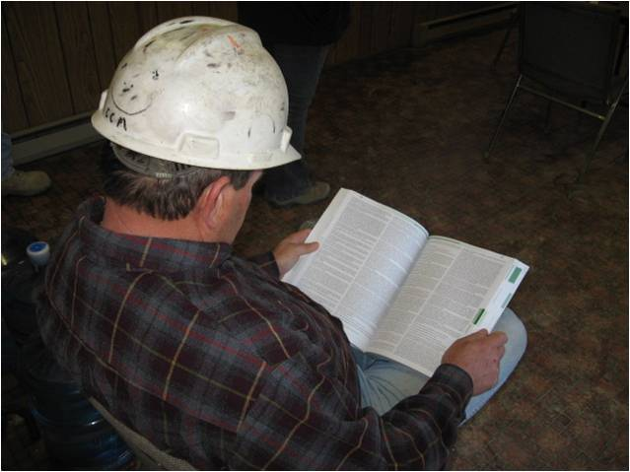
Intro to OSHA
Notes:
The lesson provides basic knowledge of: OSHA’s history and mission, worker rights under OSHA, employer responsibilities under OSHA, OSHA standards, OSHA inspections, and safety and health resources, including how to file an OSHA complaint.

Slide 2
Susan Harwood Training Grant
This material was produced under grant number SH-20868-SH0 from the Occupational Safety and Health Administration, U.S. Department of Labor. It does not necessarily reflect the views or policies of the U.S. Department of Labor, nor does mention of trade names, commercial products, or organizations imply endorsement by the U.S. Government.

Slide 3
Why is OSHA Important to You?
OSHA began because, until 1970, there were no national laws for safety and health hazards
On average, 15 workers die every day from job injuries
Over 5,600 Americans die from workplace injuries annually
Over 4 million non-fatal workplace injuries and illnesses are reported
Notes:
OSHA stands for the Occupational Safety and Health Administration, an agency of the U.S. Department of Labor. OSHA’s responsibility is worker safety and health protection.
The U.S. Congress created OSHA under the Occupational Safety and Health Act of 1970 (the OSH Act). Congress passed the law and established OSHA “to assure so far as possible every working man and woman in the nation safe and healthful working conditions and to preserve our human resources.”
OSHA began because, until 1970, there were no national laws for safety and health hazards.
With the creation of OSHA, for the first time, all employers in the United States had the legal responsibility to provide a safe and healthful workplace for employees. And, there were now uniform regulations that applied to all workplaces.

Slide 4
What Rights Do You Have Under OSHA?
You have the right to
A safe and healthful workplace
Know about hazardous chemicals
Information about injuries and illnesses in your workplace
Complain or request hazard correction from employer
Training
Hazard exposure and medical records
File a complaint with OSHA
Participate in an OSHA inspection
Be free from retaliation for exercising safety and health rights
Notes:
The Occupational Safety and Health Act of 1970 gave workers many new rights related to safety and health. OSHA standards which have been issued since then, such as
the Hazard Communication or “Right to Know” standard, provide additional rights.
Most importantly, the creation of OSHA provided workers the right to a safe and healthful workplace. Section 5(a)(1) of the OSH Act states: “Each employer shall furnish to each of his employees employment and a place of employment which are free from recognized hazards that are causing or are likely to cause death or serious physical harm to his employees."
A safe and healthful workplace means that hazards are removed and workers are trained.
If a hazard cannot be removed completely, protection (for example, respirators or earplugs) must be provided.

Slide 5
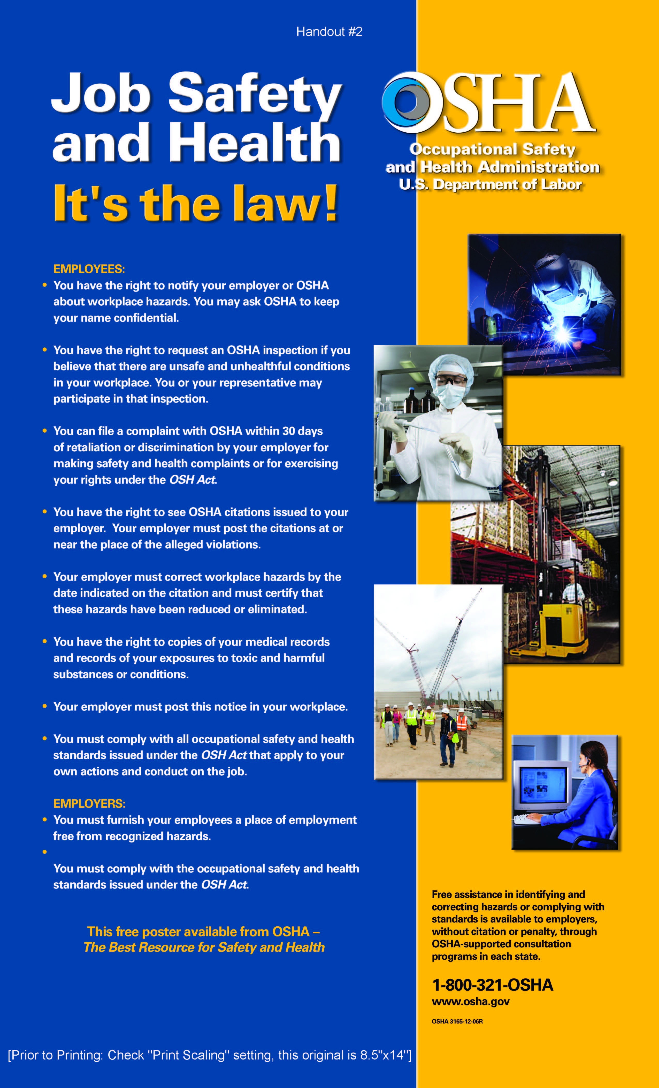
Notes:
Ask the class if they have seen the OSHA poster in their workplace. If so, ask where it is posted.
Tell the class that all employers covered by the OSHA Act must display the OSHA poster. (Employers in states operating OSHA-approved state plans should obtain and post the state’s equivalent poster.)

Slide 6
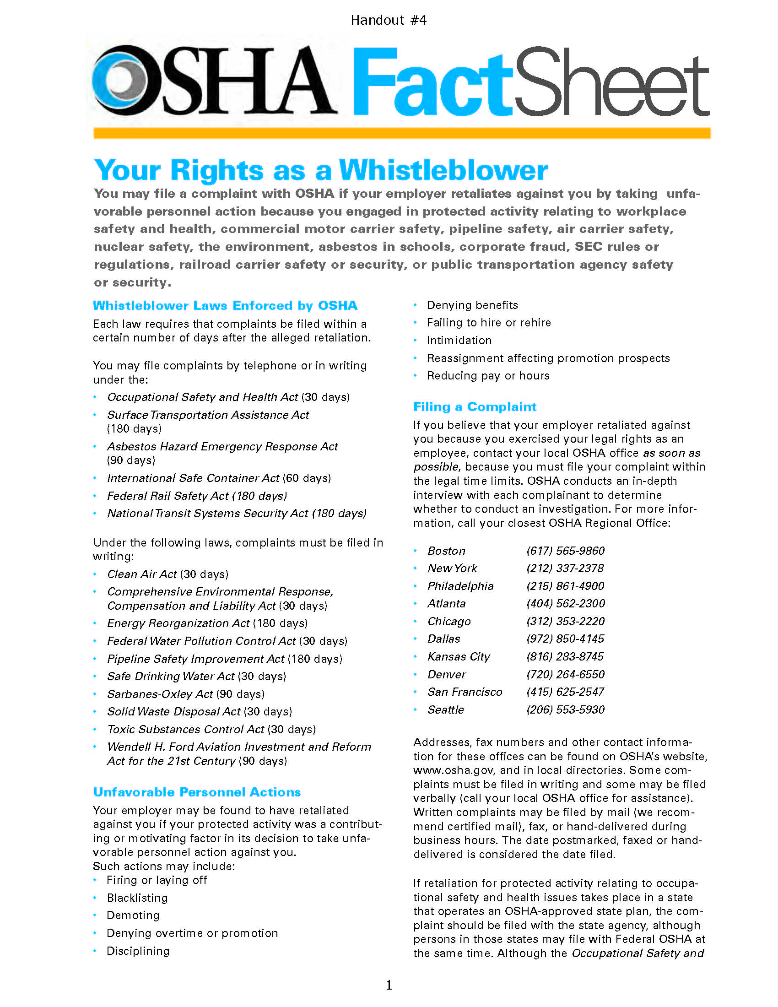
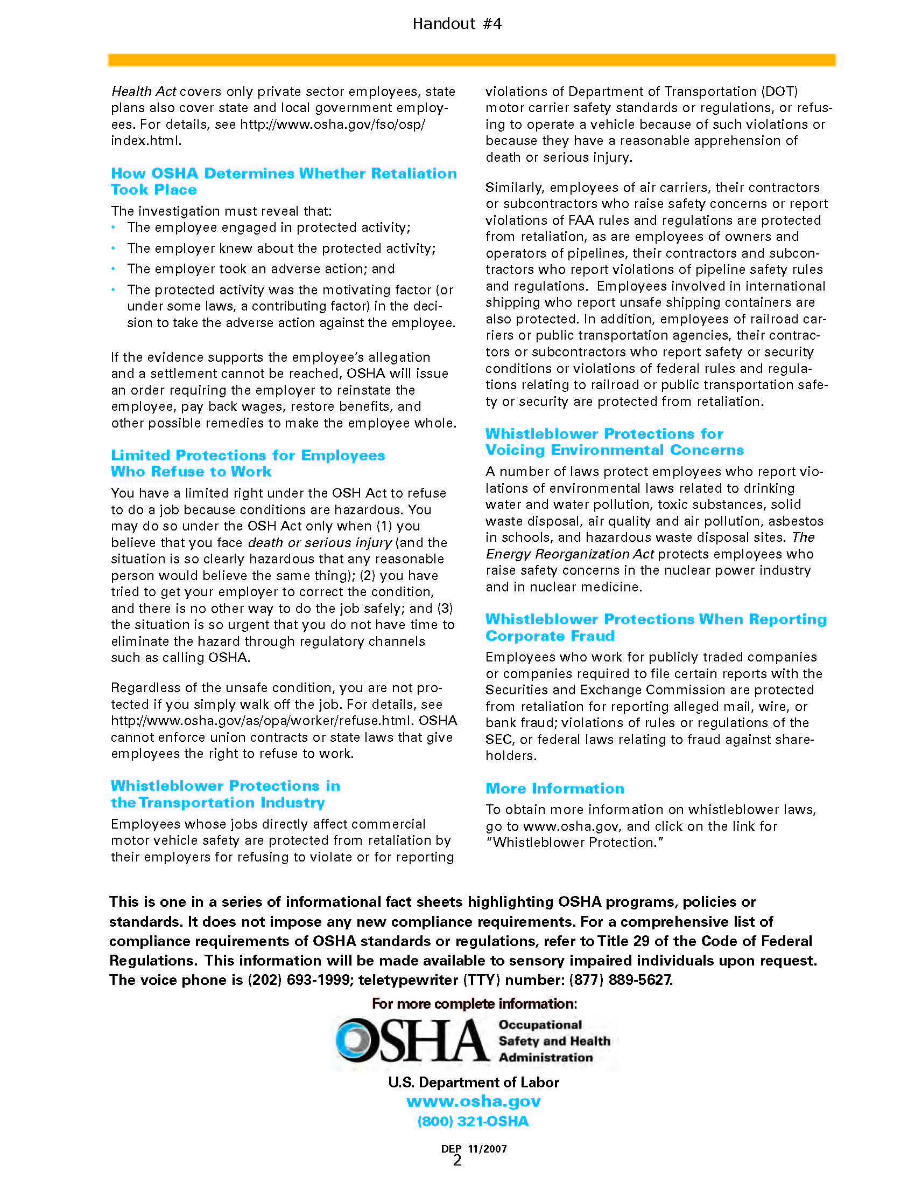
Your Rights to Seek Safety and Health Assistance
Notes:
Ask the class if they have ever reported a hazard to their supervisor. If so, what was the outcome?
Workers may bring up safety and health concerns in the workplace to their employers without fear of discharge or discrimination, as long as the complaint is made in good faith. OSHA regulations [29CFR 1977.9(c)] protect workers who complain to their employer about unsafe or unhealthful conditions in the workplace.
You cannot be transferred, denied a raise, have your hours reduced, be fired, or punished in any other way because you have exercised any right afforded to you under the OSH Act.
You may file a complaint with OSHA if you believe a violation of a safety or health standard, or an imminent danger situation, exists in your workplace. You may request that your name not be revealed to your employer. You can file a complaint on OSHA’s web site, in writing or by telephone to the nearest OSHA area office. You may also call the office and speak with an OSHA compliance officer about a hazard, violation, or the process for filing a complaint.
If you file a complaint, you have the right to find out OSHA’s action on the complaint and request a review if an inspection is not made.

Slide 7
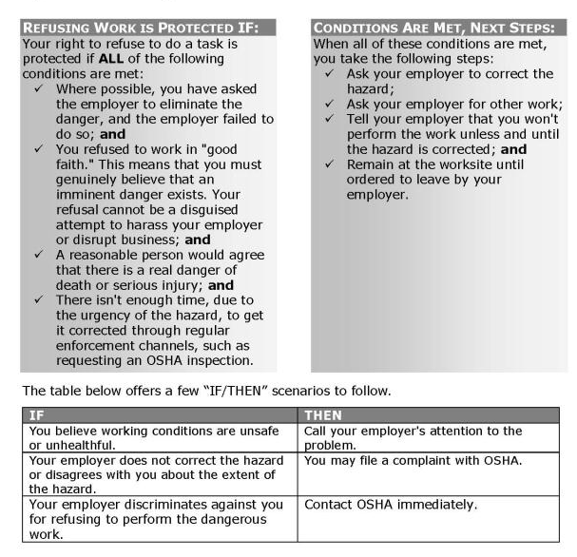
Refusing to Work Because Conditions are Dangerous
Notes:
Workers also have the right to refuse to do a job if they believe in good faith that they are exposed to an imminent danger. "Good faith" means that even if an imminent danger is not found to exist, the worker had reasonable grounds to believe that it did exist.
Since the conditions necessary to justify a work refusal are very stringent, refusing work should be an action taken as a last resort.
If time permits, the condition should be reported to OSHA or the appropriate government agency.

Slide 8
What Responsibilities Does Your Employer Have Under OSHA?
Provide a workplace free from recognized hazards and comply with OSHA standards
Provide training required by OSHA standards
Keep records of injuries and illnesses
Provide medical exams when required by OSHA standards and provide workers access to their exposure and medical records
Not discriminate against workers who exercise their rights under the Act (Section 11(c))
Post OSHA citations and abatement verification notices
Provide and pay for PPE
Notes:
Explain that the company they work for has many safety related responsibilities.
Remind them that they too have to do there part.
Ask them what they think their role is when it comes to job site safety and health.

Slide 9
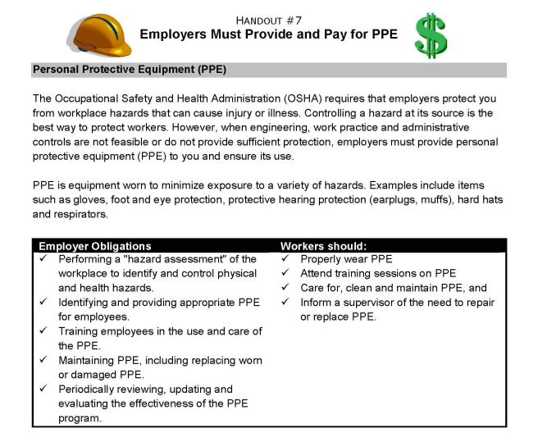
Employer Must Provide and Pay for PPE
Notes:
Ask the class if anyone wears personal protective equipment on their job and discuss the requirement for employers to provide and pay for PPE.
The Employer Payment for Personal Protective Equipment rule was effective on February 13, 2008 and had to be implemented by May 15, 2008.
As we mentioned earlier, OSHA requires the use of personal protective equipment (PPE) to reduce employee exposure to hazards when engineering and administrative controls are not feasible or effective in reducing these exposures to acceptable levels.

Slide 10

Employer Must Provide and Pay for PPE
Notes:
Employers are required to determine if PPE should be used to protect their workers.
OSHA also requires that employers pay for most required PPE, except for uniforms, items worn to keep clean, weather-related gear, logging boots, and non-specialty safety toe protective footwear (including steel-toe shoes or steel-toe boots) and non-specialty prescription safety eyewear, as long as the employer permits the items to be worn
off the jobsite.

Slide 11
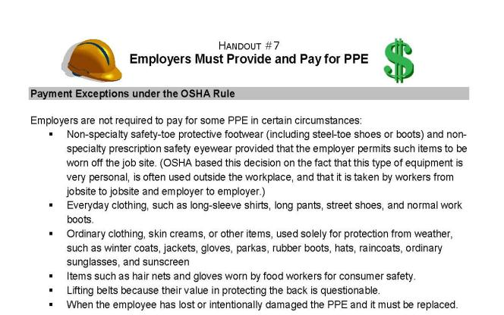
Employer Must Provide and Pay for PPE
Notes:
Examples of PPE that employers must pay for include: metatarsal foot protection, rubber boots with steel toes, non-prescription eye protection, prescription eyewear inserts/lenses for full face respirators, goggles and face shields, fire fighting PPE (helmet, gloves, boots, proximity suits, full gear), hard hat, hearing protection, and welding PPE.

Slide 12
What do the OSHA Standards Say?
OSHA standards fall into four categories: General Industry, Construction, Maritime, and Agriculture
OSHA issues standards for a wide variety of workplace hazards
Where there are no specific OSHA standards, employers must comply with the General Duty Clause, Section 5(a)(1)
Notes:
Now, let’s talk briefly about the OSHA standards. OSHA standards fall into four categories: General Industry, Construction, Maritime, and Agriculture.
In addition, as we discussed previously, where there are no specific OSHA standards, employers must comply with the OSH Act's "general duty clause." The General Duty Clause, Section 5(a)(1), requires that each employer "furnish ... a place of employment which [is] free from recognized hazards that are causing or are likely to cause death or serious physical harm to his employees.

Slide 13
How Are OSHA Inspections Conducted?
The OSH Act authorizes OSHA compliance safety and health officers (CSHO’s) to conduct workplace inspections at reasonable times
OSHA conducts inspections without advance notice, except in rare circumstances (e.g. - imminent danger)
In fact, anyone who tells an employer about an OSHA inspection in advance can receive fines and a jail term
Notes:
Since not all eight million worksites covered by OSHA can be inspected, the agency has a system of inspection priorities.
1st
Imminent Danger
2nd
Fatality/Catastrophe
3rd
Complaints/Referrals
4th
Programmed Inspections

Slide 14
Where Can You Go For Help?
Sources within the workplace/worksite
Sources outside the workplace/worksite
How to file an OSHA complaint
Notes:
There are many resources available to you if you want to find out more information about a safety or health issue in your workplace. Some sources are:
Employer or supervisor, co-workers and union representatives – OSHA encourages workers and employers to work together to reduce hazards.
Material Safety Data Sheet (MSDS) for information on chemicals – Earlier in this session, we talked about the Material Safety Data Sheet, also called an MSDS, and what information it supplies.
Labels and warning signs – Labels and signs can show hazard information to workers and can be useful in providing additional information and making you aware of a potential safety or health hazard. However, signs are not intended to take the place of actual hazard correction.
Employee orientation manuals or other training materials – Orientation manuals and training materials about your job should include information about how to work safely.
Work tasks and procedures instruction – A written job or task instruction can provide information about the proper and safe way to perform a job.

Slide 15
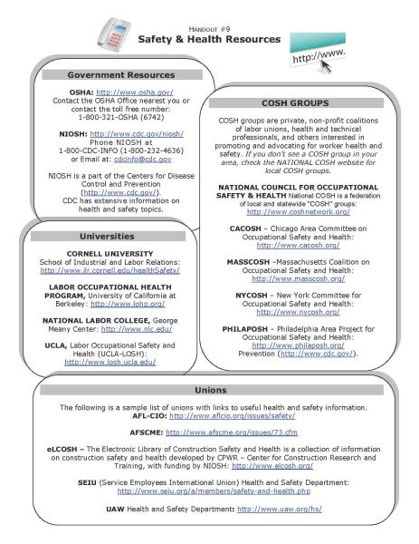
Find Out More About Safety
OSHA e-Tool
Notes:
If you cannot find out the safety and health information you need in your workplace, there are many resources available outside the workplace.

Slide 16
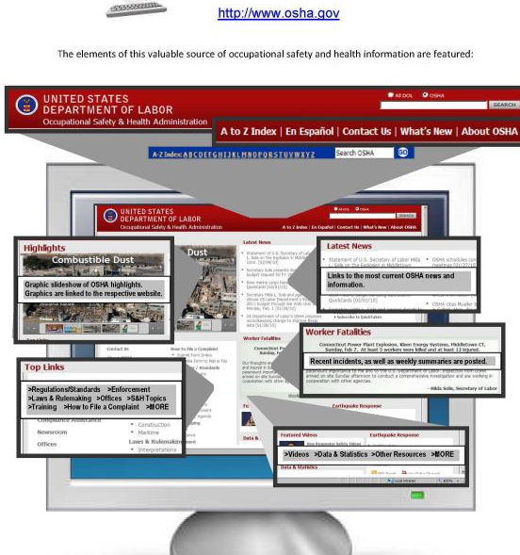
Check Out OSHA’s Web Site!
Notes:
If you have internet access, you will find that the OSHA website has a lot of safety and health information and links to resources that can help you.
For example, from the Home Page, you can:
Find information in Spanish from the OSHA en Español page.
Locate Fact Sheets and QuickCards by going to the Publications page.
OSHA FactSheets provide basic background information on safety and health hazards, and
QuickCards are small, laminated cards that provide brief, plain language safety and health information for workers. For example, there are QuickCards on fall hazards, carbon monoxide, and pneumatic nail gun safety.

