Slide 1
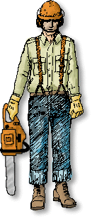
The Logger
Training
Head Protection
Eye/Face Protection
Leg Protection
Foot Protection
Hand Protection
Hand Tools and Equipment

Slide 2
This material was produced under grant number
SH-20868-SHO from the Occupational Safety and Health Administration, U.S. Department of Labor. It does not necessarily reflect the views or policies of the U.S. Department of Labor, nor does mention of trade names, commercial products, or organizations imply endorsement by the U.S. Government.

Slide 3
Training…..Who must be trained and when ?
All employees prior to working for company.
When assigned new tasks or equipment.
When unsafe work practices are identified by employer.
New employees that have had prior training are not required to be retrained if the employer determines that worker was adequately trained.
Workers who need training must work under close supervision of designated person until they prove they can safely perform their duties.
Safety meetings at least monthly !

Slide 4
Training…..What must be included ?
Work procedures,company and site requirements.
Hazard recognition, prevention, and control.
Requirements of OSHA Logging Standard.
First Aid/CPR
OSHA Bloodborne Pathogens Standard.
How to safely perform assigned work tasks.
How to safely use, operate, and maintain tools, machines and vehicles….according to the manufacturer.

Slide 5
Training….. Are training records needed ?
Written training certification must be maintained.
Must have names of employees trained, the dates, signature of employer/trainer.
If accepting another employer’s training, employer must indicate and sign date of determining acceptable prior training.

Slide 6
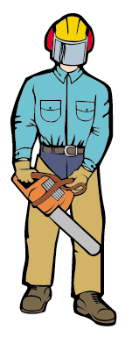
Personal Protective Equipment
Head, ears, eyes, face, hands, and legs.
Must be inspected before each shift.
Provided by employer (except boots).
At very best may prevent or lesson severity of injury !
Notes:
Notes
______________________________________________________________________________________________________________________________________________________________________________________________________________________________________________________________________________________________________________________________________________________________________________________________________________________________________________________________________________________________________________________________________________________________________________________________________________________________________________________

Slide 7

Head Protection
Most loggers are killed by being struck in the head.
Without a Hardhat , even the smallest piece of wood can be deadly.
Designed to absorb energy.
Must be ANSI approved.
Must be worn !
Notes:
Notes
______________________________________________________________________________________________________________________________________________________________________________________________________________________________________________________________________________________________________________________________________________________________________________________________________________________________________________________________________________________________________________________________________________________________________________________________________________________________________________________

Slide 8

Hearing Protection
Requirements found in 1910.95
Noise monitoring will determine if a hearing conservation program is needed, usually it is.
Hearing Conservation Programs mean….providing audiograms, training, and providing hearing protection.
Notes:
Notes
______________________________________________________________________________________________________________________________________________________________________________________________________________________________________________________________________________________________________________________________________________________________________________________________________________________________________________________________________________________________________________________________________________________________________________________________________________________________________________________

Slide 9

Eye and Face Protection
Eye and Face protection must be worn.
Equipment must comply with ANSI Standards.
No sunglasses !
Logger type mesh screens are considered to be best protection !
Notes:
Notes
______________________________________________________________________________________________________________________________________________________________________________________________________________________________________________________________________________________________________________________________________________________________________________________________________________________________________________________________________________________________________________________________________________________________________________________________________________________________________________________

Slide 10
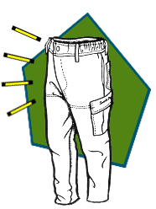
Leg Protection
Each worker who operates a chain saw must wear protection.
Made of cut resistant material.
Extend from upper thigh down to boot top.
Must be UL approved.
Notes:
Notes
______________________________________________________________________________________________________________________________________________________________________________________________________________________________________________________________________________________________________________________________________________________________________________________________________________________________________________________________________________________________________________________________________________________________________________________________________________________________________________________

Slide 11
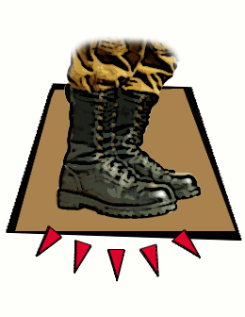
Foot Protection
Employers must make sure that workers wear.
Must be heavy duty and water repellant.
Cover and support the ankle.
If the worker uses a chain saw, boots must be cut resistant that will protect against chain saw contact.
Cut resistant boots are UL approved.
Notes:
Notes
______________________________________________________________________________________________________________________________________________________________________________________________________________________________________________________________________________________________________________________________________________________________________________________________________________________________________________________________________________________________________________________________________________________________________________________________________________________________________________________

Slide 12

Hand Protection
Required of workers who handle wire rope.
Must protect against puncture wounds and cuts.
Notes:
Notes
______________________________________________________________________________________________________________________________________________________________________________________________________________________________________________________________________________________________________________________________________________________________________________________________________________________________________________________________________________________________________________________________________________________________________________________________________________________________________________________

Slide 13
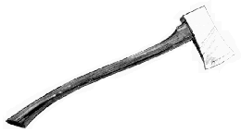
Hand Tools and Equipment
In good condition.
Inspected before each shift.
Guards in place, handles tight, no splits, splinters or sharp edges.
No mushroomed heads.
Cutting edges sharp.
Used only for purpose designed for.
When transporting in vehicle, they must be secured to prevent causing a hazard to vehicle driver or passengers !
Notes:
Notes
______________________________________________________________________________________________________________________________________________________________________________________________________________________________________________________________________________________________________________________________________________________________________________________________________________________________________________________________________________________________________________________________________________________________________________________________________________________________________________________

Slide 14
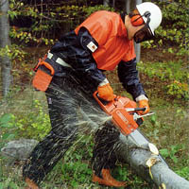
The Chain Saw
Learn the parts of your body most likely to be cut.
Learn about the tool and its parts.
Learn how to use a chain saw safely.

Slide 15
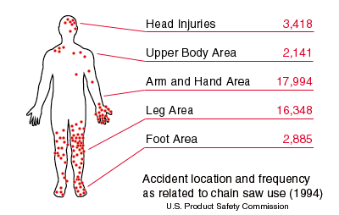
Chain Saw Injury Locations

Slide 16
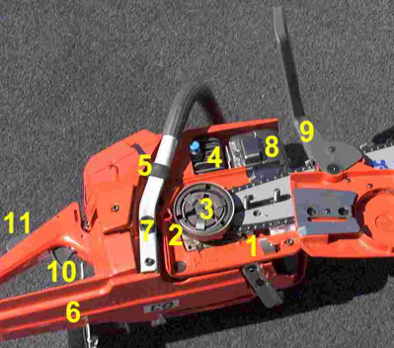
Parts is Parts
1. Chain catcher
2. Flywheel
3. Clutch
4. Decompression valve
5. Anti-vibration
6. Hand guard
7. Anti-vibration
8. Muffler
9. Chain brake
10. Throttle
11. Throttle interlock
Notes:
Notes
______________________________________________________________________________________________________________________________________________________________________________________________________________________________________________________________________________________________________________________________________________________________________________________________________________________________________________________________________________________________________________________________________________________________________________________________________________________________________________________

Slide 17
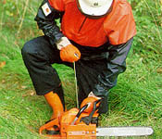
Safe Operation….before starting
Check controls, chain tension, bolts, and handles.
Adjust according to manufacturer’s instructions.
Fuel at least 10 ft. from ignition sources.
Start at least 10 ft. away from fuel.
Start with chain brake on and on the ground or firmly supported.
Fuel containers must be metal or plastic, not exceed 3 gallons, and be approved type. (metal safety cans best)
Notes:
Notes
______________________________________________________________________________________________________________________________________________________________________________________________________________________________________________________________________________________________________________________________________________________________________________________________________________________________________________________________________________________________________________________________________________________________________________________________________________________________________________________

Slide 18
Safe Operation….while running
Keep hands on handles.
Maintain secure footing.
Clear area of things that get in the way of cutting and retreat path.
Do not cut overhead.
Shut off or throttle released prior to retreating.
Shut off or chain brake engaged if terrain is hazardous or going more than50 ft.
Notes:
Notes
______________________________________________________________________________________________________________________________________________________________________________________________________________________________________________________________________________________________________________________________________________________________________________________________________________________________________________________________________________________________________________________________________________________________________________________________________________________________________________________

Slide 19

Avoid Injury as well as be more productive….
The chain saw is one of the most efficient, productive and dangerous portable power tools of any industry !
Proper operation and maintainance will help.
Learn as much as you can.
Follow manufacturer’s instructions !

Slide 20
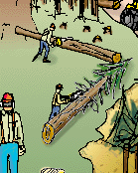
Limbing and Bucking
Learn the parts of your body most likely to be cut.
Learn about the tool and its parts.
Learn how to use a chain saw safely.

Slide 21
Before Limbing look for ….
Overhead hazards
Spring poles
Butt Movement forward (creates back pressure on limbs)
Butt twist (creates sideways pressure on limbs)
Butt off the ground ( creates tension on the tree stem)

Slide 22
Limbing and Bucking Requirements
Limbing and bucking must be done on uphill side of each tree or log.
Precautions, such as chocking or moving log to stable spot if movement or butt could strike the logger.

Slide 23
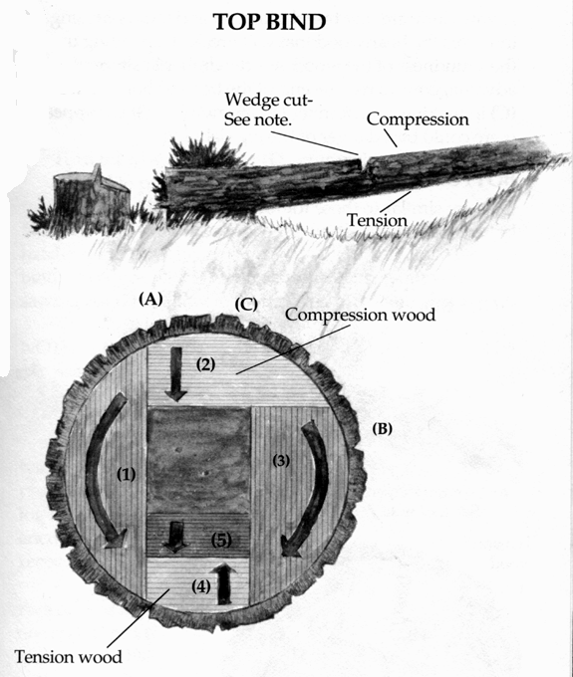
Top Bind
Arrows show saw travel.
Center is heartwood that will break.
May want to bore from point “C” to make cuts 1 & 3, if there is danger of log slabbing.
Note: a wedge section could be removed when sawing cut (2) if the top bind is excessive, to allow the tree to close as cuts (4) and (5) are made.
Notes:
Notes
______________________________________________________________________________________________________________________________________________________________________________________________________________________________________________________________________________________________________________________________________________________________________________________________________________________________________________________________________________________________________________________________________________________________________________________________________________________________________________________

Slide 24
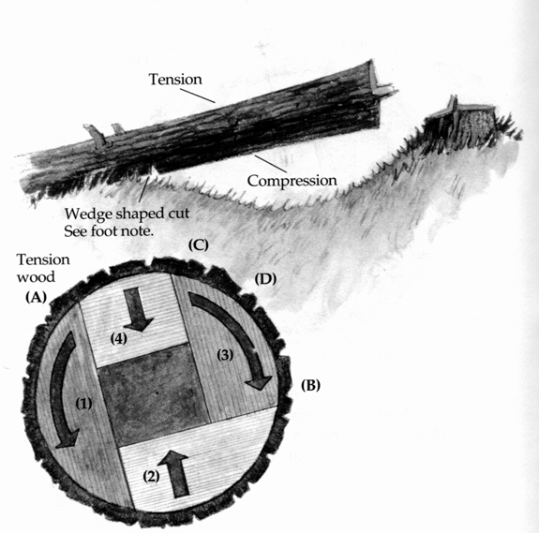
Bottom Bind
Cuts similar to top bind, except top and bottom cuts are reversed.
Notes:
Notes
______________________________________________________________________________________________________________________________________________________________________________________________________________________________________________________________________________________________________________________________________________________________________________________________________________________________________________________________________________________________________________________________________________________________________________________________________________________________________________________

Slide 25
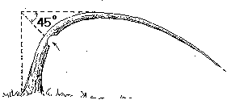
Spring Poles
Safest way to release a spring pole is to shave wood from the underside.
To find best point to shave, determine straight line up from stump.
Find where it meets a horizontal line line over from highest point.
Come down to pole at 45 degrees.
The Shave
Notes:
Notes
______________________________________________________________________________________________________________________________________________________________________________________________________________________________________________________________________________________________________________________________________________________________________________________________________________________________________________________________________________________________________________________________________________________________________________________________________________________________________________________

Slide 26
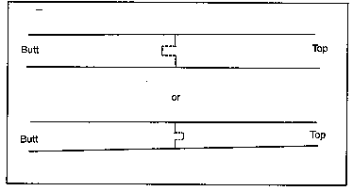
Rolling Trees
Tongue and Grove
If there is danger of tree or part of rolling on logging.
Tongue and grove can be used.
Bore cut stem first.
Then up and down cuts are made so that each of them bypasses the bore cut.
With all fibers cut, the tongue and grove will prevent movement.
Notes:
Notes
______________________________________________________________________________________________________________________________________________________________________________________________________________________________________________________________________________________________________________________________________________________________________________________________________________________________________________________________________________________________________________________________________________________________________________________________________________________________________________________

Slide 27
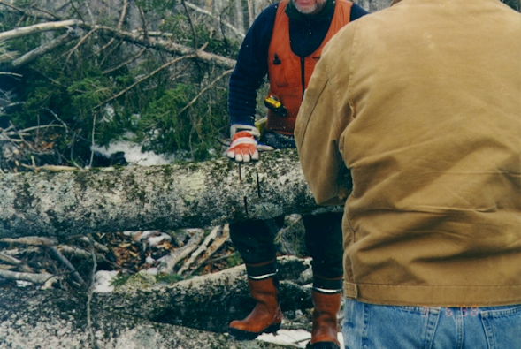
Loggers using Tongue and Grove

Slide 28
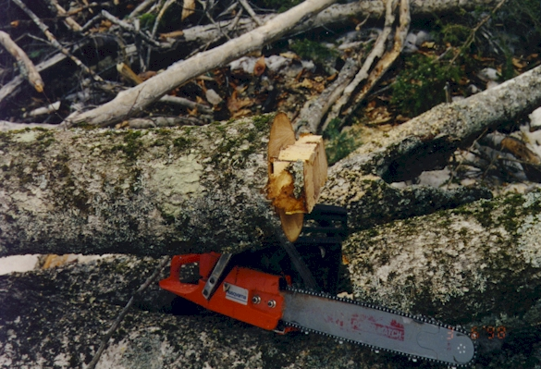
Loggers using Tongue and Grove

Slide 29
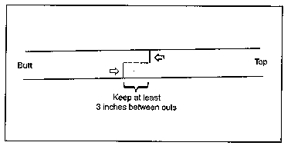
Twisting of trees and butts off ground
The Top Lock
Twisting of trees and butts off the ground create pressure on stem.
Top lock can be used to prevent the top from kicking up.
First cut is made on side of tree in compression.
Second cut on side in tension.
Top cut always made closer to tree top.
Both cuts must by-pass so that all fiber is severed.
Notes:
Notes
______________________________________________________________________________________________________________________________________________________________________________________________________________________________________________________________________________________________________________________________________________________________________________________________________________________________________________________________________________________________________________________________________________________________________________________________________________________________________________________

Slide 30
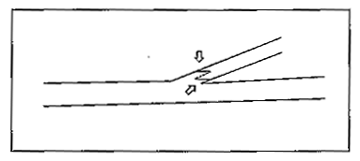
Back and sideways pressure on limbs
The Limb Lock
Limbs with pressure can severely injure a logger when severed.
A good precaution is the Limb Lock.
First cut is made on top side or bottom side of limb.
Best to make first cut side with compression pressure.
Top cut is made closer to the trunk.
Bottom cut further up on limb.
The two cuts must by-pass.
The step prevents limb from kicking back.
Notes:
Notes
______________________________________________________________________________________________________________________________________________________________________________________________________________________________________________________________________________________________________________________________________________________________________________________________________________________________________________________________________________________________________________________________________________________________________________________________________________________________________________________

Slide 31
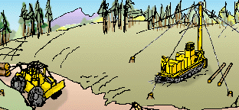
Yarding
Learn the parts of your body most likely to be cut.
Learn about the tool and its parts.
Learn how to use a chain saw safely.

Slide 32
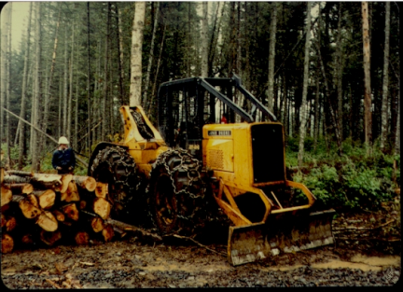
Yarding Hazards
Moving equipment.
Moving and rolling logs.
Cable releases.
Cable related cuts and punctures.
Notes:
Notes
______________________________________________________________________________________________________________________________________________________________________________________________________________________________________________________________________________________________________________________________________________________________________________________________________________________________________________________________________________________________________________________________________________________________________________________________________________________________________________________

Slide 33
Yarding Requirements
Chokers must be hooked and unhooked from uphill side of log end. (unless log is securely chocked)
Each worker must be in the clear, and the yarding machine operator must have clearly received and understood the signal to move the line.
Winching done within stability limits of machine.
Each yarded tree must be placed in a spot that doesn’t cause a hazard.

Slide 34
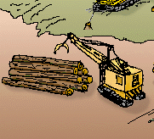
Loading and Transporting
Learn the parts of your body most likely to be cut.
Learn about the tool and its parts.
Learn how to use a chain saw safely.

Slide 35
Loading and Transporting Requirements
Only machine operator and other necessary workers allowed in area.
Log truck drivers out of cab if logs moved over the cab. (unless protected by effective means)
Each tie down left in place over peak log until the unloading lines or stakes are put in place, and tie down is released only from the side on which the unloading machine operates.

Slide 36
Loading and Transporting Requirements (con’t)
The logging truck must be positioned to provide working clearance between truck and the deck.
The load must be positioned to prevent slippage during handling and transport.
The safest load is one whose logs never go above the stanchions !

Slide 37
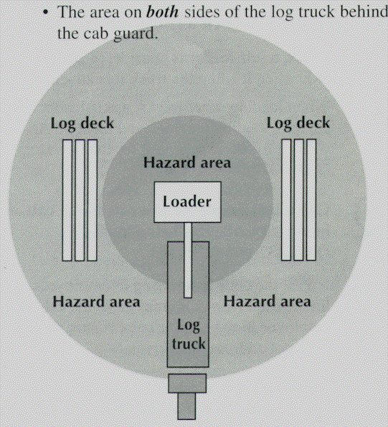
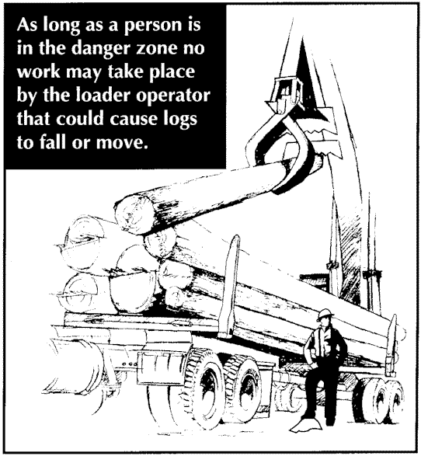
The Danger Zone !

Slide 38
Machines and Vehicles
Learn the parts of your body most likely to be cut.
Learn about the tool and its parts.
Learn how to use a chain saw safely.

Slide 39
General Safety for Machines
Must be maintained, inspected beginning each shift, not used if defect affects operation.
Manufacturer’s instructions in each vehicle and followed by operators and mechanics.
Started and operated by designated employees.
Seats securely fastened and belts used.
Tools being transported secured.

Slide 40
General Safety for Machines (con’t)
Vehicles used to transport employees must meet requirements.
Operators of machines with ROPS, FOPS or overhead guards must wear seat belts.
Must have a fire extinguisher.

Slide 41
Machine Operation
Must be operated so no hazards are created for other workers while maintaining a two tree length safety distance.
Before leaving a machine, operator must secure it by setting parking brake, placing transmission in park, placing each moving part to the ground, and discharging stored energy.

Slide 42
Brake Systems
Each machine must have working primary and secondary brakes.
Brakes must hold machine in all situations.
Must have parking brakes.

Slide 43
Getting In And Out
Each machine or vehicle must have two safe means of getting in and out of.
With climbing and working surfaces that are slip resistant.
Surfaces must be kept free of material that that could causes slipping and falling.

Slide 44
Exhaust Systems
Engine pipes must be muffled.
Pipes must be located to direct exhaust away from the operator.
Mounted or guarded to protect worker burns.
Equipped with spark arresters.

Slide 45
Moving parts and flying debris
Factory guards in place at all times.
Guards must protect worker from moving parts.
Guards must protect the worker from flying debris.

Slide 46
Protective Structures for Operators
Protective structures are cabs, FOPS, and ROPS.
Must meet OSHA standards.
Must be used to protect workers from roll overs and falling objects.
Must provide maximum visibility.
Must be used with seat belt.

Slide 47
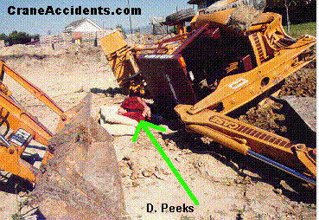
Been There - Done that !

Slide 48

First Aid
Logging operations are often in remote areas far away from emergency care.
Properly given first aid can often save a life.
OSHA requires logging operations to be ready for emergency medical care situations.

Slide 49
First Aid Requirements
All employees, including supervisors, must be certified as trained in first aid and CPR.
First aid kits are required at each work site where trees are being cut, at each active landing, and on each employee transport vehicle.
The number of kits and content must reflect the degree of isolation, the number of employees, and the hazards anticipated.

Slide 50
First Aid Requirements (con’t)
The minimum required contents of a first aid kit are provided by appendix “A” of the OSHA Logging Standard.
Person responding to accidents may be exposed to bloodborne diseases.
Workers should also be aware of first aid for insect bites, stings, tick related diseases, and snake bits.

Slide 51
1910.266 App A - First-aid Kits (Mandatory).
1. Gauze pads (at least 4 x 4 inches).
2. Two large gauze pads (at least 8 x 10 inches).
3. Box adhesive bandages (band-aids).
4. One package gauze roller bandage at least 2 inches wide.
5. Two triangular bandages.
6. Wound cleaning agent such as sealed moistened towelettes.
7. Scissors.
8. At least one blanket.
9. Tweezers.
10. Adhesive tape.
11. Latex gloves.
12. Resuscitation equipment such as resuscitation bag, airway, or pocket mask.
13. Two elastic wraps.
14. Splint.
15. Directions for requesting emergency assistance.

Slide 52
1910.266 App B - First-aid and CPR Training (Mandatory).
At a minimum, first-aid and CPR training shall consist of the following:
1. The definition of first aid.
2. Legal issues of applying first aid (Good Samaritan Laws).
3. Basic anatomy.
4. Patient assessment and first aid for the following:
a. Respiratory arrest.
b. Cardiac arrest.
c. Hemorrhage.
d. Lacerations/abrasions.
e. Amputations.
f. Musculoskeletal injuries.
g. Shock.
h. Eye injuries.
i. Burns.
j. Loss of consciousness.
k. Extreme temperature exposure (hypothermia/hyperthermia)
l. Paralysis
m. Poisoning.
n. Loss of mental functioning (psychosis/hallucinations, etc.).
o. Drug overdose.
5. CPR.
6. Application of dressings and slings.
7. Treatment of strains, sprains, and fractures.
8. Immobilization of injured persons.
9. Handling and transporting injured persons.
10. Treatment of bites, stings, or contact with poisonous plants or animals.

Slide 53
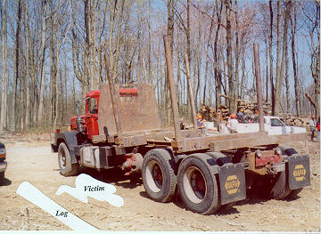
Victim, Environment, and Fatal Energy Source
This photo shows the final relationship between the truck, victim, and fatal energy source.
At the time of the incident, the load extended about one foot above the stakes.

