Slide 1
Housekeepers: Practices to Improve Health & Safety using Ergonomics
Presented by: Institute for Ergonomics The Ohio State University
Columbus, Ohio
Notes:
Dana Root’s comments
Overall, good presentation
Some info is too academic (e.g., injury development slides, disc degeneration); suggests dialing material down a notch.
More best-practices (e.g., stripping off beds, putting on sheets)
Keeping stuff in “power zone”
Don’t carry too much at one time (sheets, wet towels)
Not lifting mattress too much
Space of mattress away from headboard – not as much lifting needed to make bed

Slide 2
Disclaimer: This material was produced under grant number SH-20998-10-60-F-39 from the Occupational Safety and Health Administration, U.S. Department of Labor. It does not necessarily reflect the views or policies of the U.S. Department of Labor, nor does mention of trade names, commercial products, or organizations imply endorsement by the U.S. Government
Hotel Housekeepers:
Practices to Improve Health & Safety using Ergonomics

Slide 3
Topics
Ergonomics and its benefits
The Occupational Safety and Health Administration (OSHA)
Cumulative trauma disorders and how they develop
Injury risk factors among housekeepers
Work methods to ease housekeeping demands
Housekeeper health

Slide 4
Ergonomics

Slide 5

What is Ergonomics?

Slide 6
Ergonomics
The science of designing jobs, equipment, and workplaces to fit the person
Job
Person

Slide 7

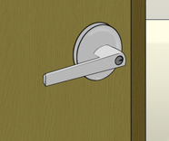
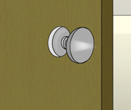

Ergonomics
Examples of ergonomics at home
Opening or Closing Doors
Easy to Turn
Harder to Turn

Slide 8
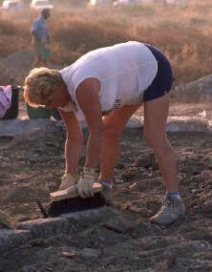

Ergonomics
Examples of ergonomics at home
Gardening
Better Posture
Poor Posture

Slide 9
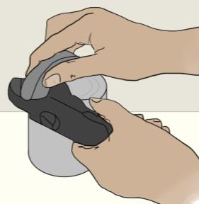
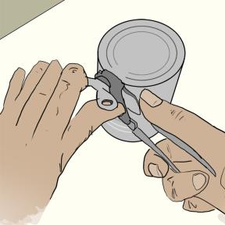
Ergonomics
Examples of ergonomics at home
Opening Food Cans
Easy
Hard

Slide 10
Ergonomics
Purpose of this training
Apply ergonomics to housekeeping work
Job
Person

Slide 11
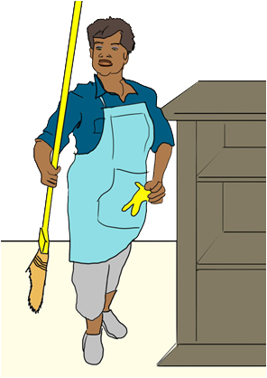
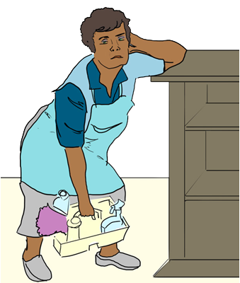
Ergonomics
Benefits
Makes housekeeping work easier

Slide 12
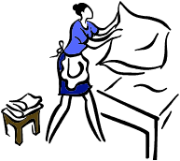
Ergonomics
Benefits
Reduces discomfort or pain
Person

Slide 13


Ergonomics
Benefits
Lowers risk of getting hurt
Healthy
Hurt
Hurt
Healthy

Slide 14
Ergonomics
Benefits
Helps get job done faster

Slide 15


Ergonomics
Benefits
Improves quality of the work

Slide 16
OSHA The Occupational Safety and Health Administration

Slide 17

OSHA
Created by U.S. Congress in 1970
Works to ensure safe and healthful working conditions for working men and women
Sets and enforces standards
Providing training, outreach, education and assistance
Funded this training

Slide 18
OSHA
Under OSHA, workers have the right to:
A safe and healthful workplace
Know about hazardous chemicals
Info about injuries and illnesses in the workplace
Request hazard correction from employer
Training
Hazard exposure information and medical records
File a complaint with OSHA
Participate in an OSHA inspection
Be free from retaliation for exercising safety and health rights

Slide 19
How Injuries Develop in the Body

Slide 20

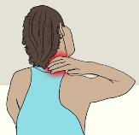

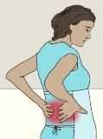
Injuries to the Body
Acute Injuries
Occur after one-time incident
Cumulative Trauma Injuries
Develop over a period of weeks, months, or years
Shoulder and neck pain
Touching a hot surface
Back pain
Tripping and falling
Wrist pain

Slide 21
Injuries Among Housekeepers
Cumulative Trauma Injuries
Comparison among hotel workers

Slide 22

Injuries Among Housekeepers
Cumulative Trauma Injuries
Body parts most affected

Slide 23
Do You Ever Feel Discomfort when Doing Your Job? If Yes, Where?

Slide 24
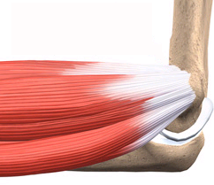
How Cumulative Trauma Injuries Develop
Overexertion
Irritation of muscles and tendons
Bone
Tendons
Muscles
Bone

Slide 25
How Cumulative Trauma Injuries Develop
Comparing Time to Heal Injured Muscles vs. Tendons
For same level of injury to muscles as to tendons

Slide 26
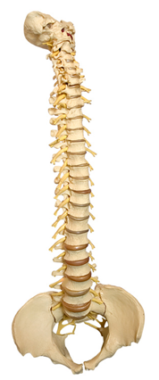
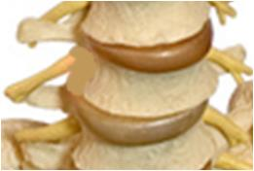
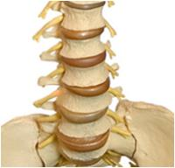
How Cumulative Trauma Injuries Develop – In the Back
Entire Spine
Lumbar Spine
Vertebrae
Bones providing support
Head
Discs
“Shock absorbers” between vertebrae
Hips

Slide 27



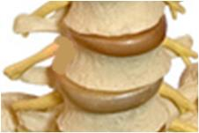

How Cumulative Trauma Injuries Develop – In the Back
Acute Injury
Is felt immediately
Cumulative Back Injury
Not felt at first
Felt only after damage

Slide 28
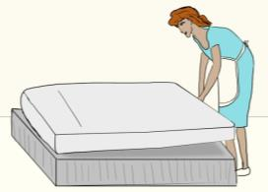
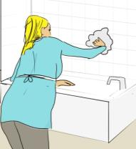
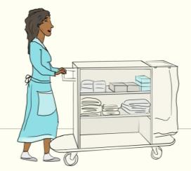
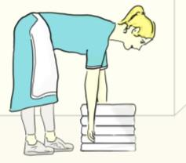
How Cumulative Trauma Injuries Develop – In the Back
Some Work Tasks Can Put a Lot of Pressure on Discs
Twisting (to clean bathtub)
Lifting or Pushing Heavy Objects
Bending at the Waist

Slide 29


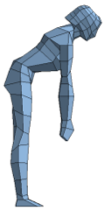
How Cumulative Trauma Injuries Develop – In the Back
Some Work Postures Put More Pressure on Discs
For Females of Average Height
25 lb
25 lb
25 lb

Slide 30
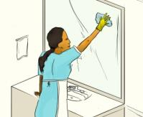
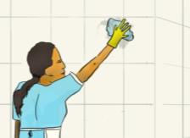
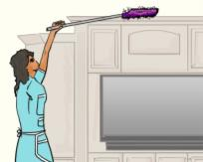
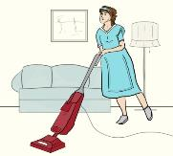
How Cumulative Trauma Injuries Develop – In the Shoulder
Some Work Tasks Can Hurt the Shoulder and Neck
Irritated or swollen tendons
Torn tendons

Slide 31
Injury Risk Factors among Housekeepers

Slide 32

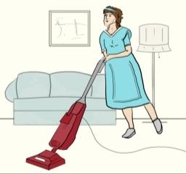
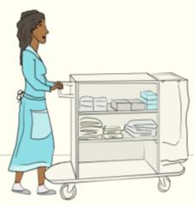
Injury Risk Factors among Housekeepers
Forceful Exertions
Examples
Lifting heavy mattresses
Pushing heavy vacuum cleaners
Moving supply carts

Slide 33
What Other Tasks Require a Lot of Effort?

Slide 34
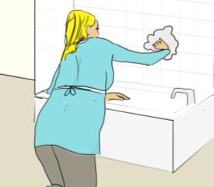
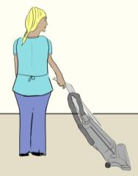
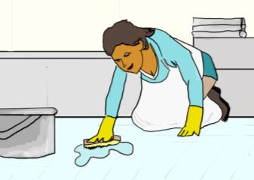
Injury Risk Factors among Housekeepers
Awkward Postures
Examples
Cleaning Bathtubs
Vacuuming
Cleaning Bathroom Floors

Slide 35
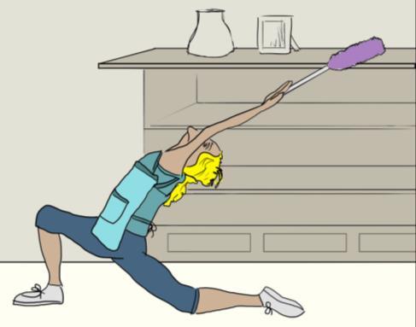
What Other Tasks Require You to Work in Awkward Postures?

Slide 36
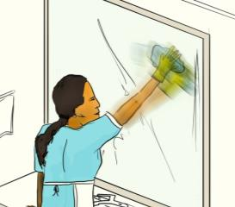
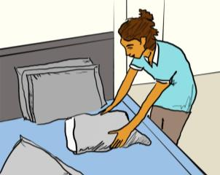
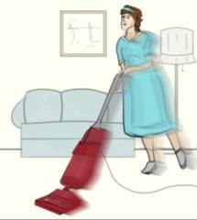
Injury Risk Factors among Housekeepers
Repetitive Activities
Examples
Cleaning mirrors
Putting on pillow cases
Vacuuming carpet

Slide 37
What Other Tasks Require You to Do Similar Tasks Over and Over?

Slide 38
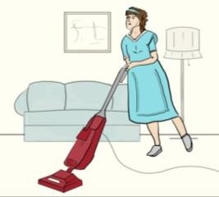
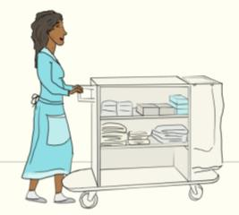
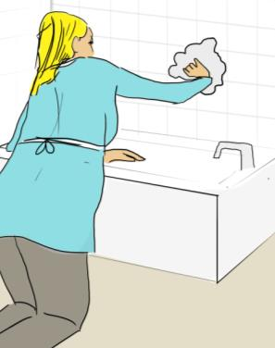
Injury Risk Factors among Housekeepers
Staying in the Same Posture for Long Periods
Examples
Standing
Kneeling

Slide 39
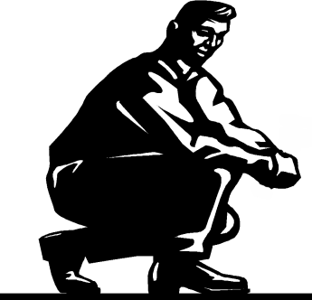
For What Other Tasks Do You Stay in the Same Posture for a Time?

Slide 40
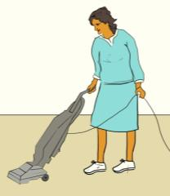

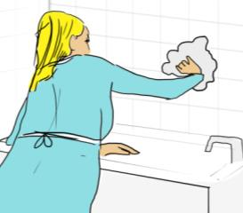
Injury Risk Factors among Housekeepers
Not Resting Your Muscles while Working
Examples
Doing many tasks using the same hand or arm

Slide 41

What Other Tasks Take a Long Time to do Before You Can Rest?

Slide 42
Symptoms of Possible Cumulative Trauma Injury

Slide 43

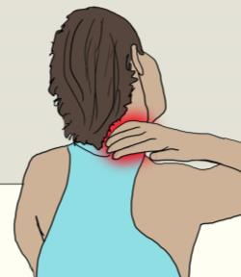
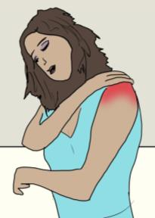
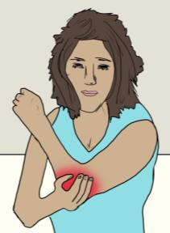
Symptoms of Possible Cumulative Trauma Injury
Nagging Pain or Tenderness that Won’t Go Away
In back
In neck
In shoulders
In elbows

Slide 44
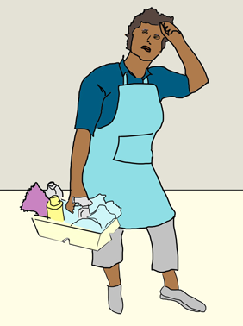
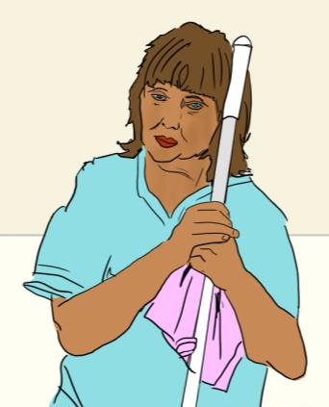
Symptoms of Possible Cumulative Trauma Injury
Muscle Weakness or Fatigue

Slide 45
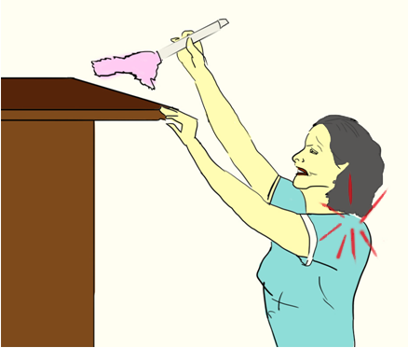
Symptoms of Possible Cumulative Trauma Injury
Joint Stiffness / Reduced Flexibility

Slide 46
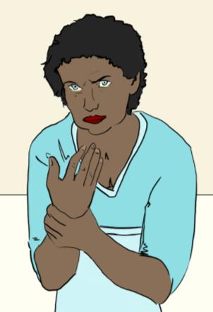
Symptoms of Possible Cumulative Trauma Injury
“Pins & Needles” Feeling or Numbness in Hands

Slide 47
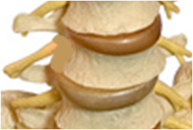
Symptoms of Possible Cumulative Trauma Injury
No Symptoms at All

Slide 48
Making Housekeeping Tasks Easier

Slide 49
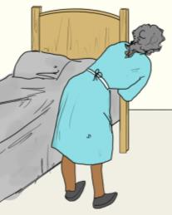
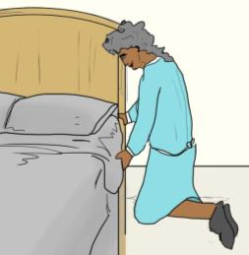

Making Housekeeping Tasks Easier
Making Beds (Lifting Mattress and Tucking in Sheets)
Good or Bad? Why?
Is This any Better? Why or Why Not?
Ideas for Better Methods?
Forward bending
Twisted back
No bending
Closer to bed

Slide 50
Making Housekeeping Tasks Easier
Making Beds (Lifting Mattress and Tucking in Sheets)
Demonstrations, if possible and time allows

Slide 51






Making Housekeeping Tasks Easier
Vacuuming
Regularly empty vacuum bag
Choose proper height setting for carpet conditions
Heavy
Light
Low Med High
Lower force to push vacuum
Less fatigue
Lower force to push vacuum
Less fatigue

Slide 52
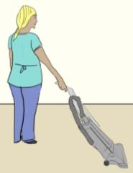


Making Housekeeping Tasks Easier
Vacuuming
Good or Bad? Why?
Line up body with path of vacuum
Ideas for Better Methods?
Stress to shoulder
Twisted back
Less awkward posture of shoulder
Back not twisted

Slide 53


Making Housekeeping Tasks Easier
Vacuuming
Good or Bad? Why?
Alternate vacuuming between the right and left hands
Stress to shoulder
Twisted back
Chance to rest frequently used muscles and body parts

Slide 54
Making Housekeeping Tasks Easier
Vacuuming
Demonstrations, if possible and time allows

Slide 55



Making Housekeeping Tasks Easier
Moving Supply Carts
Store heaviest or most used items between your hips and chest
Push cart using both hands
More body strength at this part of the body
Keeps the body from twisting
Distributes effort across both sides of body

Slide 56

Making Housekeeping Tasks Easier
Moving Supply Carts
Empty trash from cart as often as possible
Replenish supply cart a few times over shift
Heavy
Light
Makes cart easier to push
Less effort to push lighter cart
A good, brief rest break

Slide 57


Making Housekeeping Tasks Easier
Moving Supply Carts
Align cart wheels in the direction of movement
Report cart problems to supervisor
Not aligned
Aligned
Boss
Carts with aligned wheels are easier to push
Repaired carts easier to use

Slide 58
Making Housekeeping Tasks Easier
Moving Supply Carts
Demonstrations, if possible and time allows
Possible Activity: “Design your ideal cart”

Slide 59


Making Housekeeping Tasks Easier
Cleaning Bathrooms
Stand inside tub to clean wall tile (as long as there is no risk of slipping)
Outside of tub
Inside tub
Extended reaching
Stress to shoulder
Less reaching
Less stress on shoulder
Slip-resistant surface, like a dirty towel

Slide 60

Making Housekeeping Tasks Easier
Cleaning Bathrooms
Keep dirty towels off floor as much as possible
On floor
Above floor


Repeated bending to pick up towels
Little or no bending to pick up towels

Slide 61



Making Housekeeping Tasks Easier
Cleaning Bathrooms
Do not carry large or heavy weight; make more trips if possible
One large pile of wet, dirty towels
Two small piles of wet, dirty towels
1.
1.
2.
More stress on back and shoulders
Less stress on back and shoulders

Slide 62


Making Housekeeping Tasks Easier
Cleaning Bathrooms
Do work at waist level as often as possible
On floor
Above floor

Removing trash and replacing liners from floor
Little or no bending to remove trash

Slide 63




Making Housekeeping Tasks Easier
Cleaning Bathrooms
Alternate arms when cleaning surfaces
Demands of task spread to both shoulders
Gives each arm/shoulder time to rest

Slide 64
Making Housekeeping Tasks Easier
Cleaning Bathrooms
Demonstrations, if possible and time allows

Slide 65
Keeping Yourself Healthy and Injury-Free

Slide 66






Keeping Yourself Healthy and Injury-Free
Before Starting Work
Always wear comfortable shoes
Warm up your body
Back
Arms & Shoulders
Gentle bends
Gentle swings

Slide 67




Keeping Yourself Healthy and Injury-Free
At Any Time
Report any unusual aches or pains to your supervisor
Boss
In back
In neck
In shoulders
In elbows

Slide 68



Keeping Yourself Healthy and Injury-Free
At Any Time
Talk to your coworkers and supervisor about ways you’ve found to make job easier
Boss

Slide 69

Keeping Yourself Healthy and Injury-Free
All the Time
Eat a Balanced Diet
Exercise Regularly
Get Plenty of Sleep

Slide 70
Take-Home Messages
Housekeeping Work and Ergonomics
Ergonomics can be used to make your jobs easier
Specific tasks and work practices can put stress on your body
Certain aches and pains may be a sign of cumulative trauma
There are many ways that your jobs can be done differently to reduce the chances you will become hurt
You should also take steps to keep yourself healthy

Slide 71
Questions?
Thank You!

