Slide 1
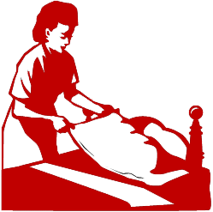
Housekeeper Managers: Improving Housekeeping Work using Ergonomics
Presented by: Institute for Ergonomics The Ohio State University
Columbus, Ohio

Slide 2
Disclaimer: This material was produced under grant number SH-20998-10-60-F-39 from the Occupational Safety and Health Administration, U.S. Department of Labor. It does not necessarily reflect the views or policies of the U.S. Department of Labor, nor does mention of trade names, commercial products, or organizations imply endorsement by the U.S. Government
Hotel Housekeepers:
Practices to Improve Health & Safety using Ergonomics

Slide 3
Topics
Ergonomics and its benefits
The Occupational Safety and Health Administration (OSHA)
Cumulative trauma disorders and how they develop
Injury risk factors among housekeepers
Products to make housekeeping easier
Improving the housekeeping “system”
Work methods to ease housekeeping demands
Housekeeper health

Slide 4
Ergonomics

Slide 5

What is Ergonomics?

Slide 6
Ergonomics
The science of designing jobs, equipment, and workplaces to fit the person
Job
Person

Slide 7

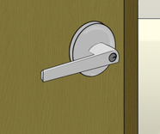
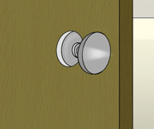

Ergonomics
Ergonomics at home
Opening or Closing Doors
Easy to Turn
Harder to Turn

Slide 8
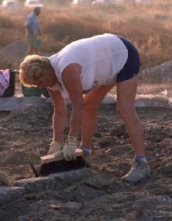

Ergonomics
Ergonomics at home
Gardening
Better Posture
Poor Posture

Slide 9
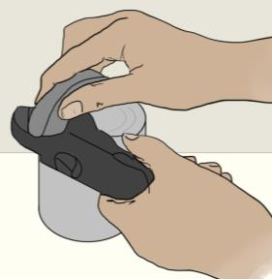
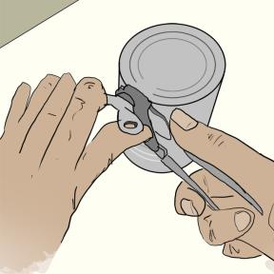
Ergonomics
Ergonomics at home
Opening Food Cans
Easy
Hard

Slide 10
Ergonomics
Purpose of this training
Apply ergonomics to housekeeping work
Job
Person

Slide 11
Ergonomics
Benefits
Improves efficiency of housekeeping work

Slide 12


Ergonomics
Benefits
Increases work quality

Slide 13
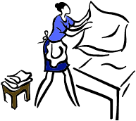
Ergonomics
Benefits
Reduces discomfort or pain in housekeepers
Person

Slide 14


Ergonomics
Benefits
Lowers housekeeper injury risk
Healthy
Hurt
Hurt
Healthy

Slide 15
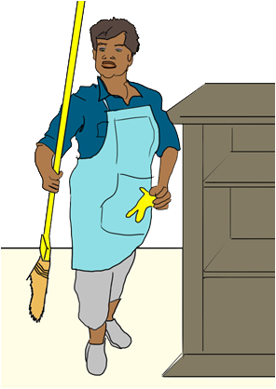
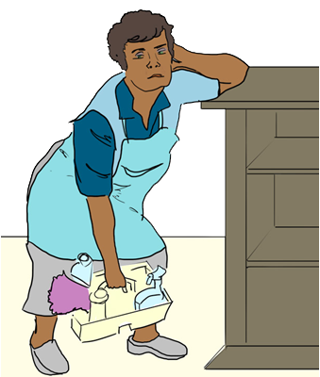
Ergonomics
Benefits
Allows housekeepers to work more easily

Slide 16
OSHA The Occupational Safety and Health Administration

Slide 17

OSHA
Created by U.S. Congress in 1970
Works to ensure safe and healthful working conditions for working men and women
Sets and enforces standards
Providing training, outreach, education and assistance
Funded this training

Slide 18
OSHA
Under OSHA, workers have the right to:
A safe and healthful workplace
Know about hazardous chemicals
Info about injuries and illnesses in the workplace
Request hazard correction from employer
Training
Hazard exposure and medical records
File a complaint with OSHA
Participate in an OSHA inspection
Be free from retaliation for exercising safety and health rights

Slide 19
How Injuries Develop in the Body

Slide 20

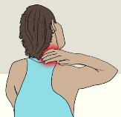

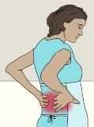
Injuries to the Body
Acute Injuries
Occur after one-time incident
Cumulative Trauma Injuries
Develop over a period of weeks, months, or years
Shoulder and neck pain
Touching a hot surface
Back pain
Tripping and falling
Wrist pain

Slide 21
Injuries Among Housekeepers
Cumulative Trauma Injuries
Comparison among hotel workers

Slide 22

Injuries Among Housekeepers
Cumulative Trauma Injuries
Body parts most affected

Slide 23
Do Your Housekeepers Report Discomfort from their Jobs? If Yes, in What Body Parts?

Slide 24
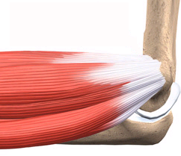
How Cumulative Trauma Injuries Develop
Overexertion
Irritation of muscles and tendons
Bone
Tendons
Muscles
Bone

Slide 25
How Cumulative Trauma Injuries Develop
Comparing Time to Heal Injured Muscles vs. Tendons
For same level of injury to muscles as to tendons

Slide 26
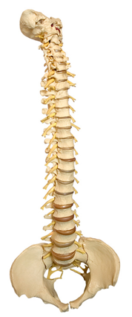
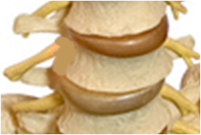
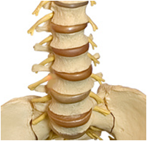
How Cumulative Trauma Injuries Develop – In the Back
Entire Spine
Lumbar Spine
Vertebrae
Bones providing support
Head
Discs
“Shock absorbers” between vertebrae
Hips

Slide 27




How Cumulative Trauma Injuries Develop – In the Back
Acute Injury
Is felt immediately
Cumulative Back Injury
Not felt at first
Felt only after damage

Slide 28
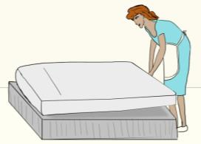
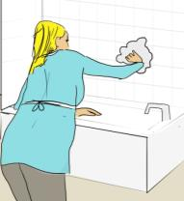
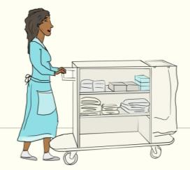
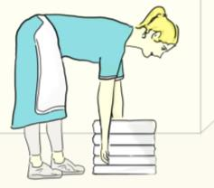
How Cumulative Trauma Injuries Develop – In the Back
Some Work Tasks Can Put a Lot of Pressure on Discs
Twisting (e.g., to clean bathtub)
Lifting or Pushing Heavy Objects
Bending at the Waist

Slide 29


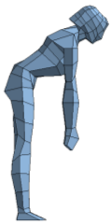
How Cumulative Trauma Injuries Develop – In the Back
Some Work Postures Put More Pressure on Discs
For Females of Average Height
25 lb
25 lb
25 lb

Slide 30
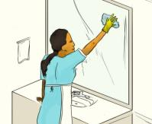
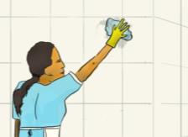
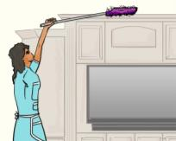
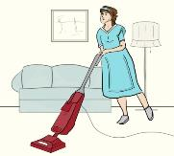
How Cumulative Trauma Injuries Develop – In the Shoulder
Some Work Tasks Can Hurt the Shoulder and Neck
Irritated or swollen tendons
Torn tendons

Slide 31
Injury Risk Factors among Housekeepers

Slide 32

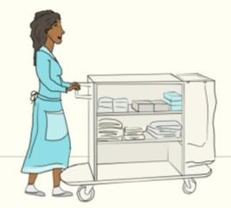
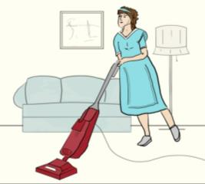
Injury Risk Factors among Housekeepers
Forceful Exertions
Examples
Lifting heavy mattresses
Pushing heavy supply carts
Pushing heavy vacuum cleaners

Slide 33
What Other Tasks Require House-keepers to Exert a Lot of Effort?

Slide 34
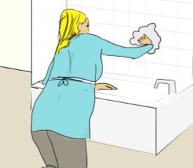
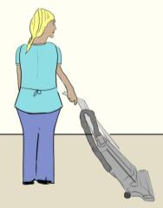
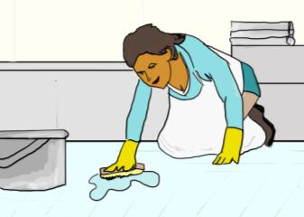
Injury Risk Factors among Housekeepers
Awkward Postures
Examples
Cleaning Bathtubs
Vacuuming
Cleaning Bathroom Floors

Slide 35
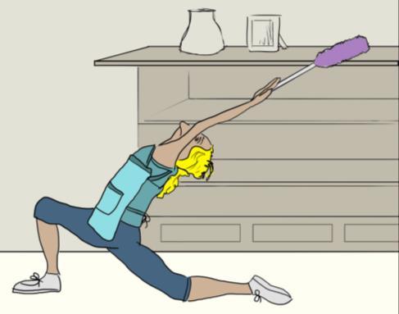
What Other Tasks Require House-keepers to Work in Awkward Postures?

Slide 36
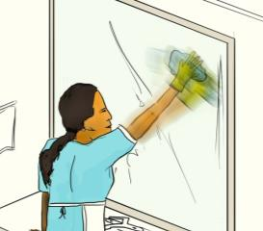
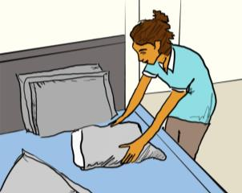
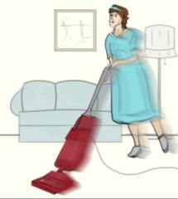
Injury Risk Factors among Housekeepers
Repetitive Activities
Examples
Cleaning mirrors
Putting on pillow cases
Vacuuming carpet

Slide 37
What Other Tasks Require House-keepers to Perform Repetitive Tasks?

Slide 38

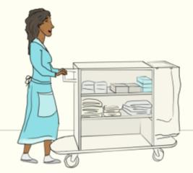
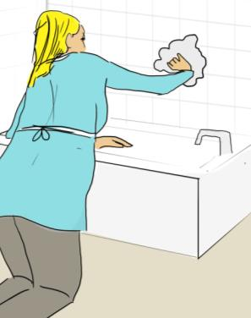
Injury Risk Factors among Housekeepers
Staying in the Same Posture for Long Periods
Examples
Standing
Kneeling

Slide 39
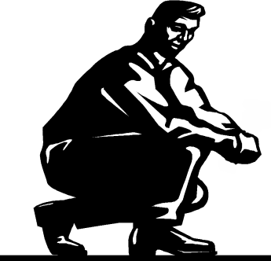
What Other Tasks Require House-keepers to do Work in One Posture for a Period of Time?

Slide 40
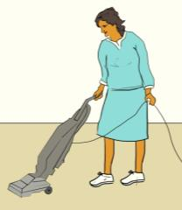

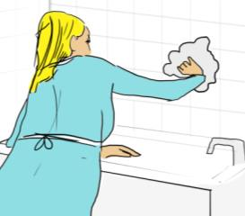
Injury Risk Factors among Housekeepers
Not Allowing Muscles to Rest while Working
Examples
Doing many tasks using the same hand or arm

Slide 41

What Other Tasks Take a Long Time for Housekeepers to Do Before They Can Rest?

Slide 42
Symptoms of Possible Cumulative Trauma Injury

Slide 43

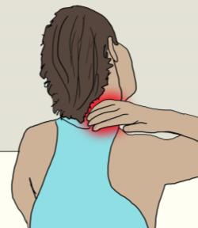
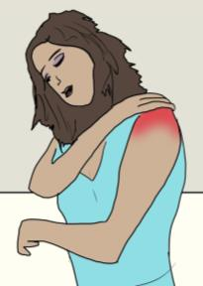
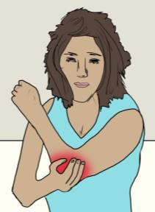
Symptoms of Possible Cumulative Trauma Injury
Chronic, Nagging Pain or Tenderness
In back
In neck
In shoulders
In elbows

Slide 44
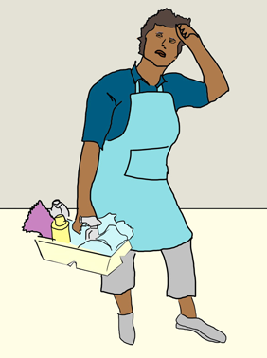
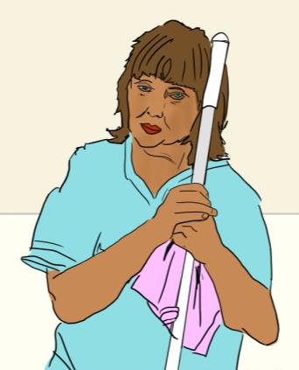
Symptoms of Possible Cumulative Trauma Injury
Muscle Weakness or Fatigue

Slide 45
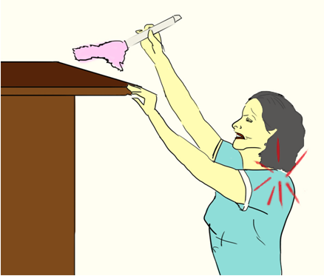
Symptoms of Possible Cumulative Trauma Injury
Joint Stiffness / Reduced Flexibility

Slide 46
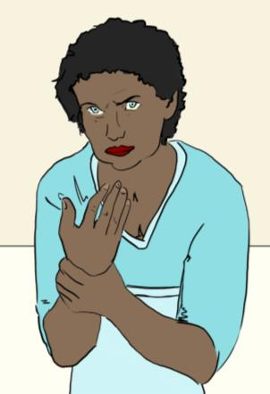
Symptoms of Possible Cumulative Trauma Injury
“Pins & Needles” Feeling or Numbness in Hands

Slide 47
Symptoms of Possible Cumulative Trauma Injury
No Symptoms at All

Slide 48
Products to Make Housekeeping Work Easier

Slide 49

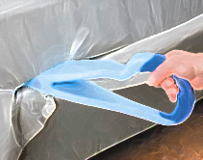
Products and Systems to Make Housekeeping Work Easier
Making Beds
Consider using fitted sheets instead of flat sheets
Have staff try using bed-making assistive devices
Less time to make beds
Reduces straightening & re-tucking
Reduces need to raise mattress
Provides another bed-making option
Note: Products identified here do not indicate an endorsement by Ohio State or by OSHA

Slide 50

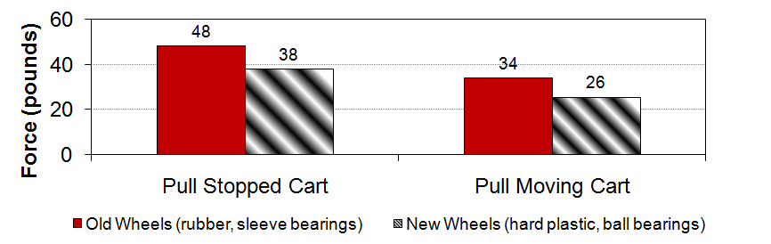

Products and Systems to Make Housekeeping Work Easier
Pushing Supply Carts and Vacuum Cleaners
Implement an equipment maintenance program
If necessary, modify carts to have larger, harder wheels
Reduces effort to move carts
Demonstrates care for employees
Requires less force to push
Can reduce overall daily fatigue
Note: Products identified here do not indicate an endorsement by Ohio State or by OSHA

Slide 51

Products and Systems to Make Housekeeping Work Easier
Pushing Supply Carts
Consider using motorized carts
Reduces physical demands
Can increase productivity
Note: Products identified here do not indicate an endorsement by Ohio State or by OSHA

Slide 52
Products and Systems to Make Housekeeping Work Easier
Vacuuming – Weight
Purchase light-weight vacuums
Consider self-propelled vacuums or those with brush-assisted movement
~8 lbs
Vacuum weight range
15+ lbs
Less effort to move and lift
Reduced stress on shoulders, back
Less force needed when vacuuming
Reduced fatigue across shift
Note: Products identified here do not indicate an endorsement by Ohio State or by OSHA

Slide 53


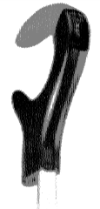


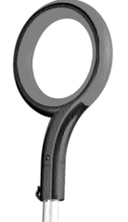

Products and Systems to Make Housekeeping Work Easier
Vacuuming – Handle Design
Look for vacuums with “ergonomic” handles
High grip force to prevent slipping
Constant grip needed to vacuum
Less grip force needed
Design allows for hand to rest
Note: Products identified here do not indicate an endorsement by Ohio State or by OSHA

Slide 54
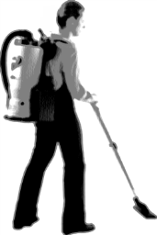
Products and Systems to Make Housekeeping Work Easier
Vacuuming –Alternative Methods
Consider replacing uprights with canister vacuums
Consider replacing uprights with backpack vacuums
Easier to push/pull lightweight wand
Flexible hose is easier to maneuver
Retractable cord reduces cord handling
Faster vacuuming time
Only the wand and hose need to be moved
Can easily change between forward-backward and side-to-side movements
Note: Products identified here do not indicate an endorsement by Ohio State or by OSHA

Slide 55


Products and Systems to Make Housekeeping Work Easier
Cleaning Bathrooms – Toilets
Use toilet brushes with long handles
Forward bending or kneeling required to clean toilet
Toilet can be cleaned in an upright posture
Less exposure to backsplash
Note: Products identified here do not indicate an endorsement by Ohio State or by OSHA

Slide 56




Products and Systems to Make Housekeeping Work Easier
Cleaning Bathrooms – Bathtubs and Showers
Use scrub brushes with long handles
Using rags / sponges / brushes with short handles requires more reaching & bending
Brushes with telescoping handles reduce reaching & bending; save time
Note: Products identified here do not indicate an endorsement by Ohio State or by OSHA

Slide 57








Products and Systems to Make Housekeeping Work Easier
Cleaning Bathrooms – Multiple Areas
Provide tool handles that are comfortable and improve gripping
Smooth or small-diameter handles are hard to hold, more so with wet hands
Larger handles fit better in the hand
Textured surface resists slippage
Note: Products identified here do not indicate an endorsement by Ohio State or by OSHA

Slide 58





Products and Systems to Make Housekeeping Work Easier
Dusting
Replace mops and lambs-wool / feather dusters with microfiber products
Picks up less dust
Tends to push dirt around
Removes significantly more particles
Tasks can be done faster
Note: Products identified here do not indicate an endorsement by Ohio State or by OSHA

Slide 59
Ergonomics in Housekeeping: Consider the Entire “System”

Slide 60





Room Features that Make Housekeeping Work Harder
Examples
Oversized mirrors
Porous surfaces
Crowded Rooms
Dark furniture
Lots of Furniture
Nightstands
Hard to reach entire surface
Pick up stains more easily
Difficult to vacuum around
Difficult to make beds
Shows dust more easily

Slide 61






Room Design Features – Consider during Selection and Renovation
Examples – Which area would be easier to clean?
Toilet
Shower
Under Nightstand
Floor-Mount
Wall-Mount
With Tub
Without Tub
On Floor
Wall-Mount

Slide 62
Ergonomics in Housekeeping: Consider the Entire “System”
The Housekeeping “System”
Goal
Safe and Efficient Work

Slide 63
Ergonomics in Housekeeping: Consider the Entire “System”
The Housekeeping “System” – Components
Work Environment
Examples
Number of beds in room
High-end or budget hotel
Goal
Safe and Efficient Work

Slide 64
Ergonomics in Housekeeping: Consider the Entire “System”
The Housekeeping “System” – Components
Work Environment
Goal
Safe and Efficient Work
Tools & Equipment
Examples
Style & condition of vacuum
Length of brush handles

Slide 65
Ergonomics in Housekeeping: Consider the Entire “System”
The Housekeeping “System” – Components
Work Environment
Goal
Safe and Efficient Work
Tools & Equipment
Examples
Size and physical condition
Attitude towards job
Employees

Slide 66
Ergonomics in Housekeeping: Consider the Entire “System”
The Housekeeping “System” – Components
Work Environment
Examples
Cleaning walk-in shower vs. tub
Method of mopping floor
Goal
Safe and Efficient Work
Job Tasks
Tools & Equipment
Employees

Slide 67
Ergonomics in Housekeeping: Consider the Entire “System”
The Housekeeping “System” – Interactions
Work Environment
Example
The vacuum used easily in one room type may be difficult to use in another
Example
Amount of cleaning required impacts speed of work
Goal
Safe and Efficient Work
Job Tasks
Tools & Equipment
Example
Employee input on equipment purchases influences its likelihood of use
Example
A housekeeper may be better at some cleaning tasks than others
Employees

Slide 68
Ergonomics in Housekeeping: Consider the Entire “System”
The Housekeeping “System” – Interactions
Work Environment
Goal
Safe and Efficient Work
Job Tasks
Tools & Equipment
Example
Employee input on equipment purchases influences its likelihood of use
Employees

Slide 69
Ergonomics in Housekeeping: Consider the Entire “System”
The Housekeeping “System” – Interactions
Work Environment
Goal
Safe and Efficient Work
Job Tasks
Tools & Equipment
Example
A housekeeper may be better at some cleaning tasks than others
Employees

Slide 70
Ergonomics in Housekeeping: Consider the Entire “System”
The Housekeeping “System” – Interactions
Example
Amount of cleaning required impacts speed of work
Work Environment
Goal
Safe and Efficient Work
Job Tasks
Tools & Equipment
Employees

Slide 71
Ergonomics in Housekeeping: Consider the Entire “System”
The Housekeeping “System” – Interactions
Work Environment
Example
A housekeeper may prefer working in a particular room set-up
Goal
Safe and Efficient Work
Job Tasks
Tools & Equipment
Example
Type of brushes used impacts work postures
Employees

Slide 72
Ergonomics in Housekeeping: Consider the Entire “System”
Keys to a Successful System
Management must:
Be committed to improvements in the system
Communicate this commitment
Provide resources
Supervisors must:
Empower employees to take part in identifying problems (e.g., difficult tasks, worn equipment) and finding solutions
Be proactive in seeking positive changes
Employees must:
Have basic understanding of injury risks and symptoms
Take responsibility for their own health and safety

Slide 73


Ergonomics in Housekeeping: Consider the Entire “System”
Consider a “Team Cleaning” Style Approach
(individuals working together to do job)
Benefits to Housekeepers
Reduces amount of isolated work
Improves employees’ occupational skills
Improves employees’ communication skills
Empowers workers
Helps to build a social support network at work
Increases morale

Slide 74
Ergonomics in Housekeeping: Consider the Entire “System”
Consider a “Team Cleaning” Style Approach
(individuals working together to do job)
Benefits to Company and Management
Helps to retain employees
Reduces equipment costs
Has been shown to:
Increase work quality
Improve productivity (e.g., a two-person team can make beds more quickly) and cut labor costs
Reduce a supervisor’s quality-check time
Reduce an employee’s temptation to steal

Slide 75
Ergonomics in Housekeeping: Consider the Entire “System”
Consider a “Team Cleaning” Style Approach
(individuals working together to do job)
Challenges
Management may be resistance to change
Implementation:
Can be time-consuming
Involves some trial-and-error
Incorrectly paired teams may create problems
Stay-over guests may not want more than one housekeeper in their rooms

Slide 76
Making Housekeeping Tasks Easier

Slide 77



Making Housekeeping Tasks Easier
Making Beds (Lifting Mattress and Tucking in Sheets)
Good or Bad? Why?
Is This any Better? Why or Why Not?
Ideas for Better Methods?
Forward bending
Twisted back
No bending
Closer to bed

Slide 78
Making Housekeeping Tasks Easier
Making Beds (Lifting Mattress and Tucking in Sheets)
Demonstrations, if possible and time allows

Slide 79




Making Housekeeping Tasks Easier
Vacuuming
Regularly empty vacuum bag
Choose proper height setting for carpet conditions
Heavy
Light
Low Med High
Lower force to push vacuum
Less fatigue
Lower force to push vacuum
Less fatigue

Slide 80



Making Housekeeping Tasks Easier
Vacuuming
Good or Bad? Why?
Line up body with path of vacuum
Ideas for Better Methods?
Stress to shoulder
Twisted back
Less awkward posture of shoulder
Back not twisted

Slide 81


Making Housekeeping Tasks Easier
Vacuuming
Good or Bad? Why?
Alternate vacuuming between the right and left hands
Stress to shoulder
Twisted back
Chance to rest frequently used muscles and body parts

Slide 82
Making Housekeeping Tasks Easier
Vacuuming
Demonstrations, if possible and time allows

Slide 83



Making Housekeeping Tasks Easier
Moving Supply Carts
Store heaviest or most used items between your hips and chest
Push cart using both hands
More body strength at this part of the body
Keeps the body from twisting
Distributes effort across both sides of body

Slide 84

Making Housekeeping Tasks Easier
Moving Supply Carts
Empty trash from cart as often as possible
Replenish supply cart a few times over shift
Heavy
Light
Makes cart easier to push
Less effort to push lighter cart
A good, brief rest break

Slide 85

Making Housekeeping Tasks Easier
Moving Supply Carts
Align cart wheels in the direction of movement
Report cart problems to supervisor
Not aligned
Aligned
Boss
Carts with aligned wheels are easier to push
Repaired carts easier to use

Slide 86
Making Housekeeping Tasks Easier
Moving Supply Carts
Demonstrations, if possible and time allows
Possible Activity: “Design your ideal cart”

Slide 87


Making Housekeeping Tasks Easier
Cleaning Bathrooms
Stand inside tub to clean wall tile (as long as there is no risk of slipping)
Outside of tub
Inside tub
Extended reaching
Stress to shoulder
Less reaching
Less stress on shoulder
Slip-resistant surface, like a dirty towel

Slide 88

Making Housekeeping Tasks Easier
Cleaning Bathrooms
Keep dirty towels off floor as much as possible
On floor
Above floor


Repeated bending to pick up towels
Little or no bending to pick up towels

Slide 89



Making Housekeeping Tasks Easier
Cleaning Bathrooms
Do not carry large or heavy weight; make more trips if possible
One large pile of wet, dirty towels
Two small piles of wet, dirty towels
1.
1.
2.
More stress on back and shoulders
Less stress on back and shoulders

Slide 90


Making Housekeeping Tasks Easier
Cleaning Bathrooms
Do work at waist level as often as possible
On floor
Above floor

Removing trash and replacing liners from floor
Little or no bending to remove trash

Slide 91




Making Housekeeping Tasks Easier
Cleaning Bathrooms
Alternate arms when cleaning surfaces
Demands of task spread to both shoulders
Gives each arm/shoulder time to rest

Slide 92
Making Housekeeping Tasks Easier
Cleaning Bathrooms
Demonstrations, if possible and time allows

Slide 93
Keeping Housekeepers Healthy and Injury-Free

Slide 94






Keeping Housekeepers Healthy and Injury-Free
Before Starting Work
Encourage housekeepers to wear comfortable shoes
Have housekeepers warm up their bodies
Back
Arms & Shoulders
Gentle bends
Gentle swings

Slide 95




Keeping Housekeepers Healthy and Injury-Free
At Any Time
Encourage housekeepers to report any unusual aches or pains
Boss
In back
In neck
In shoulders
In elbows

Slide 96



Keeping Housekeepers Healthy and Injury-Free
At Any Time
Encourage housekeepers to communicate ways they have found to make the job easier
Boss

Slide 97

Keeping Housekeepers Healthy and Injury-Free
All the Time
Encourage:
Balanced Diets
Regular Exercise
Getting Plenty of Sleep

Slide 98
Take-Home Messages
Housekeeping Work and Ergonomics
Using ergonomics principles, housekeepers can work more efficiently and produce higher quality
Certain housekeeping tasks and work practices are more likely to cause pain, discomfort, and injury
Supervisors should ask about housekeepers’ aches and pains, which indicate cumulative trauma
Injuries among housekeepers can be reduced by:
Using equipment that reduces stress on one’s body
Considering how the cleaning “system” can be improved
Modifying work practices

Slide 99
Questions?
Thank You!

