Slide 1

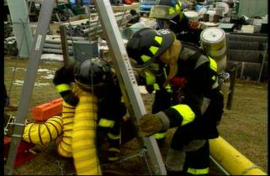
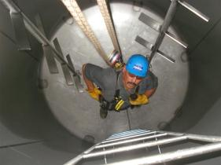
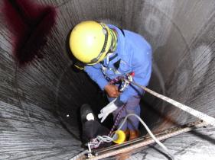
Confined Space Entry
Entrant / Attendant / Supervisor Training
Updated: 03/15/12

Slide 2
Disclaimer
“This material was produced under Grant
SH-21000-10-60-F-29 from the Occupational Safety and Health Administration, U.S. Department of Labor. It does not necessarily reflect the views or policies of the U.S. Department of Labor, nor does mention of trade names, commercial products, or organizations imply endorsement by the U.S. Government.”

Slide 3
Course Objectives
As a result of this training Participants will be able to:
Know what a confined space is.
Identify and understand Permit-Required Confined Spaces.
Identify and understand non-Permit Confined Spaces.
Understand the hazards associated with Confined Spaces.
Understand the roles associated with confined space entry.
Have an awareness understanding of emergency rescue.
Have an awareness understanding of the types of PPE that may be required for entry into confined spaces.

Slide 4
Course Objectives
As a result of this training Participants will be able to:
Understand the roles and responsibilities of:
Attendant
Entrant
Supervisor
Understand the process for testing the Atmosphere in a confined space.
How to isolate, ventilate and evaluate the space in preparation for entry.
Understand the 3 types of rescue techniques.

Slide 5
You have the right to a safe workplace
You have the right to a safe workplace. The Occupational Safety and Health Act of 1970 (OSH Act) was passed to prevent workers from being killed or seriously harmed at work.
The law requires that employers provide their employees with working conditions that are free of known dangers. The Act created the Occupational Safety and Health Administration (OSHA), which sets and enforces protective workplace safety and health standards. OSHA also provides information, training and assistance to workers and employers.
Workers may file a complaint to have OSHA inspect their workplace if they believe that their employer is not following OSHA standards or there are serious hazards.

Slide 6
Workers' rights under the OSH Act
Workers are entitled to working conditions that do not pose a risk of serious harm. To help assure a safe and healthful workplace, OSHA also provides workers with the right to:
Receive information and training about hazards, methods to prevent harm, and the OSHA standards that apply to their workplace. The training must be in a language you can understand;
Observe testing that is done to find hazards in the workplace and get test results;
Review records of work-related injuries and illnesses;
Get copies of their medical records;
Request OSHA to inspect their workplace; and
Use their rights under the law free from retaliation and discrimination.
http://www.osha.gov/workers.html

Slide 7
Confined Spaces
OSHA estimates that about 224,000 establishments have permit spaces; 7.2 million production workers are employed at these establishments and about 2.1 million workers enter permit spaces annually.
OSHA anticipates that compliance with these regulations will avoid 53 worker deaths and injuries, 4,900 lost workday cases and 5,700 non-lost time accident annually.

Slide 8
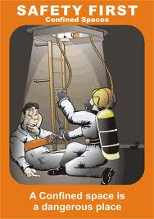
Are Confined Spaces Dangerous?
According to NIOSH Publications on Confined Spaces regarding Worker Deaths in Confined Spaces (NIOSH Publication No. 94-103- January 1994)
This publication provides a summary of surveillance findings in which 70 investigative case reports from 70 incidents in which 109 workers died. These incidents and investigations occurred between December 1983 and September 1993.
http://www.cdc.gov/niosh/topics/confinedspace/#nioshpubs

Slide 9
Are Confined Spaces Dangerous?
A NIOSH publication provides a summary of [NIOSH] surveillance findings and the full text of investigative case reports from 423 incidents in which 480 workers died. These incidents and investigations occurred between December 1983 and September 1993.“ Source: NIOSH (National Institute for Occupational Safety and Health). The following hazards were noted in the statistics
Atmospheric Hazards - Flammable/Explosive
Atmospheric Hazards - Inert Gases and Simple Asphyxiants
Atmospheric Hazards - Oxygen Deficient Air - Part 1
Atmospheric Hazards - Oxygen Deficient Air - Part 2
Atmospheric Hazards – Solvents
Atmospheric Hazards - Toxic Gases - Part 1
Atmospheric Hazards - Toxic Gases - Part 2
Physical Hazards – Engulfment
Physical Hazards – Falls
Physical Hazards – Electrocution Physical Hazards - Drowning

Slide 10
Are Confined Spaces Dangerous?
According to a report from the Canadian Centre for Occupational Health and Safety (www.ccohs.ca):
Many workers are injured and killed each year while working in confined spaces. An estimated 60% of the fatalities have been among the would-be rescuers.

Slide 11

Confined Spaces are Dangerous
Confined spaces are dangerous because:
They may contain hazards in the air
Can trap you inside the space
Can contain slip and fall hazards
Can contain hazards that you might be unable to see

Slide 12
1910.146(g) Training
The employer shall provide training so that all employees whose work is regulated by this section acquire the understanding, knowledge, and skills necessary for the safe performance of the duties assigned under this section.
Training shall be provided to each affected employee:
Before the employee is first assigned duties under this section;
Before there is a change in assigned duties;
Whenever there is a change in permit space operations that presents a hazard about which an employee has not previously been trained;
Whenever the employer has reason to believe either that there are deviations from the permit space entry procedures required by paragraph (d)(3) of this section or that there are inadequacies in the employee's knowledge or use of these procedures.

Slide 13
What is a Confined Space?
A Space that is …..
Is large enough, and so configured that, an employee can enter bodily and perform work;
Has limited or restricted means of entry or exit; and
Is not designed for continuous human occupancy.
Remember: If you break the plane of a confined space, you have entered the confined space!

Slide 14
Permit Required Confined Space
A Permit-Required Confined Space is confined space that has one or more of the following characteristics:
Contains or has the potential to contain a hazardous atmosphere;
Contains a material that has the potential for engulfing an entrant;
Has an internal configuration such that an entrant could become trapped or asphyxiated; or
Contains any other serious safety or health hazard.
Examples of Permit Required Confined Spaces:
Manholes going into sewers
Grain Silos
Trenches

Slide 15
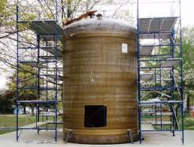
Non-Permit Confined Space
A confined space that does not contain or have the potential to contain any hazard capable of causing death of serious physical harm.
Examples of a Non-Permit Required Confined Space:
Drop ceiling
Motor control cabinets

Slide 16
Examples of Confined Spaces
Vaults
Pipes
Trenches
Tunnels
Ducts
Bins
Pits
Tanks
Manholes
Boilers
Furnaces
Sewers
Silos
Hoppers

Slide 17
Potential Hazards in Confined Spaces
Asphyxiating - Oxygen Deficiency
<19.5% or >23.5% oxygen concentration
CO2
CO₂ is toxic in higher concentrations:
1% (10,000 ppm) will make some people feel drowsy.
Concentrations of 7% to 10% cause dizziness, headache, visual and hearing dysfunction, and unconsciousness within a few minutes to an hour.
Toxic Materials
Carbon Monoxide
Hydrogen Sulphide
Welding fumes
Corrosives
Mechanical Hazards
Mixers
Crushers
Engulfment
Soil around an excavation
Grain in a silo
Powdered material in a bin

Slide 18
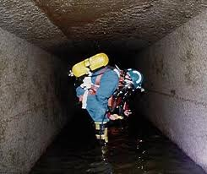
Potential Hazards in Confined Spaces
Electricity
Flammable -Combustibles
Methane
Hydrogen
Acetylene
Propane
Gasoline fumes

Slide 19
Oxygen Deficiency
Oxygen could be removed from the air in a confined space by:
Material in the space could displace the oxygen
Rusting could create a chemical reaction that uses up the oxygen
The space could be purged with a gas to prevent explosions.

Slide 20
Entry
The act by which a person intentionally passes through an opening into a confined space.
Any part of the body passing through the opening is considered entry.

Slide 21
IDLH – Immediately Dangerous to Life or Health
Any condition which poses an immediate threat to the health or life on an entrant, or;
Would cause irreversible adverse health effects, or;
Would interfere with an individual’s ability to escape unaided from a permit space.

Slide 22

Entrant
The employee who will physically enter the confined space to perform the work.

Slide 23
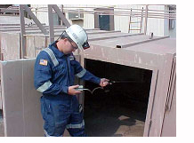
Attendant
The employee who remains outside the confined space and;
monitors the entrant(s)
guards the space against unauthorized entry
warns the entrants of any unusual conditions
and summons the rescue personnel if needed.

Slide 24
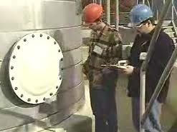
Entry Supervisor
The employee responsible for coordinating the entry into the confined space.
The “Supervisor” does not necessarily mean “management”. The supervisor can refer to anyone acting as the supervisor for the entry, whether Hourly or Management depending on company specific terminology.

Slide 25
Two Options for Entering Confined Spaces
Permit-required confined space entry
For hazardous or potentially hazardous confined space work
Non-permit confined space entry
For non-hazardous confined space work
For purposes of this training we will focus on the permit required entry.

Slide 26
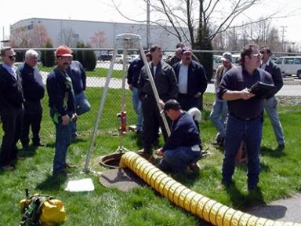
Permit-Required Confined Space Entry Procedure
Isolate the space
Ventilate the space
Complete permit
Test the atmosphere
Enter the space

Slide 27
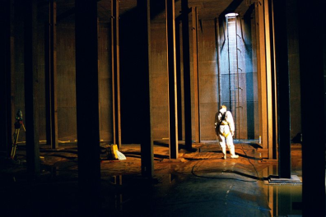
1. Isolate the Space from all hazards
Close Valves
Double block & bleed, or
Blank flange
Empty the Space
De-pressurize, vent & drain
Lockout/Tagout Equipment
Electrical sources
Rotating/reciprocating parts
Hazardous materials
Clean residue from the space
Lockout/Tagout or Block other Sources of Potential Hazards
Water
Steam
Hydraulics

Slide 28
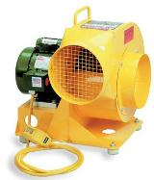
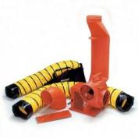
2. Isolate the Space
Use mechanical ventilation
Fans
Air horns
According to the AIHA (American Industrial Hygiene Association), an acceptable practice is 20 complete air changes per hour or one every 3 minutes for a confined space.
Ventilation of a space will also vary depending on the type of material that is being ventilated from the space.
Make sure air supply is not contaminated
Ventilation air supply must be from fresh air uncontaminated with flammables, toxins, etc.

Slide 29
3. Complete Entry Permit Form
The permit must be correctly and completely filled out prior to entry.
The permit must be activated by Entry Supervisor’s signature to be valid.
The entry permit shall identify:
The permit space to be entered;
The purpose of the entry;
The date and the authorized duration of the entry permit;
The OSHA Standard does not indicate exact times that a permit is good for. Company standards may require exact times be placed on a permit - as an example; end of shift, etc.

Slide 30
3. Complete Entry Permit Form – cont.
The authorized entrants within the permit space;
According to 1910.146(f)(4): “The authorized entrants within the permit space, by name or by such other means (for example, through the use of rosters or tracking systems) as will enable the attendant to determine quickly and accurately, for the duration of the permit, which authorized entrants are inside the permit space; NOTE: This requirement may be met by inserting a reference on the entry permit as to the means used, such as a roster or tracking system, to keep track of the authorized entrants within the permit space.”
The personnel, by name, currently serving as attendants;

Slide 31
3. Complete Entry Permit Form – cont.
The individual, by name, currently serving as entry supervisor, with a space for the signature or initials of the entry supervisor who originally authorized the entry;
The hazards of the permit space to be entered;
The measures used to isolate the permit space and to eliminate or control permit space hazards before entry;
The acceptable entry conditions;
The results of initial periodic tests performed;
The rescue & emergency services that can be summoned and the means for summoning those services;

Slide 32
3. Complete Entry Permit Form – cont.
The communication procedures used by authorized entrants & attendants to maintain contact during the entry;
Equipment, such as personal protective equipment, testing equipment, communications equipment, alarm systems, and rescue equipment to be provided;
Any other information whose inclusion is necessary, given the circumstances of the particular confined space, in order to ensure employee safety; and any additional permits, such as, for hot work, that have been issued to authorize work in the permit space.

Slide 33
3. Complete Entry Permit Form – cont.
When work is completed, the permit form should be returned to the safety department or department responsible for maintaining the completed and closed permits.
Cancelled permits must be kept on file for at least one year.
Exercise: Sample Permit Review

Slide 34
4. Test the Atmosphere
Oxygen
Content:
At least 19.5% and less than 23.5%
Check for Combustibles:
Less than 10% of the LEL (Lower Explosive Limit)
Check for Toxic Gasses:
or any other hazardous materials as determined by the use of the space.
Remember:
All confined space atmospheres must be tested for oxygen, flammability agents and other toxic agents.

Slide 35
Testing the Atmosphere
The atmosphere within the space shall be periodically tested as necessary to ensure that the continuous forced air ventilation is preventing the accumulation of a hazardous atmosphere. Any employee who enters the space, or that employee's authorized representative, shall be provided with an opportunity to observe the periodic testing.
If a hazardous atmosphere is detected during entry:
Each employee shall leave the space immediately;
The space shall be evaluated to determine how the hazardous atmosphere developed; and
Measures shall be implemented to protect employees from the hazardous atmosphere before any subsequent entry takes place.

Slide 36
Testing the Atmosphere
The employer shall verify that the space is safe for entry and that the pre-entry measures required by paragraph (c)(5)(ii) have been taken, through a written certification that contains the date, the location of the space, and the signature of the person providing the certification. The certification shall be made before entry and shall be made available to each employee entering the space or to that employee's authorized representative.

Slide 37
Notice
Any time a limit is exceeded, no matter what the reason, all personnel shall immediately exit the space, and no others shall enter until atmospheric conditions are returned to safe levels.
THERE ARE NO EXCEPTIONS TO THIS RULE!

Slide 38
Atmosphere Testing Must Be Performed
Prior to every entry when the space is vacant;
After a 10 minute ventilation period (if ventilation is necessary);
At least hourly for permit-required confined spaces. NOTE: A good practice is to re-test the atmosphere after breaks or having been out of the confined space for a period of time.
More frequently, if conditions or suspicions warrant.

Slide 39
Always test the
air at various levels
to be sure that the
entire space is safe.
Good Air
Poor Air
Good air near the opening does NOT mean there is good air at the other end!
Deadly Air

Slide 40
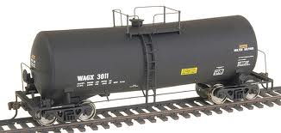
Tanker Cars
Test
Test
Test
Test
Test
Atmospheric testing for tanker cars MUST be tested in 9 locations prior to entry. Testing must be conducted on each end of the car (1 - 6) and in the middle – top (7) middle (8) and bottom (9).

Slide 41
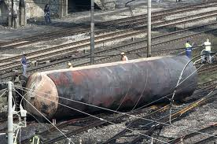
What Can Happen??? !!!!
Would you want to be inside this tanker car when this happened??? What would be your chances of survival?

Slide 42
Remember! Evaluate the Space
Determine that the space meets all the conditions set forth in the non-permit justifications
Conduct atmospheric testing
Evaluation must be certified by Entry Supervisor’s signature
Determine that the confined space does not:
contain or have the potential to contain a hazardous atmosphere
contain a material with the potential for engulfment
Has an internal configuration which could trap or asphyxiate, or contain any recognized serious safety or health hazard.

Slide 43
5. Enter the Space and Proceed with Work: And remember ......
An attendant will be posted near the entrance for the duration of the work. He shall be in constant communication with the entrants while the job is in progress.
The authorized entrants within the permit space, by name or by such other means (for example, through the use of rosters or tracking systems) as will enable the attendant to determine quickly and accurately, for the duration of the permit, which authorized entrants are inside the permit space; This may be done by inserting a reference on the entry permit as to the means used, such as a roster or tracking system, to keep track of the authorized entrants within the permit space.
The attendant must maintain the permit and sign in log for the duration of the work.

Slide 44
When the Job is Done
Remove all personnel, tools, and debris from the space
Close the space
Cancel the permit
Review the job with the employer (hazards, problems, etc.)‏

Slide 45
Contractor Confined Space Entry
Contractors must be informed of the hazards within the space
Contractors must coordinate their own established confined space entry procedures and the use their permit forms with those of the host site.
Contractors must coordinate the use of their attendants with those of the host site.
One attendant is acceptable for multiple companies’ entrants
Contractors must coordinate the use of air monitors with the host site.
Contractors must review entry after completion of job
Remember – Coordination between the contractor and the host site is critical for the safety of all involved!

Slide 46
Attendant Responsibilities
To monitor entrants during the job and during entry & exit to help insure their safety.
The attendant may not abandon his post for any reason while personnel are in the space unless relieved by another qualified attendant.
To monitor atmospheric conditions in the space prior to and during entry.
To control access to the confined space.
To summon emergency assistance as needed.
To assess hazards in and around the space, and take action on the same.
To keep records of confined space work, such as air test results, personnel entry/exit, etc.

Slide 47
Entrant Responsibilities
To assure that the space has been adequately ventilated, isolated, emptied, or otherwise made safe for entry.
To immediately exit a space, without question, upon word of the attendant, no matter what the reason.
To follow all safety rules and procedures that apply to the job.
To be familiar with the work to be performed and the procedures that apply to the job.
To use the appropriate PPE whenever necessary.

Slide 48
Supervisor Responsibilities
To assure adequate protection is provided to the entrants by verifying adequate lockout/tagout and that all hazards are isolated, controlled or eliminated.
To support the attendant’s authority in controlling access to a confined space.
To verify that all personnel have exited prior to closing the space.
To assure that all personnel involved are aware of the hazards associated with the space.
To assure that rescue services are available prior to entry.

Slide 49
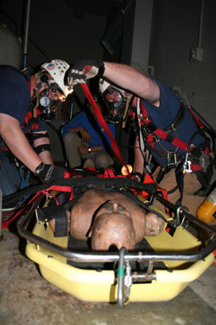
Emergency Rescue
Emergency rescue teams must be available while authorized entrants are in the confined space.
Deaths often occur during rescue. Employees attempt to rescue an entrant without the proper training and then get caught themselves in the confined space.

Slide 50
Rescue Techniques
There are 3 types of rescue techniques:
Non-entry
Entry by others
Entry by Trained employees from the company

Slide 51
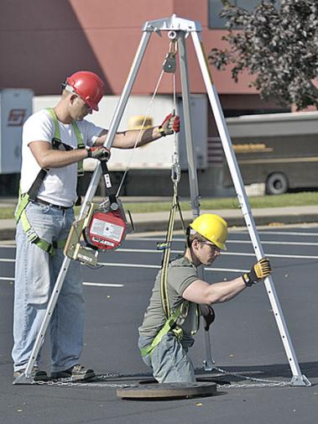
Rescue Techniques
1. Non-entry – Rescue that is conducted without entry into the confined space. This can be conducted by such means as a rope or winch.

Slide 52
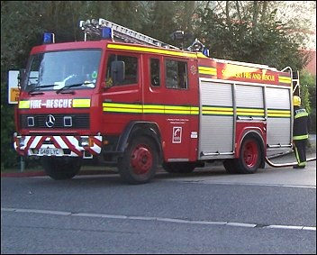
Rescue Techniques
Entry by others –
Some companies do not have trained personnel for emergency rescue. They depend on others to conduct emergency rescues such as the Fire Department.

Slide 53
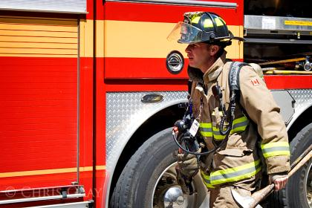
Rescue Techniques
Entry by others continued – in this case the Fire Department would need:
to be familiar with the types of confined spaces located in the facility,
the entry means into the confined spaces,
the types of rescue equipment to effect a rescue,
the types of PPE required for any potential rescue.

Slide 54
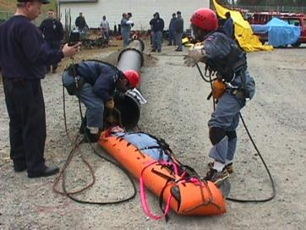
Rescue Techniques
Entry by Trained employees from the company – some companies have trained personnel within the company to conduct rescues. In this case:
All members of the team must be specially trained in confined space rescue work,
The team must have at least one member certified in CPR and first aid,
All members of the team must be trained in the techniques and equipment for specific confined spaces.
The rescue team must practice in all types of spaces in which a rescue could be required.

Slide 55
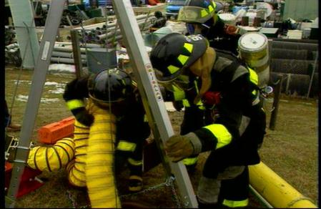
Emergency Rescue
If a rescue is required, the rescue service must close off the area, get authorized entrants out of the space and perform first aid when needed.
It is best to use a retrieval system to bring the employee out of the space. Never enter the space without proper training and unless it is necessary.
Authorized entrants should wear harnesses connected to the retrieval line. The retrieval equipment must be in place before employees enter the permit space.

Slide 56
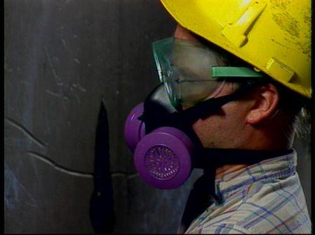
Personal Protective Equipment
One of the most important components of PPE in a confined space is a Respirator.
You will need a physician’s approval or clearance to wear a respirator.
It is important to fit test the respirator.
Other PPE that may be required are:
Safety Harnesses
Ropes and or cables for retrieval in case of emergencies.
Hearing protection, depending on the type of work being preformed in the confined space.

Slide 57
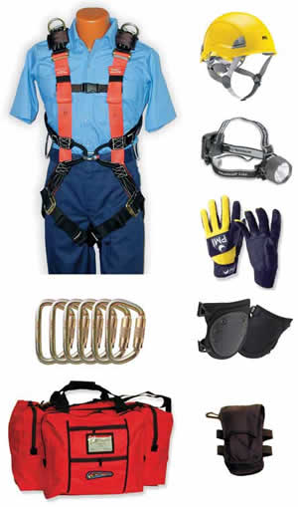
Personal Protective Equipment
Other forms of PPE can include:
Hard hats
Safety glasses
Clothing that protects the torso against chemicals, fires and other hazards
Gloves & safety shoes that protect the hands and feet from various hazards.

Slide 58
Next Steps When you get back to your site be sure to review and further train on…..
Site-specific confined spaces and hazards associated with the spaces;
Site-specific methods to eliminate and/or control the hazards (what the employer wants employees to use);
Site-specific PRCS program and procedures for entry into spaces, including the permit to be used;
Site-specific equipment used;
Site-specific personal protective equipment, including respirator and fall protection training;
Respirator medical clearance and fit testing if workers are required to wear respirators;
If you do welding - welding training including hot work permits;
Emergency procedures - sites rescue plan or use of the fire department or service.

Slide 59
Next Steps When you get back to your site be sure to review and further train on …..
Some other OSHA standards to consider:
Lockout/tagout (29 CFR 1910.147);
Respirator (29 CFR 1910.134);
Personal Protective Equipment (29 CFR 1910.132-138);
Hazard Communication (29 CFR 1910.1200);
And if you conduct rescue, you will need further training on First Aid and CPR.

Slide 60
Next Steps
The employer is to mark confined spaces that are permit-required. They must identify the hazards of the space and post a permit before allowing authorized employees to enter. Employers posts permits near the entrance of each confined space displaying the necessary information.
Authorized entrants should remember safety training and read the permit before entering the space. They should use proper PPE and be alert to potential hazards. Authorized entrants should immediately leave the space if in danger or hear an evacuation alarm.
Attendants must understand the dangers in and around the confined space as well as stay in contact with the authorized entrant and be prepared to order evacuation and call the rescue team.

Slide 61
Next Steps
The entry supervisor needs to ensure that the confined space operations conform to the permit. They should remove unauthorized personnel from the area and keep them from entering the space. The entry supervisor terminates and cancels the permit at the right time.
Make sure each hazard is identified and controlled before entering a confined space.
Emergency rescues should only be made by trained personnel or a rescue service.
Always report any concerns you may have regarding confined spaces.

