Slide 1

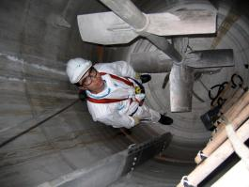
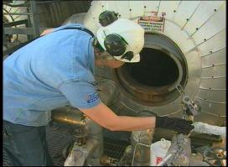
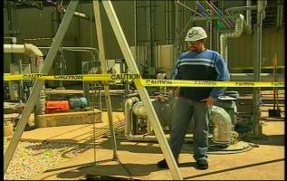
Confined Space Entry
Awareness Training

Slide 2
Disclaimer
“This material was produced under Grant
SH-21000-10-60-F-29 from the Occupational Safety and Health Administration, U.S. Department of Labor. It does not necessarily reflect the views or policies of the U.S. Department of Labor, nor does mention of trade names, commercial products, or organizations imply endorsement by the U.S. Government.”

Slide 3
You have the right to a safe workplace
You have the right to a safe workplace. The Occupational Safety and Health Act of 1970 (OSHAct) was passed to prevent workers from being killed or seriously harmed at work.
The law requires that employers provide their employees with working conditions that are free of known dangers. The Act created the Occupational Safety and Health Administration (OSHA), which sets and enforces protective workplace safety and health standards. OSHA also provides information, training and assistance to workers and employers.
Workers may file a complaint to have OSHA inspect their workplace if they believe that their employer is not following OSHA standards or there are serious hazards.

Slide 4
Workers' rights under the OSH Act
Workers are entitled to working conditions that do not pose a risk of serious harm. To help assure a safe and healthful workplace, OSHA also provides workers with the right to:
Receive information and training about hazards, methods to prevent harm, and the OSHA standards that apply to their workplace. The training must be in a language you can understand;
Observe testing that is done to find hazards in the workplace and get test results;
Review records of work-related injuries and illnesses;
Get copies of their medical records;
Request OSHA to inspect their workplace; and
Use their rights under the law free from retaliation and discrimination.
http://www.osha.gov/workers.html

Slide 5
Course Objectives
As a result of this training Participants will be able to:
Know what a confined space is.
Identify and understand Permit-Required Confined Spaces.
Identify and understand non-Permit Confined Spaces.
Understand the hazards associated with Confined Spaces.
Understand the roles associated with confined space entry.
Have an awareness understanding of emergency rescue.
Have an awareness understanding of the types of PPE that may be required for entry into confined spaces.

Slide 6
Confined Spaces
OSHA estimates that about 224,000 establishments have permit spaces; 7.2 million production workers are employed at these establishments and about 2.1 million workers enter permit spaces annually.
OSHA anticipates that compliance with these regulations will avoid 53 worker deaths and injuries, 4,900 lost workday cases and 5,700 non-lost time accident annually.

Slide 7
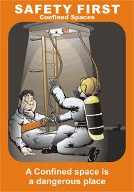
Are Confined Spaces Dangerous?
According to NIOSH Publications on Confined Spaces regarding Worker Deaths in Confined Spaces (NIOSH Publication No. 94-103- January 1994)
This publication provides a summary of surveillance findings in which 70 investigative case reports from 70 incidents in which 109 workers died. These incidents and investigations occurred between December 1983 and September 1993.
http://www.cdc.gov/niosh/topics/confinedspace/#nioshpubs

Slide 8
Are Confined Spaces Dangerous?
A NIOSH publication provides a summary of [NIOSH] surveillance findings and the full text of investigative case reports from 423 incidents in which 480 workers died. These incidents and investigations occurred between December 1983 and September 1993.“ Source: NIOSH (National Institute for Occupational Safety and Health). The following hazards were noted in the statistics
Atmospheric Hazards - Flammable/Explosive
Atmospheric Hazards - Inert Gases and Simple Asphyxiants
Atmospheric Hazards - Oxygen Deficient Air - Part 1
Atmospheric Hazards - Oxygen Deficient Air - Part 2
Atmospheric Hazards – Solvents
Atmospheric Hazards - Toxic Gases - Part 1
Atmospheric Hazards - Toxic Gases - Part 2
Physical Hazards – Engulfment
Physical Hazards – Falls
Physical Hazards – Electrocution Physical Hazards - Drowning

Slide 9
Are Confined Spaces Dangerous?
According to a report from the Canadian Centre for Occupational Health and Safety (www.ccohs.ca):
Many workers are injured and killed each year while working in confined spaces. An estimated 60% of the fatalities have been among the would-be rescuers.

Slide 10
Confined Spaces are Dangerous
Confined spaces are dangerous because:
They may contain hazards in the air
Can trap you inside the space
Can contain slip and fall hazards
Can contain hazards that you might be unable to see

Slide 11
1910.146(g) Training
The employer shall provide training so that all employees whose work is regulated by this section acquire the understanding, knowledge, and skills necessary for the safe performance of the duties assigned under this section.
Training shall be provided to each affected employee:
Before the employee is first assigned duties under this section;
Before there is a change in assigned duties;
Whenever there is a change in permit space operations that presents a hazard about which an employee has not previously been trained;
Whenever the employer has reason to believe either that there are deviations from the permit space entry procedures required by paragraph (d)(3) of this section or that there are inadequacies in the employee's knowledge or use of these procedures.

Slide 12
What is a Confined Space?
A space that:
Is large enough, and so configured that, an employee can enter bodily and perform work;
Has limited or restricted means of entry or exit; and
Is not designed for continuous human occupancy.
Remember: If you break the plane of a confined space, you have entered the confined space!

Slide 13
Permit-Required Confined Space
A Permit-Required Confined Space is confined space that has one or more of the following characteristics:
Contains or has the potential to contain a hazardous atmosphere;
Contains a material that has the potential for engulfing an entrant;
Has an internal configuration such that an entrant could become trapped or asphyxiated; or
Contains any other serious safety or health hazard.
Examples of Permit Required Confined Spaces:
Manholes going into sewers
Grain Silos
Trenches

Slide 14
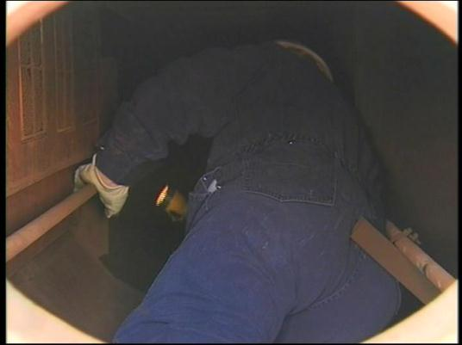
Non-Permit Confined Space
A confined space that does not contain or have the potential to contain any hazard capable of causing death of serious physical harm.
Examples of a Non-Permit Required Confined Space:
Drop ceiling
Motor control cabinets

Slide 15
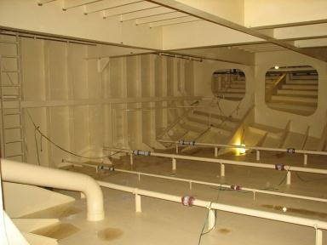
Examples of Confined Spaces:
Tanks
Manholes
Boilers
Furnaces
Sewers
Silos
Hoppers
Vaults
Pipes
Trenches
Tunnels
Ducts
Bins
Pits

Slide 16
Potential Hazards in Confined Spaces
Asphyxiating - Oxygen Deficiency
<19.5% or >23.5% oxygen concentration
CO2
CO₂ is toxic in higher concentrations:
1% (10,000 ppm) will make some people feel drowsy.
Concentrations of 7% to 10% cause dizziness, headache, visual and hearing dysfunction, and unconsciousness within a few minutes to an hour.
Toxic Materials
Carbon Monoxide
Hydrogen Sulphide
Welding fumes
Corrosives
Mechanical Hazards
Mixers
Crushers
Engulfment
Soil around an excavation
Grain in a silo
Powdered material in a bin

Slide 17
Potential Hazards in Confined Spaces
Electricity
Flamable -Combustibles
Methane
Hydrogen
Acetylene
Propane
Gasoline fumes

Slide 18
Oxygen Deficiency
Oxygen could be removed from the air in a confined space by:
Material in the space could displace the oxygen
Rusting could create a chemical reaction that uses up the oxygen
The space could be purged with a gas to prevent explosions.

Slide 19
ENTRY
The act by which a person intentionally passes through an opening into a confined space.
Any part of the body passing through the opening is considered entry.

Slide 20
IDLH
IMMEDIATELY DANGEROUS TO LIFE OR HEALTH
Any condition which poses an immediate threat to the health of life on an entrant, or;
Would cause irreversible adverse health effects, or;
Would interfere with an individual’s ability to escape unaided from a permit space.

Slide 21

ENTRANT
The employee who will physically enter the confined space to perform the work.

Slide 22

ATTENDANT
The employee who remains outside the confined space and;
monitors the entrant(s)
guards the space against unauthorized entry
warns the entrants of any unusual conditions
and summons the rescue personnel if needed.

Slide 23
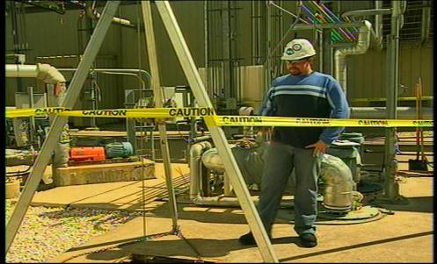
Entry Supervisor
The employee responsible for coordinating the entry into the confined space.
The “Supervisor” does not necessarily mean “management”. The supervisor can refer to anyone acting as the supervisor for the entry, whether Hourly or Management depending on company specific terminology.

Slide 24
Two Options for Entering Confined Spaces:
Permit-required confined space entry
For hazardous or potentially hazardous confined space work
Non-permit confined space entry
For non-hazardous confined space work

Slide 25
Permit Required Confined Spaces – Entry Procedures
An entry permit form must be filled out before entry into a permit required confined space is allowed.
Only authorized entrants are allowed to complete the entry permit.
The entry permit must be posted on or near the confined space for which the entry is being performed.

Slide 26
Complete Entry Permit Form
The permit must be correctly and completely filled out prior to entry.
The permit must be activated by Entry Supervisor’s signature to be valid.
The entry permit shall identify:
The permit space to be entered;
The purpose of the entry;
The date and the authorized duration of the entry permit;
The OSHA Standard does not indicate exact times that a permit is good for. Company standards may require exact times be placed on a permit - as an example; end of shift, etc.

Slide 27
Complete Entry Permit Form – cont.
The authorized entrants within the permit space
According to 1910.146(f)(4): “The authorized entrants within the permit space, by name or by such other means (for example, through the use of rosters or tracking systems) as will enable the attendant to determine quickly and accurately, for the duration of the permit, which authorized entrants are inside the permit space; NOTE: This requirement may be met by inserting a reference on the entry permit as to the means used, such as a roster or tracking system, to keep track of the authorized entrants within the permit space.”
The personnel, by name, currently serving as attendants

Slide 28
Complete Entry Permit Form – cont.
The individual, by name, currently serving as entry supervisor, with a space for the signature or initials of the entry supervisor who originally authorized the entry;
The hazards of the permit space to be entered;
The measures used to isolate the permit space and to eliminate or control permit space hazards before entry;
The acceptable entry conditions;
The results of initial periodic tests performed;
The rescue & emergency services that can be summoned and the means for summoning those services;

Slide 29
Complete Entry Permit Form – cont.
The communication procedures used by authorized entrants & attendants to maintain contact during the entry;
Equipment, such as personal protective equipment, testing equipment, communications equipment, alarm systems, and rescue equipment to be provided;
Any other information whose inclusion is necessary, given the circumstances of the particular confined space, in order to ensure employee safety; and any additional permits, such as, for hot work, that have been issued to authorize work in the permit space.

Slide 30
Complete Entry Permit Form – cont.
When work is completed, the permit form should be returned to the safety department or department responsible for maintaining the completed and closed permits.
Cancelled permits must be kept on file for at least one year.

Slide 31
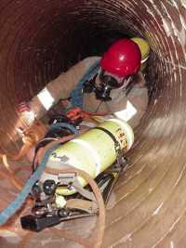
Emergency Rescue
Emergency rescue teams must be available while authorized entrants are in the confined space.
Deaths often occur during rescue. Employees attempt to rescue an entrant without the proper training and then get caught themselves in the confined space.
Only trained employees or designated resources such as Fire Departments are authorized to conduct confined space rescues.

Slide 32
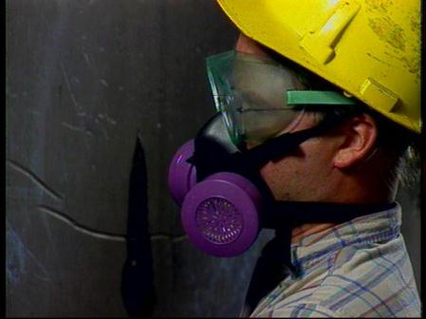
Personal Protective Equipment
One of the most important components of PPE in a confined space is a respirator.
Hearing protection may be required depending on the type of work being performed.
Other PPE that may be required are:
Safety Harnesses
Ropes and or cables for retrieval in case of emergencies.

Slide 33
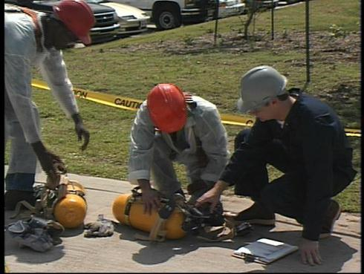
Personal Protective Equipment
Other forms of PPE can include:
Hard hats
Safety glasses
Clothing that protects the torso against chemicals, fires and other hazards
Gloves & safety shoes that protect the hands and feet from various hazards.

Slide 34
Conclusion
The employer is to mark confined spaces that are permit-required. They must identify the hazards of the space and post a permit before allowing authorized employees to enter. Employers posts permits near the entrance of each confined space displaying the necessary information.
Only Trained and Authorized Entrants are to enter a confined space.
Emergency rescues should only be made by trained personnel or a rescue service.
Always report any concerns you may have regarding confined spaces.

