Slide 1

Systems of Safety Applied to Focus Four Hazards
USDOL-OSHA
Susan Harwood Grant
SHT21005SH0

Slide 2
Systems of Safety Applied to Focus Four Hazards
This material was produced under grant number SHT21005SHO from the Occupational Safety and Health Administration, U.S. Department of Labor. It does not necessarily reflect the view or policies of the U.S. Department of Labor, nor does mention of trade names, commercial products, or organizations imply endorsement by U.S. Government.

Slide 3
CAUGHT
IN-BETWEEN

Slide 4
Learning Objectives
Identify the areas where a caught-in-between program applies and how it works inside of a system of safety
Understand the different types of caught-in-between conditions occur.
Understand what training OSHA requires and what safeguards must be in place during construction activities where there is a caught-in-between potential for hazards .
Review a Sample Caught-in-Between Training Program.

Slide 5
Are workers exposed to crushing-type hazards ?
Does the company have an excavation program?
Does company have a Lock-out Tag-out program?
Are workers trained in how to rig materials to be lifted?
Is there an equipment maintenance program?
Assess all potential stored sources of energy
Are workers familiar with procedures and do they regularly recognize caught-in-between conditions?
Assess
Write an excavation, lock-out Tag-out, rigging, and material handling program.
Purchase shoring, rigging and LOTO equipment, LOTO.
Establish written procedure to coordinate with Controlling Entity on their obligations when working with your employees to protect them.
Designate Competent Persons who understand how workers can become crushed and caugt-in-between/
Control
Consultant
&
Committee
Review
Trials
Benchmark
Rigging Class
Competent Person Training
LOTO training.
Tool box talks
Job site orientations for CAZ, LAZ, fall zones, swing zones..
Trench Training.
Rescue procedures
Train
Test Runs
Competent
Person
Review
Implement
Perform daily inspections of rigging equipment.
Review Competent Person daily pre-task inspections of shoring, underpinning etc.
Frequent communications with protection competent persons.
End of week employee debriefings
Accident or incident, near miss investigations
Monitor
Sample Caught-in-Between Safety System

Slide 6
Caught-in-Between Assessment of Hazards
Task | Hazard | Control | Means of Implementation
Working in a trench | Trench collapse | Shoring, benching, sloping | Purchase PPE and train workers when and how to wear and maintain them.
Working with a jammed piece of equipment | 1. Crushing | Lock-out Tag-out Procedures | Training for designated Authorized persons and workers affected by operations.
Working around a mobile crane | 1. Crushing | 1. Barricade swing radius. 2. Training for workers to recognize caught-in-between hazards | Training through toolbox talk to warn workers of danger of swing radius of mobile crane and fall zones. Controlling Entity performs jobsite notification of Controlled Access Zones.

Slide 7
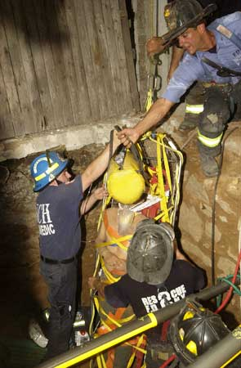
Typical Causes of
Caught-in-Between
Accidents and Fatalities
Trench/Excavation Collapse
Rotating Equipment
Unguarded Parts
Equipment Rollovers
Equipment Maintenance
Rigging accidents

Slide 8
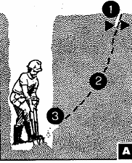
Anatomy of a Trench Collapse
1
Excavating is recognized as one of the most hazardous construction operations
Fatality rate for excavations is twice that of construction as a whole
Cave-ins number one hazard
2
3
A

Slide 9
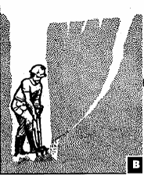
Anatomy of a Trench Collapse
Excavating is recognized as one of the most hazardous construction operations
Fatality rate for excavations is twice that of construction as a whole
Cave-ins number one hazard
B

Slide 10
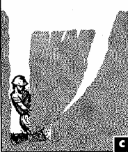
Anatomy of a Trench Collapse
Excavating is recognized as one of the most hazardous construction operations
Fatality rate for excavations is twice that of construction as a whole
Cave-ins number one hazard
C

Slide 11
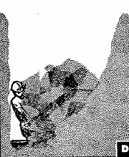
Anatomy of a Trench Collapse
Excavating is recognized as one of the most hazardous construction operations
Fatality rate for excavations is twice that of construction as a whole
Cave-ins number one hazard
D

Slide 12
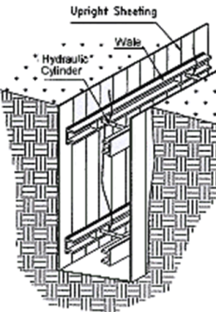
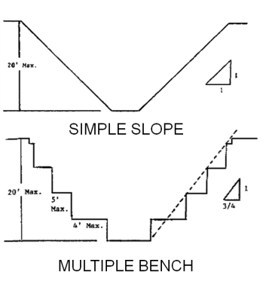
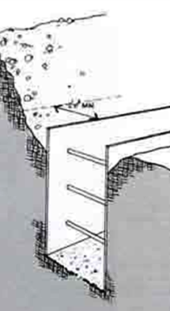
Caught-in-Between
Shoring, Sloping, Benching, Trench Boxes
Engineering Controls

Slide 13
Some Rules Concerning Excavation
All trenching operations will be performed under the supervision of a competent person.
Establish locations of underground utilities before digging.
Provide a means of egress/access when a trench reaches a depth of 4 feet that is not be more than 25 feet lateral distance from a worker’s reach.
Ladder top rails must extend at least 3 feet above grade and be secured from displacement.
All trenches where workers will enter 5 feet or more deep must be protected from collapse according to OSHA regulations.
Documented soil classification must be performed by the competent person to determine type of soil and necessary protection. (Type A, Type B, Type C soil classification).
Trenches must be inspected daily by a competent person and after the occurrence of rain or other changing conditions.
Trenches greater than 20 feet must be designed by a professional engineer.
Workers cannot be under loads nor allowed to stand alongside the loading of a vehicles to avoid being struck by spillage. The driver of a vehicle is allowed to be in the cab if the cab is designed to withstand impact of loads.

Slide 14
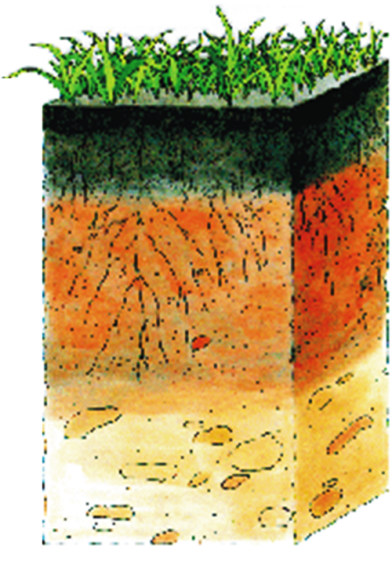
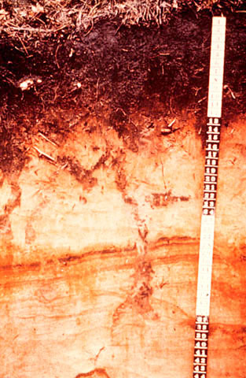
Soil Basics: Undisturbed Horizons
Notes:
Undisturbed soils will typically appear to be layered. These layers are called strata or horizons. A soil profile is the sequence of natural layers, or horizons, in a soil. Each soil series consists of soils having major horizons that are similar in color, texture, structure, reaction, consistency, mineral and chemical composition, and arrangement in the soil profile. The soil profile extends from the surface downward to unconsolidated material. Most soils have three major horizons called the surface horizon, the subsoil, and the substratum.

Slide 15

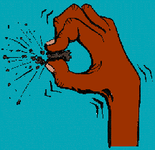
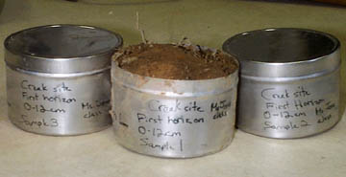
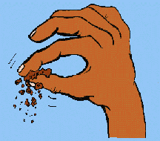
Soil Basics: Textures of Different Types of Soils
Textures of Soils
Sand are the largest particles and they feel "gritty.“
Silt are medium sized, and they feel soft, silky or "floury.“
Clay are the smallest sized particles, and they feel "sticky" and they are hard to squeeze.

Slide 16
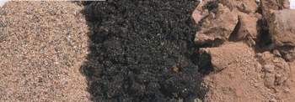
Soil Basics : Characteristics and Appearance
Sand Loam Clay
If the soil:
Is somewhat to really sticky
Hard to squeeze
Stains your hands
Has a shine when rubbed
Forms a long ribbon (5+ cm)
without breaking,
Call it a clay
If the soil:
Does not cling together
When squeezed and is
granular
Call it sandy
If the soil is:
Soft Smooth
Easy to squeeze,
At most slightly sticky,
Forms a short ribbon
(less than 2 cm)
Call it a loam

Slide 17
OSHA Classification of Soil Types
Soil Types
  Type A - Most stable (undisturbed) clay, silty clay, and hardpan (resists penetration). No soil is Type A if it is fissured, is subject to vibration of any type, has previously been disturbed, or has seeping water.
  Type B - Medium stability: silt, sandy loam, medium clay and unstable dry rock; previously disturbed soils unless otherwise classified as Type C; soils that meet the requirements of Type A soil but are fissured or subject to vibration.
  Type C - Least stable: gravel, loamy sand, soft clay, submerged soil or dense, heavy unstable rock, and soil from which water is freely seeping.

Slide 18
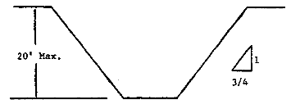
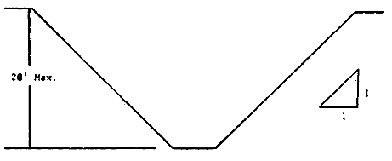
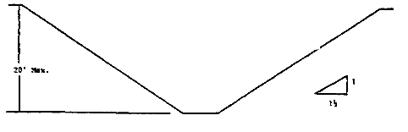
Sloping for Type “A” soil
(53 degrees)
Sloping for Type “B” soil
(45 degrees)
Sloping for Type “C” soil
(34 degrees)

Slide 19
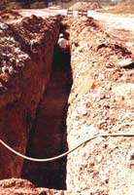
Notes:
Trench is deeper than five feet
Spoil pile is closer than 2 feet from edge of trench

Slide 20
Notes:
Trench is deeper than five feet
Excavator adds weight to banks of trench surcharge or superimposed load
Spoil pile appears closer than 2 feet from edge of trench

Slide 21
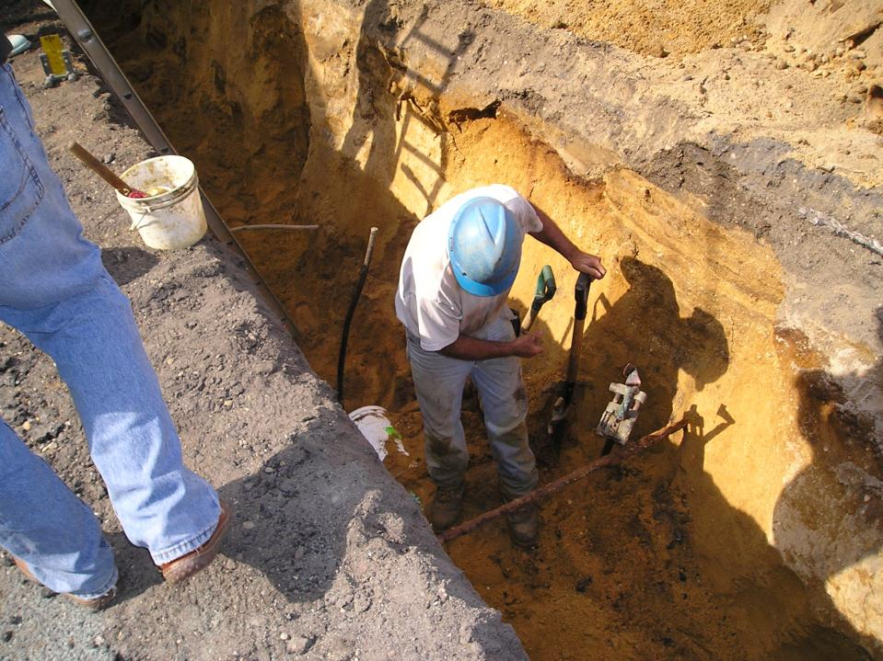
Notes:
21
21

Slide 22
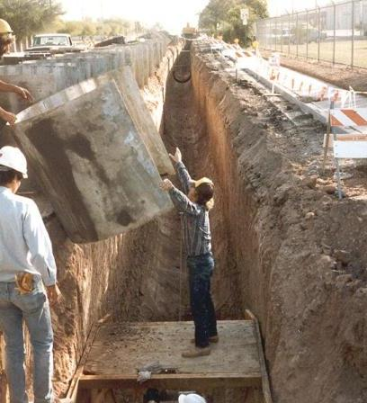
Notes:
Trench is deeper than five feet
Workers have no hardhats

Slide 23
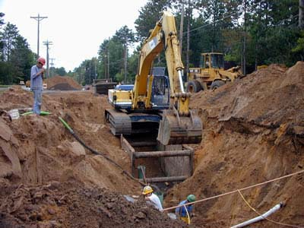
Notes:
Reference 1926.652(a) and (b) and (c)

Slide 24
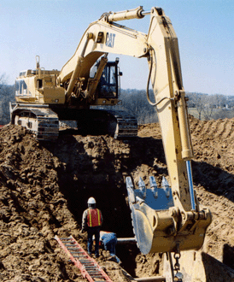
Notes:
1. Means of egress not in place
2. Workers under load
3. Spoil pile closer than two feet from edge.

Slide 25
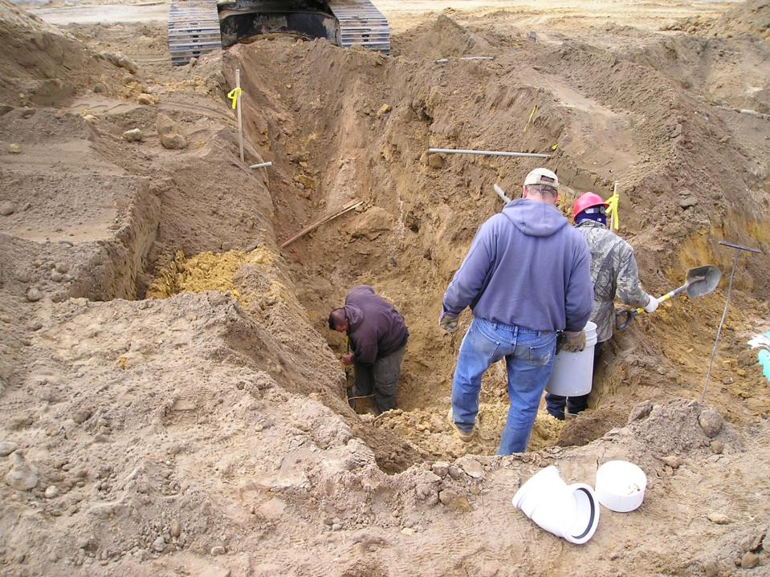
Notes:
Trench is deeper than five feet and improperly benched
Excavator adds weight to banks of trench surcharge or superimposed load
Worker have no hardhats

Slide 26
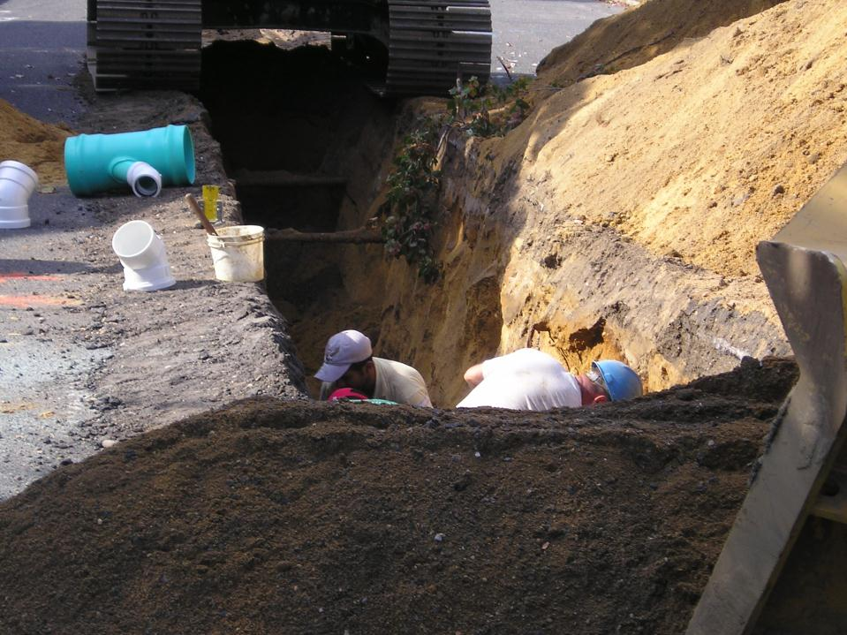
Notes:
26
26
Trench is deeper than five feet
Excavator adds weight to banks of trench surcharge or superimposed load
Workers have no hardhats
Spoil pile is closer than 2 feet from edge of trench

Slide 27
The COMPETENT PERSON conducts the VISUAL TEST to look for:
  Fissured ground
  Layered soil
  Disturbed earth
  Seepage
  Vibration
  Poor drainage
  Also checks:
  Depth
  Loads adjacent to trench
  Adjacent structures that can be compromised by excavation
Notes:
Discuss each Visual Test and ask if the students have any questions.

Slide 28
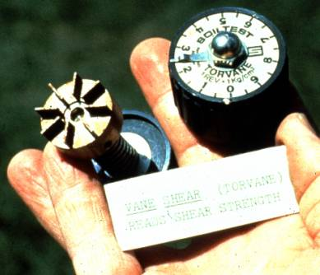
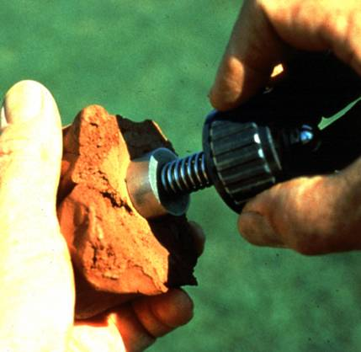
Torvane Shear Test
Notes:
Designed to be used on saturated cohesive clay soil
Vanes are inserted into soil
Twist and shear soil at base and around circumference of vanes
Select fresh clod or block of undisturbed soil from spoil pile
Cut a smooth surface on the clod
Insert vanes of device into the soil
Retract vanes to show foot imprint
Set indicator at zero
Hold device firmly against soil and twist in clockwise manner until soil fails in shear
Designed to be used on saturated cohesive clay soil
Vanes are inserted into soil
Twist and shear soil at base and around circumference of vanes
Select fresh clod or block of undisturbed soil from spoil pile
Cut a smooth surface on the clod
Insert vanes of device into the soil
Retract vanes to show foot imprint
Set indicator at zero
Hold device firmly against soil and twist in clockwise manner until soil fails in shear

Slide 29
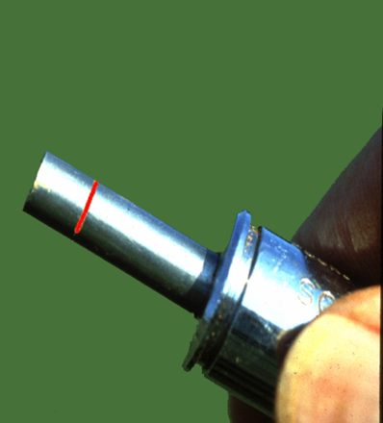
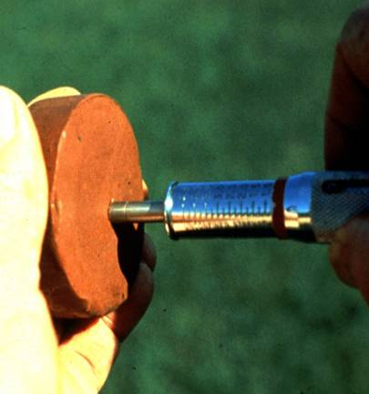
Pocket Penetrometer Test
Notes:
Device is designed to work on saturated clay soil
Measures unconfined compressive strength of soil
Twice the value of shear strength of same soil
Note machine ring about a quarter of an inchPush red ring on the barrel all the way toward the handle
Push shaft into the soil up to the red ring
Hold barrel so as to not to interfere with the spring inside the barrel
NOTE slip ring moved on the barrel as barrel was pushed back into the handle

Slide 30
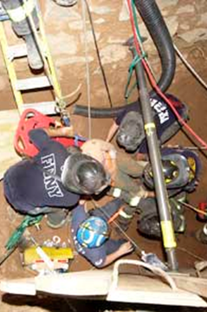
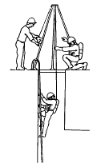
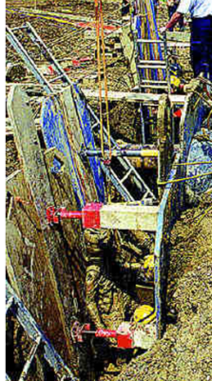
What do you do if a worker falls unconscious in a trench? It May Contain a Hazardous Atmosphere!
Always anticipate rescue have a plan: Remember the best means of rescue go in this hierarchal order.
  Self Rescue when a worker removes themselves
  Non-entry rescue by a retrieval device
  Entry rescue by a qualified persons
Notes:
Photographs depict from left to right: (left) actual emergency by qualified rescuers, (middle) a non-entry rescue device where a worker is climbing out on his on after determination that the entry is no longer habitable, and (right) another actual emergency by qualified rescuers.

Slide 31
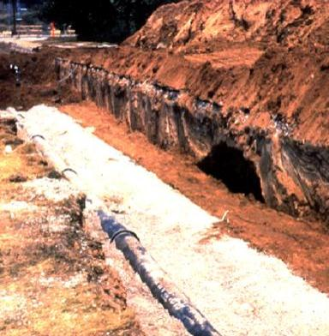
Spoils
Don’t place spoils within 2 feet from edge of excavation
Measure from nearest part of the spoil to the excavation edge
Place spoils so rainwater runs away from the excavation
Place spoil well away from the excavation
Notes:
Reference 1926.651(j)(2)
Protect employees from materials or equipment that could fall or roll into excavations.
You may also use retaining devices that are sufficient to prevent materials or equipment from falling or rolling into excavations

Slide 32
Spoils
These loads not only create force too heavy for the soil below to carry, they also hide signs of failure.
Tension Cracks

Slide 33
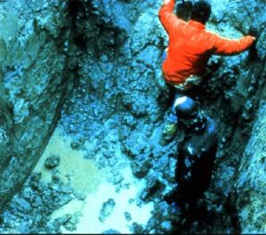
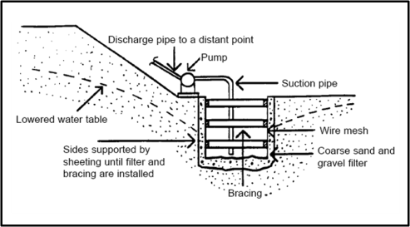
Dewatering
Worker should not be in excavation with water present
Dewatering Well Point
When water is present in an excavation it is extremely hazardous to enter!
Dewatering Sump-pump
Notes:
Drawings are intended only for depiction purposes. In the field you will notice that water pumped from a well point is clearer and hence does not lessen the strength of soils around a trench by removing smaller particles, while soil around a trench de-watered with sump-pumps is muddy and hence carries with it the cohesive parts of the soil, typically silts.

Slide 34
Competent Person
Must have had specific training in and be knowledgeable about:
  Soils classification
  The use of protective systems
  The requirements of the standard
Must be capable of identifying hazards, and authorized to immediately eliminate hazards
Notes:
Reference 1926.650(b) "Competent person"
One who is capable of identifying existing and predictable hazards in the surroundings, or working conditions which are unsanitary, hazardous, or dangerous to employees, and who has authorization to take prompt corrective measures to eliminate them.
Preamble Page 45909 – “Competent Person”
The term is used throughout existing subpart P, but was not defined within the subpart, and there were no references to the existing definition in subpart C, in the proposal, OSHA added the definition to subpart P to help those using the standard.
A competent person must:
Make daily inspections
Before work starts and as needed after rainstorms, high winds or other occurrence which may increase hazards.
When you can reasonably anticipate an employee will be exposed to hazards.
If there are problems
Exposed employees must be removed from the hazardous area
Employees may not return until the necessary precautions have been taken

Slide 35
Excavation Reminders
Preplan.
Call for mark out utilities.
Remove or divert standing, running, or seeping water whenever possible.
Never have anyone work alone in a trench.
Use barricades, signs, and flag persons as necessary.
Check to make sure that materials (especially pipe) cannot roll into the trench.
Be sure that operators have ample means of communication with coworkers, including a single point of reference for responsible signaling.
Reduce all sources of vibration where.
When loading dirt or moving materials, do not move equipment over the head of any worker.
Be aware of the weather's impact on an excavation.
Make sure that excavation cuts are made vertically (no bell shapes)
Do not undermine existing structures such as buildings, sidewalks, and walls.

Slide 36
Excavation Reminders
Dirt that is dramatically different in color, or flagging, may indicate utilities below. Sometimes seeping water indicates utilities because often the flow of water follows the gravel surrounding utilities.
Hazardous atmospheres. Test for them when reasonable to do so and have the proper personal protective equipment (PPE) if a hazard cannot be eliminated administratively or through engineering means. You may have to treat the area as a "Permit-required confined space."
Wear a hard hat to prevent being hit directly on the head by falling objects.
Wear hearing protection to prevent hazards from noise.
Inspect chokers, slings, and chains for excessive wear, knots, and kinks. Avoid shock loading of any rigging system. Do not lift with the teeth of the bucket.
inspect, and watch for signs of failure or weakness: tension cracks, bulging, slip planes, and defective materials--and don't forget the running rats Subtle changes in site conditions can immediately impact a soil's stability.
Train all your coworkers on how to spot signs of failure.

Slide 37
Excavation Reminders
Anticipate a rescue; for instance, establish job responsibilities or find out who can supply a vacuum truck to remove soil if needed.
Ladders, ramps, or stairs must be spaced no more than 50 feet on center when trench excavations exceed 4 feet in depth.
Safety vests with vehicular traffic.
You must test for hazardous atmospheres.
Spoils and equipment must be restrained or kept a minimum of 2 feet from the edge of a cut to prevent material from falling into an excavation.
Competent Person daily inspect the excavation and surrounding areas. An inspection is also required after a hazardous occurrence such as a rainstorm or damage to the structural member of a shore or trench box.
As support systems are removed, the excavation must be immediately backfilled and the supports must be removed from the bottom up.
Notes:
Anticipate a rescue; for instance, establish job responsibilities or find out who can supply a vacuum truck to remove soil if needed.
Ladders, ramps, or stairs must be spaced no more than 50 feet on center when trench excavations exceed 4 feet in depth--29CFR 1926.651(c)
Safety vests with vehicular traffic--29 CFR 1926.651(d).
You must test for hazardous atmospheres--29CFR 1926.651(g).
Spoils and equipment must be restrained or kept a minimum of 2 feet from the edge of a cut to prevent material from falling into an excavation--29 CFR 1926.651(j)(2).
Competent Person daily inspect the excavation and surrounding areas. An inspection is also required after a hazardous occurrence such as a rainstorm or damage to the structural member of a shore or trench box--29 CFR 1926.651(k).
As support systems are removed, the excavation must be immediately backfilled and the supports must be removed from the bottom up--29 CFR 1926.652(e).

Slide 38
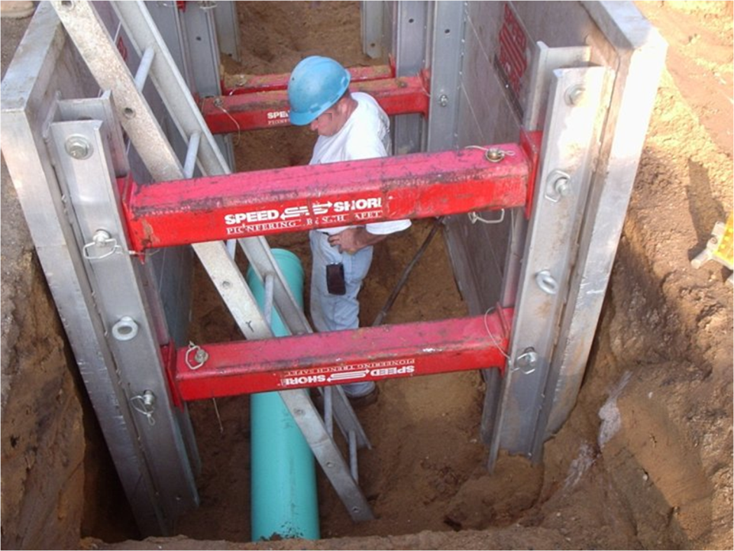
Notes:
38
38

Slide 39
Caught-in-between
Mechanical Crushing - case study
This accident occurred when a 48-year old victim, a mechanic, was attempting to disconnect a wind row elevator from an asphalt lay down machine. The mechanic accessed the hitch pins from inside the hopper of the lay down machine, upon removal of the second of two pins, the front of the wind row elevator collapsed, pinning the victim between the hopper bed and the wind row elevator. Victim was not found until approximately 45 minutes later. He was pronounced dead at the scene.

Slide 40
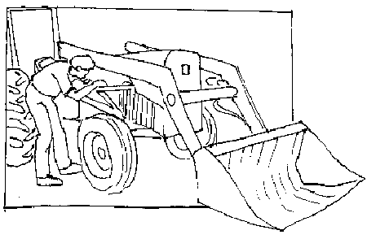
Caught-in-between
To avoid crushing injuries, make sure that the bucket is on the ground or solidly blocked before working on the tractor or loader. Shut off the engine and take the key, unless otherwise specified by the manufacturer. With the engine off, rock the hydraulic control levers to relieve pressure in the hydraulic system so that high-pressure fluid isn't unexpectedly released.
Lock-Out Tag-Out Procedures Program
Engineering Controls

Slide 41
Demolition Crushing: Case Study
Caught-in-between
Employee was assigned by his employer to dismantle a 10' by 20' wooden building. The employee initially removed most all of the siding from the outside of the building and then went inside of the building to remove the wall paneling. During the removal of the wall paneling the building collapsed onto the employee causing fatal injuries.

Slide 42
Caught-in-between
Preparatory operations
Prior to permitting employees to start demolition operations, an engineering survey shall be made, by a competent person, of the structure to determine the condition of the framing, floors, and walls, and possibility of unplanned collapse of any portion of the structure. Any adjacent structure where employees may be exposed shall also be similarly checked. The employer shall have in writing evidence that such a survey has been performed.
Demolition: Engineering Survey
Administrative Control

Slide 43
Caught-in-between
Preparatory operations
When employees are required to work within a structure to be demolished which has been damaged by fire, flood, explosion, or other cause, the walls or floor shall be shored or braced.
Demolition: Shoring and Bracing
Administrative Control

Slide 44
Caught-in-between
Machinery
Construction Worker Caught Between Forklift and Cement Truck
A construction worker was killed when the forklift he had been operating rolled forward, pinning him against the rear of a cement truck. He was standing between a forklift and a concrete truck to adjust the concrete chute on the rear of the truck. The forklift rolled forward, pinning him.

Slide 45
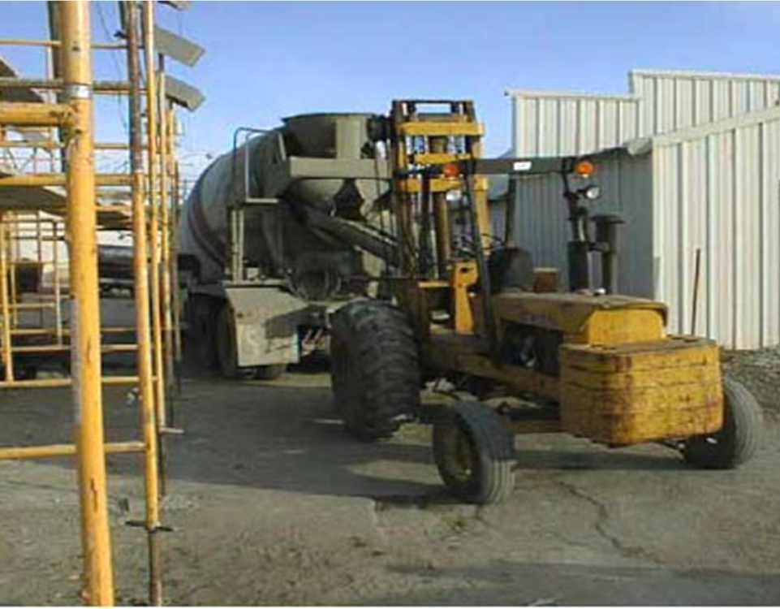
Area between where worker was killed
Notes:
This is the actual scene of a fatal accident. Can we make recommendations?

Slide 46
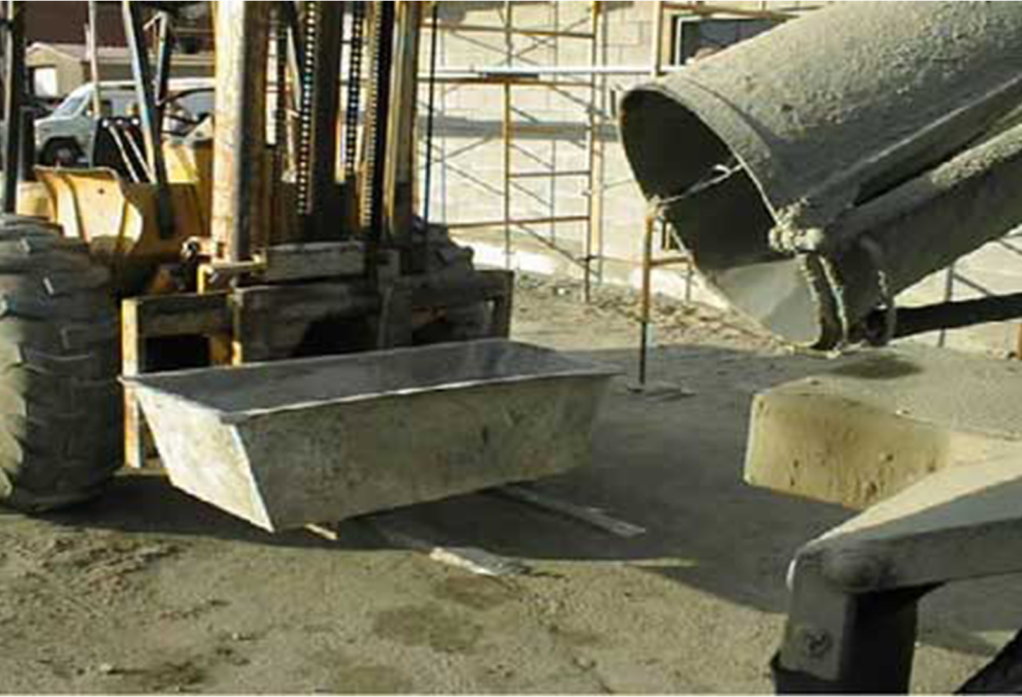
Notes:
This photograph is informative, taken at scene depicting two sources of potential caught-in-between sources the forklift and concrete truck and chute.

Slide 47
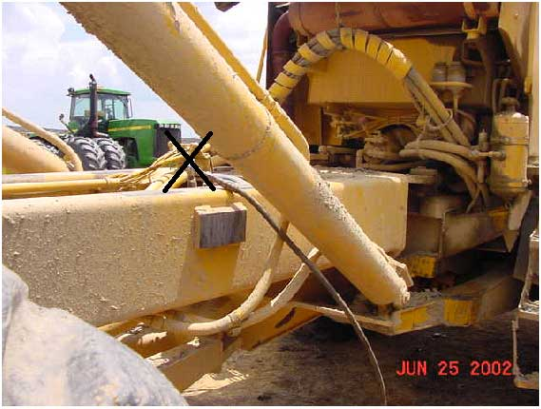
Caught-in-between
Machinery:
Fatal Accident:
This photo illustrates the area of a truck where a victim was working when he was caught in-between two parts of a lever mechanism. Note the grease gun's rubber hose. The “X” demonstrates the approximate location of the victim following the incident.

Slide 48
Caught-in-between
Machinery Recommendations:
Employers should ensure that each powered truck operator is competent to operate a powered industrial truck safely.
Employers should establish a routine maintenance program for all equipment to meet or exceed regulatory requirements.
Employers should provide a safe and healthful workplace, free from recognized hazards by developing, implementing and enforcing formal safety programs that includes a Lock-out tag-out program.

Slide 49
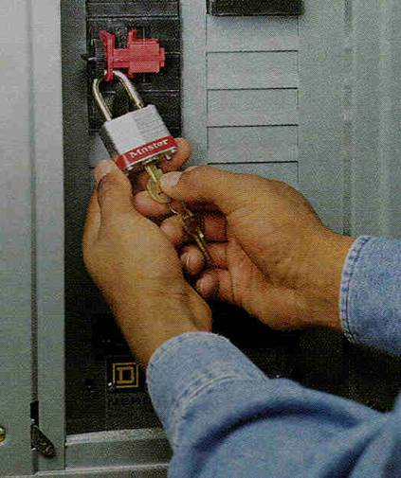
Lockout/Tagout
1
Notes:
“This training is required by WISHA under their Lockout/tagout Rules.”

Slide 50
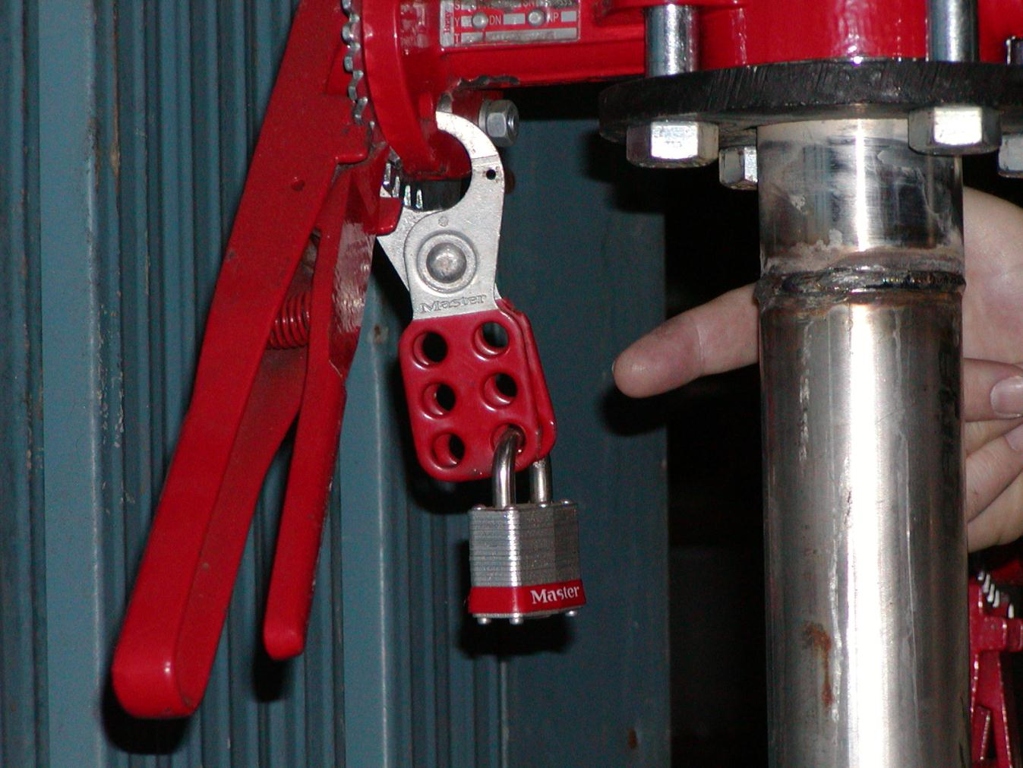

Slide 51
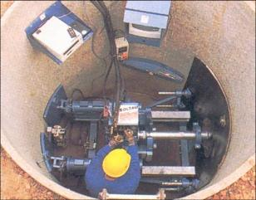
Lockout/Tagout and Confined Spaces
Lockout/Tagout is important in confined spaces since it is easy to get trapped and hard to escape.
Pipelines leading into tanks must be blanked off before entering the space.
All electrical and mechanical hazardous energy must be addressed and locked out or tagged as needed.
Notes:
If your employees enter confined spaces that include hazardous energy sources, these must also be addressed in your confined space standard. These workers must be trained in Confined Space entry and in the locking out and tagging of sources of hazardous energy.

Slide 52
Service and Maintenance Examples
Installing, constructing,
adjusting, modifying,
unjamming, cleaning,
lubrication, inspecting,
setup - preparing for normal function
These activities often require a worker to place all or part of their body into the machine’s hazard zone.
Notes:
“Service & Maintenance -- when the machine isn’t being used for actual production and service, repair or maintenance work is being done.
Setup - a particular type of service to a machine when it is being prepared for production use.
In the photo, the setup person is installing and adjusting the dies for production stamping of a composite material.
Problems:
There is no block under the upper die to positively prevent it from coming down.
A key in the computer control on the other side of the machine is all that prevents machine activation.”

Slide 53
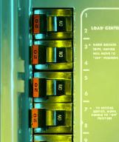
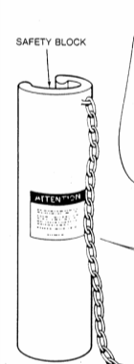
What is an energy-isolating device?
A device that physically prevents transmission or release of energy such as:
An electrical circuit breaker,
A pipeline valve,
A machine block,
Anything else that positively blocks or isolates energy.
Notes:
“These are also called “energy control devices”. Regular on-off switches (push buttons, selector switches, etc.) are not energy-isolating devices since they can fail – they are not designed for energy isolation.
There is one exception: On a motor vehicle such as a trucks and forklifts, WISHA will accept removal of the key from the ignition as electrical lockout even though a complete energy isolating measure would be to disconnect the battery.”

Slide 54
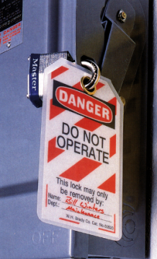
What is a Lockout Device?
A device that positively:
prevents a machine from being started up or turned on,
prevents a machinery part from moving,
prevents electrical energizing,
blocks a pipeline, steam line or air line
Notes:
“A lockout device is a usually a lock, key, valve or switch cover that holds an energy isolating or control device in the off or safe position until the lockout device is removed. Lockout must be done according to an established procedure.”

Slide 55
Fluid & Gas Lockout Devices
Notes:
“These lockout devices prevent the valves in air, water, gas or steam lines from being opened.”

Slide 56
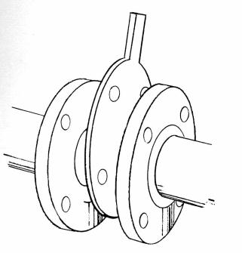
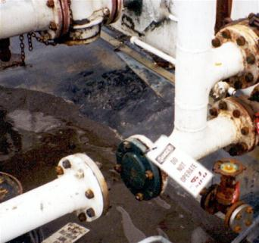
Pipe Lockout Examples
Notes:
“A physical block or break in a pipeline prevents steam, gas or liquids from flowing through the pipe to the area where maintenance work is being done. For example, the pipe to a chemical tank must be blocked or disconnected before someone goes in to do repair or maintenance.”

Slide 57
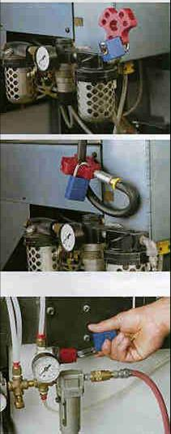
Pneumatic Lockout Examples
Notes:
“These devices prevent compressed air from flowing through lines and moving some part of the machinery. The locks prevent anyone from hooking up the lines while maintenance is being done.”

Slide 58
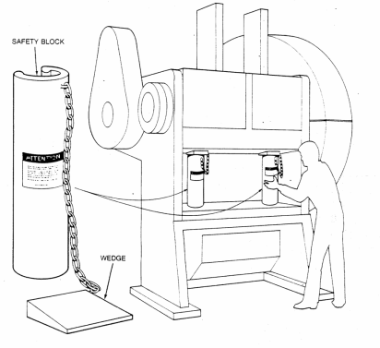
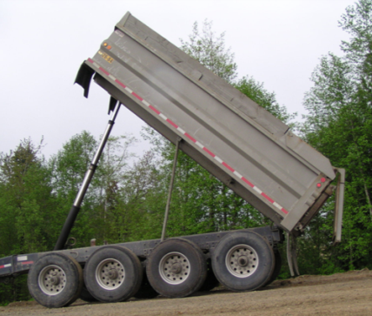
Physical Blocks
Truck bed lockout
Punch press blocks
Notes:
“WISHA has a specific rule regarding the support for a dump truck body. It has to be permanently mounted on the dump truck as shown in the photo of the truckbed.”

Slide 59

Group Lockout Devices
Used when more than one person doing maintenance or repair on same machine or equipment.
Machinery or equipment can’t be started up until all locks are removed.
Each person places and removes their own lock.
Notes:
“Group or “gang” locks are typically used when several people are doing maintenance and repair at the same time on a machine or piece of equipment. Each lock should have a clear identification (usually a name) showing who it belongs to. No one can remove another person’s lock.”

Slide 60


What is Tag-out?
Tags are warning devices only
They don’t provide the same level of protection as lockout devices.
They can only be removed by an authorized person.
They must be legible, securely attached and resistant to degradation.
Notes:
“Tags cannot be used as a substitute for lockout devices. They can only be used alone if there is no other way to positively control hazardous energy. However, they are often used along with lockout devices as an additional warning. The separate sign can be used as further warning or information.”

Slide 61


Slide 62

Tags must be:
  standardized
  substantial
  identifiable
  durable

Slide 63
Lockout Steps
Notify
employees
Shutdown
Equipment
Isolate
Energy
Attach Lockout
Device
Release
Stored Energy
Verify Lockout
Service &
Maintenance
Notes:
[A visual view of the two preceding slides.]

Slide 64
Typical Lock-Out Tag-Out
Start-up Procedures
Only authorized employee can do startup
All warned to stay clear
Remove all tools, locks and tags
Remove, reverse, open or reactivate isolating devices
Visual check that all is clear
Start up machine, process or line flow
Lock-out Tag-out Equipment Program
Engineering Controls

Slide 65
The End
&
The
Beginning

