Slide 1

Systems of Safety Applied to Focus Four Hazards
USDOL-OSHA
Susan Harwood Grant
SHT21005SH0

Slide 2
Systems of Safety Applied to Focus Four Hazards
This material was produced under grant number SHT21005SHO from the Occupational Safety and Health Administration, U.S. Department of Labor. It does not necessarily reflect the view or policies of the U.S. Department of Labor, nor does mention of trade names, commercial products, or organizations imply endorsement by U.S. Government.

Slide 3
ELECTRICAL

Slide 4
The Electrical System of Safety
In Construction
On average, nearly one worker per day is electrocuted.
Electricity is dangerous and undetectable without instruments.
The objectives of this following section is to help us understand how implement and maintain an effective systematic electrical safety program on the jobsite and better understand OSHA’s construction electrical requirements

Slide 5
US Construction Electrocution Fatalities 2007
Data Source: Bureau of Labor Statistics Census of Fatal Occupational Injuries

Slide 6
Learning Objectives
Identify the parts of an Electrical Hazard Protection System
Understand the nature of electricity and how it works and can warm and kill you.
Understand what training OSHA requires and what safeguards must be in place during construction activities.
Review a Sample Electrical Training Program.

Slide 7
Are workers exposed to electrical hazards?
Does the company have an electrical protection program?
Are GFCI’s used throughout jobsites?
Are there regular inspections of extension cords, electrical tools, portable generators and other sources of electrical hazards including grounding?
Does the company have a Lock-out-tag-out program?
Has any worker ever received a shock on a jobsite?
Are workers trained in how to identify and avoid electrical hazards?
Assess
Write an electrical control program.
Purchase Lock-out tag-out equipment and Ground-fault-circuit-interrupters.
Create tool and extension cord maintenance checklists.
Establish a written procedure to coordinate with Controlling Entity their obligations under contract to provide general electrical conditions and lighting.
Designate Competent Persons organization structure for electrical hazards.
Control
Consultant
&
Committee
Review
Trials
Benchmark
Electrical Hazard Awareness Training
Competent Person Training
Lock-Out Tag-out procedures
Protocol for employees who receive an electrical shock.
Tool maintenance
Electrical fire hazards
Train
Test Runs
Competent
Person
Review
Implement
Perform daily inspections of extension chords.
Review Competent Person daily pre-task inspections of electrical hazards controls.
Frequent communications with fall protection competent persons.
End of week employee fall protection debriefings
Accident or incident investigations
Monitor
Sample Electrical Safety System

Slide 8
Electrical : Assessment of Hazards
Task | Hazard | Control | Means of Implementation
Working with an electrical tool | Shock Electrocution Indirect falls Burns | Grounding GFCI Inspection of tools Inspection of extension cords | Purchase GFCI Have a daily electrical inspection by a competent person. Train workers in the recognition of electrical hazards and how they can harm them.
 | Fire | Correct sized conductors | Follow applicable electric code for wire gauge size to amperage of circuit .
Electrical work | Shock Electrocution Indirect falls Burns | Lock-out –Tag Out | Create a full Lock-out tag-out program for electrical work Train electricians in how to use a lock-out-tag our program
 | Fire | Correct sized conductors | Follow applicable electric code for wire gauge size to amperage of circuit .
Sample Electrical Job Hazard Analysis (JHA)
Notes:
This is a sample of the format of which a Job Hazard Analysis should follow.

Slide 9
Electrical Terms
Current -- electrical movement (measured in amps)
Circuit -- complete path of the current. Includes electricity source, a conductor, and the output device or load (such as a lamp, tool, or heater)
Resistance -- restriction to electrical flow
Conductors – substances, like metals, with little resistance to electricity that allow electricity to flow
Grounding – a conductive connection to the earth which acts as a protective measure
Insulators -- substances with high resistance to electricity like glass, porcelain, plastic, and dry wood that prevent electricity from getting to unwanted areas
Notes:
Resistance – Measured in ohms.
Four factors determine the resistance of a material to the flow of electricity.
What it is made of (silver is best, copper is most common)
Its diameter (smaller diameter = more resistance)
Its temperature (higher temperature = higher resistance)
Its length (longer = higher resistance)

Slide 10



Conductivity The More Conductive the Less Resistance
The Best Conductors
Silver 105
Copper 100
Gold 70
Aluminum 61
Brass 28
Zinc 27
Nickel 22
Iron 17
Tin 15
Phosphor Bronze 15
Lead 7
Steel 3-15
Silver
Copper
Gold

Slide 11
Electrical Conductors, Insulators and Semiconductors (3-Tunnel Train Analogy)
Tunnel (thousands of miles long)
Conductors
Tunnel (thousands of miles long)
Insulators
Tunnel (thousands of miles long)
Semiconductors

Slide 12
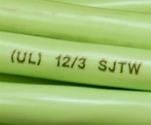
Extension cords sets used with portable electric tools and appliances shall be of three-wire type and shall be designed for hard or extra-hard usage. Flexible cords used with temporary and portable lights shall be designed for hard or extra-hard usage.

Slide 13




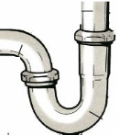
Simplified Analogy to an Electric Circuit
Pipes
+
Work
Reservoir
-
Where does water come from?

Slide 14
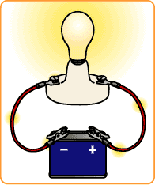
A Simple Circuit
Electrical Source
Light

Slide 15
Simplified Analogy to an Electric Circuit
Pipes
+
Work
Reservoir
-
-
GROUND
Clog (break path)
What can go wrong?

Slide 16
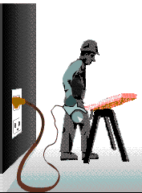
Grounding
Grounding creates a low-resistance path from a tool to the earth to disperse unwanted current.
When a short or lightning occurs, energy flows to the ground, protecting you from electrical shock, injury and death.
Notes:
Grounding is a secondary method of preventing electrical shock.
Grounded electrical systems are usually connected to a grounding rod that is placed 6-8 feet deep into the earth.
Grounded - connected to earth or to some conducting body that serves in place of the earth.
Grounded, effectively (Over 600 volts, nominal.) Permanently connected to earth through a ground connection of sufficiently low impedance and having sufficient ampacity that ground fault current which may occur cannot build up to voltages dangerous to personnel.
Grounded conductor. A system or circuit conductor that is intentionally grounded.
Grounding conductor. A conductor used to connect equipment or the grounded circuit of a wiring system to a grounding electrode or electrodes.

Slide 17
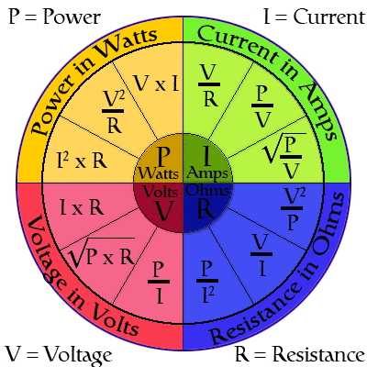
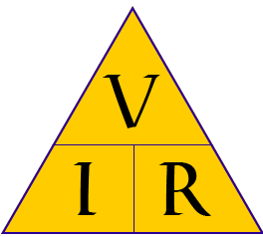
Electrical Resistance
Watch How Simple This Can Be

Slide 18
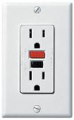
Simplified Analogy of Ground Fault Circuit Interrupter
Pipes
100 Gallons IN
100 Gallons IN
GFCI TRIP
+
Work
Reservoir
-
-
GROUND
99 Gallons OUT
100 Gallons OUT

Slide 19
Electrical Injuries
There are four main types of electrical injuries:
Direct:
1.Electrocution or death due to electrical shock
2. Electrical shock
3. Burns
4. Indirect - Falls
Notes:
When an electrical shock enters the body it may produce different types of injuries. Electrocution results in internal and external injury to body parts or the entire body – often resulting in death. After receiving a “jolt” of electricity all or part of the body may be temporarily paralyzed and this may cause loss of grip or stability. A person may also involuntarily move as a result of receiving an electrical shock, resulting in a fall. Internal or external burns may result from contact with electricity.

Slide 20
ELECTRICAL SAFETY Effects of Amount of AC Current ma=1/1000th of an amp
3 ma- painful shock which cause indirect accidents
10ma- muscle contraction...”no let go” danger
30ma- lung paralysis- usually temporary
50ma- possible ventricular fibrillation (heart dysfunction, usually fatal)
100 ma- certain ventricular fibrillation, fatal
4 amps- heart paralysis, severe burns

Slide 21
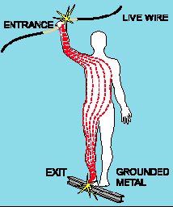
Shock Severity
Severity of the shock depends on:
Path of current through the body
Amount of current flowing through the body (amps)
Duration of the shocking current through the body,
LOW VOLTAGE DOES NOT MEAN LOW HAZARD
The National Safety Council estimates that approximately 300 people in the United States die each year as a result of an electric shock from low voltage systems (120 or 277 volt circuits). People become injured and death occurs when voltage pushes electrons through the human body, particularly through the heart.
Notes:
Other factors that may affect the severity of the shock are:
- The voltage of the current.
- The presence of moisture
- The general health of the person prior to the shock.
Low voltages can be extremely dangerous because, all other factors being equal, the degree of injury increases the longer the body is in contact with the circuit.
The resistance of the body varies based on:
The amount of moisture on the skin (less moisture = more resistance)
The size of the area of contact (smaller area = more resistance)
The pressure applied to the contact point (less pressure = more resistance)
Muscular structure (less muscle = less resistance)

Slide 22


Slide 23
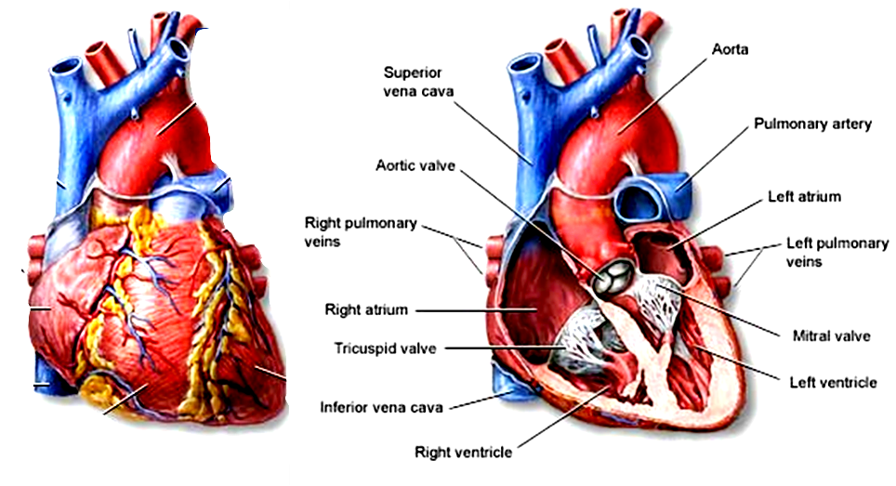
The Heart
Front View
Section View

Slide 24
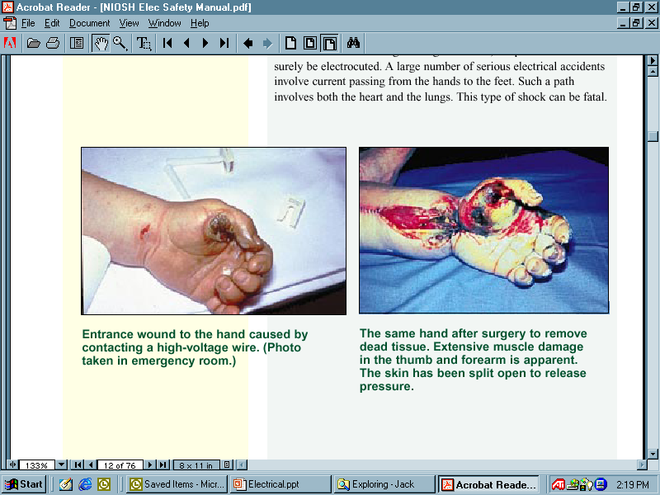
Burns
Most common shock-related injury
Occurs when you touch electrical wiring or equipment that is improperly used or maintained
Typically occurs on hands
Very serious injury that needs immediate attention
Notes:
Shock-related injuries include burns, internal injuries, and injuries due to
involuntary muscle contractions.
The most common shock-related injury is a burn. Burns suffered in electrical incidents may be one or more of the following three types.
Electrical burns cause tissue damage, and are the result of heat generated by the flow of electrical current through the body. These are one of the most serious injuries you can receive and require immediate attention.
Arc or Flash burns are caused by high temperatures near the body produced by an electrical arc or explosion. Attend to them immediately.
Thermal contact burns occur when skin comes in contact with overheated electric equipment, or when clothing is ignited by an electrical incident.

Slide 25
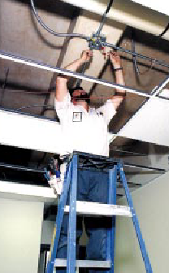
Falls
Electric shock can also cause indirect injuries
Workers in elevated locations who experience a shock may fall, resulting in serious injury or death

Slide 26
Electrical Hazards and How to Control Them
Electrical accidents are caused by a combination of three factors:
Unsafe equipment and/or installation,
Workplaces made unsafe by the environment, and
Unsafe work practices.
Lightning
Notes:
Electrical shocks, fires, or falls result from these hazards:
Exposed electrical parts
Overhead power lines
Inadequate wiring
Defective insulation
Improper grounding
Overloaded circuits
Wet conditions
Damaged tools and equipment
Improper PPE

Slide 27
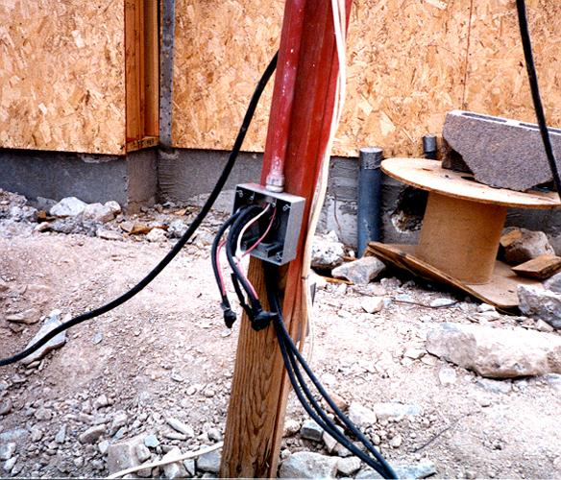
Hazard – Exposed Electrical Parts
Cover removed from wiring or breaker box
Notes:
Electrical equipment, panels and junction boxes can pose direct exposure to live electricity; these sources must be covered.

Slide 28
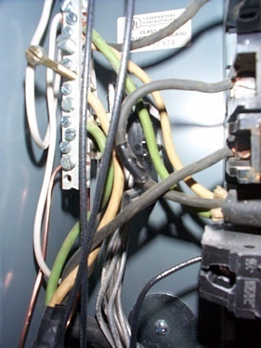
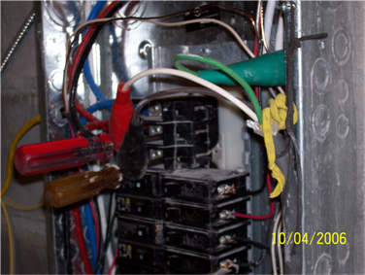
Control – Isolate Electrical Parts
Use guards or barriers
Replace covers
Guard live parts of electric equipment operating at 50 volts or more against accidental contact
Notes:
Reference 1926.403(i)(2)
Except as required or permitted elsewhere in the subpart, live parts of electric equipment operating at 50 volts or more shall be guarded against accidental contact by cabinets or other forms of enclosures, or by any of the following means:
* By location in a room, vault, or similar enclosure that is accessible only to qualified persons.
* By partitions or screens so arranged that only qualified persons will have access to the space within reach of the live parts. Any openings in such partitions or screens shall be so sized and located that persons are not likely to come into accidental contact with the live parts or to bring conducting objects into contact with them.
* By location on a balcony, gallery, or platform so elevated and arranged as to exclude unqualified persons.
* By elevation of 8 feet or more above the floor or other working surface and so installed as to exclude unqualified persons.

Slide 29
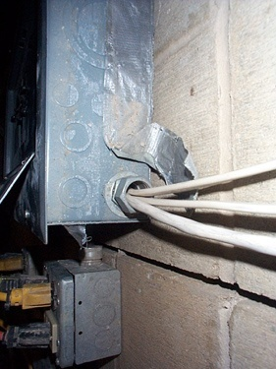
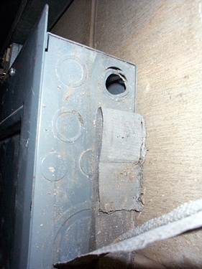
Control – Isolate Electrical Parts - Cabinets, Boxes & Fittings
Conductors going into them must be protected, and unused openings must be closed
Notes:
Reference 1926.405(b)(1)
Conductors entering boxes, cabinets, or fittings. Conductors entering boxes, cabinets, or fittings shall be protected from abrasion, and openings through which conductors enter shall be effectively closed. Unused openings in cabinets, boxes, and fittings shall also be effectively closed.
Covers and canopies. All pull boxes, junction boxes, and fittings shall be provided with covers. If metal covers are used, they shall be grounded. In energized installations each outlet box shall have a cover, faceplate, or fixture canopy. Covers of outlet boxes having holes through which flexible cord pendants pass shall be provided with bushings designed for the purpose or shall have smooth, well‑rounded surfaces on which the cords may bear.

Slide 30
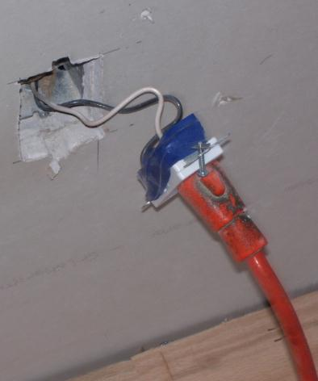
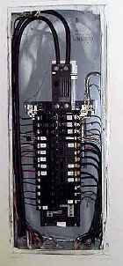
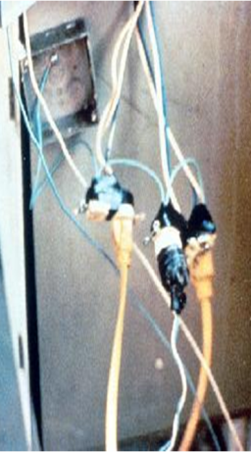
Control – Close Openings
Junction boxes, pull boxes and fittings must have approved covers
Unused openings in cabinets, boxes and fittings must be closed (no missing knockouts)

Slide 31
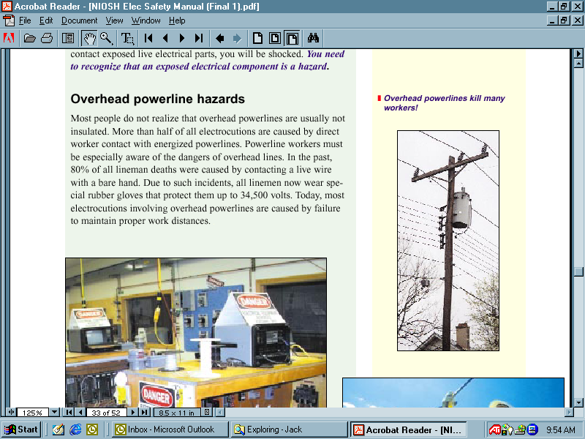
Hazard - Overhead Power Lines
Usually not insulated
Examples of equipment that can contact power lines:
Crane
Ladder
Scaffold
Backhoe
Scissors lift
Raised dump truck bed
Aluminum paint roller
Notes:
Overhead and buried power lines are especially hazardous because they carry extremely high voltage. Fatal electrocution is the main risk, but burns and falls from elevation are also hazards. Using tools and equipment that can contact power lines increases the risk.
More than half of all electrocutions are caused by direct worker contact with energized powerlines. Powerline workers must be especially aware of the dangers of overhead lines. In the past, 80% of all lineman deaths were caused by contacting a live wire with a bare hand. Due to such incidents, all linemen now wear special rubber gloves that protect them up to 34,500 volts. Today, most electrocutions involving overhead powerlines are caused by failure to maintain proper work distances.
Overhead power lines must be deenergized and grounded by the owner or operator of the lines, or other protective measures must be provided before work is started. Protective measures (such as guarding or insulating the lines) must be designed to prevent contact with the lines.
PPE may consist of rubber insulating gloves, hoods, sleeves, matting, blankets, line hose, and industrial protective helmets.

Slide 32
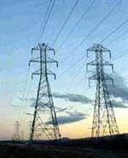
Control - Overhead Power Lines
Stay at least 10 feet away
Post warning signs
Assume that lines are energized
Use wood or fiberglass ladders, not metal
Power line workers need special training & PPE
Notes:
1926.416(a)
How Do I Avoid Hazards?
-- Look for overhead power lines and buried power line indicators. Post warning signs.
-- Contact utilities for buried power line locations.
-- Stay at least 10 feet away from overhead power lines.
-- Unless you know otherwise, assume that overhead lines are energized.
-- Get the owner or operator of the lines to de-energize and ground lines when working near them.
-- Other protective measures include guarding or insulating the lines.
-- Use non-conductive wood or fiberglass ladders when working near power lines.

Slide 33
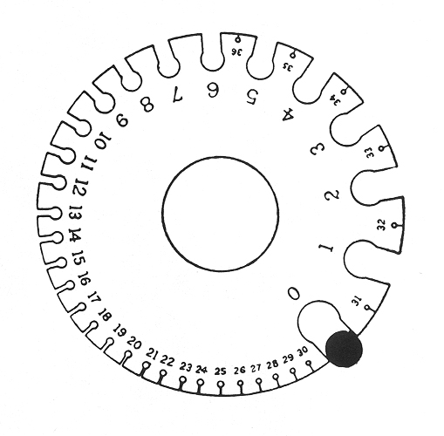
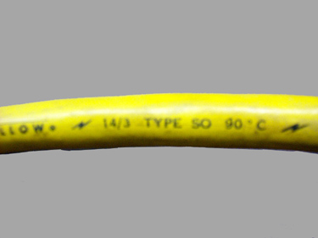
Hazard - Inadequate Wire Gauge and type (conductors and conduits)
Wire Gauge
WIRE
Must be 3-wire type and designed for hard or extra-hard use
Notes:
An electrical hazard exists when the wire is too small a gauge for the
current it will carry. Normally, the circuit breaker in a circuit is
matched to the wire size. However, in older wiring, branch lines to
permanent ceiling light fixtures could be wired with a smaller gauge
than the supply cable.
Note that wire-gauge size is inversely related to the diameter of the wire. For example, a No. 12 flexible cord has a larger diameter wire than a No. 14 flexible cord.
Choose a wire size that can handle the total current. Remember: The larger the gauge number, the smaller the wire!
American Wire Gauge (AWG)
Wire size Handles up to
#10 AWG 30 amps
#12 AWG 25 amps
#14 AWG 18 amps
#16 AWG 13 amps

Slide 34
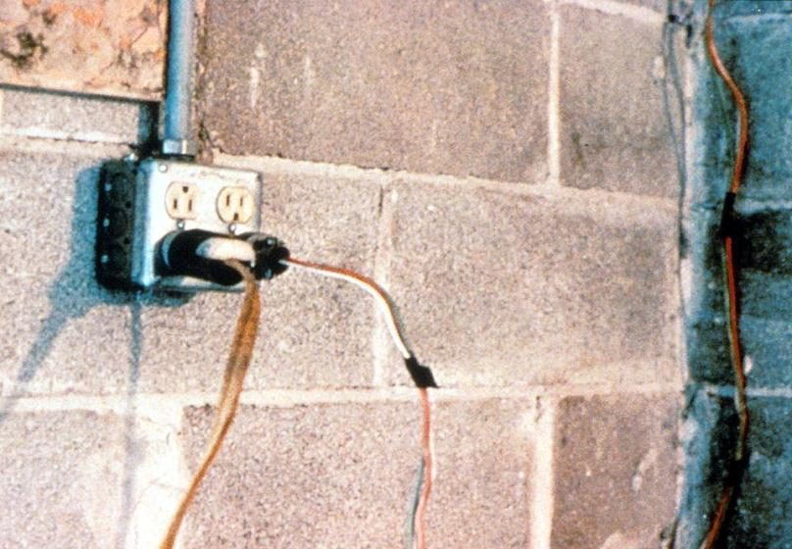
Hazard – Defective Cords & Wires
Notes:
Extension cords may have damaged insulation. Sometimes the insulation inside an electrical tool or appliance is damaged. When insulation is damaged, exposed metal parts may become energized if a live wire inside touches them. Electric hand tools that are old, damaged, or misused may have damaged insulation inside. If you touch damaged power tools or other equipment, you will receive a shock. You are more likely to receive a shock if the tool is not grounded or double-insulated.

Slide 35
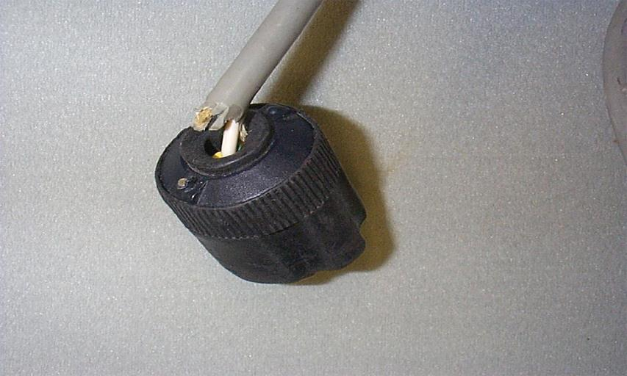
Hazard – Damaged or Defective Cords & Wires
Notes:
Extension cords may have damaged insulation. Sometimes the insulation inside an electrical tool or appliance is damaged. When insulation is damaged, exposed metal parts may become energized if a live wire inside touches them. Electric hand tools that are old, damaged, or misused may have damaged insulation inside. If you touch damaged power tools or other equipment, you will receive a shock. You are more likely to receive a shock if the tool is not grounded or double-insulated.

Slide 36
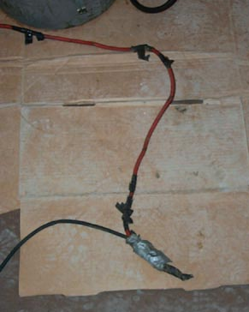
Hazard – Damaged or Defective Cords & Wires
Notes:
Extension cords may have damaged insulation. Sometimes the insulation inside an electrical tool or appliance is damaged. When insulation is damaged, exposed metal parts may become energized if a live wire inside touches them. Electric hand tools that are old, damaged, or misused may have damaged insulation inside. If you touch damaged power tools or other equipment, you will receive a shock. You are more likely to receive a shock if the tool is not grounded or double-insulated.

Slide 37
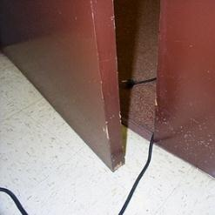
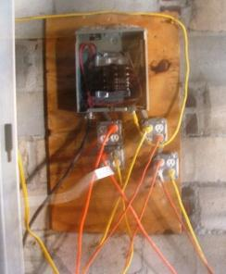
Hazard – Damaged Cords
Cords can be damaged by:
Aging
Door or window edges
Staples or fastenings
Abrasion from adjacent materials
Activity in the area
Improper use can cause shocks, burns or fire
Notes:
Reference 1926.405(a)(2)(ii)(I)
The normal wear and tear on extension and flexible cords at your site can loosen or expose wires, creating hazardous conditions. Cords that are not 3-wire type, not designed for hard-usage, or that have been modified, increase your risk of contacting electrical current.

Slide 38
Permissible Use of Flexible Cords
DO NOT use flexible wiring where frequent inspection would be difficult or where damage would be likely.
Flexible cords must not be . . .
run through holes in walls, ceilings, or floors;
run through doorways, windows, or similar openings (unless physically protected);
hidden in walls, ceilings, floors, conduit or other raceways.
Notes:
Other use examples:
Elevator cables
Wiring of cranes and hoists
Prevention of the transmission of noise or vibration
Appliances where the fastening means and mechanical connections are designed to permit removal for maintenance and repair
DO NOT use flexible wiring in situations where frequent inspection would be difficult, where damage would be likely, or where long-term electrical supply is needed. Flexible cords cannot be used as a substitute for the fixed wiring of a structure.
Flexible cords must not be . . .
run through holes in walls, ceilings, or floors;
run through doorways, windows, or similar openings (unless physically protected);
attached to building surfaces or
hidden in conduit or other raceways.

Slide 39
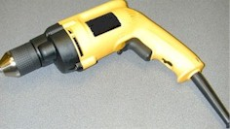
Control – Ground Tools & Equipment
Ground power supply systems, electrical circuits, and electrical equipment
Frequently inspect electrical systems to insure path to ground is continuous
Inspect electrical equipment before use
Don’t remove ground prongs from tools or extension cords
Ground exposed metal parts of equipment
Notes:
A typical extension cord grounding system has four components:
a third wire in the cord, called a ground wire;
a three-prong plug with a grounding prong on one end of the cord;
a three-wire, grounding-type receptacle at the other end of the cord; and
a properly grounded outlet.
Two kinds of grounds are required by the standard:
1. Service or system ground. In this instance, one wire, called the neutral conductor or grounded conductor, is grounded. In an ordinary low-voltage circuit, the white (or gray) wire is grounded at the generator or transformer and again at the service entrance of the building. This type of ground is primarily designed to protect machines, tools, and insulation against damage.
2. For enhanced worker protection, an additional ground, called the equipment ground, must be furnished by providing another path from the tool or machine through which the current can flow to the ground. This additional ground safeguards the electric equipment operator if a malfunction causes the metal frame of the tool to become energized.

Slide 40
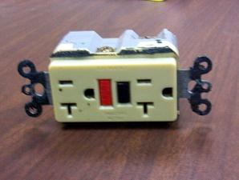
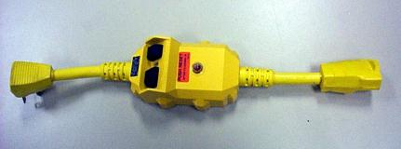
Control – Use GFCI (ground-fault circuit interrupter)
Protects you from shock
Detects difference in current between the black and white wires
If ground fault detected, GFCI shuts off electricity in 1/40th of a second
Use GFCI’s on all 120-volt, single-phase, 15- and 20-ampere receptacles, or have an assured equipment grounding conductor program.
Notes:
Reference 1926.404(b)(1)(i)
GFCI:
Matches the amount of current going to an electrical device against the amount of current returning from the device.
Interrupts the electric power within as little as 1/40 of a second when the amount of current going differs from the amount returning by about 5 mA
Must be tested to ensure it is working correctly.
NEC requires GFCI’s be used in these high-risk situations:
Electricity is used near water.
The user of electrical equipment is grounded (by touching grounded material).
Circuits are providing power to portable tools or outdoor receptacles.
Temporary wiring or extension cords are used.
There is one disadvantage to grounding: a break in the grounding system may occur without the user's knowledge. Using a ground-fault circuit interrupter (GFCI) is one way of overcoming grounding deficiencies.

Slide 41
Control - Assured Equipment Grounding Conductor Program
Program must cover:
All cord sets
Receptacles not part of a building or structure
Equipment connected by plug and cord
Program requirements include:
Specific procedures adopted by the employer
Competent person to implement the program
Visual inspection for damage of equipment connected by cord and plug
Notes:
Reference 1926.404(b)(1)(iii)
Assured Equipment Grounding Conductor Program (AEGCP).
The employer shall establish and implement AEGCP on construction sites covering all listed above which are available for use or used by employees. This program has the following minimum requirements:
- Daily visual inspections,
- Periodic test inspections (3 months at most for temporary cords and cords exposed to damage, 6 months for fixed cords not exposed)
- Written description,
- A competent person to implement the program, and
- Record of the periodic tests.
When portions of the building(s) or structures(s) which have been completed and no longer expose employees to weather or damp and wet locations, or to other grounding hazards, GFCIs or an assured equipment grounding program may not be required when approved extension cords are plugged into the permanent wiring at construction sites.

Slide 42
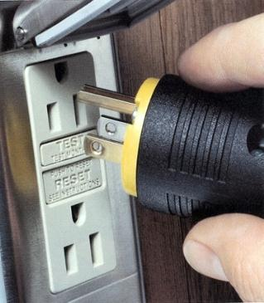
Power Tool Requirements
Have a three-wire cord with ground plugged into a grounded receptacle, or
Be double insulated, or
Be powered by a low-voltage isolation transformer
Notes:
Common Examples of Misused Equipment = OSHA Violations
* Using multi-receptacle boxes designed to be mounted by fitting them with a power cord and placing them on the floor.
* Fabricating extension cords with ROMEX® wire.
* Using equipment outdoors that is labeled for use only in dry, indoor locations.
* Attaching ungrounded, two-prong adapter plugs to three-prong cords and tools.
* Using circuit breakers or fuses with the wrong rating for over-current protection, e.g. using a 30-amp breaker in a system with 15- or 20-amp receptacles. Protection is lost because it will not trip when the system's load has been exceeded.
* Using modified cords or tools, e.g., removing ground prongs, face plates, insulation, etc.
* Using cords or tools with worn insulation or exposed wires.

Slide 43
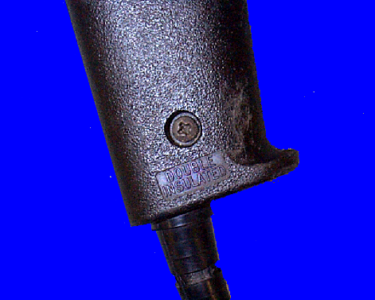
Preventing Electrical Hazards - Tools
Inspect tools before use
Use the right tool correctly
Protect your tools
Use double insulated tools
Double Insulated marking
Notes:
* Use tools and equipment according to the instructions included in their listing, labeling or certification.
* Visually inspect all electrical equipment before use. Remove from service any equipment with frayed cords, missing ground prongs, cracked tool casings, etc. Apply a warning tag to any defective tool and do not use it until the problem has been corrected.

Slide 44
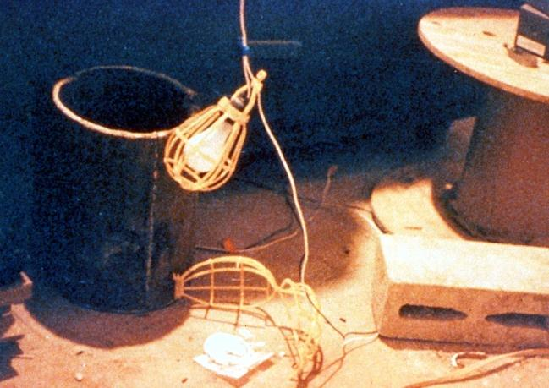
Temporary Lights
Protect from contact and damage, and don’t suspend by cords unless designed to do so. GFCI protected when subject to water and when extension whips are use.
Notes:
Reference 1926.405(a)(2)

Slide 45
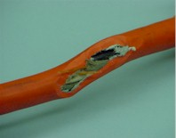
Clues that Electrical Hazards Exist
Tripping circuit breakers or blown fuses
Warm tools, wires, cords, connections, or junction boxes
GFCI that shuts off a circuit
Worn or frayed insulation around wire or connection
Notes:
There are “clues” that electrical hazards exist. For example, if a GFCI keeps tripping while you are using a power tool, there is a problem. Don’t keep resetting the GFCI and continue to work. You must evaluate the “clue” and decide what action should be taken to control the hazard.
There are a number of other conditions that indicate a hazard.
Tripped circuit breakers and blown fuses show that too much current is flowing in a circuit. This could be due to several factors, such as malfunctioning equipment or a short between conductors. You need to determine the cause in order to control the hazard.
An electrical tool, appliance, wire, or connection that feels warm may indicate too much current in the circuit or equipment. You need to evaluate the situation and determine your risk.
An extension cord that feels warm may indicate too much current for the wire size of the cord. You must decide when action needs to be taken.
A cable, fuse box, or junction box that feels warm may indicate too much current in the circuits.
A burning odor may indicate overheated insulation.
Worn, frayed, or damaged insulation around any wire or other conductor is an electrical hazard because the conductors could be exposed. Contact with an exposed wire could cause a shock. Damaged insulation could cause a short, leading to arcing or a fire. Inspect all insulation for scrapes and breaks. You need to evaluate the seriousness of any damage you find and decide how to deal with the hazard.
A GFCI that trips indicates there is current leakage from the circuit First, you must decide the probable cause of the leakage by recognizing any contributing hazards. Then, you must decide what action needs to be taken.

Slide 46
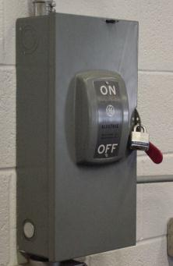
Lockout and Tagging of Circuits
Apply locks to power source after de-energizing
Tag deactivated controls
Tag de-energized equipment and circuits at all points where they can be energized
Tags must identify equipment or circuits being worked on
Notes:
Reference 1926.417:
(a) Controls. Controls that are to be deactivated during the course of work on energized or de-energized equipment or circuits shall be tagged.
(b) Equipment and circuits. Equipment or circuits that are deenergized shall be rendered inoperative and shall have tags attached at all points where such equipment or circuits can be energized.
(c) Tags. Tags shall be placed to identify plainly the equipment or circuits being worked on.
(d) Lockout and tagging. While any employee is exposed to contact with parts of fixed electric equipment or circuits which have been de-energized, the circuits energizing the parts shall be locked out or tagged or both.
Case study
An electrician was removing a metal fish tape from a hole at the base of a metal light pole.
(A fish tape is used to pull wire through a conduit run.) The fish tape became energized, electrocuting him. As a result of its inspection, OSHA issued a citation for three serious violations of the agency’s construction standards.
If the following OSHA requirements had been followed, this death could have been prevented.
• De-energize all circuits before beginning work.
• Always lock out and tag out de-energized equipment.
• Companies must train workers to recognize and avoid unsafe conditions

Slide 47
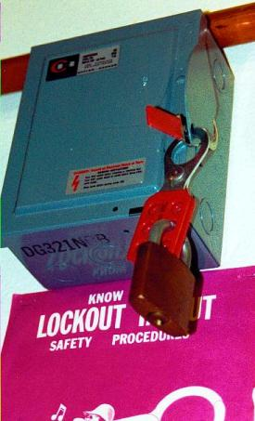
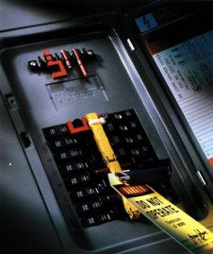
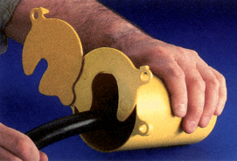
Electrical Lockout Devices
Locked out circuit breaker
Locked out electrical panel
Locked out electrical plug
Notes:
“If you don’t have an electrical disconnect next to a machine, then you can attach a lock to the electrical panel. There are also individual circuit breaker locks, which may be better than locking the electrical panel cover since in an emergency, it may be necessary to get to the panel to shut off breakers other than the one that is locked out.
You don’t have to have a lockout procedure for a machine with all its energy controlled by pulling the plug if the worker maintains exclusive control of the plug. If that is not the case, the photo on the right shows how to lockout a plug at the end of an electrical cord.”

Slide 48
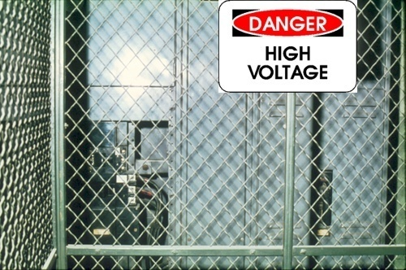
Safety-Related Work Practices
Use barriers and guards
Post hazard warnings signs
Keep working spaces and walkways clear of cords
Remove jewelry
Avoid wet conditions and overhead power lines
Notes:
1926.416, 1926.417
Employees must not work near any part of an electric power circuit that the employee could contact in the course of work, unless the employee is protected against electric shock by de-energizing the circuit and grounding it or by guarding it effectively by insulation or other means.
* In work areas where the exact location of underground electric power lines is unknown, employees using jack‑hammers, bars, or other hand tools which may contact a line shall be provided with insulated protective gloves.
* Before work is begun, inquire or observe by instruments whether any part of an energized electric power circuit is so located that the performance of the work may bring any person, tool, or machine into physical or electrical contact with the electric power circuit. Post and maintain proper warning signs where such a circuit exists. The employer shall advise employees of the location of such lines, the hazards involved, and the protective measures to be taken.

Slide 49
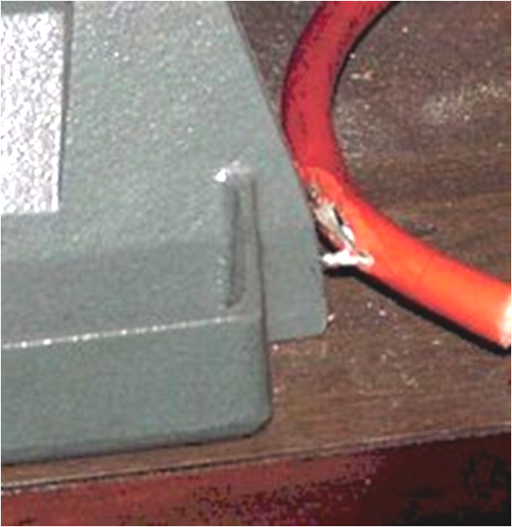
Safety-Related Work Practices
Use special insulated tools when working on fuses with energized terminals
Don’t use worn or frayed cords and cables
Don’t fasten extension cords with staples, hang from nails, or suspend by wire.
Notes:
1926.416, 1926.417
Only qualified persons may work on electric circuit parts or equipment that have not been de-energized. Such persons shall be capable of working safely on energized circuits and shall be familiar with the proper use of special precautionary techniques, PPE, insulating and shielding materials, and insulated tools.
De-energize live parts that an employee may be exposed to before the employee works on or near them, unless the employer can demonstrate that deenergizing introduces additional or increased hazards or is infeasible due to equipment design or operational limitations. Live parts that operate at less than 50 volts to ground need not be deenergized if there will be no increased exposure to electrical burns or to explosion due to electric arcs.
If the exposed live parts are not de-energized other safety-related work practices shall be used to protect employees who may be exposed to the electrical hazards. Employees must be protected against contact with energized circuit parts with any part of their body or indirectly through some other conductive object.
Lock or tag out (or both) the circuits energizing the parts while any employee is exposed to contact with parts of fixed electric equipment or circuits which have been de-energized.
If working near overhead lines, the lines shall be de-energized and grounded, or other protective measures shall be provided before work is started.
Portable cord and plug connected equipment and extension cords shall be visually inspected before use on any shift for external defects (such as loose parts, deformed and missing pins, or damage to outer jacket or insulation) and for evidence of possible internal damage (such as pinched or crushed outer jacket).

Slide 50
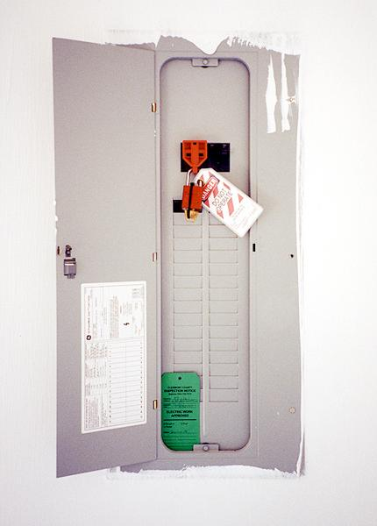
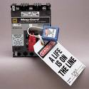
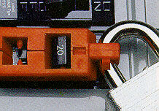
Notes:
Make your environment safer by doing the following:
Lock and tag out circuits and machines.
Prevent overloaded wiring by using the right size and type of wire.
Prevent exposure to live electrical parts by isolating them.
Prevent exposure to live wires and parts by using insulation.
Prevent shocking currents from electrical systems and tools by grounding them.
Prevent shocking currents by using GFCI’s.
Prevent too much current in circuits by using over current protection devices.

Slide 51
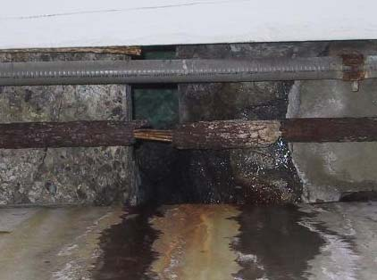
Avoid Wet Conditions
If you touch a live wire or other electrical component while standing in even a small puddle of water you’ll get a shock.
Damaged insulation, equipment, or tools can expose you to live electrical parts.
Improperly grounded metal switch plates & ceiling lights are especially hazardous in wet conditions.
Wet clothing, high humidity, and perspiration increase your chances of being electrocuted.
Notes:
A damaged tool may not be grounded properly, so the housing of the tool may be energized, causing you to receive a shock.
Improperly grounded metal switch plates and ceiling lights are especially hazardous in wet conditions. If you touch a live electrical component with an uninsulated hand tool, you are more likely to receive a shock when standing in water. But remember: you don’t have to be standing in water to be electrocuted. Wet clothing, high humidity, and perspiration also increase your chances of being electrocuted.
Use extra caution when working with electricity when water is present in the environment or on the skin. Pure water is a poor conductor, but small amounts of impurities, like salt and acid (both are in perspiration), make it a ready conductor.

Slide 52
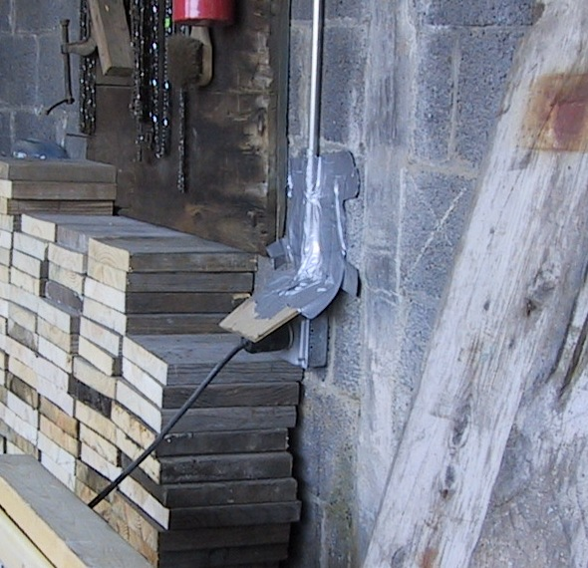
Notes:
This photo depicts an inappropriate means of protection from water. The roof in this work area was leaking so worker provided an inappropriate makeshift shield. 1926.405 (e) Enclosures for damp or wet locations.
(1) Cabinets, fittings, and boxes. Cabinets, cutout boxes, fittings, boxes, and panel board enclosures in damp or wet locations shall be installed so as to prevent moisture or water from entering and accumulating within the enclosures. In wet locations the enclosures shall be weatherproof. 1926.405 (j)(2) (ii) Damp and wet locations. A receptacle installed in a wet or damp location shall be designed for the location.

Slide 53
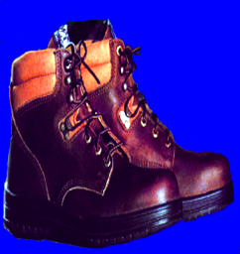
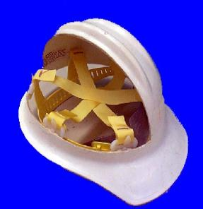
Preventing Electrical Hazards - PPE
Proper foot protection (not tennis shoes)
Rubber insulating gloves, hoods, sleeves, matting, and blankets
Hard hat (insulated - nonconductive)
Notes:
Personal protective equipment (PPE) should always be the last line of defense against a hazard. If the hazard is unavoidable, and cannot be addressed in any other safe manner, then employees must be fitted with proper PPE.
Safety shoes should be nonconductive and protect your feet from completing an electrical circuit to ground. They can also protect against open circuits of up to 600 volts in dry conditions. These shoes should be used with other insulating equipment and in connection with active precautions to reduce or eliminate the potential for providing a path for hazardous electrical energy.
When it is necessary to handle or come close to wires with a potential live electrical charge, it is essential to use proper insulating PPE to protect employees from contact with the hazardous electrical energy.
Specific types of hard hats are needed when performing electrical work.
A “Class B” Electrical/Utility type hard hat protects against falling objects and high-voltage shock and burns.

Slide 54
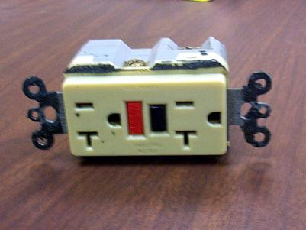
Preventing Electrical Hazards – Proper Wiring and Connectors
Use and test GFCI’s
Check switches and insulation
Use three prong plugs
Use extension cords only when necessary & assure in proper condition and right type for job
Use correct connectors
Notes:
If the polarity is reversed on a GFCI, the lights will test good, but the press to test button will not trip the circuit.

Slide 55
Training
Train employees working with electric equipment in safe work practices, including:
De-energize electric equipment before inspecting or repairing
Using cords, cables, and electric tools that are in good repair
Lockout / Tagout recognition and procedures
Use appropriate protective equipment
Notes:
1926.21(b)(2)
De-energizing Electrical Equipment.
Accidental or unexpected starting of electrical equipment can cause injury or death. Before ANY inspections or repairs are made, the current must be turned off at the switch box and the switch padlocked in the OFF position. At the same time, the switch or controls of the machine or other equipment being locked out of service must be securely tagged to show which equipment or circuits are being worked on.
Employees shall be trained in and familiar with the safety-related work practices that pertain to their respective job assignments.

Slide 56
Summary Hazards/ Protective Measures
Inadequate wiring/ Electrical wiring installed by a qualified person and properly grounded.
Exposed electrical parts/ Competent person inspections, close or guard live parts with covers, plates or barricades , Ground-fault-circuit-interrupters.
Wires with bad insulation/Regular inspections and care of extension cords, proper use and avoidance sharp or abrasive edges.
Ungrounded electrical systems and tools/Competent person inspections and electrical wiring installed by qualified persons.
Overloaded circuits/ wiring installed by qualified persons
Damaged power tools and equipment/ Inspections and proper use.
Using the wrong PPE and tools/Training
Overhead powerlines/ Competent person inspection
All hazards are made worse in wet conditions/ Control sources of water accumulation use Ground-fault-circuit-interrupters.

Slide 57
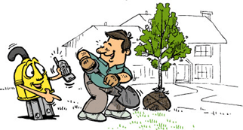
Call Before You Dig Before digging, the competent person should verify if there are any underground utilities such as electric, gas or water. (Many states have a one-call phone number to provide a mark-out for the locations of utilities buried under and nearby a proposed excavation)

Slide 58

Electrical Rescue
911
Electrical Rescue Order
Call for Help
Notes:
Keep in mind that someone who touches someone who is energized through an electrical circuit may also become part of the same electrical circuit.

Slide 59

High Voltage Crane/Excavator Contact
Strike
Voltage differential across the ground
Notes:
A worker moving away from an area where electrical energy is dissipating into the earth, which creates rings of electrical differential, the worker should avoid taking wider steps because the wider the steps the greater connection of rings of differential. Instead the worker should take short shuffle-like steps keeping his feet close to minimize differently between each leg.

Slide 60

High Voltage Crane Contact
Jump clear. If an emergency such as fire forces you to leave the equipment, jump clear. If part of your body contacts the ground while another part touches the machine, current will travel through you. In cases of high-voltage contact, jump clear and shuffle away in small steps. With voltage differential across the ground, one foot may be in a higher voltage area than the other. The difference could kill you.

Slide 61

"If you can see it, flee it; if you can hear it, clear it."

Slide 62
Lightning Decision Tree
"If you can see it, flee it; If you can hear it, clear it.“
Weather Channel; NOAA Weather Radio
Make decision to suspend activities and notify people.
The 30/30 Rule says to shut down when lightning is six miles away. Use a "flash to bang" (lightning to thunder) count of five seconds equals one mile (10 = 2 miles; 20 = 4 miles; 30 = 6 miles).
Notify people via radio, siren or other means.
Move to safe location A large permanent building or metal vehicle is best.
Unsafe places are near metal or water; under trees; on hills; near equipment, in open areas, roof tops.
Reassess the hazard. It’s usually safe after no thunder and no lightning have been observed for thirty minutes. Be conservative here.

Slide 63
Let’s look at some electrical hazard photos of actual worksites and see if you can recognize them….

Slide 64


Notes:
The most frequently violated OSHA electrical regulation is improper grounding of equipment and circuitry. The metal parts of an electrical wiring system that we touch (switch plates, ceiling light fixtures, conduit, etc.) should be grounded and at 0 volts. If the system is not grounded properly, these parts may become energized. Metal parts of motors, appliances, or electronics that are plugged into improperly grounded circuits may be energized. When a circuit is not grounded properly, a hazard exists because unwanted voltage cannot be safely eliminated. If there is no safe path to ground for fault currents, exposed metal parts in damaged appliances can become energized.
Extension cords may not provide a continuous path to ground because of a broken ground wire or plug.
Electrical systems are often grounded to metal water pipes that serve as a continuous path to ground. If plumbing is used as a path to ground for fault current, all pipes must be made of conductive material (a type of metal). Many electrocutions and fires occur because (during renovation or repair) parts of metal plumbing are replaced with plastic pipe, which does not conduct electricity.

Slide 65

Notes:
These striped wires were inappropriately used to connect into the adjacent electrical receptacle. 1926.449 (c) With respect to custom-made equipment or related installations which are designed, fabricated for, and intended for use by a particular customer, if it is determined to be safe for its intended use by its manufacturer on the basis of test data which the employer keeps and makes available for inspection to the Assistant Secretary and his

Slide 66

Notes:
This inappropriately repaired extension cord must be removed from service. (c) With respect to custom-made equipment or related installations which are designed, fabricated for, and intended for use by a particular customer, if it is determined to be safe for its intended use by its manufacturer on the basis of test data which the employer keeps and makes available for inspection to the Assistant Secretary and his

Slide 67

Notes:
This extension cord shows signs of being twisted and is being crushed in rubble with a wire rope (condutive material) laying over it. 1926.404 (b)(1)(iii) [C] Each cord set, attachment cap, plug and receptacle of cord sets, and any equipment connected by cord and plug, except cord sets and receptacles which are fixed and not exposed to damage, shall be visually inspected before each day's use for external defects, such as deformed or missing pins or insulation damage, and for indications of possible internal damage. Equipment found damaged or defective shall not be used until repaired.

Slide 68

Notes:
This inappropriately electrical box must be removed from service. (c) With respect to custom-made equipment or related installations which are designed, fabricated for, and intended for use by a particular customer, if it is determined to be safe for its intended use by its manufacturer on the basis of test data which the employer keeps and makes available for inspection to the Assistant Secretary and his

Slide 69

Notes:
This generator is not grounded and wires are laying in water. 1926.404(f) (2) Separately derived systems. Where paragraph (f)(1) of this section requires grounding of wiring systems whose power is derived from generator, transformer, or converter windings and has no direct electrical connection, including a solidly connected grounded circuit conductor, to supply conductors originating in another system, paragraph (f)(5) of this section shall also apply.
(3) Portable and vehicle-mounted generators.

Slide 70

Notes:
Manufacture’s manuals will point out specifically where generators should be grounded. 1926.404(f) (2) Separately derived systems. Where paragraph (f)(1) of this section requires grounding of wiring systems whose power is derived from generator, transformer, or converter windings and has no direct electrical connection, including a solidly connected grounded circuit conductor, to supply conductors originating in another system, paragraph (f)(5) of this section shall also apply.
(3) Portable and vehicle-mounted generators. Note: electrical codes can vary by jurisdiction and may be more protective.

Slide 71
Electrical System Summary
You Should Know
You should know how an electrical hazard protection program works in a system.
You should know what OSHA requires in an electrical protection program
You should be trained in the avoidance of electrical hazards and know the rules and how to apply them in the field.
You should be able to recognize, avoid and prevent falls on the job. RAP
Notes:
Or instructor, if the instructor wants to be contacted.

Slide 72
The End
&
The
Beginning

