Slide 1

Systems of Safety Applied to Focus Four Hazards
USDOL-OSHA
Susan Harwood Grant
SHT21005SH0

Slide 2
Systems of Safety Applied to Focus Four Hazards
This material was produced under grant number SHT21005SHO from the Occupational Safety and Health Administration, U.S. Department of Labor. It does not necessarily reflect the view or policies of the U.S. Department of Labor, nor does mention of trade names, commercial products, or organizations imply endorsement by U.S. Government.

Slide 3
FALLS

Slide 4
The Fall Protection System
Falls are the leading cause of deaths in the construction industry.
Most fatalities occur when employees fall from open-sided floors and through floor openings.
Falls from as little as 4 to 6 feet can cause serious lost-time accidents and sometimes death.
Open-sided floors and platforms 6 feet or more in height must be guarded.

Slide 5
Construction Fall Fatalities 2007
Data Source: Bureau of Labor Statistics Census of Fatal Occupational Injuries

Slide 6
Learning Objectives
Identify the parts of a Fall Protection System
Determine what workers must know about their roles in a Fall Protection System.
Understand what training OSHA requires that any worker whom might be exposed to a fall hazard MUST have.
Fall Protection Training Sample.

Slide 7
Are there any risks of falls on our jobsites?
Have there been any fall related accidents or citations?
Does the company have a Fall Protection Program that fits the tasks employees regularly perform?
What Equipment does the company use?
What do other companies do to protect workers from falls.
Is our workforce trained and do they follow their training in the field?
What are the attitudes and aptitudes of employees?
Assess
Can we eliminate fall hazards
by prefabrication or substitution?
Fall Protection Equipment
Job specific Subpart M training
Write Fall Program
Create Fall Protection Field Checklists, Form, templates.
Rescue Equipment
Write recordkeeping harness inspection logs, safe work plan templates and pre-task surveys.
Designate Competent Persons organization structure.
Control
Consultant
&
Committee
Review
Trials
Benchmark
Perform Subpart M Training
Competent Person Training
Create Toolbox Talks
Hands-on Harness Training
Guardrail systems training
Employee’s role in fall plan
Practice Rescue Drills
Safety & Health Bulletins
Train
Test Runs
Competent
Person
Review
Implement
Perform frequent and regular inspections of sites.
Review Competent Person daily pre-task inspections of fall protection controls.
Frequent communications with fall protection competent persons.
End of week employee fall protection debriefings
Accident or incident investigations
Monitor
Sample Fall Protection System

Slide 8
The Fall Protection System Questions You Should Ask
Where are employees subject to fall hazards at or above 6 feet?
Are workers subject to falls into impalement hazards, dangerous equipment or sources of uncontrolled energy?
Are workers trained in to recognize a properly built guardrail system or other fall protection systems?
Are workers trained in how to wear full-body harnesses and use personal fall arrest systems?
Does the company have a fall protection program in its Health and Safety Plan?
Is housekeeping maintained through all phases of work?
Do all workers have certified fall protection training?
Has anyone ever fallen on one of our sites?
Have there been any near misses on our sites?
Are there open holes on our sites?
Notes:
The advantages of checklists created by your employer can keep us on point. Stress that even experts can’t focus well in times of emergency so deliberate checklists during our planning stages can be very useful in a real emergency. Training in those plans of course is essential.

Slide 9
Fall Protection Assessment of Hazards
Task | Hazard | Control | Means of Implementation
Connecting Steel | Falls to a lower level | Personal Fall Arrest System Retractable lifelines | Purchase PFAS equipment Train Workers to use PFAS equipment Subpart M Training
Installing wire rope perimeter protection | Falls to below | Prefabrication of perimeter wire rope before steel is hoisted into place | Contract with steel fabricator to deliver steel with wire rope perimeter protection in place or have iron workers install protections at ground level before hoisting into place.
Sample Fall Protection JHA

Slide 10
Fall Protection Training
Employee Training must:
Focus on identifying fall hazards.
Provide training in a manner that is fully understandable and clearly defines an employee’s responsibilities inside of the overall system.
Clearly defines the Competent Person’s role in the safety process and system.
Use safe work practices
Use fall protection equipment
Understand the requirements of their company’s fall protection plan.
Know their role in the fall protection plan and rescue.

Slide 11
Fall Protection Training
Employer shall provide a training program for each employee who
might be exposed to fall hazards, which includes minimally:
The nature of fall hazards in the work area and how to recognize them.
The correct procedures for erecting, maintaining, disassembling, and inspecting fall protection systems employees use.
How guardrail systems, personal fall arrest systems, safety net systems, warning line systems, safety monitoring systems, controlled access zones, and other protections work and how to recognize defects in such systems.
The role of each employee in the safety monitoring system when this system is used.
The limitations on the use of mechanical equipment during the performance of roofing work on low-sloped roofs if such tasks are performed.
The correct procedures for the handling and storage of equipment and materials and the erection of overhead protection.
The role of employees in fall protection plans;
The standards contained in Subpart M 29 CFR 1926.500.

Slide 12
Certification of Training
Employer shall have a written certification record that will contain the
Name or other identity of the employee trained,
date of the training,
signature of the person who conducted the training or the signature of the employer. (If the employer relies on training conducted by another employer the certification record shall indicate the date the employer determined the prior training was adequate rather than the date of actual training.
Retraining: When the employer has reason to believe that an employee does not have the proper understanding and skill required by the fall protection training or when there are changes in the workplace, changes in the types of fall protection systems or equipment to be used render previous training obsolete; or inadequacies in employee's knowledge or behavior around protection systems or equipment indicate that the employee has not retained the requisite understanding or skill.

Slide 13
Competent Person Responsibilities
Designated competent person:
Has the knowledge and experience needed to identify fall hazards
Has authority to eliminate fall hazards
Has authority to stop work if unsafe conditions exists
Competent person is responsible for implementing the fall protection plan
Identifying and evaluating fall hazards
Establishing fall protection system to use
Assessing workers use of fall protection systems
Conducting safety inspections
Review and drill of rescue procedures for Personal Fall Arrest System (PFAS)

Slide 14
Competent Person Responsibilities
Designated competent person:
Has the knowledge and experience needed to identify fall hazards
Has authority to eliminate fall hazards
Has authority to stop work if unsafe conditions exist
Can evaluate fall hazards and protections
Assesses workers who use fall protection systems
Conducts safety inspections

Slide 15
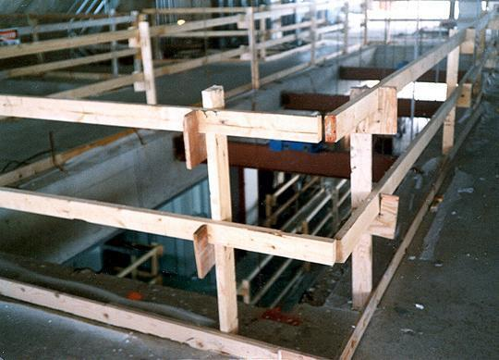
Guardrails
Top Rail
Mid- Rail
Toeboard
Top rails between 39 and 45 inches tall
Toeboards at least 3 1/2 inches high
Notes:
Reference 1926.502(b) and 1926.502(j)
How do guardrail systems protect me from falling?
Guardrail systems provide a barrier to protect the employee from falling:
Top edge of the guardrail must be 39-45 inches above the walking/working level.
There must also be protection from falling between the top rail and the walking/working surface. Midrails, screens, mesh, or intermediate vertical members may be used for this protection. There are specific requirements for their installation.
The protective barriers must be strong enough to support a falling employee. Wood, chain and wire rope may be used for top rails and midrails.

Slide 16
Methods of Fall Protection
Safety Nets...shall be installed as close as practicable under the walking/ working surfaces on which employees are working...in no case more than 30 feet....when they extend outward, nets should extend 8 feet when up to 5 feet above, 10 feet when between 5-10.... And 13 feet when more than 10 feet.....safety nets, dropped tested, inspected weekly for wear and tear or immediately after an occurrence that could affect integrity of net.....Take material, debris out of nets ASAP, 36 sq.. inches for structural net no more than a 6” opening (6” x 6”)

Slide 17
Alternate methods of Fall Protection
Controlled Access Zones....for leading edge work..close off the area to all but trained personnel.....overhand bricklaying......control lines consists of ropes, wires, tapes etc.... flagged at 6 foot intervals.....new steel standard mentions the “controlled decking zone” as another alternative to conventional fall protection.....

Slide 18
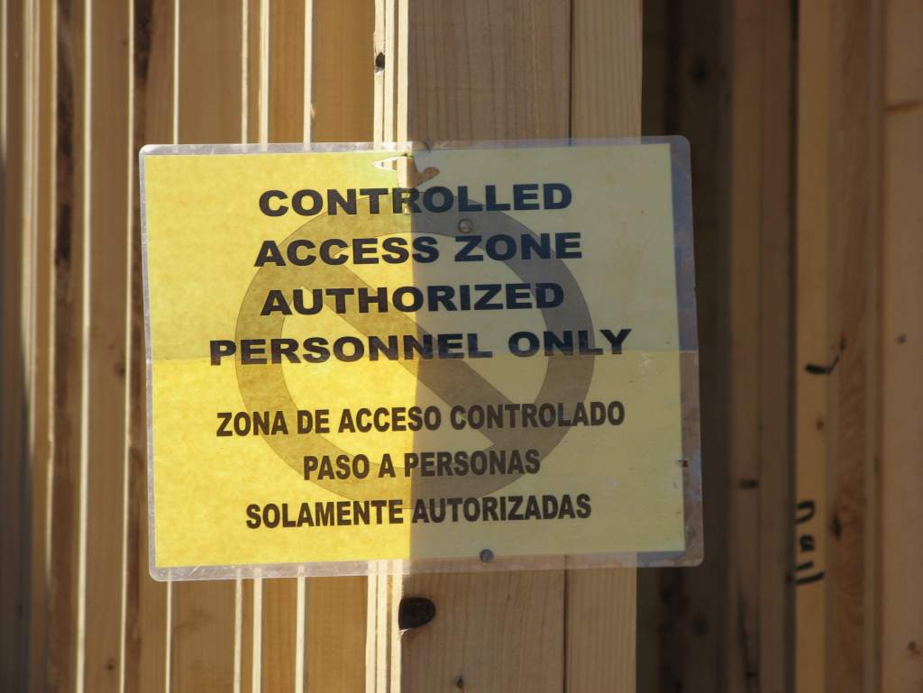

Slide 19
Alternate methods of Fall Protection
Safety Monitoring System.....when other systems are not feasible....designated person....monitor the safety of employees...competent to recognize fall hazards.....warns the employees...same walking/working surface...within visual sighting ......no other responsibilities.....

Slide 20
Alternate methods of Fall Protection
Fall Protection Plan is allowed only in leading edge work, pre-cast concrete erection...or residential construction.......if it can be proven that conventional fall protection is infeasible......
OSHA Regulations Standards
29 C.F.R. §1926
Safety and Health Regulations for Construction
Subpart M, Appendix E – Sample Fall Protection Plan

Slide 21
Covers
Support twice the weight applied....covers secured.....to prevent accidental displacement....by wind, employees, or equipment....needed to close any gap (hole) more than 2” wide.... Marked “Hole” or “Cover”

Slide 22
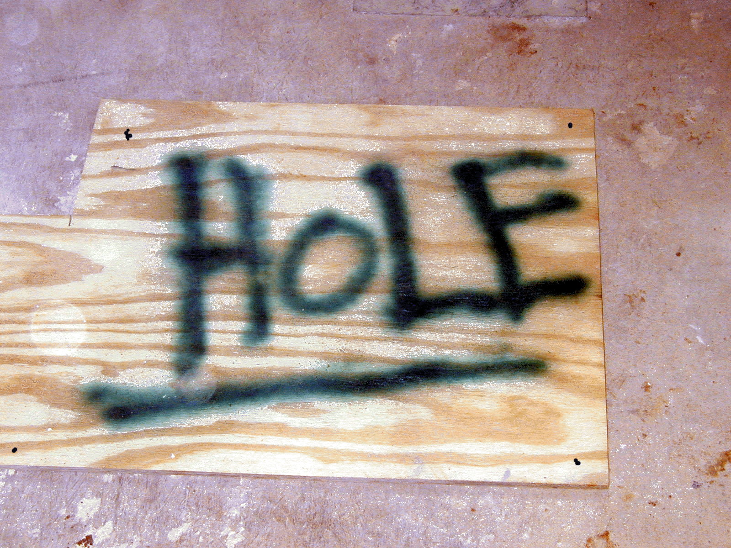
Must be marked with the word "HOLE" or "COVER”

Slide 23
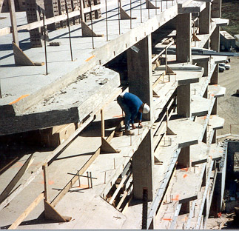
Notes:
1926 Subpart M – Fall Protection
This photo represents a worker exposed to a fall above 6 feet. What side of the guardrails should a worker work?

Slide 24
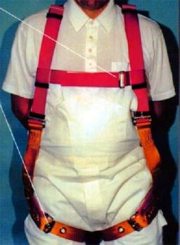
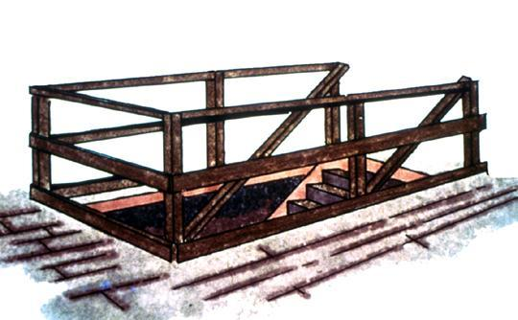

Fall Protection Options
Personal Fall
Arrest System
(PFAS)
Guardrails
Safety Net
Notes:
Reference 1926.501(b)(1)
General rule: If an employee can fall six feet or more onto a lower level, fall protection must be provided.
What type of fall protection will I need?
In most cases, a guardrail system, a safety net system, or a personal fall arrest system must be used. In some cases fences, barricades, covers, equipment guards or a controlled access zone may be used.
Employees must be protected not just from falling off a surface, but from falling through holes and from having objects fall on them from above.

Slide 25
General Requirements Housekeeping
All places of employment, passageways, storerooms, and service rooms shall be kept clean and orderly and in a sanitary condition.
The floor of every workroom shall be maintained in a clean and, so far as possible, a dry condition.
Every floor, working place and passageway shall be kept free from protruding nails, splinters, holes, or loose boards.
Good housekeeping prevents fires.
Bad housekeeping is a breeding place for all types of accidents.

Slide 26
Protection of Open-Sided Floors & Platforms
Regardless of height, open-sided floors, manholes, walkways, platforms, or runways above or adjacent to dangerous equipment or similar hazards shall be guarded with a standard railing and toeboard or covered with an appropriate cover.

Slide 27
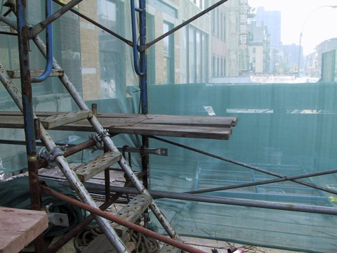
Notes:
Note. Planks are extended past 12 inches over bearer and not fall protection is provided to preclude entry to cantilevered area of planks. 1926.451 (b)(5)(i) Each end of a platform 10 feet or less in length shall not extend over its support more than 12 inches (30 cm) unless the platform is designed and installed so that the cantilevered portion of the platform is able to support employees and/or materials without tipping, or has guardrails which block employee access to the cantilevered end.

Slide 28
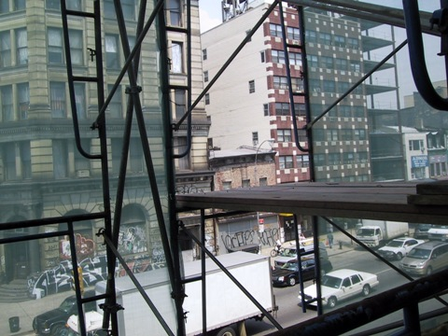
Notes:
Missing guardrail system, including toeboards is missing. 1926.451(h)(2)(ii) A toeboard shall be erected along the edge of platforms more than 10 feet (3.1 m) above lower levels for a distance sufficient to protect employees below, except on float (ship) scaffolds where an edging of 3/4 x 1 1/2 inch (2 x 4 cm) wood or equivalent may be used in lieu of toeboards. 1926.451 (4) Guardrail systems installed to meet the requirements of this section shall comply with the following provisions (guardrail systems built in accordance with Appendix A to this subpart will be deemed to meet the requirements of paragraphs (g)(4)(vii), (viii), and (ix) of this section):
(i) Guardrail systems shall be installed along all open sides and ends of platforms. Guardrail systems shall be installed before the scaffold is released for use by employees other than erection/dismantling crews

Slide 29
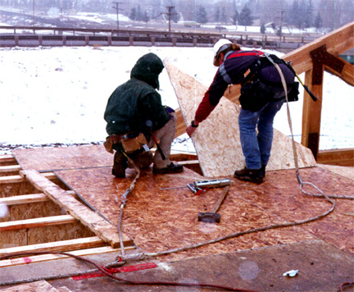
Fall Protection Planning
Lanyards and Personal Fall Arrest System (PFAS) in use
Fall protection systems and work practices
must be in place before you start work.
(Workers are tied-off together)
Notes:
Reference 1926 Subpart M App C
An employer may use a variety of fall protection systems to protect employees. These systems must meet OSHA requirements. The competent person must make frequent and regular inspections, as required, to determine if these systems meet OSHA requirements before employees rely on these systems. More detail may be found in 29 CFR 1926.502.
Employers engaged in leading edge work, precast concrete erection work, or residential construction work who can demonstrate that it is infeasible or it creates a greater hazard to use conventional fall protection equipment may develop a fall protection plan that provides other measures to be taken to reduce or eliminate fall hazards for workers. Fall protection plans must conform to OSHA provisions and be prepared by a qualified person. Although a fall protection is required, it does not have to written, nor does it have to be site specific. Fall protection plans must identify locations where conventional fall protection methods cannot be used and set up controlled access zones and any necessary safety monitoring systems.
See STD 3-0.1A

Slide 30
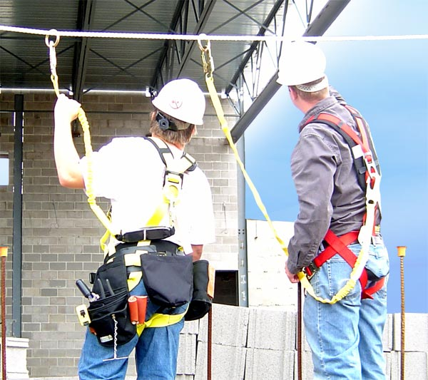
5,000 lbs
5,000 lbs
10,000 lbs.
Designed and installed by a qualified person and work overseen by a qualified person

Slide 31
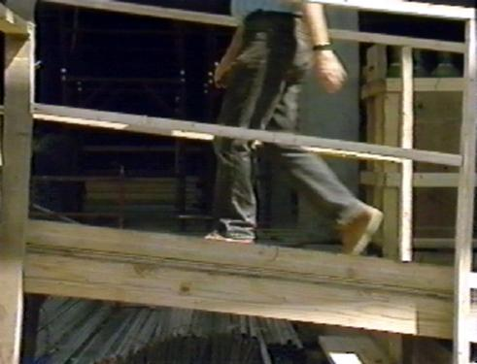
Walkways and Ramps
Guard ramps, runways, and other walkways
Notes:
Reference 1926.501(b)(6)
Ramps, runways, and other walkways must be protected by guardrail systems when employees can fall 6 feet or more.
The walking/working surface must be strong enough to support employees safely. If not, employees may not work on the surface. This knowledge will be gained during frequent and regular inspections made, as required, by competent persons designated by the employer.

Slide 32
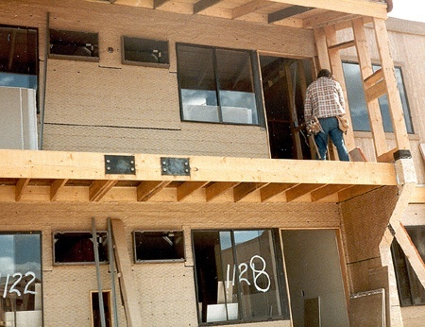
Fall Protection -
Residential Construction
In All general construction, you must be protected if you can fall more than 6 feet
Notes:
Reference 1926.501(b)(13)
This is correct for activities not covered by STD 3-0.1A
All other activities – refer to STD 3-0.1A, Interim Fall Protection Guidelines for Residential Construction

Slide 33
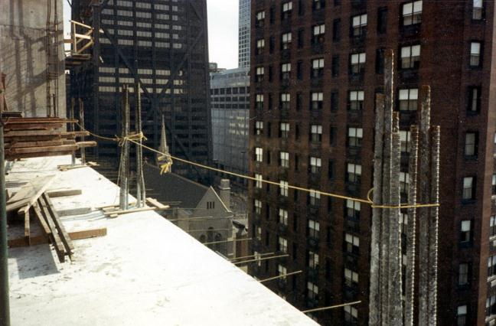
Sides & Edges - Improper Guarding
This 1/4" nylon rope alone is not a proper way to guard this open floor
Notes:
Reference 1926.502(b)
What’s wrong with this?
¼ inch rope is allowed, but it must meet the criteria of 1926.502(b)(3), etc.
no midrail
no toeboards
- sagging is not allowed

Slide 34
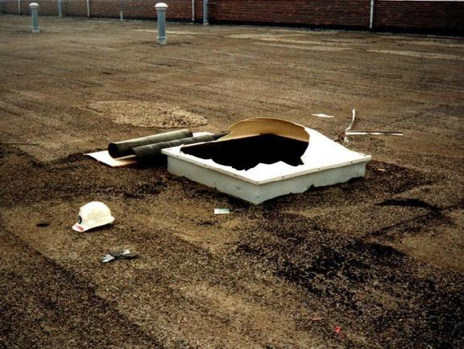
Sky Lights and Other Openings
Holes more than 6 feet high must be protected
This opening could be made safe by using a
guardrail, or strong cover
Notes:
Reference 1926.501(b)(4)(i), 1926.501(b)(10), 1926.501(b)(11), and 1926.502(i)
Covers must be:
-- able to support at least twice the weight of employees, equipment, and materials that may be imposed on them at one time.
-- secured to prevent accidental displacement from wind, equipment, or workers’ activities.
-- color coded or bear the markings “HOLE” or “COVER.”
Holes - 1926.501(b)(4):
Personal fall arrest systems, covers, or guardrail systems shall be erected around holes (including skylights) that are more than 6 feet above lower levels.
NOTE – All floor holes must be protected against slips/trips – even if less than 6 feet

Slide 35
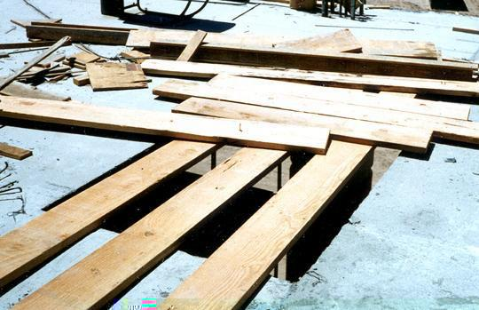
Floor Holes
Improperly
Covered
Cover completely and securely
If no cover, can guard with a guardrail
Notes:
Reference 1926.501(b)(4)

Slide 36
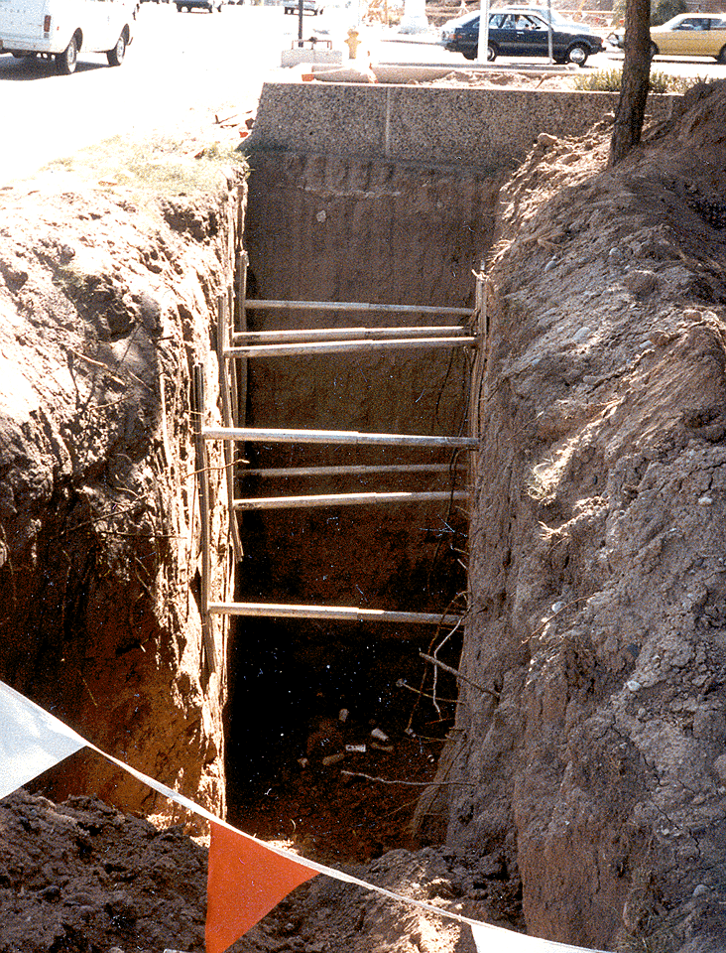
Excavations
Guard excavations more than 6 feet deep when they are not readily seen because of plant growth or other visual barriers
In addition to needing guarding, this excavation is not properly shored
Notes:
Reference 1926.501(b)(7)
Employees at the edge of an excavation 6 feet or more deep shall be protected from falling by guardrail systems, fences, barricades, or covers.
If walk-ways are used to permit workers to cross over excavations, guardrails are required on the walkway if the fall would be 6 feet or more to the lower level.

Slide 37

Wall Openings
Wall opening
If you work near wall openings 6 feet or more above lower levels you must be protected from falling
Notes:
Reference 1926.501(b)(14)
Employees working on, at, above, or near wall openings (including those with chutes attached) where the outside bottom edge of the wall opening is 6 feet or more above lower levels and the inside bottom edge of the wall opening is less than 39 inches above the walking/working surface must be protected from falling by the use of
either a guardrail system, a safety net system, or a personal fall arrest system.

Slide 38
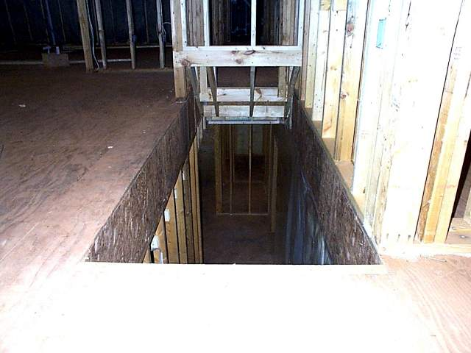

Slide 39
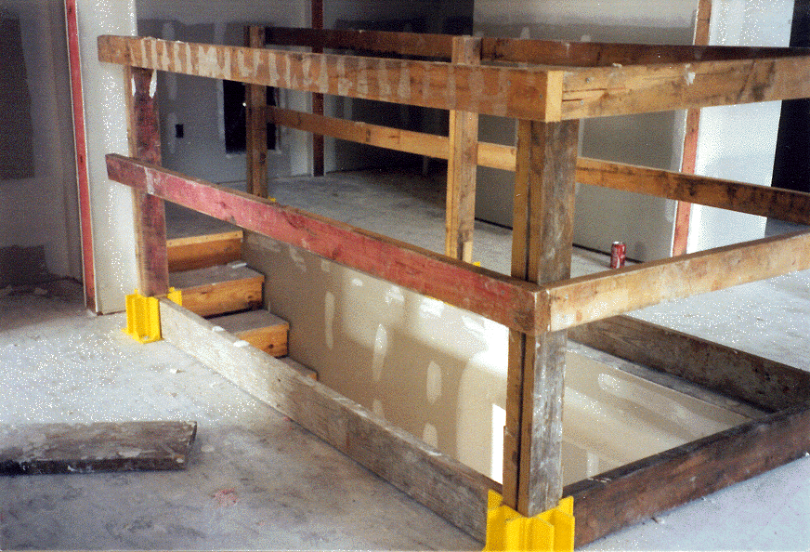
Top-rail @ 42”
Mid-rail @ 21”
Toeboard @ 3-1/2”
Notes:
This photo shows a properly installed guardrail system around a stairwell opening.
Top-rail = 42in.
Mid-rail = 21in.
Toeboard = 3 ½ in. (4in. Nominal)

Slide 40
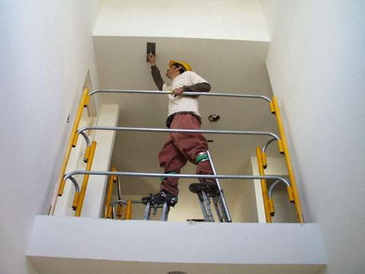
Guardrails For Elevated Workers
When using stilts, increase the height of the top edge of the top rail to an amount equal to the height of the stilts.

Slide 41
Less than 39”
Notes:
The guardrail was installed in this window at one point in time, but was removed to deliver material through the window and was never replaced. 1926.451 (b) Guardrail systems. Guardrail systems and their use shall comply with the following provisions:
(1) Top edge height of top rails, or equivalent guardrail system members, shall be 42 inches (1.1 m) plus or minus 3 inches (8 cm) above the walking/working level. When conditions warrant, the height of the top edge may exceed the 45-inch height, provided the guardrail system meets all other criteria of this paragraph.

Slide 42
Requirements for Handrails and Stair rails
Toprail
36 in. (.9 m) above the tread vertically in line with the riser
Install handrail 3” from wall
Midrail
Halfway between toprail and stair stringer
Toe Board
Minimum of 3 1/2 in. (4 in. nominal) (10.2 cm)
Weight Requirement
At least 200 lbs. (90.9 kg)

Slide 43
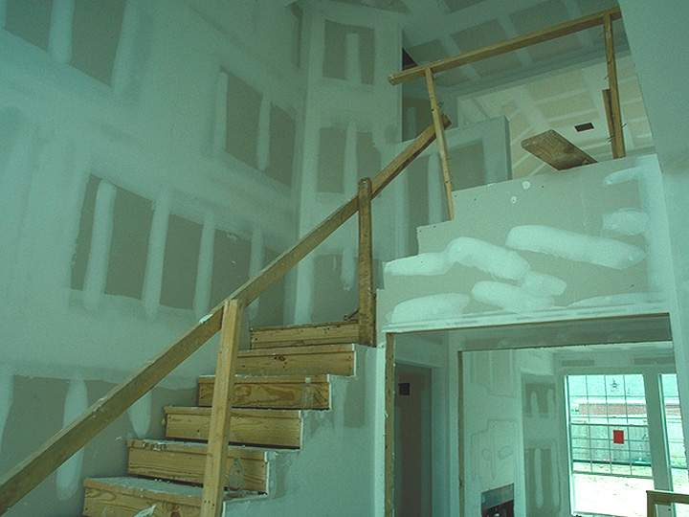
Notes:
Is this an acceptable stairrail/guardrail system?
Point out the deficiencies with the stairrail/guardrail.

Slide 44
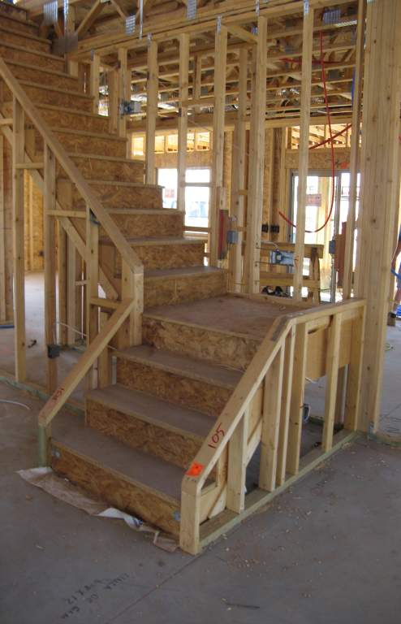
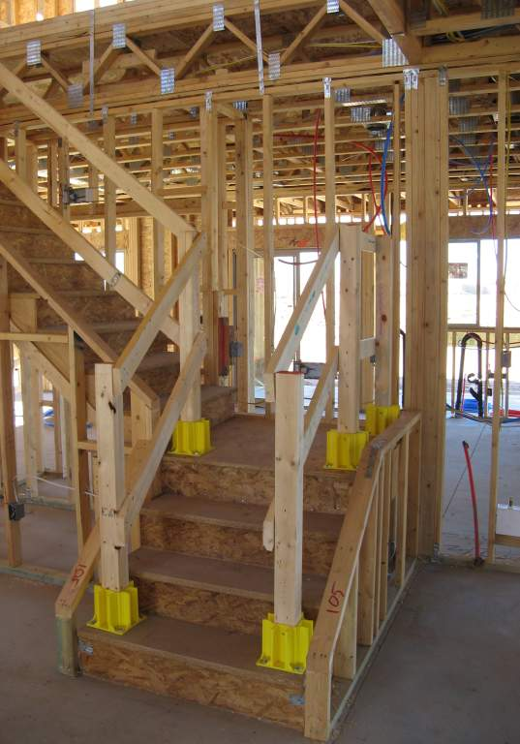

Slide 45
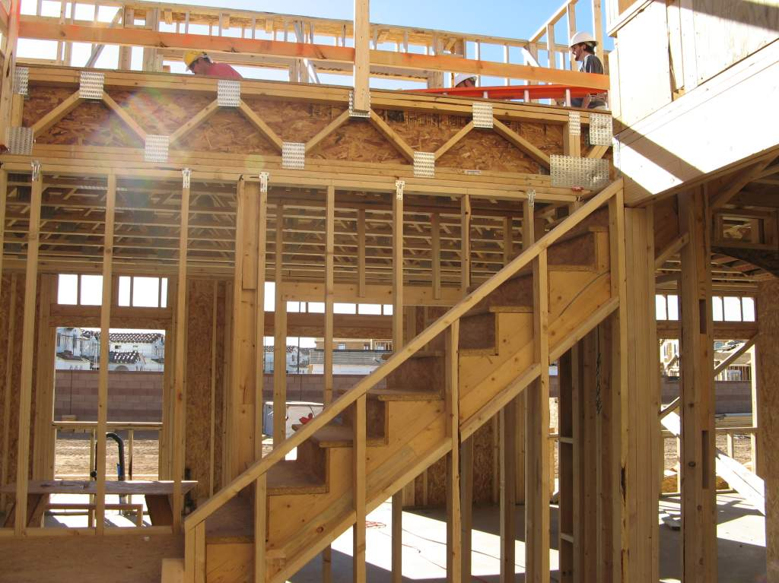
Notes:
Handrails are not provided along stairs. 1926.1052 (c) Stairrails and handrails. The following requirements apply to all stairways as indicated:
(1) Stairways having four or more risers or rising more than 30 inches (76 cm), whichever is less, shall be equipped with:
(i) At least one handrail; and
(ii) One stairrail system along each unprotected side or edge.

Slide 46
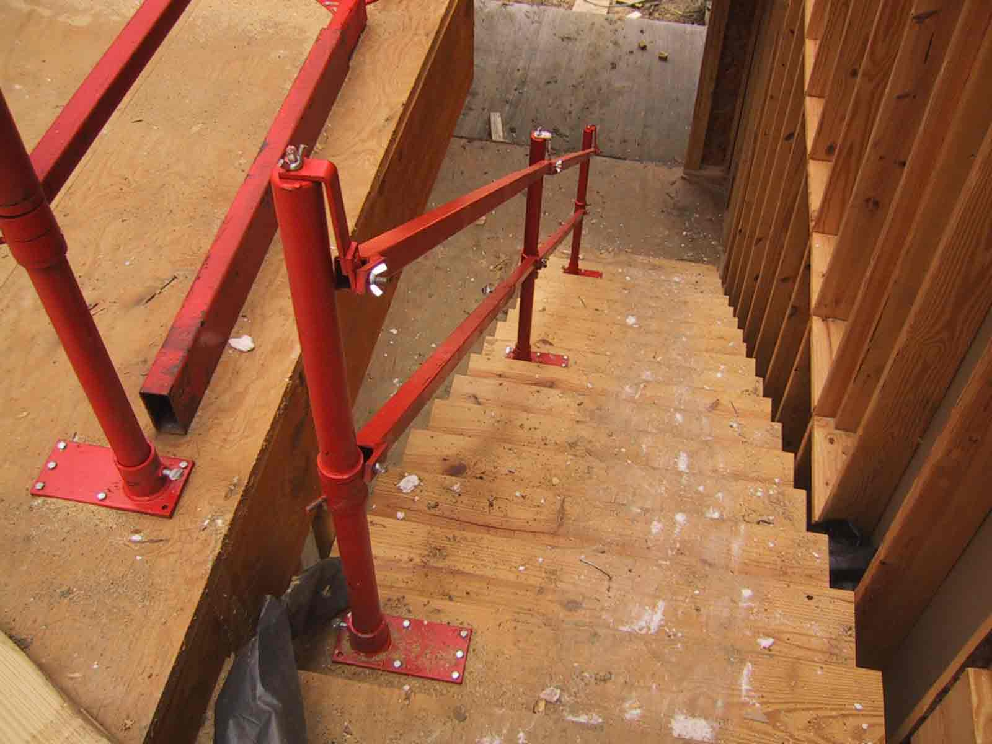

Slide 47
Hole Covers
Secured and marked cover which protects workers from tripping or stepping into or through a hole and keeps objects from falling through a hole
Protects against falls through hazards in this category:
Floor Holes
Notes:
A hole cover is a secured and marked cover which protects workers from tripping or stepping into or through a hole on walking/working surfaces and keeps objects from falling through a hole.

Slide 48
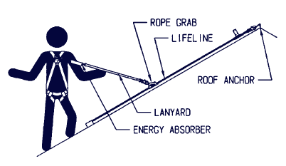
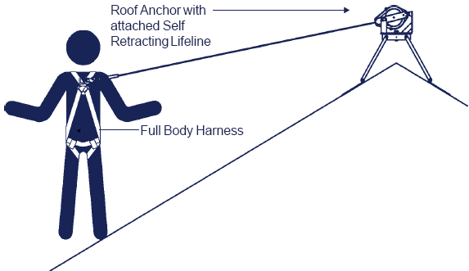
Components of a PFAS
OR
Anchor point
Lifeline
Rope grab
Shock absorbing lanyard
Full body harness
Anchor point
Self-retractable lifeline
In lieu of lifeline, rope grab, and shock-absorbing lanyard
Full body harness

Slide 49
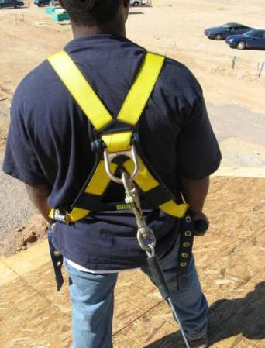
Using a Personal Fall Arrest System (PFAS), cont.
Proper Wear:
Locate the attachment of the body harness in the center of your back, near the shoulder level, or above your head.

Slide 50
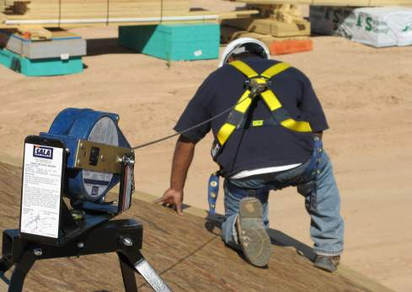
Using a PFAS, cont.
Proper Wear:
If using a retractable lifeline attach it directly to the D-ring on the full-body harness.

Slide 51
Safety Net Systems
System consisting of connectors and net installed below a working surface; designed to prevent a worker from contacting a lower level or structure in the event of a fall.

Slide 52
Stay Clear of Falling Objects
Do not work under or near a hazard or hazardous process.
Do not allow other workers below your work area.
If you are not directly involved, stay clear of these activities:
Lifting of a balloon-framed wall
Truss or rafter installation
Roof sheathing work
Work in a attic

Slide 53
Protect Impalement Hazards
Guard all protruding ends of steel rebar.
Use appropriate rebar caps.
Bend rebar so exposed ends are no longer upright.
Secure a 2x4 (5.1 x 10.2 cm) over the exposed rebar.
Do not use Mushroom type caps.

Slide 54
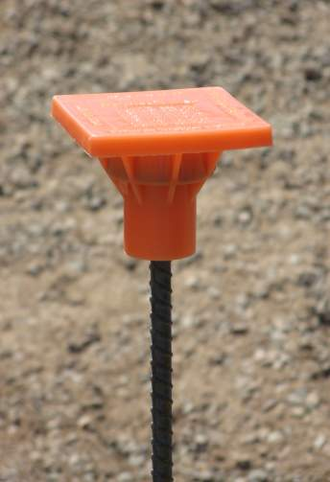
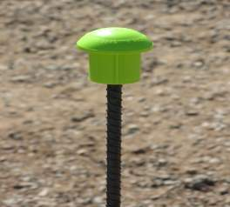
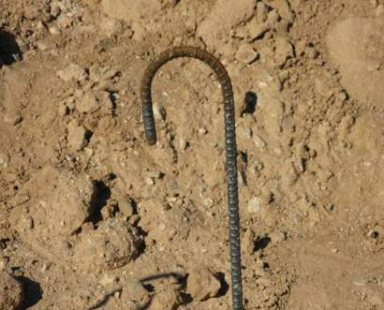
Protect Impalement Hazards, cont.

Slide 55
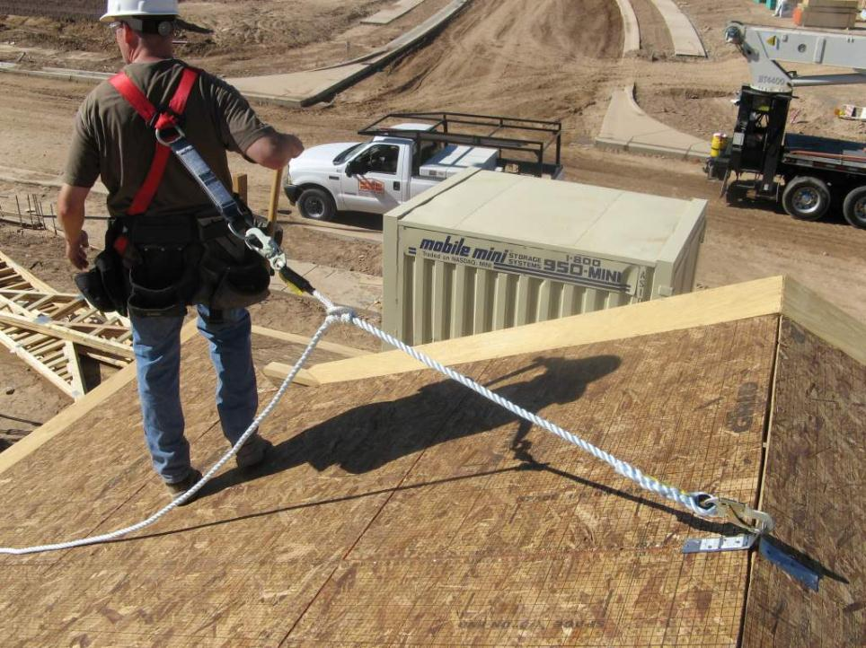
Personal Fall Arrest System (PFAS) Components
4. Shock Absorbing Lanyard
5. Full Body Harness
2. Life Line
1. Anchor Point
3. Rope Grab

Slide 56
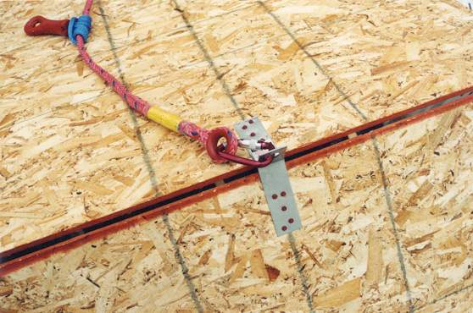
Notes:
A roof bracket is installed according to manufacture’s specifications providing adequate anchorage point for fall protection.

Slide 57
Swing Fall Hazard
Minimize swing falls:
Work directly below the anchor.
Do not extend your work zone more than 30º from the anchor.
Manage the slack in the rope.

Slide 58
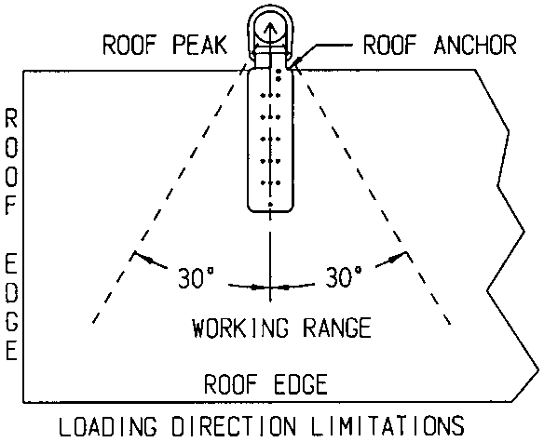
Swing Fall Hazard, cont.

Slide 59
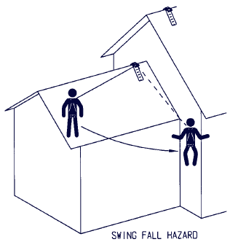
Swing Fall Hazard, cont.
On most homes, multiple anchor points will be required to manage swing-fall hazards.
It is also important to locate anchor points at a height that prevents striking a lower level should a fall occur.

Slide 60
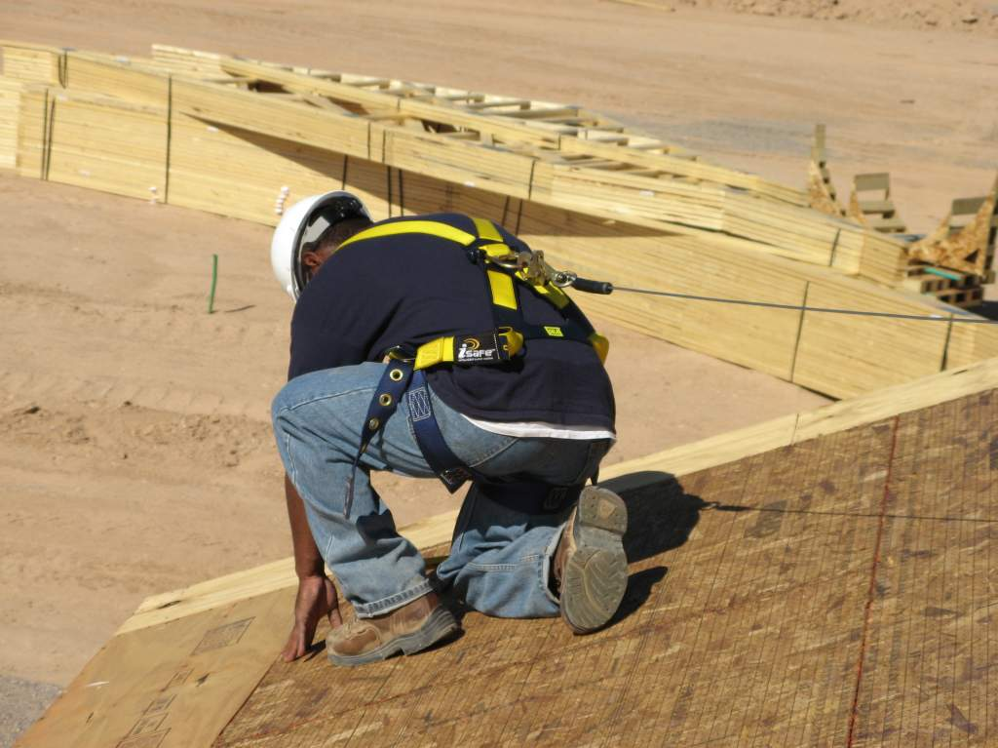

Slide 61
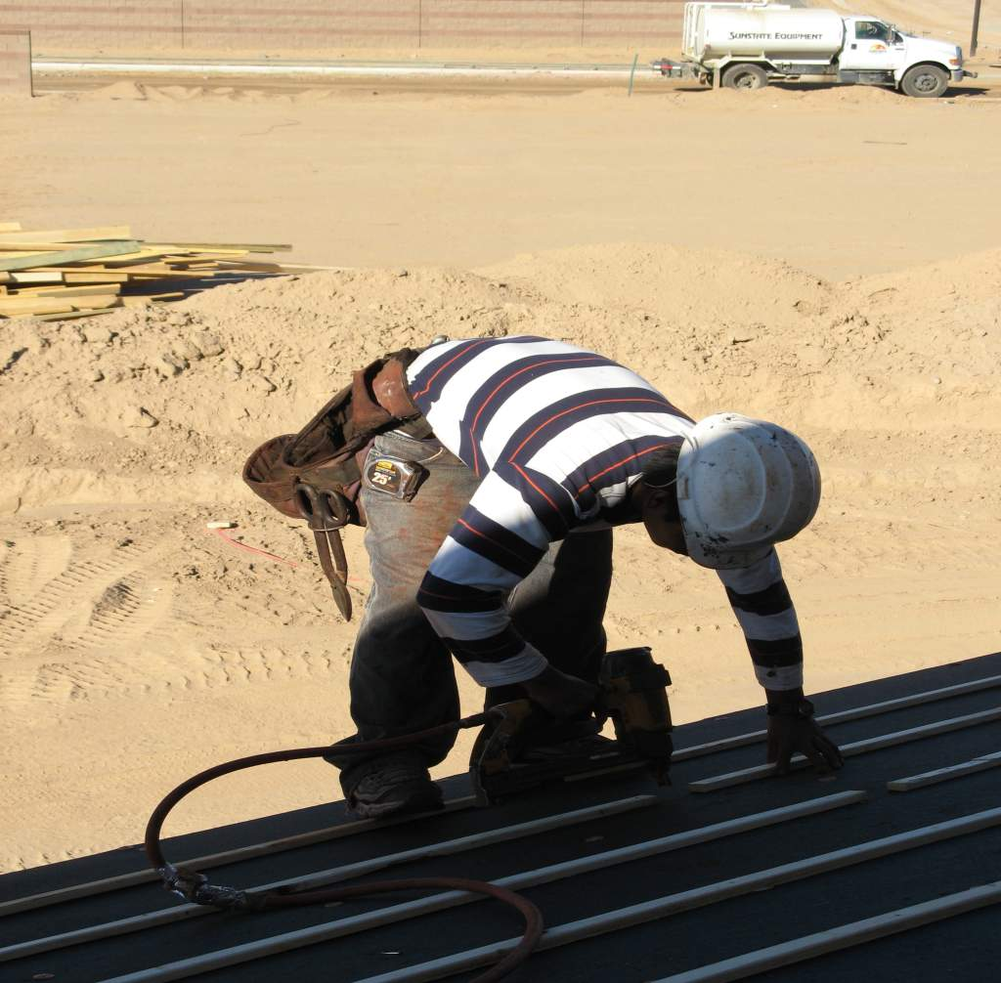
Notes:
Worker has no means of fall protection. 1926.501 (b)(1) Unprotected sides and edges. Each employee on a walking/working surface (horizontal and vertical surface) with an unprotected side or edge which is 6 feet (1.8 m) or more above a lower level shall be protected from falling by the use of guardrail systems, safety net systems, or personal fall arrest systems.

Slide 62
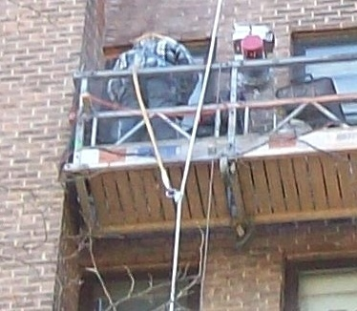

Slide 63
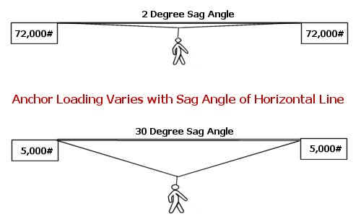

Slide 64
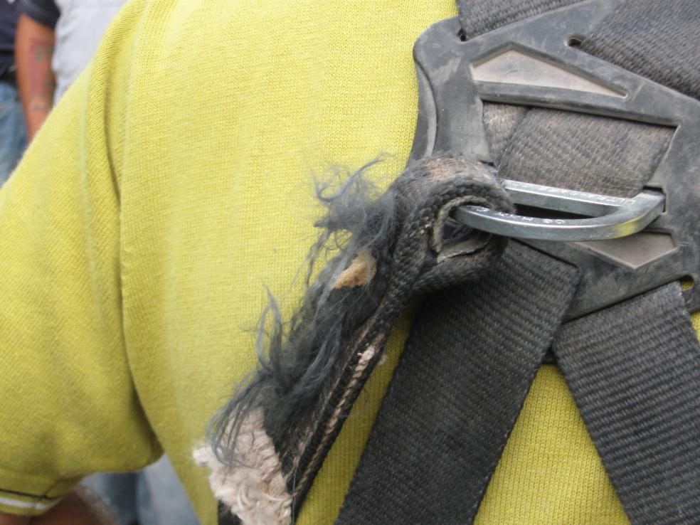
Notes:
This workers PFAS harness is worn and frayed. 1926.502 (21) Personal fall arrest systems shall be inspected prior to each use for wear, damage and other deterioration, and defective components shall be removed from service.

Slide 65
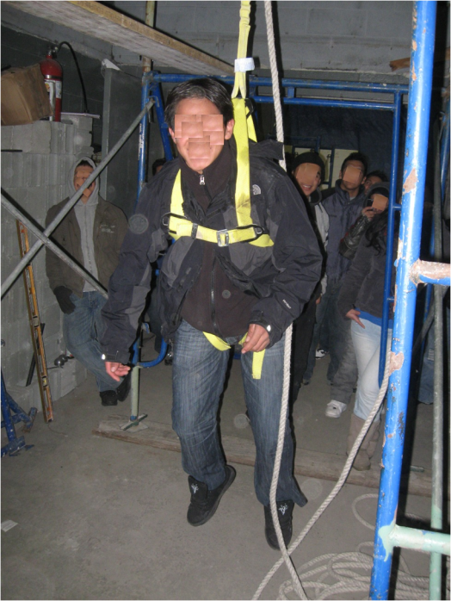
Training in how to: How to Use How to Inspect How to maintain How to Rescue

Slide 66
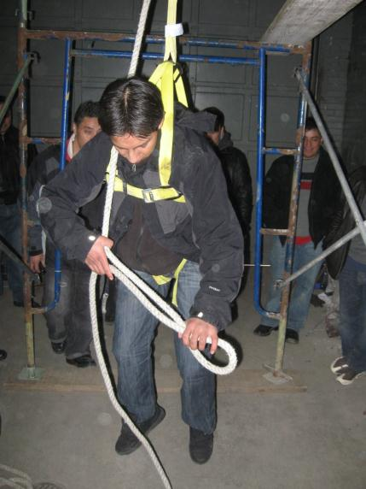
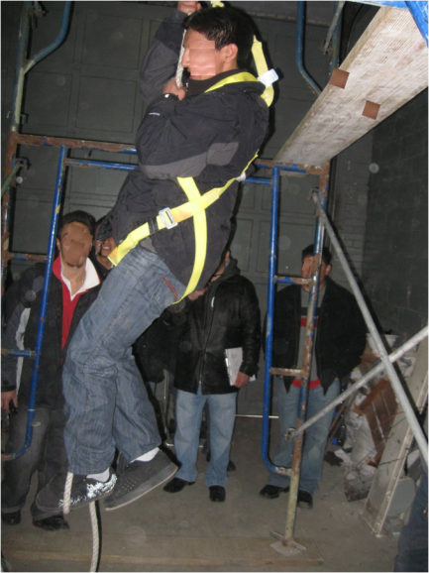
Providing you are not hurt already, after a fall, you have about 15 minutes until you may suffer very serious injury…..

Slide 67
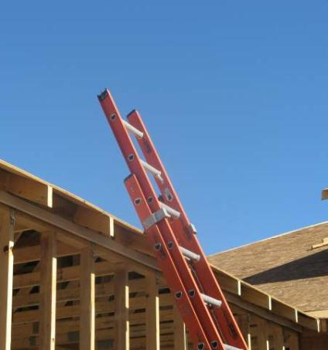
Proper Height Extension Ladders
When using an extension ladder for access to another level, the ladder must extend at least 3 ft. above the landing to provide a hand hold for getting on and off the ladder.

Slide 68
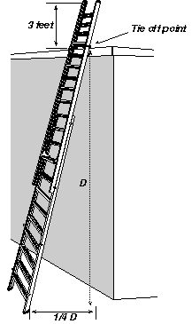
Pitch Extension Ladders
Extension ladders should be used at a 4 to 1 pitch (1.2 to .3 m).
For every 4 ft. (1.2 m) in height, the bottom of the ladder should be 1 ft. (.3 m) away from the structure.
Example:
20 ft. (height) ÷ 4 ft. = 5 ft. pitch

Slide 69
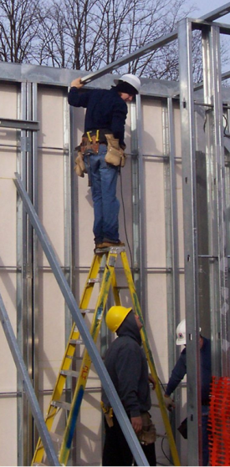
Pitch Stepladders
Stepladders are designed for use in an opened-and-locked position.
Do not use a stepladder that is folded or in a leaning position
Do not use top step of ladder to stand
Notes:
Workers is standing on top step of ladder. 1926.1053 (b)(13) The top or top step of a stepladder shall not be used as a step.

Slide 70
Secure and Stabilize Ladders
Extension ladders should be secured at the top or bottom to prevent movement.
The base of an extension ladder must be secured in place by using the safety feet on the ladder or other effective means.

Slide 71
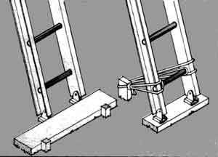
Secure and Stabilize Ladders, cont.

Slide 72
Secure and Stabilize Ladders
Slippery Surfaces
Never use a ladder on a slippery surface, unless it is secured to prevent movement.
Wet or slippery surfaces may require a cleat.
Ladder feet should dig into the ground, and the ladder should be secured at the bottom to prevent movement/slipping.

Slide 73
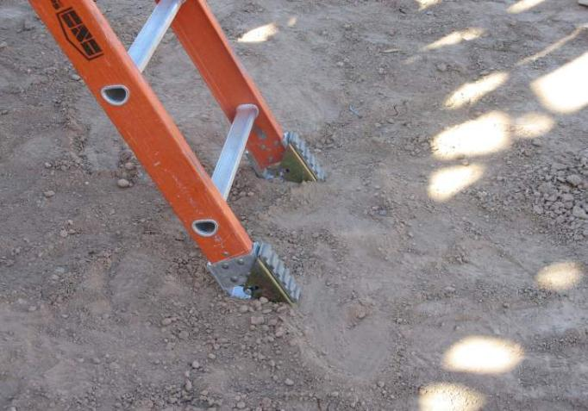
Loose Soil
Notes:
On loose soil or a soft base, dig feet into the ground and competent person must make assessment. 1926.1060 (a) The employer shall provide a training program for each employee using ladders and stairways, as necessary. The program shall enable each employee to recognize hazards related to ladders and stairways, and shall train each employee in the procedures to be followed to minimize these hazards.
(1) The employer shall ensure that each employee has been trained by a competent person in the following areas, as applicable:
(i) The nature of fall hazards in the work area;
(ii) The correct procedures for erecting, maintaining, and disassembling the fall protection systems to be used;
(iii) The proper construction, use, placement, and care in handling of all stairways and ladders;
(iv) The maximum intended load-carrying capacities of ladders used; and
(v) The standards contained in this subpart.

Slide 74
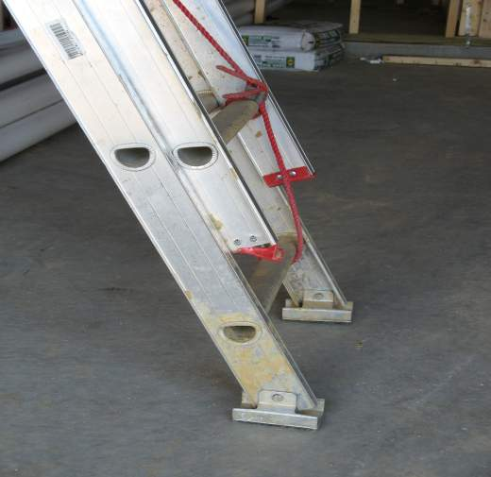
Firm Base
Notes:
On a firm base, set feet level and on the rubber pads. 1926.1060 (a) The employer shall provide a training program for each employee using ladders and stairways, as necessary. The program shall enable each employee to recognize hazards related to ladders and stairways, and shall train each employee in the procedures to be followed to minimize these hazards.
(1) The employer shall ensure that each employee has been trained by a competent person in the following areas, as applicable:
(i) The nature of fall hazards in the work area;
(ii) The correct procedures for erecting, maintaining, and disassembling the fall protection systems to be used;
(iii) The proper construction, use, placement, and care in handling of all stairways and ladders;
(iv) The maximum intended load-carrying capacities of ladders used; and
(v) The standards contained in this subpart.

Slide 75
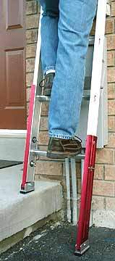
Secure and Stabilize Ladders, cont.
Uneven Surface
When the surface is not level, use a ladder leveler (accessory) to provide even contact points.

Slide 76
Maintain a Safe Position on Ladders
Face the ladder when ascending or descending.
Maintain three points of contact at all times.
Keep your body centered on the ladder.
Never let your belt buckle pass either ladder siderail

Slide 77
Maintain a Safe Position on Ladders, cont.
Do not overreach when working from the ladder.
Do not stand on the top two rungs of a stepladder.
Do not allow another person on a ladder at any given time, unless you are using a double-cleated ladder that is intended for two-way traffic.

Slide 78
Interior and Exterior Scaffolding
Job-built scaffolding that is improperly constructed is extremely hazardous.
Various types and brands of interior and exterior scaffolding are commercially available.
Always, follow the manufacturer’s safety instructions.

Slide 79
Interior and Exterior Scaffolding, cont.
Scaffolding that is 10 ft. or higher must be equipped with guardrails.
A competent person must supervise the set-up and take down of all scaffolding.
Walls that support exterior scaffold must be capable of supporting, without failure, the weight of the scaffold and four times the maximum intended load on the scaffolding.
Scaffolding must be fully planked, and planks must be secured so they cannot move.

Slide 80


Scaffold Grade Plank Stamps
Notes:
SPIB - Southern Pine Inspection Bureau
WCLB - West Coast Lumber Inspection Bureau
Solid sawn wood used as scaffold planks shall be selected for such use following the grading rules established by a recognized lumber grading association or by an independent lumber grading inspection agency.
Such planks shall be identified by the grade stamp of such association or agency. The association or agency and the grading rules under which the wood is graded shall be certified by the Board of Review, American Lumber Standard Committee, as set forth in the American Softwood Lumber Standard of the U.S. Department of Commerce.

Slide 81

Notes:
Planks with visible defects, such as bowing and cracks (as shown in this slide) must not be used.

Slide 82
Fall Protection System Summary
You Should Know
You should know your role in the fall protection program.
You should know what OSHA requires in the fall protection program
You should be trained in fall protection so you know the rules and how to apply them in the field.
You should be able to recognize, avoid and prevent falls on the job. RAP
Notes:
Or instructor, if the instructor wants to be contacted.

Slide 83
The End
&
The
Beginning

