Slide 1

Systems of Safety Applied to Focus Four Hazards
USDOL-OSHA
Susan Harwood Grant
SHT21005SH0

Slide 2
Systems of Safety Applied to Focus Four Hazards
This material was produced under grant number SHT21005SHO from the Occupational Safety and Health Administration, U.S. Department of Labor. It does not necessarily reflect the view or policies of the U.S. Department of Labor, nor does mention of trade names, commercial products, or organizations imply endorsement by U.S. Government.

Slide 3
A Systematic Approach to
Safety & Health in Construction
Applied to:
1. Falls
2. Electrical Hazards
3. Caught-in-Between Conditions
4. Struck-by Events
Two-thirds of Construction fatalities are in one of these four categories

Slide 4
What Rights Do You Have Under OSHA?
You have the right to:
  A safe and healthful workplace
  Know about hazardous chemicals
  Information about injuries and illnesses in your workplace
  Complain or request hazard correction from employer
  Training
  Hazard exposure and medical records
  File a complaint with OSHA
  Participate in an OSHA inspection
  Be free from retaliation for exercising safety and health rights
Workers have a right to report safety issues without fear of retaliation
Workers may report safety concerns to OSHA at 1-800-321-OSHA

Slide 5
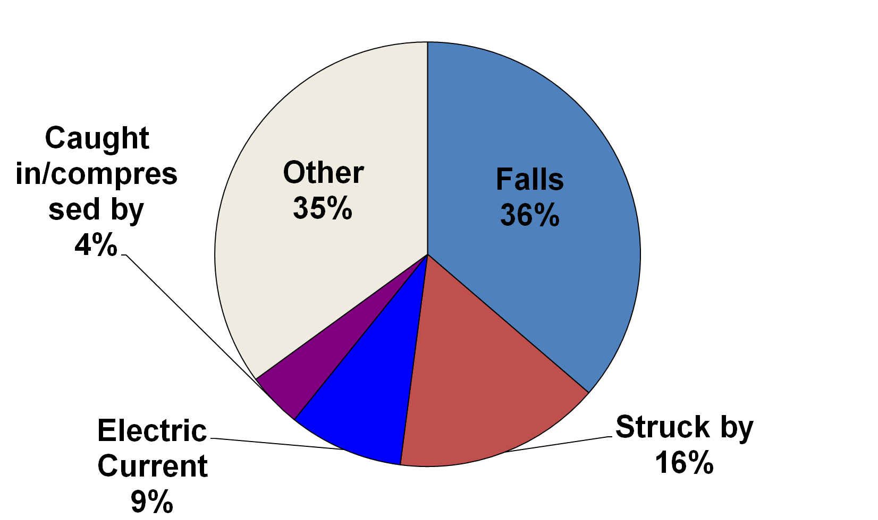
US Construction Fatalities by Event (2007)
Data Source: Bureau of Labor Statistics Census of Fatal Occupational Injuries

Slide 6
Learning Objectives
Examine What is Meant by a “System”
Explore How a System’s Approach to Safety and Health works.
Learn how to apply key concepts to a System’s Approach to OSHA’s Focus-Four Hazard Categories:
        Falls
        Struck by
        Contact with Electric Current
        Caught in or Compressed by

Slide 7
What is a System?
System: From Late Latin and Greek systema, sy meaning together, sta, the root and histanai meaning cause to stand.
“Together the parts stand”
System: (1) A group of interacting, interrelated, or interdependent elements forming a whole. (2) A set of methods, procedures and routines created to perform some function.
Notes:
Systems can be tremendously large, such as a solar system, or infinitesimally small such as atoms and moldecules

Slide 8

The Solar System
…. A system inside a system…

Slide 9
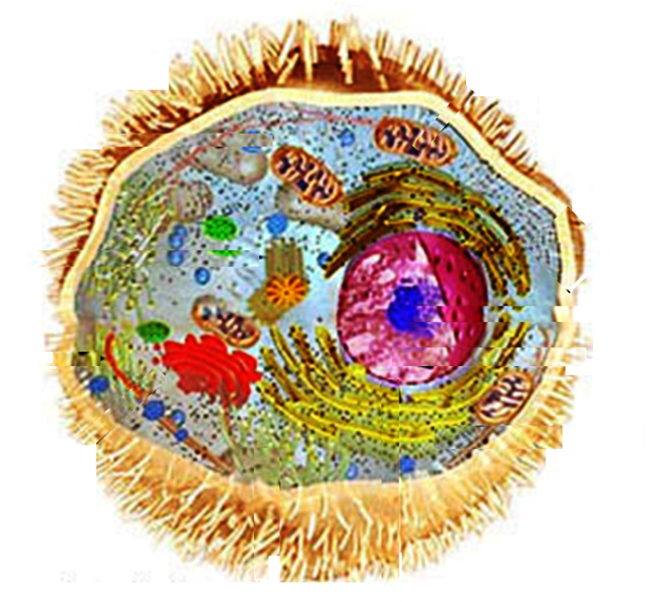
Eukaryotic Cell
Systems
Inside of
Systems
Inside of
Systems…..

Slide 10

Government Systems
Systems inside of Systems Inside of Systems

Slide 11

Financial Systems
Systems inside of Systems Inside of Systems

Slide 12
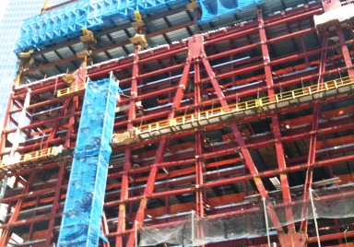
Building Systems
Systems inside of Systems Inside of Systems

Slide 13

…and the longest lasting, most successful systems are those that possess an internal means of regulation to sustain the system and keep it from malfunctioning.
All Businesses are Systems

Slide 14
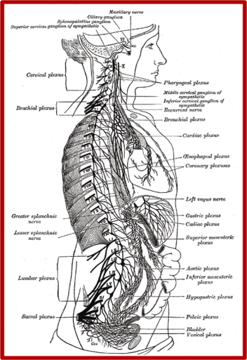
…and the longest lasting, most successful systems are those that possess an internal means of regulation to sustain the system and keep it from malfunctioning.
Our Bodies are Systems

Slide 15
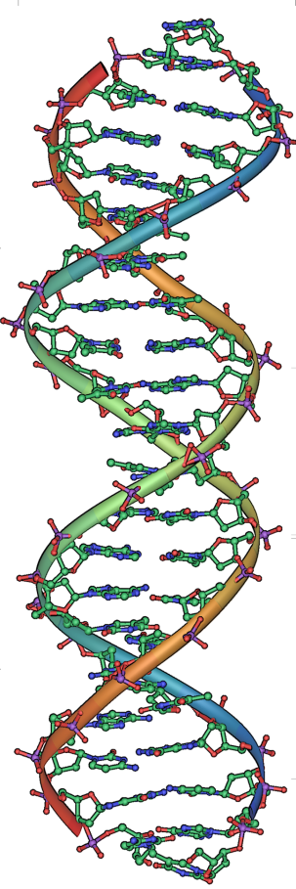
Self-Repairing System
Each day, hundreds of million mistakes occur in the human body yet DNA repair mechanisms repair them at an incredible rate, constantly monitoring and repairing malfunctions in the system. When something goes wrong it is identified and fixed
DNA almost never exists alone within a cell. It is a system that must adapt and must self-regulate less mutations and disease occur.
Our Inspiration ! .

Slide 16
First 2 Steps to Establish a Healthy Environment to Promote a Good Culture
Management Commitment
Employee Involvement

Slide 17
Systems

Slide 18
Existing Documents
Observe Means and Methods
Interview Personnel
Create Questionnaires
Hazards Specific to Trade
Environmental Sampling
Evaluate Tools and Equipment
Establish Health Baselines
Identify Sources of Energy
Investigate past incidents
Assess Employee Aptitude
Review Employee Training
Audit Checklists
Assess
Hierarchy of Controls
Benchmark Best Practices
Safety and Health Plan
Safety and Health Committees
Handbooks and Toolbox Talks
Formalize Operating Procedures
Equipment Program
Logistics and Estimates
Recordkeeping Programs
Control
Consultant
&
Committee
Review
Trials
Benchmark
Authorized OSHA Training
Competent Person Training
Mentoring and Coaching
On the Job Training
Toolbox Talks
Skills Training-Hands On
Practice Drills Rescue
Safety & Health Bulletins
Train
Test Runs
Competent
Person
Review
Implement
Audits and Surveys
Safety Logs / Daily Reports
Near Misses/Accidents
Regulatory Citations
Equipment Malfunctions
Dedicated Safety Meetings
Oversight of records and checklists
Budgetary Status
OSHA Recordables
Debriefings
Employee Feedback
Monitor
General Safety and Health System

Slide 19

Assess Your Circumstances
Processes must remain firm but the system flexible
Review Existing Documents
Observe Means and Methods
Interview Personnel
Create Questionnaires
Review Records
Fatal Facts & Lessons Learned
Environmental Sampling
Evaluate Existing Equipment
Establish Health Baselines
Survey Work Environment
Identify Sources of Energy
Benchmark Industry Trends
Evaluate Regulatory Compliance
Investigate past incidents
Assess Employee Aptitude
Review Employee Training
Focus on:
People
Materials
Equipment
Environment
Review our Assessment

Slide 20
Checklists for Unsafe
  Failure to follow training requirements
  Failure to wear PPE
  Failure to wear PPE correctly
  Failure to wear correct PPE
  Ignoring broken or defective tools, equipment, electrical cords etc.
  Ignoring warnings, signs or barricades
  Working in controlled access zones without specialized training.
  Improper use of tools or equipment
  Horseplay
  Drug or Alcohol use
  Working outside authority (untrained)
Review our Assessment

Slide 21
Checklists for Unsafe Conditions
  Does the environment or process create hazards?
  Is there adequate access and egress to and from the work area?
  Are workers exposed to temperature extremes?
  Is the lighting adequate?
  Can the weather create a hazard?
  Is illumination adequate?
  Is the work done at heights?
  Do the tools or equipment create a hazard?
  Is there excessive noise or vibration or great potential energy?
  Can any part of the worker's body or clothing be caught in the equipment?
  Is the tool or equipment appropriate for the task (strength, size, power, etc.)?
Notes:
The advantages of checklists created by your employer can keep us on point. Stress that even experts can’t focus well in times of emergency so deliberate checklists during our planning stages can be very useful in a real emergency. Training in those plans of course is essential.

Slide 22
Job Hazard Analysis and the
Application of Controls
A job hazard analysis is a technique that focuses on job tasks as a way to identify hazards before they occur. It focuses on the relationship between the worker, the task, the tools, the work environment and the necessary steps to control a hazard.
Task | Hazard | Control | Means of Implementation
Break tasks down to smaller sub-tasks. | List all possible associated hazards preferably in an order of severity | Use the Hierarchy of Controls Elimination Engineering Mitigation | Should set out procedures that are easy to understand and accomplish in the field. Include the use equipment and requisite training and administrative
Notes:
White board exercise. Define Competent Person (someone who has knowledge of safety and health procedures, experience in the task at hand, and authority to take corrective action-give examples of corrective action. Define a Qualified Person as someone who has knowledge and experience but no authority.

Slide 23
Risk Assessment
Sequence of task at hand
Known Hazards (historically associated)
Potential Hazards
Environment
Competence or workers and workforce
Skill and Experience
Workforce
Level of training
Equipment and tools
Associated externalities
MATERIALS (natural, manufactured, combined)

Slide 24
Conducting a Job Safety Analysis
Once the job is identified, you must break it into key components or sub-tasks and then identify and list all the hazards associated with each subtask.
  What can go wrong?
  What are the consequences?
  How could a problem happen?
  How likely is it that the hazard will occur?

Slide 25
Make Use of a Competent Person
What is meant by a Competent Person?
Whom Makes the Competent Person?
“…..one who is capable of identifying existing and predictable hazards in the surroundings or working conditions …..who has authorization to take prompt corrective measures to eliminate them…”
  Knowledgeable of applicable standards
  Experience to know Job Requirements
  Authority to take Corrective Action
The Employer designates the Competent Person
Notes:
White board exercise. Define Competent Person (someone who has knowledge of safety and health procedures, experience in the task at hand, and authority to take corrective action-give examples of corrective action. Define a Qualified Person as someone who has knowledge and experience but no authority.

Slide 26
Hierarchy of Hazard Controls
1. Elimination Control: Simply eliminate the hazard.
2. Engineering Control: Will prevent accident or exposure from occurring.
3. Mitigation Control: Minimizes the conditions, lessens the exposures or effects.
    Administrative
      Job Rotation
      Scheduling
    Personal Protective Equipment (Mitigation) PPE
    Work Practices
    Special Training

Slide 27
TRAINING
THE EMPLOYER MUST PROVIDE TRAINING:
STRESS EMPLOYEE’S ROLE IN THE SAFETY AND HEALTH SYSTEM
THE USE OF EQUIPMENT.
WHEN PPE IS NECESSARY.
WHAT PPE IS NECESSARY.
THE LIMITATIONS OF THE PPE.
PROVIDE RETRAINING AS REQUIRED.
MAKE TRAINING THAT IS EASY TO UNDERSTAND.
CARE AND MAINTENANCE OF EQUIPMENT.
TRAIN ALL EMPLOYEES PRIOR TO JOB ASSIGNMENT.
Notes:
11
11
11
11

Slide 28
Why is Monitoring So Important?
Who Monitors the Safety Process?
OSHA Compliance Officers?
Management?
Competent Persons?
Safety Professionals?
EVERYONE!
Instill in ALL Stakeholder!
“If you see Something-Say Something”

Slide 29
The End
&
The
Beginning

