Slide 1
Introduction to Nanomaterials and Occupational Health Kristen M. Kulinowski, Ph.D.
8-Hour Training Course
Notes:
Trainer Notes:

Slide 2
This material was produced under grant number SH-21008-10-60-F-48 from the Occupational Safety and Health Administration, U.S. Department of Labor. It does not necessarily reflect the views or policies of the U.S. Department of Labor, nor does mention of trade names, commercial products, or organizations imply endorsement by the U.S. Government.
Notes:
Trainer Notes:
[insert a disclaimer about the limitations of these materials]

Slide 3
Eight-Hour Training Course
Module 1 | Introduction to Nanotechnology and Nanomaterials
Module 2 | What Workers Need to Know about Nanomaterial Toxicology
Module 3 | Assessing Exposure to Nanomaterials in the Workplace
Module 4 | Controlling Exposure to Nanomaterials
BREAK
Module 5 | Risk Management Approaches for Nanomaterial Workplaces
Module 6 | Regulations and Standards Relevant to Nanomaterial Workplaces
Module 7 | Tools and Resources for Further Study
Notes:
Trainer Notes:
Explain where the current module fits within the full eight-hour course, where appropriate. If this module is being offered as a standalone training, you can modify or hide the slide or use it to describe the other available modules.
Use this opportunity to explain where the restrooms and water fountains are located and what emergency evacuation procedures should be followed should the need arise.

Slide 4
Lesson Overview
Purpose
To provide workers with introductory information about nanotechnology and nanomaterials
Topics
How small is a nanometer?
Definitions and commonly used terms
How is the nanoscale different from the macroscale or the atomic scale?
Major classes of nanomaterials and their benefits
Notes:
Trainer Notes:
Explain that this is intended to be an introduction to a very broad and diverse area. This module can in no way cover all of nanotechnology and nanomaterials but will provide a basic understanding of what they are, some of the types of materials workers may encounter and some of the features that warrant focused health and safety training. Some of this material may be well understood by those who have a background in chemical safety. These students should be encouraged to share their knowledge with their peers and provide examples for discussion.

Slide 5
Learning Objectives
At the end of this module you should be able to
Contrast objects at the nanoscale with larger and smaller forms of matter
Define key terms in nanotechnology
Explain some of the ways nanomaterial properties differ from molecules and microscale particles
Describe some of the physical and chemical characteristics that can change at the nanoscale
Describe some of the major classes of nanomaterials produced today and their properties and potential benefits
Notes:
Trainer Notes:
Review these objectives with the class and explain that you will return to them at the end of the module to see if the learning objectives have been achieved. You can also post them on a flipchart or repeat this slide as you move between Topics to indicate where you are in the timeline of the module if desired.

Slide 6
How small is a nanometer?
Topic 1

Slide 7
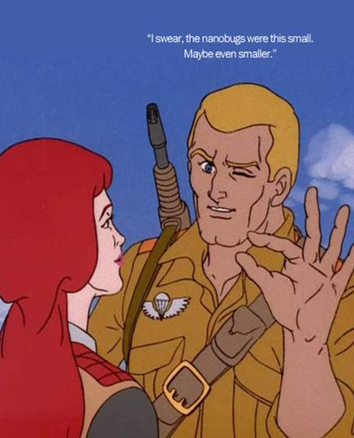
Topic 1: How small is a nanometer?
1 nm = 0.000000001 m
= 10⁻⁹ m
= one billionth meter
http://www.sniffcode.com/view.php?id=8
Notes:
Trainer Notes:
If desired, ask the class to point out the fallacy in the cartoon. (Or you could just let them laugh.) The size of any object worthy of the name “nanobug” cannot be estimated by squeezing together one’s fingers nor seen by squinting one’s eyes! The nanoscale is much too small for us to experience directly with our senses.
IMPLICATION FOR WORKERS: As with chemical substances, nanoscale objects may be present in the working environment with little to alert the worker of a possible exposure. Just because you can’t see it, feel it, smell it or taste it doesn’t mean it’s not there.

Slide 8
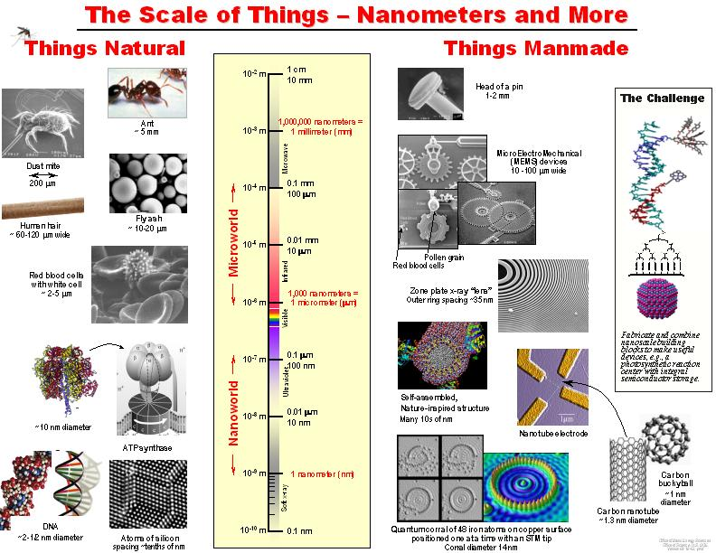
Handout 1
VIRUS
Courtesy Office of Basic Energy Sciences, Office of Science, U.S. DOE
Notes:
Trainer Notes:
The nanometer is difficult to conceptualize because we cannot experience it directly with our senses. Be sure to emphasize that “nano” does not simply mean “very small” and that there are many forms of matter much smaller than a nanometer, including electrons, atoms and most molecules. Rather, the nanoscale is in between the very small atomic regime and the larger regime of microparticles and colloids.
On the left of the diagram are naturally occurring objects of various sizes. On the right are human-designed objects of various sizes.
Note that there are plenty of natural objects that fall within the nanoscale, notably DNA and some larger proteins. Whether these can be called “nanotechnology” will be addressed in Topic 2.

Slide 9
Where does each of these fit?
Place the following objects on the ruler according to their approximate size. (Use diameter unless otherwise specified.)
Bacterium
Ant
Molecule
Buckyball (C₆₀)
Virus
Human hair
Atom
Notes:
Trainer Notes (OPTIONAL):
Have the students place examples 1-7 on the ruler to within an “order of magnitude” or closest power of 10. Give the students a couple of minutes to test their understanding of the nanoscale then go over the answers with them.
Bacterium: 10⁻⁶
Ant: 10⁻³
Molecule: 10⁻¹⁰-10⁻⁸
Buckyball: 10⁻⁹
Virus: 10-100 nm
Human Hair: 10⁻⁴
Atom: 10⁻¹⁰

Slide 10
Definitions and commonly used terms
Topic 2

Slide 11
Topic 2: Definitions and Commonly Used Terms
Key terms: nanotechnology, nanoscale, nanomaterial, nanoparticle, nanofiber
There are several standard definitions for each of these
GROUP ACTIVITY (See Handout 2)
In groups of 3-5, find similarities and differences among the definitions of nanotechnology, nanoparticle and nanomaterial published by ASTM, BSI and OSHA.
Notes:
Trainer Notes:
Introduce the ASTM and BSI standards and OSHA definition on Handout 1. Explain that there are other standards produced by voluntary standard developing organizations, most notably ISO, but that no consensus has emerged yet about which set of definitions will prevail. OSHA’s definition of nanotechnology conforms more or less to that posted on the National Nanotechnology Initiative’s nano.gov website.
Ask Students to compare and contrast the definitions
Nanotech: All three reference a scale range of between 1-100 nm; ASTM and OSHA emphasize novel features, BSI does not (but it does in the term nanomaterial)
Nanoparticle: ASTM has 2-3 nanoscale dimensions; BSI has 1-3 nanoscale dimensions; OSHA does not define this term
Nanomaterial: Like its definition for nanoparticle, BSI’s nanomaterial definition references one or more dimensions at the nanoscale. However, it distinguishes between external dimensions (meaning “of the whole object”) and internal structure. Therefore an object can be larger than 100 nm in all three dimensions yet still be considered a nanomaterial if it has structural features within the nanoscale range. OSHA simply refers to one or more dimensions between 1-100 nm. Both BSI and OSHA refer to special properties but the BSI definition is less restrictive about this requirement (“could exhibit” for BSI vs. “that exhibit” for OSHA). ASTM does not define this term.
Yes this is all a bit confusing and reflects the lack of consensus about these terms. For the purposes of this course, we will use the OSHA definition of nanomaterial and the ASTM definition of nanoparticle.

Slide 12
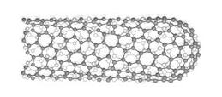
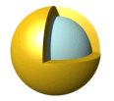
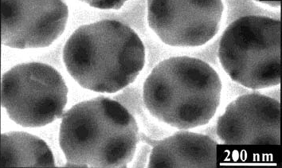
What is it?
Nanofiber OR Nanomaterial
1.5 nm x 1.5 nm x 10 μm
Nanoparticle OR Nanomaterial
60 nm diameter (57 nm core: 3 nm shell)
Nanostructured material
Large voids: >200 nm diameter
Small inner pores: ~60 nm diameter
Notes:
Trainer Notes:
Have the students use the flowchart to determine what each of these objects should be called.
Buckyball 1 nm: nanoparticle or nanomaterial
Nanotube: 1-1.5 nm in diameter, > 10 μm in length: nanomaterial or nanofiber
Gold nanoshell: 57 nm core, 3 nm shell: nanoparticle or nanomaterial
Macroporous nickel film showing the smaller
pores (60 ± 10 nm) that interconnect the air cavities: nanostructured material
SOURCE: nanoshell is from nanospectra.com; macroporous nickel is from [Advanced Materials article]

Slide 13
Different Types of Nanomaterials
Naturally Occurring | Human Origin (Incidental) | Human Origin (Engineered)
Forest fires | Cooking smoke | Metals
Sea spray | Diesel exhaust | Quantum dots
Mineral composites | Welding fumes | Buckyballs/Nanotubes
Volcanic ash | Industrial effluents | Sunscreen pigments
Viruses | Sandblasting | Nanocapsules
Nanotechnology
Notes:
Trainer Notes:
The items in the table are just some examples. There are others.
Another important distinction to make is whether the particle is naturally occurring, of human origin but unintentionally produced or intentionally engineered for a specific purpose.
Naturally occurring: There are many examples of materials that satisfy the size requirements of the nanoscale but that are produced naturally rather than in a factory or research lab. Combustion products (e.g., from a forest fire) and volcanic ash are both composed of a range of substances and particle sizes, some of which are on the nanoscale. Viruses could even be considered nanoscale particles.
Human Origin (incidental): Humans engage in many activities that produce nanoscale particles as an unintentional waste product of the process. Workers may be familiar with examples from welding, sandblasting or other industrial processes. Some of these particles have been implicated in unwanted public or occupational health outcomes.
Human Origin (Engineered): When we speak in this course about nanomaterials we will be talking about the third class shown in the table, the particles that have been intentionally designed to be in the nanoscale and are being studied or used commercially because of their novel properties. Some examples, about which more will be presented later, include nanoscale metals such as nanosilver, semiconducting nanoparticles known colloquially as quantum dots, carbon-based nanomaterials such as nanotubes, ceramic (metal oxide) nanoparticles such as titanium dioxide which is found in sunscreens, and polymeric hydrocarbon-based nanoparticles such as capsules used for drug delivery.
The main differences between Incidental and Engineered nanomaterials are that Engineered nanomaterials are intentionally designed to exploit a novel feature that accompanies the small size and are typically more well-controlled than randomly produced Incidental nanomaterials.

Slide 14
How is the nanoscale different from the macroscale or the atomic scale?
Topic 3

Slide 15


Topic 3: How is the nanoscale different from the macroscale or the atomic scale?
Baseball: ~2.8 inches in diameter
Softball: ~3.8 inches in diameter
Notes:
Trainer Notes (OPTIONAL):
Ask the students how different a baseball is from a softball. Prompt the students to respond that baseballs and softballs are different in size but not really different in terms of their properties or their composition. Changing the size of the ball has only a modest impact on how it behaves. When either ball is hit, it is fairly easy to figure out where it’s going to end up. This is how big objects behave and we’re all familiar with this from our everyday experience.
But the same is not true for objects at the nanoscale. The reason is that nanoscale objects resemble atoms a lot more than they resemble baseball.
IMAGE CREDIT softball: en.wikipedia.org; baseball is microsoft clipart

Slide 16
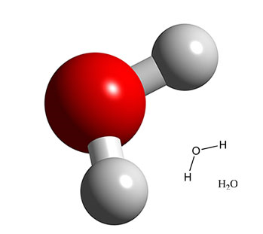
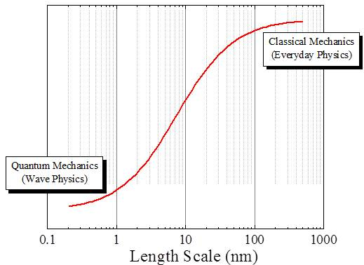

Nanomaterial Properties Can Change with Size
The nanoworld
At the nanometer scale, fundamental physical and chemical properties depend on the size of the object.
Notes:
Trainer Notes:
Explain that very small forms of matter such as atoms and molecules have their own set of rules and don’t behave the same way as larger objects. In other words, a water molecule is not just a very, very small water drop. They are made of the same chemical substance, H₂O, but they behave very differently. In order to understand the nanoscale it’s helpful to consider how gaseous water vapor in the atmosphere becomes a water drop that falls to Earth.
Start with an individual water molecule. We can’t see or feel individual water molecules but when conditions are right the individual molecules start to cluster together into tiny droplets. The droplet may start off as a cluster of 5 or 6 molecules, at which point it’s not much different than a single molecule. However, the bigger the cluster gets, the more it begins to resemble a raindrop. As more and more molecules cluster together, the droplet gets heavier and heavier until eventually it falls from the sky, getting some unlucky person below all wet. In other words, there is a point at which the cluster of water molecules stops resembling an individual gas-phase molecule and starts resembling a liquid-phase raindrop. The water undergoes a smooth transition from gas to liquid simply as a result of its change in size.
This is an important concept for nanomaterials. The nanoscale world lies between the realms of molecules (such as H₂O) and larger objects we can perceive with our senses (such as a raindrop). A nanoparticle’s properties can change with its size because it is transitioning from the atomic world to the macroscopic world. Unlike water, though, the changes some substances go as they transit through the nanoscale can include properties we wouldn’t expect to change. This will be explored with specific examples on the next slides.

Slide 17
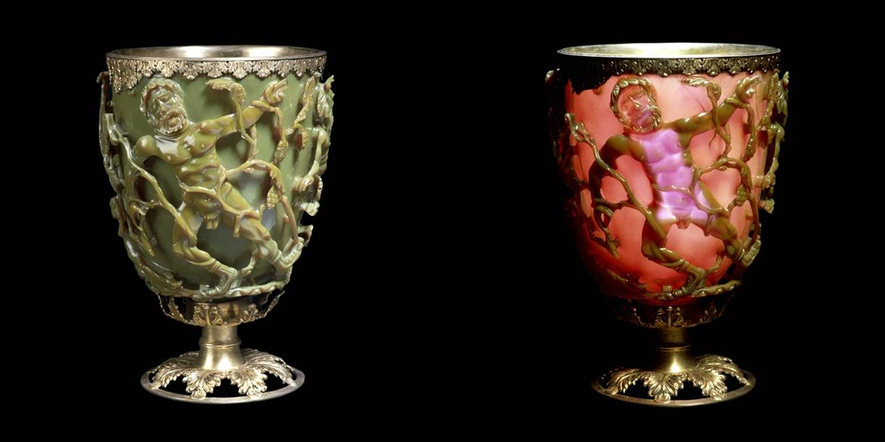
Early Nanotechnologists
Lycurgus Cup
http://www.britishmuseum.org/explore/highlights/highlight_objects/pe_mla/t/the_lycurgus_cup.aspx
Notes:
Trainer Notes: (OPTIONAL EXTRA SLIDE)
Explain that while the term nanotechnology is new, in fact artisans have been making and working with nanoparticles for millenia.
The Lycurgus [lie∙KUR∙guss] cup is a stunning example of dichroic (“two colors”) glass from the late Roman period (4th century AD). The cup appears green in reflected light and red when lit from behind. Modern analysis revealed the glass contains 50-100 nm particles of a silver-gold alloy. These small size of these particles is responsible for the dichroic effect.
There are many other examples of the shape-shifting nature of nanomaterials.
The cup depicts the triumph of Dionysus over King Lycurgus who attacked one of Dionysus’s maenads, Ambrosia. She transforms herself into a vine and holds him captive while Dionysus sets his followers to kill him.

Slide 18
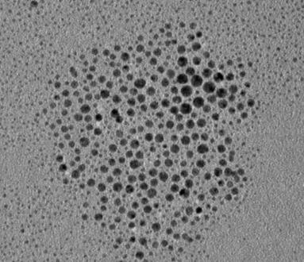

Would you buy this gold?
Gold (~ 10 nm)
Bulk Gold (Au) = Yellow
Conductive
Nonmagnetic
Chemically inert
Nano Gold = Red
Loses conductivity at ~ 1-3 nm
Becomes magnetic ~ 3 nm
Explosive and catalytic!
Notes:
Trainer Notes:
Prompt the audience to list some of the properties of bulk gold: lustrous (shiny), ductile (can be drawn into wires), malleable (can be pounded into sheets), yellow color, inert (doesn’t easily react chemically, especially with atmospheric oxygen) and nonmagnetic. These qualities make gold extremely valuable because it can be shaped into various forms, doesn’t corrode and is pleasing to the eye.
But what about nanogold?
Well if you take gold down to the nanoscale it becomes red (10 nm)! Or green or blue, depending on the size.
It also
Melts at a lower temperature (830°C for a 5-nm particle and 350°C at 2 nm vs. 1064°C for bulk gold);
Ceases to be metallic between 1-3 nm but becomes magnetic at that size AND
Becomes an excellent catalyst!
IMPLICATION FOR WORKERS: You cannot assume that you understand the behavior of a nanomaterial just because you understand the same material at the atomic/molecular or macroscopic levels.

Slide 19
Physical and Chemical Properties that can Change at the Nanoscale
Color
Melting temperature
Crystal structure
Chemical reactivity
Electrical conductivity
Magnetism
Mechanical strength
…
Notes:
Trainer Notes:
This is a partial list of some of the physical and chemical properties that can change for a given nanomaterial. Not all of these changes will be relevant for every nanoparticle; each will have its own set of variable properties.

Slide 20
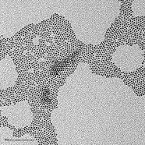
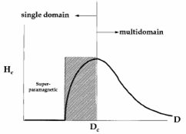
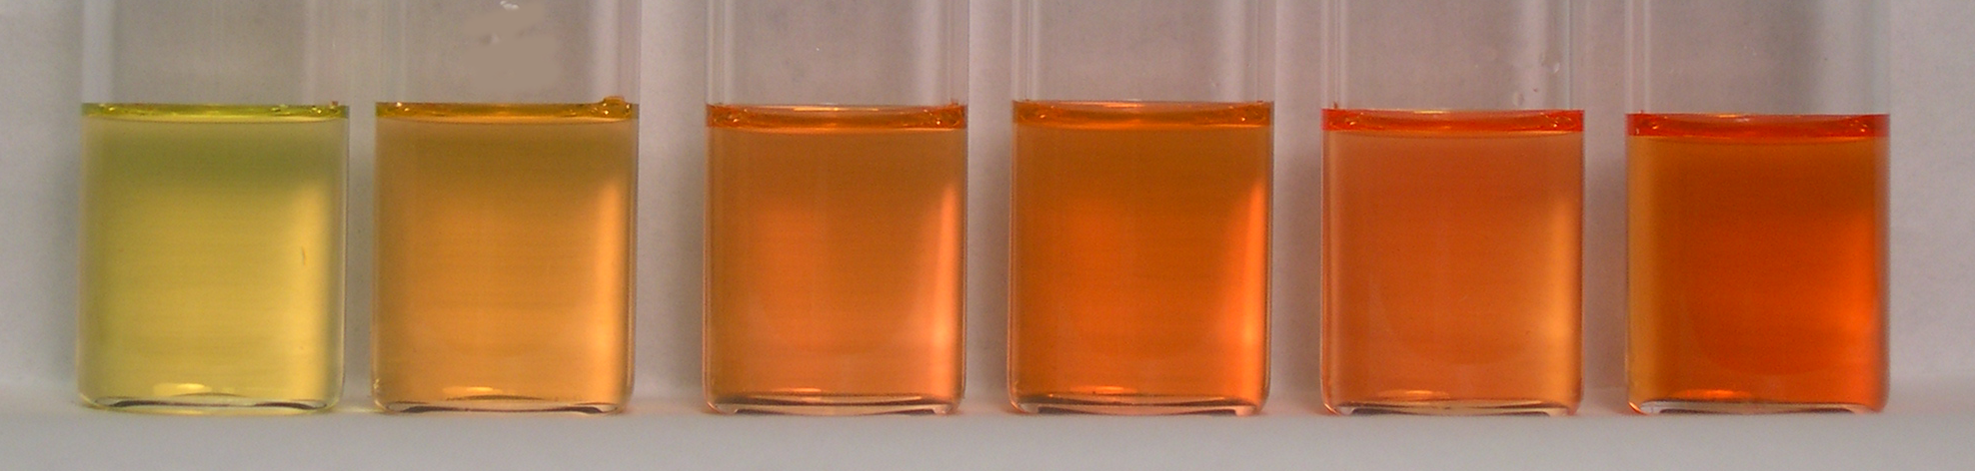
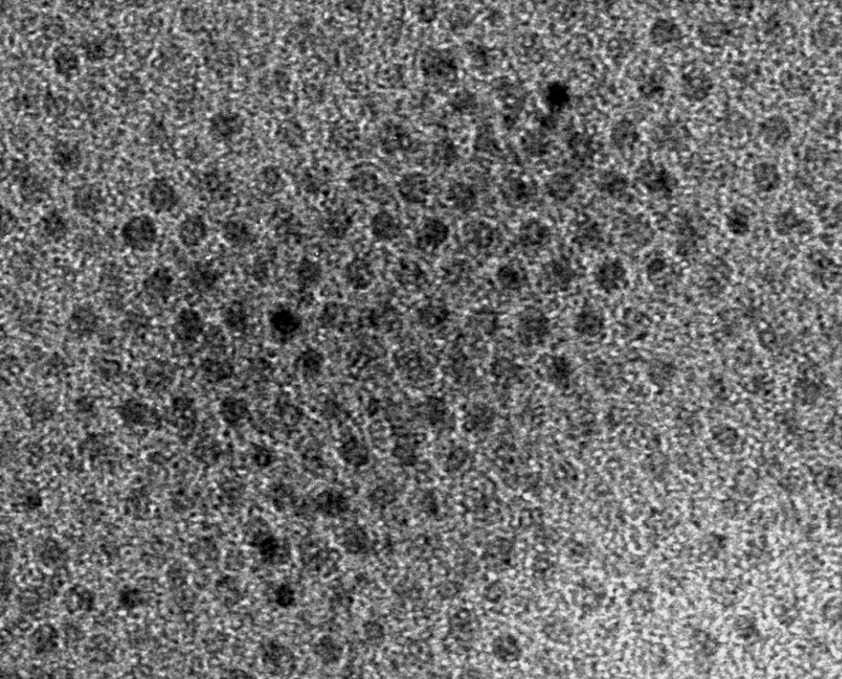
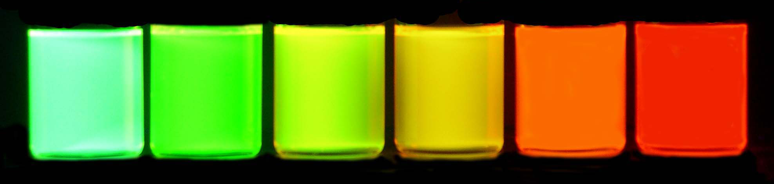
Some Other Size-Dependent Properties
Fe₃O₄, Magnetite (4 nm)
CdSe (8 nm)
Magnetism
Emission
Notes:
Trainer Notes:
Optional additional examples of properties that change as a result of the nanoscale size of the object.
LEFT: The form of iron oxide known as magnetite exhibits size-dependent magnetism. The magnetic strength of a permanent magnet does not change with the magnet’s size at the macroscale. But tiny magnets can actually exhibit larger magnetic fields than bigger magnets. The figure shows a parameter associated with magnetic field strength H plotted against particle diameter D. Note that as the magnet gets smaller the field strength goes up until it reaches a maximum.
[This is called superparamagnetism and can be explained by the fact that at a certain size, within the nanoscale, the material can form a single crystal (or domain) in which all the magnetic moments are aligned in the same direction. In larger magnets, multiple “domains” are present with slightly misaligned magnetic fields, which weakens the overall field strength. An analogy is the difference in power between a tug-of-war team that is all pulling straight back vs. one in which some of the members are pulling the rope off to one side or the other. The overall pulling power of the team is weakened if all members are not pulling in the same direction.]

Slide 21
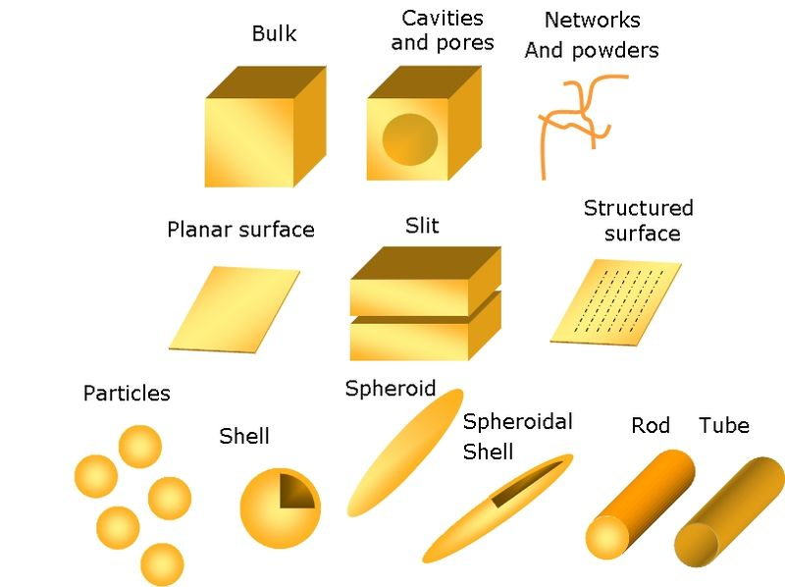
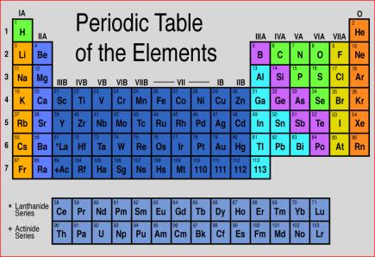

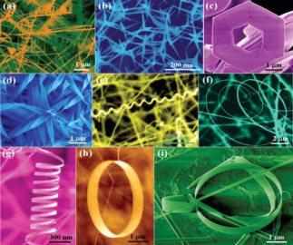
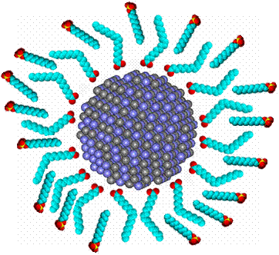
Nanomaterials Exhibit Diversity in…
Chemical composition
Form or shape
Surface treatments
Notes:
Trainer Notes:
TOP: Novel materials can be made just by taking elements in the periodic table and combining them to form objects within the nanoscale range. There is incredible chemical diversity among nanomaterials.
MIDDLE: Note the wide variety of different shapes of the objects shown in the middle image (and that the color was added to the microscope images for visual appeal). Now reveal that each one of those objects has exactly the same chemical formula: ZnO. Nanoscientists and engineers can take the same substance and shape it into many different types of nanoscale objects. There is great structural diversity among nanomaterials.
BOTTOM: Manufacturers often change the surface of a nanoparticle during product formulation to achieve the desired dispersability, stability or activity. These surface modifications may impact the properties to such an extent that the surface-treated particle is, for all purposes, an entirely different substance than the non-treated particle.
Image credits: (top) http://facstaff.gpc.edu; (middle left) K. Molhave, Opensource Handbook of Nanoscience and Nanotechnology, (middle right) Zhong Lin Wang, (bottom) CBEN, Rice University

Slide 22
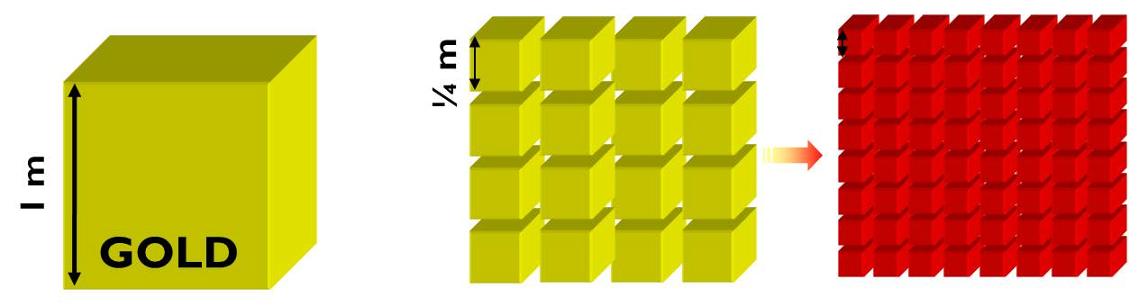
Surface Area is a Big Factor
Each side =1/4 m
Mass ≈ 43,000 lb
SA = 24 m²
Each side =1 nm
Mass ≈ 43,000 lb
SA = 6 billion m² ≈ 2500 miles²
State of Delaware = 2490 miles²
Each side =1 m
Mass ≈ 43,000 lb
Surface Area (SA) = 6 m²
≈ 8 ft x 8 ft room
Notes:
Trainer Notes:
One reason why a nanomaterial is different than the larger form of the same substance is the increased surface area that results from dividing the larger material into many smaller pieces. Walk through this example to illustrate how much more surface area a large block of gold has when it is divided up so that all the pieces are nanometer in dimension. Emphasize that the mass and volume of the material is unchanged by the division of the block into small pieces. If all the 1-nm pieces were opened up and spread out flat, the entire state of Delaware could be gold-plated!
IMPLICATION FOR WORKERS: The gold atoms inside the big block are effectively hidden from whatever it is exposed to but cutting the block up into smaller pieces brings more of the gold atoms to the surface where they become available to react. Surface area and quantum mechanical effects account for many of the changes in chemical and physical properties observed at the nanoscale.
[Calculations:
The area of a square is calculated by multiplying length x width. The total surface area of a cube is the surface area of a face x the number of faces (6).
For the leftmost cube this is 1 m x 1 m = 1 m² per face and 6 m² total area
In the middle example we cut the cube into quarters along its length, width and depth, which creates a total surface area of 24 m² .
Taking this to the extreme, when each cube is 1 nm on a side we get on the order of 6 billion m²
(0.9 m leads to 6,442,450,944 m²)
http://www.scribd.com/doc/10309/Loading-capacity-of-nano-gold-

Slide 23
Major classes of nanomaterials and their benefits
Topic 4

Slide 24
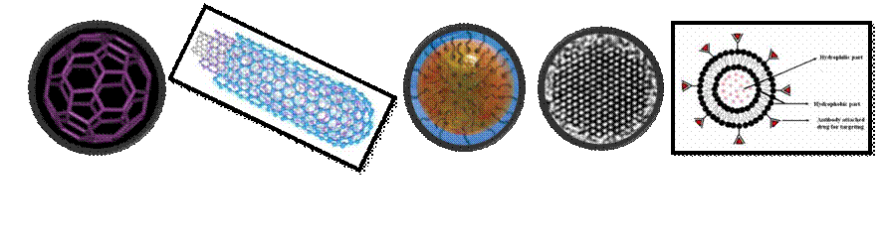
Major Classes of Nanomaterials and Sample Applications
Category | Chemical Composition | Product example
Fullerenes, Nanotubes; Nanowires | carbon, boron nitrides | Anti-static fabrics
Metals | silver, gold, iron, copper | Anti-microbial wound dressings
Ceramics (metal oxides) | titanium dioxide, zinc oxide, cerium oxide | Sunscreen filters, self-cleaning glass
Semiconductors (Quantum dots) | cadmium selenide, cadmium telluride | Medical imaging agents
Polymeric | hydrocarbon polymers | Drug delivery devices
Notes:
Trainer Notes:
One way to categorize nanomaterials is by their chemical composition. Many of the most commercially important nanomaterials can be categorized into one of the five classes listed here.
Fullerenes, Nanotubes; Nanowires: Most materials in this class are made from carbon. These include the family of compounds derived from the C₆₀ molecule known as buckminsterfullerene or buckyball, as well as the class of materials known as nanotubes. Nanotubes are simply elongated versions of the buckyball and can exist in single-walled, double-walled or multi-walled configurations. A single-walled carbon nanotube is represented in the top image on Slide 12: What is it?
Metals: There are many examples of nanometals in use today. The most commercially relevant is likely to be nanosilver, which is prized for its potent and broad-spectrum antimicrobial properties. Nanosilver is used in a number of consumer products ranging from spray disinfectants to toothpaste and teddy bears, as well as in many medical applications such as wound dressings and catheters. Nanosilver is even being researched for use in animal feed to reduce the need for conventional antibiotics
Ceramics: Another very broad class of materials that includes titanium dioxide, which is used in sunscreens and to coat so-called “self-cleaning glass”, as well as cerium oxide, which is a fuel additive that promotes greater fuel efficiency.
Semiconductors (Quantum Dots): These exhibit very bright photoluminescence and can be used as medical imaging agents. Unlike conventional dyes, quantum dots do not degrade quickly and have much brighter luminescence, thus enhancing the signal in a medical image. Their surfaces can be modified to direct them to specific cells in the body, including cancer cells which can aid in disease detection.
Polymeric: Polymeric nanoparticles are small beads made from polymeric hydrocarbons. They can serve as containers for drug molecules and can be designed to deliver the drug to the precise location via surface modification with biomarkers that target a certain type of cell, for example. Polymeric nanoparticles are also used in the cosmetics industry to encapsulate active ingredients and potentially deliver them beneath the epidermis.

Slide 25
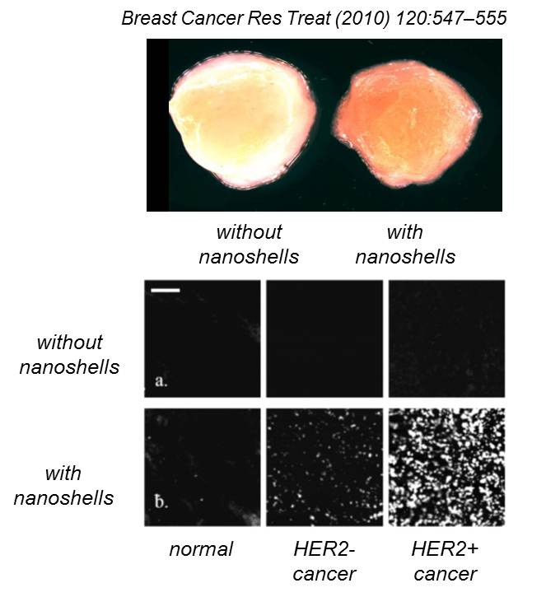
Detecting Cancer Cells
What is it?
Small SiO₂ (silica) sphere with thin gold coating
Advantages
Enhances the detection of cancer cells in real time
Why Nano?
Particle size affects its response to light
Notes:
Trainer Notes:
Nanoshells are nanoparticles with a core of silica (SiO₂, silicon dioxide, main component of glass) and a thin coating of gold. In this application the nanoshells have a molecule attached to the surface that causes it to bind to the surface of a particular type of breast cancer cell (HER2+). Once bound to the cancer cell the nanoshell’s optical properties, which are a direct consequence of its nanoscopic size, enable the cancer cells to be more easily detected.
TOP: Application of targeted nanoshells creates a red hue in tumor tissue that can be visualized macroscopically with the eye.
BOTTOM: Nanoshells also cause the cancer cells to light up under a microscope (near-infrared reflectance confocal microscopy)
In either case this technology could permit the surgeon to assess whether all the cancerous tissue has been removed while the patient is still on the operating table rather than relying on post-operative assessment which could result in additional surgery.

Slide 26

Self-Cleaning Glass
What is it?
Thin film of titanium dioxide bonded to glass
Advantages
Reduces energy usage
Self-cleaning glass
PPG Industries
Reduces cost and effort of cleaning glass
Why Nano?
Film doesn’t change glass color
Nano-size enhances the photocatalytic effect
Notes:
Trainer Notes:
In self-cleaning glass, a thin film of titanium dioxide (TiO₂ or titania) is bonded to glass. Upon exposure to UV from sunlight, the titania catalyzes breakdown of dirt. Rainwater then washes dirt away. The film also creates a hydrophobic surface which causes water to flow in sheets rather than beading up. As a result, little to no streaking occurs after water evaporates.
This coating can also be made to reflect UV light which can result in greater energy efficiency for the building due to reduced air-conditioning costs.

Slide 27

Small Change, Big Savings
What is it?
Thin film of polymer bonded to paint
Advantages
Reduces friction-causing debris build-up on plane surface
Reduces fuel consumption 1-2%  ~$22 million
Why Nano?
Film adds a mere 4 oz to weight of the jet (compared to 176 pounds of paint)
Notes:
Trainer Notes:
UK-based airline Easy Jet is testing a new nanotechnology coating on 8 of its jets in hopes that it can reduce fuel consumption by as much as 2% per jet per year. The coating fills in all the tiny crevices in the surface of the paint, creating an ultra-smooth, low-friction surface that repels debris and reduces drag. For an airline that spends nearly $1.2 billion in fuel per year, the coating could save them 10’s of millions of dollars.
If you have time and Internet access, click on the image to open the website and play a one-minute video
Credit: http://www.bbc.co.uk/news/business-12428667

Slide 28

Balancing the Benefits and Risks
Nanomaterials’ special physical and chemical properties may lead to unexpected interactions with biological and environmental systems.
Notes:
Trainer Notes:
The novelty of certain nanomaterials may be a double-edged sword. Society supports the development of novel nanoscale materials because of their different physical and chemical properties. But this novelty could result in unwanted impacts on humans or the natural environment. As we’re developing technologies to solve one problem we should ensure we are not contributing to another.
There is a growing body of information about nanomaterial toxicity that must be considered in designing and implementing a safe workplace. That’s where we’re going next.
Image Credit: Scale-Microsoft Clipart

Slide 29
Eight-Hour Training Course
Module 1 | Introduction to Nanotechnology and Nanomaterials
Module 2 | What Workers Need to Know about Nanomaterial Toxicology
Module 3 | Assessing Exposure to Nanomaterials in the Workplace
Module 4 | Controlling Exposure to Nanomaterials
LUNCH (on your own)
Module 5 | Risk Management Approaches for Nanomaterial Workplaces
Module 6 | Regulations and Standards Relevant to Nanomaterial Workplaces
Module 7 | Tools and Resources for Further Study
Notes:
Trainer Notes:
The next module will review what we know about nanomaterial toxicology and environmental impacts. But before we move on, let’s review our learning objectives from this segment.

Slide 30
Learning Objectives
At the end of this module you should be able to
Contrast objects at the nanoscale with larger and smaller forms of matter
Define key terms in nanotechnology
Explain some of the ways nanomaterial properties differ from molecules and microscale particles
Describe some of the physical and chemical characteristics that can change at the nanoscale
Describe some of the major classes of nanomaterials produced today and their properties and potential benefits
Notes:
Trainer Notes:
This slide is identical to the one posted at the beginning. Take this opportunity to probe the class for any topics that may be unclear.

