Slide 1
Module 2: What Workers Need to Know about Nanomaterial Toxicology
Introduction to Nanomaterials and Occupational Health
Kristen M. Kulinowski, Ph.D.
8-Hour Training Course
Notes:
Trainer Notes:

Slide 2
This material was produced under grant number SH-21008-10-60-F-48 from the Occupational Safety and Health Administration, U.S. Department of Labor. It does not necessarily reflect the views or policies of the U.S. Department of Labor, nor does mention of trade names, commercial products, or organizations imply endorsement by the U.S. Government.
Notes:
Trainer Notes:
[insert a disclaimer about the limitations of these materials]

Slide 3
Eight-Hour Training Course
Module 1 | Introduction to Nanotechnology and Nanomaterials
Module 2 | What Workers Need to Know about Nanomaterial Toxicology
Module 3 | Assessing Exposure to Nanomaterials in the Workplace
Module 4 | Controlling Exposure to Nanomaterials
LUNCH (on your own)
Module 5 | Risk Management Approaches for Nanomaterial Workplaces
Module 6 | Regulations and Standards Relevant to Nanomaterial Workplaces
Module 7 | Tools and Resources for Further Study
Notes:
Trainer Notes:
Explain where the current module fits within the full eight-hour course, where appropriate. If this module is being offered as a standalone training, you can modify or hide the slide or use it to describe the other available modules.
Use this opportunity to explain where the restrooms and water fountains are located and what emergency evacuation procedures should be followed should the need arise.

Slide 4
Lesson Overview
Purpose
To provide workers with information on the environmental, health and safety impacts of nanomaterials
Topics
  Federal support for nanotechnology and nano- environmental, health and safety (EHS) impacts research
  Tools for finding the most up-to-date information on nano-EHS impacts research
  Significant findings from the nanoEHS literature
Notes:
Trainer Notes:
This module will give you an overview of the current understanding of nanomaterials’ health and safety impacts with an emphasis on human health.

Slide 5
Learning Objectives
At the end of this module you should be able to
Find the latest research on the environmental, health and safety (EHS) impacts of nanomaterials using freely available web resources
Summarize some of the significant EHS research of the past few years
Articulate the significance of the EHS research to occupational safety
Notes:
Trainer Notes:
Review these objectives with the class and explain that you will return to them at the end of the module to see if the learning objectives have been achieved. You can also post them on a flipchart or repeat this slide as you move between Topics to indicate where you are in the timeline of the module if desired.

Slide 6
  Federal support for nanotechnology and nano-environmental, health and safety (EHS) impacts research
Topic 1

Slide 7
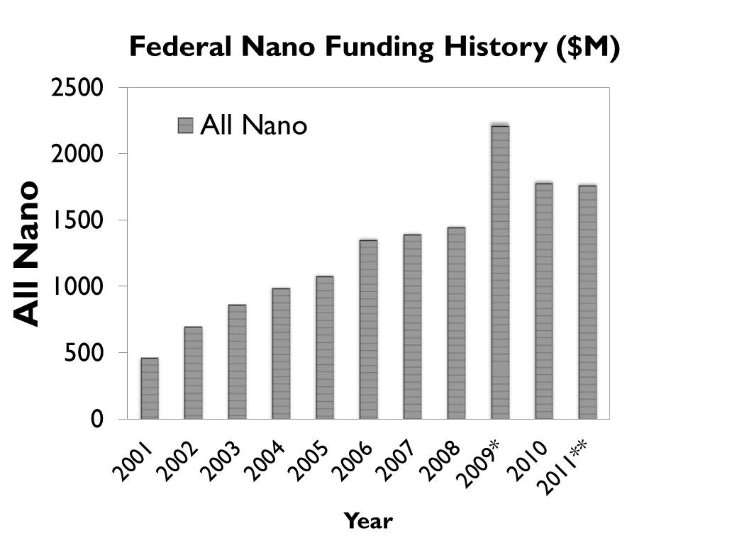
Federal Investment in Nanotechnology Research
The National Nanotechnology Initiative (NNI) was created in 2001 to organize federal investments in nanotechnology research
Notes:
Trainer Notes:
The National Nanotechnology Initiative (NNI) was created in 2001 under President Clinton to organize the loose federation of federal agencies that were then supporting research and development of nanotechnologies. Twenty-five different agencies are part of the NNI. Each of them has its own funding for nanotechnology R&D activities. The numbers on these graphs are the sums of all agencies’ nanotechnology activities.
MIN: $464 million in 2001
MAX: $2.2 billion in 2009*
Additional Facts:
*The bump in 2009 funding is the result of additional funding from the American Reinvestment and Recovery Act (“stimulus”).
** The 2011 numbers are proposed and won’t be finalized until the agencies receive their formal budgets from Congress (due in October 2010)

Slide 8
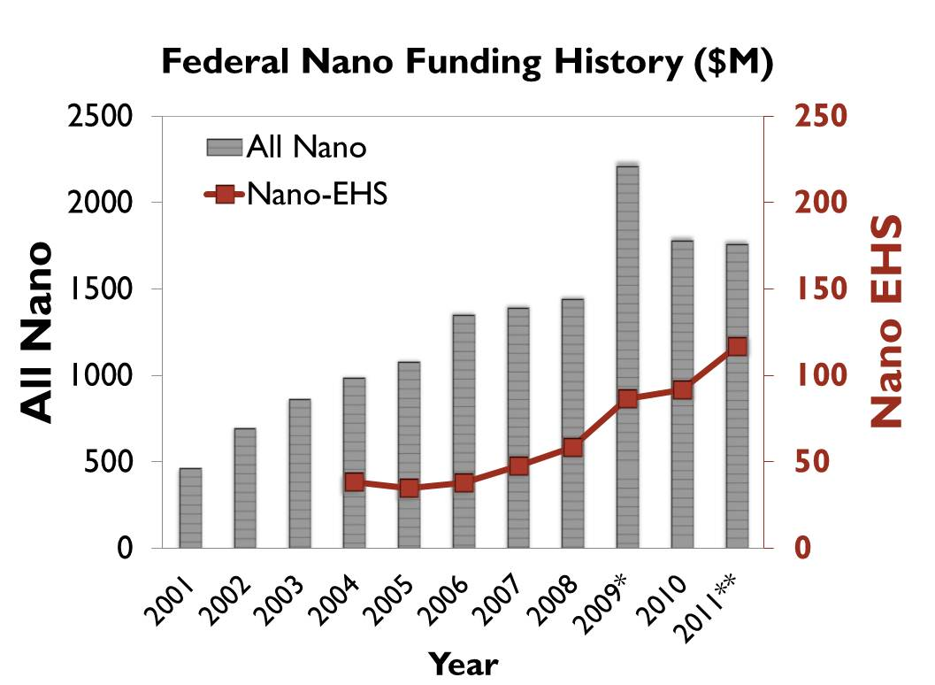
Federal Investment in NanoEHS Research
Environmental, Health and Safety (EHS) research has made up 3-7% of the federal nanotechnology budget
Notes:
Trainer Notes:
Here is the same graph presented before showing total NNI funding since its inception in 2001. Superimposed on top of that are the portions of those dollars that went toward NanoEHS research. Note that the NanoEHS numbers correspond to the right-hand y axis which is 10 times smaller than the left-hand y axis. The bottom line is that NanoEHS research has made up between 3-7% of the total NNI budget.
Additional Facts:
NanoEHS numbers are not provided for the early years of the NNI before 2004 but probably did not exceed 4% of the total NNI budget. During this time, EHS research was funded but often combined for reporting purposes with educational and social science funding.

Slide 9
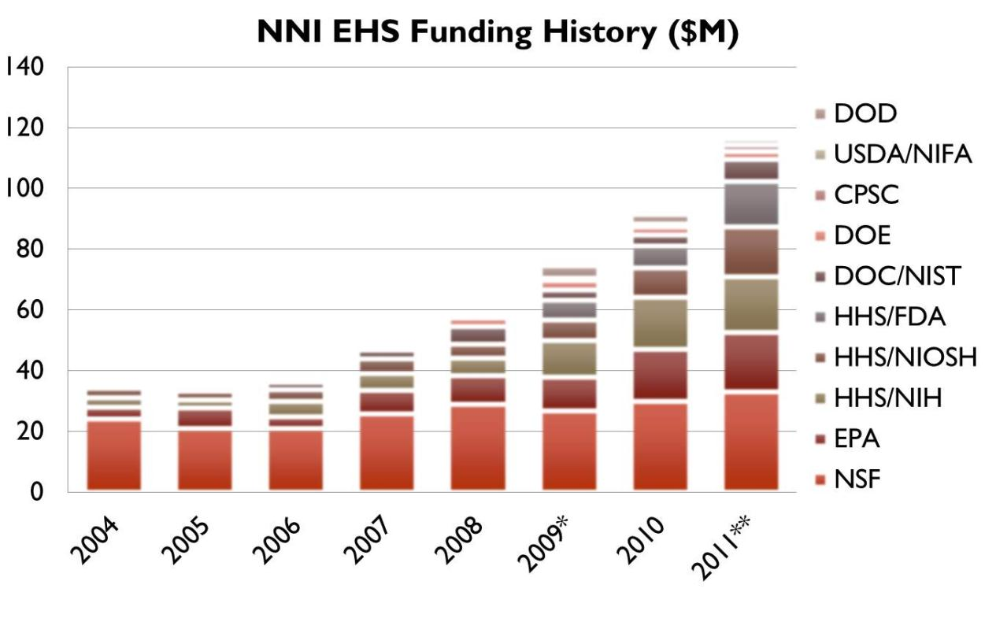
NanoEHS Funding by Federal Agency
Notes:
Trainer Notes:
This graph represents levels of funding for nano-EHS research by agency. Over 40% of federally sponsored nanoEHS research has been funded by the National Science Foundation (NSF) which greatly exceeds any other agency. Here are the rest:
Environmental Protection Agency – 16%
National Institutes of Health – 15%
National Institute for Occupational Safety and Health – 10%
Food and Drug Administration – 6%
National Institute for Standards and Technology – 5%
Department of Energy – 3%
Consumer Product Safety Commission – 1%
US Department of Agriculture/National Institute of Food and Agriculture – 1%
Department of Defense – 2%
OSHA does not fund NanoEHS research. Though the regulatory side of HHS/FDA had been active in nanotechnology issues for several years prior, FDA only began to fund NanoEHS research in 2009.
So, what can almost 10 years of NanoEHS research tell us about how to handle these materials?

Slide 10
  Tools for finding the most up-to-date information on nanoEHS impacts research
Topic 2
Notes:
Trainer Notes:
Topic 2 will provide participants practical tools for finding the latest research on nanomaterial toxicity and environmental impact. It is highly desirable to do this segment with access to the Internet so that live searches can be performed. In cases where this is impracticable, screen shots have been provided.

Slide 11
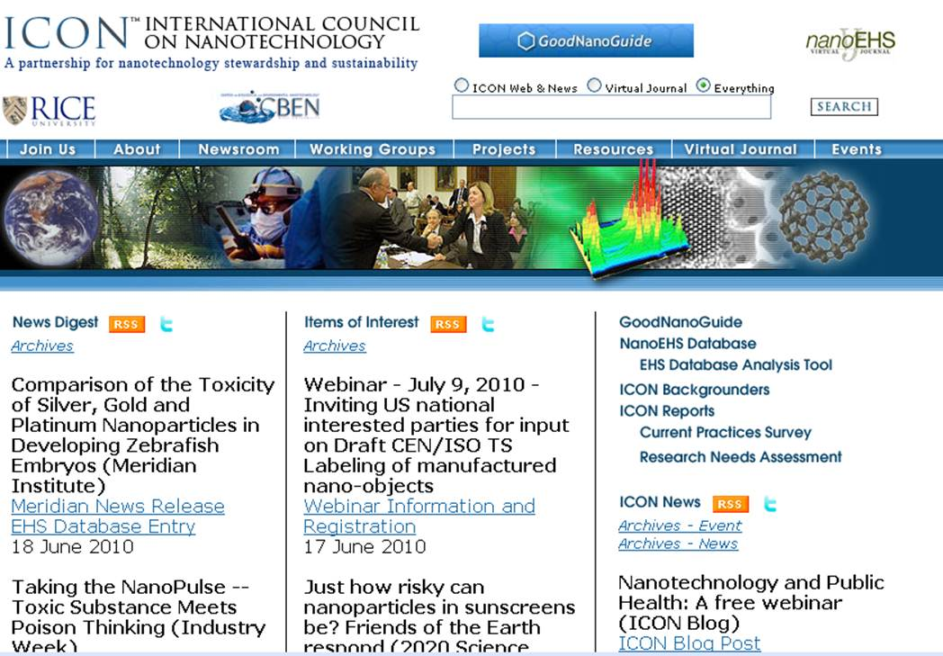
One-Stop Shop for NanoEHS Info
http://icon.rice.edu
Notes:
Trainer Notes:
The International Council on Nanotechnology (ICON), a group based at Rice University in Houston, TX, maintains a comprehensive website on all aspects of nanomaterial environmental, health and safety impacts. Appearance on the ICON website does not endorse the material as authoritative, merely that it is relevant to the subject of NanoEHS.
Either navigate your browser to http://icon.rice.edu or use the screen shot to point out the following features:
News Digest: Collects media stories, reports and other news
Items of Interest: News items of particular interest to ICON members
ICON News: New offerings from ICON
Above ICON News there is a list of shortcuts to ICON’s most popular information products, including an industrial survey on nanomaterial handling practices and the GoodNanoGuide, about which more will be presented later

Slide 12
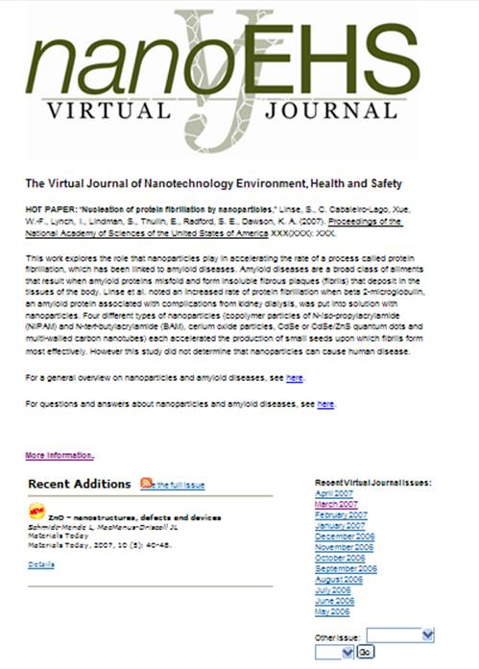


Virtual Journal of NanoEHS
Database of citations to peer-reviewed nanoEHS papers
Weekly updates
Over 5100 records
Rating system
9 tags applied to each entry
⬇⬇⬇⬇ [out of five]
“This paper makes a major contribution to the literature …”
http://icon.rice.edu/virtualjournal.cfm
Notes:
Trainer Notes:
Prior to the course, update the slide as needed to reflect the current total number of papers. Do this by going to the Virtual Journal and selecting Browse by Author from the right-hand column. The total number of papers will appear above the first search result.
An easy way to keep track of the current nano-EHS research is provided by the “Virtual Journal of NanoEHS,” a repository of citations to research papers that study some aspect of NanoEHS impacts. This is called a virtual journal the because it collects work published in other journals, filters it by topical relevance and organizes it into a searchable format. The database is updated weekly and contains thousands of citations. The VJ does not provide the papers themselves but posts the abstracts and links to the source journal where the papers can be obtained.
If you have Internet access, pull up the VJ and demonstrate a few of the features.
Click Details for one of the entries to display the full record
Highlight the Link to Journal Abstract, which brings you to the source journal, and the tags below the Non-technical Summary, such as Content Emphasis, Exposure or Hazard Target, etc.

Slide 13
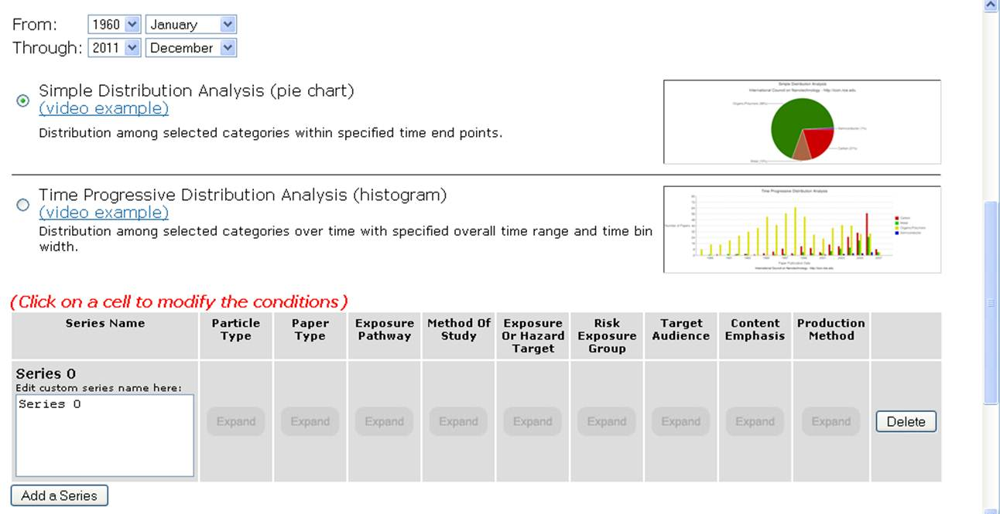
Do Your Own Analyses
http://icon.rice.edu/report.cfm
Notes:
Trainer Notes:
Each entry into the VJ is tagged according to 9 indices, including particle type, exposure pathway and risk exposure group. The Database Analysis Tool allows one to search and do comparative analyses of the database.
Example question (feel free to make up your own): How many peer-reviewed publications in each year of the last decade addressed the hazards of carbon-based nanomaterials vs. semiconducting quantum dots?
If you do NOT have Internet access, use the next slide to demonstrate the results.
If you have Internet access do the search live:
Select dates From 2001 January to 2010 December
Select Time Progressive Distribution Analysis (histogram)
Keep Data Grouping Period at One Year
Select Particle Type: Carbon / Paper Type: Hazard / Content Emphasis: Peer Reviewed Journal Article. Leave the others unchecked. Replace the text in the box Series 0 with “Carbon”
Then Click Add a Series and repeat the search but select Particle Type: Semiconductor instead of Carbon. Replace the text in the box Series 1 with Quantum Dots
Click Generate Report
Discuss the results with the class. Note that if you click on the hyperlinks in the table below the graph the papers that resulted in that number will be returned.

Slide 14
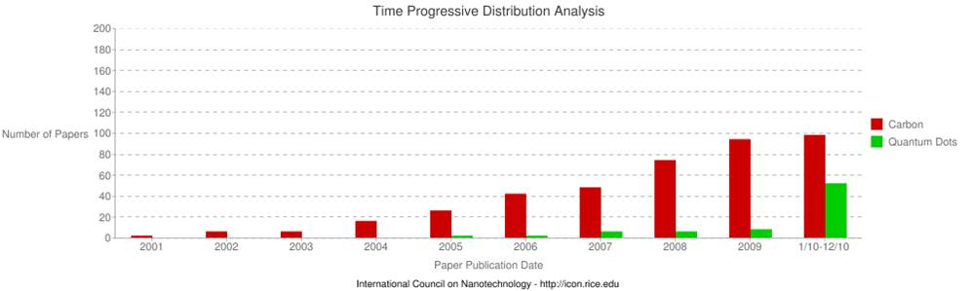
Search Results
Search fields
Particle Type: Carbon or Semiconductor
Paper Type: Hazard
Content Emphasis: Peer Reviewed Journal Article
Notes:
Trainer Notes:
Discuss the results with the class. Note you can hide this slide if you have Internet access and are able to do the search live.

Slide 15
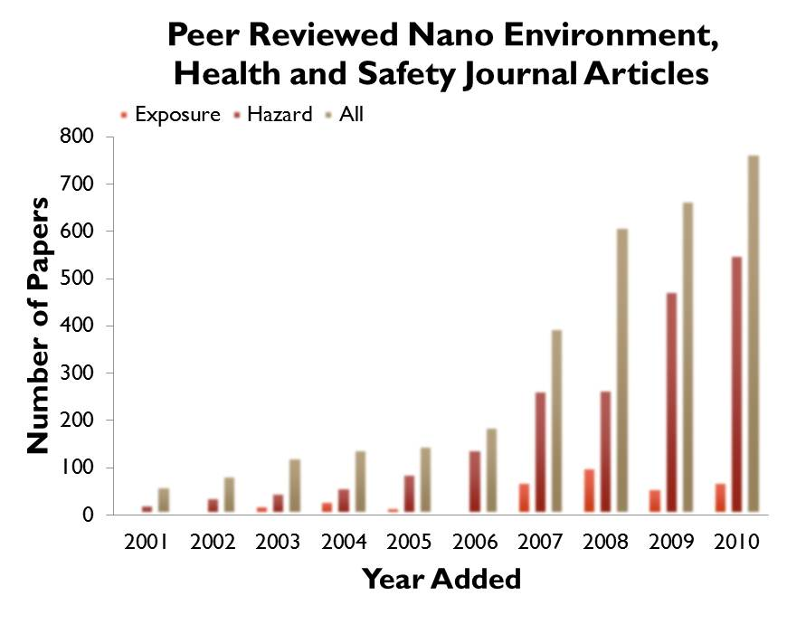
What Does All This Research Tell Us?
Gaps
Greater knowledge base on hazard than exposure
Most hazard studies done in cell culture
Occupational and environmental research is almost non-existent
RESULT: Research knowledge base
has little practical application to human health
Source: http://icon.rice.edu/report.cfm
Notes:
Trainer Notes:
Mining a literature database is not a substitute for detailed analysis of the knowledge base in an area; however, it can illuminate some trends that are real. For nanomaterials, several knowledge gaps in the published research correspond closely with gaps that researchers in the field have agreed are critical to fill. These graphs were produced using the analysis tool.
The first gap is one of hazard vs. exposure. Many papers in the database assess the toxicity of a particular nanomaterial in a laboratory setting. Hazard papers represent more than 60% of all the published nanomaterial risk research over the last decade. Many of these studies were done in cell culture. In contrast, a much more limited body of work has explored the potential for exposure to nanomaterials by documenting sources and releases, translocation within the body or an ecosystem, etc. Just because a substance kills cells in a Petri dish doesn’t mean it will cause harm to a worker. The exposure research needs to catch up with the hazard research so a more complete assessment of risk can be made.
Two other gaps revealed by the database and supported by expert analysis are knowledge about the impacts of nanomaterials on the environment and research of direct relevance to occupational practice. In this analysis, environmental research comprises 13% of all papers published in the last decade and occupationally relevant research comes in at a mere 4%. Examples of occupationally relevant research are studies that measure nanomaterial flow in a fume hood, field studies of workplace exposure, tests of personal protective equipment against nanomaterials or efficacy of particle counters, etc.
So, while nearly 5000 papers seems like a lot, this knowledge base still has little practical application to human health.

Slide 16
Different Types of Nanomaterials
Naturally Occurring | Human Origin (Incidental) | Human Origin (Engineered)
Forest fires | Cooking smoke | Metals
Sea spray | Diesel exhaust | Quantum dots
Mineral composites | Welding fumes | Buckyballs/Nanotubes
Volcanic ash | Industrial effluents | Sunscreen pigments
Viruses | Sandblasting | Nanocapsules
Nanotechnology
Notes:
Trainer Notes:
Remember this slide from Module 1? We’re focusing in this course on the human origin or engineered nanoscale materials but when it comes to occupational health there is much we can learn from research on the health effects of incidentally produced nanoscale particles.
Prompt the audience to share what they might know about the health effects of any of these categories. Each item in this list has a wealth of scientific research linking exposure to unwanted health outcomes such as cardiovascular disease, pulmonary illnesses and other diseases.

Slide 17
Incidental Nanoparticles’ Health Effects
Human Origin (Incidental) | Health Impacts
Cooking smoke
Diesel exhaust
Welding fumes
Industrial emissions/effluents
Sandblasting
Notes:
Trainer Notes:
Here are some of the documented effects from small particulate matter of human origin.
Sources
Cooking smoke: http://www.who.int/mediacentre/factsheets/fs292/en/index.html
Diesel exhaust: http://www.arb.ca.gov/research/diesel/diesel-health.htm
Welding fumes: http://www.osha.gov/SLTC/healthguidelines/weldingfumes/recognition.html
Industrial effluents: http://oehha.ca.gov/public_info/facts/airkids.html
Silicosis: http://www.cdc.gov/niosh/92-102.html

Slide 18
Incidental Nanoparticles’ Health Effects
Human Origin (Incidental) | Health Impacts
Cooking smoke | Pneumonia; chronic respiratory disease; lung cancer
Diesel exhaust | Cancer; respiratory disease
Welding fumes | Metal fume fever; infertility; benign pneumoconiosis
Industrial emissions/effluents | Asthma, atherosclerosis, chronic obstructive pulmonary disease
Sandblasting | Silicosis
Notes:
Trainer Notes:
Here are some of the documented effects from small particulate matter of human origin.
Sources
Cooking smoke: http://www.who.int/mediacentre/factsheets/fs292/en/index.html
Diesel exhaust: http://www.arb.ca.gov/research/diesel/diesel-health.htm
Welding fumes: http://www.osha.gov/SLTC/healthguidelines/weldingfumes/recognition.html
Industrial effluents: http://oehha.ca.gov/public_info/facts/airkids.html
Silicosis: http://www.cdc.gov/niosh/92-102.html

Slide 19
  Significant findings from the nanoEHS literature
Topic 3

Slide 20
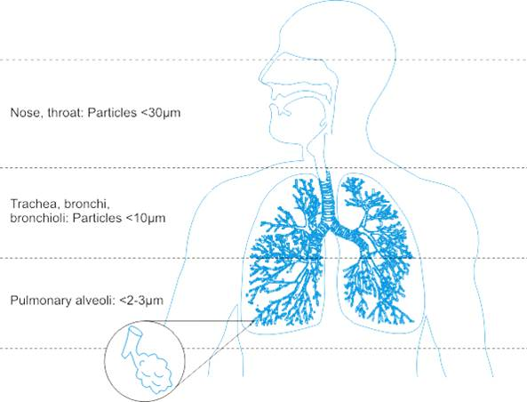
Routes of Exposure: Inhalation
Inhalation has been a major focus of the nanotoxicology community;
NP penetration into the lung depends on its aggregation state
Airborne NPs can be inhaled and deposit in the respiratory tract
Inhaled NPs may enter the blood stream and translocate to other organs
Image: http://upload.wikimedia.org/wikipedia/commons/3/36/Respiratory_Tract.png
Notes:
Trainer Notes:
The ability of a particle to deposit in the respiratory tract depends on its size. Particles larger than about 10 microns (10,000 nm) get trapped by the mouth, nose and throat; only particles less than ~10 microns enter the conductive airways (trachea and bronchi). Many of these particles are trapped by mucus and ultimately ingested. Nanoparticles’ small size permits them to be inhaled into the alveolar (deep) region of the lung where gas exchange occurs. For this reason, many studies and guidance documents have focused on inhalation as the primary route of exposure to nanoparticles in the workplace.
Animal studies have indicated that nanoparticles in the lung may be able to enter the bloodstream and translocate to other organs.
In many of these studies the nanoparticles were modified to prevent them from agglomerating together into particles larger than 2-3 microns. Some studies have shown that the primary effect of nanoparticles in the lung was asphyxiation when the particles clumped together and physically blocked the airways. The actual impact of a nanoparticle encountered in the workplace will depend critically on whether or not that nanoparticle agglomerates prior to or after entering the body.
SOURCE
Image: http://upload.wikimedia.org/wikipedia/commons/3/36/Respiratory_Tract.png

Slide 21
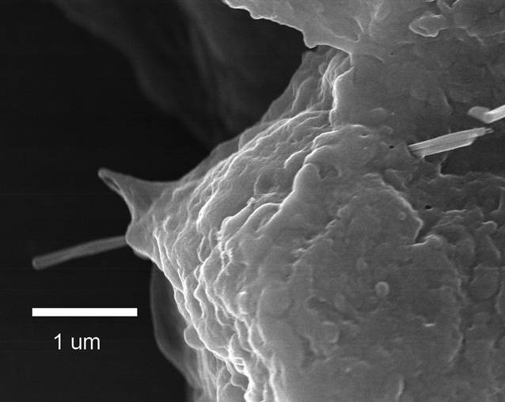
Inhalation Hazards
Certain nanomaterials can
Induce cancers, including mesothelioma
Cause rapid and persistent pulmonary fibrosis
Cause cardiovascular dysfunction
Migrate along the olfactory nerve into the brain
Alveolar Epithelial Penetration by Multi-walled Carbon Nanotube
Courtesy of R. Mercer, NIOSH
Notes:
Trainer Notes:
The growing body of research into the hazards of inhalation exposure of nanomaterials demonstrates the potential for unwanted health outcomes IF there is exposure. Not all types of nanoparticles have demonstrated these hazards and not all the research has been done on commercially relevant forms of the nanoparticles. With those caveats in mind here are some examples of significant findings from the hazard literature.
The image shows a multi-walled carbon nanotube penetrating the alveolar epithelium. This is significant because it suggests that MWNTs that get into the lung have the potential to penetrate the epitehlium and get into the space where mesothelioma originates.
Certain multi-walled carbon nanotubes were able to induce fibrosis and mesothelioma-like symptoms when instilled in rodent lungs. The effect was observed for long, stiff nanotubes (that resemble the shape of the harmful form of asbestos) but not for short, tangled nanotubes. The researchers hypothesized that the mechanism of injury was similar to asbestos because of the fibrous nature of stiff nanotubes.
Single-walled carbon nanotubes and titanium dioxide nanoparticles have been implicated in the formation of arterial plaques
Certain nanoscale metals and metal oxides have been shown to travel along the olfactory nerve and get into the brain.
Sources
Mesothelioma: Nature Nanotechnology 3, 423 - 428 (2008) and The Journal of Toxicological Sciences Vol. 33 (2008) , No. 1 February 105-116
Cardiovascular: Environ Health Perspect 115 (3): 377–382 (2007)
Olfactory: Journal of Nanoscience and Nanotechnology, 9(8): 4996-5007 (August 2009) and Environmental Health Perspectives Volume 114, Number 8, August 2006

Slide 22
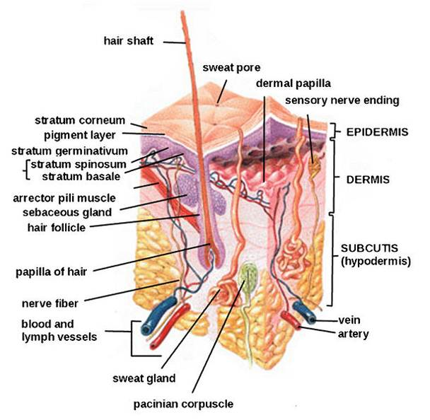
Routes of Exposure: Dermal
Available data are limited and often conflict;
Skin cannot be ruled out as a potential route of exposure
Several studies show little to no penetration of nanoscale oxides beyond surface skin layers
Polysaccharide and metal nanoparticles have been shown to penetrate flexed, damaged or diseased skin
Quantum dots were found to penetrate intact pig skin within 8-24 hours at occupationally relevant doses
Notes:
Trainer Notes:
Research on skin as a route of exposure is more limited than that on inhalation. The methods for measuring skin penetration are still evolving and better validation and standardization are needed.
Dozens of papers demonstrate the ability of intact skin to protect against penetration of nanoparticles beyond the surface layers of the skin. This is particularly evident for titanium dioxide and zinc oxide nanoparticles used in topical sunscreens.
Fluorescently tagged polysaccharide (dextran) beads of 500- and 1000-nm diameter were found to penetrate to the dermis when the skin was mechanically flexed. Silver nanoparticles embedded in a wound dressing caused elevated levels of silver to be detected in plasma and urine and graying of the skin (argyria) of a burn patient.
Quantum dots of various sizes, surface coatings and shapes were found to penetrate intact skin to the epidermal and dermal layers within 8 hours. The researchers concluded that the time scale (typical work day) and dosage were relevant for occupational exposures.
Sources
Int Arch Occup Environ Health (2009) 82:1043–1055
IMAGE: http://en.wikipedia.org/wiki/File:HumanSkinDiagram.jpg

Slide 23
Dermal Hazards
Various nanoparticles have been shown to
Inhibit cell proliferation (iron oxide, nanotubes, TiO₂, silver)
Affect cell morphology (silver, nanotubes)
Initiate irritation response (quantum dots, nanotubes)
Damage cell membrane (fullerenes)
Induce DNA damage (cobalt chrome alloy)
Notes:
Trainer Notes:
Dozens of studies have tested toxicity of various nanoparticles to human skin cells in culture. Oxides, metals, quantum dots and carbonaceous nanoparticles have all demonstrated the ability to damage skin cells through a variety of mechanisms, most notably as a result of oxidative stress.
Source
Review of dermal toxicity literature: Int Arch Occup Environ Health (2009) 82:1043–1055

Slide 24

Routes of Exposure: Ingestion
Ingestion is a viable route of exposure;
Ingested nanoparticles can translocate throughout the body
Ingestion may occur after inhalation exposure when mucus is brought up the respiratory tract and swallowed.
Poor work practice can result in hand-to-mouth transfer
Ingested nanoparticles do translocate to other organ systems
  SWCNT delivered into gut for treating Alzheimer’s disease were found in liver, brain and heart
  Ingestion of colloidal silver can result in permanent discoloration of skin, nails and eyes
Notes:
Trainer Notes:
Unintentional ingestion of nanoparticles may result subsequent to inhalation when mucus moves up out of the respiratory tract and is swallowed. (This clearance mechanism is called the mucociliary escalator.)
And, as is the case with other substances in the workplace, poor work practices, such as eating or smoking in the work area, can result in unintentional ingestion.
Occupational exposure via ingestion is perhaps the least well researched of the three pathways discussed in this module. However, the use of nanoparticles as drug delivery agents is a huge area in medical research. Some of these agents are meant to be ingested and then translocate to other areas of the body. This is itself demonstrates that ingested nanoparticles have routes out of the digestive tract and into other bodily systems. For example recently a single-walled carbon nanotube (SWCNT) agent introduced into rodent stomachs through gastrogavage was subsequently found in the liver, heart and brain as well as the lower intestine.
Excess ingestion of “colloidal” silver (much of which contains nanosilver) can result in a permanent discoloration of the skin (argyria) and eyes (argyrosis) from silver depositing into these tissues.
Sources
IMAGE: Microsoft image gallery
SWCNT: Nanomedicine: Nanotechnology, Biology, and Medicine 6 (2010) 427–441
Silver: Journal of Applied Biomedicine 2008, 6(3): 117-129

Slide 25
Ingestion Hazards
Various nanoparticles have been shown to
Slightly damage liver (silver)
Trigger immune response in intestinal dendritic cells (TiO₂ and SiO₂)
Be cytotoxic to human intestinal cells (TiO₂, SiO₂ and ZnO)
Damage DNA of human intestinal cells (ZnO)
Be genotoxic to liver and lungs after oral adminstration (C₆₀ and SWNT)
Notes:
Trainer Notes:
There is limited research about the effects of nanoparticles post-ingestion. However, some studies indicate that certain nanoparticles have the potential to damage intestinal cells and, after translocating out of the gut, induce unwanted health effects in other organs. This research is too preliminary to draw major conclusions and most papers conclude that more research is needed to better understand the effects of ingested nanoparticles.
Sources
Silver liver damage: Particle and Fibre Toxicology, 2010, 7:20 (11 pp)
Intestinal dendritic cells: Nanotoxicology, 2010 Early Online, DOI: 10.3109/17435390.2010.506957
Cytotoxic: Nanotoxicology, 2009 3(4): 355-364
DNA damage: Nanotoxicology, 2009 3(4): 355-364
Genotoxicity: Environ Health Perspect 117(5), 703-708 May 2009

Slide 26
Conclusions
Much of the early nanoEHS research has focused on simple systems of limited relevance to human health (e.g., cytotoxicity)
Some nanoparticles can translocate throughout the body after exposure via inhalation, contact with skin or ingestion
Some nanoparticles can induce unwanted health effects in animals or cell cultures
It makes sense to control exposure to those nanomaterials for which preliminary hazard data show unwanted health effects or hazards are unknown
Notes:
Trainer Notes:
Go over conclusions and ask for questions

Slide 27
Learning Objectives
At the end of this module you should be able to
Find the latest research on the environmental, health and safety (EHS) impacts of nanomaterials using freely available web resources
Summarize some of the significant EHS research of the past few years
Understand the significance of the EHS research to occupational safety
Notes:
Trainer Notes:
This slide is identical to the one posted at the beginning. Take this opportunity to probe the class for any topics that may be unclear.

Slide 28
Eight-Hour Training Course
Module 1 | Introduction to Nanotechnology and Nanomaterials
Module 2 | What Workers Need to Know about Nanomaterial Toxicology and Environmental Impacts
Module 3 | Assessing Exposure to Nanomaterials in the Workplace
Module 4 | Controlling Exposure to Nanomaterials
LUNCH (on your own)
Module 5 | Risk Management Approaches for Nanomaterial Workplaces
Module 6 | Regulations and Standards Relevant to Nanomaterial Workplaces
Module 7 | Tools and Resources for Further Study
Notes:
Trainer Notes:
The next module will review current thinking about assessing exposure to nanomaterials in the workplace. But before we move on, let’s review our learning objectives from this segment.

