Slide 1
Module 3:
Assessing Exposure to Nanomaterials in the Workplace
Introduction to Nanomaterials and Occupational Health
Module created by Bruce Lippy, Ph.D., CIH, CSP
8-Hour Training Course
Notes:
Trainer Notes:

Slide 2
This material was produced under grant number SH-21008-10-60-F-48 from the Occupational Safety and Health Administration, U.S. Department of Labor. It does not necessarily reflect the views or policies of the U.S. Department of Labor, nor does mention of trade names, commercial products, or organizations imply endorsement by the U.S. Government.
Notes:
Trainer Notes:
[insert a disclaimer about the limitations of these materials]

Slide 3
Eight-Hour Training Course
Module 1 | Introduction to Nanotechnology and Nanomaterials
Module 2 | What Workers Need to Know about Nanomaterial Toxicology and Environmental Impacts
Module 3 | Assessing Exposure to Nanomaterials in the Workplace
Module 4 | Controlling Exposure to Nanomaterials
LUNCH (on your own)
Module 5 | Risk Management Approaches for Nanomaterial Workplaces
Module 6 | Regulations and Standards Relevant to Nanomaterial Workplaces
Module 7 | Tools and Resources for Further Study
Notes:
Trainer Notes:
Explain where the current module fits within the full eight-hour course, where appropriate. If this module is being offered as a standalone training, you can modify or hide the slide or use it to describe the other available modules.
Use this opportunity to explain where the restrooms and water fountains are located and what emergency evacuation procedures should be followed should the need arise.

Slide 4
Lesson Overview
Purpose
To provide nanoworkers with a basic awareness of sampling and analytical approaches being used for nanoparticles, the limitations of the results and the viability of alternative hazard assessment methods.
Notes:
Trainer Notes:
Explain that this is intended to be an introduction to a very broad and diverse area. This module can in no way cover all of nanotechnology and nanomaterials but will provide a basic understanding of what they are, some of the types of materials workers may encounter and some of the features that warrant focused health and safety training. Some of this material may be well understood by those who have a background in chemical safety. These students should be encouraged to share their knowledge with their peers and provide examples for discussion.

Slide 5
Lesson Overview
Topics
  Methods currently being used to sample and analyze nanoparticles
  Value of standard IH procedures and equipment for nanoparticle sampling
  Use and limitation of sampling data
  Status of NIOSH, OSHA and international occupational exposure limits
Notes:
Trainer Notes:
[Review these topics and see if they are of interest to your audience.]
Topics
Methods currently being used to sample and analyze nanoparticles
Value of standard IH procedures and equipment for nanoparticle sampling
Use and limitation of sampling data
Status on NIOSH, OSHA and international occupational exposure limits

Slide 6
Learning Objectives
At the end of this module you will be able to
Compare and contrast standard IH sampling and analytical methods with those used for nanoparticles
Describe the equipment used for nanoparticle sampling and analysis
Evaluate sampling results and compare them to recommended occupational exposure limits
Discuss the limitations of nanoparticle sampling and analysis
Notes:
Trainer Notes:
[Review these objectives with the class and explain that you will return to them at the end of the module to see if the learning objectives have been achieved. You can also post them on a flipchart or repeat this slide as you move between Topics to indicate where you are in the timeline of the module if desired.]
Learning Objectives
At the end of this module you will be able to
Compare and contrast standard IH sampling and analytical methods with those used for nanoparticles
Describe the equipment used for nanoparticle sampling and analysis
Evaluate sampling results and compare them to recommended occupational exposure limits
Discuss the limitations of nanoparticle sampling and analysis
Describe alternative methods of hazard assessment like control banding

Slide 7
Special thanks to NIOSH for their kind assistance and particularly to
Charles L. Geraci, Jr, Ph.D., CIH
Coordinator,
Nanotechnology Research Center
for the generous use of his slides
Notes:
Trainer Notes:
Special thanks to NIOSH for their kind assistance and particularly to Charles L. Geraci, Jr, Ph.D., CIH, Coordinator, Nanotechnology Research Center for the generous use of his slides

Slide 8
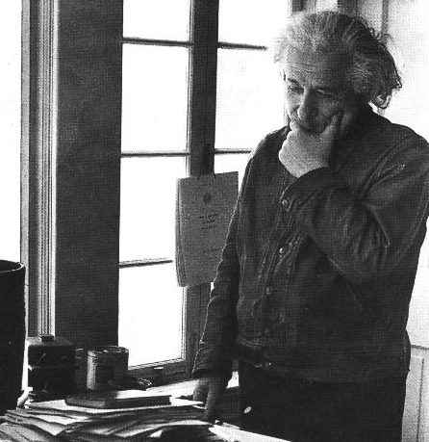
“In the long term, nanotechnology will demand a revolutionary re-thinking of occupational health and safety.” John Howard, MD, NIOSH
Notes:
Trainer Notes:
“In the long term, nanotechnology will demand a revolutionary re-thinking of occupational health and safety.” John Howard, MD, NIOSH

Slide 9
“It is likely that no single metric will completely characterize exposure.”
Linda Abbott and Andrew Maynard, Risk Analysis, 2010
Notes:
Trainer Notes:
[Emphasize with the class that this is the main message from this module.]
“It is likely that no single metric will completely characterize exposure.” Linda Abbott and Andrew Maynard, Risk Analysis, 2010

Slide 10
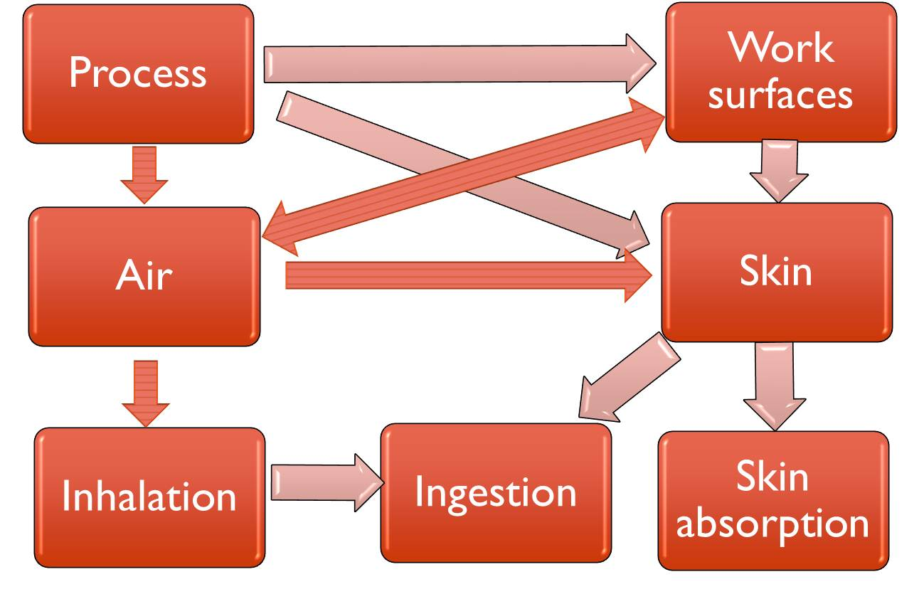
Let’s start with an exposure pathway model (Mulhausen and Damiano)
Notes:
Trainer Notes:
This model is helpful for thinking about how inhalation hazards can also be problems associated with ingestion and absorption. Ask for examples of each of the pathways of exposure.

Slide 11
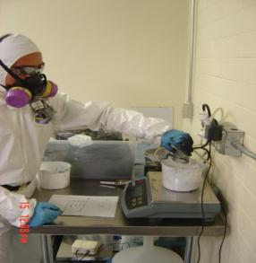
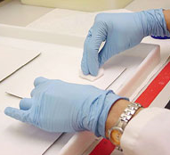
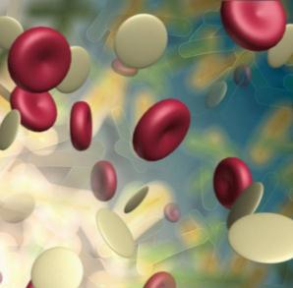
Monitoring is classified as personal, area or biological
personal
area
biological
3-11
Notes:
Trainer notes:
Personal monitoring is the most common but area and biological monitoring also serve important purposes in ensuring occupational health.
Fundamentals of Industrial Hygiene: Chapter 15 - Evaluation

Slide 12
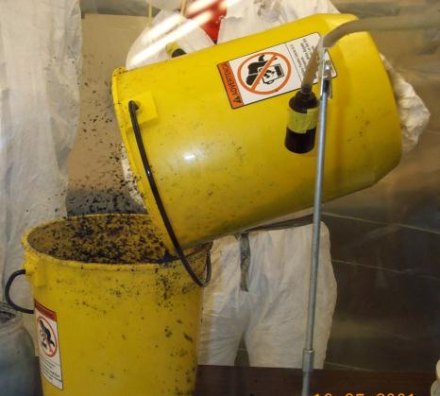
Area monitoring determines concentration at a location over time
Photo courtesy NIOSH
3-12
Notes:
Trainer notes:
Area monitoring is often used to measure concentration in ambient air prior to, during or after a job or event. Area monitoring can be used to establish background concentrations, trigger alarms in the event of elevated concentrations and monitor long-term changes in air quality.

Slide 13
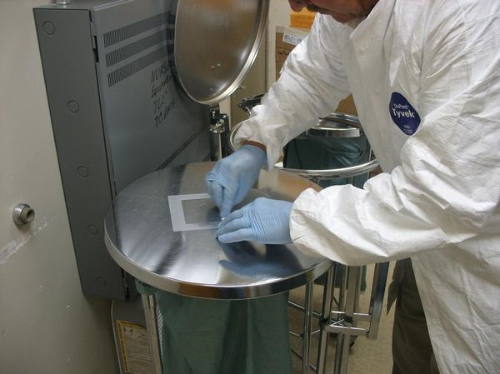
Wipe sampling is another form of area monitoring
Photo courtesy NIOSH
3-13
Notes:
Trainer notes:
Wipe sampling is another form of area monitoring. Instead of sampling a known volume of air, a known surface area is sampled or wiped. Notice the template being used to ensure the area sampled is consistent between samples. A clean template should be used for each sample to reduce the likelihood of contaminating samples. Currently, there are no standards for nanoparticles on surfaces.

Slide 14
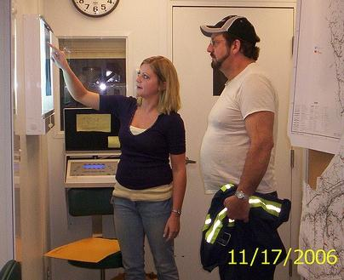
Biological monitoring measures contaminants, metabolites or enzymes in the blood, urine or exhaled breath
  What does NIOSH recommend for nanoworkers?
3-14
Notes:
Trainer notes:
Biological monitoring measures contaminants, metabolites or enzymes in the blood, urine or exhaled breath.
[Ask the class the question, “What does NIOSH recommend for nanoworkers?]
Currently, there are no specific biological tests to show nanoparticle exposures.

Slide 15
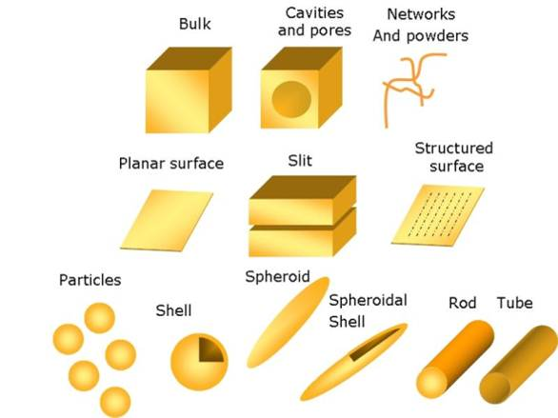
Group exercise:
What could we sample?
Typical nanostructure geometries.
Illustration courtesy of the Opensource Handbook of Nanoscience and Nanotechnology
3-15
Notes:
Trainer Notes:
Group exercise: What could we sample?
[Ask the class to work in their group or pair up and discuss what industrial hygiene sampling method they know about and whether they could be applied to nanoparticles. Tell them to specifically consider these various structures of nanoparticles].

Slide 16
What should we sample?
Metric | Qualification
Mass | Not always relevant
Surface area | Better for low solubility particles
Surface chemistry | Tox studies show effects
Particle number | Within ranges
Particle size | Implicated in particles translocating
Particle shape | Fiber-like, spheres, mats
3-16
Notes:
Trainer Notes:
Point out that there are limitations to any metric we choose.

Slide 17
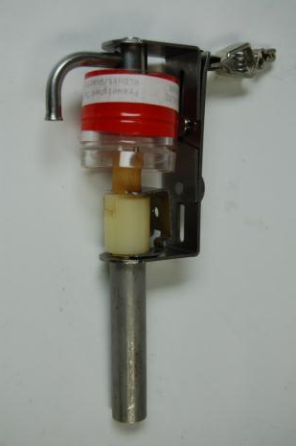
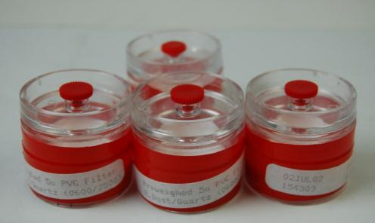
Can we use standard industrial hygiene methods?
Yes!
Pre-weighed cassettes for gravimetric sampling
Respirable dust sampling
3-17
Notes:
Trainer Notes:
Take the opportunity to pass out sampling cassettes so folks can see them and make sure they understand that we can definitely use much of the equipment and many of the techniques we have always used in industrial hygiene.

Slide 18
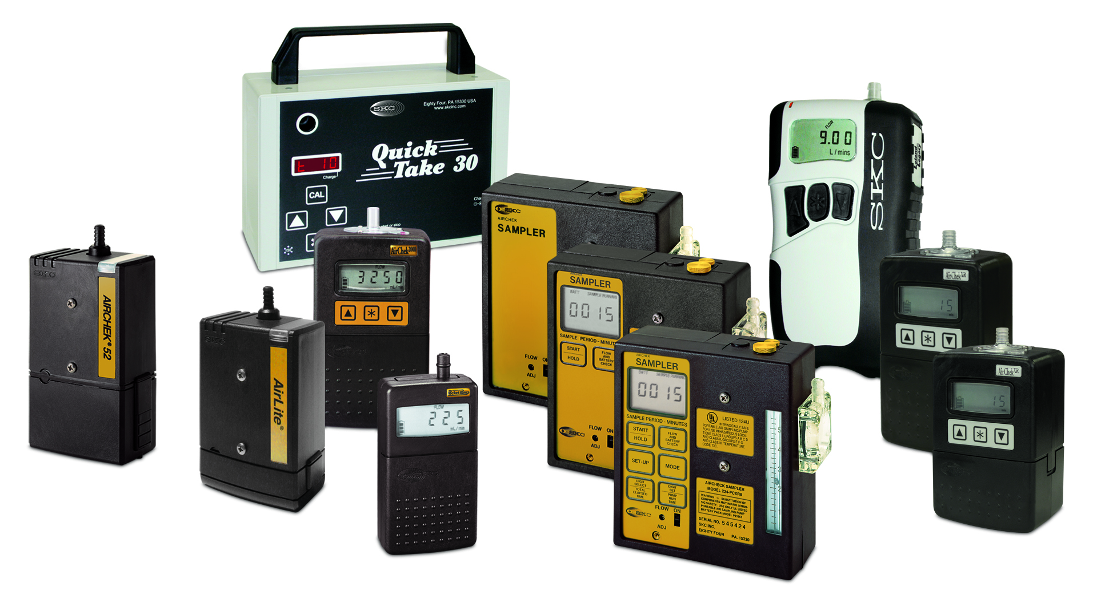
Active sampling uses pumps to pull contaminated air through appropriate media
Photo courtesy SKC
3-18
Notes:
Trainer notes:
Active sampling uses a pump to pass contaminated air through media. Pumps are generally classified as “high flow” if they draw more than 1 liter per minute and “low flow” if they draw less than 1 liter per minute.
[Pass around sampling pumps if you have any available.[]

Slide 19

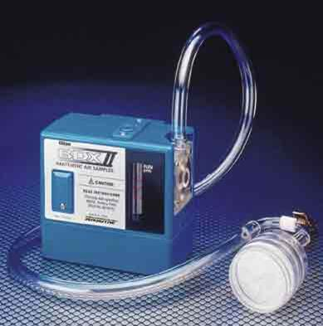
Personal pumps are hung on a worker’s belt with the media in the breathing zone
Photo courtesy Lawrence Berkeley National Laboratory
Image courtesy Wikimedia
3-19
Notes:
Trainer Notes:
[If time permits you should bring a volunteer out of the audience to wear a sampling pump and cassette. Best to let one person volunteer to wear it and another volunteer to hang it. You could prepare for nano-sampling using 25 mm MCE 0.45 um cassettes. Point out that this person is left-handed so we are hanging the pump on his or her right.

Slide 20
Most exposure limits are based on 8 hour time-weighted averages
exposure
limit
1 2 3 4 5 6 7 8
hours
Increasing
Exposures
This includes NIOSH’s recommendation for carbon nanotubes
3-20
Notes:
Draw a line that goes above and below the exposure limit. Show the dip for work stopping at lunch.

Slide 21
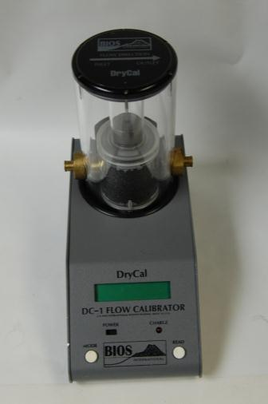
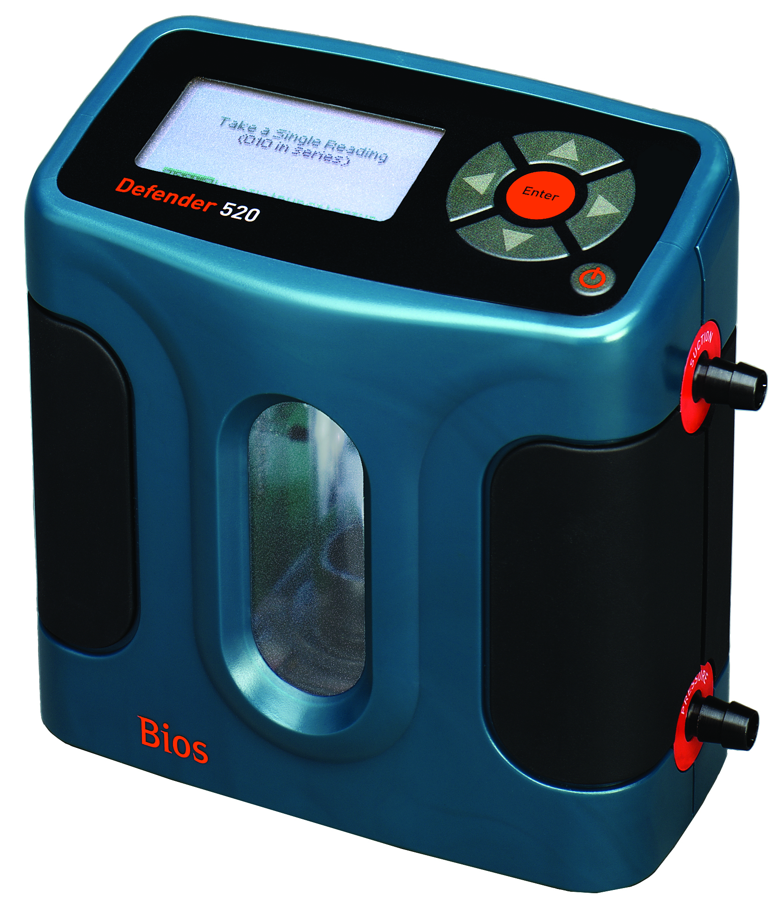
Pumps must be calibrated before and after sampling
Photo courtesy SKC, Inc.
3-21
Notes:
Trainer notes:
Pumps must be calibrated before and after sampling. Calibration devices are classified as “primary” or “secondary”. Primary calibration devices are preferred because they directly measure the dimensions of a physical space and are traceable to a standard. The National Institute of Standards Technology’s (NIST) standards are the most common in the United States. Examples of primary calibration instruments include a glass bubble burette, a spirometer, similar to those used in doctor’s offices to test lung capacity, and an electronic bubble meter, such as the Bios Defender show here. Secondary calibration devices do not have a fixed volume, are likely to become less accurate with use and are not traceable to a NIST or other standard. Examples of secondary calibration devices include rotameters, wet-test meters and dry gas meters. The dry gas meter used by industrial hygienist operates in much the same way as the natural gas meter on a home.
Calibration of sampling pumps should be performed before and after air sampling and with all sampling media inline. In most cases the post use flow rate is within a few percent of the pre use flow rate and an average flow rate can be determined. If the flow rates are more than a few percent different then we can not be sure of the sample volume and the sample will likely be considered invalid.

Slide 22
Particles are classified by their penetration. Where do nanoparticles fit?
Inhalable
100 μm diameter
Thoracic
10 μm diameter
Respirable
4 μm diameter
3-22
Notes:
Trainer Notes:
[Ask the question and let the class tell you that nanoparticles are well below 4 micrometers in at least one dimension so they are respirable.]
Particles are classified by their penetration. Where do nanoparticles fit?

Slide 23
Nanoparticles Have Almost No Mass
Edge of a single 10 micron particle
Relative size of 10 nanometer particles for comparison
A 10 μm particle weighs the same as one billion 10 nm particles
Courtesy Larry Gibbs
3-23
Notes:
Trainer Notes:
[The entire point of this graphic is to demonstrate that nanoparticles have almost no mass.]
A 10 μm particle weighs the same as one billion 10 nm particles

Slide 24
Large particles bias mass measurements
Standard
37-mm filter cassette
If you’re carrying a grocery bag full of cantaloupes, you’re not going to notice a handful of grapes
Courtesy L. Gibbs
3-24
Notes:
Trainer Notes:
Large particles bias mass measurements

Slide 25
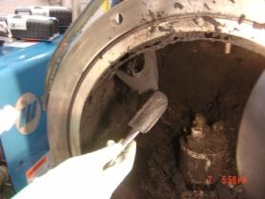
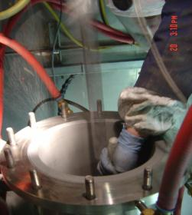
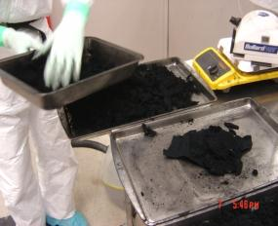

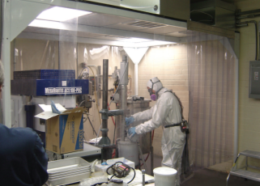
Examples of Potential Exposures
Photos courtesy of M. Methner, NIOSH
3-25
Notes:
Trainer Notes:
[Discuss the examples of potential exposures and make the point that these are mostly research scale and not large production units.]

Slide 26
NIOSH recommends a graded approach to measurement
Step 1: screen area and process
Particle counters and simple size analyzers
Step 2: collect samples at source
Filter based samples for EM and elemental analysis
Step 3: collect personal samples
Filter-based samples for EM and elemental analysis
Step 4: use less portable equipment
More sensitive aerosol sizing equipment
3-26
Notes:
Trainer Notes:
NIOSH recommends a graded approach to measurement.

Slide 27
NIOSH’s Nanoparticle Emission Assessment Technique (NEAT)*
Initial assessment is semi-quantitative comparing particle numbers at sources to background
Extended investigation using less portable, more expensive analyzers
Focused on determining leakage from operations, not personal exposures
* Nifty government acronym
3-27
Notes:
Trainer Notes:
NIOSH’s Nanoparticle Emission Assessment Technique (NEAT)
Initial assessment is semi-quantitative comparing particle numbers at sources to background
Extended investigation using less portable, more expensive analyzers
Focused on determining leakage from operations, not personal exposures

Slide 28
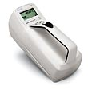
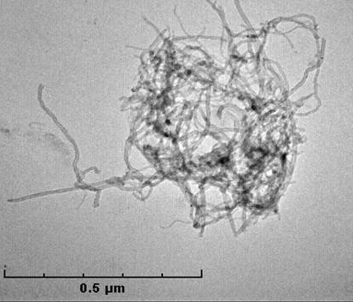
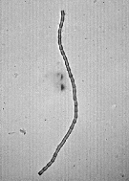
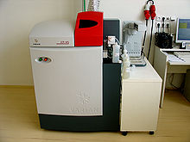
NEAT correlates simple and complex measurements
Starting Point
Particle Counters and Size Analyzers
TEM and Elemental Analysis
More complex
3-28
Notes:
28
Trainer Notes:
NEAT correlates simple and complex measurements. [Point out that NIOSH recommends generally starting with particle counters to detect increases of particle counts that could be associated with leaks of particles from glove boxes or process enclosures.]

Slide 29
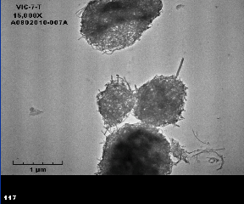
The NEAT protocol has some difficulties
TEM sample can be overloaded (as we learned at WTC)
Nominally collect at 7 lpm for duration of task (15-30 minutes)
MWCNTs
3-29
Notes:
Trainer Notes:
The NEAT protocol has some difficulties. TEM sample can be overloaded (as we learned at WTC). Nominally collect at 7 lpm for duration of task (15-30 minutes)

Slide 30
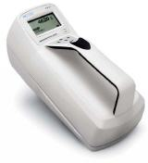

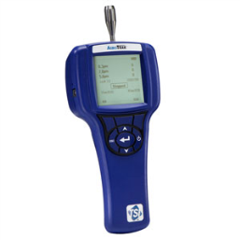
NEAT instrumentation
Condensation Particle Counter (10 -1000nm range, p/cc)
Optical Particle Counter (300-10,000nm, p/l)
Reports 3 particle sizes
TSI 3700 CPC
Kanomax Model 3800 Condensation Particle Counter
TSI Aerotrak 9303
3-30
Notes:
Trainer Notes:
Condensation particle counters have been used for a long time to perform quantitative fit testing. The technology uses alcohol to coat particles, which renders them large enough to count with a laser. This also allows the counting of smaller particles than the optical counter. The TSI AEROTRAK 9303 Handheld Particle Counter is an example of the latter type. It has an internal memory that can store up to 1,500 sample records of particle count data that can be viewed on screen or downloaded using a USB port. The instrument reports up to 3 particle sizes simultaneously and comes with an internal alarm. It measures particles in the size range 0.3 - 10μm at a flow rate of 2.8 liter per minute. .

Slide 31
Condensation particle counter operation
Pump
Laser
Detector
What difference does this make?
Condenser
Heated
saturator
Alcohol-soaked felt
Notes:
Trainer Notes:
[Review this diagram to help students understand why condensation particle counters are able to measure smaller particles than optical counters, but why they can’t provide particle size ranges. The alcohol droplets are all about the same size.]
This diagram is reconstituted from a more detailed explanation on the TSI website. They also have a good description of the process: “In general, laminar-flow CPCs operate by drawing an aerosol sample continuously through a heated saturator, in which alcohol is vaporized and diffuses into the sample stream. Together, the aerosol sample and alcohol vapor pass into a cooled condenser where the alcohol vapor becomes supersaturated and ready to condense. Particles present in the sample stream serve as condensation sites for the alcohol vapor. Once condensation begins, particles grow quickly into larger alcohol droplets and pass through an optical detector where they are counted easily.

Slide 32
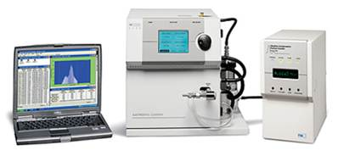
Scanning mobility particle sizers provide more data, but are more difficult to use in the field
2.5 - to 1,000 nm particles
167 size channels
TSI Series 3936
3-32
Notes:
Trainer Notes:
[The following is a description of this equipment from the manufacturer, TSI, but doesn’t represent an endorsement.]
The Series 3936 Scanning Mobility Particle Sizer TSI Series 3936 systems feature a versatile Series 3080 Electrostatic Classifier and your choice of Condensation Particle Counter (CPC). The end result is unmatched flexibility due to the many configurations possible. Collectively, SMPS systems measure particles from 2.5 to 1000 nm and display data using up to 167 actual size channels (up to 64 channels per decade).Model 3034 Scanning Mobility Particle SizerThe Model 3034 Scanning Mobility Particle Sizer (SMPS) spectrometer from TSI is a simple alternative to multicomponent systems. It houses an Electrostatic Classifier and a Condensation Particle Counter in the same cabinet. The integrated design means easy transport and quick set up. Th Model 3034 SMPS measures aerosol particles in the size range from 10 to 487 nm. It displays data using 54 size channels (32 channels per decade).Submicrometer Particle SizingTSI offers many choices for applications involving submicrometer particle sizing. See detailed descriptions Series 3936 systems and Model 3034.Features and Benefits· High-resolution measurements of ultrafine particles· Component and single-box options for specific measurement needs· Choice of CPC and DMA (Series 3936 systems only) provides the ultimate in sizing flexibility

Slide 33
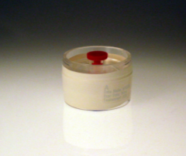
NIOSH recommends Method 5040 to quantify exposure to airborne carbon nanotubes*
37-mm quartz-fiber filter
Flow rate of 2 to 4 liters per minute
Size selective samplers may be needed
Reported as elemental carbon
* NIOSH Draft Current Intelligence Bulletin, 2010
37-mm
quartz-fiber filter
3-33

Slide 34

NIOSH chose mass-based REL over counting with electron microscopy
Animal toxicology studies are mass-based
Counting protocols haven’t been developed, although ASTM has a committee working on it
3-34

Slide 35
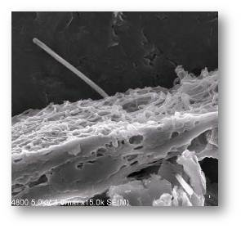
But mesotheliomas have been produced in mice with MWCNTs that are fibers with long aspect ratios (Takagi 2008, Poland 2008)
Multi-walled carbon nanotube penetrating the pleura of the lung. Courtesy of Robert Mercer, and Diane Schwegler- Berry, NIOSH
3-35

Slide 36
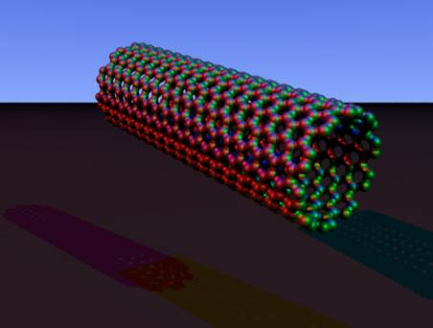
NIOSH says 10,000 carbon nanotube combinations are possible
≠
3-36
Notes:
Trainer Notes:
[The key point with this slide is that the graphic of a carbon nanotube on the left doesn’t represent the reality of what they look like in airborne samples, like the aggregated mass of nanotubes on the right.]
NIOSH says 10,000 carbon nanotube combinations are possible.

Slide 37






The counting protocols will be similar to asbestos TEM methods now in place
1 structure (fiber)
1 structure (bundle)
2 structures (fibers)
1 structure (cluster)
3 structures (fibers)
1 structure (matrix)
EPA AHERA Method Appendix A to Subpart E of Part 763
3-37
Notes:
Trainer Notes:
The counting protocols will be similar to asbestos TEM methods now in place.

Slide 38
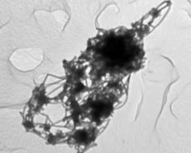
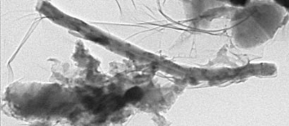

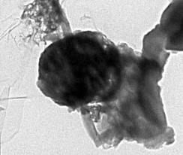
Your turn! Categorize and count the following structures
1.__________________
2.__________________
3.__________________
4.__________________
3-38

Slide 39
Electron microscopy is the gold standard. It allows:
Characterization of bulk material for comparison to airborne particles
Indication of the presence of specific engineered nanomaterial (ENM)
3-39
Notes:
Trainer Notes:
Electron microscopy is the gold standard. It allows:
Characterization of bulk material for comparison to airborne particles
Indication of the presence of specific engineered nanomaterial (ENM)

Slide 40
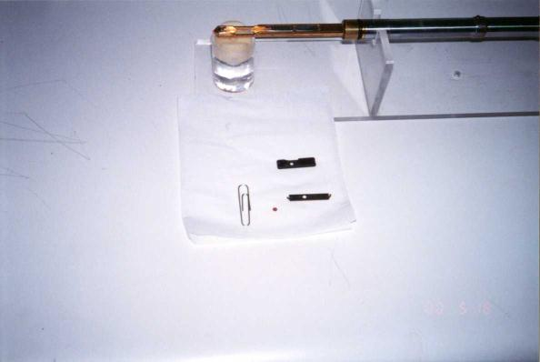
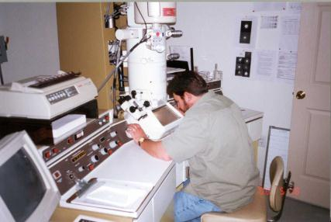
Transmission electron microscopy methods resemble asbestos analysis
Grid inserted into holder
Grid with sample
Notes:
Trainer Notes:
Transmission electron microscopy methods resemble asbestos analysis.
[Make the point of indicating how small the TEM grid that holds the sample. It is helpful for those familiar with phase contrast microscopy to see how much smaller the section of filter is that gets onto the grid compared with the pie wedge that is cut out and mounted on a standard glass slide for PCM.]

Slide 41
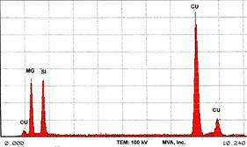
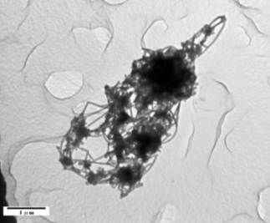
TEM allows several measurements
Morphology
EDS (EDXA) for chemical composition
Particle count
Particle length and diameter
EDS
NIOSH image of MWCNT
3-41
Notes:
Trainer Notes:
TEM allows several measurements:
Morphology
EDS (EDXA) for chemical composition
Particle count
Particle length and diameter
[Point out that this is the strength of TEM: you can see the shape of the particles to compare to the raw stock, you can use the electron beam to generate x-rays that are characteristic for each element thus identifying the chemical composition, you can count particles (as long as you have counting rules) and you can measure the particles length and diameter. For a tube, with a measured length and diameter, you can determine volume and choose a density to calculate mass.]

Slide 42

Elemental analysis for metals allows better characterization
NIOSH recommends sampling high emission areas: both breathing zone and area
Conduct elemental analysis (NIOSH 7300, metals with ICP)
Characterize and verify by TEM
Raw single walled nanotubes,
photo courtesy NIOSH
3-42
Notes:
Trainer Notes:
Elemental analysis for metals allows better characterization:
NIOSH recommends sampling high emission areas: both breathing zone and area
Conduct elemental analysis (NIOSH 7300, metals with ICP)
Characterize and verify by TEM
[Some nanoparticles are metals or oxides of metals so Inductively coupled plasma analysis will detect them in low concentrations. Additionally, metals, such as iron, nickel and cobalt, are used as catalysts for the production of carbon nanotubes.]

Slide 43
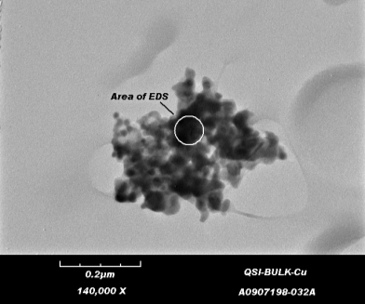
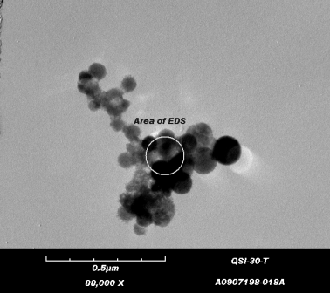
NIOSH analysis of metal reactor cleanout provides good example of EM capabilities
Bulk product sample
Air sample
3-43
Notes:
Trainer Notes:
NIOSH analysis of metal reactor cleanout provides good example of EM capabilities
[Use a laser pointer to illustrate how focused the beam of a TEM is to perform Energy Dispersive analysis of the materials to determine its elemental composition. Production of many nanomaterials requires metal catalysts and EDS analysis will show that as a peak.]

Slide 44
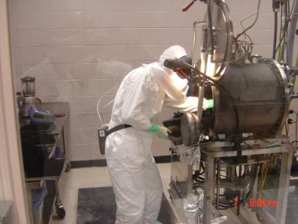
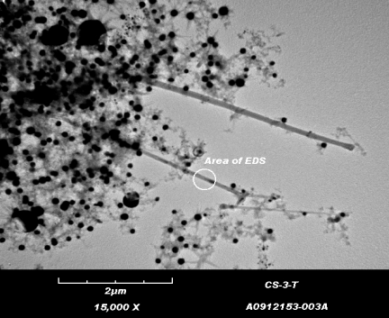
Harvesting SWCNTs from a Carbon Arc Reactor
Task-based BZ air sample analyzed via TEM w/EDS
Images courtesy NIOSH
3-44
Notes:
Trainer Notes:
[These are shots from NIOSH of a worker in full protective clothing harvesting single-walled carbon nanotubes from a carbon arc reactor inside an enclosed work area. Note the reflection in the glass. The lower image is a TEM shot of SWCNTs collected in the breathing zone of that worker. Point out that the black dots are metal catalyst that wasn’t cleaned from the final product.]

Slide 45
There are no OSHA PELs, but there are several recommended OELs
Nanomaterial | OEL | Ref. | Year
Titanium dioxide | 0.3 mg/m³ ultrafine 2.4 mg/m³ fine | NIOSH | 2011
Photocopier toner | 0.06 mg/m³ | BAuA | 2009
CNTs | 0.01 f/cm³ | IFA | 2009
Fibrous (3:1 aspect ratio, length 75,000 nm) | 0.01 f/cm³ | BSI | 2007
MWCNTs | 0.05 mg/m³ | Bayer only | 2010
MWCNTs | 0.0025 mg/m³ | Nanocyl only | 2009
CNTs and nanofibers | 0.007 mg/m³ | NIOSH Draft REL | 2010
Adapted and updated from Schulte et al. J Nanopart Res (2010) v.12
3-45
Notes:
Trainer Notes:
There are no OSHA PELs, but there are several recommended OELs.
[This table from Dr. Paul Schulte of NIOSH was updated to reflect the revised REL set by NIOSH for titanium dioxide. You may want to point out that several firms set their own recommended OELs, like Bayer and Nanocyl. The NIOSH draft REL for carbon nanotubes came after these firms set their company OELs and it is lower than the Bayer OEL.]

Slide 46
Possible Group Exercise: Review sampling reports and answer the following questions:
What kind of samples were collected?
What media did they use?
What method did they use to analyze them?
What types of structures did they find?
Is there anything in the report that you don’t understand?
3-46
Notes:
Trainer notes:
[Sample reports need to be provided. Have each group decide on a spokesperson and a scribe. If possible, give a different report to each group. Allow at least 20 minutes for them to answer the questions and at least 10 minutes per group to report back.]
What kind of samples were collected?
What media did they use?
What method did they use to analyze them?
What types of structures did they find?
Is there anything in the report that you don’t understand?

Slide 47
Learning Objectives
At the end of this module you will be able to
Compare and contrast standard IH sampling and analytical methods with those used for nanoparticles
Describe the equipment used for nanoparticle sampling and analysis
Evaluate sampling results and compare them to recommended occupational exposure limits
Discuss the limitations of nanoparticle sampling and analysis
Notes:
Trainer Notes:
[Review these objectives with the class and explain that you will return to them at the end of the module to see if the learning objectives have been achieved. You can also post them on a flipchart or repeat this slide as you move between Topics to indicate where you are in the timeline of the module if desired.]
Learning Objectives
At the end of this module you will be able to
Compare and contrast standard IH sampling and analytical methods with those used for nanoparticles
Describe the equipment used for nanoparticle sampling and analysis
Evaluate sampling results and compare them to recommended occupational exposure limits
Discuss the limitations of nanoparticle sampling and analysis
Describe alternative methods of hazard assessment like control banding

Slide 48
Learning Objectives
At the end of this module you will be able to
Compare and contrast standard IH sampling and analytical methods with those used for nanoparticles
Describe the equipment used for nanoparticle sampling and analysis
Evaluate sampling results and compare them to recommended occupational exposure limits
Discuss the limitations of nanoparticle sampling and analysis
Notes:
Trainer Notes:
[Review these objectives with the class and explain that you will return to them at the end of the module to see if the learning objectives have been achieved. You can also post them on a flipchart or repeat this slide as you move between Topics to indicate where you are in the timeline of the module if desired.]
Learning Objectives
At the end of this module you will be able to
Compare and contrast standard IH sampling and analytical methods with those used for nanoparticles
Describe the equipment used for nanoparticle sampling and analysis
Evaluate sampling results and compare them to recommended occupational exposure limits
Discuss the limitations of nanoparticle sampling and analysis
Describe alternative methods of hazard assessment like control banding

Slide 49
Questions or Comments?

