Slide 1
Module 4: Controlling Exposure to Nanomaterials Introduction to Nanomaterials and Occupational Health BRUCE LIPPY, PH.D., CIH, CSP
8-Hour Training Course
Notes:
Trainer Notes:

Slide 2
This material was produced under grant number SH-21008-10-60-F-48 from the Occupational Safety and Health Administration, U.S. Department of Labor. It does not necessarily reflect the views or policies of the U.S. Department of Labor, nor does mention of trade names, commercial products, or organizations imply endorsement by the U.S. Government.
Notes:
Trainer Notes:
[Note that OSHA requires this disclaimer about the limitations of these materials.]

Slide 3
Eight-Hour Training Course
Module 1 | Introduction to Nanotechnology and Nanomaterials
Module 2 | What Workers Need to Know about Nanomaterial Toxicology and Environmental Impacts
Module 3 | Assessing Exposure to Nanomaterials in the Workplace
Module 4 | Controlling Exposure to Nanomaterials
LUNCH (on your own)
Module 5 | Risk Management Approaches for Nanomaterial Workplaces
Module 6 | Regulations and Standards Relevant to Nanomaterial Workplaces
Module 7 | Tools and Resources for Further Study
4-3
Notes:
Trainer Notes:
Explain where the current module fits within the full eight-hour course, where appropriate. If this module is being offered as a stand-alone training, you can modify or hide the slide or use it to describe the other available modules.
Use this opportunity to explain where the restrooms and water fountains are located and what emergency evacuation procedures should be followed should the need arise.

Slide 4
Lesson Overview
Purpose
To provide nanoworkers with a basic awareness of the hierarchy of controls and its application to eliminate or reduce exposures to engineered nanoparticles. Every level of the hierarchy will be addressed in this module: elimination, substitution, engineering controls, administrative controls and personal protective equipment.
4-4
Notes:
Trainer Notes:
To provide nanoworkers with a basic awareness of the hierarchy of controls and its application to safely handling engineered nanoparticles. Every level of the hierarchy will be addressed in this module: elimination, substitution, engineering controls, administrative controls and personal protective equipment, the last line of defense.

Slide 5
Lesson Overview
Topics
The concept and importance of the hierarchy of controls
Elimination and the difficulties of substitution
Local exhaust ventilation as the primary engineering controls for nanoparticles
High efficiency particulate filters
Personal protective equipment as the last line of defense against nanoparticle exposures
The fire hazards of nanoparticles
4-5
Notes:
Trainer Notes:
[Review these topics and see if they are of interest to your audience.]
Topics
The concept and importance of the hierarchy of controls
Elimination and the difficulties of substitution
Local exhaust ventilation as the primary engineering controls for nanoparticles
High efficiency particulate filters
The concept and applicability of control banding
Personal protective equipment as the last line of defense against nanoparticle exposures

Slide 6
Learning Objectives: At the end of this lesson you will be able to:
Explain the hierarchy of controls and how to apply it to nanoparticles
Describe the difficulties with substitution
Describe how a HEPA filter works and its effectiveness against nanoparticles
Discuss which ventilation systems work best for nanoparticles
Describe the respiratory protection used by nanoworkers
List NIOSH’s PPE recommendations for nanoworkers
Differentiate between qualitative and quantitative fit testing
Don and doff an elastomeric half-face respirator and/or an N-95 filtering facepiece respirator
4-6
Notes:
Trainer Notes:
[Review these objectives with the class and explain that you will return to them at the end of the module to see if the learning objectives have been achieved. You can also post them on a flipchart or repeat this slide as you move between Topics to indicate where you are in the timeline of the module if desired.]
Learning Objectives
At the end of this module you will be able to:
Explain the hierarchy of controls and how to apply it to nanoparticles
Describe the difficulties with substitution
Describe how a HEPA filter works and its effectiveness against nanoparticles
Discuss which ventilation systems work best for nanoparticles
Describe the respiratory protection used by nanoworkers
List NIOSH’s PPE recommendations for nanoworkers
Differentiate between qualitative and quantitative fit testing
Don and doff an elastomeric half-face respirator and/or an N-95 filtering facepiece respirator

Slide 7
Hierarchy of controls

Slide 8
This model has underpinned industrial hygiene control efforts for a long time
Elimination
Substitution
Modification
Containment
Ventilation
Work Practices
Personal Protection
Engineering controls
4-8
Notes:
Trainer Notes:
Adapted from http://www.cdc.gov/niosh/topics/ctrlbanding/images/hierarchy_of_controls.jpg
This graphics shows the industrial hygiene hierarchy of controls. Controls are listed in decreasing order of preference. Modification, containment and ventilation are considered engineering controls and will be discussed in this presentation. Elimination and substitution were previously discussed and are preferred over engineering controls. Work practices, or administrative controls, and personal protective equipment are less desirable controls than engineering controls and will be discussed in the near future.

Slide 9
How do we actually apply the hierarchy to engineered nanoparticles?
4-9
Notes:
Trainer Notes:
[Ask the question and allow time for discussion.]
How do we actually apply the hierarchy of controls to engineered nanoparticles?

Slide 10
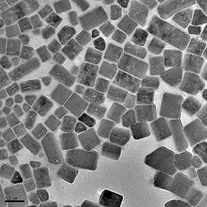
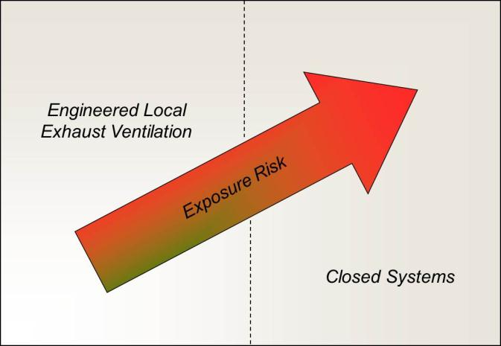
We need to consider these factors
mild / reversible
Occupational Health Hazard
severe / irreversible
kilograms
8 hours
Quantity
Task Duration
milligrams
15 minutes
slurry/suspension
agglomerated
highly dispersed
Physical Form
Courtesy NIOSH
4-10
Notes:
Trainer Notes:
We need to consider these factors.
[Work through each element and describe why the exposure risk would increase. As that risk increases, the controls go from ventilation to a closed system. You should point out that these parameters will be seen later when we review control banding.]

Slide 11
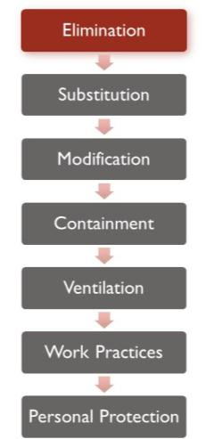
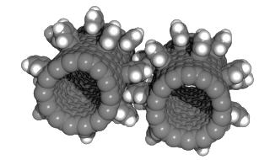
Elimination
Why would we eliminate nanoparticles? Why is this the least practical control approach?
Fullerine nanogears, photo courtesy NASA and Wikimedia
4-11
Notes:
Trainer Notes:
Elimination: Why would we eliminate nanoparticles? Why is this the least practical control approach?
[These are important questions because engineered nanoparticles have obviously been added because they provide some added capability to the product that will go away if the nanoparticles are eliminated. Consider generating a discussion and writing the answers on the board. They might include:
Evaluation showed that the product released nanoparticles into the environment.
The added benefits were just marginal and the unknown risks weren’t acceptable.
Health complaints were being received from users of the product that may have been associated with the nano-sized component.]

Slide 12
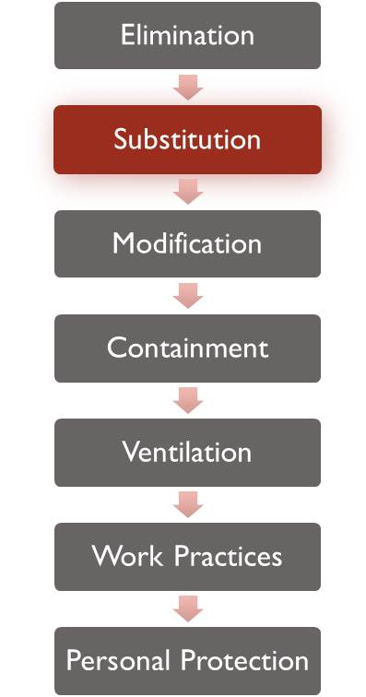
Substitution
Is substitution more likely than elimination?
What are possible difficulties with substitution?
4-12
Notes:
Trainer Notes:
[Ask these questions and try to generate a response before moving to the answer.]
Is substitution more likely than elimination?
What are possible difficulties with substitution?

Slide 13
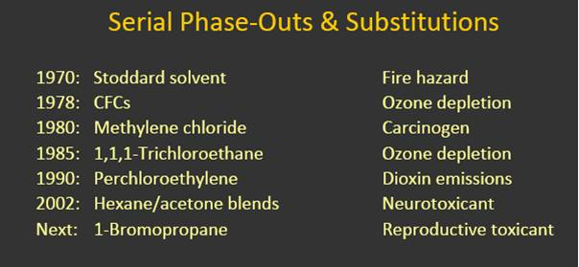
Substitution isn’t as easy as it sounds
Each of the solvents above was replaced by another chemical that later proved to pose risks
Courtesy Michael Wilson
4-13
Notes:
Trainer Notes:
Substitution isn’t as easy as it sounds.
[It isn’t necessary to review all of these chemicals. The main point is to show that replacing Stoddard solvent in the seventies because it was a fire hazard with chlorofluorocarbons that aren’t flammable led to ozone depletion. They were banned in 1978 and replaced with methylene chloride, which turned out to be a carcinogen, etc.]

Slide 14
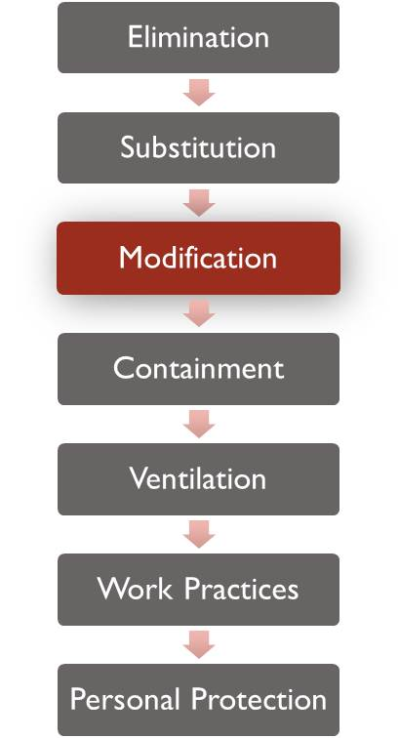
Engineering Controls: Modification
What modification could we make to a process to reduce airborne nanoparticles?
4-14
Notes:
Trainer Notes:
[Ask the question.] “What modifications could we make to a process to reduce airborne nanoparticles?”
[The next slide answers this: keeping raw materials wet, if possible, can make a major difference.]

Slide 15
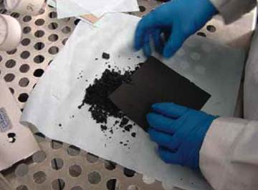
Nanoparticles are often provided and worked in a wet state to reduce the risks of exposures
Would this crumbling carbon nanofiber paper present less risk if the material were kept wet?
Photo courtesy Mark Methner, NIOSH
4-15
Notes:
Trainer Notes:
Nanoparticles are often provided and worked in a wet state to reduce the risks of exposures.

Slide 16
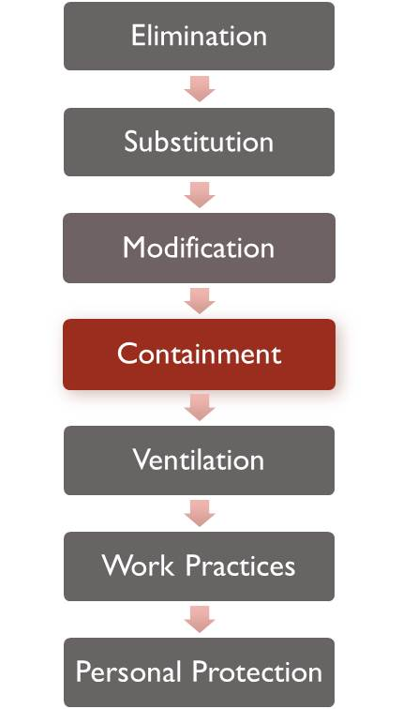
Engineering Controls: Containment
What are some examples of containment for nanoparticles?
4-16
Notes:
Trainer Notes:
Ask the question: “What are some examples of containment for nanoparticles?” The class should be able to give you some examples.

Slide 17
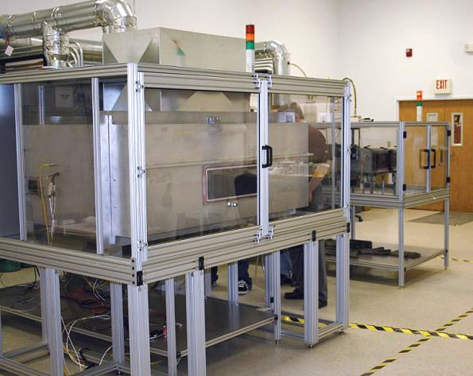
Nanocomp (NH) produces CNTs in these enclosed furnaces
Photo courtesy NIOSH and Nanocomp Technologies, Inc.
4-17
Notes:
Trainer Notes:
These furnaces are used to produce carbon nanotubes and are enclosed while production is underway.

Slide 18
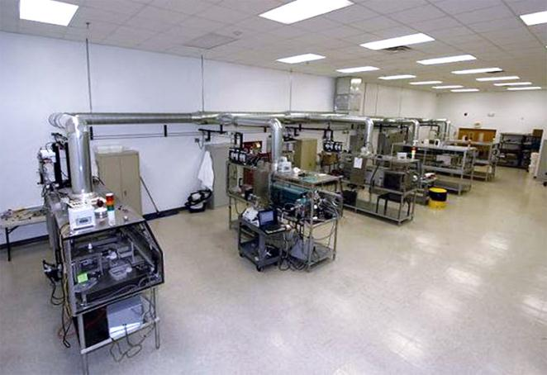
Broader view of manufacturing containment
Photo courtesy NIOSH and Nanocomp Technologies, Inc.
4-18
Notes:
Trainer Notes:
[This shows the ventilation pulling from all of the furnaces up through a high-efficiency filter and then outside.]

Slide 19
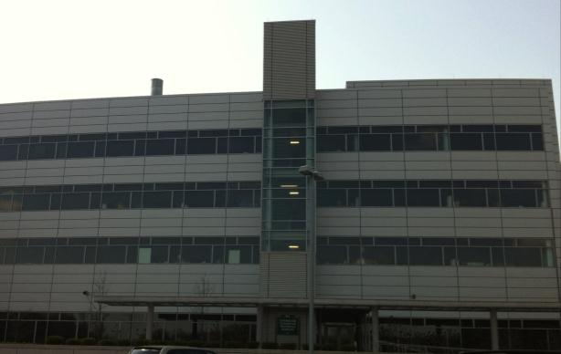

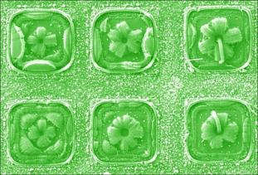
Oak Ridge’s Center for Nanophase Materials Science
Photos courtesy ORNL
Notes:
Trainer Notes:
[This is a shot of the Center for Nanophase Materials Science at Oak Ridge. The photo on the left is a Ga ball-Si crystal-SiO_{x} nanowire octopus. On the right are carbon nanotube flowers, Photos courtesy Zhengwei Pan Oak Ridge National Laboratory.]

Slide 20
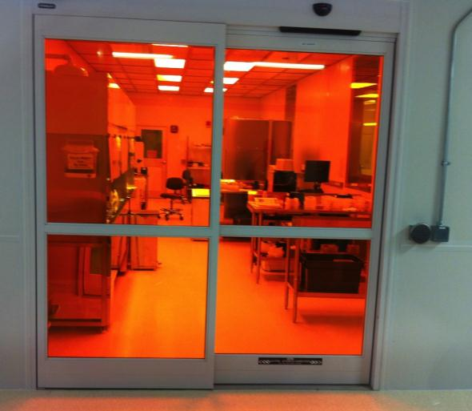
Oak Ridge’s research containment
Notes:
Trainer Notes:
Oak Ridge’s research containment.

Slide 21
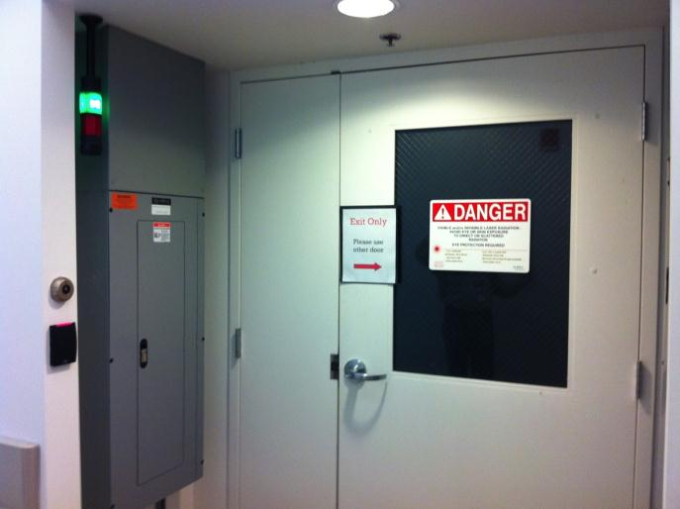
Oak Ridge’s Nanophase Materials Research facility
Notes:
Trainer Notes:
Oak Ridge’s Nanophase Materials Research facility. [Not the signage, card swipe security on the left and status lighting.]

Slide 22
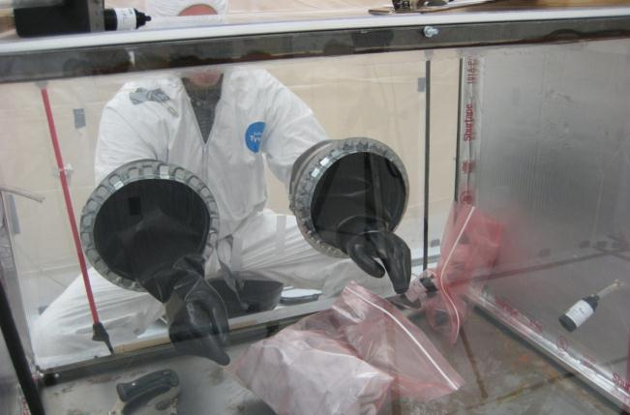
Gloveboxes are a type of containment being used for handling nanoparticles
Air sample
Nanomaterial testing. Photo courtesy EPI Services, Inc.
4-22
Notes:
Trainer Notes:
Gloveboxes are a type of containment that can contain work with raw nanoparticles. Point out the 25 mm cassette pulling air inside the box to determine how much gets airborne.

Slide 23
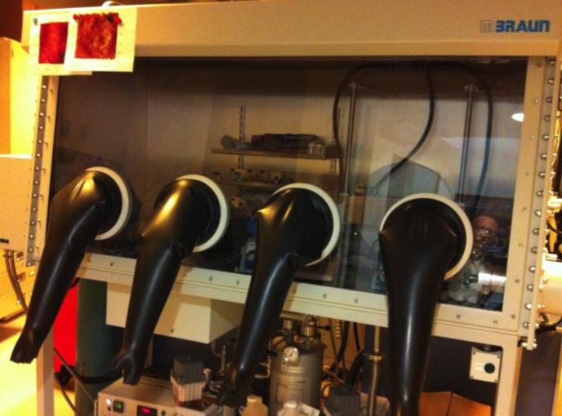
Glove box at ORNL Nanophase Materials Research facility
Notes:
Trainer Notes:
Glove box at ORNL Nanophase Materials Research facility

Slide 24
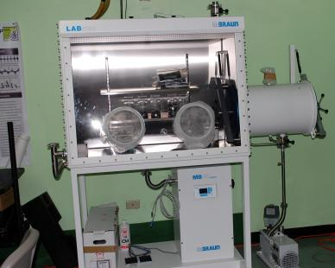
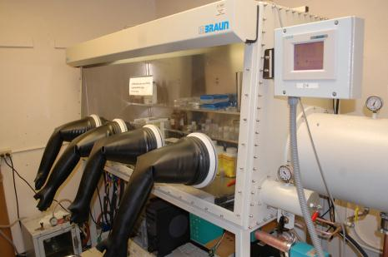
U. Puerto Rico gloveboxes in nanolabs
Notes:
Trainer Notes:
U. Puerto Rico gloveboxes for nano.

Slide 25
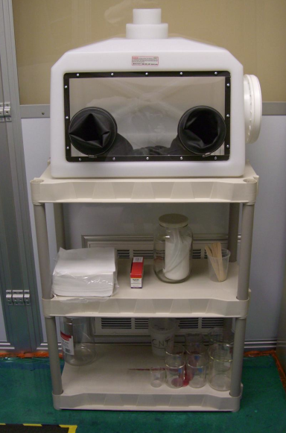
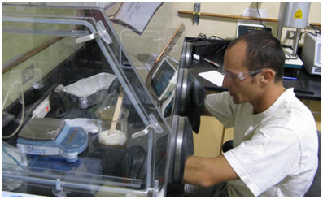
Gloveboxes inside a “Nanoparticle Containment Room”
Photos courtesy Jitendra S. Tate, Ph.D., Professor, Texas State University-San Marcos
4-25
Notes:
Trainer Notes:
Nanoparticle Containment Room.
Specialized Nanoparticle Containment Room for Carbon Nanotubes and Related materials
Texas State University does not allow the use of carbon nanotubes in glove boxes with other materials, but instead isolate the operation in a portable clean room referred to as the ‘Nanoparticle Containment Room’. This room is designed and manufactured (as per our requirements) by Liberty Industries, Inc. Berlin, CT 06023. This room has been installed in one small room within the lab. Please, refer Figure 2.
The Ingram School of Engineering has spent about $6000 on the glove box and $15,000 on the ‘Nanoparticle Containment Room’. The following are the highlights of this nanoparticle containment room.
This is 8’ x 10’ hard-wall ready-made clean room
This room maintains negative pressure and there is dedicated exhaust to this room (with blower on the roof).
The filters used are ULPA (Ultra-Low Penetration Air) Filters rated 99.999% efficient with particles 0.12 microns (120 nm) in diameter. Traditional HEPA filters are good up to 0.3 microns (300 nm) with rated efficiency of 99.98%.
Researchers who would like to use this room have to wear half-mask respirator, lab suit, and other personal protected equipment (PPE).
All these people will have to pass ‘Pulmonary Function Test’ and undergo ‘Respirator Training.’
PI, 3 technicians, and 3 students have undergone this training in summer 08.

Slide 26
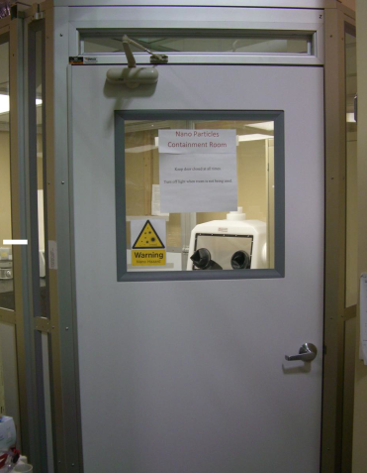
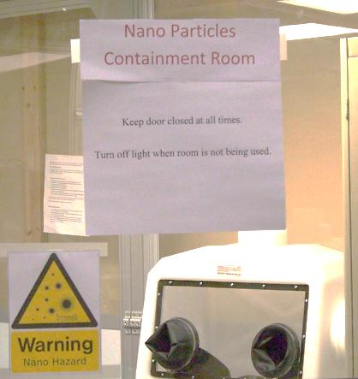
“Handling dry nanoparticles in open atmosphere is not allowed. ”
Nanoparticle Containment Room,
Texas State University
Photos courtesy Jitendra S. Tate, Ph.D., Professor, Texas State University-San Marcos
4-26
Notes:
Trainer Notes:
Nanoparticle Containment Room.
[Point out the seal on the door. The room has ultra high efficiency filtration. Also note the nano warning sign. It isn’t required or defined by any consensus standard, but shows good practice.]
The quote, “Handling dry nanoparticles in open atmosphere is not allowed” is Texas State University policy.

Slide 27
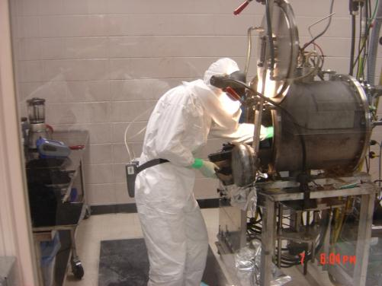
Work practices and PPE will still be needed when enclosures are opened
Harvesting SWCNTs from a
Carbon Arc Reactor
4-27
Notes:
Trainer Notes:
[Although we have shown excellent enclosures, it is critical that the class understand that all enclosures need to be opened to remove product, wastes or for maintenance and cleaning. Consequently, work practices are needed.[

Slide 28
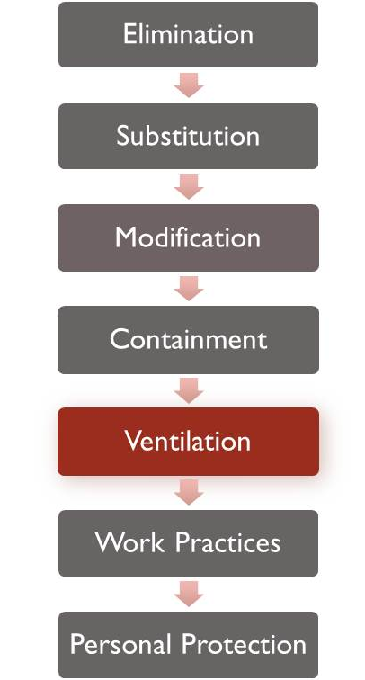
Engineering Controls: Ventilation
What are the two main divisions?
1) dilution ventilation
2) local exhaust ventilation
4-28
Notes:
Trainer Notes:
[Again, reiterate that we are moving from more protective to less protective as we move down the hierarchy.]

Slide 29
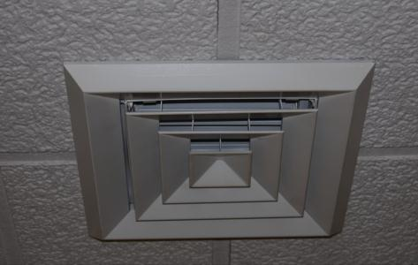
Dilution ventilation is okay for nonhazardous exposures, but isn’t acceptable for nanoparticles
Standard supply diffuser in an office
4-29
Notes:
Trainer Notes:
Dilution ventilation is used to control less hazardous exposures and to provide conditioned air, but is not okay for nanoparticles.

Slide 30
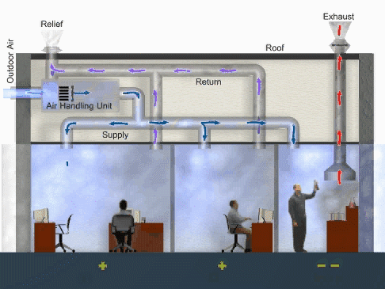
Dilution ventilation supplies some outdoor air, but mostly recycles room air. What about the lab?
Graphic courtesy EPA
4-30
Notes:
Trainer Notes:
Dilution ventilation supplies outdoor air. This graphic shows a functioning dilution ventilation system with local exhaust ventilation in the right most room. The air handling unit mixes outdoor air with return air and conditions it before it is supplied to each of the rooms. Conditioning may included heating, cooling or adjusting the humidity of the air. Notice that the air enters each room on one side and leave the other side to ensure good mixing. The plus signs below the left two rooms indicate the pressure in the these rooms is greater than the right most room which has negative signs below it. Higher pressure in the offices ensures that if there are leaks between them and the laboratory that air will flow into the lab and minimize the number exposed.
http://www.epa.gov/iaq/largebldgs/i-beam/visual_reference/series_1/index.html

Slide 31
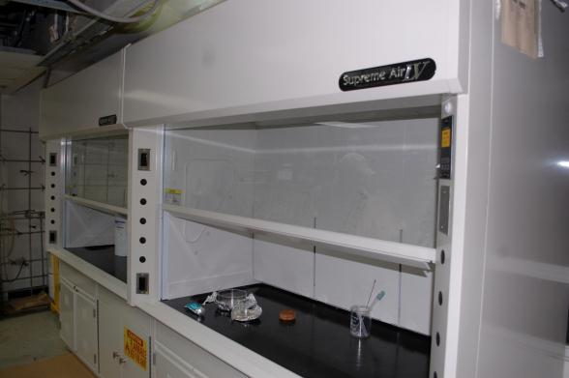
Local exhaust ventilation (LEV) controls more hazardous exposures
New laboratory hoods in U. Puerto Rico

Slide 32
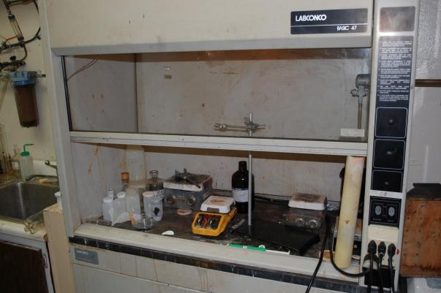
Lab hoods need to be tested for face velocity and the sash height marked
Any safety issues with this nano research hood?
Notes:
Trainer Notes:
Lab hoods need to be tested for face velocity and the sash height marked.
[Ask the question about whether there are any safety issues. They should point out the pipe used to prop the sash open, no markings on the side to indicate property sash height and cords running out of the hood.]

Slide 33
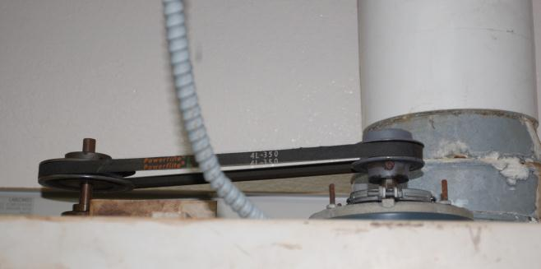
Lab hoods need to be checked routinely for maintenance
In-running nip points
Lab hood used for nano research
Notes:
Trainer Notes:
Lab hoods need to checked routinely for maintenance.
[Belts slip and reduce the actual flow rate or, like in this case, covers can be removed and not replaced, exposing in-running nip points that can cut off fingers. ]

Slide 34
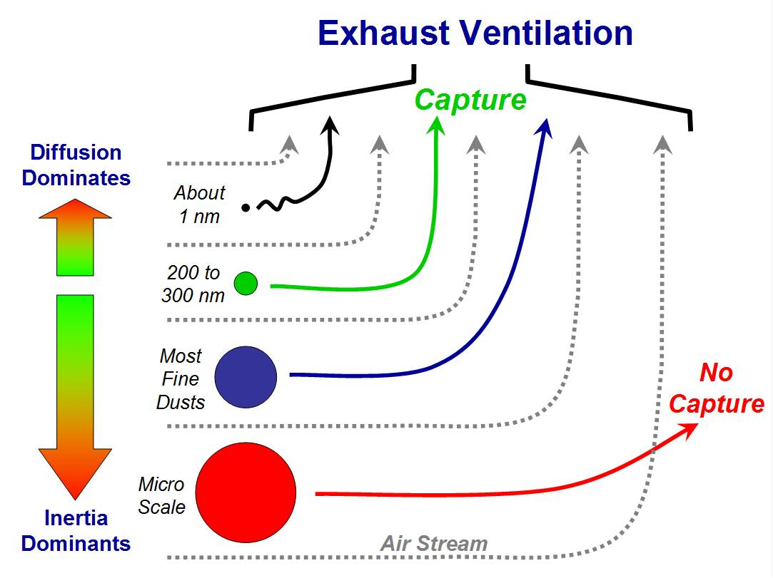
Conventional controls should work
Courtesy NIOSH
4-34
Notes:
Trainer Notes:
This graphic from NIOSH shows that 1 nanometer-sized particles are captured with local exhaust ventilation, primarily through diffusion. Explain that with particles that are in the micro scale, the forces of inertia may keep them from following the air stream as it turns to go towards the hood.

Slide 35
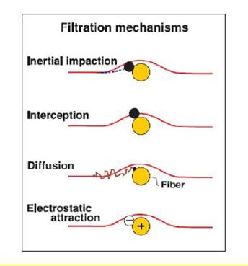
Method of particle capture
Courtesy Roland Berry Ann, NIOSH
4-35
Notes:
Trainer Notes:
This graphic shows an individual fiber in a filter and the manner that particles are captured onto the fiber. Point out the the very small particles are captured by diffusion. Capturing with a charge, i.e. electrostatic attraction, only works with smaller particles. It is the principle of filtration for N-95 filtering face-piece respirators, which have media that are charged.

Slide 36
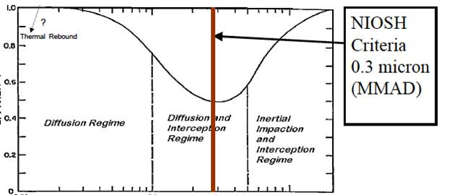
What is the most penetrating particle size?
Efficiency
Particle diameter
Courtesy Roland Berry-Ann, NIOSH
4-36
Notes:
Trainer Notes:
This is a concept that many people don’t understand because it isn’t intuitive. Most people when they think of filters, think of screens and assume that particles below a certain size naturally get through. This graph points out that the reason HEPA is defined as a filter that is 99.97 percent efficient at a 0.3 micrometer Median Mass Aerodynamic Diameter. That is the toughest particle size to capture because it is too small to catch with impaction, but too large to operate by diffusion. It operates under Brownian Motion. Consequently, if you can capture particles of 0.3 micrometer dimension at 99.97% efficiency, you do better with larger particles and with smaller partlcles, as this graph indicates.

Slide 37
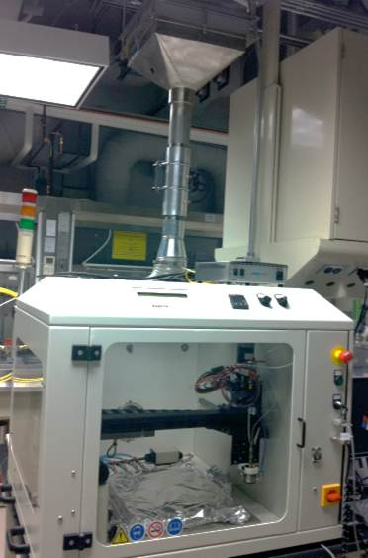
Processes have HEPA filters on exhaust systems
Courtesy Oak Ridge’s Nanophase Materials Research facility
Notes:
Trainer Notes:
Nanoparticle enclosures and gloveboxes often have HEPA filters on their exhaust systems.

Slide 38
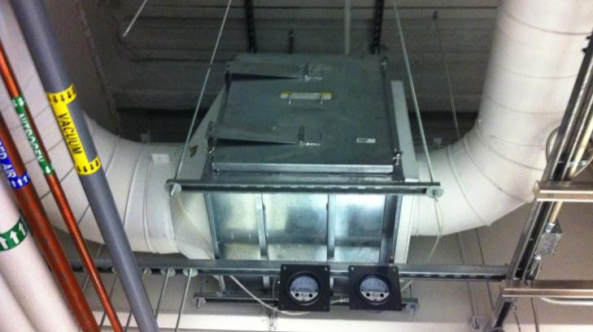
What risks might this HEPA pose?
Courtesy Oak Ridge’s Nanophase Materials Research facility
Notes:
Trainer Notes:
What risks might this HEPA pose?
[Ask this question and help the class understand that we need to think about safety issues, too. In this case, someone has to work from an elevated work station, e.g. a ladder, baker scaffold or scissor lift, to change this HEPA filter.

Slide 39
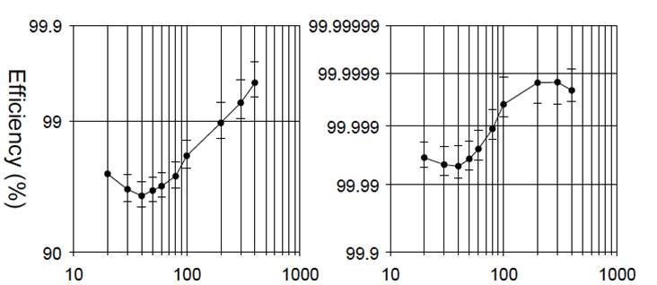
With nanoparticles between 20 - 400 nm, 40 nm is the most penetrating size
N-95
P-100
Particle Diameter
4-39
Notes:
Trainer Notes:
[Make the point that this is a test that was done with particles between 20 and 400 nanometers in diameter and the most penetrating for both the N-95 and P-100 was around 40 nanometers, but just like we saw on the other graph, smaller and larger particles were both captured more efficiently.

Slide 40
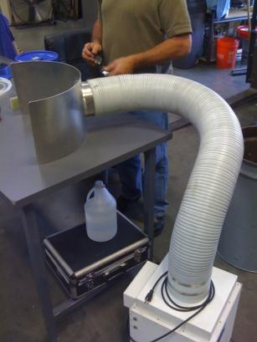
LEVs need to be very close to the source
Cleaning of metal oxide reactor with LEV use. Photo courtesy Mark Methner, NIOSH
4-40
Notes:
Trainer Notes:
This is a great rule to understand. Capture ability drops off dramatically unless the face is close to the particles.

Slide 41
ICON surveyed means of control for firms and labs in 2006:
43% used laboratory hoods
32% glove boxes
23% vacuum systems
20% closed circuits
15% laminar flow ventilation tables
12% biosafety cabinets
12% glove bag
4-41
Notes:
Trainer Notes:
An international survey by the International Council on Nanotechnology (ICON) in 2006 of manufacturing firms and research labs found that the principal means of controlling exposure are:
43% laboratory hoods,
32% glove boxes,
23% vacuum systems,
23% white rooms,
20% closed circuits,
15% laminar flow ventilation tables,
12% biosafety cabinets and
12% glove bag.

Slide 42
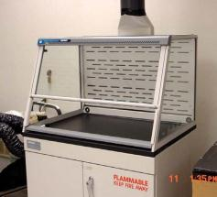
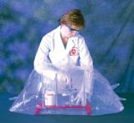
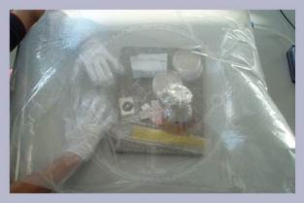
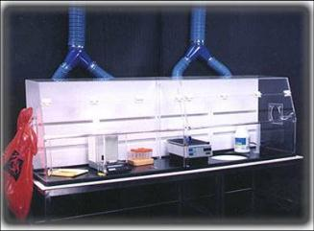
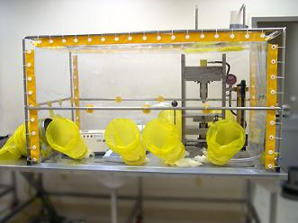
Effective controls for lab-scale work are available including low-flow lab hoods
4-42
Notes:
Trainer Notes:
[Point out that two of these units are disposable and cheap. Not all ventilation units have to be expensive and permanent.]
Effective controls for lab-scale work are available, including low-flow lab hoods.

Slide 43
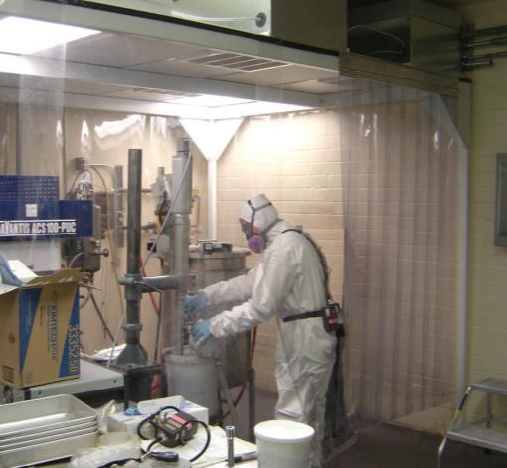
Larger scale controls can work for nanoparticles
Mixing of CNFs inside ventilated enclosure. Air is drawn underneath plastic strips and up to ceiling exhaust vents.
Why is this worker in PPE? Is it worn properly?
Photo courtesy of Mark Methner, PhD, CIH, NIOSH
4-43
Notes:
Trainer Notes:
Point out that walk-in operations can still be kept under negative pressure and filtered through HEPA. In this image a worker is mixing carbon nanofibers inside a ventilated enclosure. Air is drawn underneath plastic strips and up to ceiling exhaust vents where it goes through a HEPA filter before being exhausted out of the building.
Mixing of CNFs inside ventilated enclosure. Air is drawn underneath plastic strips and up to ceiling exhaust vents

Slide 44
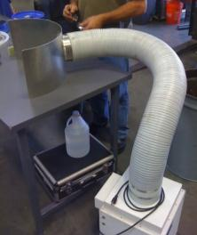
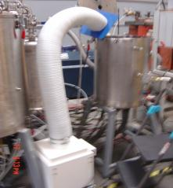
NIOSH found that LEV use during reactor cleanout achieved significant reductions
Gas phase condensation reactors produced nanoscale metal oxides 15-50 nm diameter spherical particles
Produce approx 1 kg/day/reactor
Mark Methner, PhD, CIH; JOEH June 2008
4-44
Notes:
Trainer Notes:
NIOSH found that LEV use during reactor cleanout achieved significant reductions.
The operation was producing nanoscale metal oxides such as manganese, iron, silver, nickel and cobalt 15-50 nm diameter spherical particles
Using gas phase condensation reactors
Produce approx 1 kg/day per reactor

Slide 45
Mass air concentration reductions with LEV (ug/m³)
Operation | Air conc w/o LEV | Air conc with LEV | % Reduction due to LEV
Mn reactor cleanout | 3,619 | 150 | 96
Ag reactor cleanout | 6,667 | 1,714 | 74
Fe reactor cleanout | 714 | 41 | 94
Background prior to cleanout | ND | ND | n/a
Mean (+/- S.D.) |  |  | 88 (+/- 12)
Data courtesy Mark Methner, NIOSH
Notes:
Trainer Notes:
[Review the mass air concentration reductions with the simple local exhaust system.]

Slide 46
The LEV effectiveness as measured in particle count was higher
Mean % reduction | Standard deviation (+/- %) | Basis
96 | 6 | Particle count
88 | 12 | Mass-based
Notes:
Trainer Notes:
The LEV effectiveness as measured in particle count was higher.
[This gets to the Module 3 point that these measurement methods usually don’t closely agree with each other.]

Slide 47
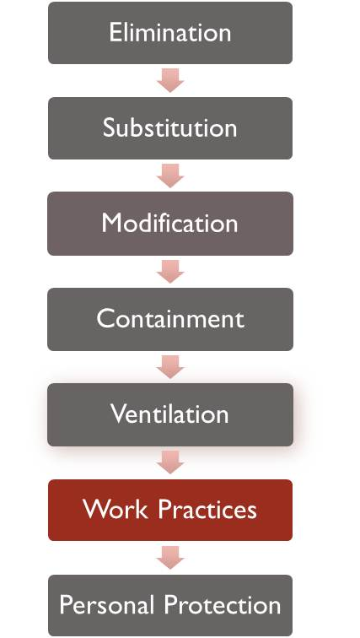
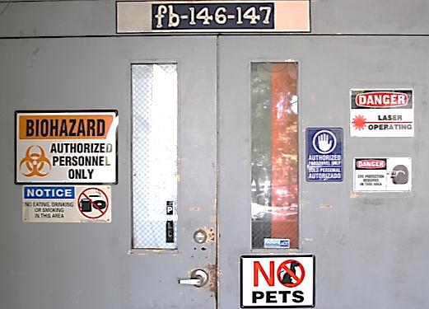
Administrative Controls: Work Practices
What practices could make a difference?
Notes:
Trainer Notes:
[Point out to the class that we are near the bottom of the hierarchy. Ask what work practices could make a difference.]

Slide 48
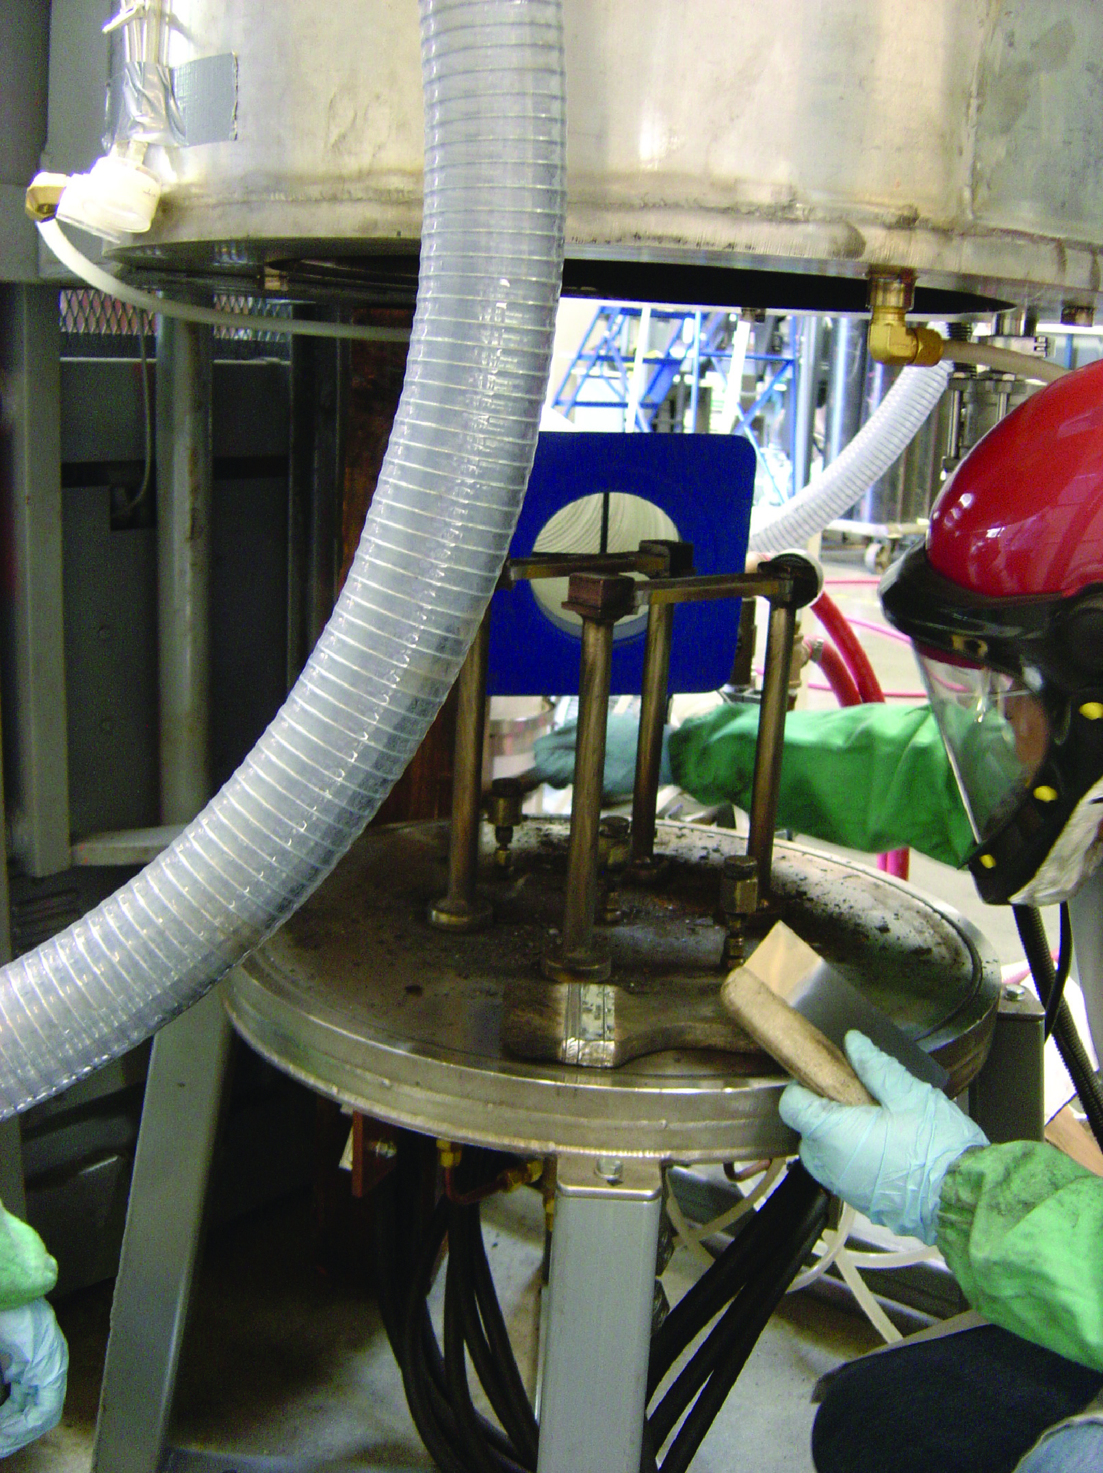
NIOSH found that work practices during cleanout made a real difference
4-48
Notes:
Trainer Notes:
NIOSH found that during this furnace cleanout of carbon nanotubes, if the worker was less vigorous and brushed towards the LEV, the concentrations were much lower.

Slide 49
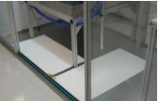
Work practices for cleanup at end of the shift:
Clean work areas using either a HEPA-filtered vacuum or wet wiping
Clean in a manner that prevents contact with wastes
Comply with all federal, state and local regulations when disposing of wastes
Wash hands frequently, particular before eating or leaving the worksite
Wear assigned PPE and keep it maintained properly
Use sticky mats and gowning procedures
Source: NIOSH and Oak Ridge National Laboratory
Sticky pads in lab
4-49
Notes:
Trainer Notes:
[Review these commonsense work practices that came from NIOSH and Oak Ridge National Laboratory.]
Work practices for cleanup at end of the shift:
Clean work areas using either a HEPA-filtered vacuum or wet wiping
Cleanup in a manner that prevents contact with wastes
Comply with all federal, state and local regulations when disposing wastes
Wash hands frequently, particular before eating or leaving the worksite
Wear assigned PPE and keep it maintained properly
Use sticky mats and gowning procedures

Slide 50
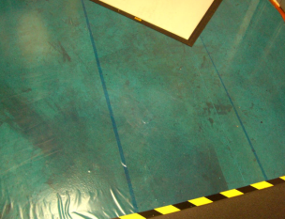


Special flooring includes tacky covering and sticky mats
Photos courtesy Jitendra S. Tate
Texas State University San Marcos
Sticky mat
Notes:
Trainer Notes:
[This is inside the Nanoparticle Containment Room and shows a green floor that is a permanent, washable, tack-regenerating mat designed specifically for the removal of footborne and wheelborne contamination. It covers the cracks and depressions in normal concrete flooring that hold contamination. In addition, there is a Sticky Mat is a stack of sheets of polyethylene film, with a specially treated pressure sensitive adhesive on one side, upon which persons entering a cleanroom or clean zone walk (and vehicles are rolled) to remove the last trace of contamination on shoe heels and soles, and on wheels. When a sheet becomes loaded with contamination, it is peeled off, exposing a new clean sheet for use, thus eliminating messy and time-consuming cleaning and washing.
This is in the section on work practices because proper replacement of sticky mats is critical and constitutes a good work practice. It is part of the broader work practices of decontamination.]

Slide 51

Personal Protective Equipment
Why is PPE at the bottom?
4-51
Notes:
Trainer Notes:
Ask the question: Why is PPE at the bottom? You should get responses that note that this relies on workers each time to get the fit right and it doesn’t remove the contaminant or lessen its concentration.

Slide 52


Personal Protective Equipment Overview
Which level do you think we may need for handling nanoparticles?
Body
Hand
Eye
Foot
Respiratory
Level A
Level B
Level C
Level D
Courtesy Kirkwood Community College
4-52
Notes:
Trainer Notes:
Point out that we will be talking about PPE for whole body, hand, eye, foot and lungs. Briefly review that Level A is a totally chemically impermeable suit with a SCBA inside the suit for maximum protection. Level B is also a self-contained breathing apparatus, but it is worn outside the suit so chemical penetration isn’t as significant a threat. Level C is a protective garment, generally Tyvec with an air purifying respirator. Level D is just protective garment without a respirator. The answer is that workers who handle nanoparticles will either wear Level C or Level D. It is a good time to make the point that working with self-contained breathing apparatus is overkill and the suits would not permit the kind of dexterity that is needed for most work with nanomaterials in a lab or production operation.
Slide is courtesy of Kirkwood Community College.

Slide 53

Tyvec is the most widely used body covering for nano operations
Photo courtesy EPI Services
4-53
Notes:
Trainer Notes:
This is a shot of a researcher at EPI Services, Inc. about to perform some testing of a product containing nanoparticles. Note that he is wearing a half-face respirator with High Efficiency cartridges (purple) combined with ammonia protection (yellow). He is also wearing a personal sampling pump (out of view) attached to a 25 mm diameter cassette holding a 0.45 micron porosity mixed cellulose ester filter. The black cassette is taped in his breathing zone. Note, too, that he has donned his respirator before pulling up his hood. This is the correct way to do it, but you will see photos from NIOSH in this presentation where the straps are on the outside of the suit.
You may want to ask the class whether he has put on his respirator correctly. The reason you should never wear the straps outside is you want to leave the respirator on until everything else has been removed so contamination can’t be accidentally dislodged from clothing and breathed. If straps are on the outside, it forces you to remove your respirator to take off the suit.

Slide 54

Are protective clothes only worn for worker protection?
Center for Nanophase Materials Science
Notes:
Trainer Notes:
Ask: Are protective clothes only worn for worker protection? [The answer is no. This researcher is wearing garments to protect the product from dust and fibers from regular street clothes.]

Slide 55

NIOSH recommends wearing hand protection when working with nanoparticles
Nitrile (most generally used)
Neoprene
Polyvinyl chloride (PVC)
Latex
Nitrile gloves
4-55
Notes:
Trainer Notes:
NIOSH recommends wearing hand protection when working with nanoparticles. There is limited data indicating penetration of the skin by nanoparticles, but cuts in the skin may offer an easier path. Point out that disposable nitrile gloves are the most widely used because they provide protection against a wide range of chemicals, but it is important to check what glove is recommended for specific chemicals. This information can be found at most glove manufacturers’ websites.

Slide 56

Eye protection may also be necessary
Must meet ANSI Z-87.1
4-56
Notes:
Trainer Notes:
Eye protection may also be necessary. Ask when goggles would be preferred over safety glasses. You should get the answer that goggles prevent splashes from getting in the eyes much better than safety glasses. All must meet a specific standard from the American National Standards Institute called ANSI Z-87.1

Slide 57

Respirators may be required for some nano operations. If so, OSHA’s standard (1910.134) would apply
Written program
Training
Medical evaluation
Fit testing
Respirator maintenance program
Photo courtesy IUOE Hazmat Program
4-57
Notes:
Trainer Notes:
Respirators may be required for some nano operations. If so, OSHA’s standard (1910.134) would apply. It would mandate the company having:
Written program
Training
Medical evaluation
Fit testing
Respirator maintenance program

Slide 58

NIOSH found no evidence of nanoparticles passing through respirator filters at a higher rate (2-07)
U. of MN tested respirator filter media to 3 nm
Flat plate tester
4-58
Notes:
Trainer Notes:
FROM the NIOSH 2-07 report, “Progress Toward Safe Nanotechnology in the Workplace”: This device is a flat plate test system for measuring respirator filter penetration of 3 to 20 nm silver particles. Scientific information is available to characterize the efficiency of respirator filtration for particles larger than 20 nm in diameter. However, less is known about smaller particles. To increase knowledge and understanding of these smaller particles, NIOSH funded a study in 2005 at the University of Minnesota’s Center for Filtration Research. The purpose of this study was to measure the penetration of nanoparticles between 3nm and 20nm in size through various filter media, including glass fiber, electret, and nanofiber. The respirator filter media tested in this study effectively collected nanoparticles down to 3nm in size. There was no evidence that particles in this size range pass through filter media at a higher rate than the larger particles. The NTRC is planning studies to validate these findings using NIOSH-approved respirators,and to evaluate the likelihood of worker exposure to nanoparticles when his/her respirator does not fit correctly.

Slide 59

Filtration performance of an example NIOSH approved N95 filtering facepiece respirator
n = 5; error bars represent standard deviations
TSI 3160; Flow rate 85 L/min
4-59
Notes:
Trainer Notes:
It is important to make sure the class understands that % penetration (vertical axis) is the opposite of % efficiency. A 95% efficient respirator would by definition have a 5% penetration. Note that the smallest sizes, which were of greatest concern because of a phenomenon called thermal rebound have the least penetration. The particle size with the greatest penetration is that around 40-50 nm, which is what we saw earlier.

Slide 60


Respirators can be divided into two broad classes
Air supplying
Air purifying
PentAir airline respirator courtesy Draeger Safety
Which offers more protection? Why?
4-60
Notes:
Trainer Notes:
Respirators can be divided into two broad classes: air supplying and air purifying. Click the question: “Which offers more protection?” and allow the class to respond. It should be clear that if you don’t have to filter the air, it is safer for the worker. Make sure everyone is comfortable with this basic concept.

Slide 61


Another key difference is the pressure inside the mask when inhaling
Negative pressure
Positive pressure
Which offers more protection? Why?
Courtesy Kirkwood
Community College
4-61
Notes:
Trainer Notes:
Another key difference is the pressure inside the mask when inhaling. Point out that a respirator like the N-95 becomes slightly negative when the wearer takes a breath. If there is a leak anywhere around the face-to-facepiece seal, the air will go through the opening rather than through the mask’s filtration media. With a mask like the powered air purifying respirator (PAPR) shown, even though it is still filtering air like the N-95, it maintains a positive pressure inside the face-piece because of a battery-powered fan that constantly blows air into the mask. This makes a major difference. The N-95 is given an applied protection factor of 10, while a tight fitting PAPR like that shown is given an applied protection factor of 1,000. So obviously the PAPR offers more protection.

Slide 62


Respirators can be further divided based on facial coverage
Full-face
Half-face
Which offers more protection? Why?
Courtesy Kirkwood
Community College
4-62
Notes:
Trainer Notes:
Respirators can be further divided based on facial coverage. They are either full-face or half-face. Which offers more protection? The important point to make here is that a full-face isn’t given additional points for eye protection (as many workers think). Full-face respirators have a major design advantage: they go across the forehead. Building a respirator that goes across the forehead is much less problematic than trying to cover the bridge of the nose where there is much greater human variation. Not surprisingly, the greatest leakage occurs at the bridge of the nose. Consequently, OSHA gives half-face respirators an applied protection factor of 10 while full-face are given 50.

Slide 63


EPA requires full-face N-100 cartridge respirators for CNT manufacturers under consent order, unless they prove no exposure
MSA Full-face Respirator
Courtesy MSA
North Full-face Respirator
Courtesy North Corporation
Notes:
Trainer Notes:
EPA requires full-face N-100 cartridge respirators for CNT manufacturers under consent order, unless they prove no exposure

Slide 64


Fitting an N-95 disposable respirator
Mike Cooper, CIH, CSP, MPH
1. Place on face
2. Fit top strap on crown
4-64
Notes:
Trainer Notes:
Walk the class through the fitting of an N-95 (or P-100) filtering facepiece respirator. The first step is to seat the respirator comfortably on the face. Next pull the top strap onto the crown of the head.
Ideally you should pass out respirators for each class member to try on and follow along with these steps. At a minimum, you should have someone demonstrate this for the class. This type of respirator is definitely being used in some nano laboratories.

Slide 65


Next Steps
3. Place bottom strap on neck
4. Press nose clip in place with both hands
4-65
Notes:
Trainer Notes:
The third step is to pull the lower strap over the first one and place it on the neck. The final step is to use both hands (to get equal pressure on both sides) and press the metal nose clip into place to hold the respirator securely. Be sure to tell the class that many N-95 respirators do not have a nose clip, but have been approved by NIOSH. A nose clip does allow tightening the fit of the respirator.

Slide 66


OSHA requires that workers pass a fit test before wearing a respirator
Quantitative
Qualitative
Both are acceptable. Which is better?
PortaCount Quantitative Fit Testing System
Courtesy TSI, Inc.
Allegro Complete Smoke Fit Test Kit Photo Courtesy Gempler’s
4-66
Notes:
Trainer notes:
OSHA requires that workers pass a fit test before wearing a respirator. This is critical. A worker has no idea if a respirator fits unless it is tested. OSHA accepts either quantitative or qualitative. The picture shows a blue Portacount unit that measures the number of particles outside the respirator and then inside the respirator and provides a protection factor by dividing the outside number by the inside number. Qualitative uses approved test agents like irritant smoke, saccharine or isoamyl acetate to challenge the fit to see if the wearer can detect the agent.
Click the advance and then ask which is better? There is no right answer, but most practitioners prefer to test with a quantitative unit because you can see the different fits that are afforded with various manufacturers. Medium size half-face respirators can provide dramatically different fits on an individual. You can’t determine this with qualitative testing. It is either yes or no.

Slide 67

User seal checks must be performed before each use to ensure a good fit
But only after passing a fit test
4-67
Notes:
Trainer Notes:
A major point that is often confused about respirators is the difference between a fit check and a seal check. The former is the qualitative and quantitative tests that we just described. They determine that a specific manufacturer and size respirator is right for you. That is a fit check. After we know what respirator fits you, it is important that you perform seal checks each time to be sure the respirator is seated properly. A seal check is done by covering the material with you hands and seeing if the respirator buckles in during inhalation and bubbles out slightly during exhalation. A seal check is easier to perform with an elastomeric respirator.

Slide 68


Air purifying respirators filter out dusts and vapors
Must have the correct color-coded cartridge
Must be NIOSH-approved
4-68
Notes:
Trainer Notes:
Air purifying respirators filter out dusts and vapors
Must have the correct color-coded cartridge
Must be NIOSH-approved

Slide 69
What type of filter may be needed for nanoparticles?
Color | Type
Magenta, purple | High Efficiency Particulate Air (HEPA)
Black | Organic vapors only
Yellow | Acid gases and organic vapors
4-69
Notes:
Trainer Notes:
Color coding is standardized for all manufacturers. Ask the class what type of filter is needed for protection against nanoparticles. The answer is purple, the HEPA filter.

Slide 70
Particulate filters are classified based on resistance to oil
N
Not resistant to oil
R
Resistant to oil
Good for one shift in oil mist
P
Oil Proof
Good for prolonged use in mist
4-70
Notes:
Trainer Notes:
NIOSH researchers noted that oil, like that found in the oil mists of factories where metal working equipment is constantly lubricated, was significantly damaging the filtration medium for particulate respirators. Consequently, they established a new classification system under 42 CFR 84 that set up 3 classifications for particulate respirators:
N = Not resistant to oil
R = Resistant to oil, which generally means good for one shift in oil mist
P = Oil Proof, which is good for prolonged use in oil mist

Slide 71
Particulate filters are further classified based on efficiency
95 percent ⇨ designated 95
99 percent ⇨ designated 99
99.97 percent ⇨ designated 100 (HEPA filter)
4-71
Notes:
Trainer Notes:
These particulate filters are further classified based on efficiency.
95 percent efficient is designated 95
99 percent is designated 99
99.97 is designated 100 (this is the definition of HEPA)

Slide 72
This gives 9 categories of particulate respirators
N | R | P
100 | 100 | 100
99 | 99 | 99
95 | 95 | 95
Acceptable for nanomaterial work, unless oil is present
4-72
Notes:
Trainer Notes:
Review this chart and make sure the class understands that this is not an attempt to make things complicated, but to provide options depending on the severity of the hazards. N media, which is not resistant to oil, should be fine for most work that includes exposures to nanoparticles because no appreciable oil mist is generated.

Slide 73

NIOSH has developed a selection logic that can be applied to nanoparticles
http://www.cdc.gov/niosh/docs/2005-100
Notes:
Trainer Notes:
NIOSH has developed a selection logic that can be applied to nanoparticles

Slide 74

OSHA has added APFs to its respirator regulation that generally match the NIOSH Logic 1910.134(d)(3)(i)(A)
Notes:
Notes to trainers:
It is important to review the notes from this table:
1Employers may select respirators assigned for use in higher workplace concentrations of a hazardous substance for use at lower concentrations of that substance, or when required respirator use is independent of concentration.
²The assigned protection factors in Table 1 are only effective when the employer implements a continuing, effective respirator program as required by this section (29 CFR 1910.134), including training, fit testing, maintenance, and use requirements.
³This APF category includes filtering facepieces, and half masks with elastomeric facepieces.
⁴The employer must have evidence provided by the respirator manufacturer that testing of these respirators demonstrates performance at a level of protection of 1,000 or greater to receive an APF of 1,000. This level of performance can best be demonstrated by performing a WPF or SWPF study or equivalent testing. Absent such testing, all other PAPRs and SARs with helmets/hoods are to be treated as loose-fitting facepiece respirators, and receive an APF of 25.
⁵These APFs do not apply to respirators used solely for escape. For escape respirators used in association with specific substances covered by 29 CFR 1910 subpart Z, employers must refer to the appropriate substance-specific standards in that subpart. Escape respirators for other IDLH atmospheres are specified by 29 CFR 1910.134 (d)(2)(ii).

Slide 75
OSHA requires the employer to select a respirator that maintains exposure at or below the Maximum Use Concentrations (MUC)
MUC = APF X PEL
“When no OSHA exposure limit is available…an employer must determine an MUC on the basis of relevant available information and informed professional judgment.”
Notes:
Trainer Notes:
OSHA requires the employer to select a respirator that maintains exposure at or below the Maximum Use Concentrations (MUC)
MUC = APF X PEL
“When no OSHA exposure limit is available…an employer must determine an MUC on the basis of relevant available information and informed professional judgment.”

Slide 76
Applying the MUC: Class Exercise
Where must exposures be measured?
An airborne concentration of 185 ug/m³ is measured as an 8-hr. TWA for a CNT furnace cleanout.
Is this an overexposure if the worker wore a full-face air-purifying respirator with P-100 cartridges? What OEL did you use?
What about for a half-face respirator with P-100 cartridges?
Notes:
Trainer Notes:
[Get folks to pair up and work together for this quick calculation.]
Applying the MUC: Class Exercise
Where must exposures be measured?
An airborne concentration of 185 ug/m³ is measured as an 8-hr. TWA for a CNT furnace cleanout.
Is this an overexposure if the worker wore a full-face air-purifying respirator with P-100 cartridges? What OEL did you use?
What about for a half-face respirator with P-100 cartridges?

Slide 77

Physical stressors need to be considered
Lack of physical fitness
Age
Dehydration
Obesity
Work Rate
Ambient Temperature
4-77
Notes:
Trainer Notes:
It is important to consider physical stressors before allowing a worker to wear a respirator or a suit. The factors to consider:
Lack of physical fitness
Age
Dehydration
Obesity
Work Rate
Ambient Temperature

Slide 78
What do we know about the fire hazards of nanoparticles?

Slide 79
The British HSLab reviewed the literature and concluded in 2004:
Increasing range of materials capable of producing explosive dust clouds are being produced as nanopowder
Concerns are centered on toxic effects; potential explosion hazards have not been addressed
No data on explosive characteristics of particles 1 to 100 nm
Notes:
Trainer Notes:
1. An increasing range of materials that are capable of producing explosive dust clouds are
being produced as nanopowders. At the same time new uses of nanopowders are further adding
to the demand for these powders. While some of these nanopowders are only being produced in
very small quantities at present, and may continue to be for the foreseeable future, the
production of others is likely to increase significantly over the next few years.
2. There is a growing concern over the impact the increased use of nanopowders and other
nanomaterials will have on health and safety and the environment. These concerns are almost
exclusively centred on the potentia l toxic effects of nanomaterials. The potential explosion
hazards of nanopowders have not been addressed.
3. There is a considerable body of knowledge on the explosion characteristics of micronscale
powders (particle sizes ranging from about 10 to 500 mm). A literature search has found
no data for nanopowders (particle sizes of 1 to 100 nm). It is considered that the extrapolation
of the data for larger particles to the nano-size range cannot be carried out with any degree of
confidence, due to marked change in the chemical and physical properties of particles below
sizes of about 100 nm.
4. It is recommended that the explosion characteristics of a representative range of
nanopowders be determined using the standard apparatus and procedures already employed for
assessing dust explosion hazards. Comparison with data for micron-scale powders of the same
materials will allow knowledge of particle size effects to be extended into the nanosize range.

Slide 80

Minimum ignition energy drops steeply as particle size drops
Netherlands Organization for Applied Scientific Research)
Notes:
Minimum ignition energy: the lowest spark energy capable of igniting a sample when dispersed in the form of a dust cloud. Line for aluminum continues to at least 0.3 um or 300 nm. Comment: polyethean (dutch) – polyethylene

Slide 81
Questions or Comments?
Notes:
Trainer Notes:
Questions or comments?

